Slide 1


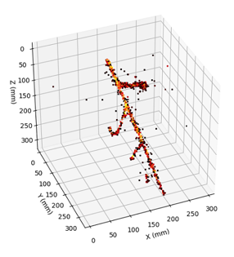
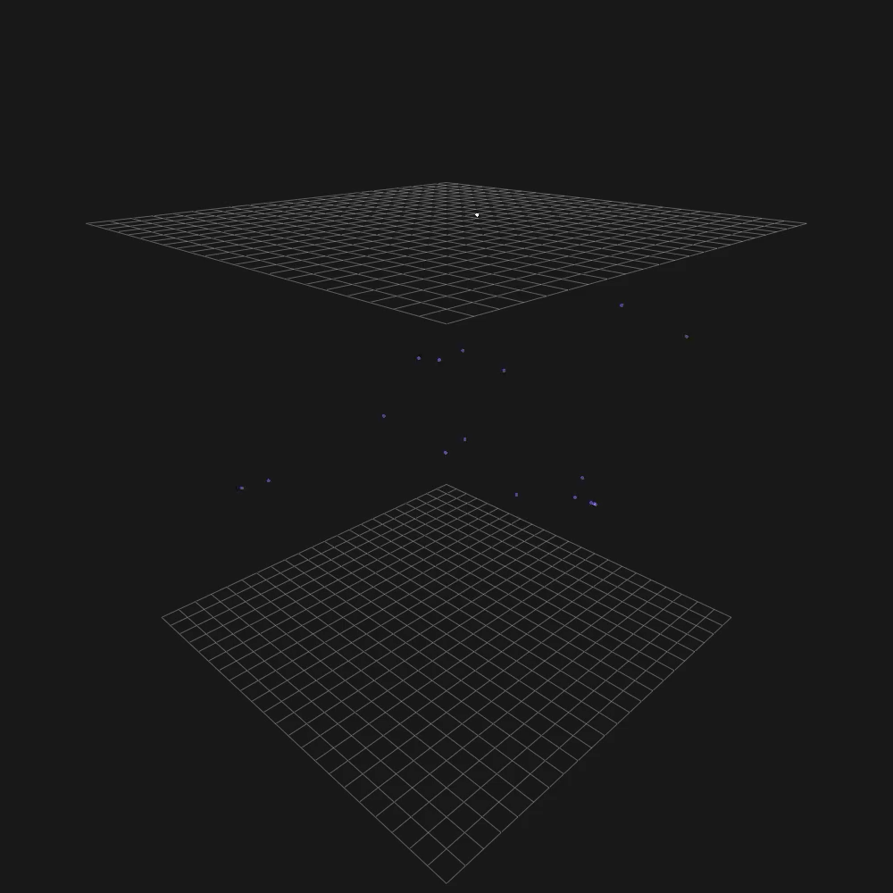
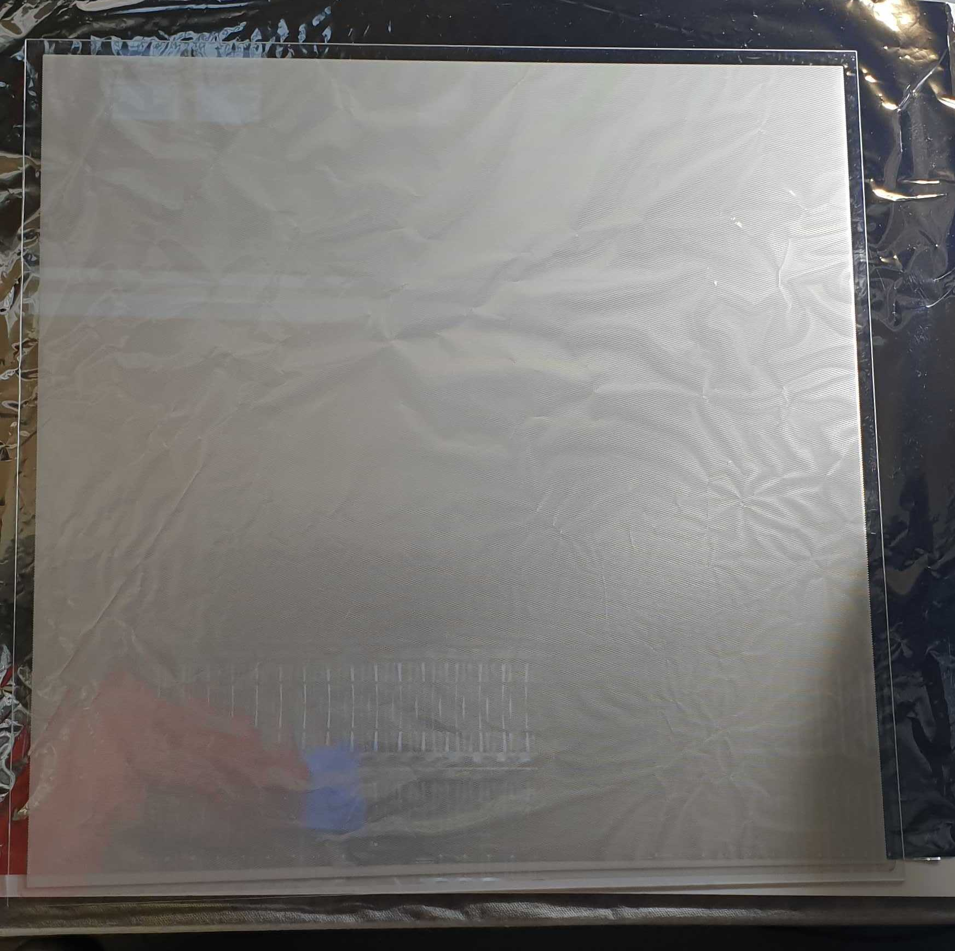

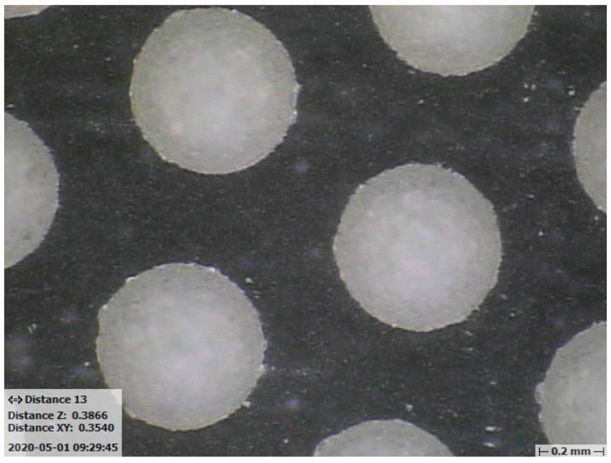
Innovating Technologies for Liquid Argon Detectors; Behind the Scenes
http://hep.ph.liv.ac.uk/ariadne
Kostas Mavrokoridis
k.mavrokoridis@liv.ac.uk
TIPP, ICFA awards 2023

Slide 2
Outline
Challenges for the kton scale liquid argon neutrino experiments
Highlights from over a decade of personal key R&D activities and evolution of the ARIADNE program
Recent activities and looking ahead

Slide 3
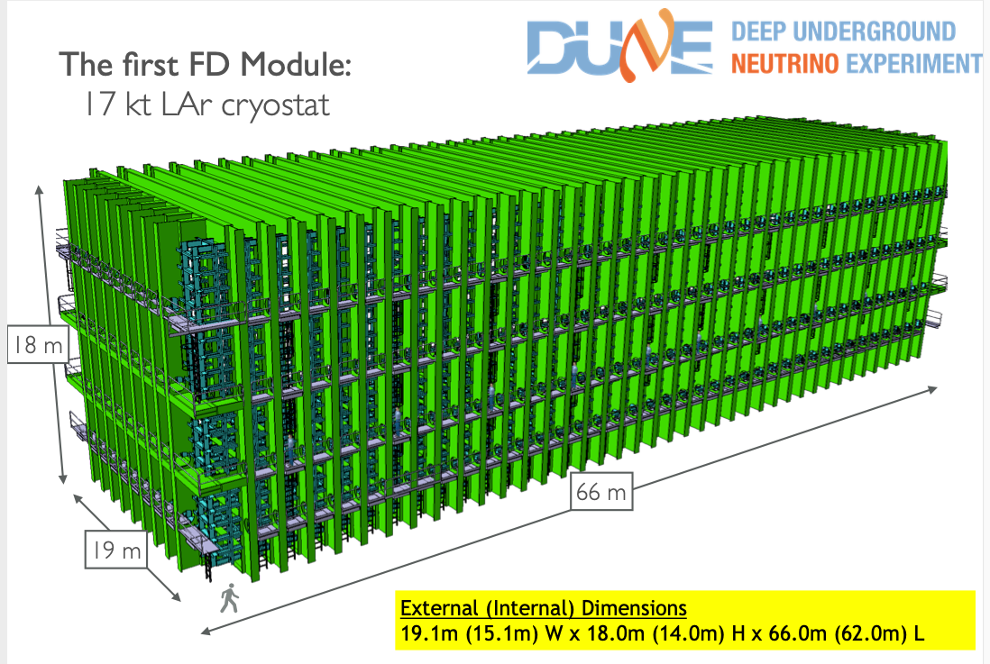

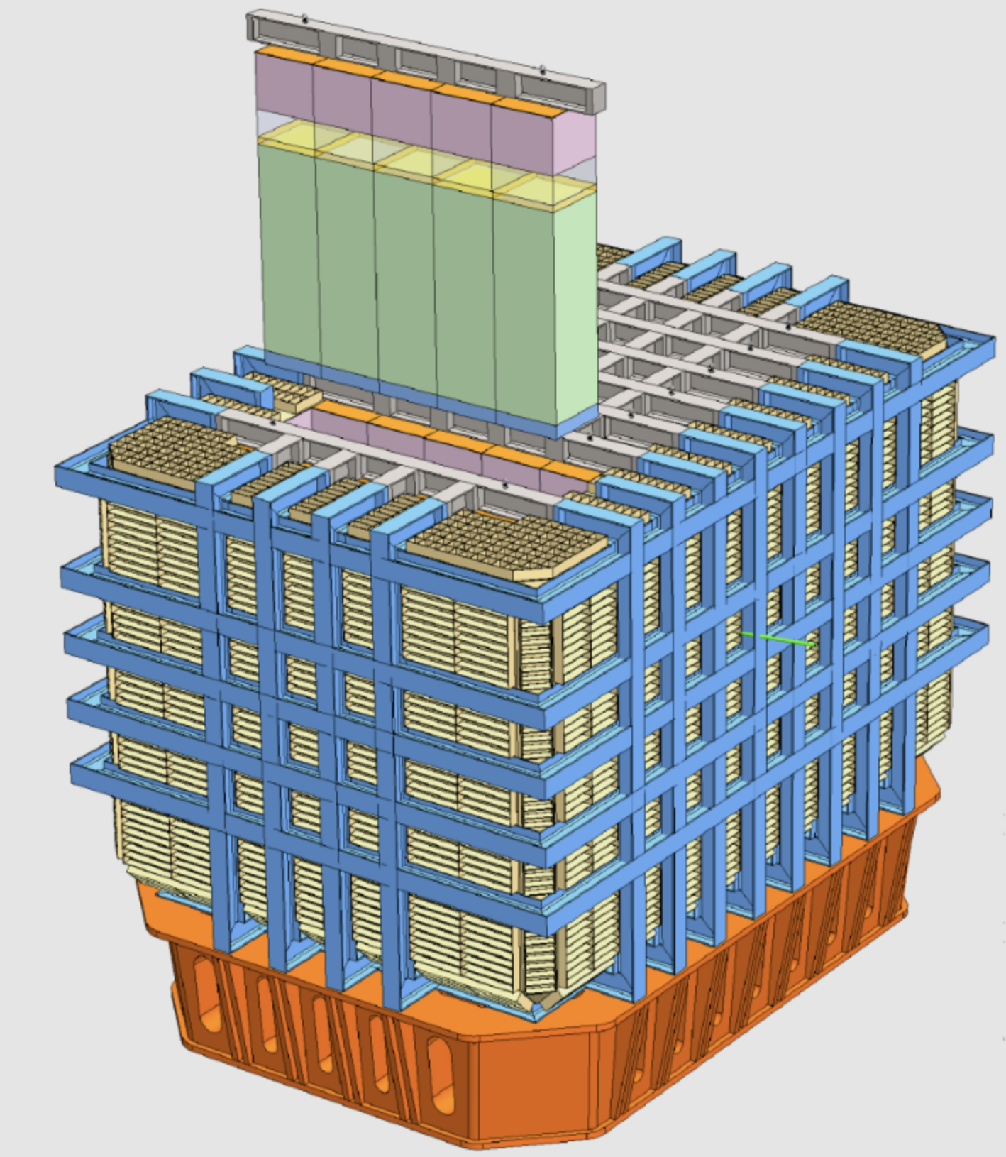
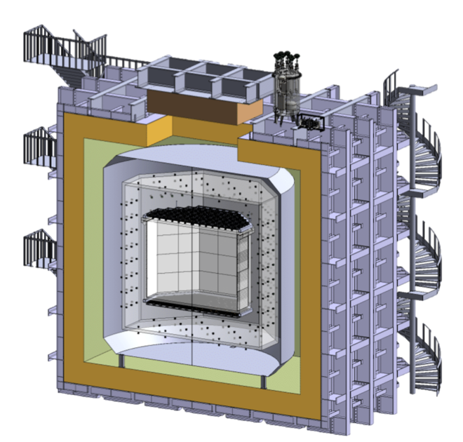
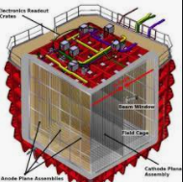
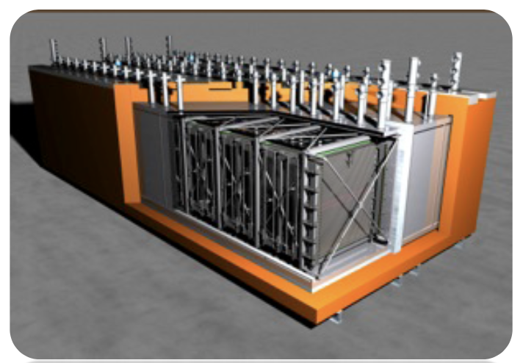
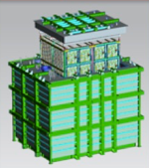
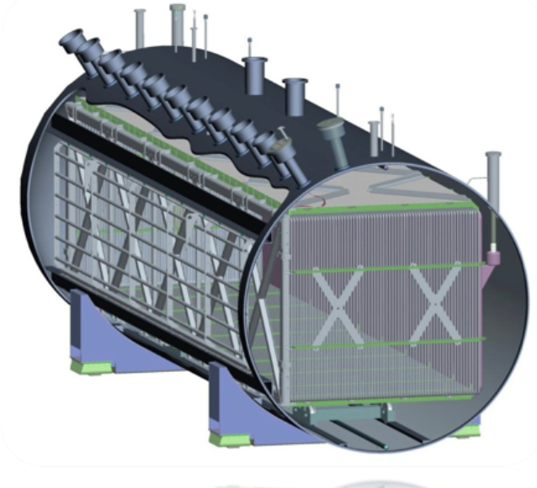
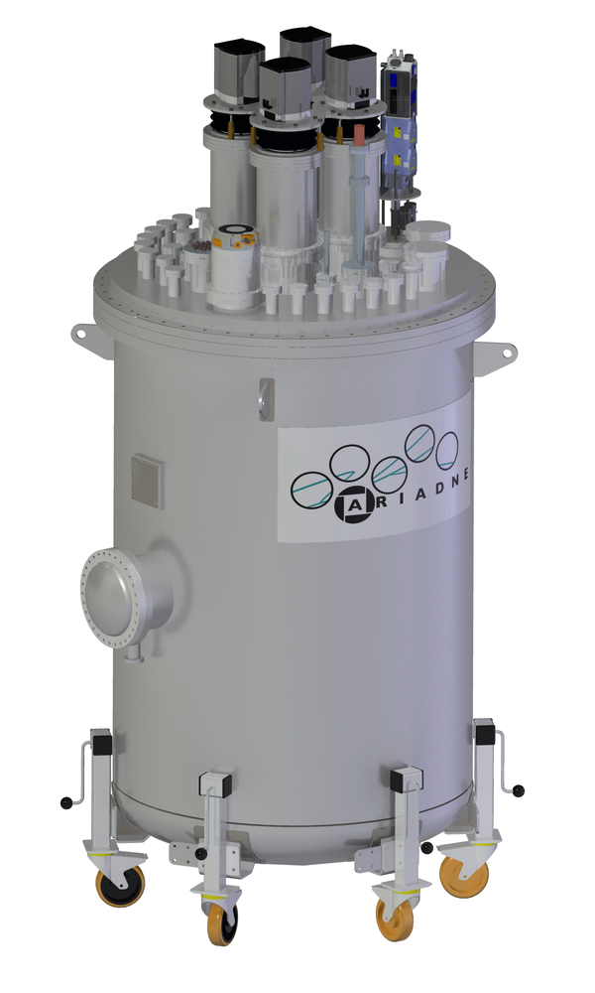
A very Exciting Era for LAr Detectors
DarkSide-20k
DUNE- ND LAr
DUNE FD 10kt
ICARUS T600
SBND -112t
ProtoDUNEs 750t @CERN
1-ton prototypes
ARIADNE
MicroBooNe

Slide 4
Major R&D challenges toward kton scale LAr TPCs
Ultra-high purity
liquid argon in non
evacuated vessels
Very long e⁻ drift length requires very high voltage
Systems 100kV -600 kV
Scalable charge readout methods –high granularity tracking & good energy threshold
kton scale
LAr TPCs
Scalable light readout methods –high granularity tracking & good energy threshold
multichannel DAQ system & Cold electronics
Cryostats & cryogenics

Slide 5
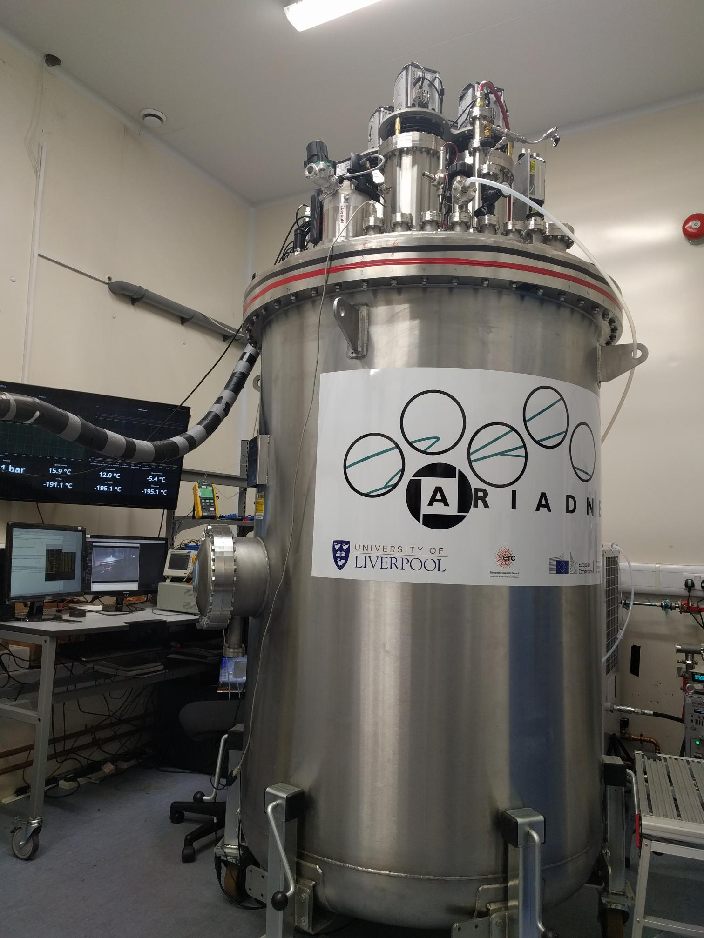
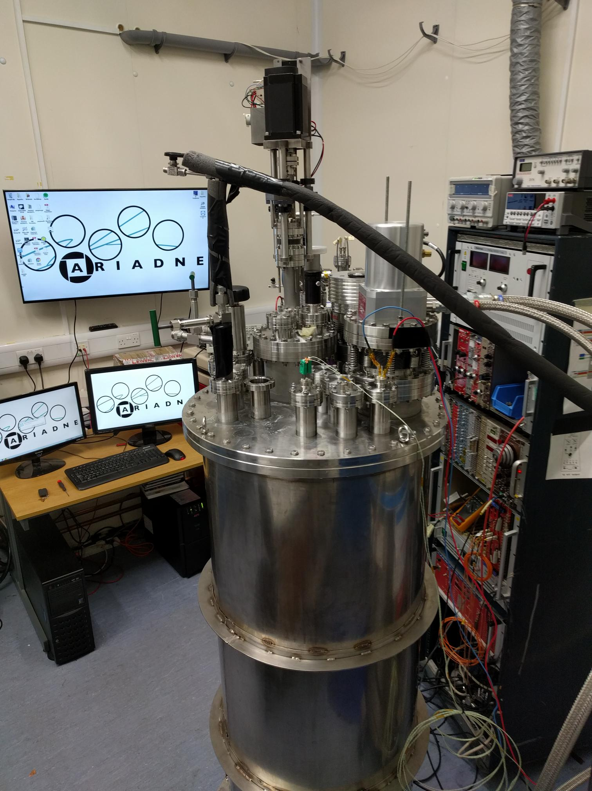
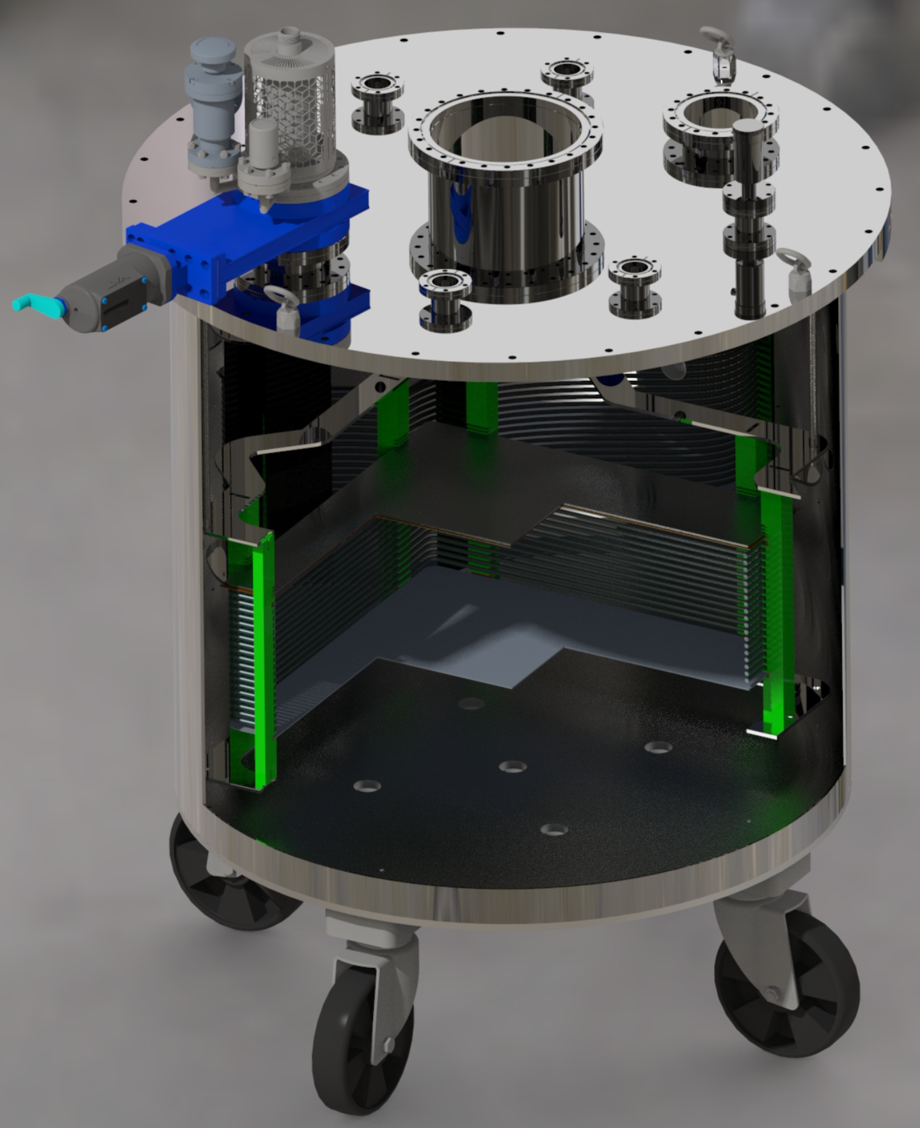
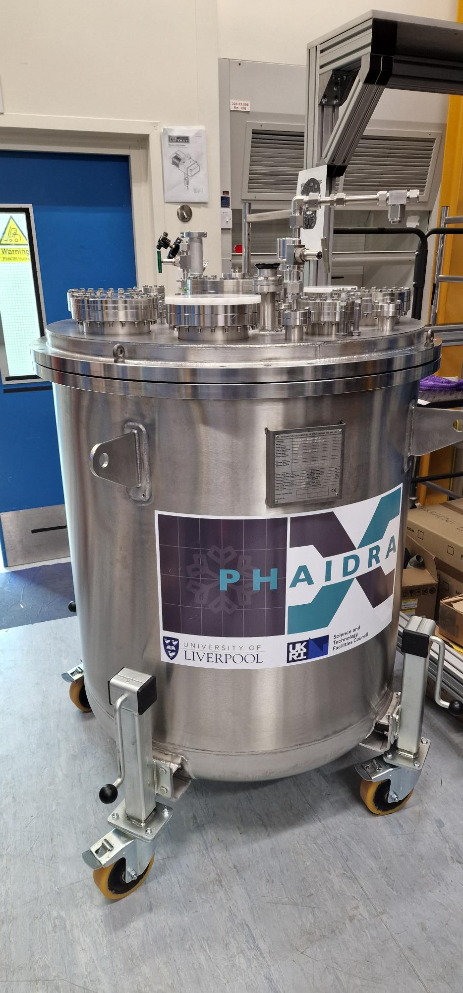
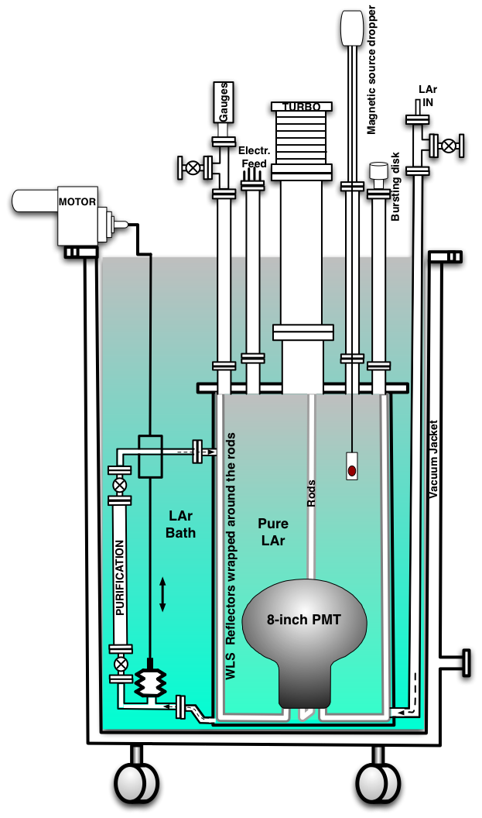
Establishing a LAr facility
2009
2011
2013
2015
2017
2019
2021
2023
500 L gas
40 L
250 L
1500 L
900 L

Slide 6
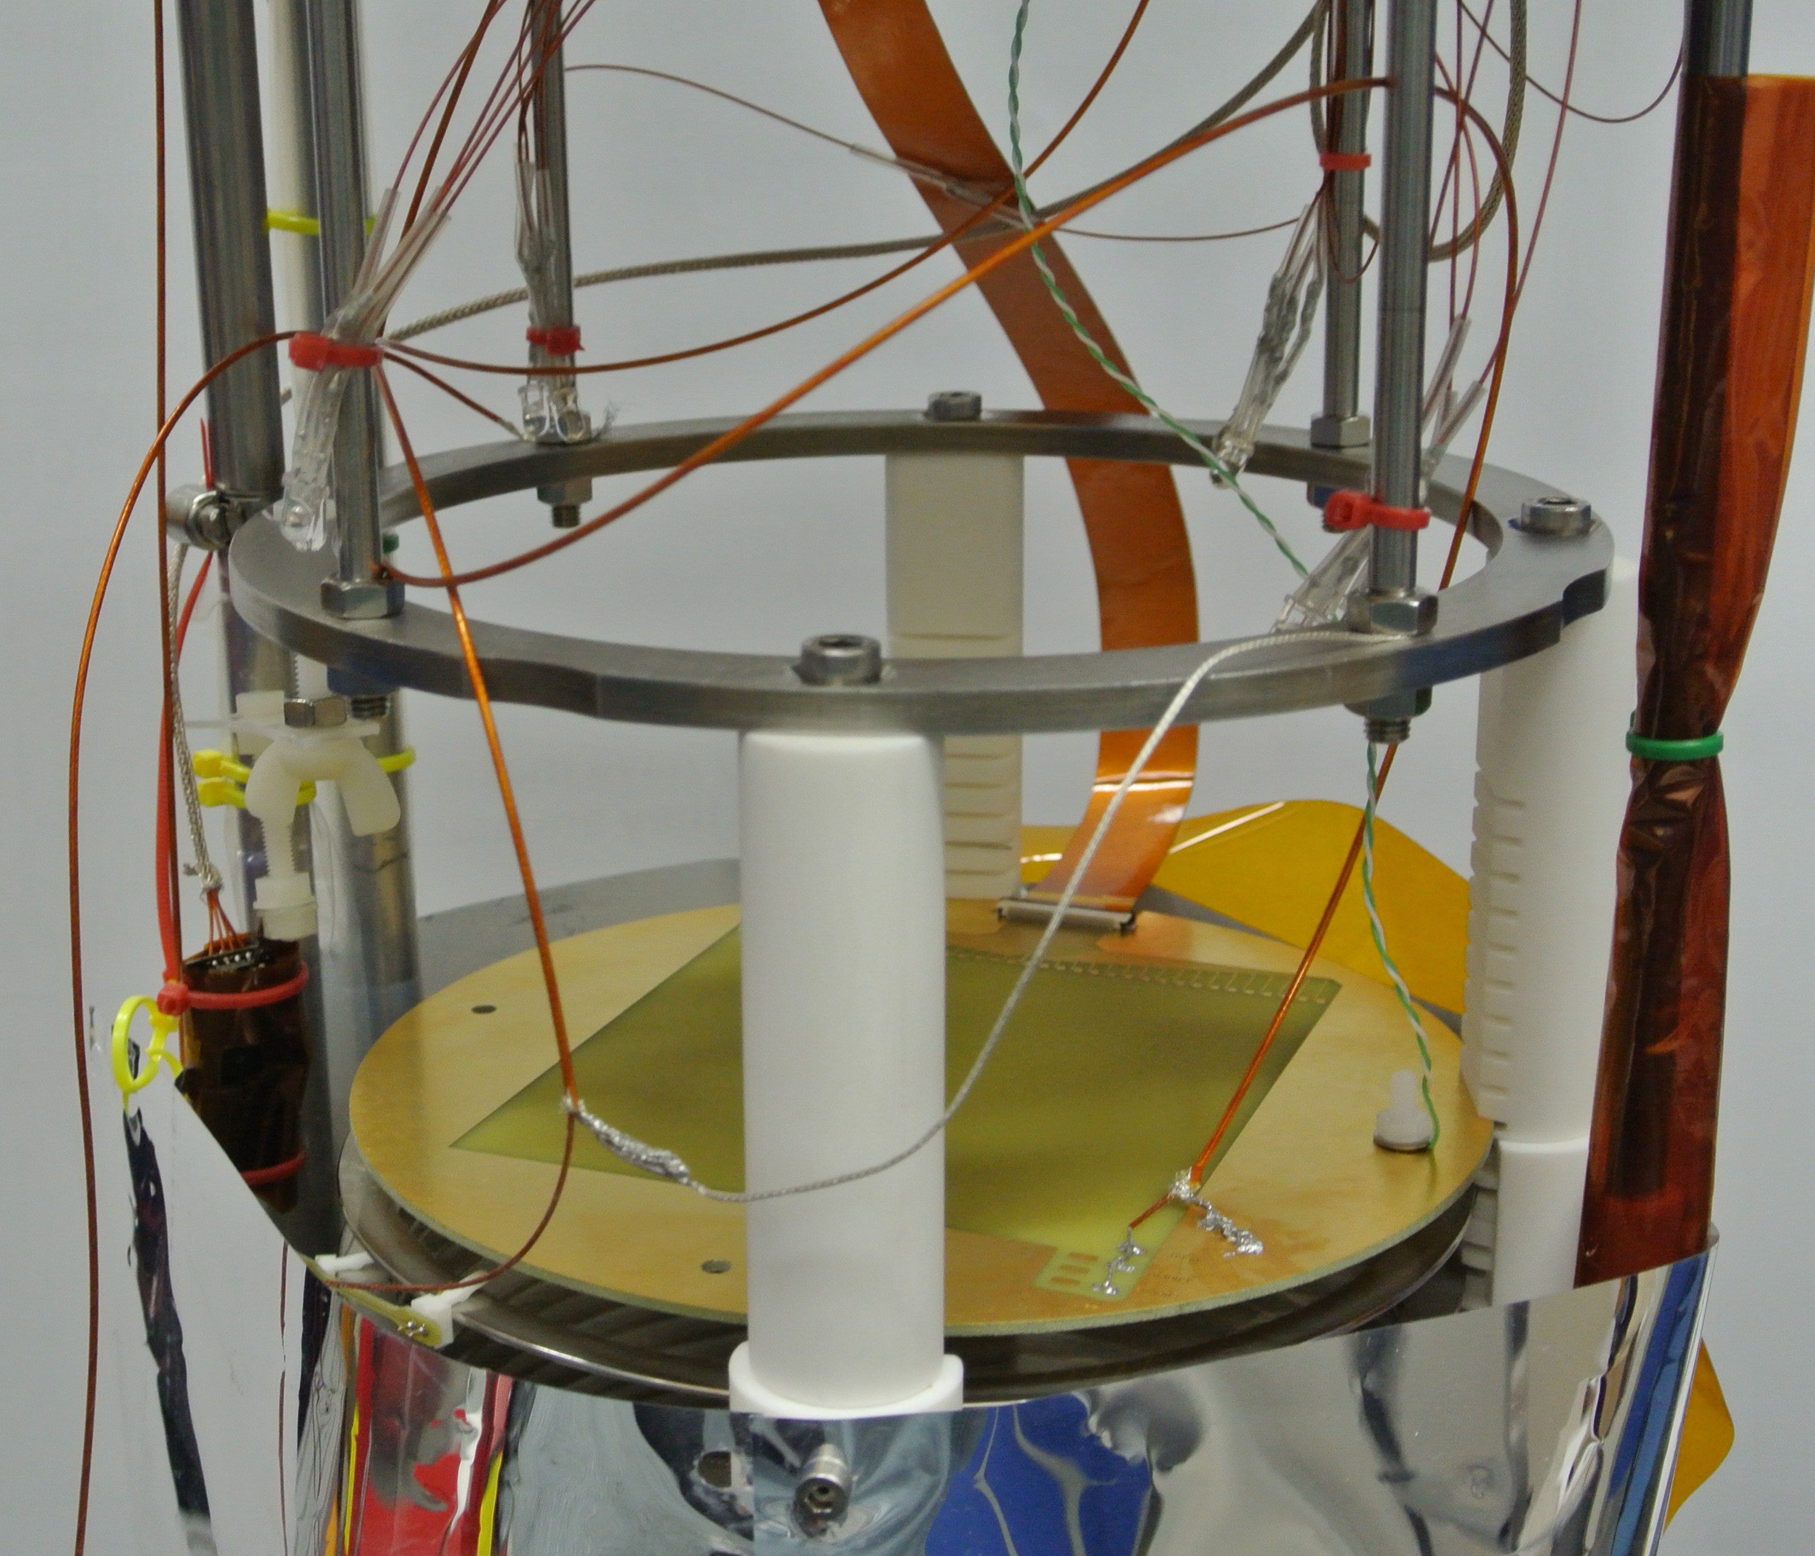
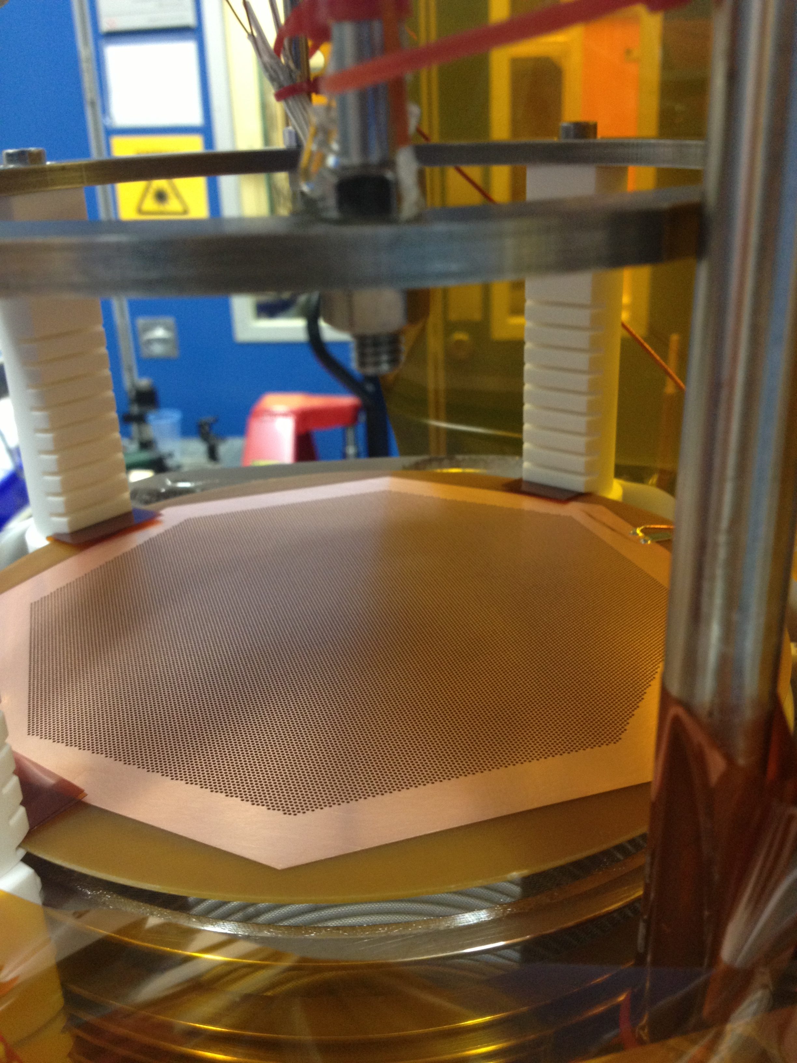
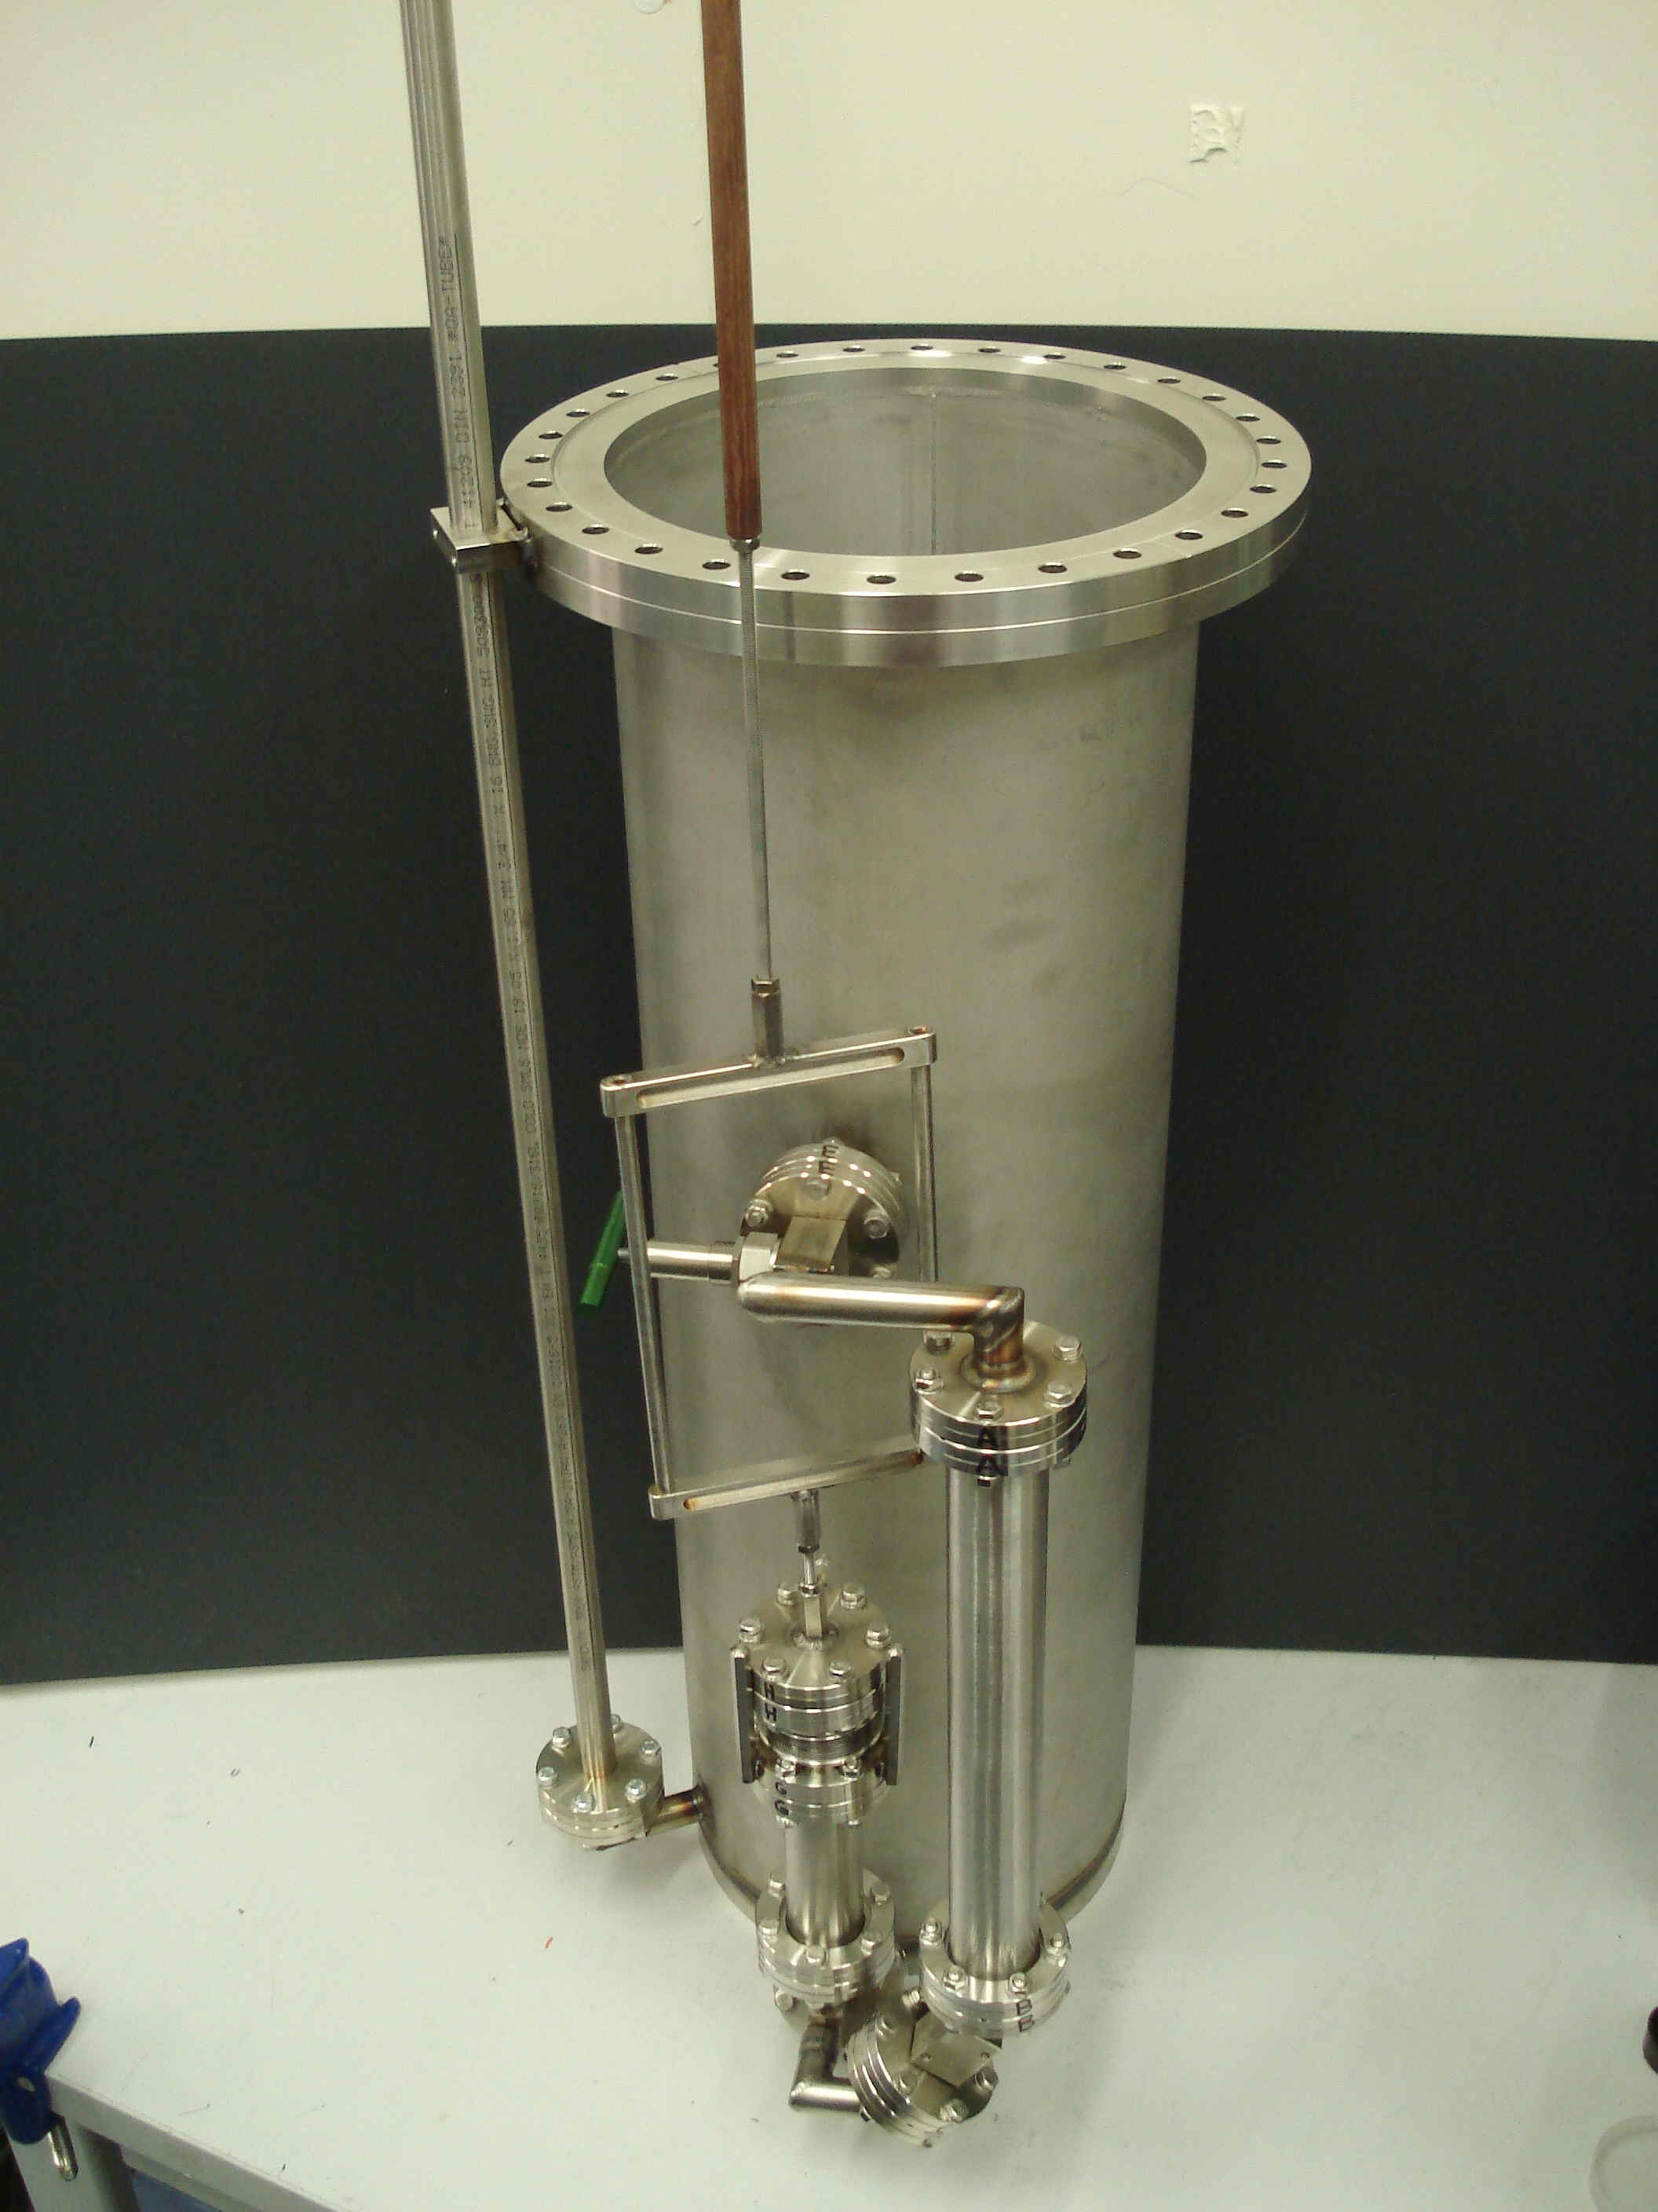
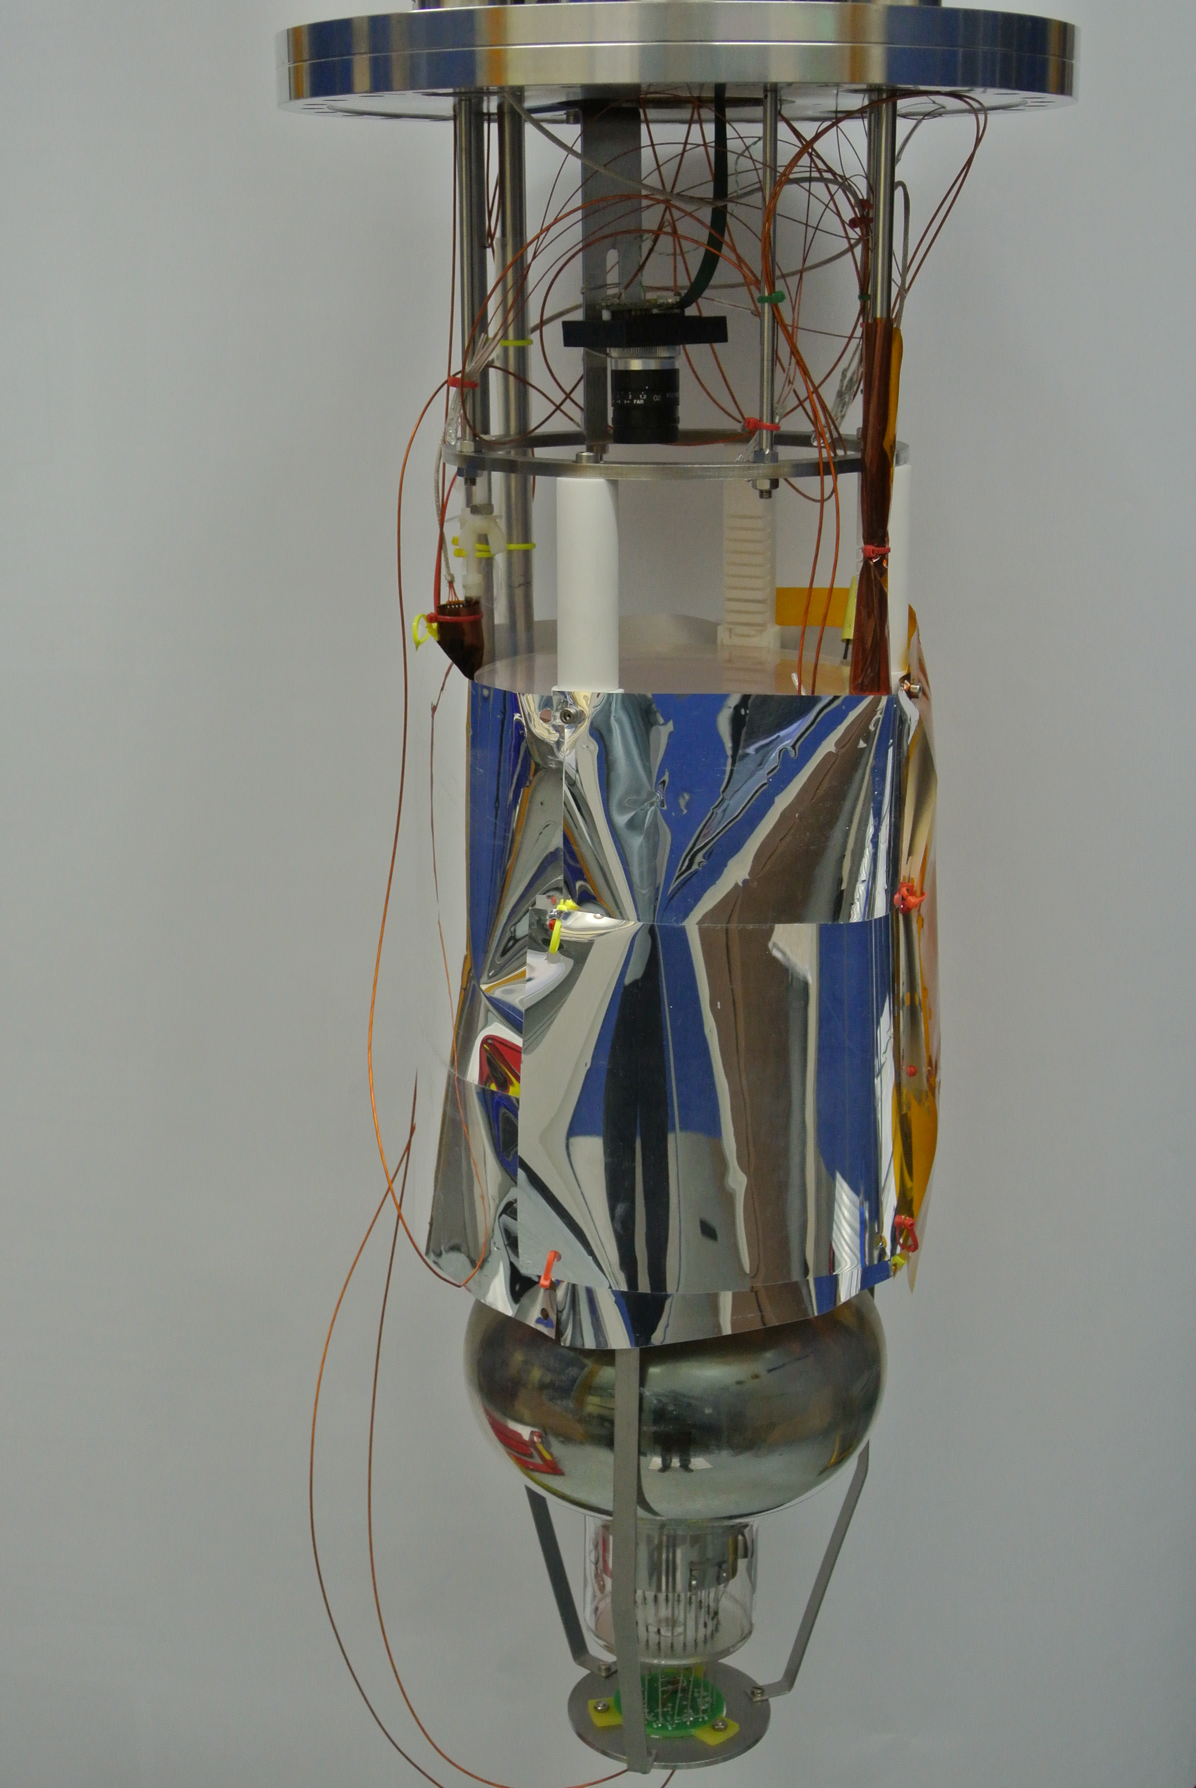
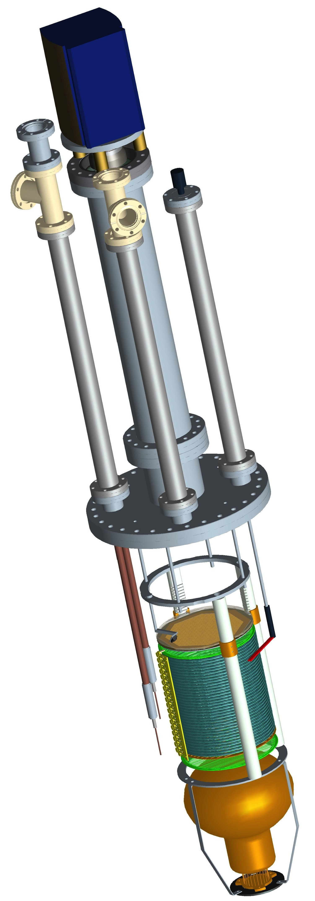
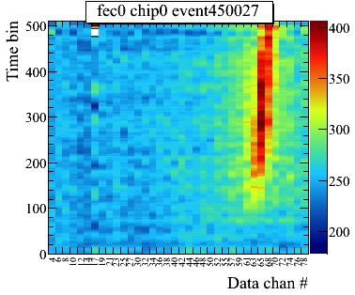
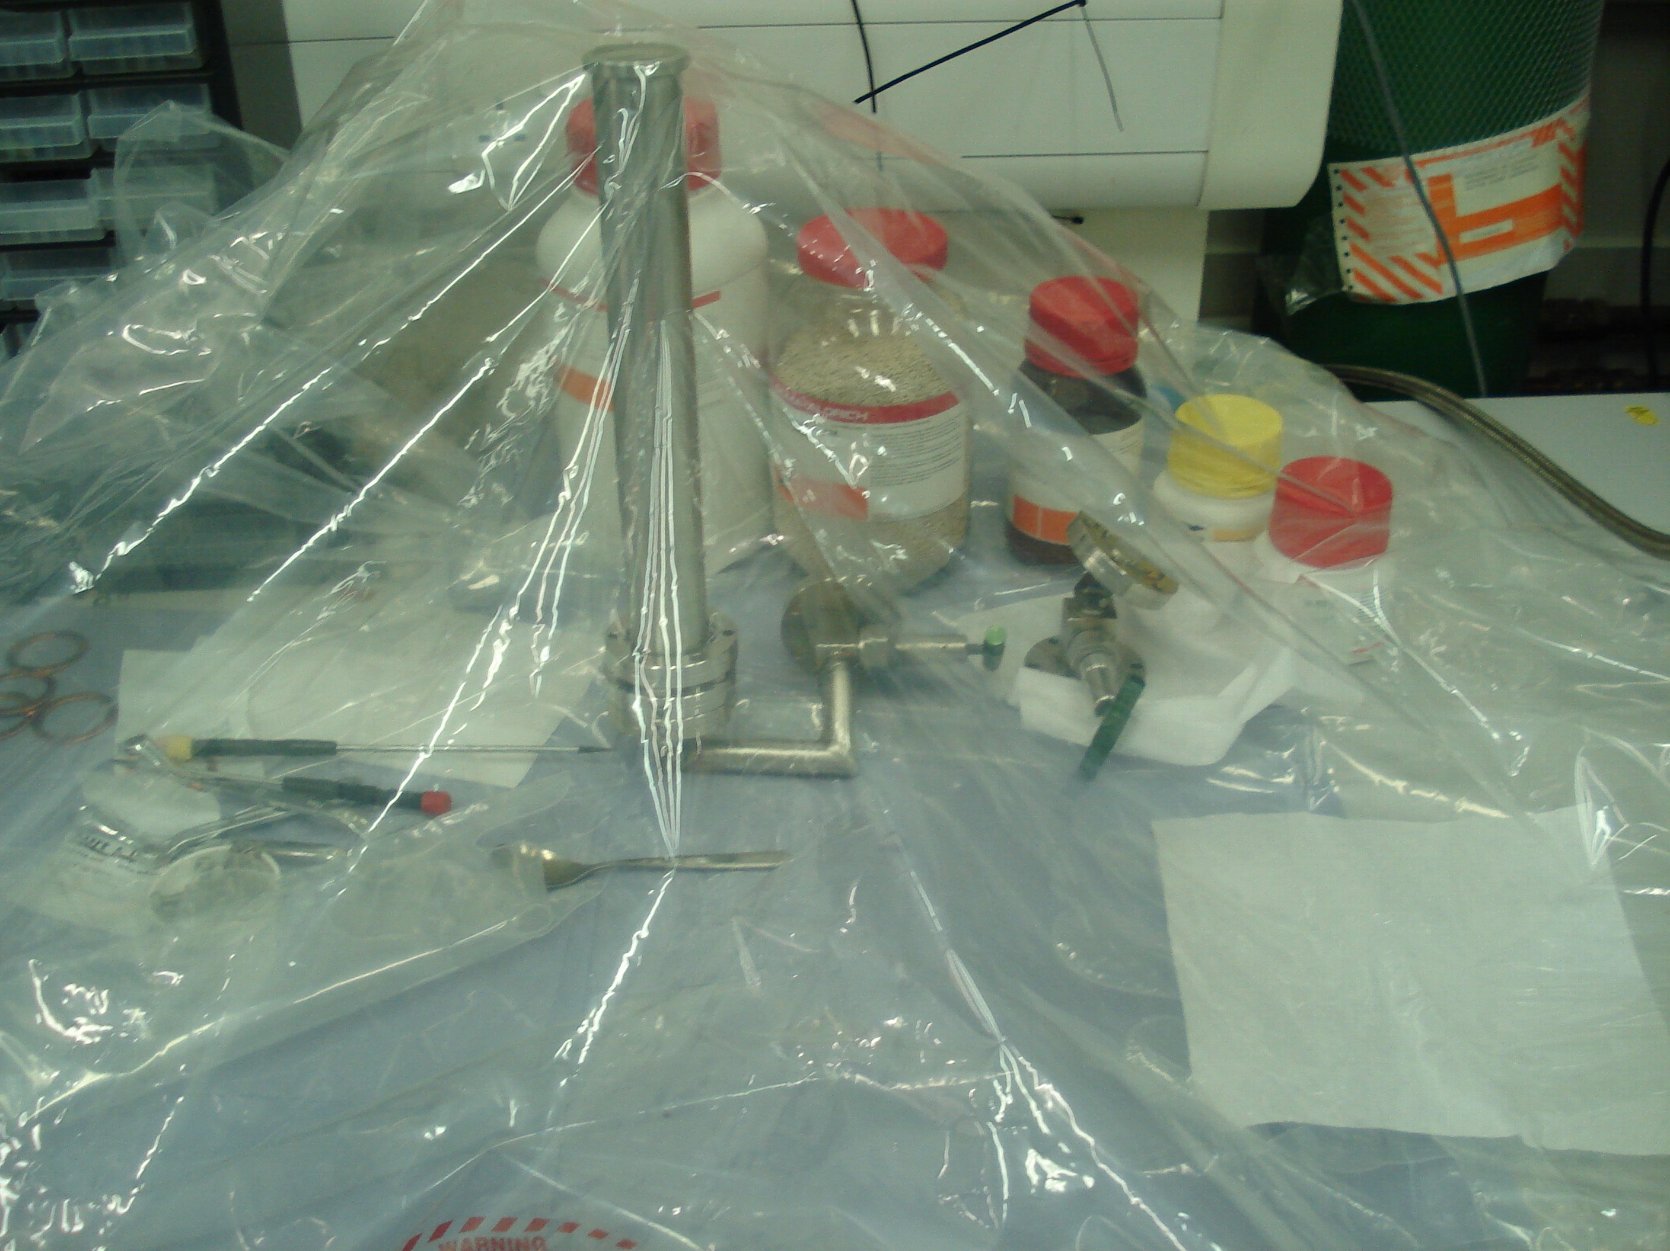
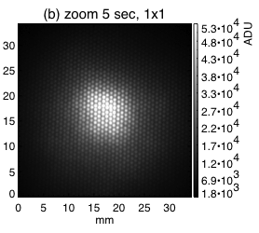
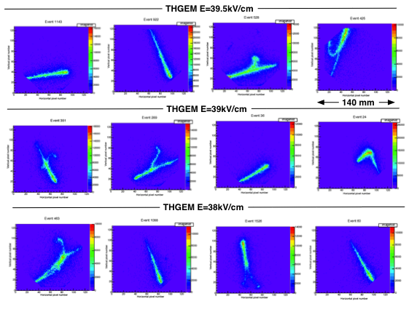
Early activities with 40 L setup
Cosmic muon
EMCCD, Successful imaging LAr Muon tracks
bulk Micromegas in collaboration with CEA Saclay
-Not enough gain in pure argon
Purification and LAr recirculation studies
CCD imaging integrated S2
DOI 10.1088/1748-0221/6/08/P08003
DOI 10.1088/1748-0221/9/02/P02006
DOI 10.1088/1748-0221/10/10/P10004

Slide 7
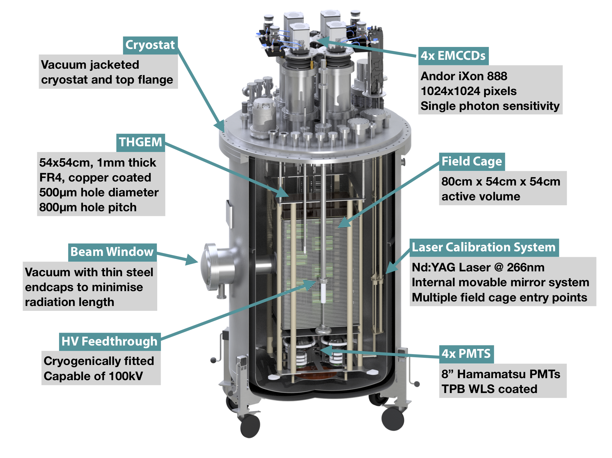
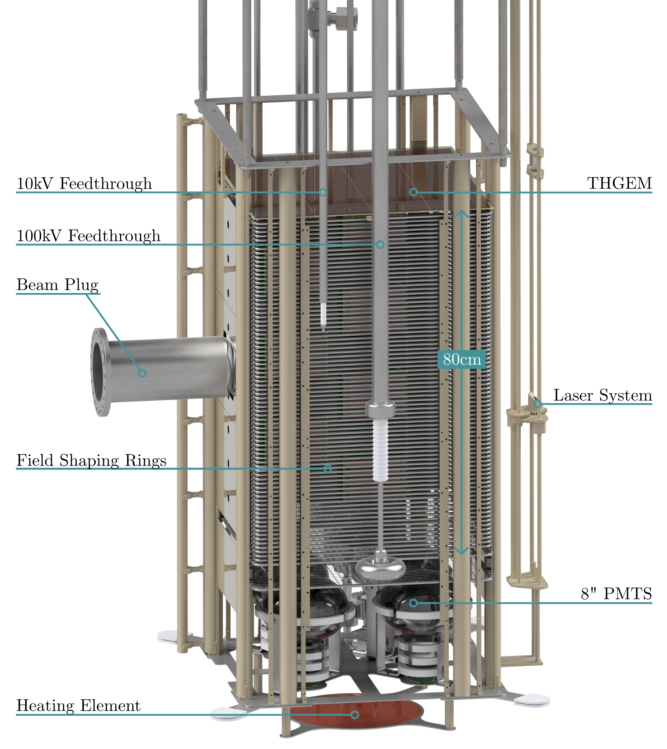
The start of ARIADNE program
ERC funding boosted the LAr R&D incredibly
Progressing optical readout and testing tracking capabilities
1500L LAr cryostat

Slide 8
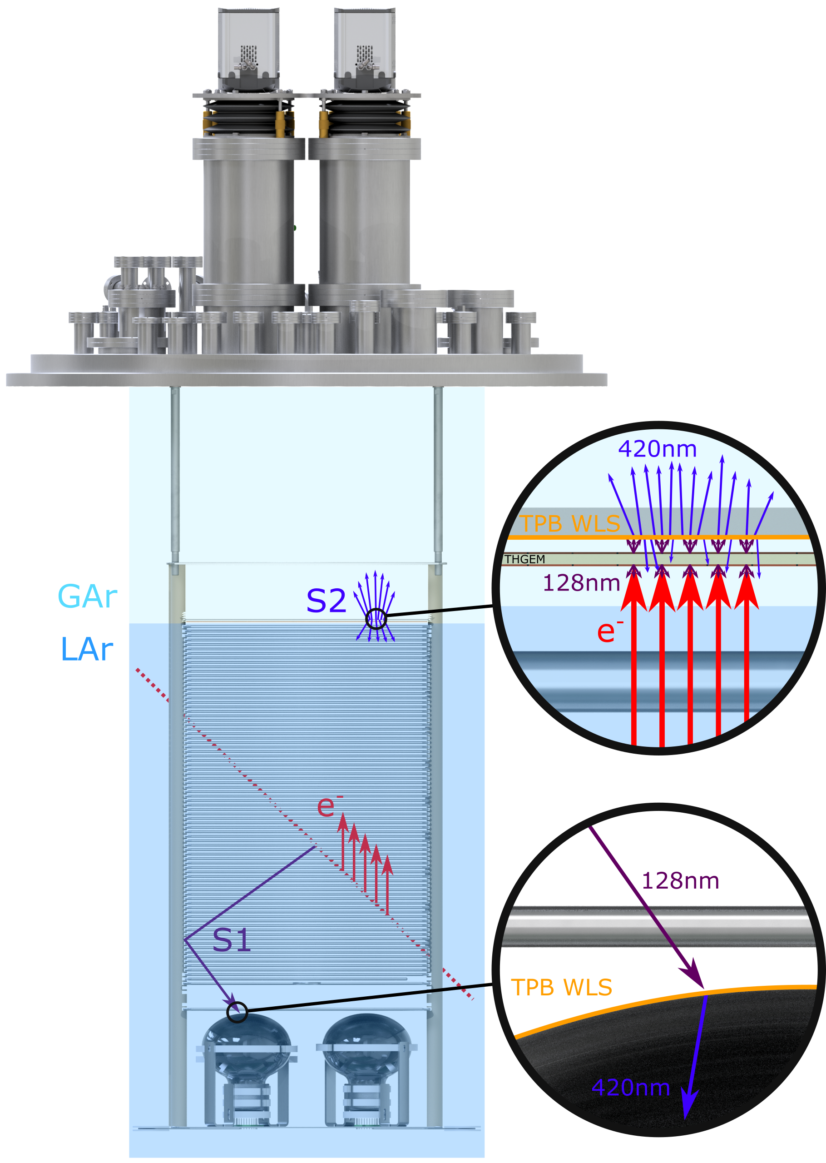
ARIADNE Detection Principle
Cameras
ARIADNE has demonstrated light readout as a viable alternative to charge in dual-phase TPC neutrino experiments
Benefits over previous charge readout techniques:
High resolution
Sensitivity to low energies
Very low noise, decoupled from TPC
Ease of access
Cost efficient
Incoming particles ionise LAr and create prompt scintillation light (S1)
Electrons drift towards the extraction grid situated below the liquid level
A THGEM (THick-Gaseous Electron Multiplier) amplifies drift charge (capable of >30 kV/cm in LAr) generating secondary scintillation light (S2)
WLS (Wavelength Shifting) before imaging with Timepix3 camera
ARIADNE (ARgon ImAging DetectioN chambEr)

Slide 9
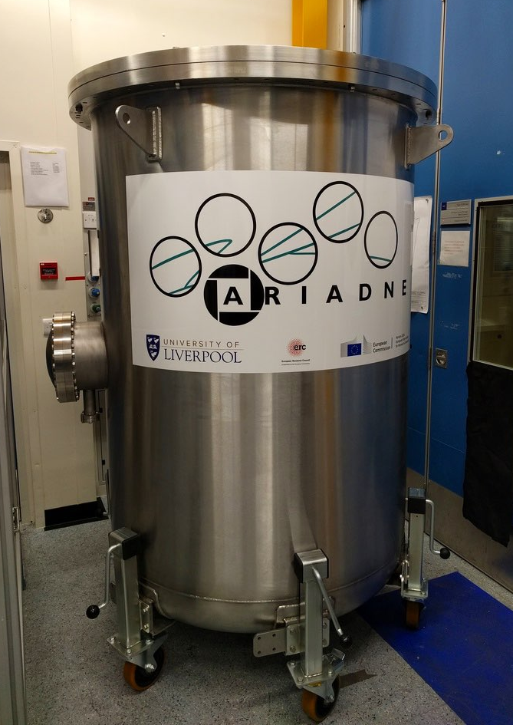
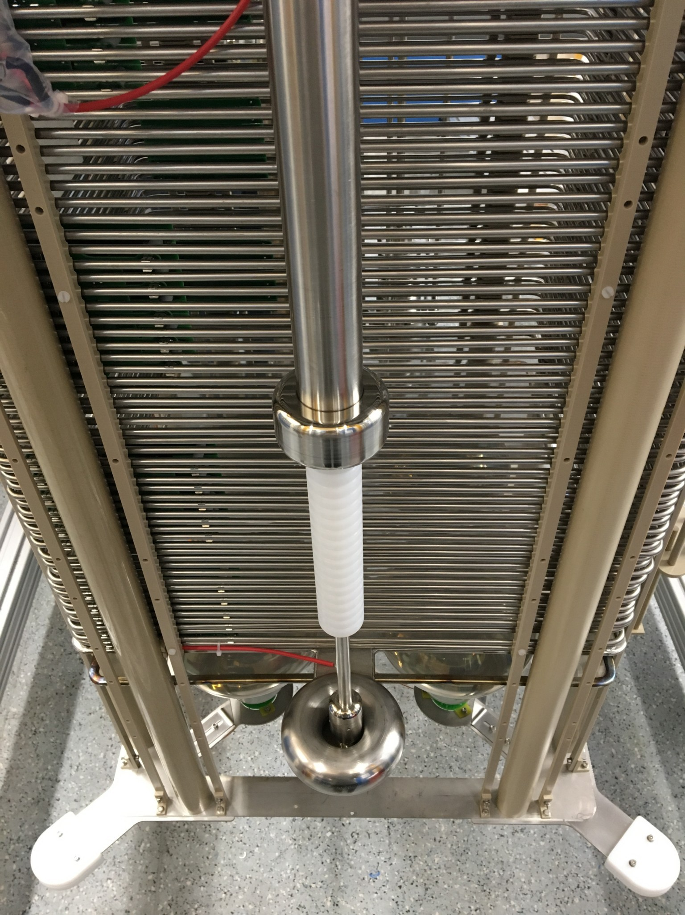
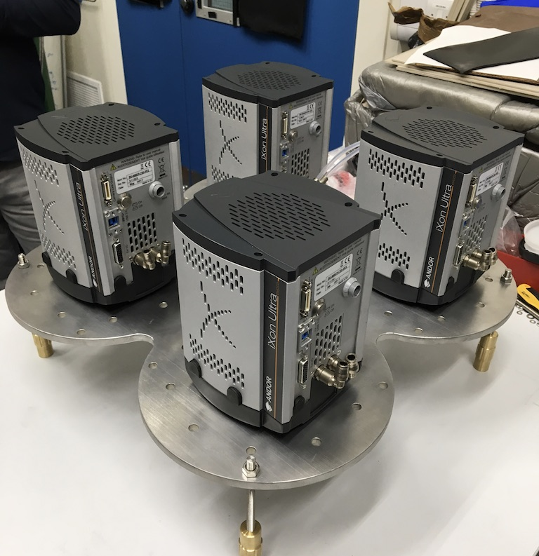
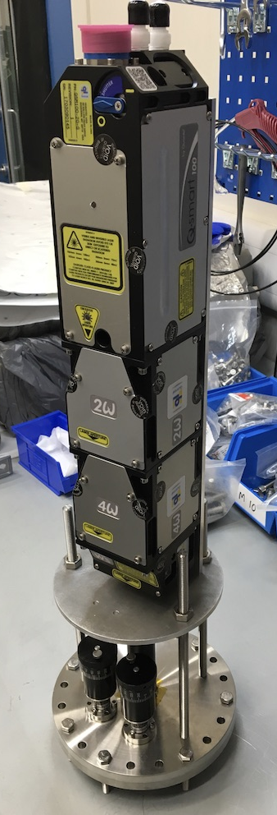
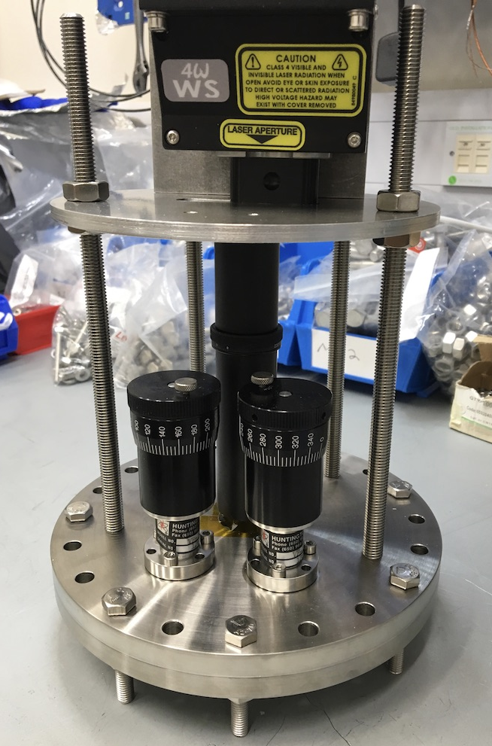
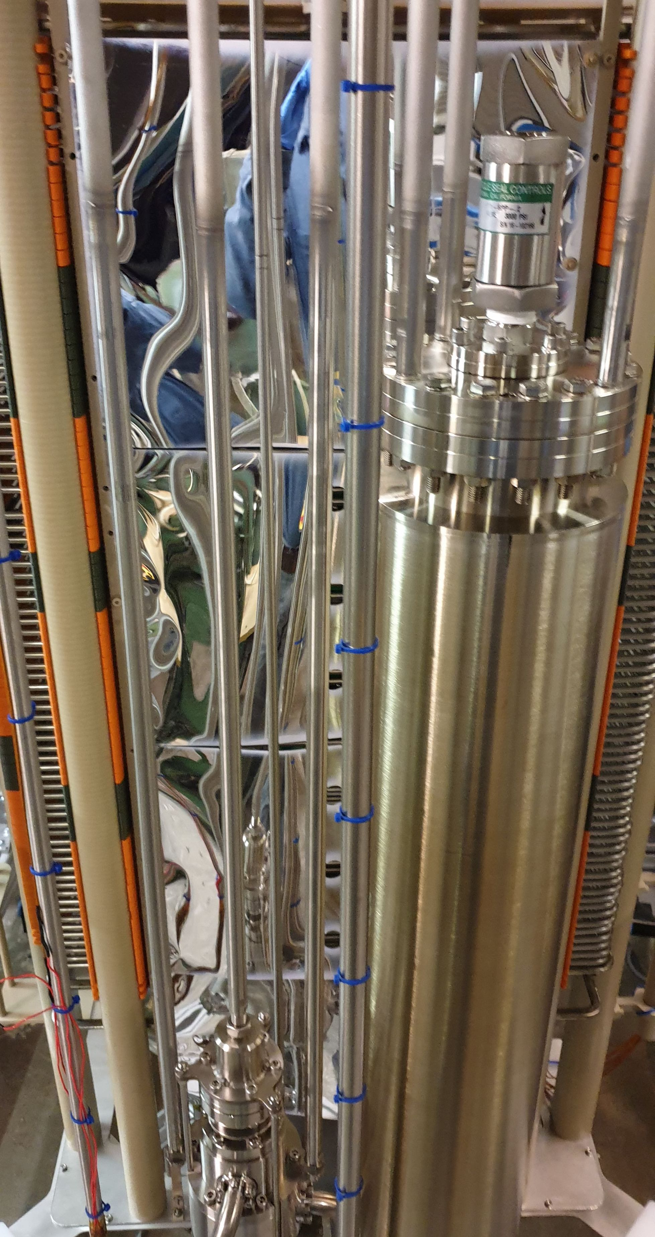
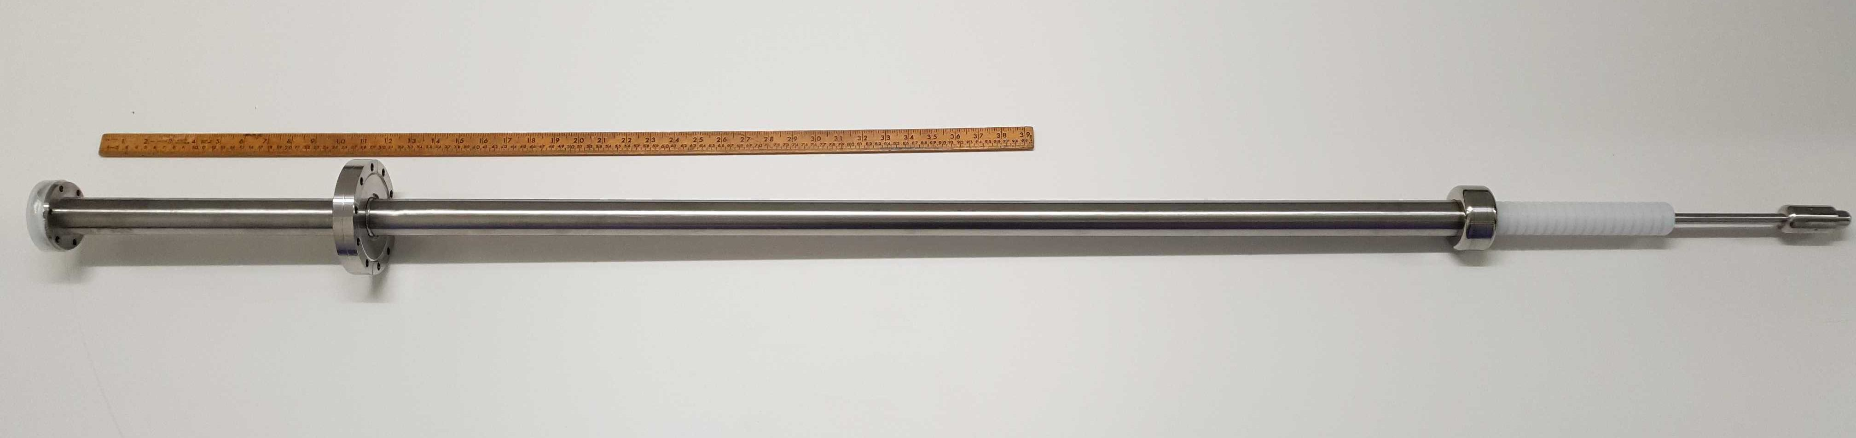
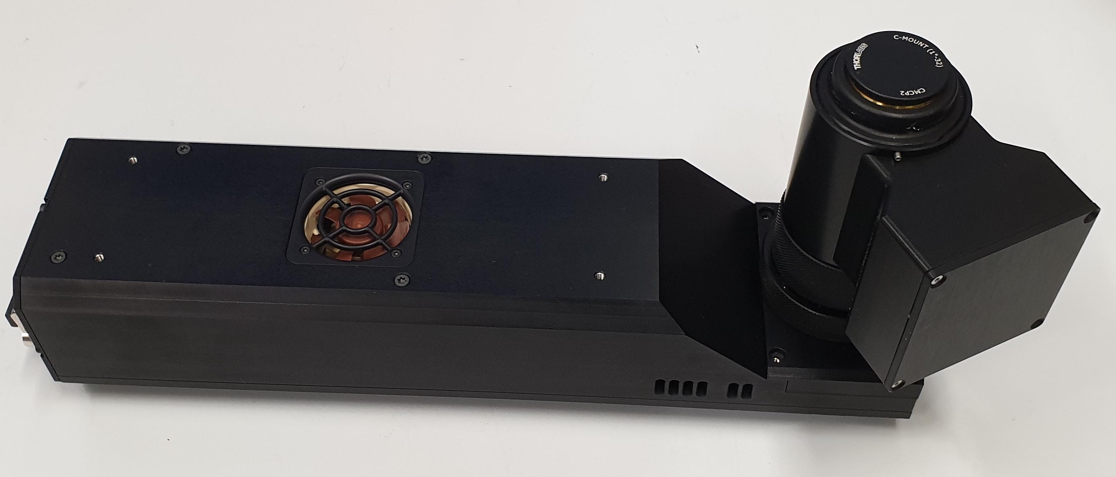
Technologies in ARIADNE
LASER calibration
EMCCDs
Beam window Cryostat 1500 litres
80 cm field cage
Pump and purification
100kV cryogenically fitted FT
TPX3Cams

Slide 10
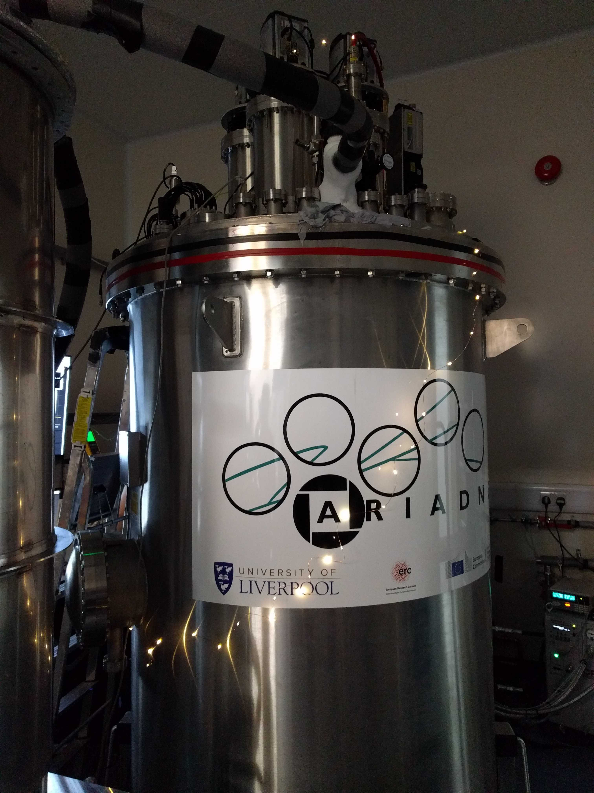
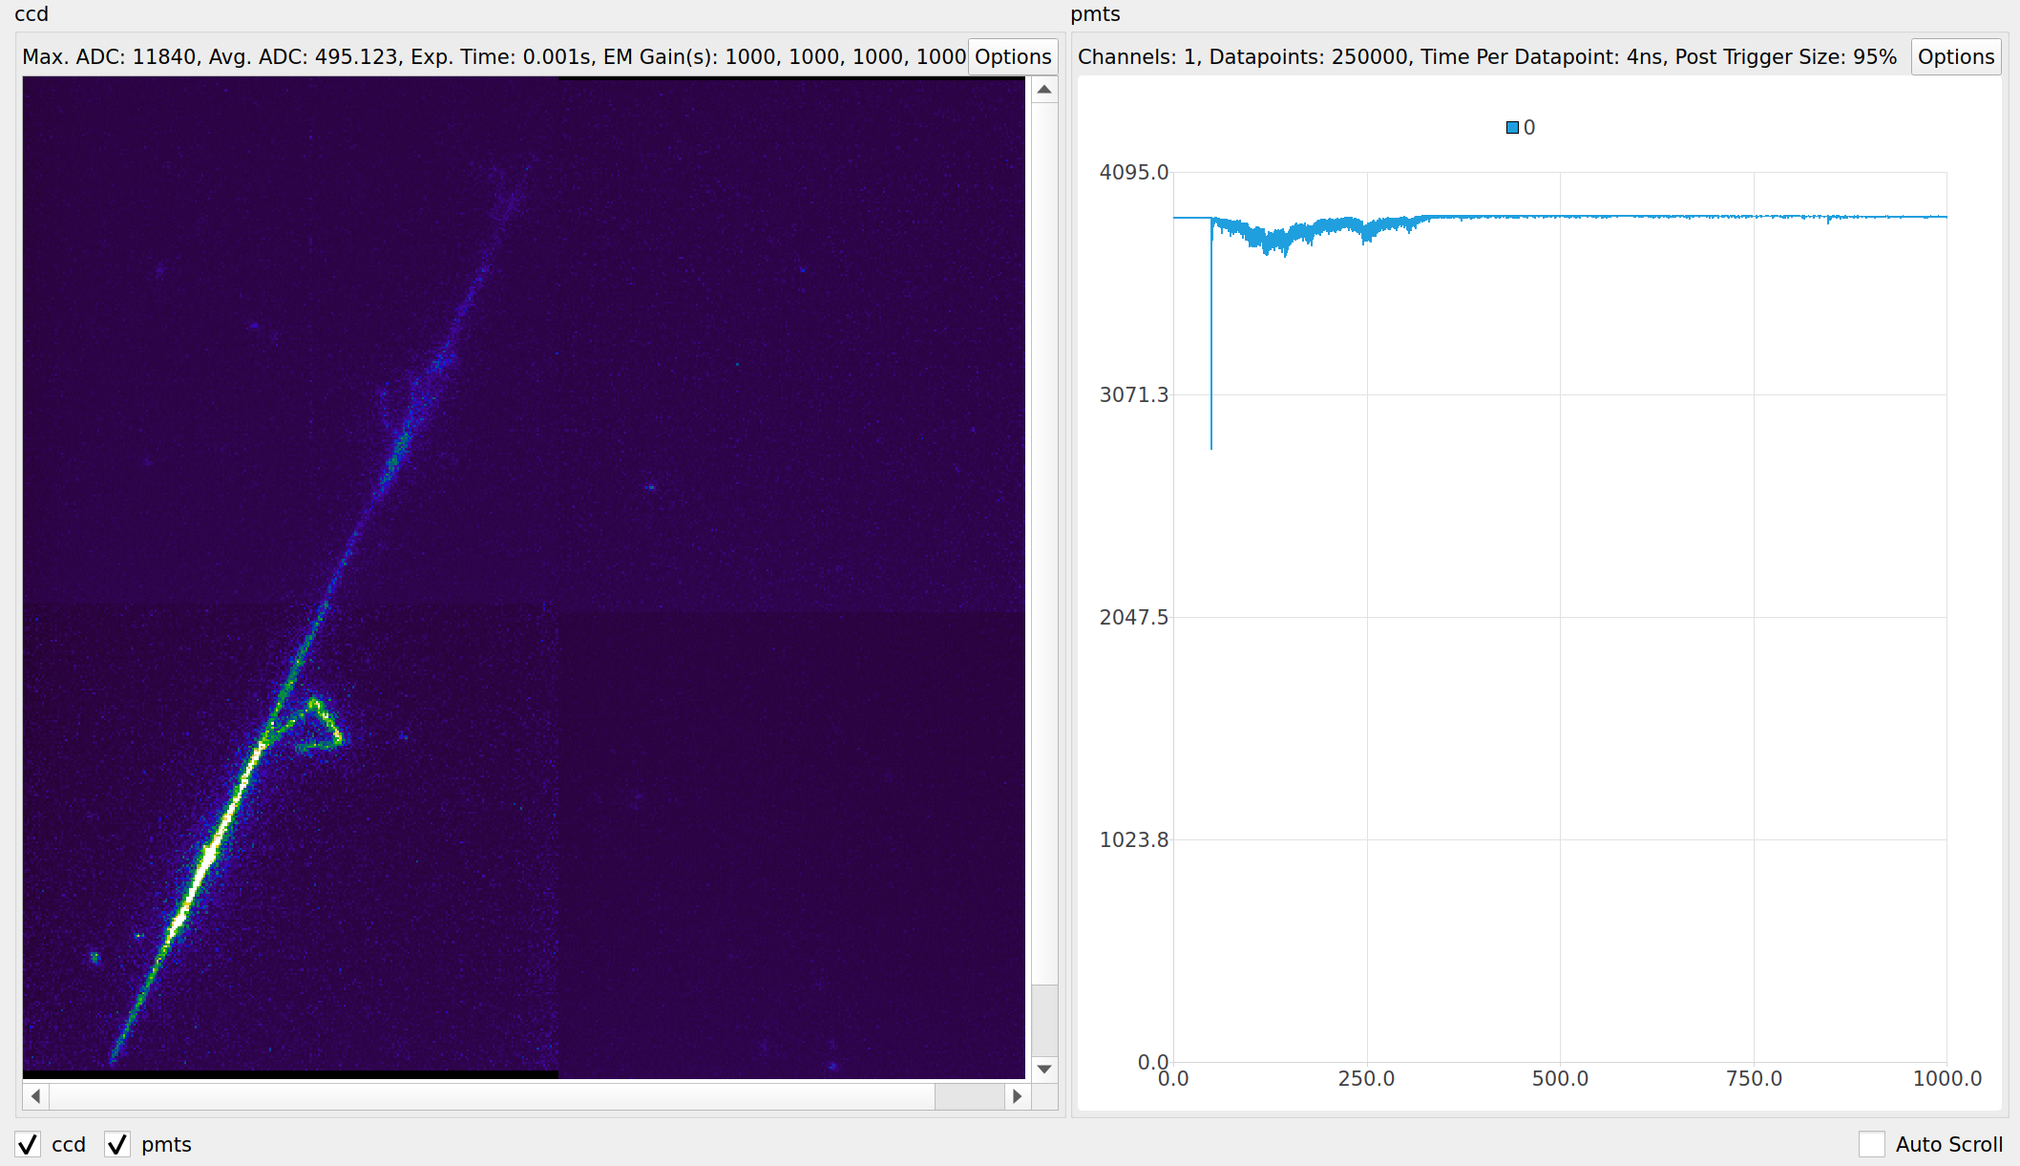
Xmas before shipping to CERN
Very first hard task, build 1 ton optical LArTPC and position it at a CERN beamline within 2 years!
X-mas in the lab -sent to SPSC confirmation of working detector 31st Dec
Correlated PMT signal
Cosmics

Slide 11
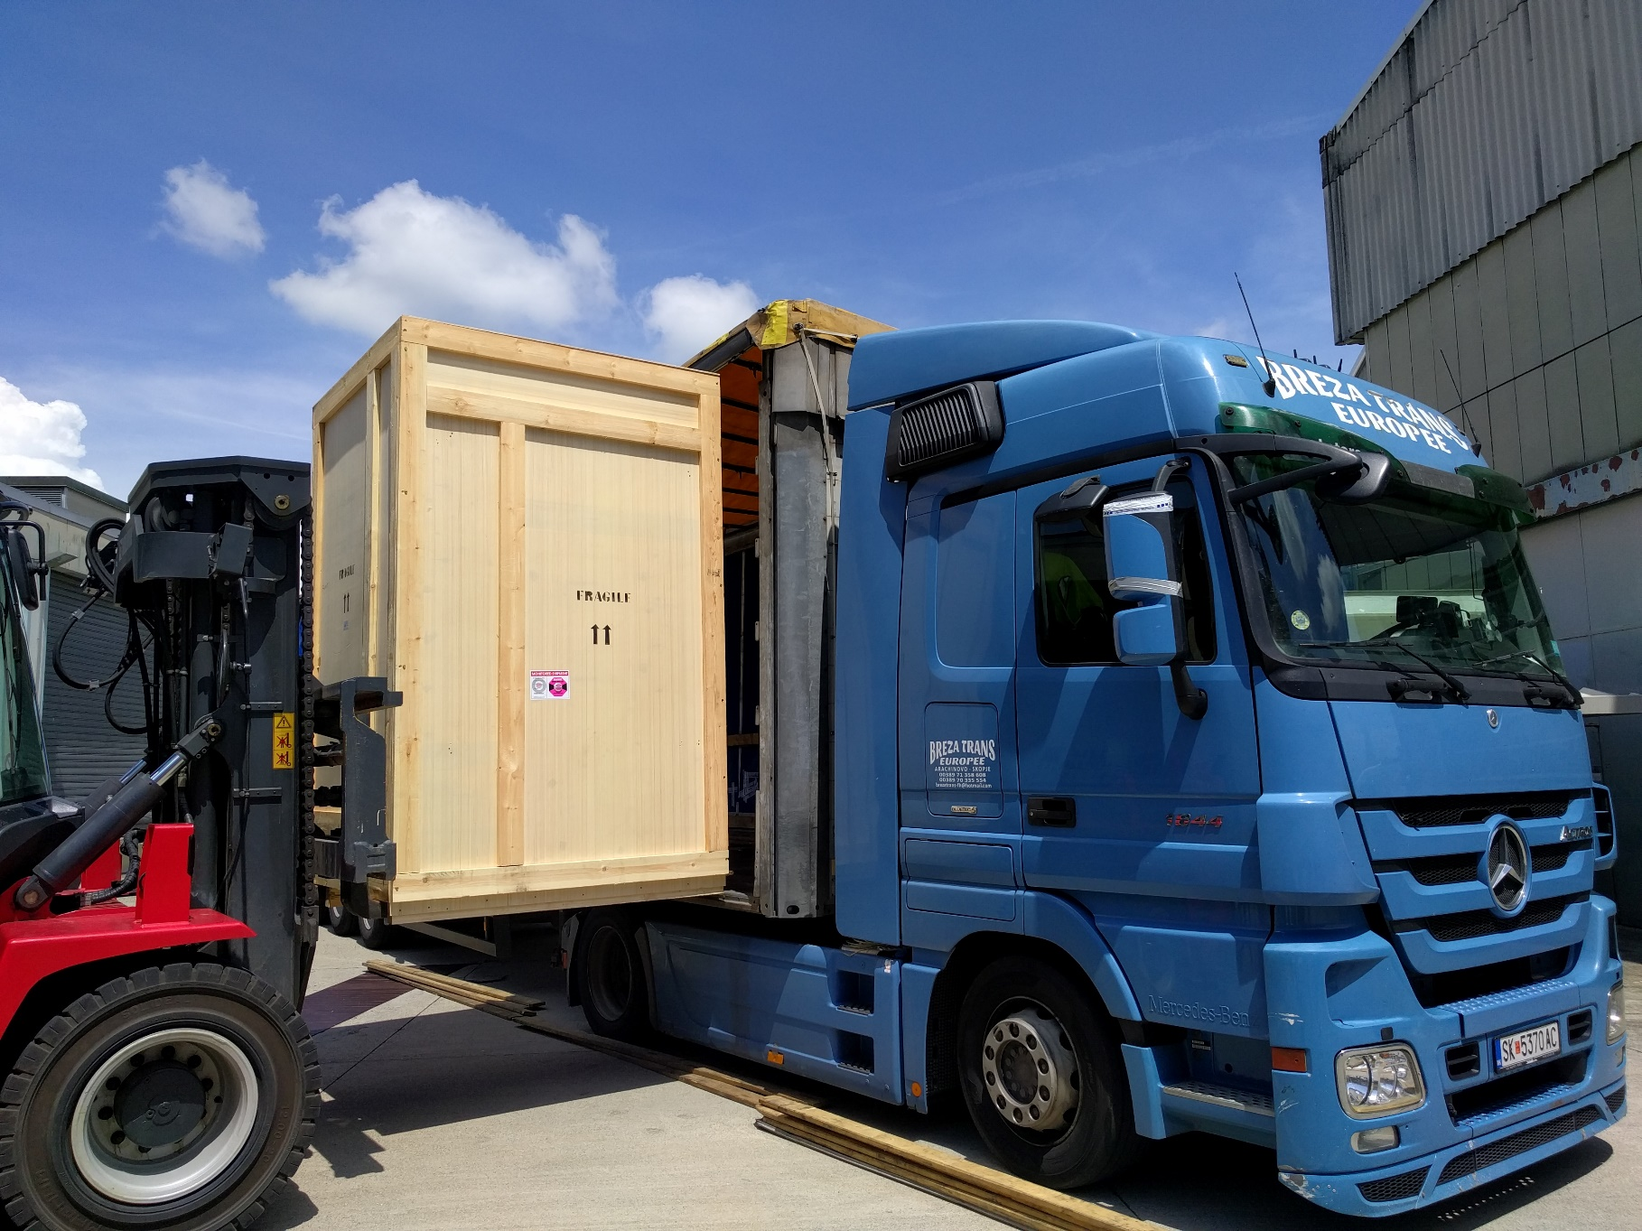
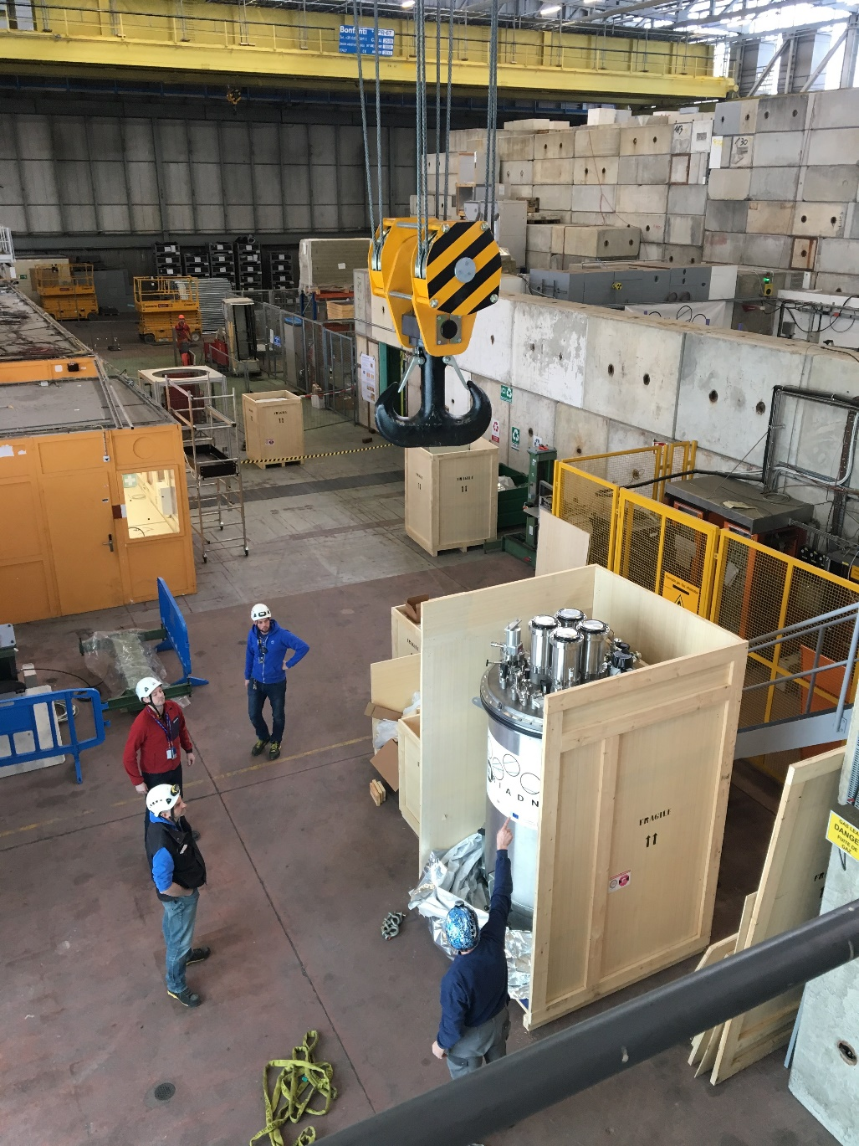
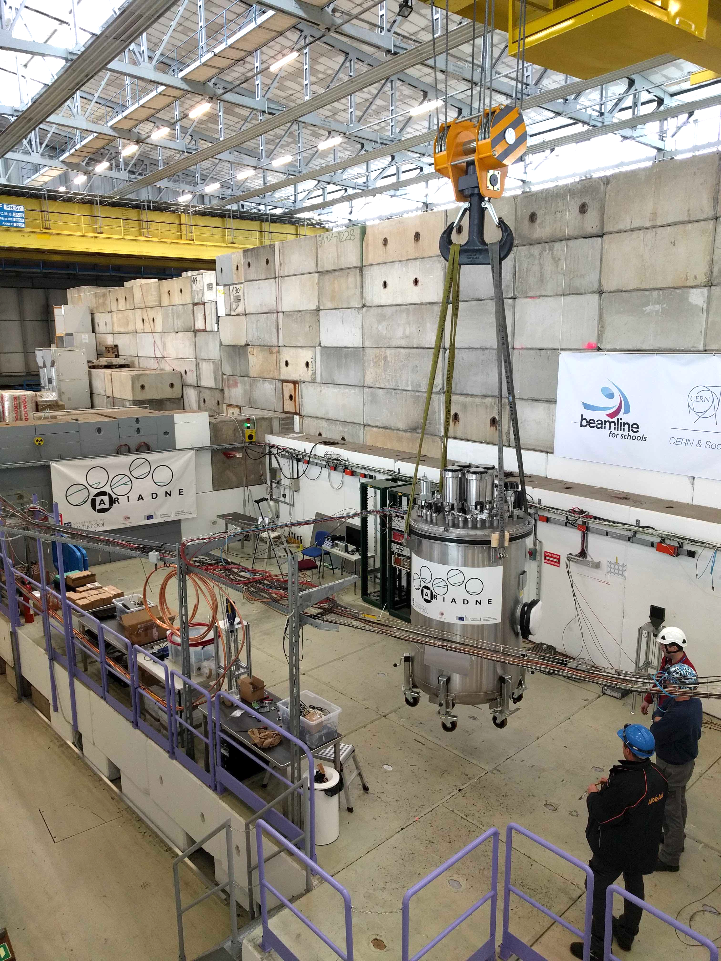
ARIADNE arriving at CERN

Slide 12
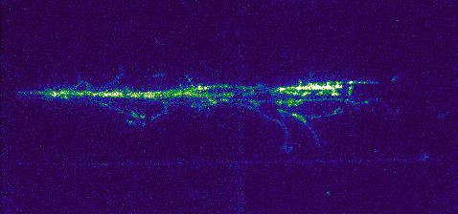
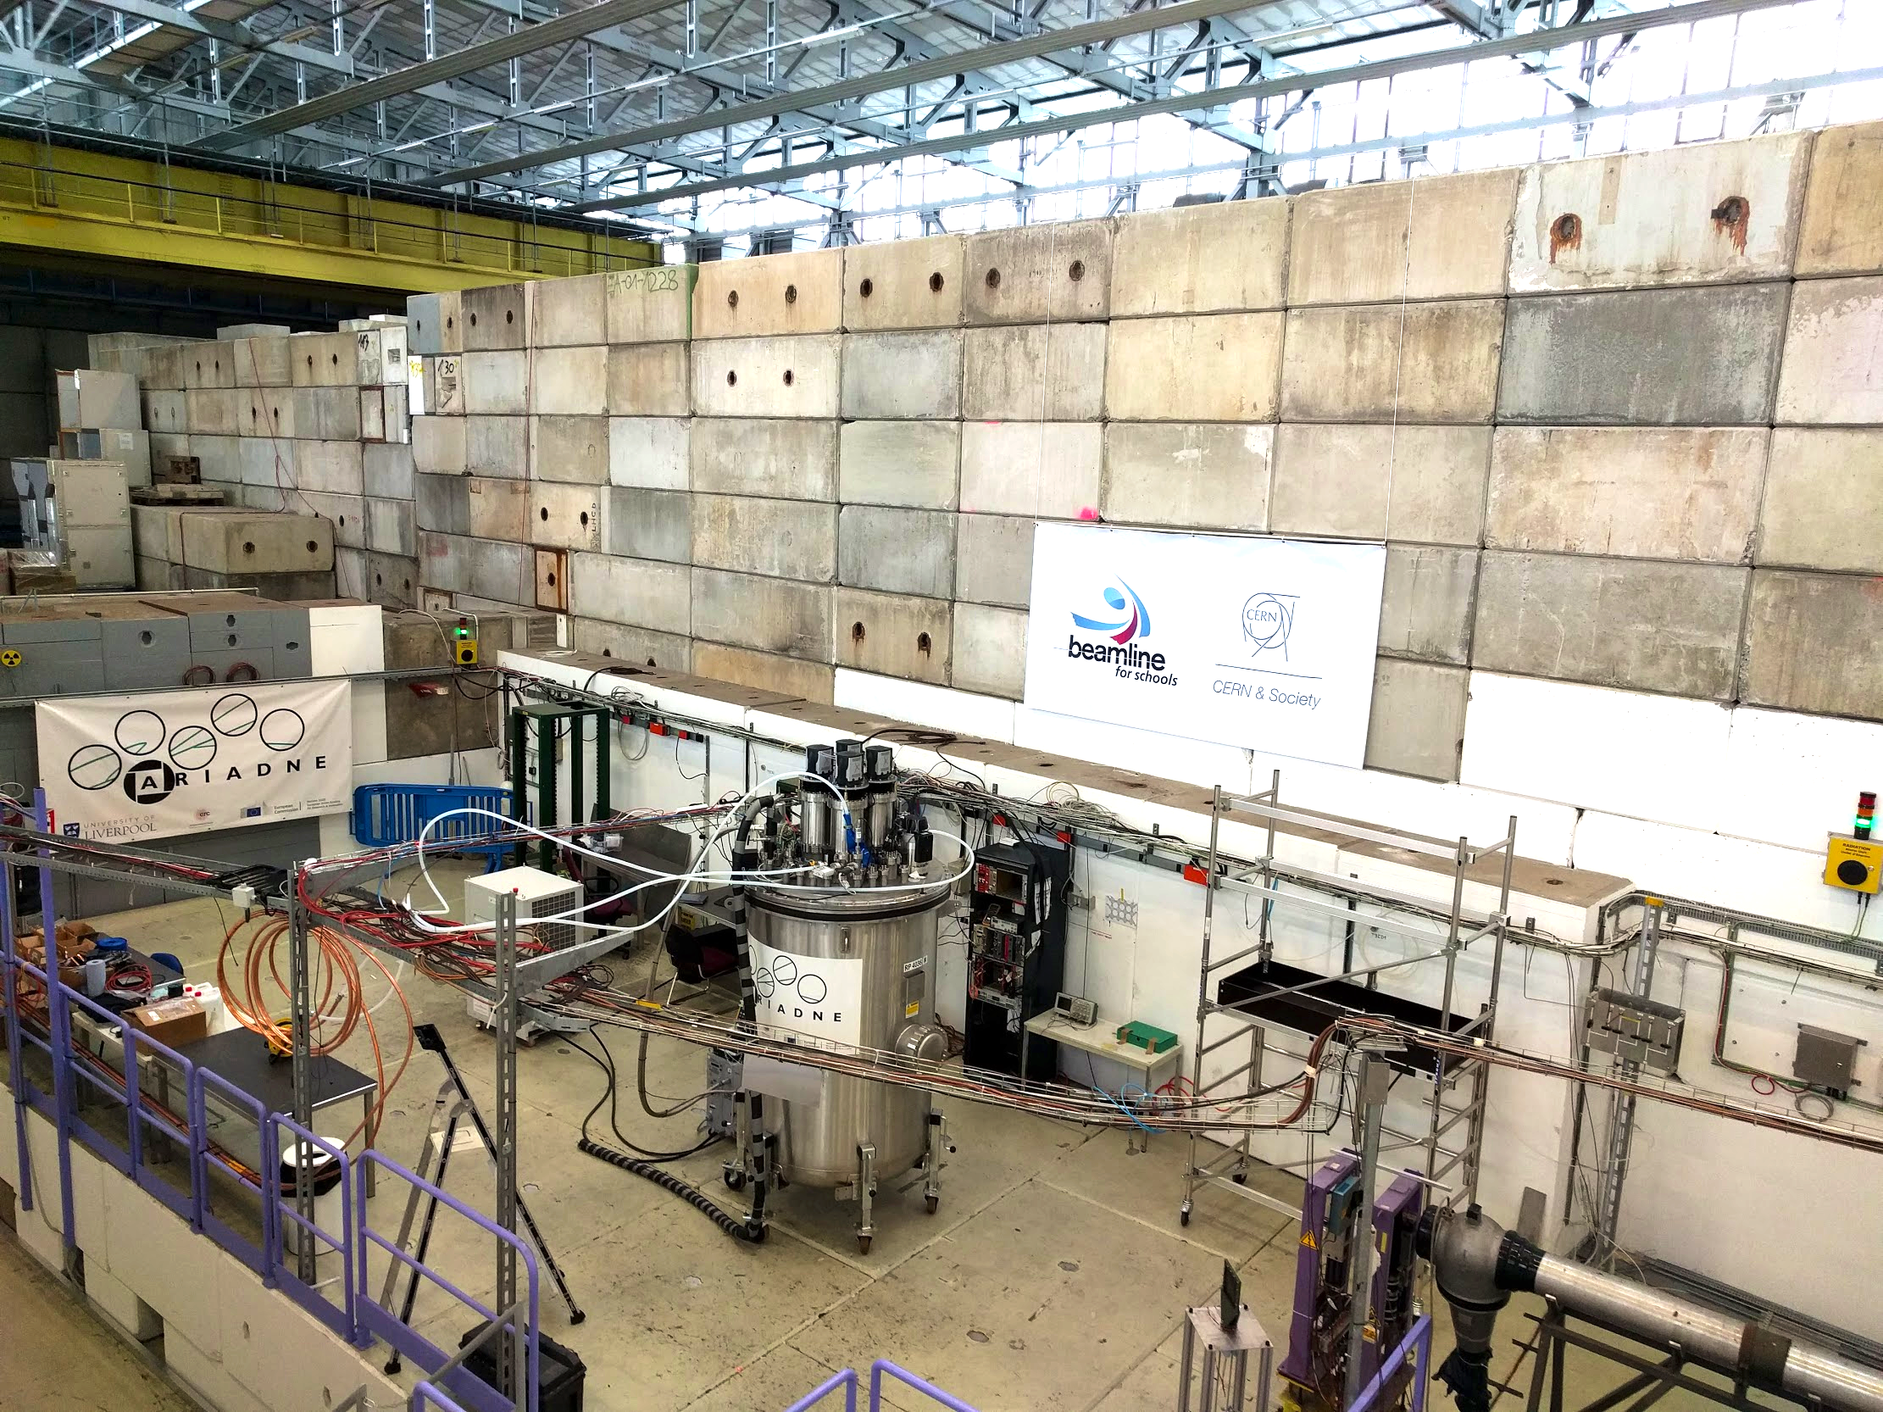
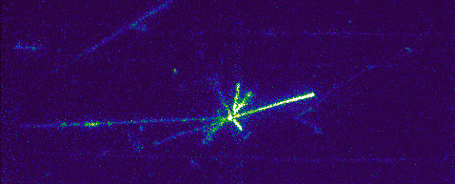
ARIADNE at CERN T9
EMCCD data taking 3 weeks April 2018.
T9 Beamline, East Area, CERN.
Mix of particles: e ±, μ ±, π ±, p±. (0.5 – 8 GeV/c.)
43 cm
35 cm
DOI 10.1088/1748-0221/15/03/P03003

Slide 13
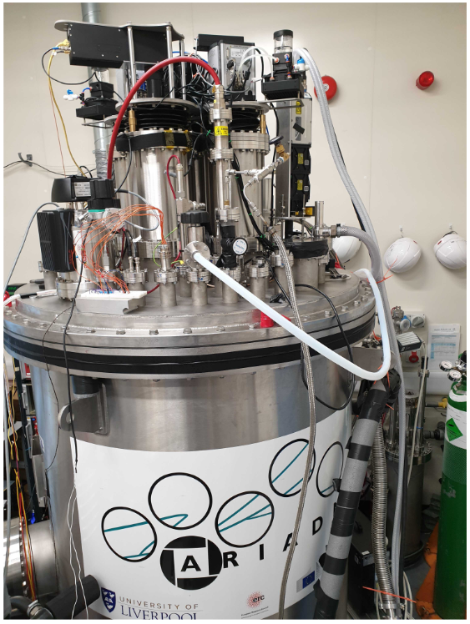
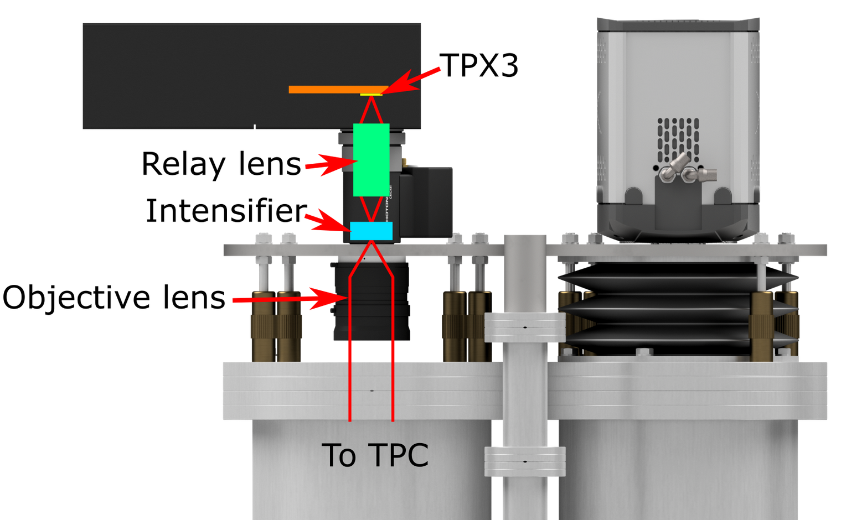
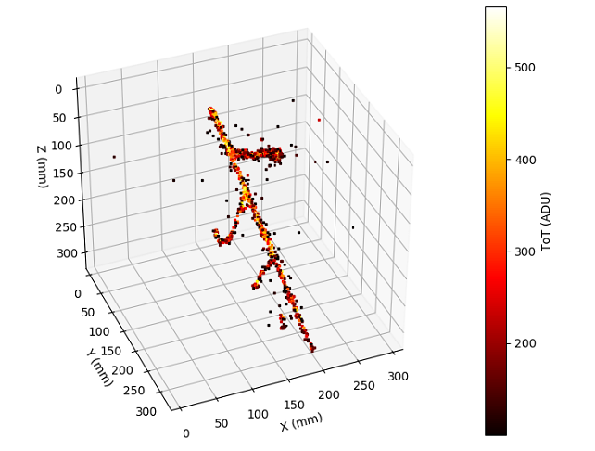
Going from 2D to 3D: TPX3Cam optical TPC readout
Timepix3 camera installed in place of an EMMCD camera
TPX3 provides simultaneous time-over-threshold (ToT) and time-of-arrival (ToA). Complete (x,y,z,E) event reconstruction using a single device.
Photonis Cricket image intensifier with Hi-QE green photocathode.
VUV Image intensifiers are now also available
Coldbox Intensifier
ARIADNE results
TPB emission
https://iopscience.iop.org/article/10.1088/1748-0221/14/06/P06001
https://www.mdpi.com/2410-390X/4/4/35

Slide 14
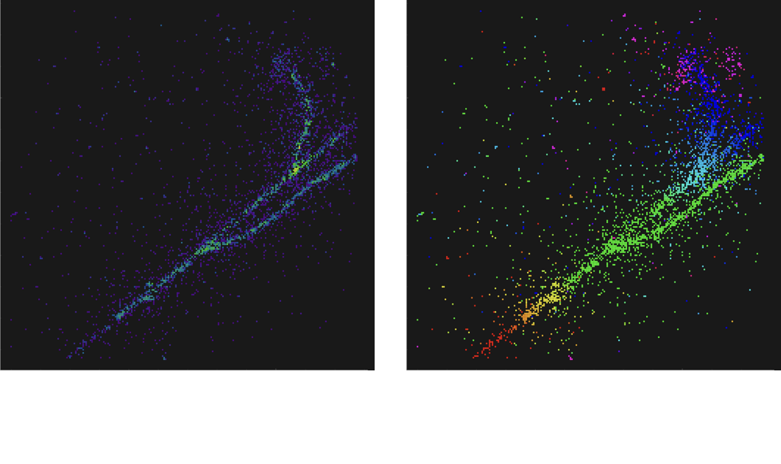
TPX3Cam Optical Readout

Slide 15
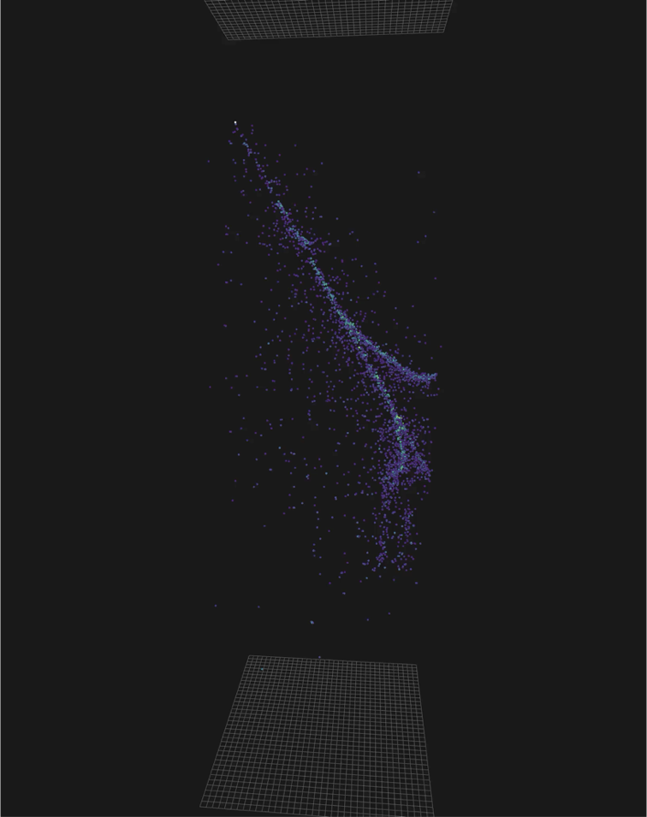
TPX3Cam Optical Readout

Slide 16

TPX3Cam 3D Cosmics LAr
Continuous streaming, 10 msec slice (playing 1ms jump per frame)
Side View
Top View

Slide 17





Larger Scale Demonstration at the CERN Neutrino Platform –ARIADNE⁺
Operation Spring 2022
Test optical readout on a scale relevant for DUNE using the existing cold box
CERN LOI: https://cds.cern.ch/record/2739360

Slide 18

ARIADNE⁺: Cryostat Optical Configuration
20-ton Cryostat
TPX3 Camera
Assembly (1 x VUV)
TPX3 Camera
Assembly (3 x visible)
Large scale test of ARIADNE optical readout principle for dual-phase LArTPCs.
Four Timepix3 based cameras, each covering 1m x 1m readout area.
Three cameras detect visible light (wavelength shifter installed above THGEMs)
One camera directly detects VUV.
Light Readout Plane (LRP)
Cathode

Slide 19



TPX3 Camera System
Timepix 3 Camera
Relay optics
Image intensifier
Objective lens
Visible lenses (f0.95, 10.5 mm)

Slide 20

50cm Glass THGEMs
Novel Glass THGEMs developed at Liverpool (Patent GB2019563.2)
Sixteen 50cm x 50cm glass THGEMs
1.1mm thick,
500μm ID holes,
800μm pitch hexagonal array

Slide 21




Novel G-THGEM Production Method
-Going away from FR4 THGEMs
G-THGEM: https://www.mdpi.com/2076-3417/11/20/9450
FR4 THGEM with Copper electrodes and holes formed by mechanical drilling.
Borofloat 33 substrate G-THGEM
G-THGEM with ITO electrodes and holes formed by abrasive machining.
Abrasive machining vs drilled holes with chemically etched rims.

Slide 22


Light Readout Plane (LRP)
LRP assembly at CERN

Slide 23


Light Readout Plane
LRP G-THGEMs from underneath

Slide 24




Commissioning at CERN

Slide 25


TPX3Cam Cosmics
Visible intensifier: cosmics 30 sec exposure
Visible
VUV
Energy Calibration
https://arxiv.org/pdf/2301.02530v2.pdf

Slide 26



Using ProtoDUNE dual phase to test optical readouts for Neutrinos and DM; TPX3Cams, X-ARAPUCAs & DarkSide type SiPMs
Next Step
Proposal to SPSC:
TPX Cameras

Slide 27




Acknowledgments
Many thanks to ICFA committee and community for this award,
it’s a great honor to have this recognition
Core Liverpool team
A. Lowe, A. Roberts, K. Majumdar, B. Philippou, S. Ravinthiran, D. Hollywood, S. Marafico, K. McCormick, G. Stavrakis, J. Vann

