Slide 1
Heat Dissipation Improvement of ATLAS Electronics by Thermal Interface Materials Based on Carbon Nanomaterials
Department of Physics
Presented by: Othmane Mouane

Slide 2
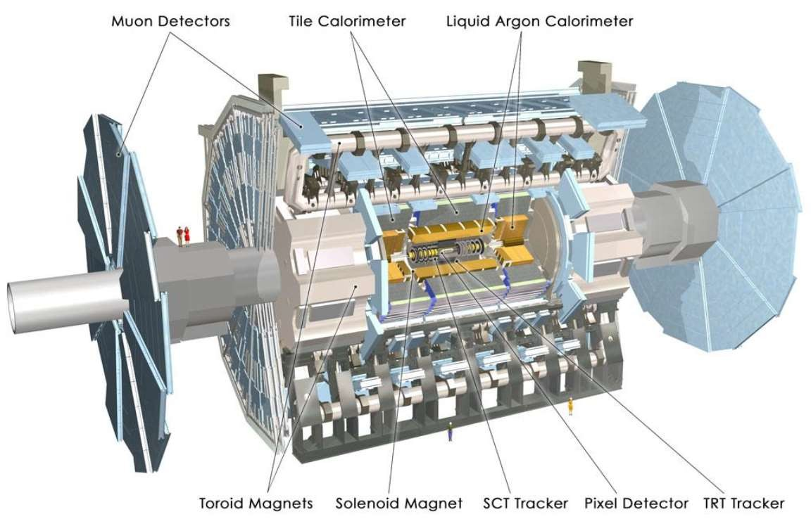
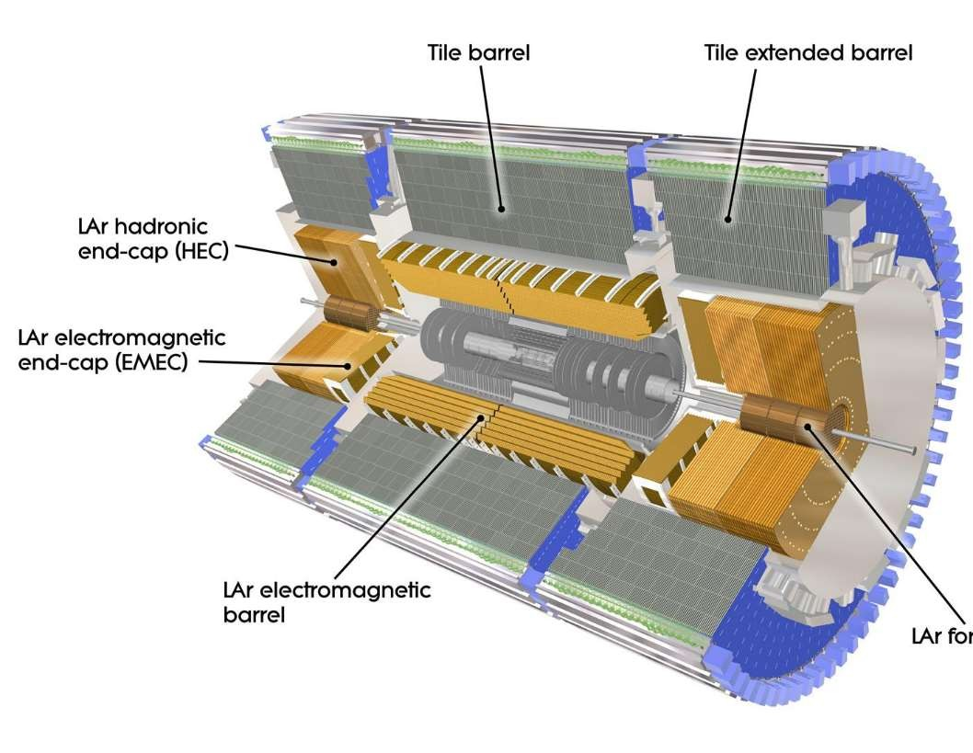
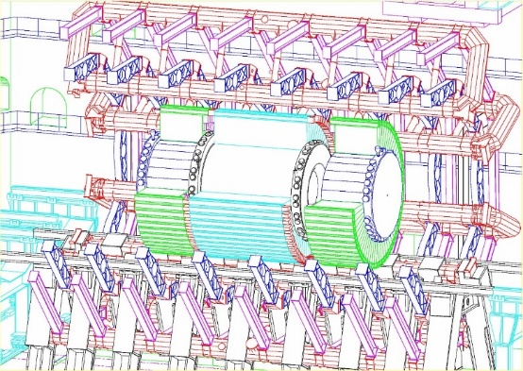
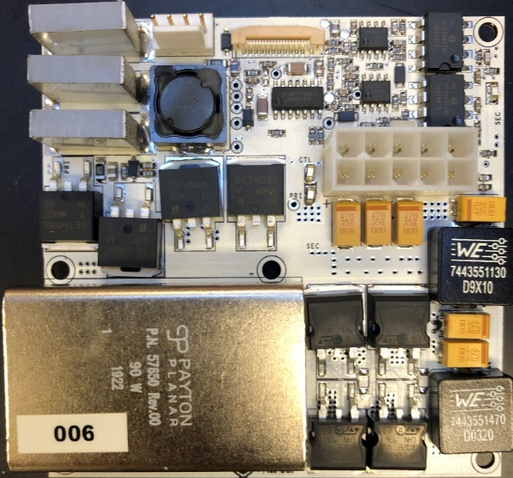
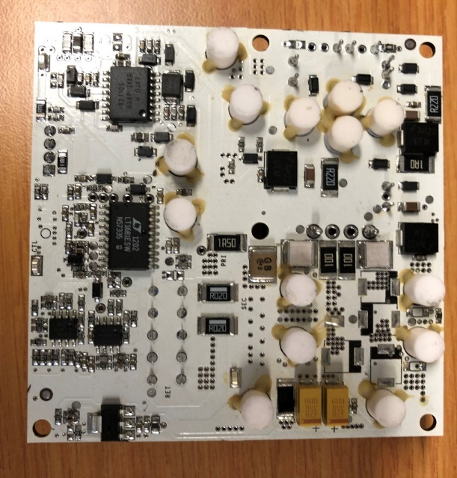
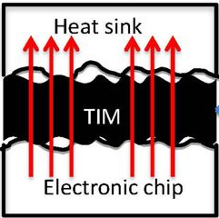
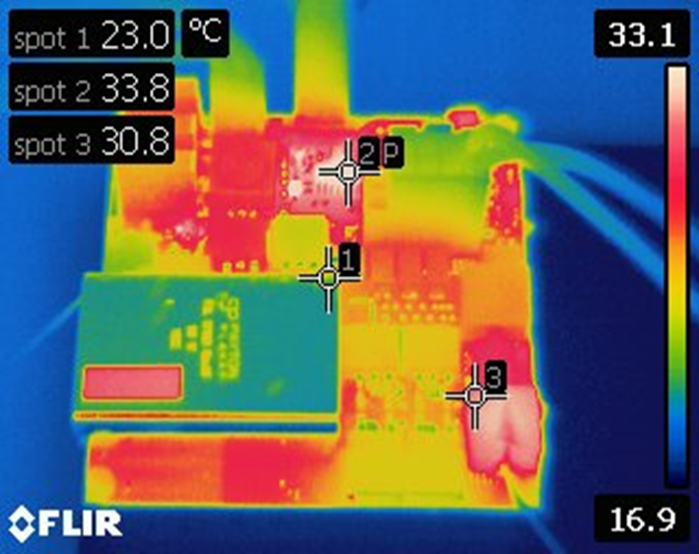
ATLAS / TileCal
Particle detectors of the LHC accelerator had been designed to have integrated electronics.
big constraints: continuous radiation exposure, very limited space, only water cooling available, and an external DC magnetic field from superconducting magnets.
Protecting the electronics inside the detectors from damages and overheating, and expanding their lifespan, is required.
Continuous and good heat dissipation is necessary.
1
Part of the upgrade of TileCal
Improve reliability through redundancy to limit the impact of component failures.
All electronics to be replaced with newer technologies and should be radiation hard.
Low Voltage Power Supply (LVPS)
The LVPS brick is a 6 layer board with dimensions 80.26 mm square.
The main electronic components are the transformer, MOSFETs and inductors.
The thermal posts are in contact with the rear of the electronic components via a third-party material referred as the Thermal Interface Material (TIM).
×
×
Thermal Interface Materials (TIM)
Material utilised in between two interfaces in electronic devices.
TIM are polymer or metal-based materials, filled with conductive particles.
Protect expensive systems (overheating, damage…), expand their lifespan.
Heat conduction coefficient of the Thermal Interface Material is considered low for many contemporary applications (micro- and nano-electronic…).
Integrating Carbonaceous Nanomaterials
MOSFET
T₂
×
×
MOSFET
×
×
Inductor

Slide 3
Carbon Nanomaterials
2
Global Nanotechnology Market & Forecast to 2024
The global nanotechnology market is expected to exceed US$ 125 Billion mark by 2024.
the nanomaterials captured highest share of the global nanotechnology market.
Nanoparticles holds over 85% share of the global nanomaterials market.
Carbon Allotropes
3D: Graphite, Diamond, Amorphous Carbon.
2D: Graphene, Carbon nanoribbons (unzipped carbon nanotubes).
1D: Carbon Nanotubes (single and multi walled), Carbon Nanohorns.
0D: Fullerene, Nanodiamonds, Carbon Dots, Carbon Nanospheres.
Applications
Electronics, Energy, Biomedicine, as controlled/targeted drug delivery systems, supercapacitors, catalyst supports, superconductivity, hydrogen storage¹.
¹ "A. A. Deshmukh, S. D. Mhlanga and N. J. Coville, "Carbon spheres," Materials Science and Engineering: R: Reports, vol. 70, no. 1-2, pp. 1-28, 2010.

Slide 4
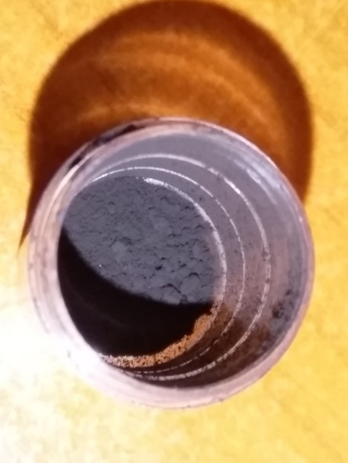
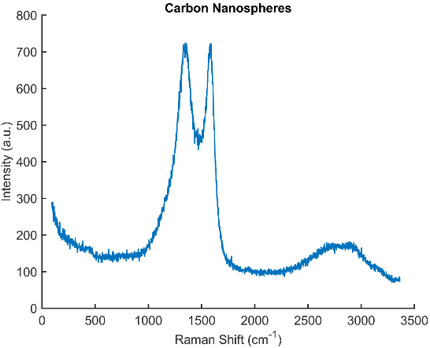
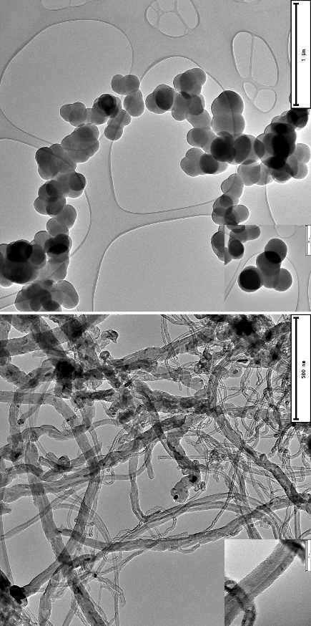
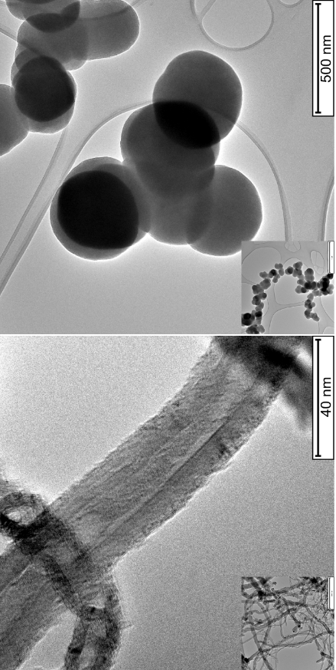
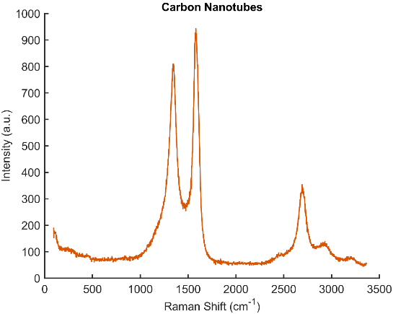
Preparation of TIM (Epoxy/CNMs)
3
Furnace
Carbon nanomaterials
Gas input
Gas output
600-1200 °C
Seal
Hydrocarbon gas
Quartz tube

Slide 5
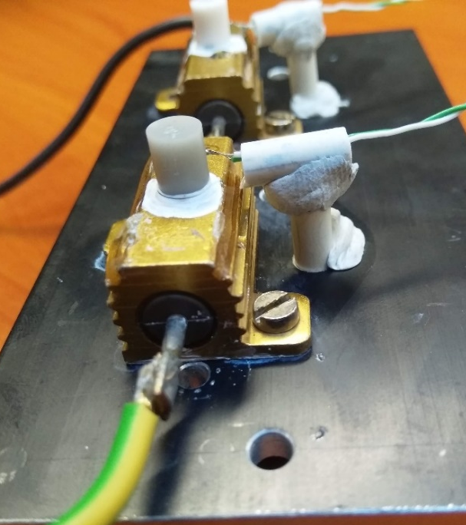
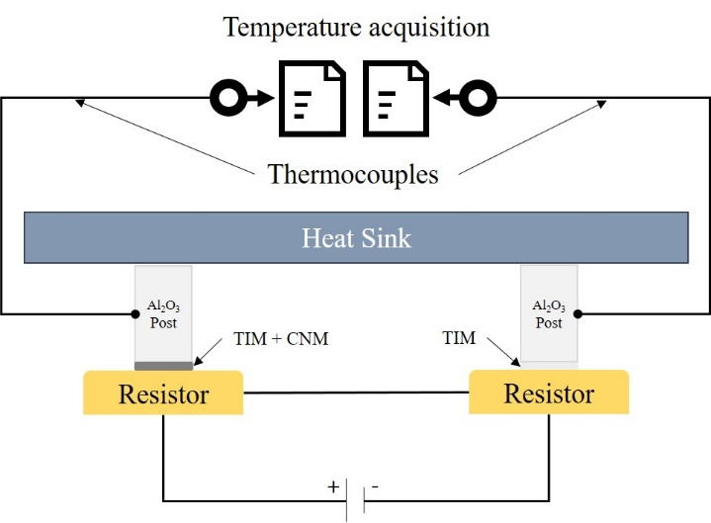
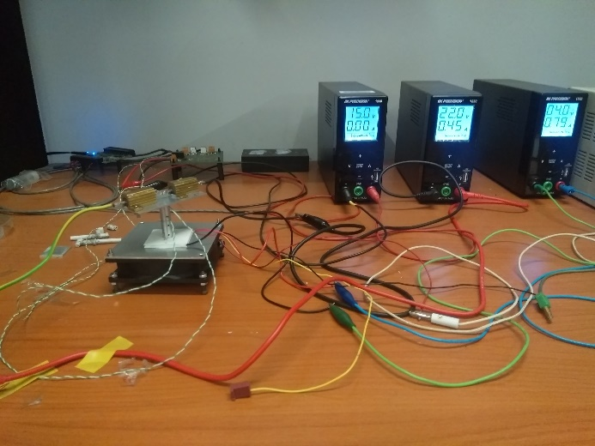
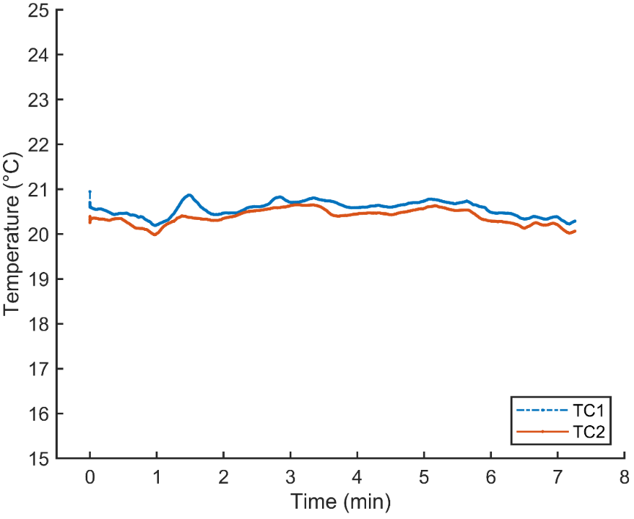
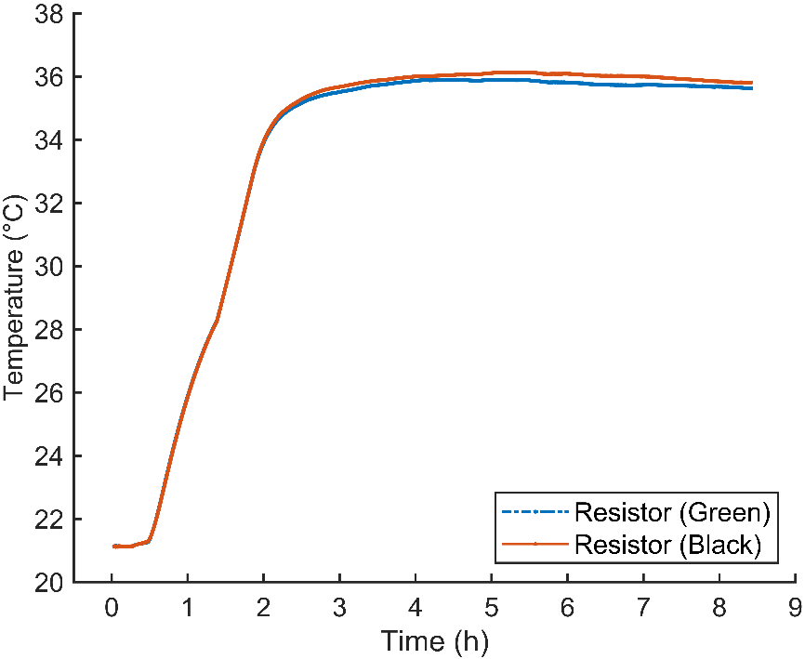
Experimental Setup
4
Q ∝ ΔT
ΔT = T_{in} – T_{out}
Q ∝ 1/T_{out}
Q : Heat transfer
ΔT : Temperature gradient
T_{out} : Temperature of the post

Slide 6
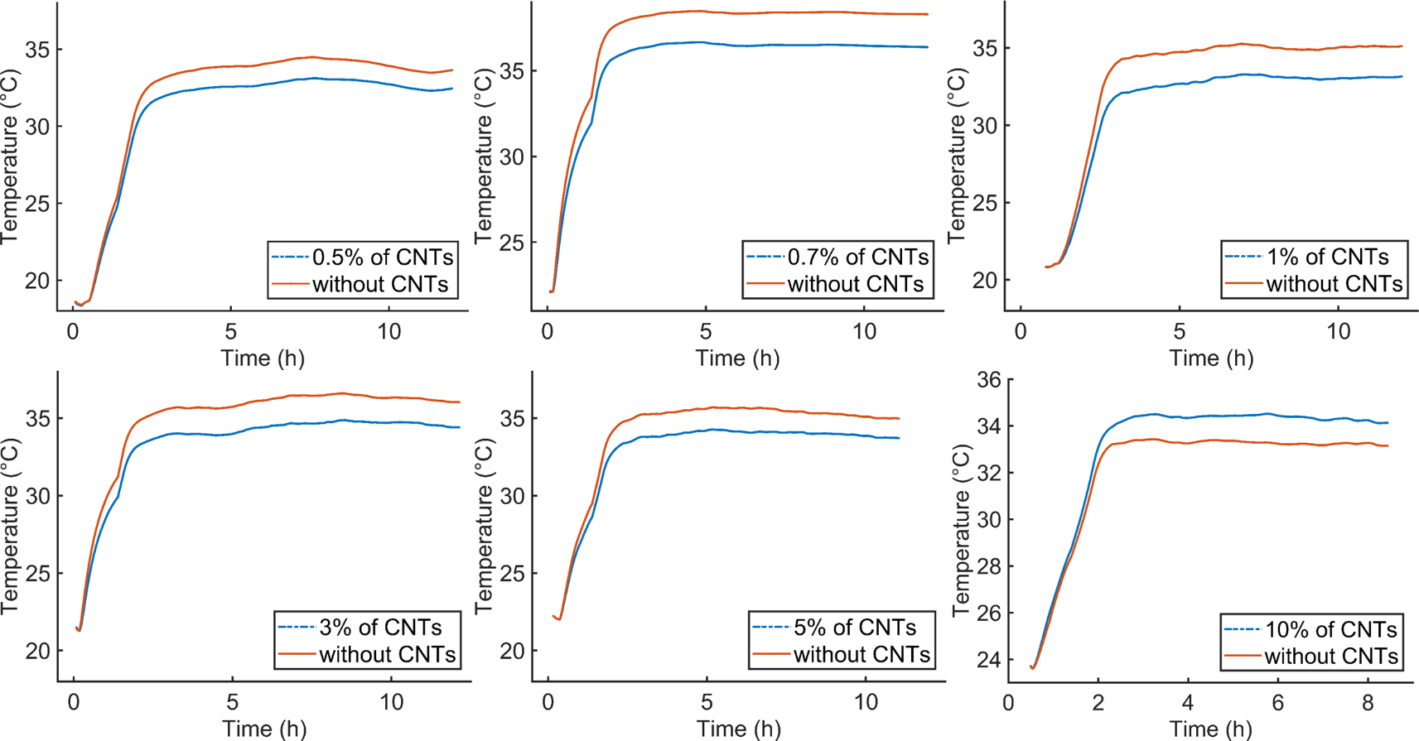
Results (TIM_{with-CNTs} vs TIM_{without-CNTs})
5
Q_{0.5% of CNTs} > Q_{Epoxy}
Q_{0.7% of CNTs} > Q_{Epoxy}
Q_{1% of CNTs} > Q_{Epoxy}
Q_{3% of CNTs} > Q_{Epoxy}
Q_{5% of CNTs} > Q_{Epoxy}
Q_{10% of CNTs} < Q_{Epoxy}
Q_{1% of CNTs} > Q_{5% of CNTs} > Q_{0.5% of CNTs} > Q_{epoxy} > Q_{10% of CNTs}

Slide 7
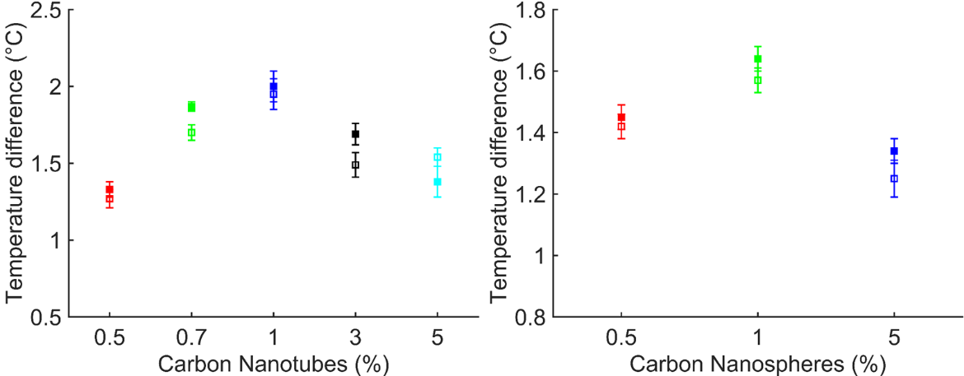
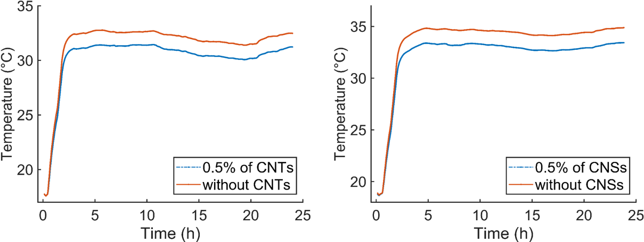
Results (TIM_{with-CNSs} vs TIM_{without-CNSs})
6
The temperature gradient t_{diff} as a function of the amount of the carbon nanomaterials incorporated in the TIMs
Q_{0.5% of CNSs} > Q_{Epoxy}
Q_{1% of CNSs} > Q_{Epoxy}
Q_{5% of CNSs} > Q_{Epoxy}
Amount of CNM (%) | T_{diff} of TIM_{CNTs} (°C) | T_{diff} of TIM_{CNSs} (°C)
0.5 | 1.33 ± 0.05 | 1.45 ± 0.04
0.7 | 1.87 ± 0.03 | -
1 | 2.0 ± 0.1 | 1.64 ± 0.04
3 | 1.69 ± 0.07 | -
5 | 1.38 ± 0.1 | 1.12 ± 0.11
10 | (-)1.08 ± 0.07 | -
Amount of CNM (%) | T_{diff} of TIM_{CNTs} (°C) | T_{diff} of TIM_{CNSs} (°C)
0.5 | 1.33 ± 0.05 | 1.45 ± 0.04
0.7 | 1.87 ± 0.03 | -
1 | 2.0 ± 0.1 | 1.64 ± 0.04
3 | 1.69 ± 0.07 | -
5 | 1.38 ± 0.1 | 1.12 ± 0.11
10 | (-)1.08 ± 0.07 | -
Q_{1% of CNSs} > Q_{0.5% of CNSs} > Q_{5% of CNSs} > Q_{epoxy}
The magnitude of the gap between the temperatures of the two posts depends on the amount of carbon nanomaterials incorporated.
Incorporation of carbon nanomaterials in the thermal compound results in a heat conduction enhancement.
The heat transfer of TIMs with 1% of CNTs is observed to be larger in comparison to TIMs with 1% of CNSs.
The gradual decrease in the heat transfer for TIMs containing more than 1% of carbon nanomaterials is due the CNT-CNT or CNS-CNS couplings.
Clear and desirable adhesive contact was observed while trying to dismount the Al₂O₃ posts from the heat source.
The recorded temperatures over 24 h for TIMs with 0% and 0.5% of CNSs and CNTs. The measurements show the consistency of the temperature gradient T_{diff} at the steady state over time in hours.
The temperature gradient T_{diff} (filled markers) and the repeated measurements (empty markers) plotted as a function of the amount of CNTs and CNSs. The graphs show the reproducibility and sustainability of the temperature gradient over time.

Slide 8
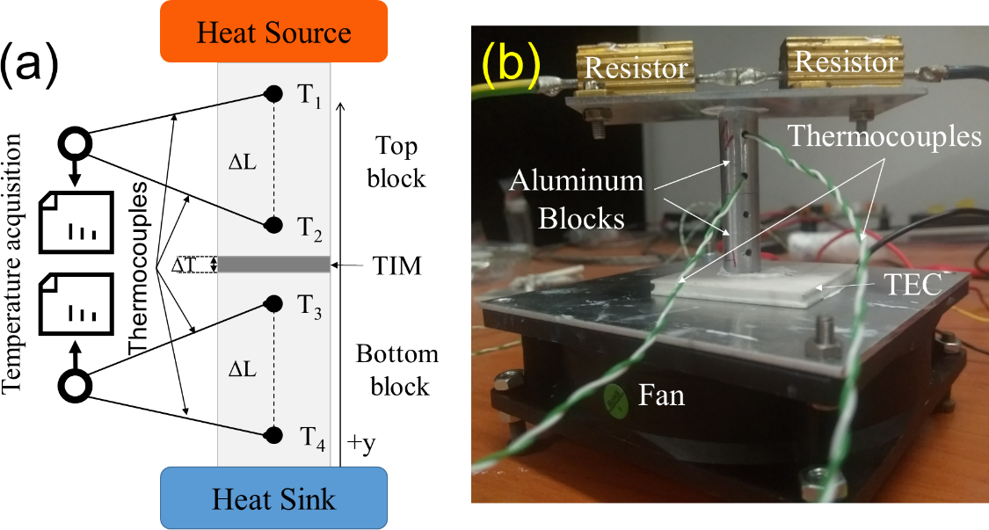
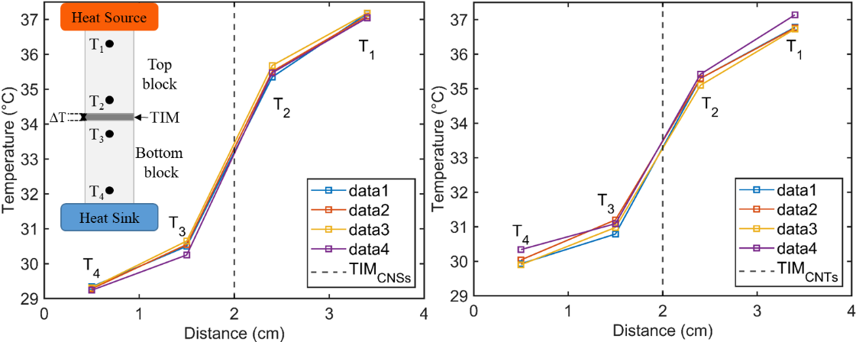
Thermal resistance characterization (ASTM D5470 approach)
7
$$ΔT={(T}_{2}−0.5 ×(T_{1}−T_{2}))−(T_{3}+0.5×(T_{3}−T_{4}))$$
$$Q=(Q_{top}+Q_{bot})/2$$
$$Q_{top}=k_{Al}×A_{bl}×(T_{1}−T_{2})/ΔL$$
$$Q_{bot}=k_{Al}×A_{bl}×(T_{3}−T_{4})/ΔL$$
$$R_{th}=ΔT×A_{S}/Q$$
R_{th}= 100.90 mm²K/W
R_{th}= 80.14 mm²K/W
The thermal resistance R_{th} of the TIM with 1% of CNTs was estimated to be 80.14 mm²K/W, while for TIM with 1% of CNSs, it was calculated to be 100.9 mm²K/W.
The measured thermal resistance of the fabricated TIMs shows a significant upgrade in the thermal properties of the initially used heat transfer compound (Unick) as a base (50 % decrease).
The thermal resistance R_{th} of various TIMs with a thickness of 180 μm.
TIM | R_{Th} (mm²K/W)
Unick | 200
ZS-GF-Z10 | 150
TG-AS606B | 94.73
RS S606C | 36

Slide 9
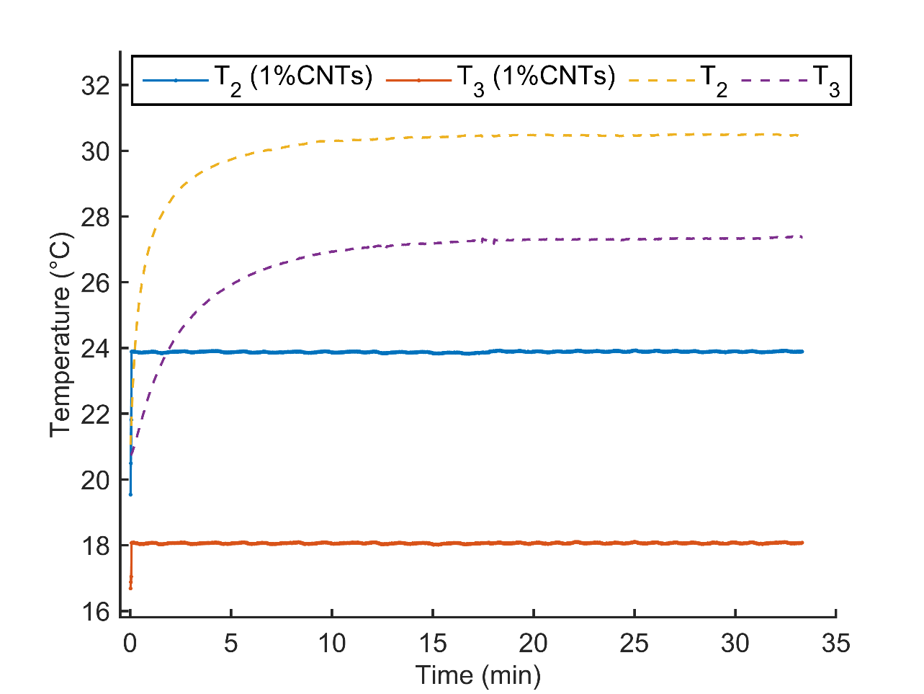
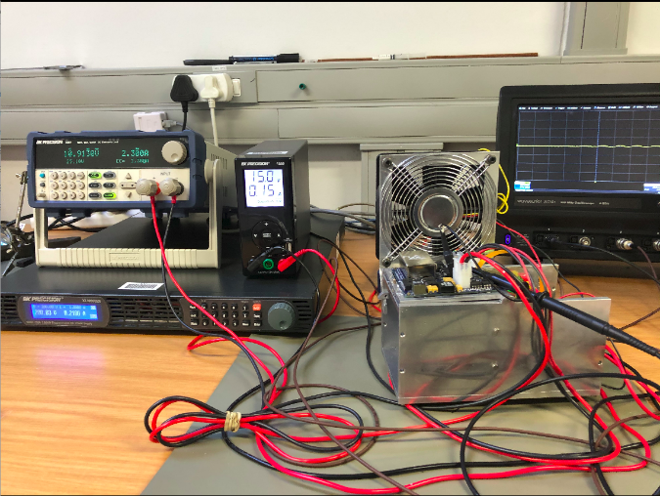
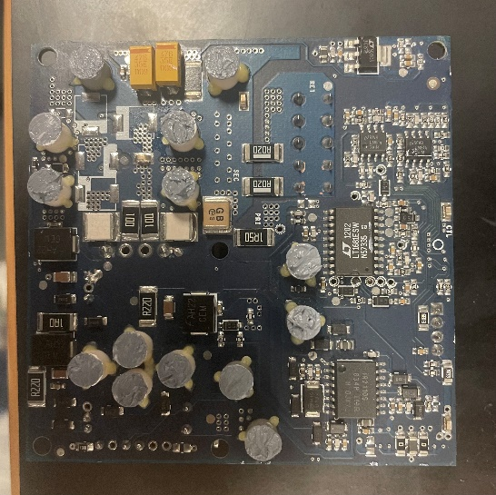
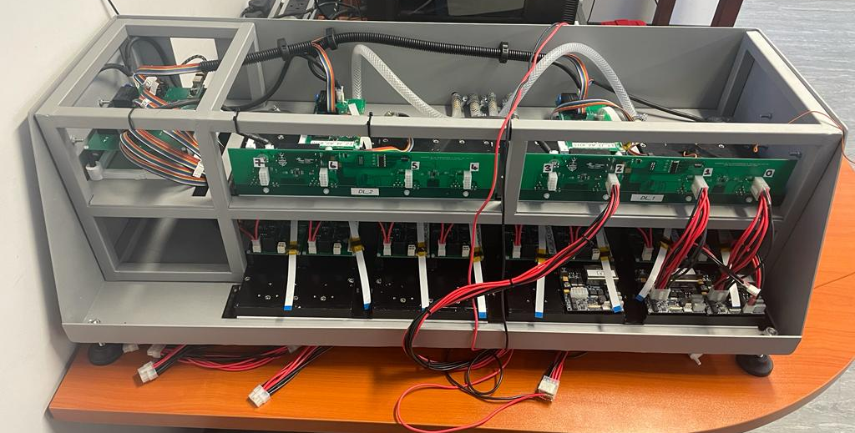
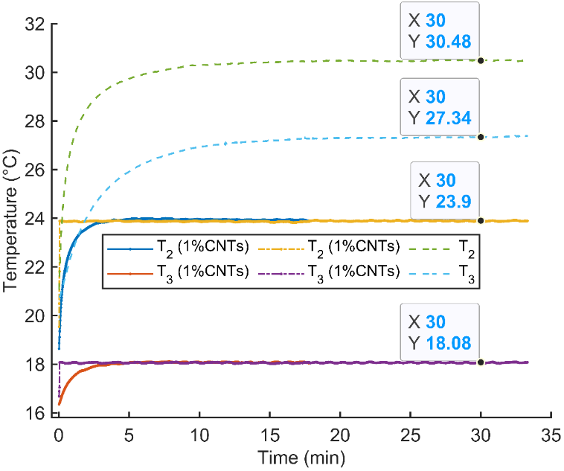
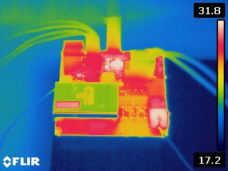
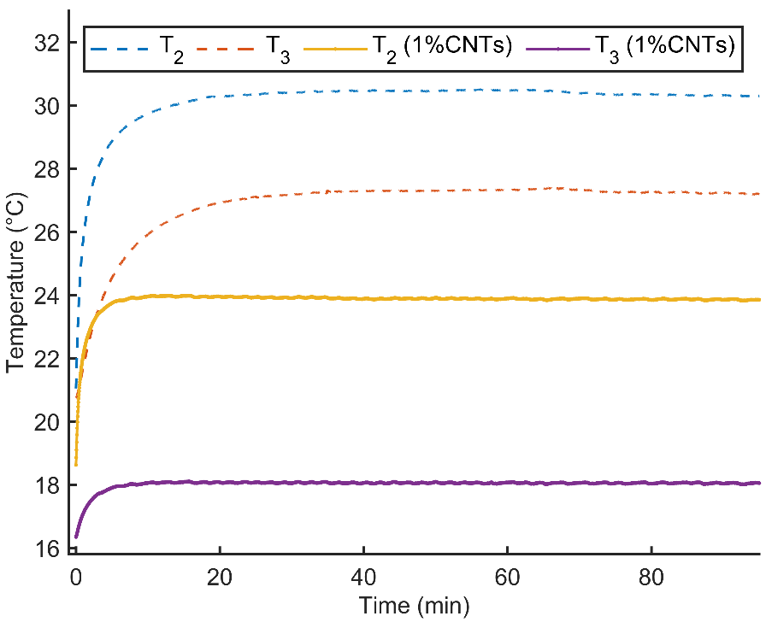
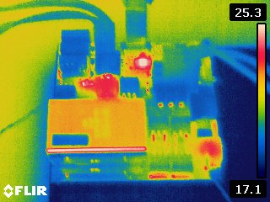
Applicability on test bench and burn-in station
8
TIM only
Temperatures T₂ and T₃ of the brick tested in the burn-in station with TIMs containing 0% (dashed) and 1% (continuous) of CNTs separately with identical parameters.
The plots reveal a large decrease of temperatures of the brick operating with 1% of CNTs based TIM.
The incorporation of 1% of CNTs in the thermal compound shows a temperature drop of 6.5 °C (30.48 to 23.9 °C) for T2, while a decrease of 9.2 °C (27.34 to 18.08 °C) is depicted for temperature T3
TIM with 1% of CNTs

Slide 10
Summary
9
As part of the upgrade of the Atlas detector a continuous and high heat dissipation within the electronic devices is required for a good performance.
Integrating Carbon nanomaterials in the thermal interface materials.
The integration of carbon nanomaterials in the epoxy showed an important enhancement of the heat dissipation in comparison to the use of only the commercial epoxy.
The improvement is measured to reach 2 °C with a 1% of Carbon Nanotubes and 1.6 °C with 1% of Carbon Nanospheres.
The measured thermal resistance of TIMs containing 1% of CNTs (80.14 mm²K/W ) and 1% CNSs (100.90 mm²K/W ) were in accordance with the measurements recorded by the test stand.
This innovation in the fabrication of TIMs based on carbon nanomaterials is important for electronic devices in general as well as for the LVPS bricks in particular as it protects against overheating and damage and ensures a longer life span

Slide 11
Thank you

