Slide 1
Dynamics of Charm Production in AA and pp Collisions using Parton Cascade Model
Dinesh K. Srivastava, Rupa Chatterjee,
Steffen A Bass
Phys. Rev. C96:064906, Phys. Rev. C98: 054910, & arXiv:1812.08661, and work in suspended animation!

Slide 2
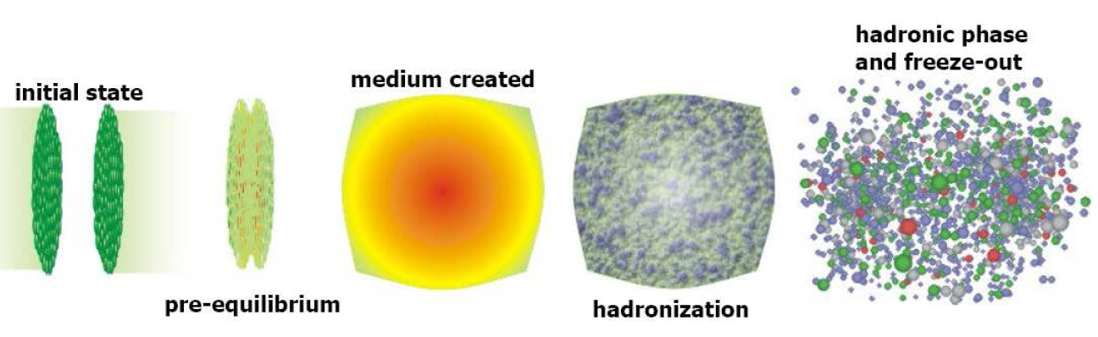
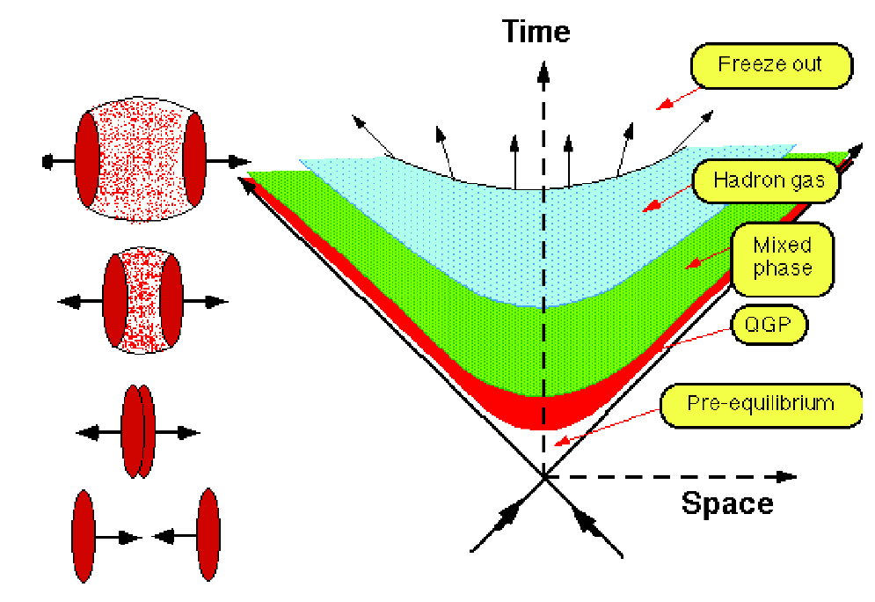
Different stages of heavy ion collisions
time

Slide 3
Excellent meeting evaluated Heavy Flavours
from small to large systems, October 2022
(HF2022); VECC November 2022.
Charm (and bottom) quarks are produced very
early in pp or AA collisions (τ ~1/2m_{Q}≈0.07 fm/c)
when their numbers get frozen, and they clearly
stand out in the background. QCD describes
their production, fairly accurately (Q²>>Λ²_{QCD}).
They traverse the plasma, colliding with other
partons in the plasma and radiating gluons.
3. These energy losses suppress the production
of high energy heavy quarks in AA collisions.

Slide 4
Some Early Works
Propagation of Charm Quarks in Equilibrating Quark-Gluon Plasma, M G Mustafa, D Pal, DKS, PRC 57, 889-898.
Estimated drag and diffusion coefficients
for heavy quarks, using kinetic theory →
Collision Energy Loss. → Diffusion
Radiative energy-loss of heavy quarks in a quark-gluon plasma, M G Mustafa, D Pal, DKS, M Thoma, PLB 428, 234–240
First Estimate of Radiative Energy Loss
All possible sources of charm production and their correlations, and E-loss determined empirically.
JPG 39, 025001; JPG 37, 115006; JPG 40, 065004, JPG 3.
095003

Slide 5
Collisional and Radiative Energy Loss of Heavy Quarks
Initially severely criticised and then found to be quite reasonable, from more sophisticated calculations!

Slide 6
D(2πT)=6
Langevin Eq.
S. Cao and S. A. Bass, PRC 84, 064902;
Excellent Review: S. K. Das et al., e-Print: 2208.13440 [nucl-th].

Slide 7
Generalized expression of gluon radiation off a charm quark (e.g., Qq→ Qqg):
where D stands for dead-cone effect.
R. Abir, et al. PRD 85, 054012

Slide 8


Slide 9
Both Energy Losses
Collisional and Radiative
Make Important Contributions
R. Abir, U. Jamil, M. G. Mustafa, DKS,
PLB 715, 183-189

Slide 10
Correlation of Cheam Quarks
Initial Production
LO
gg or qqbar → Q Qbar : Δφ=π
NLO (the above plus)
gg→ gg* → g QQbar : Δφ ∼0
And
gg or qqbar → Qg Qbar or Q Qbar g : Δφ ∼ 0 − π

Slide 11
Correlation:
Sensitive to process of production
Sensitive to E-loss Mechanism
Radiative E-loss-→ correlation same as for initial production
Collisional E-loss → Correlation will get altered from the initial.
If both?
For Bottom?

Slide 12
Flavour Dependence of Energy Loss

Slide 13
How can parton cascade model help?
Extend the Parton Cascade
Model (VNI/BMS) to include production and
propagation of heavy quarks in hadronic/
nuclear collisions.
2. Study production of charm quarks in Au+Au
collisions at top RHIC energy and in pp
collisions at 0.2, 2.76, 5.02, 7.00 and 13.00
TeV.
3. Preliminary results for bottom quarks.

Slide 14
Two Main Results
1. The trend of R_{AA} for charm quarks at RHIC
energies is reproduced if we permit
multiple collisions of partons followed by
radiation of gluons.
2. We suggest that in high multiplicity events
in pp collisions at LHC, a dense
interacting partonic medium is formed,
which admits multiple scattering and LPM
effect.

Slide 15
Basic Principles of the PCM
Rewrote the program(VNI)

Slide 16
Parton Cascade Model, VNI/BMS, is a relativistic quantum-kinetic description of the dynamics of evolution of high energy hadronic collisions.
The description includes semi-hard pQCD interaction of partons populating the nucleons (which populate the nuclei) undergoing scatterings and fragmentations while propagating.
The pQCD cross-sections are regularized by introducing a lower p_{T} (cut-off).
The fragmentations are terminated once the virtuality of the partons falls to M₀²=m_{i}²+μ₀², where μ₀=1 GeV and m_{i} is their current mass.

Slide 17
degrees of freedom: quarks and gluons
classical trajectories in phase space (with relativistic kinematics)
initial state constructed from experimentally measured nucleon structure functions and elastic form factors
an interaction takes place if at the time of closest approach d_{min} of two partons
system evolves through a sequence of binary (2→2) elastic and inelastic scatterings of partons and (initial and) final state radiations within a leading-logarithmic approximation (2→N)
binary cross sections are calculated in leading order pQCD with a momentum cut-off (or ad hoc Debye screening) to regularize the IR behaviour
guiding scales: initialization scale Q₀, p_{T} cut-off p₀ / Debye-mass μ_{D,} intrinsic k_{T}, virtuality > μ₀

Slide 18
Parton-Parton Scattering Cross-Sections
g g → g g |  | q q’ → q q’
q g→ q g |  | q qbar→ q’ qbar’
g g → q qbar |  | q g →q γ
q q → q q |  | q qbar → g γ
q qbar → q qbar |  | q qbar → γ γ
q qbar → g g
a common factor of πα_{s}²(Q²)/s² etc.
further decomposition according to colour flow

Slide 19
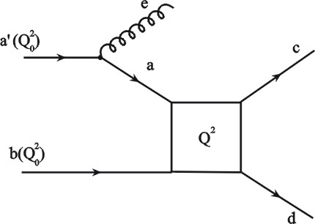
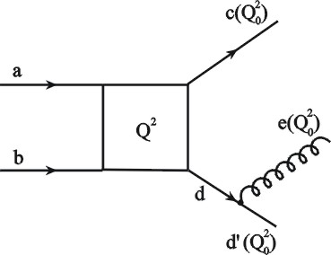
(Initial &) Final State Radiation (based on PYTHIA)
Probability for a branching is given in terms of the Sudakov form factors:
(initial state) space-like branchings:
(final state) time-like branchings
(with angular ordering):
Altarelli-Parisi splitting functions included: P_{q→qg} , P_{g→gg} , P_{g→qqbar} & P_{q→qγ}

Slide 20
Landau Pomeranchuk Midgal Effect
In order to take main characteristics of LPM effect into account, we introduce a formation time:
where ω is the energy of the radiated particle and k_{T} its transverse momentum.
During the formation time, the radiated particle is given zero cross-section and does not collide. The radiating particle, however, can collide during the formation time.
If the radiating particle collides during the formation time, the shower (i.e., the radiated particle) is killed.

Slide 21
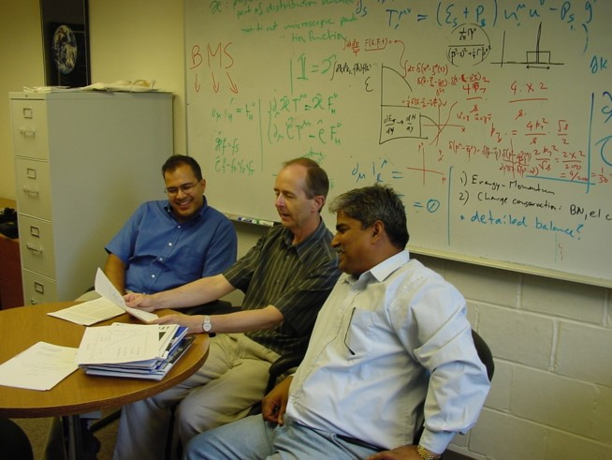

Slide 22
Parton rescattering and screening in Au+Au collisions at RHIC, Phys. Lett. B 551, 277 (2003)
Light from cascading partons in relativistic heavy ion collisions, Phys. Rev. Lett. 90, 082301 (2003),
Semi-hard scattering of partons at SPS and RHIC: A Study in Contrast, Phys. Rev. C 66, 061902 (2002),
Photon interferometry of Au + Au collisions at the BNL RHIC, Phys. Rev. Lett. 93, 162301 (2004),
Dynamics of the LPM effect in Au + Au collisions at S**(1/2) = 200-AGeV, Phys. Lett. B 632, 632 (2006),
Net baryon density in Au+Au collisions at the relativistic heavy ion collider, Phys. Rev. Lett. 91, 052302 (2003),
Transverse momentum distribution of net baryon number at RHIC, J. Phys. G 29, L51 (2003),
Strangeness production at RHIC in the perturbative regime, J. Phys. G 30, L7 (2004),
Perturbative dynamics of strangeness production at RHIC, J. Phys. G 31, S1005 (2005).

Slide 23
Production of Heavy Quarks
q qbar → Q Qbar and g g → Q Qbar

Slide 24
For g g → Q Qbar
where,

Slide 26
And for q qbar→Q Qbar
Note that these differential cross-sections remain finite and no momentum cut-off is needed.

Slide 27
We have also included the scatterings qQ→ qQ and gQ→gQ, which require a momentum cut-off for regularization. These matrix elements for qQ→qQ are:

Slide 28
While for gQ→ gQ, these are given by:
with

Slide 30

Initial State
Nucleon positions sampled from:
ρ( r ) = ρ₀$/[1+exp⁡(\frac{r−R}{a})]$
Parton positions sampled from:
h( r )=[ν³/(8π)] exp(-νr)
where R_{rms}=sqrt(12/ν)=0.81 fm

Slide 31
Parton momenta sampled from PDF (GRV-HO) initialized at:
(Q_{ini})²= (p_{T}^{cut-off})².
For most of our calculations at top RHIC energy, we have used:
(p_{T}^{cut-off})² =0.589 GeV² . x₁ x₂ sqrt{s_{NN}} > 2p_{T}, x_{i}^{min}~2p_{T}^{cut-off}/sqrt{s_{NN}}

Slide 32
-Confidence Building Measures- Box Mode Implementation of PCM
Closely Reproduces Collisional and
Radiative Energy Losses
M. Younus,
C. Coleman-Smith,
S. A. Bass, and DKS,
PRC 91 (2015) 024912

Slide 33
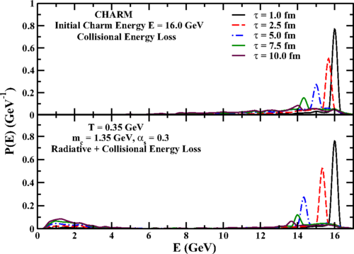
Release a lot of Heavy Quarks of a Given Energy in Infinite QGP!

Slide 34
-Confidence Building Measures-
Eikonal Approximation and Independent Minijet Calculations

Slide 35
1. Multiple collisions without fragmentaions of partons
(radiation of gluons).
2. Multiple collisions as well as radiations (fragmentations) off final state partons.

Slide 36
What does
fragmentation
of final state
partons do?
It leads to
many more collisions
already in
pp collisions,

Slide 37
DKS, S. Bass, R. Chatterjee, PRC 96:064096

Slide 38
Where are the charm quarks produced?
Au+Au (b=0), 200A GeV

Slide 39
Where are the charm quarks produced?
Au+Au (b=0), 200 AGeV

Slide 40
Where are the charm quarks produced?
Au+Au (b=0), 200 AGeV
~ T_{AB}(x,y, b=0)

Slide 41
When are the charm quarks produced?
Au+Au (b=0), 200 AGeV

Slide 42
How often do the charm quarks collide?
How often do they radiate gluons?

Slide 43
Spectra with D_{cD}(z)~δ(1-z)
No Free Parameters
p_{T}^{cut-off}=0.7 GeV

Slide 44
R^{D}_{AA}(p_{T}) (b=0)

Slide 45
Dynamics of pp Collisions in
Parton Cascade Model

Slide 46
Charm Production in pp Collisions

Slide 47
Charm Production in pp Collisions

Slide 48
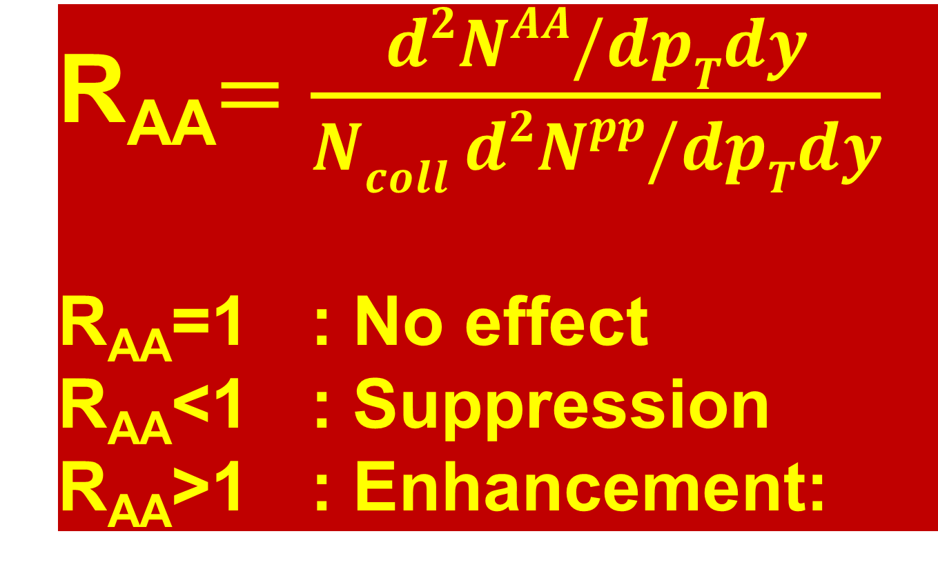
Paradise Lost
R_{AA}$=\frac{d2NAA/dpTdy}{Ncoll d2Npp/dpTdy}$
R_{AA}=1 : No effect
R_{AA}<1 : Suppression
R_{AA}>1 : Enhancement:

Slide 49
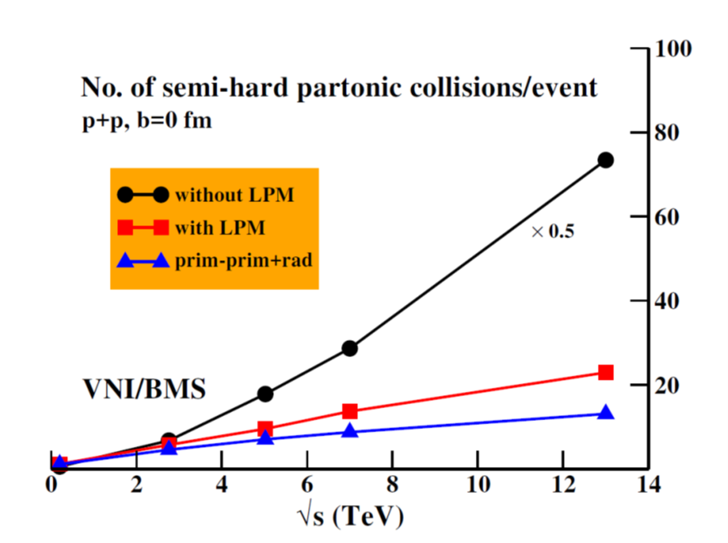
Number of semi-hard partonic collisions rises rapidly with CM energy
LPM effect suppresses the gluon multiplication and multiple collisions.

Slide 50
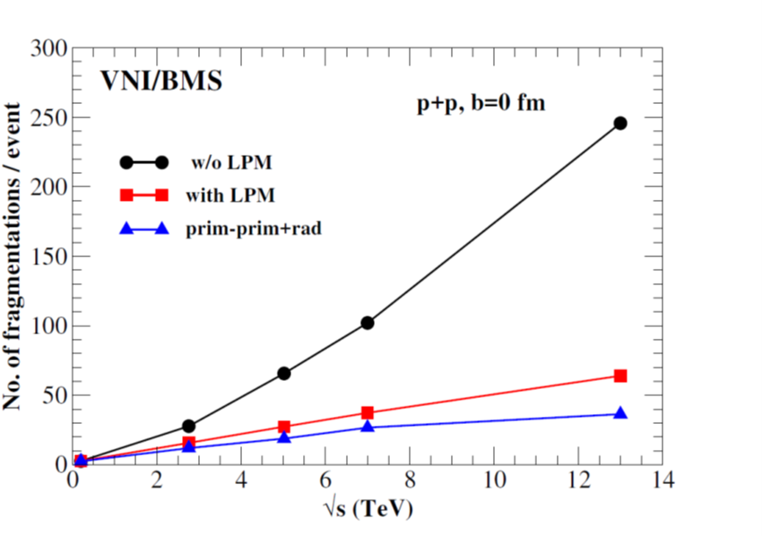
Number of fragmentations rises rapidly with CM energy
LPM effect suppresses these as multiple collisions reduce.

Slide 51
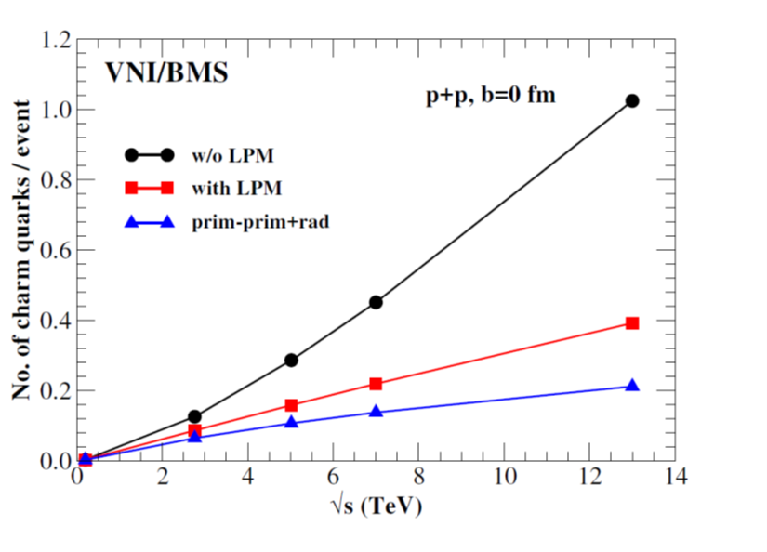
Number of charm quarks produced rises with CM energy
LPM effect suppresses it as multiple collisions reduce.

Slide 52
Transverse Momentum Distribution

Slide 59
Editors’ Suggestion
For a quark-gluon plasma to form in nuclear collisions, the resulting partonic medium must be dense, and its constituents must interact. The authors examined proton-proton collisions at LHC energies, and focused on the production of charm quarks, since these are only produced in hard perturbative QCD interactions. The results indicate the formation of an interacting medium that is dense enough for the suppression of radiation to set in and yet permits multiple scatterings among partons. Their study shows the importance of multiple parton interactions even in proton-proton collisions.

Slide 60
Switching on LPM delays emergence
of gluons, while the system continues to evolve- this reduces collisions

Slide 62
Fragmentation of final state partons following a collision leads to:
i) parton multiplication.
ii) increase in collisions.
It thus feeds and is fed by multiple collisions.
Calculations involving multiple collisions and fragmentations lead to suppression of charm mesons at large p_{T} in AA collisions.
Switching on LPM delays emergence
of gluons, while the system continues to
evolve- this reduces multiple collisions.

Slide 63
Conclusions
Parton Cascade Model applied to Au+Au collisions at 200 AGeV provides valuable insights into the dynamics of production and propagation of charm quark and suggests its suppressed production at large p_{T} due to collisions and radiations.
Parton Cascade Model applied to pp collisions at LHC energies points to opening up of semi-hard interactions leading to multiple collisions and fragmentations and a large production of strangeness and charm, especially at higher energies, and formation of a dense interacting partonic medium.

Slide 64
Thank you

Slide 65
Limitations and ..
Fundamental Limitations:
lack of coherence of initial state (though
all partons have colour and colour flow is
taken care of).
range of validity of the Boltzmann Equation
interference effects are included only
schematically (angular ordering).
hadronization has to be modeled in an ad-
hoc fashion
how much can we stretch perturbative
physics!

Slide 66
Medium ?
Need to evolve the cascades in medium
- a hydrodynamic river?
- medium modified matrix
elements?
- add drag without double
counting?
- add 3→2 for detailed balance?

