Slide 1
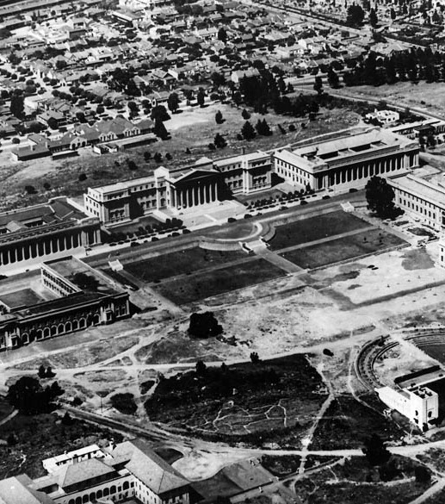

The origins of SA-CERN:
Lessons on Leadership
A tribute to a leader:
ZZ Vilakazi (University of the Witwatersrand)

Slide 2


Layout of the presentation
Physics in SA
Early origins of SA HEP activity
How did SA-CERN start?
  Jean’s legacy to SA Science
What has been achieved?
The Future

Slide 3
Context and South Africa’s history of HEP
Some prominent physicists/cosmologists who were educated in RSA
Stanley Mandelstam (Dirac medal); B. Sc. Hons (Witwatersrand)
Jonathan Dorfan [ex SLAC director]; B. Sc. (Cape Town)
Werner Israel [Cosmologist]; B. Sc (Cape Town)
Saul Teuklosky [Astrophysics] B. Sc Hons (Witwatersrand) (Dirac medal 2021)
Peter Sarnack (Maths Wolf Prize); B. Sc. Hons (Witwatersrand)
George Ellis (FRS) – still at UCT
All the above – barring Ellis – were based abroad.

Slide 4
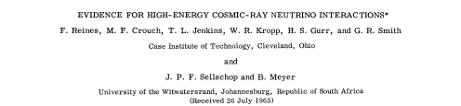
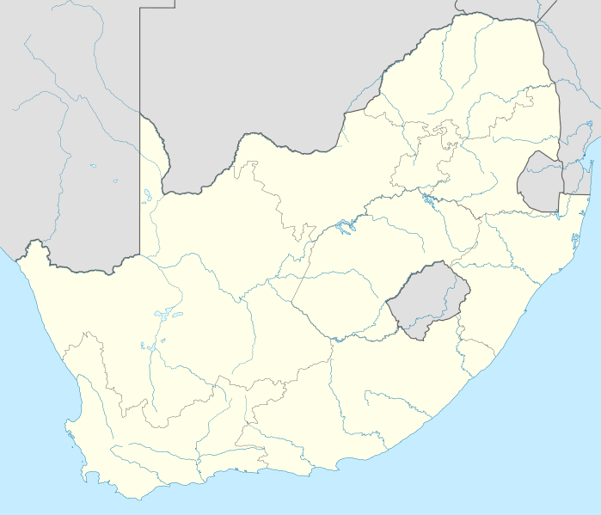
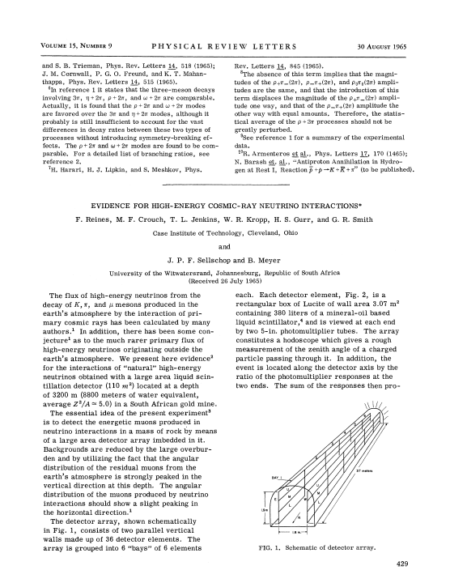

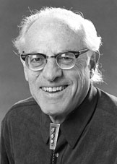
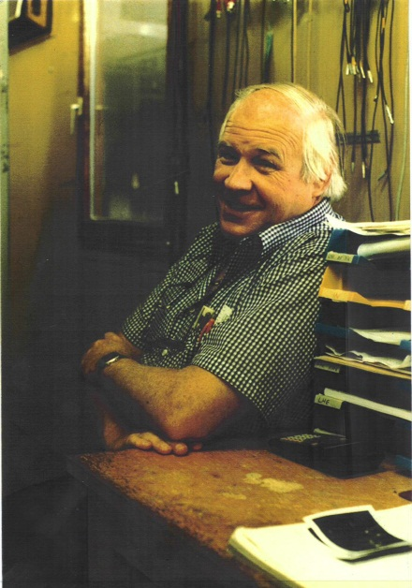
History of underground Physics in SA
Phys. Rev. Lett. 15, 429 (1965)
Frederick Reines
Friedel Shellschop
Phys Rev Lett, 15, 429 (1965)

Slide 5
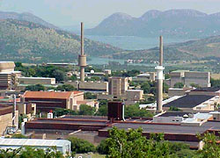
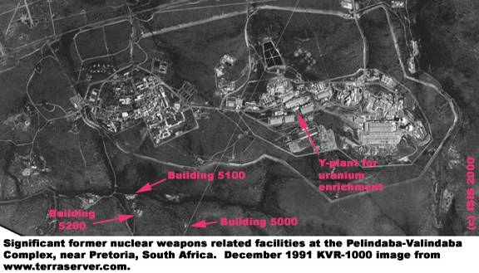
Early Physics in SA
The first Universities were established in the late 1800’s.
The Council for Scientific and Industrial Research established in 1945
The Atomic Energy Board was established in 1950 – Nuclear weapons programme.
The South African Institute of Physics was established in 1955.

Slide 6
Beginning of Nuclear Research in SA
1948 – 1950: At CSIR, newly appointed head of the Nuclear Physics Division sent to the Nobel Institute in Stockholm to do Nuclear Physics research with a classical cyclotron.
1950: Decision to design and build a 16 MeV deuteron classical cyclotron at the Nuclear Physics Division, CSIR
Southern University Nuclear Institute (SUNI) established jointly by Universities of Stellenbosch & Cape Town [1964]
Pioneering Neutrino experiments (led by F Riennes & JPF Sellschop) in the mines of Johannesburg (circa: 1966)
JPF Sellschop establishes a research accelerator at University of Witwatersrand, Johannesburg [1972]:
    EN Tandem van de Graaff
CSIR: Council for Scientific and Industrial Research

Slide 7
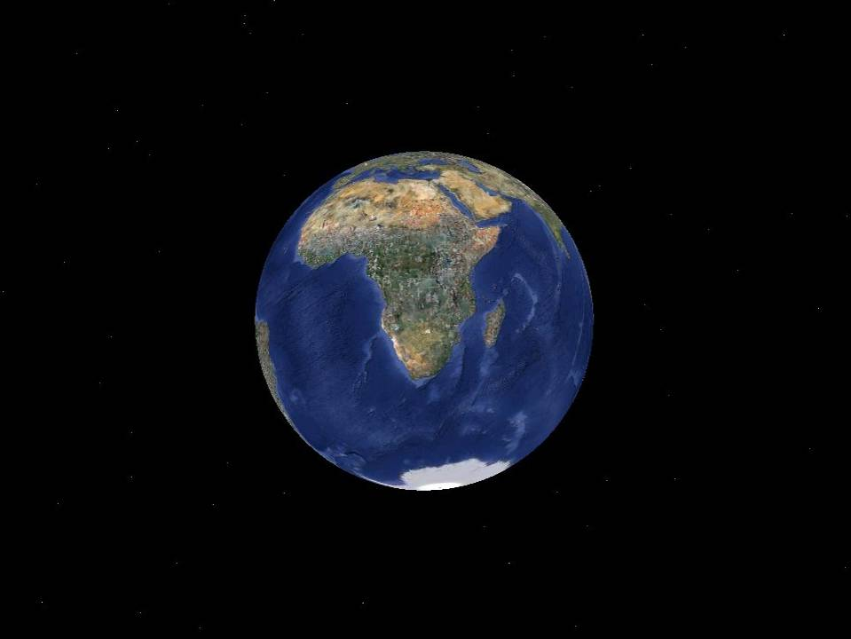
South African Science at external Large Scale International Facilities
Inbound
Outbound
Astronomy : SALT, SKA
Nuclear : iThemba, …
Other : ……
HEP/Nuclear : CERN/JINR
Interdisciplinary : Synchrotrons
Astronomy : HESS, CTA, LIGO

Slide 8
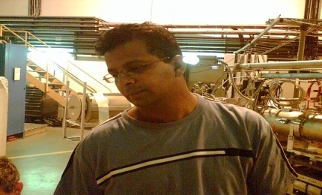
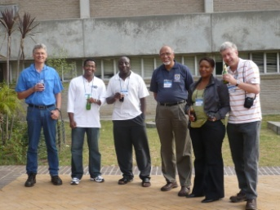
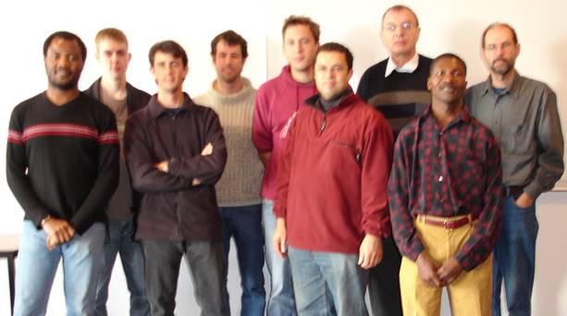
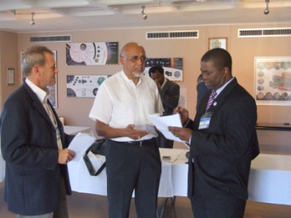

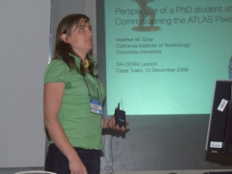
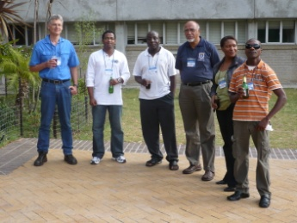
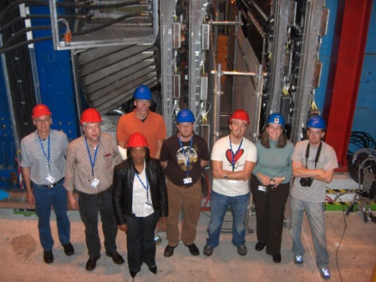
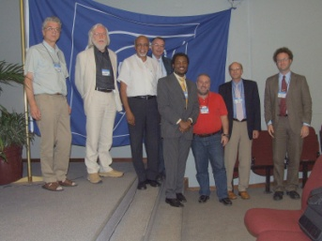
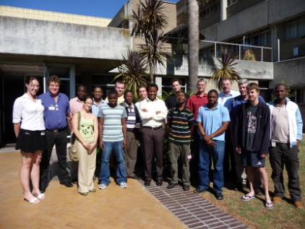
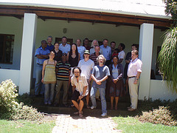
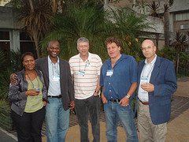
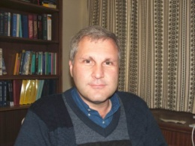
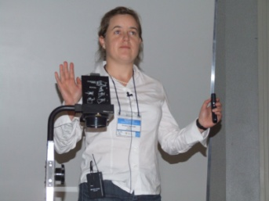
THE SA-CERN PROGRAMME
The
Role
Players

Slide 9
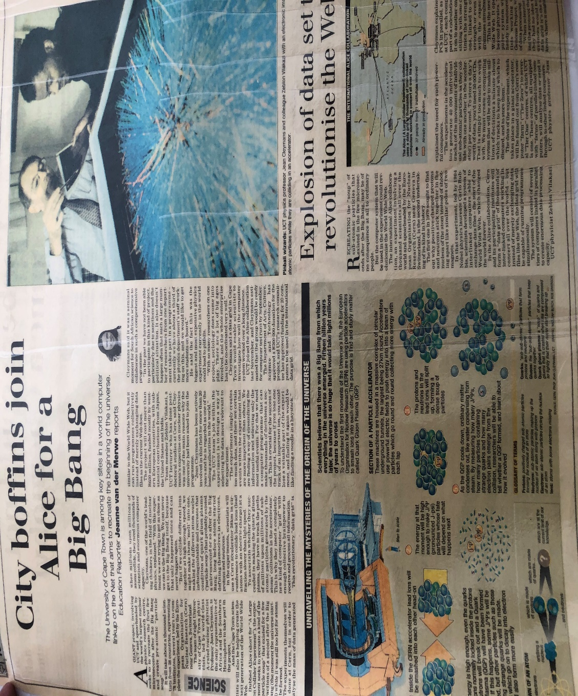

Background: History from UCT-ALICE to SA-CERN
JWAC invites ZV to apply for a position at UCT (1998)
UCT joins ALICE (November 2001)
UCT-CERN Research Centre (August 2003)
SA-CERN (15 December 2008)
  ALICE (joint UCT/iThemba effort)
MoU – Muons & Grid Computing (21 March 2011)
Wits joins ALICE (March 2014)
CHPC signs MoU: computing for ALICE&ATLAS (April 2015)
SA-ALICE joins LS-2 Upgrade (March 2018)

Slide 10
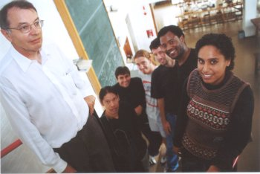
My 20 year Physics Journey with Jean
1994 —1997 : Ph. D.; CERN- NA43 experiment (Wits/Aarhus) : met Jean at Wits in 1997
  Presentation on LPM suppression – K Redlich
1999 — 2006 : Staff member at University of Cape Town -> [J Cleymans]
  UCT-ALICE -> UCT-CERN
2007 —2013 : Director: iThemba LABS —> SA-CERN programme
  Jean was chairperson of the SA- CERN programme committee based at iThemba LABS
Deputy V-C Research: university of the Witwatersrand (2014 – ) [ALICE + ATLAS]
  Continued with the collaboration and served with jean in joint JINR (NP & PP) PAC sessions

Slide 11

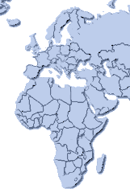
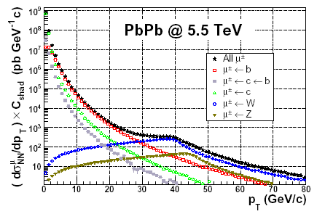
Participation of SA in ALICE
Cape Town in ALICE: currently 4 senior staff + several students
  UCT joined 2001, became UCT-CERN research center in 2003
  iThemba Labs joined in 2008
Projects
  Dimuon Arm: algorithms for online High Level Trigger (dHLT, commissioned in 2008)
  Grid Computing: Computing Cluster integrated into ALICE GRID
  Physics: Dimuon studies (acceptance, efficiency); W production in pp; ..
Tromsø
Bergen
Dubna
Heidelberg
HLT data challenge: Nov. 2004
Online test on ‘Grid’ !
Test latency tolerance
Run stable for > 15 hours
Rate limited by bandwidth
IEEE Trans.Nucl.Sci.55:703,2008.
UCT group 2004
Cape Town

Slide 12
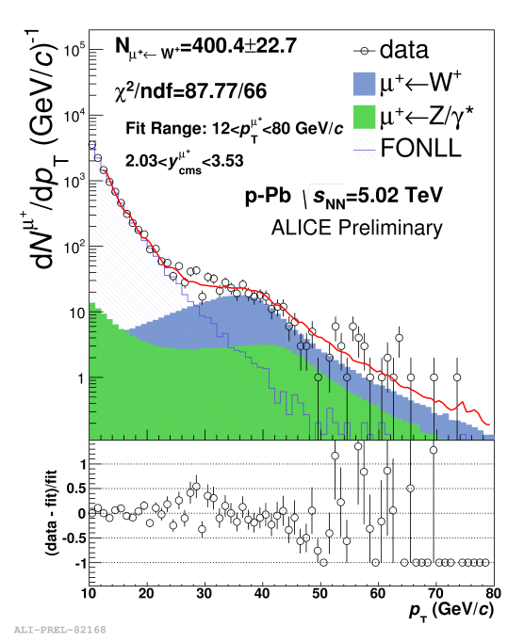
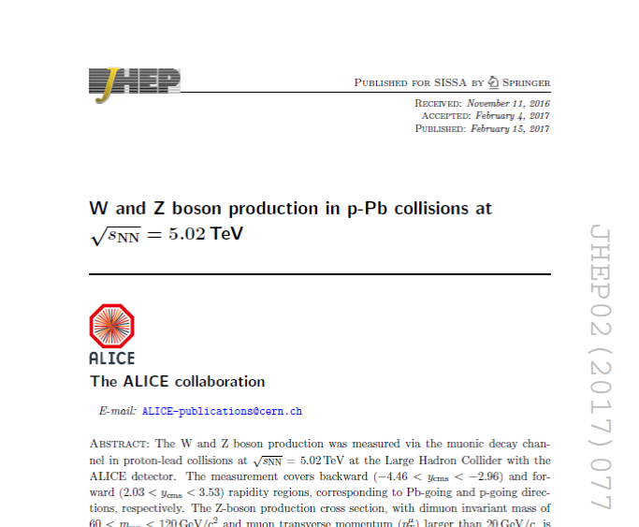
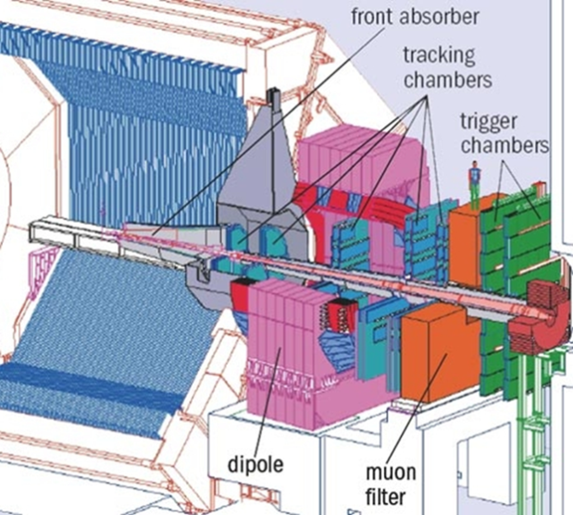
W-Z Boson — Standard Model Test
pp: PDFs at large Q2
p-Pb: Cold Nuclear Matter (CNM) effects, nuclear PDFs
Pb-Pb: binary collision/Ncoll scaling of hard processes
μ
Work done in collaboration with Subatech (France) and Wuhan (China)
The W boson production is an important benchmark of the Standard Model --✇ “candle” for LHC luminosity
W± are produced in initial hard scatterings and are not affected by the QGP.
In Pb-Pb collisions: test the scaling of hard processes with the number of binary nucleon-nucleon collisions
In p-Pb collisions: investigate Cold Nuclear Matter (CNM) effects and constrain nuclear parton distribution functions (PDFs)
In pp collisions: obtain information on quark PDFs at large Q²

Slide 13
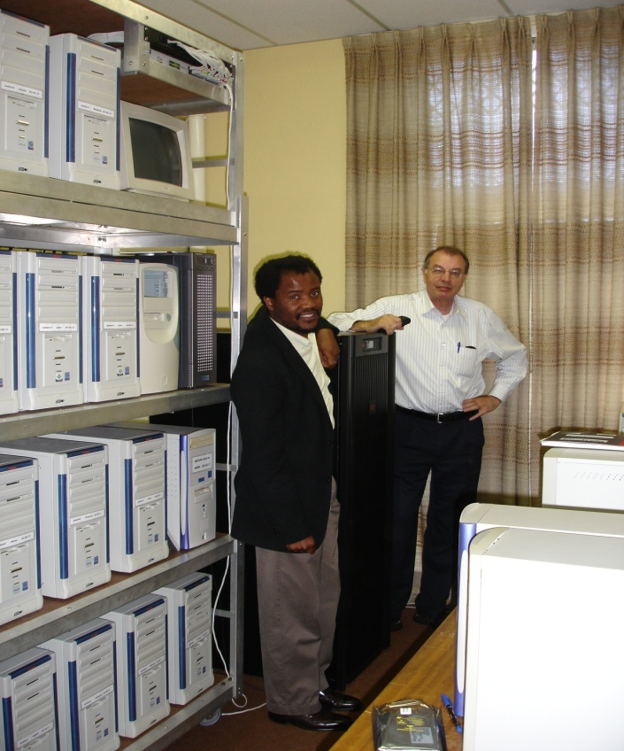
Test station for implementing HLT Publisher Subscriber paradigm
Thus a distributed online processing framework is needed to provide the transport to and from processing elements
64bit rack mounted server cluster used for simulations for a PC farm/cluster used to filter data coming off the experiment.
Efficiency => save on transport CPU cycles.
Flexibility => modular components. common communication interface.
Fault Tolerance => dynamically circumvent errors, even for entire nodes.
32bit whitebox cluster used for PubSub testing
R200,000 grant from DST: Rob Adam

Slide 14
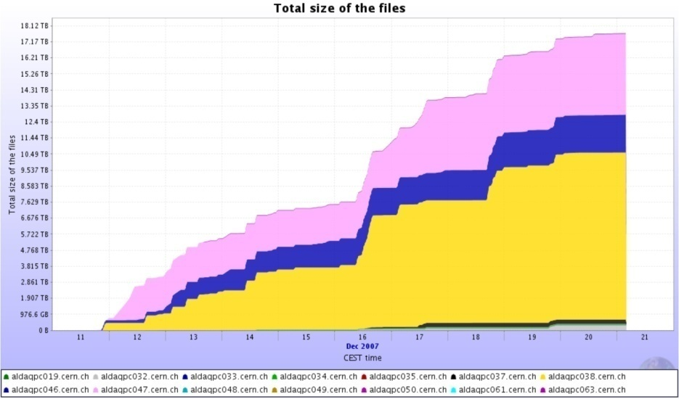
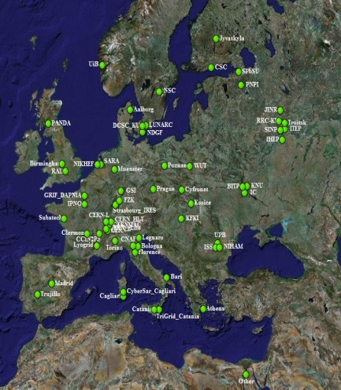
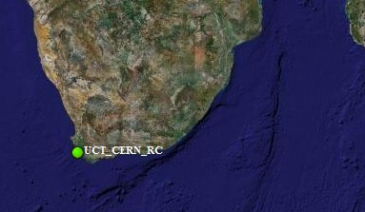
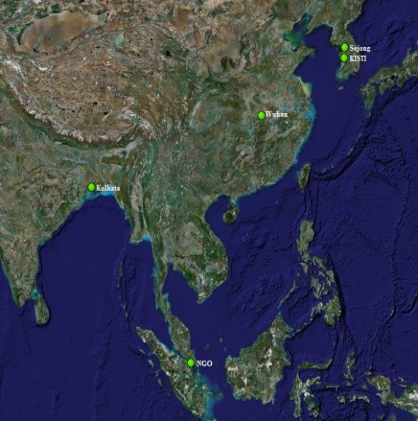
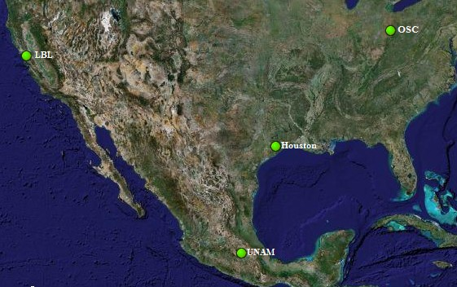
Off-line Data processing
18TB
Dec 2007: Data Processing during
1st global Commissioning Run
systematic reconstruction of all RAW
data
Reconstructed events made available
to collaboration
Accumulated data
Europe
In 2007:
  65 Sites on 4 continents
  7500 CPUs
  1PB of storage
Africa
Asia
GRID operation during
December Run
North America
14

Slide 15
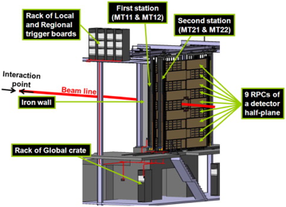
Muon Tracking Detector
Testbeam for LS-2 Upgrade
F Bossu, S Arkar, D Azmi, J Senosi, R Kuriakose,
S Mhlanga, C Monteverdi, S Delsanto, D Steyn,
Z Buthelezi, S Förtsch
Detector Maintenance during LS-1

Slide 16
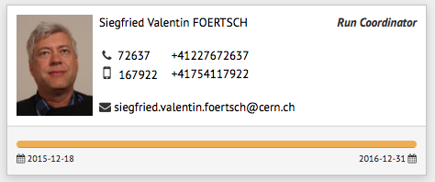
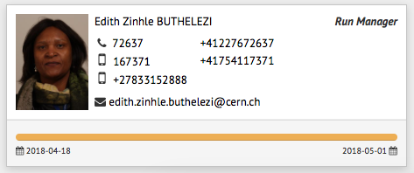
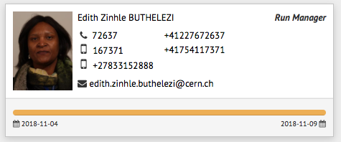
Run Coordination
Siegfried Förtsch
  Run Coordinator 2016
Zinhle Buthelezi
  Run Manager
  April 2018: start of data taking
  November 2018: start of Pb-Pb run

Slide 17
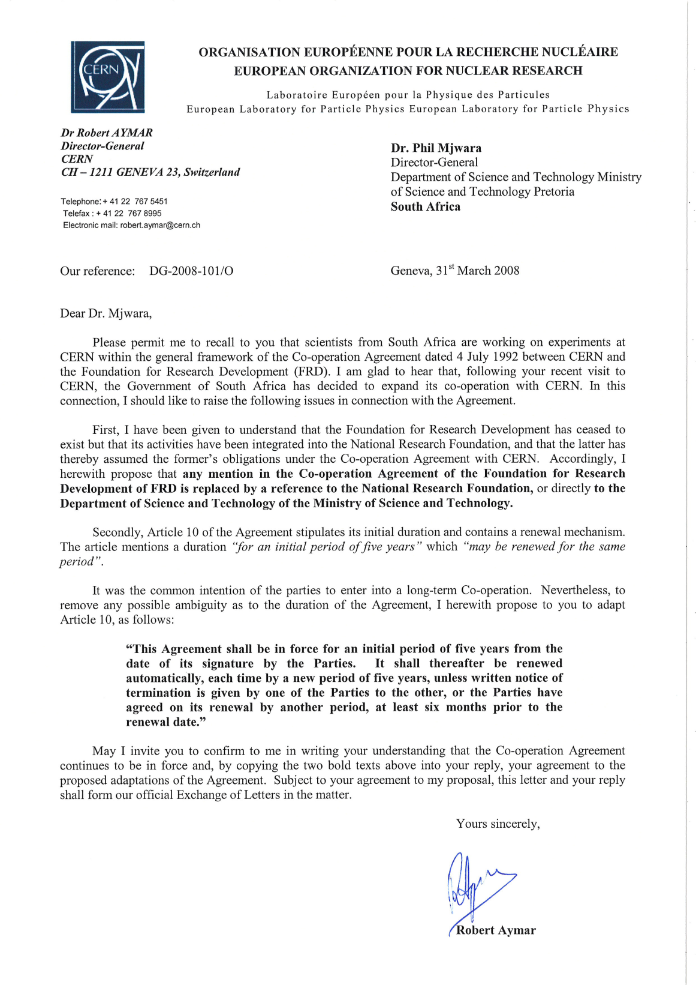
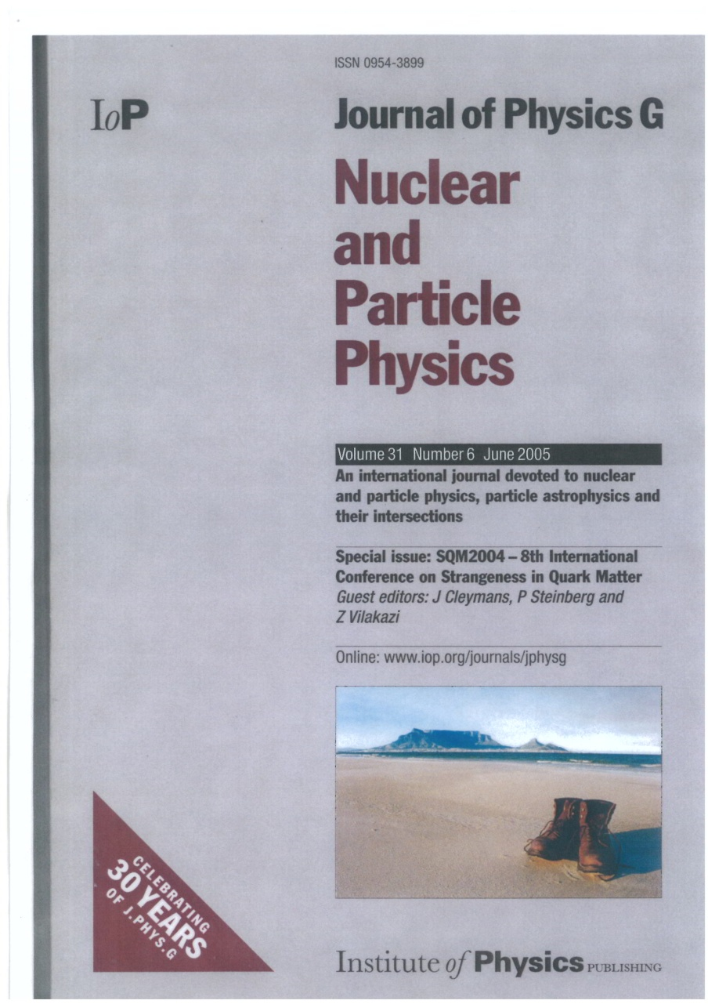
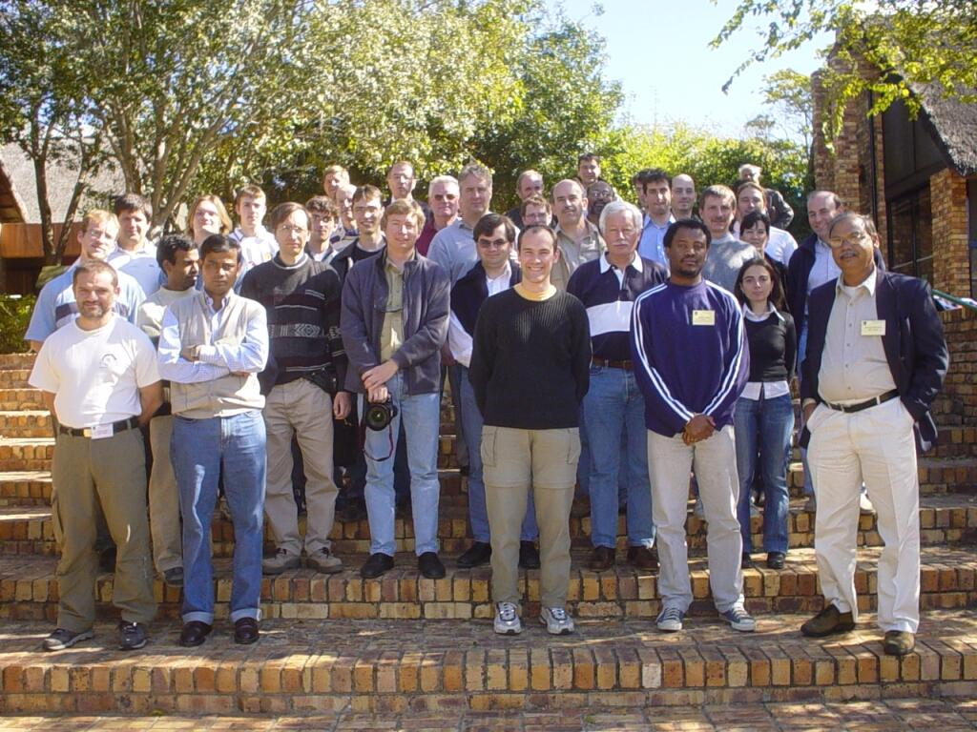
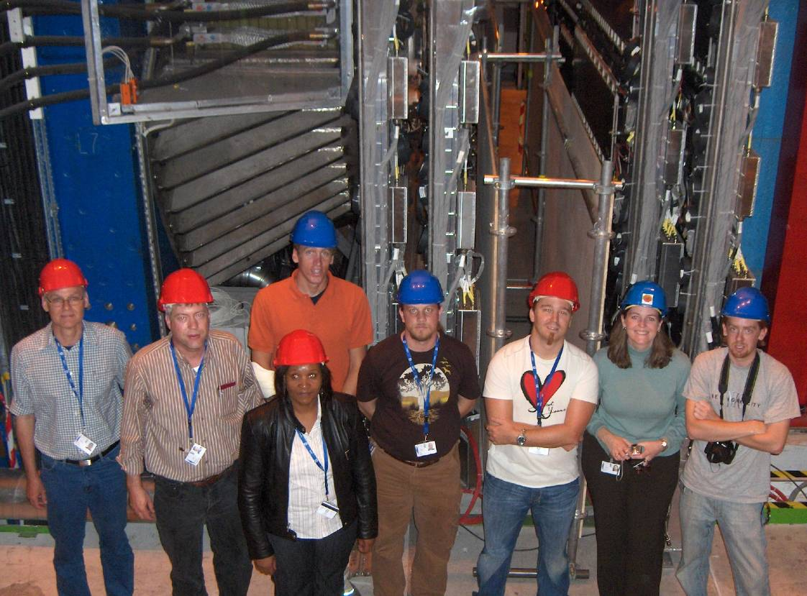
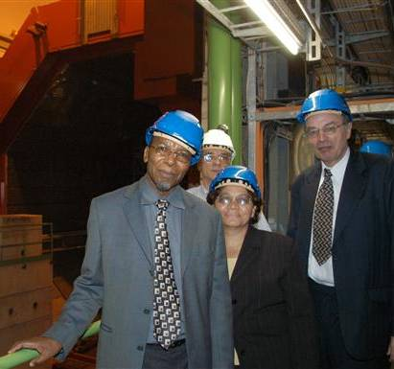
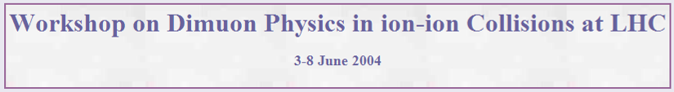
High-level Engagement
Regular short/medium visits at CERN
  Inter. Workshop on dimuon physics SA, 2004
VIP visits
  Minister Mangena(S&T), June 005
  Dr Mjwara (DG DST), July 2007
  M. Shuttleworth, Feb. 2007
Minister M. Mangena, June 2005
SA team in ALICE, 2007

Slide 18
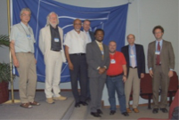
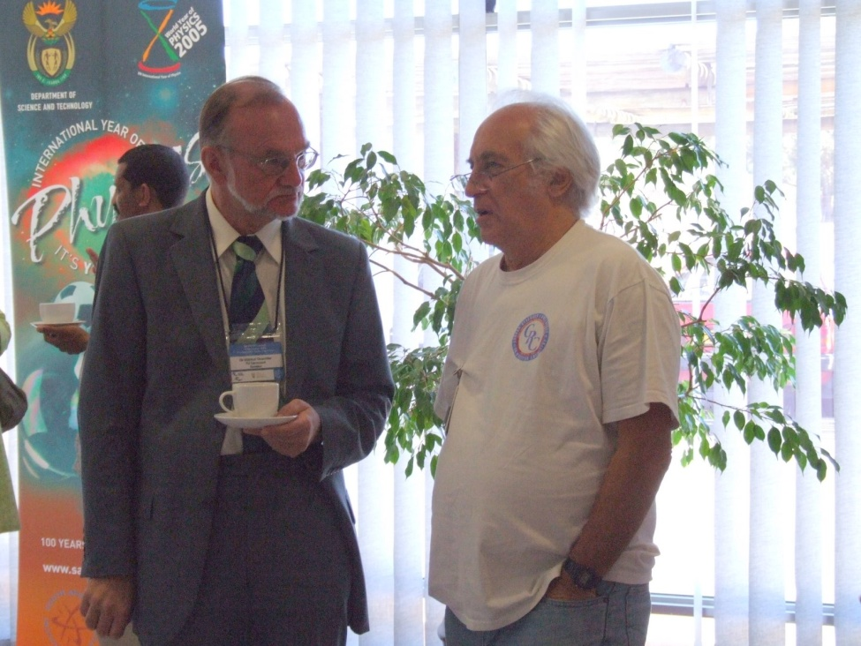
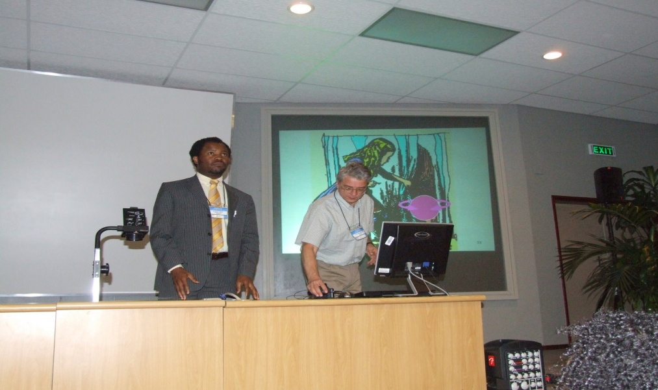
Launch of the SA-CERN consortium December 2008.

Slide 19
SA-CERN Program
Host Institution: iThemba LABS (iTL)
Original Governance Structure
Advisory Committee
Executive Committee
Chairman
J Cleymans (UCT)
DST
SAIP
NRF
International
Reviewer/s
HOST MEMBERS
(Director)
V Spannenberg
(Business Manager)
ALICE
T Dietl (UCT)
S V Förtsch
(iThemba)
ATLAS
T Vickey
B Mellado
(wits)
ISOLDE
K Bharuth-Ram (UKZN)
Nuclear and Particle Theory
Group Leader
S Karataglidis (Johannesburg)

Slide 20
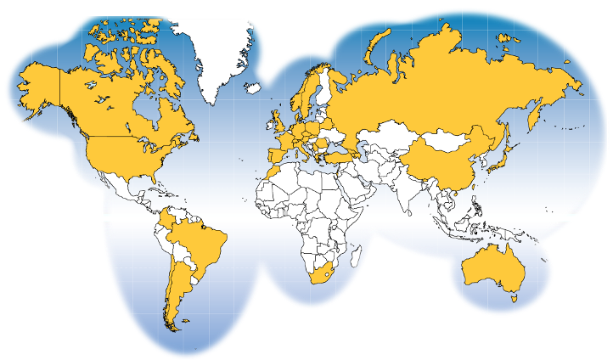


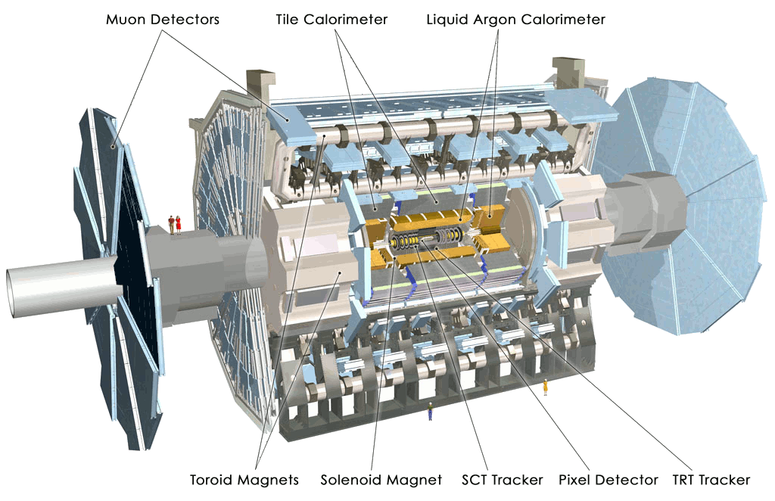



SA@ATLAS

Slide 21
ISOLDE
Principal Scientists:
  Krish Bharuth-Ram (KwaZulu-Natal and Durban U. of Technology)
  Hillary Masenda & Deena Naidoo (Witwatersrand),
  Nico Orce & S. Trambak (Western Cape)
  Mathis Wiedeking (iThemba LABS/WITS), Christine Steenkamp (Stellenbosch)
Post-doctoral fellows:
  S. Sithole (Stellenbosch and iThemba LABS) Kumar Raju (Western Cape)
Students: 13 MSc and PhD students

Slide 22

Kruger: Discovery Physics at the LHC
biennial workshop
since 2010
co-organized by SA-CERN
ca. 100 participants

Slide 23
Flurry of other scientific activities …

Slide 24


Outreach
2015: CERN Beamline for Schools Competition
St. John’s College and Barnato Park High School team
International masterclass April 2014
“Looking for Strange Particles in ALICE”
Organized by SA-ALICE and iThemba LABS
24 students from 6 schools
International video discussion with Cairo, Geneva &Warsaw
Simon H. Connell (University of Johannesburg)

Slide 25
Raised the Bar of South African Physics (laundry list in 2008)
Capacity building
  Student calibre and throughput specifically treated further on
  HEP skills very productive (physics, maths, team-work, networking, computer skills, high tech)
Science Awareness
  Massive worldwide public interest generated around LHC
  SA Public in unprecedented science literacy and thirst for news
Physics program
  Networks, collaborators, facilities, infrastructure accepted as world’s best.
  Direct access to CERN Outreach Engine
  Teach Programme
  Summer student programme
  High Energy Physics Masterclasses for local deployment
Student magnet
  Students are strongly attracted to HEP.
Tech transfer
  GRID technology
  Involve engineers and technologists at CERN : Wits has built an electronics lab
  Many opportunities

Slide 26


“It is always seems impossible until it's done.”
Nelson R Mandela (1918-2013)
Ex Africa Semper Novi

Slide 27



Thank You
WITS
UCT
iThemba LABS

