Slide 1
Experimental investigation of the (n,xγ) reactions using tagged neutron method
N.A. Fedorov, on behalf of TANGRA collaboration
FLNP JINR
nfedorov@jinr.ru

Slide 2
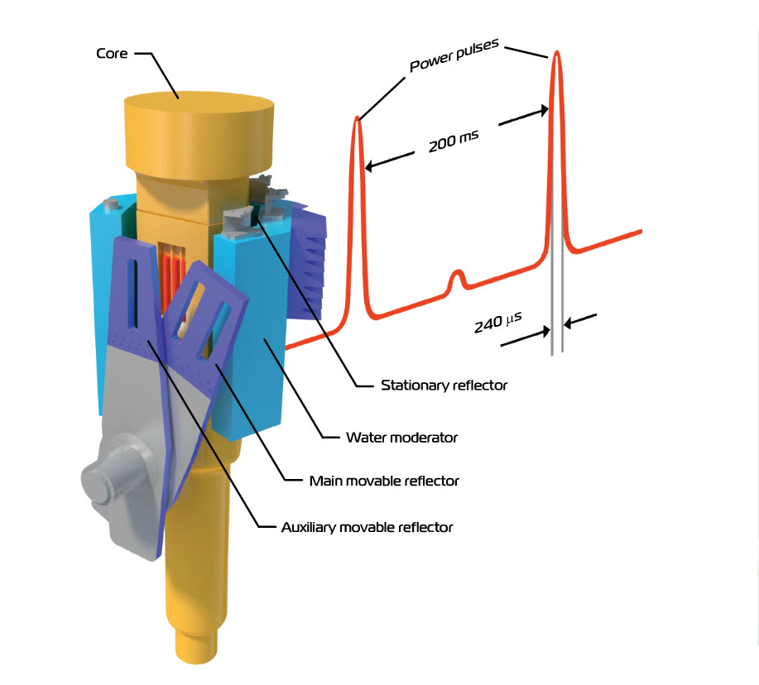
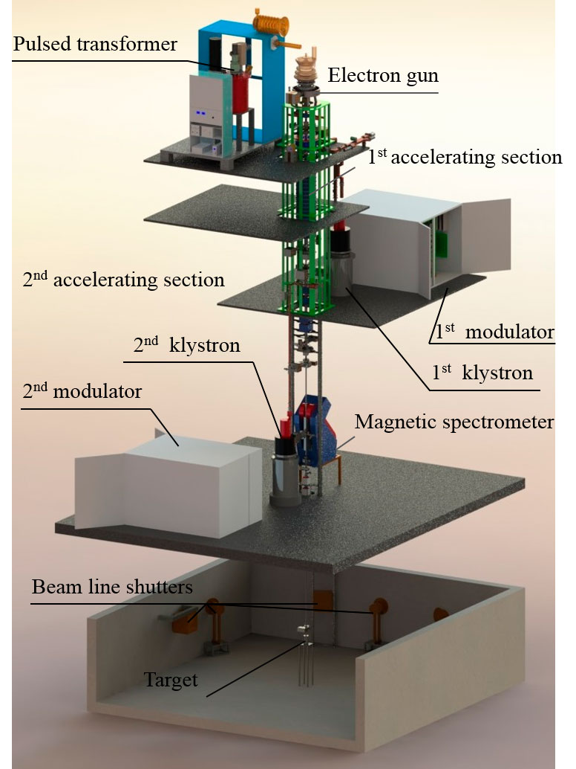
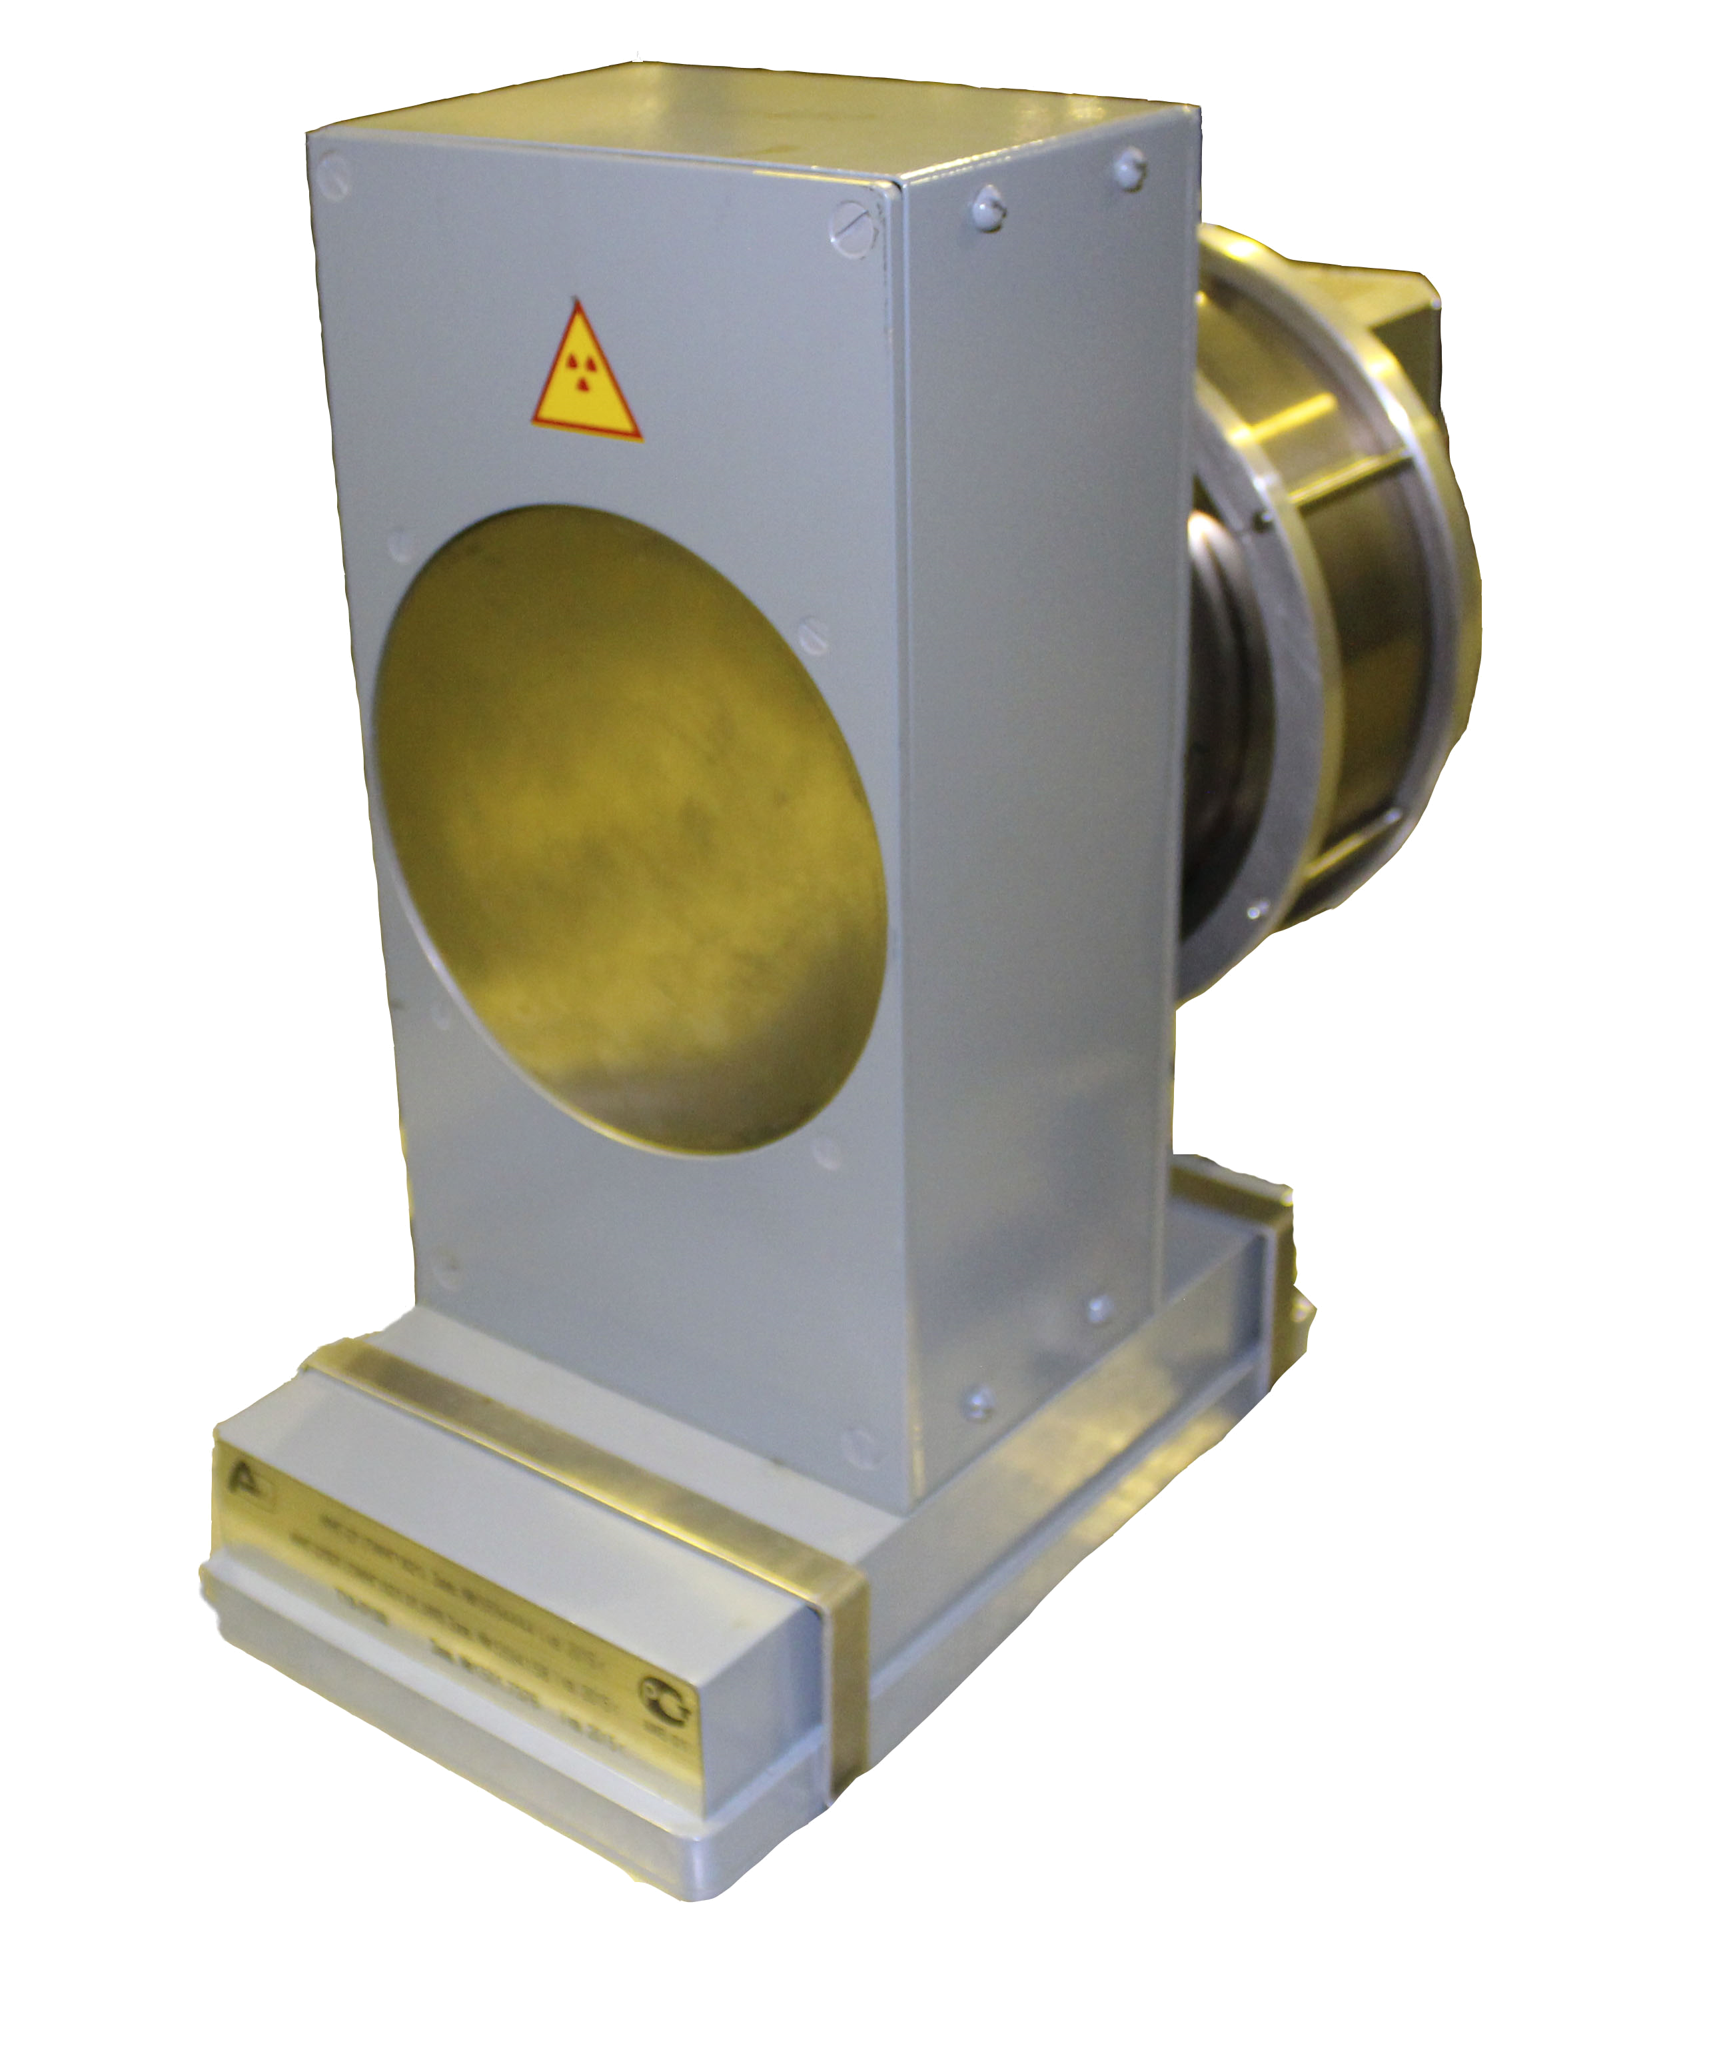
Frank Laboratory of Neutron Physics
FLNP
Established in 1956
Unique facility: IBR pulse reactor (launched 06.23.1960)
IBR-2 pulse reactor
IREN accelerator neutron source
EG-5 Van-der-Graaff accelerator
DT neutron generators
Group |  | Energy band E_{n}, eV | Structures | Available in FLNP
Slow | Ultracold | < 3·10⁻⁷ | Macroscopic | No :(
 | Cold | 3·10⁻⁷ – 0,025 | Molecules and crystals | Yes!
 | Thermal | 0,025 – 0,5 | Crystals, nuclei | Yes!
 | Resonance | 0,5 – 10³ | Nuclei | Yes!
 | Intermediate | 10³ – 100·10³ | Nuclei | Yes!
Fast |  | > 100·10³ | Nuclei | Yes!
ING-27
20 cm

Slide 3
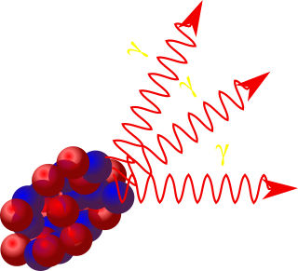
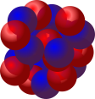
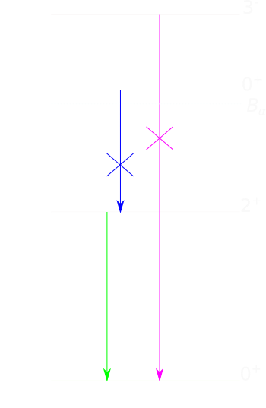
What are (n,xγ) reactions?
^{A}Z
^{A’}Z’*
n
(n,α)
x
In general, it is a set of nuclear reactions induced by n, leading to n’,p, np or α emission
The residual nucleus is excited and producing γ-radiation
(n,n’γ)
We are studying reactions with 14 MeV neutrons (produced in d-t reaction)

Slide 4
Why (n,xγ) are important?
(n,α)
(n,n’γ)
Diamond is pure carbon

Slide 5
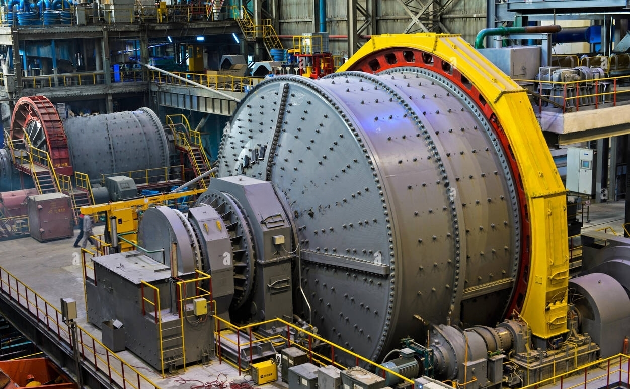
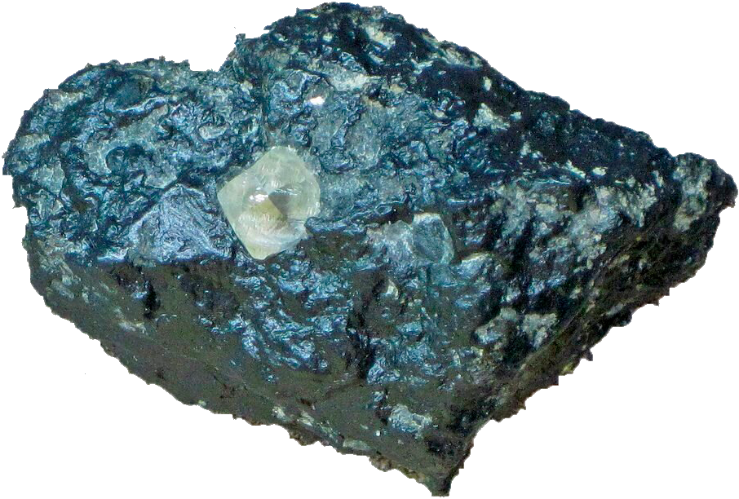
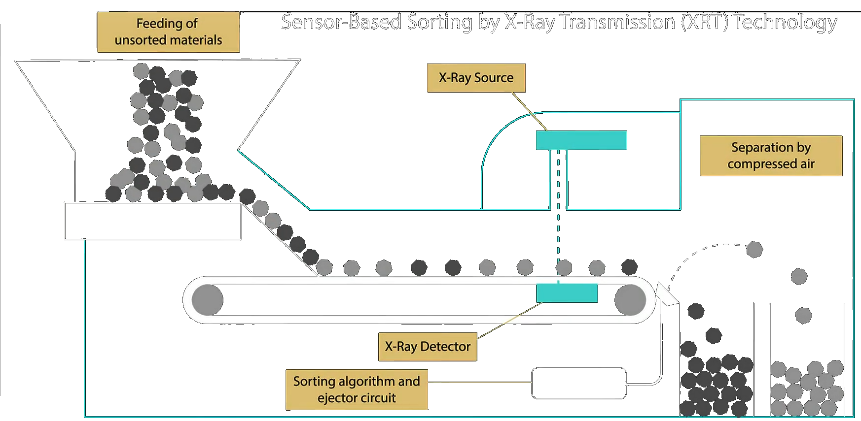
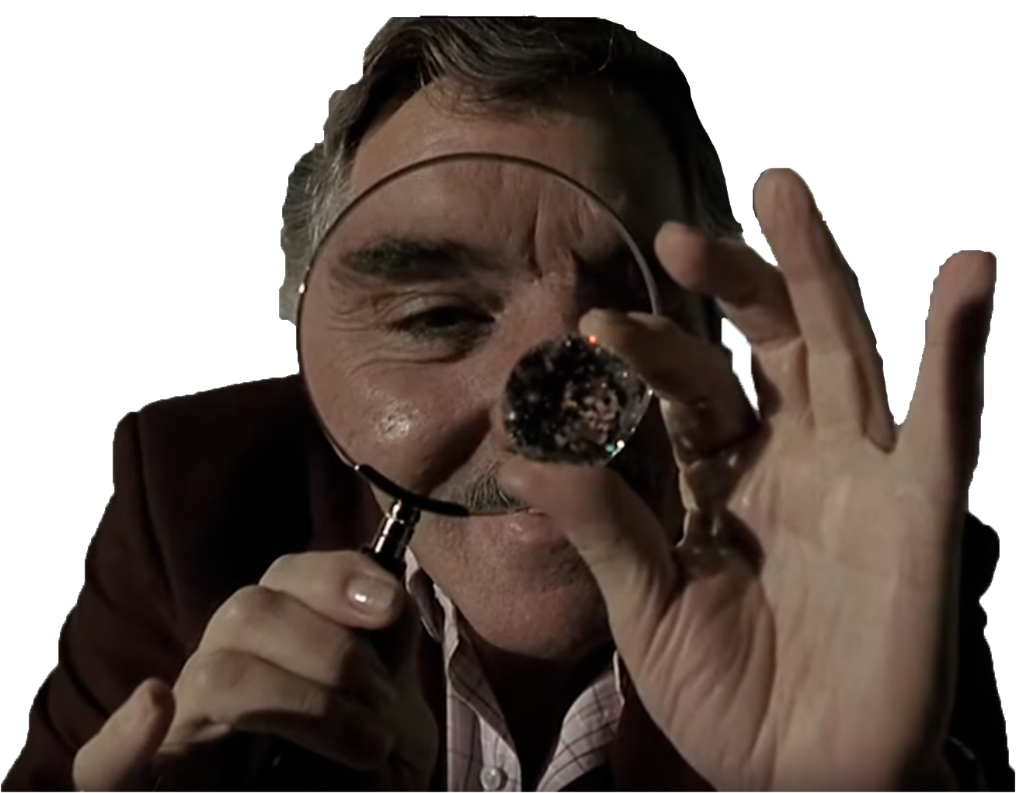
Why (n,xγ) are important?
Large diamonds could
be crushed!
Fluorescence cannot
Be seen through rock!

Slide 6
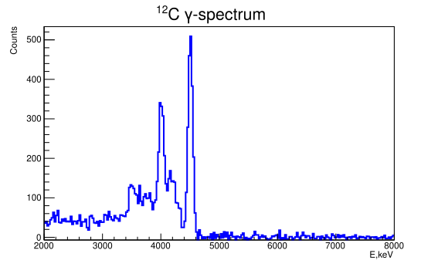
Why (n,xγ) are important?

Slide 7
Why (n,xγ) are important?
Carrying information about structure of nuclei
Could be used for theoretical model validation (i.e. Talys can calculate cross-sections of γ-emission)
Could be used for model parameters optimization in combination with other neutron data
Needed for Monte-Carlo modeling of elemental analysis setups
Accurate database of (n,xγ) cross-sections is in highly demand

Slide 8
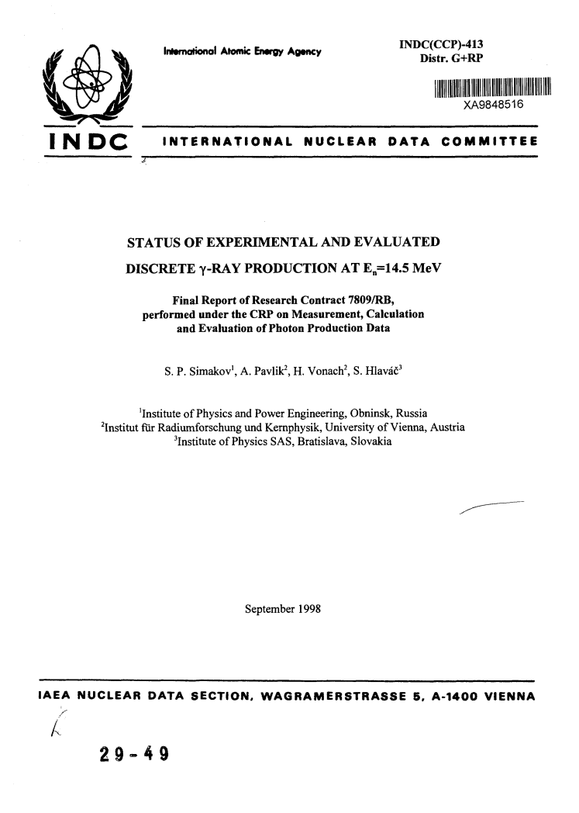
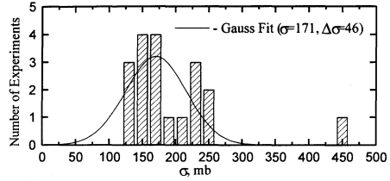
What we know about (n,xγ)?
Discrepancy in two times!
The most complete set of (n,xγ) cross-sections
Reason: issues in neutron flux monitoring

Slide 9
It would be great to have a direct neutron counting for CS measurements

Slide 10
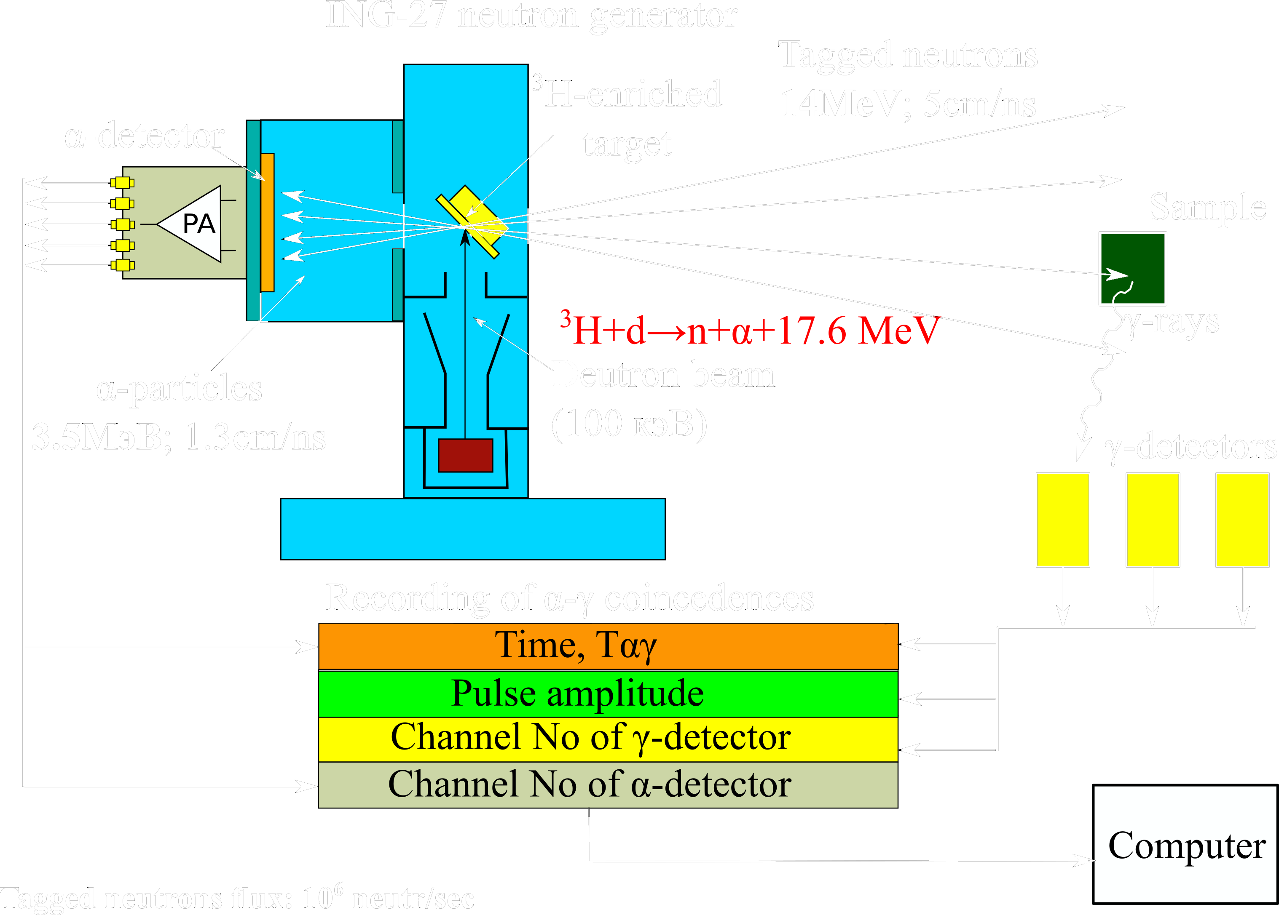
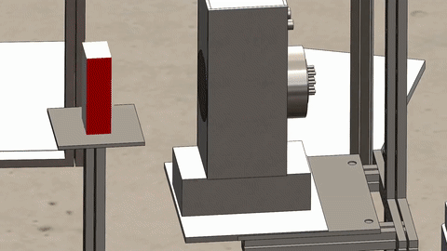
Idea of the Tagged neutron method (TNM)
TANGRA
(TAgged Neutrons & Gamma RAys)
Application of the Tagged neutron method improves peak/background ratio
It is possible to determine all 3 spatial coordinates of reaction
Direct count of neutrons using α-detector → good for CS measurements
ING-27 is industrial NG produced by VNIIA (Russia)

Slide 11
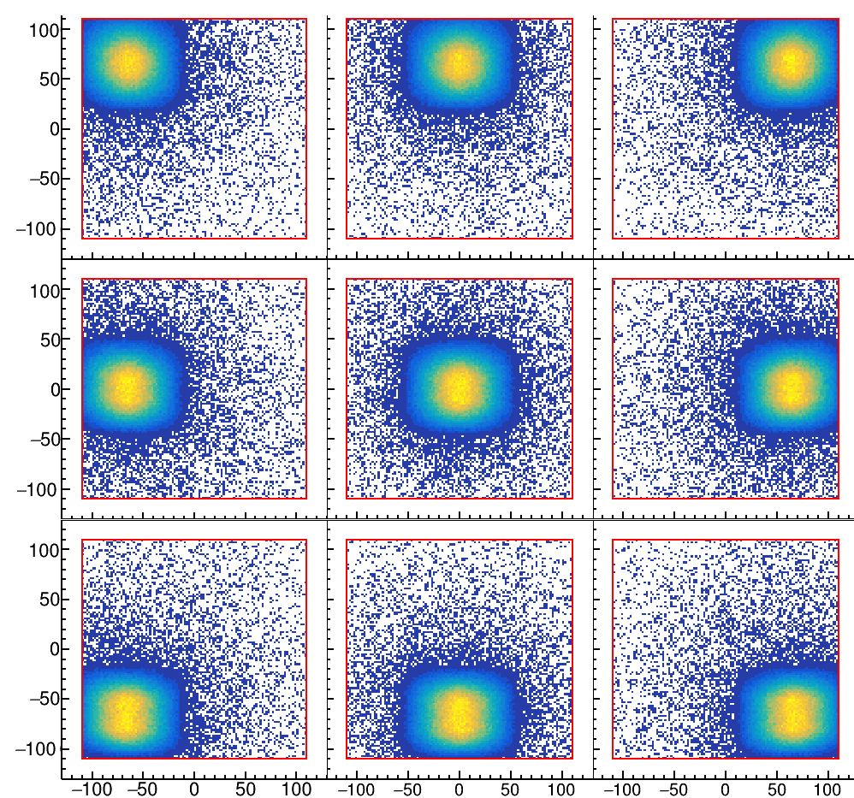
ING-27 neutron beams
Tagged beams are not tiny!
(FWHM~50 mm at 340 mm from 9-px NG)
Each α pixel and γ-detector combination see ‘own’ angular range between n beam and γ-quantum.
We have to use large samples to use as much neutrons as possible
This nice picture determines design of experimental setup as well as…

Slide 12
Technical demands & challenges
Measure more γ-lines than in the past
Measure more accurate than in the past
TNM with multiple beams
Data on γ-quanta angular distribution is needed
HPGe detectors
Cost
Dead time
Radiation damage
Large sample
Set of γ-detectors with low resolution
Limited number of detectors
(we have only 2)
Shielding
(See P. Filonchick report)
Many angular distribution points
Sophisticated data processing
Data on γ-quanta angular distribution is needed
MC corrections
(See P. Filonchick report)
Response function
(see D.N. Grozdanov report on Sunday)

Slide 13
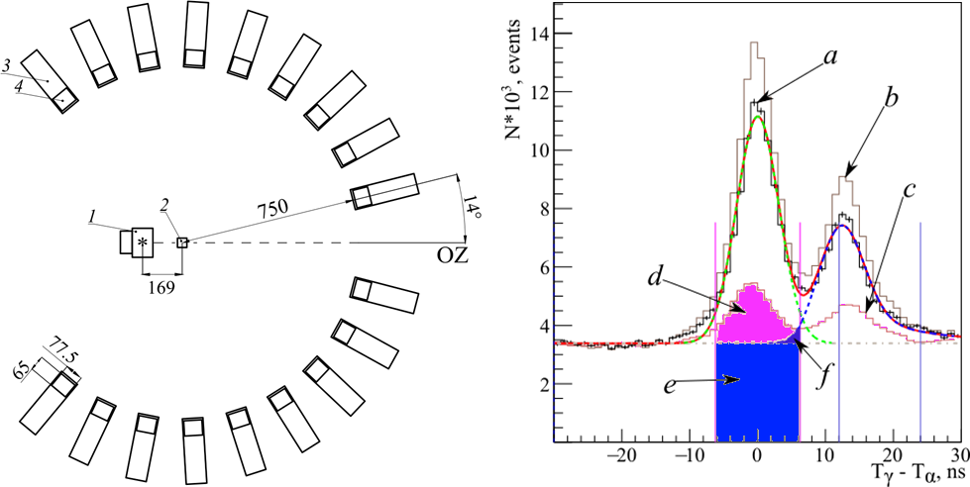
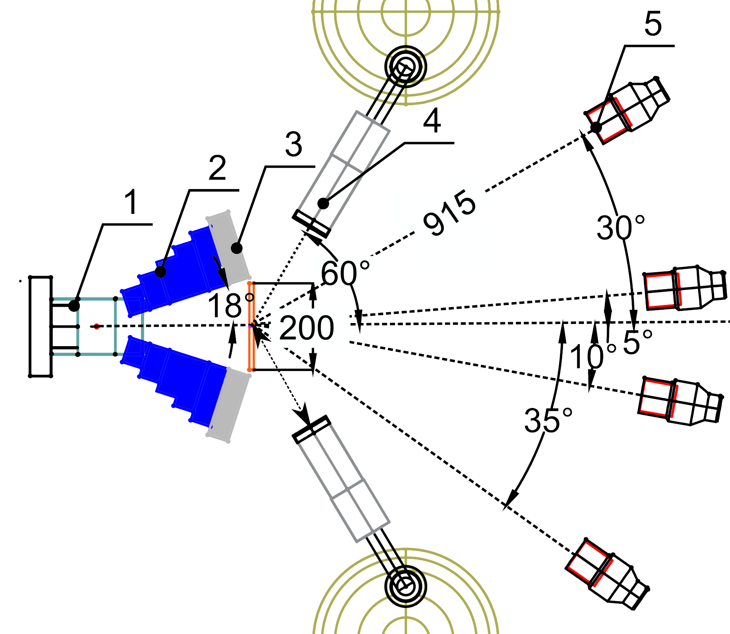
Two configurations of experimental setups
Configuration with 18 BGO detectors and
64-beams neutron generator was used for angular distribution measurements
New setup with 2 HPGe and 4 LaBr detectors will be used for cross-section measurements (test configuration is shown)

Slide 14
Measurements of γ-quanta angular distributions
1-ING-27 neutron generator, 2-sample, 3-BGO γ−detector, 4-BGO crystal.
Peak a corresponds to γ−quanta from the sample, peak b – to direct and scattered neutrons. Time window used for selection of γ−correlated events is shown by pink lines.

Slide 15
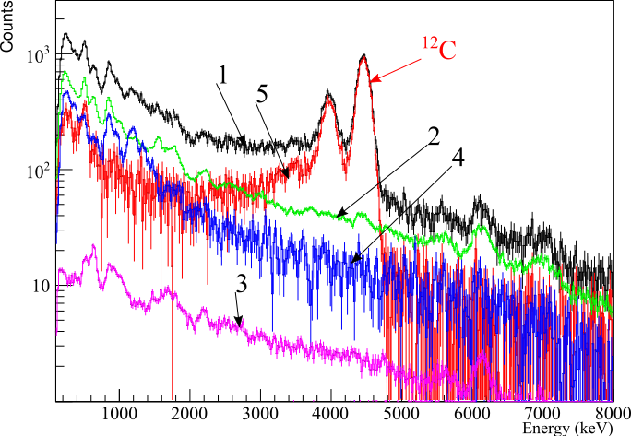
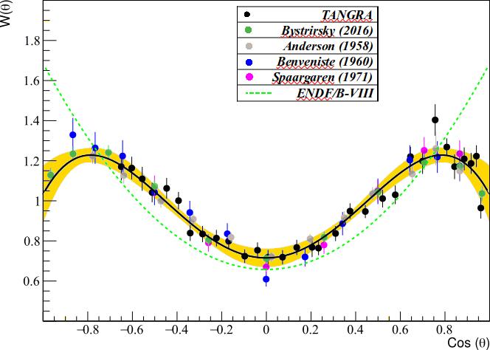
Measurements of γ-quanta angular distributions
±2σ_{γ}
1-spectrum in ±2σ window, 2-random coincidence background, 3-neutron background, 4-gamma background (measurement w/o sample) 5-residual spectrum
Angular distribution for 4.4 MeV γ−quanta emitted by ¹²C

Slide 16
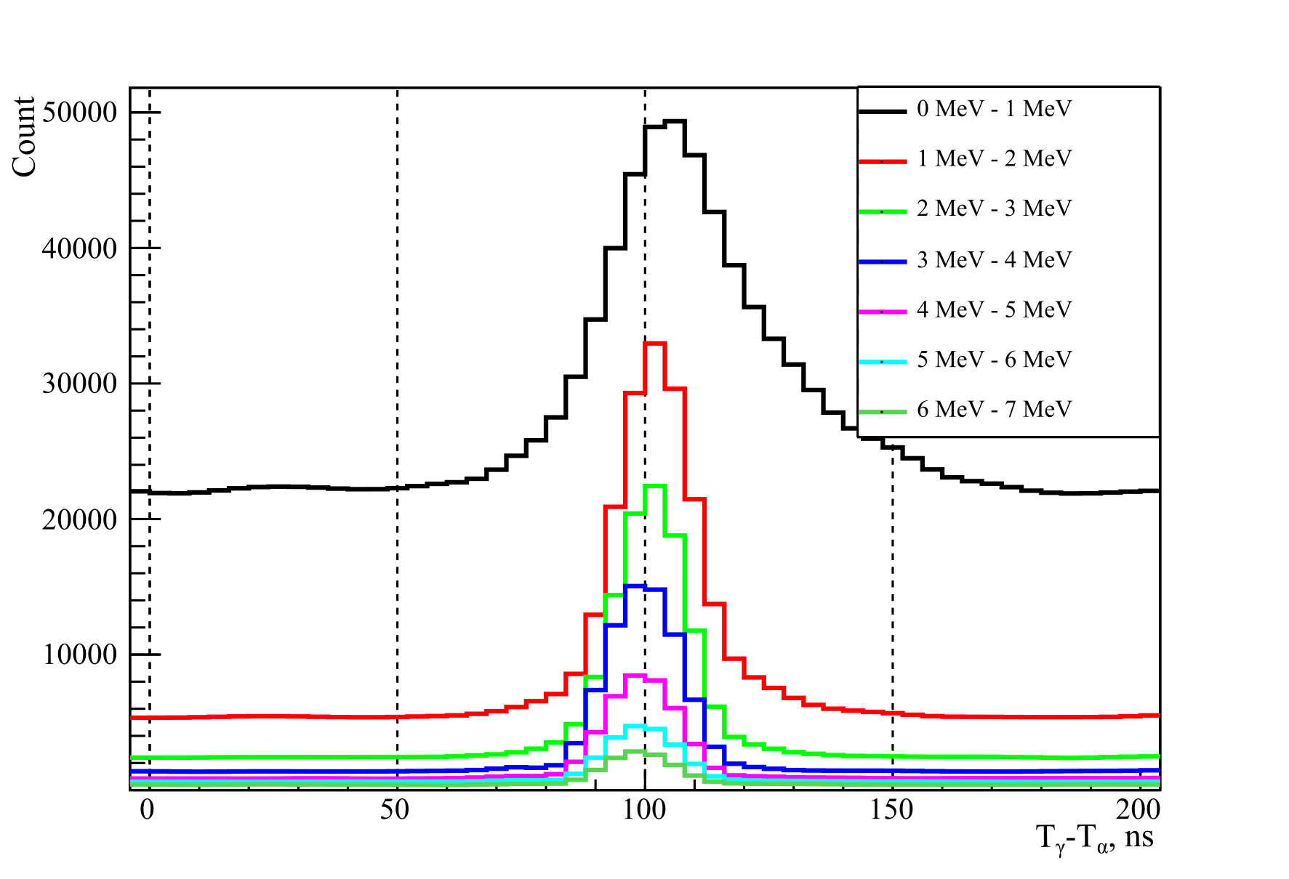
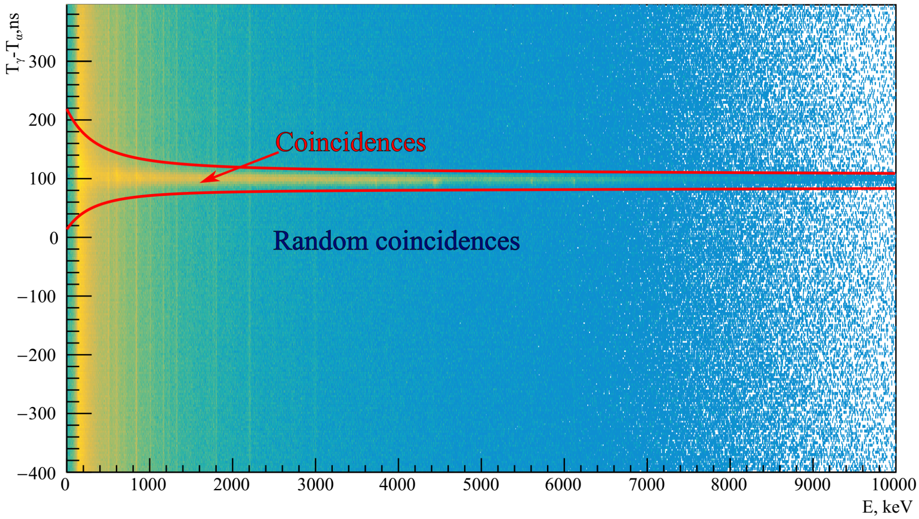
Cross-section measurements
1-ING-27, 2-iron-, 3-lead parts of the collimator, HPGe detector, 5-LaBr detector, sample is shown with orange lines.

Slide 17
Cross-section measurements
Time resolution of HPGe is low
HPGe has good energy resolution → background peaks are identified by energy
Procedures for LaBr and BGO are same.
LaBr is used now as additional source of CS data. Will be used for angular distribution measurements

Slide 18
Cross-section measurements
We use the following formula:
where N^{γ}(θ) – amount of registered gammas (extracted from spectra), Nn – number of emitted neutrons, W(θ) - Legendre approximation of γ angular distribution data. Coefficient η
l, ϵ - MC calculation
takes into account properties of the sample (density, molar mass, chemical composition and effective thickness). Coefficient ϵ describes γ-absorption and detector efficiency for spread γ-source, τ – dead time correction

Slide 19
Results & conclusion
We have performed 2 test measurements with SiO₂ (nat) and carbon (nat):
γ-transition | Our result, mb | Recommended value [INDC], mb | Range [INDC], mb
1779.0 keV ²⁸Si(n,n’),²⁹Si(n,2n’) | 350±20 | 403±20 | 293±28…488±70
6129.9 keV ¹⁶O(n,n | 113±10 | 148±10 | 84±17…179±22
4438.9 keV ¹²С(n,n’) | 175±6 | 187±5 | 121±8…440±80
Our results are inside range from INDC compilation, good agreement for 4438.9 keV ¹²С(n,n’) transition with recommended value.
(More data & details for SiO₂ see in P. Filonchick report on Sunday)
Created experimental setup was tested, preliminary data has been obtained. Angular distribution of γ-rays is taken into account.
TODO: estimation of systematic uncertainties, continue measurements to improve statistical accuracy.
It is planned to measure γ-emission cross-sections for more than 50 elements until 2025 and build a database useful for fundamental and applied purposes.

Slide 20
THANKS!
Questions?
If you are interested, please visit the TANGRA project webpage!

Slide 21
ING-27 neutron source
1 – neutron generator target, 2 – α-detector, 3 – signal connector of α-detector, 4 – high-voltage power connectors, 5 - low-voltage control connector

Slide 22
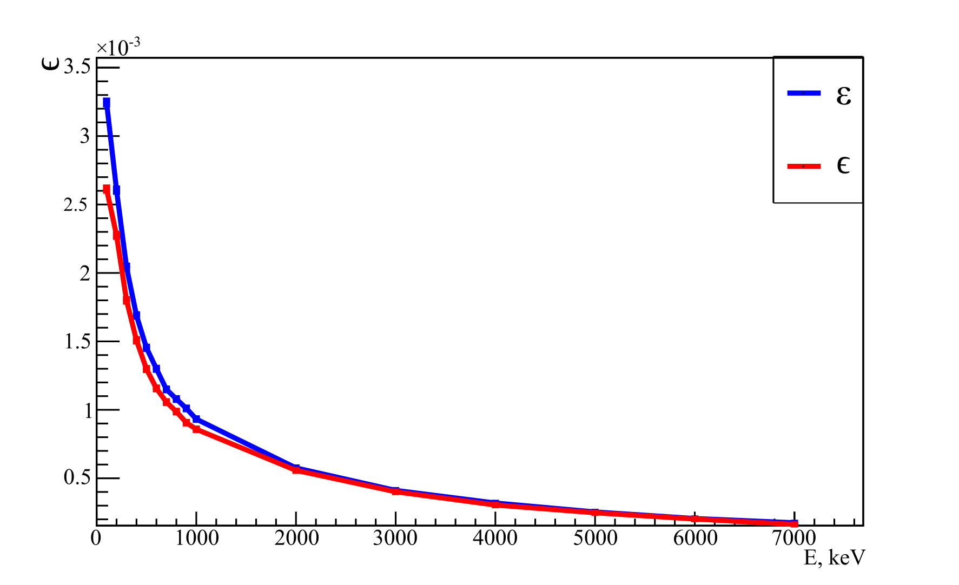
MC calculated efficiency
Red line: absorption included
Blue line: absorption disabled

Slide 23
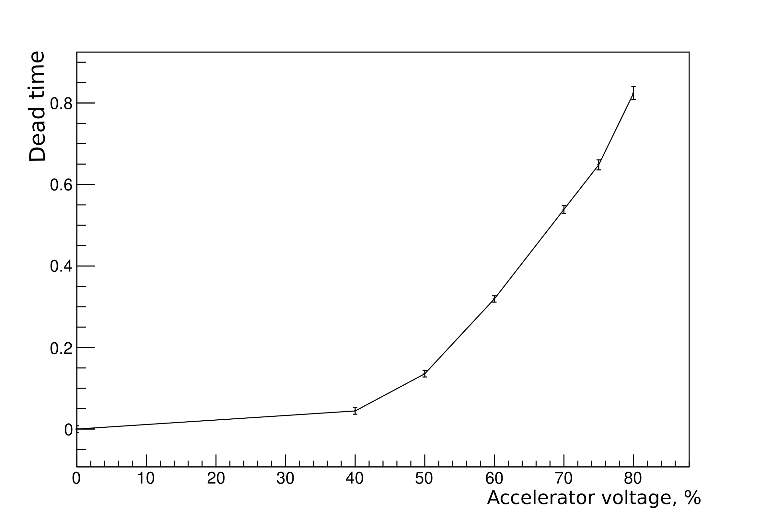
Dead time

Slide 24
CONTENTS OF TALK
Introduction.
Idea of the TNM.
Neutron source.
Research directions and setups:
γ-quanta angular distributions.
γ-quanta yields and cross-sections.
n’ – angular distributions & n’ γ correlations

Slide 25
Joint Institute for Nuclear Research
JINR
International intergovernmental scientific research organization
16 member states
Established in 1956
7 laboratories that cover wide area of nuclear physics-related topics:
Veksler and Baldin Laboratory of High Energy Physics (VBLHEP)
Dzhelepov Laboratory of Nuclear Problems (DLNP)
Bogoliubov Laboratory of Theoretical Physics (BLTP)
Frank Laboratory of Neutron Physics (FLNP)
Flerov Laboratory of Nuclear Reactions (FLNR)
Meshcheryakov Laboratory of Information Technologies (MLIT)
Laboratory of Radiation Biology (LRB)

Slide 26
FLNP now
Sector of Raman Spectroscopy (19 employees)
Sector of the new source and complex of moderators (19 employees)
FLNP
(526 employees)
Division of Nuclear Physics (125 employees)
Division of Condensed Matter Research and Developments (138 employees)
Sector of investigations of neutron-nuclear interactions (51 employees)
Sector of investigations of neutron fundamental properties
(17 employees)
Department of Neutron Investigations of Condensed Matter (88 employees)
Department of Spectrometers Complex IBR-2
(49 employees)
Sector of Neutron Activation Analysis and Applied Research
(24 employees)
Sector №1 Detectors and Electronics (27 emp)
IREN facility
(28 employees)
Sector №1 Diffraction (55 emp)
Sector №2 Neutron Optics (11 emp)
TANGRA
NERA group
YuMO group

Slide 27
TANGRA collaboration
TAgged Neutrons & Gamma RAys
An international collaboration
Main goals:
Nuclear reactions research using tagged neutron method (TNM)
Searching for new application of TNM
Development of fast elemental analysis techniques and compact setups

