Slide 1
Particle Physics Instrumentation
Christian Bohm
Stockholm University
Similar instrumentation is used for nuclear physics and nuclear medicine.
Advanced detectors are often combinations of different specialized subdetectors
Here I discuss different subdetectors used in the LHC environment more specifically the ATLAS detector
Outline
LHC and its detectors
ATLAS and its subdetectors
Future Accelerators
Calorimeters
TDAQ

Slide 2
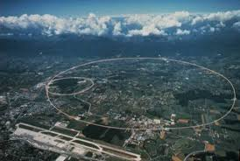
The Large Hadron Collider
27km circumference double ring collider where 7 TeV protons meet 7 TeV protons in 4 interaction points with the detectors – ATLAS, CMS, LHC-B and ALICE to record debris.
The colliding beams are focused into a size of 16 μ and a flux of 10³⁴ protons/cm²/sec
1600 strong superconducting magnets (up to 9T) re responsible for bending and focusing the beams
7 TeV protons move at 0.999999993 times c, i.e. 2m/s less than c
The total beam energy is about 600 MJ – enough to melt 2 ton of cupper
ALICE
ATLAS
LHCB
CMS

Slide 3
The Large Hadron Collider
Most protons will pass through and continue to recirculate, but some collide (also with rest gas)
Eventually all protons are lost, but before that they will pass each other many times
A feasible design is to group the protons in bunches and let the bunches collide
Bunch length: 30cm
Bunch distance: 7.5m
Bunches each with about 10¹¹ protons each collide every 25 ns,
but only ~ 20 non-elastic collisions per bunch crossing
These operations started 2010 (2008)
ALICE
ATLAS
LHCB
CMS

Slide 4
Local time reference
The bunch spacing is so close that when the particles formed in a bunch crossing move away (close to c) from the
interaction point new bunch crossings occur (at the interaction point).
The local time reference for all detector elements are adjusted so that they relate to correct bunch crossing event i.e. with the correct Bunch Crossing number (BC)
BC-2
BC-1 (previous bunch crossing)
BC (current bunch crossing)

Slide 5
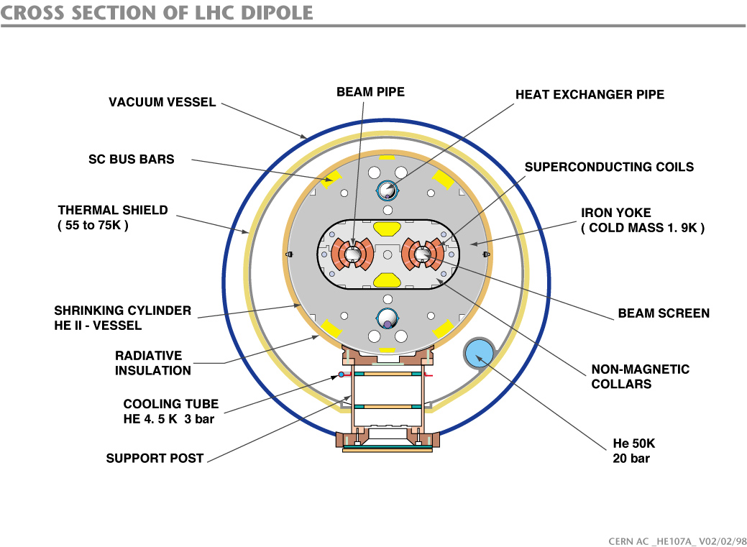
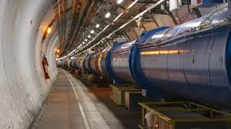
The Large Hadron Collider
Cryogenics
Multilevel temperature zones
Thermal Shield:55-75 K
Iron Yoke: 1.9 K
High Vacuum
Insulation vacuum at 10⁻⁶ mBar in a volume of 15000m³
Beam pipe vacuum 10⁻¹⁰ mBar (as on the moon)

Slide 6
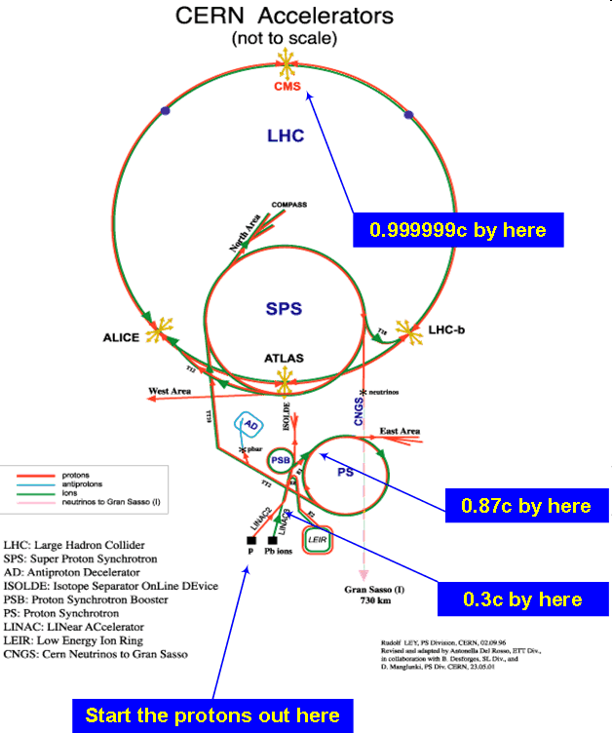
The CERN Accelerator Systems
A hierarchical system of accelerators
Linac 2 → PS Booster → PS → SPS → LHC
50 MeV 1.4 GeV 25GeV 450GeV 6.5 (7) TeV
One or two injections into LHC per day
450 GeV injected protons accelerate to 6.5 TeV in 20 minutes
7 TeV after 2022
CERN Accelerator chronology
Linac 1 and PS started 1959
PS Booster started in 1972
SPS started in 1976
Linac 2 started in 1978
LEP started in 1989 reached 104+104 GeV
Notes:
Step from 6.5 to 7 is tedious and involve many quenches, 8.3 to 9

Slide 7
Detectable Standard Model particles
The Standard Model, explains most of the particle physics we have observed (but not all).
The most basic constituents are:
Leptons, quarks and bosons
These can be created in collisions in high energy physics experiments at accelerators, but short lived particles decay before they reach the active parts of the detector. They can only be deduced from their decay products.
We can detect electrons, (positive) muons and their anti-particles (positrons and negative muons)
The only boson we can detect directly is the photon.
We can detect composite particles (charged and uncharged) formed by quarks, called hadrons but have problems identifying them.
The hadrons can be mesons and baryons such as protons and neutrons

Slide 8
Jets
In the standard model there are 6 types of quarks and 6 types of antiquarks.
Free quarks are never seen. You only see combinations of them, hadrons.
They can combine into baryons (3 quarks) or mesons (a quark-antiquark pair).
One way to illustrate the quark behavior is to see them as string ends.
A mesons will then be modelled as: and a baryon (e.g. a proton) as: or
If you stretch a meson, i.e. trying to move the quark and antiquark away from each other, the string breaks.
Forming two strings with two new string ends, a new quark-antiquark par, and thus two mesons
*

Slide 9
Jets
If the quarks in a meson separate with a high kinetic energy there will be multiple string ruptures a jet of hadrons is produced
Whenever a quark tries to escape a jet is formed
Jet
1 meson
2 mesons
4 mesons
Jet fragmentation

Slide 10
Short lived particles
You have to infer the existence of short lived (< 10⁻¹⁰ sec) particles by recording the disintegration products
But this opens for mistakes:
If A → B, C and you record B and C it is not certain they came from the same A. They might have come from different processes
Need to know the direction with high precision, to be able to identify if it is a secondary vertex
Secondary vertex
Primary vertex
Primary vertex
False event

Slide 11
Missing Transverse Momenta (Energy)
The Center Of Momenta of all particles created in an explosion stay at the collision center course
The vector sum of all momenta in the COM system is 0
Same thing can be seen in the transverse projection
If one particle is not detected there will be a missing transverse momenta
3D
Missing transverse momenta can be due to:
Particles that cannot be detected (e.g. neutrinos)
The detector contains holes (failing detector elements) that allow particles to escape, i.e. it is not what we call hermetic
Transverse projection

Slide 12
Detector and Subdetectors
LHC detectors are often onion-like with multiple subdetector.
Long-lived particles, such as e-, e+, γ, hadrons (p, n..., jets), μ+, μ-, ν, enter the detector from the beam pipe..
Short-lived particles decay before leaving the beam-pipe
The inner detector (tracker) with Pixel, SCT and TRT find charged particle tracks
The solenoid magnet bend the tracks so that charge and momentum can be determined
The electromagnetic calorimeter is used to measure e/m tracks and energy
The hadron calorimeter to measure hadron and jet tracks and energy
The muon detector to detect muon tracks and momentum
Notes:
Toroid around the muon detector

Slide 13
Identifying the collision event
An electron (e⁻) leaves a track in the inner detector with negative (here counter clockwise) curvature and showers and is absorbed in the electromagnetic calorimeter
ν
p⁺
An high energy positron (e⁺) leaves a positive smaller curvature
μ⁺
n
A photon (γ) leaves no track in the inner detector
A positive muon (μ⁺) leaves a positive curvature track in the inner detector, a weak track in the hadron calorimeter and a signal in the muon spectrometer
γ
e⁺
e⁻
A proton (p) leaves a positive curvature track in the inner detector, a track in the e/m calorimeter and a track in the hadron calorimeter
Dashed lines
are not recorded
by the detector
A neutron (n) leaves no track in the inner detector o the e/m calorimeter and but a track in the hadron calorimeter
A neutrino (ν) does not leave any tracks at all

Slide 14
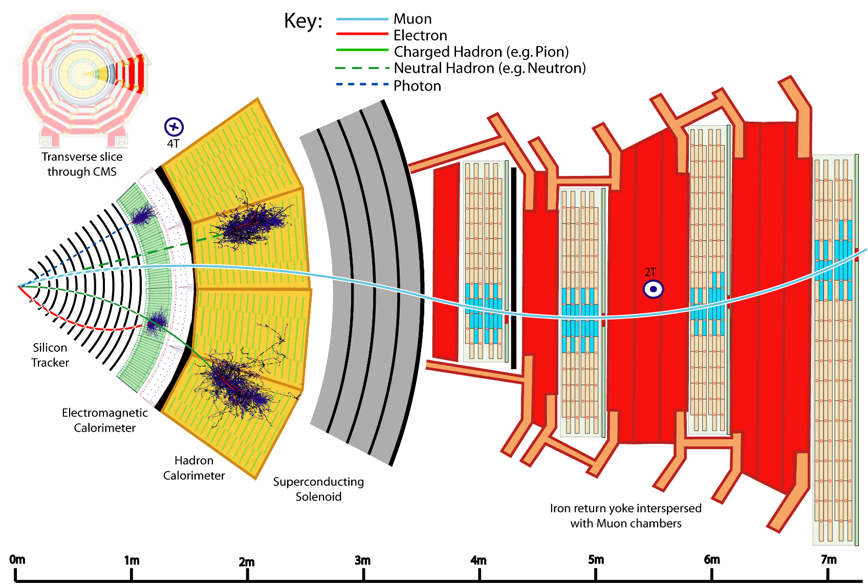
Identifying the collision event
Group particles from the same interaction point – could be outside beam pipe
Deduce source particle:
e⁺+e⁻ ->Z
μ⁺+μ⁻ ->Z
2Z-> H

Slide 15


Collisions
New physics can be explored by colliding high energy particles
The new particles can then be produced in these collisions if the energy is sufficiently high.
If we collide single protons the probability (cross section) for producing new particles is extremely small.
You need many collisions – for this you need high luminosity and many repetitions
To release a large amount of energy the collision must be head on.
The protons contain three quarks, so not only must the protons collide head-on but also their constituents.
After many repetitions, we look for unusual interesting events.
One such event is not sufficient, we want many such events to believe the results.
Thus,
We must collide a large number of protons each time – use high luminosity proton beams
We must repeat collisions many times – use high collision rates

Slide 16
Why we need to record many events
Normal distribution
Almost the same
as Poisson if N>50
To determine if N observed events include new unknown types of events we must determine if the data could be explained by combinations of already well-understood events. The probability for such background events (B) is known to be Poisson distributed with the standard deviation σ(B)=sqrt(B).
For N to contain a potential discovery, N must be significantly larger than B
For example if N is 80 and B is 64 then σ(B) is 8
N is 2σ above i.e. 2% probability that N is just random noise
If we measure 4 times as long N´ will be at 320 and B´ 256 making σ(B´) 16, i.e. the difference is about 4σ(Β×) corresponding to 0.004% that the measurement is just random noise. This is a much smaller probability but it is not enough to claim a discovery.
To claim a discovery 5σ (0.00002% it is random noise) is often required.
68.3
95.5
99.7
μ−σ
μ
μ+σ

Slide 17
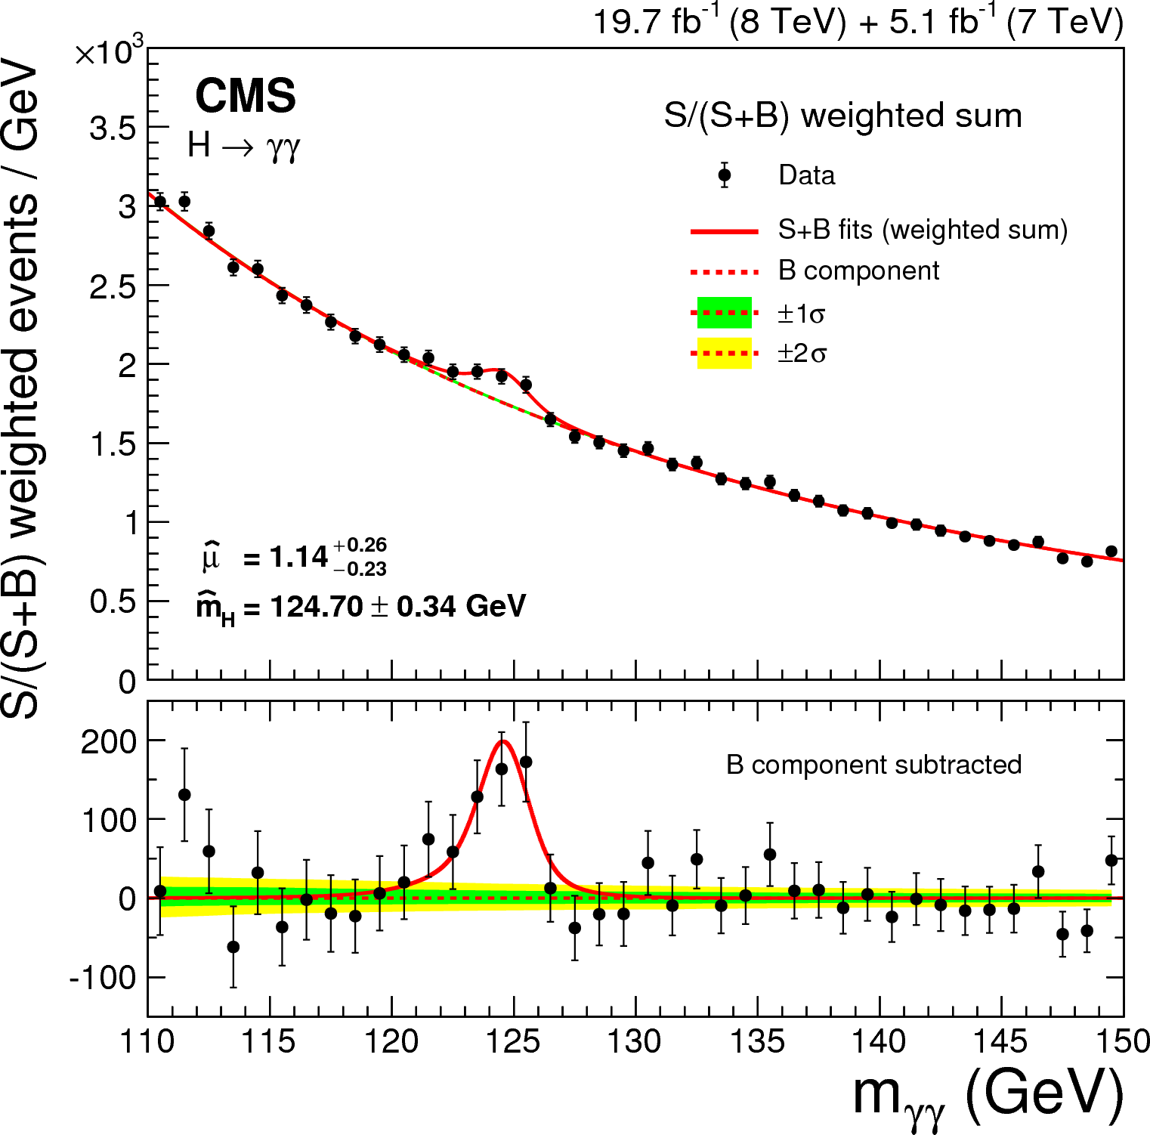
Why we need to record many events
The significance of N will grow after more measurements if it is a real effect, but the significance could also decrease or even disappear if it is not.
There are many 3σ effects that have disappeared, but a 5σ must have been a 3σ at some point (750GeV diphoton excess)

Slide 18
Beyond the Standard Model
We have a theory, the Standard Model, to explain much of the particle physics we have observed, but not all.
The task is to explore Beyond Standard Model (BSM) physics
One way is to find new observational results that cannot be explained by the Standard Model
Better precision (higher luminosity and longer measuring time) increases the probability for finding deviations
Another way is to propose theories that agrees with existing experimental results but also predicts new results that can be tested with experiments
Some potential BSM theories predict super symmetric partners to all normal particles – none of which have been seen so far
To progress we need to know where the Standard Model fails
We need more data and/or higher energies

Slide 19
Desirable detector properties
High precision inner detector position information to identify secondary vertices, but amplitude information is not needed here – many layers and many channels
Inner detector should be a light construction that does not compromise calorimeter resolution
Good energy information and position information in calorimeters and muon detector to determine missing momentum accurately
All detectable particles should be detected – hermeticity
Detector signals are often long, many bunch crossings, but must be associated with correct bunch crossing, if not, causing false missing momentum – pile-up is also a problem at high count rates
E/M calorimeter should be deep enough to contain electrons and γ
Hadron calorimeter should be deep enough to contain hadrons
Higher energies → larger calorimeter structures
Radiation exposure determine choice of detectors and electronics
Design compromises necessary for economical reasons
Pile-up

Slide 20
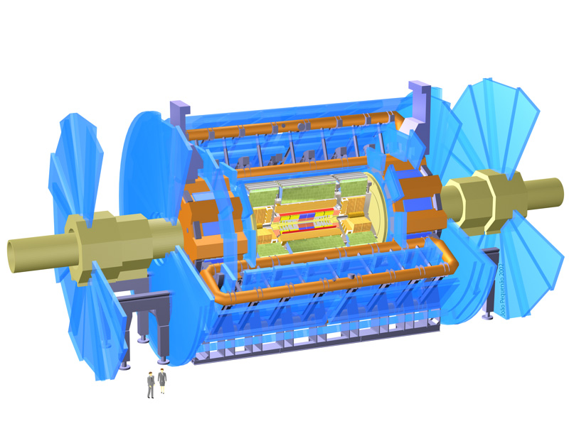
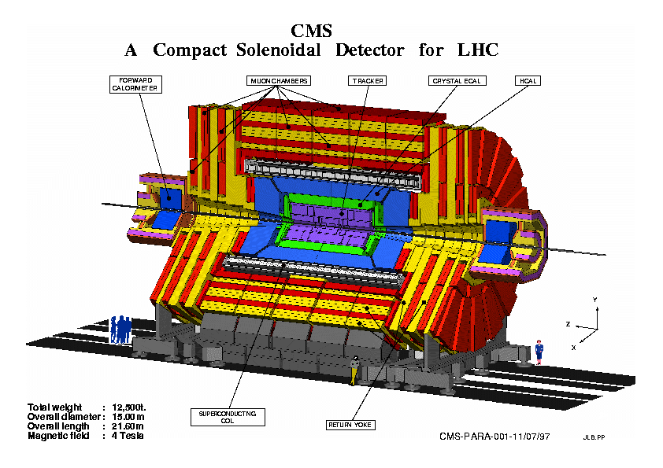
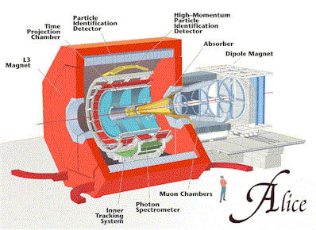
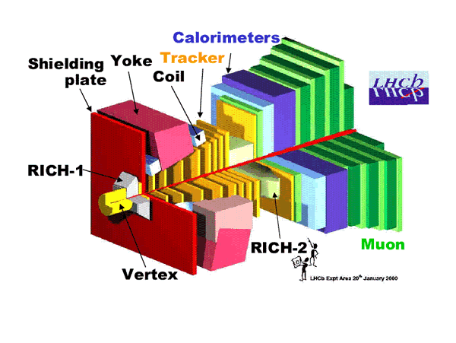
LHC Detectors
ATLAS
ATLAS -CMS
Similar but different – magnet system,
detector solutions, TDAQ system
Competition – Collaboration
Different sizes:
ATLAS 46x25 m
CMS 21x15 m
Alice 26x16 m
LHCB 21x10x13 m
Heavy ion experiments about 2 weeks/year
Heavy ion experiments,
Pb – Pb or Au – Au
B physics at lower luminosities

Slide 21
LHC results and cost
RESULTS so far
Verified the Standard Model
Higgs particle discovered 2012 July 4th (Nobel prize 2013)
No strong indications for BSM physics (Beyond Standard Model) yet
No SUSY (SuperSymmetry) yet
COSTS
LHC material costs ~3.1 G€
ATLAS material costs ~.3 G€

Slide 22
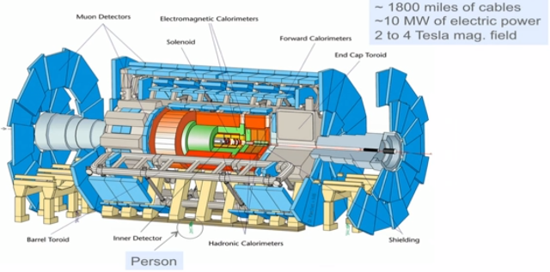
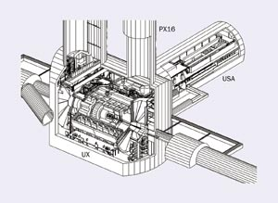
A ToroidaL ApparatuS - ATLAS
46 meters
25 meters
USA = Underground Storage Area 100m below surface
Access shafts 12 – 22 m diam.
Inner detector 1 bit? - ~86 Mch
E/M calorimeter 16 bit - ~300 kch
Hadron calorimeter 16 bit ~10kch
Muon detector x bit ~100 kch
Weight 7000 tons
3000 physicists + x engineers
181 institutes from
38 countries

Slide 23
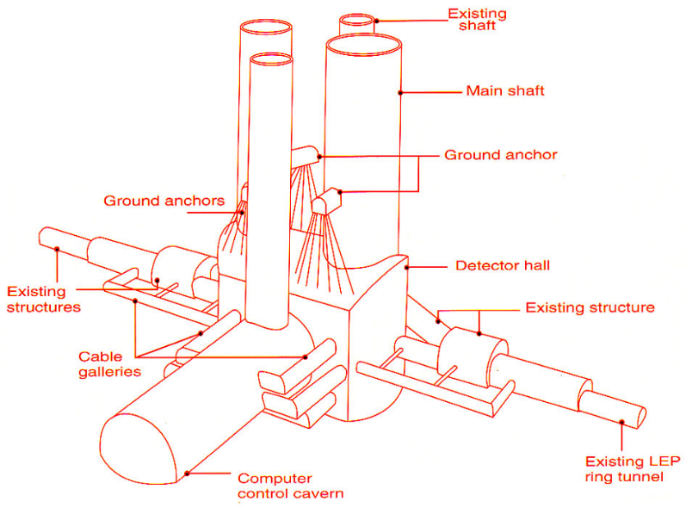
A ToroidaL ApparatuS - ATLAS
A ToroidaL ApparatuS - ATLAS
46 meters
25 meters
Inner detector 1 bit? - ~86 Mch
E/M calorimeter 16 bit - ~300 kch
Hadron calorimeter 16 bit ~10kch
Muon detector x bit ~100 kch
Dipole magnet 2T 2.4m diam
Toriod magnets
Barrel 4T 20.1 m diam
Endcap 4T 10.7 m diam
Weight 7000 tons
3000 physicists + x engineers
174 institutes from
38 countries
USA = Underground Storage Area 100m below surface
Access shafts 12 – 22 m diam.

Slide 24
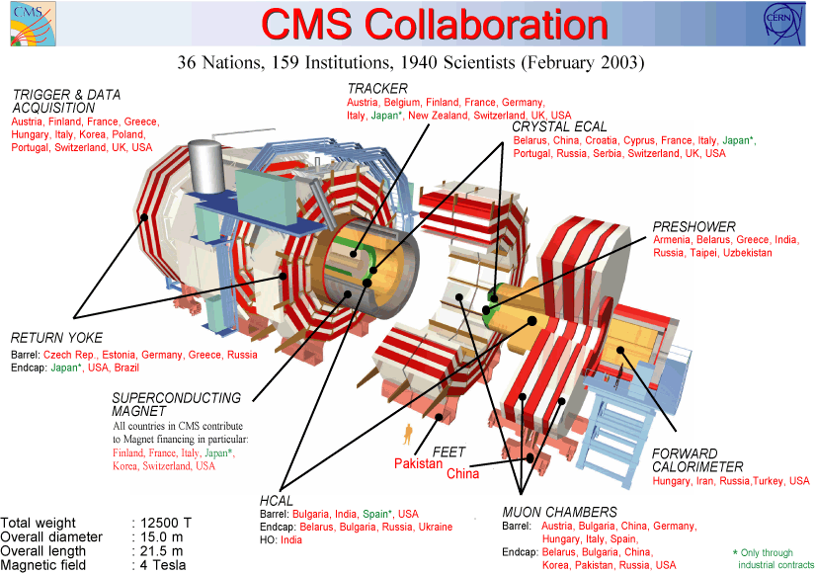
CMS – Compact Muon Solenoid
14 m diam

Slide 25
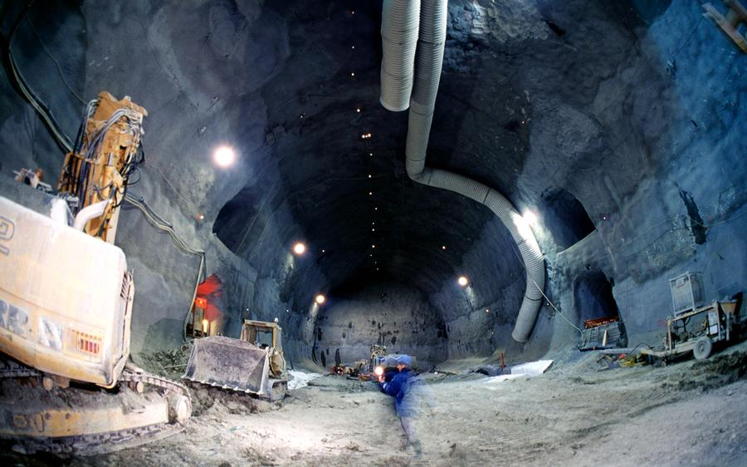
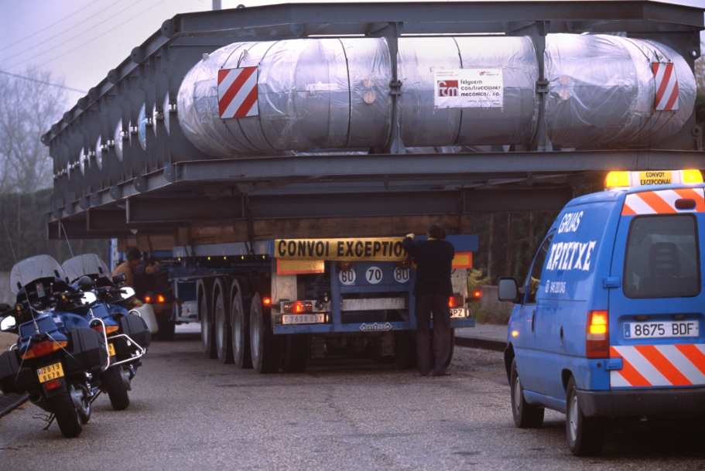
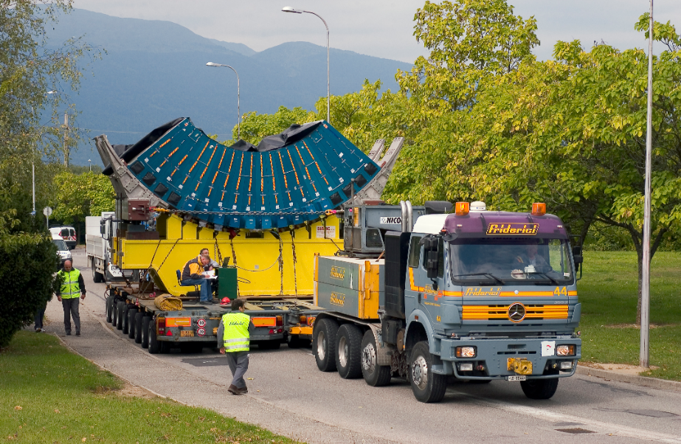
ATLAS installation

Slide 26
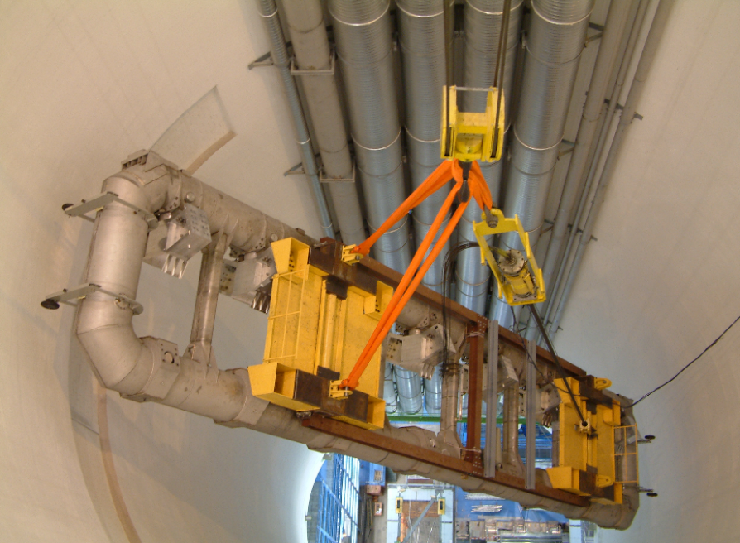
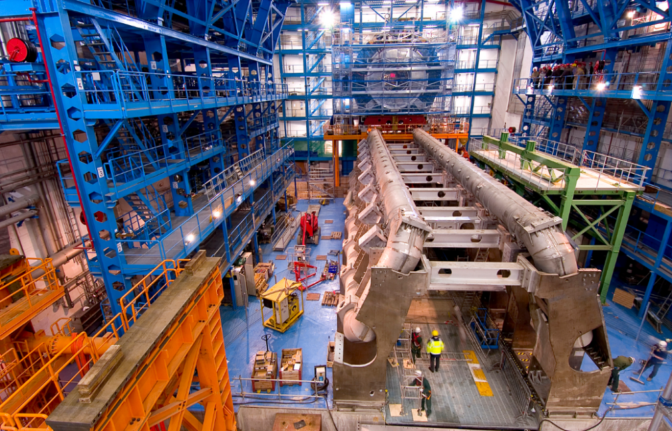
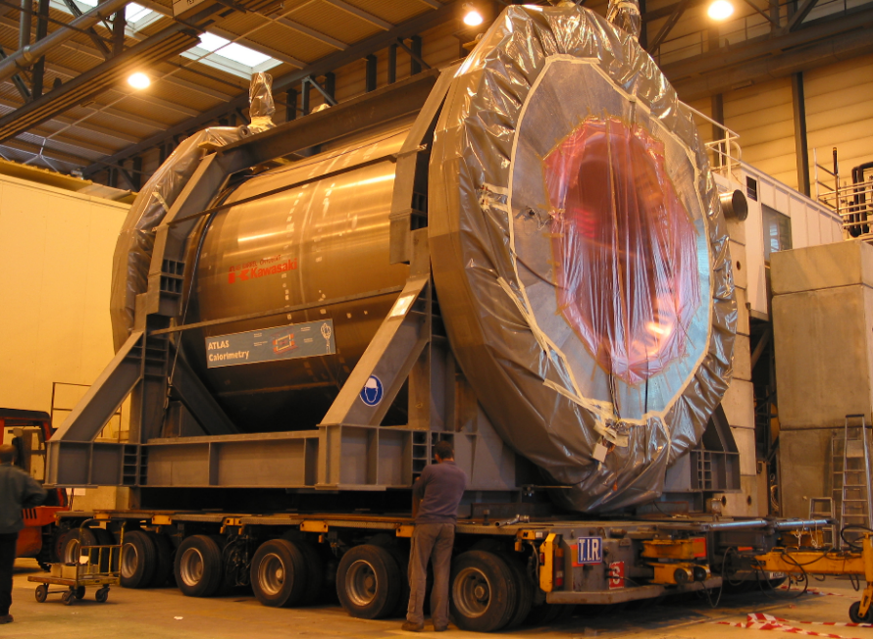
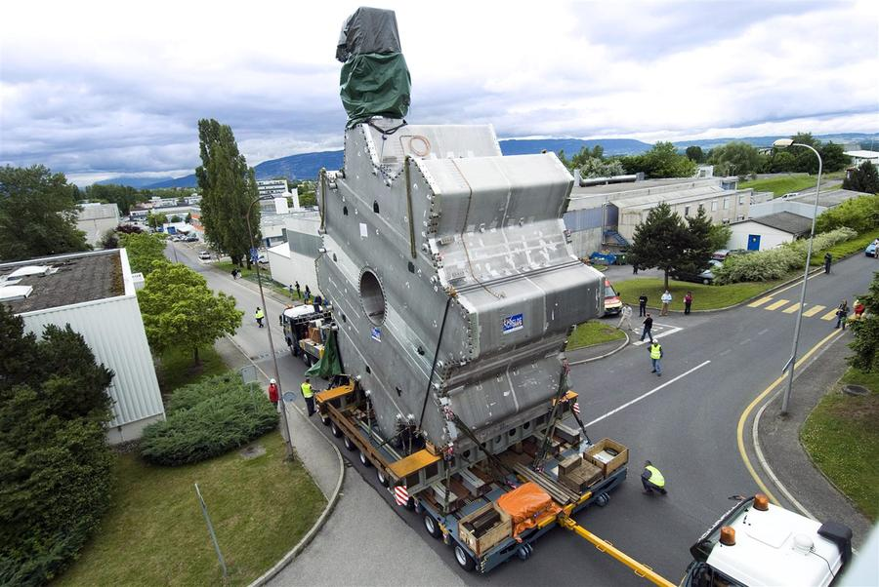
ATLAS installation

Slide 27

Radiation Detectors
All the subdetectors use radiation detectors or radiation detection principles to produce data signals.
In radiation detectors particles are converted into electrical signals, sometimes via light
A large class of radiation detectors are based on scintillation where the ionizing radiation excites the inorganic or organic scintillator material. When the scintillator de-excites it emits light of characteristic wavelengths
The light can be collected by photo multipliers (PMTs), APDs (avalange photo diodes) or SiPMs (arrays of small GM detectors).
In another class of radiation detectors the radiation ionizes the media and an electric field separates the electrons and the ions. The media can be gaseous or liquid. Different media and different voltage gives different performance.
In semiconductor detectors the radiation creates electron-hole pairs that are separated by the field over a p-n junction
PMT
SiPM

Slide 28
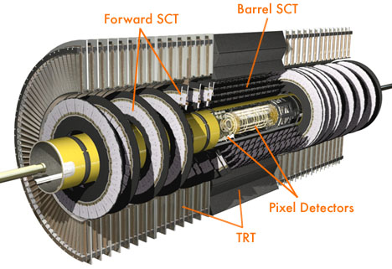
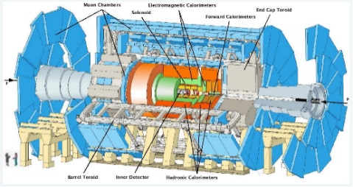
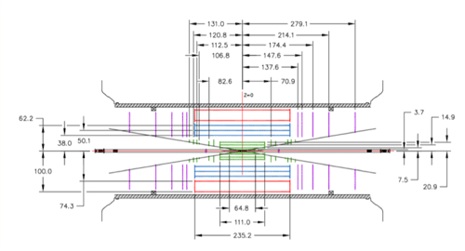
ATLAS inner detector
Magnetic field 2T
3 different detector types
Pixel detector 80 Mch
Silicon pad detector 2D resolution 12 μx110μ
Semiconducor Tracker (SCT) 6 Mch
Silicon strip detector (1D)
Double layers Resolution 23 μ x800μ
Transition Radiation Tracker (TRT) 300kch
Gas detector – straw tubes
Electron identification

Slide 29
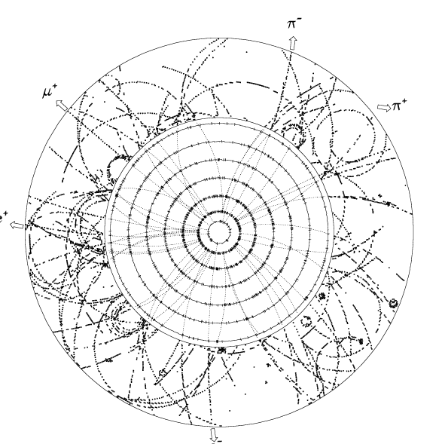
ATLAS inner detector
Magnetic field 2T
3 different detector types
Pixel detector 80 Mch
Silicon pad detector 2D resolution 12 μx110μ
Semiconducor Tracker (SCT) 6 Mch
Silicon strip detector (1D)
Double layers Resolution 23 μ x800μ
Transition Radiation Tracker (TRT) 300kch
Gas detector – straw tubes
Electron identification
Pixel detector 3 sample points
Strip detector 4 sample points
TRT 36 sample points
About 1000 particles

Slide 30
ATLAS inner detector
Magnetic field 2T
3 different detector types
Pixel detector 80 Mch
Silicon pad detector 2D resolution 12 μx110μ
Semiconducor Tracker (SCT) 6 Mch
Silicon strip detector (1D)
Double layers Resolution 23 μ x800μ
Transition Radiation Tracker (TRT) 300kch
Gas detector – straw tubes
Electron identification
Pixel detector
TRT
SemiConductor Tracker

Slide 31
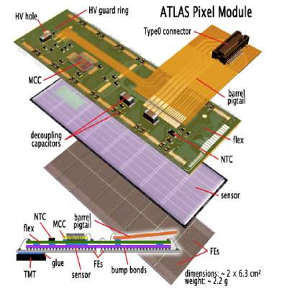
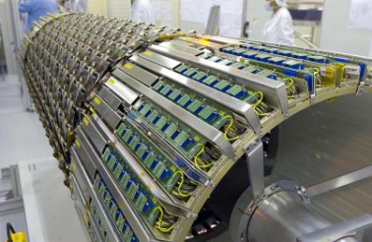
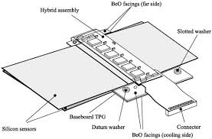
ATLAS inner detector
Radiation tolerance, power and cooling problematic

Slide 32
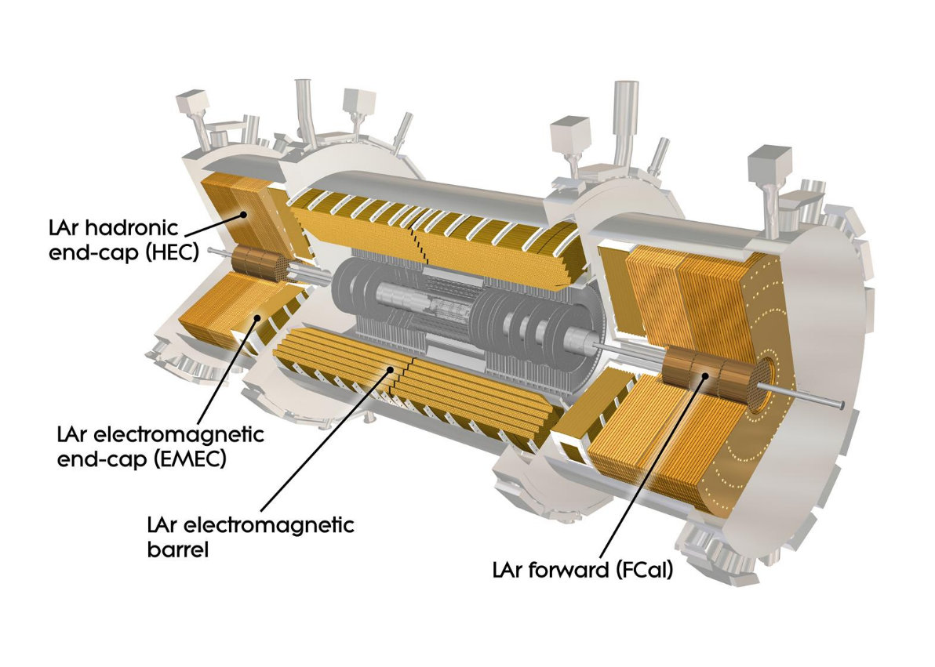
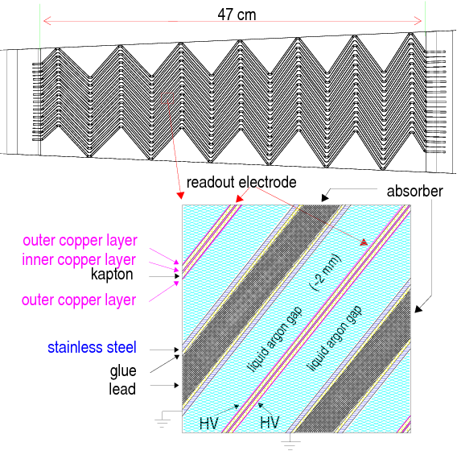
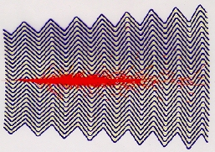
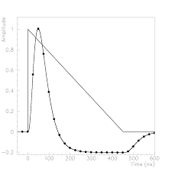
Liquid Argon e-m calorimeter
Liquid Argon-Lead/stainless steel calorimeter (87ºK)
16-bit dynamic range
Cooled preamplifiers
4 layers + presampler

Slide 33
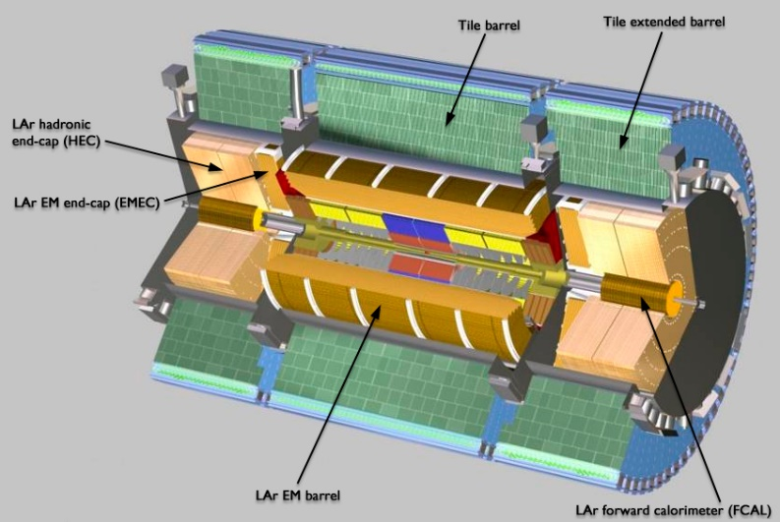
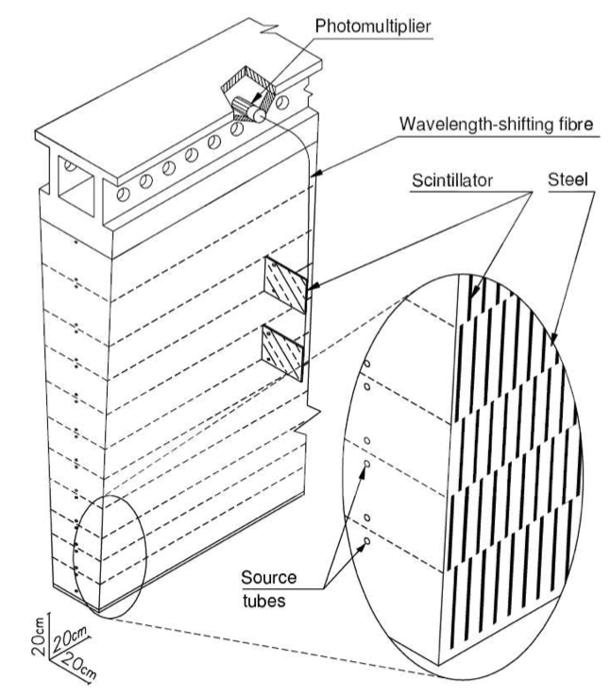
TileCal hadron calorimeter
Interleaved wedge shaped modules with steel and scintillator tiles
256 modules, each weighing 10 tons
4 depth layers
Coarse spatial but good amplitude resolution
Wave Length Shifting fiber – good light transfer
Clear fiber – bad light transfer

Slide 34
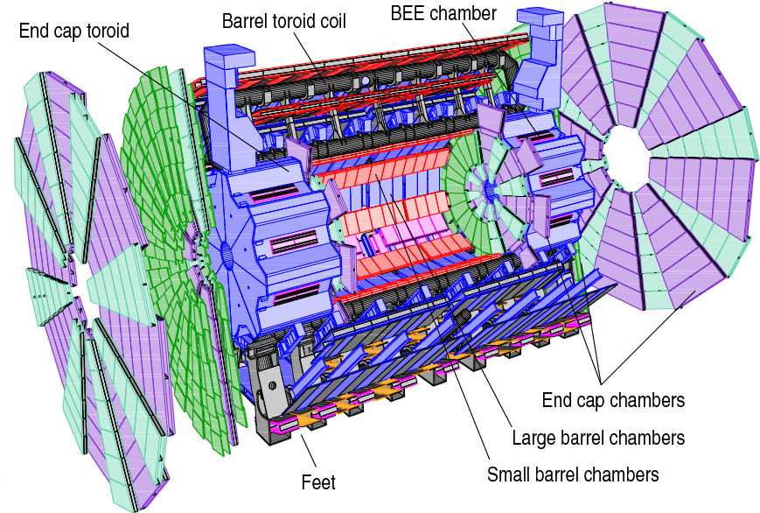
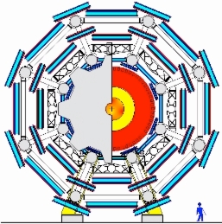
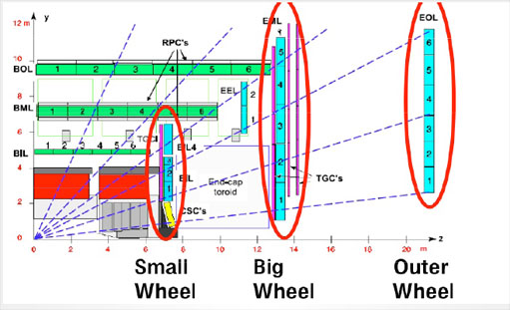
The Muon Spectrometer
Geometrical alignment precision 30 μm
Alignment can change due to temperature change or deformations when the magnet field is changed
Cost → Use gas detectors, different types for precision and trigger and different types for normal and high intensity regions, close to beam pipe
MDT(Monitored Drift Tubes) and CSC (Cathode Strip Chambers) for high precision. CSC for high intensity forward regions
RPC (Resistive Plate Chambers) and TGC (Thin Gap Chambers) for trigger. TGC for high intensity regions.
34

Slide 35
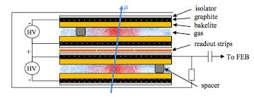
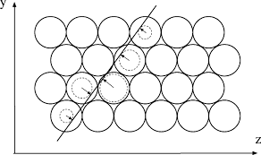
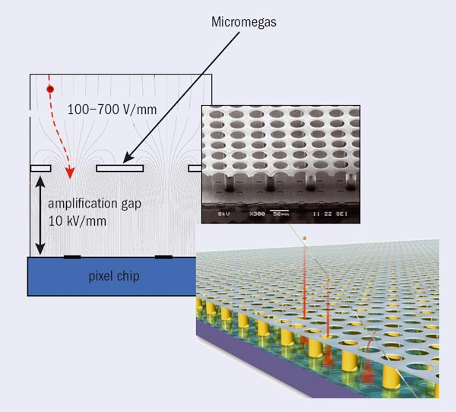
The Muon Spectrometer
RPC – Resistive Plate Chamber
MDT – Monitored Drift Tubes
Micromegas for muon detector upgrade

Slide 36
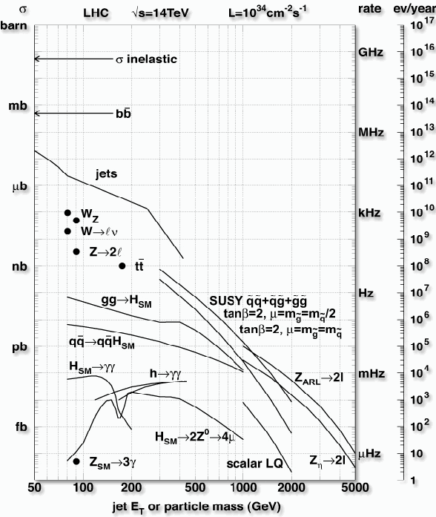
Trigger and Data Acquistion (TDAQ)
20 event per BC at nominal
Luminosity
But SUSY not discovered yet

Slide 37
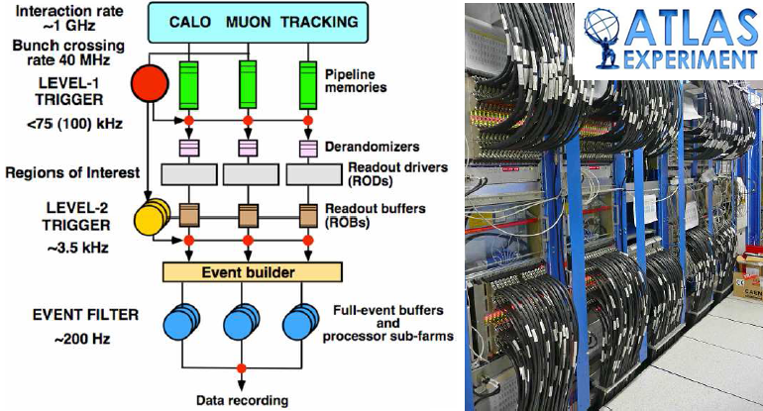
Trigger and Data Acquistion (TDAQ)
Reading out all data, every bunch crossing, was completely impossible 2008 – due to data transfer limitations
Solution -> use multilevel trigger – but introduce data storage limitations due to radiation tolerance problems
CMS

Slide 38
Trigger and Data Acquistion (TDAQ)
First level trigger – pipe-lined processing (in FPGAs) of merged calorimeter and muon data with reduced spatial and amplitude information - delivers Regions Of Interest
Second level trigger – PC based software processing full resolution data from all subdetectors but only from RIOs
Third level trigger – Event Builder – PC farm to on-line analyze all data at highest precision
A first selection criteria is to require large transverse energy components to guarantee a head-on collision

Slide 39
First level trigger
Calo TP
CTP
Muon TP
The Calorimeter trigger processor and the Muon trigger processor reports to the Central Trigger Processor (CTP)
CTP looks for characteristic signatures in the data that indicates that the data contains an interesting event e.g.
    4 isolated electrons or
    4 muons or
    2 high energy electrons over a certain threshold and 2 jets
    etc.
The search criteria are defined in the Trigger Menu data base
The current Trigger Menu selection is defined at the start of a run

Slide 40
First level trigger
Calo TP
CTP
Muon TP
All data can be stored on the detector for maximum 2.5 μs – the latency of the first level trigger
Before this, a decision must made on saving or not saving that data
The specified data latency allows for sending the data from the detector to the trigger processor in USA-15 (Underground Storage Area), process it and send the result back to the detector for possible transmission of the entire data set.

Slide 41
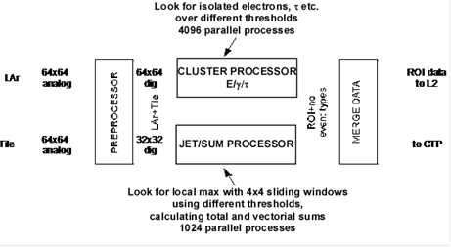
First level trigger
Each bunch crossing, i.e. each 25ns
4096 trigger data values arrive from LAr and Tile
64 cell rows around the calorimeter cylinder and 64 cells in each row along the detector
For each corresponding trigger cell one must study if it contained an interesting event
4096 parallel processes start every 25ns and should be completed within 1 μs
FPGAs widely used together with pipelined processing

Slide 42
Pipelined Processing

Slide 43
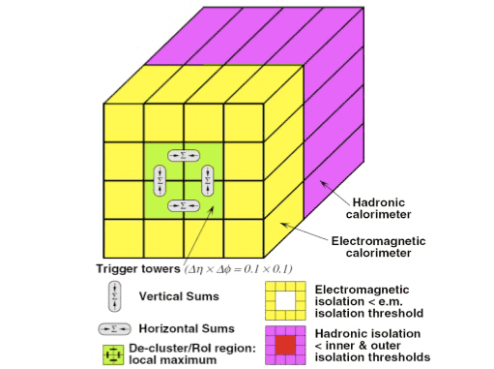
First level trigger
CLUSTER FINDING e/γ ALGORITHM
For each cell anf each set of thresh.
Vert. SUM or Hor. SUM > thresh.
Em isolation SUM< thresh.
Had isolation SUM < thresh.
JET MAX ALGORITHM
43

Slide 44
Synchronization
The Timing, Trigger and Control (TTC) system is responsible for synchronization
The accelerator clock 40.08 MHz distributed to all Front-End units with local phase control
L1A distributed to all FE-boards with programmable delay to maintain sync.
Addressed commands to configure local FE-boards
Maintains Bunch Crossing Identifier BCID to label events

Slide 45
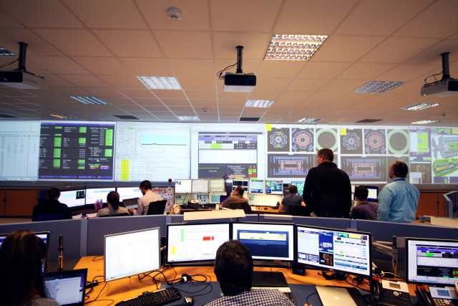
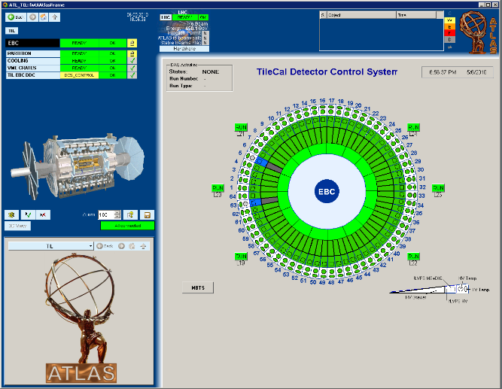
Detector Control - DCS
The Detector Control System or Slow Control, as it was called before, is responsible for initializing and monitoring of all system components including configuring programmable logic (FPGAs).
It will monitor parameters like temperatures, fan operation, pressures, voltages, currents, humilities, error conditions etc..
It is also responsible for safety functions and alarms
It records error conditions and archives monitored parameters
When supervising DCS it is important to have efficient and intuitive GUIs
ATLAS control room
Click
to see
Drawer
Click
to see
fLVPS

Slide 46
ATLAS upgrades
LHC has yearly stops for minor repairs (End of YEar Stops, EYES)
and regular stops for longer maintenance and upgrade, LS 1-
End of operation 2037?
Initial operation - Run 1
Reduced energy 6.5 TeV
Luminosity:

Slide 47
ATLAS upgrades
LHC has yearly stops for minor repairs (End of YEar Stops, EYES)
and regular stops for longer maintenance and upgrade, LS 1-
End of operation 2037?
Upgrade phase 0 (LS 1) – 2008-2010
Prepare for almost full energy 13 TeV
Insertable B-layer (3.3 cm from beam center) – replaced the inner pixel layer

Slide 48
ATLAS upgrades
LHC has yearly stops for minor repairs (End of YEar Stops, EYES)
and regular stops for longer maintenance and upgrade, LS 1-
End of operation 2037?
Upgrade phase 1 (LS 2) – 2019-2022
3 times higher luminosity, need better algorithms and more processing power
Full energy 14 TeV
New Small Wheels
Topological trigger – not only count events but also consider their geometrical relationship
LAr fully digital trigger
New trigger architecture

Slide 49
ATLAS upgrades
LHC has yearly stops for minor repairs (End of YEar Stops, EYES)
and regular stops for longer maintenance and upgrade, LS 1-
End of operation 2037?
Upgrade phase 2 (LS 3) – 2025-27
Prepare for HL-LHC (High Luminosity LHC)
5 times nominal instantaneous luminosity, need still better algorithms
10 times total luminosity – luminosity leveling
New Trigger system – level 0 (L0a: 1MHz, Latency: 6μs) (level1 (L1a:<400kHz,Latency: <30μs))?
New inner detector – no TRT
New TileCal electronics – read out all data to USA-15 – fully digital trigger
New trigger architecture, higher rates, longer latencies
200 non-elastic collisions per bunch crossing

Slide 50
Different electronic design strategies
When designing the first (present) version of the ATLAS electronics then:
Special rad hard (tolerant) electronics was available (close to end of cold war)
High speed data transmission (optical or electrical) expensive→
Send reduced trigger data to external L1 trigger processor.
Keep data on detector until L1 accepted –> reduced data flow
Now:
standard electronics reasonably radiation tolerant – SingleEveventError problems
High speed transmission available →
Remove all data from detector as soon as possible
Then:
FPGAs unsafe
Now:
SEE mitigation techniques exist making on-detector FPGAs feasible

Slide 51
Mistakes
We learn from mistakes but some times we forget what we learned’
Connector problems
Power supply problems
Radiation sensitivity problems
Problems with new untested techniques

Slide 52
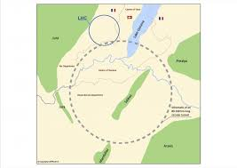
Future
General trends
Higher energies
Higher luminosity
Higher granularity in all detector sub-systems
More complicated events to process early in the triggers
More on-detector FPGAs – new FPGAs more radiation tolerant to hard but not soft
errors – develop correction strategies for soft errors
More high speed data transmission – 40 Gb/s or more
Early digitization – less analog, more digital
After 2037: FCC??
Future Circular Collider
FCC
50+50TeV
>10³⁵ protons/cm²/sec
First e⁺ - e⁻ later p – e and p - p
100 km circumference
Assumes new magnet technologies
16TeV Nb₃Tn magnets
Conceptual Design Report 2019

Slide 53
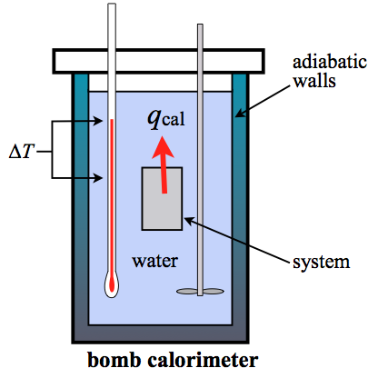
Calorimeters
This is a classical calorimeter used by chemists
Its task is to measure all the heat dissipated by the system under study

Slide 54
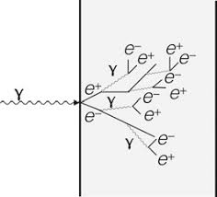
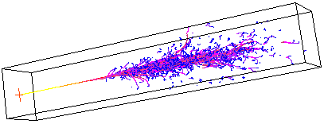
Calorimeters
A particle physics calorimeter is supposed to contain all radiation of a certain type and estimate its energy and preferably also its trajectory
A calorimeter can be composed of a crystal or a combination of absorber and scintillator
If the incoming particle with the energy E is showered into n particles with similar energy, the total energy should be proportional to n and its standard deviation σ_{E} proportional to sqrt(E), i.e.
σ_{E} /E proportional to E^{-1/2}
This assumes that the resolution is only dependent on statistics
A simulated shower

Slide 55

Calorimeters
EM calorimeters and hadron calorimeters are optimized differently
Fluctuations in a hadron calorimeter deviates from E^{-1/2}
A hadronic shower consist of two parts, e and h
The “break-up of nuclei” contribution is lost to the signal
A hadron calorimeter can be characterized by the e/h ratio
a stochastic term b constant term and c noise term
number of shower inhomogenities electronic
Particles non-linearities noise
$$\frac{σ\left(E\right)}{E}=\frac{a}{\sqrt{E}} ⊕b⊕c/E$$

Slide 56
Calorimeters
Two main types of calorimeters
Homogeneous
Crystal or liquid
Sampling
Interleaved absorbers and scintillators
Hight Z values good for EM using U and W have been used
CMS ECAL is homogeneous and CMS HCAL sampling
ATLAS Lar (E/M) and TileCal (Hadron) are both sampling
To understand the calorimeter response require
multiple test beam campaigns
Lar: Ar (liq)+Pb
TileCal: Steel+plastic scintillator

Slide 57
Calibration - problem for TileCal
Scintillators and fibers age due to radiation
PMTs age when exposed to light
Three calibration methods:
Cesium calibration – with circulating sources
Laser calibration – with clear fibers
Charge injection – in FEB
Performed often sometimes in gaps during measurements
Ref:
Richard Wigmans

Slide 58
TDAQ
Trigger and Data Acquisition
TDAQ tasks:
  Read out data from the detectors (Readout)
  Collect complete events (Event Building)
  Keep some typical uninteresting events for further analysis
  Stores event data (Data logging)
  Provides control, configuration and monitoring facilities (Detector Control System, DCS)

Slide 59
Front-End modules
Most detector systems perform the digitization inside the front-end unit
Preamplifiers are needed to amplify weak sensor signals
A signal conditioner will shape the signal to improve signal/noise ratio
A low pass filter will reduce high frequency noise
If a large dynamic range is desired the signal can be duplicated with different amplifications
The ADC will sample the signal at a suitable rate depending on the frequency range of the signal.
Nyquist sampling rate
Detector control is needed to program and calibrate the front end modules

Slide 60
Front-End modules
Constant fraction discriminators are used to make the trigger point amplitude independent
Instead of ADC a TOT, Time Over Threshold circuit can be used with a TDC, Time to Digital Converter to measure the pulse length
There is a non-linear relation between TOT and the amplitude.
This solution is suitable to use in combination with integrated circuits, i.e. ASICs or FPGAs

Slide 61
Front-End modules
A wave form sampler can be used in the front-end were analog samples are stored in a switched capacitor array - capable of multi Gbps sample rates
A stored trigger signal is read out at a reduced the clock rate so that a standard ADC can be used
Also called transient recorder

Slide 62
Trigger
Problem: How to extract meaning full information from ~10⁸ channels and store it without exceeding the storage capacity
How to reduce data without loosing important data
Data Reduction – two different strategies
Traditional DAQ
Self triggered DAQ

Slide 63
On/off-detector Processing
In the original ATLAS electronics high band width communication was expensive ->
Send reduced (amplitude and granularity data) trigger data to off detector LEVEL 1
Trigger processor. The decision is sent back to the detector.
On-detector electronics
Off-detector electronics
On-detector electronics
Off-detector electronics
In the upgraded system digitized data is sent off the detector without delay.
The new strategy is necessary to cope with the needs of the High-luminosity LHC and its 200 collision event at every bunch crossing.

Slide 64
ATLAS Phase-II TDAQ
Present system
Phase II system

Slide 65
Radiation tolerance
The on-detector electronics need to be sufficiently radiation tolerant
Verified by radiation testing
Expose system to different types of radiation – photon, electron, proton…
Different types of errors:
TID – Total Ionizing Dose
The total energy absorbed by matter.
NIEL – Non-Ionizing Energy Loss
elastic and non-elastic nuclear interactions,
displacement damage
SEE – Single Event Effect
Single energetic particles cause bit flips
Simulate to estimate radiation levels
Apply correction factors
Test component samples and system parts to verify functionality at different
Radiation tolerance can vary
From fabrication process to process
From manufacturer to manufacturer
From foundry to foundry
From lot to lot
Mitigation methods
Rad-hard (rad-tolerant) electronics
Redundancy
Partitions to limit error consequences
TMR – tripple mode redundancy

Slide 66
Future Detector R/D projects
EGFA Detector R&D Roadmap
Future Circular Collider Conceptual Design Report
NuPECC Roadmap for Construction of Nuclear Physics - Research Infrastructures in Europe

Slide 67
Thank you for your attention

