Slide 1

Medical Physics
Introduction to nuclear medicine
P. Le Dû
patrickledu@me.com
TIPP School Capetown

Slide 2
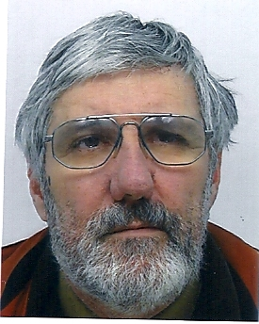
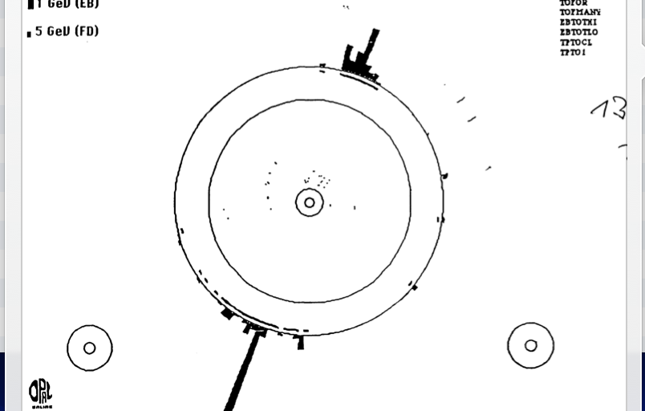
Who I am ? -
NA3 @ CERN (Di-Muon Drell Yan) : 1974-1980
  Large MWPC (4x4 m2)
  Trigger & DAQ
LEP - OPAL @ CERN (1980-1990)
  TOF system
  Trigger & DAQ → First Z⁰
SSC- SDC @ Dallas/LBL Berkeley (1990-1994)
  Trigger L2
  Shower Max Detector electronics (APD & SCA)
LHC- ATLAS @ CERN (1994-2000)
  L2 trigger & LARG calorimeter Read Out electronics (SCA)
D0 @ FNAL (1996-2005)
  L1 Calormeter trigger and L2 trigger.
ILC study group (1996-2008)
  Trigger & DAQ convener → Software triigeer
2000→Technology transfer advisor for medical application (PET & Particle therapy)
Ultra fast (picosecond) timing and TOF
Experimental Physicist
  CEA Saclay (1969-2008)
  IN2P3-IPN Lyon (2009 ..)

Slide 3
Goals of this lecture
A very simple basic introduction of Medical Physics seen from a HEP experimental physicist.
I will present mainly the radiation instrumentation aspect around the nuclear medicine and its perspectives
Might be a bit too naive and simple sometime BUT give a broad overview of the medical nuclear domain
Notes:
This overview interdisciplinary talk has the main purpose to present how HEP developments and evolution of front end deadtimeless low noise electronics, parallel read-out , real time selection of events (trigger), terabit data networking (DAQ) and on-line processing farms can be use to improve drastically the performances and efficiency of medical imaging devices like the Positron Emission Tomograph (PET) of next genration. The first part of the presentation will introduce the generic architectural model of future large colliding experiments like the future Colliders (ILC/CLIC) and its main features like the software trigger concept. An example of possible implementation will be shown using the new Advance Telecom Computing Architecture (ATCA) standard. Then, it will be discussed how these innovative ideas, tools and techniques of modern architectural concept in data acquisition can be applied in two particular applications of the future: the whole body Time Of Flight Positron Emission Tomography (TOF-TEP) for tumour diagnostic and the Hadrontherapy In-Beam PET for cancer treatment.

Slide 4
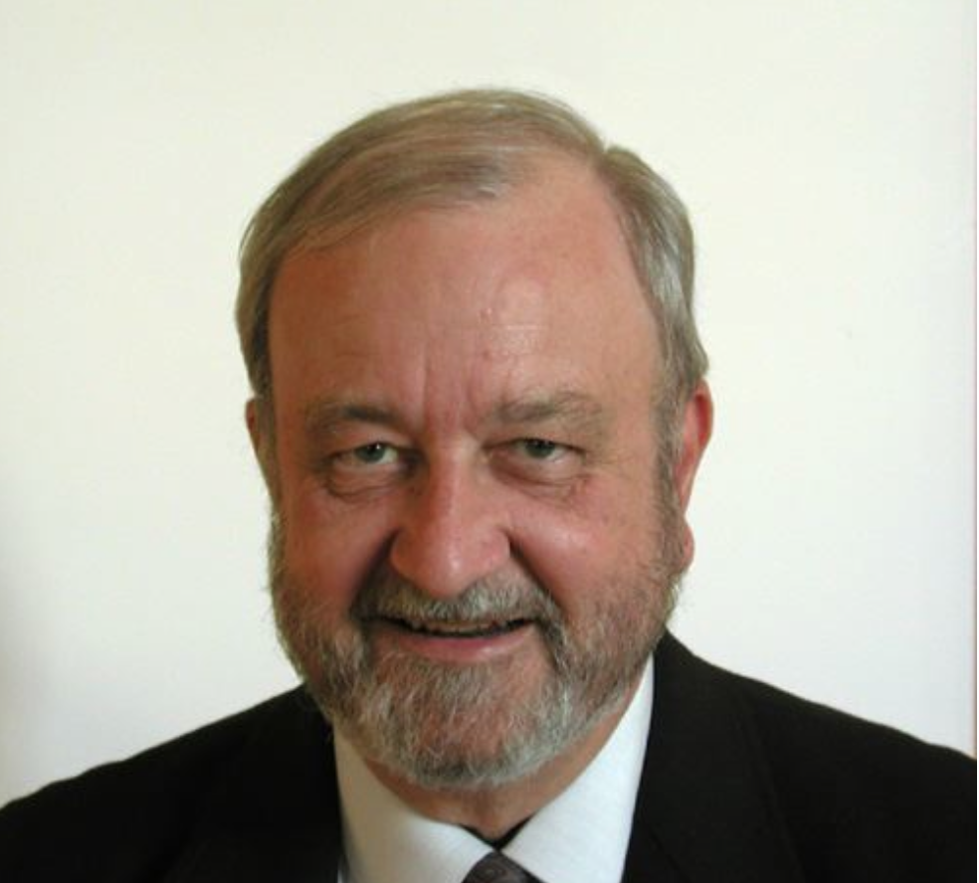
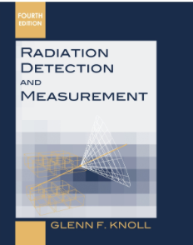
Few words about Radiation Detectors
Radiation
Instrumentation
THE Book
Glenn Knoll

Slide 5
What is medical physics outlines
A little bit of history
Radiation effects units
Basics of Radiology
From Radiotherapy to Particle Therapy
Introduction to Nuclear medicine
Radioactive tracers for diagnosis and treatment
Short survey of Imaging tools and techniques from diagnostic to therapy and their future

Slide 6
Some history
.. how the development of radiation instrumentation has been crucial for fundamental scientific discoveries
and for the improvement of human life...
More in ‘back up slides’

Slide 7
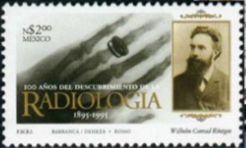
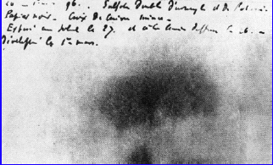
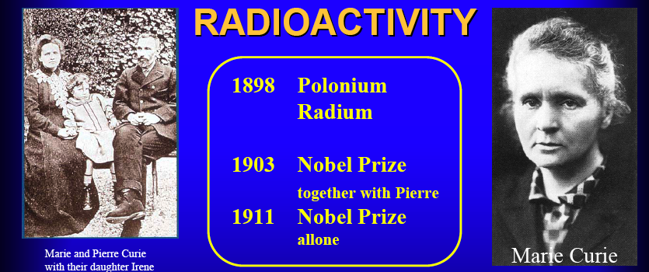
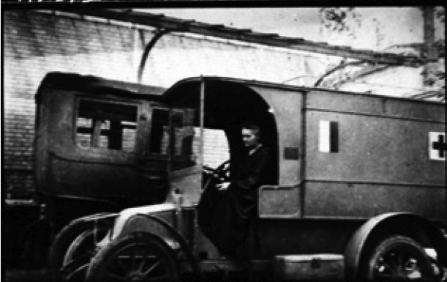
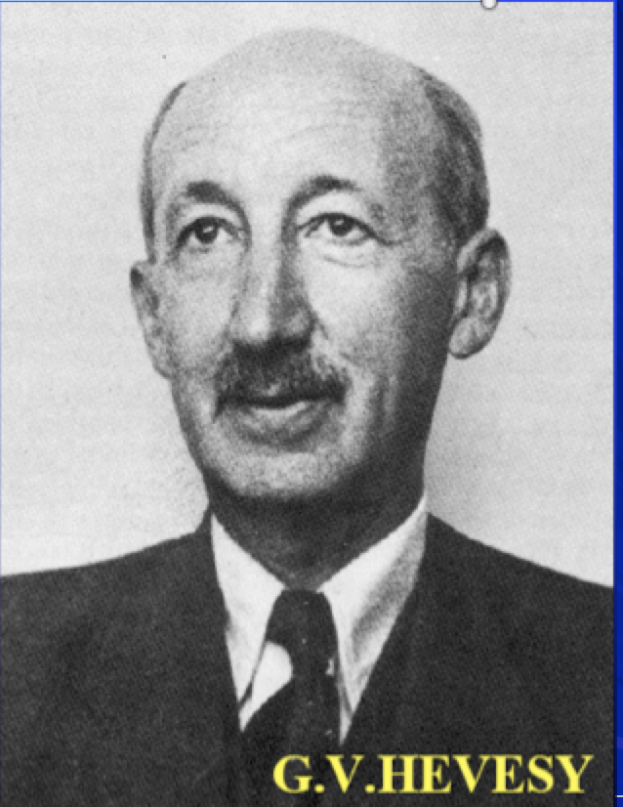
How physics discoveries have impacted our life (1)
1895
W.C. Rontgen
Discovery of X Ray
1896 - Discovery of natural radioactivity by H. Becquerel
1897 – J.J. Thomson – electron
1899 – E. Rutherford : Alpha & Beta
1900 – U. Vilars – the Gamma
First image of
potassium uranyl disulfide
1898
Pierre and Marie Curie
the Radioactivity
Polonium,Radium
1923 - The Tracer principle
`G.V.Hevesy- the father of
nuclear medicine
1910
X Ray
Radiography

Slide 8
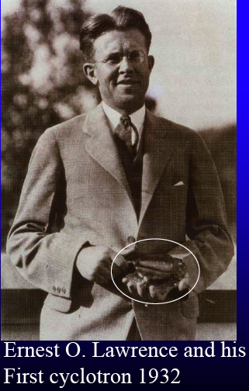
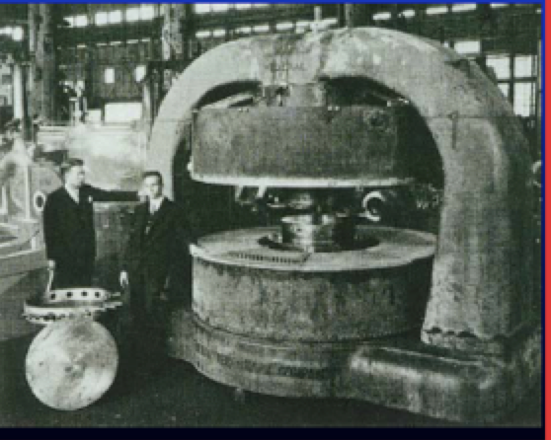
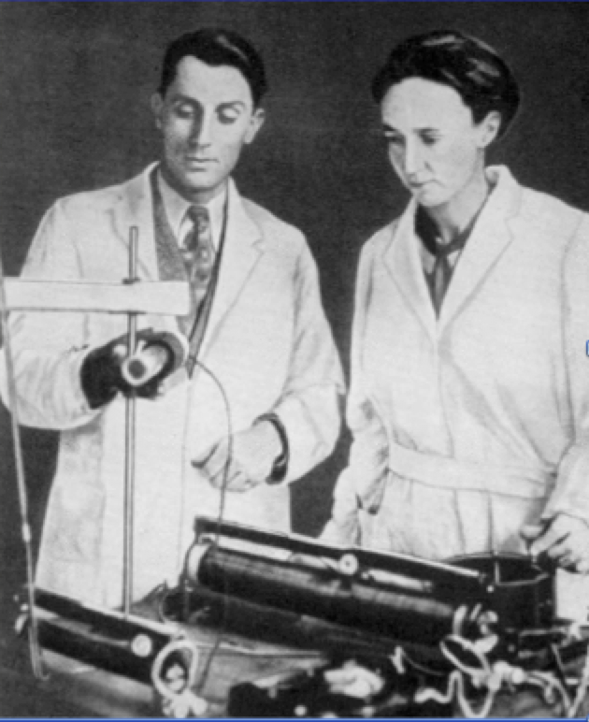
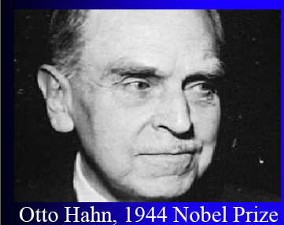
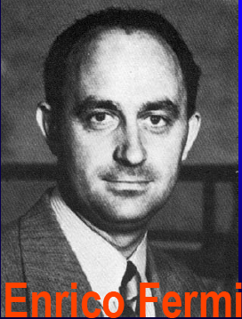
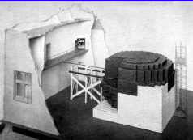
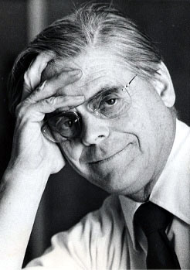
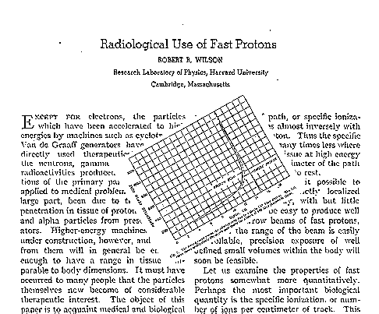
How physics discoveries impact our life (2)
1932 - The Invention of the cyclotron
Production of radioisotopes
1934 - Artificial radioactivity
Irène and Fréderic Jolio Curie
in combination with the cyclotron open the door to the production of useful radio indicators.
1938-1942 Fission of Uranium
From discovery to first
graphite miler in Chicago
To the Production of long lived
radio-isotopes and nuclear energyproduction
O.Hahn
E. Fermi
1946 – R.R.Wilson The origin of particle therapy
Using the Bragg peak discovery (1903)

Slide 9
Effects of radiation
on human body
What is a Curie,Bequerel, Seivert?
From Prof. Aurengo - Hopital de la Salpetriere - Paris

Slide 10
The Units - a bit of definition!
Activity = Number of decays per second
  Becquerel Bq : 1 decay / second
  Curie Ci : 37 x 10⁹ Bq (37 GBq)
Dose : GRAY = amount of radiation absorbed in any material = absorbed energy / mass unit
  Gy : 1 joule / kilogram = 100 Rad
Effective dose : SEIVERT Sv = estimates biological effect from the absorbed radiation
→ indication of global risc
  = absorbed dose x WR* x WT**
    Particle → WR*= 1 pour RX, beta and gamma, p=5, α=20
    Organ → WT** = 0.05 for thyroïd, 0.01 for skin

Slide 11
Effective dose values
10.000 mSv : high irradiation / rapid death
1.000 mSv : moderate irradiation / clinical visible signs (burn… )
5 mSv : annual irradiation in Clermont-Ferrand (volcanic soil)
2,5 mSv : annual irradiation in Paris
1 mSv : legal limit irradiation in France
1 mSv : average annual medical irradiation in France
1 Sv = 1 J/kg equivalent 1 Sv = 100 rem

Slide 12

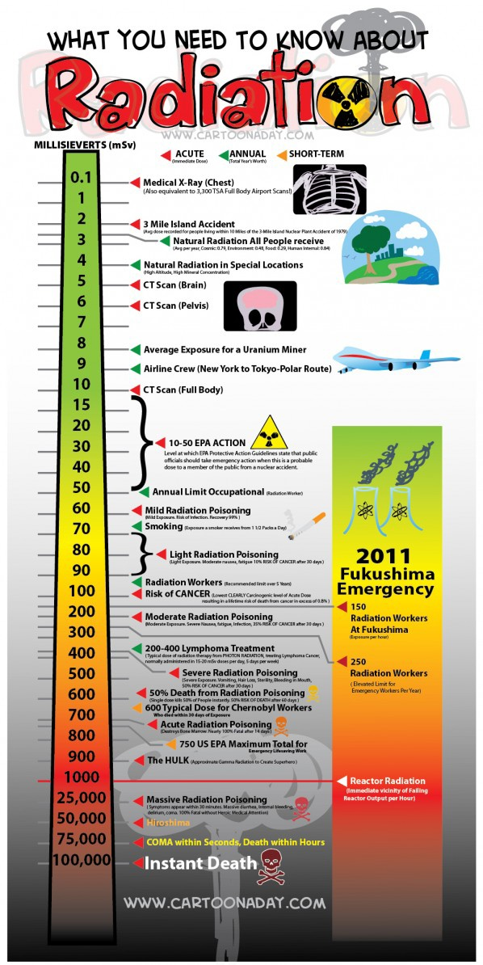
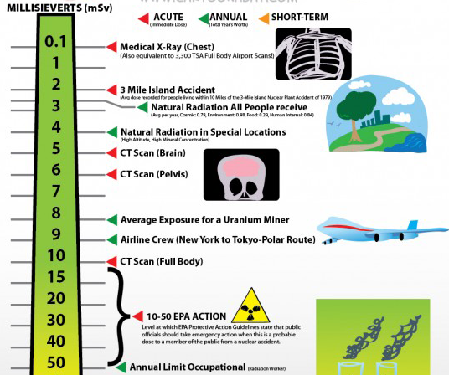
12

Slide 13
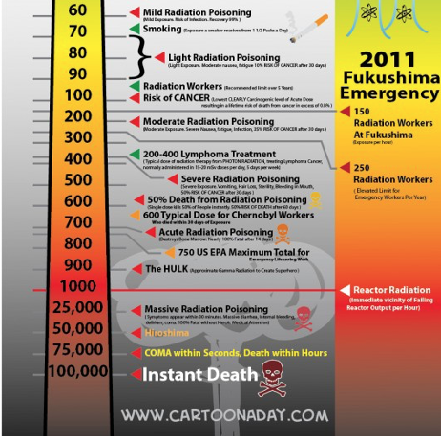

Slide 14
Some simple exemple
a ‘standard’ Scintigraphy exam
W_{R} W_{T} %
RX : 100 mGy / 50 cm² skin 1 0,01 30 %
¹³¹I : 10 mGy / thyroïde 1 0,05 100 %
Effective dose = (100 x 1 x 0,01 x 0,30) + (10 x 1 x 0,05 x 1)
= 0,8 mSv
Mammogram : 2 view x 2 breasts
X ray with Q factor WR = 1
Tissue weighting factor = 0,12
Absorbed dose: 4 x 1 = 4 mSv
Effective dose: 4 x 0.12 ≈ 0.5 mSv
Mammogram exposure equivalent to whole-body dose of 0.5 mSv

Slide 15
Variation of natural radioactivity
Cosmic rays
  sea level 0,25 mSv / year
  Mexico (2240 m) 0,80 mSv / year
  La Paz (3900 m) 2,00 mSv / year
External exposure due to earth exposure
  average 0,9 mSv / year
  Espirito Santo (Bresil) 35 mSv / year
  Maximum (Iran) 100 mSv / year
  Marseille (France) 0,20 mSv / year
  Limousin (France) 1,20 mSv / year
Internal exposure due to water
  Evian water 0,03 mSv / year
  St Alban water 1,25 mSv / year

Slide 16
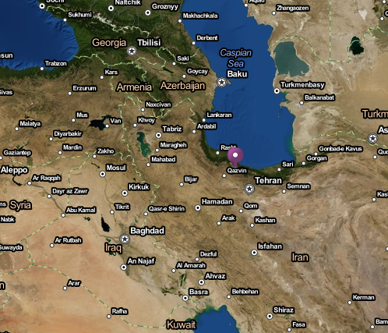
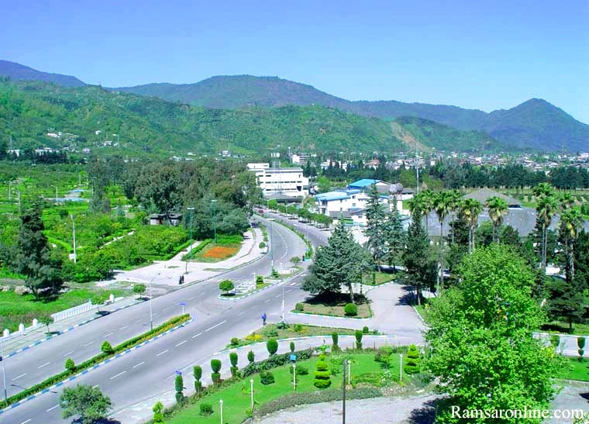
Most radioactive place in the world: Ramsar, Iran
Background radiation: 100- mSv / year due to ²²⁶Radium
No epidemiological evidence of adverse affects
Residents demonstrate a marked increase in DNA repair capacity
Proposal: to relocate the inhabitants (2000) to a lower radioactive area!
16

Slide 17
Main sources of ionizing radiation
Nuclear & industry
1 %
Earth has been radioactive ever since its formation into a solid mass over 4½ billion years ago. However, we have only known about radiation and radioactivity for just over one hundred years...
Water Food
6 %
soils
11 %
radon
34%%
Medical
exposure
41 %
Cosmic rays
7 %

Slide 18
Conclusion & question ?
Sv= Unit well adapted to radioprotection
However : why this official’ limit of 1 mSV/ year is so low ?
  No sanitary argument : industrial irradiation :10 -15 µSv
  Interpretation of the ‘low’ absolute value might be controversial!
Do not take into account debit and age ..an personal sensitivity, instant vs integrates
The total radiation accumulates along the full life
  At 70’s I have received certainly 200—300 mSr ?

Slide 19
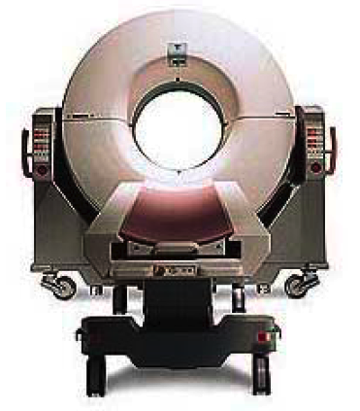
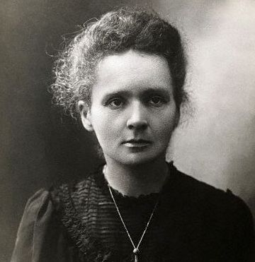
2010
1910
Radiology
Common tools & techniques

Slide 20
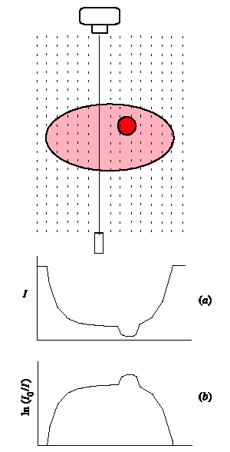
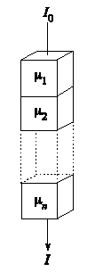


Radiology principle
The most common exam
Transmission of X rays through tissue

Slide 21
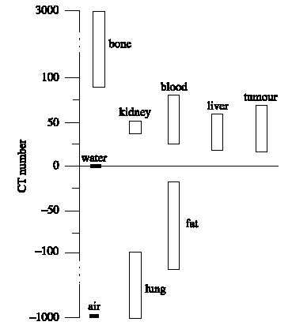
Radiology problem = contrast
black
How to get the best contrast?
white

Slide 22
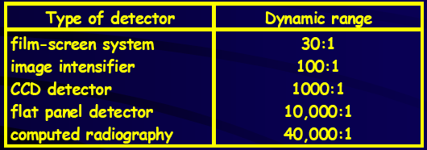
Detection techniques
The standard : film scren system
How to replace the film
  More sensitive --> better contrast
  Less dose
  Affordable ?

Slide 23
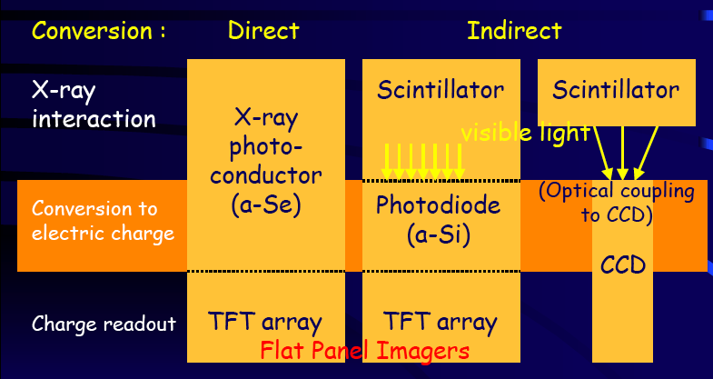
Radiology survey of electronically readable detectors

Slide 24
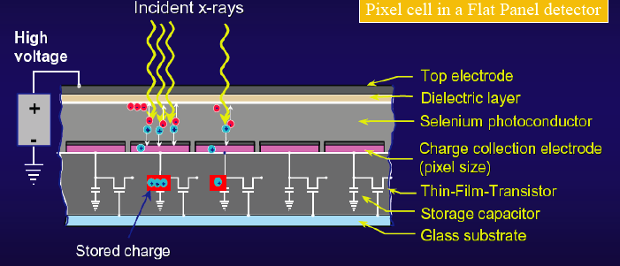
Radiology: Flat panel direct detection
Xray ---> electron --> electric signal
Selenium

Slide 25
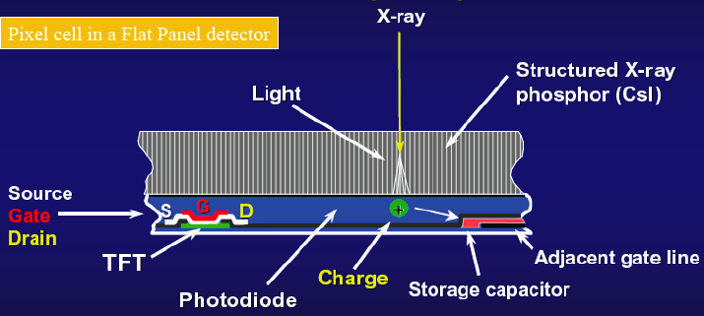
Radiology :Flat panel indirect detection
Xray -->Light--> electron ---> electronic signal

Slide 26
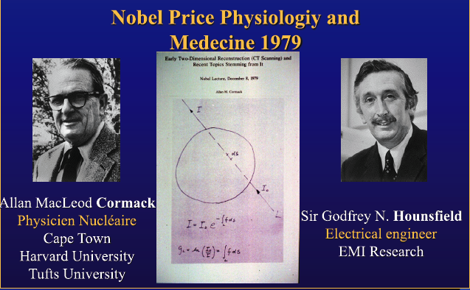
State of the art :Computed Tomography (CT)

Slide 27
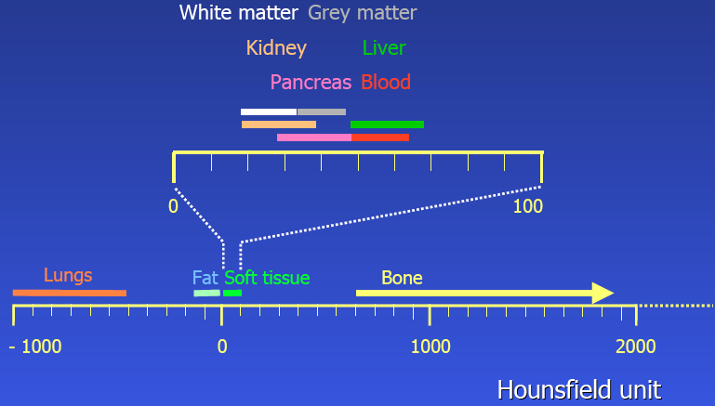
Contrast (Houndsfield) units

Slide 28
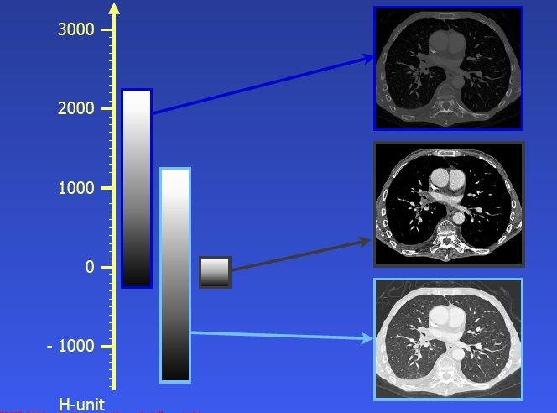
From Hounfield units to image

Slide 29
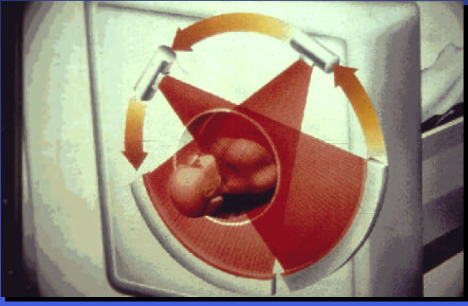
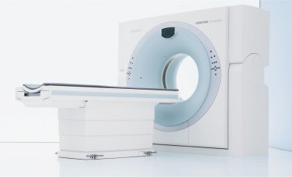
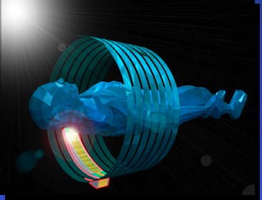
CT Scaner principle
Spatial resolution and speed
  64 … 320 detector rows
  Slice thickness 0.33 … 0.6 mm
  Tube rotation time 0.3 s
    Organ in a sec
    Whole body < 10 sec
  dual source (180° → 90°)
  Volume coverage with one rotation: 4 … 16 cm

Slide 30
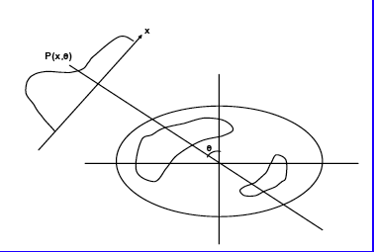
Computed Tomography
Basic method of Image reconstruction
Take 1D profiles or 2D projection at discrete angle around the object
Assume that each measured point = sum of actvity elements along the Line of Response (LOR)
Raw data can be displayed as a ‘sinogram’

Slide 31
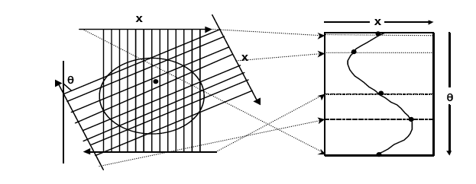
Computed Tomography
Basic method of Image reconstruction
Projection
Sinogram
Raw data can be displayed as a ‘sinogram’
Then a lot of corrections …..

Slide 32
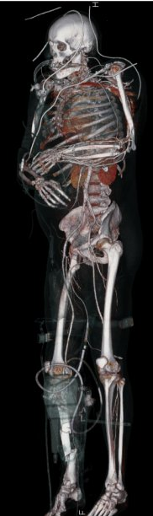
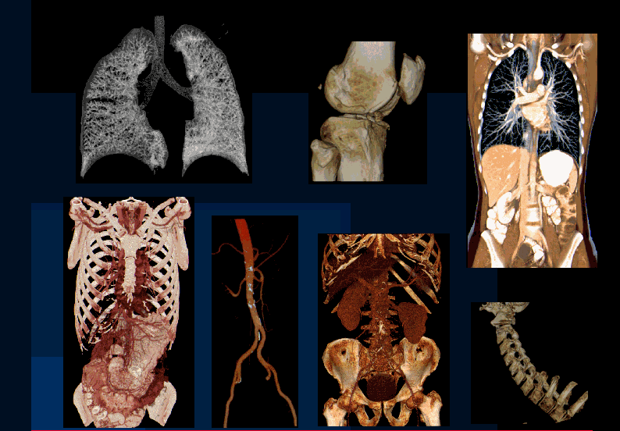
Computed Tomography scaner (CT)
The best device widely used for precise exam
  Whole body
  Cardiology
Still a lot of radiation full body CT = 4-10 mSv (depending organ)
  Standard radiography = 0.1 mSv

Slide 33
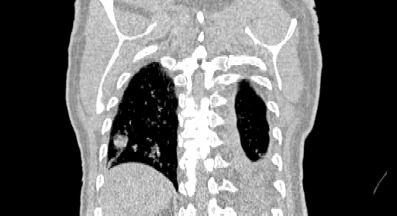
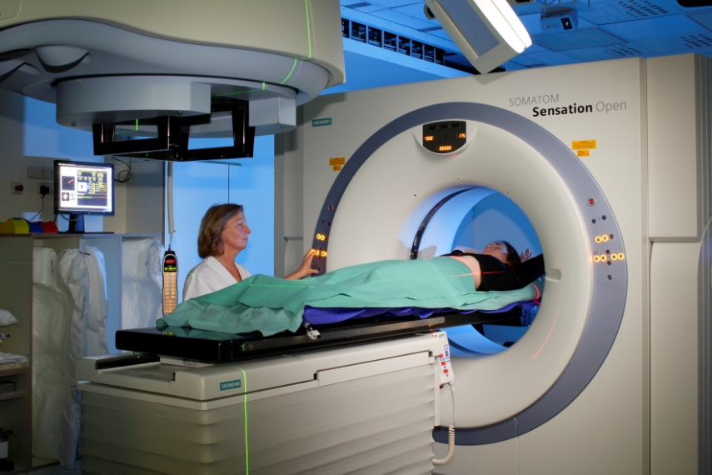
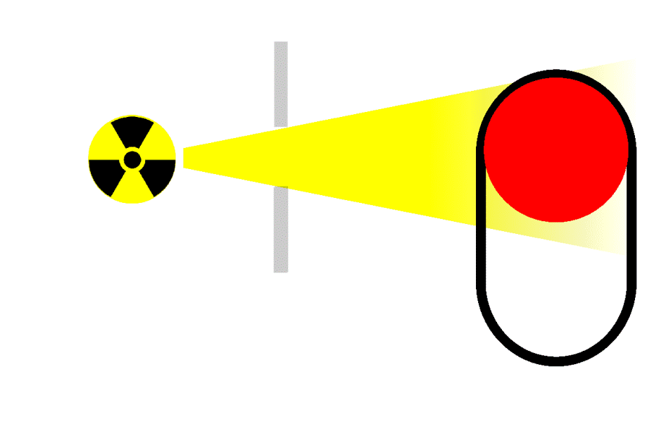
State o the art : 4D CT
Position influenced by the
breathing motion

Slide 34
Exposure for radiological exams
Some examples
organ dose skin effective dose
mGy mSv
Thorax, face 0,2 - 0,5 0,015 - 0,15
Lumbar region 4 - 28 1,5
Urography 40 - 60 3
Brain scan 7 - 78 1
Whole Body scan 30 - 60 4 - 10
Mammography 7 - 25 0,5 - 1

Slide 35
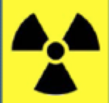

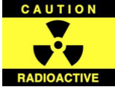
Patient Radiation Dose is Limited!
Image Noise Is Limited by Counting Statistics
Cannot Increase too much Source Strength
See the BU slides about how to decrease the dose using gaseous detetors

Slide 36
Deacreasing the dose
with HEP Gazeous detector

Slide 37
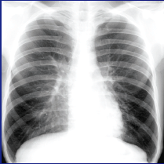
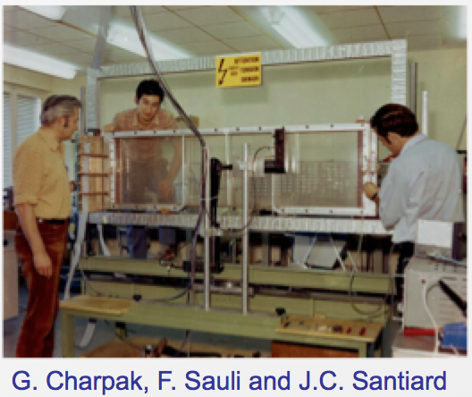
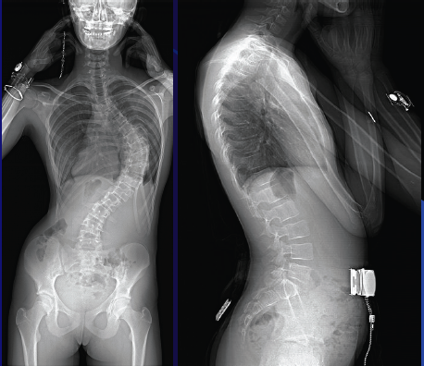
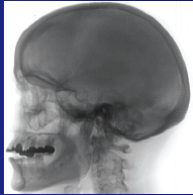



The 1970’s dream : Digital radiography with MWPC
A tribute to George Charpak
With 10 time less dose
1992
Multiwire Proportional Chamber
Georges Charpak
1924 - 2010
1968

Slide 38


The Future ?: New Si detector and signal processing
On the way to photon counting?
Medipix3
- 8 simultaneous energies
- 55 µm isometric resolution
- Excellent energy resolution
- 10⁸ photons per second per mm²
Jacubek & al. Prague University
Xray source
Medipix
See presentation of Stanislav Pospisil about Timepix

Slide 39

Time Of Flight X ray imaging
Time-of-flight gives significant insight on scattered photons in x-ray imaging
10 ps total timing (source + detector) required for optimal performance.
Potential to reduce the radiation dose in X-ray imaging
Very Preliminary
Courtesy of
Sherbrooke University

Slide 40



1930
Today
Radiotherapy
Common tools
& techniques

Slide 41
Fight again cancer – Radiotherapy
Local irradiation to kill tumour → 100 Gy = 90 % of sterilization
Frequent treatment (2/3 of cases).
Efficient treatment: cure → 40 to 50% of recovery
Allow good quality of life and tolerance
non invasive, itinerant and without important physical effects.
Cheap (< 10%) of the cancer budget (France)
Essentially X rays
  (Linear accelerators) & photons (curietherapy)
50%
10%
chimiotherapy
40%
radiothérapy
surgery

Slide 42

RT modern techniques
Conformal RT
Intensity Modulated (IMRT)
Image guided (IGRT)
Robotic Stereotactic

Slide 43


PORTAL IMAGING
VERY HIGH RATE GAMMA RAYS DETECTION and measurement
Real Time Imaging
and Dosimetry
GEM-BASED PIXEL DETECTOR
ROYAL INSTITUTE OF TECHNOLOGY AND KAROLINSKA HOAPITAL (STOKHOLM)
C. Iacobaeus et al, IEEE Trans. Nucl. Sci. NS-48 (2001)1496

Slide 44


‘standard’ RT devices
Intensity Modulated
(IMRT)
Conformal 3D radiotherapy

Slide 45


Slide 46


State of the art: Robotic Stereostatic RT
Multiple beams and radiation sources ( Co ⁶⁰)
High Precision 1 mm
Dedicated & invasive (radiochirurgy with Co⁶⁰)
Cyberknife TM

Slide 47
Radiatherapy X
No substitute for RT in the near future
Number of patient increasing
Present limitation of RT→ 30 % of patients recurs
Why Radiotherapy X is NOT 100 % efficient?
  Complication < 5 %
  Tolerance of saine tissue is the limiting factor
    Close to Organ at Risk
  Failures due to radioresistant tumors!
  Second cancer 30 years after Radio Therapy (from recent statistics)
    Adult : 1.1
    Chidren : 6
Particle therapy
Around 25% of the case

Slide 48
Today
From radiotherapy to
Particle therapy

Slide 49


Why use Hadrons for Therapy?
Most dose is deposited in the sharp "Bragg Peak", with no dose beyond
Escalate the dose in the tumor
Reduction of dose in surrounding normal tissue

Slide 50

Comparing Proton and conventional RT
Photon
IMRT Photon
Proton
Conventional Radiotherapy:
Important dose outside
the tumor
Scattering technique :
Low dose outside
IMRT = Intensity
Modulated
Radio Therapy:
still non negligable dose
outside the tumor

Slide 51


Comparison IMRT-Protons
Courtesy of IBA

Slide 52

What are the critical issues & challenges?
This is NOT a ‘simple target’ but a human body
  Treatment and quality assurance techniques of conventional radiotherapy not adequat for particle therapy
    A complex procedure for the ‘treatment planning’
How to be sure that the dose is delivered at the right place (tumour) ?
  Particle beam are error sensitive
    Displaced organ & overdose
    Moving organ in some case
What is the dose deposited ?
How to verify the treatment?

Slide 53
The two ‘simultaneous’ challenges
Reducing error means → Real Time imaging
  3D in vivo dosimetry and tomography
    Use fragments of beam projectile reactions in the biological matter emerging from the tumor target volume
Verification using Computed Tomography/Radiography:
  CT imaging in charged Particle therapy is needed for:
    Target volume definition (anatomical boundaries with additional information from multimodality imaging (CT/MRI/PET studies)
    Dose and range calculation
    Patient alignment verification
But today these process are made at different moment and place

Slide 54



Particle therapy workflow
Step 1 → Treatment planning after CT scan
  Dose to be distributed
  MC simulation
  Give information to the machine
Step 2 → Treatment
  10-20 fractions (tumour irradiation)
Step 3 → verification using CT scan
Overdosage in normal tissue

Slide 55



In-beam nuclear method principle for ‘in vivo’ dosimetry
Target
Nucleons
& projectile/target fragments
Projectile
10⁻²¹ 10⁻¹⁸ 10⁻¹⁵ 10⁻¹² 10⁻⁹ 10⁻⁶ 10⁻³ 10⁰ 10³
Time (s)
after collision
Particles
β⁺ - emitter decay
Prompt γ-rays
Balance of promptly emitted
particles outside the target:
Incident protons: 1.0 (~10¹⁰)
γ-rays: 0.3 (3·10⁹)
Neutrons: 0.09 (9·10⁸)
Protons: 0.001 (1·10⁷)
a-particles: 2 · 10⁻⁵ (2·10⁵)
However the photon energy different from standard medical (Anger) SPECT camera
Relation between dose and β+ activities

Slide 56




Present examples: in beam PET
Extraction
A₂
B₂
P
¹H-therapy at the National Cancer Center, Kashiwa, Japan
In-beam PET scanner at
¹²C-therapy unit at GSI
Large beam background
No Real time capability
Low signal to noise ratio

Slide 57
More topics on Particle therapy
(another presentation)
1946 : R. Wilson propose to use protons in radiotherapy
1954->1970 : first clinical trials (Boston, Uppsala, Berkeley)
1970 : first clinical programmes (Boston, Berkeley)
1990-1991 : new centers (CPO Orsay, Nice, GSI,PSI,NAC South Africa). First dedicated center : Loma Linda (cost per patient for treating prostate cancer → 120 K$
Today more than around 130 Facilities are running or planned: that increase very rapidly (>10/year) over the world !
Becoming Commercial market now (IBA,Siemens,Hitachi …. )
Proton versus ion (use cyclotron and synchrotron ..Linear? )
NEW: FLASH THERAPY with Minibeam projects → deliver Very High dose ( 40/GY/sec) → Machine?
Big annual conference (PTCOG)

Slide 58


Radiograph of a phantom
Uwe Schneider PhD thesis (1978,PSI)
Another dream
The Proton CT
A tribute to G.Charpak

Slide 59


1970
Today
Nuclear medicine

Slide 60
What is Nuclear medicine ? Definition
Use in vivo of radioactive elements (tracers) injected to the patient orally or by blood injection to image the function of the body
Functional and metabolic (scintigraphy)
In vivo biochemistry
Study of a radioactive molecule in a living organism
  Images are Static 2D/3D (x,y,z)
  Or 4D (+time) --> dynamic
  Or 5D (+ Energy) --> Multisotopes /multitracers

Slide 61

What about tracers ?

Slide 62

Isotopes in medicine

Slide 63




Common DiagnosisTracers
Application
Requirement
Isotope
MTR = Material Testing Reactors
There are different solutions available worldwide to produce artificial radioisotope, i.e. by accelerators, nuclear reactors or research reactors such as the JHR Material Test Reactor.
Cyclotrons

Slide 64

EU tracer production situation
Very worry about the future this why we are building the RJH

Slide 65
RJH Producing radioisotope for nuclear medicine
The JHR Material Test Reactor (70MWh) has been designed to produce artificial radioisotope by way of fission or neutron capture, The need for artificial radioisotope has been increasing year after year, especially for nuclear medicine where radioisotopes are used for examinations (diagnostics) and cancer treatment (therapy).
Producing between 25% (representing about 2 millions patients diagnosed) and 50% of European yearly requirements
Diagnostic radioelement
    ⁹⁹Mo/^{99m}Tc • ¹²⁵I ¹³¹I• ¹³³Xe produced by ²³⁵U fission
Therapeutic radioelement
    ⁸⁹Tc, ⁹⁰Y, ¹⁵³Sm, ¹⁶⁶Ho, ¹⁶⁹Er, ¹⁷⁷Lu, ¹⁸⁶Re, ¹⁹²Ir, ¹⁰³Pd, ¹²⁵I
    ¹⁹²Ir, ⁶⁰Co, ⁷⁵Se ….

Slide 66

The Jules Horowitz MTR Reactor
Cadarache France
2025?
WEB site: https://jhrreactor.com/

Slide 67
Therapy with
radioelement

Slide 68



Curietherapy/Brachytherapy
1910
Today
Local (contact) deposit of the dose by needles or implants

Slide 69


First cancer cure by brachy (ulcus rodens, basal cell carcinoma): Goldberg and
London in Moscow, 1903

Slide 70


First brachy treatment, any disease, generally credited to be Danlos:
Henri Alexandre Danlos,
Parisian dermatologist,
exhibiting a woman who he
successfully treated for
lupus vulgaris of the
face. Pierre Curie loaned
him the source and he
treated her in 1901.

Slide 71
BRT (typically 10-20% of patients)
1) Radiation sources placed in the tumor, ergo less toxicity
2) Dose homogeneity in the target not an issue
3) Conformal treatment without complicated technological
tools
4) Generally invasive (except intracavitary)
5) In BRT timing is critical
6) Overall risk of a second cancer is claimed to be lower for
brachy
A. The actual dose delivered can be precisely known (a
double-edged sword…)
B. Full QC (operator-independent treatment)
C. Ideal for focal therapy (radiobiology not needed)

Slide 72
Modern imaging

Slide 73
The various types (modalities) of imaging
Organ
Function
Cell
Anatomy Physiology Metabolism Molecular
PET,SPECT
NMR/MRI*
X ray (CT)
Ultrasounds
Optical
Complementary !
Depends on what you want to see
MRI/MMR* = Magnetic resonnance

Slide 74




Medical Imaging Modalities
X-ray radiology
X-ray Radiography
Computed Tomography (CT)
Emission tomography
Tomo-Densitometry (DXA)
Single Photon Emission Computerized
Tomography (SPECT)
Positron Emission Tomography (PET)
Magnetic Resonance (MR)
Magnetic Resonance Imaging (MRI)
Ultrasonic imaging
Magnetic Resonance Spectroscopy (MRS)
Functionnal MRI (fMRI)

Slide 75


NMR & PET Images of Epilepsy
NMR
PET
NMR “Sees” Structure with 0.5 mm Resolution
PET “Sees” Metabolism with Few mm Resolution but with very high sensitivity (picomolar level)

Slide 76

The first gamma camera (Hanger,1956)

Slide 77

SPECT Gamma camera components
Collimator
  Ability to localize the photon sourse in the patient (6-12 mm)
Detection system
  Ability of the large NaI scintillator and photomultiplier to localize the photon interaction in the crystal
Problem :
  only few useful photons
  1:100 000

Slide 78



Anger Camera
First commercial Anger camera was delivered by Nuclear Chicago to W. Myers, Ohio State 1962
First camera had 7 PMTs
Anger camera invented in 1957

Slide 79

Single Photon Emission Computed Tomography (SPECT)
Two ways
  Tc ⁹⁹ tracer and a gamma camera
  Positron emitting tracers with positron camera

Slide 80


SPETCT images
Hearth
Multiview skeleton with Tc⁹⁹

Slide 81


Modern SPECT camera

Slide 82
Few word about PET

Slide 83





The PET sequence
Produce radio-active sugar (FDG)
Cyclotron
Intravenous injection
10mC
Reconstruct
image coincidence
events
Wait for
accumulation
in target site
Get 2 gamma
events
Detect
coincidence
events

Slide 84





HEP & PET
Similarities and differences
PET
Camera
Calorimeter
HEP
Biomedical
Imaging
CMS
Similarities
Geometry and granularity
Detector (Crystals & scintillator)
Sensor (PMT,APD)
Digitizers: ADC,TDC,
Data volume (Gbytes)
Differences
Energy range
(10GeV → -511keV)
Event Rate 40 → 10 MHz
No synchronization
Self triggered elrctronics
Multiple vertices

Slide 85
Survey of common area with HEP
Energy
    From Kev to Tev with very good resolution
Scintillator & crystal
Photodetector
  compact, high QE, high gain and stability
  Standard : PMT ---> SiPM/MPPC,DSiPM
Fast Electronics devices
  We are speaking today to achieve the PICOSECOND
# Channels
  Billions due to ‘pixellated & high granularity detectors

Slide 86







Historical Evolution of PET
C-PET Philips
1977
First Steps
Townsend & Jeavons
1997
First mouse imaging with ¹⁸F
2007
Biograph PET + X ray-CT

Slide 87






From Today ---> Tomorrow Challenge
2017
no TOF
~600 ps TOF
TDM/PET-TOF (250 psec)
2022
Sucima PET-MRI EU project
~200-ps TOF PET Siemens Biograph Vision 600

Slide 88


From Today ---> Tomorrow Challenge
CRT = Laboratory 30ps
→ 10 to 1 psec 3 min scan
SNR, Direct imaging Multi-photon imaging, Positronium imaging
Scintillation, Cerenkov, Metascintillators, Photonics
AI vs TOF, Cost?
2022
2027 ?
Iseult Project: 11.7T Whole-Body MRI
Explorer total body project

Slide 89



Non conventional ideas
Free of geometric constraints for tomography High solid angle coverage with smaller detector area
Total-Body System
Brain Imaging
System
Cardiac or Breast
Imaging System

Slide 90

Example : the VRAIN head PET (Japan)

Slide 91

















Imaging technology: PET/CT and PET/MR
1984 - Today
SiPM
PET/CT
PET/CT
SiPM
PET/CT
PET/CT
Gunma 1984
Gunma 1984
UPMC 1998
UPMC 1998
(ps): 1200 500 590 550 380 214 228
2011 2012 2013 2014 2015 2016
2011 2012 2013 2014 2015 2016
2005
2017 2018 2019 2020 2021
2005
2010
2000
2010
1998 1999
2000
2006 2007 2008 2009
1998 1999
2001 2002 2003 2004
2006 2007 2008 2009
2001 2002 2003 2004
PET/MR
Neuro
Insert
PET/MR
Neuro
Insert
PET/CT
Prototype
PET/CT
Prototype
PET/MR
PET/MR
PET/MR
PET/MR
SiPM PET/CT
SiPM PET/CT
91
12
91

Slide 92
Summary of PET evolution
Began with Scintillators - one crystal per photosensor (PMTs for most systems to date) → SiPMT
As we moved to smaller crystals, started doing many on one (crystals to photosensors) designs to reduce cost and allow for physical size of the photosensors
Added time-of-flight to the mix in the 2000’s
Looked at alternatives, including plastic Scintillators and fibers, various solid state devices
Recent advances in photosensors, crystals, and solid state materials have opened up the field for many new designs to move the capabilities of PET scanners forward.

Slide 93
Simulation & Sofware

Slide 94

GATE ‘early ’Collaboration 2004)
Uni Louis Pasteur (IRES) Strasbourg
Uni Joseph Fourier (LPSC) Grenoble
Forschungszentrum-Jülich (IME)
Uni. Massachusetts, Worcester
CHU Morvan (LATIM) Brest
Uni California (CRUMP) Los Angeles
Uni Toronto (CAMH)
CEA (DAPNIA) Saclay
MSKCC New York
Uni Athens (IASA)
Uni Lausanne (IPHE)
Uni Clermont-Ferrand (LPC)
Uni Ghent (ELIS)
CHU Pitié-Salpêtrière (U494 INSERM) Paris
Vrije Uni Brussel (IIHE)
CERMEP, Lyon
CEA (SHFJ) Orsay
CHU Nantes (U463 INSERM)
Sungkyunkwan Uni. Seoul
Uni Claude Bernard (IPNL) Lyon
Irène Buvat CEA SHFJF – Orsay-F)
Technical Coordinator: S. Jan (CEA - Orsay, F)

Slide 95



GATE : Geant4 Application for
Tomographic Emission
Monte-Carlo simulation allowing to :
define geometries
(size, materials,…)
define sources
(geometry, nature, activity)
choice of physical process
(low energy package of G4)
follow track point by point
GATE specificities:
CERN GEANT4 libraries
Time modellign
(sources , movement,random…)
Script language(avoid C++)
Code interactivity
Sharing development

Slide 96

AI in GATE (EGEEE)
Enabling GRID for EsciencE
GEANT4 Application to Tomography Emission
Scientific objectives
  Radiotherapy planning for improving the treatment of cancer by ionizing radiations of the tumours.
  Therapy planning is computed from pre-treatment MR scans by accurately locating tumours in 3D and computing radiation doses applied to the patients.
Method
  GEANT4 base software to model
  physics of nuclear medicine.
  Use Monte Carlo simulation to
  improve accuracy of computations (as
  compared to the deterministic classical
  approach)

Slide 97
Thank you for your attention
Questions?
Or send me an email
patrickledu@me.com

Slide 98
Instrumentation schools References
IRSTS 14 Osaka
http://rt2014.rcnp.osaka-u.ac.jp/rt2014-school/index.html
IRTS 16 HoChiMinh City
http://ntlab.hcmus.edu.vn/en/rt2016-school/
Le Cap South Africa.18
https://indico.cern.ch/event/661919/overview
ICISE July 19
https://indico.in2p3.fr/event/19513/
IRSTS Kuala Lumpur (Malaysia) Nov 2019 https://indico.cern.ch/event/854879/surveys/1178
IEEE NPSS Workshop on Radiation Instrumentation – Dec 2021
Dakar Senegal
https://indico.cern.ch/event/954194/
IEEE NPSS Workshop on Radiation Instrumentation – Nov 2020
Jakarta Indonesia
Thank you
for your attention
https://indico.cern.ch/event/954199/

Slide 99
Lecture-Review references
CERN SiPM Workshop 2011, State of the art in SiPM’s, Y. Musienko
RICH 2013, Status and Perspectives of Solid State Photo-Detectors, G. Collazuol
New Developments in Photodetection 2014, Tutorial SiPMs, V. Puill
https://www.hamamatsu.com/resources/pdf/etd/PMT_handbook_ v3aE.pdf
PHOTOMULTIPLIER TUBES. Principles & applications. S-O Flyckt* and Carole Marmonier**,Photonis, Brive, France
Large Area Picosecond Photo-Detectors Project http://psec.uchicago.edu/Papers

Slide 100
Acknowledgements and References
Slides
  ,Bill Moses, Steve.Derenzo, P.Lecoq, Veronique Puill, Dieter Renker, Kanai Shah, and many others
Books/References
  G. F. Knoll, 􏰴Radiation Detection and Measurement, 3rd Edition, New York, Wiley, 2000
  Hamamatsu Photonics K. K., “Opto-Semiconductor Handbook”

Slide 101
Thanks to
C. DaVia (Manchester ).
D.Townsend (U. Singuapor)
H. Frisch ( U. Chicago)
P. Lecoq ( CERN)
R. Lecomte (Sherbrook)
W. Moses ( LBL)
S. Cherry (Davis)
K. Parodi (HIT)
Pr. J.N. Talbot (Hopital Tenon - Paris)
… and many others
Thank you
for your attention

Slide 102
May be
Interest you
Back up & extra slides

Slide 103

18 Nov, 1895 W.C. Rontgen discovers Xrays

Slide 104

1996 - Discovery of the natural radioactivity by Henri Becquerel
First image of potassium uranyl disulfide

Slide 105


1898 the Radioactivity

Slide 106

1923 - The Tracer principle

Slide 107

1934 - Artificial radioactivity
Irène & Frederic Joliot-Curie

Slide 108

The discovery of artificial radioactivity in combination with the cyclotron open the door to the production of useful radio indicators. Practically any element could be bombarded in the cyclotron to generate radioactive isotopes.

Slide 109

1932 - The Invention of the cyclotron

Slide 110
Deacreasing the dose
with HEP Gazeous detector

Slide 111

Multi Wires Proportional chambers MWPC
MODERN GASEOUS DETECTORS:
POWERFUL TOOLS FOR RADIATION DETECTION
AND LOCALIZATION IN PARTICLE PHYSICS,
BASED ON THE MULTIWIRE PROPORTIONAL CHAMBER
(Georges Charpak, 1967)
CATHODE
-V
TWO-DIMENSIONAL MWPC READOUT CATHODE
INDUCED CHARGE (Charpak and Sauli, 1973)
CONVERSION
S ~ 1 mm
CHARGE COLLECTION
ANODE WIRES
AVALANCHE MULTIPLICATION
+V
Spatial resolution determined by: Signal / Noise Ratio
Typical (i.e. ‘very good’) values: S ~ 20000 e: noise ~ 1000e
Space resolution < 100 μm
-V
CATHODE
E. Gatti et al, Optimum geometry for strip cathodes … , Nucl. Instr. and Meth. 163(1979)83

Slide 112

TWO-DIMENSIONAL LOCALIZATION
TWO-DIMENSIONAL LOCALIZATION FROM SIGNALS INDUCED ON CATHODE PLANES (Charpak & Fabio Sauli, ~1973)
CATHODE STRIPS
ANODE WIRES
CATHODE STRIPS
LOW-DOSE DIGITAL RADIOGRAPHY WITH MWPC:
CHARPAK’S HAND (2002):

Slide 113



X Ray imaging
GEM for 2D Imaging:
Using the lower GEM signal, the readout can be self-triggered with energy discrimination:
Wire Chamber Radiography:
9 keV absorption radiography of a
small mammal
(image size ~ 60 x 30 mm²)
Position resolution ~ 250 μm
A. Bressan et al, Nucl. Instr. and Meth. A 425(1999)254
F. Sauli, Nucl. Instr. and Meth.A 461(2001)47
G. Charpak, Eur. Phys. J. C 34, 77-83 (2004)
F. Sauli, http://www.cern.ch/GDD
Position resolution ~ 100 μm
(limited by photoelectron range in the gas)

Slide 114




From MWPC’s to MGPD’s
MGPD
Drift Chamber
MWPC
1970 - 1990
PS- ISR- SPS- LEP
1975 - 1995
UA2-LEP
1990 -
Multiwire Proportional Chamber
Georges Charpak 1968
GEM F.Sauli)
Micromegas Y. Giomataris

Slide 115




MPGD
From 1988-1998 Micro-technologies and etching techniques allowed development of Micro Patter Gaseous Detectors
MICROMEsh GAseous Structure
  Thin gap Parallel Plate Chamber: micromesh stretched over readout electrode.
Gas Electron Multiplier
  Thin, metal-coated polymer foil with high density of holes, each hole acting as an individual proportional counter.

Slide 116



Exemple with GEM Detector
Thin, metal-clad polymer foil, chemically pierced by a high density of holes (70-80 μm diameter).
On application of a difference of potential between the two electrodes, electrons released by radiation in the gas on one side of the structure drift into the holes, multiply and transfer to a collection region.
Cascading several foils results in high multiplication factors.
70 µm
F.Sauli & al.
Notes:
Another approach could be given by the GEM detector, where a charge amplification is obtained through tiny holes chemically pierced in a thin metal-clad polymer foil

Slide 117



Next → INGRID
InGrid :integrate the Micromegas/GEM concept on top of a MediPix pixel CMOS chip ( Timepix)
    pixel size: 55 x 55 μm²
    per pixel: preamp – shaper – 2 discr. –
    Thresh. DAQ - 14 bit counter
metalized foil
~100 μm ~1mm
Use → Large Trackers & Calorimeters

Slide 118


Timepix Hybrid detector
On the way of photon counting
Medipix is a Silicon pixel-based detector technology AND signal processing that can be employed to measure charged particles,photons, and neutrons.
It is based on a read-out chip that embeds the electronics for each pixel within the pixel’s footprint!
Detector and electronics readout are optimized separately
developed for use in the CERN LHC Central Trackers
Medipix 3/TimePix This technology is an extension of designs originally
  Integrate a TDC ….
Pixelated 300 μm silicon sensor
(256 x 256 pixels)
14 mm
TU Prague - J. Jakubec
NSS-MIC 2013 Seoul J4-3
Timepix readout ASIC
Detector bias voltage

Slide 119

Medipix-CT setup for detector investigations & material analysis
Example → USB flash drive
300 µm
TPX 110µm + CdTe 2mm 8x2 tiles / mag. 1.5x
65kV / 200µA
M

Slide 120
1946 - The origin of particle therapy
R.R. Wilson, Radiology 47(1946), 487-491
The origin of particle therapy
using the Bragg peak discovery (1903)

Slide 121
Basics of particle imaging
The particle (proton/ion) go through the patient at high energy
Advantages:
  Decrease the uncertainties → better dose accuracy
  Reduce the dose delivered to the patient
Challenge → the data reconstruction
  correctly reconstruct the path of the proton
Proton CT:
1) replaces X-ray absorption with proton energy loss
2) reconstruct mass density distribution instead of electron distribution
Radiograph of a phantom
Uwe Schneider PhD thesis (1978,PSI)
A tribute to G.Charpak

