Slide 1
TIPP School
Simulation workshop on Micro-Pattern Gas Detectors
Maria Teresa Camerlingo and Djunes Janssens
maria.teresa.camerlingo@cern.ch
djunes.janssens@cern.ch
On behalf of the RD51 collaboration
August 2023
Presenter Name
Date

Slide 2
A «good» Detector R&D recipe
Detector design and production
RD51 Collaboration working:
WG1 - Technological Aspects and Development of New Detector Structures
WG2 - Common Characterization and Physics Issues
WG3 - Training and Dissemination
WG4 - Simulations and Software Tools
WG5 - MPGD related electronics
WG6 - Production
WG7 - Common Test Facilities
Measurements
Simulation
R&D

Slide 3
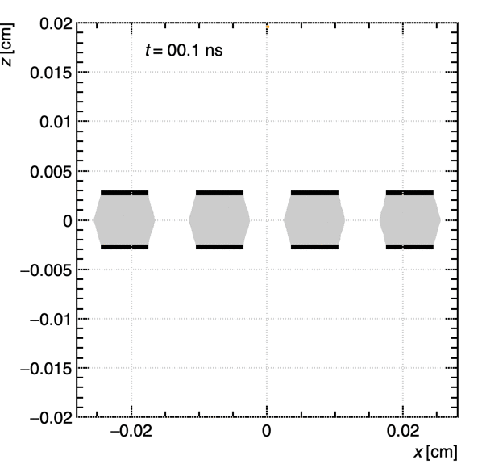
Introduction
Garfield++ is an open-source toolkit for the detailed simulation of signals in particle detectors that are based on ionization measurement in gases or semiconductors
Customised modifications are needed in:
Field calculations
Microscopic tracking
Resistive layers
Upgrades for gases:
Excited states
Ion chemistry
New mixture with eco-friendly replacements for Greenhouse gases
Garfield: https://garfield.web.cern.ch/garfield/
Garfield++: https://garfieldpp.web.cern.ch/garfieldpp/

Slide 4
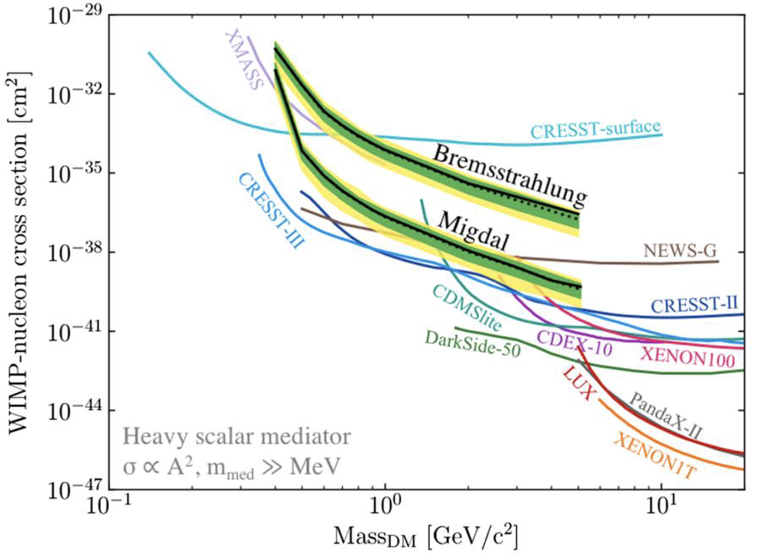
MIGDAL experiment
Direct dark matter experiments exploit the Migdal effect to extend their sensitivity to low-mass WIMPs, yet the Migdal effect itself has not yet been observed to occur in nuclear scattering.
Images taken from T. Marley’s presentation

Slide 5
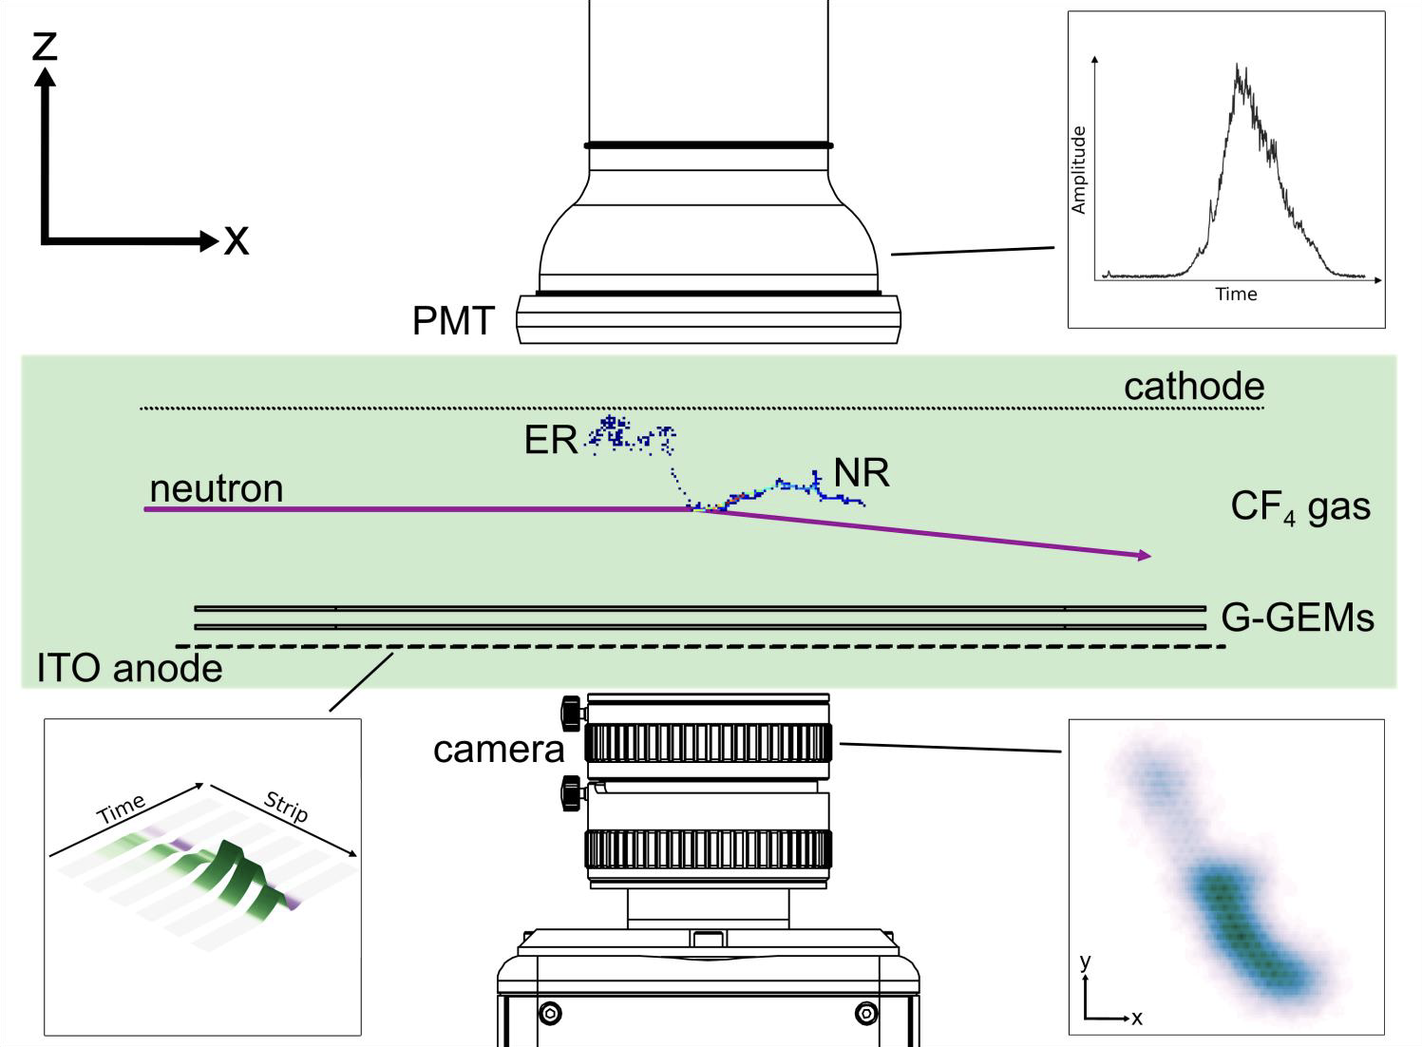
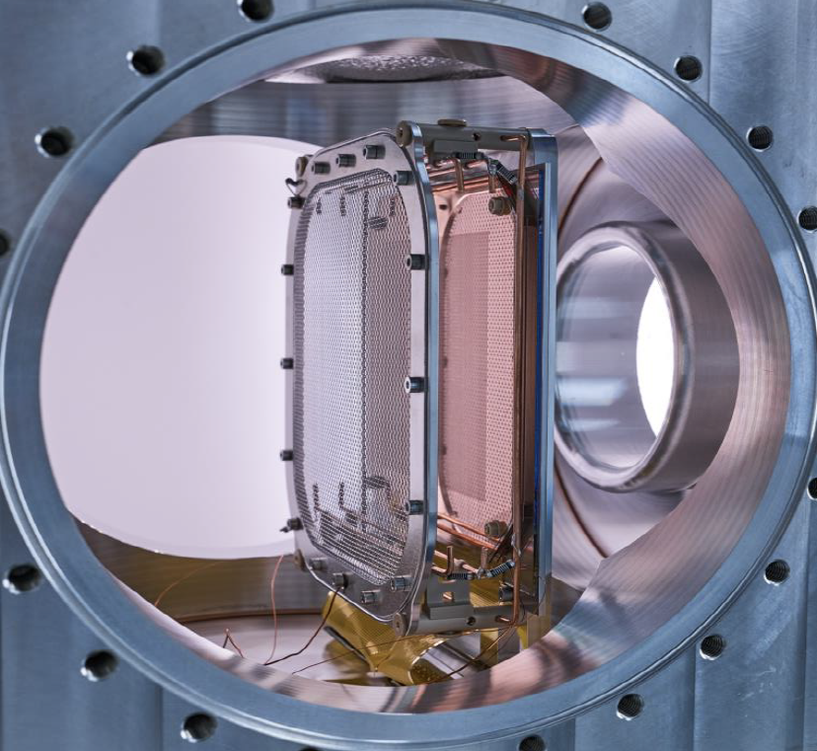
MIGDAL experiment
Using a GEM based optical time-projection chamber filled with pure CF4 at 50 Torr - for its high scintillation yield and emission spectrum in the visible light – the experiment aims to capture Migdal interactions.
Images taken from T. Marley’s presentation

Slide 6
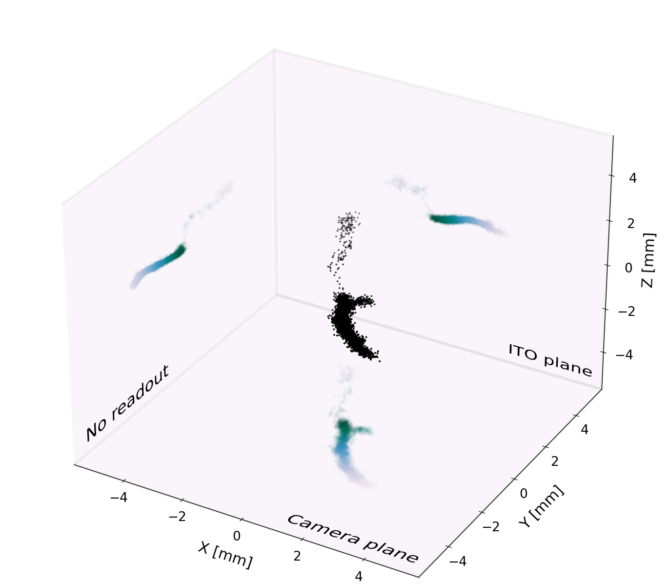
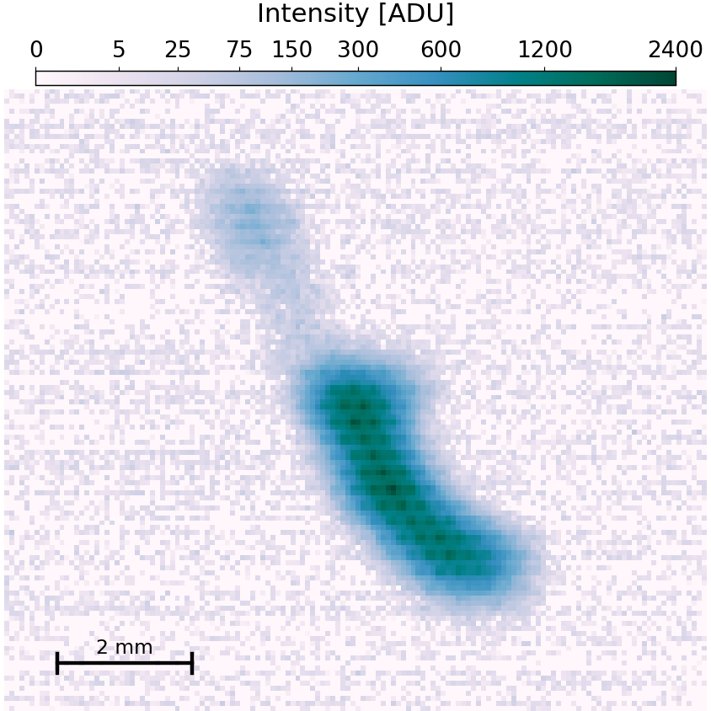
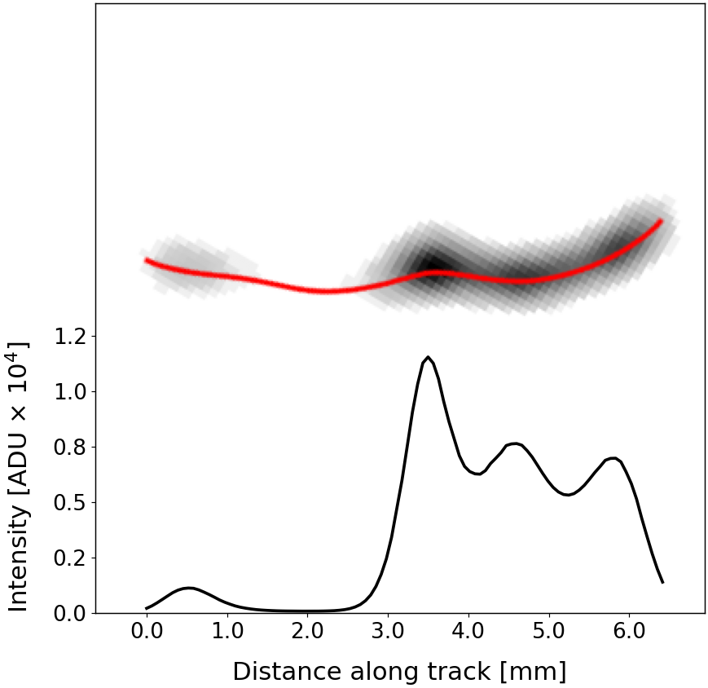
MIGDAL experiment
Detailed simulations were performed in preparation of the experiment to better understand what could be expected.
electron
NR
Images taken from T. Marley’s presentation

Slide 7
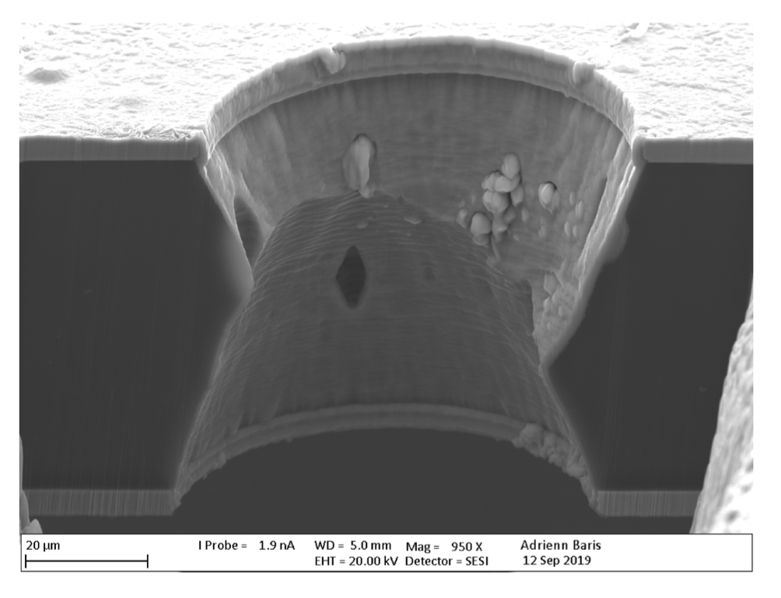
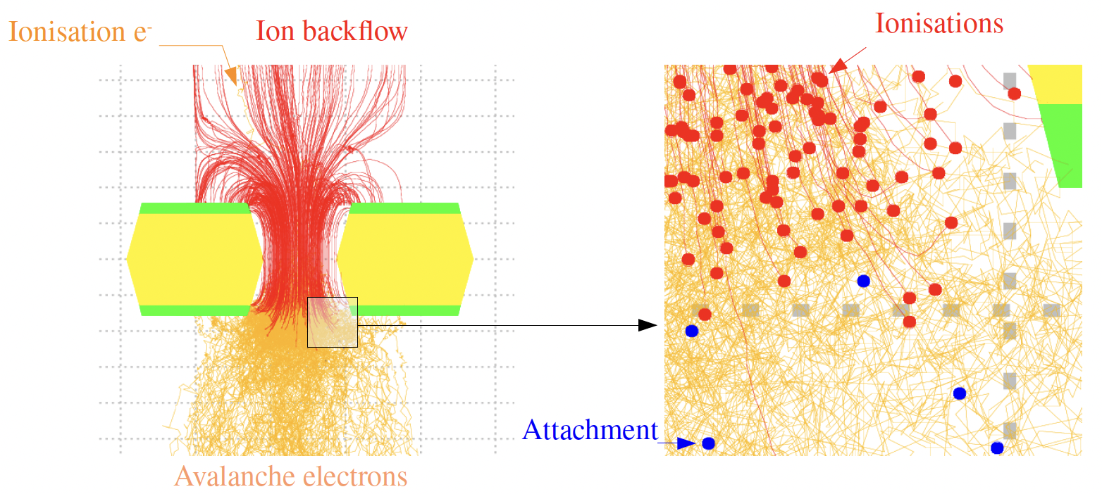
GEM detector
More commonly the readout is based on signal induction, as is the case of the ALICE TPC. Here, a GEM gain multiplication is modelled microscopically.
Courtesy of Gabriele Croci and Matteo Alfonsi

Slide 8
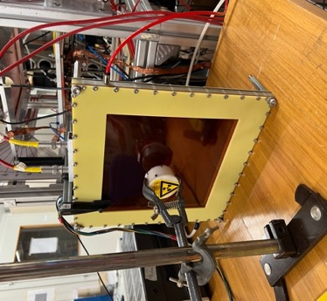
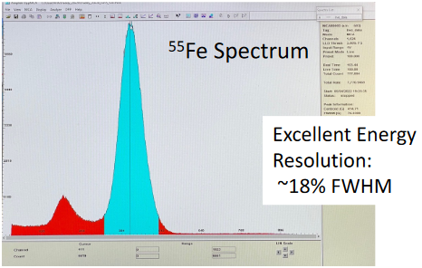
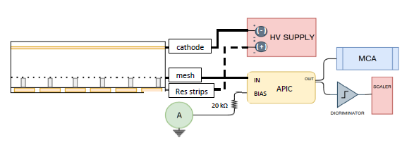
MPGD LAB SESSION @TIPP School
Simulated studies of a MPGD precision tracker
In the LAB
TASK 1
Studies of gain using ⁵⁵Fe
An essential quantity is the number of primaries
Simulation of the number of primaries in ArCO₂(93:7)%, which are the involved processes?
Blabla

Slide 9
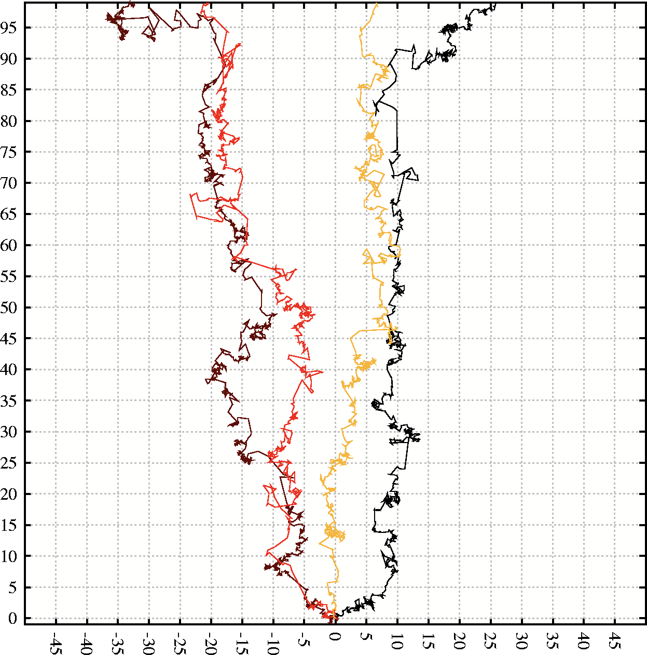
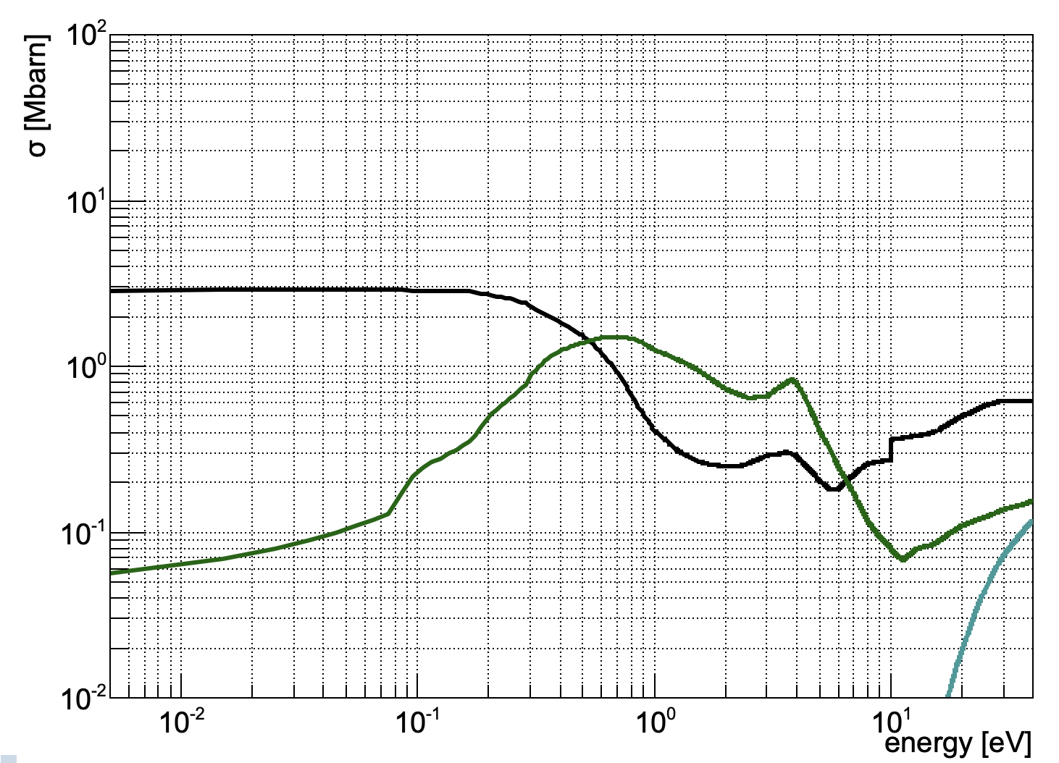
MPGD LAB SESSION @TIPP School
Simulated studies of a MPGD precision tracker
Charge motion inside a gas volume
TASK 2
Simplified CO₂ cross-section
$$\vec{E}$$
Start point
Simulation of electron diffusion and drift velocity varying the CO2 fraction and electric field

Slide 10
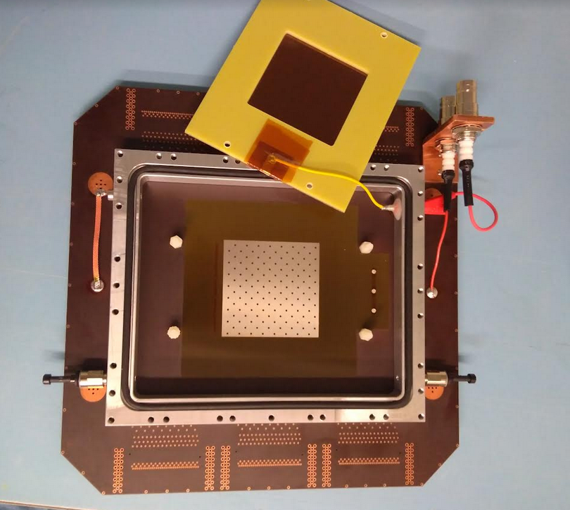
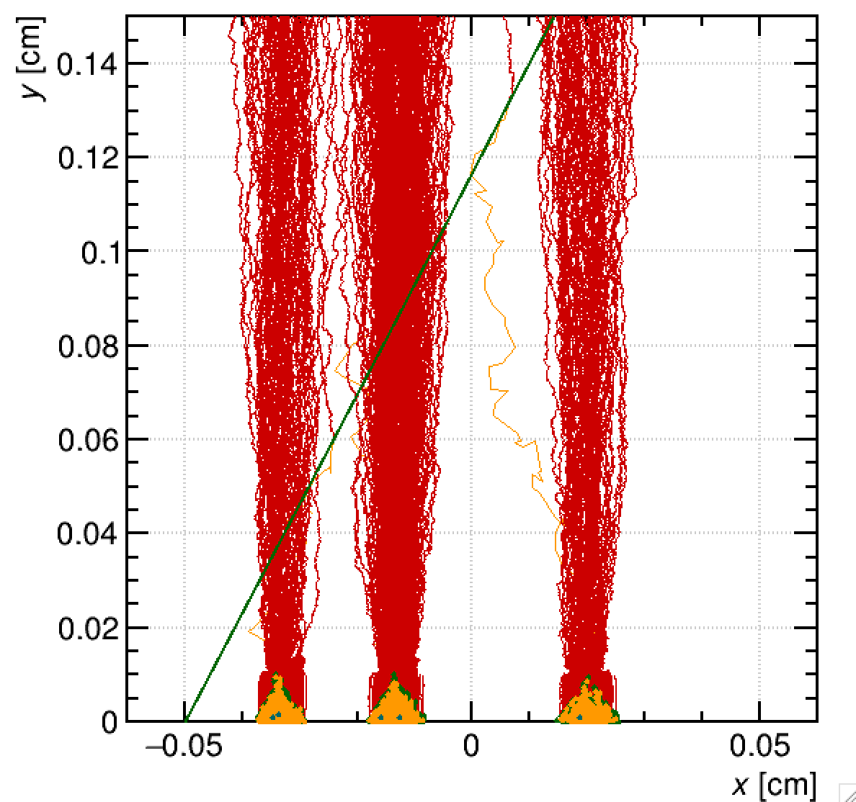
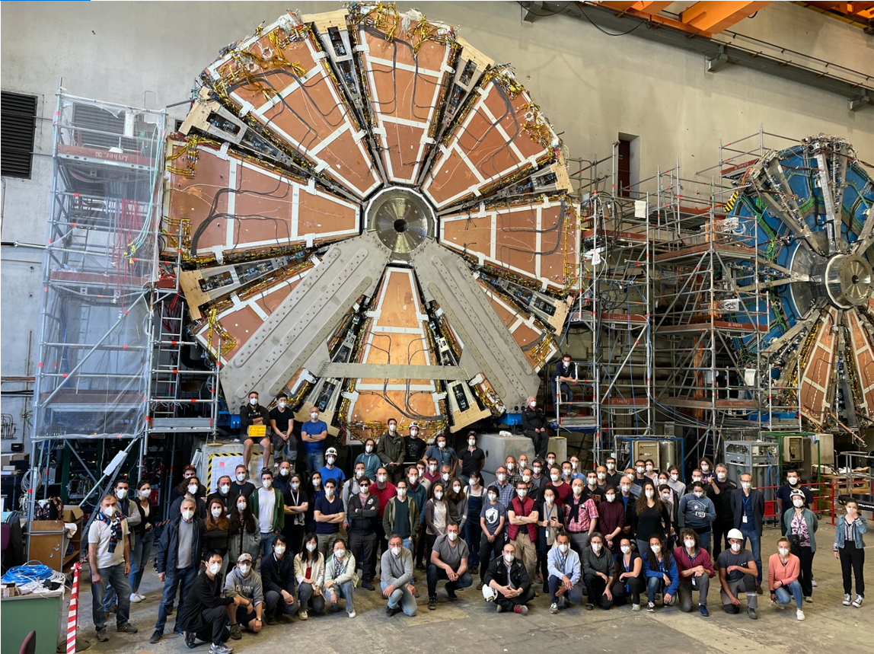
MPGD LAB SESSION @TIPP School
Simulated studies of a MPGD precision tracker
Micromegas
TASK 3
ion
e⁻
𝜇
To reconstruct the track position of a charged particle in a Micromegas detector.

Slide 11
See you soon….

