Slide 1
Instrumentation School in Particle, Nuclear and Medical Physics.
iThemba Labs 2023
Team 1
Alice McKnight
Nkosiphendule Njara
Anza-Tshilidzi Mulaudzi
iThemba Labs Instrumentation School 2023
1

Slide 2
Exercise 1 – Resolution of a silicon pixel detector
Main goal:
Optimise the resolution of a single silicon sensor of the CMS type.
Vary various parameters i.e. digitisation, rotation, magnetic field.
The Allpix² framework:
A generic, open-source software framework for the simulation of silicon pixel detectors. Its goal is to ease the implementation of detailed simulations for both single detectors and more complex setups such as beam telescopes, from incident radiation to the digitised detector response.
It consists of four main stages of the simulation from a particle crossing a silicon sensor to the final detector response: Interaction, Propagation, Assignment to readout channel, Front-end response.
iThemba Labs Instrumentation School 2023
2

Slide 3
Exercise 1: Allpix²
Interaction:
In this very first stage, an incident particle interacts with the detector material, depositing energy in the material. This energy loss is converted to electron-hole pairs in silicon.
Propagation:
After electrons and holes have been created, they move in the silicon lattice owing to drift and diffusion processes. In the simulation, a (user-defined) electric field inside the active sensor volume is used to guide the charge carriers towards the collection electrodes.
Assignment to readout channel:
The signal formed by the movement of charge carriers is processed by the front-end electronics. In the simulation, the signal has to be assigned to a front-end channel, i.e. a pixel collection electrode, before this takes place.
Front-end response:
the behaviour of the readout circuitry is simulated: The charge assigned to individual pixels is processed by the amplifier and discriminator in this pixel cell, digitizing the signal with a configurable conversion from charge carriers to charge-to-digital converter
iThemba Labs Instrumentation School 2023
3

Slide 4
Exercise 1 – Resolution of a silicon pixel detector
Conditions for simulation:
Magnetic field = 8.3T in x-axis
Rotation angle = 0 deg (run 1) and 27 deg (run 2)
Particle = electron
Source energy = 5 GeV
Voltage = -150 V
Depletion voltage = -50 V
temperature = 293K
Resolution: 1(run 1) and 8 (run 2)
iThemba Labs Instrumentation School 2023
4

Slide 5
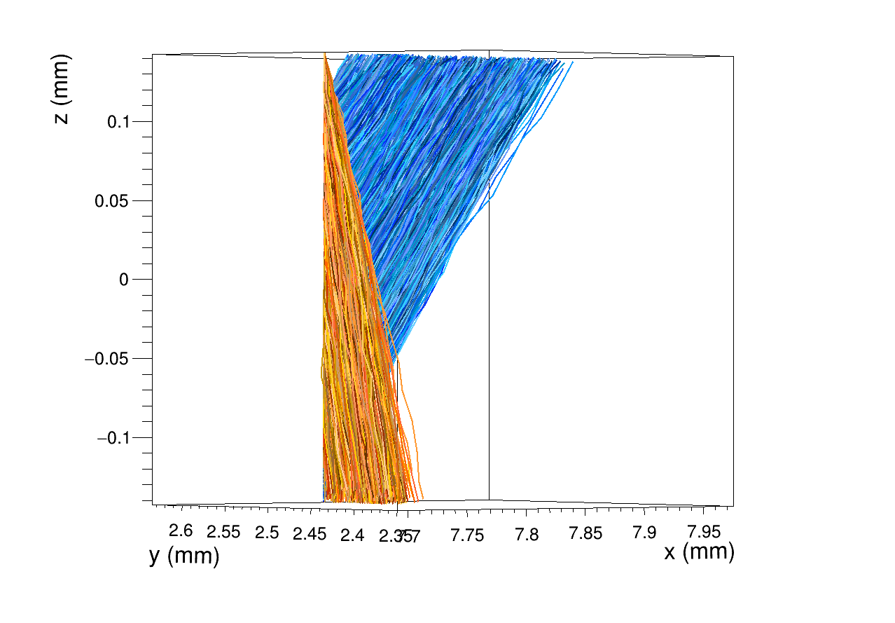
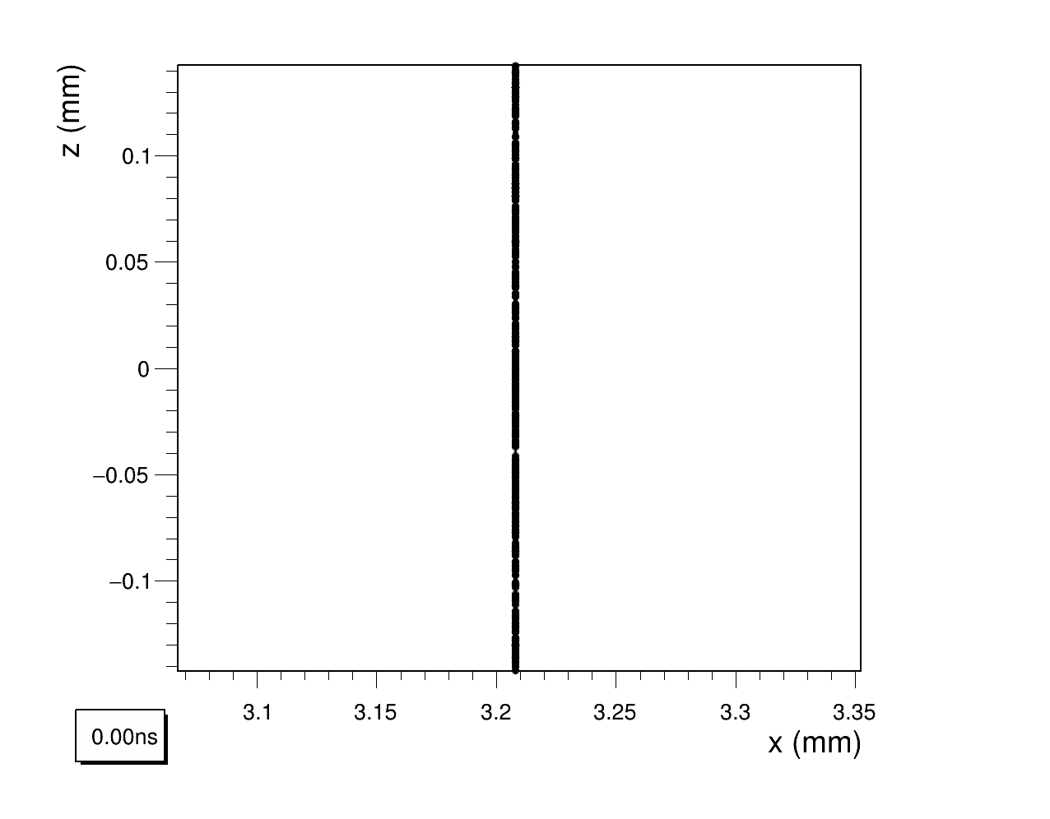
Exercise 1 – Resolution of a silicon pixel detector
Run 1:
iThemba Labs Instrumentation School 2023
5

Slide 6
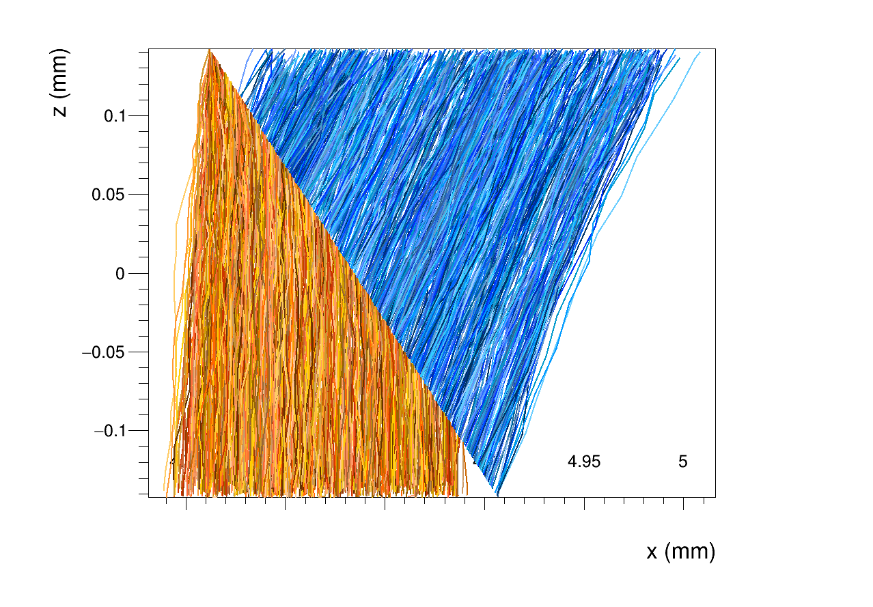
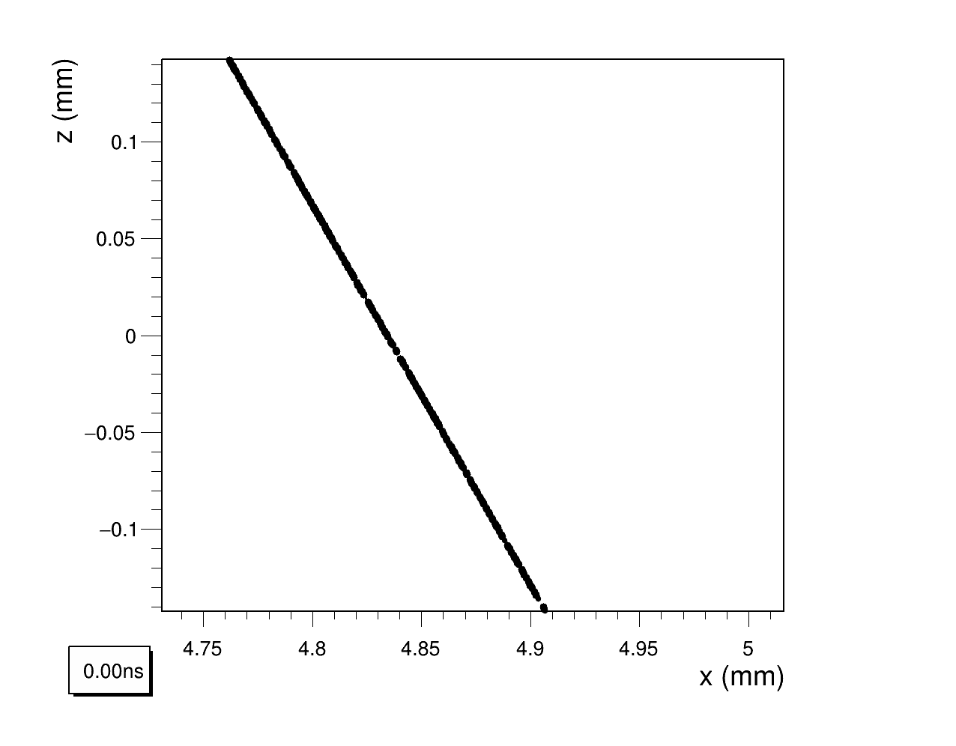
Exercise 1 – Resolution of a silicon pixel detector
Run 2:
iThemba Labs Instrumentation School 2023
6

Slide 7
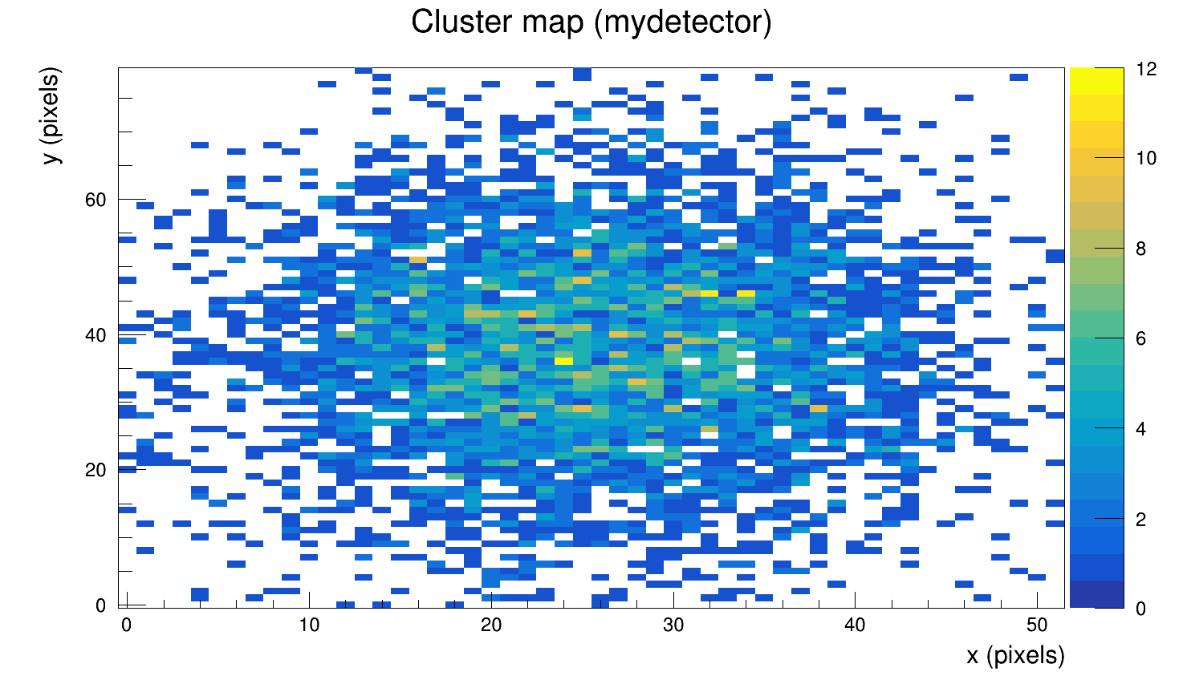
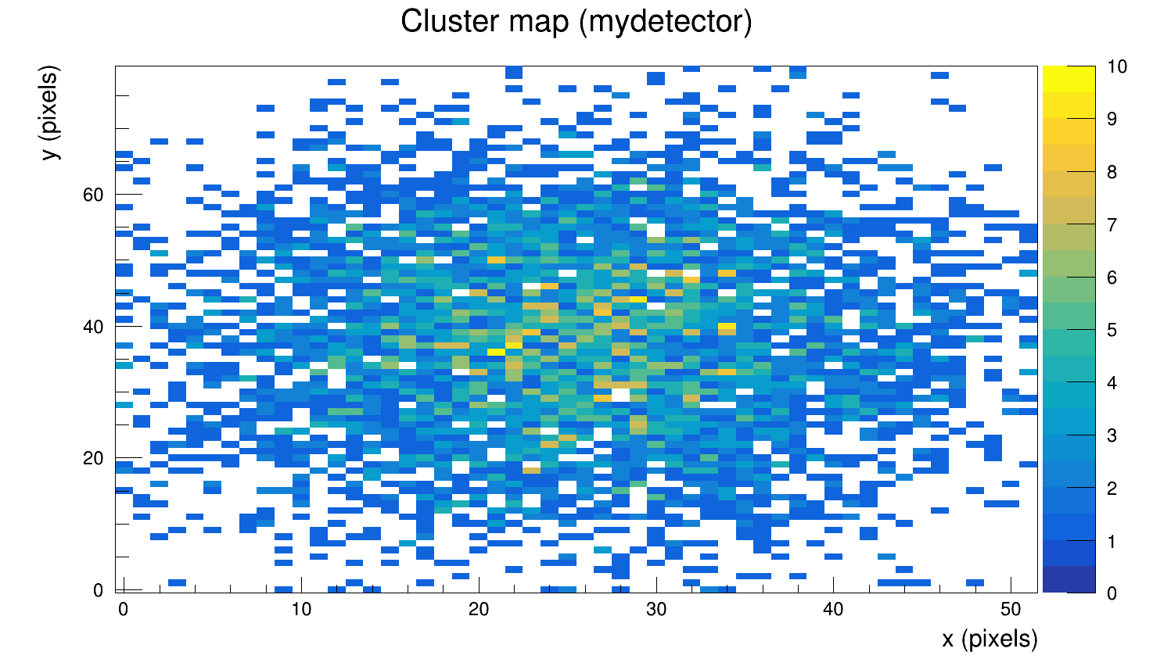
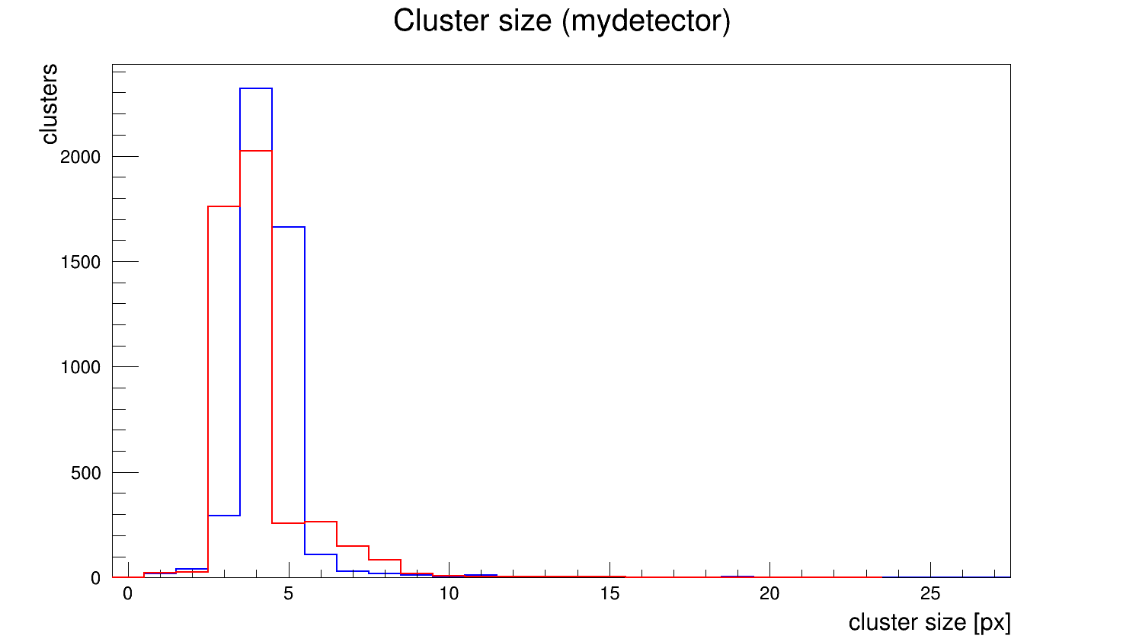
Exercise 1 – Resolution of a silicon pixel detector
Run 1
Run 2
iThemba Labs Instrumentation School 2023
7

Slide 8
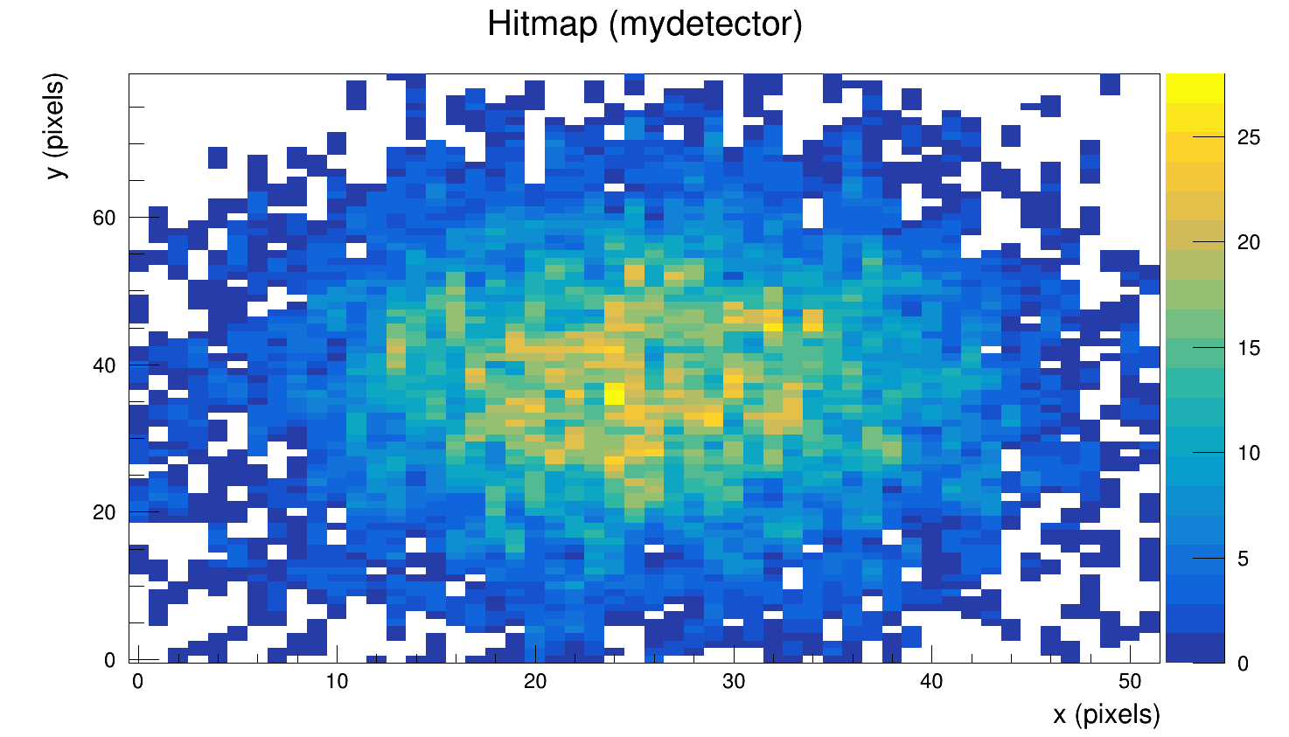
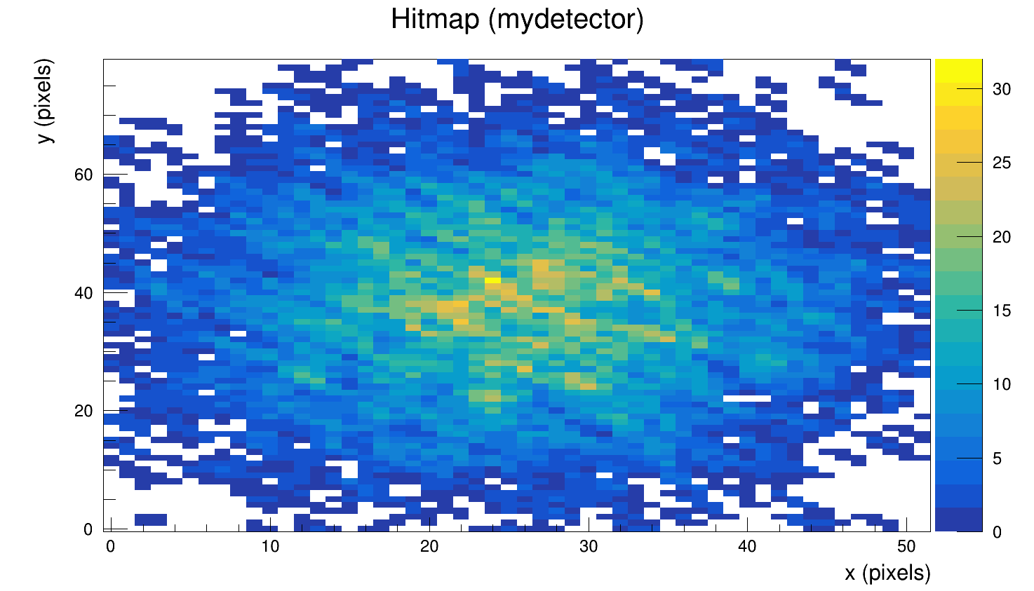
Exercise 1 – Resolution of a silicon pixel detector
Run 1
Run 2
iThemba Labs Instrumentation School 2023
8

Slide 9
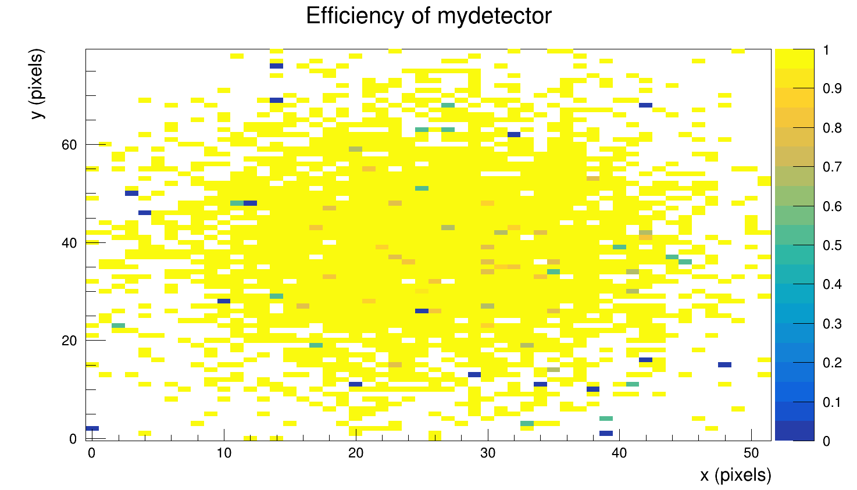
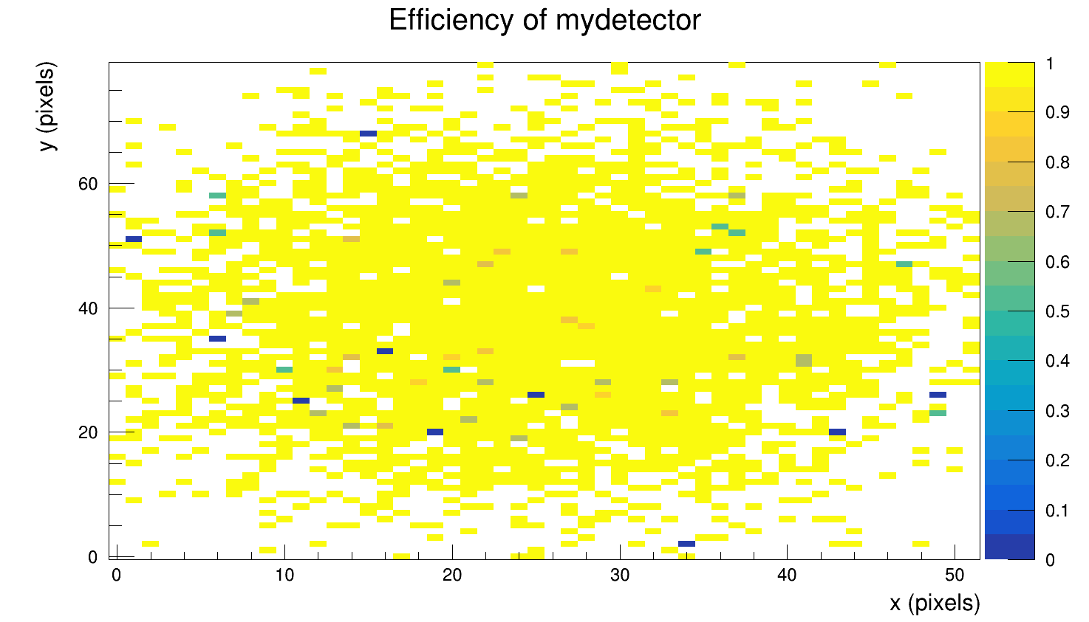
Exercise 1 – Resolution of a silicon pixel detector
Run 1
Run 2
iThemba Labs Instrumentation School 2023
9

Slide 10
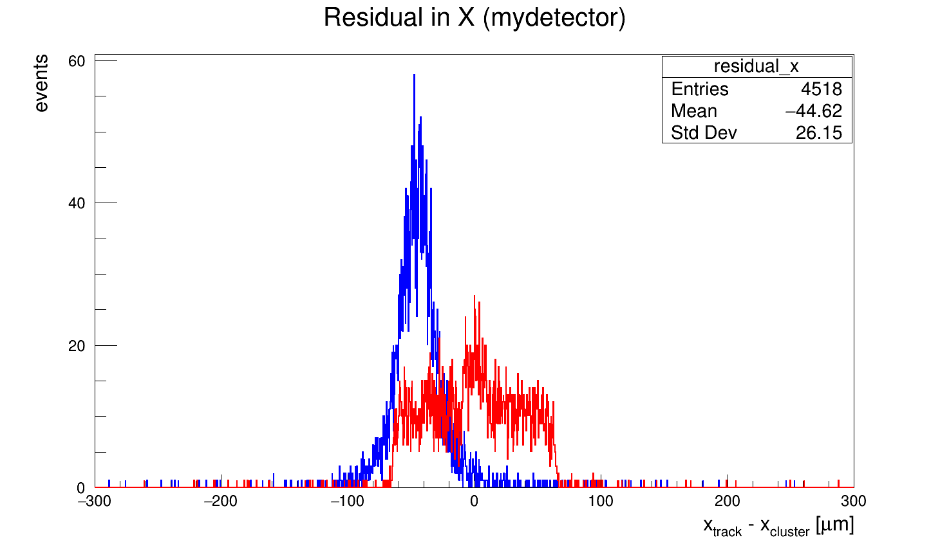
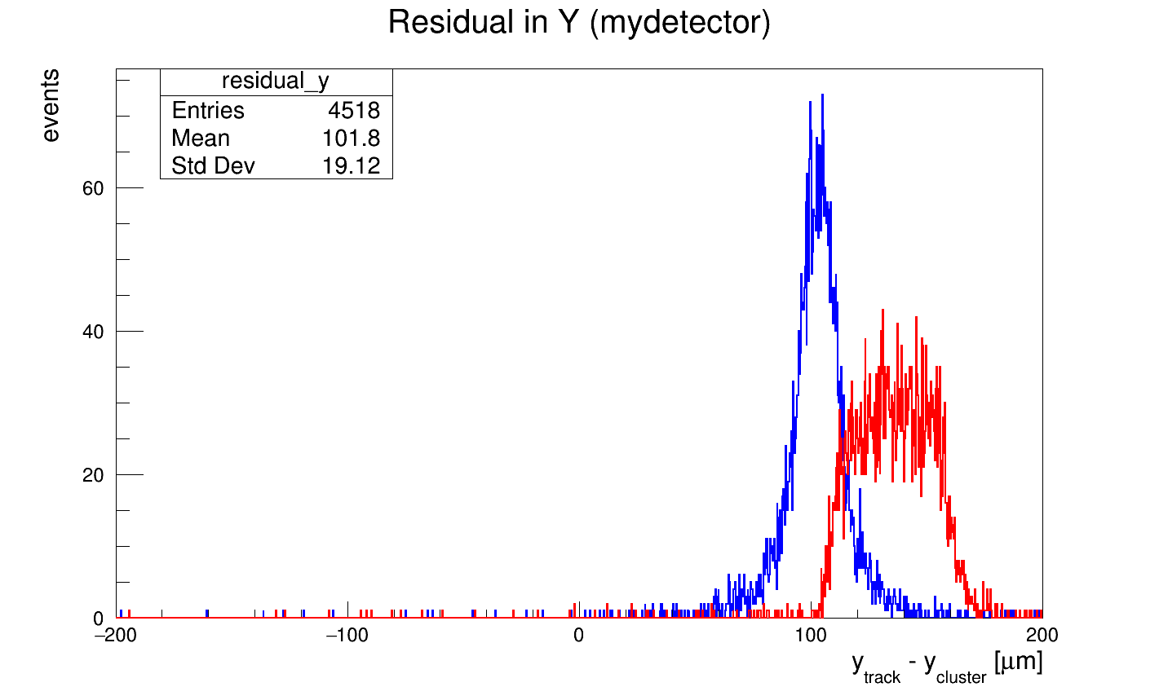
Exercise 1 – Resolution of a silicon pixel detector
iThemba Labs Instrumentation School 2023
10

Slide 11
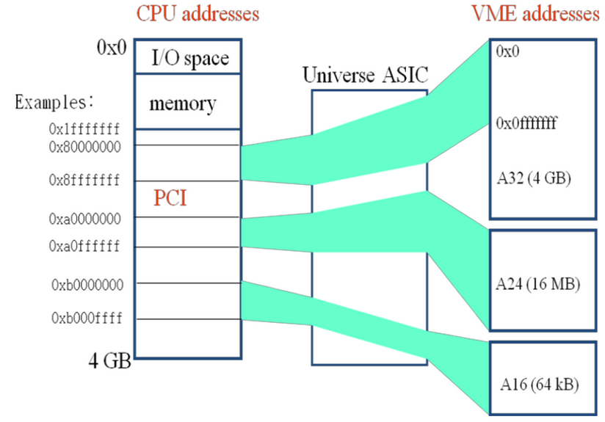
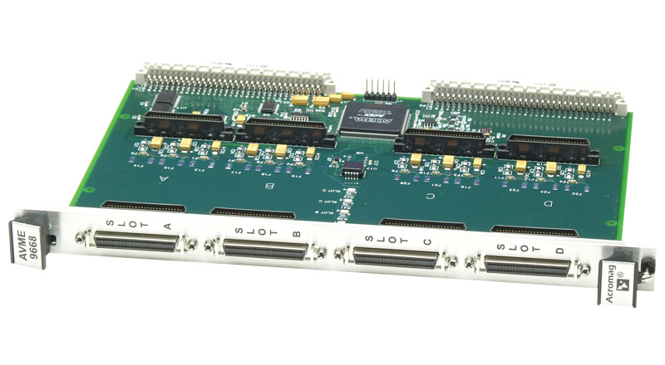
Exercise 2 – Data Acquisition using VMEBus
Learning achievements:
Read/Write data in A32/D32 mode
Single Cycles vs Block transfers
Safe vs Fast modes
Master, Slave and Analyzer
iThemba Labs Instrumentation School 2023
11

Slide 12
Exercise 4 – Micro Pattern Gas Detector
ArCO2 (70:30)%.
Two processes occur namely, Auger Effect and Photo electric effect.
Large peak due to Auger Effect where 2 electrons are liberated, giving rise to more charge collection.
Smaller peak as a result of Photoelectric effect, liberating only 1 electron.
iThemba Labs Instrumentation School 2023
12

Slide 13
Exercise 4 – Micro Pattern Gas Detector
Movement of electrons (yellow) and ions (red)
Electric field in xy plane due to wire mesh and surrounding electrodes:
Incoming signal from charge collection:
iThemba Labs Instrumentation School 2023
13

Slide 14
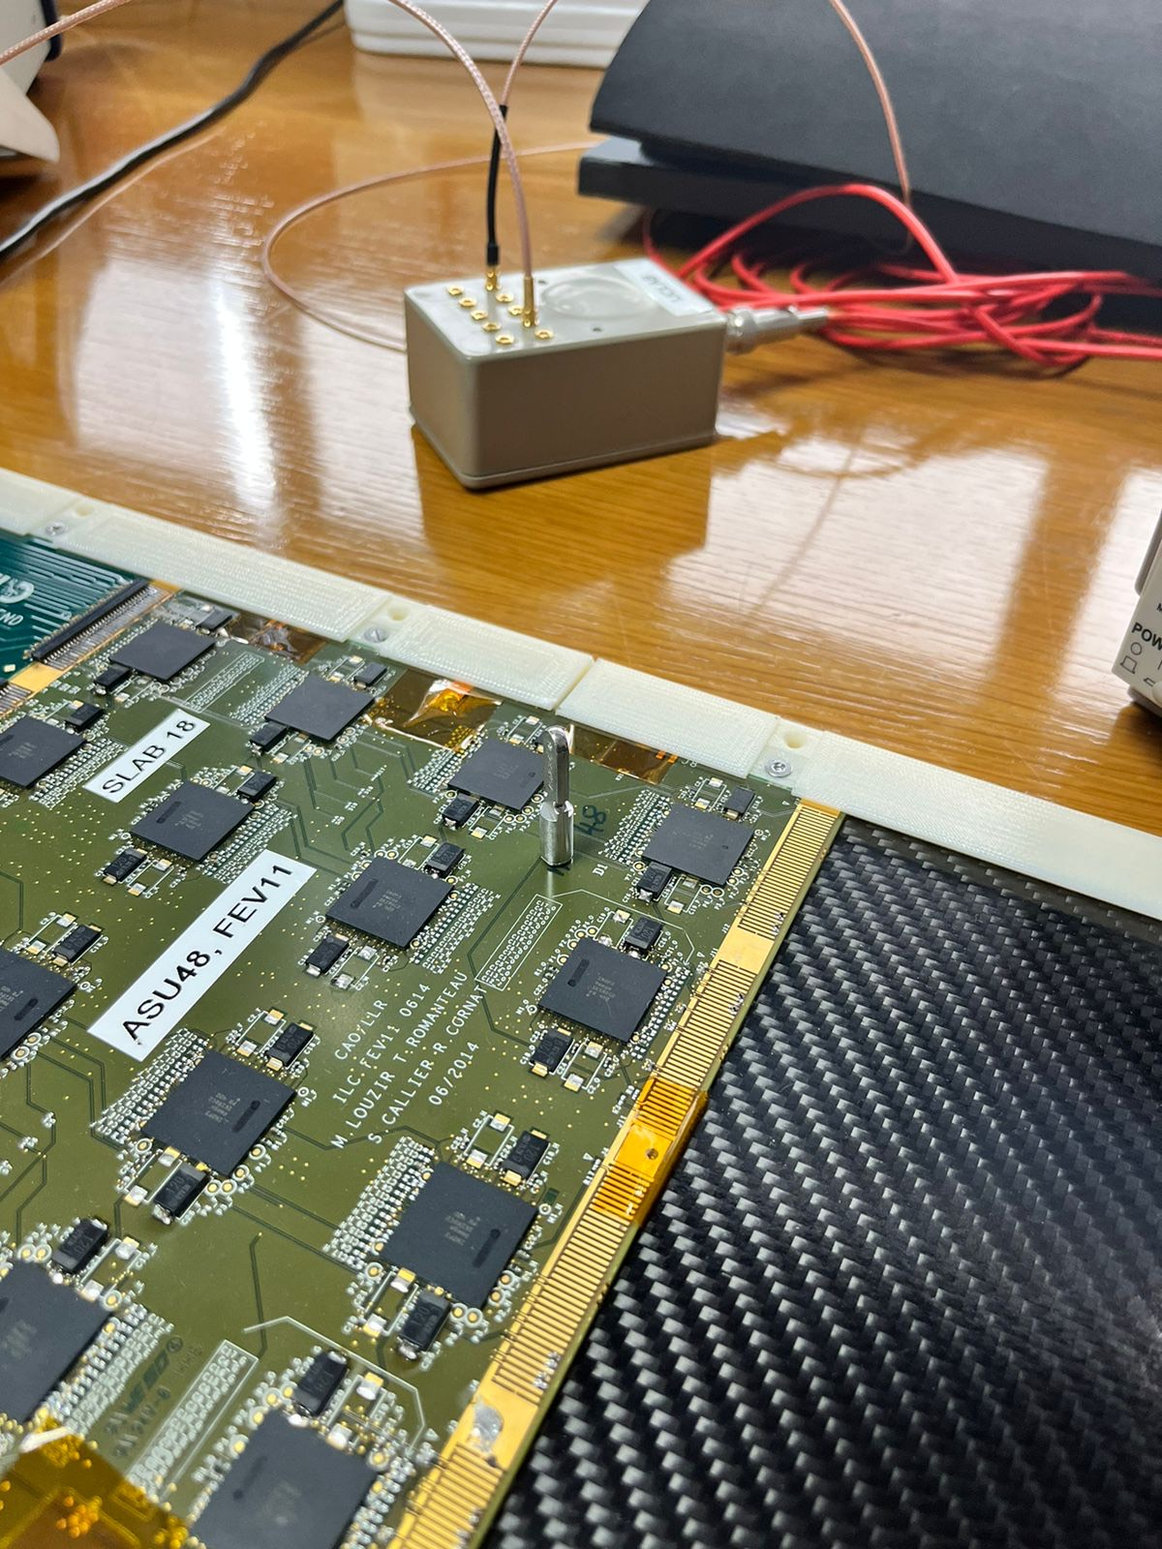
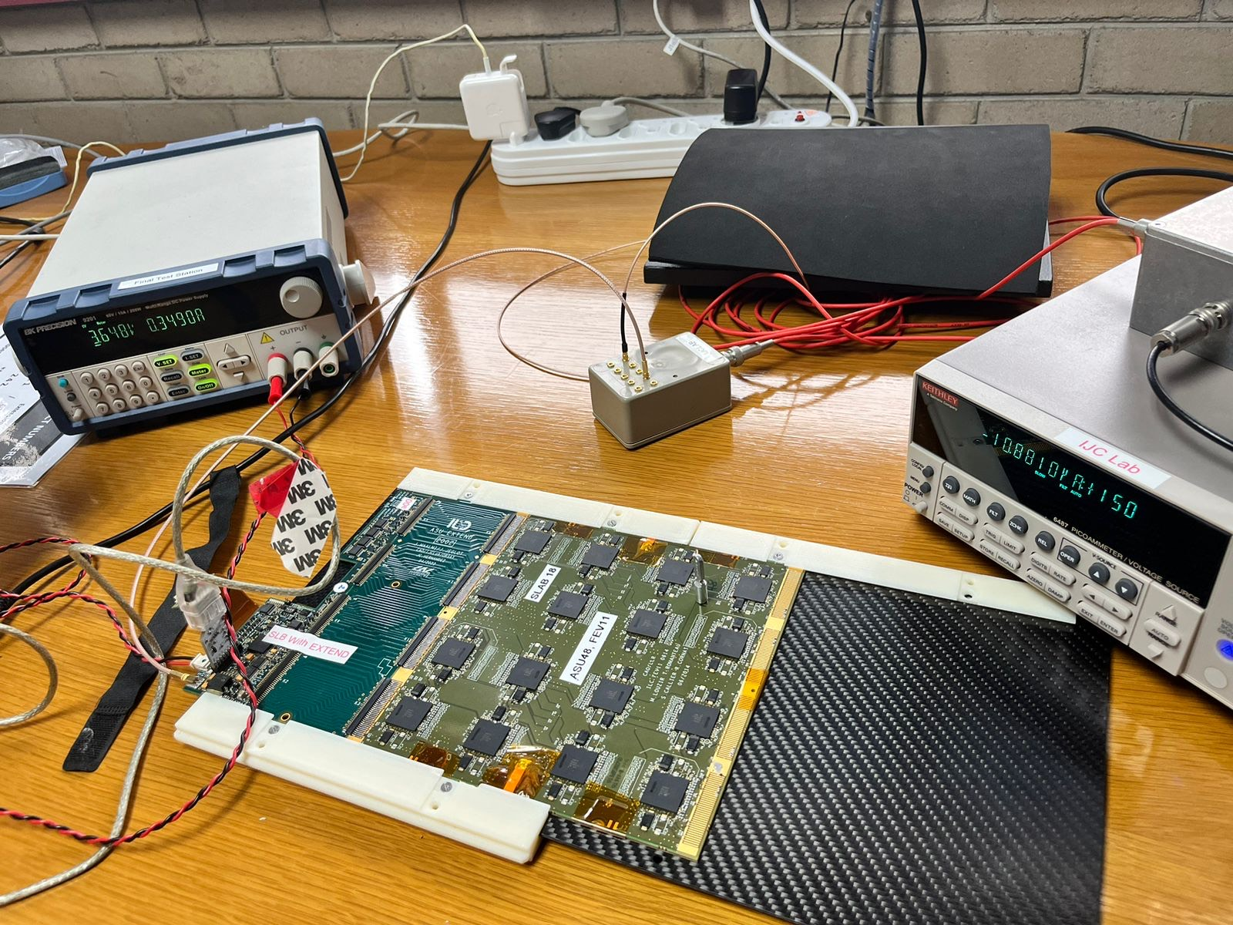
Exercise 5 – Calorimetry Silicon Tungsten
PCB containing 16 chips reading out the 1024 silicon cells
Low voltage power supply
High voltage power supply
iThemba Labs Instrumentation School 2023
14

Slide 15
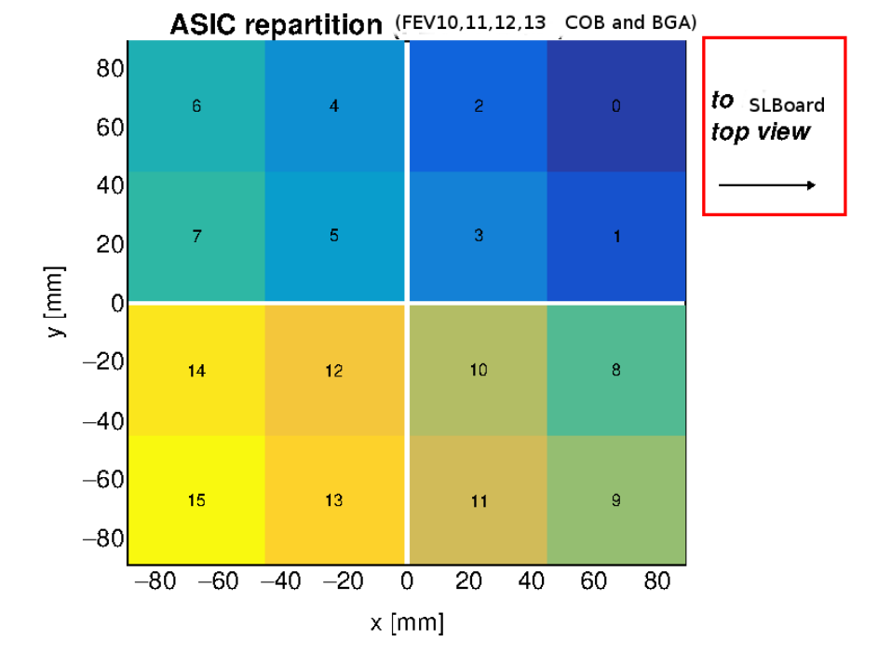
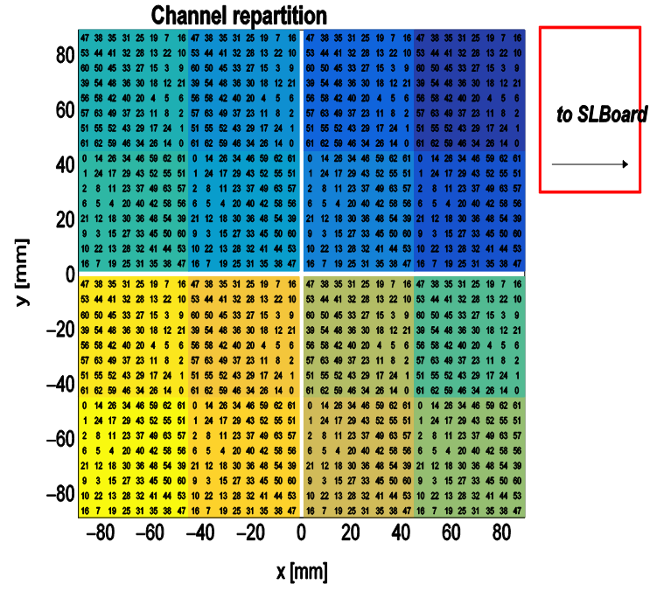
Exercise 5 – Calorimetry Silicon Tungsten
iThemba Labs Instrumentation School 2023
15

Slide 16
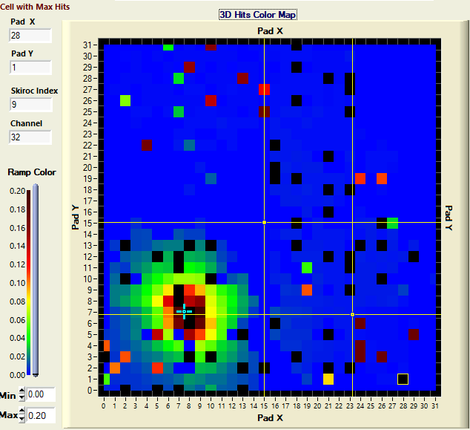
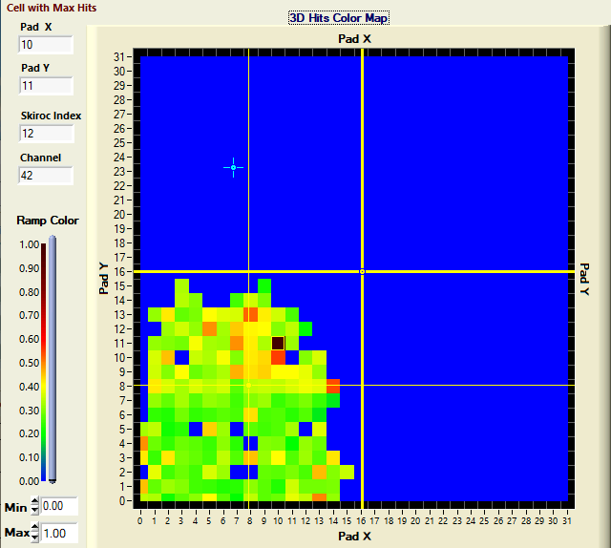
Exercise 5 – Calorimetry Silicon Tungsten
Radium Source:
Iron-55 Source:
iThemba Labs Instrumentation School 2023
16

Slide 17
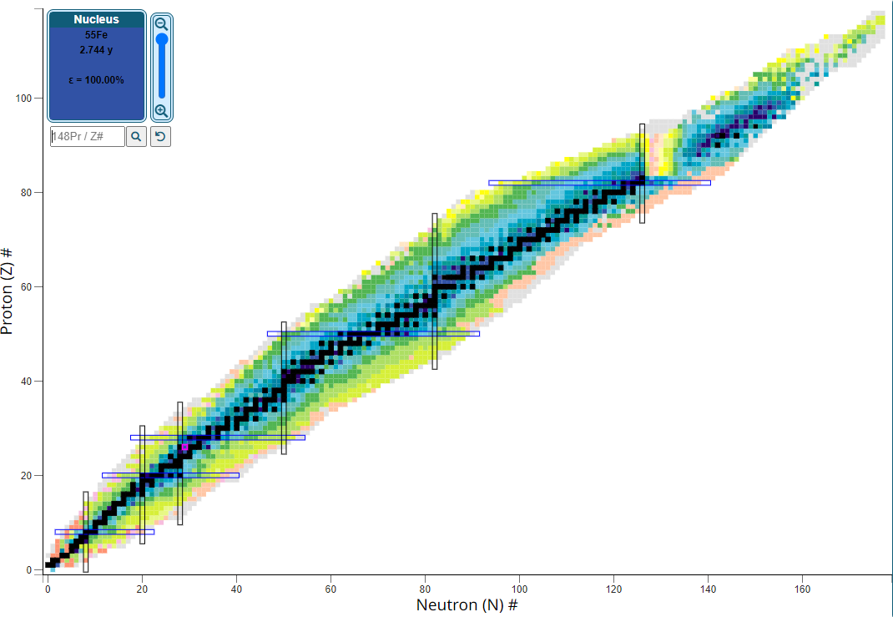
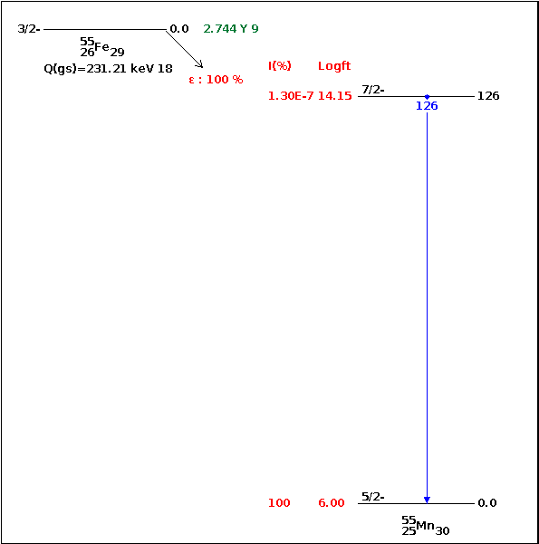
Exercise 5 – Calorimetry Silicon Tungsten
Table of Isotopes:
Iron-55 Decay Scheme:
126 keV should interact with silicon, but…
Photoelectric effect
(at low energies)
Silicon: Z = 14
Low intensity source…
Low statistics…
:
Decays via electron capture
p + e⁻ → n + ν_{e}
Daughter nucleus ⁵⁵Mn de-excites releasing a 126 keV photon
iThemba Labs Instrumentation School 2023
17

Slide 18

Thank you !

