Slide 1
Instrumentation School 2023
Team 5
Dineo Sebuso
Sanele Gumede
Thuso Mathaha
Lungisani Phakathi
Hamza Mohamed

Slide 2
OUTLINE
Purpose of the exercises
Resolution of a Silicon pixel detector
Data Acquisition
Micro pattern gas detector
Cloud chamber
Calorimetry Silicon Tungsten

Slide 3
Purpose of the exercises
To get hands-on training for world class experiments from international experts on the detection measurements.

Slide 4
Resolution of a Silicon pixel detector
Incoming particles will deposit energy to the silicon detector creating electron-holes pair.
Diffusion and drift process will propagate the electron-holes pairs then the signal will be formed by moving charges.
Front-end electronics will finalize the signal for output.
AllpixSquared is used to simulate the output signals

Slide 5
Results
Due to zero rotation

Slide 6
Data Acquisition
Purpose of this exercise is to demonstrate that the difference between internal and external memory is little.
It is important to understand that VMEbus memory has to be mapped into the (virtual) address space of a user process before it can be accessed.
In order to transfer data the appropriate mappings for the type of VMEbus must be created.
CPU controls the data transfer.
CPU
MASTER
SLAVE

Slide 7
Micro pattern gas detector
It is important to understand that how the charge particles interact with the gas.
As the charge particles interact with the gas it ionizes gas molecules.
Charge particles are transported by electric field within the gas volume.
The movement of charge particles induces the current in electrode, then the signals will be processed.

Slide 8
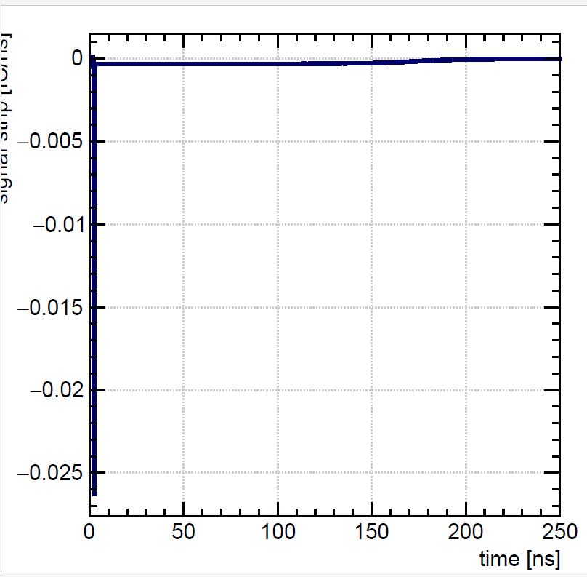
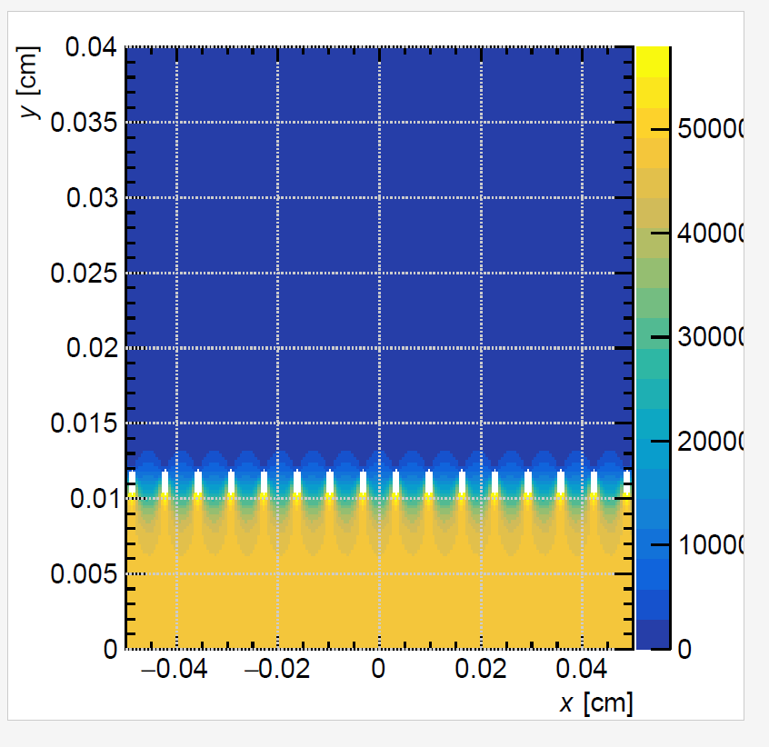
Results - 3
Less electric field
Due to Auger effect
Signal
Electric field
Due to photo-electric effect

Slide 9
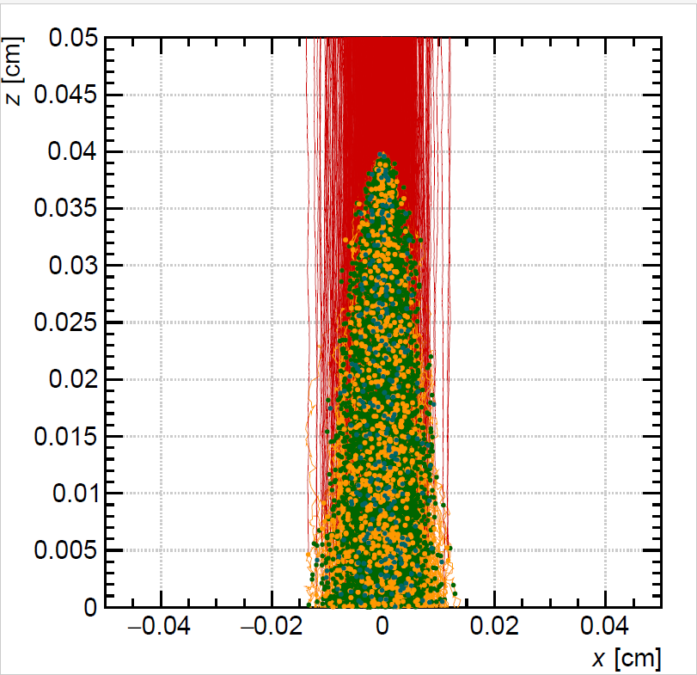
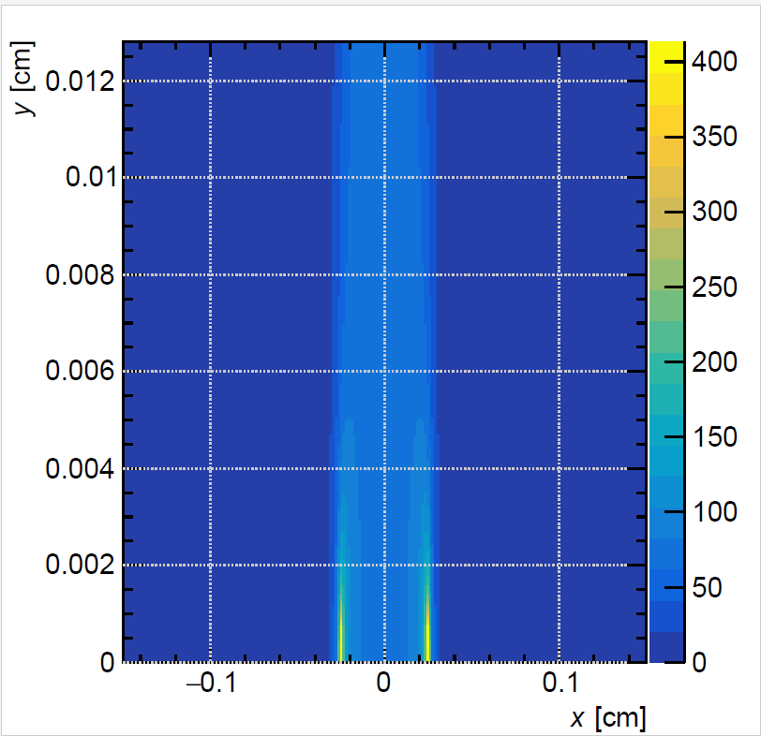
Results – 3.2
Avalanche effect

Slide 10
Cloud chamber
There are number of particles coming from the universe to Earth that are invisible.
Cloud chamber detector experiment has been used to make those particles visible.
This experiment has been used in the first particle physics experiment.

Slide 11
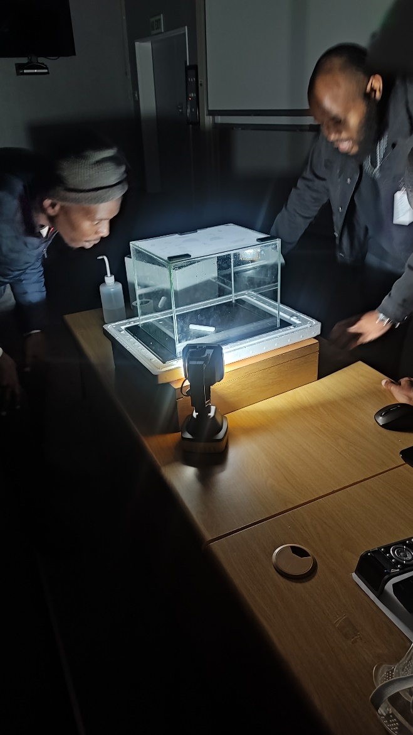
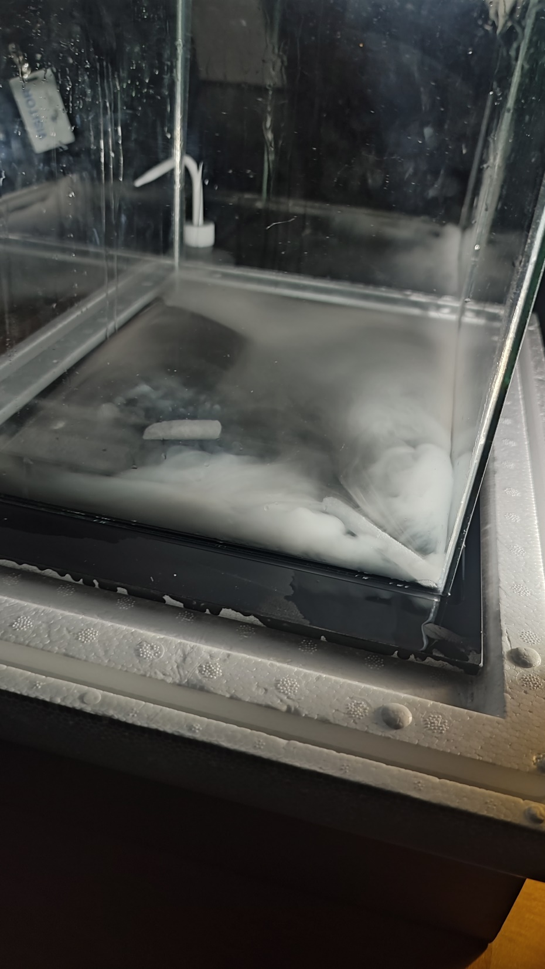
Experiment Setup & Results - 4

Slide 12
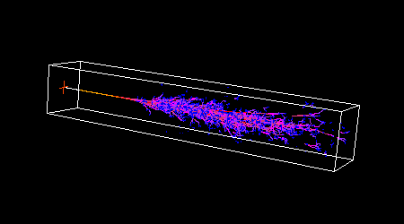
Calorimetry Silicon Tungsten
Interaction of particle with matter and basics of electromagnetic showers
Detection Process is based on scattering of particles while passing detector material.

Slide 13
Results – source 1
Americium 241

Slide 14
Results – source 2
Radium 226

Slide 15
Results – cosmic runs

Slide 16
Thank You!!!!!

