Slide 1



Establishing the Deformation Characteristics of ⁶⁶Ge
Nikita Bernier
nbernier@uwc.ac.za
Advanced Nuclear Science and Technology Techniques Workshop (ANSTT5)
19 April, 2024.

Slide 2
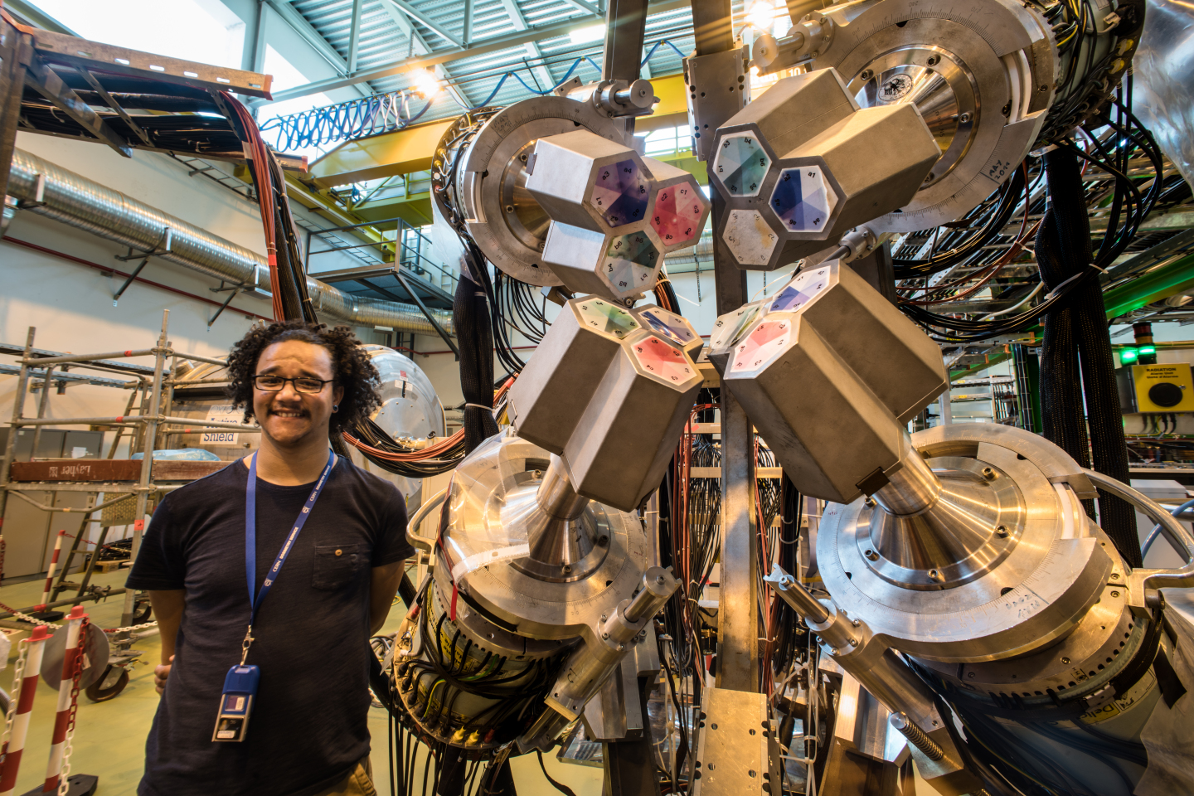
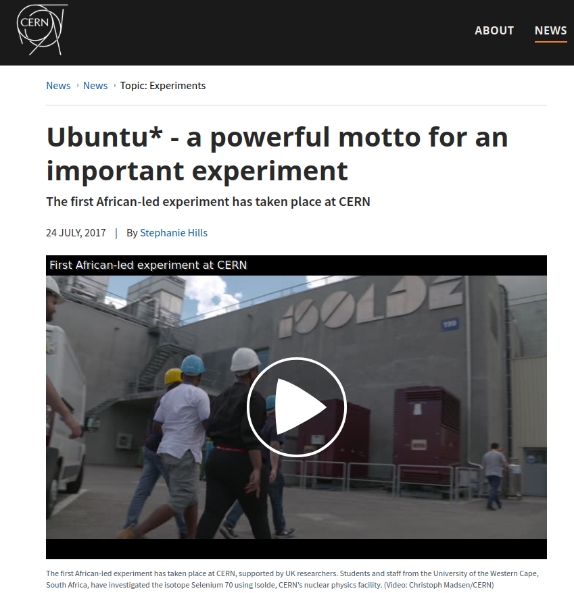
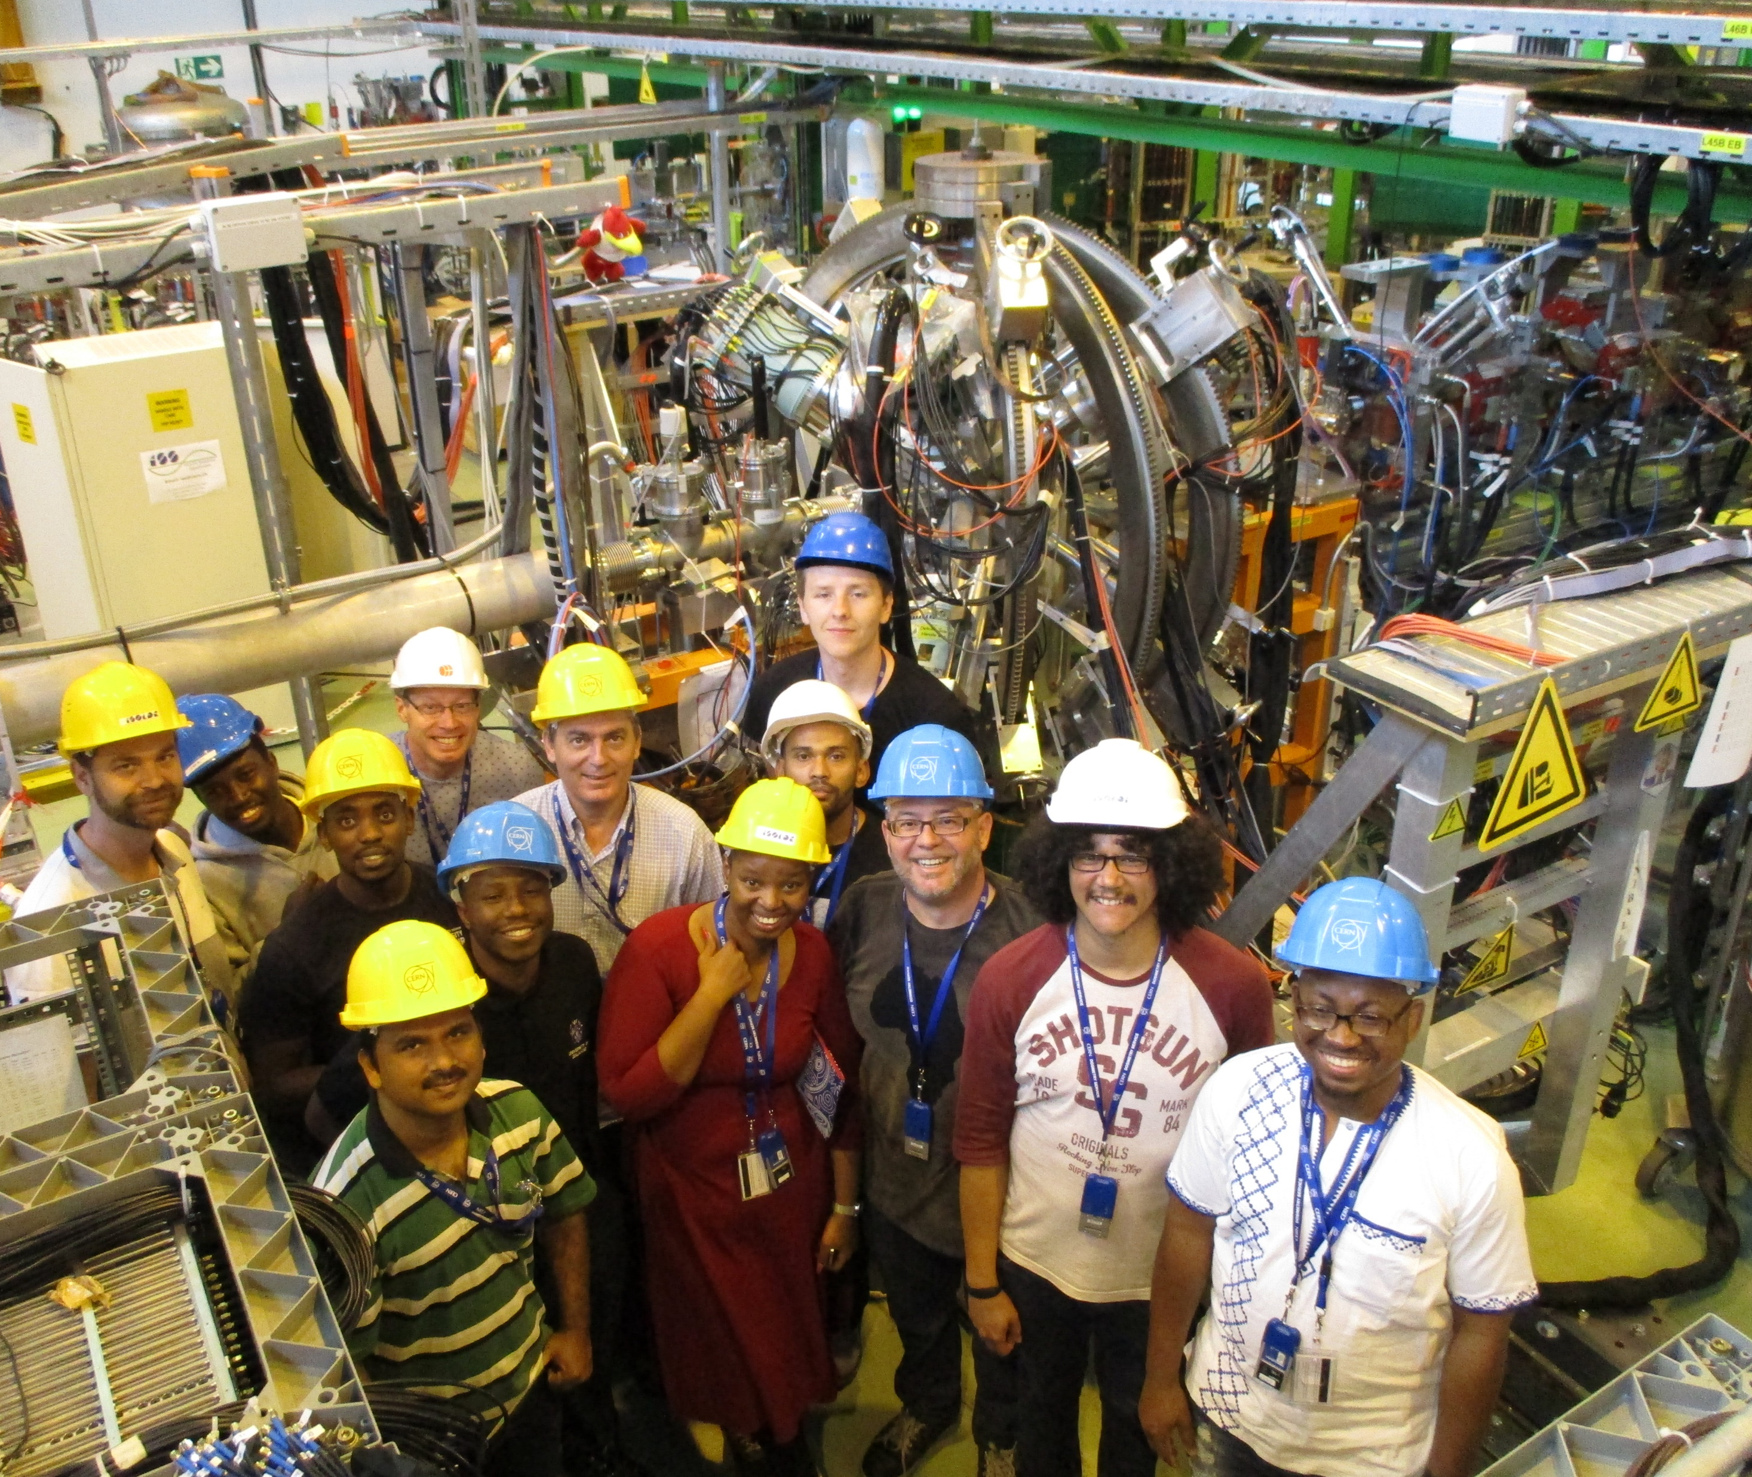
UWC at CERN
2
Nine students from South Africa went to CERN in July 2017 to run what CERN called the Ubuntu experiment
Ph.D. awarded to Kenzo Abrahams in 2021
https://home.cern/news/news/experiments/ubuntu-powerful-motto-important-experiment

Slide 3
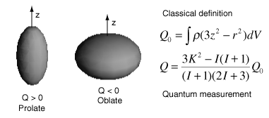
Shapes of nuclei
3
Atomic nuclei have different shapes, such as the axially-symmetric quadrupole prolate or oblate.
Electric quadrupole moment Q tells the shape
Measured electric quadrupole moments of ground states indicate that all doubly-magic nuclei have spherical shapes, while nuclei situated in-between the magic numbers are deformed.
Q = 0
Q_{S} < 0
Q_{S} > 0

Slide 4
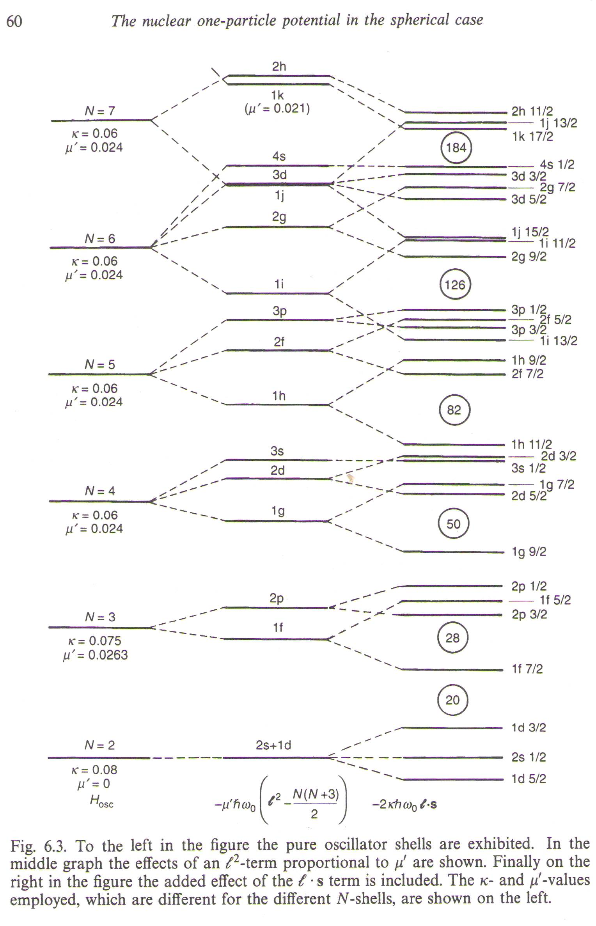
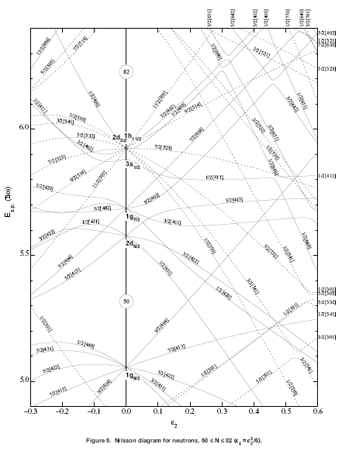
Nuclear shell model
4
Triaxial shapes are proposed to explain extremely deformed shapes!

Slide 5
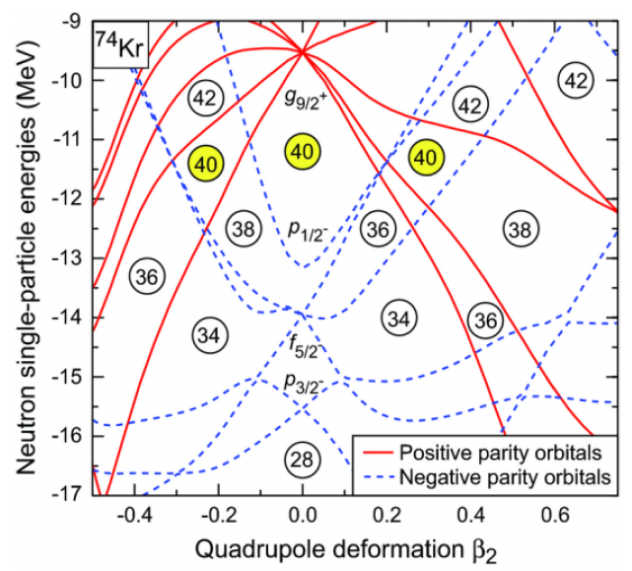
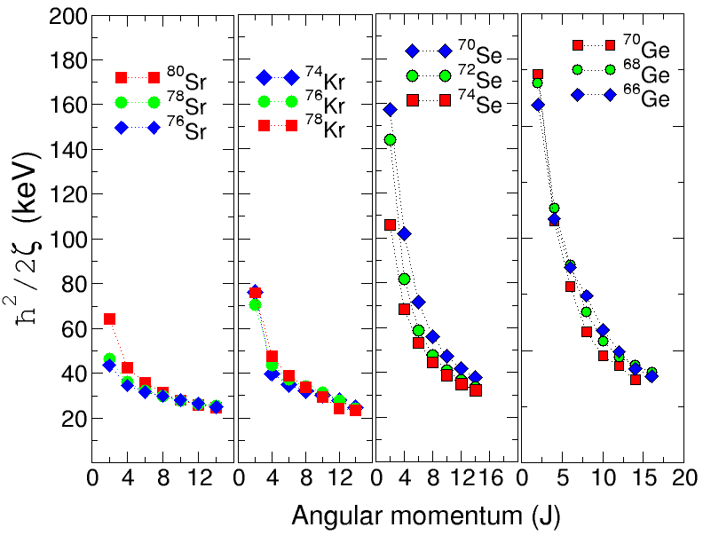
Evolving nuclear shape in the A ~ 70 region
5
A ~ 70 region is a great testing ground for rapidly-changing nuclear shapes because of the subshell gaps at proton and neutron numbers 34, 36 and 38.
2⁺ rotational parameter is anomalously high, which is a signature for shape coexistence
1

Slide 6
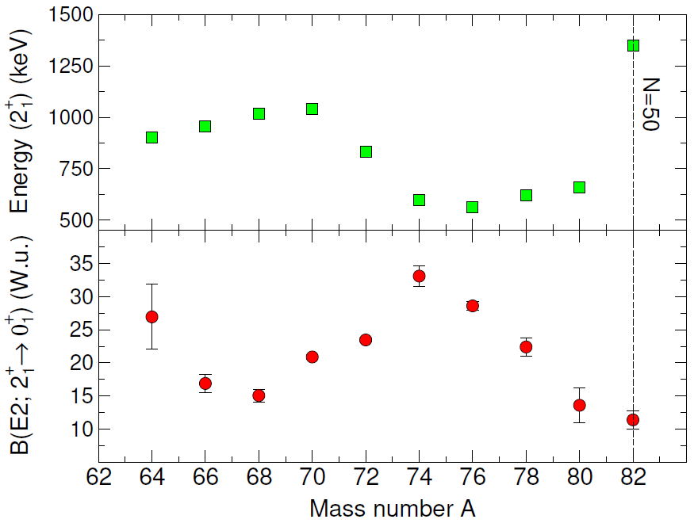
Shell model curiosity
6
⁶⁶Ge (N = 34) has a similar E2 strength to ^{80,82}Ge (N = 50)
What is the deformation of ⁶⁶Ge in the first 2⁺ state?
⁶⁶Ge

Slide 7
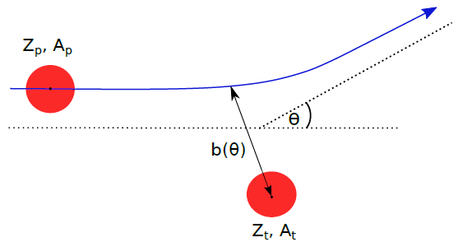
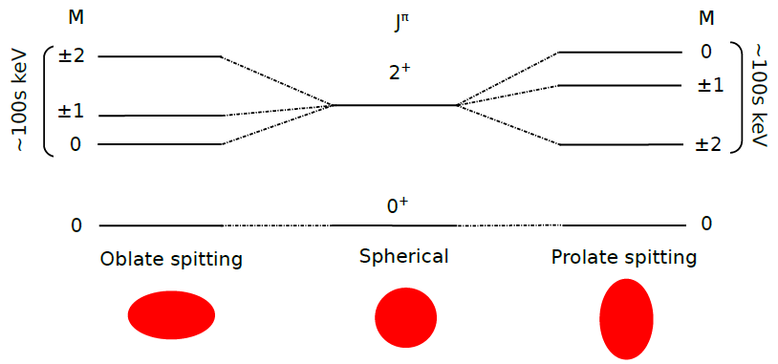


Coulomb excitation
7
The reorientation effect is a second-order perturbation in Coulomb-excitation theory useful to determine quadrupole moments Q_{S} of excited states, i.e. nuclear shapes
Nuclear contributions can be eliminated by choosing a "safe" bombarding energy well below the Coulomb barrier.

Slide 8
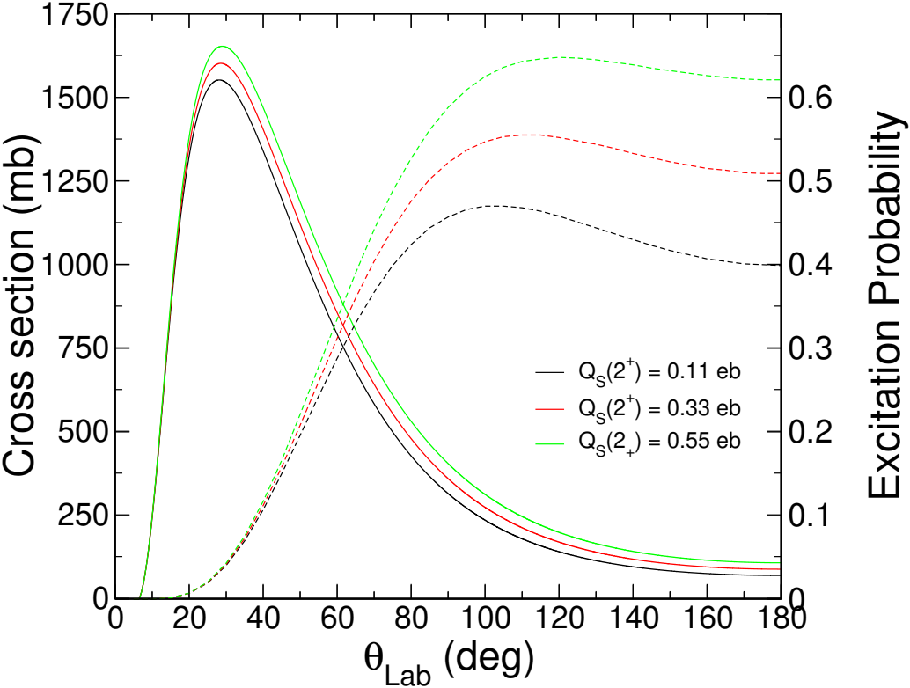
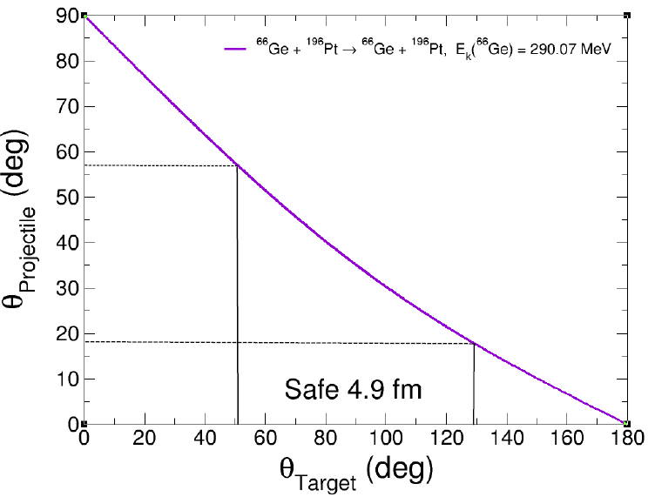
Cross section and excitation probability
8
The Coulomb-excitation cross section and the angular distribution of the γ-rays emitted depend on the magnitude and sign of Q_{S}:
Beam-gated data at forward angles [18.2^{ᵒ} – 56.2^{ᵒ}] is sensitive to B(E2) value
Target-gated data, corresponding to backward angles 52.1^{ᵒ} – 128.1^{ᵒ}, is sensitive to Q_{S}(2⁺)
¹

Slide 9
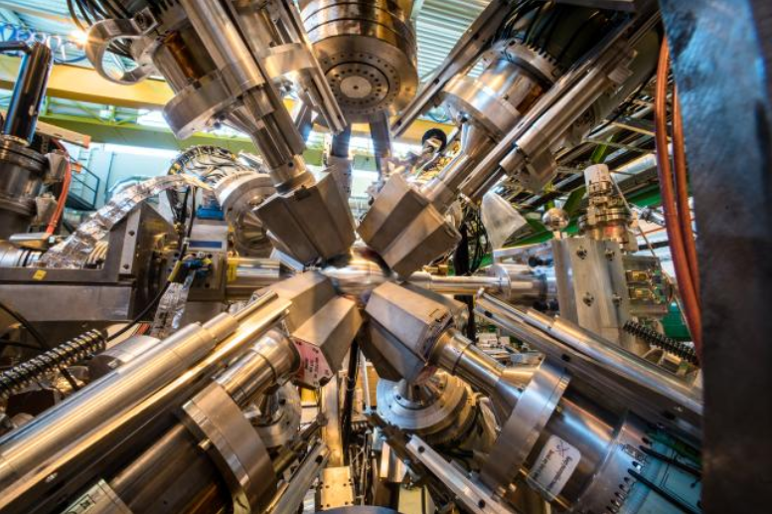
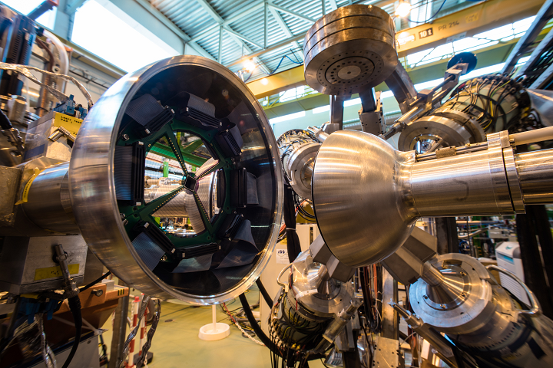
Particle-γ coincidences with MINIBALL
9
First time ⁶⁶Ge was accelerated at low energies: 4.395 MeV/u bombarded onto a 4 mg/cm² ¹⁹⁶Pt target (97.25%)
8 segmented triple-cluster high-purity germanium (HPGe) detectors, for high detection efficiency and accurate position sensitivity
CD-type Double Sided Silicon Strip Detector (DSSSD) with 16 rings and 24 sectors for angular distributions and Doppler correction, placed at 27.34 mm and covering 18.2^{ᵒ} – 56.2^{ᵒ}
Implantation to study beam contaminants.

Slide 10
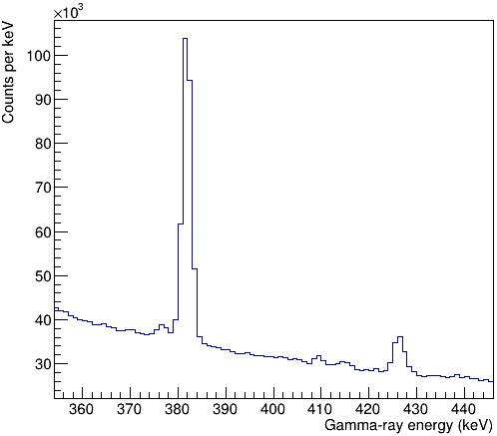
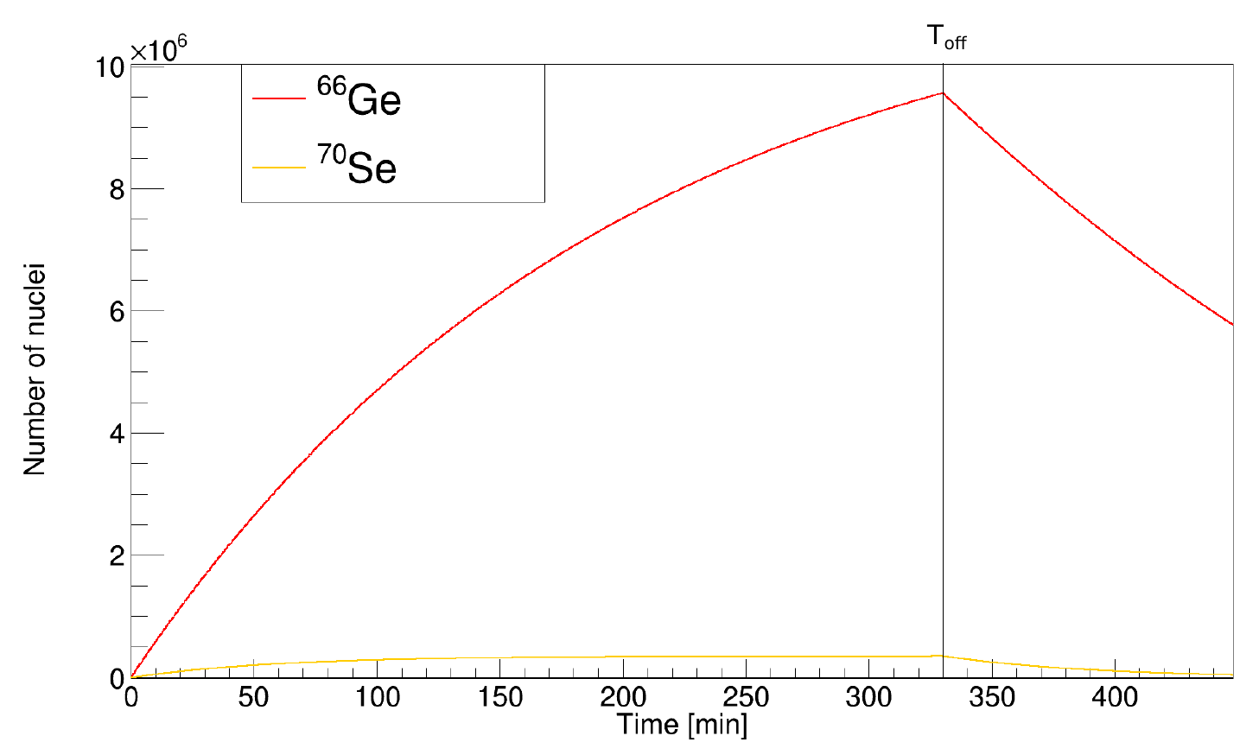

Beam composition
10
Sulfur in the ZrO₂ target enabled production of ⁶⁶Ge³²S with ⁷⁰Se¹²C¹⁶O
Beam composition estimated at the tape station ⁶⁶Ge/⁷⁰Se ~ 10
Mass = 98 molecular beam (⁶⁶Ge³²S vs. ⁷⁰Se¹²C¹⁶O) was implanted on aluminium foil
381.9 keV
⁶⁶Ge → ⁶⁶Ga
I_{β}= 28%
t_{1/2} = 2.26 h
426.2 keV
⁷⁰Se → ⁷⁰As
I_{β} = 29%
t_{1/2} = 41.1 min
Implantation
Decay

Slide 11
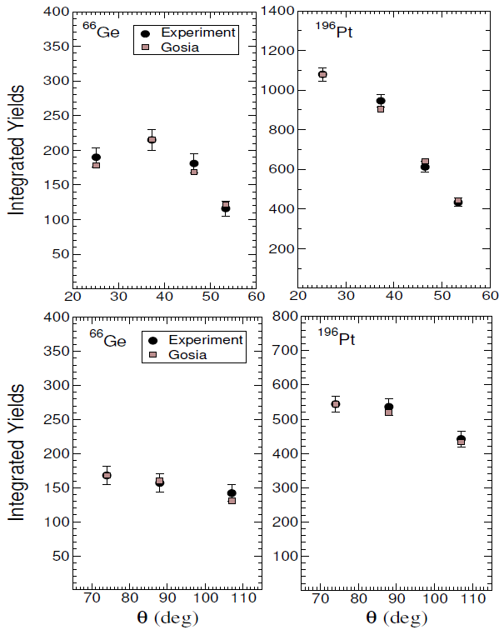
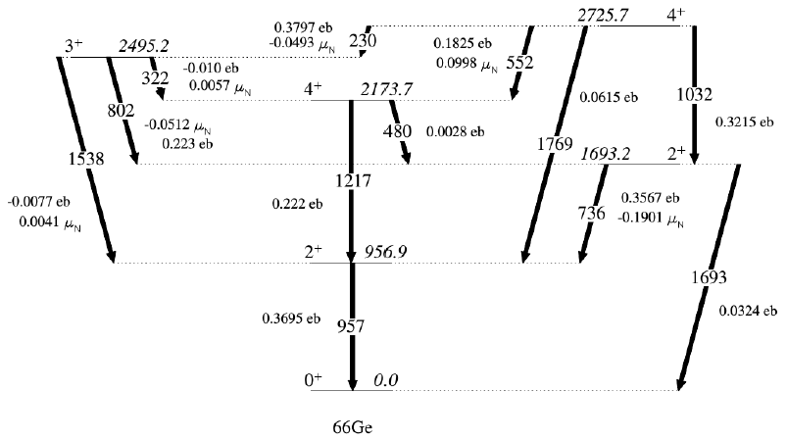
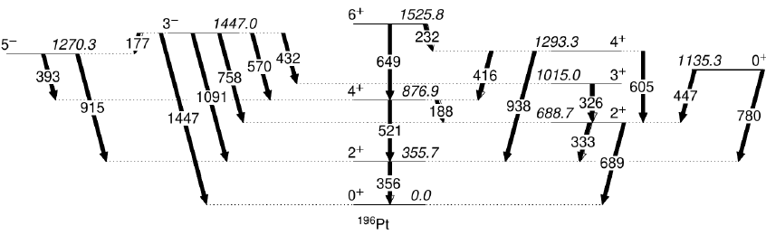
Angular distributions
11
Integrated yields for the 2⁺ states in ⁶⁶Ge and ¹⁹⁶Pt predicted by GOSIA in good agreement
1
Beam-gated
Target-gated

Slide 12
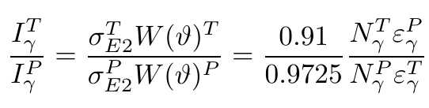
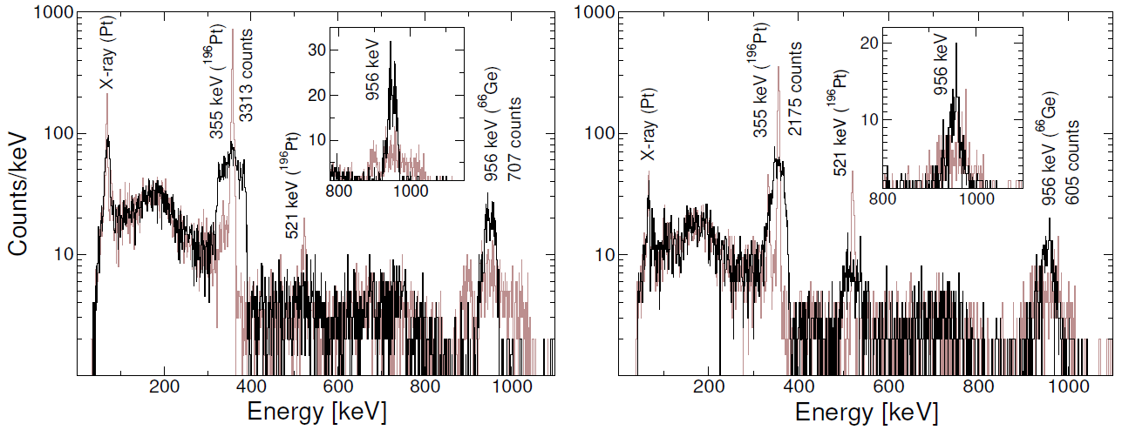
Normalization method
12
Minimizes systematic uncertainties (e.g. dead time, difference in beam currents)
Beam-gated: ¹⁹⁶Pt/⁶⁶Ge intensity ratio = 2.24(5)
Target-gated: ¹⁹⁶Pt/⁶⁶Ge intensity ratio of 1.72(5)

Slide 13
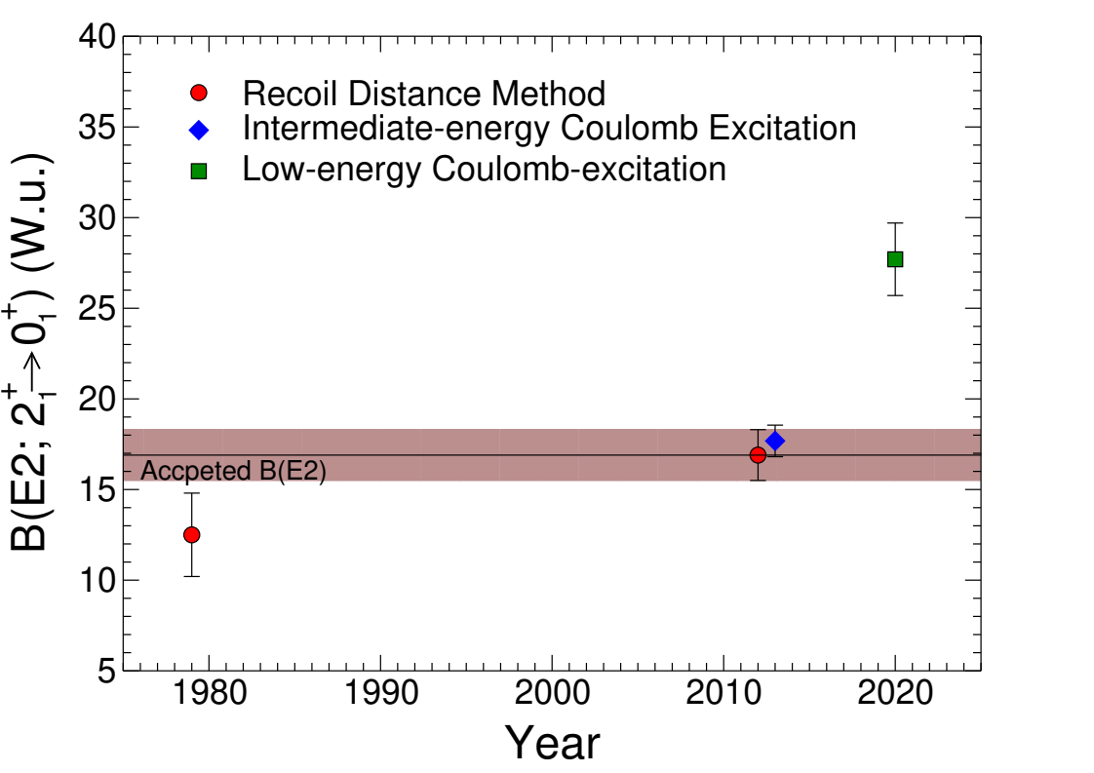
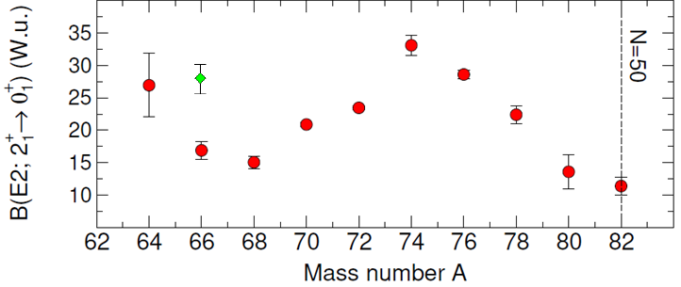
Determination of B(E2) value
13
B(E2; 2⁺ → 0⁺) = 27.7(20) W.u. : 1σ from accepted value
Large B(E2) value confirms that ⁶⁶Ge is more collective than previously measured, solving finally the problem with the low collectivity in ⁶⁶Ge :-)
1

Slide 14
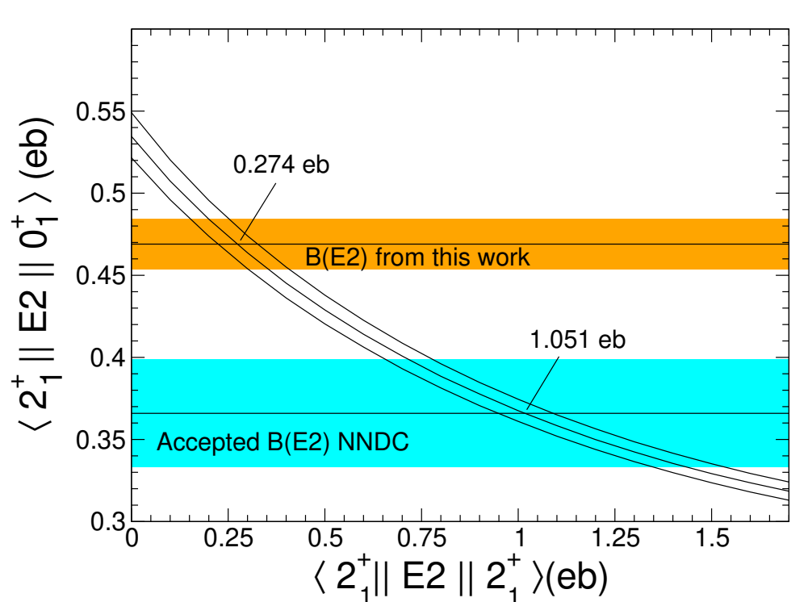
Determination of Q_{S}(2⁺)
14
Q_{S}(2⁺) = +0.21(5) eb : positive diagonal matrix element means oblate!
Smaller than the anomalously large diagonal matrix element obtained using accepted value
1
Target-gated

Slide 15
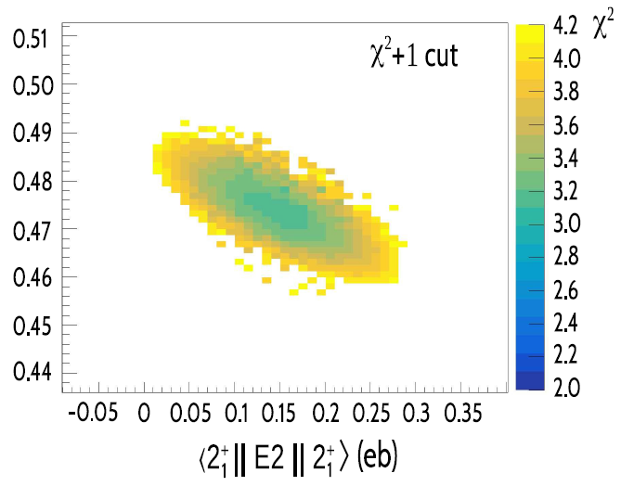

Minimization method
15
Y-axis: Transitional Matrix Element = 0.4744(284) eb → B(E2; 2⁺ → 0⁺) = 28.4(33) W.u.
X-axis: Diagonal Matrix Element = 0.15-0.13 eb → Q_{S}(2⁺) = +0.11-0.10 eb
1
+0.14
+0.11
1

Slide 16
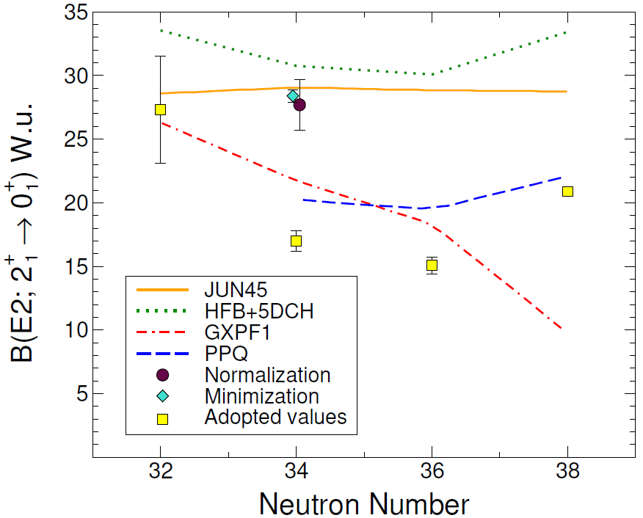
Shell model calculations
16
Large B(E2) value in agreement with JUN45 [Honma et al., 2009], which includes the 1f_{5/2}, 2p_{3/2}, 2p_{1/2}, and 1g_{9/2} orbitals
Single-particle energies treated as fitting parameters instead of experimental data
133 two-body matrix elements and 4 single-particle energies determined by fitting 400 experimental binding and excitation energies from 69 nuclei

Slide 17
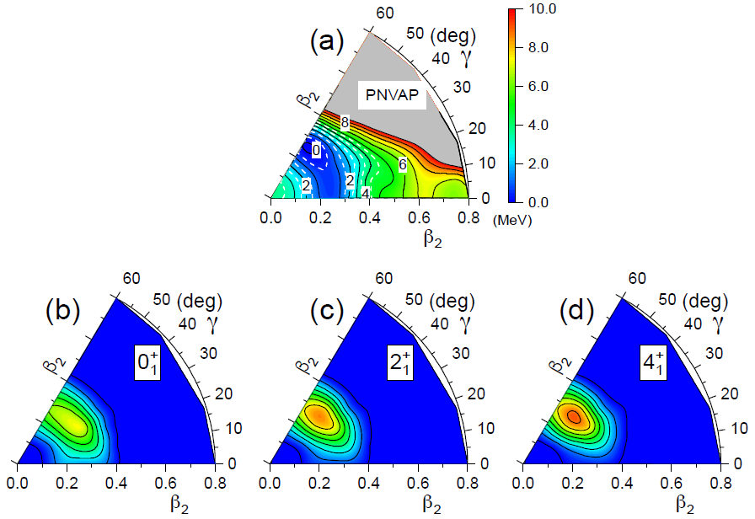
Beyond mean-field calculations
17
Particle Number Variation After Projection (PN-VAP) beyond mean-field calculations iteratively vary the shape and minimize the energy to obtain the collective behaviour of a given nucleus
The energy and collective wave functions for different states are obtained by solving the Schrödinger equation
Oblate deformation with Q_{S}(2⁺)_{theory} = 0.21 eb in ⁶⁶Ge in agreement with our measurement!
1

Slide 18
Conclusions
18
Successful Coulex of neutron-deficient Ge isotopes at safe energies at ISOLDE
Large positive Q_{S}(2⁺) value is in agreement with the oblate deformation calculated by beyond mean-field calculations
Large B(E2) value confirms that ⁶⁶Ge is more collective than previously measured, in agreement with SM and beyond-mean field calculations
Measured values suggest that ⁶⁶Ge presents strong oblate collectivity, long-sought in this region of the nuclear chart!
1

Slide 19
Thank you for your attention!
K. J. Abrahams,¹ J. N. Orce,^{1, 2} L. P. Gaffney,^{3, 4} D. G. Jenkins,^{5, 1} T. R. Rodríguez,⁶ N. Bernier,^{1,2}
E. H. Akakpo,^{1, 7} G. de Angelis,⁸ M. J. G. Borge,⁴ A. Brown,⁵ D. T. Doherty,⁹ P. E. Garrett,^{10, 1}
S. Giannopoulos,⁴ K. Johnston,⁴ M. Kumar Raju,^{1, 11} E. J. Martín Montes,¹ D. L. Mavela,¹ S. Masango,¹ C. V. Mehl,¹ D. R. Napoli,¹² B. S. Nara Singh,¹³ C. Ngwetsheni,¹ S. S. Ntshangase,⁷ G. G. O’Neill,¹
P. Spagnoletti,¹³ G. Rainovski,¹⁴ F. Recchia,^{15, 16} R. Wadsworth,⁵ N. Warr,¹⁷ and R. Zidarova^{4, 14}
¹ U of the Western Cape
² NITheCS
³ U of Liverpool
⁴ CERN
⁵ U of York
⁶ U Complutense de Madrid
⁷ U of Zululand
⁸ INFN Legnaro
⁹ U of Surrey
¹⁰ U of Guelph
¹¹ iThemba LABS
¹² Laboratori Nazionali di Legnaro
¹³ U of the West of Scotland
¹⁴ St. Kliment Ohridski U of Sofia
¹⁵ U degli Studi di Padova
¹⁶ INFN Sezione di Padova
¹⁷ U of Cologne

