Slide 1


Application of an electronic spreadsheet package and a dedicated spectral analysis software for the calibration of a gamma-ray spectrometer
Presented at the Advanced Nuclear Science and Technology Techniques (ANSTT5)
Workshop, 15-19 April, 2024. iThemba LABS, Cape Town, South Africa.
Michael Adeleye
Bingham University, Nigeria
18th of April, 2024.
Notes:
Focusing on Metrology, Neutron Physics, Environmental Measurements and Networking. Conference hosted by iThemba LABS, Laboratory for
Accelerator Based Sciences, Cape Town, South Africa.

Slide 2
PRESENTATION OUTLINE
Introduction
Focus of this study
Crucial role of full energy peak efficiency of detectors in analytical accuracy
Efficiency calibration with spectral analysis software
Efficiency calibration with Microsoft Excel electronic spreadsheet package
Efficiency computation and fitting with electronic spreadsheet for GEM 30195 at 2cm & 15cm geometries
Comparison of the FEPE calibration results obtained from both approaches (spreadsheet and k₀_IAEA)
Results & discussion
Conclusion

Slide 3

Centre for Energy Research and Training (CERT) NAA laboratories
Notes:
However, I must acknowledge that NaI(TI) scintillation detectors have higher efficiencies but lower resolutions compared to (HPGe) detectors .
Superior resolution capabilities of HPGe detector systems. As the result of this improved resolution, many nuclear energy levels that could not be seen with NaI(Tl) detectors are easily identified with HPGe detectors.

Slide 4
Strategic Utilization Plan for NIRR-1
This study was carried out as part of the strategic development plans for the optimum utilization of the Nigeria Research Reactor-1 (NIRR-1) since it was installed and commissioned in 2004.
It was specifically designed for use in
neutron activation analysis (NAA) and
limited radioisotope production.
Notes:
However, I must acknowledge that NaI(TI) scintillation detectors have higher efficiencies but lower resolutions compared to (HPGe) detectors .
Superior resolution capabilities of HPGe detector systems. As the result of this improved resolution, many nuclear energy levels that could not be seen with NaI(Tl) detectors are easily identified with HPGe detectors.

Slide 5
NIRR-1 DESIGN SPECIFICATIONS
A geometric diagram of NIRR-1 core mid-plane from MCNP code
(NIRR-1) is a low-power Miniature Neutron Source Reactor (MNSR) designed by China Institute of Atomic Energy (CIAE) with a tank-in-pool structural configuration and a nominal thermal power rating of 31 kW at thermal neutron flux setting of 5 x 10¹¹ n.cm⁻².s⁻¹
Notes:
However, I must acknowledge that NaI(TI) scintillation detectors have higher efficiencies but lower resolutions compared to (HPGe) detectors .
Superior resolution capabilities of HPGe detector systems. As the result of this improved resolution, many nuclear energy levels that could not be seen with NaI(Tl) detectors are easily identified with HPGe detectors.

Slide 6
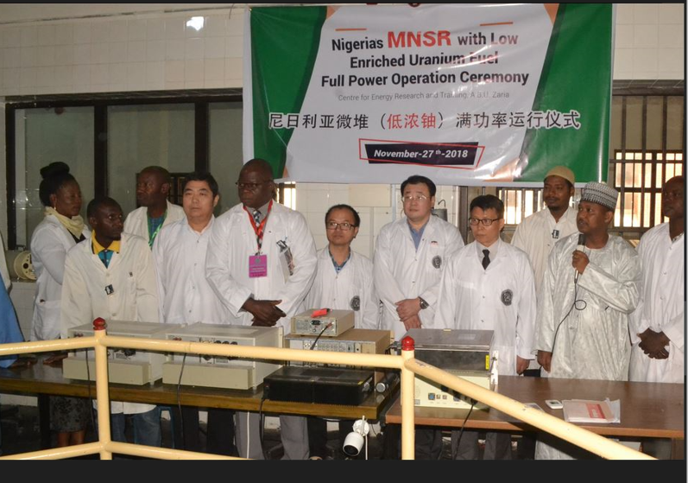
NIRR-1 CONVERSION FROM HEU TO LEU
Conversion from 90% to 12% uranium-235 enrichment
Notes:
However, I must acknowledge that NaI(TI) scintillation detectors have higher efficiencies but lower resolutions compared to (HPGe) detectors .
Superior resolution capabilities of HPGe detector systems. As the result of this improved resolution, many nuclear energy levels that could not be seen with NaI(Tl) detectors are easily identified with HPGe detectors.

Slide 7
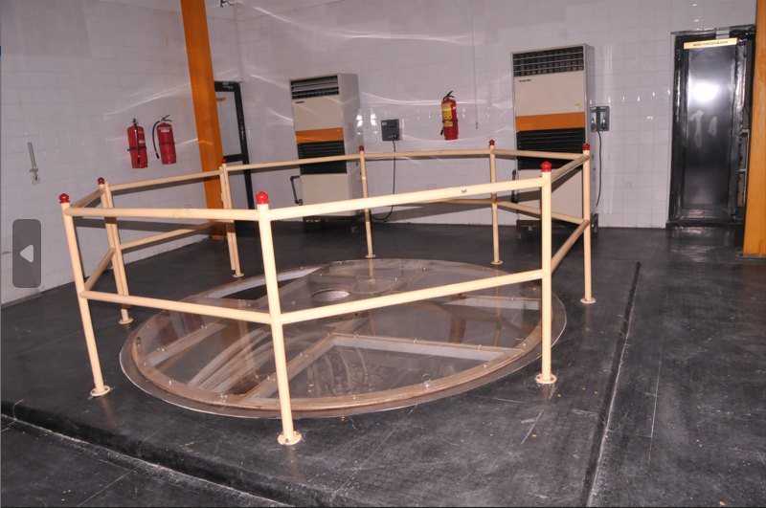
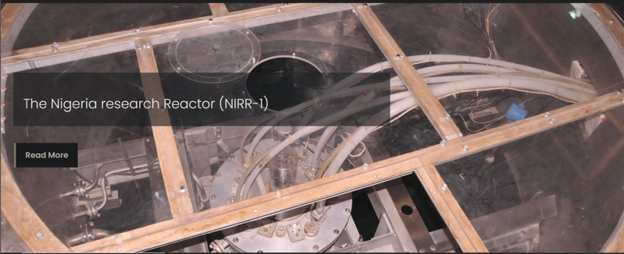
NIRR-1
Reactor Hall
Reactor Core
Notes:
However, I must acknowledge that NaI(TI) scintillation detectors have higher efficiencies but lower resolutions compared to (HPGe) detectors .
Superior resolution capabilities of HPGe detector systems. As the result of this improved resolution, many nuclear energy levels that could not be seen with NaI(Tl) detectors are easily identified with HPGe detectors.

Slide 8
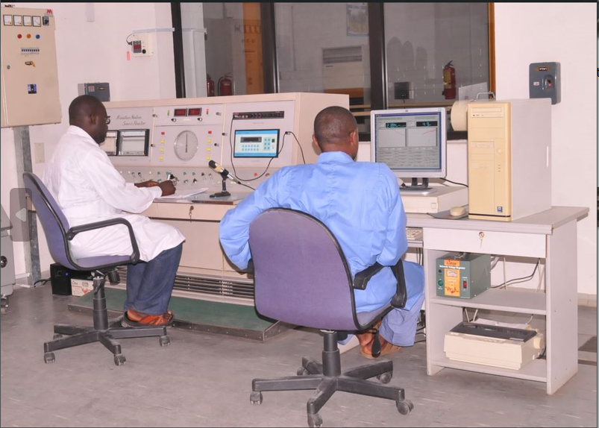
NIRR-1 Control Room
Notes:
However, I must acknowledge that NaI(TI) scintillation detectors have higher efficiencies but lower resolutions compared to (HPGe) detectors .
Superior resolution capabilities of HPGe detector systems. As the result of this improved resolution, many nuclear energy levels that could not be seen with NaI(Tl) detectors are easily identified with HPGe detectors.

Slide 9
INTRODUCTION
Instrumental Neutron Activation Analysis (INAA) is a nuclear analytical technique with high sensitivity and multi-elements capability.
Results from k₀-standardized INAA labs depend on accurate efficiency calibration of detectors at specific counting positions called geometries which must be known in advance. (De Corte et al., 2004)
The ultimate goal of detector calibrations is in carrying out routine analysis of samples.
Notes:
A detection efficiency curve, that is, a set of photopeak efficiencies over the energy region of interest must be known in advance for the geometries of measurements. This is done only once except the detector is etched. Notwithstanding, energy calibration is required to be carried on once a week or in two weeks.

Slide 10
FOCUS OF THIS STUDY
To use a novel method that does not rely on spectral analysis software to generate full-energy peak detection efficiency data and fitted curve for gamma rays within the energy range of 59.54 – 2447.71 KeV for a High Purity Germanium (HPGe) detector using electronic spreadsheet package. This covers the entire range over which the spectrometer is to be used.
The result was compared with the one obtained from a dedicated proprietary spectral analysis software.

Slide 11
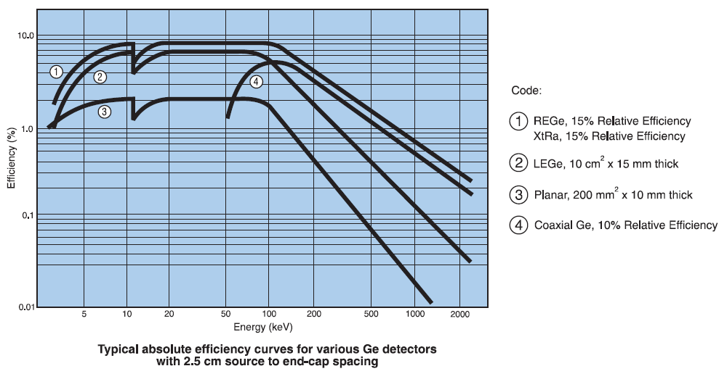
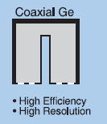
FOCUS OF THIS STUDY

Slide 12
KEY STEPS INVOLVED IN THE IMPLEMENTATION OF THE k₀-STANDARDIZATION METHOD OF NAA
Characterization of the irradiation facility
Calibration of the detectors
The two processes are done once because
One of the hallmarks of MNSRs such as NIRR-1 is their neutron flux stability.
Detectors’ efficiency re-calibration would only be necessary if the detector is etched.
Notes:
Similarly, there would only be need for re-characterization of the irradiation channels if the reactor core is converted e.g. from HEU to LEU core or re-fueled.

Slide 13
FULL ENERGY PEAK EFFICIENCY OF DETECTORS AS CRUCIAL COMPONENT IN THE ANALYTICAL RESULT
Full energy peak efficiency of detectors is used in evaluation of the peak area of elements of interest in a sample, hence determining the activity of either Naturally Occurring Radioactivity in Materials (NORMS) or induced radioactivity from matrices irradiated in a research reactor.
This activity forms the basis for quantifying the elements of interest in the sample. (Jonah et al., 2006).

Slide 14
k₀-NAA STANDARDIZATION METHOD
The formula for computing the analyte mass fraction c_{a} is:
1st term describes the results of the gamma-ray spectrometry measurements,
2nd term is the corresponding k₀ factor,
3rd term is related to the full energy peak efficiency calibration of detector
4th term accounts for the contribution of the epithermal activation (reactor-dependent).

Slide 15
CHARACTERIZING OF IRRADIATION FACILITY
The irradiation facility is characterized by the following neutron flux parameters:
Φ_{th} - thermal neutron flux and its uncertainty.
- the thermal to epithermal neutron flux ratio.
Φ_{f} – the fast neutron flux and its uncertainty.
α – shape factor of the epithermal neutron flux
T – the temperature of the Maxwell-Boltzmann velocity distribution that describes the thermal component of the neutron spectrum.
- the ratio of the thermal to fast neutron flux

Slide 16
NEUTRON SPECTRUM PARAMETERS FOR FOUR NIRR-1 IRRADIATION CHANNELS
Parameter | Inner |  | Outer
 | A1 | B2 | A2 | B4
α | -0.046 ± 0.005 | -0.052 ± 0.002 | 0.024 ± 0.002 | 0.029 ± 0.003
f | 18.4 ± 0.3 | 19.2 ± 0.5 | 49.5 ± 0.1 | 48.3 ± 3.3
Φ_{th}/Φ_{f}(f_{T}) | 5.2 ± 0.2 | 5.0 ± 0.2 | 15.0 ± 0.8 | 15.5 ± 0.9
T_{n}(ºC) | 52.3 ± 2.6 | 60.6 ± 3.7 | 40.4 ± 2.4 | 44.5 ± 2.7
Φ_{th}(cm⁻²s⁻¹) | 5 x 10¹¹ | 5 x 10¹¹ | 2.5 x 10¹¹ | 2.5 x 10¹¹

Slide 17
Routine irradiation and measuring regimes for NIRR-1 facilities (Optimized protocol)
Neutron flux/irradiation channel | Procedure | T_{irr} | T_{d} | T_{m} | Activation products
2.5 x 10¹¹ n/cm²s/outer irradiation channels (B4) | S1 | 1 min | 10 – 15 min | 10 min | ²⁷Mg, ²⁸Al, ⁴⁹Ca, ⁵¹Ti, ⁵²V, ⁶⁶Cu,
2.5 x 10¹¹ n/cm²s/outer irradiation channels (B4) | S2 | 1 min | 3 - 4 h | 10 min | ⁴²K, ⁵⁶Mn, ¹⁶⁵Dy,
5 x 10¹¹ n/cm²s/inner irradiation channels (B2 and B3) | L1 | 6 h | 4 – 5 d | 30 min | ²⁴Na, ⁷²Ga, ⁷⁶As, ¹⁴⁰La, ¹⁵³Sm, ²³⁸U,
5 x 10¹¹ n/cm²s/inner irradiation channels (B2 and B3) | L2 | 6h | 11 – 12 d | 60 min | ⁴⁶Sc, ⁵¹Cr, ⁵⁹Fe, ⁶⁰Co, ⁶⁵Zn, ⁸⁶Rb, ¹³¹Ba, ¹³⁴Cs, ¹⁵²Eu, ¹⁷⁷Lu, ¹⁸¹Hf, ¹⁸²Ta, ²³²Th

Slide 18
PART A – Energy and Efficiency calibration with spectral analysis software

Slide 19
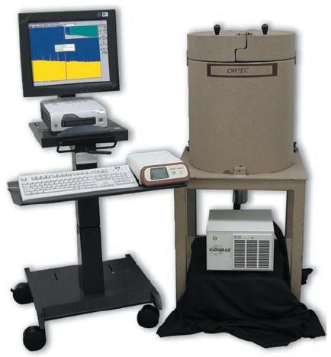
TOOLS REQUIRED FOR THE SPECTRAL ACQUISITION & ANALYSIS
High-Purity Germanium
detectors (HPGe 30195)
Analog to digital converter (ADC)
Digital gamma-ray spectrometer hardware DSPEC jr 2.0
MAESTRO-32 gamma-ray data acquisition software
Multi-channel analyzer (MCA) emulation software
A personal computer and associated electronic modules
Standard calibration sources
k₀-IAEA software for spectral analysis.
WINSPAN 2004 spectral analysis software
Courtesy of Ortec.

Slide 20
CONTROL OF THE SPECTRAL ACQUISITION & ANALYSIS
The detector is coupled to the integrated digital gamma-ray spectrometer hardware DSPEC jr 2.0 which is completely computer-controlled with the MAESTRO-32 multi-channel analyzer (MCA) emulation software. Complete computer control of the front end electronics means there are no knobs to turn or buttons to push, eliminating the possibility of accidental misadjustment. Precise adjustment of all front end electronics is accomplished via emulated controls - right on the screen. The DSPEC jr 2.0 is connected via a USB port to the host personal computer which is used for configuring the hardware settings (such as high voltages, presets and amplifier gain) through the multichannel buffer (MCB) interface of the MAESTRO-32 software. (DSPEC jr 2.0 Hardware User’s Manual)

Slide 21
DATA ACQUISITION
MCA plug-in card and MAESTRO-32 gamma ray data acquisition and MCA emulation software for control of the MCA functions.

Slide 22

SPECTRAL ANALYSIS
Version 5.00 of the k₀-IAEA program was used for
the calibration of the detector.
Freely distributed gamma spectroscopy software developed by The International Atomic Energy Agency, Vienna, Austria.

Slide 23
CALIBRATIONS OF THE DETECTOR IN k₀-IAEA PROGRAM
Storing of background spectrum
Peak shape calibration
(3) Energy calibration
(4) Efficiency curve calibration
Peak-to-total ratio
(for only the farthest geometry)
(b) Full-energy peak efficiency curves
(for all detector-source distances to be used)

Slide 24
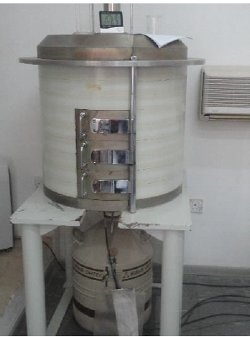
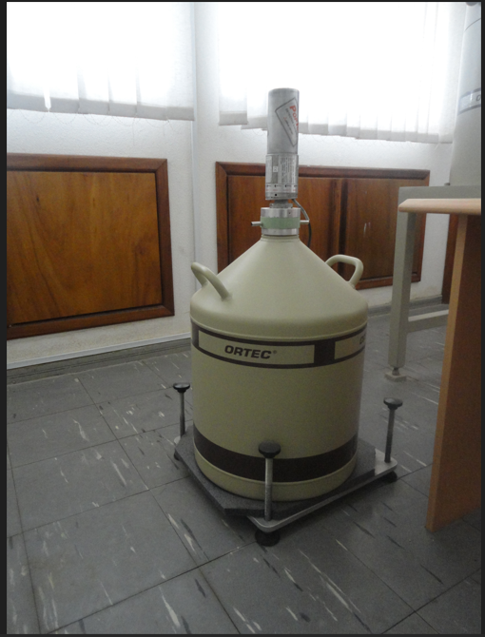
THE COAXIAL HPGE DETECTOR MODEL NUMBER “GEM-30195” USED
GEM 30195 detector mounted on 30-liter liquid nitrogen dewar
for cooling to cryogenic temperatures (77K or -196°C) and
surrounded by lead shield to reduce the background caused by
sources other than the sample.
Notes:
This include cooling to operate them at cryogenic temperatures in order to reduce the thermal generation of charge carriers (thus reverse leakage current) to an acceptable level. Otherwise, the leakage current induced noise will destroy the energy resolution of the detector. Liquid nitrogen (LN) with a temperature of 77 K is often used as the cooling medium for these detectors.

Slide 25
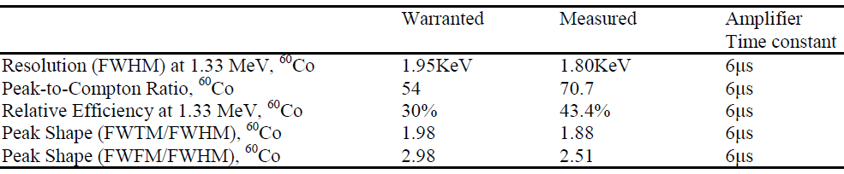
THE TECHNICAL/PERFORMANCE SPECIFICATIONS OF GEM-30195 FROM THE CERTIFICATE
High-purity coaxial germanium detector (HPGe) 30195 with
relative efficiency of 30% and a resolution of 1.95 keV
(FWHM) for the 1.33 MeV gamma line of ⁶⁰Co.
Notes:
high-purity coaxial germanium detector (HPGe) 30195 with relative efficiency of 30% and a resolution of 1.95 keV (FWHM) for the 1.33 MeV gamma line of ⁶⁰Co.

Slide 26
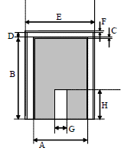
DETECTOR’S DIMENSIONS (SPECIFICATIONS OF GEM-30195 FROM THE CERTIFICATE)
Detector type | Coaxial | Well-type
A | Crystal diameter | Crystal diameter
B | Crystal length | Crystal length
C | Dead layer thickness | Not used
D | End cap to crystal | Not used
E | Top cover diameter | Not used
F | Top cover thickness | Cover thickness
G | Core diameter | Well diameter
H | Core height | Well depth

Slide 27
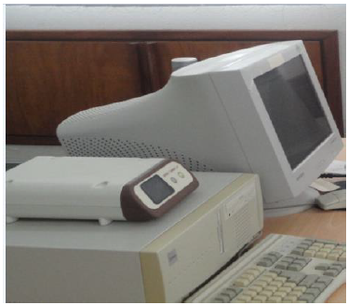
DATA ACQUISITION
Digital Spectrometer (DSPEC jr 2.0) connected to desktop computer
Coupled with MCA plug-in card and MAESTRO-32
gamma ray data acquisition software and MCA
emulation software for control of the MCA functions.
Notes:
As the nuclear measurement industry has matured and evolved into a wide range of critical applications, the requirements for computer software have evolved as well. Where years ago a spectroscopist might have operated a hardwired MCA with its own user interface - today the MCA interface is emulated in computer software.

Slide 28
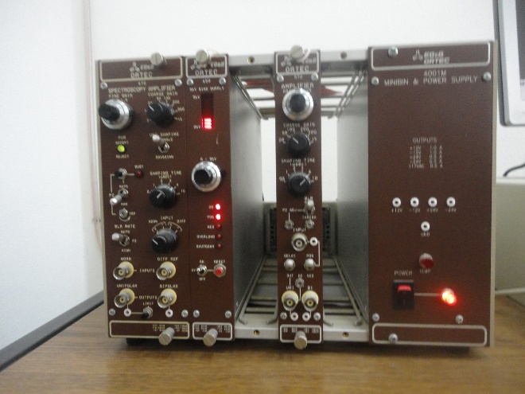

EVOLUTION OF SPECTRAL ACQUISITION SYSTEM
Modern digital Spectrometer
connected to desktop computer
and coupled with MCA plug-in
card and MCA emulation
software for control of the MCA
functions.
Hardwired MCA with its own user interface - today the MCA interface is emulated in computer software.
Notes:
As the nuclear measurement industry has matured and evolved into a wide range of critical applications, the requirements for computer software have evolved as well. Where years ago a spectroscopist might have operated a hardwired MCA with its own user interface - today the MCA interface is emulated in computer software.

Slide 29
ESSENTIAL FEATURES OF THE SPECTRAL ANALYSIS PROGRAM (k₀-IAEA) FOR ENERGY CALIBRATION
Peak search – using a peak-search algorithm
to find full-energy peaks above the background in a spectrum. (The peaks are superposed on the continuum)
(2) Assignment of energy - to each detected peak using the Energy calibration. Peaks in all channels.
(3) Peak match – nuclide identification, determining the element to which each peak belongs using the computer based nuclear data library. Identifying particular γ-rays with specific nuclides.
(4) Net peak area calculation - to determine activity and subsequently the elemental concentration.

Slide 30
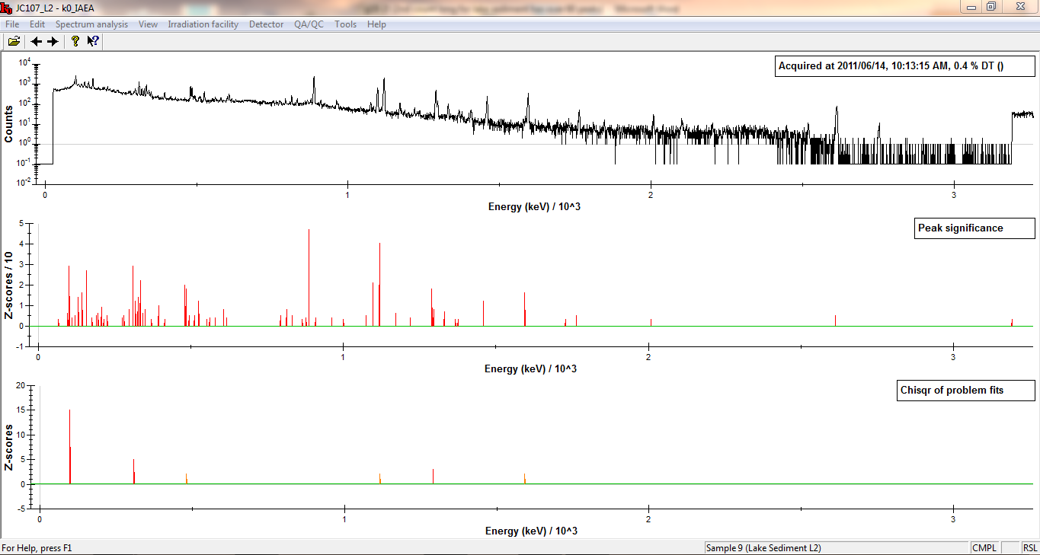
Typical gamma-ray spectrum as recorded by HPGe 30195 detector and displayed k₀-IAEA software
(With 62 detected peaks by version 5.00 of the k0-IAEA program)

Slide 31
ENERGY CALIBRATION
Routine energy calibration of the MAESTRO-32
spectrum acquisition software has to be carried out
once a week or every two weeks using a mixed
energy gamma ray calibration sources e.g. ¹³⁷Cs,
⁶⁰Co and ⁸⁸Y.
The spectrum is acquired long enough to clearly
identify the positions of the pure photopeaks in
the spectrum. This usually takes about five minutes.
Notes:
For old manually operated MCA- Start acquisition on the MCA and observe the spectrum. Adjust the 672 gain until the two sharp photopeaks are positioned as shown in Fig. 7.8. In this measurement the two photopeaks should be separated by at least 200 channels, based on a MCA conversion gain of 1024 channels total.

Slide 32
ENERGY CALIBRATION
For the point sources used - ¹³⁷Cs, ⁶⁰Co and ⁸⁸Y,
the corresponding peaks could be seen prominently
at 661.6 KeV, 1173 keV, 1332 keV and 1836 keV
respectively. Good spread and cover almost the
entire range over which the spectrometer is to be
used.
The calibration is carried out by replacing the channel
number placeholders for these peaks on the
horizontal axis of the spectrum plot with the well
known actual values of the expected peak energies
from these calibration sources.
Notes:
Since only 3 calibration points are needed (one close to the beginning of the energy range, one in the end and one in the middle) the user can throw out all unwanted peaks retaining only 3 calibration points to be used. These 3 points must have prominent peaks corresponding to high gamma photon relative abundances.

Slide 33
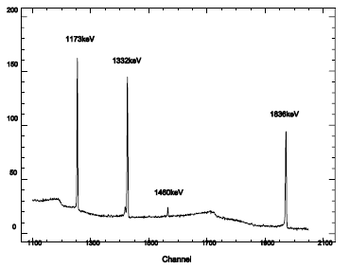
ENERGY CALIBRATION
γ-ray spectrum segment showing energy calibration (⁶⁰Co [1173, 1332 keV], ⁸⁸Y [1836 keV]) and impurity (⁴⁰K [1460 keV]) peaks.
Courtesy of IAEA-TECDOC-1401
Notes:
For old manually operated MCA- Start acquisition on the MCA and observe the spectrum. Adjust the 672 gain until the two sharp photopeaks are positioned as shown in Fig. 7.8. In this measurement the two photopeaks should be separated by at least 200 channels, based on a MCA conversion gain of 1024 channels total.

Slide 34
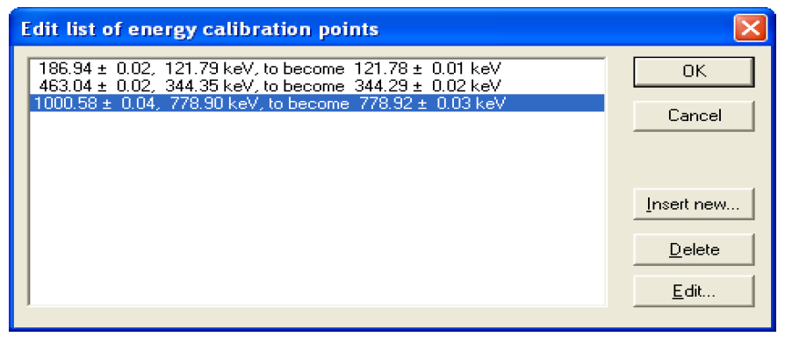
ENERGY CALIBRATION WITH Eu-152 SPECTRUM ANALYSED IN k₀-IAEA PROGRAM
Window of the menu “Spectrum analysis/Energy
calibration” with typical values of data entered for
energy calibration with Eu-152 spectrum analysed.
Notes:
Eu-152 spectrum acquired with MAESTRO-32 spectrum acquisition software and analysed in k₀-IAEA PROGRAM.

Slide 35
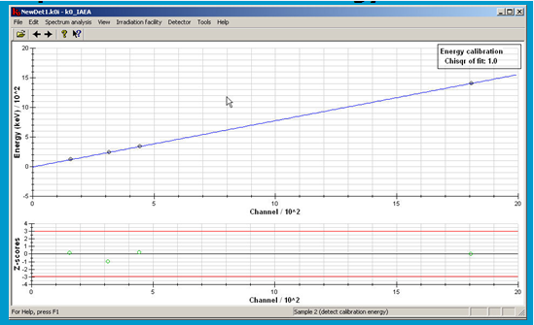
TYPICAL ENERGY CALIBRATION CURVE WITH k₀-IAEA PROGRAM

Slide 36
FULL-ENERGY PEAK EFFICIENCY CALIBRATION
The efficiency calibration establishes the relationship
between the peak energy and the probability of the
detector recording a count in the full energy peak.
This is done once for a detector and stored in the
permanent database of the software except it is
etched, then the calibration has to be repeated.

Slide 37
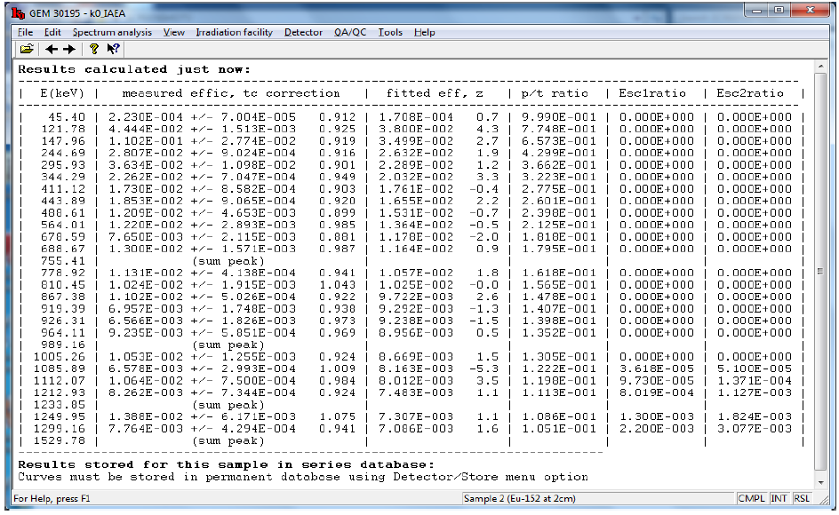
Efficiency calibration datapoints for GEM 30195 at
2 cm source-detector geometry with k₀-IAEA program

Slide 38
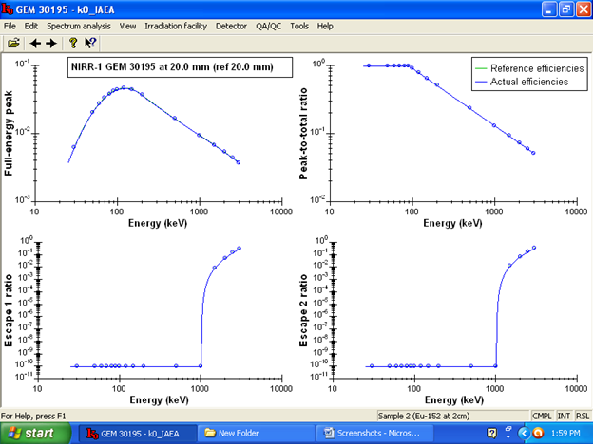
EFFICIENCY CALIBRATION CURVE OF GEM 30195 AT 2cm WITH k₀-IAEA PROGRAM

Slide 39
FULL-ENERGY PEAK EFFICIENCY CALIBRATION
The efficiency calibration was carried out for
GEM 30195 at 2cm and 15 cm source-detector
geometry with Eu-152 calibration source.
2 cm and 15 cm are the two optimum source-detector
distances for the counting with the GEM 30195
detector.

Slide 40
PART B – Energy and Efficiency calibration with Microsoft Excel electronic spreadsheet package

Slide 41
FULL-ENERGY PEAK EFFICIENCY CALCULATION
Notes:
In the equation for activity cited above, the value for efficiency is dependent on the geometry of the sample – size, density, and distance from detector. For the detectors used in gamma analysis, efficiency varies significantly with energy. Therefore, each counting geometry requires an efficiency calibration, using a known standard in the same geometry which includes multiple energies. A series of data pairs of efficiency vs. energy are generated from the relationship:
Efficiency = ?? Where Activity is the strength (in Bq) of the standard source (at collection time) at the given energy, yield is the branching ratio fraction and live time is the actual ADC live time in seconds. In the Genie software system, the calibration data from the standard are entered into a “Certificate File”, with these data being used for subsequent efficiency calibrations. The software will automatically correct for source decay by the formula: ??

Slide 42
POST SPECTRAL ACQUISITION DATA ANALYSIS
The graph of efficiency versus gamma-ray energy was plotted using the Microsoft Excel on a log-log scale.
Since a non-linear relationship was obtained, a polynomial function of degree 3 was fitted to the experimental data points of the detector’s efficiency curve.

Slide 43
CURVE FITTING TO THE EXPERIMENTAL DATA
An interpolation of efficiency at any required gamma-ray energy between two tabulated and plotted data points could then be calculated using the equation obtained from the trend line and regression analysis.
Non-linear least square method was used as a criterion for determining the best fitting curve which is as close as possible to the experimental data.
The correlation coefficient given by the electronic spreadsheet is a measure of how the two variables relate.

Slide 44
COMBINED CALIBRATION SOURCES USED IN THE EFFICIENCY WITH ELECTRONIC SPREADSHEET
3 calibration sources (Am-241, Eu-152 & Ra-226) were combined to cover the low, intermediate, and high energy regions under investigation.
Combined multiple calibration sources also reduces the energy gaps which may lead to large uncertainties in the efficiency during analysis due to interpolations in the fitted curves.
Notes:
Here spectra acquired from 3 calibration sources are used covering the energy region of interest (59.54 – 2447.71 KeV). Whereas using a single point source such as Eu-152 limited the energy range to between 121.78 KeV and 1408 KeV.

Slide 45
EVALUATION OF THE NET FULL ENERGY PEAK COUNTS FOR EACH PHOTON OF INTEREST
After accumulating sufficient counts by a MCA for each of the sources, MAESTRO emulation software was used to evaluate the net full energy peak (background subtracted) counts for each photon of interest.
The activity for each source was normalized to the measurement date before obtaining the full energy peak efficiency through the calculation of the net peak count rate per photon emission rate, using the emission probability table of Erdmann and Soyka, (1979).
Notes:
Safe, calibrated solid sealed sources are fabricated by depositing a license exempt quantity of radioisotope in the well of a 50 mm (2 in.) diameter x 3 mm (1/8 in.) thick plastic disk. After drying, the well is filled with an epoxy material; sealing the radioisotope inside the source. Calibrations are ±5% and are performed using a high-purity germanium detector for which peak efficiencies have been established using a NIST traceable standard. Each disk is identified by radionuclide, activity, serial number and calibration date. The words “Caution – Radioactive Material” appear on the label of each source.

Slide 46
EFFICIENCY COMPUTED AND FITTED WITH ELECTRONIC SPREADSHEET FOR GEM 30195 WITH SOURCES AT 2 CM FROM DETECTOR END CAP
Nuclide | Energy (KeV) | Efficiency
Am-241 | 59.54 | 0.009084383
Eu-152 | 121.78 | 0.045945262
Eu-152 | 244.7 | 0.032750254
Eu-152 | 344.28 | 0.026325629
Eu-152 | 367.76 | 0.023403456
Eu-152 | 444 | 0.019739155
Eu-152 | 778.9 | 0.012700505
Eu-152 | 867.38 | 0.012206212
Eu-152 | 1212.94 | 0.00773334
Eu-152 | 1298.7 | 0.007228203
Ra-226 | 1509.19 | 0.005574393
Ra-226 | 1661.28 | 0.004065313
Ra-226 | 2118.54 | 0.003298883
Ra-226 | 2204.12 | 0.003446851
Ra-226 | 2293.36 | 0.003573887
Ra-226 | 2447.71 | 0.003721455
Notes:
Here spectra acquired from 3 calibration sources are used covering the energy region of interest (59.54 – 2447.71 KeV). Whereas using a single point source such as Eu-152 limited the energy range to between 121.78 KeV and 1408.03 KeV.

Slide 47
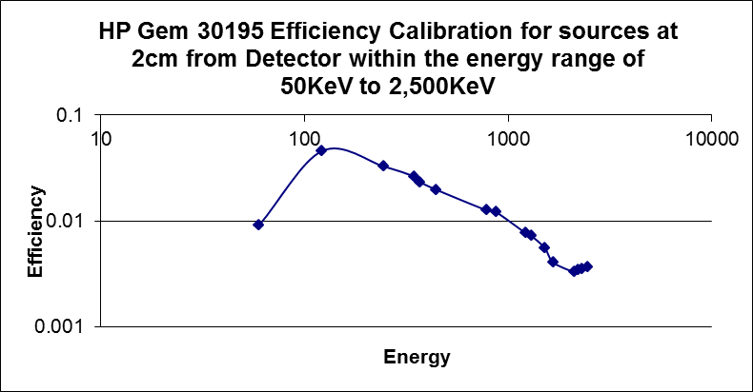
EFFICIENCY COMPUTED AND FITTED WITH ELECTRONIC SPREADSHEET FOR GEM 30195 WITH SOURCES AT 2 CM FROM DETECTOR END CAP
Notes:
Here spectra acquired from 3 calibration sources are used covering the energy region of interest (59.54 – 2447.71 KeV). Whereas using a single point source such as Eu-152 limited the energy range to between 121.78 KeV and 1408.03 KeV.

Slide 48
EFFICIENCY COMPUTED AND FITTED WITH ELECTRONIC SPREADSHEET FOR GEM 30195 WITH SOURCES AT 15 CM FROM DETECTOR END CAP
Nuclide | Energy (KeV) | Efficiency
Am-241 | 59.54 | 0.000613337
Eu-152 | 121.78 | 0.003553117
Eu-152 | 244.7 | 0.00295213
Eu-152 | 344.28 | 0.002491134
Eu-152 | 367.76 | 0.002412776
Eu-152 | 411.3 | 0.00216846
Eu-152 | 444 | 0.002089715
Eu-152 | 778.9 | 0.00132318
Eu-152 | 867.38 | 0.001252362
Eu-152 | 964 | 0.001204472
Eu-152 | 1112 | 0.001111782
Eu-152 | 1212.94 | 0.001109479
Eu-152 | 1408.03 | 0.000931153
Ra-226 | 1729.6 | 0.000770708
Ra-226 | 1764.51 | 0.000740934
Ra-226 | 2118.54 | 0.000589674
Ra-226 | 2204.12 | 0.000595507
Ra-226 | 2447.71 | 0.000574499
Notes:
Here spectra acquired from 3 calibration sources are used covering the energy region of interest (59.54 – 2447.71 KeV). Whereas using a single point source such as Eu-152 limited the energy range to between 121.78 KeV and 1408.03 KeV.

Slide 49
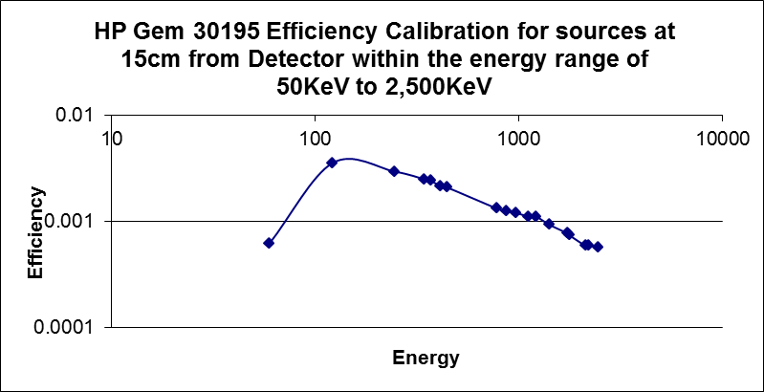
EFFICIENCY COMPUTED AND FITTED WITH ELECTRONIC SPREADSHEET FOR GEM 30195 WITH SOURCES AT 15 CM FROM DETECTOR END CAP
Notes:
Here spectra acquired from 3 calibration sources are used covering the energy region of interest (59.54 – 2447.71 KeV). Whereas using a single point source such as Eu-152 limited the energy range to between 121.78 KeV and 1408.03 KeV.

Slide 50
IMPORTING AND STORING OF THE CALCULATED EFFICIENCY IN THE DATABASE OF SPECTRAL ANALYSIS SOFTWARE
Because of the large data set and measurements involved in NAA implementation, there was the need to import the efficiency data generated using this novel, alternative approach into a proper spectral analysis software and stored in its database for future use during routine analysis of samples.
Notes:
Here spectra acquired from 3 calibration sources are used covering the energy region of interest (59.54 – 2447.71 KeV). Whereas using a single point source such as Eu-152 limited the energy range to between 121.78 KeV and 1408 KeV. The efficiency curve data can be imported into k₀-IAEA program or measured using a spectrum of a calibration source with multi-gamma lines.

Slide 51
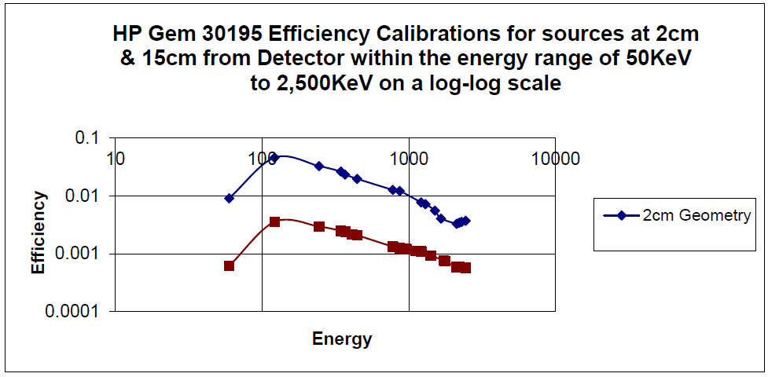
EFFICIENCY COMPUTED AND FITTED WITH ELECTRONIC SPREADSHEET FOR GEM 30195
Notes:
Similarly for 15 cm geometry from detector end cap.

Slide 52
RESULTS & DISCUSSION

Slide 53
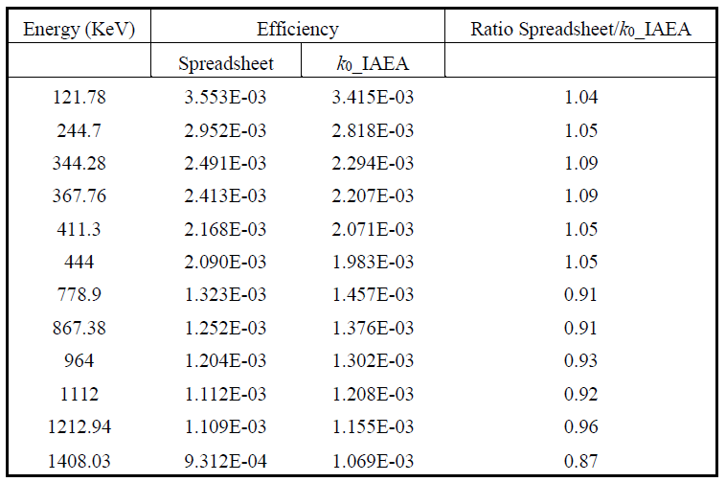
COMPARISON OF THE FULL-ENERGY PEAK EFFICIENCY CALIBRATION RESULTS OBTAINED FROM SPREADSHEET AND K₀_IAEA SOFTWARE FOR 15 CM SOURCE-DETECTOR DISTANCE
Notes:
Similarly for 15 cm geometry.

Slide 54
COMPARISON OF THE FULL-ENERGY PEAK EFFICIENCY CALIBRATION RESULTS OBTAINED FROM SPREADSHEET AND K₀_IAEA SOFTWARE FOR THE 15 CM SOURCE-DETECTOR DISTANCE
Notes:
Similarly for 15 cm geometry.

Slide 55
COMPARISON OF THE ANALYTICAL RESULTS USING WINSPAN 2004 AND K₀_IAEA 5.00 PROGRAM WITH CERTIFIED VALUES FOR LAKE SEDIMENT IAEA-SL-3
ELEMENT | k₀_IAEA Program | C.V. (Range) | WINSPAN-2004
 | IAEA-SL-3 Lake Sediment [mg/kg]
Al | 24500 ± 953 | 23300 – 25700 | 24530 ± 491
As | 3.03 ± 0.41 | 3.0 – 3.4 | 2.5 ± 0.2
Ba | 256 ± 64 | ----- | 231 ± 28
Br | 5.27 ± 0.43 | 4.8 – 6.4 | 5.2 ± 1.3
Ca | 116700 ± 13887 | 107200 – 115000 | 127000 ± 4699
Ce | ----- | 43.8 – 47.2 | -----
Co | 4.21 ± 0.40 | ----- | 3.4 ± 0.4
Cr | ----- | ----- | 29 ± 3
Cs | BDL | 1.24 – 1.52 | 1.4 ± 0.3
Dy | 1.66 ± 0.47 | 1.65 – 2.79 | 2.9 ± 0.5
Eu | BDL | 0.64 – 0.68 | 1.1 ± 0.1
Fe | 14660 ± 733 | ----- | 11480 ± 230
Hf | 8.80 ± 0.58 | 8.5 – 9.7 | 8.8 ± 0.3
K | 9031 ± 1117 | 7910 – 9570 | 8975 ± 323
La | 20.0 ± 1.0 | 21.5 – 23.5 | 16.6 ± 0.8
Lu | ----- | 0.27 – 0.33 | 0.30 ± 0.03
Mg | 24910 ± 5206 | 24600 – 29400 | 20440 ± 1553
Mn | 539 ± 28 | ----- | 435 ± 2
Na | 6550 ± 263 | 6360 – 7020 | 648 ± 1
Rb | ----- | 36.9 – 40.7 | 37.2 ± 4.2
Sb | 0.72 ± 0.09 | 0.46 – 0.66 | 7.2 ± 0.4
Sc | 3.92 ± 0.31 | 3.64 – 4.18 | 3.87 ± 0.05
Sm | 3.58 ± 0.50 | 3.53 – 4.13 | 2.97 ± 0.003
Ta | 0.71 ± 0.23 | 0.65 – 0.75 | 0.6 ± 0.1
Tb | 0.51 ± 0.15 | 0.44 – 0.54 | -----
Th | 7.94 ± 0.65 | 6.5 – 7.5 | 6.9 ± 0.2
Ti | 2731 ± 489 | 2300 – 2920 | 2117 ± 385
U | 1.41 ± 0.40 | 2.08 – 2.52 | 1.4 ± 0.2
V | 21.4 ± 4.5 | ----- | 25 ± 4
Yb | 1.84 ± 0.49 | 1.77 – 2.01 | 1.8 ± 0.2
Zn | ----- | ----- | BDL
BDL = Below Detection Limit
----- = Not Analysed
Notes:
Similarly for 15 cm geometry.

Slide 56
ADVANTAGE OF THE ALTERNATIVE APPROACH
This alternative approach to the efficiency data generation in Neutron Activation Analysis has advantage of increasing the range of the calibration from e.g. from 1408 KeV to 2447.71 KeV, hence broadening the range of elements that could be analysed with the spectrometer at the laboratory.
In terms of performance, this methodology has performed fairly well in comparison to the conventional proprietary software counterpart.

Slide 57
THE DOWNSIDE OF THE ALTERNATIVE APPROACH
The calculations of the efficiency and the fitting of the curve has to be done semi-manually in electronic spreadsheet approach. Whereas these procedures are automated in dedicated proprietary spectrum analysis software.
The large data set and complexities of the calculation involved in the implementation of the k₀-INAA necessitated the computerization of the procedures making use of electronic spreadsheet very tedious and time-consuming.
Spectrum analysis software such as k₀-IAEA program has modules for storage of background spectrum, shape calibration, energy calibration and efficiency calibration after acquiring and analyzing the spectrum of the relevant calibration point sources.

Slide 58
THE DOWNSIDE OF THE ALTERNATIVE APPROACH 2
The peak-to-total ratio has not been taken into account in this efficiency curve fitting via the electronic spreadsheet approach.
The peak-to-total ratio which is required for true coincidence effect correction is especially important when the source-detector distance becomes small such as the 2cm geometry in this case.

Slide 59
RESEARCH FINDINGS
On the whole, the two methods and corresponding software are at par in terms of accuracy and effectiveness. However, k₀-INAA holds out great prospects with exciting possibilities given its several advantages over relative method which have been earlier enumerated.

Slide 60
RECOMMENDATIONS
For the k0_IAEA software, the following improvements are suggested:
Enhancement of the code to make it capable of resolving multiplet or overlapping peaks into individual components for accurate net peak area determination without the user intervention. Hence reducing the manual selection of the region of interest (ROI) for some photopeaks before peak area analysis. Taking into consideration the fact that even high resolution detectors and MCA do sometimes select a gate for energy range which includes more than one gamma line.
Integration of the two key aspects of a spectroscopy application, which is data acquisition and spectra analysis, into a unified platform by using the same software for both the acquisition and analysis of spectra used for the implementation of the k0-INAA.
Integration of the installation files into a single one-step setup file, rather than the present four.
Backward compatibility of the software so that users will not have to manually backup the permanent data and restore it each time after installing a newer version or an update.

Slide 61
CONCLUSION
Two approaches (k₀_IAEA software and electronic spreadsheet) for calculating the full-energy peak efficiency for the high purity germanium detector GEM 30195 have been compared.
On the whole, the performance of the two approaches in terms of accuracy and effectiveness are close at higher geometries with less than 10% variation.
However, the proprietary software has several routines in its suite for automating most of the calibration procedures which makes it more suitable for spectral analysis than the electronic spreadsheet.

Slide 62
FURTHER WORK???
Major challenge is lack of access to research facility. As of now, Kaduna is the epicenter of the kidnapping in Nigeria.
I therefore solicit
Collaborations
Access to research facilities of fellow participants
Donation of old, but abandoned detectors etc. Especially portable ones for in-situ measurements o the field.

Slide 63
ACKNOWLEDGEMENT
The contributions and the goodwill of the following organizations is hereby gratefully acknowledged:
IAEA
Centre for Energy Research and Training, Zaria, Nigeria
Bingham University, Nigeria
African Leadership Academy, South Africa

Slide 64

FOR YOUR ATTENTION!

