Slide 1




Recent achievements regarding the dynamics of weakly bound nuclei at energies around the Coulomb barrier
Luis Acosta
IEM-CSIC, Spain
IF-UNAM, Mexico

Slide 2
Outlook
The developing of technology regarding beam production, charge particle detection and data acquisition systems is allowing to revisit some reactions involving weakly bound nuclei.
During the last 8 years, we have developed a number of experiments in different laboratories involving reactions with weakly bound nuclei, mostly halo nuclei, impinging in medium mass and heavy targets at energies in the vicinity of Coulomb barrier.
For several years, the analysis of this kind of reaction has shown a degree of differences in the elastic scattering comparing with stable similar nuclei in the same conditions.
Moreover, the reaction products have shown in particular cases, the preference to follow not always the same process, when the reaction is measured in a wide angular range.
The global conclusion shows that, not all the halos follow the same behaviour when their dynamics is tested at barrier energies.
In the present work, recent results regarding such nuclei and other recent visited cases will be presented, as well as a brief description of the instrumentation developed for such studies.

Slide 3
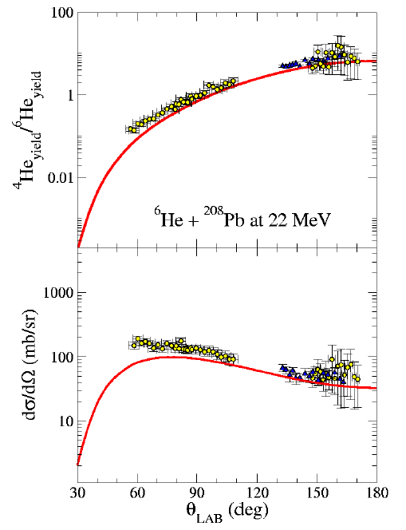
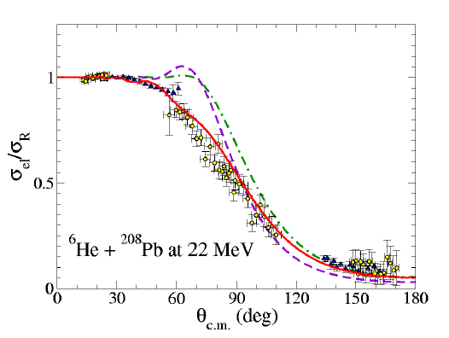
⁶He + ²⁰⁸Pb at 22 MeV. CRC U. Louvain-la-Neuve (2004-2005)
⁴He products
elastic
(Purple) Simple Optical Model (1 channel)
(Green) CDCC including 2-neutron breakup channel (2 channels).
(Red) CDCC including breakup channel + the effect of dipole polarizability, by including the polarization potential, due to the important role of the B(E1) strength distribution in weakly bound nuclei scattering.
With this it can be probed that the coupling with the continuum states is contributing in a large scale to the absorption observed on the scattering.
⁴He products: The calculation is DWBA. It underestimates data at middle angles, however, it reproduces in a good way the alpha production at bigger angles.
L. Acosta et al. PRC 84, 044604 (2011)
A.M. Sánchez-Benítez et. al., NPA, 803 (2008)
D. Escrig et. al., NPA 792 (2007)

Slide 4
⁴He produced at forward angles??? “Frame-scattering!!!
PhD. Thesis, L. Acosta (2009)
Bachelor Thesis in Physics, Jaqueline Perez (2022)
Notes:
Extended Phonon-Projection Model

Slide 5
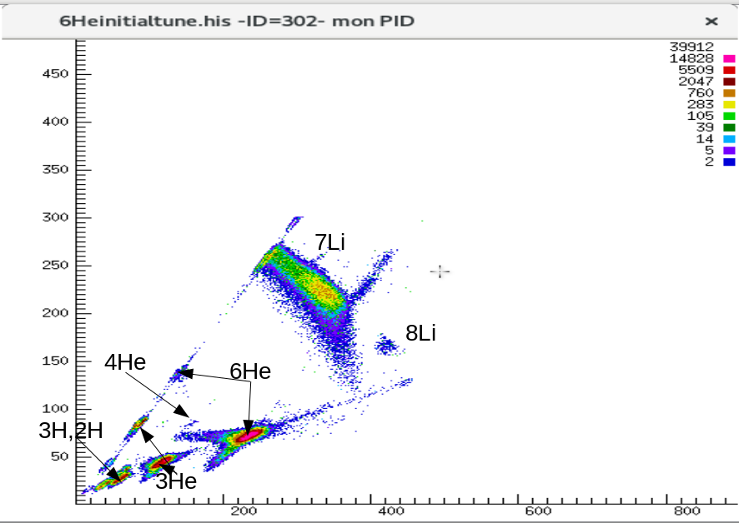
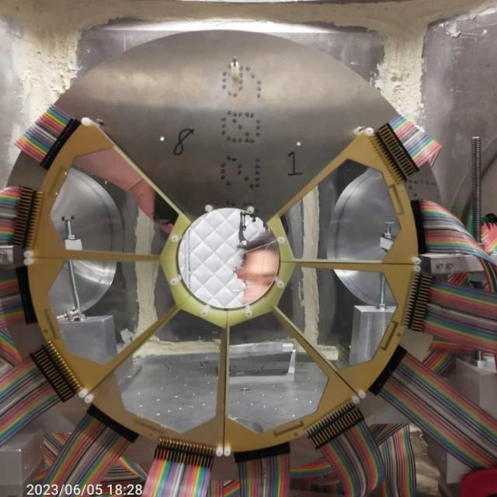
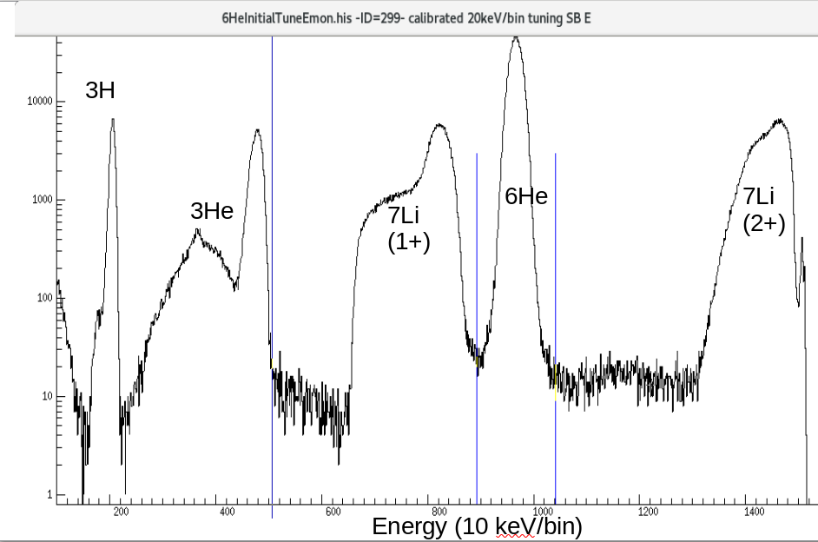
⁶He + ²⁰⁸Pb @ 19 MeV (2023)
TriSol Facility, Nuclear Science Laboratory University of ND (USA)
70 mm (16 SSSSD) + 1000 mm (PAD) wedge telescopes (6 of them)
Reaction used to produce ⁶He is ⁷Li(d,³He)⁶He
Analysis in progress!!!

Slide 6
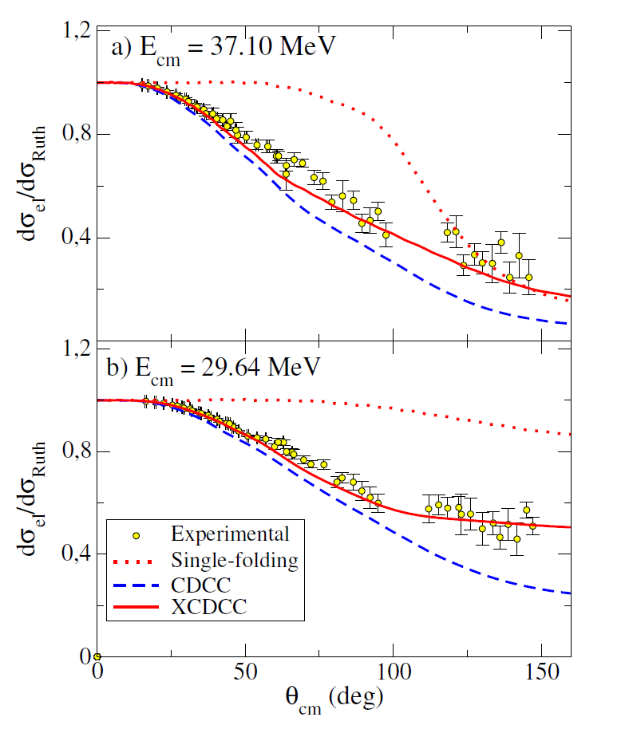
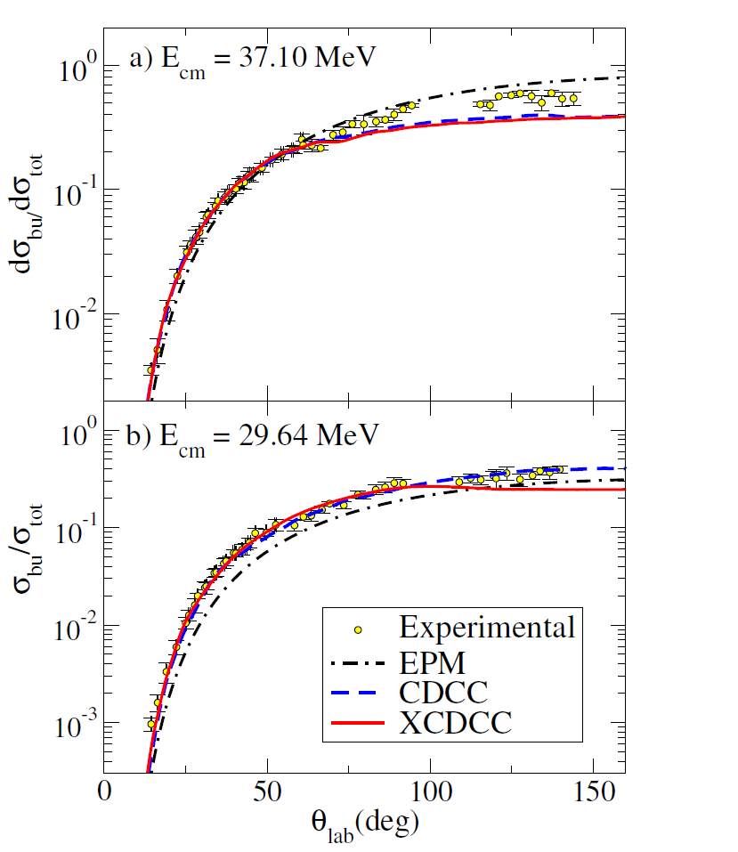
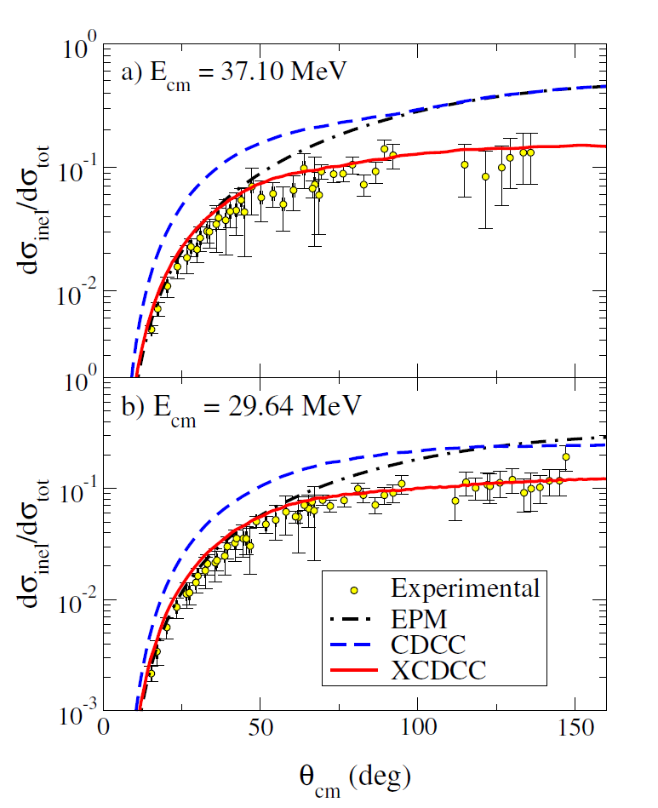
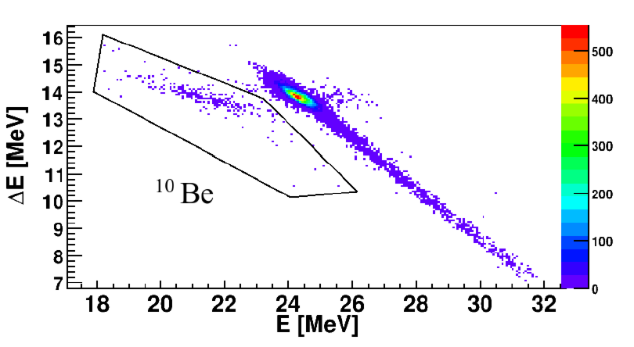
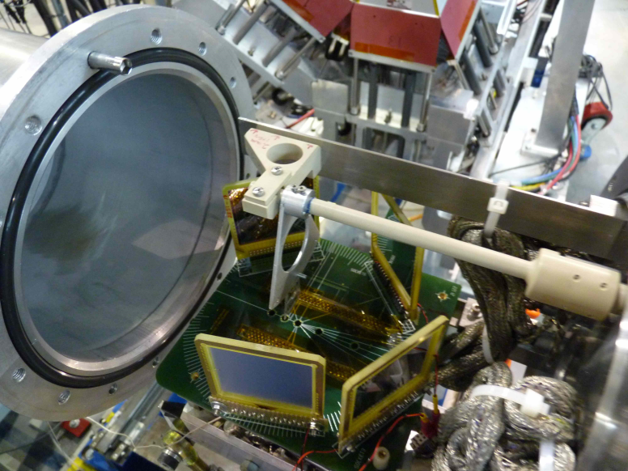
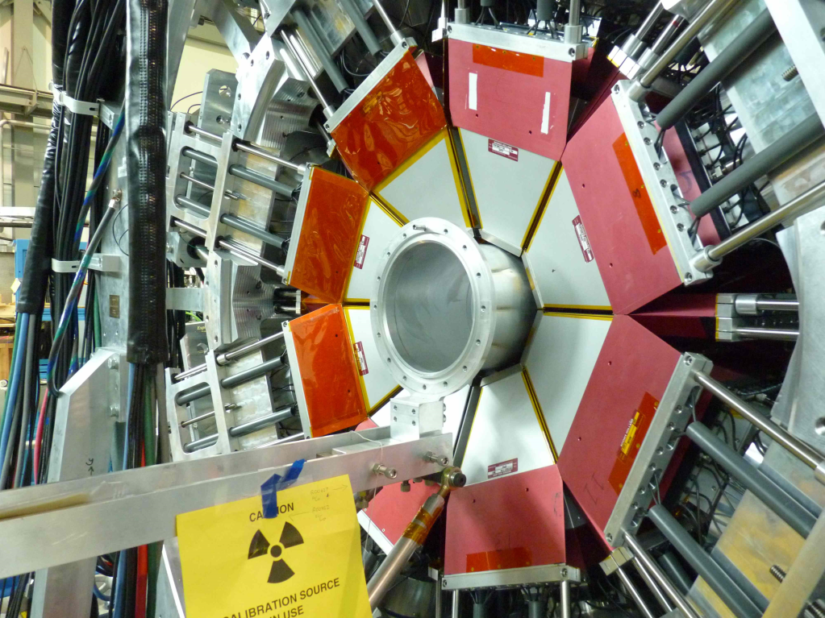
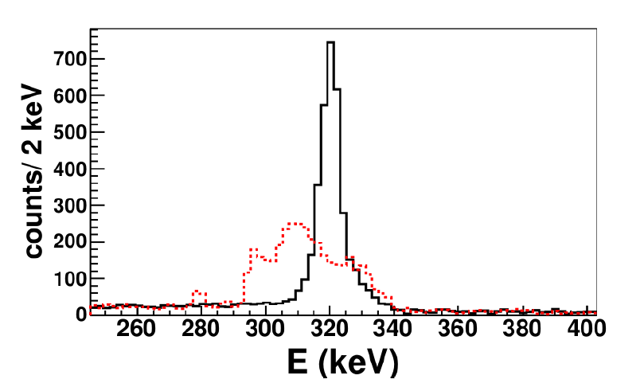
¹¹Be + ¹⁹⁷Au (29 and 37 MeV) TRIUMF (2011-2012)
elastic
breakup
inelastic
First time that the single excited state of ¹¹Be is measured, by using the coincidence between gamma emission and the scattering on silicon detectors. As before, the strong absorption is observed this time in a wide angular range.
First order semi-classical calculation including E1 couplings.
CDCC calculation, including bound and unbound states of the ¹¹Be+n projectile and couplings among them to all orders;
Extended CDCC calculation (XCDCC) which incorporates the deformation of the ¹⁰Be core in the structure of ¹¹Be, and the possible excitation of the core during the interaction.
V. Pesudo et. al., PRL 118 152502 (2017)
Partial γ-ray spectrum in coincidence with the T1 silicon detector (14º-43º). The red dashed line corresponds to the Doppler-shifted spectrum and the black solid line to the Doppler-corrected one.
Notes:
EPM “equivalent photon method”.
This is a crucial advantage with respect to the standard procedure based on the Equivalent Photon Method (EPM) which does not properly take into account nuclear distortion, higher order coupling effects, or Coulombnuclear interference terms

Slide 7
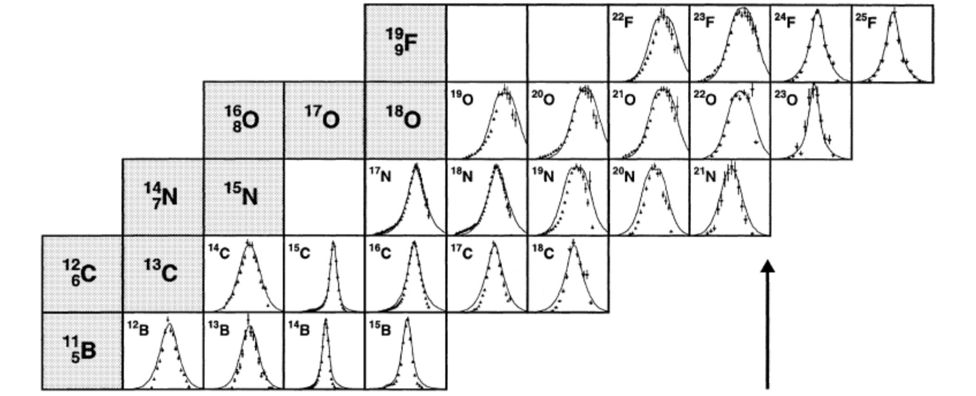
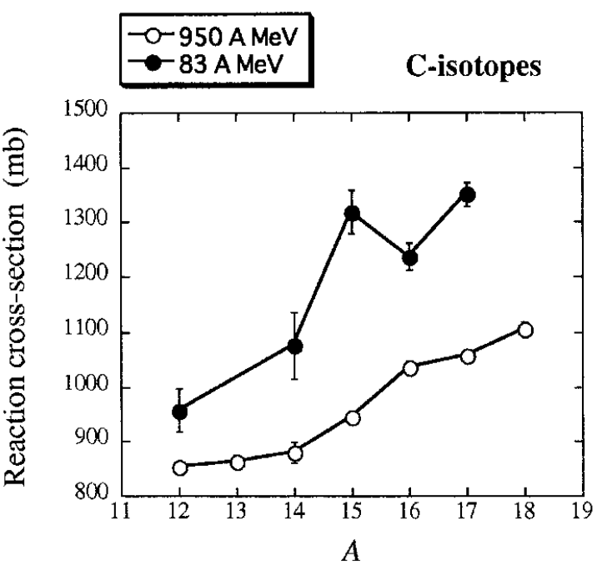
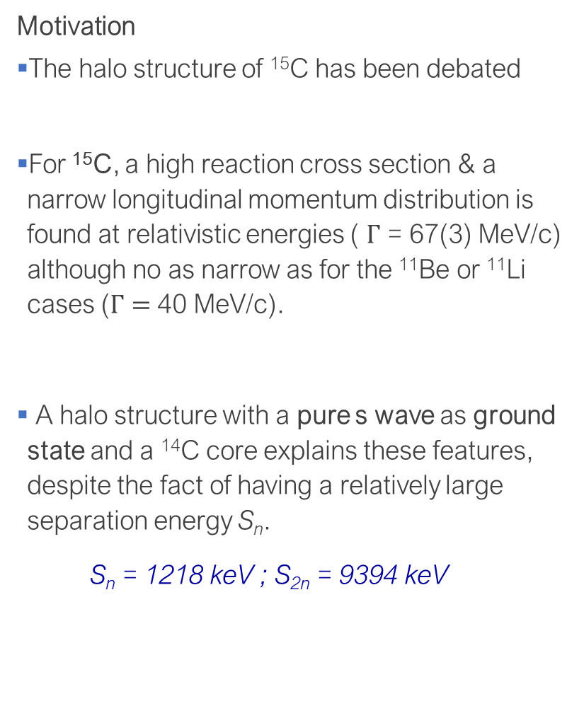
The “1-neutron halo” ¹⁵C (new measurement)
Motivation
The halo structure of ¹⁵C has been debated
For ¹⁵C, a high reaction cross section & a narrow longitudinal momentum distribution is found at relativistic energies ( $Γ$ = 67(3) MeV/c) although no as narrow as for the ¹¹Be or ¹¹Li cases ($Γ=$40 MeV/c).
A halo structure with a pure s wave as ground state and a ¹⁴C core explains these features, despite the fact of having a relatively large separation energy S_{n}.
S_{n} = 1218 keV ; S_{2n} = 9394 keV
Auman EPJA26(2005)441
Ozawa. Nuc Phys A 738 (2004) 38
Notes:
The case of 15C is special since some high energy experiments have showed a large total interaction cross section and a very narrow distribution of the longitudinal component of the momentum of the fragments following breakup. This was reported by Ozawa in 2004 and this paper says that all these features would be consistent with a structure consisting of a 14C core plus a 1n in halo configuration with a pure s-wave as ground state, despite of having a relatively large separation energy above 1 MeV. Still the difference with the separation energy of 2 neutrons, which is closer to 10 MeV, is considerable.

Slide 8
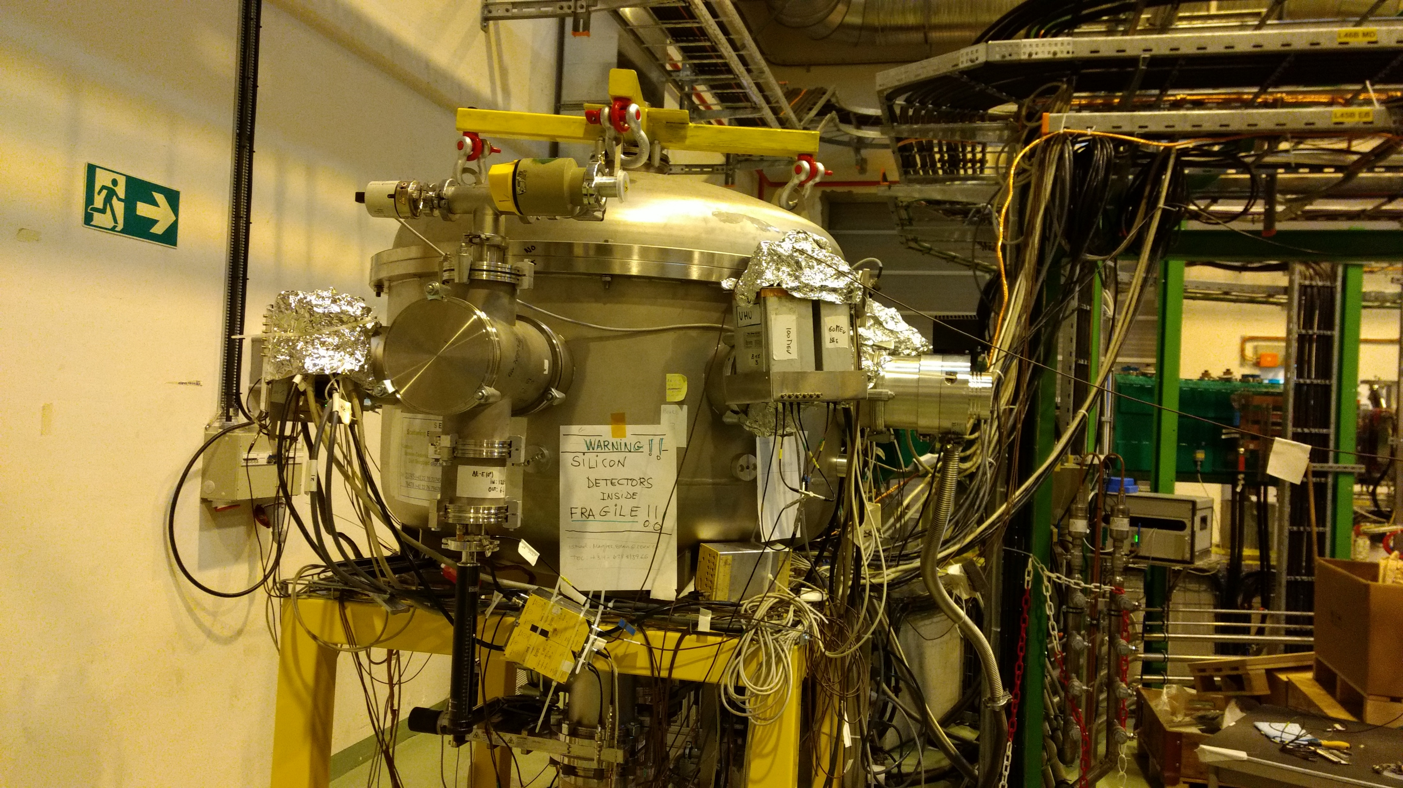
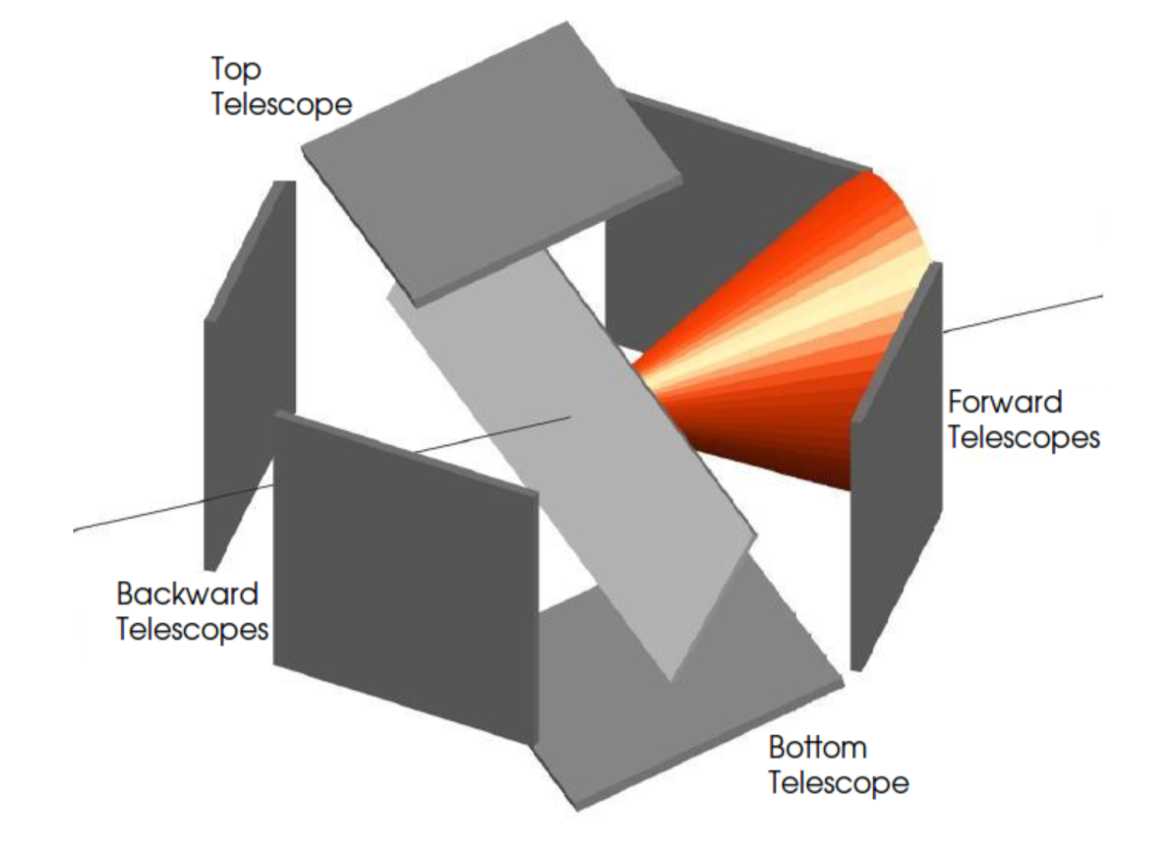
The “1-neutron halo” ¹⁵C
¹⁵C + ²⁰⁸Pb @ 65 MeV ISOLDE-CERN (2017)
2017, IS619 I. Martel O. Tengblad Effects of the neutron halo in ¹⁵C scattering at energies around the Coulomb barrier
The loose bound structure near the strong electromagnetic field of target induces a dipole polarization in the projectile. These structure effects manifest on the angular distribution of the elastic cross section.
F
B
SEC
+
GLORIA
A
Cocktail beam A/q = 3 for calibration
¹²C⁴⁺ + ¹⁵N⁵⁺ + ¹⁸0⁶⁺ at 4.37 MeV/u
E
beam (Stripping foil)@ 4.37 MeV/u
Unexpected Difficulties
Production of ¹⁵C very low 1% of ¹⁵N
The ¹⁵N + ²⁰⁸Pb originally thought as calibration and reference could not be used. At intermediate angles the ¹⁵N stopped in front detector.
We then had to use for normalization the ¹²C + ²⁰⁸Pb
The scattered ¹⁵N beam produced channelling effects that force to disregard central pixels
𝛉_{LAB} = 36º-39º

Slide 9
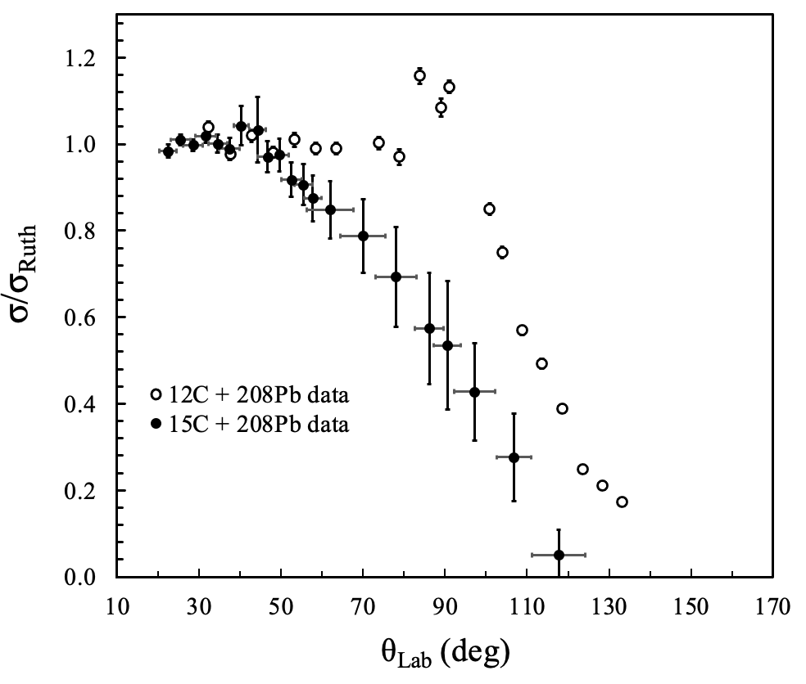
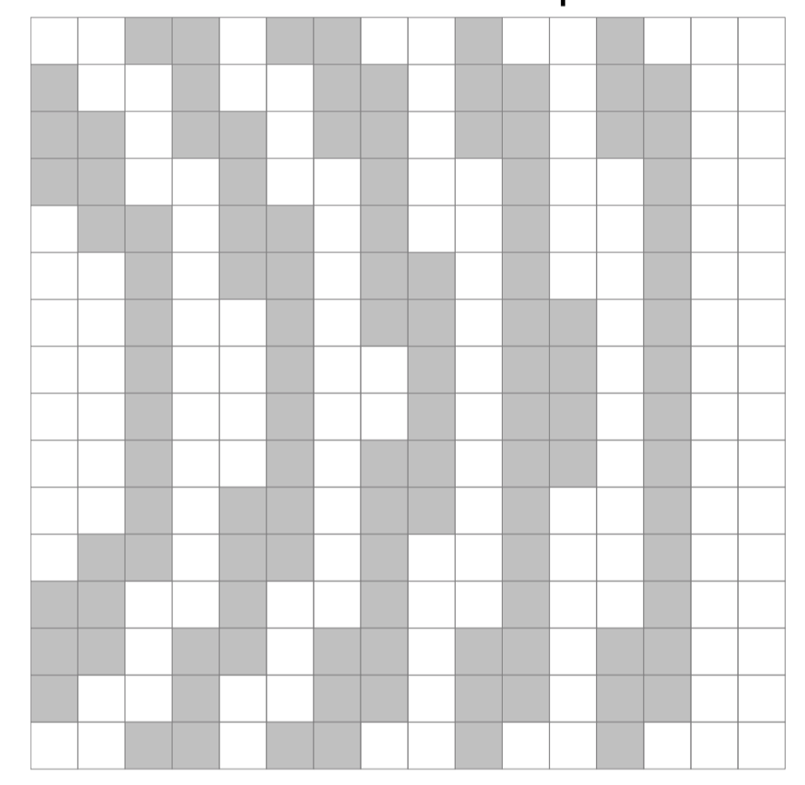

The “1-neutron halo” ¹⁵C
¹⁵C+²⁰⁸Pb
¹²C+²⁰⁸Pb
¹⁵C + ²⁰⁸Pb @4.37 MeV/u
Long range
absorption
No
Rainbow
Santra PRC64(2001)024602
12C data, Santra PRC 64(2001) 024602
$θ$_{cm} (deg)
Halo effects in ¹⁵C are clearly demonstrated:
Complete lack of a Coulomb rainbow peak
Long-range absorption -> ~50° Lab
Single-neutron stripping and breakup can play an important role in this system – Keeley, Eur. Phys. J. A 50, 145 (2014).
Angular distribution on the DSSSD’s
Contents of last 3 slides, courtesy of M.J.G. Borge and I. Martel

Slide 10
Recent results for ¹⁵C+²⁰⁸Pb @ 4.37 MeV/u
Near-barrier quasi-elastic scattering of ¹⁵C from a high-Z target (²⁰⁸Pb) was measured for the first time
The halo nature of ¹⁵C is demonstrated by
  the observation of the long-range absorption effect,
  the disappearance of the Coulomb rainbow,
  the large reaction cross section, 4 times larger than ¹²C.
The effects due to the halo are clearly seen as compared to ¹²C
Quasi-elastic scattering data for 65 MeV ¹⁵C + ²⁰⁸Pb
The quasi-elastic scattering predicted by the full (breakup + stripping coupling) calculation (dashed red curve)
pure elastic scattering result (solid black curve).
(b) The pure elastic scattering predicted by the full (breakup + stripping cou-pling) calculation (solid curve)
breakup coupling only (dashed curve) and stripping coupling only (dotted curve). Also shown is the no coupling result (dot-dashed curve).
V.G. Távora, J.D. Ovejas, I. Martel, N. Keeley, L. Acosta, M.J.G. Borge, O. Tengblad et. al., PLB 855 (2024) 138770
Notes:
inelastic scattering to the bound 0.74 MeV 5∕2+

Slide 11
The proton halo ⁸B (recent results)
2018 Measurement (published in 2021)
  A. Di Pietro (INFN-LNS) “Reaction mechanisms in collisions induced by ⁸B beam close to the barrier”.
  ISOLDE-CERN IS616: ⁸B beam on ⁶⁴Zn at 38.5 MeV (1.5 C.B.)
  GLORIA cover a wide angular range.
  Unique beam existing post-accelerated.
2019 Measurement (published in 2020)
  A. Pakou, L. Acosta, P. O’Malley, J.J. Kolata (U. Ioannina, IFUNAM, UND) “Fusion hindrance at sub-barrier energies for weakly bound nuclei on heavy targets: the ⁸B + ²⁰⁸Pb case”.
  TwinSol Facility, Nuclear Science Laboratory University of ND. Cocktail beam including ⁸B on ²⁰⁸Pb at 30 MeV (0.6 C.B.).
  SIMAS covering a particular angular range.
  In-flight beam ⁸B is identified in a cocktail beam using time filters.

Slide 12
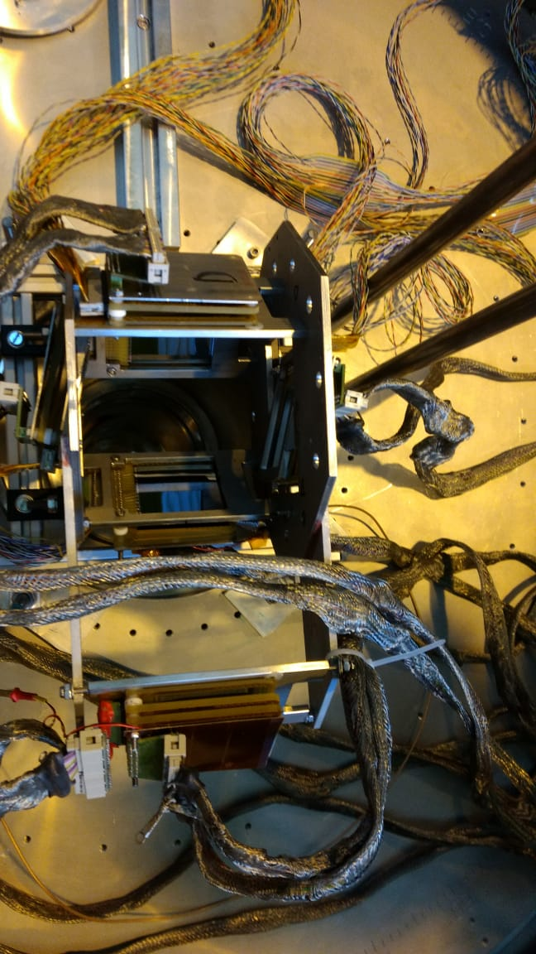
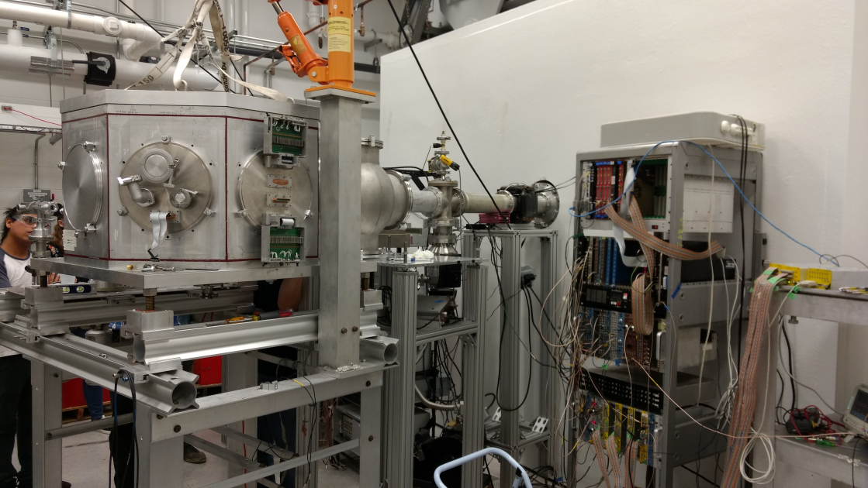
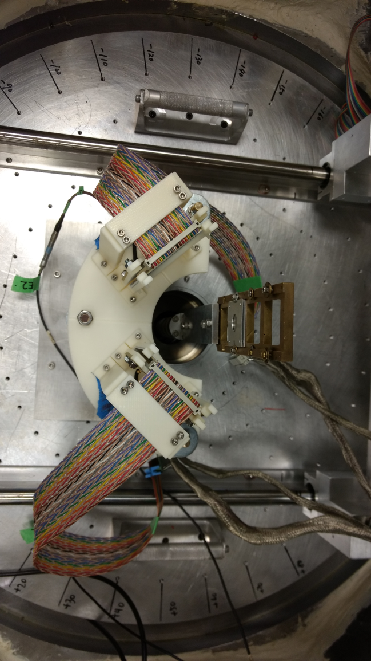
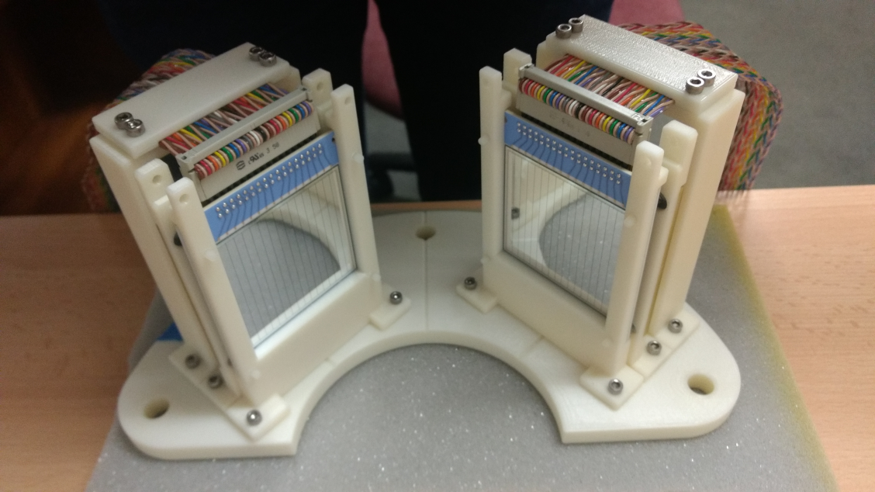
SEC + GLORIA
Experimental setups
TwinSol Chamber + SIMAS

Slide 13
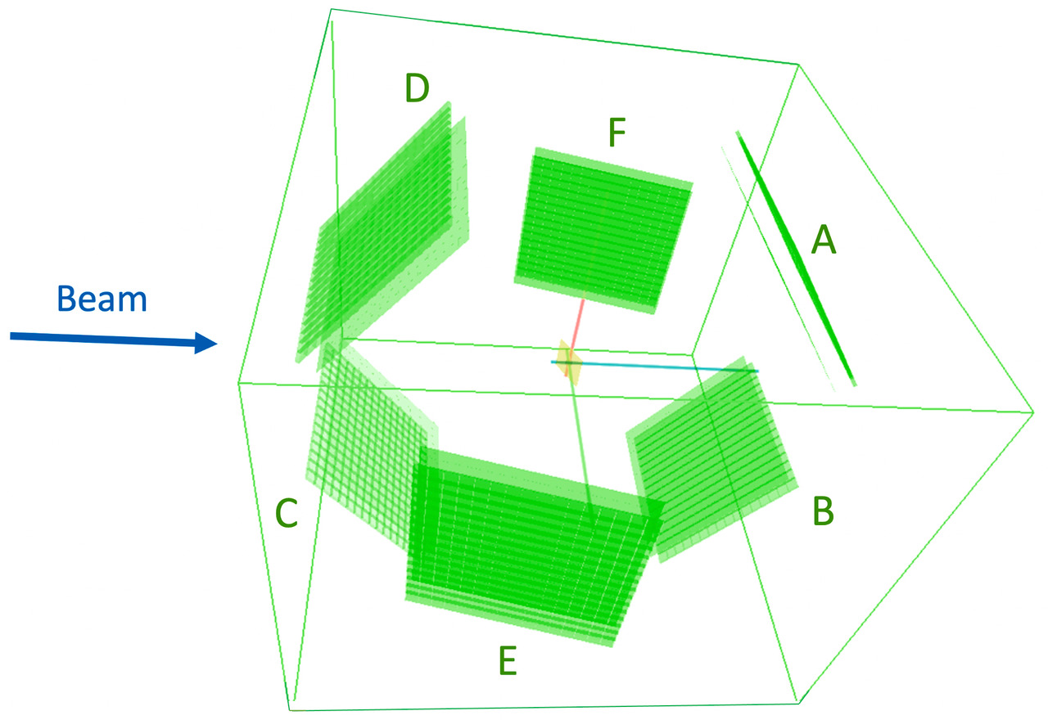
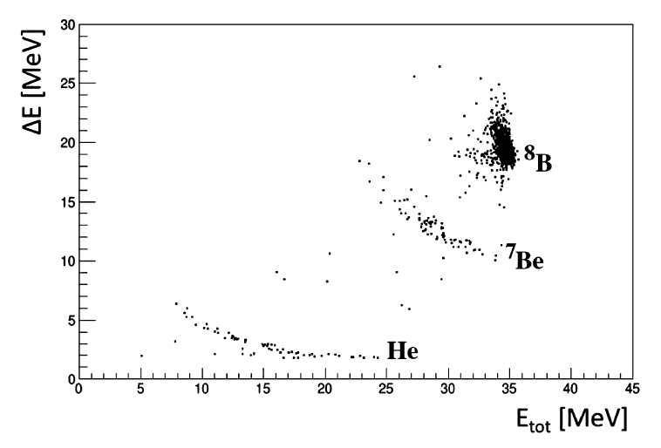

Scattering of ⁸B on a ⁶⁴Zn Target (IS616) HIE-ISOLDE-CERN
First ⁸B beam @ HIE-ISOLDE
Yield ∼ 400 pps
E = 4.9 MeV/u (1.5 V_{B} ∼ 30 MeV)
1,05 mg/cm² ⁶⁴Zn-target
Aim
Measure Diff Elastic Cross Section
Measure Break-up & Transfer Distributions
Total Cross Section
Deduce the Nuclear & Coulomb Contributions
⁸B+⁶⁴Zn @ 39,2 MeV
15$°≤ θ ≤62,5°$
⁸B→⁸Be*→ 2α
Breakup
Large angular range-high granularity GLORIA
G. Marquinez-Durán et. al., NIM A 755 (2014) 69
Notes:
Proton halo effects in the 8B+64Zn reaction at an energy around 1.5 times the Coulomb barrier have been studied at HIE-ISOLDE CERN using, for the first time, the only existing postaccelerated 8B beam. This, together with the use of a high granularity and large solid angle detection system, allowed for a careful mapping of the elastic angular distribution, especially in the Coulomb-nuclear interference region. Contrary to what is observed for the one-neutron halo nucleus 11Be on the same target in a similar energy range, the analysis of the elastic scattering angular distribution shows only a modest suppression of the Coulomb-nuclear interference peak, with no remarkable enhancement of the total reaction cross-section. Inclusive angular and energy distributions of 7Be produced in direct reaction processes have also been measured. The comparison of these data with the results of theoretical calculations for the elastic and non-elastic breakup contributions indicate that both processes are important. Overall, the experimental data suggest a 8B collision dynamics at the barrier very different from the one of neutron halo nuclei, showing only modest effects of coupling to continuum

Slide 14
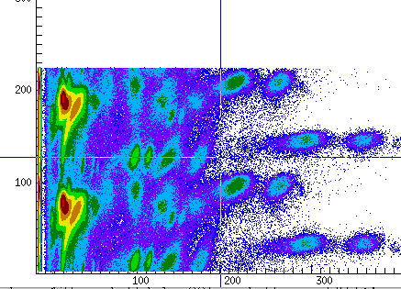
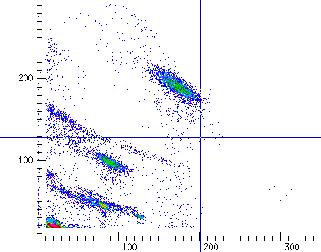
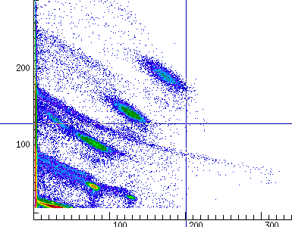
Scattering of ⁸B on a ²⁰⁸Pb Target (TwinSol-UND)
ToF Spectrum 2 days of ⁸B beam
two-proton transfer reaction ⁶Li+³He. A primary bunched
beam of ⁶Li was accelerated at 37 MeV at the UND FN tandem and impinged on a gas target of 3He at a pressure of 1 atm.
reaction products included in the secondary beam
  ⁷Li @ 13.1 MeV, ⁷Be @ 22.4 MeV and ⁸B @ 30.5 MeV.
ΔE-E Spectrum, 2 days of ⁸B beam
ΔE-E Spectrum, 2 days of ⁸B beam
(ToF filter for ⁷Be)

Slide 15
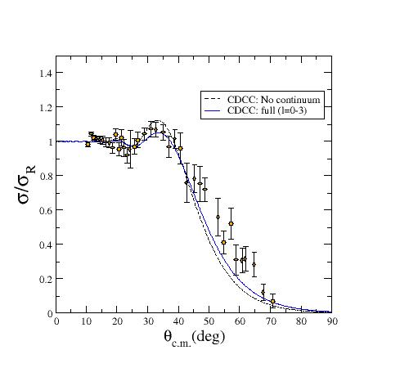
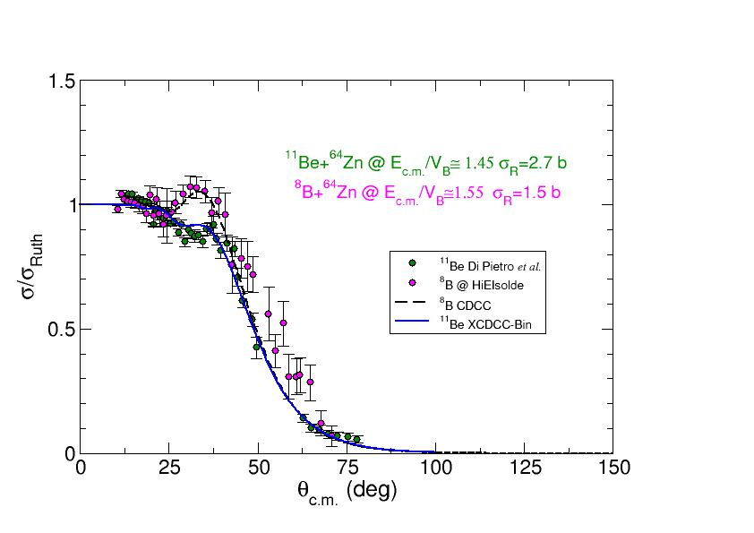
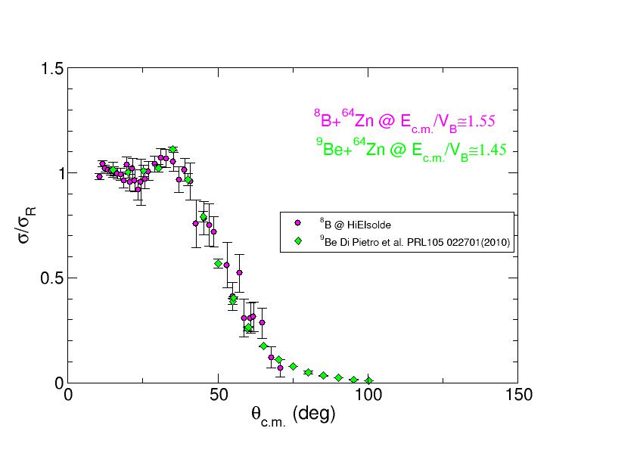
Results: Scattering of ⁸B on a ⁶⁴Zn Target
⁸B,⁹Be+⁶⁴Zn:
p-halo vs weakly bound
⁸B,¹¹Be+⁶⁴Zn: p-halo vs n-halo
p
⁸B+⁶⁴Zn @ 39.2 MeV
⁷Be
⁸B
⁸B
¹¹Be
⁹Be
R. Spartà et al. Phys. Lett. B 20(2021)136
Total reaction cross-section for ⁸B+⁶⁴Zn σ_{R} ⩳1.5 b
similar to ⁹Be+⁶⁴Zn at similar E_{c.m.} / V_{c}
Proton halo behaves as a more bound nucleus ⁹Be
as predicted by
A. Bonaccorso et al. PRC 69, 024615 (2004)
Contrary to the case of the 1n-halo ¹¹Be, almost no suppression of the Coulomb-Nuclear Interference peak
No suppression of rainbow
For ⁸B total s_{R} a factor ∼ 2 lower than in n-halo ¹¹Be
Courtesy of M.J.G. Borge and A. Di Pietro
Notes:
Proton halo effects in the 8B+64Zn reaction at an energy around 1.5 times the Coulomb barrier have been studied at HIE-ISOLDE CERN using, for the first time, the only existing postaccelerated 8B beam. This, together with the use of a high granularity and large solid angle detection system, allowed for a careful mapping of the elastic angular distribution, especially in the Coulomb-nuclear interference region. Contrary to what is observed for the one-neutron halo nucleus 11Be on the same target in a similar energy range, the analysis of the elastic scattering angular distribution shows only a modest suppression of the Coulomb-nuclear interference peak, with no remarkable enhancement of the total reaction cross-section. Inclusive angular and energy distributions of 7Be produced in direct reaction processes have also been measured. The comparison of these data with the results of theoretical calculations for the elastic and non-elastic breakup contributions indicate that both processes are important. Overall, the experimental data suggest a 8B collision dynamics at the barrier very different from the one of neutron halo nuclei, showing only modest effects of coupling to continuum

Slide 16
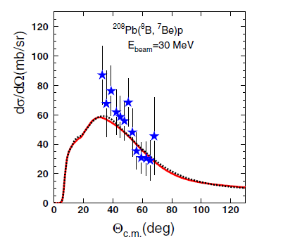
⁷Be+p as reaction products below and above de barrier: ⁷Be
ISOLDE results “well-above the barrier”
TwinSol results “well-below the barrier”
In the same angular region, the breakup behaviour is very similar, and the cross sections remains at similar levels.
Evidently, above the barrier at smaller angles, the breakup cross section is bigger.
Calculation below the barrier, doesn’t show the higher peak at 10°. It shows just the direct breakup.
- full CDCC Coulomb +
nuclear potentials
-- Coulomb potentials only
R. Spartà et al. Phys. Lett. B 20(2021)136
A. Pakou, L. Acosta, P. D. O’Malley et. al., PRC 102, 031601(R) (2020)
Even when the estimate cross section are very similar (~300 mb in both cases) the calculation for the “above the barrier” case, is a sum of elastic and nonelastic breakup “NEB” i.e. the dissociated proton interacts non-elastically with the target:
  non-capture breakup
  target excitation
  proton absorption by the target (incomplete fusion)
  proton transfer leading to bound states of ⁶⁵Cu.
Large uncertainties in both cases make possible different interpretations. A more precise experiment is necessary. Nevertheless, the light shed by these measurements is very valuable, considering the complex production of ⁸B beam.
Notes:
Ichimura, Austern and Vincent (IAV) [56]. Starting with the DWBA post-form amplitude and making use of the Feshbach projection formalism, the model provides a closed-form of the double differential cross-section of the detected fragments.

Slide 17
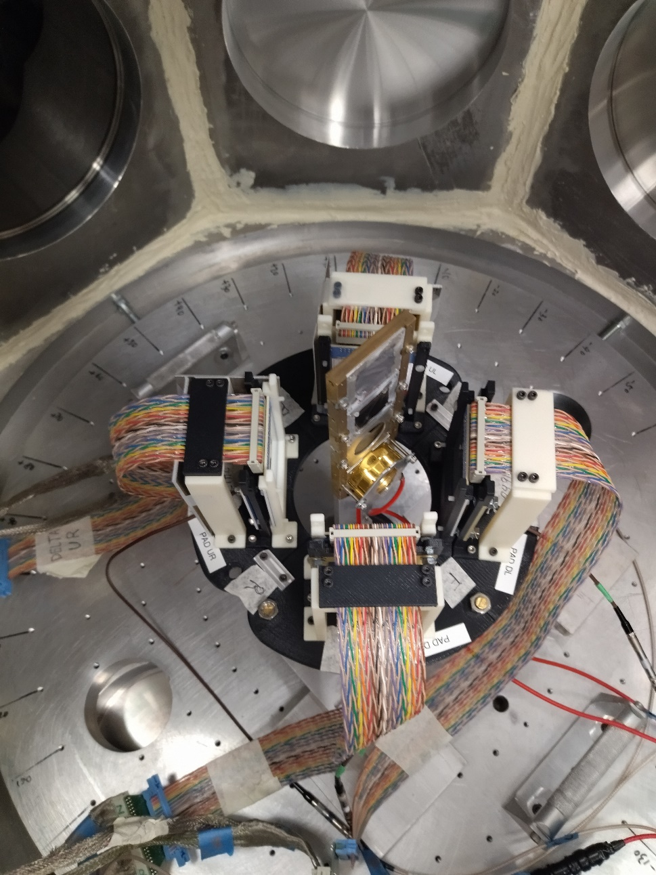
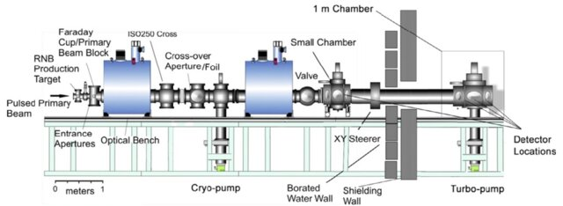
2nd measurement NDU (2022)
“Reaction mechanisms at sub - barrier energies for weakly bound nuclei : the ⁸B + ⁹⁰Zr case”.
Grouping Mexican and Spanish telescopes (20+130 μm ΔE-E).
1st ⁸B experiment of TriSol Facility with 4 SIMAS telescopes (4th from LIFE-UHU)
⁷Be+natZr Eproj = 23.7 MeV θlab = 43º

Slide 18
Experimental results for ⁷Be and ⁸B on ^{nat}Zr at different energies
K. Palli, A. Pakou, A. M. Moro, P. D. O’Malley, L. Acosta, A. M. Sánchez-Benítez, G. Souliotis, E. F. Aguilera, E. Andrade, D. Godos, O. Sgouros, V. Soukeras, et. al.,
PRC 107, 064613 (2023).
K. Palli, A. Pakou, P. D. O’Malley, L. Acosta, A. M. Sánchez-Benítez, G. Souliotis , A. M. Moro, E. F. Aguilera, E. Andrade, D. Godos, O. Sgouros, V. Soukeras et. al., PRC 109, 064614 (2024)
Notes:
we can conclude that excitation to continuum is moderate and
substantial for the higher energies. Elab
C.b.
= 24.3 MeV
For 8B is ≈12 times higher than the relevant one of
its core 7Be, indicating the halo nature of this exotic
Nucleus
Elastic scattering and a weak impact in the case of 8B, the latter effect
confirmed in this study.
Finally, our CDCC analysis corroborates previous findings
for 8B on heavy (208Pb) and medium-mass (120Sn) targets,
demonstrating that the coupling to continuum is not substantial,
despite the dynamics of direct reactions described above.

Slide 19
Some conclusions…
Very recent results related to the dynamics of weakly bound nuclei, along to previous ones were shown and compared (1n, 2n, 1p halo).
While the elastic scattering in most of the cases shows a well identified behaviour -strong absorption (neutron halo) and “stable” behaviour (proton halo)- the reaction products not always seems to come from the same process: elastic breakup, transfer and nonelastic breakup (several kind of process) can occur.
The exotic production is every time improved, as well as the detection systems and DAQ. In some of the cases, very precises and wide measurements have been reached.
It is very important to continue the study of weakly bound nuclei to understand a number of reaction effects and considering their importance in several astrophysical processes.

Slide 20












Thank you for your attention.
This work has been partially supported by DGAPA-UNAM IG101423, CONAHCyT ApoyosLNC-2023-
58 and PID2023-147569NB-C21 MICIN projects.

Slide 22
ADICIONAL SLIDES

Slide 23
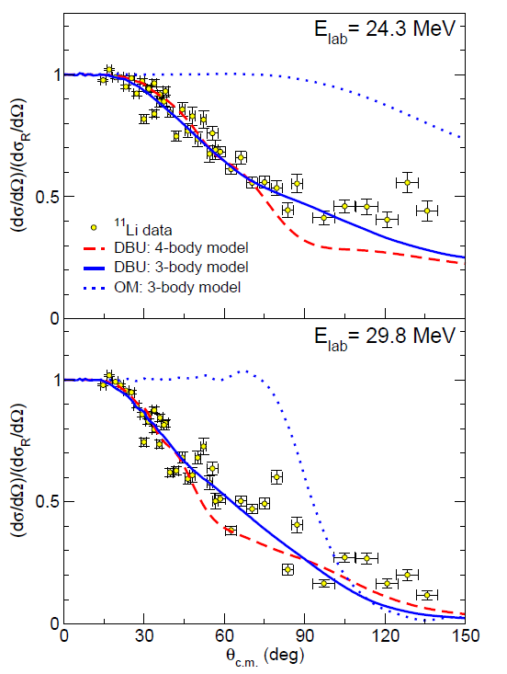
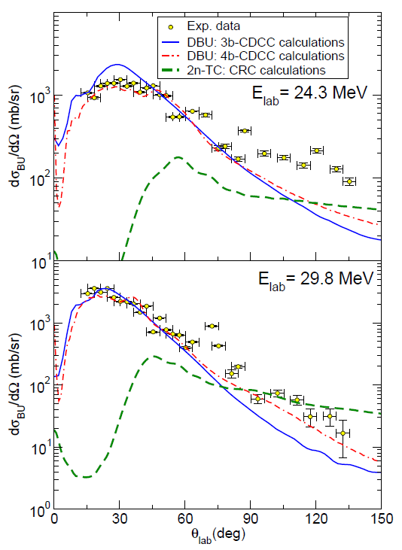
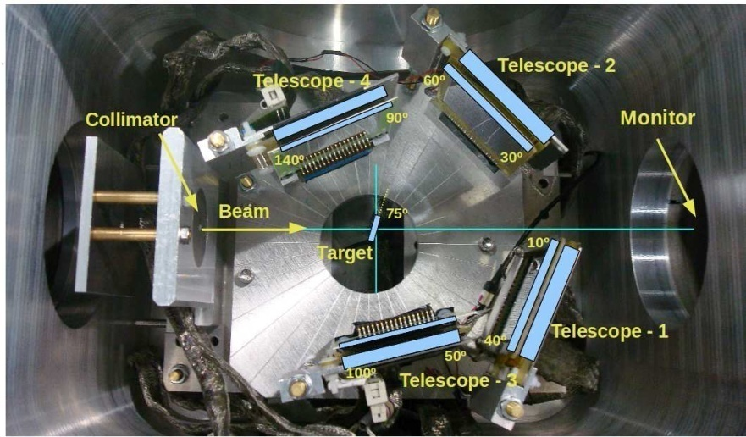
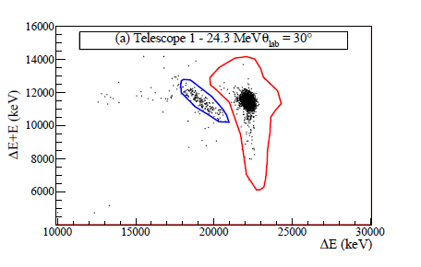
The ¹¹Be and ¹¹Li, scattering and products
¹¹Li + ²⁰⁸Pb @ 24.3 y 29.8 MeV
TRIUMF 2008-2009
elastic
Direct breakup
For the ¹¹Li (Borromean 2-neutron halo) the scattering close to the barrier shown strong absorption. This effect can be observed starting at very forward angles. The 3 and 4-body CDCC show this strong dipole coupling.
Due to the detectors position, a strange behavior is observed in some data.
The breakup follows in good way both calculations at forward angles, showing discrepancies for backward angles, where is possible to expect a competition between transfer a direct breakup.
J. P. Fernández-García, PRL, 110, 142701 (2013).
M. Cubero, PRL 109, 262701 (2013)
J.P. Fernández-García, PRC 92, 044608 (2015).

Slide 24
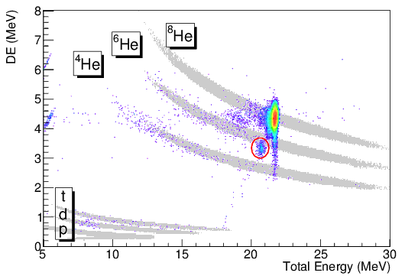
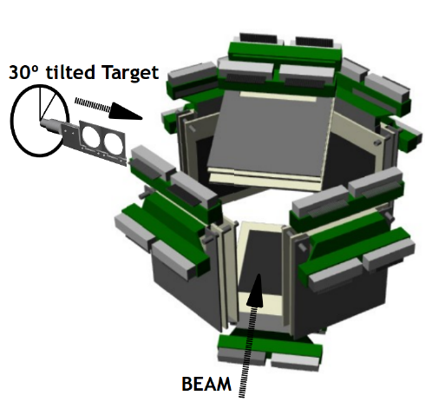
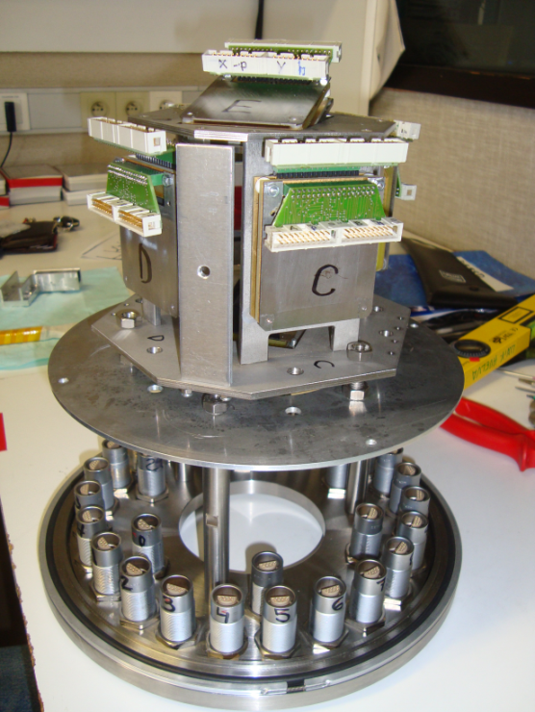
The skin nuclei ⁸He
The He radioisotopes, scattering and products
Reaction channels using Montecarlo simulations with the NPTool (Orsay-Must-2) code, based on GEANT4 and ROOT.
G. Marquínez-Durán, L. Acosta. I. Martel, A.M. Sánchez-Benítez, R. Berjillos, ,J.A. Dueñas, K. Rusek NIM-A 755 (2014).
⁸He + ²⁰⁸Pb @ 22 MeV GANIL (2010)
For elastic scattering of ⁸He this is the most complete angular distribution at Coulomb energies.
The results shows the success of GLORIA array, considering the obtained well behavior of the whole distribution.
Comparing with ⁶He distribution at the same energy, the ⁸He shows a larger absorption.
This was not expected considering the binding energies of neutrons at the ⁸He skin, bigger that those of ⁶He.
Seeing this, we can conclude that the dynamics and structure of ⁸He still needs a depth studies.
G. Marquínez-Durán, et. al., Acta Phys.Pol. B. 47-3, (2016).
G. Marquínez-Durán et. al., PRC 94, 064618 (2016).

Slide 25
⁸He products
The He radioisotopes, scattering and products
16 MeV
⁶He
⁴He
22 MeV
⁶He
⁴He
In the spectra could be observed ⁶He (blue) and ⁴He (red), 16 (a) y 22 (b) MeV on the cross section figures.
Calculation are fits.
Dashed lines are DWBA for 1-neutron striping,
Theoretical representation allow to conclude that some other process are involved in the fragmentation.
The number of bodies appearing in the reaction make difficult to establish any more precise association to possible processes.
G. Marquínez-Durán, I. Martel, A. M. Sánchez-Benítez, L. Acosta, J. L. Aguado,
R. Berjillos, A.R. Pinto, T. García, N. Keeley et. al., PRC 98, 034615 2018.

Slide 26
Recent ⁶He measurement (June 2023)
Determining the astrophysical three-body radiative capture reaction rate for ⁴He(2n,γ)⁶He from inclusive Coulomb break-up measurements. Spokespersons: A.M. Sánchez-Benítez, L. Acosta, J.P. Fernández García.
Motivation
The starting point of the r-process is composed by heavy elements so-called seeds in an extremely high neutron density (~ 10²¹ cm⁻³ ) environment with temperatures T = 1-10 GK.
How to reach the region of seeds starting from protons and neutrons?
beginning of r-process consists of protons and neutrons forming α particles (⁴He) ...
… it is the piece of path for synthetizing ¹²C from neutrons and α particles the issue under investigation!
once ¹²C is synthetized, the path towards production of seed nuclei is well understood
So, the relevant question is: How to reach ¹²C starting from neutrons and α-particles?
Notes:
Depending upon the relative amounts of alfa-particles and neutrons, one path may be favoured against the other… In particular, red path may be the dominant one for low values of Ye Ye=np/(np+nn)

Slide 27
How the spectra looks… (12 hrs, target (1.782 mg/cm²), 9x10⁴ pps of ⁶He events)
Very forward ones suffered frame-scattering
Clean in at least 9 strips.
Promising analysis in progress!!!

Slide 28
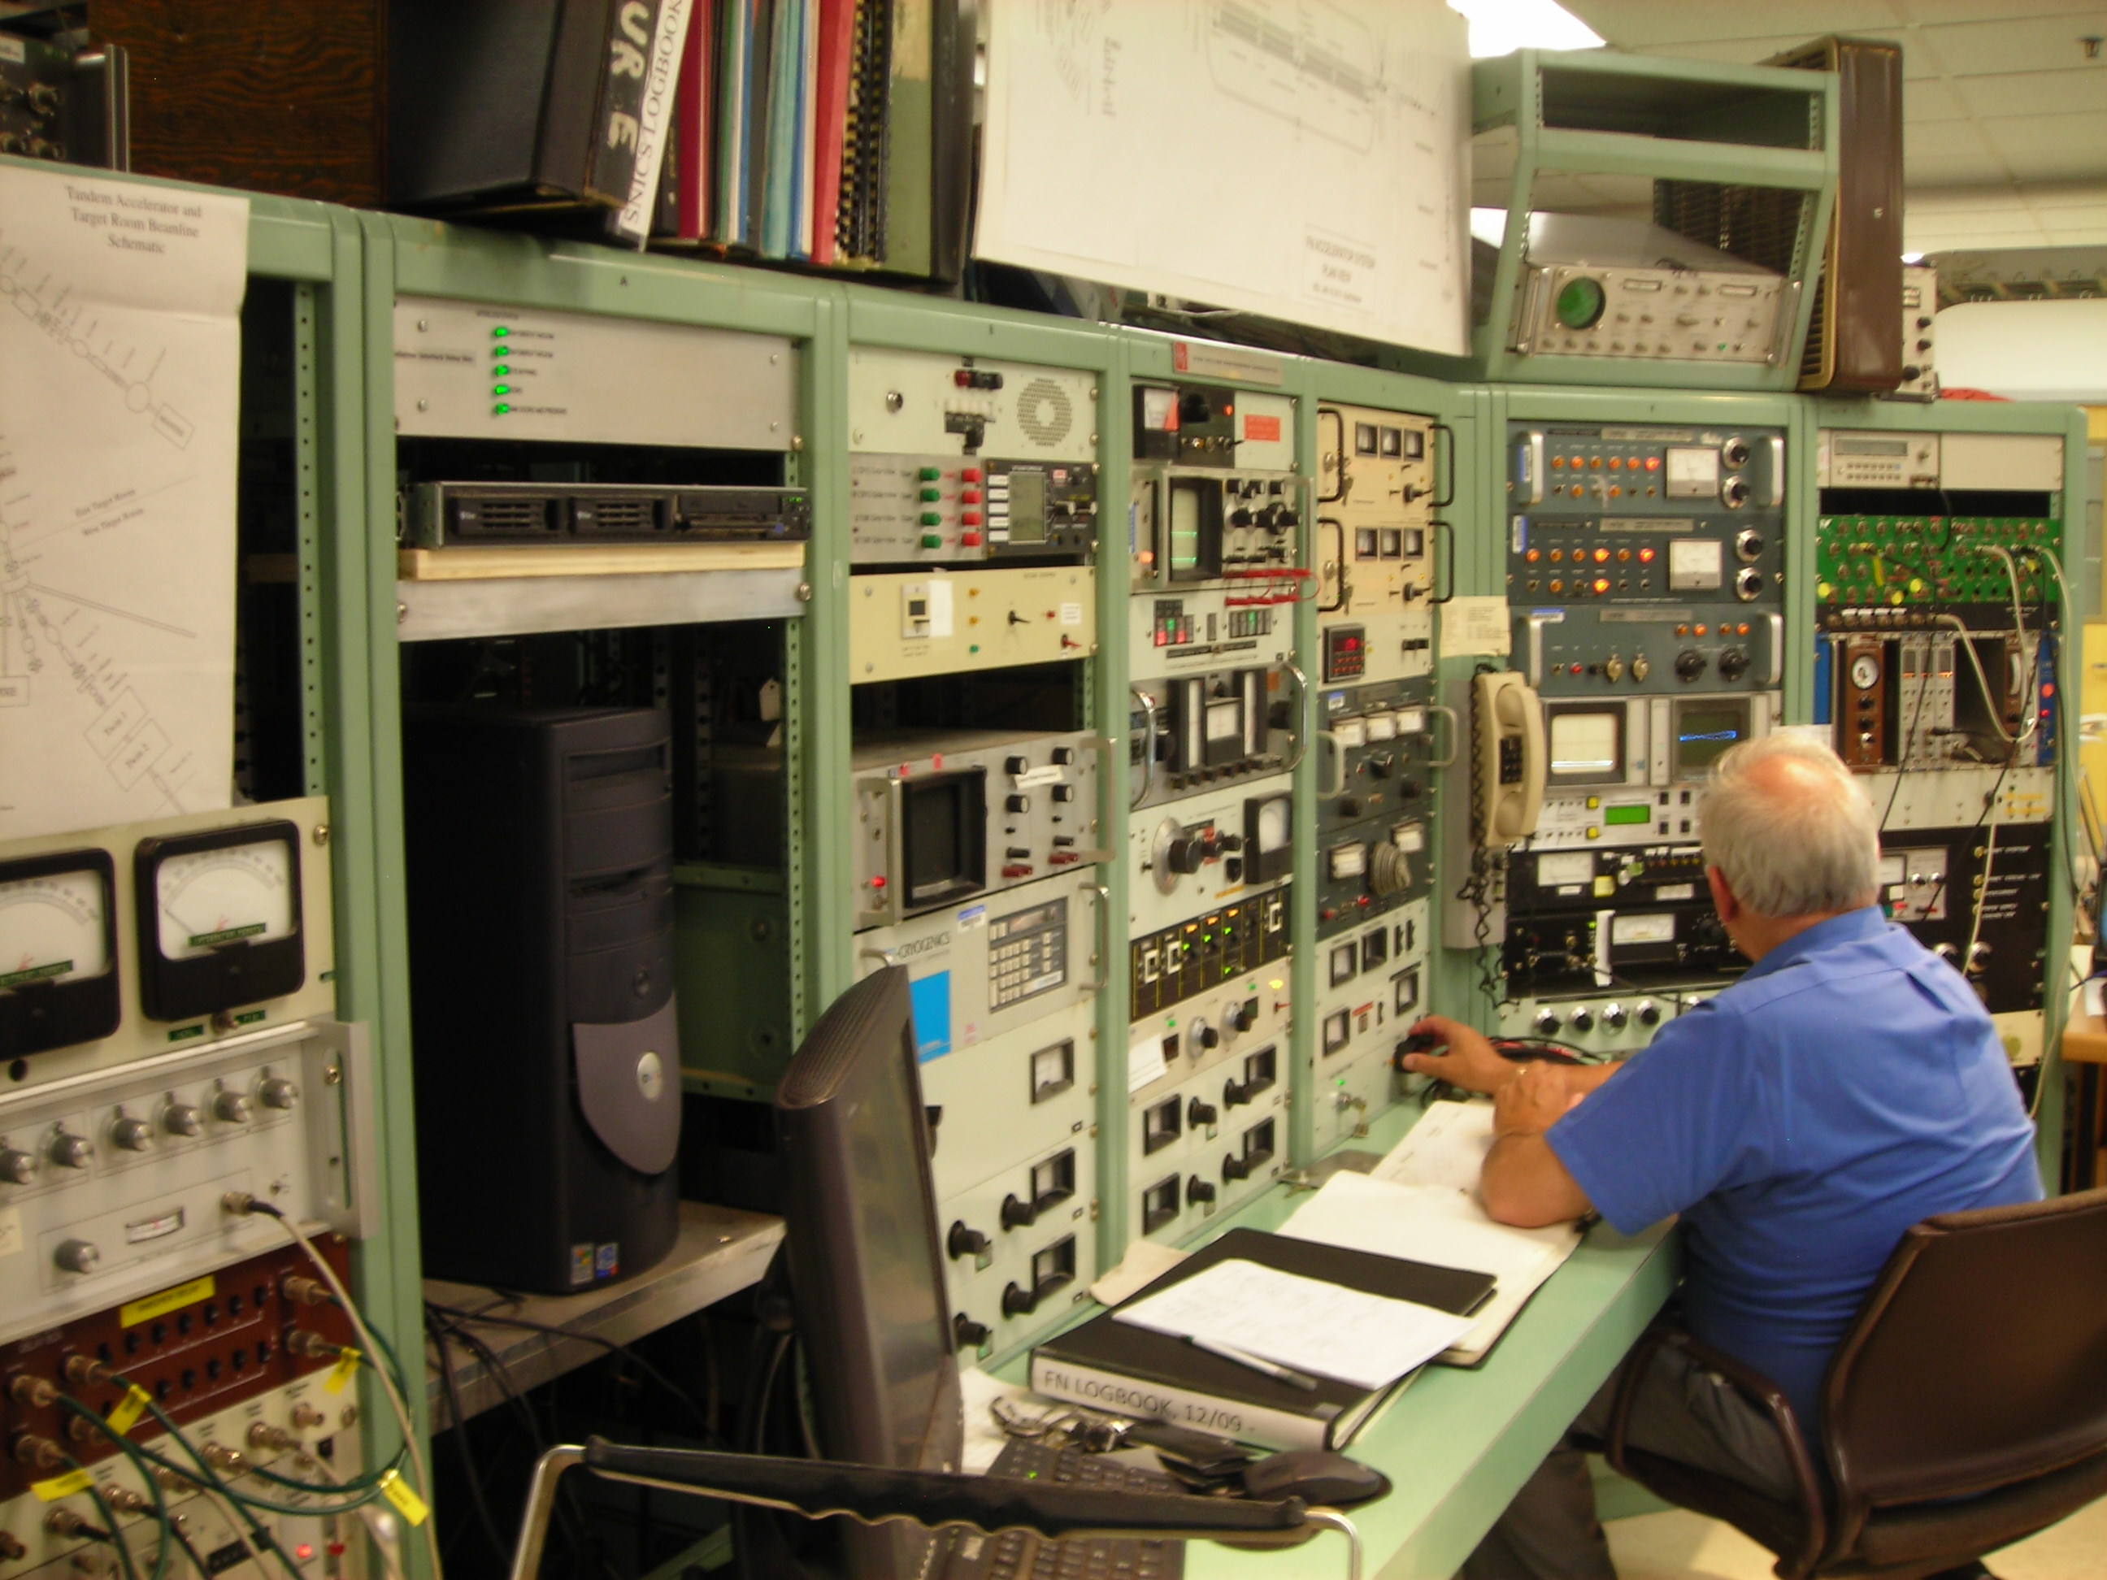
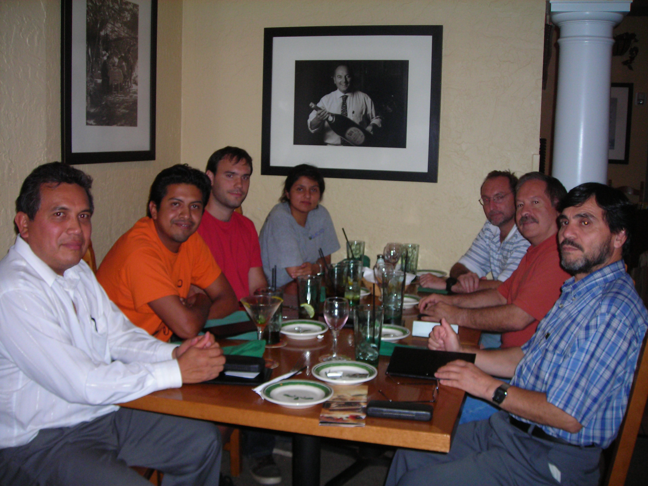
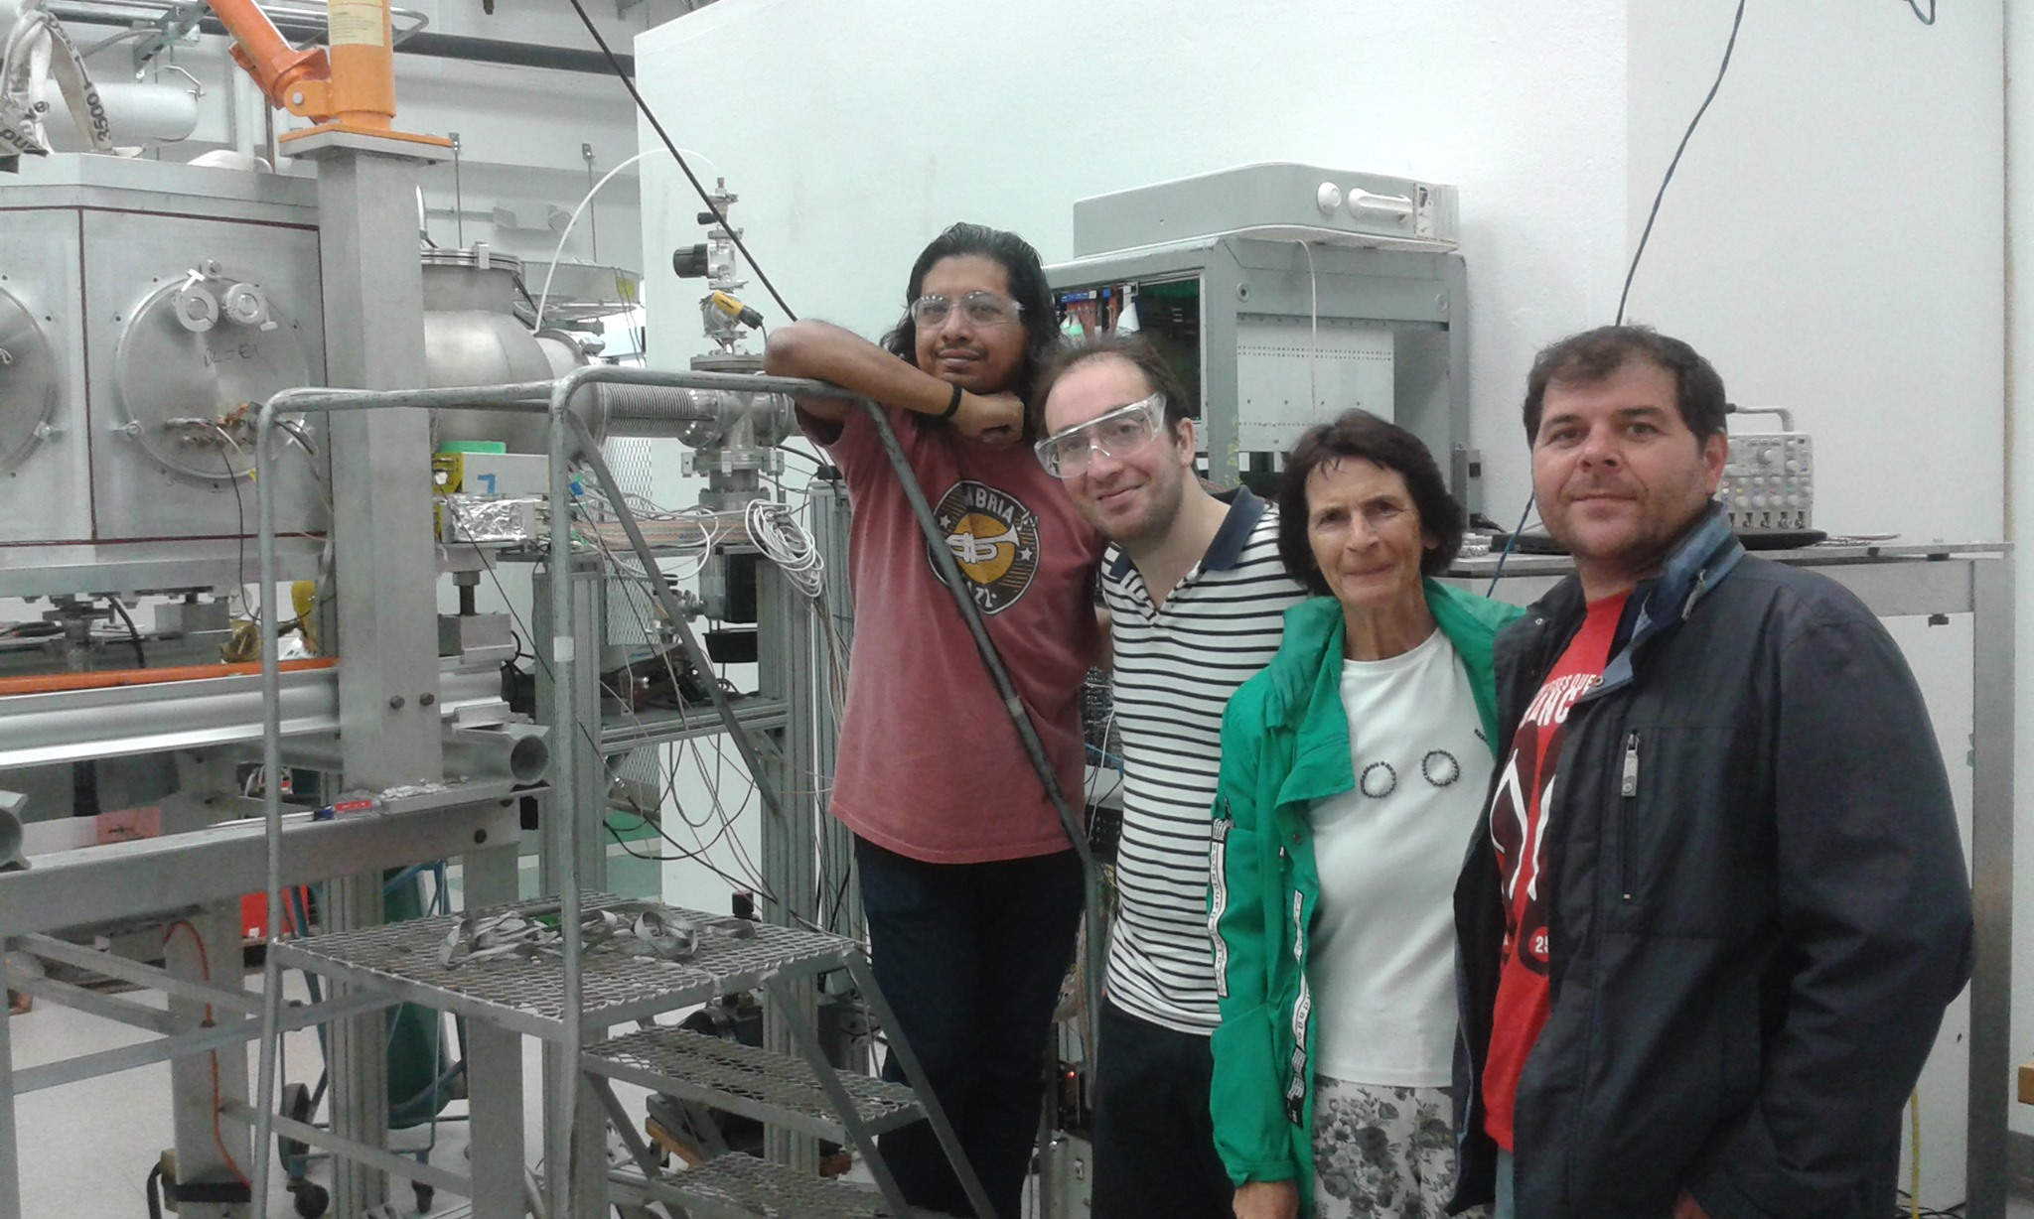
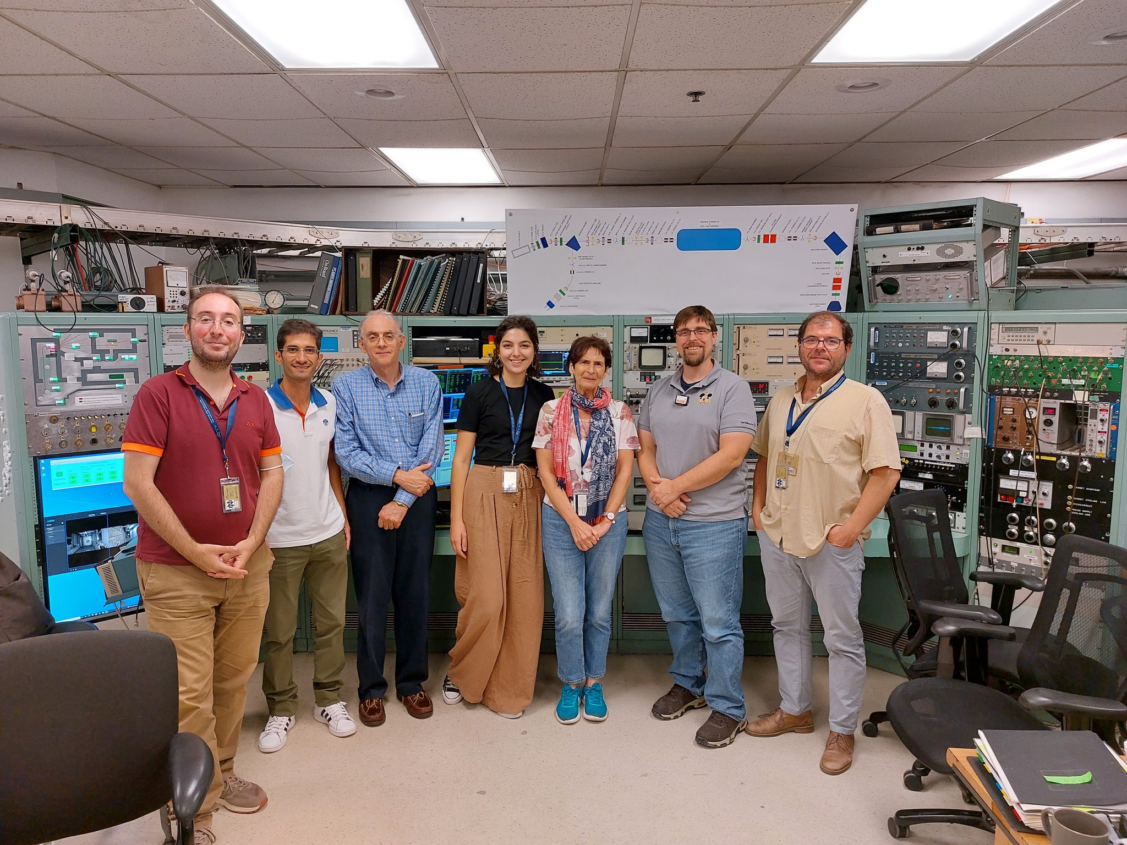
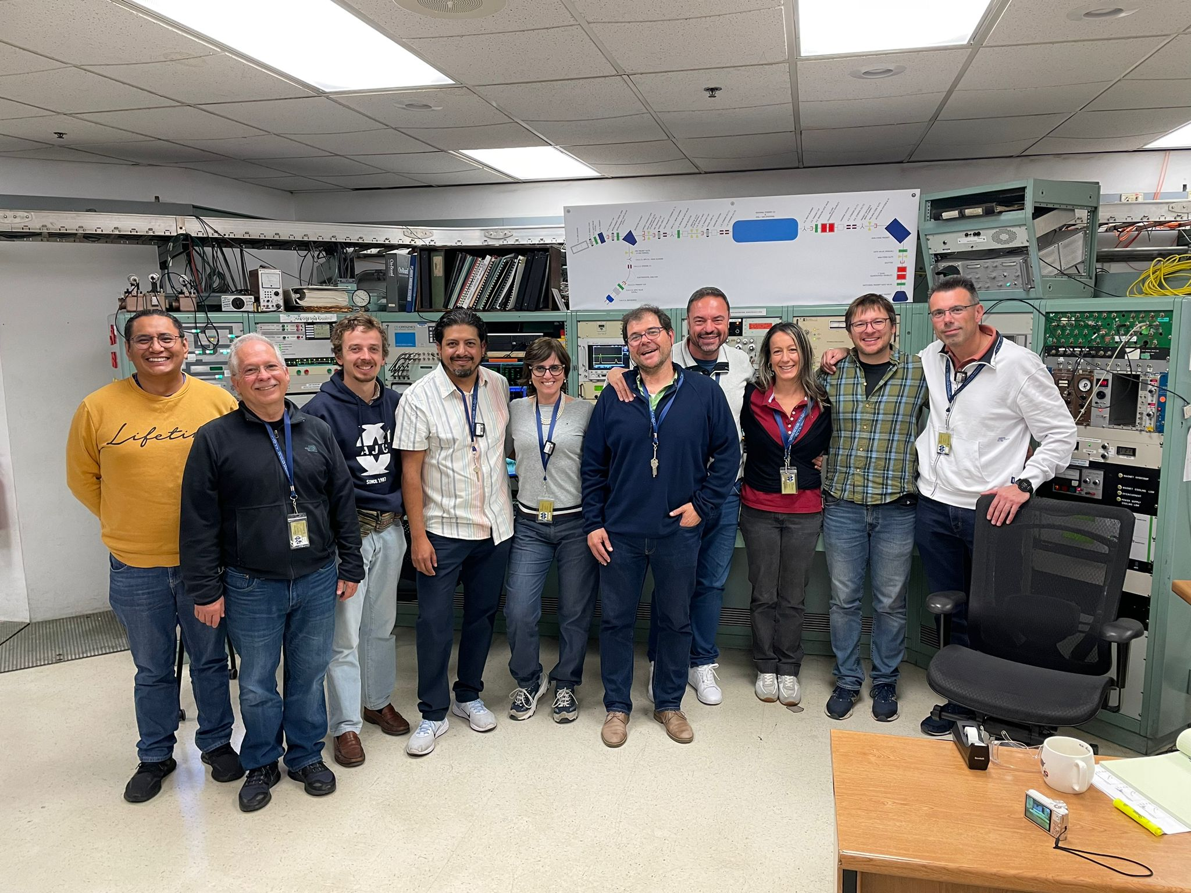

Many years collaborating with ND (Aguilera-Kolata)
Announcement
2010
2019
As an iniciative of E. Aguilera and M. Wiescher, 2 years ago was create IANNA “Ibero American Network of Nuclear Astrophysics” which immediately was linked to IRENA “International Research Network for Nuclear Astrophysics”.
IANNA has presently Mexico, Brazil, Argentina, Spain and Portugal as country members.
2022
2023

Slide 29

The first IANNA-IReNA workshop on new reaction rates for Nuclear Astrophysics is being organized as a collaboration between IANNA (Ibero American Network of Nuclear Astrophysics) and IReNA (International Research Network for Nuclear Astrophysics), with main co-sponsorship from IReNA.
It will be held during June 9-11, 2024, in the Embassy Suites by Hilton South Bend at Notre Dame, US, just across from the campus of the University of Notre Dame.
SAVE THE DATES
Abstract submission, first days of February’24
Organizing Committee
Luis Acosta, IFUNAM (Mexico) IEM-CSIC (Spain) (chair)
Richard James deBoer, University of Notre Dame, US (co-chair)
E.F. Aguilera, ININ, México, L. Gasques, Instituto de Física, Universidad de Sao Paulo, Brazil, Andrés Arazi, Lab TANDAR, Comisión Nacional de Energía Atómica (CNEA), Argentina,
Daniel Galaviz, Lab de Instrumentación e Física Exp de Partículas (LIP), Portugal and
Marcos Aurelio González Álvarez, Univ. de Sevilla, Spain

Slide 30
Calculations by Nick Keeley for the proposal
Breakup Couplings CDCC (FRESCO): ¹⁵C → n + ¹⁴C
  ¹⁴C inert core
  Optical Model potentials
    n + ²⁰⁸Pb – Koning & Delaroche, NPA713 (2003) 231
    ¹⁴C + ²⁰⁸Pb – ¹²C data S. Santra, PRC64, 024602 (2001)
Stripping Coupling: CRC (FRESCO) ²⁰⁸Pb(¹⁵C,¹⁴C)²⁰⁹Pb
n+¹⁴C potential + s.f (C²S = 0.98); [Kovar NPA231 (1974) 266]

