Slide 1
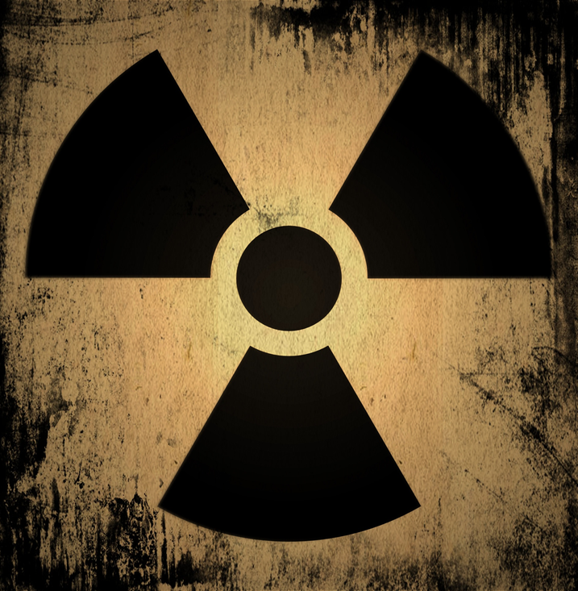

From uNclear to Nuclear How nuclear science contributes to our society
Prof Thomas Elias Cocolios – KU Leuven
Dr Charlot Vandevoorde – GSI
African Nuclear Physics Conference – 25 November 2025

Slide 2
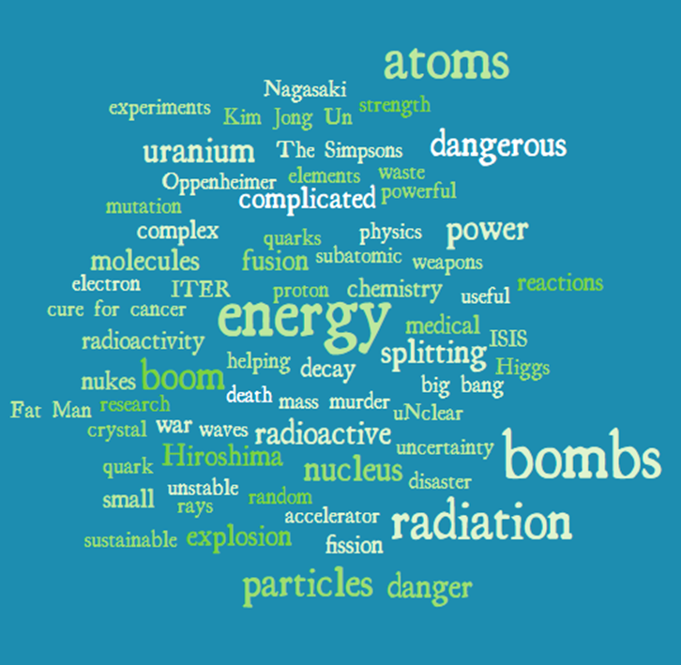
Children and fools tell the truth…

Slide 3
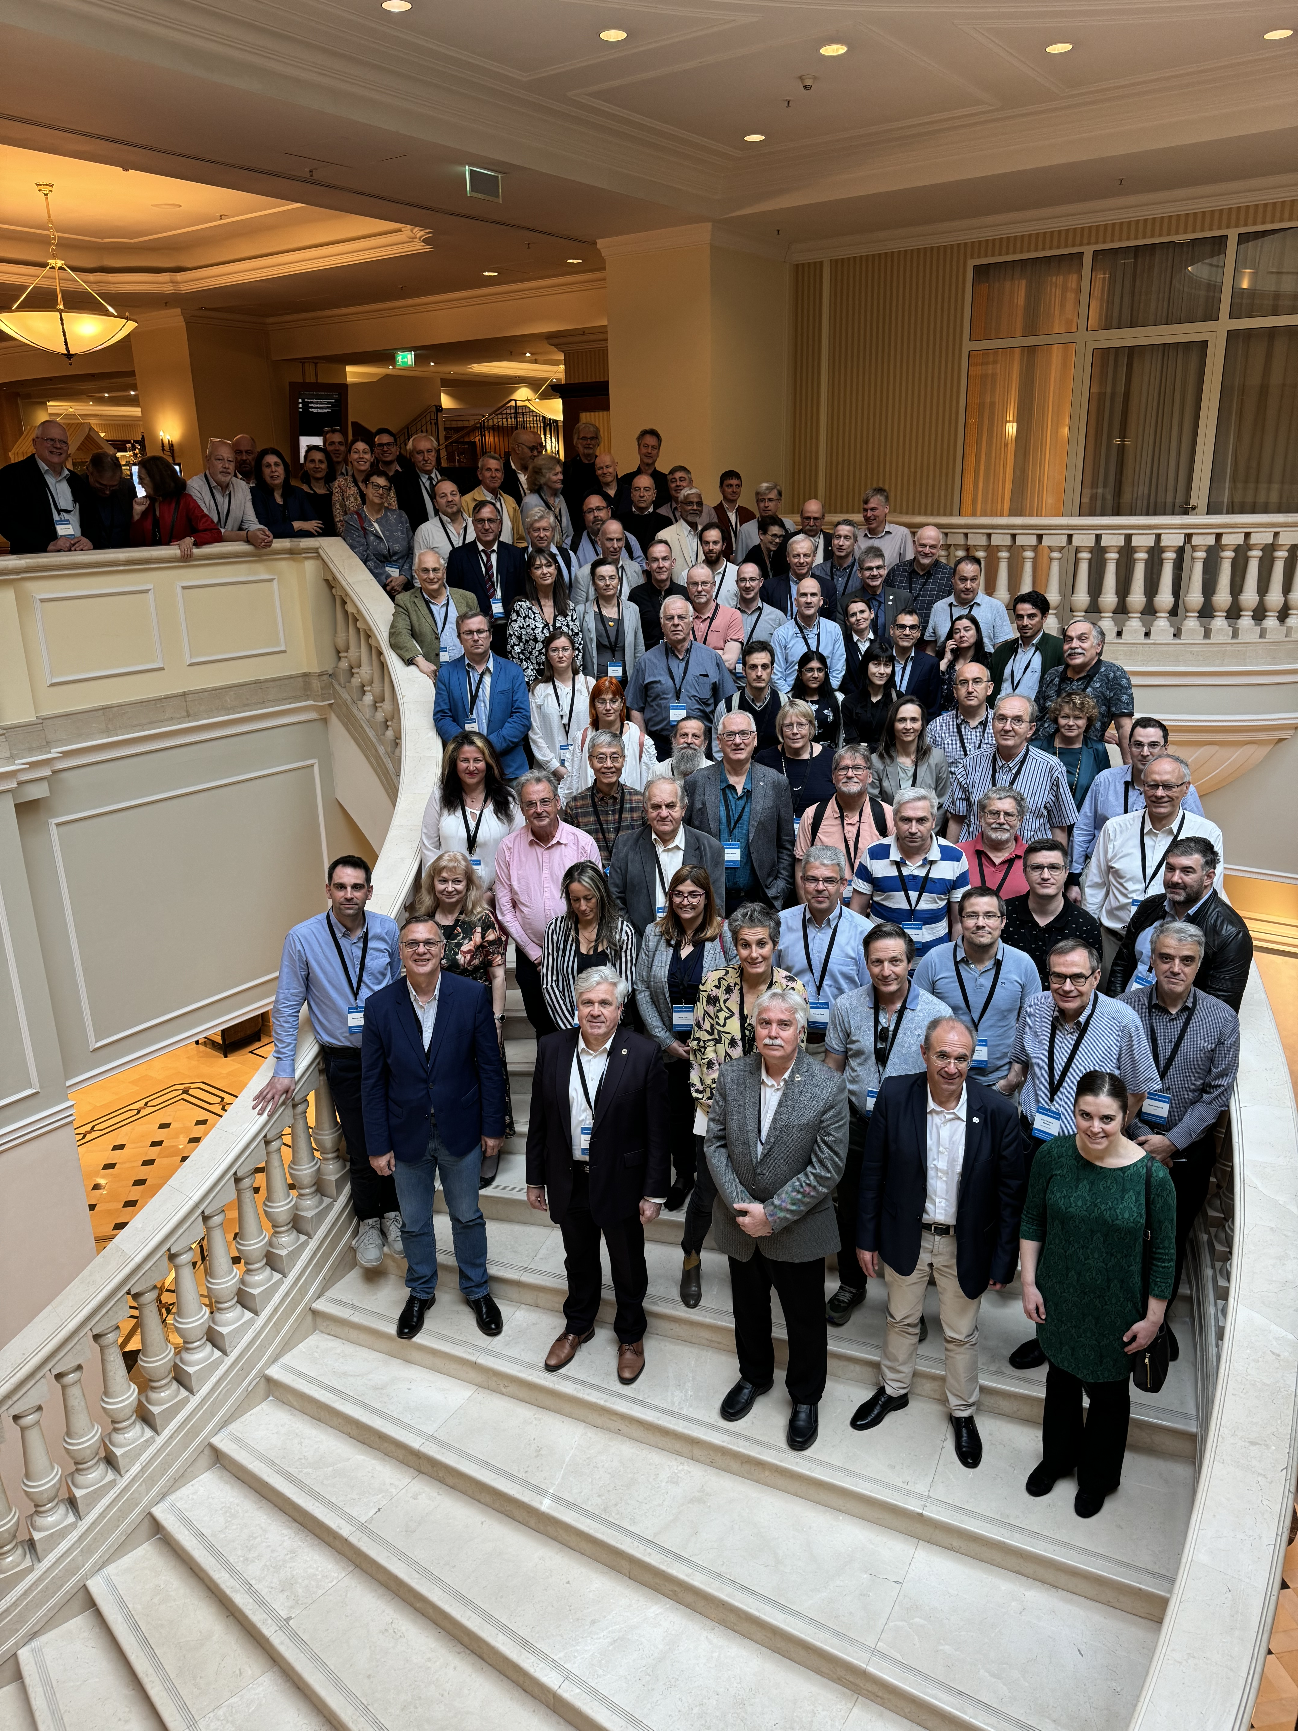
NuPECC Long Range Plan 2024
For over a year, the nuclear science community across Europe has been busy with answering that same question: what does nuclear science stand for and where do we go as nuclear scientists?
And while we were at it, we reflected on what we – nuclear scientists – also bring to society.
Full Long Range Plan: https://arxiv.org/abs/2503.15575
Executive summary: https://nupecc.org/pub/nupecc_lrp2024_brochure.pdf

Slide 4
Acknowledgement
Hamid | Abderrahim | SCK CEN
Michail | Athanasakis-Kaklamanakis | CERN/KU Leuven
Claude | Bailat | CHUV
Sayana | Biswas | PSI
Iva | Bogdanovic Radovic | Zagreb
Daniel | Cano-Ott | CIEMAT
Thomas Elias | Cocolios | KU Leuven
Seán | Collins | NPL
Charlotte | Duchemin | CERN
Marco | Durante | GSI
Giles | Edwards | Manchester
Peik | Ekkehard | PTB
Muriel | Fallot | Subatech Nantes
Anne-Marie | Frelin | GANIL
Robin | Golser | Vienna
Angel | Ibarra | CIEMAT
Ulli | Köster | ILL
Zsolt | Ksztovszky | Budapest
Armandina | Lima Lopes | Porto
Renata | Mikołajczak | POLATOM
Enrique | Nacher | CSIC
Katia | Parodi | GSI
Vincenzo | Patera | Rome
Nikolas | Patronis | University of Ioannina
Lino Miguel | Pereira Da Costa | KU Leuven
Arjan | Plompen | JRC Geel
Lucia | Popescu | SCK CEN
Marco | Ripani | INFN Genova
Zeynep | Talip | PSI
Eugenia | Toimil-Molares | GSI
Charlot | Vandevoorde | GSI
Ana | Vaniqui | SCK
Vladimir | Wagner | Prague
Clemens | Walter | Hannover

Slide 5
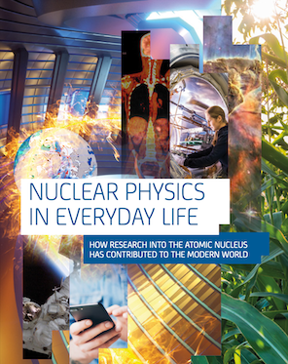
NuPECC’s Nuclear Physics in Everyday Life
https://www.nupecc.org/pub/np_life_web.pdf
(2022)

Slide 6
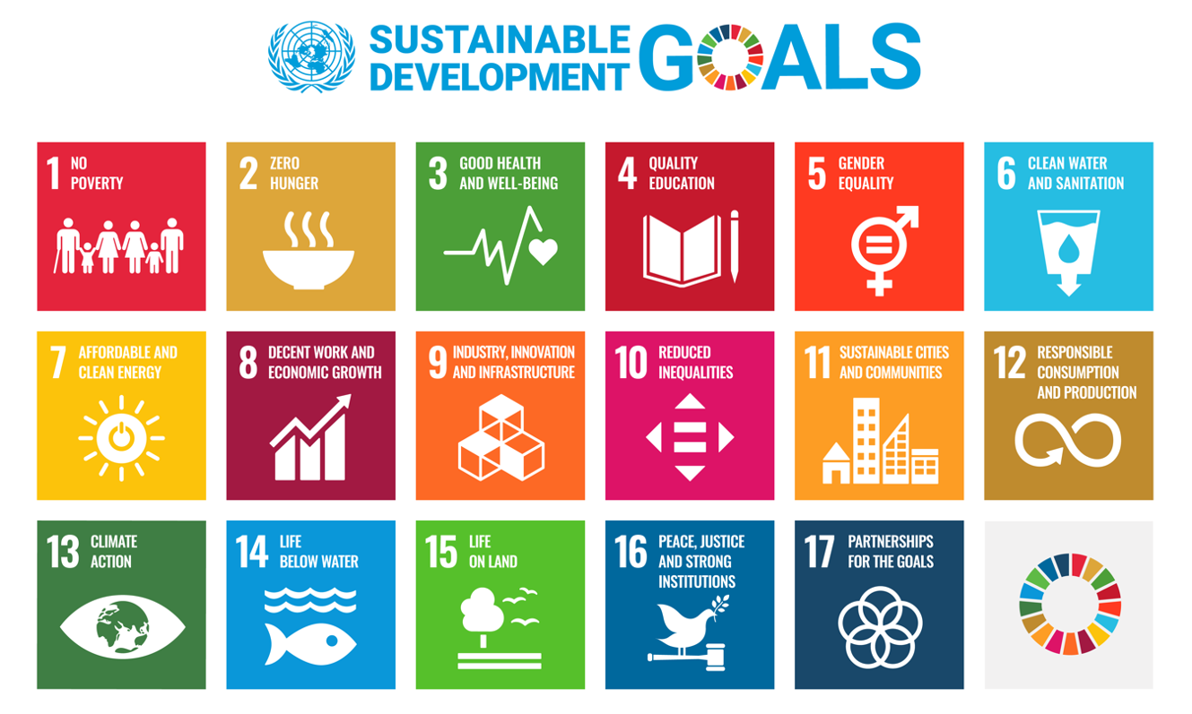
What is societal benefit?
https://sdgs.un.org/goals

Slide 7
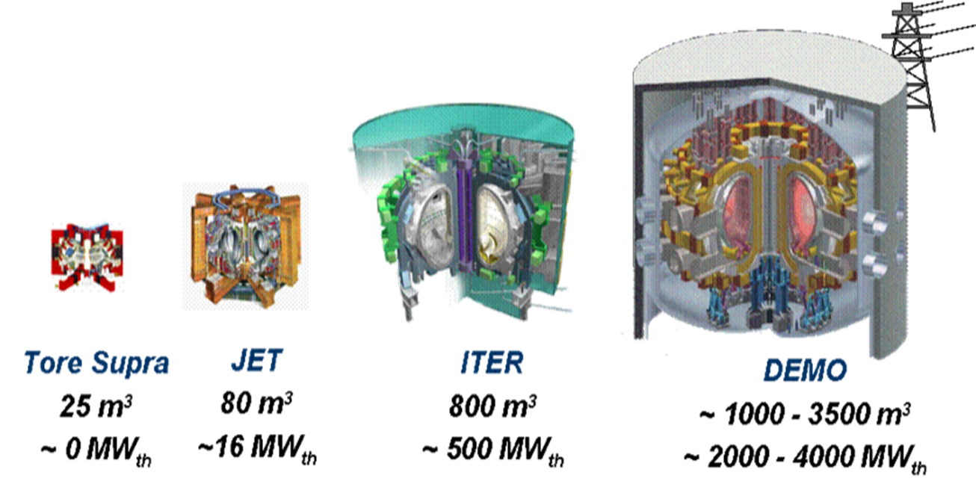
Energy
Towards carbon-free, sustainable energy supply

Slide 8
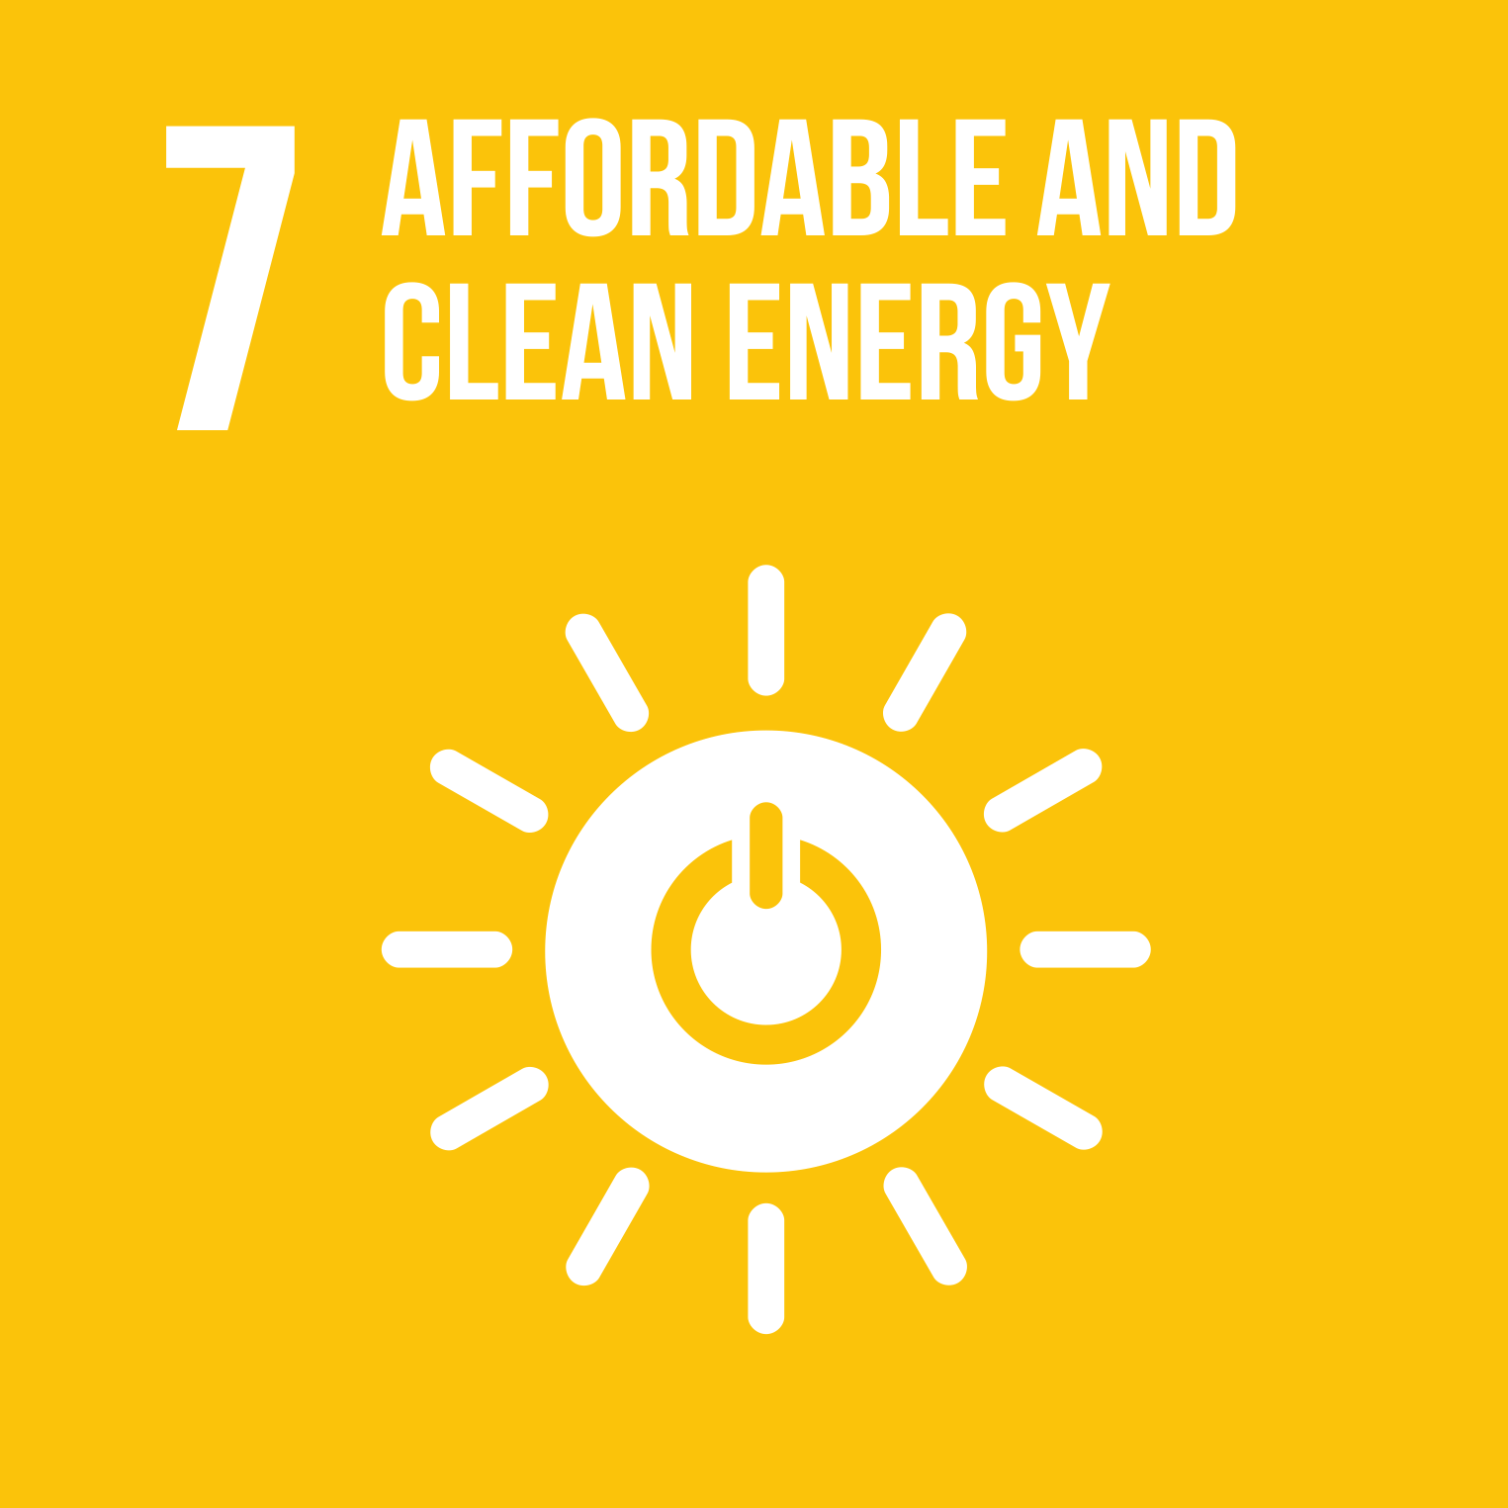


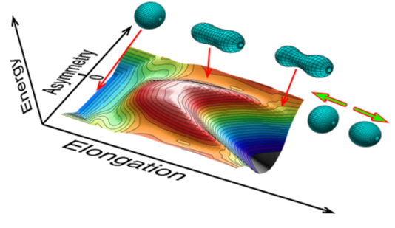


Nuclear power for civil applications
Nuclear fission
Nuclear fusion
U-Pu are well established.
Th is on the horizon.
Established technology with much improvement possible.
Concerns with very long-lived waste and safety.
Promises to supply clean energy for all.
It is so close!
But it always seems to be 30 years away…

Slide 9
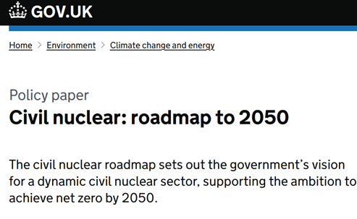
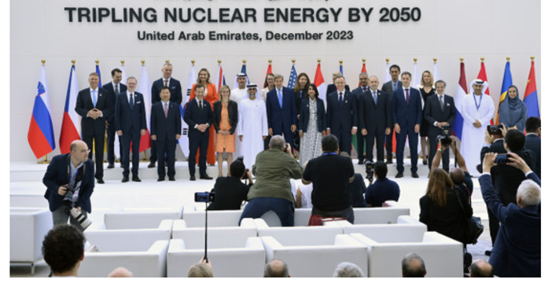
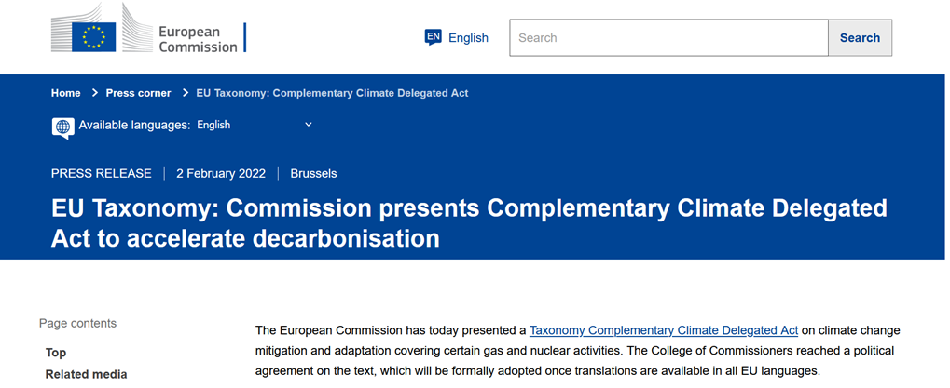
Shifting world view
Decarbonisation goals and security of supply represent critical global challenges. Nuclear energy will continue to provide a significant contribution to energy production for decades to come.
Several national and international initiatives: COP28 tripling nuclear energy by 2050, EU Complementary Climate Delegated Act 2022, UK Nuclear Power Roadmap.

Slide 10

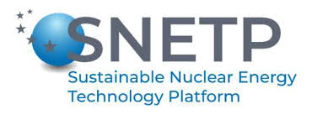
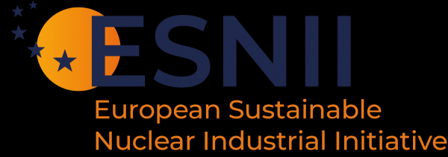
Nuclear fission for energy
Fission reactors: new reactors concepts to achieve improvements in safety, security and efficiency:
Minimize long-lived minor actinide production
More efficient use of fuel
Improved thermodynamic efficiency
Opportunity to produce hydrogen
Stronger safety features
Widespread implementation of several Small Modular Reactor (SMR) designs around the world, with a growing interest for non-electricity applications like district heating.
Lifetime extensions and innovative fission reactor designs: need for facilities for neutron irradiations and high precision neutron data for several reactions.

Slide 11
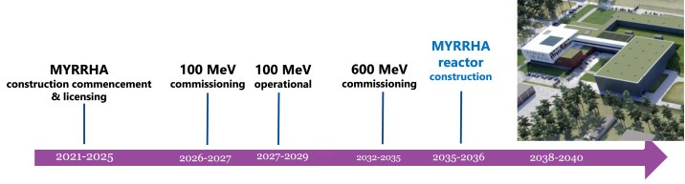
Next generation nuclear fission
Accelerator Driven Systems (ADS):
Subcritical fission core with better reactivity control and the possibility to load high quantities of minor actinides (MAs).
Partitioning and Transmutation: need to separate MAs from spent fuel.
MYRRHA: European initiative to test this concept in a multipurpose facility.
Lay-out of the MYRRHA ADS complex in Belgium
The completion of MYRRHA is crucial to realize the ambition of reducing our current nuclear waste before its long-term geological disposal.
Figure adapted Van Oost et al. – Fus Engin Des 2024

Slide 12
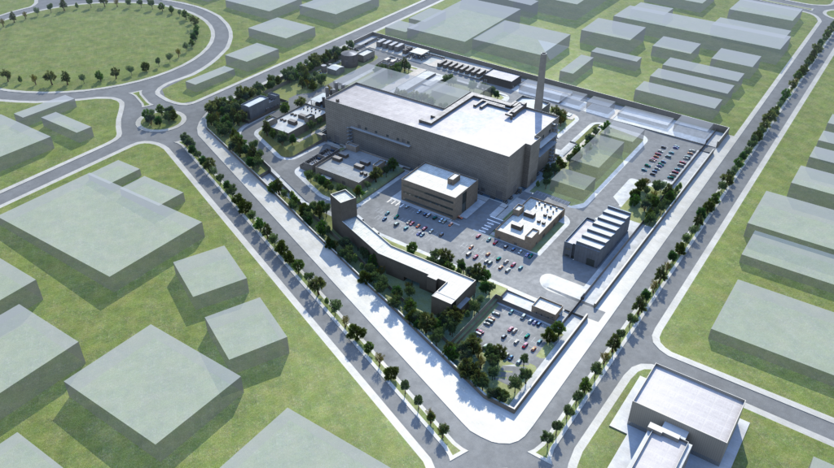
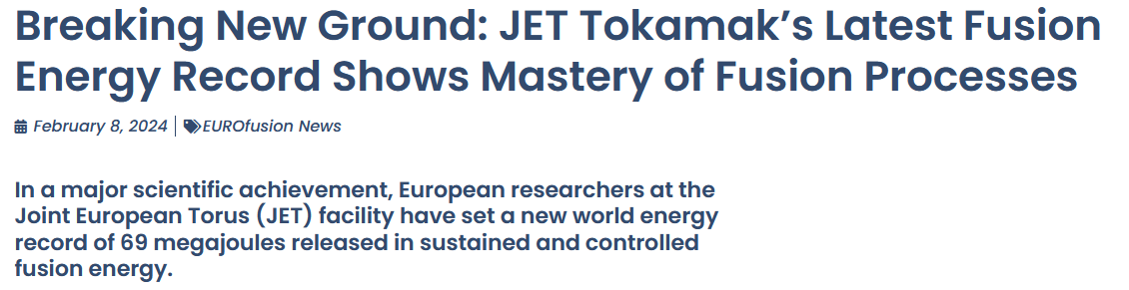
Nuclear fusion
Fusion reactors: development of the main projects outlined in the global fusion roadmap - completion of ITER and construction of DEMO – and growing interest from private sector.
Many plasma physics experimental machines will start operation in the coming years.
ELI-ERIC: strengthened the European interest in the inertial fusion energy production approach.
IFMIF-DONES: intense neutron source (d-Li) provides opportunities to improve cross-section data required for new fusion reactor technology.
Figure from https://ifmif-dones.es/fusion-energy/about-ifmif-dones/

Slide 13
Addressing the concerns
Waste:
Reduce the waste to be disposed in geological repositories: transmutation with ADS.
Increase our knowledge of MAs: systematic radiochemical investigations to predict their behaviour on the long term.
Security and safeguards:
New technologies to investigate nuclear materials in repositories or container transport.
High-brilliance γ-ray source (ELI-NP): implement active interrogations based on nuclear resonance fluorescence.
Detector developments in other fields of nuclear physics applications may be utilized for security applications (e.g., radioactive waste management, nuclear installation decommissioning, heritage or material science).
Adequate support for translation of technology to this sector is key.

Slide 14
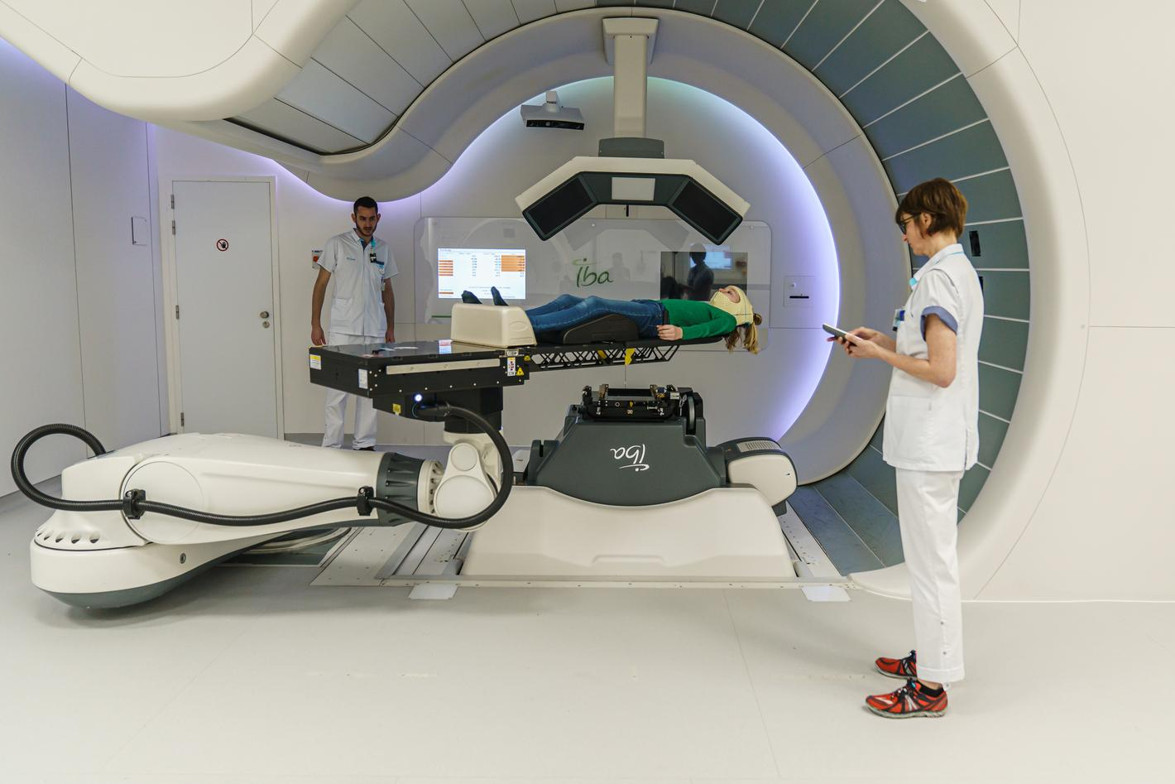
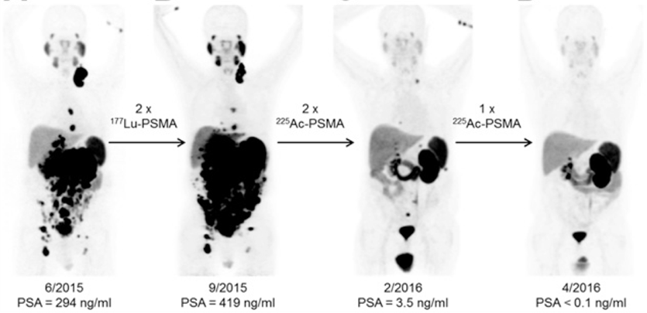
Health
Beyond just protecting ourselves from radiation, how can we harness its power to treat patients with cancer?

Slide 15


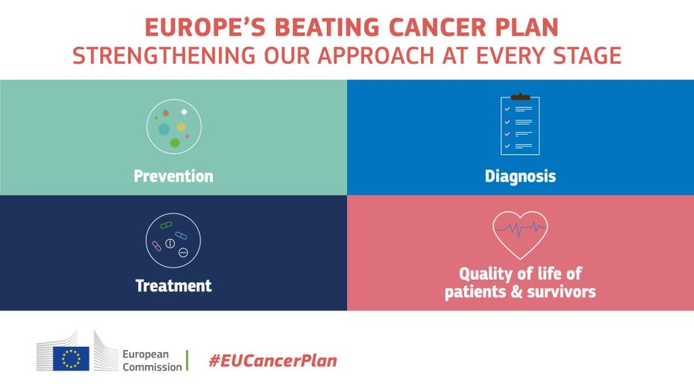
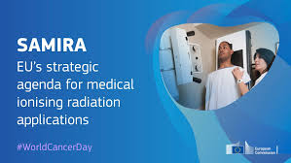
Health
The nuclear physics community plays a central role in the radiation oncology field, from the production of medical radioisotopes up to the development of new diagnostic and therapeutic techniques that make use of particle beams
These applications are essential to meet Europe’s Beating Cancer Plan, enshrined in Strategic Agenda for Medical Ionizing Radiation Applications (SAMIRA) action plan

Slide 16
Medical imaging
Medical imaging is in constant evolution to provide higher accuracy, use less radiation, and achieve earlier detection of possible conditions.
Range inaccuracies in hadron therapy are still arising from the challenging translation of photon absorption data to charge particle stopping powers. Need for hadron imaging.
Quantitative imaging offers additional information on how to adapt treatments to each patient towards personalized medicine.
Detector developments are key to improving the imaging setups, as evidenced with many new devices coming recently on the market
Total body PET
CZT SPECT/CT
Notes:
Mention box on detector technology → importance of segmentation and advanced front-end electronics

Slide 17
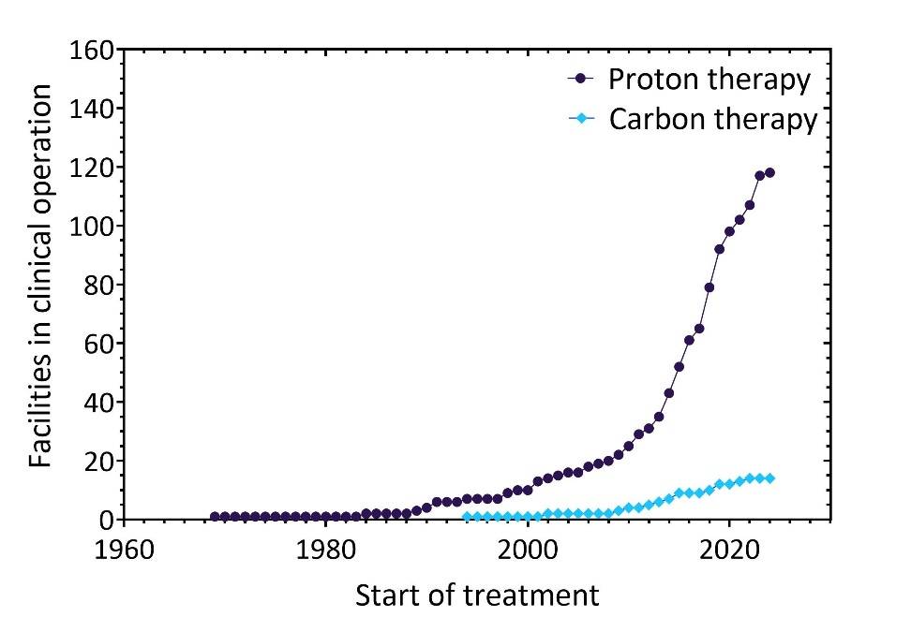
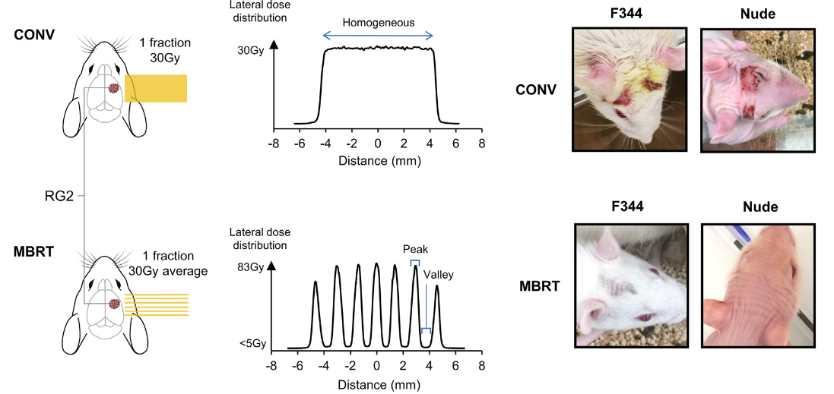
Particle therapy
Particle Therapy:
Radiobiological properties of ion beam and combination treatments
Technological advances:
Up-right beam delivery systems
Novel accelerator concepts for particle therapy
“Novel” ions for treatment (⁴He, ¹⁶O and ²⁰Ne)
Spatially fractionated radiotherapy (SFRT)
Figure from Bertho et al. – Rad Oncol Biol Phys 2022

Slide 18
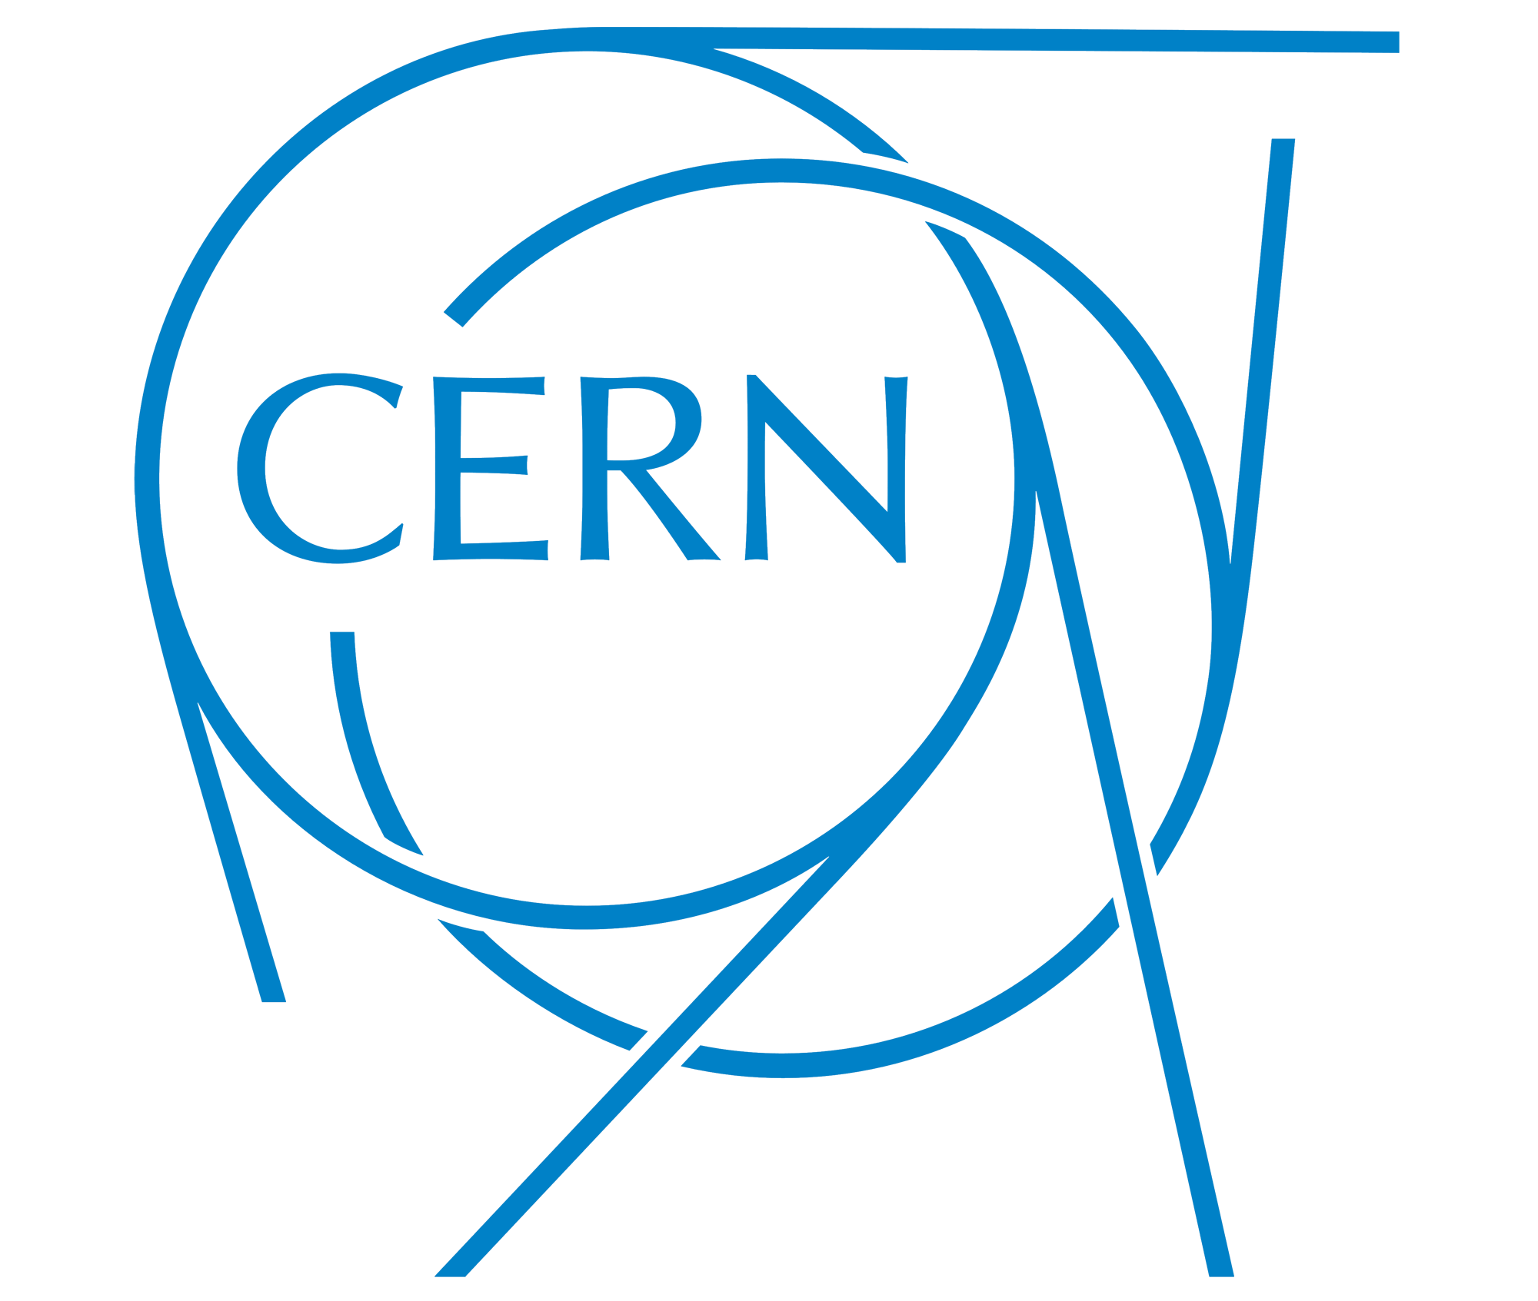

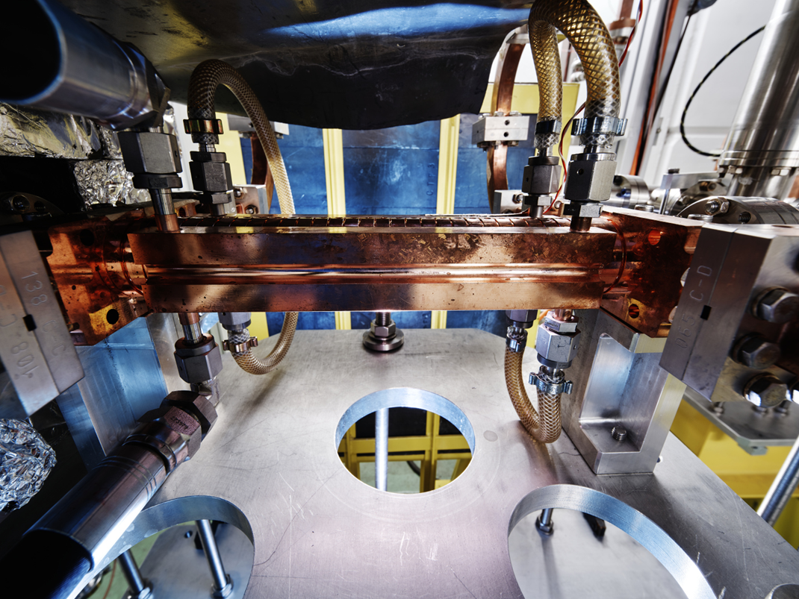
Progress in particle therapy
Normal tissue toxicity remains a limiting factor for the efficient treatment of radioresistant tumours and lesions near radiosensitive structures
FLASH Radiotherapy
Ultra-high dose rates: > 40 Gy/sec
Very short delivery times: < 1 sec
Spare normal tissue, while still enabling tumour control.
¹¹C hadron therapy
Overcome uncertainty in particle range
RIB beam for treatment and online PET imaging, allows on-line correction to obtain image-guided particle therapy.
Fig: Compact Linear Collider (CLIC) accelerator component, as part of the CERN-CHUV laser-driven accelerator project, aiming to use very high energy electrons (100 – 200 MeV) for FLASH radiotherapy.
Fig: Experiment at GSI/FAIR in February 2024, where mice were imaged and treated with a ¹¹C ion beam.

Slide 19
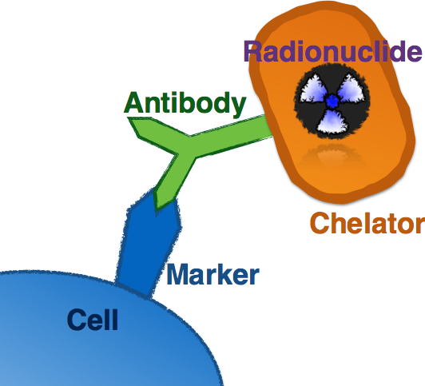
Targeted radionuclide therapy
Targeted Radionuclide Therapy (TRNT) uses a type of radiopharmaceuticals to selectively destroy cells in a patient, mostly against metastatic cancers. TRNT has seen a pronounced growth in the recent years and many new treatments are on the horizon, in particular with the use of ¹⁷⁷Lu against cancers of the endocrine system and prostate cancer.
Targeted Alpha Therapy (TAT) is the use of alpha emitters for therapy. Only ²²³Ra is currently clinically available but a lot of efforts is invested to develop new radiopharmaceuticals using ²¹¹At, ²¹²Pb, ²¹³Bi, or ²²⁵Ac.
Auger electron therapy is the next development on the horizon.
Notes:
Can comment on the economical growth of the field to several tens of billions per year.
We can here emphasize on what we recommend orally – namely the better geographical distribution and the detailed study of key isotopes. PRISMAP and the facilities could be mentioned as well. I could add a few extra slides on that eventually

Slide 20
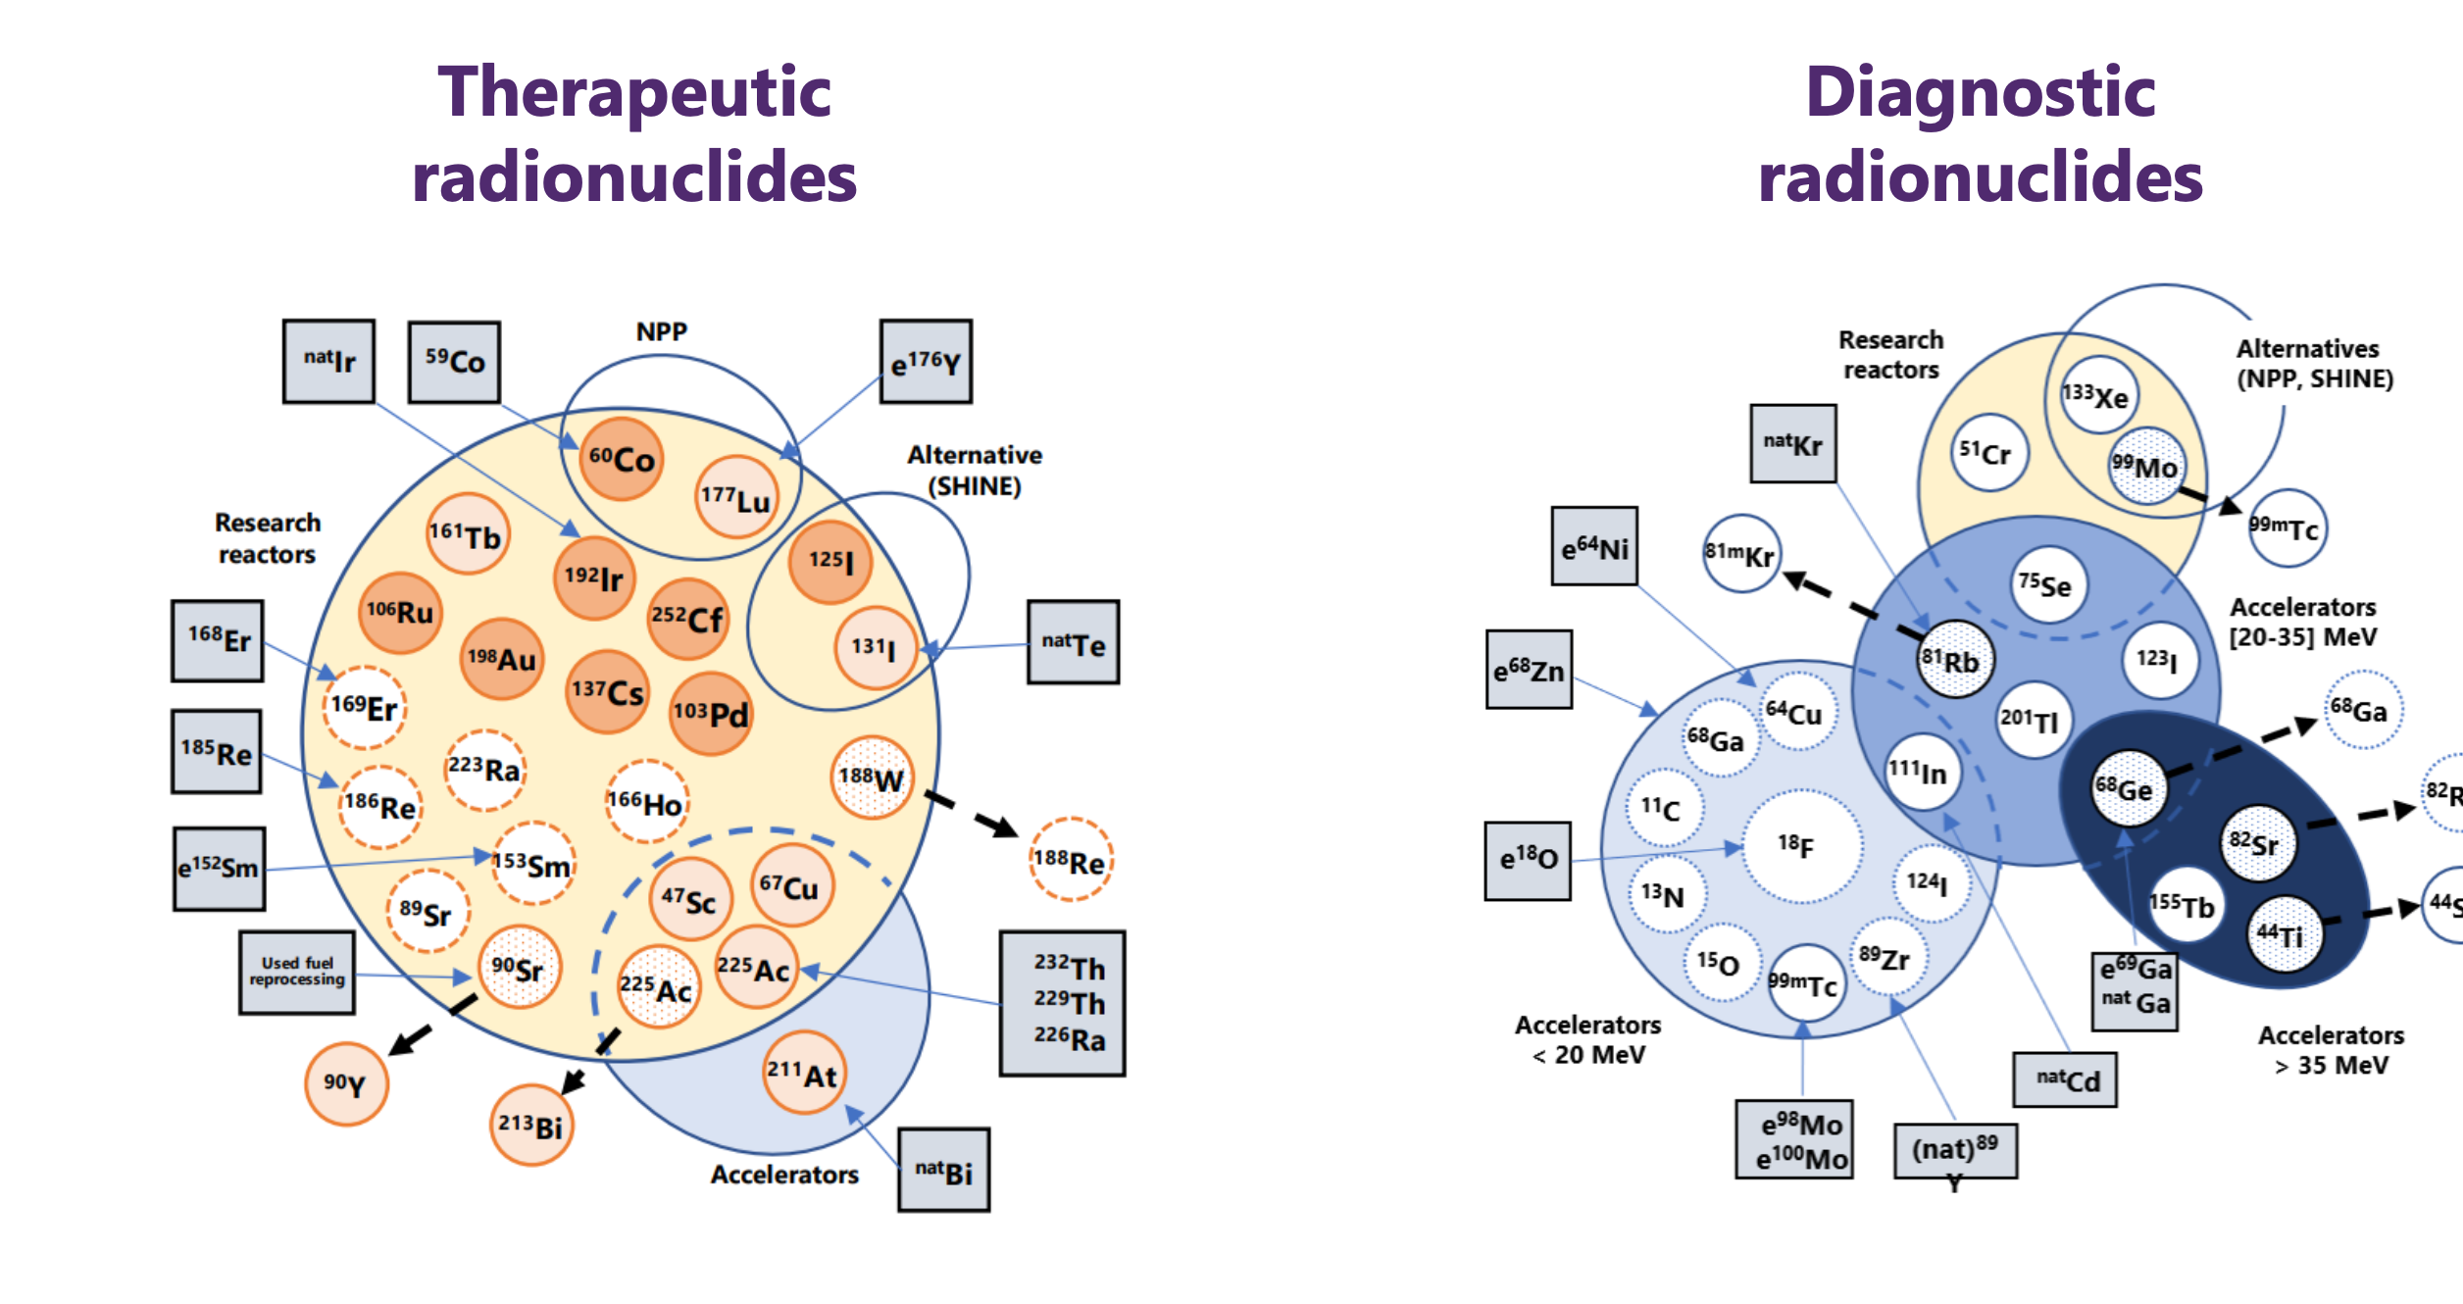
Where are the radionuclides from?
https://op.europa.eu/en/publication-detail/-/publication/4599de47-3ac6-11ec-89db-01aa75ed71a1/language-en
Courtesy Michiel Van de Voorde (SCK CEN)

Slide 21
Medical radionuclide supply
In nuclear reactors
At particle accelerator
Medical radionuclides are produced in nuclear reactors either from neutron capture or from fission of ²³⁵U.
The irradiated material always requires heavy radiochemical post-processing in hot cells.
Well established pipeline but limited (and ageing) infrastructure.
Accelerators are very modular and depending on their energy and particles accelerated, different reactions are possible.
Many hospitals have their own accelerator and are thus independent.
Innovative radionuclides require exotic accelerators.

Slide 22
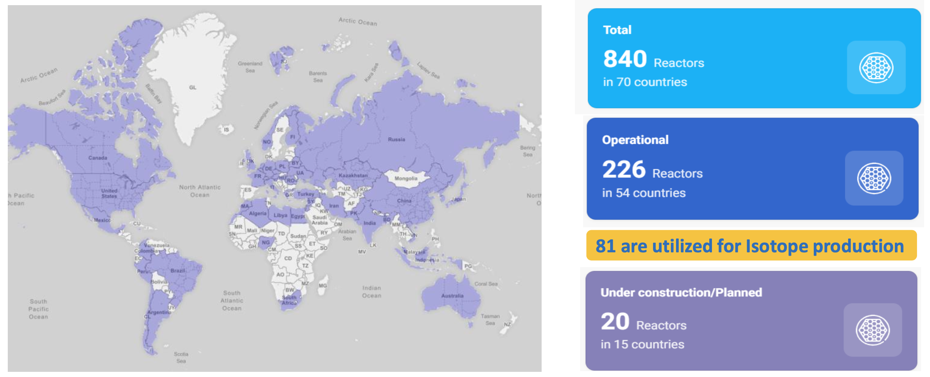
Research reactors worldwide
https://nucleus.iaea.org/rrdb/#/home
https://nuclearmedicineeurope.eu/security-of-supply/

Slide 23
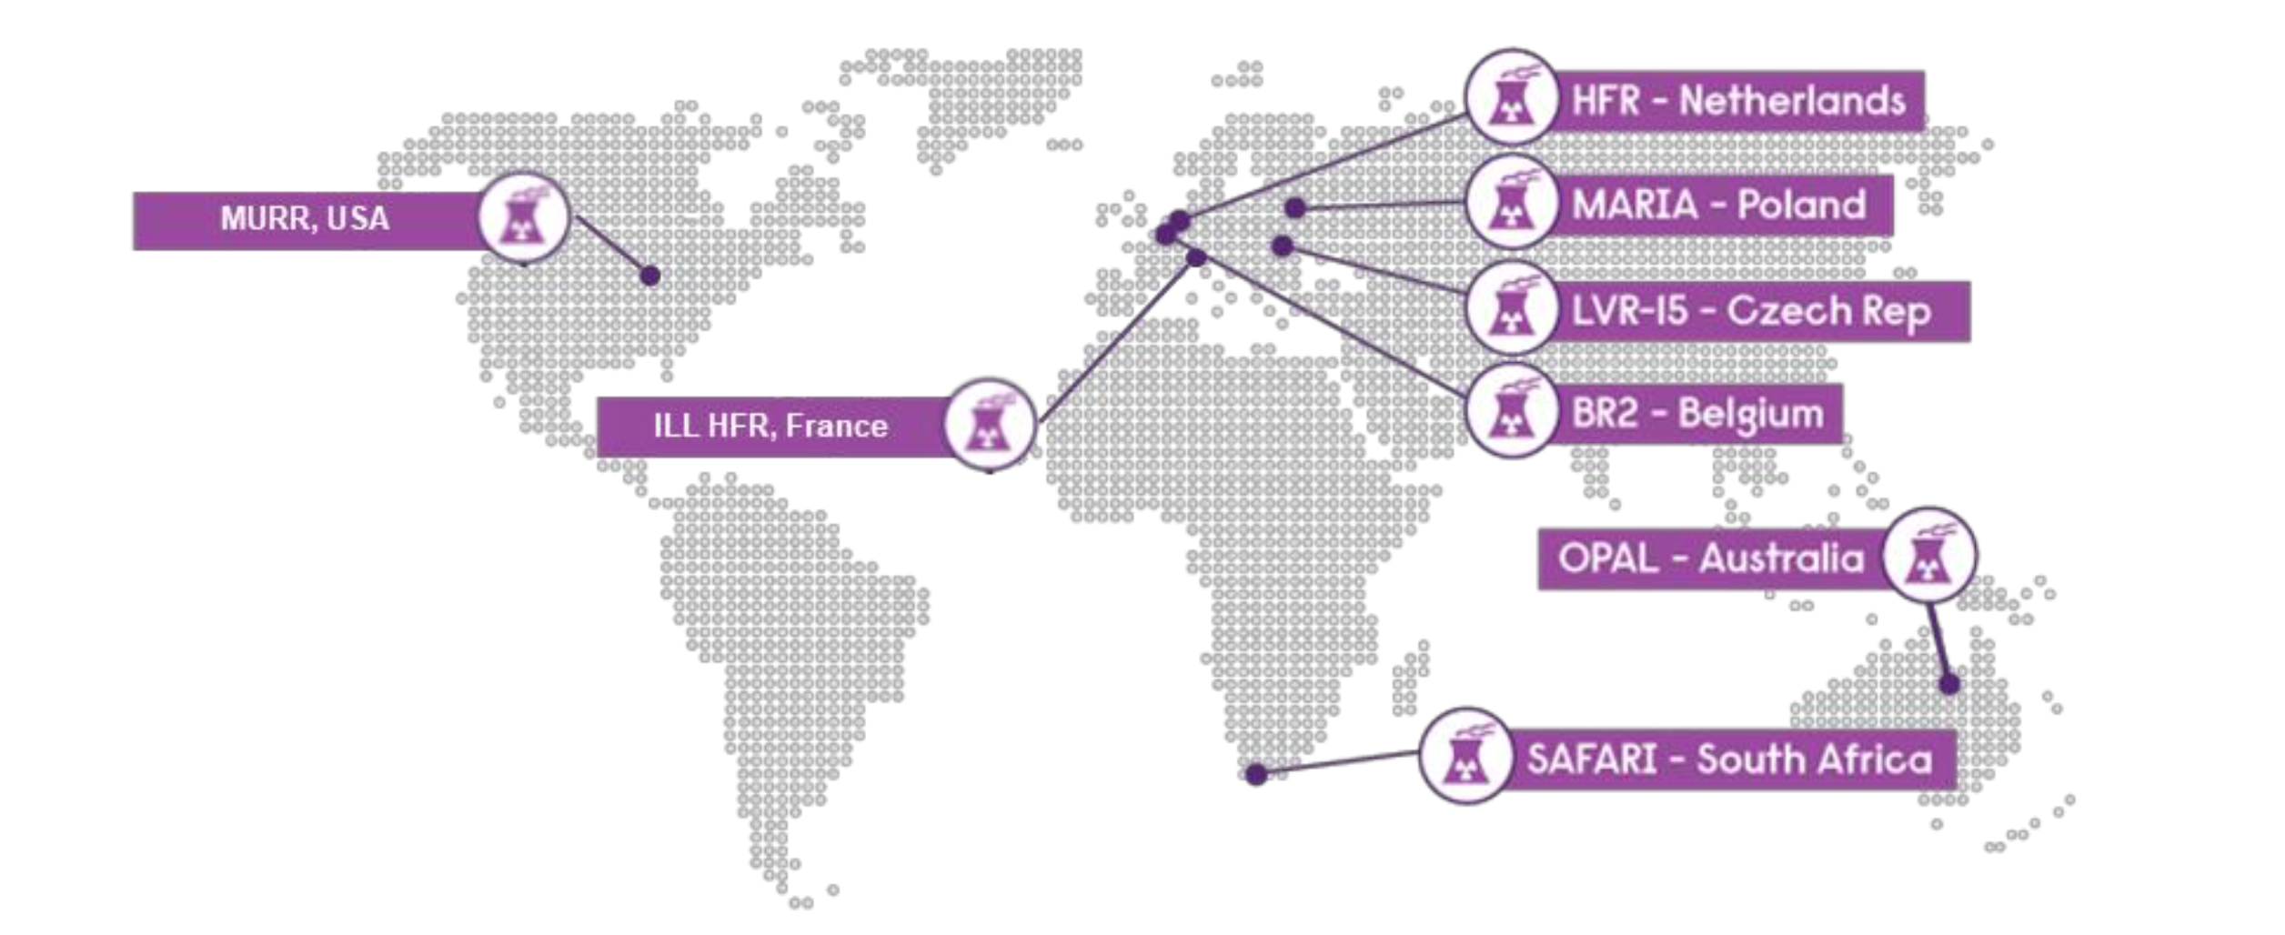
Research reactors worldwide
https://nucleus.iaea.org/rrdb/#/home
https://nuclearmedicineeurope.eu/security-of-supply/

Slide 24

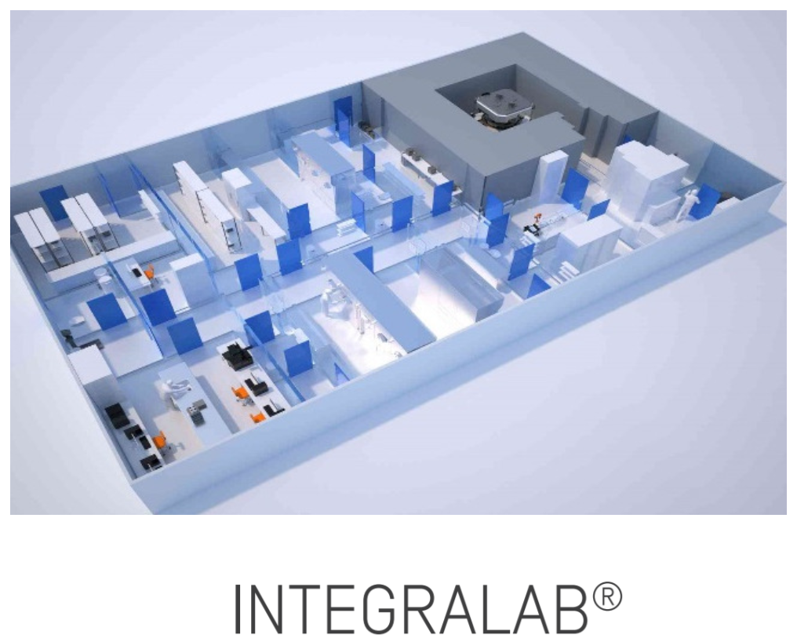
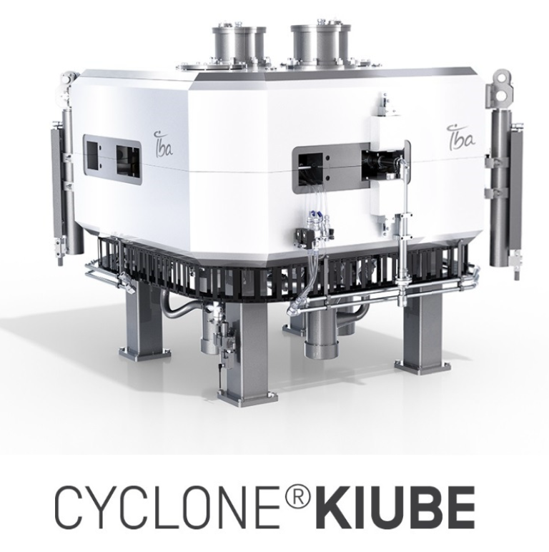
Medical cyclotrons
Those can be found in many hospitals around the world, coupled with the local radiopharmacy.
They consist of typically low-energy machines, up to 11 or 18 MeV, with built-in target systems that may even already process the radiochemistry part of the preparation and can be integrated with automated synthesis of the radiopharmaceuticals.
Ideal for PET isotopes ¹¹C and ¹⁸F.

Slide 25
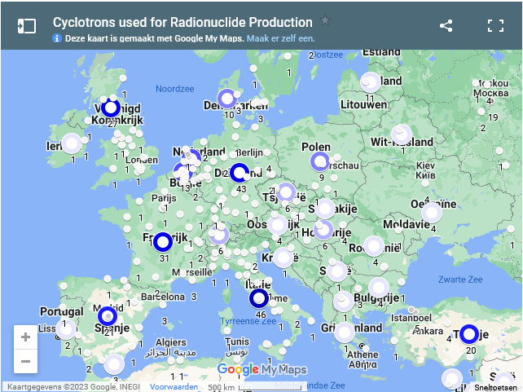
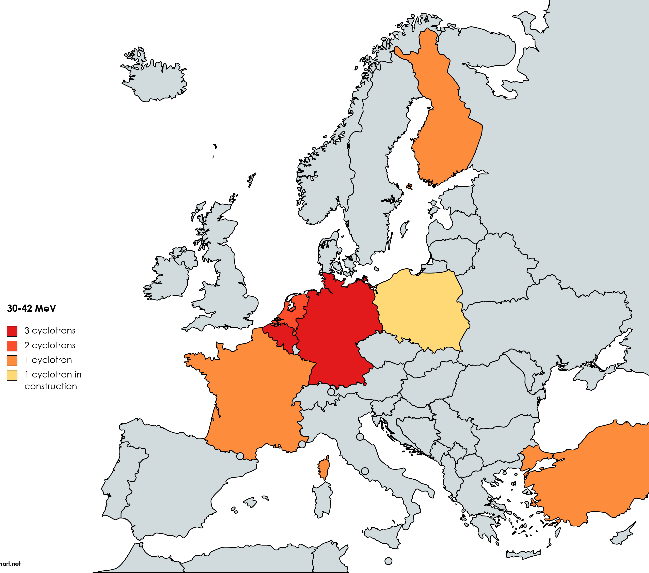
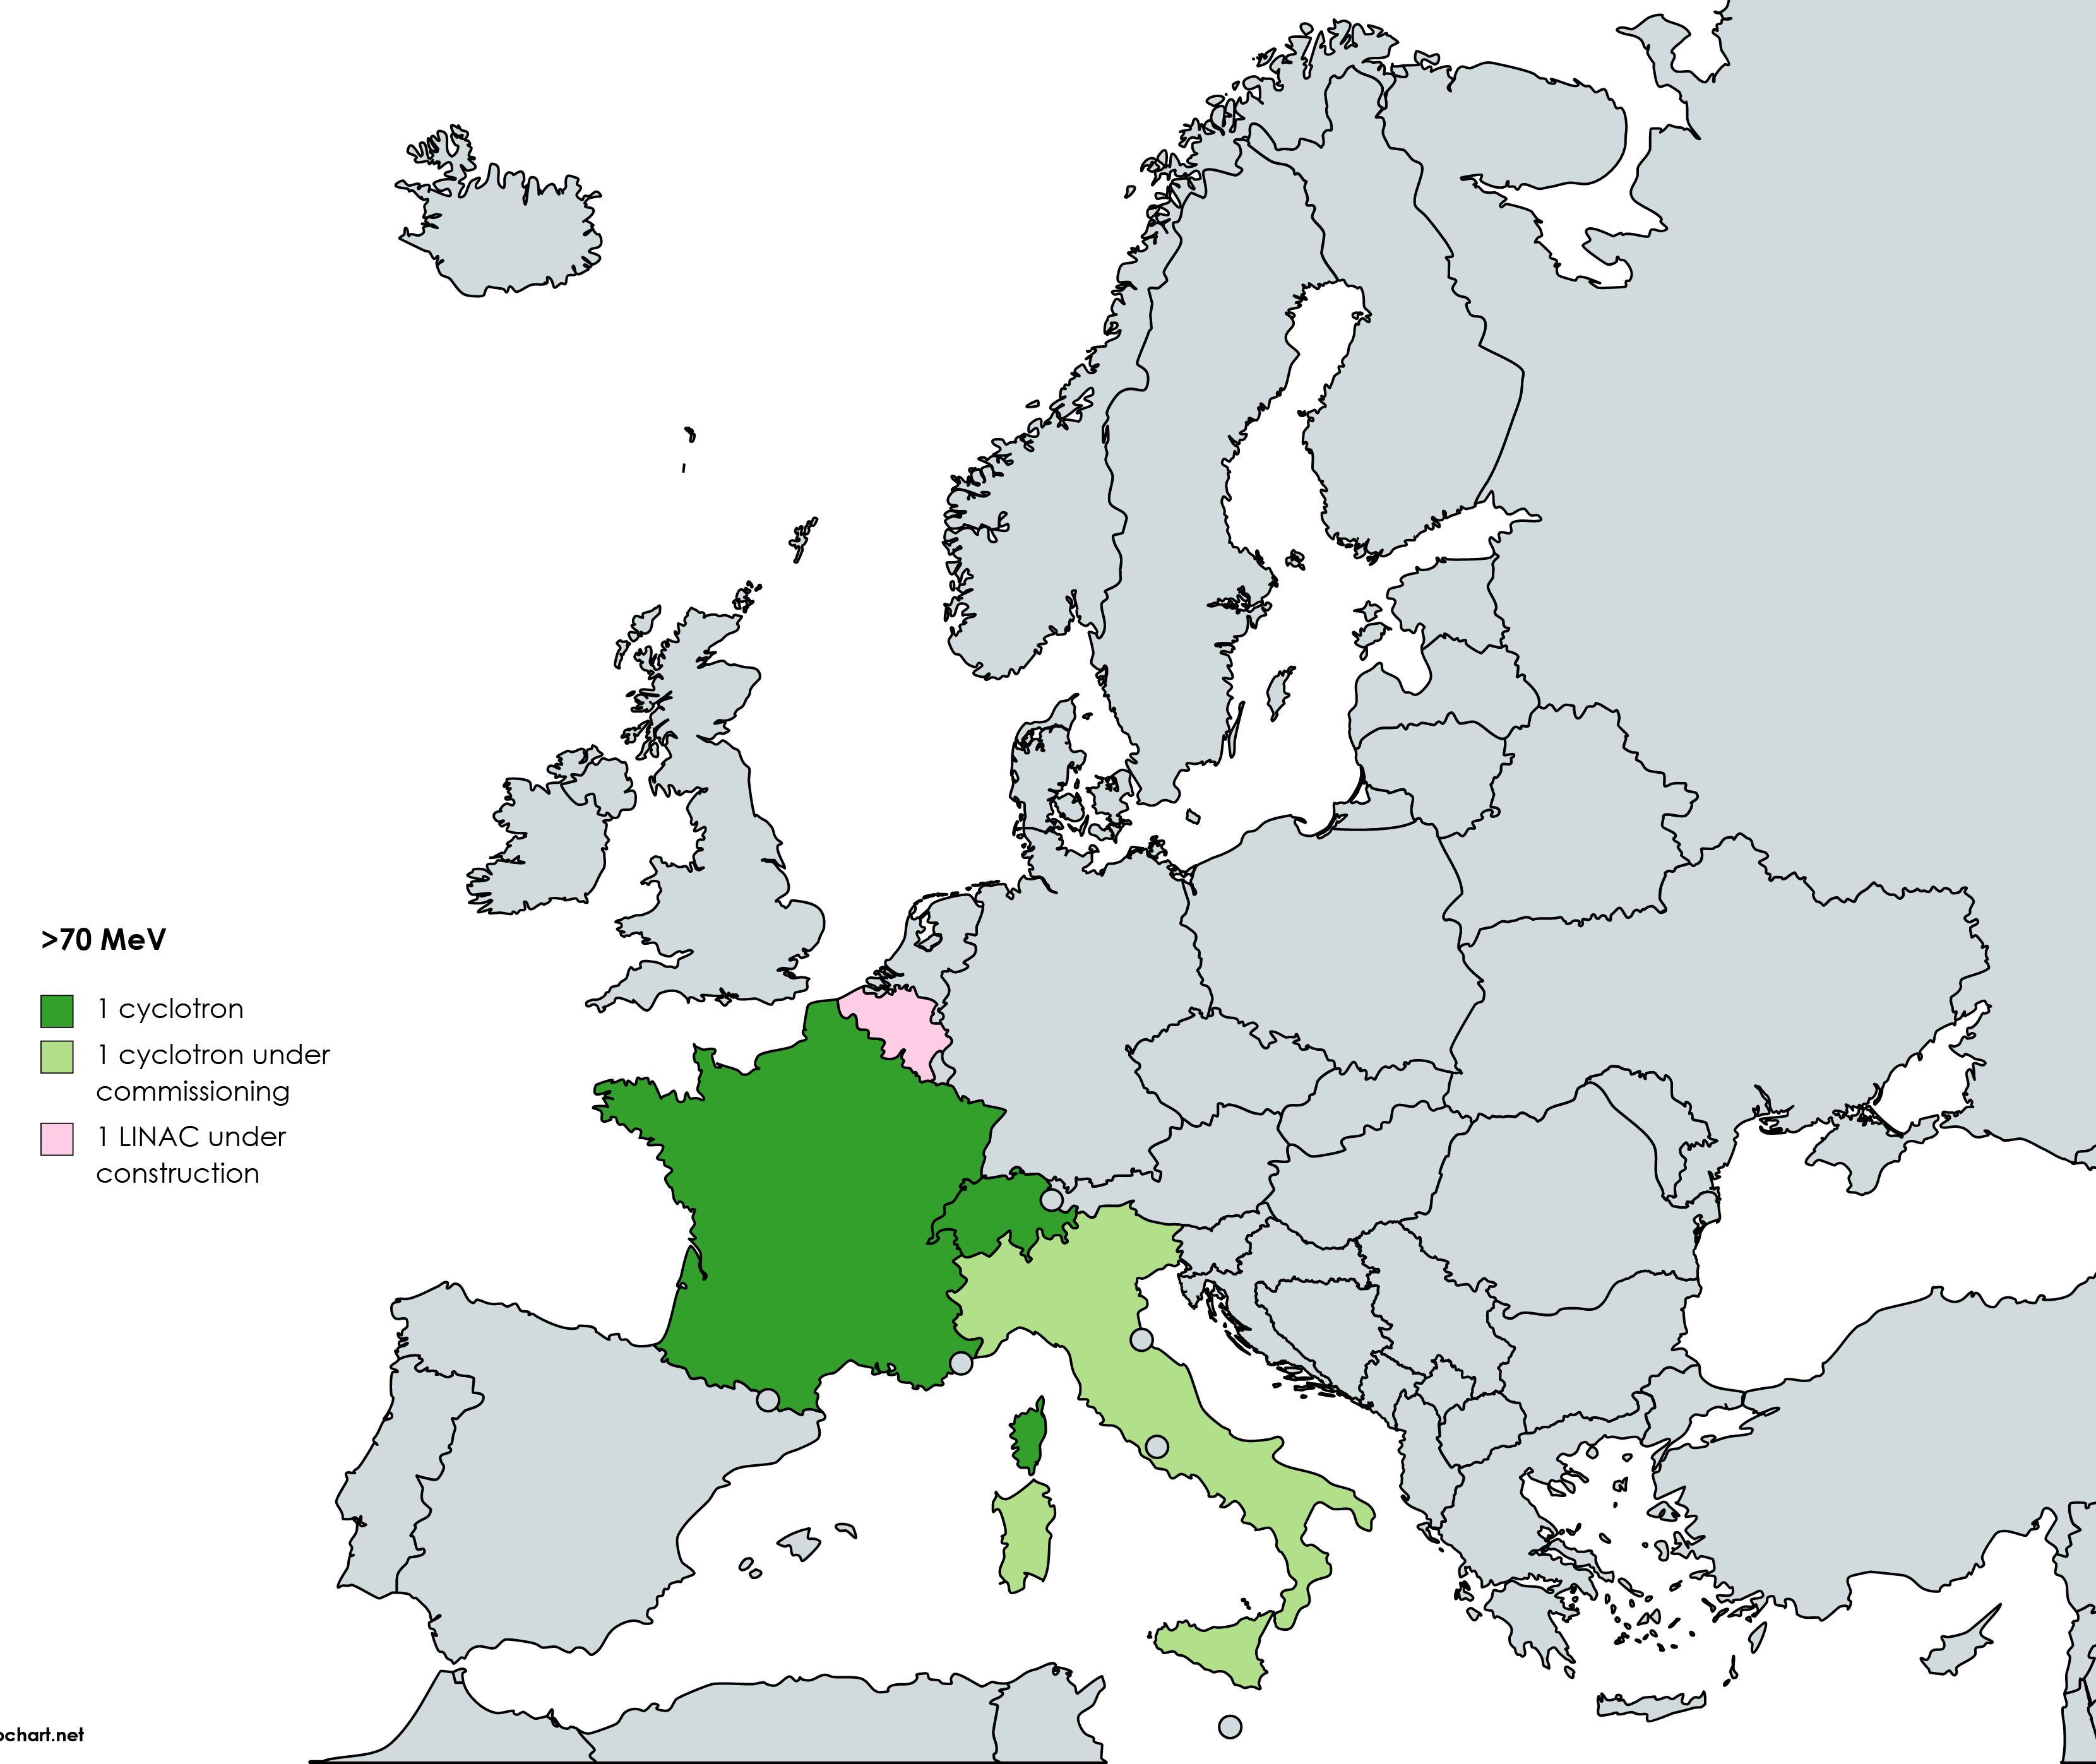
From standard to advanced cyclotrons
10(+1) medium energy cyclotrons
2(+2) medium-high energy accelerators
https://nucleus.iaea.org/sites/accelerators/Pages/Cyclotron.aspx

Slide 26
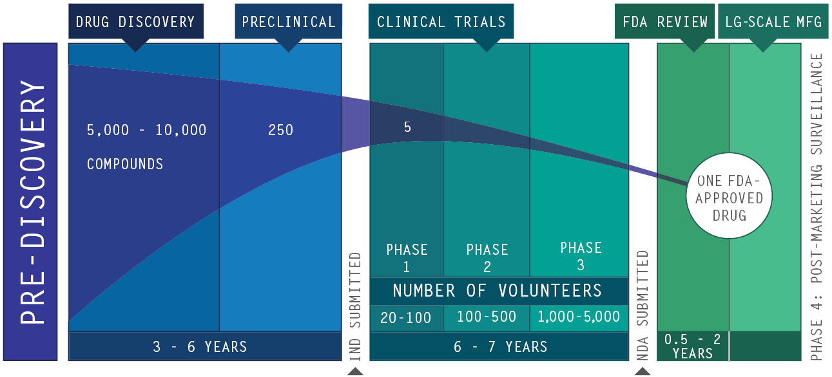
Drug development pipeline
Copyright © 2007 by the Pharmaceutical Research and Manufacturers of America

Slide 27
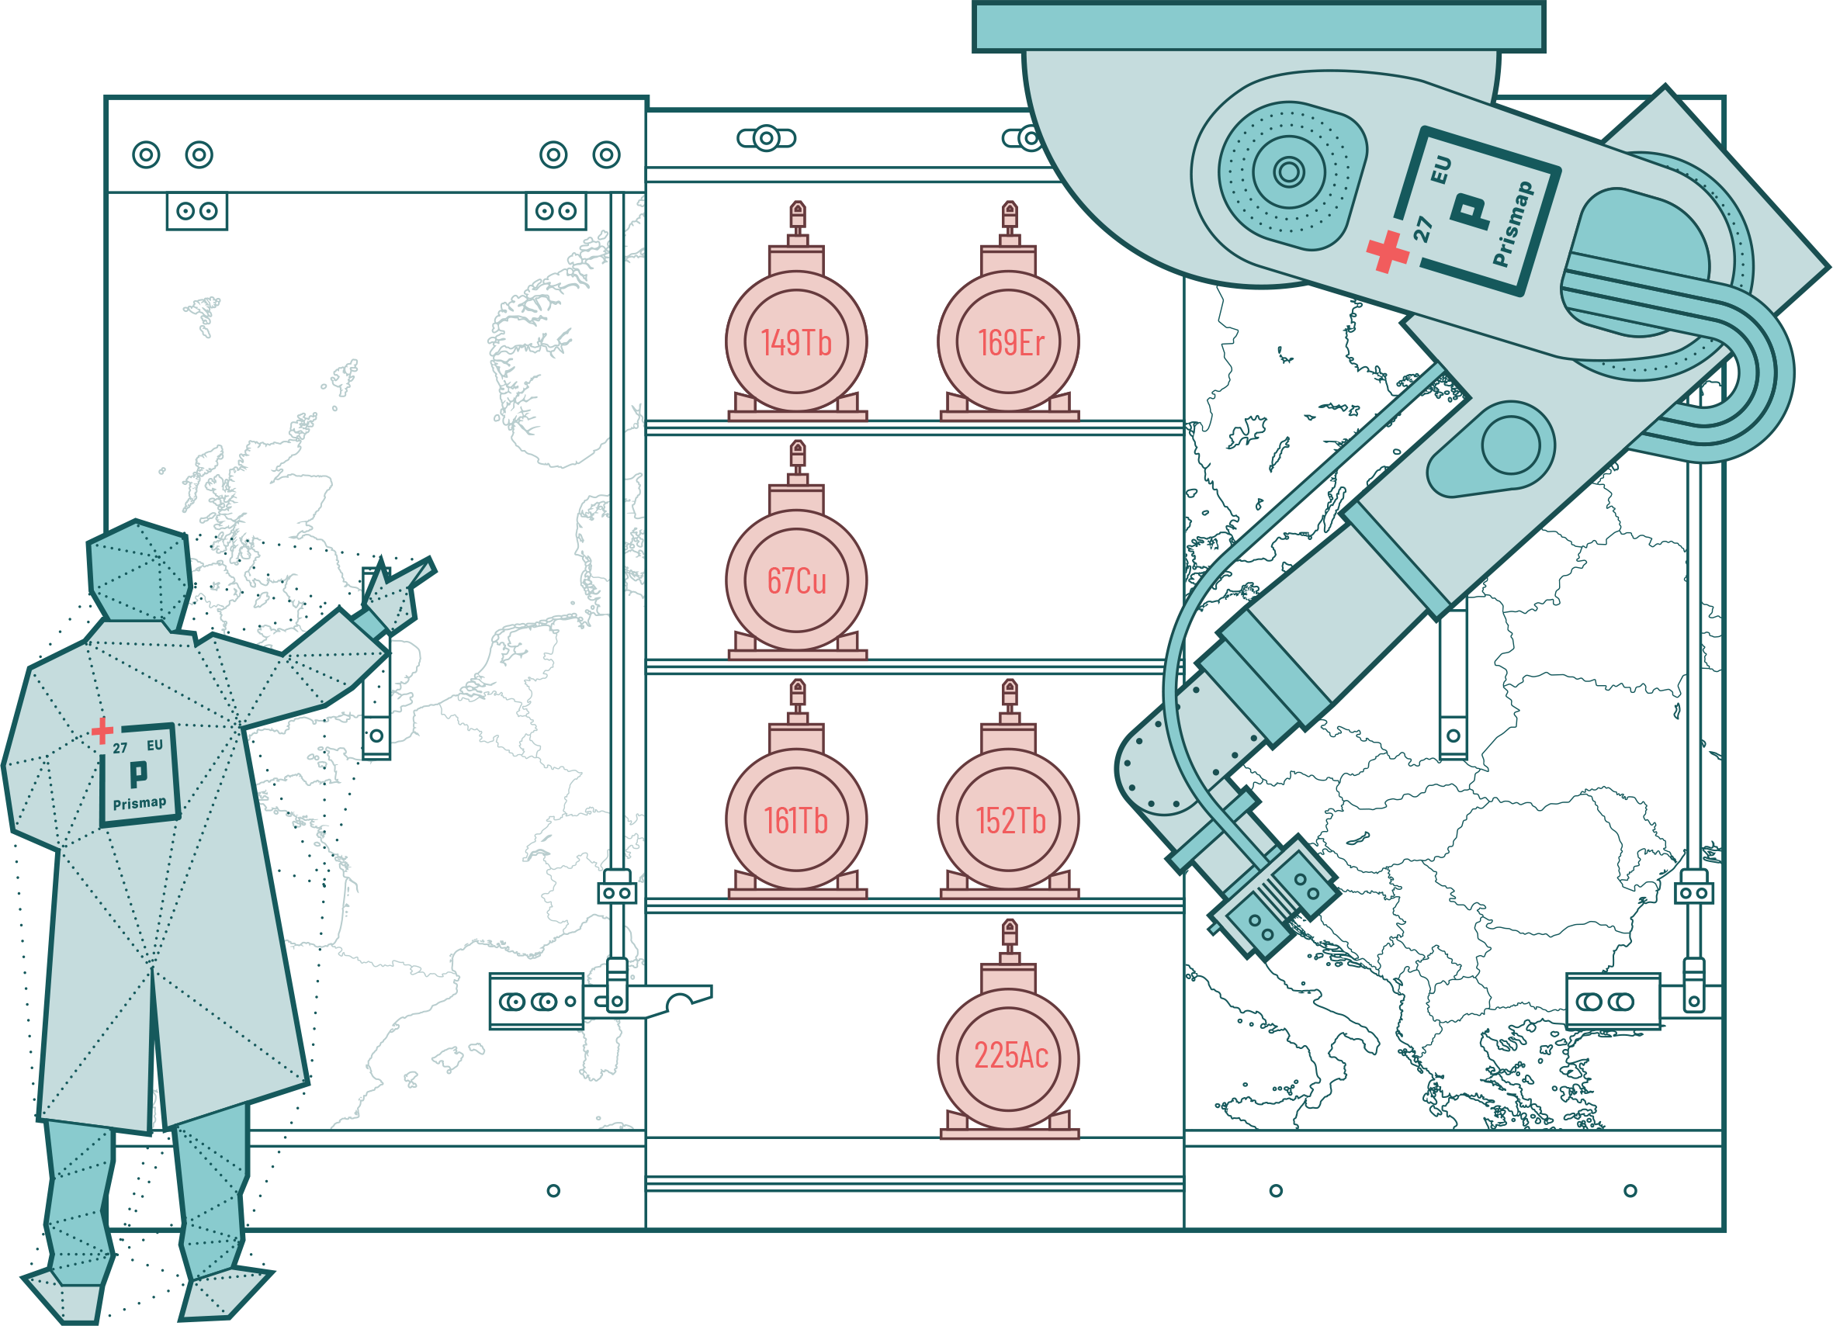
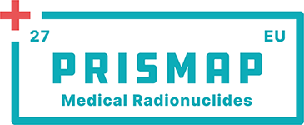
PRISMAP
European infrastructure programme
Provides transnational access to novel radioisotopes for medical research, as well as access to facilities for biological research with those isotopes.
Excellence-based selection by a User Selection Panel. Two calls for project per year.
PRISMAP Community to stay informed about our programme and to contribute to its future.
https://www.prismap.eu/radionuclides/user-forum/

Slide 28
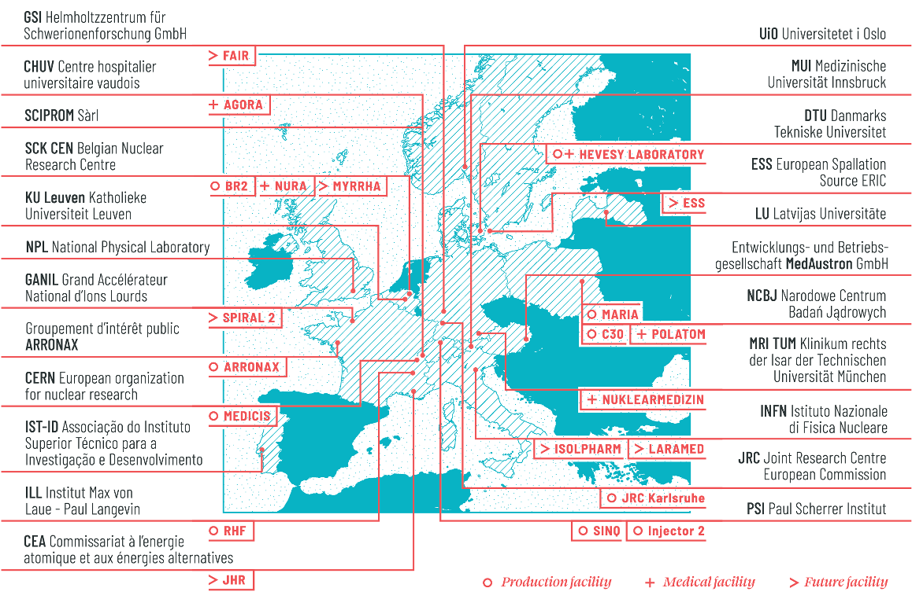
PRISMAP
https://www.prismap.eu/radionuclides/

Slide 29
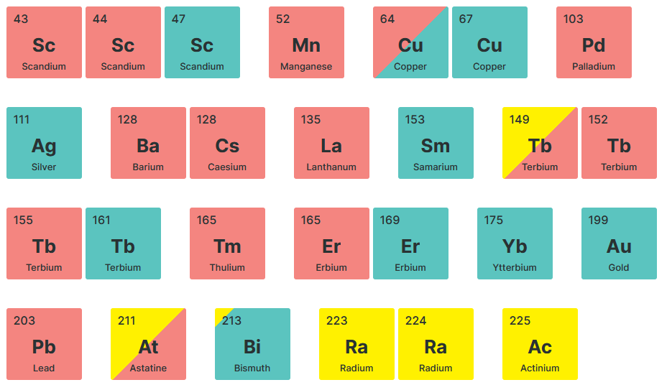
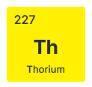
PRISMAP portfolio
PRISMAP has served 17 different radionuclides for 47 projects with 167 deliveries (last one last week!)
Many isotopes require high-energy projectiles and/or mass separation to reach the necessary quality
Mass separation currently only available at CERN MEDICIS
PRISMAP only offers transnational access for research purpose towards first-in-human trials
New facilities will be needed across Europe to supply medical institutions for patient care
https://www.prismap.eu/radionuclides/portfolio/

Slide 30
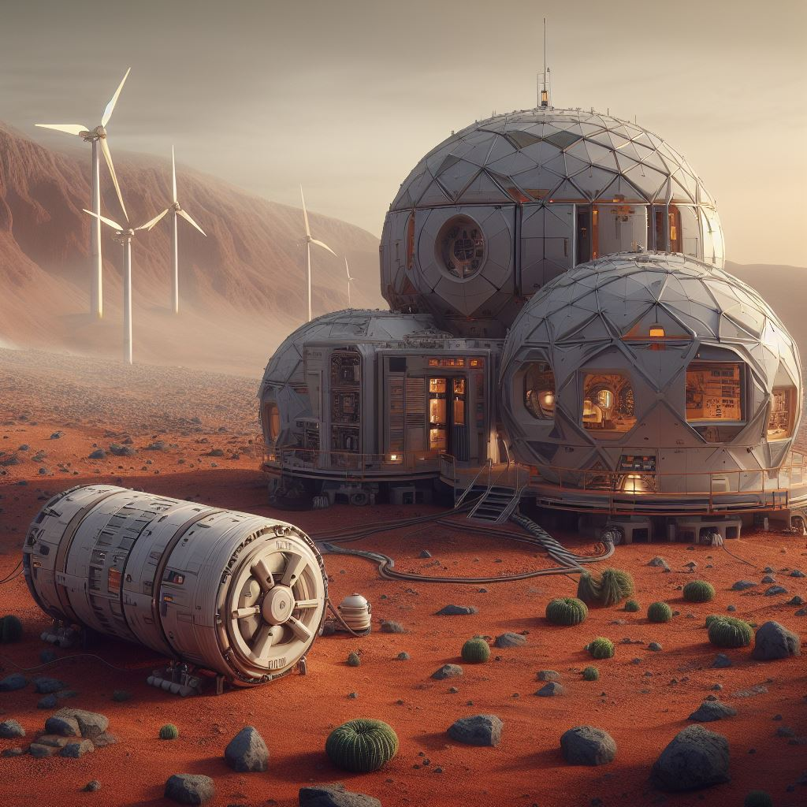
Space
AI-generated image ©Bing ©Dall-E

Slide 31
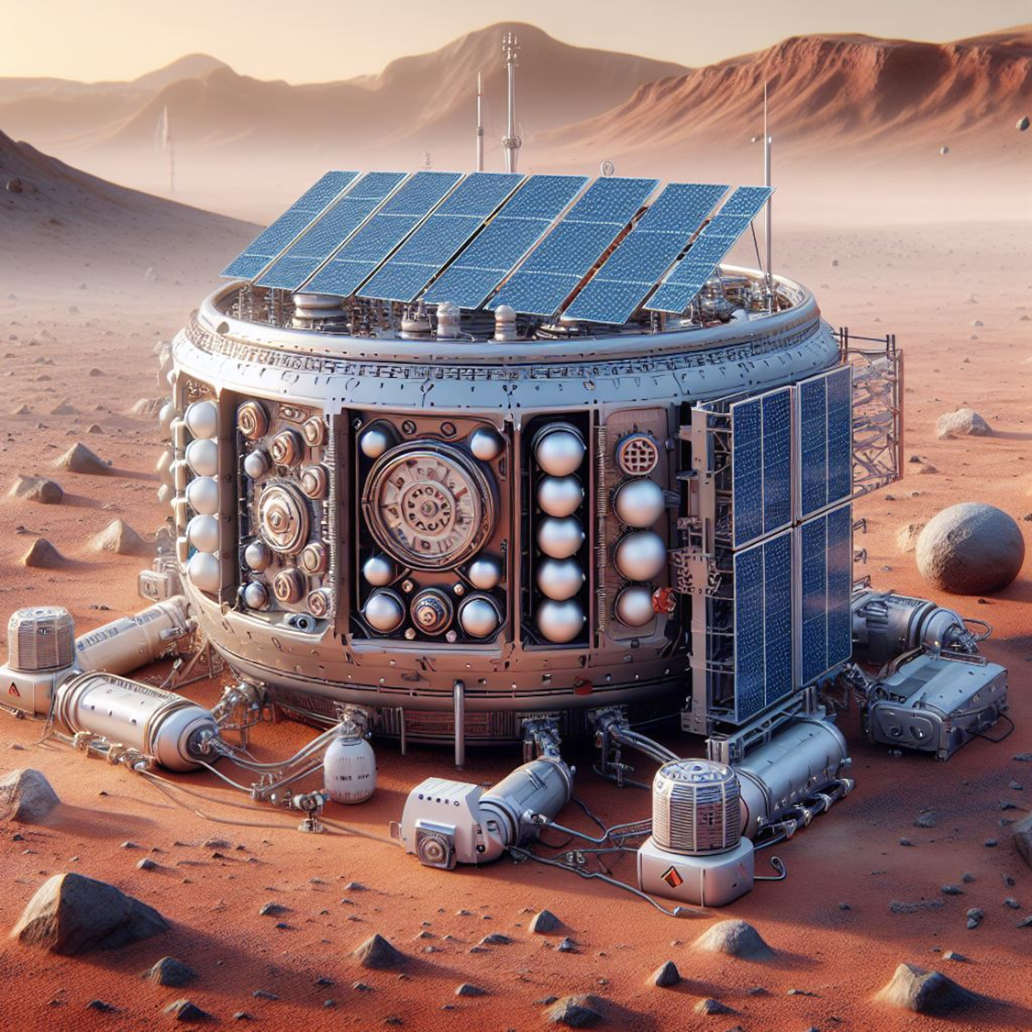
Space habitat power
The planned human exploratory missions to the Moon and Mars require a substantial reduction of the existing uncertainties on space radiation health risks, ensure reliable equipment and safe habitats in space, as well as develop effective countermeasures.
Ground-based research programs and Monte Carlo-based approaches will be decisive to achieve these goals.
Energy in space:
Limits to the use of solar panels
Current solution for ongoing missions (e.g., Curiosity, Perserverance…): Radioisotope Thermal Generators (RTG)
Establishment of habitats and mining systems to extract raw materials for establishing a complete base on an external planet: rely on nuclear power generation with SMR-type reactors

Slide 32
Space exploration: people
Health of astronauts:
Solar particle events (SPEs): sporadic, intense storms of solar particles such as high energy protons and some heavy ions.
Shielding is generally effective
Galactic cosmic radiation (GCR): originate from outside our solar system, mostly protons but also high charge and energy (HZE) ions.
Protection with shielding is difficult
Secondary radiation field inside spacecraft and habitats, including high energy neutrons.

Slide 33
Space exploration: equipment
Radiation hardness testing:
Critical role in the development and selection of detectors and materials for space missions.
Modern ASICs (Application-Specific Integrated Circuits) or FPGAs (Field-Programmable Gate Arrays) contain millions of transistors, making it difficult to identify all the potential disturbances that a single-event effect (SEE) might trigger.
In order to improve the existing health risk estimations for deep space missions and to conduct thorough testing of materials before they are sent to space, ground-based experiments at high-energy heavy ion accelerator facilities and high-energy neutrons sources are warranted.
ESA and GSI/FAIR are building the first GCR simulator in Europe, exploiting fast energy switching of mono-energetic ⁵⁶Fe beams on specially designed beam modulators.

Slide 34
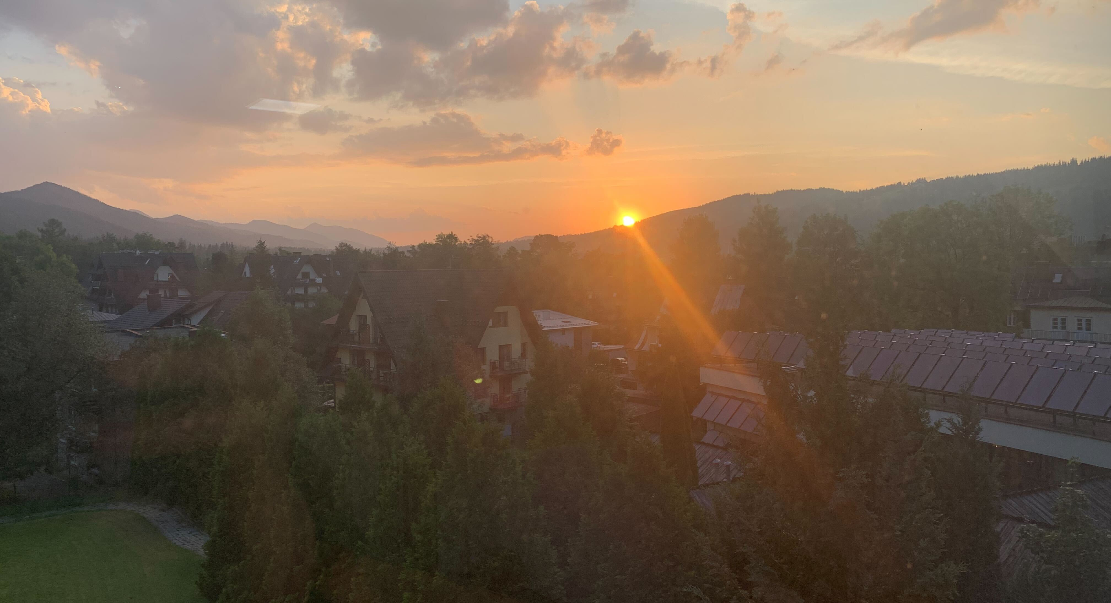

Climate and our planet

Slide 35
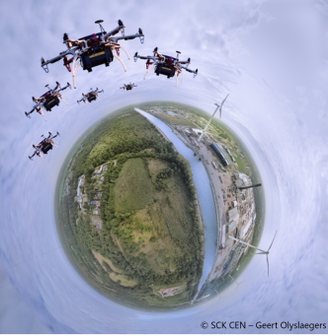
Survey & monitoring
Various techniques that were developed by the nuclear physics community are now routinely used for the measurement of elemental composition as well as high-sensitivity isotopic ratio spectrometry for a variety of environmental monitoring applications
Aerial monitoring is critical to identify potential environmental releases, either from operating nuclear facilities or storage facilities. New concepts are under development combining novel technologies (e.g., drones) with detector innovation. It requires fast sampling combined with sensitive detection techniques.
Notes:
Also mention the nuclear decommissioning question in passing without spending too much time.

Slide 36
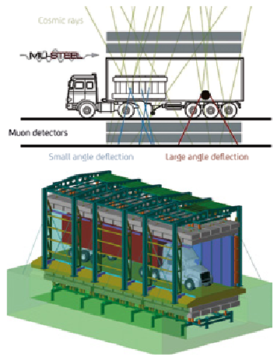

Safety & security
Muon tomography – inspired from the study of hidden chambers in pyramids – is now being considered for large scale deployment. Cosmic muons are tracked through a cargo container to determine the density of its content by comparing the incoming and exiting muons.

Slide 37
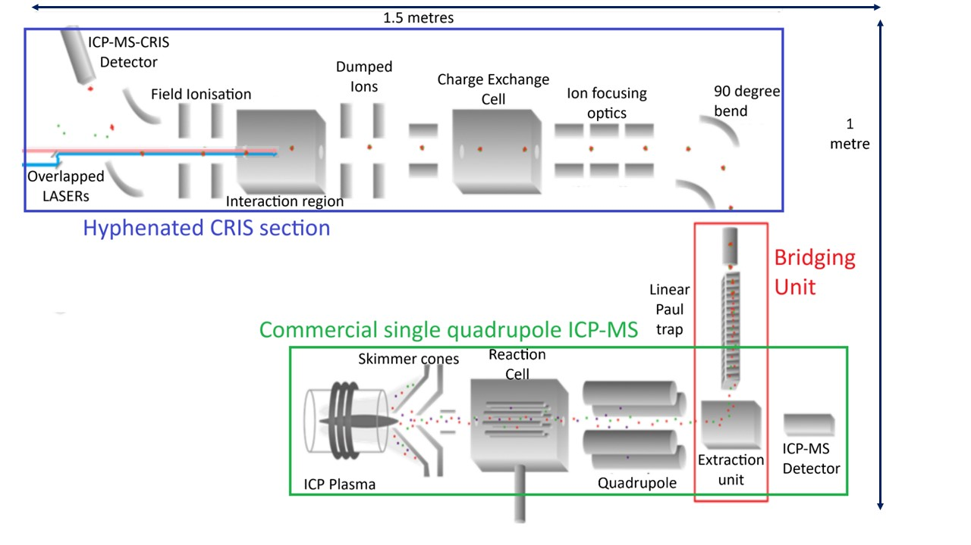
Trace analysis
ICP-MS-CRIS is a new approach in trace analysis that is under development, based on the laser spectroscopy developments of the next decades. This illustrates once more how the work carried out within the NuPECC community can be translated beyond the RIB laboratories.

Slide 38
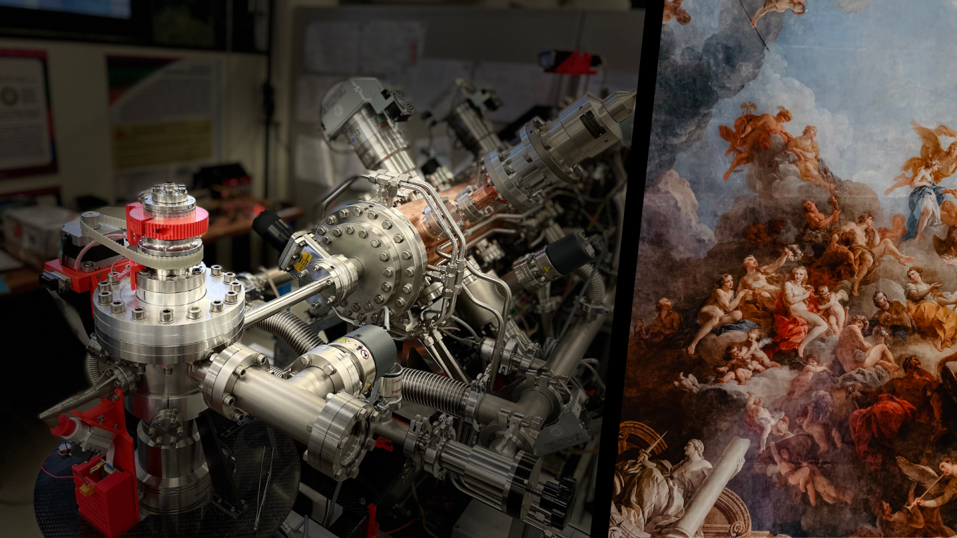
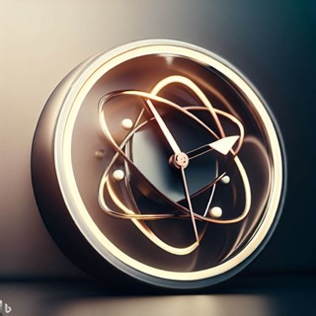
Further applications

Slide 39
Heritage science
Heritage science covers both natural heritage – relating to landscape, the biosphere, … – and cultural heritage – artefacts from our civilization, …
Nuclear analytical techniques are used extremely useful to study our heritage while ensuring minimal impact on the artefact through mostly non-destructive techniques.
Nuclear irradiation techniques can be used for the preservation of heritage.
Access to infrastructures and techniques remain a big challenge. New access models have to be considered for that community. New developments are constantly ongoing (e.g., MACHINA from INFN & CERN or MIXE at PSI).

Slide 40
Material research
Nuclear techniques provide unique tools for materials research, including the synthesis, modification and characterisation of materials.
Swift Heavy Ions – SHIs (MeV-GeV range): important facilities are the future linear accelerator HELIAC at GSI and the online Electron Paramagnetic Resonance (EPR) at GANIL. SHIs are used to perform radiation hardness tests, ion-track technology, astrochemistry, etc…
Radioactive ion beams: applied to probe local environments for materials, using techniques like emission channelling, perturbed angular correlation spectroscopy, and Mössbauer spectroscopy. Renewed interest due to the role of individual distortions and defects in nanoscale devices.
Neutron beams: activities spanning from investigations of atom arrangement in crystals to nano- and microscale heterogeneities, allowing bulk and in situ analysis. Importance of small-scale and diversification of facilities in Europe.
Muons: muon spin rotation, relaxation and resonance (μSR) properties to study magnetism and the characterization of semiconductor detectors. MIXE for non-destructive analysis and operando studies.

Slide 41
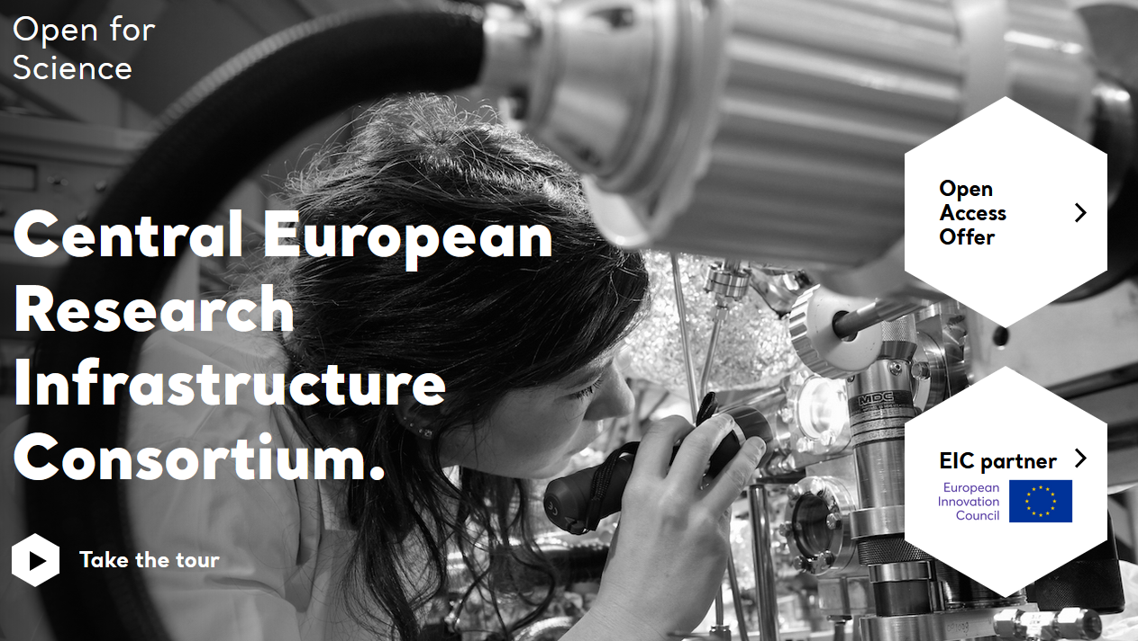
Forensics
Forensics: in daily forensic work, commercially available, high-throughput, table-top instruments dominate, but nuclear analytical techniques (NAT) have some unique features that are making them increasingly attractive when standard forensic techniques fail.
Examples: NAT applied to heritage to identify archeological objects from forgeries; NAT and IBA are applied in bulk analysis of food, drugs, …; ¹⁴C AMS is used to solve criminal cases.
Obstacle: need to go outside forensic laboratories to accelerator or reactor institutes.
CERIC-ERIC: integrating and providing open access to some of the most advanced analytical facilities in 8 European countries through a single-entry point. This new model may be relevant to many other distributed infrastructures.

Slide 42
Metrology
The second quantum revolution has brought quantum physics from being a subject of research to being an engineering tool. There as well, the nuclear science community can bring forth its contribution.
In the search for optimal qbits, many elements are being considered. However, the use of (long-lived) radioactive isotopes opens the door to extra degrees of freedom, such as the nuclear spin (e.g., ¹³³Ba⁺ vs ^{135,137}Ba⁺).
The development of a nuclear clock based on ²²⁹Th has just seen a dramatic progress in the last years and will now become a metrology tool to provide ever increasing precision on time measurements.
The advanced studies with radioactive atoms and molecules is providing a unique testing ground for quantum chemistry calculations.

Slide 43
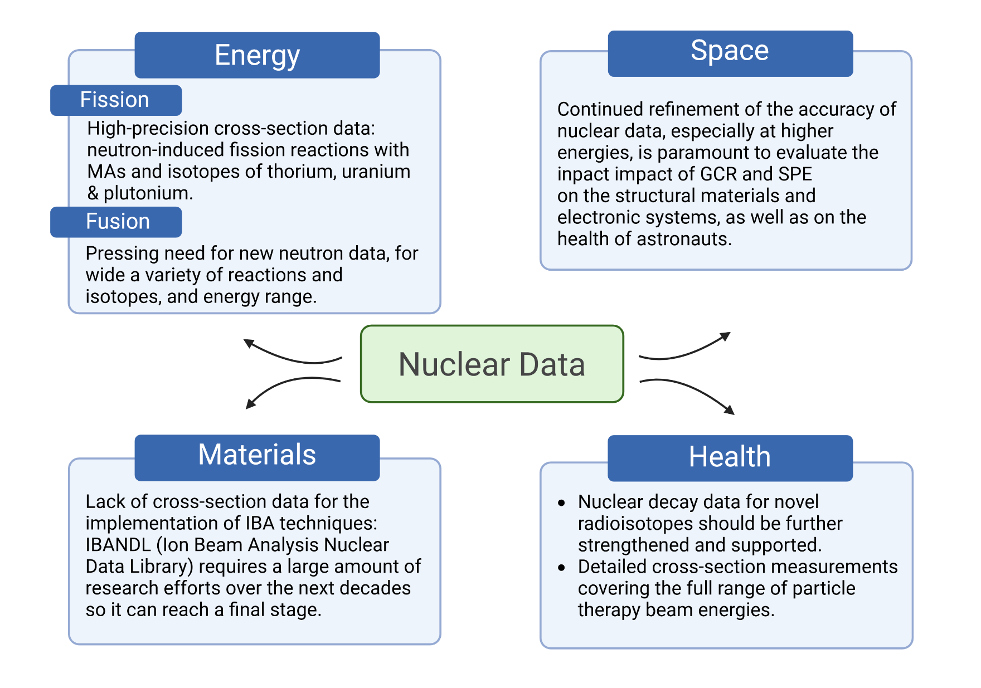
Nuclear data

Slide 44
Nuclear science has more to offer society than crazy scientists!
Nuclear energy is going through a revival with new opportunities arising to replace the ageing park of nuclear fission reactors. Small Medium Reactors are getting ready for deployment, while the Thorium cycle is being investigated and we develop an Accelerator Driven System to manage the accumulated nuclear waste. Partitioning and understanding of the chemistry of MA remain active challenges.
Nuclear fusion is being seriously explored and gets ever closer.
Particle therapy and Targeted Radionuclide Therapy are promising treatment modalities for cancers that are up to now difficult to treat, with much work left to scientists to develop the facilities and collect the necessary data, but also better understand the biological effects of radiation.
Nuclear research is enabling future space missions through investigations of space radiation and power solutions.
Nuclear technologies are also providing solutions for forensics analysis, heritage science, material science, trace analysis, … However, many applications are limited by access, visibility, and nuclear data.

