Slide 1
IAEA activities in support of nuclear physics research and applications Serving Member States
Kalliopi Kanaki/Laboratory Head
On behalf of NSIL
Department Nuclear Sciences & Applications
Division Physical & Chemical Sciences
Physics Section
nsil@iaea.org

Slide 2
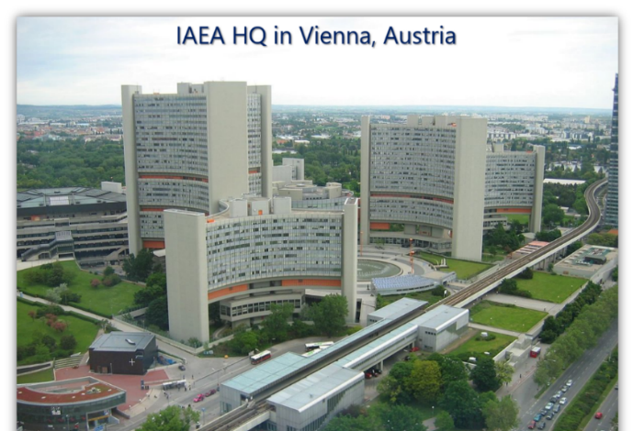
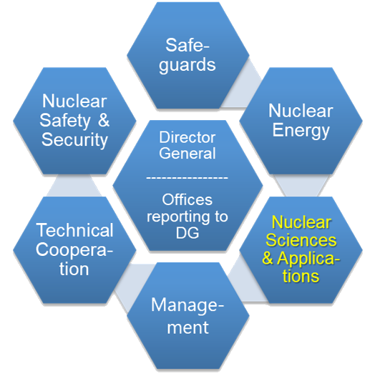
An autonomous international organization within the UN system
180 Member States; 2500+ staff from over 100 Member States; HQ in Vienna
Labs in Seibersdorf, Vienna and Monaco
Regional offices in Toronto and Tokyo; Liaison offices in New York and Geneva

Slide 3
Division of Physical & Chemical Sciences (NAPC)
Nuclear Science, Nuclear Data, Nuclear Physics, Radiation and Isotope Sciences & Applications, Water Resource Management
Nuclear Data
Data Development
Data Services
Physics
Accelerator & Research Reactor Applications
Nuclear Instrumentation
Atomic & Molecular Data
Radiochemistry & Radiation Technology
Medical Radioisotope production, Radiopharmaceuticals
Radiotracers, NCS & NDT in industry
Radiation technology applications
Isotope Hydrology
Isotopic methods for groundwater assessment
Water resource management
Scenario modelling
Terrestrial Environment
Nuclear Fusion
3

Slide 4
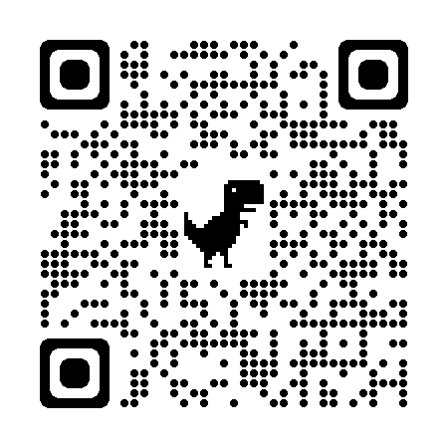
12 Laboratories@IAEA under the Department of Nuclear Sciences and Applications
Vienna
Isotope hydrology
Monaco
Radioecology
Radiometrics
Marine Environmental Studies
Seibersdorf
Plant Breeding and Genetics
Soil and Water Management & Crop Nutrition
Animal Production and Health
Insect Pest Control
Terrestrial Environmental Radiochemistry
Dosimetry (medical)
Food Safety and Control
Nuclear Science and Instrumentation
https://www.iaea.org/virtual-tours/nuclear-sciences-and-applications

Slide 5
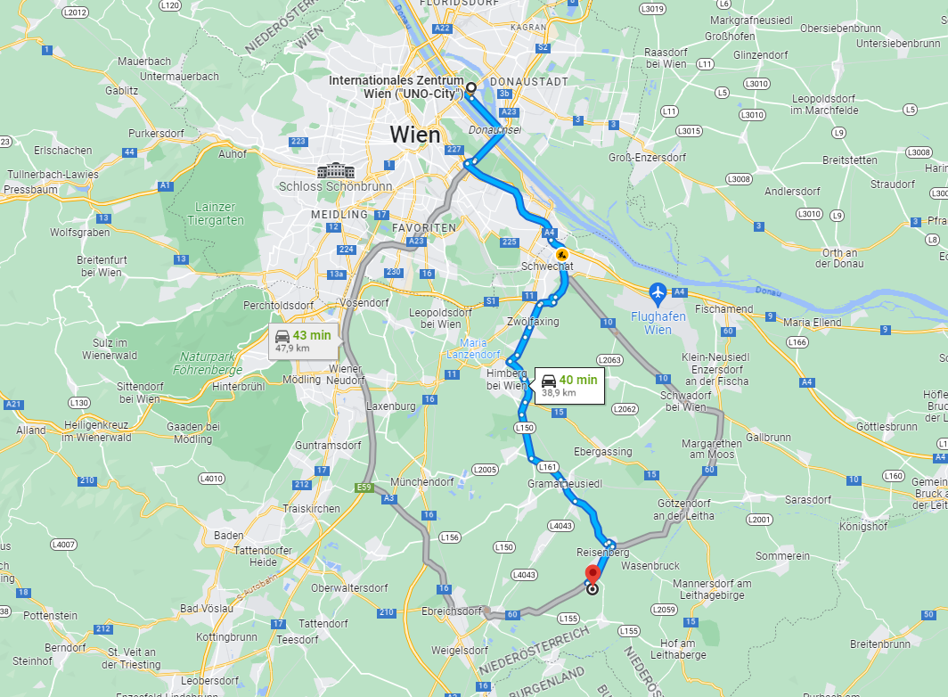
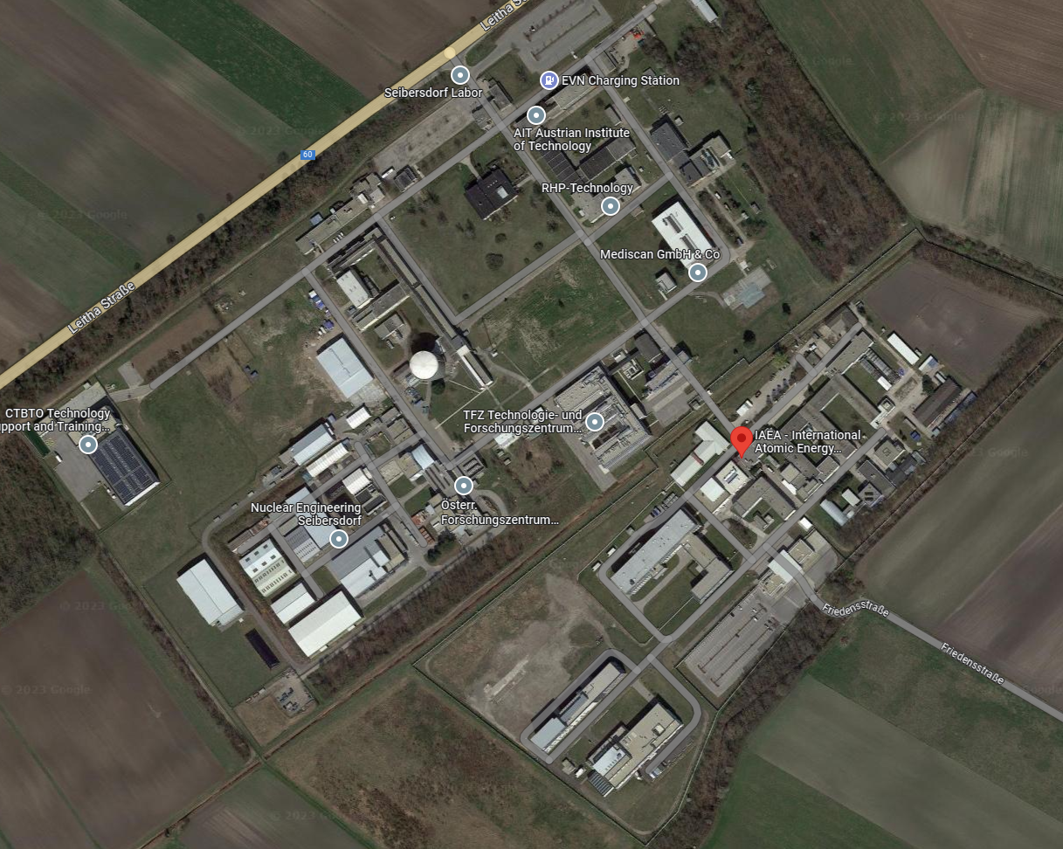
Location of NSIL
“Sharing” site with
Austrian Institute of Technology &
CTBTO
40 Km south of Vienna

Slide 6
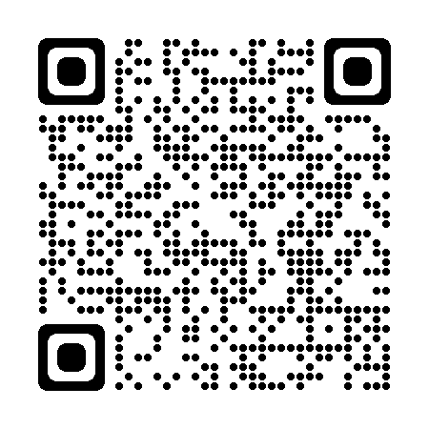
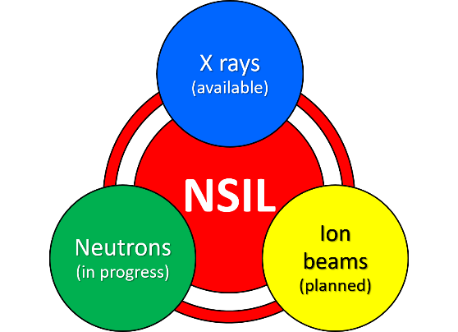
Lab mission
To assist the IAEA member states in introducing and extending the use of nuclear instrumentation and radiation measurement techniques, including related capacity building
Achieved via dedicated trainings, fellowships, internships, scientific visits, expert missions, services, development projects
Areas of activities: X-ray fluorescence, neutron generators, mobile and in-situ radiological mapping (7 core people at the moment)
Nuclear Science and Instrumentation Portal
Nuclear Sciences and Applications | IAEA (virtual tours)
(available)

Slide 7
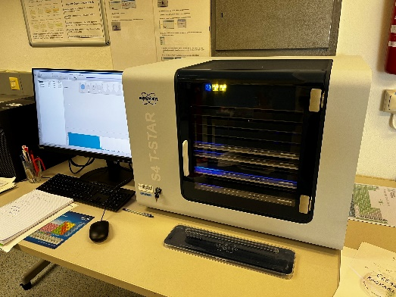
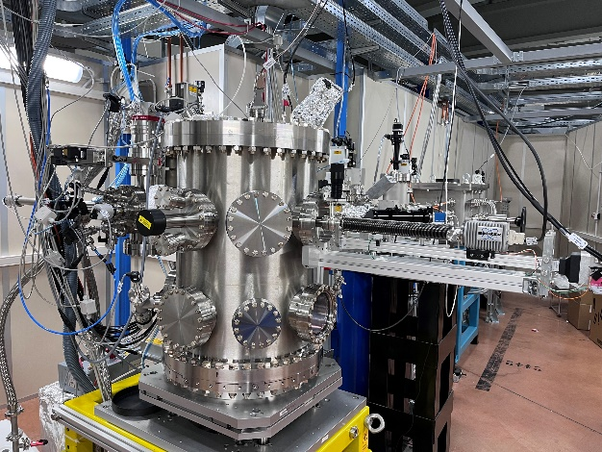
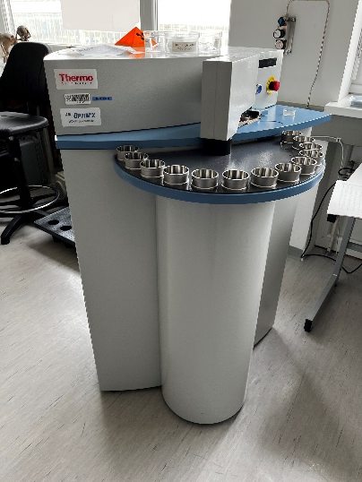
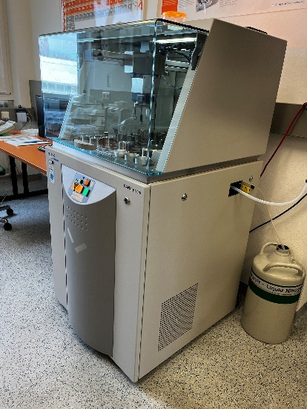
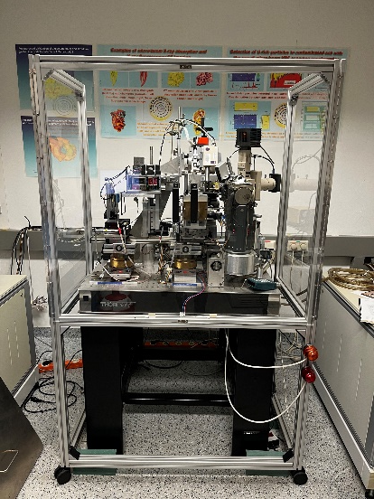
X-ray instruments available
Secondary Target – Energy Dispersive XRF
Wavelength Dispersive XRF
Total reflection XRF
μ and confocal XRF (in-house development)
X-ray tomography (in-house development)
SEM-EDS
XRF 2D scanner (in-house development in cooperation with ICTP-MLAB, Italy)
Handheld XRF
Bench-top XRD
Sample preparation lab for solids and liquids

Slide 8
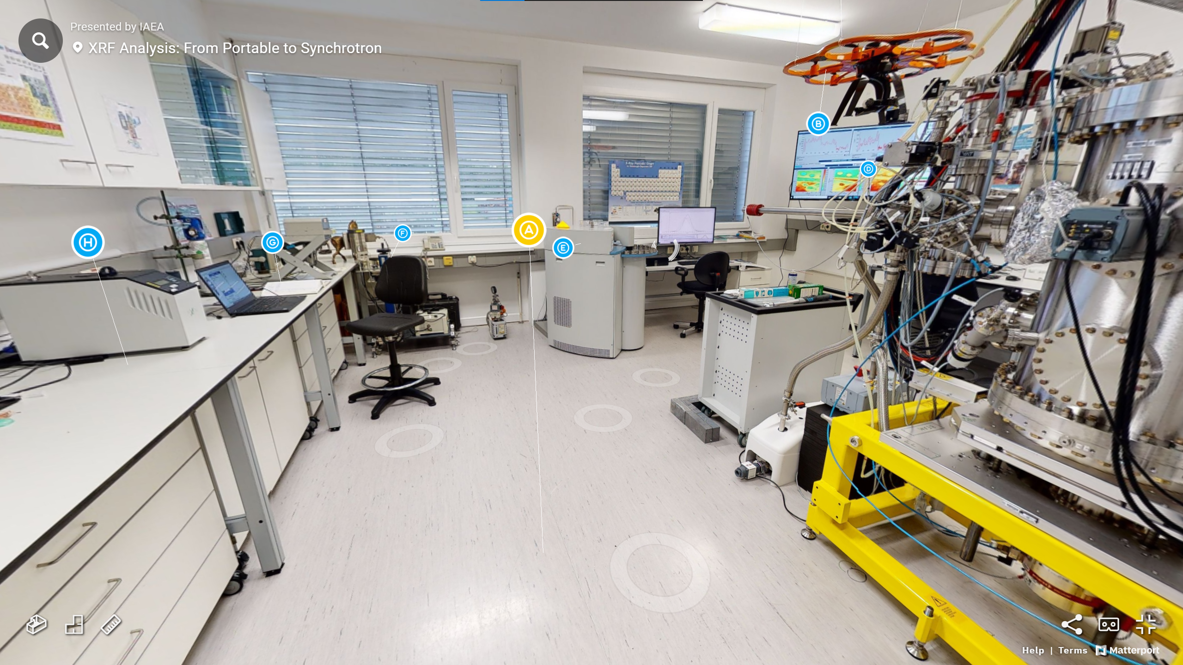
Wide view of the old NSIL XRF facility

Slide 9
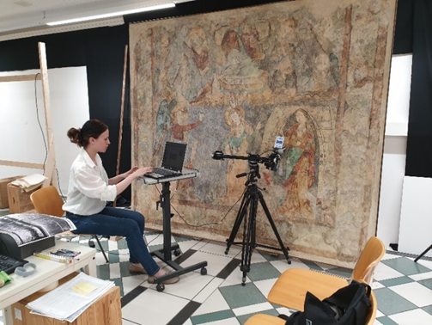
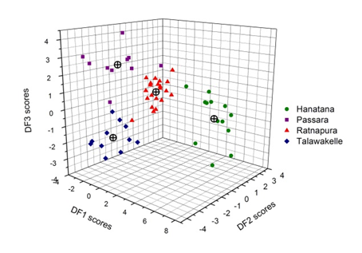
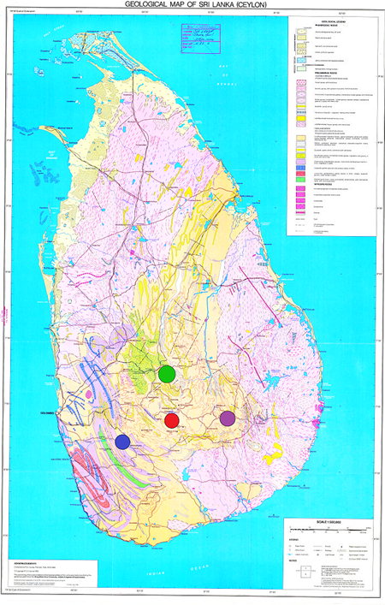
Examples of past and current projects
Inspection of a mural painting at the Vienna Institute of Conservation and Restoration
Identification of Sri Lankan tea regional provenance based on their elemental and stable isotope contents
2D and 3D distribution of elements in the altered surface of ancient silver coins
9
9

Slide 10
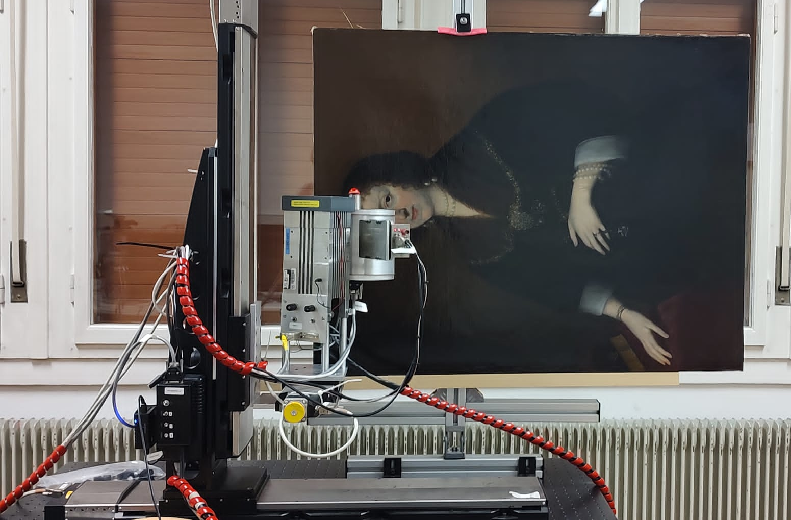
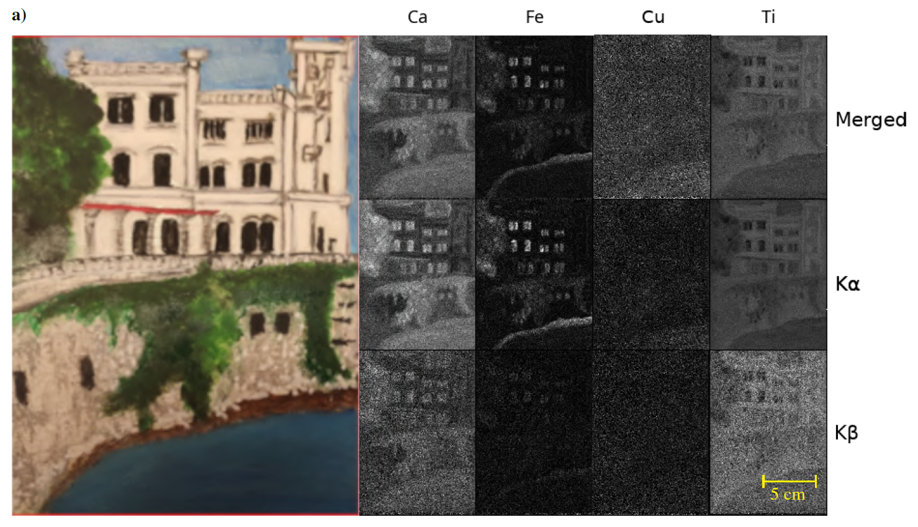
2D MA-XRF scanner (ICTP-NSIL collaboration)
Applications in cultural heritage, e.g. scanning of painting surfaces
Scanner already used for trainings and first museum samples
GUI is ready to facilitate use
Resolution 0.3-0.5 mm
https://doi.org/10.1002/xrs.3496

Slide 11
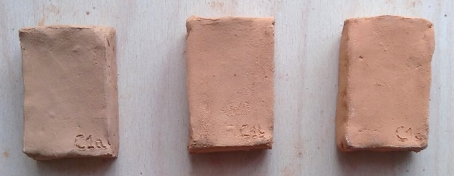
XRD analysis of Roman roof tiles from Noricum (modern day Italy-Slovenia)
PRELIMINARY
XRD patterns of raw clay and experimental bricks prepared fired at different temperatures (left) and PCA analysis of the XRD patterns (right). The PCA analysis helps create a reference for estimating the firing temperature of ancient bricks just by examining their diffractograms.

Slide 12
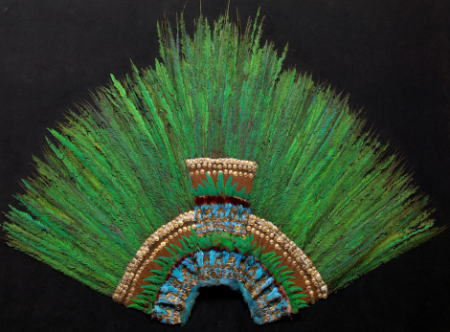
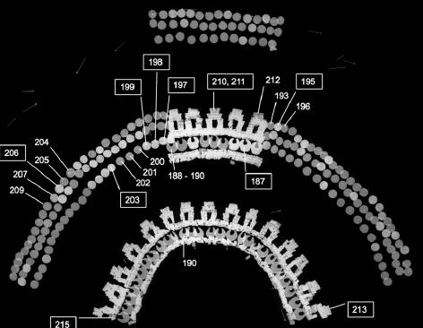
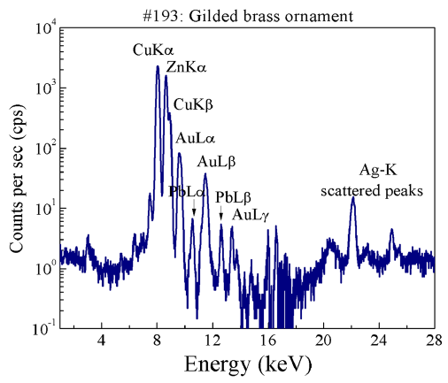
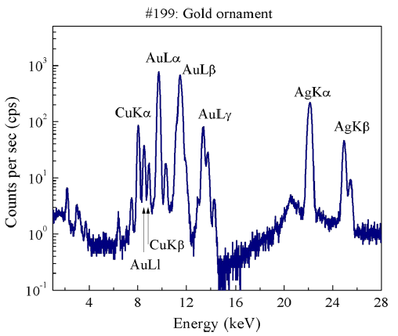
Study of gold decorations in Mexican feather headdress
16th century Aztec Moctezuma II(?) feather headdress
Gilded brass Gold
Thickness of gild from Au-La/Au-Lb ratio
DOI 10.1002/xrs.2529

Slide 13
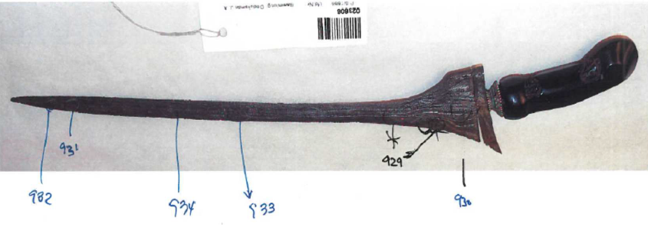
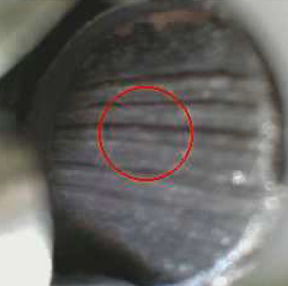
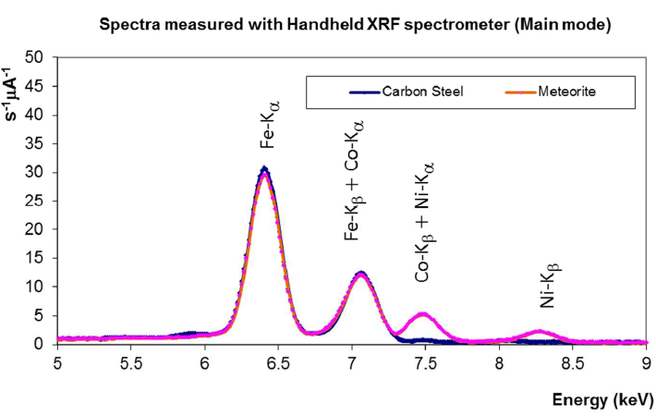
Study of Kris (Keris) daggers from Java, Indonesia
Meteoritic iron used in hammered successive layers
High contents of Ni (0.4-12.5 wt%) and Co (0.1-1.5 wt%)

Slide 14
SEM images of insect ovaries (Drosophila Suzukii)
Modified atmosphere under cold storage does not reduce
phytosanitary irradiation efficacy for Drosophila suzukii

Slide 15
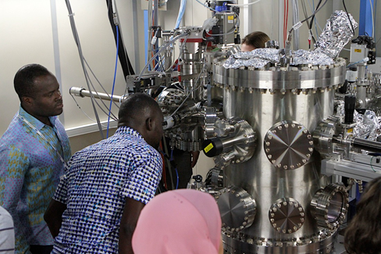
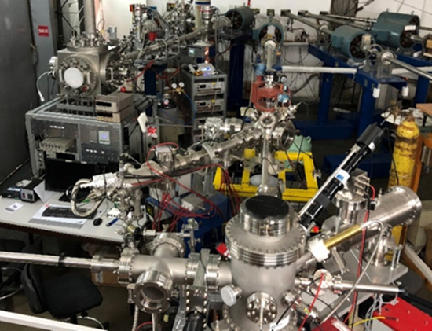
Access to accelerator facilities
Collaboration with Elettra synchrotron (Trieste, Italy) concluded – SESAME in Jordan is considered
Annual Training Workshop on Synchrotron Technologies and Techniques and their Applications
Collaboration with Rudjer Boskovic Institute ion beam facility (Zagreb, Croatia)
Biannual Training Workshop on Accelerator Technology, Associated Instrumentation, Including Operation and Maintenance Aspects
15
Researchers attending hands-on-training at the IAEA X-ray spectrometry end-station at the X-ray Fluorescence beamline in Elettra Sincrotrone
Beamlines at the RBI accelerator facility
15

Slide 16
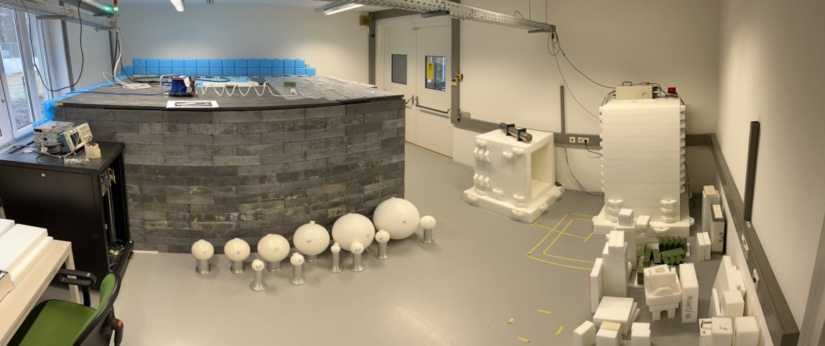
The Neutron Science Facility (NSF)

Slide 17
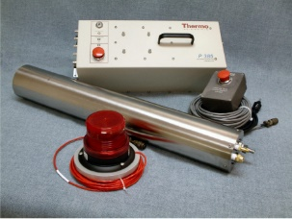
Neutron sources at the NSF
Sealed tube neutron generators with moderate intensities
DD (Thermo Fisher): 2.45 MeV neutrons, emission rate up to 5e6 n/s
DT (Thermo Fisher): 14.1 MeV neutrons, emission rate up to 5.4e8 n/s

Slide 18
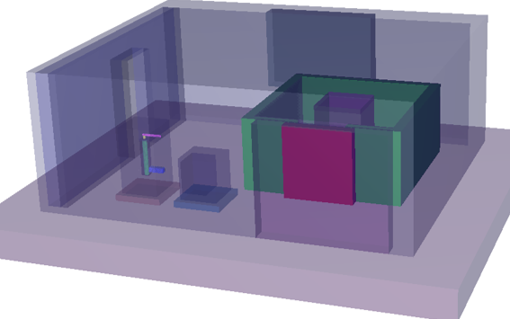
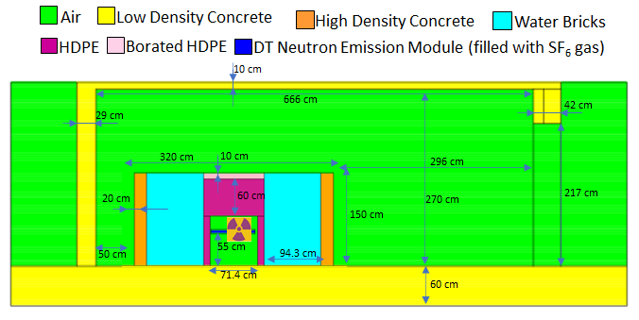
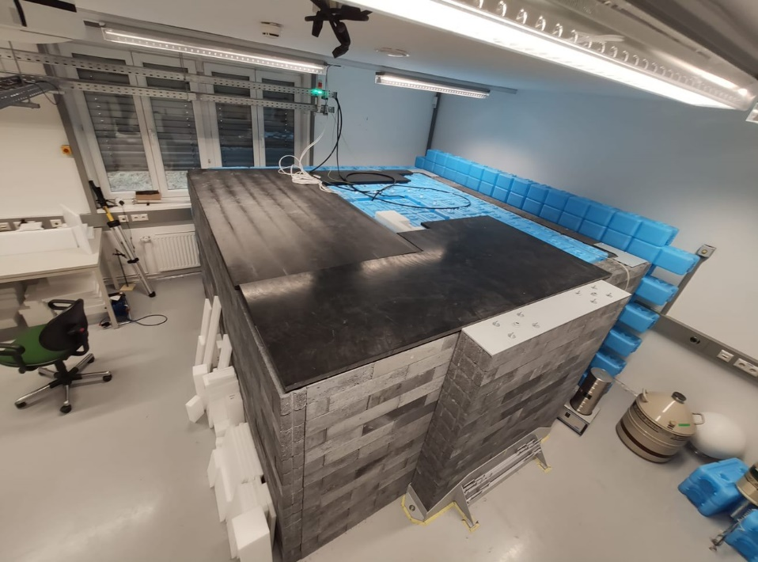
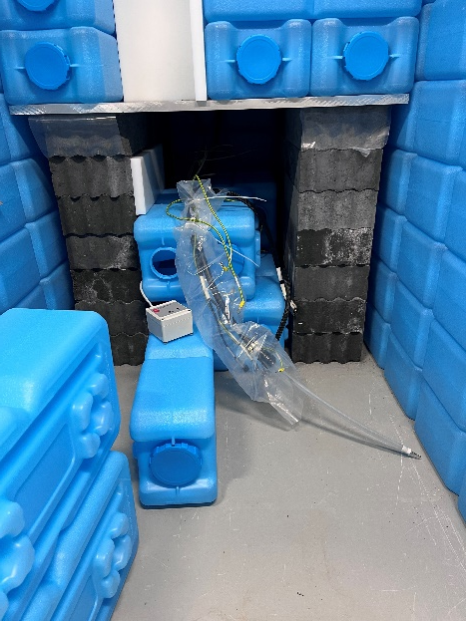
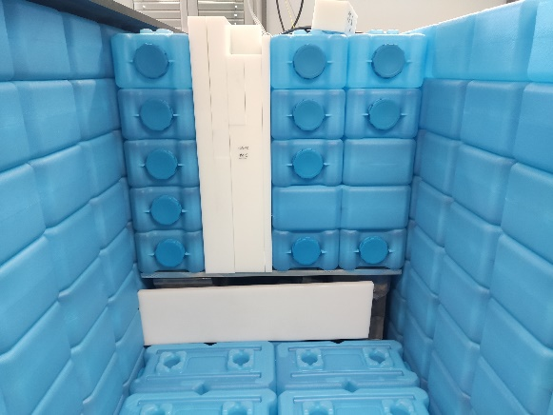
DT shielding setup
DT operates in mixed water-bricks /polyethylene/conrete shielding
Irradiation cavity accessible from top through vertical
channel 12 × 15 cm²
18

Slide 19
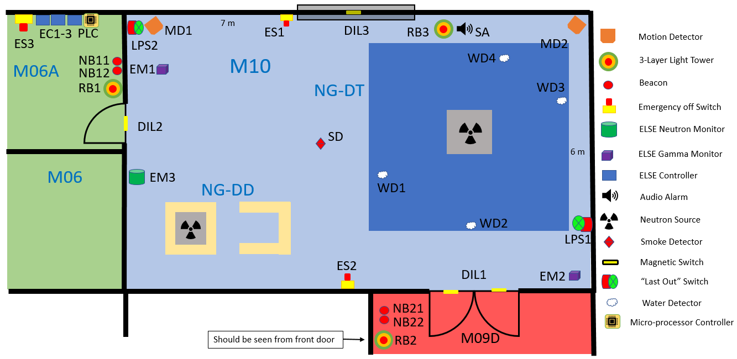
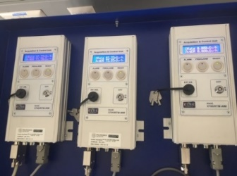
Safety and radiation monitoring systems
The facility safety system resembles bigger facilities for training purposes
One neutron (BF₃ based) and two gamma dose rate meters
Several TLDs at the boundary of control area
Interlock system includes emergency-off buttons, motion sensors, magnetic trip switches placed on the doors and windows, smoke detector and four water leak detectors, “last person” out switches, and radiation monitoring system.

Slide 20
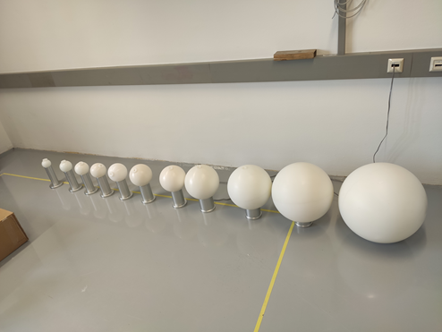
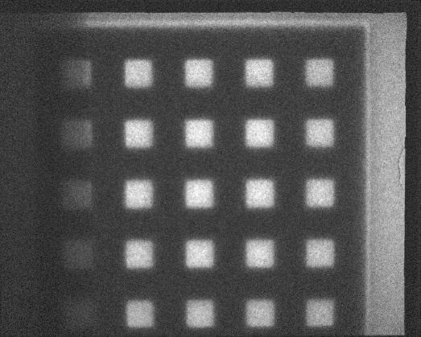
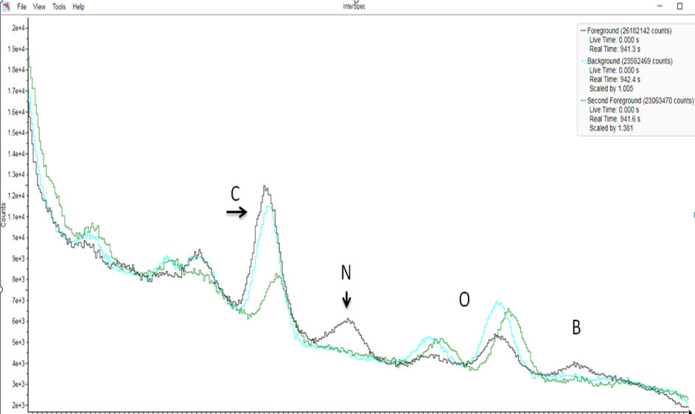
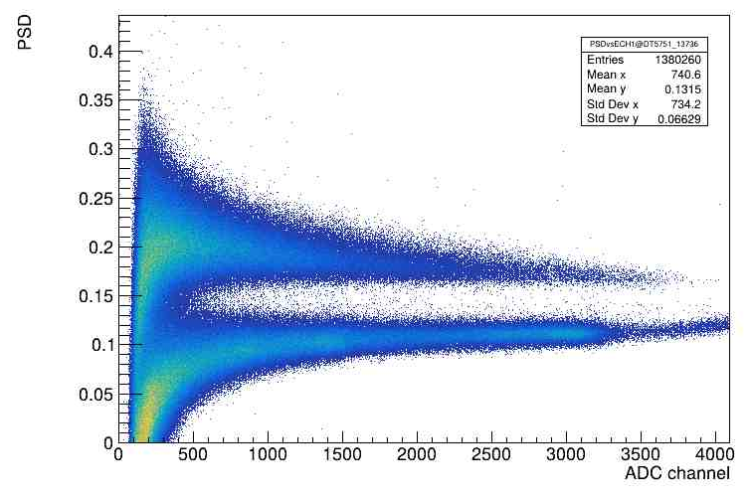
Training topics with neutrons
Operation & maintenance of neutron facility based on DD/DT generators
Radiation protection in neutron and gamma fields
Neutron detection with He3, BF3, fission chamber, organic
scintillators, PSD
Spectrometry with Bonner spheres
ToF with AmBe source
Foil activation for neutron flux estimates
Neutron activation analysis (NAA)
PGNAA for detection of light elements (drug and explosive simulants)
Imaging, including runs at the TU Vienna research reactor
Delayed neutron counting for detection of fissile material
Showcase of pulsed operation for background suppression
Ground moisture detection (TBD)

Slide 21
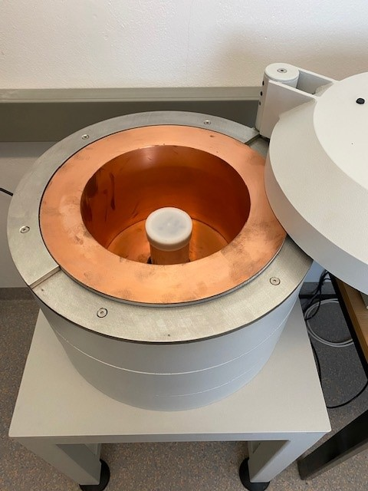
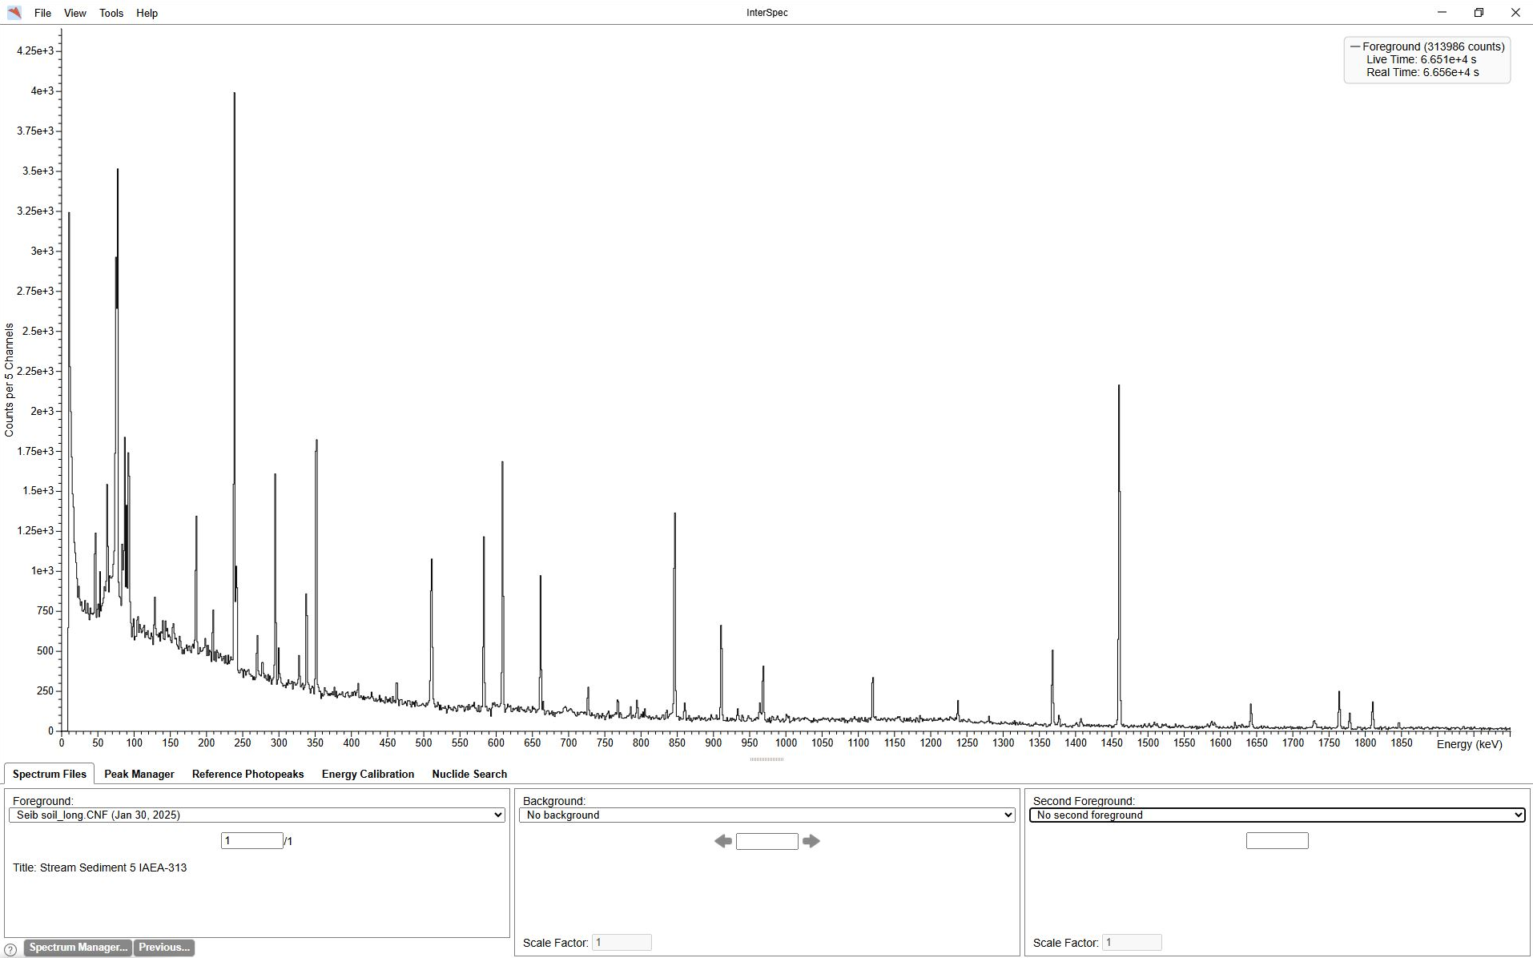
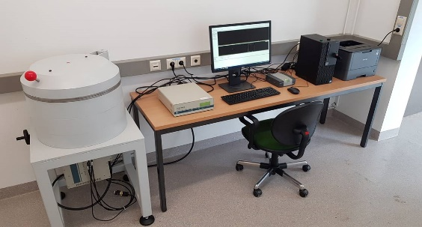
Neutron activation and gamma spectrometry delayed and prompt NAA

Slide 22
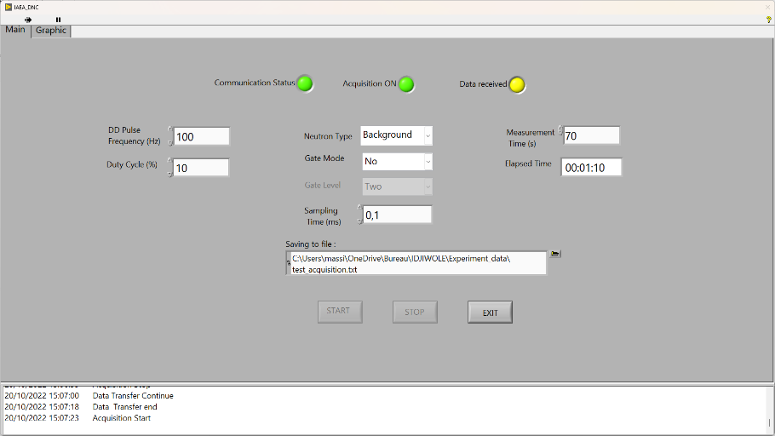
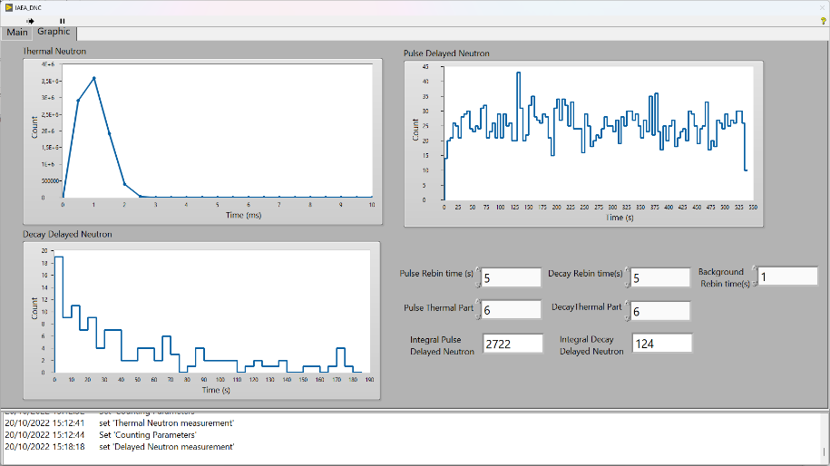
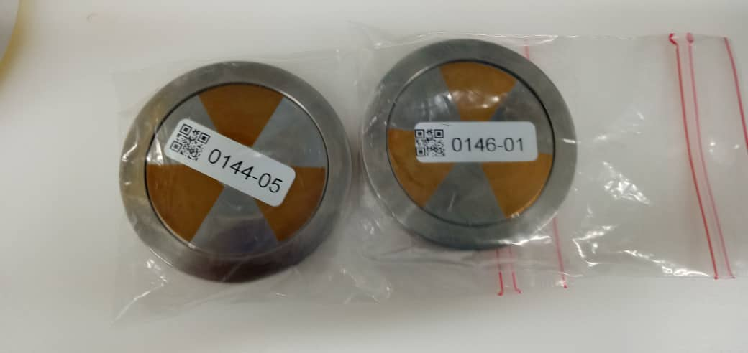
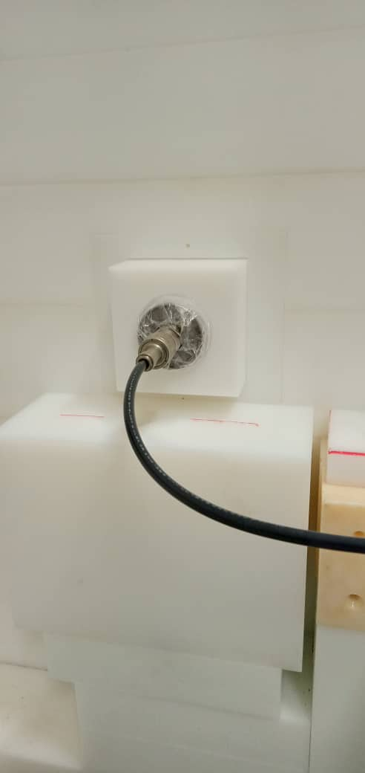
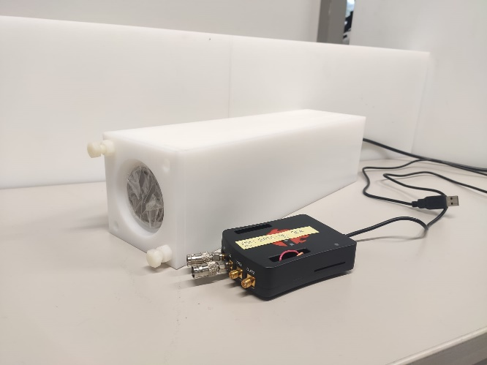
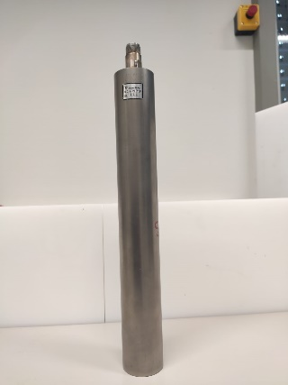

Delayed neutron counting
Based on donated He-3 tubes and poly moderator
Data acquisition for DNC developed in house
Red Pitaya LabView environment
Can measure thermal neutron removal

Slide 23
Use of NSF for R&D
"Gamma/neutron classification with SiPM CLYC detectors using frequency-domain analysis for embedded real-time applications“, https://doi.org/10.1016/j.net.2023.11.013
Gamma/Neutron Online Discrimination Based on Machine Learning With CLYC Detectors, DOI: 10.1109/TNS.2024.3498321

Slide 24



Use of NSF by external users
CEA, France
Experiments on neutron-photon discrimination and energy spectrum unfolding using liquid organic scintillators EJ309; AmBe, DD and DT neutron sources
UKAEA, UK
Activation experiments in connection to EUROfusion project with relevance to code validation used for nuclear waste characterization and decommissioning
2x SS316L(N) foils, ITER stainless steel as closure plates materials.
2x XM-19 foils, ITER XM-19 as divertor material
2x Al-Bronze foils as ITER divertor material
Courtesy of Clément BESNARD-VAUTERIN, PhD thesis report, Paris-Saclay University, CEA
Courtesy of Lee PACKER, UKAEA and IAEA
24
https://doi.org/10.1016/j.radphyschem.2025.112780

Slide 25


Radiological mapping: mobile & UAV
Mobile & Backpack Techniques of Radiological Mapping
Aerial (UAV) Techniques of Radiological Mapping
Notes:
A special emphasis has been placed on the development and capacity building in filed of radiation monitoring techniques using backpack spectrometers and unmanned aerial vehicles.
Thanks to the project with Fukushima Prefecture in 2012-2020, NSIL has become a leader in this field at the IAEA and provides MSs with expertise under TC projects as well as in co-organizing specific TM and WS.
Trainee Notes:
(leave blank for this page – trainees may take their own notes in this space)

Slide 26




Mobile monitoring/instrumentation
5 scintillator backpacks (NaI, CsI)
3 drones operated with detectors
1 photogrammetry drone
A wide series of table-top detectors of all types (scintillators, HPGe, PIN diodes)
Analogue & digital DAQs – both commercial and in-house developments
Open-source software for data treatment

Slide 27


Examples of mobile monitoring activities
Trainings on backpack/UAV/photogrammetry/data analysis protocols
Trainings on basic instrumentation, e.g. educational kits, bench-top detectors, DAQ systems
Open-source software development for data treatment (R, Python)
Expert missions, e.g. Namibia (granite mine assessment), St. Lucia (search for lost moisture gauge)
Collaborative efforts on machine learning launched
Gamma spectrometry – peak identification (with U. Lisbon)
TinyML (2026 training in Kyrgyzstan - gamma peak identification)
Consultancy meeting in December in Vienna to decide direction of activities

Slide 28

3D Photogrammetry Results: Characterization of Temporary Waste Storage Site
Support to Fukushima Prefecture

Slide 29


NSIL development of UAV unit: First test flight with integrated subsystems
NSIL digital pulse processing units for SiPM readout
Finding “hidden/target” gamma source, placed in the cart
Wireless extender (also shown in the picture) allows uninterruptedly communication for a range of up to 300 meters
System keeps operation and data recording even if communication is lost

Slide 30

First test flight with integrated subsystems
Recorded flight data with Eu-152 gamma source placed close to the ground level
Flight data imported to Google Earth, featuring count-rate at diverse locations and altitude
The highest activity was detected nearby the gamma source

Slide 31


Web-based GUI
Real-time telemetry and flight path
Map color scale based on count-rate
Same platform, diverse applications:
UAV radiation monitoring
Benchtop instrument for trainings
Accessible from any tablet or computer, regardless of the operating system (multiplatform)
Interactive MCA and oscilloscope
Waterfall (spectrogram) and count-rate history plots
Configurable user and detector settings

Slide 32

3D enclosure
Rugged design for flight operation
Optimized volume + weight
Replicable with off-the-shelf 3D printers
Easy to adapt for benchtop or training deployments

Slide 33
Summary
We developed an ANN for identification of radionuclides in unknown sources, involving combinations of up to 10 different sources: ²²Na, ⁵⁷Co, ⁶⁰Co, ⁸⁸Y, ¹⁰⁹Cd, ¹³³Ba, ¹³⁷Cs, ¹⁵²Eu, ²⁰⁴Tl, ²⁴¹Am.
The ANN performed better than conventional automatic methods based on peak recognition software.
The number of FPs and FNs was very low, once the actual information present in the experimental data is considered with respect to the LOD.
The key for successful implementation is the ability to generate high quality synthetic spectra in numbers sufficient to train a complex ANN.

Slide 34
Outlook
Further work:
Increase the number of synthetic spectra generated from background experimental spectra, to reduce the rate of FPs (expose the ANN to more negative results).
Include spectra with worse signal to background ratio in the training set, for instance relaxing the LOD criterium, to try to obtain an ANN better trained to identify signals close to the LOD.
In the presence of multiple lines, include cross-checks.
Have the ANN provide confidence limits on the positive results reported; e.g., by including the LOD in the reported outputs, or by a range of ANN quantitative outputs, for instance from 0 (not present) to 10 (high confidence), instead of 0/1 (no/yes).
Expand the experimental data set to include uranium isotopes and plutonium.

Slide 35


Past (3 years) & present
Capacity building, services
More than 100+ people trained each year (1 week – 1 year)
Capacity building activities online, on-site and abroad (Trieste-ICTP, Doha, RBI, Elettra)
Topics ranging from basic instrumentation to applications
4-5 regular budget HANDS-ON trainings per year plus TC-funded fellows/events
Annual proficiency test with 80-120 participating institutes each time
Tens of interns hosted
Development
In-house scintillator readout system (digital MCA base for PMT, SiPM) ready
Open-source software for data treatment of portable detectors publicly available
Exploration of the use of ML in gamma spectroscopy
XRF protocols for Cd quantification

Slide 36



The immediate future
Transition to Curie-Meitner Nuclear Applications Center
Further strengthen collaboration with other NA laboratories and other departments (NS, NE)
Enhance scientific profile of NSIL
Host more M.Sc. and Ph.D. students
Host long-term fellows
Attract cost-free experts
Support Ion Beam Facility (IBF) project

Slide 37


The not so immediate future: Ion Beam Facility (IBF) project
Comprehensive survey conducted high interest from the user communities (>60 replies from 40 countries (out of 59 operating accelerators) as well as internally within IAEA:
→Training in accelerator technology, applications and associated instrumentation,
→Services relevant to ion/neutron beam analysis and irradiations,
→Enhanced access to and use of ion/neutron beam techniques.
Feasibility study showed that, to match the NSIL’s mission and stakeholder needs, the most optimal and cost-effective technology option would be 3.0 MV tandem.
Total capital costs: 10.4 M€ Staff required: 3 persons
Operational costs: 200 k€/year
Call for extrabudgetary support, contributions in kind & collaborative arrangements:
UN Global Market https://www.ungm.org/Public/Notice/275529

Slide 38

IBF project: role and impact

Slide 39


Ion Beam Facility (IBF) project: layout
Neutron hall
→ 6 MeV protons (up to 50µA current) + heavier ions
→ Multiple beam lines/end-stations (PIXE, PIGE, RBS, Microbeam…)
→ Neutron production capability
* source intensity: up to 5x10¹¹ n/s
* thermal flux: up to 10⁶ n s⁻¹cm⁻²
Accelerator hall

Slide 40
Thank you! Ευχαριστώ!
Notes:
Thank you!

