Slide 1




The nuclear astrophysics program at n_TOF
PAST
FUTURE
PRESENT
Paolo Maria MILAZZO
On behalf of the n_TOF Collaboration

Slide 2
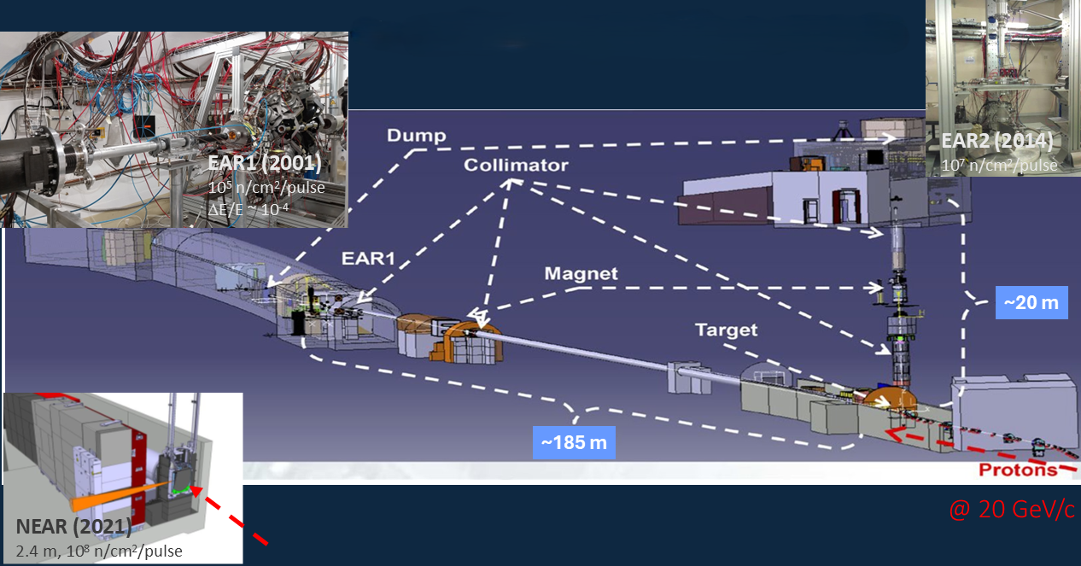
The CERN neutron Time of Flight facility
For details and a complete description please follow the Jorge Lerendegui-Marco invited talk

Slide 3
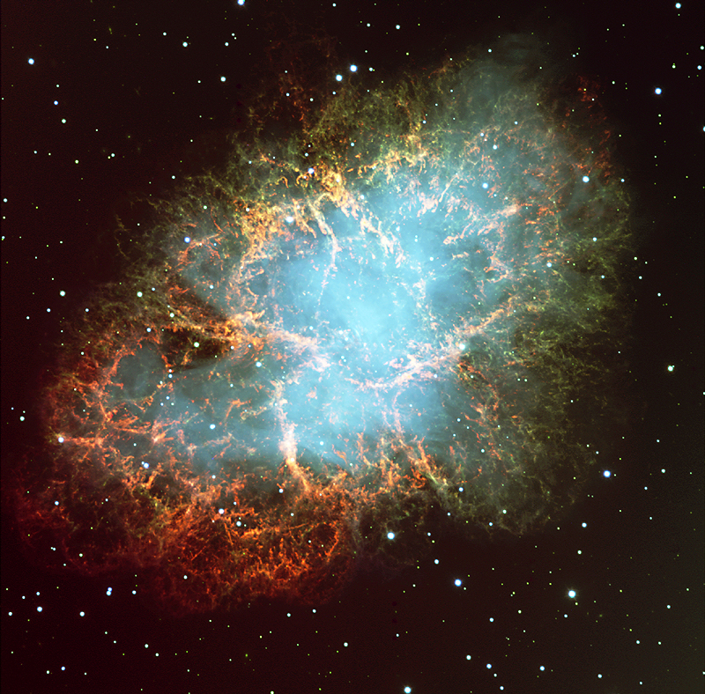
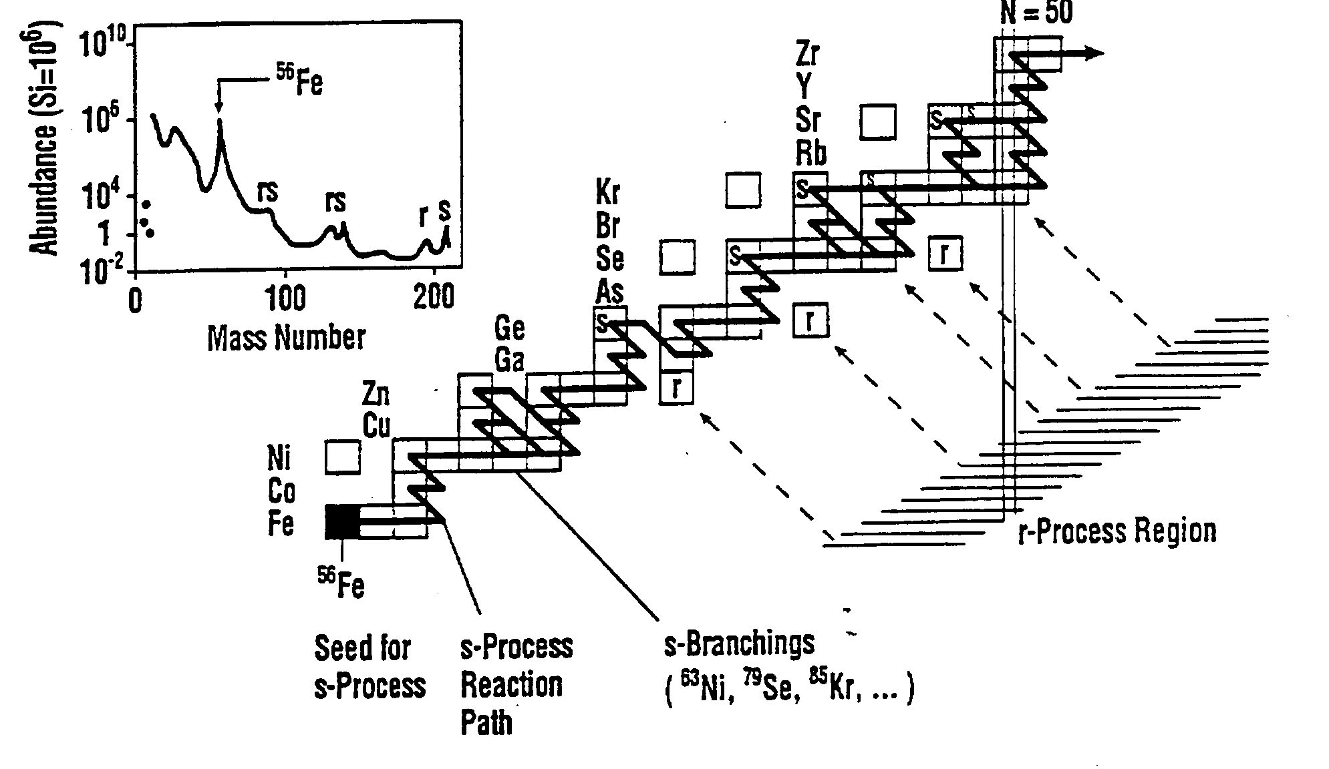
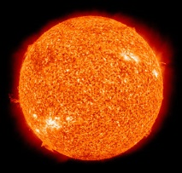
Neutron-induced reaction provide data of paramount importance for Nuclear Astrophysics
Stellar nucleosynthesis
Cosmocronology
Investigation of stellar environments
Primordial nucleosynthesis
(more than 60 isotopes investigated)

Slide 4
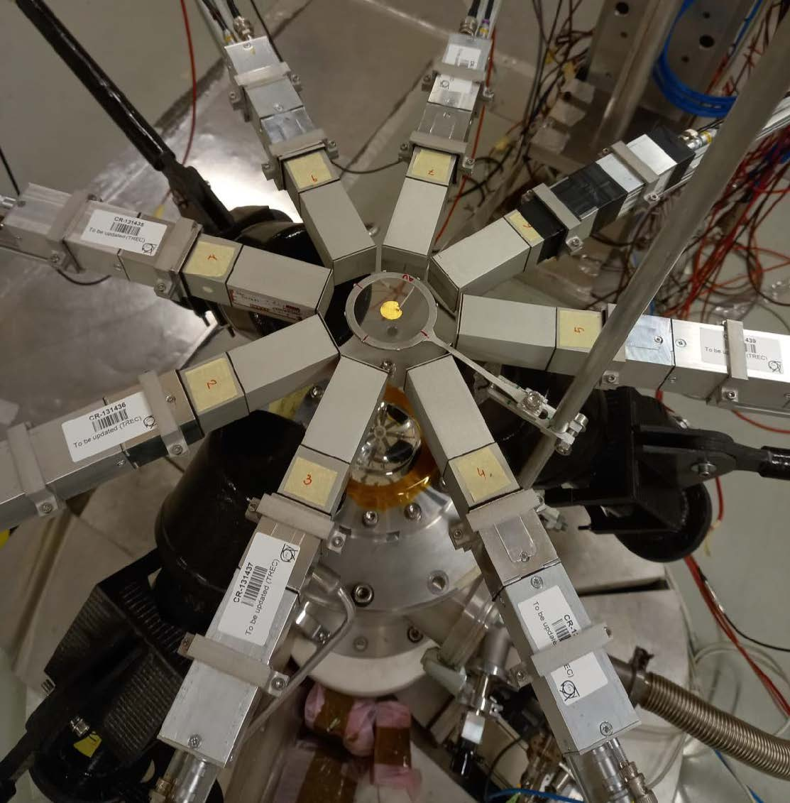
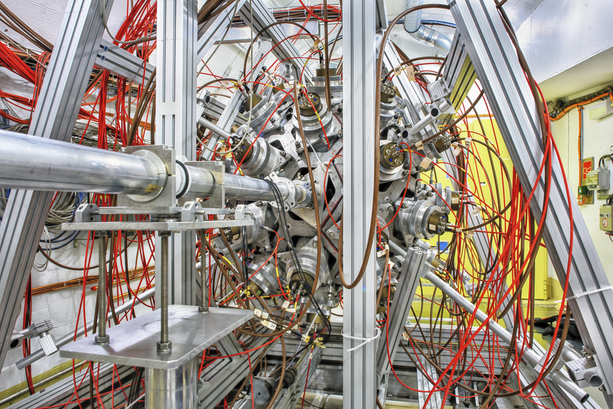
Experimental set-up – Neutron Capture measurements
C₆D₆ and their upgrading
The Total Absorption Calorimeter
Made of 40 BaF2 crystals
4π geometry
Segmented Total Energy Detectors

Slide 5
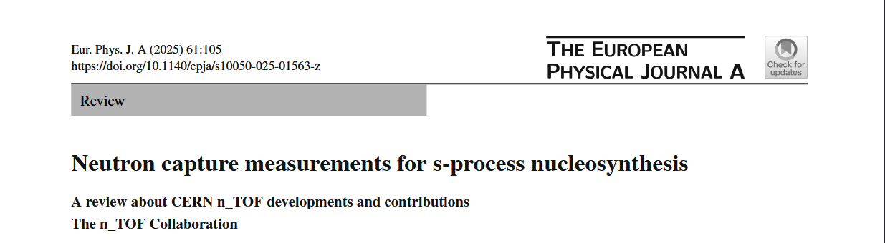
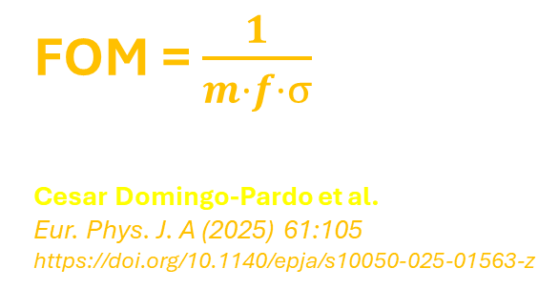
Increasing performances
FOM = $\frac{1}{m·f·σ}$
Cesar Domingo-Pardo et al.
Eur. Phys. J. A (2025) 61:105
https://doi.org/10.1140/epja/s10050-025-01563-z
151_{Sm}
Mass m = 200 mg
Enrichment factor f = 0.9
Capture cross section at 30 keV, σ=3b
79_{Se}
m = 2.7 mg
f = 7x10⁻⁴
σ = 0.2 b

Slide 6
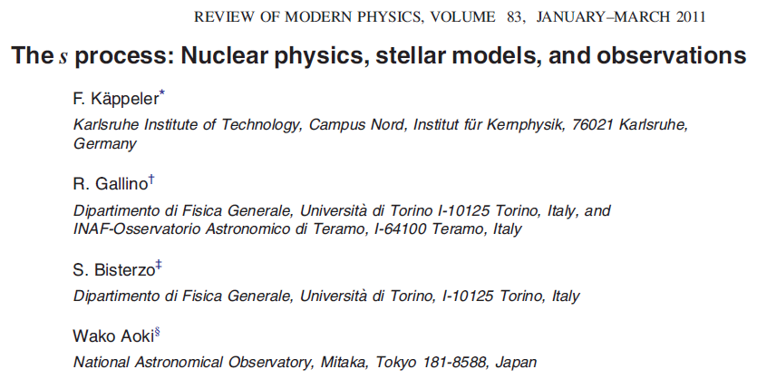
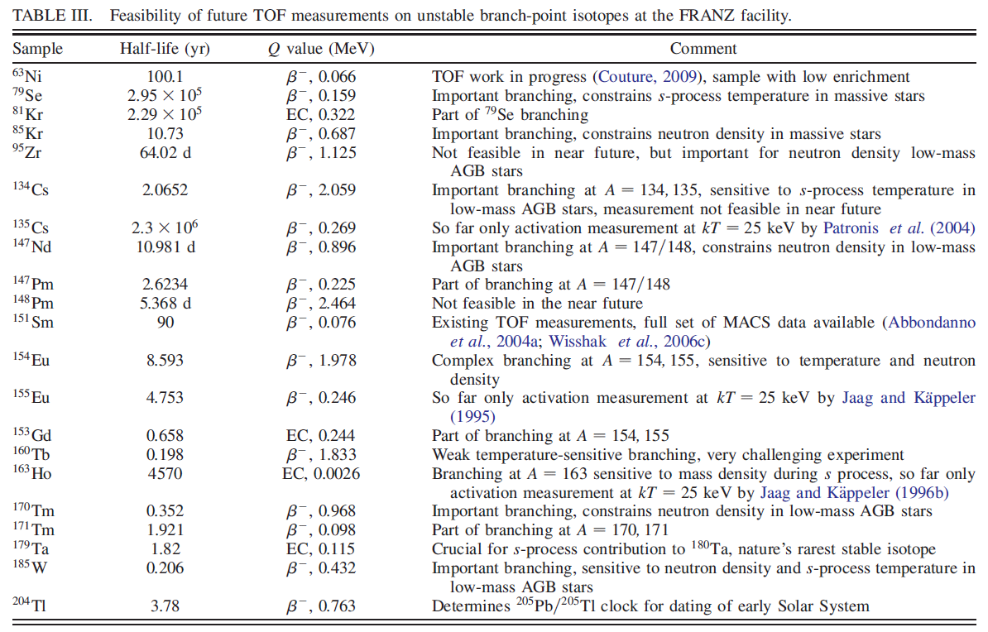
Stellar Nucleosynthesis

Slide 7
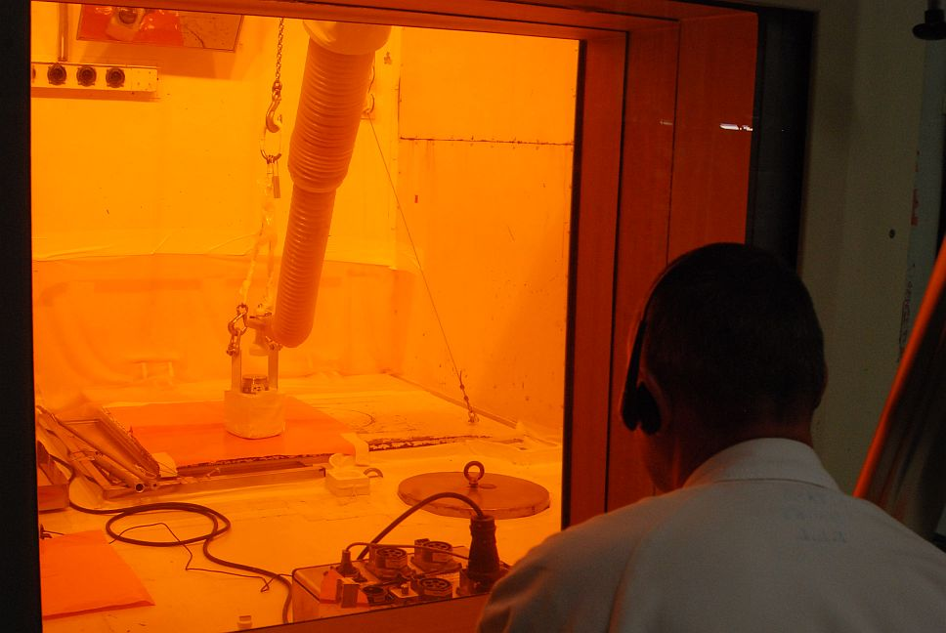
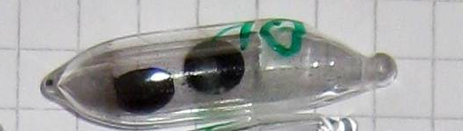
Stellar Nucleosynthesis (e.g.)
Stable isotopes (¹⁷⁰Er, ²⁰³Tl) irradiated at the high-flux reactor at ILL, Grenoble
(60 days at 1.5x10¹⁵ n/cm²/s)
Preparation of samples at the Paul Scherrer Institute
[with an enrichment of 1.8% (¹⁷¹Tm) and 5.3% (²⁰⁴Tl)]
and measurements at CERN n_TOF
¹⁷¹Tm
T_{½}= 1.92 years
M ≈ 3.6 mg
²⁰⁴Tl
T_{½}= 3.78 years
M ≈ 11 mg

Slide 8
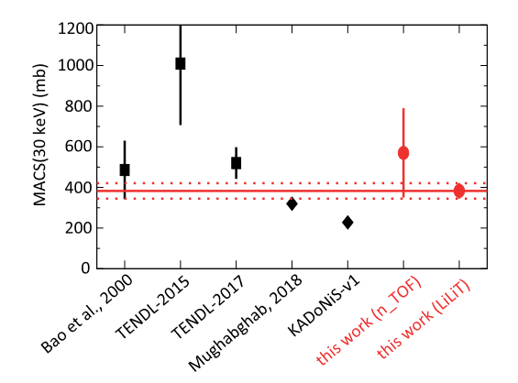
Stellar Nucleosynthesis (e.g.)
Extracted MACS at the s-process temperatures
of kT ≈ 8 keV and kT ≈ 30 keV ,
are about 3% lower and 20% higher, respectively,
than the corresponding theoretical values
widely used in nucleosynthesis simulations.
New data report to the agreement with the ²⁰⁴Pb abundance
measured in the solar system.
The result of experiment at EAR1 n_TOF
provided the first ever set of resonance parameters
¹⁷¹Tm(n,γ)
²⁰⁴Tl(n,γ)
C.Guerrero et al., Physical Review Letters 125 142701 (2020)
A.Casanovas-Hoste et al., Physical Review Letters 133 052702 (2024)

Slide 9
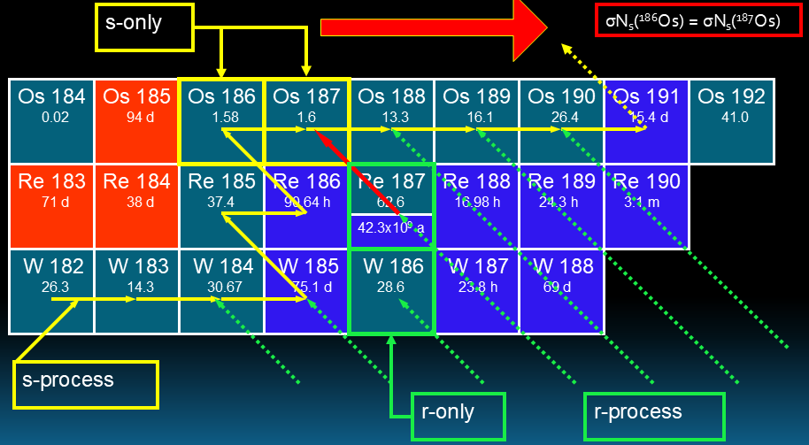
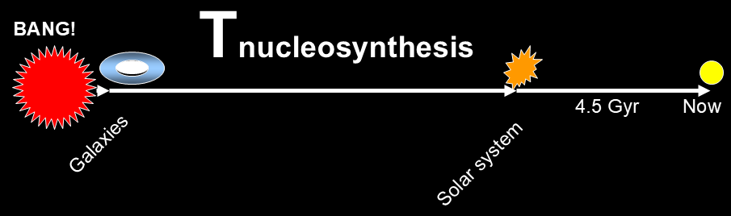
The Re/Os cosmochronometer
The β-decay half life of ¹⁸⁷Re is 43.7 Gyr → influences on abundances of the daughter ¹⁸⁷Os

Slide 10
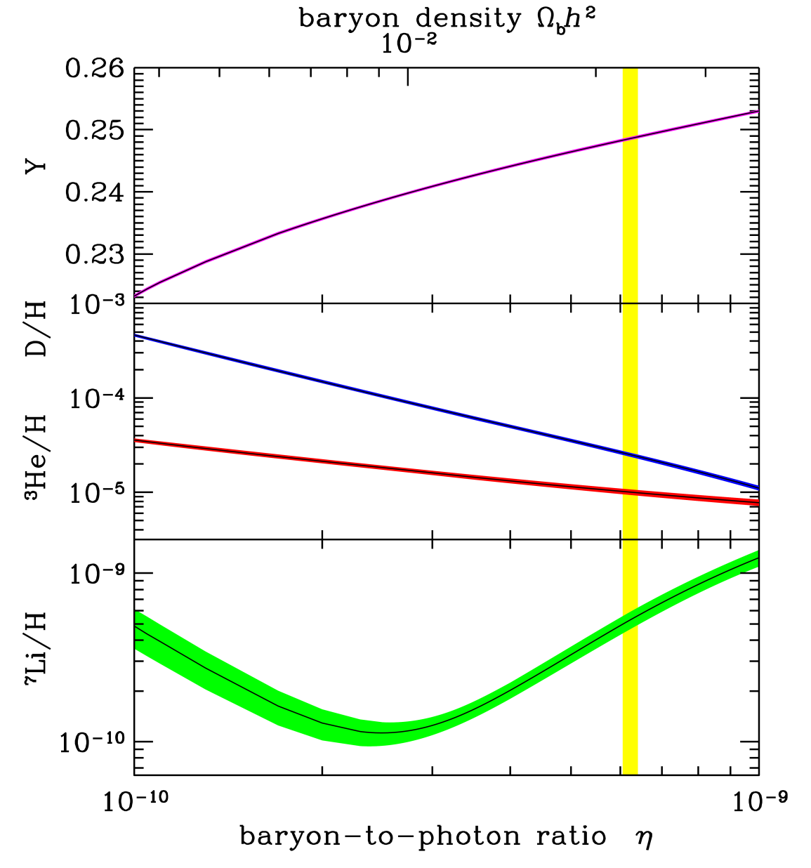
Primordial nucleosynthesis
Big Bang Nucleosynthesis (BBN), together with Cosmic Microwave Background Radiation,
is one of the cornerstones for Big Bang Theory.
BBN gives the sequence of nuclear reactions leading to the
synthesis of light elements in the early stage of Universe (0.01-1000 sec)
BBN is a parameter free theory,
being the cross-sections of reactions involved the only input to the theory.
BBN successfully predicts the abundancies of light elements, i.e. D and ³He.
*
A large discrepancy between the predicted abundance of ⁷Li
and value inferred by measurements is present.
Cosmological Lithium problem (CLiP)

Slide 11
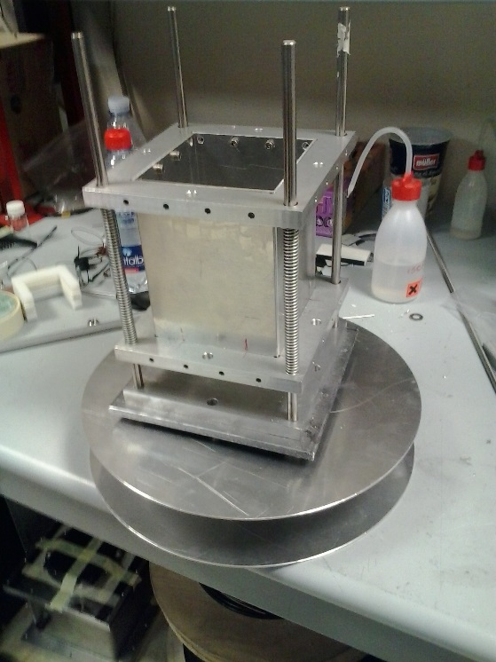
Primordial nucleosynthesis
The abundance of ⁷Li is essentially determined by the production and destruction of ⁷Be.
(≈95% of primordial ⁷Li is produced from the electron capture decay of ⁷Be)
Silicon 1
sample
neutrons
Silicon 2
Sandwich of silicon detectors
directly inserted in the beam
Detection of both α particles (E≈9 MeV)
[Coincidence technique allows a strong rejection of background]
⁷Be(n,α)
Before the measurement at EAR2 n_TOF
Only an experimental point was available in the literature
@ 25 meV
(P. Bassi et al., Il Nuovo Cimento XXVIII, 1049 (1963))
L. Damone et al., Physical Review Letters 121 042701 (2018)

Slide 12
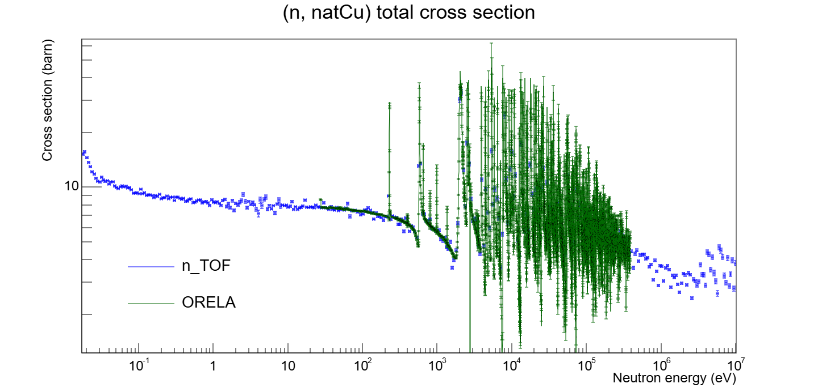
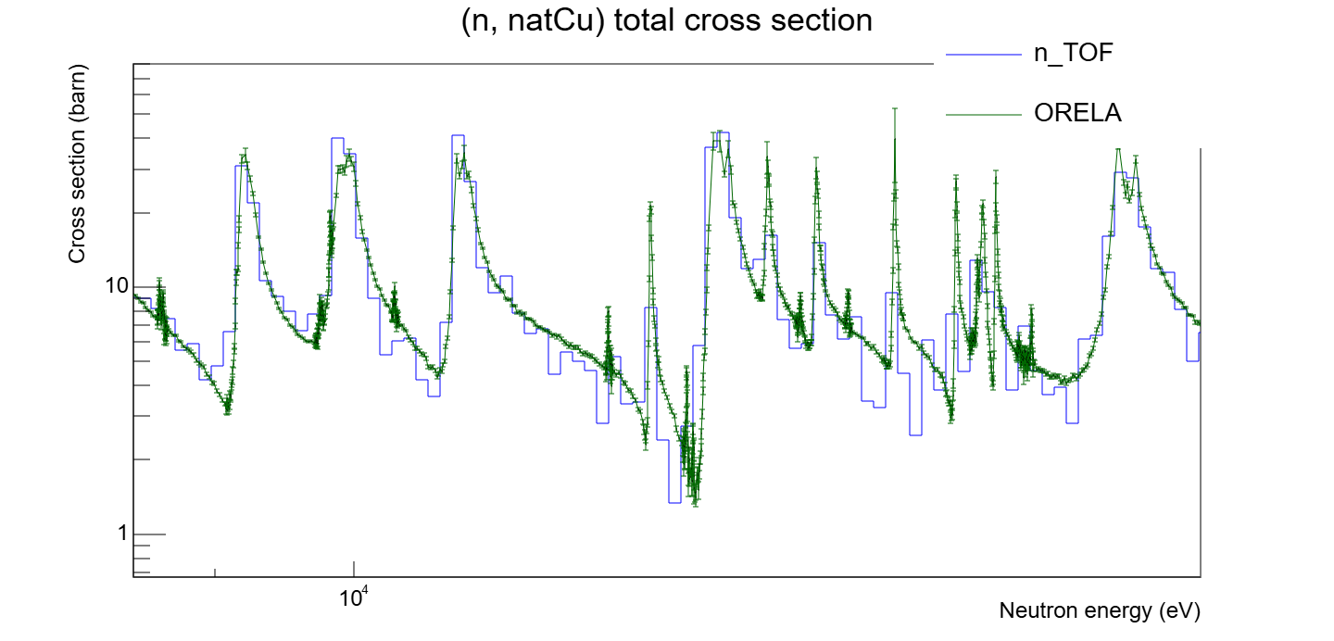
With a look towards the future
A transmission station is operative

Slide 13
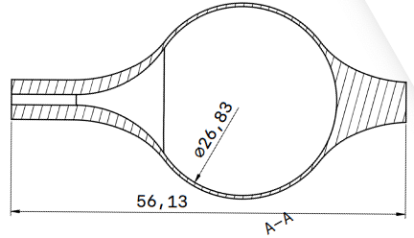
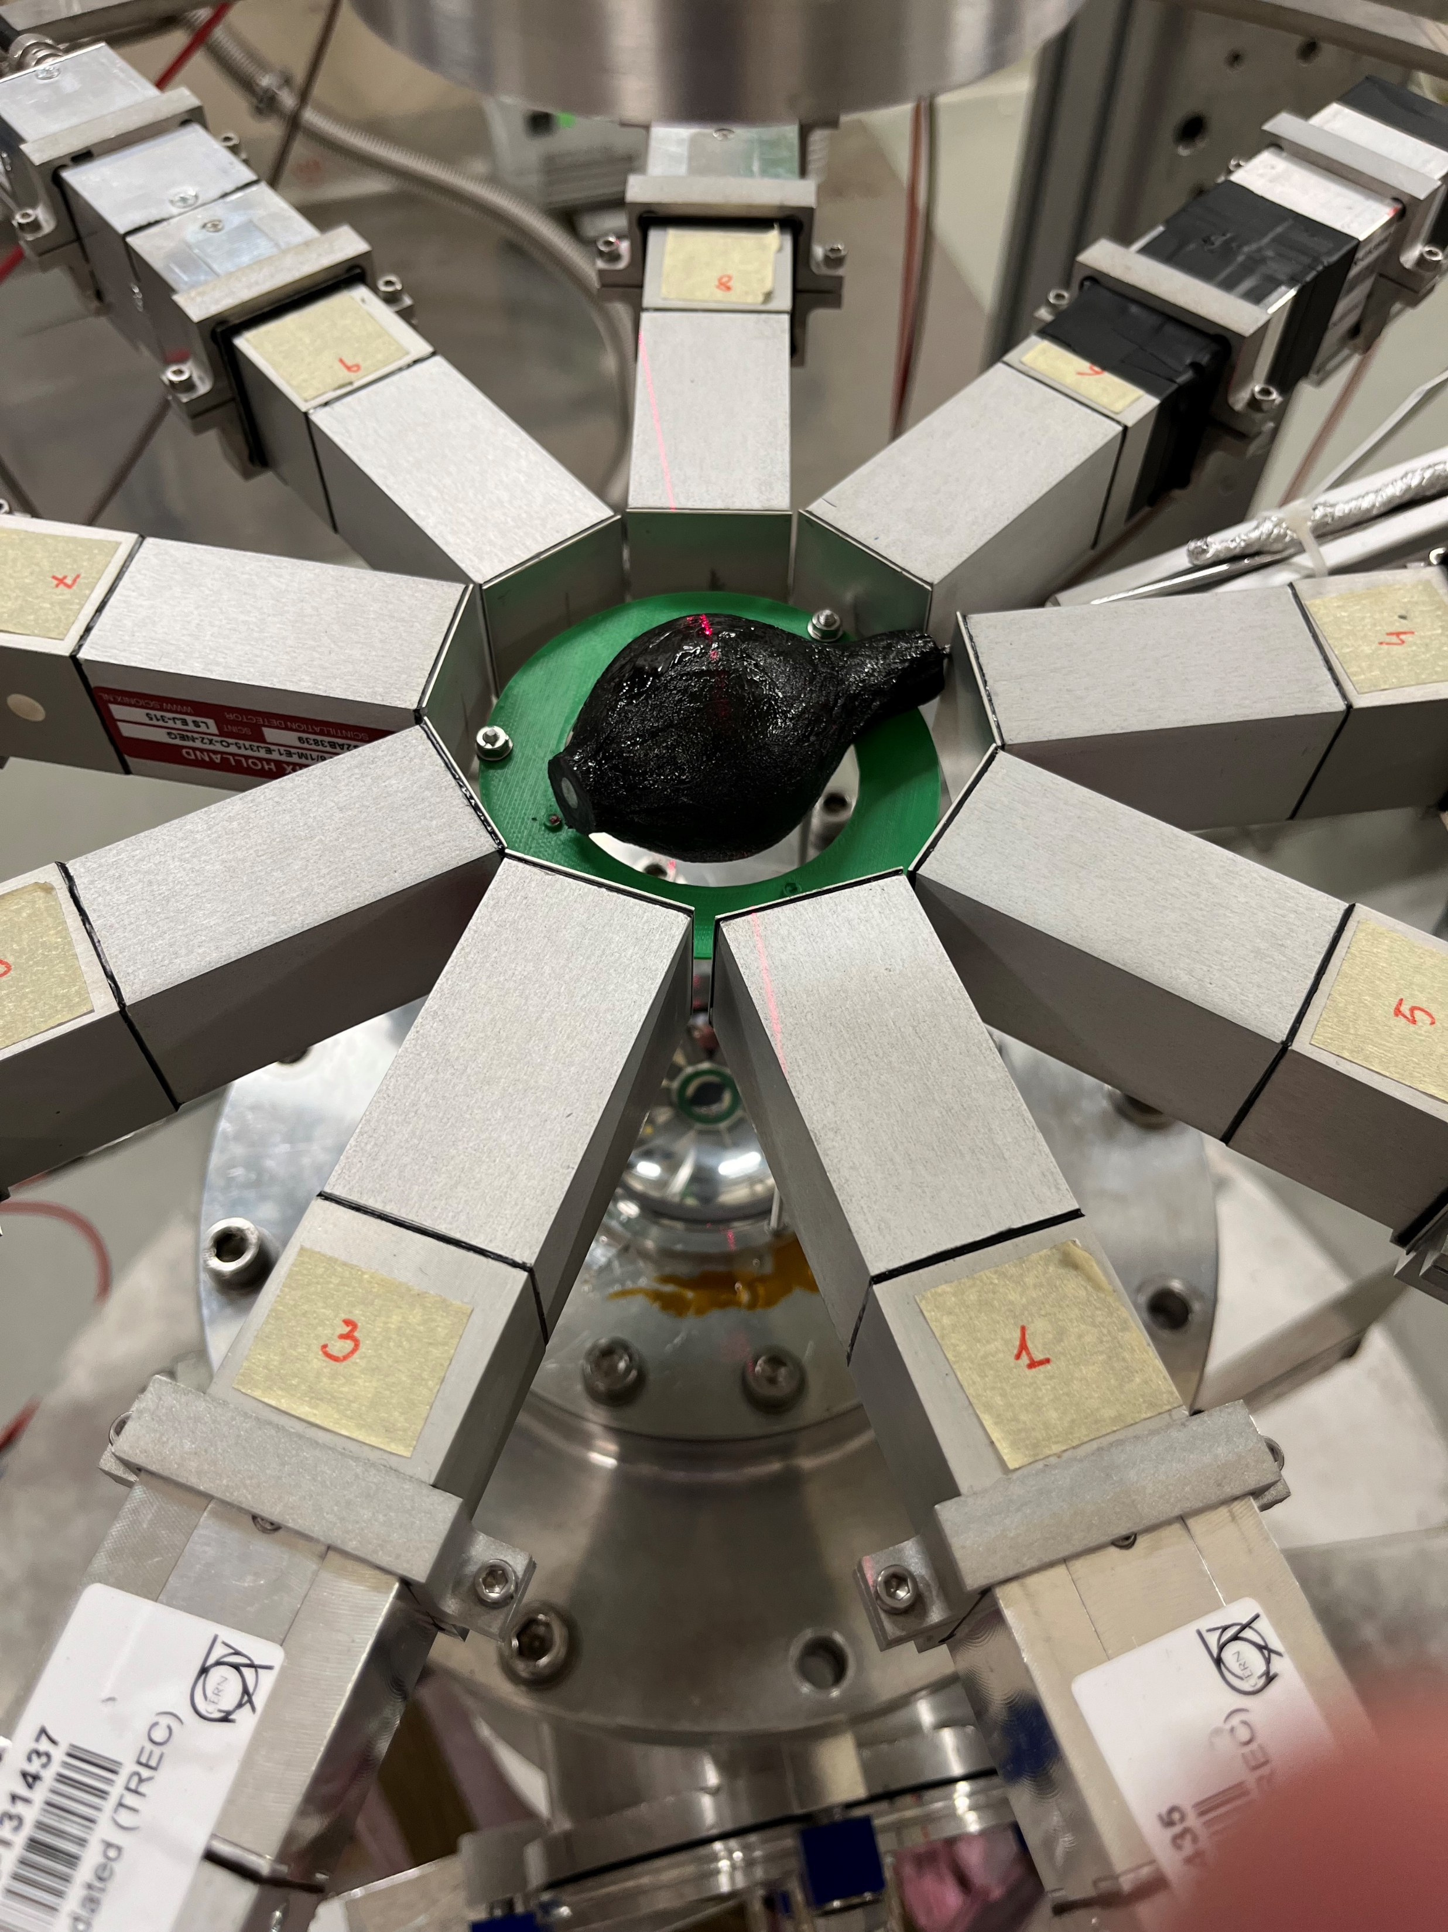
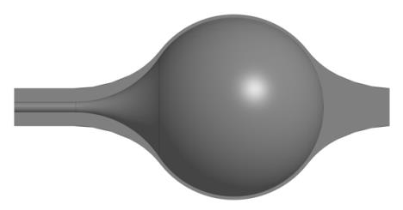
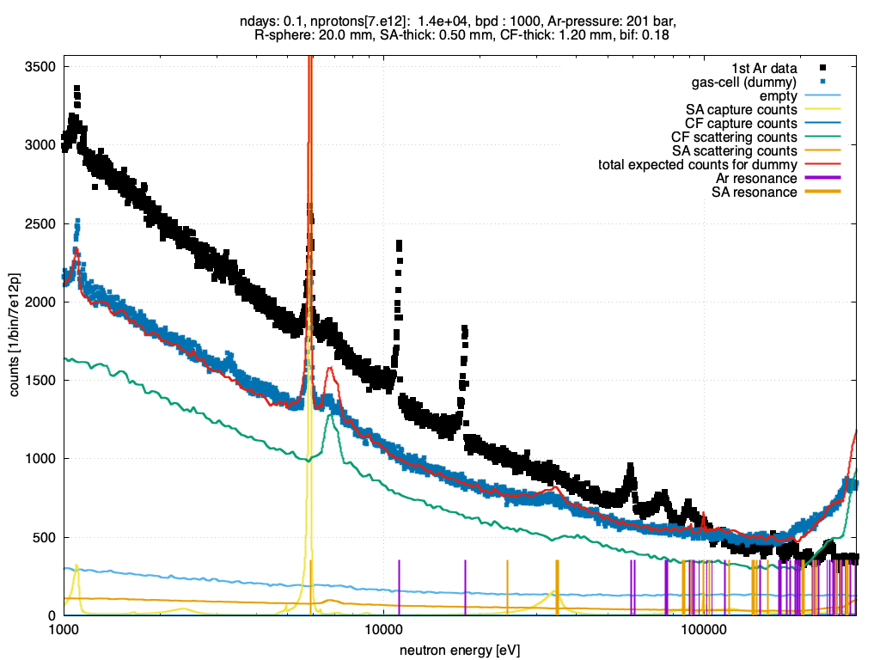
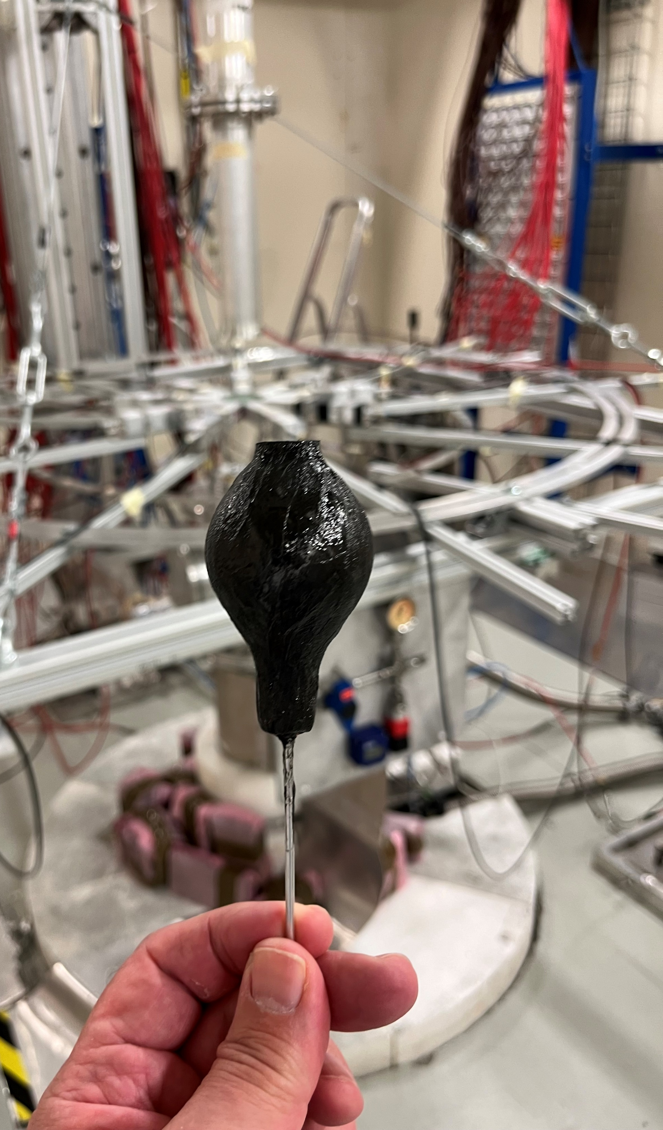

With a look towards the future
First measurement on a gas target performed at n_TOF
200 bar Argon gas-cell developed by the n_TOF Collaboration
full operation watched over by CERN safety authorities (including RP)

Slide 14
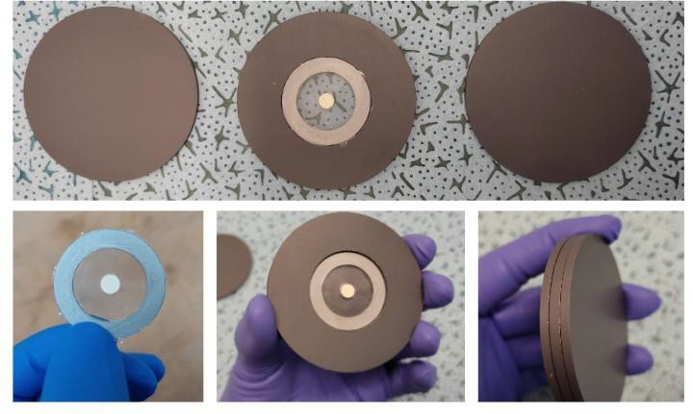
With a look towards the future
The high instantaneous neutron flux and excellent neutron energy resolution make the n_TOF facility well suited for measuring radioactive isotopes to suppress backgrounds from radioactivity and sample impurities.
In the past years, a collaboration with several laboratories (CERN-Isolde, ILL, Joint Research Center (JRC) Geel,
Los Alamos National Laboratory (LANL), PSI) that are able to isolate desired isotopes has been fruitfully established.
Isotopes with half-lives higher than about a hundred of days available in a sufficient amount can be measured
using the time-of-flight technique,
while the activation technique can be applied even in more challenging physics cases.
Filtering at the NEAR station
The n_ACT initiative @ BDF

Slide 15
n_TOF
Along 25 years of activity has delivered key-data for nuclear astrophysics,
Planned upgrades will further enhance the capabilities of the facility, enabling a wider area of research
A bright future promising even more accurate results from n_TOF is envisaged.
Universe 11 329 (2025)

