Slide 1

Mechanical stresses in solids irradiated with swift heavy ions: in-situ and post-radiation examination
Vladimir Skuratov
Flerov Laboratory of Nuclear Reactions
Joint Institute for Nuclear Research
Dubna, Russia

Slide 2
Motivation
The knowledge about of high energy (E> 1 MeV/amu) heavy ion-induced stress is of considerable practical value in view of simulation of fission product impact in radiation resistant oxides and ceramics, considered as candidate materials for nuclear waste management (inert matrix fuel host)
Main questions addressed to real-time measurements:
Radiation damage and stress accumulation processes before and
after ion track region overlapping
Variation in the stress state under ion irradiation characterized
by specific ionizing energy losses higher and lower than the threshold
of radiation damage formation via electronic excitations.
Notes:
Radiation defects produced by swift heavy ions are concentrated within small volume, surrounding ion trajectory. This inevitably results in generation of local mechanical stress, which in own turn may affect final defect structure. The knowledge about of such a high energy heavy ion track-assisted stress is of considerable practical value in view of simulation of fission product impact in radiation resistant oxides and ceramics, as candidate materials for nuclear waste management and prediction of their long-term radiation stability. In this report we give a review of experiments aimed at evaluation of mechanical stresses in radiation resistant ceramics (Al2O3, Si3N4, AlN) during and after irradiation with high energy Kr, Xe and Bi ions. To characterize stress a piezospectroscopic method, utilizing the relationship between the stress and changes in the ionoluminescence, photoluminescence and Raman spectra has been used.

Slide 3
Motivation
Experimental techniques which can be used used for evaluation of
mechanical stress accumulation during ion irradiation
X-ray diffraction

Slide 4
Accumulation of mechanical stresses under swift heavy ion irradiation
XRD is not convenient for real-time examination
Notes:
The d-spacing can described as the distance between planes of atoms that give rise to diffraction peaks. Each peak in a diffractogram results from a corresponding d-spacing. The planes of atoms can be referred to a 3D coordinate system and so can be described as a direction within the crystal. So d-spacing as well as having a dimension, usually quoted in Ångstroms, can labelled with a plane direction hkl.

Slide 5
Motivation
Experimental techniques which can be used used for evaluation of
mechanical stress accumulation during ion irradiation
X-ray diffraction
Optical piezospectroscopy
Piezospectroscopic effect connects the changes in optical spectra (absorption, luminescence, Raman) with changes in stress state of material

Slide 6
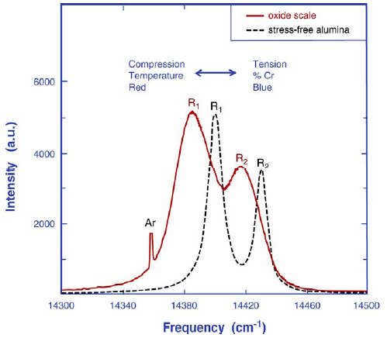
Accumulation of mechanical stresses under swift heavy ion irradiation
Basis of the piezospectroscopic effect – the applied stress strains the lattice and alters the energy of transitions between electronic states
Δν = Π_{ij}×σ_{ij}
Π_{ij} – piezospectroscopic coefficients
R1-line
R2-line
Typical piezospectroscopic probes: Cr³⁺ in Al₂O₃
Eu³⁺, Nd³⁺ in silica glasses
Sm³⁺ in borosilicate glasses
D. Clarke et. al.

Slide 7
Accumulation of mechanical stresses under swift heavy ion irradiation
Dose dependence of ionoluminescence spectra in Al₂O₃:Cr measured
during 167 MeV Xe ion irradiation at 80 K.

Slide 8
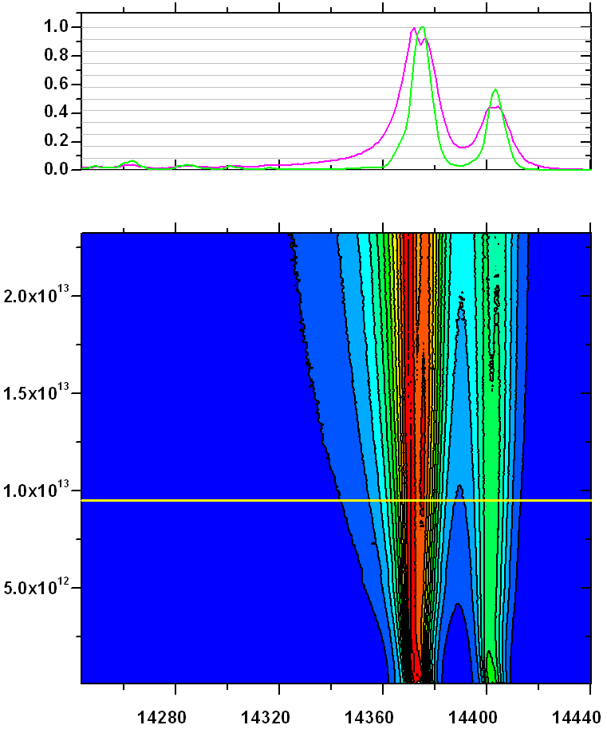
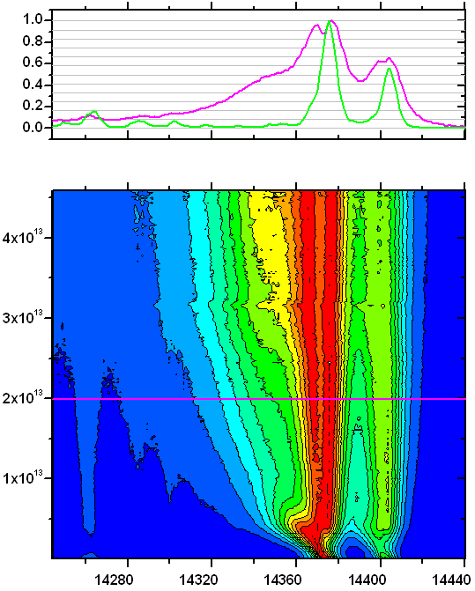
Accumulation of mechanical stresses under swift heavy ion irradiation
The splitting of the R-lines directly indicates on the presence of differently stressed regions in the irradiating ruby specimen
each Cr³⁺ ion acts as an independent strain sensor
Ion fluence, cm⁻²
Kr
Xe
S_{e}=16 keV/nm
wavenumber, cm⁻¹
S_{e}=25 keV/nm
The stresses are compressive in basal plane of the sample and tensile in perpendicular direction

Slide 9
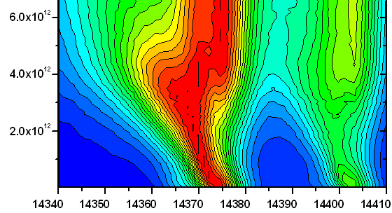
Accumulation of mechanical stresses under swift heavy ion irradiation
Xe
S_{e}=25 keV/nm
Ion fluence, cm⁻²
wavenumber, cm⁻¹

Slide 10
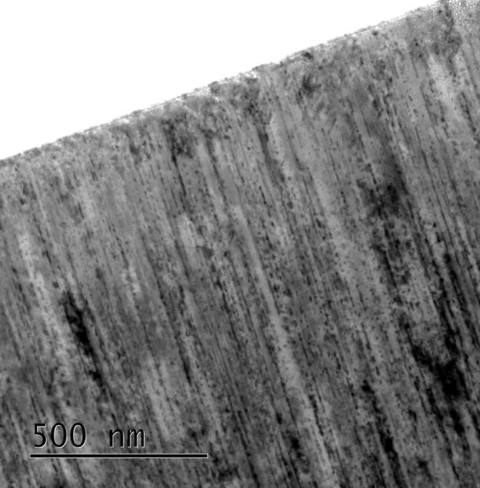
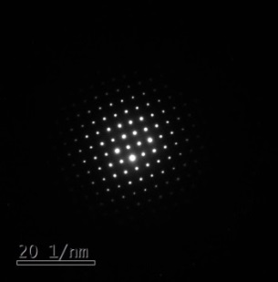
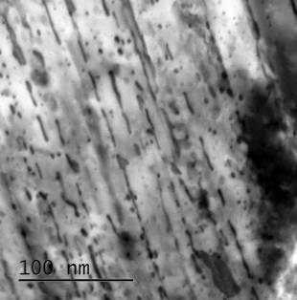
167 MeV xenon ion induced tracks in Al₂O₃

Slide 11
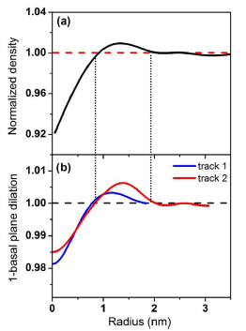
Normalized density variation as a function of radial distance from the track center (MD simulation)
Two experimental plots of 1 mean basal plane lattice dilation as a function of radial distance from the track center (TEM images processing)
J.H. O’Connell et al., NIM B (2015), http://dx.doi.org/10.1016/j.nimb.2015.09.067

Slide 12
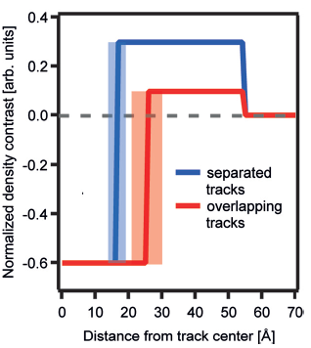
Density profiles of 185 MeV Au ions fit for α-SiO₂ irradiated to a fluence of 6×10¹² ions/cm⁻².
Kluth et al. J. Appl. Phys. 110, 123520 (2011)

Slide 13
STRESS IN Al₂O₃:Cr UNDER SWIFT HEAVY ION IRRADIATION
167 MeV Xe
σ_{h}
R₂
R
R₁
R₁ = 2.9 nm
R₂ = 5.2 nm

Slide 14
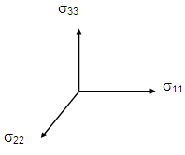
STRESS IN Al₂O₃:Cr UNDER SWIFT HEAVY ION IRRADIATION
Kr,107 MeV
Xe,167 MeV
Bi,700 MeV
Δν₁=3.26(σ₁₁+σ₂₂)+1.53σ₃₃
Δν₂=2.73(σ₁₁+σ₂₂)+2.16σ₃₃
σ_{ii} (i = 1, 2, 3) – stress tensor components, oriented along a, m and с axes

Slide 15
STRESS IN Al₂O₃:Cr UNDER SWIFT HEAVY ION IRRADIATION

Slide 16
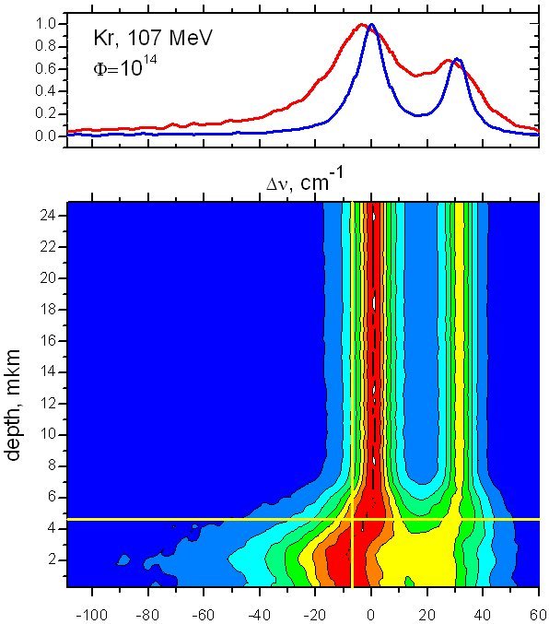
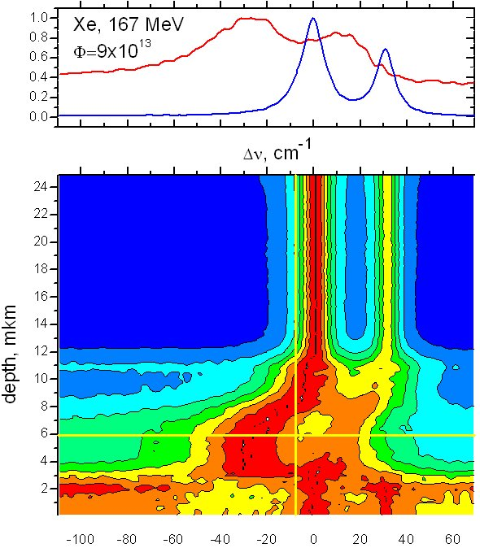
Stress profiles in swift heavy ion irradiated Al₂O₃:Cr single crystals
Δν₁ =3.26(σ₁₁+σ₂₂)+1.53σ₃₃
Δν₂=2.73(σ₁₁+σ₂₂)+2.16σ₃₃
σ_{ii} (i = 1, 2, 3) – stress tensor components, oriented along a, m and с axes
Depth variation of the R-lines luminescence spectra in 107 MeV Kr and 167 MeV Xe ion irradiated ruby crystals

Slide 17
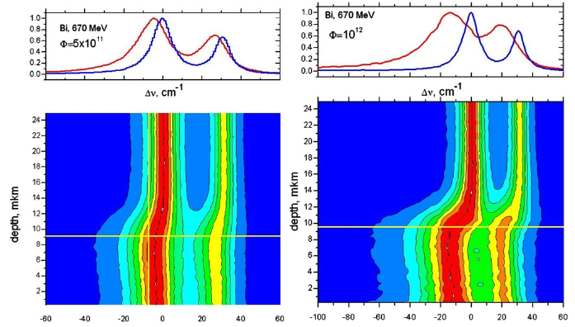
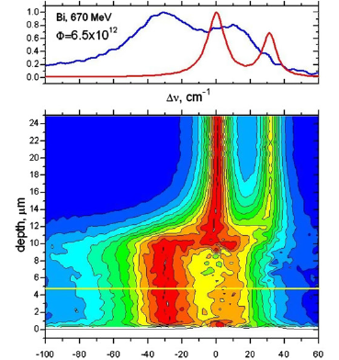
Stress profiles in swift heavy ion irradiated Al₂O₃:Cr single crystals
Depth variation of the R-lines luminescence spectra
in 670 MeV Bi ion irradiated ruby crystals

Slide 18
Residual stress and ionizing energy loss profiles in Al2O3:Cr
σ_{h} (GPa) ≈ Δν₂(cm⁻¹)/7.61 R_{p}=21 μm

Slide 19
Mechanical stress profiles in radiation-resistant ceramics irradiated with high-energy heavy ions: Si₃N₄ vs AlN
Silicon and aluminium nitrides have different structural response to swift heavy irradiation
The threshold of amorphous latent track formation in Si₃N₄ = 17 keV/nm
No latent tracks are registered in AlN till (dE/dx)_{ion} < 35 keV/nm

Slide 20
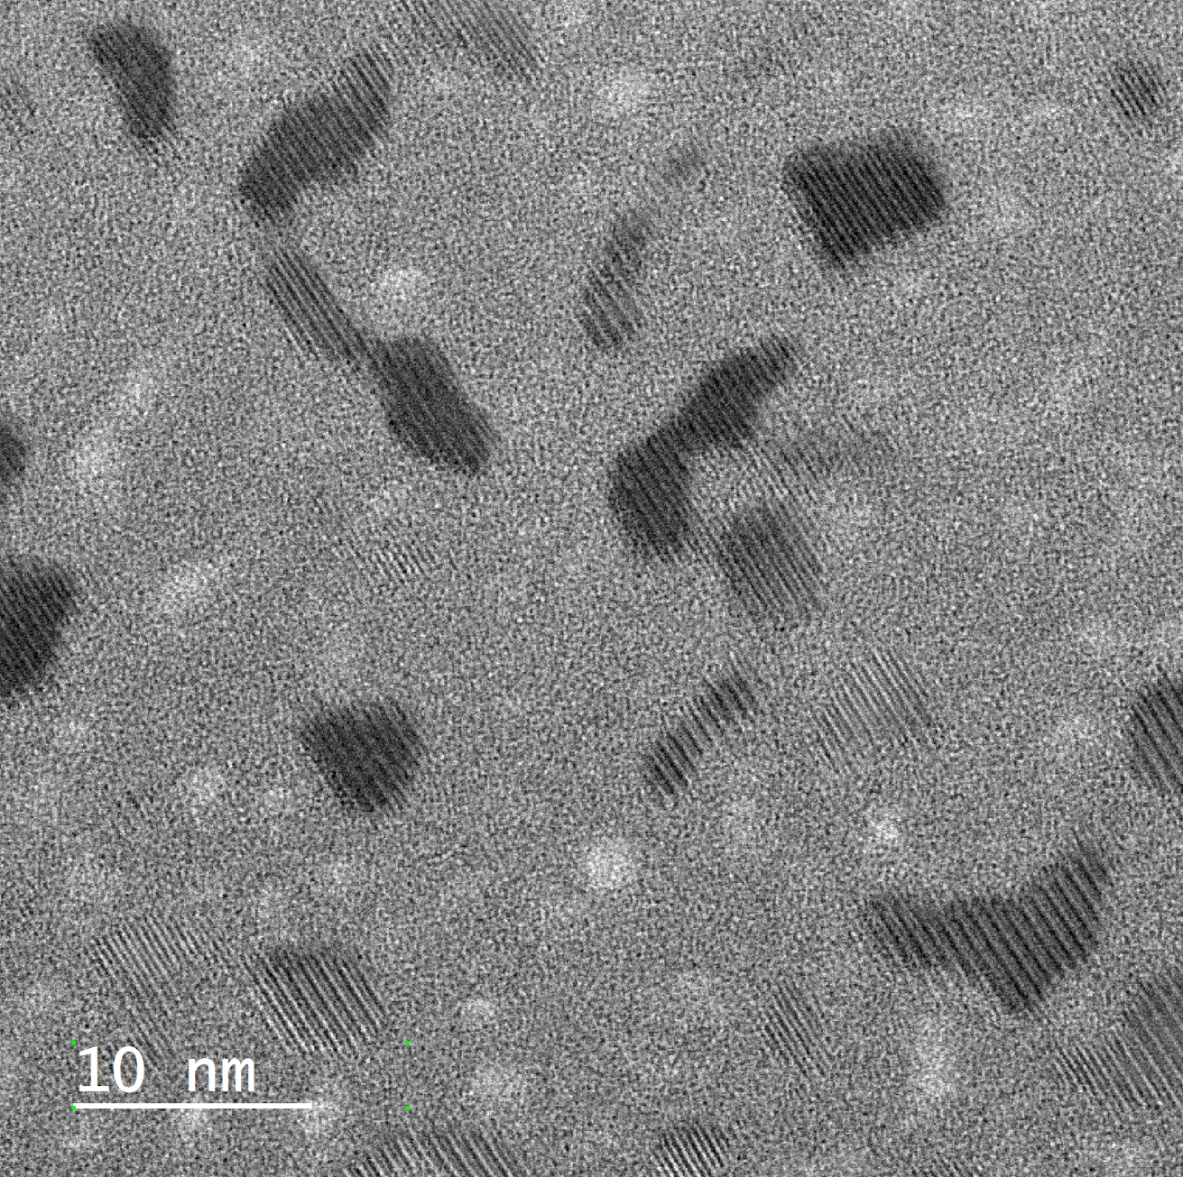
Si₃N₄ + Bi 710 МэВ

Slide 21
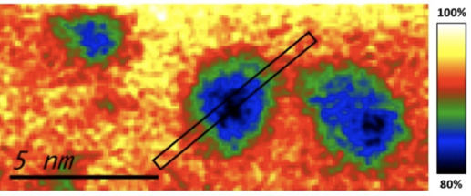
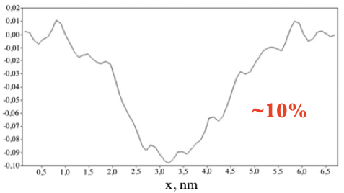
p-Si₃N₄ + Xe 220 МэВ, 2х10¹⁴ см⁻²

Slide 22
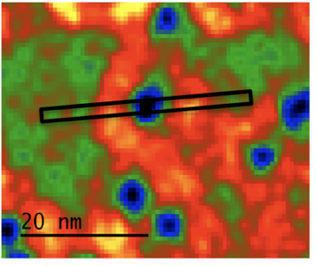
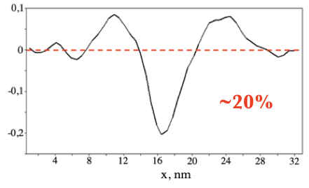
p-Si₃N₄ + Bi 710 МэВ, 1,2x10¹³ см⁻²

Slide 23
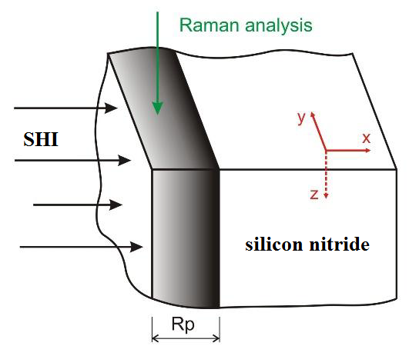
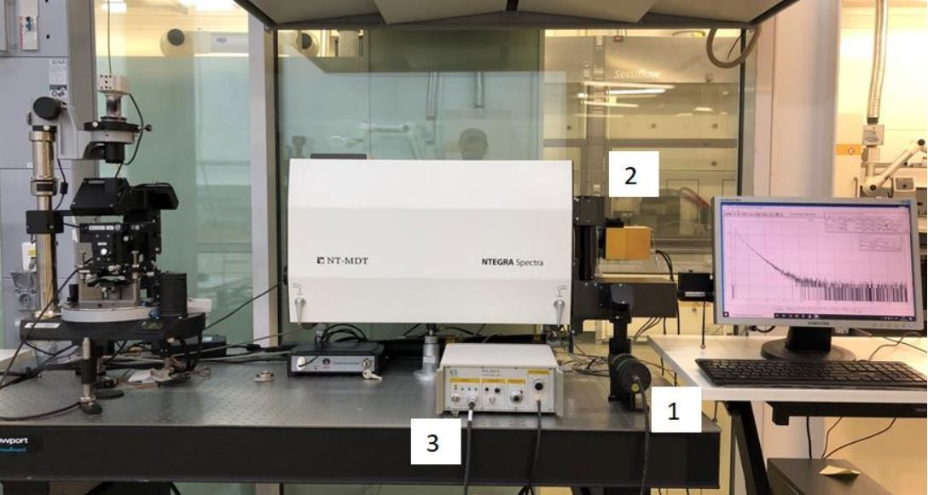
Mechanical stress profiles in Si₃N₄ and AlN irradiated with swift heavy ions: microraman piezospectroscopy examination
Δν = Π_{ij}×σ_{ij}
Π_{ij} – piezospecroscopic coefficients
Si₃N₄ Π_{ij} = 2.22 cm⁻¹/GPa
ν = 862 cm⁻¹
AlN₄ Π_{ij} = 2.0 cm⁻¹/GPa
ν = 658 cm⁻¹
Depth resolution = 1 мкм

Slide 24
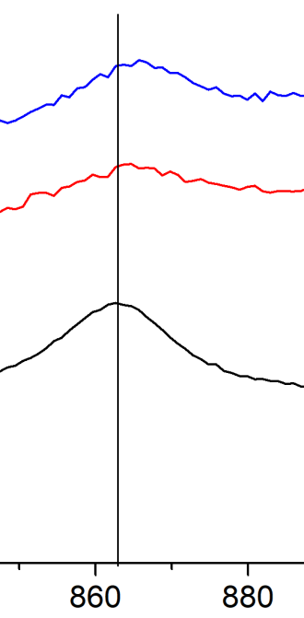
Профили механических напряжений в Si₃N_{4,} облученном ионами ксенона и висмута: Анализ методами микрорамановской пьезоспектроскопии
ν = 862 cm⁻¹

Slide 25
AlN + Bi 710 МэВ

Slide 26
Depth profiles of mechanical stresses Si₃N_{4,} irradiated with swift Bi and Xe ions: Depth-resolved microraman examination

Slide 27
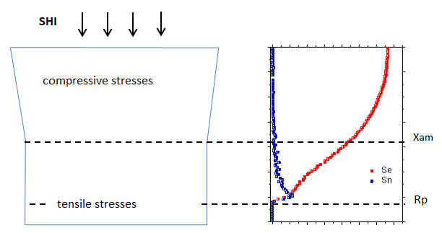
Schematic drawing of SHI irradiated target and energy loss profiles

Slide 28
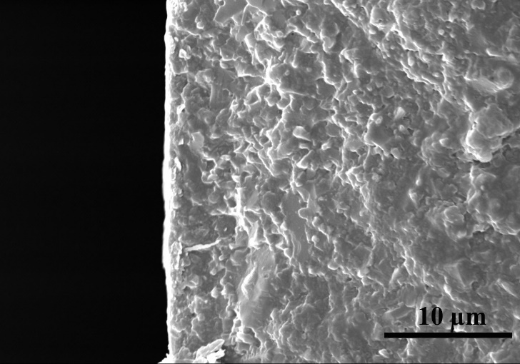
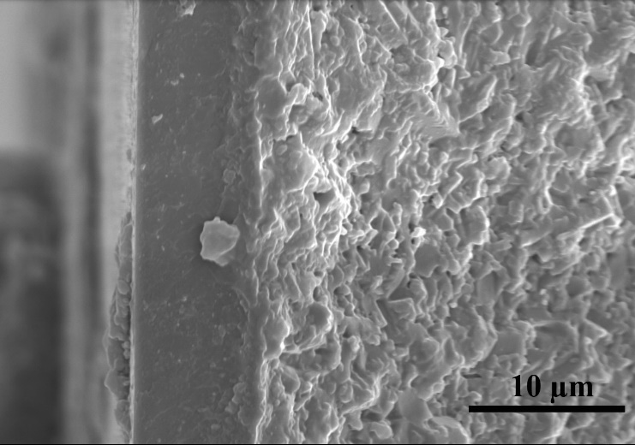
Si₃N₄ + Xe 167 МэВ
Cross-sectional SEM image of Si₃N₄ irradiated with 167 Xe ions

Slide 29
Variation of the spectral position of the 862 cm⁻¹ (Si₃N₄) and 658 cm⁻¹ (AlN) lines with the Bi ion fluence over the depth of the irradiated layer

Slide 30
Thank you for your attention!

