Slide 1



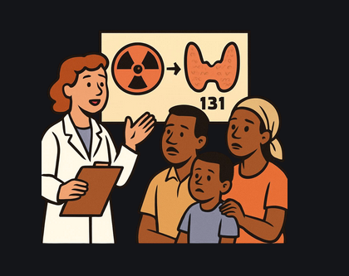
6th Advanced Nuclear Science and Technology Techniques (ANSTT6) workshop
6th Advanced Nuclear Science and Technology Techniques (ANSTT6) workshop
ESTIMATION OF RADIATION EXPOSURE TO FAMILY MEMBERS OF I-131 PATIENTS
A Study from Tanzania
Penina G. Mbago and Innocent J. Lugendo

Slide 2
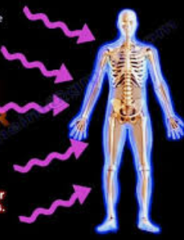
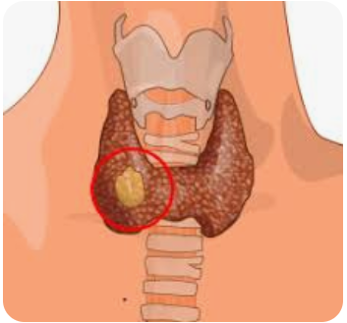
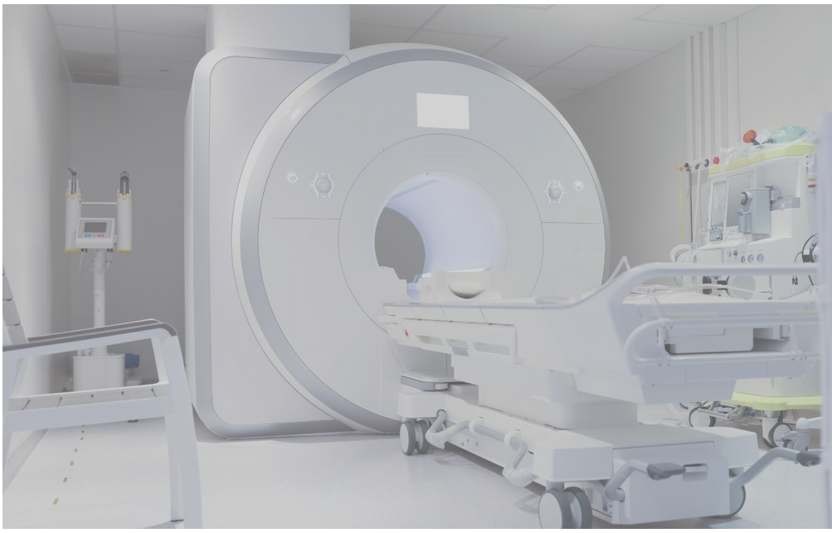
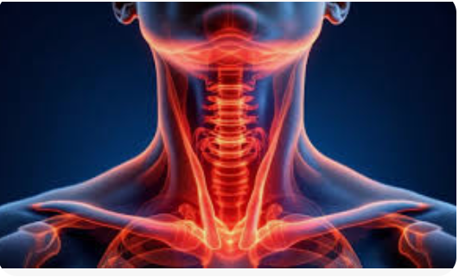
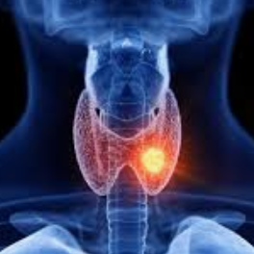

6th Advanced Nuclear Science and Technology Techniques (ANSTT6) workshop
Advantages of Science and Technology in Treatment
I-131 is among the radiopharmaceuticals used in Nuclear Medicine
It treats thyroid conditions like thyroid cancer and hyperthyroidism
The emitted beta particles are the ones used to kill thyroid cancerous cells
The emitted gamma rays are the concern
Normal cells
Cancer cells
I-131
Irradiated cancer cells

Slide 3
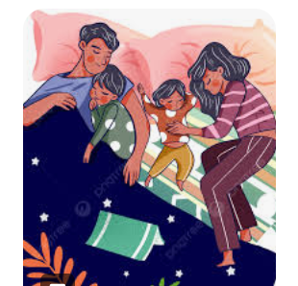
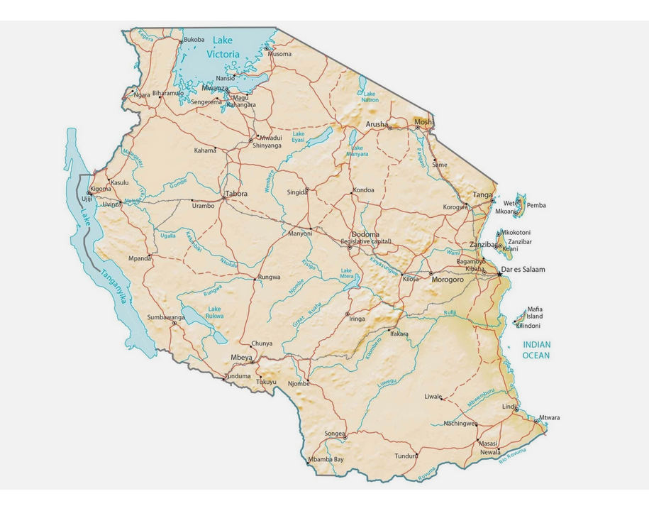
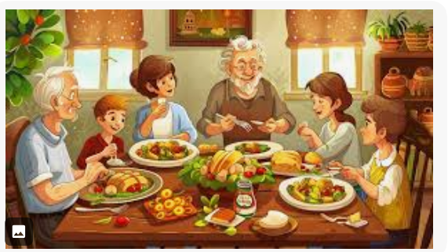
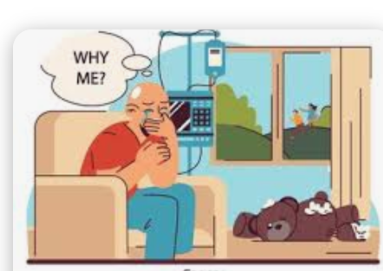
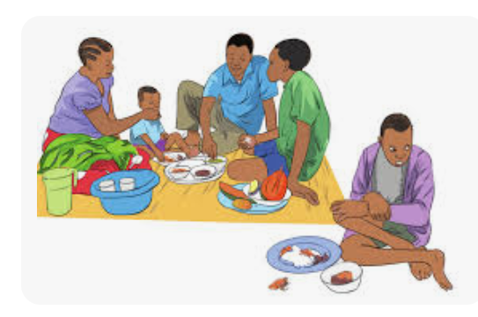

6th Advanced Nuclear Science and Technology Techniques (ANSTT6) workshop
Why does it matter?
We are family, you know
Population 62 millions
80% to 90% of cancer cases are diagnosed at an advanced stage
From the 2022 records, 44,931 new cancer cases recorded
suggests that roughly 35,000 to 40,000 people are diagnosed late each year.
You are cursed
Based on the records of 2017/2018, the number of patients diagnosed at NM was 2,246 and the number of patients treated with radioiodine was 835

Slide 4

6th Advanced Nuclear Science and Technology Techniques (ANSTT6) workshop
Objectives
During
Estimate the radiation exposure to family members of patients undergoing nuclear medicine treatment in Tanzania using PHITS
After
Combination

Slide 5
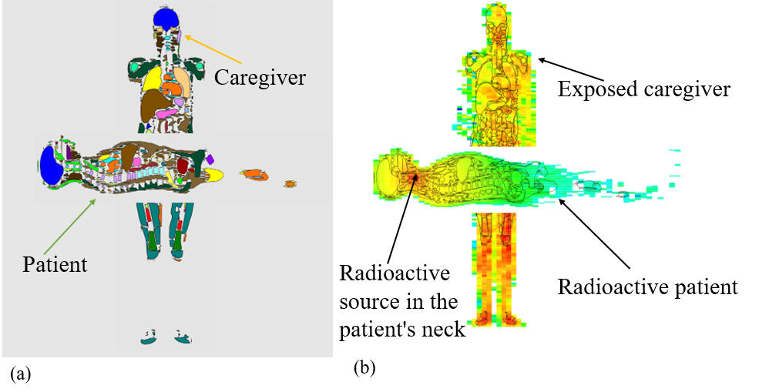
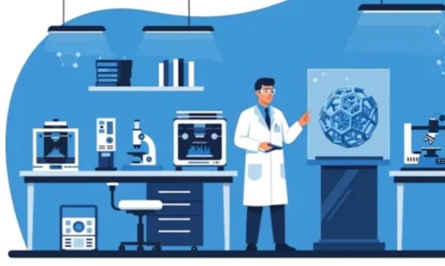
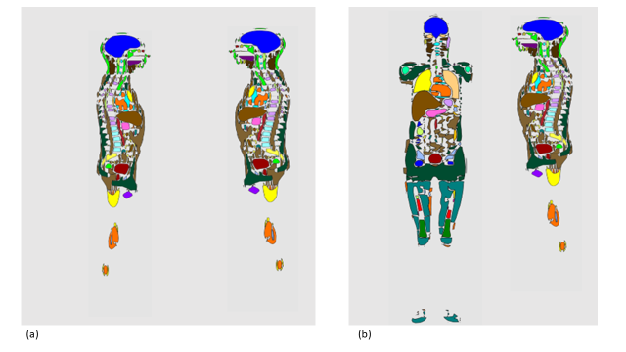
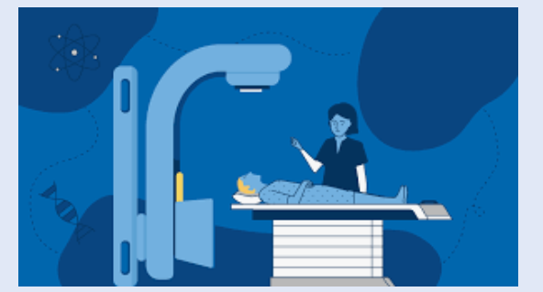

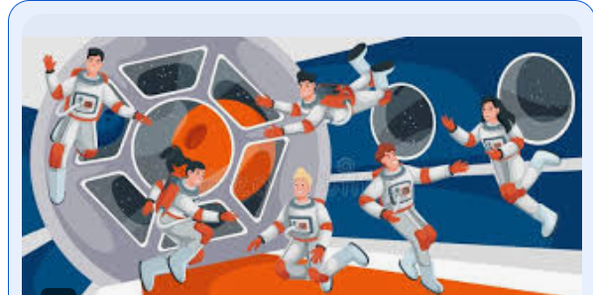

6th Advanced Nuclear Science and Technology Techniques (ANSTT6) workshop
Methodology
The constructed 2D images with different orientation

Slide 6

6th Advanced Nuclear Science and Technology Techniques (ANSTT6) workshop
Results and Discussion
The exposure rate decreased with distance and activity
For all activities and distances, on the leg side, the exposure is least
The drop in exposure rate on the neck and leg side for all activities
Distance (cm)

Slide 7

6th Advanced Nuclear Science and Technology Techniques (ANSTT6) workshop
Results and Discussion cont..
100 mCi
150 mCi
200 mCi
Maximum time the family member needs to stay with the patient before exceeding various dose limits

Slide 8
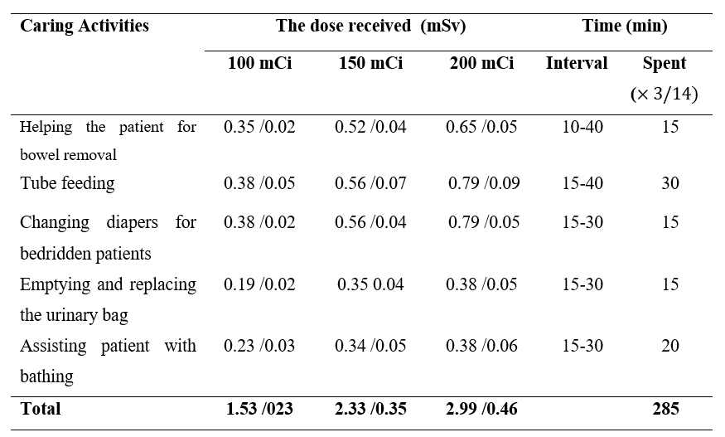
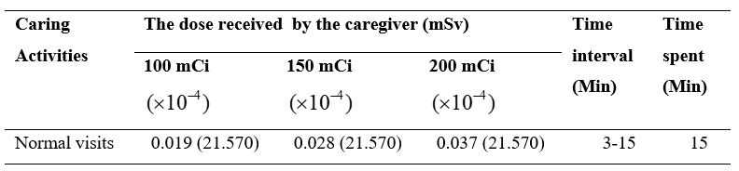

6th Advanced Nuclear Science and Technology Techniques (ANSTT6) workshop
Results and Discussion cont..
Dose received by a family member when taking care of a totally independent patient during hospitalization
Accumulated dose for 17 days of care 1.76 mSv, 2.68 mSv and 3.45 mSv
Dose received by a family member when taking care of a total dependent patient during and after hospitalization

Slide 9
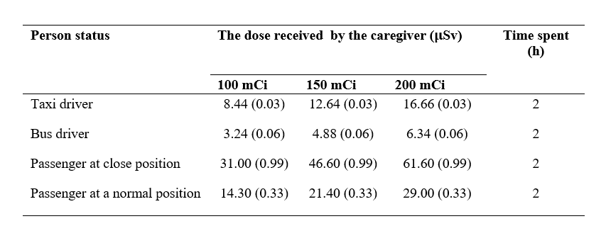

6th Advanced Nuclear Science and Technology Techniques (ANSTT6) workshop
Results and Discussion cont..
Dose received by taxi driver, bus driver and passengers during the patient’s journey home

Slide 10
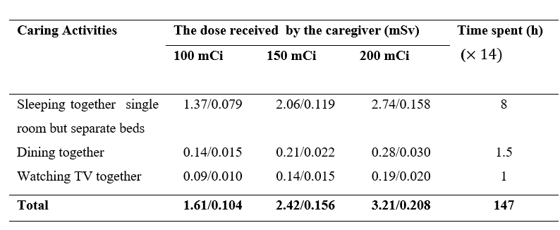

6th Advanced Nuclear Science and Technology Techniques (ANSTT6) workshop
Results and Discussion cont..
Dose received by a family member at home when not or following the radiation protection recommendations

Slide 11
6th Advanced Nuclear Science and Technology Techniques (ANSTT6) workshop
Take Away Points
Observe the Radiation Safety Regulations
The overall exposure dose did not exceed the designated dose limit
Alternate in taking care of our patients
Make them to feel safe whenever around their family

Slide 12

6th Advanced Nuclear Science and Technology Techniques (ANSTT6) workshop
THANK YOU
By Penina G. mbago
Email: penygm@gmail.com

