Slide 1

Investigating radiological risk due to solid-phase ‘black powder’ from the Secunda Gas Pipeline
Advanced Nuclear Science and Technology Techniques Workshop Programme
(18th -22nd May 2026)
Tsholofelo Mokgele
Supervisor: Dr. Tebogo Kupi
North-West University (NWU), Centre for Applied Radiation Science and technology (CARST)

Slide 2

Content
1 Problem statement and motivation
2 Aim and objectives
3 Methodology
4 Results and discussion
5 Conclusion
6 References

Slide 3
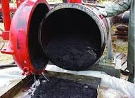

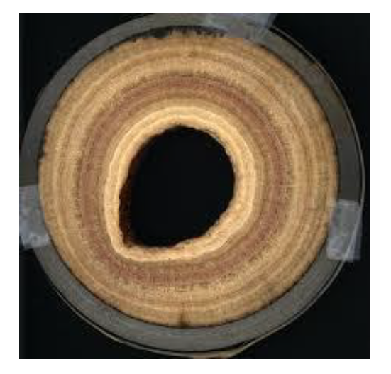
Problem statement
1
2
rglfwflrg
3
Image sources: Kurt Rhea, Understanding Radiation, NORM and TENORM, SECURE Energy Services; Sytbay, Properties of Alkaline Earth Metals Explained Clearly 2026; Gulf Energy Information, Pipeline & Gas Journal, August 2024.

Slide 4
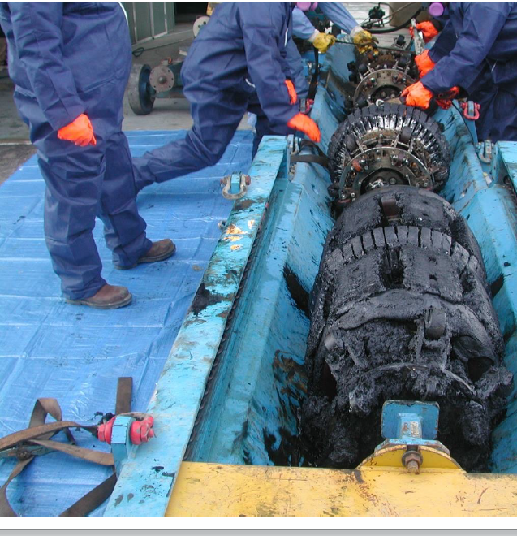
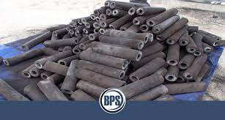
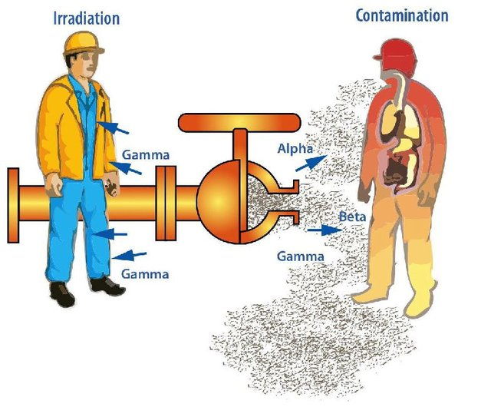
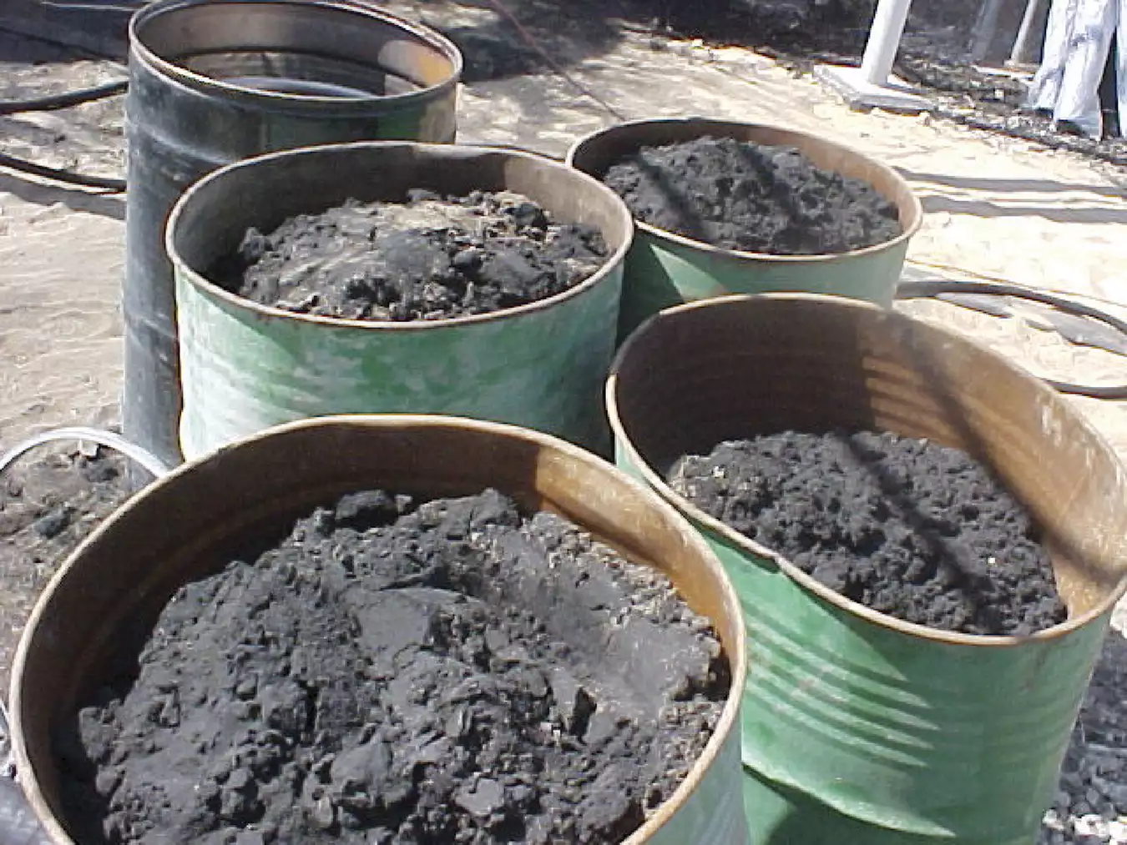
Motivation
4
5
7
6
4
Image sources: Kurt Rhea, Understanding Radiation, NORM and TENORM, SECURE Energy Services; formation and movement of NORM in oil and gas production systems (adapted from Pall Corporation, “Black Powder Prevention in Oil and Gas Pipelines”) 2002; Black Powder Solutions, Crude Oil Slop Tank Recovery Case Study.

Slide 5
Aim and Objectives
The aim of this study was to characterise the radioactive waste scale and estimate the potential radiological risk due to enhanced natural radionuclides.
The objectives of the study were to:
1. Characterise the radioactive nuclides as follows:
a. Identifying of the radioactive nuclides
b. Determine individual nuclide activity concentration using High Purity Germanium (HPGe)detector,
2. Estimate the potential external radiological exposure risk from gamma emission and
3. Calculate the internal dose due to inhalation of contaminated scale.

Slide 6
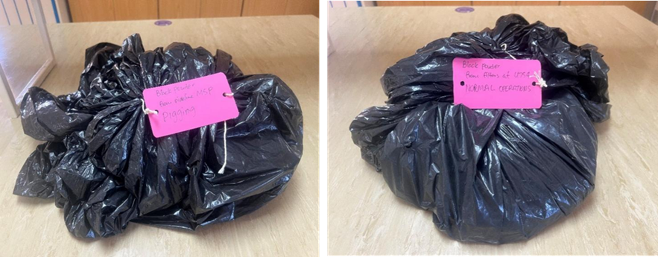
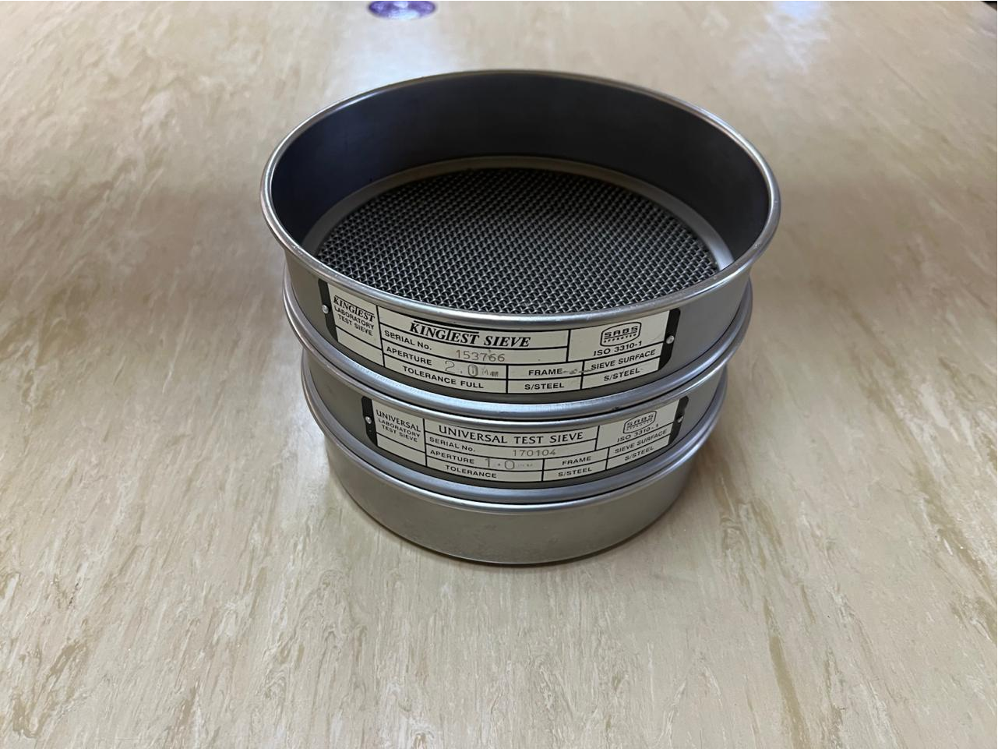
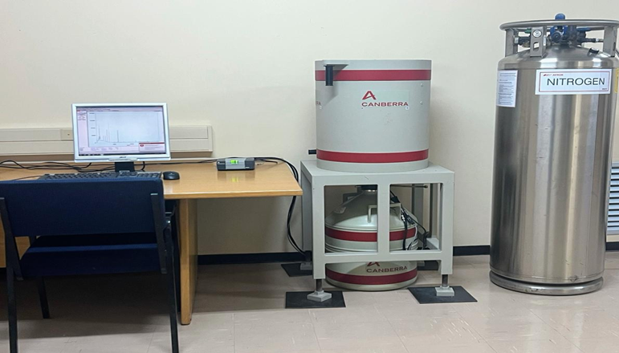
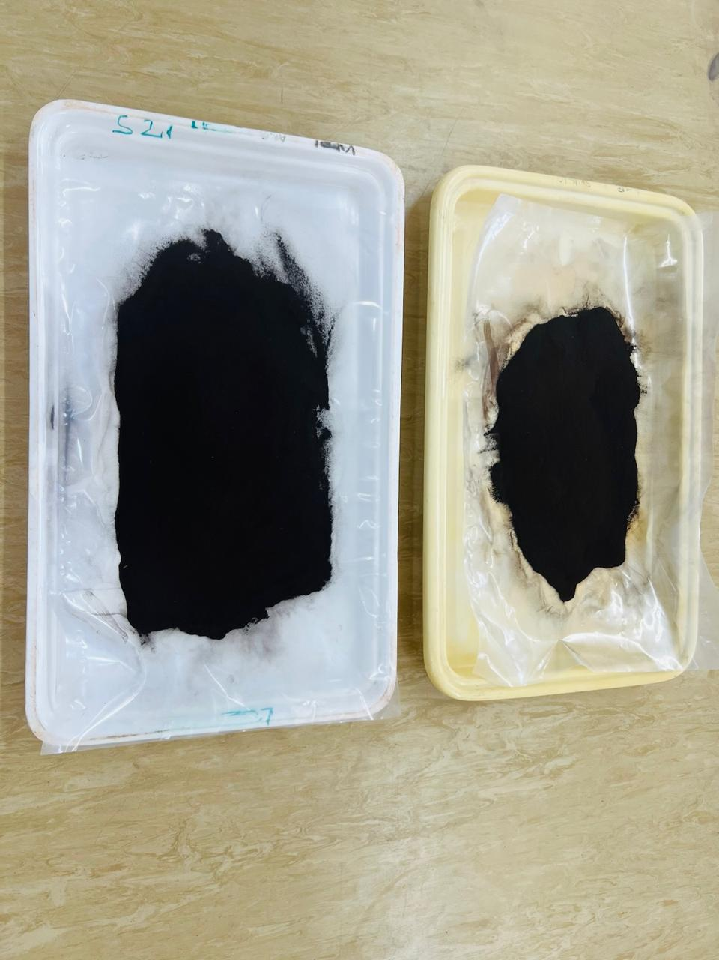
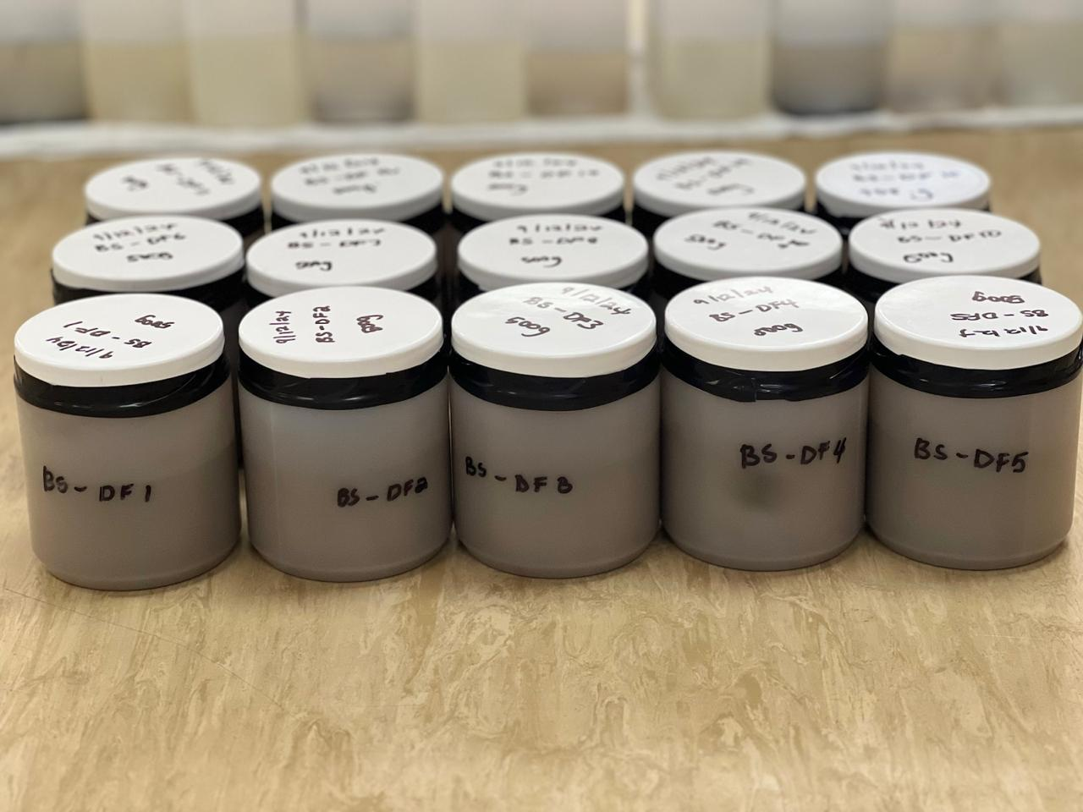
Methodology
Sample collection and preparation
8
10
12
9
11

Slide 7
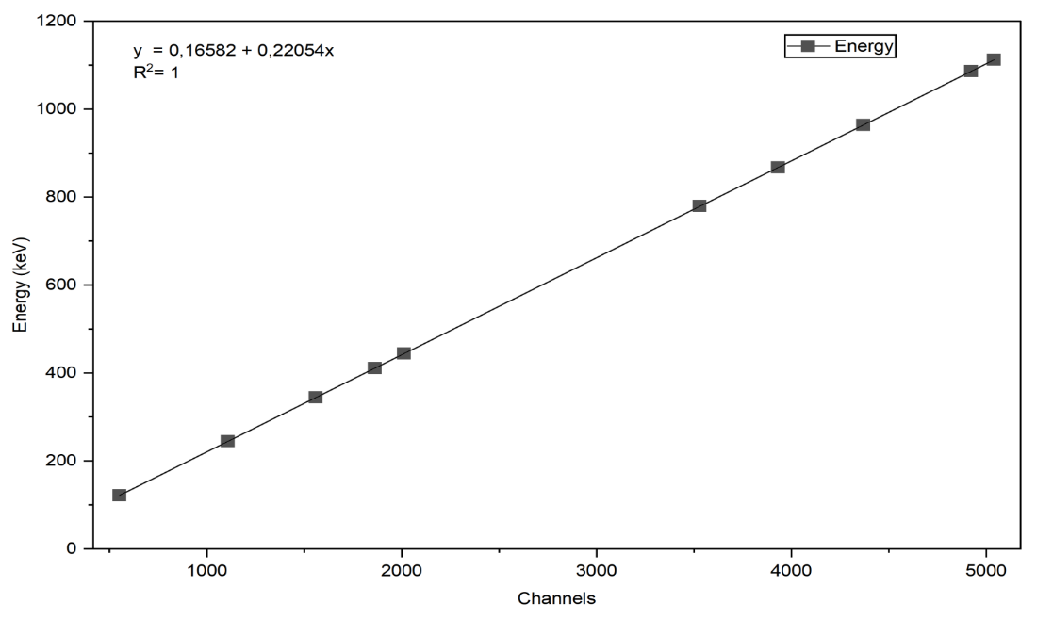
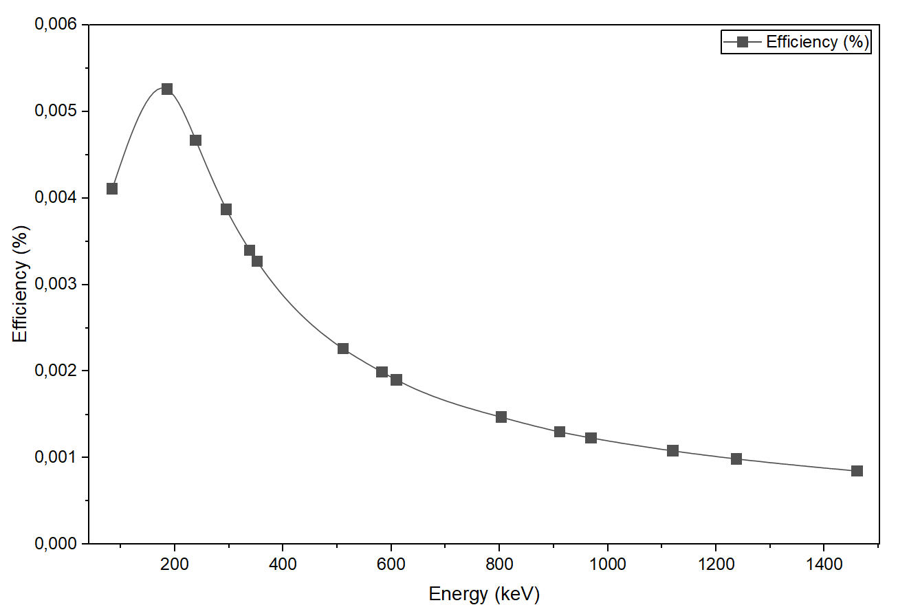
Methodology cont’
Energy and efficiency calibration
For energy calibration two standard gamma point sources (²⁴¹Am and ¹⁵² Eu) were used, covering the energy spectrum from 59.5 keV up to roughly 1400 keV.
IAEA-RGU-1, IAEA-RGTh-1 and the IAEA-RGK-1 standard reference sources were used for the full energy peak efficiency calibration.

Slide 8

Methodology cont’
Activity concentrations for black powder samples
Table 1: Gamma emission peaks used to determine the activity concentrations of ²²⁶Ra, ²³²Th and ⁴⁰K.
Equation 1 was used to determine activity concetration
$A=\frac{N_{C}}{\text{ε}×P_{γ}×m×t}$ (1)
A = Activity concentration (Bq/kg)
$N_{C}$= Net counts (background counts under the peak were subtracted)
$ε$= Detector efficiency at that gamma energy
$P_{γ}$= Gamma emission probability (branching ratio)
$t$= Counting time (seconds)
$m$= Mass of the sample (kg)

Slide 9

Methodology cont’
Radiological hazards assessments for black powder samples
Radium equivalent activity (Raeq)
Equation 2 was used to obtain the Raeq;
${Ra}_{eq}=A_{Ra}+{1.43 A}_{Th}+{0.077A}_{K }$ (2)
Where A_{Ra}, A_{Th} and A_{K} represents the activity concentrations (Bq/kg) of ²²⁶Ra, ²³²Th, and ⁴⁰K, respectively.
The external hazard index (H_{ex})
The external hazard index obtained from the Ra_{eq} expression. H_{ex} was estimated as illustrated in Equation 3:
$H_{ex}= \frac{A_{Ra}}{370}+\frac{A_{Th}}{259}+\frac{A_{K}}{4810}$ (3)
The internal hazard index (H_{in})
Internal radiation resulting from the inhalation of ²²²Rn along with its short-lived decay daughters is measured through the internal hazard index given by Equation 4;
$H_{in}= \frac{A_{Ra}}{185}+\frac{A_{Th}}{259}+\frac{A_{K}}{4810}$ (4)

Slide 10

Methodology cont’
The absorbed dose (D_{ab}) in air
This is an indicator of gamma radiation arising from terrestrial radionuclides ²²⁶Ra, ²³²Th and ⁴⁰K present in air at 1 m above ground. The absorbed dose is represensted in Equation 5.
$D_{ab}\left(\frac{nGy}{h}\right)=0.462 A_{Ra}+0.604 A_{Th}+0.0417A_{K}$ (5)
The annual effective dose equivalent (AEDE)
Equation 6 illustrates the AEDE, which is the total external or internal radiation dose equivalent deposited to an individual over the course of a year (Kidane et al., 2024),
$AEDE \left(\frac{mSv}{y}\right)=D_{ab}×T×DC×OF$ (6)
T is Time (8760 h/year), DC is the Dose conversion coefficient (0.7 × 10⁻⁶ Sv/nGy), OF is the Occupancy factor (a 0.2 occupancy factor was assumed).
Excess Life Cancer Risk (ELCR)
$ELCR= AEDE× DL ×RF$ (7)
ELCR is the annual effective dose equivalent, DL is duration of life (typically 70 years) and RF is the risk factor (0.05 fatal cancer risk per sievert) as shown in Equation 7.

Slide 11
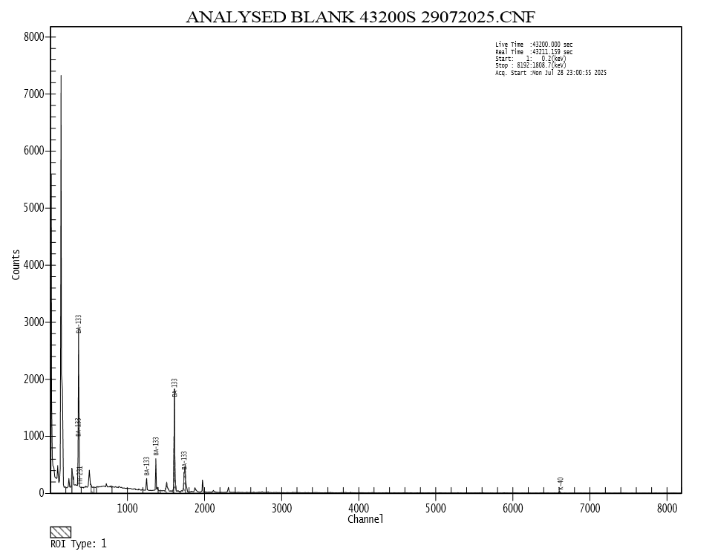
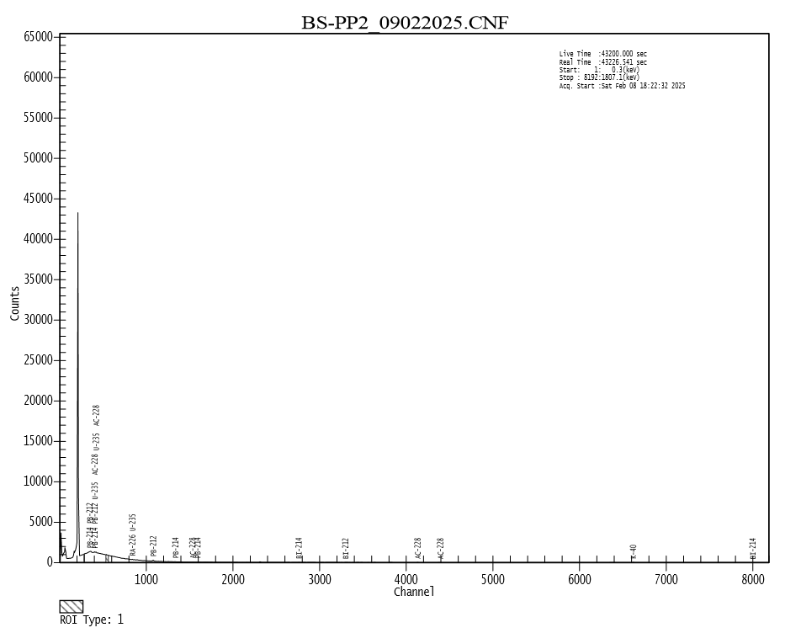
Results and discussion
Activity concentrations for black powder samples

Slide 12
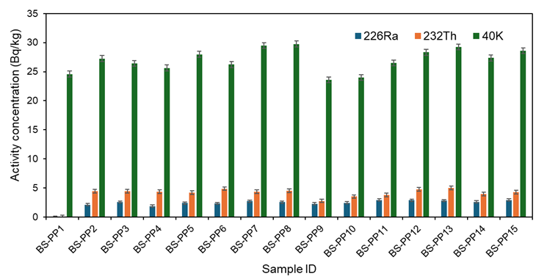
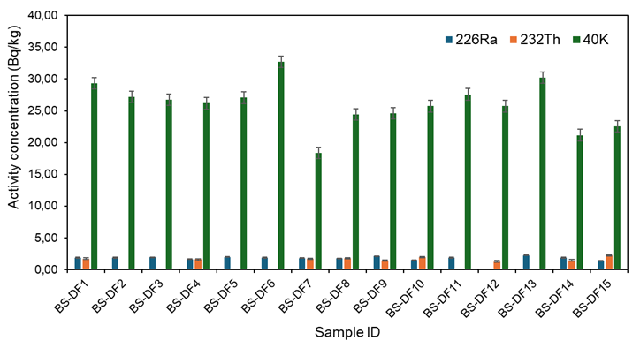
Results and discussion
Activity concentrations for black powder samples
Overall, the average specific activity of ²²⁶Ra, ²³²Th and ⁴⁰K in both BS-PP and BS-DF samples are significantly lower than the exemption level of 1000 Bq/kg for ²²⁶Ra and ²³²Th and 10000 Bq/kg for ⁴⁰K as reported in the IAEA basic safety standard.

Slide 13
Results and discussion
Table 2: Comparison of activity concentrations of (²²⁶Ra, ²³²Th, and ⁴⁰K) in black powder (BP) samples from pigging and filter operations in South Africa with values reported for other countries

Slide 14
Results and discussion
Table 3: Radiological hazard indices in black powder from pigging operations
Sample ID | Ra_{eq} (Bq/kg) | H_{ex} | H_{in} | D_{ab} (nGy/h) | AEDE (mSv/yr) | ELCR
BS-PP1 | 1,89 | 0,01 | 0,01 | 1,02 | 1,26E-03 | 4,40E-06
BS-PP2 | 10,58 | 0,03 | 0,03 | 4,80 | 5,89E-03 | 2,06E-05
BS-PP3 | 10,97 | 0,03 | 0,04 | 4,98 | 6,11E-03 | 2,14E-05
BS-PP4 | 10,09 | 0,03 | 0,03 | 4,57 | 5,61E-03 | 1,96E-05
BS-PP5 | 10,51 | 0,03 | 0,03 | 4,79 | 5,88E-03 | 2,06E-05
BS-PP6 | 11,34 | 0,03 | 0,04 | 5,12 | 6,28E-03 | 2,20E-05
BS-PP7 | 11,22 | 0,03 | 0,04 | 5,12 | 6,28E-03 | 2,20E-05
BS-PP8 | 11,32 | 0,03 | 0,04 | 5,16 | 6,32E-03 | 2,21E-05
BS-PP9 | 8,08 | 0,02 | 0,03 | 3,72 | 4,56E-03 | 1,60E-05
BS-PP10 | 9,32 | 0,03 | 0,03 | 4,25 | 5,22E-03 | 1,83E-05
BS-PP11 | 10,39 | 0,03 | 0,04 | 4,75 | 5,82E-03 | 2,04E-05
BS-PP12 | 11,84 | 0,03 | 0,04 | 5,38 | 6,59E-03 | 2,31E-05
BS-PP13 | 12,22 | 0,03 | 0,04 | 5,54 | 6,80E-03 | 2,38E-05
BS-PP14 | 10,37 | 0,03 | 0,04 | 4,73 | 5,81E-03 | 2,03E-05
BS-PP15 | 11,24 | 0,03 | 0,04 | 5,12 | 6,28E-03 | 2,20E-05
Average | 10,68 | 0,03 | 0,04 | 4,86 | 5,96E-03 | 2,09E-05
Max | 12,22 | 0,03 | 0,04 | 5,54 | 6,80E-03 | 2,38E-05
Min | 8,08 | 0,02 | 0,03 | 3,72 | 4,56E-03 | 1,60E-05
Reference safety limit (UNSCEAR 2000, IAEA 2017) | 370 | ≤1 | ≤1 | 59 | 1 | 1,00E-04

Slide 15
Results and discussion
Table 4: Radiological hazard indices in black powder from dust filters obtained during normal operation
Sample ID | Ra_{eq} (Bq/kg) | H_{ex} | H_{in} | D_{ab} (nGy/h) | AEDE (mSv/yr) | ELCR
BS-DF1 | 6,58 | 0,02 | 0,02 | 3,12 | 3,83E-03 | 1,34E-05
BS-DF2 | 3,93 | 0,01 | 0,02 | 1,98 | 2,43E-03 | 8,52E-06
BS-DF3 | 3,97 | 0,01 | 0,02 | 2,00 | 2,45E-03 | 8,58E-06
BS-DF4 | 5,86 | 0,02 | 0,02 | 2,78 | 3,41E-03 | 1,19E-05
BS-DF5 | 4,07 | 0,01 | 0,02 | 2,04 | 2,51E-03 | 8,77E-06
BS-DF6 | 4,39 | 0,01 | 0,02 | 2,23 | 2,73E-03 | 9,56E-06
BS-DF7 | 5,63 | 0,02 | 0,02 | 2,62 | 3,21E-03 | 1,12E-05
BS-DF8 | 6,19 | 0,02 | 0,02 | 2,91 | 3,56E-03 | 1,25E-05
BS-DF9 | 6,00 | 0,02 | 0,02 | 2,84 | 3,49E-03 | 1,22E-05
BS-DF10 | 6,20 | 0,02 | 0,02 | 2,91 | 3,57E-03 | 1,25E-05
BS-DF11 | 3,99 | 0,01 | 0,02 | 2,01 | 2,47E-03 | 8,64E-06
BS-DF12 | 3,80 | 0,01 | 0,01 | 1,84 | 2,26E-03 | 7,90E-06
BS-DF13 | 4,57 | 0,01 | 0,02 | 2,29 | 2,81E-03 | 9,85E-06
BS-DF14 | 5,54 | 0,01 | 0,02 | 2,61 | 3,20E-03 | 1,12E-05
BS-DF15 | 6,24 | 0,02 | 0,02 | 2,89 | 3,55E-03 | 1,24E-05
Average | 5,13 | 0,01 | 0,02 | 2,47 | 3,03E-03 | 1,06E-05
Max | 6,58 | 0,02 | 0,02 | 3,12 | 3,83E-03 | 1,34E-05
Min | 3,80 | 0,01 | 0,01 | 1,84 | 2,26E-03 | 7,90E-06
Reference safety limit (UNSCEAR 2000, IAEA 2017) | 370 | ≤1 | ≤1 | 59 | 1 | 1,00E-04

Slide 16
Conclusion
This study investigated the radiological risks associated with black powder from the Secunda Gas Pipeline, with particular emphasis on potential radiation hazards to workers.
The radionuclides identified in the black powder samples were ²²⁶Ra, ²³²Th, and ⁴⁰K.
⁴⁰K exhibited the highest activity concentrations, followed by ²³²Th and ²²⁶Ra. The elevated activity concentrations of ⁴⁰K are attributed to its naturally high abundance in geological formations, whereas the relatively lower concentrations of ²²⁶Ra are likely due to its reduced solubility in formation or produced water.
The average Ra_{eq}, H_{ex}, H_{in}, D_{ab}, AEDE and the ELCR radiological hazard indices were significantly lower than the recommended regulatory safety limits, indicating negligible radiological risks to maintenance workers during pigging and filter replacement operation.
Next step: Consolidate these activity concentration and dose assessments into a comprehensive programme basis for future handling of these NORM scale waste product.

Slide 17
References
Ali, M. M., et al. (2019). "Concentrations of TENORMs in the petroleum industry and their environmental and health effects." Rsc Advances 9(67): 39201-39229.
Alshahrani, B., et al. (2025). "Assessing radiological hazards from NORM in oil and gas production residues: a comprehensive study." Radiation Effects and Defects in Solids 180(9-10): 1307-1330.
Attallah, M., et al. (2012). "Environmental radioactivity of TE-NORM waste produced from petroleum industry in Egypt: review on characterization and treatment." Natural Gas-Extraction to End Use: 75-158.
IAEA (2011). Radiation protection and safety of radiation sources International Basic Safety Standards. Interim Edition. Vienna, IAEA.
Kpeglo, D. O. (2015). Radiation Exposure to Natural Radioactivity in Crude Oil and Petroleum Waste from Oil Fields in Ghana; Modelling, Risk Assessment and Regulatory Control, University of Ghana.
Le, H. T., et al. (2024). "NORM Waste Management in Vietnam’s Oil and Gas Industry: Lessons from Malaysia." Journal of Hazardous, Toxic, and Radioactive Waste 28(1): 04023043.
Li, J., et al. (2024). "Geochemical properties and mineralization of thorium." Ore and Energy Resource Geology: 100081.
Li, J., et al. (2017). "Scale formation and control in oil and gas fields: A review." Journal of Dispersion Science and Technology 38(5): 661-670.
Linge, K. L. and K. E. Jarvis (2009). "Quadrupole ICP‐MS: Introduction to instrumentation, measurement techniques and analytical capabilities." Geostandards and geoanalytical research 33(4): 445-467.
Manyane, T. (2023). The South African Energy Sector Report 2023: Directorate: Energy Economics and Statistics. Pretoria, Department of Mineral Resources and Engergy.
Martin, J. E. (2006). Physics for radiation protection: a handbook, John Wiley & Sons.
Matovic, M. (2010). "Basic principles of scintillation detectors and gamma camera." Board of Editors: 73.
Mauz, B., et al. (2021). "Quantifying uranium-series disequilibrium in natural samples for dosimetric dating–Part 1: gamma spectrometry." Geochronology Discussions 2021: 1-18.
Merdhah, A. B., et al. (2008). "Study of scale formation due to incompatible water." Jurnal Teknologi 49: 9-26.
Mernagh, T. P. and Y. Miezitis (2008). A review of the geochemical processes controlling the distribution of thorium in the Earth's crust and Australia's thorium resources, Geoscience Australia Canberra, Australia.
Mezek, G. p. K. (2013). Semiconductor detectors for detection of elementary particles.
Miller, S. and T. van Meelis (2005). Industrial relations in the oil industry in South Africa, ILO.
Mohammed, A.-R. (2020). PN Junction, technical report.
Nagy, S. (2010). "Kinetics of radioactive decay & growth." Budapest, Hungary: ELTE, KI.
Ribeiro, A., et al. (2024). "Decontamination of equipment with oil and gas NORM: the need for internal individual monitoring." Brazilian Journal of Radiation Sciences 12(1A (Suppl.)): e2262-e2262.

Slide 18
THANK YOU
North-West University
Private Bag X 2046, Mmabatho, 2735
North West Province
South Africa
www.nwu.ac.za

