Slide 1
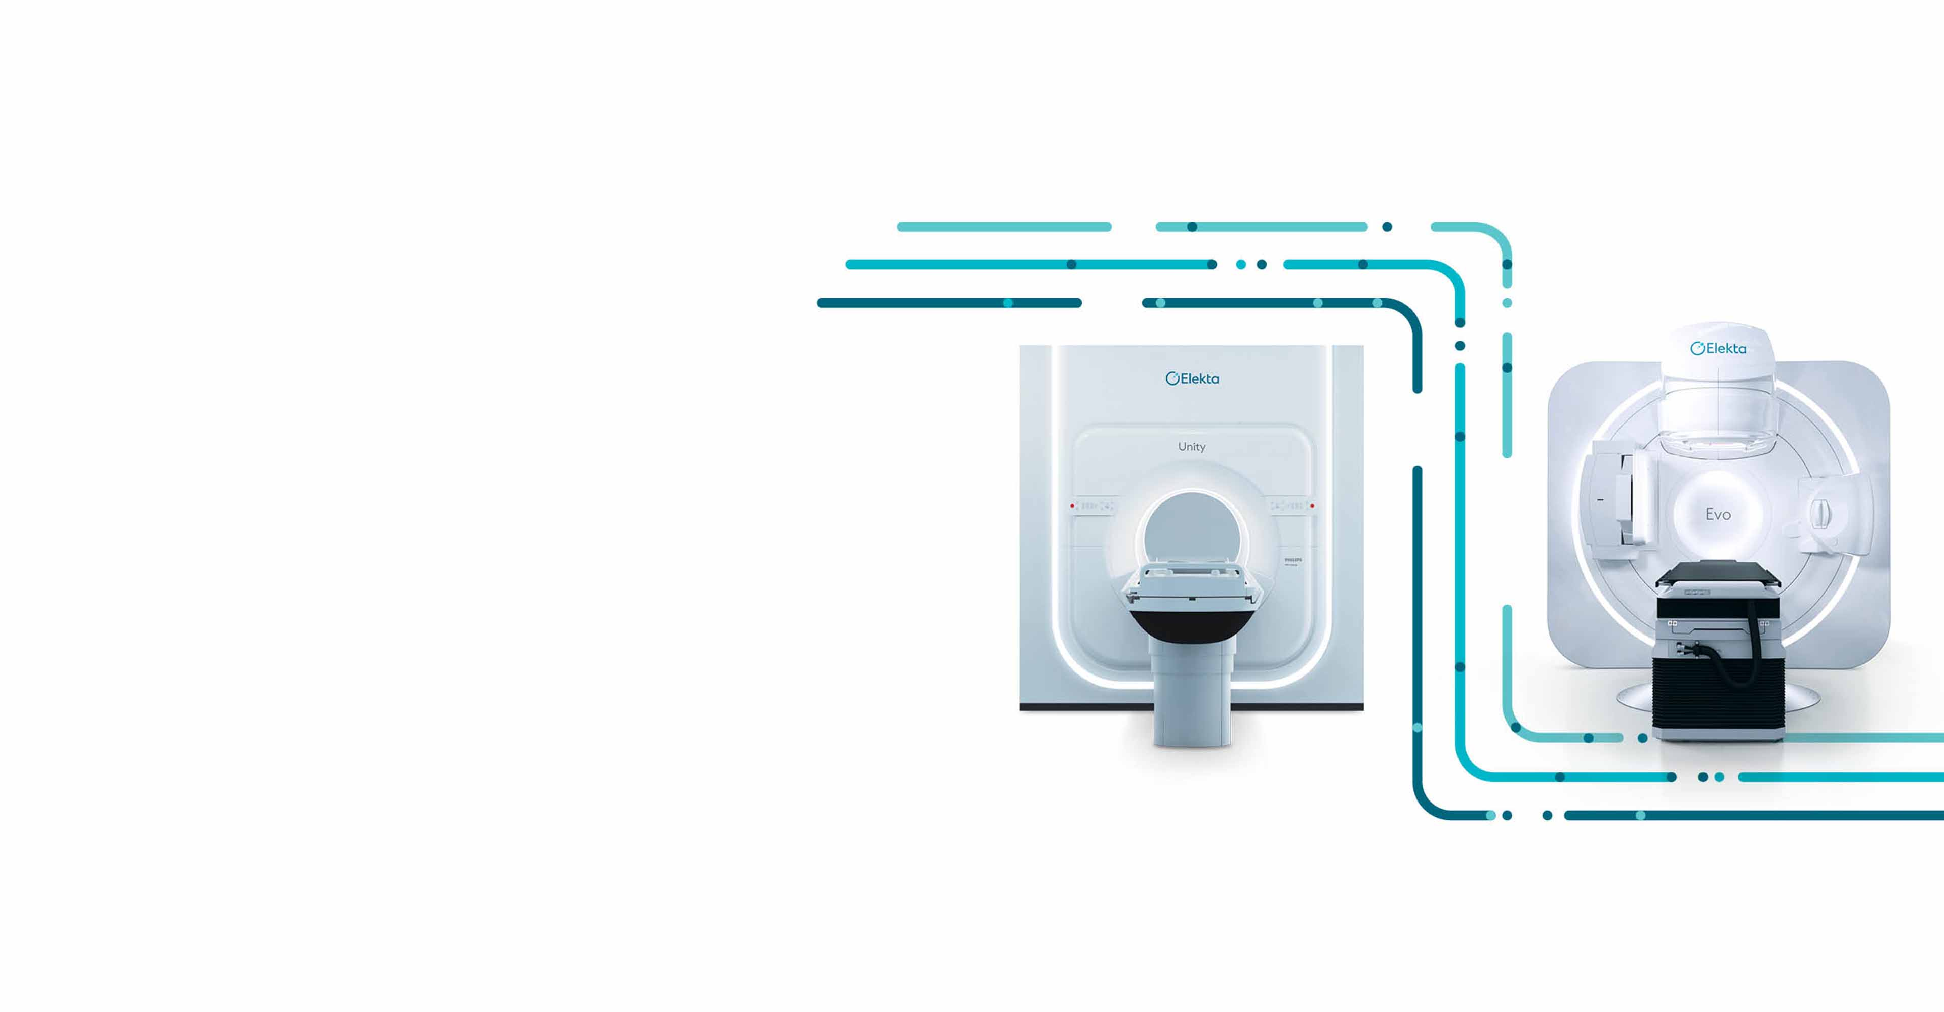

Comparison of tangential-intensity modulated radiotherapy (t-IMRT) and volumetric modulated arc therapy (VMAT) for different sizes of left-sided breast cancer
Presenter: Abuobaida Ahmed (56095155@mynwu.ac.za)
Supervisor: Prof Manny Mathuthu
Co-supervisor: Dr LN Ntombela
18 MAY 2026
ANSTT 6 - iThemba LABS

Slide 2

INTRODUCTION
Breast cancer is the most common cancer among women. Every year, approximately 1.2 million women are newly diagnosed with breast cancer, and 500,000 women die from it (Zhao et al., 2015).
Radiotherapy is a cornerstone of its management (Zhang et al., 2024).
Generating treatment plans faces challenges in both achieving good radiation dose conformity to the target volume and minimising radiation doses to the organs at risk (OARs). (Inoue et al., 2020)
Modern treatment planning techniques aim to achieve optimal tumour control while minimising exposure to critical organs (Lamprecht et al., 2022).
Despite technological advancements, selecting the most effective planning technique remains challenging, particularly in patients with varying breast sizes (Moussawi et al., 2025).
1

Slide 3
CONT…
This study aims to compare the effectiveness of t-IMRT and VMAT for hypo-fractionated small, medium, and large sizes breast cancer treatment.
Objectives:
Evaluate the dose distribution.
Estimate the OARs sparing level.
Determine Homogeneity and Conformity Index.
Recommend the more effective technique between t-IMRT and VMAT.
2

Slide 4
METHODOLOGY
CT of 30 female patients with left-sided breast cancer between 2020 and 2025 at SBAH were used.
Breast sizes: small breasts ≤ 589.77 cc, medium breasts between 590 and 900 cc, and large breasts ≥ 900 cc.
T-IMRT and VMAT plans were generated using the Monaco treatment planning system with a Monte Carlo algorithm.
A prescription dose of 26 Gy in five fractions was delivered.
Target Coverage (D_{95%}Gy ≥ 95%), Homogeneity index, and Conformity index.
OARs parameters, Heart (V7Gy < 5% and V1.5Gy < 30%), and Ipsilateral lung (V8Gy < 15%).
Two-way ANOVA was used (P < 0.05).
3

Slide 5
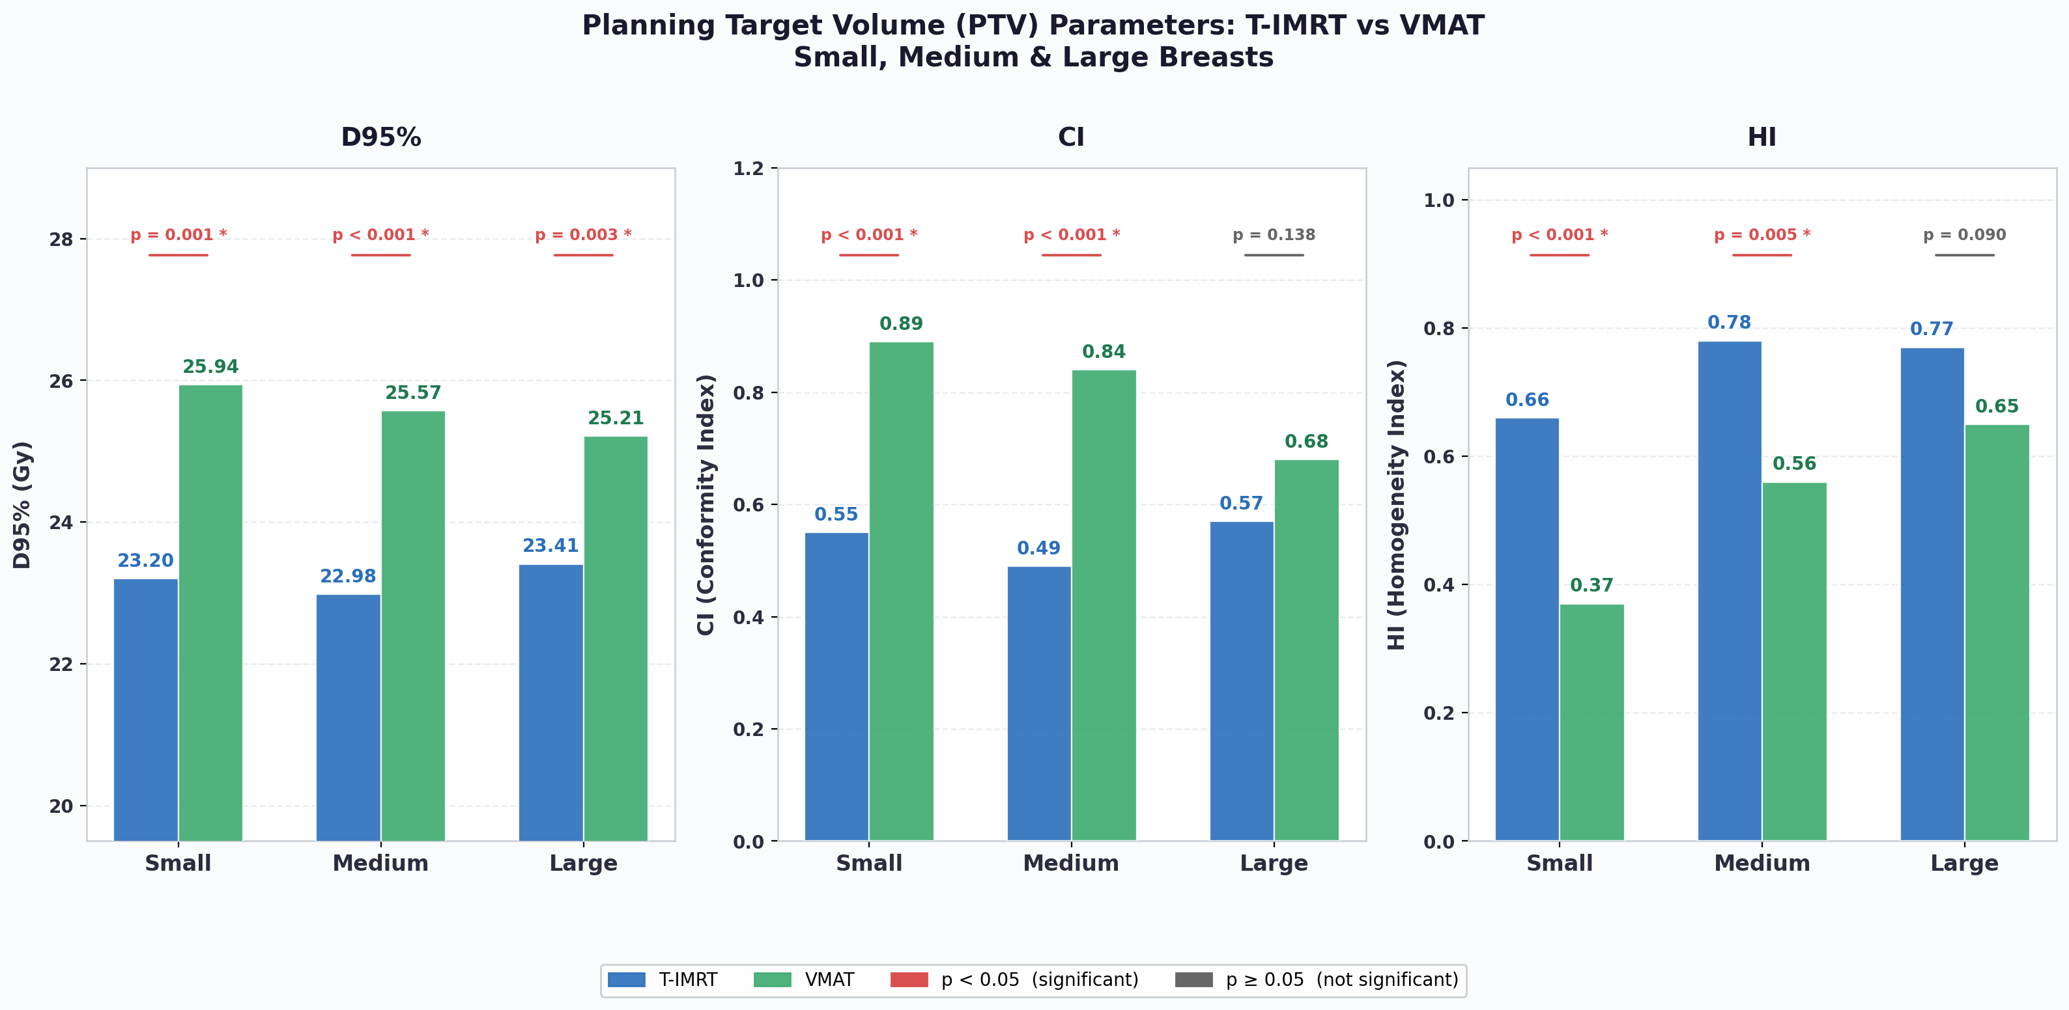
RESULTS & DISCUSSION
Target Coverage
4

Slide 6
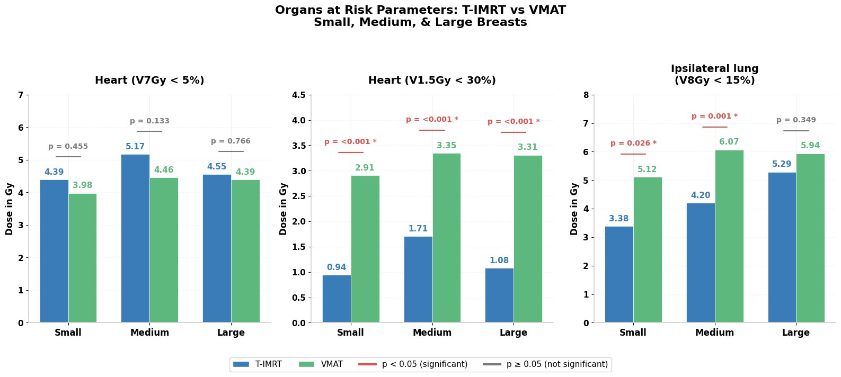
CONT…
5

Slide 7
CONCLUSION & RECOMMENDATION
VMAT is preferable when the target coverage is the highest priority.
Tangential-IMRT is superior when minimising heart and lung toxicity is the priority, especially for patients with pre-existing cardiovascular risks.
RECOMMENDATION
If VMAT is chosen for its superior coverage, it is highly recommended to be used in conjunction with DIBH to mitigate the higher cardiac doses.
6

Slide 8

THANK YOU FOR YOUR ATTENTION

