Slide 1

Categorization and characterization of uranium-bearing materials for nuclear forensic attribution using ICP-MS
Presenter: Khumoetsile Jonas (MSc candidate)
Supervisor : Dr TG Kupi
Co-supervisor: Dr OS Friday
Centre for Applied Radiation Science and Technology (CARST)
North-West University
South Africa
The 6th Advanced Nuclear Science and Technology Techniques (ANSTT6) workshop, 18 – 22 May 2026 at NRF-iThemba LABS, Cape Town

Slide 2
Content
1 BACKGROUND
2 METHODOLOGY
3 RESULTS
4 CONCLUSION
5 REFERENCES

Slide 3
Background
Illicit trafficking of radioactive material and especially nuclear material (thorium, uranium, and plutonium) has been an issue of concern since the beginning of the 1990s, when the ﬁrst seizures of nuclear material were reported to the International Atomic Energy Agency (IAEA) (Wallenius et al., 2006).
Nuclear material are used daily in research, medicine, electricity production and in military.
The improper handling, storage or transport of nuclear or radioactive materials can lead to considerable long lasting hazard as well as possible diversion and proliferation (Moody et al., 2014)
The majority of incidents reported to the IAEA over the years have been due to theft and poor management.

Slide 4
Background cont…
The main security concerns relating to nuclear and radioactive material use are the potential for theft and construction of radiological dispersive devices (RDDs) (Hutcheon, Kristo et al. 2013).
In South Africa, there are a few cases of illicit trafficking, illegal possession and theft or illegal smuggling of nuclear material (Mogafe et al., 2015).
For this reason, these incidents highlight the need for effective nuclear forensic methods to support the identification and attribution of illicit nuclear materials.
This study aims to apply nuclear forensic techniques to investigate Rare-Earth Elements (REEs) in uranium-bearing materials as forensic signatures.
In the context of this work, nuclear forensics would refer to the process of identifying signature (REE pattern) in the uranium ore and triuranium octoxide (U₃O₈) samples.

Slide 5
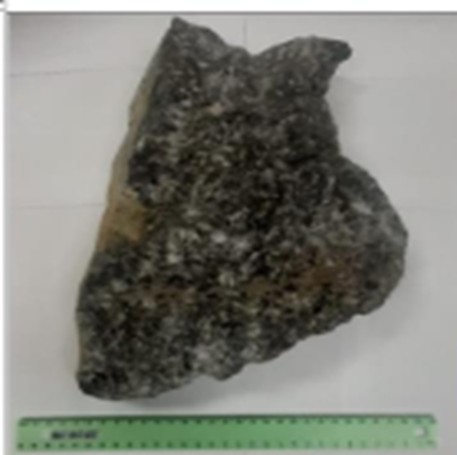
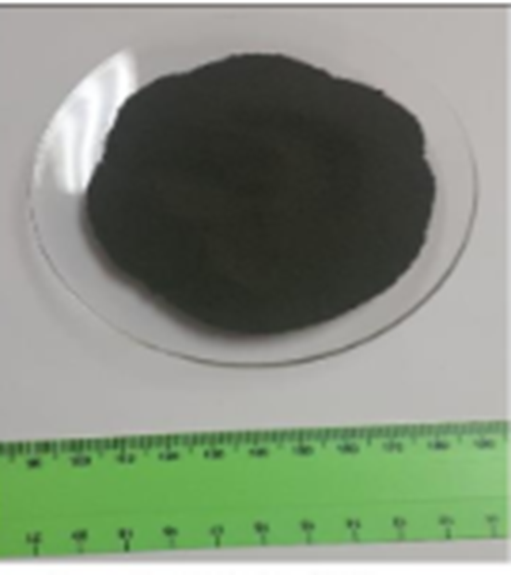
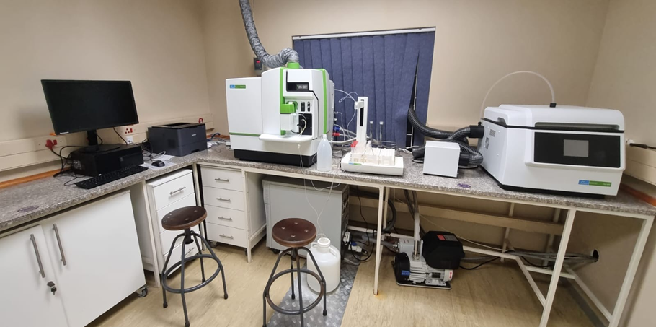
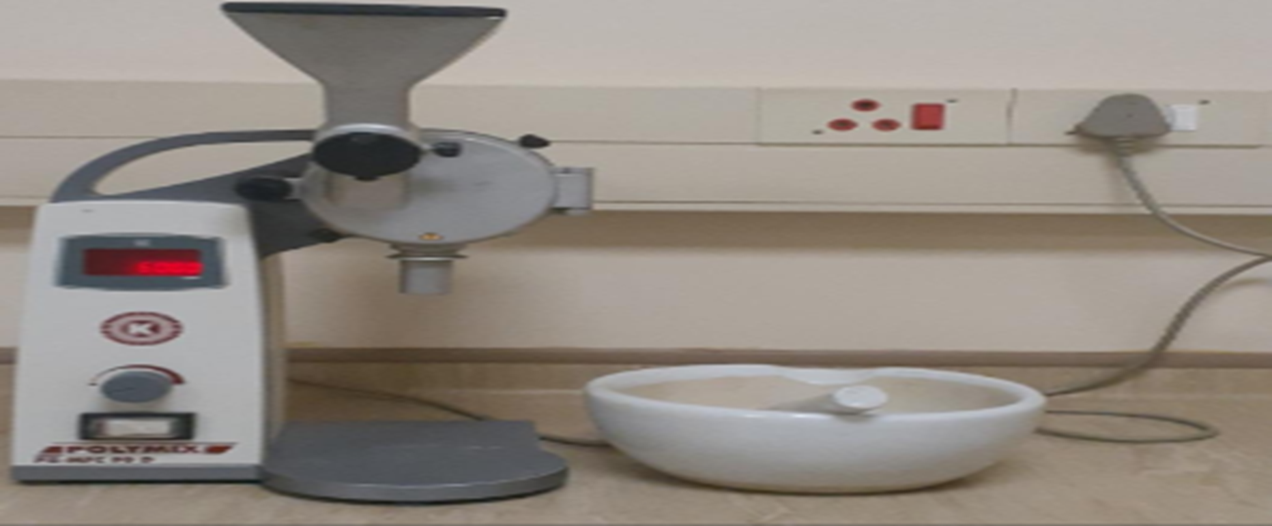
Methodology (categorization and characterization )
Samples Analytical Technique
NexIon 2000 ICP-MS
Study Area
South African uranium mine
(Witwatersrand Basin)
Crushing and milling instrument
Triuranium octoxide (U₃O₈)
Uranium ore
Sample | Uranium ore | U₃O₈
Type | Rock | Powder
Form | Ore | U3O8
Mass | 24.59 kg | 1 kg
Expanded uncertainty | 0.0003 | 0.0002
Colour code | RAL9007 | RAL9005

Slide 6

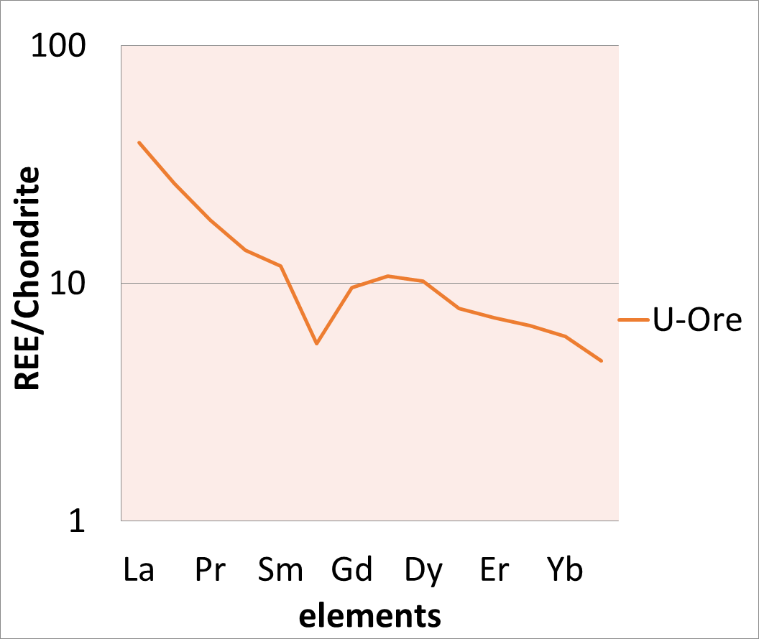
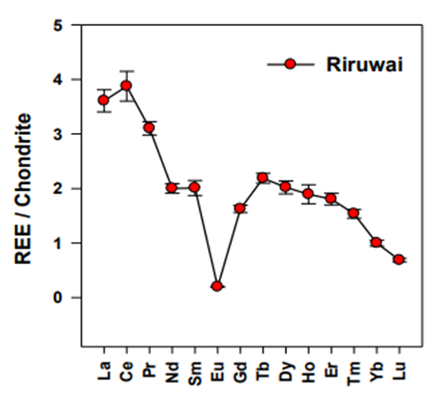
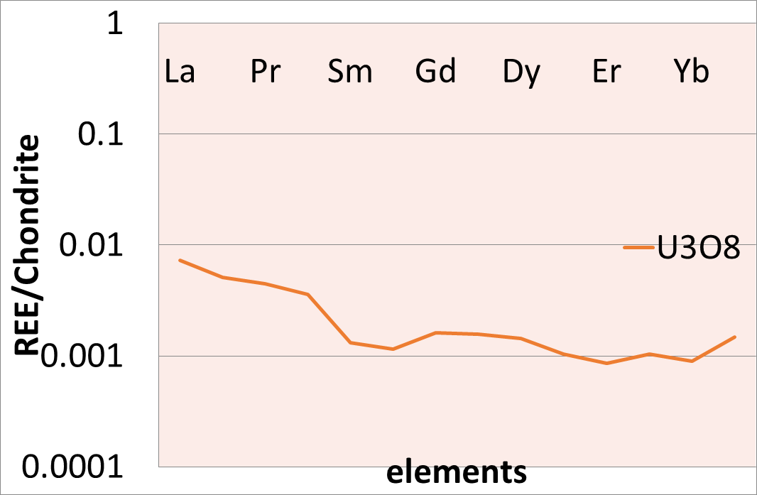
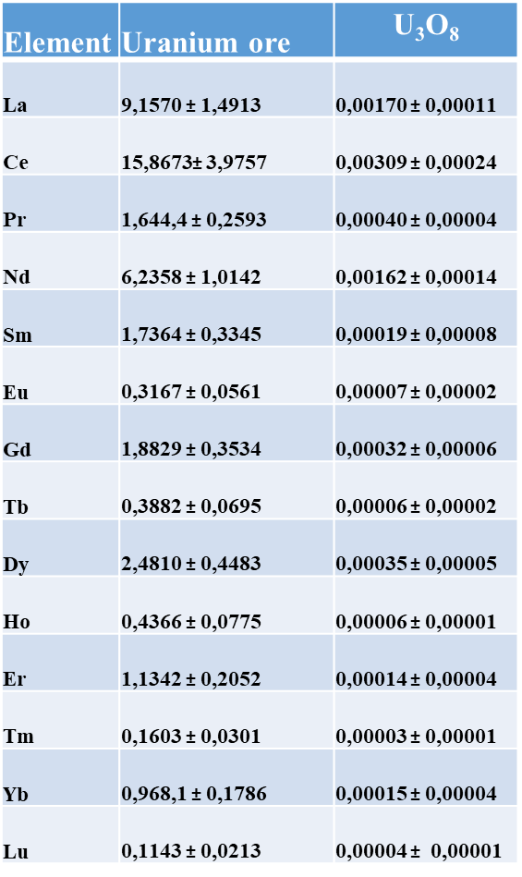
Results
Element | Uranium ore | $$\text{U}\text{3}\text{O}\text{8}$$
La | 9,1570 ± 1,4913 | 0,00170 ± 0,00011
Ce | 15,8673± 3,9757 | 0,00309 ± 0,00024
Pr | 1,644,4 ± 0,2593 | 0,00040 ± 0,00004
Nd | 6,2358 ± 1,0142 | 0,00162 ± 0,00014
Sm | 1,7364 ± 0,3345 | 0,00019 ± 0,00008
Eu | 0,3167 ± 0,0561 | 0,00007 ± 0,00002
Gd | 1,8829 ± 0,3534 | 0,00032 ± 0,00006
Tb | 0,3882 ± 0,0695 | 0,00006 ± 0,00002
Dy | 2,4810 ± 0,4483 | 0,00035 ± 0,00005
Ho | 0,4366 ± 0,0775 | 0,00006 ± 0,00001
Er | 1,1342 ± 0,2052 | 0,00014 ± 0,00004
Tm | 0,1603 ± 0,0301 | 0,00003 ± 0,00001
Yb | 0,968,1 ± 0,1786 | 0,00015 ± 0,00004
Lu | 0,1143 ± 0,0213 | 0,00004 ± 0,00001
REE pattern normalised to chondrite for South African uranium ore sample.
REE pattern normalised to chondrite for uranium ore sample from Riruwai, Nigeria (John et al., 2021)
REE pattern normalised to chondrite for South African U₃O₈ sample.

Slide 7
Conclusion
Uranium ore and U₃O₈ samples, their chondrite normalized REE pattern revealed a unique nuclear forensic signature for the South Africa’s nuclear material.
These results confirmed that, the REE patterns used for the origin location did reflect significant variation within the mine and thus provided valuable information about the geochemical formation and origin.
The composition of the REEs in this work can be applied to nuclear forensic investigations as a viable signature.

Slide 8
References
Wallenius, M., et al. (2006). Forensic Sci. Int. 156: 55.
Karpas, Z. (2014). Analytical chemistry of uranium: environmental, forensic, nuclear, and toxicological applications, CRC press.
Keegan, E., et al. (2008). Appl. Geochem. 23: 765.
Khumalo, N. (2017). Application of ICP-MS ahd Isotopic Techniques in Resolving Nuclear Forensic Signatures in Uranium Mining and Processing, North-West University (South-Africa).
Ntsohi, L. (2019). Characterization of uranium mined ore for nuclear forensic applications, University of the Witwatersrand, Johannesburg (South Africa).
Seemela, K. and T. Kupi (2023). "Determination of REE in uranium bearing-material for nuclear forensics purposes using ICP-MS."
Kamunda, C., et al. (2016). "An assessment of radiological hazards from gold mine tailings in the province of Gauteng in South Africa." International Journal of environmental research and public health 13(1): 138.

Slide 9
THANK YOU
North-West University
Private Bag X 2046, Mmabatho, 2735
North West Province
South Africa
www.nwu.ac.za

