Slide 1

SEKU
Advanced Nuclear Science and Technology Techniques Workshop (ANSTT 6)
Monte Carlo-Based Assessment of Occupational Radiation Protection in a Diagnostic Radiology Facility at Kitui County Level V Hospital, Kenya
MUTHAMA MATSITSI
Supervisors
Dr. James. M. Linturi
South Eastern Kenya University
P.O Box 170-90200
Kitui.
Dr. Jeremiah M. Kebwaro
Karatina University
P.O BOX 1957-10101
Kerugoya
Dr. Felix O. Wanjala
International Atomic Energy Agency
P.O Box 100
Viena- Austria

Slide 2
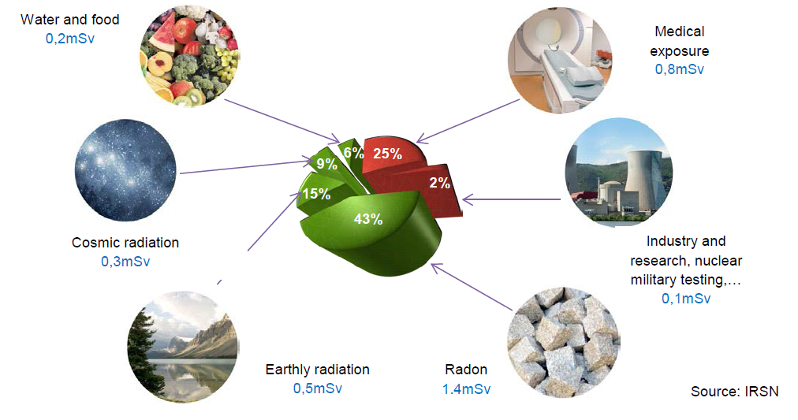
Background to the Study
Radiation - form of energy (emitted as particles or electromagnetic waves)
Sources- Natural and artificial
Variation based on several factors.
Indoor radiation; radiation within enclosed spaces (building) – constitute indoor exposure.

Slide 3
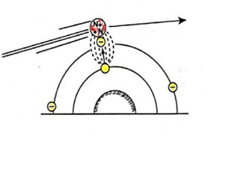
Excitation Process
Ionization Process
Electron from
K shell
Non-ionizing radiation: has energy below ionization threshold (~10 eV).
Causes excitation of atoms and molecules (e.g., water and biomolecules)
(Infrared, Visible & most Ultraviolet light)
Ionizing radiation: Energy >~10 eV per interaction.
Experimental data: DNA strand breaks occur in the eV–tens of eV range (Kenny, 2022).
MC simulation data: DNA damaging energy deposition in the eV range (Youssef, 2022).
examples [α(⁴₂He), β(e⁻) & X-ray & γ] – radiations

Slide 4
DNA Interactions with ionizing Radiation
Ionization event (formation of water radicals)
Effects of Radiation on DNA
Light damage - reparable
DNA strand breaks; SSBs and DSBs
Cell damage; repair, apoptosis
Mutations: Base changes, insertions, deletions
Chromosomal damage: translocations, deletions, inversions
Long-term effects Cancer & hereditary effects
Primary particle track
delta rays
e⁻
Water radicals attack the DNA
OH•
Clustered damage - irreparable
The mean diffusion distance of OH
radicals before they react is only 2-3 nm
Courtesy R. Schulte
Need to characterize radiation fields ; according to Linear No Threshold

Slide 5
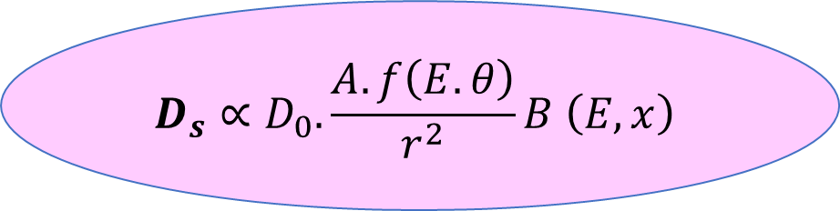
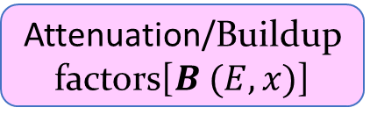
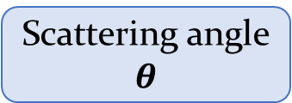
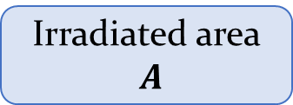
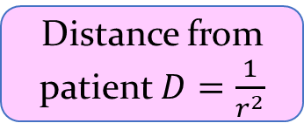
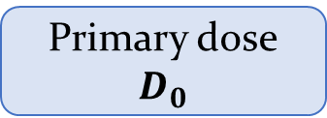
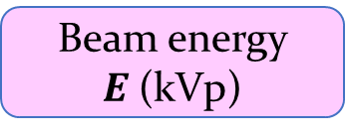
Scatter radiation in clinical environments is governed by a complex multi-parameter interaction
Distance from patient $D=\frac{1}{r^{2}}$
Scattering angle
$$θ$$
Irradiated area
$A$
$$D_{s}∝D_{0}.\frac{A.f\left(E.θ\right)}{r^{2}}B \left(E,x\right)$$
Primary dose
$$D_{0}$$
Attenuation/Buildup factors[$B (E,x)$]
Beam energy $E$(kVp)
The complexity of diagnostic scatter fields may limit analytical modelling; necessitating Monte Carlo techniques for accurate indoor dose assessment

Slide 6
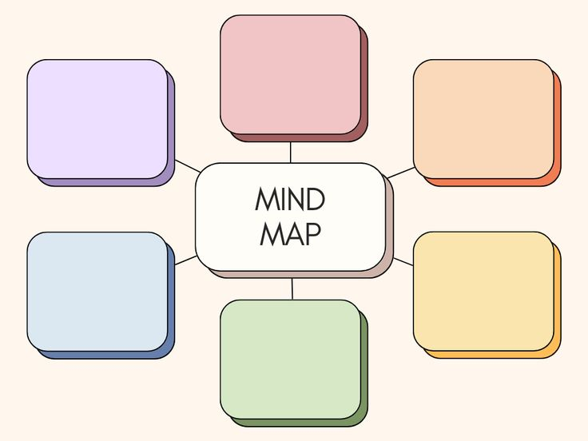
Integrated Experimental + Monte Carlo
Generalized data available in literature
Uncertainty in shielding/dose estimation
Research Gap
Dominance of patient scatter in radiography
Linear No Threshold (LNT) risk implication
Multivariate dependency of scatter dose

Slide 7
Objective of the Study
To develop and validate a Geant4 Monte Carlo-based model for assessing occupational radiation protection in a diagnostic radiology facility at KCRH
Evaluate the influence of
  Operator distance,
  Tube potential (kVp),
  Field size,
  Mobile lead shielding on occupational scatter dose distribution.
To propose practical radiation protection strategies consistent with ALARA principles.

Slide 8
Literature on occupational Exposure
Ambient Gamma Radiation
(UNSCEAR 2000);
Global average ≈ 0.41 mSv·y⁻¹
Bangladesh {0.021-0.622 mSv. y-1} 0.021-0.622 mSv.
Nigeria 0.011 mSv·y⁻¹; Rilwan et al. (2021);
Ambient Gamma Radiation
Malawian [0.39, 5.03, and 4 µSv h⁻¹] Chinangwa et al., 2017
Kenya (Mrima Hills; Chege et al. (2019)
Monte Carlo Studies
Vazquez-Bañuelos et al. (2023); Scatter dose persisted
Azinkhah et al. (2023) ; estimated scatter level
Monte Carlo Studies
Paulis et al. (2024) ; Scatter dose strongly depended on angle
Mahmoud et al., 2020; scatter dose decreases with optimized beam geometry and distance
Current studies don’t integrate experimental measurement and simulation (Monte Carlo)

Slide 9
MATERIALS AND METHODS
Purposive Sampling
Government Medical facilities
Private Medical facility
Level IV
Level V
The Kitui Jordan Level V Hospital
Ikanga
Zombe
Mwingi
Kitui County Referral
Targets rooms; Wards, offices, radiation rooms
At least 10 rooms were be sampled
A total of 70 occupational rooms were sampled
Study period was 3 consecutive months

Slide 10
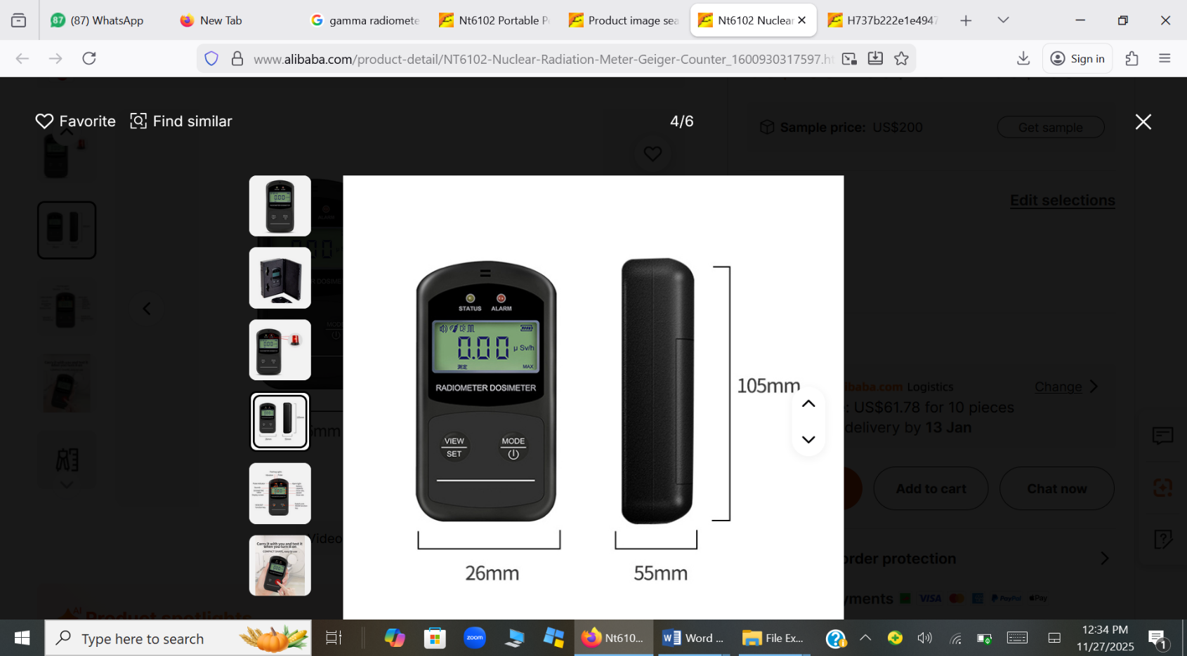
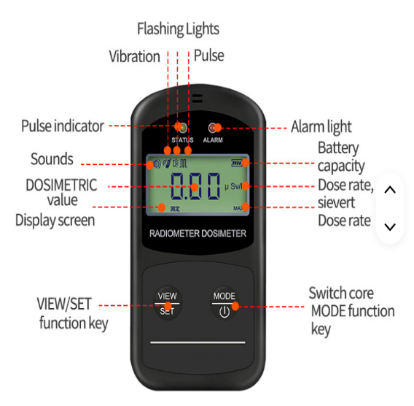
MATERIALS AND METHODS (CONT,.)
Model NT6102 Shanghai Minghe China
Model NT6102 Shanghai Minghe China
The NT6102 portable radiation dosimeter (Shanghai Minghe, China)
Provides real-time monitoring of X–γ radiation dose rates.
It incorporates battery-status indication and programmable alarm functions.
The instrument has an energy range of 40 keV to 3 MeV, with a dose-rate detection range of 0.01–10000 μSv·h⁻¹.
Measurements were acquired using a 30-minute sampling interval to improve statistical reliability.
Notes:
Usage: TLD cards are generally used for short-term measurements of radiation levels in specific areas. TLD badges are used for longer-term monitoring of individual radiation exposure, particularly in occupational settings.
Application: TLD cards are often used for area monitoring, where they are placed in specific locations to measure radiation levels in those areas. TLD badges are worn by individuals to monitor their personal radiation exposure over a defined period.
A TLD card is a small, flat dosimeter that contains one or more thermoluminescent crystals. These crystals are sensitive to ionizing radiation. When the TLD card is exposed to radiation, the energy from the radiation is trapped within the crystal lattice. During readout, the card is heated, and the trapped energy is released in the form of visible light (thermoluminescence). The intensity of the emitted light is proportional to the amount of radiation exposure.
TLD Badge: A TLD badge is a dosimeter that is worn like a badge or attached to clothing. It consists of a small container that holds one or more TLD chips (crystals). The badge is designed to be worn by individuals who are potentially exposed to radiation in occupational settings, such as nuclear power plants, medical facilities, and research labs. TLD badges are typically used to monitor the radiation exposure of workers over a specified period, often a month. At the end of the monitoring period, the badges are collected, and the TLD chips are read using specialized equipment. The accumulated radiation exposure is then calculated based on the measured thermoluminescence.

Slide 11
^{E}
^{F}
Main X-ray Room
2.7 m
Main rooms air
G
Main room
H
Key Components
A-Operators representation
B-Operators room door
C-Main rooms door
D-Shared window
E-Main Room’s Window E
F-Main Room’s Window F
G- X-ray tube support system
H-Collimation box
Linac System Gantry
Patients Coach
C
B
D
4.8 m
Operators representation
A
2.6 m
3.0 m
Operators room

Slide 12
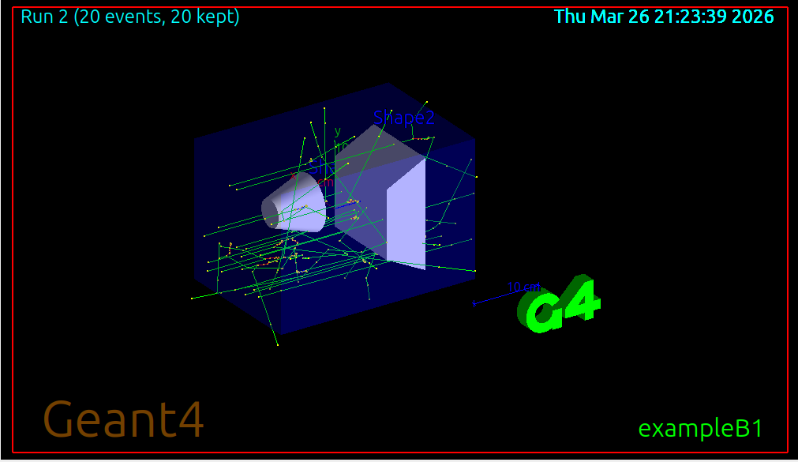
MATERIALS AND METHODS (CONT,.)
GEANT4 INSTALLATION
UBUNTU
TEST INSTALLATION
EXAMPLE B1
LIBRARIES
OUTPUT
GEANT4
SOURCING
Figure 4.1: Typical workflow of software hosting hierarchy for setting up Geant4 simulation environment.

Slide 13
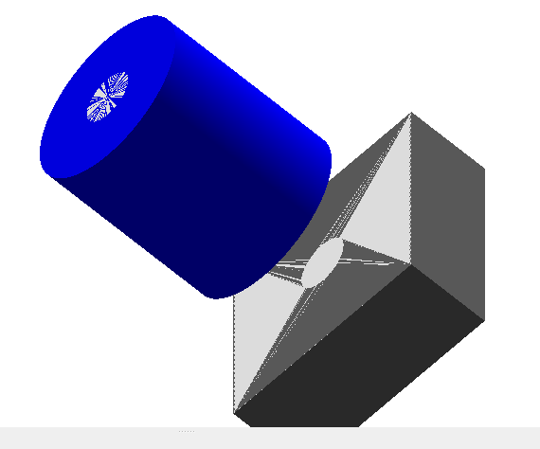
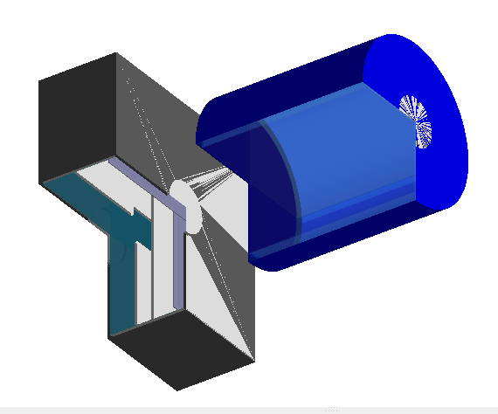
Project Structure
Tube head
Simulation Environment
Core Modules
Collimator box
Geometry | Physics | Source
Control & Transport
Dosimetry
Oil layer
Collimator jaws
Output & Analysis

Slide 14
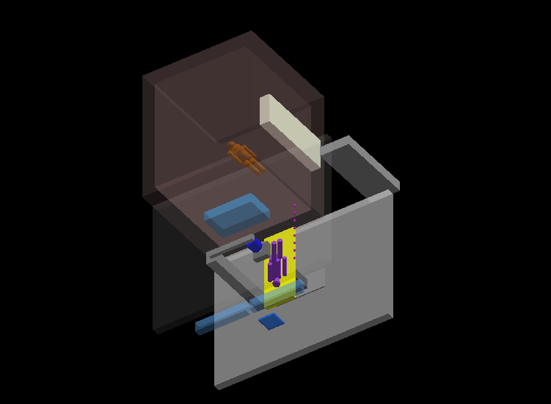
Proximus made from China
Operator’s door
Parameter | Description
Model | Manual Collimator
Equivalent Filtration | 1.5 mm Al @ 100 kVp
Input rating | 24V DC 6A
Serial Number | 134730HL1
Date of manufacture | February 2016
Max KV | 150 kVp
Examination room door
Operator’s phantom
Part | Dimension (m)
Main room | 4.8 x 3.6 x 2.7 m
Operator Room | 3.0 x 2.7x 2.5
Ceiling and floor | 0.20 m
Operator dimensions | 0.4 x 0.3 x 0.6 m
Doors | 0.8 x 2.1 m
Windows | 0.2 x 1.4 m
Wall thickness | 0.26 m
Patient Coach | 2.5 x 1.9 x 1. 6 m
Patient coach height | 0.7 m
Shared window | 1.3 x 0.78
Shared window height | 0.8
Lead glass window
Spherical dosimeters
X-ray system
Patient’s phantom
Main room’s window
Patient’s Table
Natural sources (NIST Library)
Chest Bucky
Tube voltage: 120 kVp ; Tube current: 5 mA; total of 5 × 10⁷ primary photons were simulated

Slide 15
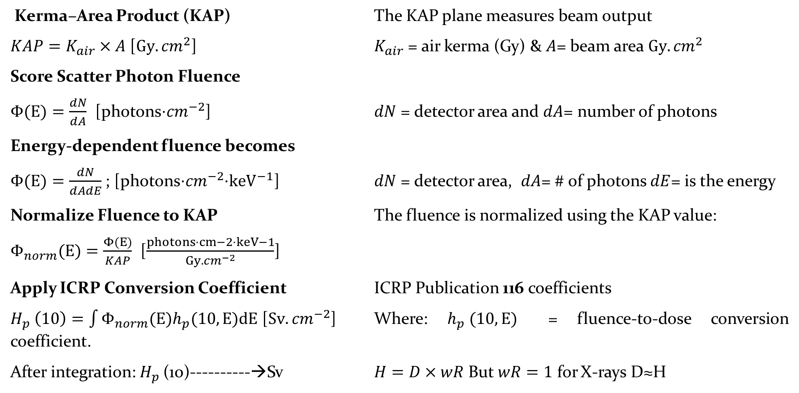
Kerma–Area Product (KAP) The KAP plane measures beam output
$KAP=K_{air}×A$ [${Gy.cm}^{2}$] $K_{air}$ = air kerma (Gy) & $A$= beam area ${Gy.cm}^{2}$
Score Scatter Photon Fluence
$Φ(E)=\frac{dN}{dA}$ [photons⋅${cm}^{−2}$] $dN$ = detector area and $dA$= number of photons
Energy-dependent fluence becomes
$Φ(E)=\frac{dN}{dAdE}$ ; [photons⋅${cm}^{−2}$⋅${keV}^{−1}$] $dN$ = detector area, $dA$= # of photons $dE$= is the energy
Normalize Fluence to KAP The fluence is normalized using the KAP value:
$Φ_{norm}(E)=\frac{Φ(E)}{KAP}$ [$\frac{photons⋅cm−2⋅keV−1}{{Gy.cm}^{−2}}$]
Apply ICRP Conversion Coefficient ICRP Publication 116 coefficients
$H_{p} \left(10\right)=\int{Φ_{norm}(E)h_{p}​(10,E)dE}$ [${Sv.cm}^{−2}$] Where: $h_{p} ​(10,E)$ = fluence-to-dose conversion coefficient.
After integration: $H_{p}$(10)----------→Sv $H=D×wR$ But $wR=1$ for X-rays D≈H

Slide 16
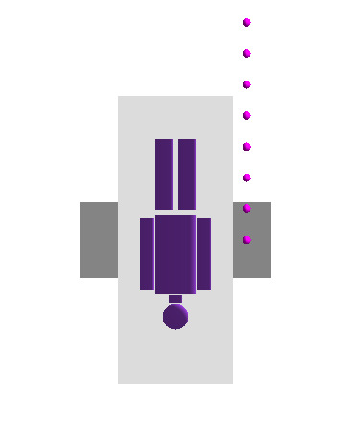
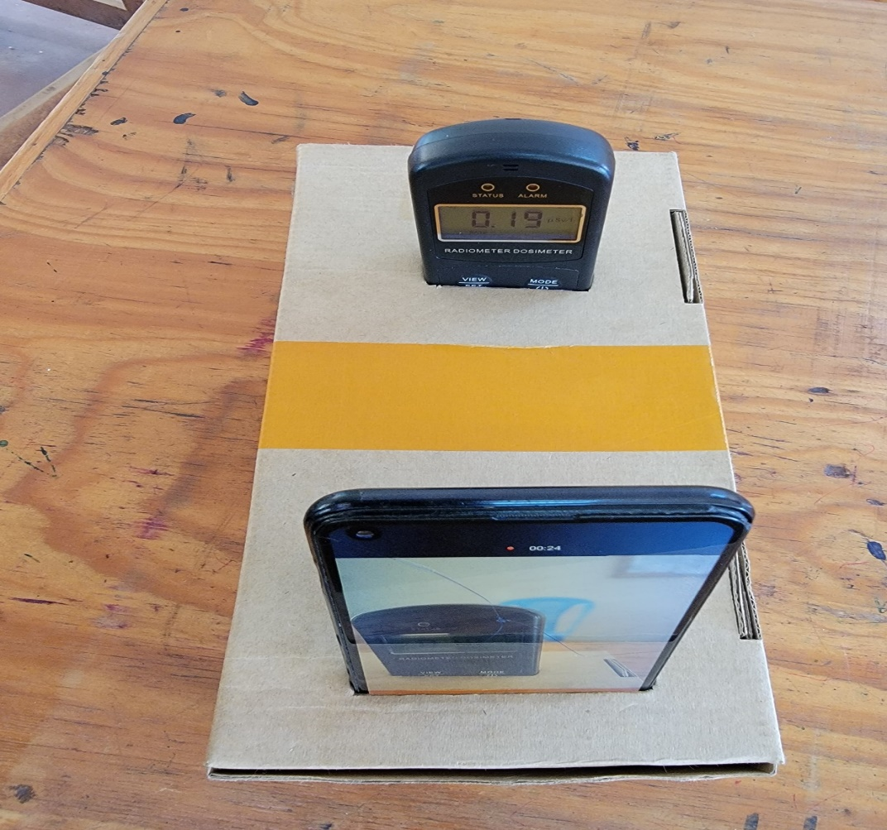
VALIDATION SET UP
Spherical Dosimeters
Gamma radiometer
Patient Phantom
Patient Table
Android Phone

Slide 17
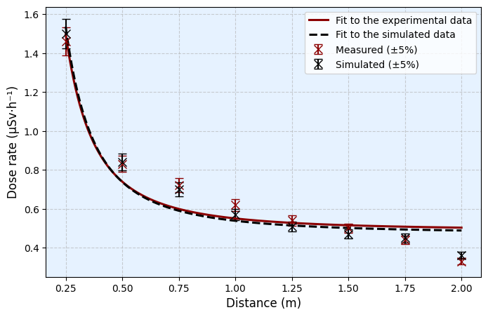
Model Validation
Experimental and simulated uncertainties were estimated at ±5%.
Most deviations between measured and simulated dose rates were below 5%, with all points remaining within the accepted ≤10% validation range.
The agreement is consistent with published Monte Carlo validation studies in diagnostic X-ray scatter dosimetry (e.g., Jarry et al., 2022; Alnewaini et al., 2017).
Experimental and simulated Hp(10) dose-rate variation along the operator axis at 120 kVp and 4 mAs.

Slide 18
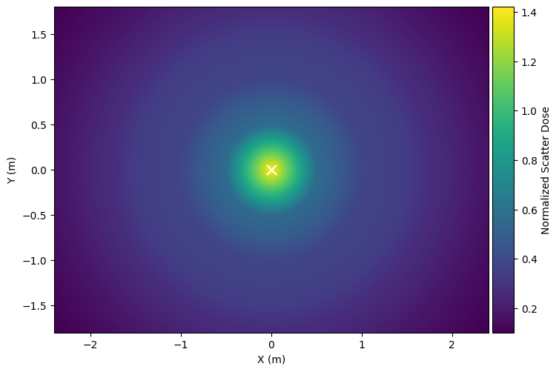
Warmer colors indicate higher scatter dose regions, with peak intensities.
No distinct zones, but near the patient position
Progressively lower intensities at increasing distances, suggesting safer operator zones
Two-dimensional color-coded map of normalized scatter dose distribution within the radiography room.

Slide 19
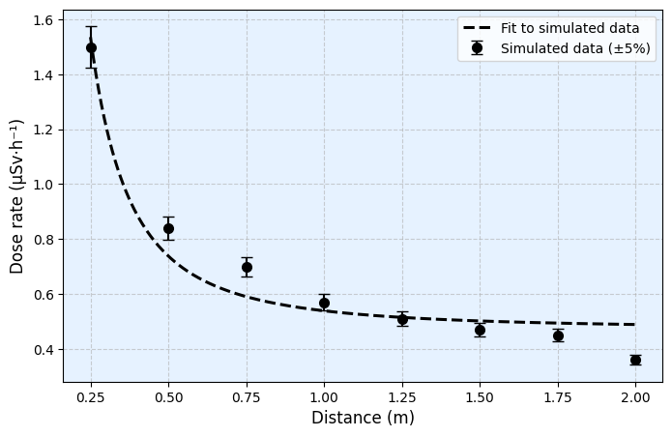
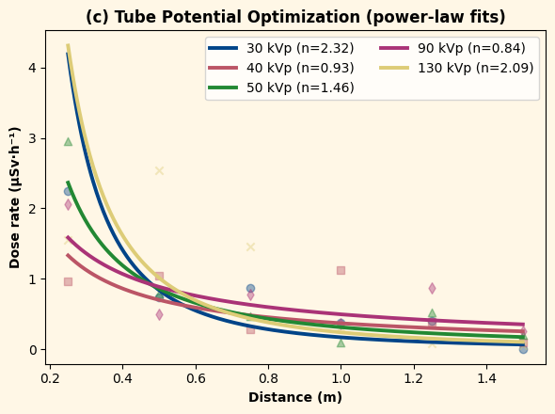
Operator-Source-Distance
Operational potential vs Scatter Dose
Low kVp (30–40 kVp) produced intense localized backscatter that attenuated rapidly with distance.
Intermediate kVp (50 kVp) produced maximum near-field scatter, likely due to enhanced Compton interactions.
High kVp (90–130 kVp) generated more penetrating forward scatter, maintaining dose at larger distances.
kVp controls scatter distribution, not just magnitude.
Scatter dose decreases by approximately 76% from (1.51 to 0.36) µSv·h⁻¹ between (0.25 to 2.00) m.
The steepest drop; the near-field between (0.25 - 0.75) m where the dose fall from (1.51 - 0.73 µSv·h⁻¹). > strong forward angle and minimal geometric dispersions
A transition region between (0.75–1.25) m shows a slower dose decrease from 0.73 to 0.57 µSv·h⁻¹ due to wider-angle and multiple-scatter contributions
A low-intensity tail (beyond 1.25 m) dose fall 0.54 - 0.36 µSv·h⁻¹ . Distance is a primary ALARA control

Slide 20
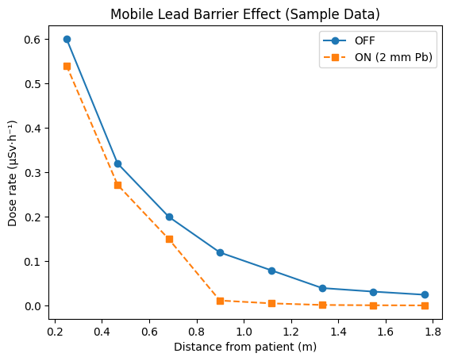
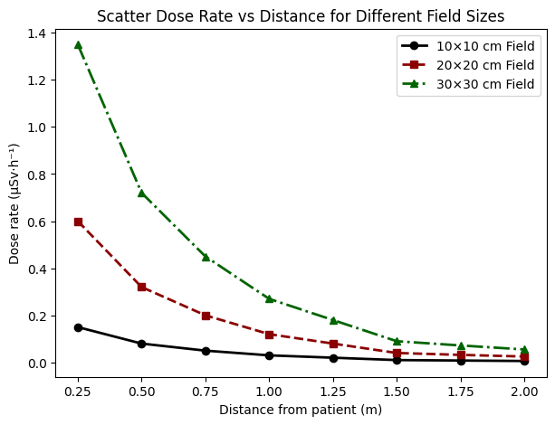
Mobile lead shield Vs Patient distance
Effects of Field size variation on scatter dose
Dose reduces from 0.60 → 0.54 µSv·h⁻¹ (10%) at 0.25 m, but reaches 90–96% reduction beyond 1.00 m (e.g., 0.12 → 0.012 µSv·h⁻¹ at 1.00 m).
Low near-field efficiency is due to high fluence and harder scatter, while distance softens the spectrum, improving attenuation.
Consistent with Rosiak et al. (2022) and Jeon et al. (2024). Shielding is highly effective when combined with distance.
Scatter increases with field size: 0.15, 0.60, 1.35 µSv·h⁻¹ (10×10, 20×20, 30×30 cm at 0.25 m) (~4× and 9× scaling with area).
This trend persists at all distances (e.g., 0.006 vs 0.055 µSv·h⁻¹ at 2.00 m), showing field size controls affects scatter Dose. Agrees with Ylimaula et al. (2023) and Tam et al. (2023).
Collimation is a high-impact source control.

Slide 21
CONCLUSION
Developed and validated Monte Carlo scatter dose model with 10% agreement.
Occupational scatter dose: Distance, kVp, Mobile shielding, and field size.
Geant4 simulation supports optimization of radiation protection.
RECOMMENDATION
Optimize distance and shielding to reduce occupational scatter dose.
Maintain strict beam collimation during radiographic procedures.
Apply Monte Carlo simulation for facility-specific radiation protection planning.

Slide 22
END OF PRESENTATION
THANK YOU

