Slide 1


Collimator-Free, Non-Collinear Cascade Gamma Rays Coincidence (CGC) Imaging: A GATE-Based Study Achieving Sub-Millimeter Resolution and High Sensitivity
1. Mr. Enock M. Mwita
2. Dr. Leonid L. Nkuba
3. Mr. Innocent Junior
Presenter
4. Prof. Najat K. Mohammed
5. Dr. Innocent J. Lugendo
enockmwita17@gmai.com

Slide 2
Introduction
Cascade gamma rays:
Have potential to solve limitations related to trade-off between sensitivity and spatial resolution in SPECT
Positron movement in PET
Approaches using Cascade Gamma Rays;
Collimated detector Approach e.g Collimated CGC
ToF Approach
Uncollimated detector Approach - Proposed in this study, was realized through GATE Monte Carlo simulation
ANSTT 6

Slide 3
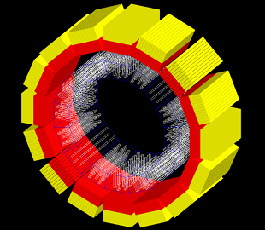
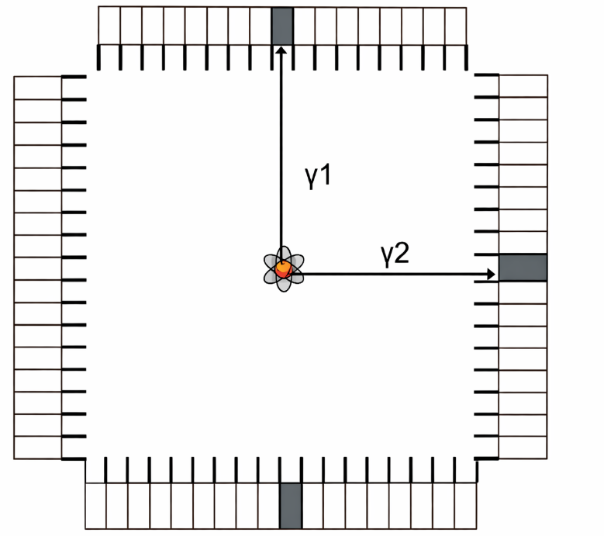
Recent CGC Configurations
(i) Collimated Configuration (Olshanoski et al. 2023)
Only photon hitting the detector 90 degrees is counted
Collimators;
  Absorb photons – ↓sensitivity
  Septal penetration – blur the image (false counts)
  Dictate the FWHM
To acquire more counts, high activity sources are needed (↑patient dose)
Detector
Cascade Photon
Emitter
Collimators
ANSTT 6

Slide 4
Recent CGC Configurations
(ii) ToF CGC Approach (Chiang et al. 2020)
No filtration (collimators)
Depend on TDOA of the two cascade photons detected in coincidence.
Improved;
Sensitivity and Coincidence Efficiency
Reduce statistical noise and enhance contrast
Limitation: Highly sensitive and fast-timing detectors e.g, LaBr3 (Expensive).
ANSTT 6
Notes:
relies on the estimated time-difference-of-arrival (TDOA) of the two cascade photons detected in coincidence

Slide 5

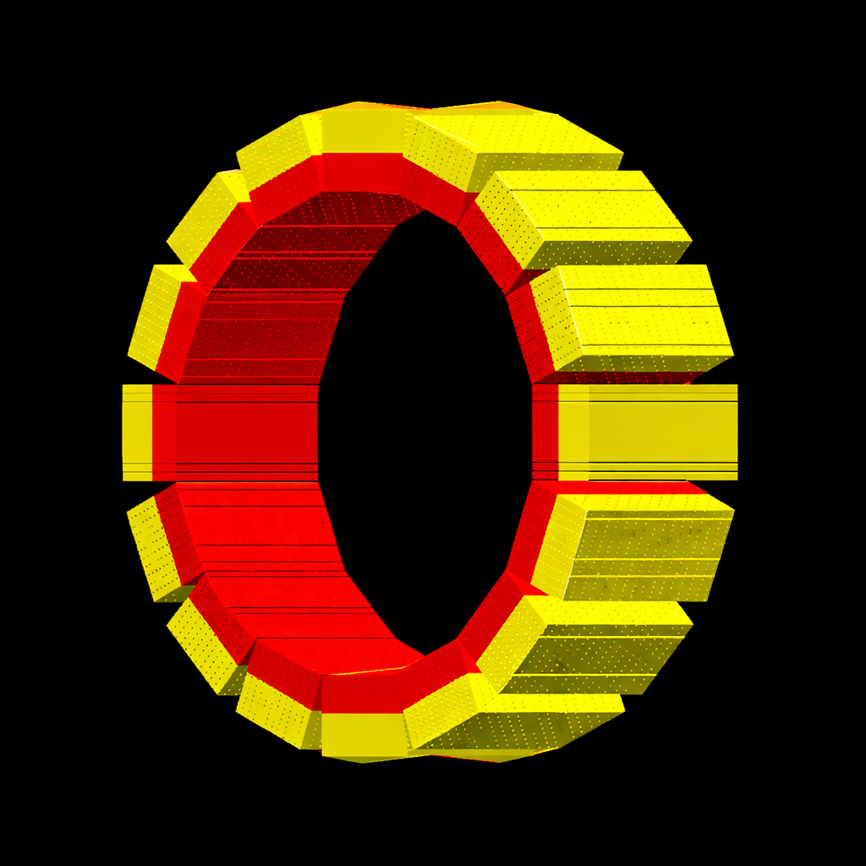
Proposed CGC Configurations
Uncollimated Configuration
No filtration (collimators)
Each event reaching the detector is recorded and used;
  Low patient dose
Improved;
Spatial resolution,
Sensitivity and Coincidence Efficiency
Common scintillator detector e.g, GSO, BGO can be used (Inexpensive).
5
ANSTT 6

Slide 6

Cascade Emitter (Source) Modelling
Criteria for Selection;
Optimal half-lives
Compatibility to human physiology
Short lifetime of excited states
Higher emission probability (except for ¹⁷⁷Lu: to be used for comparison-in later stages).
TCW (99%):
Nuclide | Energies (keV) and emission probabilities (%) | Intermediate state half-lives and TCW | Physical Half-life
⁴³K | 617.5 keV (79.2%) 372.8 keV (86.8%) | 0.046 ns 1 ns | 22.3 hrs
¹¹¹In | 171.3 keV (90.7%) 245.4 keV (94.1) | 84.5 ns 100 ns | 2.83 days
¹⁷⁷Lu | 208.4 keV (10.41%) 112.9 keV (6.23%) | 0.541 ns 4.0 ns | 6.64 days
⁷³Se | 361.2 keV (97%) 67.1 keV (70%) | 4.95 ns 33.0 ns | 7.1 hrs
6
ANSTT 6
Notes:
Detector timing resolution- About 0.549 ns (Matulewicz et al. 1996).
TCW that retain 99% of valid cascade events
¹⁷⁷Lu is chosen not for physics optimization, but because it is clinically indispensable. Testing it ensures your imaging system is relevant to actual patient therapies, making the study translational rather than purely theoretical.

Slide 7
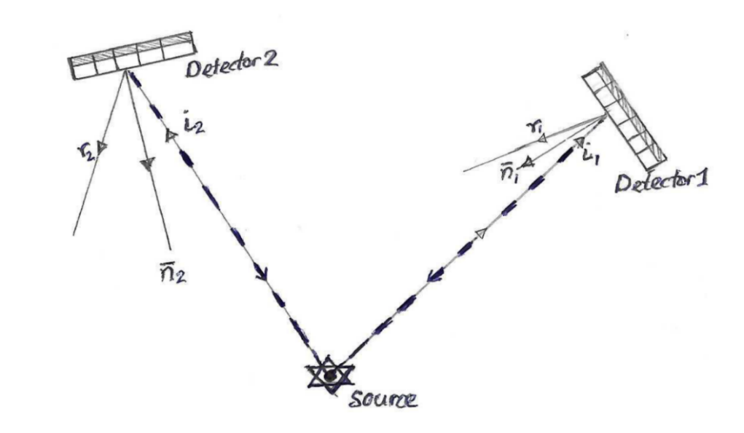
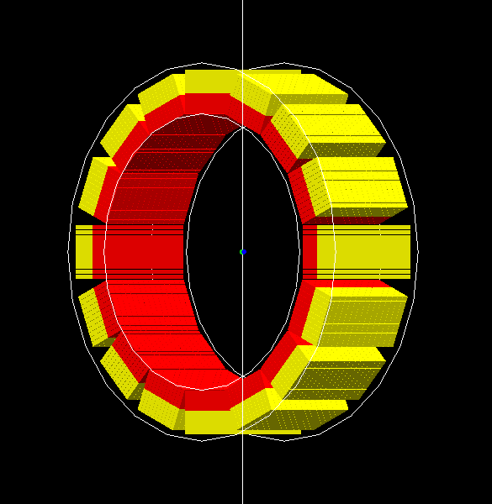

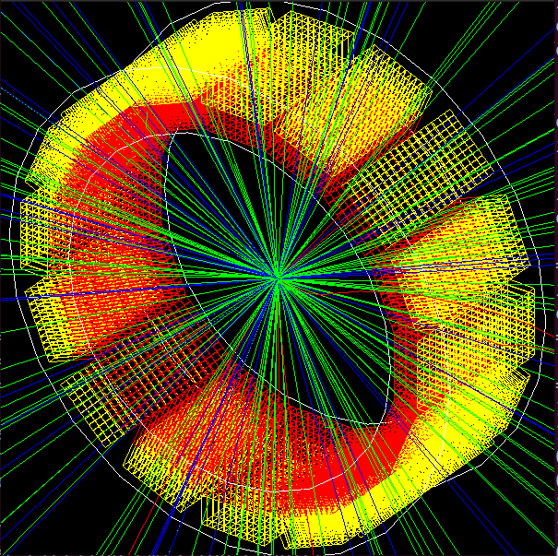
Geometry Design and Image Reconstruction Algorithm
Defining the detector geometry and model
Model physical process using various modules (Digitizer chain)
Identify paired gamma events within a specific TCW (coincidence sorter)
Trajectory Mapping and Back-Projection of Coincident Gamma rays
¹¹¹In, ⁴³K, ¹⁷⁷Lu, ⁷³Se
ANSTT 6
Notes:
Upper Layer
Cerium conc. [mol%]: 1.5
Decay time [ns]: 30
Dimensions [mm]: 1.6$×2.4×7.0$
Lower Layer
Cerium conc. [mol%]: 0.4
Decay time [ns]: 63
Dimensions [mm]: 1.6$×2.6×8.0$
Gadolinium Oxyorthosilicate (GSO)
Layers consist of scintillators doped with cerium (Ce) at different concentrations.
Each dual-layer block is organized into an 11 × 15 matrix, making 165 pixels per module.
Thin BaSO₄ reflector placed between each crystal to optimize light collection.
The thinner line shows the incident rays (i₁ and i₂), after hitting detector crystals, are then back projected through the lines and angle of incidences (dashed thicker line), and at the point of their intersection is the location of the decay.

Slide 8
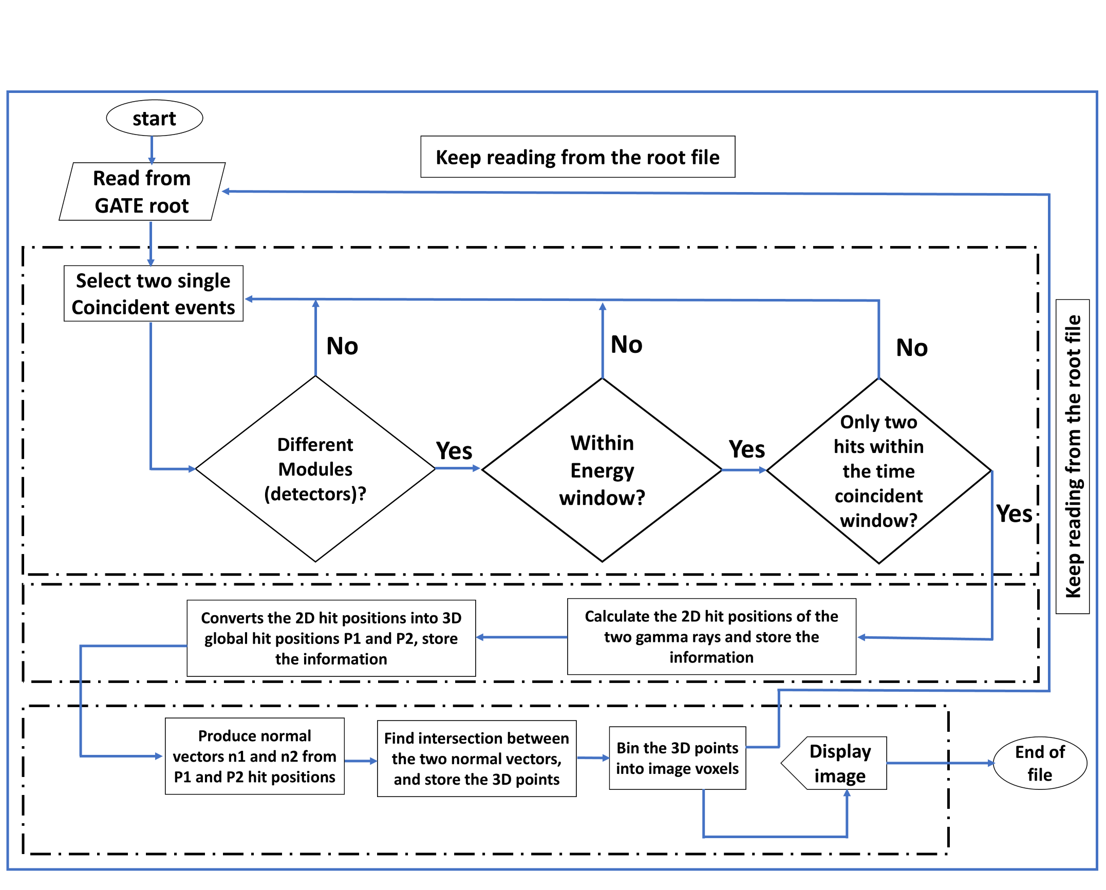

1
2
3
ANSTT 6

Slide 9

Image Reconstruction Algorithm
Incident and
Normal vectors
Reflected trajectory
Intersection/Midpoint
i = 1 or 2 (1 stand for the first and 2 for second gamma ray)
ANSTT 6

Slide 10
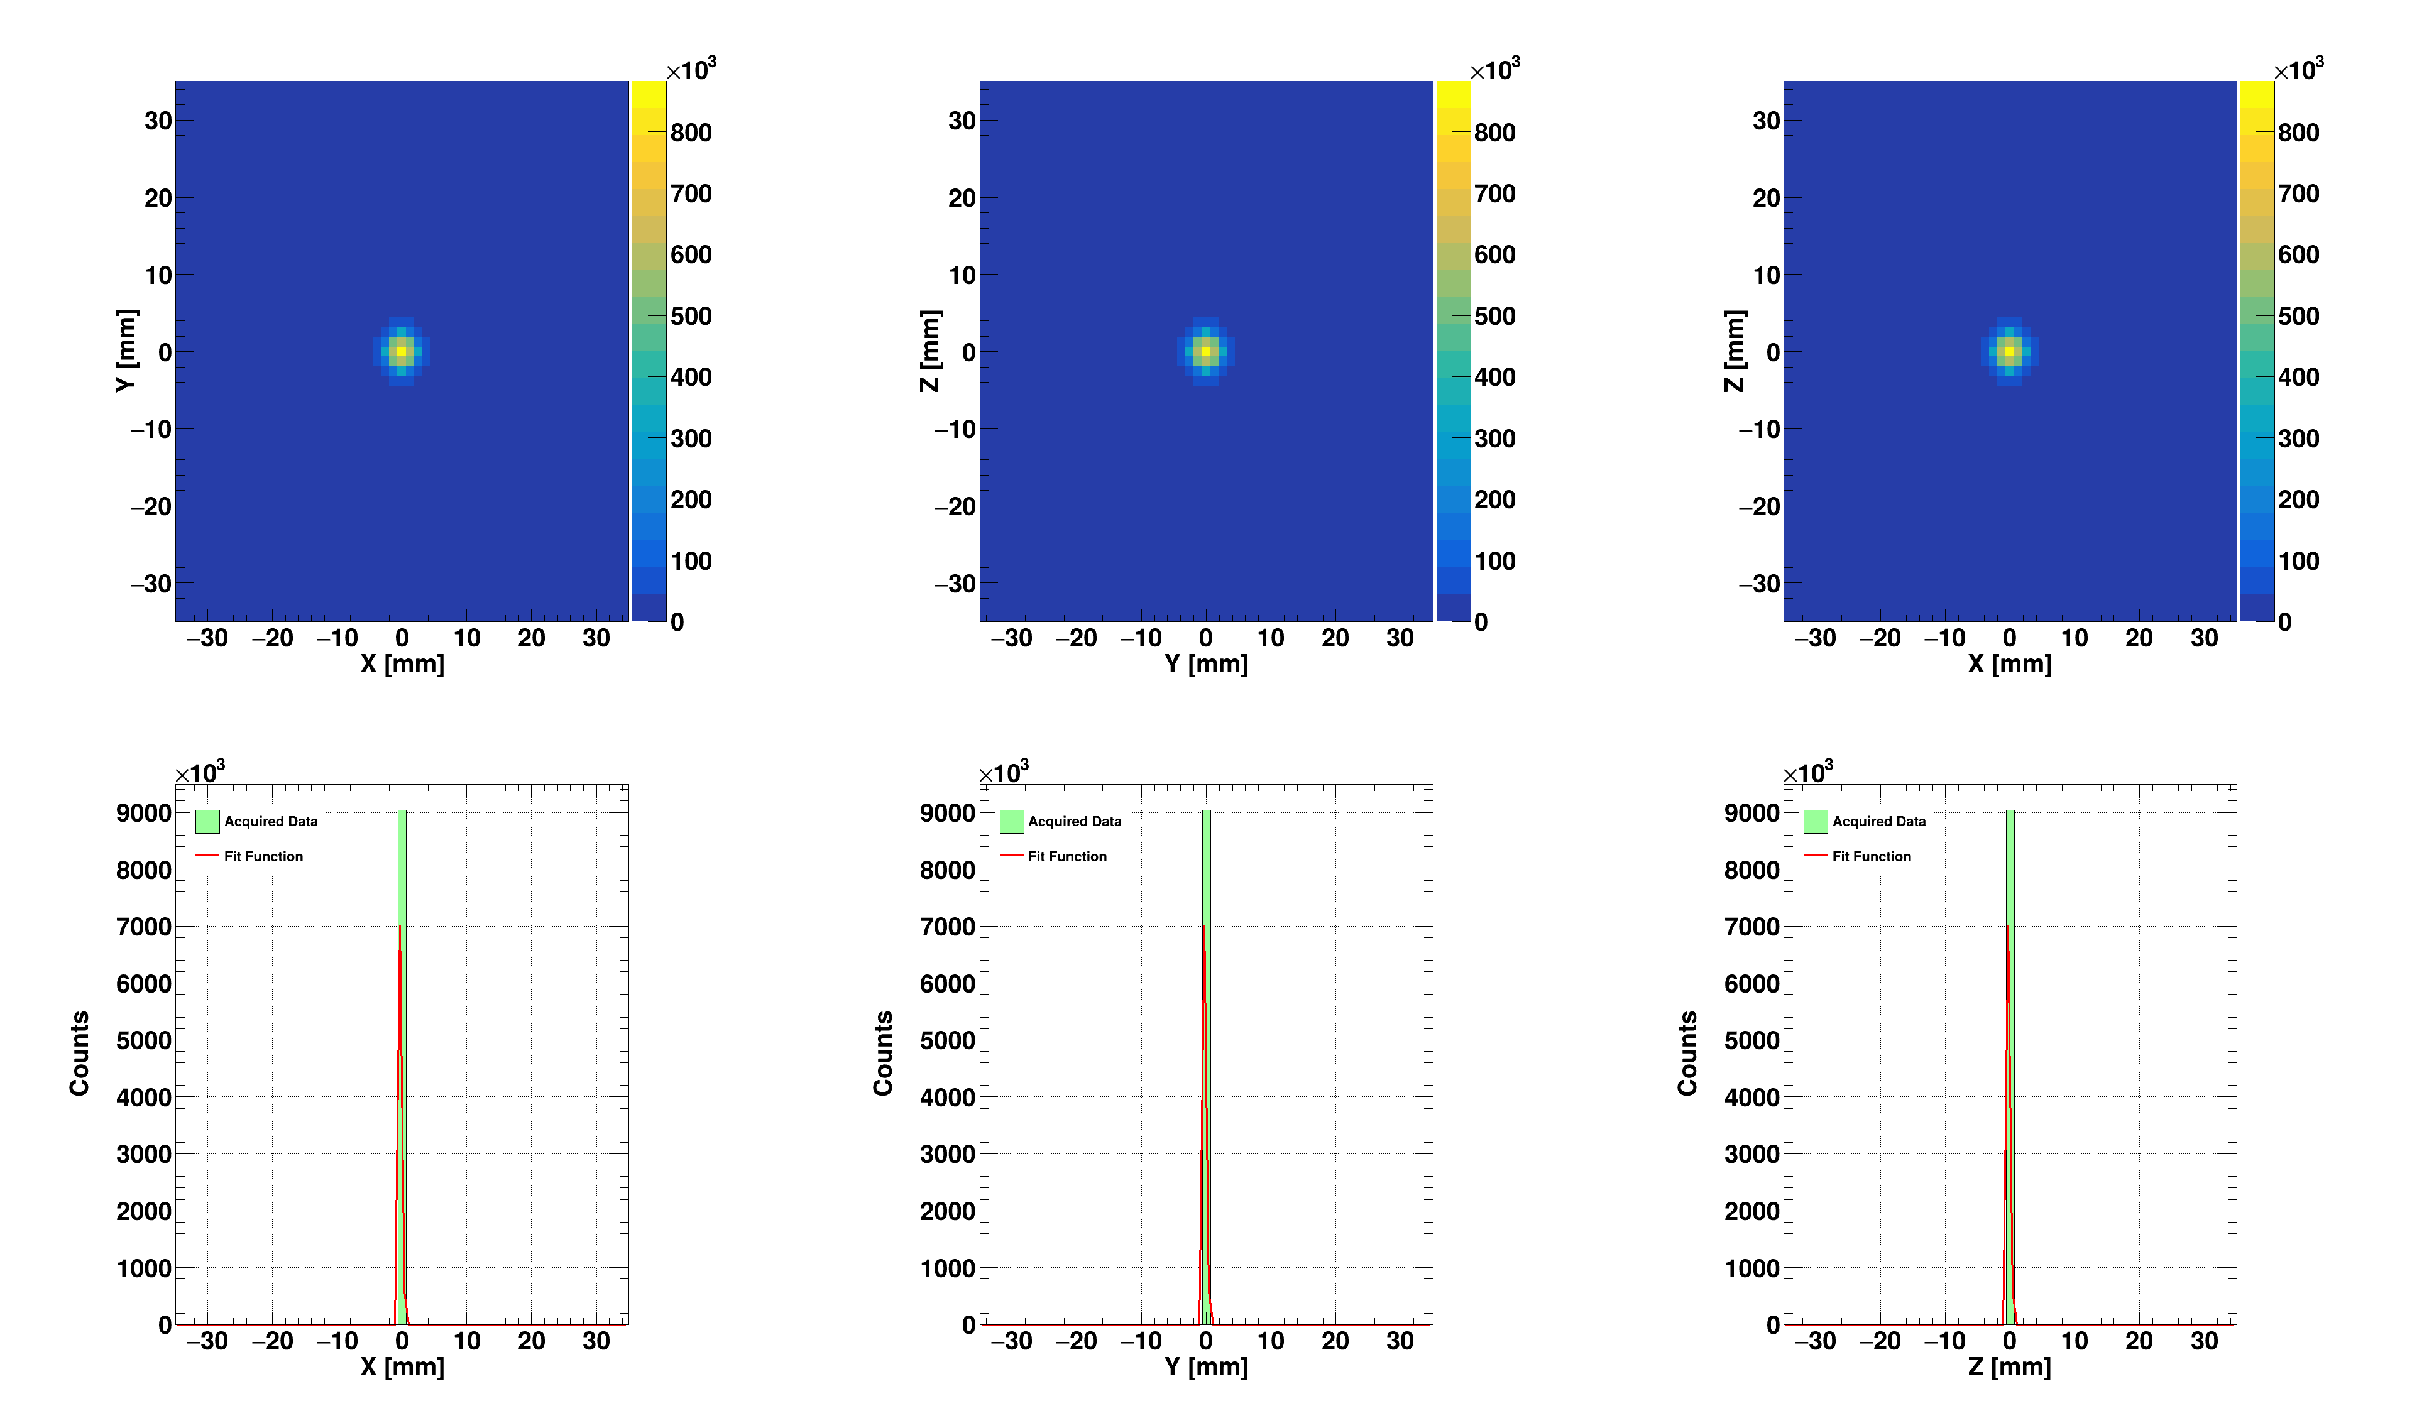
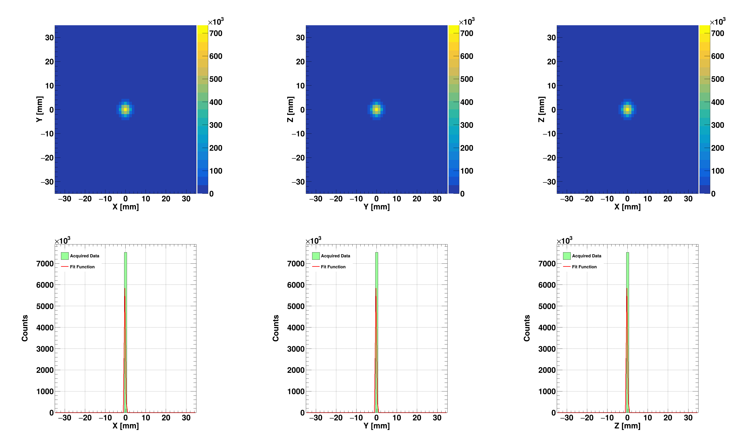
Position Reconstruction Efficiency
Simulation of ¹¹¹In
Source Activity: 1.0 MBq
DAQ time= 600 s
Energy window= 15%
Air at (0,0,0)
PMMA Phantom
Air
PMMA
Source localized with high precision, even in the absence of collimation and ToF detectors
Figure: 2D flattened image of a single ¹¹¹In point-source at (0,0,0) in Air and Phantom. (a) Transverse view, (b) Coronal view and (c) Sagittal view.
10
ANSTT 6
Notes:
AIR: x = −0.14545 ± 1.93×10⁻³, (b) y = −0.14545 ± 1.93×10⁻³ and (c) z = −0.14545 ± 1.93×10⁻³) mm
PMMA: x = −0.14545 ± 2.11×10⁻³ mm, (b) y = −0.14545 ± 2.11×10⁻³ mm and (c) z = −0.14545 ± 2.11×10⁻³ mm

Slide 11

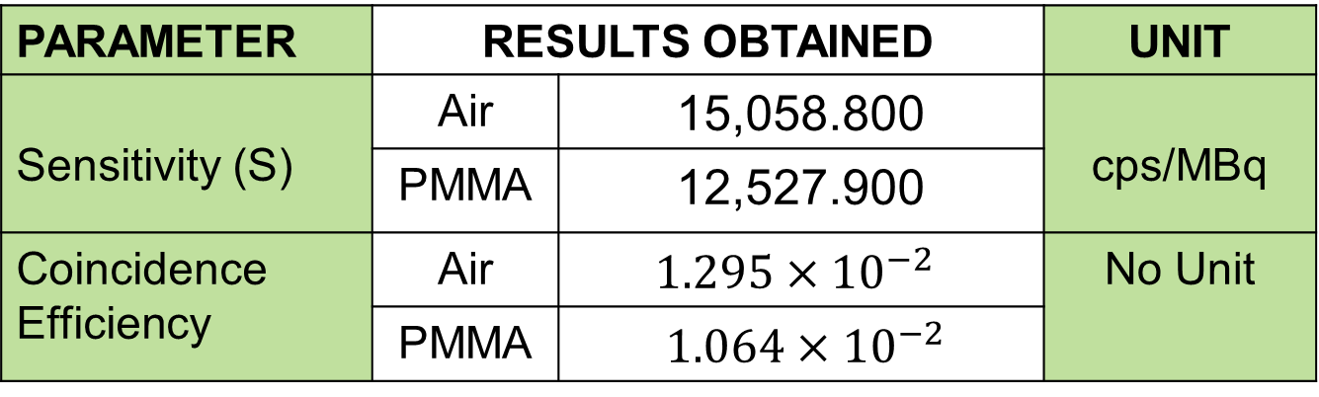
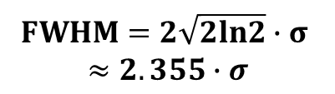

Performance Metrics from ¹¹¹In
PARAMETER | RESULTS OBTAINED |  | UNIT
Sensitivity (S) | Air | 15,058.800 | cps/MBq
 | PMMA | 12,527.900
Coincidence Efficiency | Air | $$1.295×{10}^{−2}$$ | No Unit
 | PMMA | $1.064×{10}^{−2}$
FORMULA
$$S=\frac{N_{det}}{A∙t}$$
$$ε_{coinc}=\frac{N_{coinc}}{N_{total}}$$
Spatial Resolution (FWHM)
Air | 0.477
PMMA | 0.477
mm
$$FWHM=2\sqrt{2ln2}∙σ$$
$$≈2.355∙σ$$
Sensitivity (reduced by factor of about 1.202),
Photon absorption within phantom material.
Spatial resolution – Consistent even under attenuation (phantom)
11
ANSTT 6
Notes:
Importantly, the efficiency remained high, indicating that the system maintains strong detection capability even in realistic tissue‑equivalent conditions.

Slide 12
Positional Reconstruction Assessment
Z: (0,0,0) to (17,0,0): (4 mm), good up to 17 mm
X: (0,0,0) to (25,0,0): (10 mm) ≠Beyond 16 mm
Z±17 mm (This study) vs ±12.0 mm
(Nkuba et al. 2025)
X±16 mm (This study) vs ±5.0 mm
ANSTT 6
Notes:
FoV: 27,330.56 mm³ Vs 1,884 mm³
4.8187 mm - Attributed to detector crystal alignment and edge effects, rather than systematic reconstruction errors
V=Area*Length(h)
A= pie(r²)
V=pie((axial)²h), h=17*2=34 mm
V=pie(16^{2*}34)
V=27330.56 mm³

Slide 13
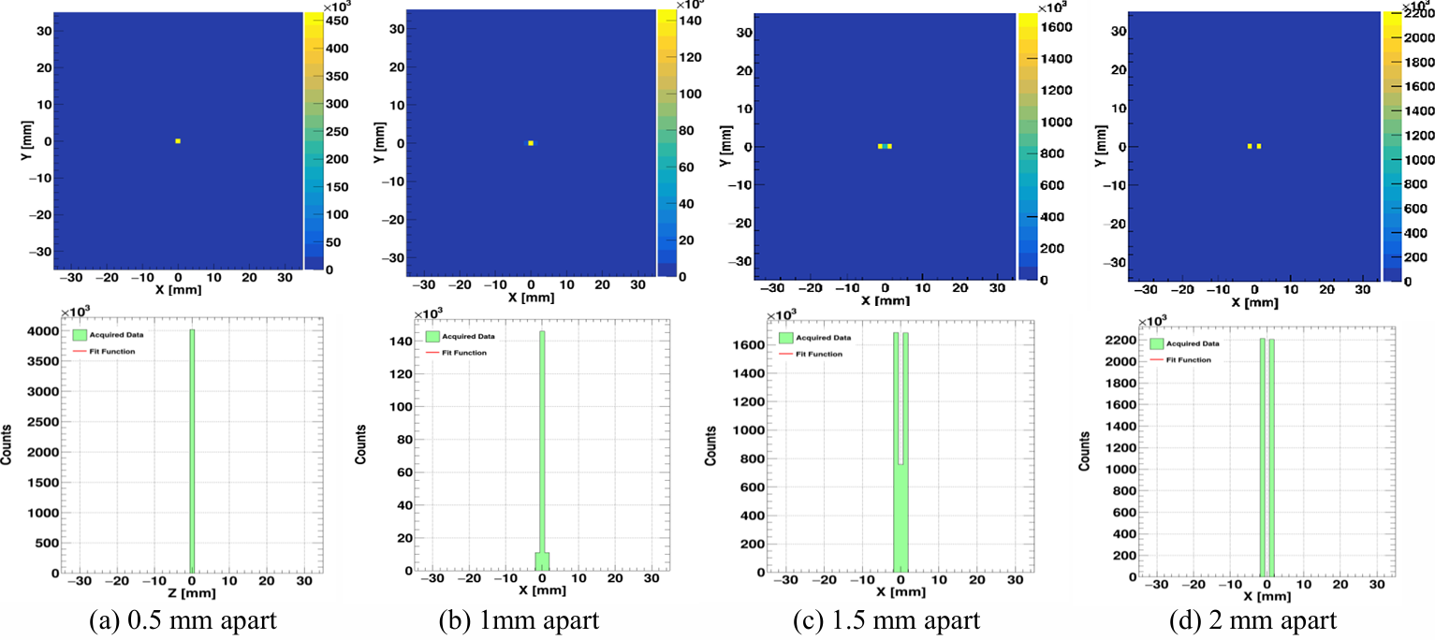
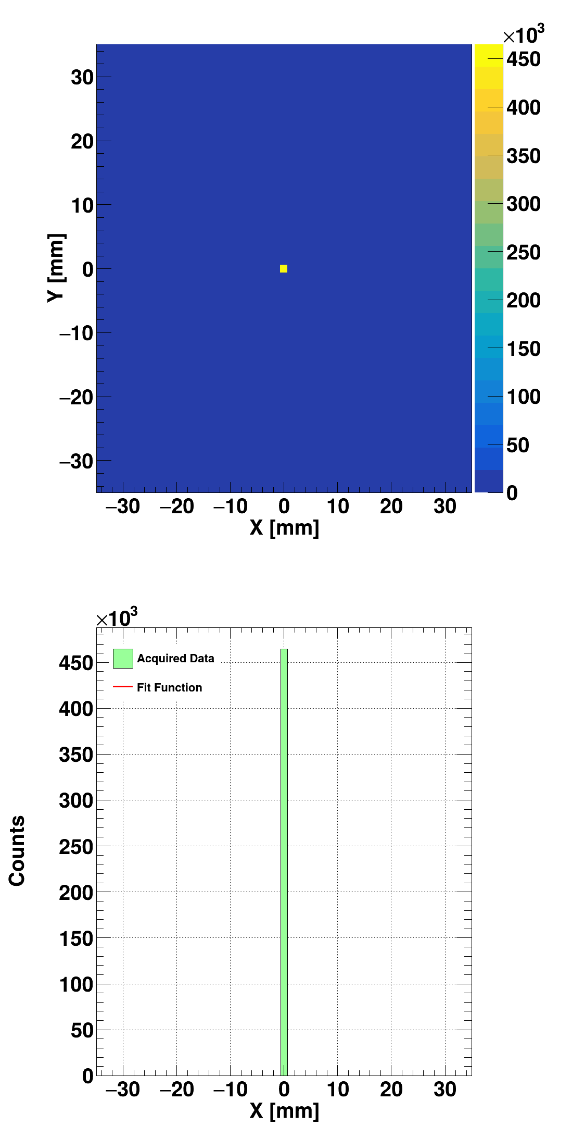
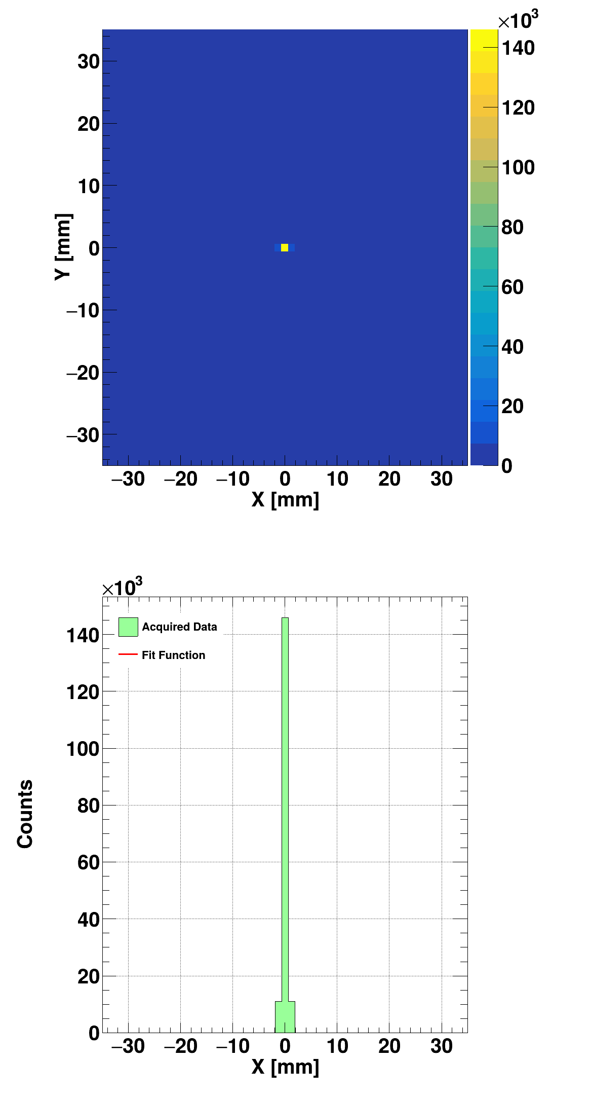

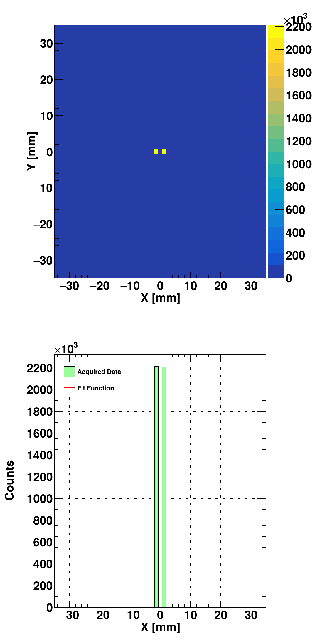
Resolving Capability in Transaxial Direction
Collimated CGC
Partial
7.0 mm
Resolved
8.0 mm
(a) 0.5 mm apart
(b) 1.0 mm apart
(c) 1.5 mm apart
(d) 2.0 mm apart
Figure: 2D flattened images integrated over the x-axis showing dual points apart at different distances
13
ANSTT 6

Slide 14
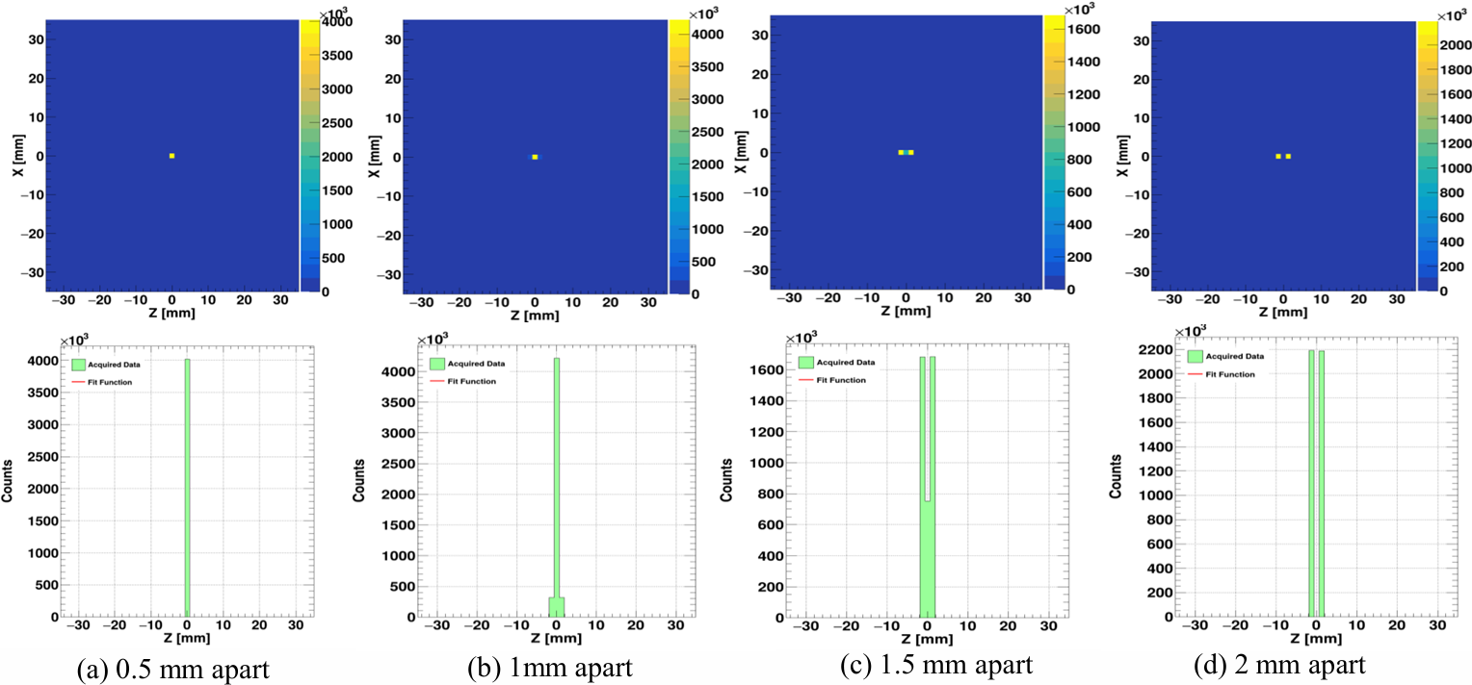
Resolving Capability in Axial Direction
Collimated CGC
Partial
9.0 mm
Resolved
10.0 mm
CAUSE:
-Finite FWHM
-PSF Overlap
(a) 0.5 mm apart
(b) 1.0 mm apart
(c) 1.5 mm apart
(d) 2.0 mm apart
Figure: 2D flattened images integrated over the z-axis showing dual points apart at different distances
14
ANSTT 6
Notes:
At 1.5 mm - This transitional region reflects the practical resolution threshold of the system, where sources are distinguishable but not yet fully separated.

Slide 15
Effects of Different Radionuclide Decay Characteristics in Selected Imaging Performance
Cascade Emitter | Spatial Resolution (FWHM) |  |  | Sensitivity (cps/MBq)
 | Along x-axis (mm) | Along y-axis (mm) | Along z-axis (mm)
⁴³K | 0.477 | 0.477 | 0.477 | 3,981.150
¹¹¹In | 0.477 | 0.477 | 0.477 | 15,058.800
¹⁷⁷Lu | 0.477 | 0.477 | 0.477 | 5,311.320
⁷³Se | 0.477 | 0.477 | 0.477 | 7,667.720
Strongly dependent on source physics
Resolution - Governed by system design (IRA & detector geometry), same across all 4 sources
15
ANSTT 6

Slide 16
Effects of Different Radionuclide Decay Characteristics in Selected Imaging Performance
Nuclide | Cascade Coincidence Detection Efficiency (CCDE) | Random -to- True Coincidence Ratio (R/T) | Evaluation of R/T
⁴³K | 3.981 × 10⁻³ | 0.002 (0.2%) | < 10%
⁷³Se | 7.668 × 10⁻³ | 0.032 (3.2%) | < 10%
¹¹¹In | 15.059 × 10⁻³ | 0.246 (24.6%) | > 10%
¹⁷⁷Lu | 5.311 × 10⁻³ | 0.006 (0.6%) | < 10%
Noise Equivalent Cascade Count Rate (NECCR) | Scatter Fraction (SF)
3.375 × 10⁶ | 0
7.326 × 10⁶ | 0.036
6.957 × 10⁶ | 0
2.547 × 10⁶ | 0
CCDE: Behave like sensitivity (source physics dependent)
R/T for ¹¹¹In is above the minimum recommended limit, <10% (Longer t_{1/2} and TCW)
16
ANSTT 6

Slide 17
Conclusion and Recommendation
Conclusion
Sensitivity and Coinc. Efficiency; Improved several order of magnitude
Isotropic spatial resolution
No trade-off in sensitivity and FWHM
Expanded field of view &
Strong under attenuation.
Take Away Points & What Next?
Potential for improving performance of medical imaging systems;
    solved limitations for PET and SPECT
    solved limitations for Collimated CGC Imagers and ToF information CGC Imagers
Experimental validation required
ANSTT 6

Slide 18
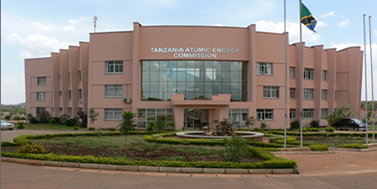
ASANTE SANA
enockmwita17@gmail.com

