Slide 1
Incident follow up with Major Event Reports
process, tools and examples of incidents and improvements through major event reporting.
P. Sollander – CERN BE/OP/TI

Slide 2
Major Event Reporting
Setting the scene
Definition and Scope
Goal
Process
Tools
Statistics and Results

Slide 3

CERN sites
Lake Geneva
LHC
Jura
SWITZERLAND
FRANCE
SPS
PS

Slide 4


Slide 5
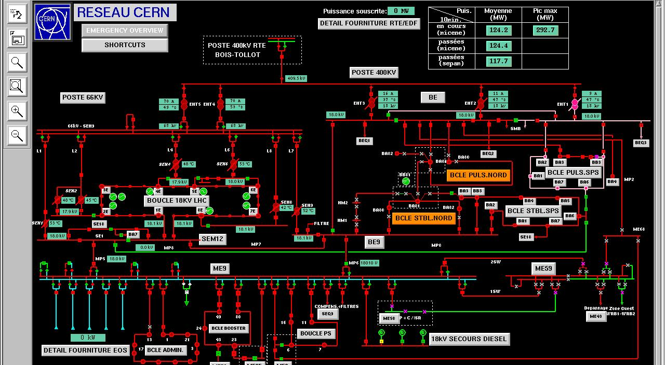
Electrical distribution

Slide 6
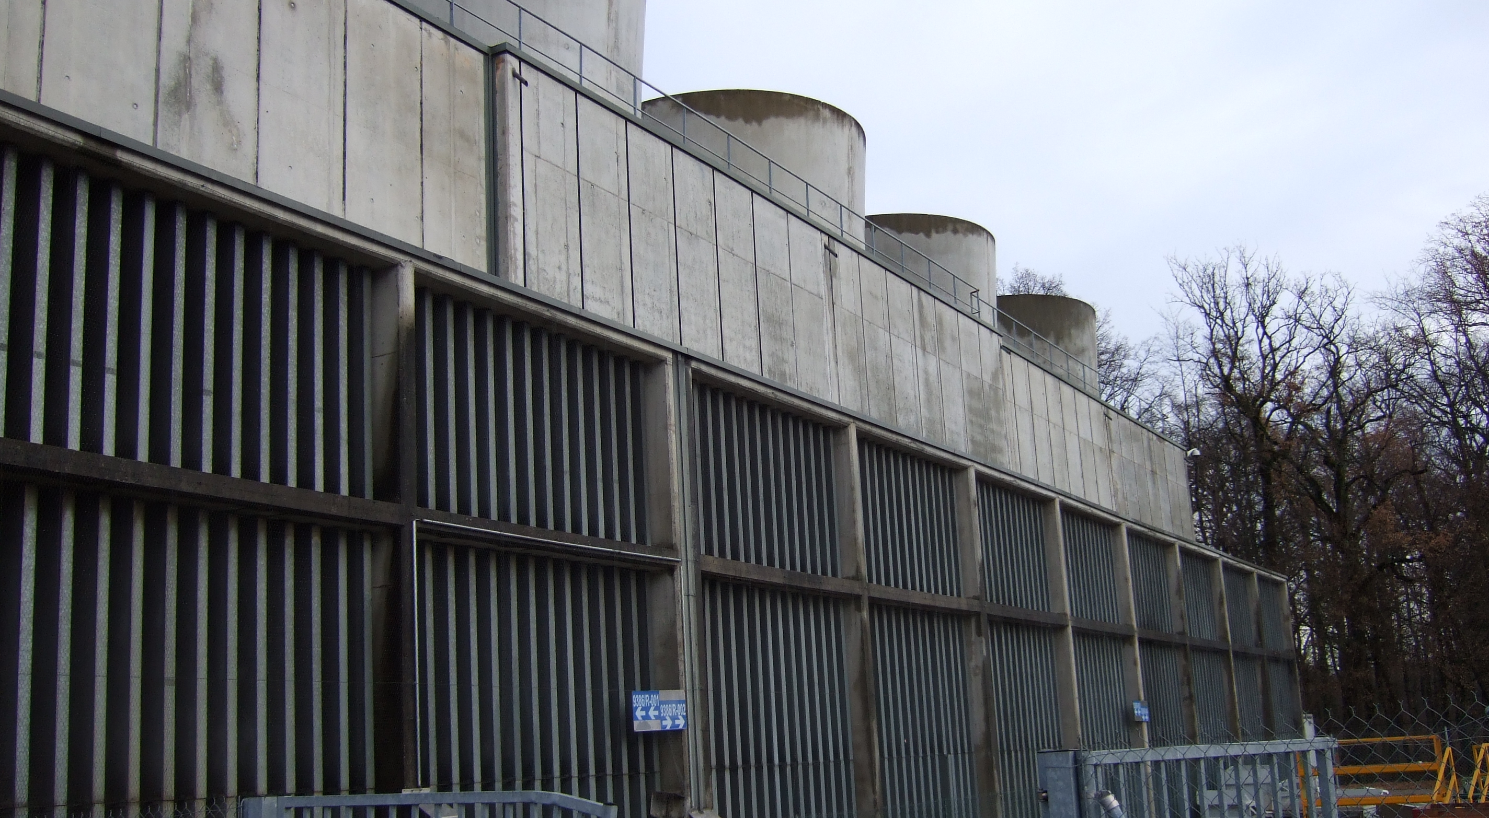
Water cooling

Slide 7
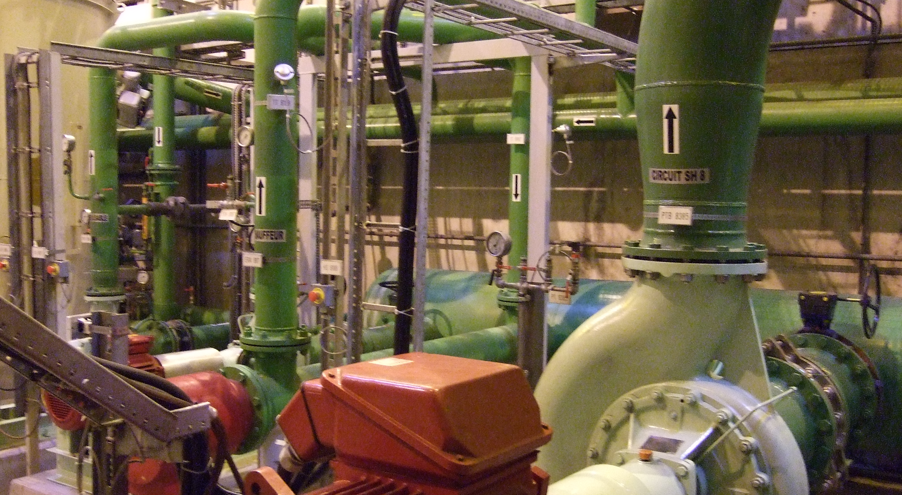
Water cooling

Slide 8
Operation
CERN
BE
EN
TE
GS
IT
EL
CV
OP
OP
OP
LHC
SPS
TI
…
CRG
OA
OD
…
…

Slide 9
Definition and Scope
Definition: An event on the technical infrastructure causing down time of physics or of an important facility at CERN
Scope: infrastructure
  Electricity
  Cooling and ventilation
  Safety systems
  Lifting and handling
  …
Examples
  Electrical perturbation on 400kV supply dumping beams
  Emergency stop button fault cuts 18kV supply for cryogenics
  Inundation alarm in tunnel requires intervention by fire brigade
  …

Slide 10
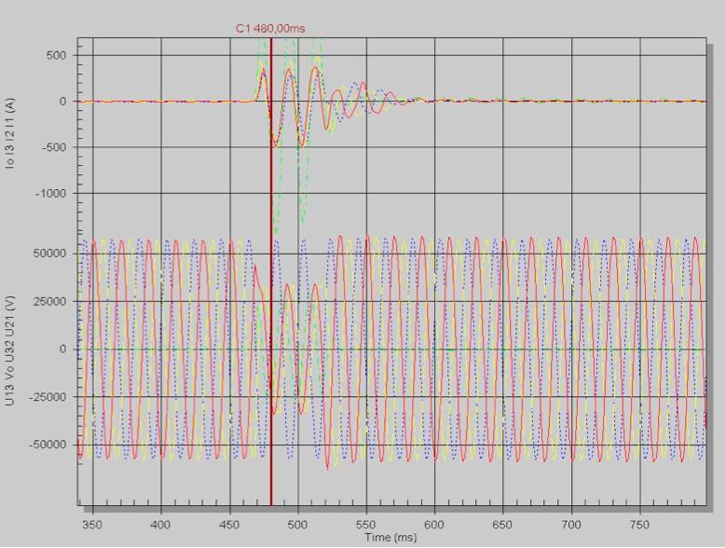
400kV perturbation
Voltage drop 40% on 2 phases for 60ms

Slide 11
Goals with Report
Get full understanding of event
Classify and time event for yearly beam statistics
Inform users of events
Implement improvements where possible

Slide 12
Report format
Event origin
  date, type of fault, equipment at fault
Users affected (LHC, SPS, computer centre, …), down time
Reports (OP, groups, users)
  Description
  Cause
  Consequence
  Actions
  Remarks
Conclusion

Slide 13
Procedure
Create
Technical Infrastructure operator creates the report
Fill
Equipment groups complete draft report before coming TIOC
Approval
TIOC Wednesday meeting treats report
E-mail distribution of first draft within 24 hours
Report is sent to users
Comment
Users give their input on the event
Conclude
TIOC adds conclusion and publishes report CERN wide

Slide 14
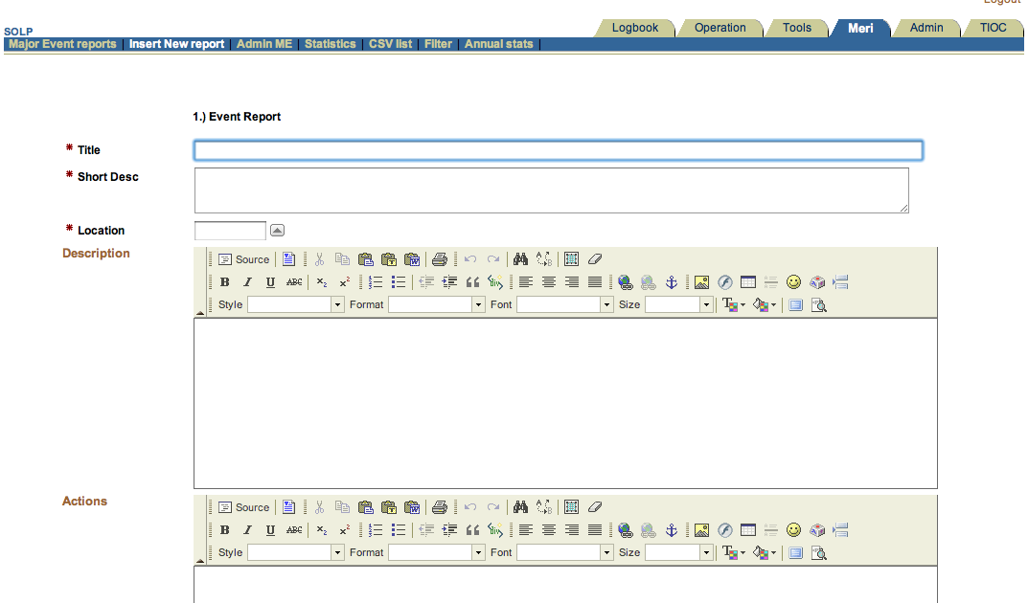
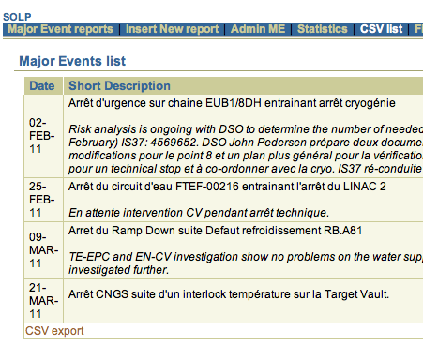
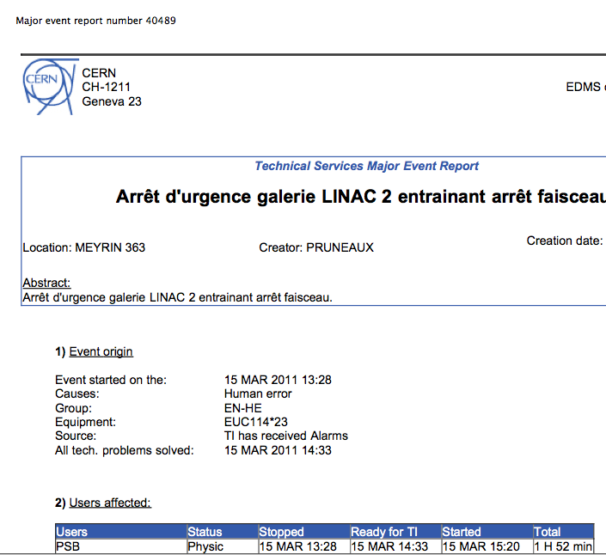
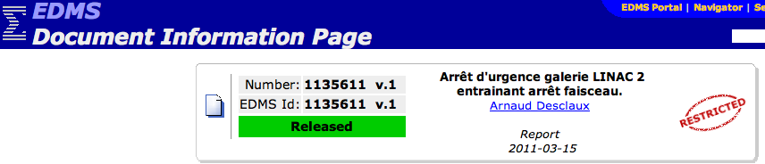
Tools
Oracle
DB

Slide 15
Major event per year

Slide 16
Major Events by system in 2010

Slide 17
Results
High level view of recurring problems
Keep track of pending repairs and improvements
In 2005, study of 167 events
  Preventive maintenance
  Electrical perturbations: will take place, minimize effects
  No need to shut down accelerators preventively in thunder storms
Current SVC restart procedure result of major event analysis
Recent example: analysis and re-distribution of emergency stop installations at the LHC after major event on February 2, 2011.
On-going analysis of spurious “electrical perturbations” seen on the LHC

Slide 18
Possible improvements
Major Event tools can be improved
Full reporting from end users not always easy to get.
  Report too late?
  Difficult for users to analyze causes and consequences
Only faults treated by technical infrastructure operators generate reports
  Extend to other systems possible (magnets, power supplies, RF, ….)
Better integration of statistics with beam statistics to correlate down time
Questions?

