Slide 1
Approaches to the maintenance at LNL
  Davide CARLUCCI
  PIAVE -Tandem- ALPI Operation Supervisor and Maintenance Leader
    LNL - INFN
    Viale dell'Universita' 2, 35020 Legnaro (PD) - Italy
    carlucci@lnl.infn.it
LNL – INFN – Legnaro -- Italy

Slide 2
OUTLINE
Introduction to LNL
Reliability Modeling is the correct approch, but …
New constraint in LNL
Approaches to the maintenance at LNL
Some example of maintenance
Summary
LNL – INFN – Legnaro -- Italy

Slide 3
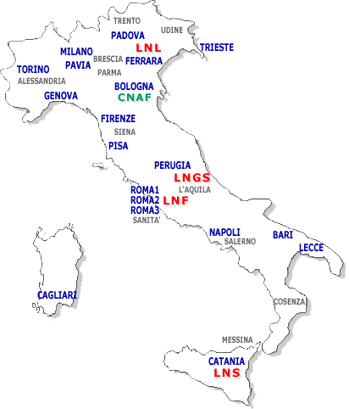

LNL - INFN - Identity Card
MULTI TASK
MULTI DISCIPLINARY
But mainly
Nuclear Physics Based
User Oriented
Laboratories
CORE RESEARCH ACTIVITIES
Nuclear Structure and Dynamics
Applications and Interdisciplinary use of ion
beams and nuclear techniques and methods
LNL – INFN – Legnaro -- Italy

Slide 4
Laboratori Nazionali di Legnaro
(2000)
PIAVE-Tandem--ALPI Complex
AN2000 accelerator
High Energy
Physics Building
my office
CN accelerator
Main Gate
LNL – INFN – Legnaro -- Italy

Slide 5
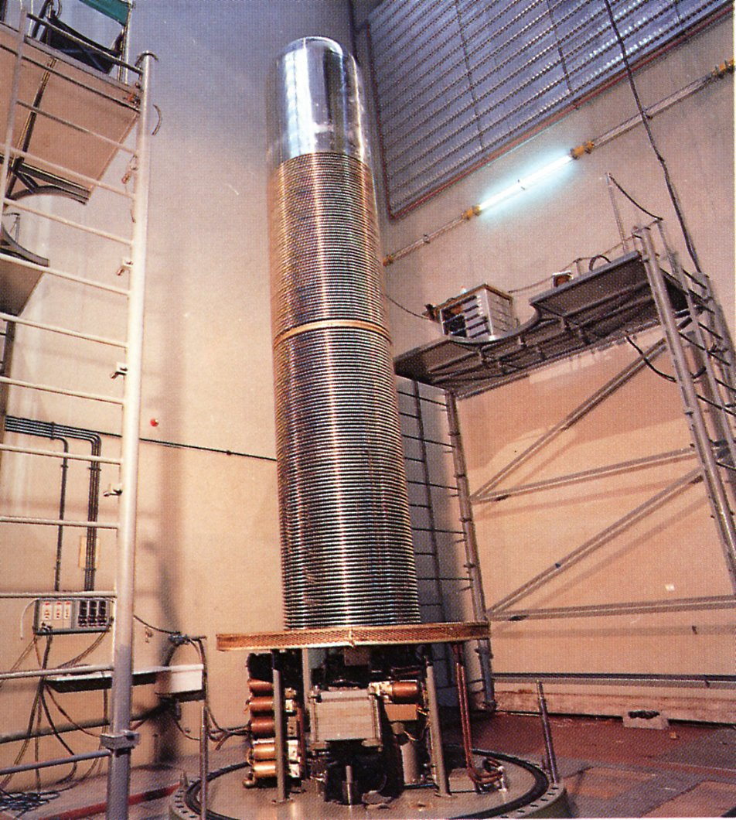
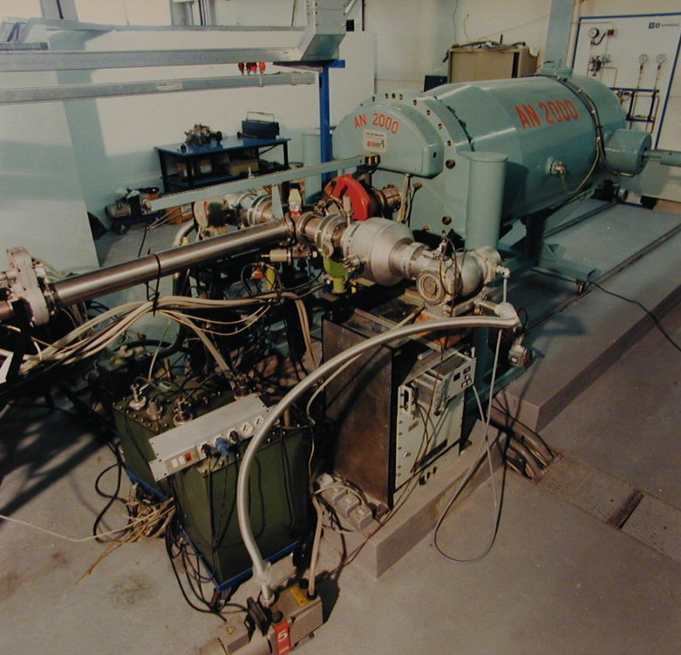
2 low energy electrostatic accelerators
7-MV - CN - Van de Graaff (1961)
2-MV – AN 2000
Van de Graaff (1971)
LNL – INFN – Legnaro -- Italy

Slide 6
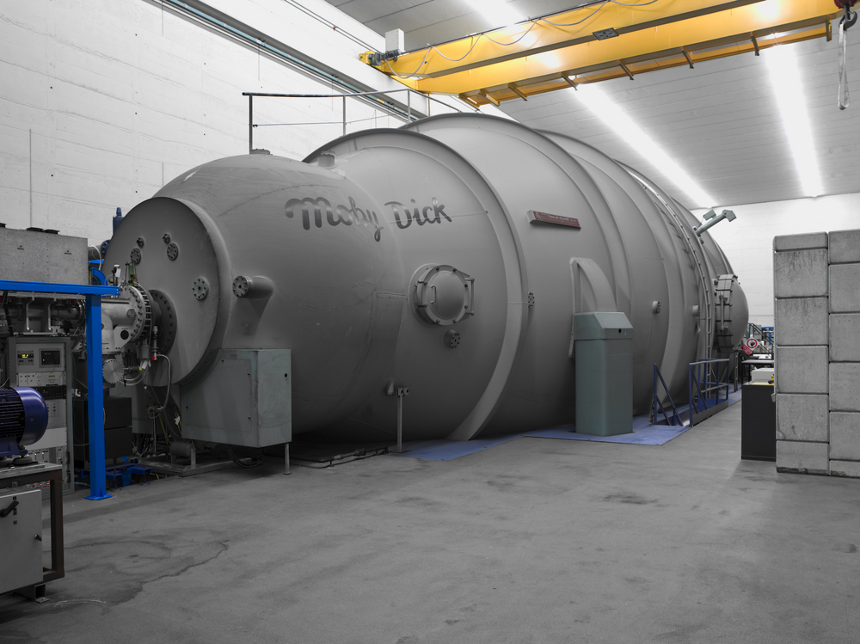
Tandem-Accelerator (1981)
DDB, 5 Mhz, 10Mhz
Negative ion source
14,5 MV terminal voltage
SF6 insulating gas at 7 bars
Single or double stripping stages

Slide 7
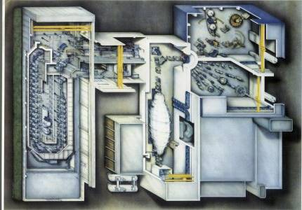
III Ex. Hall
Here is displayed
the PIAVE-
Tandem-ALPI
complex, the
beams being
injected by the
XTU Tandem
into the three
experimental
Halls, or in to the
superconductive
LINAC
and then
distributed
to three
experimental
halls, two of them are shown.
I & II Ex. Halls
PIAVE
ALPI
XTU Tandem
PIAVE-Tandem-ALPI- COMPLEX
LNL – INFN – Legnaro -- Italy
Notes:
Here is displayed the TANDEM-ALPI complex, the beams being injected by the XTU TANDEM into the superconductive LINAC and then distributed to three experimental halls, two of them are shown. The main limitation of this concept is the use of the TANDEM (the stripping section) as injector, affecting not only the intensities of the accelerated beams but also the number of atomic species which can be accelerated. Such considerations have motivated the construction of the new injector PIAVE (presented later this day). Here You can see the energy per nucleon of the accelerated beams for all possible masses using the TANDEM only, the TANDEM+LINAC and the PIAVE+LINAC compared with the Coulomb barrier for reference systems. You can notice the strong increase in beam intensity (reported in the quoted numbers) of more then one order of magnitude.
I will now rapidly go through the experimental facilities (grouped arbitrarily by main topic) present at the TANDEM ALPI:
The GASP and EUROBALL arrays, this last one having been hosted here for one and half year and now at Strasbourg. The first is a 3% gamma array using individual Ge detectors with AC shields, the second using composite Ge detectors for recovering to the photopic part of the event which undergo Compton scattering, with a 9% efficiency. Below You can see the observational limit of some of the gamma detector arrays compared with nuclear structure phenomena, just to give an idea where GASP (and EB) are located.
Legnaro is hosting two magnetic spectrometers (RMS and PRISMA) and also a time of flight spectrometer called PISOLO and not shown here. Both have a large acceptance (in solid angle and momentum) the RMS being able to work at zero degree, so for fusion evaporation reactions, used alone or in conjunction with the GASP spectrometer, the PRISMA spectrometer having a much bigger acceptance is dedicated to multinucleon transfer reactions (out of the zero degree). We indeed plan to use a part of the EUROBALL array coupled to the PRISMA spectrometer to investigate the structure of neutron rich nuclei produced by multinucleon transfer (or deep inelastic) reactions and selected by the spectrometer, one can use very neutron rich stable nuclei (accelerated with PIAVE) to drive the transfer far from stability and study the gamma decay at relatively low recoiling velocity respect to the one produced by fragmentation (much more suited for doing gamma spectroscopy with a Ge array).
Then we have two charged particle odoscopes, 8plp and GARFIELD, both 4 pi devices, the first dedicated to the detection of light charged particles together with fission fragments or neutrons in specific set-ups, the second to heavy ions at low energy. Compared with other detectors built to study mutifragmentation at MSU, GANIL or CATANIA, GARFIELD has his specificity in being optimised for the detection of heavy ions produced at low energies compatible with the LNL accelerator complex.
Then we have to array dedicated to the detection of high energy gamma rays, HECTOR and SERPE of the Milano the first and Napoli university the second, mainly dedicated to investigate the Giant Dipole response of hot nuclei and related shape and isospin effects.
Here I have also reported the beam time mean distribution at the TANDEM-ALPI for the different detectors. Generally 40% is used for Nuclear Spectroscopy (GASP), 18% for the time of flight spectrometer, 4 to 6% for the others and about 18% for interdisciplinary researches, basically irradiation for space applications, studies of effects of defects on high temperature superconductivity etc. Below the beam time distribution for the TANDEM only and the TANDEM + ALPI.

Slide 8
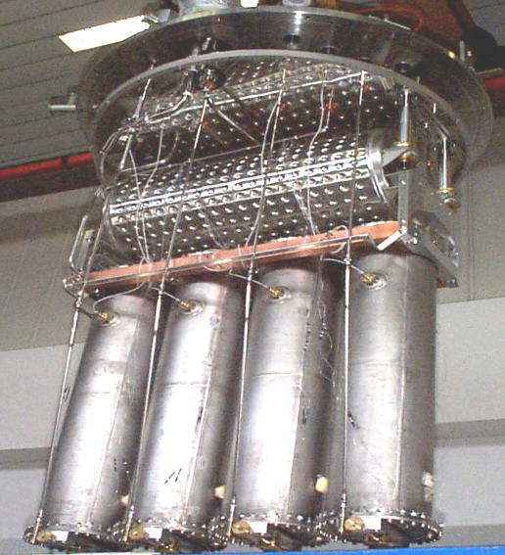
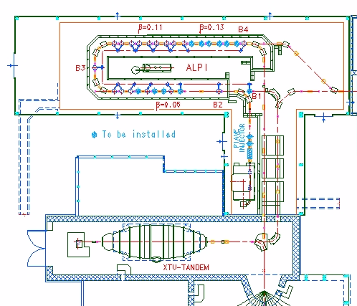
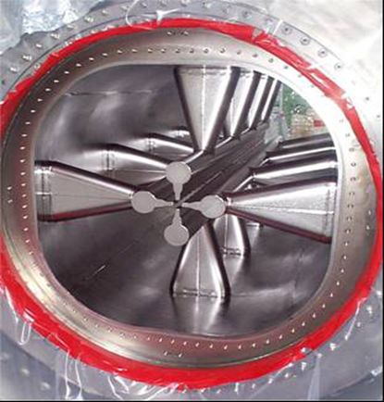

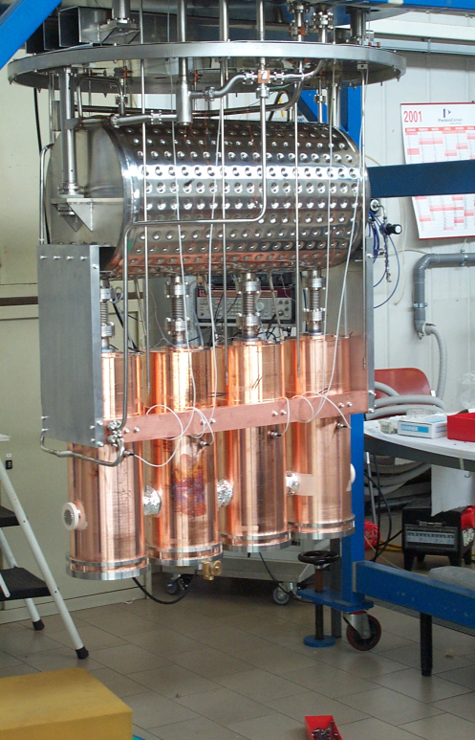
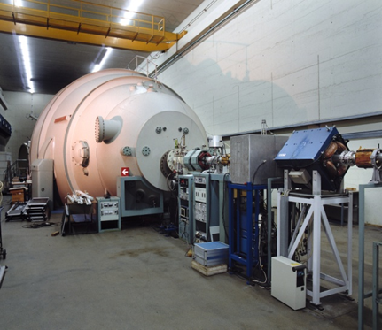

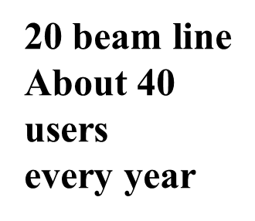

LNL –PIAVE-Tandem-ALPI- COMPLEX
20 Full Nb, 80 MHz
Low β Ea 6MV/m
ALPI-77 SC Quarter Wave Resonators (Nb, Nb/cu)
In 20 Cryostat V_{eq} ~ 48 MV
III EX. Hall
PI Injector PIAVE
57 Nb /Cu,
160 MHz
medium β Ea 5MV/m
XTU-Tandem
I & II EX. Halls

Slide 9

TANDEM-ALPI REPRESENTATIVE BEAMS
Beam | E [MeV] | E/A [MeV/A] | I target [pnA]
^{1H1+} | 240 | 20.0 | 2
¹⁶O⁷⁺ | 328 | 20.5 | 2
⁴⁸Ca¹⁰⁺ | 505 | 10.5 | 1.3
⁸²Se¹²⁺ | 582 | 7.1 | 7
⁹⁰Zr¹⁴⁺ | 700 | 7.7 | 0.3
LNL – INFN – Legnaro -- Italy

Slide 10
PIAVE REPRESENTATIVE BEAMS
Beam | E [MeV] | E/A [MeV/A] | I target [pnA]
²²Ne⁴⁺ | 243 | 11.0 | 2
⁸⁴Kr¹⁸⁺ | 800 | 9.5 | 5÷10
¹²⁰Sn²¹⁺ | 850 | 7.1 | 1
¹³⁶Xe³⁴⁺ | 1240 | 9.1 | 1
¹⁹⁷Au³⁰⁺ | 1200 | 6.1 | 1
LNL – INFN – Legnaro -- Italy

Slide 11
How to decide the Maintenance aproach ?
Identify all the machine systems, the subsystem of each system......, and after that you can decide the right aproach
Static-Preventive
Dinamic-Last minute
1 subsistem
Charge system control every maintenance
Laddertron change evry 14000 hours
2 Subsitem
Alternatore belt change every 20000 hours
Corona point change every 3 years
3 Subsistem
Voltage divider control every maintenance
Nylatron bar change every 40000 hours
P.S. For the charge sistem in the terminal
P.S. For vacuum pom p sistem in the terminal
Air compress….
Water cooling….
Valve….
If the number of Dinamic-Last minute
maintenance events increases, change approach tos Static Preventive maintenance,
or development, or up-granding
LNL – INFN – Legnaro -- Italy

Slide 12
Versatility of Weibull Model
Failure Rate:
Constant Failure Rate Region
Failure Rate
Early Life
Region
Wear-Out
Region
0
Courtesy of George Dodson
Time t

Slide 13

Reliability Modeling is the correct approch, but:
in the real life of our Laboratory,
there is a new constraint, and maybe in many Laboratories as well.
Which is ?
Or RAND, or….
The famous Mr. BUDGET.
LNL – INFN – Legnaro -- Italy

Slide 14
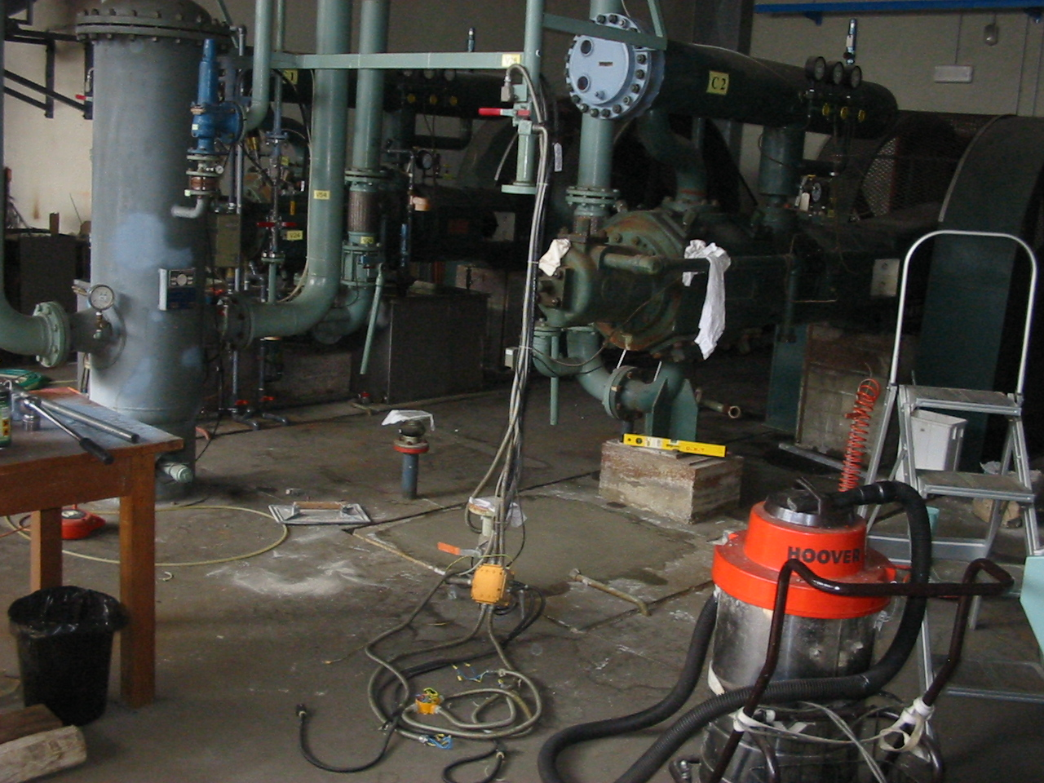
Why maintenance ?
1 Day beam loss cost ~ 30 K euro
Electrical power
Staff cost
User cost
Safety reason
Cost
LNL – INFN – Legnaro -- Italy

Slide 15
LNL –PIAVE-Tandem-ALPI- COMPLEX
Main device in ALPI _ PIAVE
77 QWR s (coupler, tuning system, pick-up ecc)
2 Criogenic Plant
1 ECR Source
2 SRFQs
120 Step motor
140 Power supply for quadrupole
and Dipole
40 Corrector
30 Power supply for steerer
120 Rf Amplifier
120 Rf controller
30 Motor controller
40 BMP
40 FC
90 Air compressor distribution
170 Valve
120 Vacuum pump
Ecc ecc
Main device in the Tandem
2500 Resistors
1 Laddertron (1300 Link, ecc)
765 m³ of SF6 at 7 Bar
2 Compressor and the regeneration system for the transfer of the SF6
20000 Spark gap
1 Negative ion source
3 Ion pump ( in the HV terminal )
9 Power supply ( in the HVterminal )
10 Variac ( in the HV terminal )
1 Electostatic Lens( in the HV terminal )
1200 Resistors support
1 Dillon Cell
4 Gauge for Dew Point meter system
8 Cable for the CC ( in HV) for each of 8 section ecc ecc.
LNL – INFN – Legnaro -- Italy

Slide 16
Approaches to the maintenance at LNL
The spares parts for each systems will cost >> our budget (+30%);
It is very important to find the major criticality
Find out the critical ageing equipment to be replaced in the Tandem accelerator;
On PIAVE-ALPI we concentrate on the strictly high reliable element.
LNL – INFN – Legnaro -- Italy

Slide 17
Not Maintenance alone
In any case the maintenace, preventive, Last minute, predictive, Development and the Up-grading, they must complete the necessary puzzle for high Relaiability
Up-grading
Preventive
Development
Last minute
LNL – INFN – Legnaro -- Italy

Slide 18
What could happen...Started as Development ended as Maintenance of all cryostats
LNL started to think about ALPI, a heavy ion SC linac equipped with QW, Pb on Cu resonators, less expensive and easier to build than Nb QWR.
Since the beginning we investigated the possibility to substitute in the future Pb with Nb.
A laboratory for Nb QWR sputtering was set up and a devoted research project was funded in 1987.
1987: Funding a Development on QWR Nb sputtering
1988-1999: Biased sputtering choice and system set-up
1990: Obtaining good SC performance on samples
1991: Sputtering on a simplified prototype
1994: Design of a ALPI high β resonator suitable for sputtering production and compatible with existing cryostats
1995/1998 Production and installation of 4 high b cavities in ALPI
1998 Sputtering of a standard medium β ALPI resonator
2003 Maintenance and Upgrading of the medium b ALPI resonators
LNL – INFN – Legnaro -- Italy

Slide 19
2003 Medium β ALPI cavities from Pb to Nb
Accelerating Field [MV/m]

Slide 20
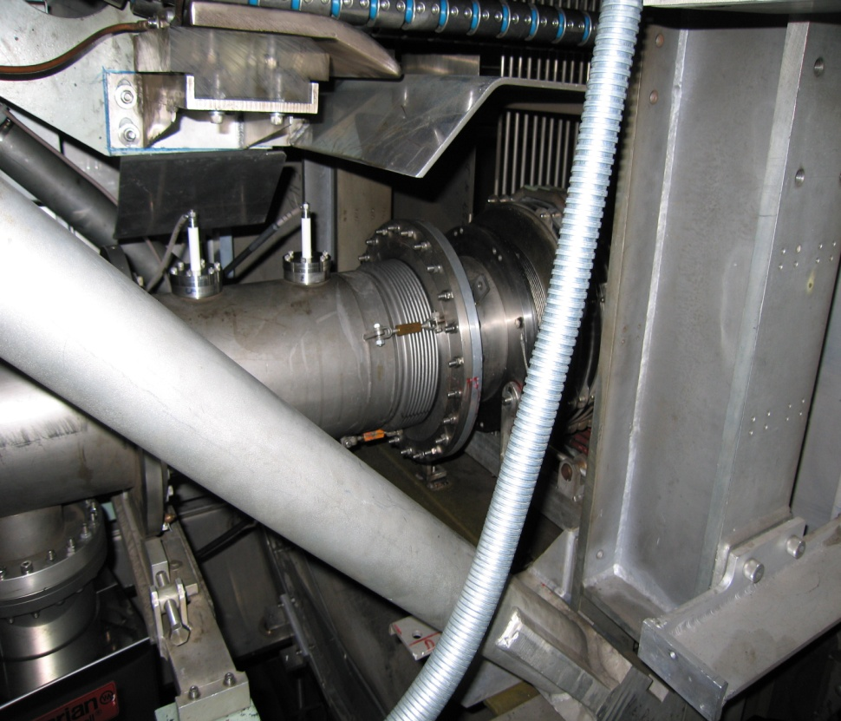
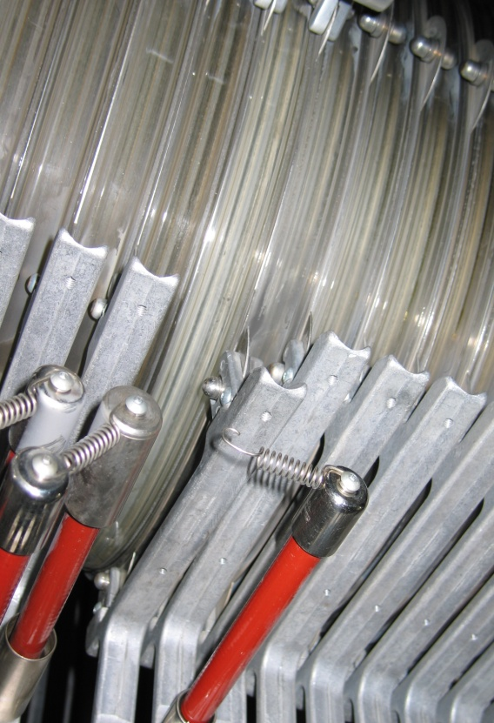
Example of maintenance
Ocober-December 2005:
10 unscheduled opening: 9 for broken resistor support and 1 for vacuum problem
1
9
LNL – INFN – Legnaro -- Italy

Slide 21
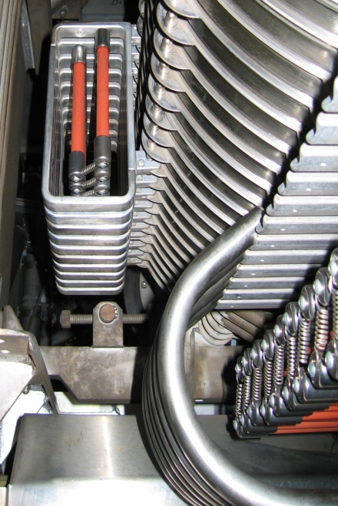
Analysis of the statistic problems
April: Nylatron bars mounted
Tandem installation at LNL
LNL – INFN – Legnaro -- Italy

Slide 22
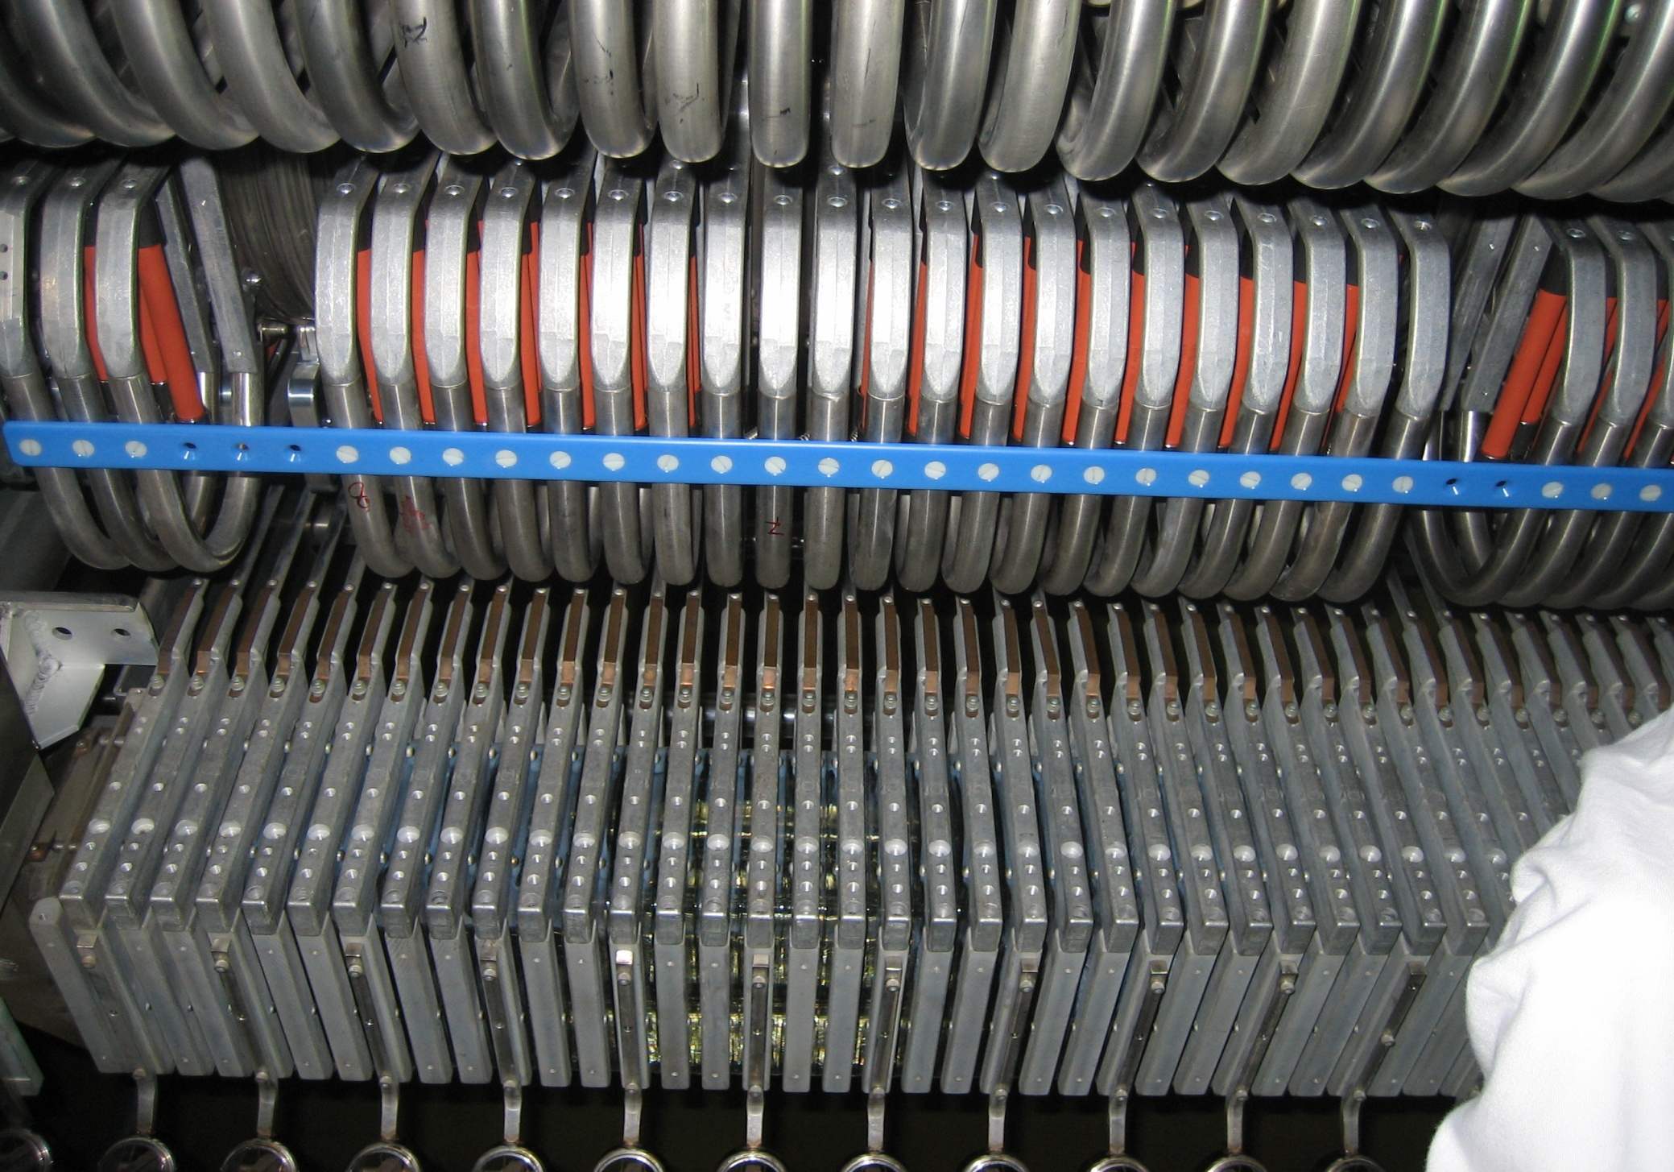
After the statistic analysis
Fixed spacer bar among Rs holders
(matirial: nylatron mc 901.)
LNL – INFN – Legnaro -- Italy

Slide 23
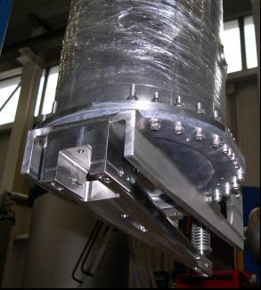
ΔP in the Cold-box meaning Δf in the cavity
Could happen... Started as maintenance...low-β tuning device ended as an upgrade
The main source of detuning, in these cavities, is the change of pressure of the helium bath. The standard ALPI mechanical tuner, although sufficient for slow corrections, is not well suited for frequency tracking in the presence of fast pressure fluctuations, due to large mechanical backlash and poor reproducibility.
1 mbar ~ 1 Hz
1. Resolution ∼0.33 μm or better; this corresponds to
frequency resolution below 1 Hz.
2. Very small and reproducible backlash in order to
allow a fast tuner recovery .
We used the lever design of the TRIUMF QWR tuner
with commercial backlash-free “C-FLEX” joints.
The system is linear and its theoretical resolution of on
the tuning plate is 0.1 μm. This results in about 0.3 Hz
tuning resolution for low-β quarter wave resonators; this
value is well suited for our application.
New tuner
LNL – INFN – Legnaro -- Italy

Slide 24
Low-β tuning device upgrading
Resolution ∼0.33 μm or better; this corresponds to
frequency resolution below 1 Hz.
C-flex joints do not deteriorate the Q (> 10⁹)of the QWR
good linearity, resolution and reliability
tuning range > 10 kHz
LNL – INFN – Legnaro -- Italy

Slide 25
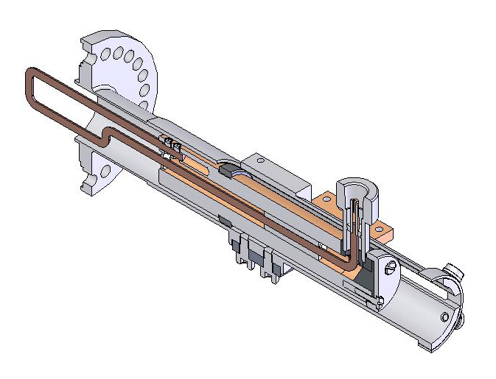
The same problem (ΔP in the cold-box) trigger the start for an Upgrade of RF coupler for the Low β QWR
A new, liquid nitrogen cooled RF coupler, inspired by the ISAC_2 one, has been designed in order to maintain stable temperature with a forward power up to 500W, while limiting the thermal load to the liquid helium system within 1W. The main difference from the TRIUMF model is the 90 degrees corner near the connector, that allows
keeping the overall length within 160 mm (the maximum available space in our cryostats) while leaving an effective stroke of 80 mm; this results in a larger tuning range. The calculated heat load towards the liquid He circuit is around1 W.
FIG 1: Cut view of the new cooled coupler prototype
LNL – INFN – Legnaro -- Italy

Slide 26
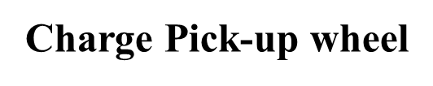
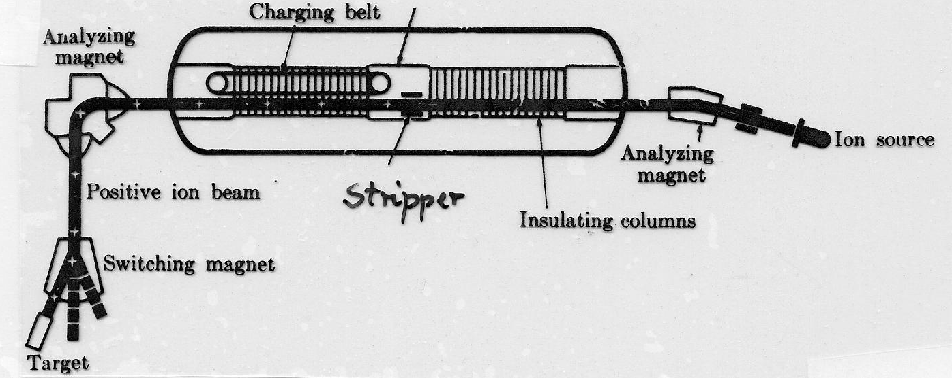
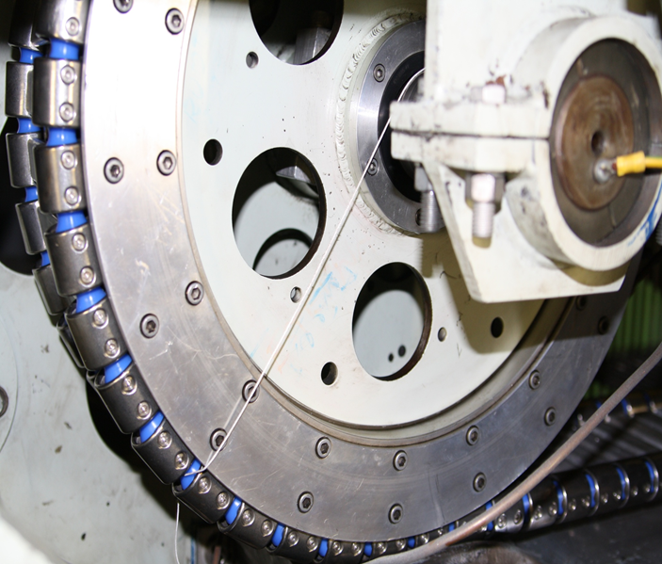
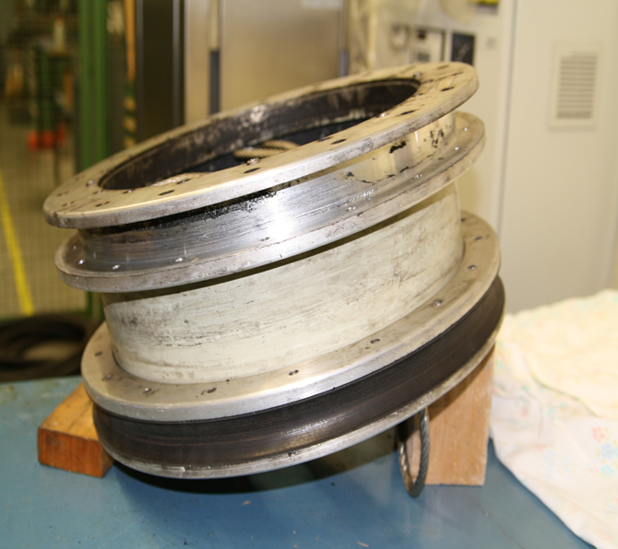
Charge system of Tandem Accelerator
Charge Pick-up wheel
LNL – INFN – Legnaro -- Italy

Slide 27
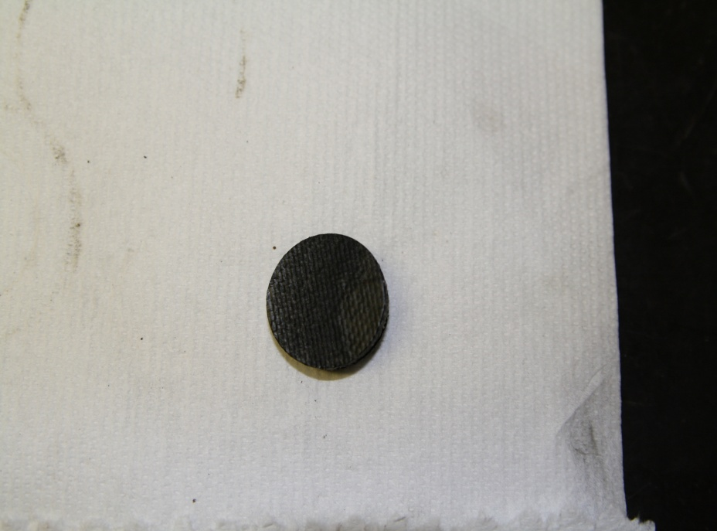

Charge Pick-up wheel history
During maintenance of the older machines it is important to take special care of equipment which is no longer available «off the shelf», due to technical obsolecence and no longer supported by industry.
We were forced to search for alternative sources as we were not able to manufacture the part in LNL.
For quality control purposes, the conductive rubber which is the charge pick-up wheel was tested to conform to stringent conductive and strength requirements, by the University of Padua.
LNL – INFN – Legnaro -- Italy

Slide 28
Charge Pick-up wheel history
This process can be a lengthy and costly process.
After 1 ½ years of unsuccessfull attempts we were able to locate a small supplier who agreed to produce the part according to our requirements.
Charge Pick-up wheel
Composed of Nylon fibre layered with polyurethane impregnated by «carbon black powder».
It is derived chemically from virgin Naptha produced by burning in the absence of oxigen. The conductivity is proportional to the size of the carbon powder.
A Spanish firm is able to produce this part reliably.
LNL – INFN – Legnaro -- Italy

Slide 29
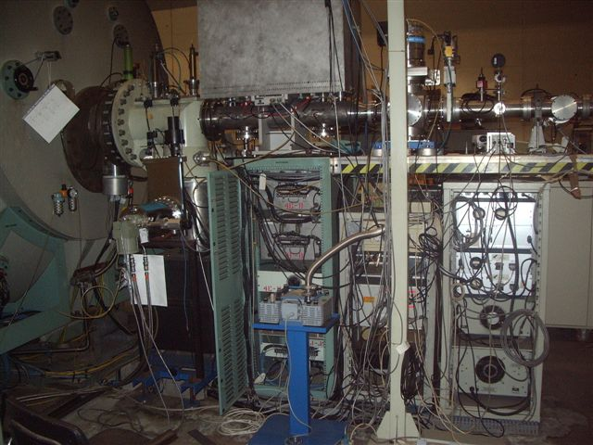
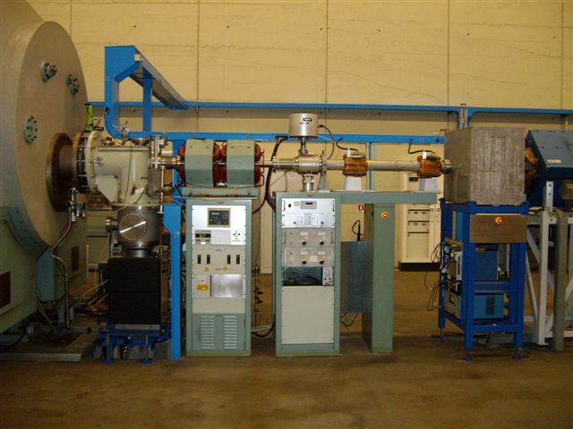
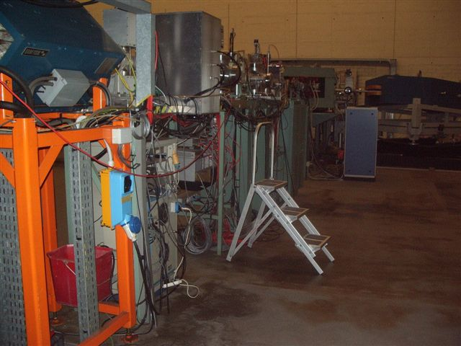
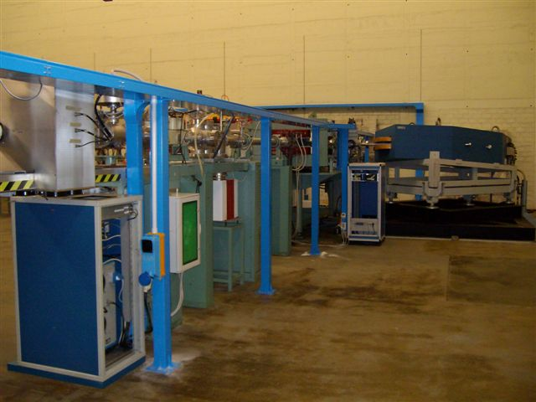
Safety maintenaince of electrical wiring at Tandem XTU
LNL – INFN – Legnaro -- Italy

Slide 30
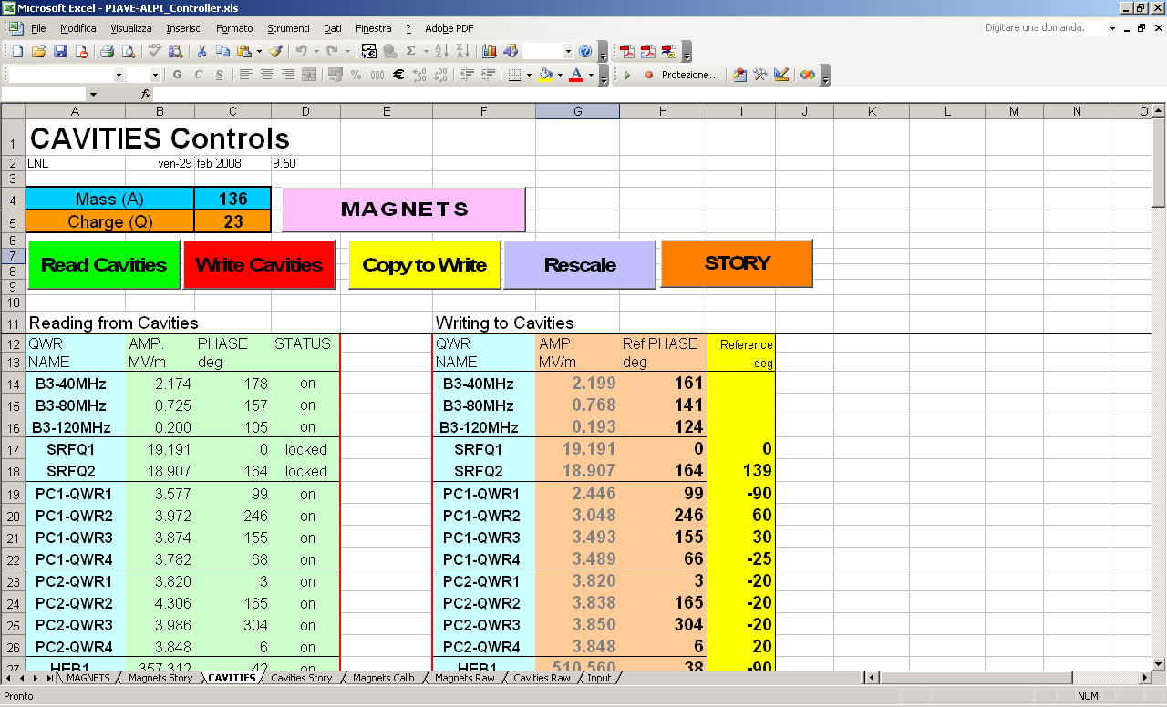
Smooth transition from an all-on-paper to all-on DB E-Logbook
LNL – INFN – Legnaro -- Italy

Slide 31
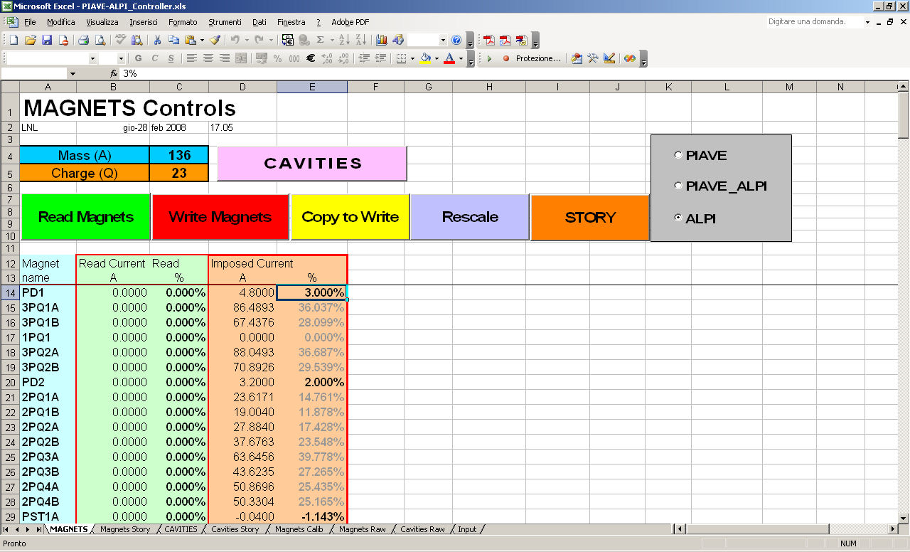
Smooth transition from an all-on-paper to all-on DB E-Logbook
LNL – INFN – Legnaro -- Italy

Slide 32
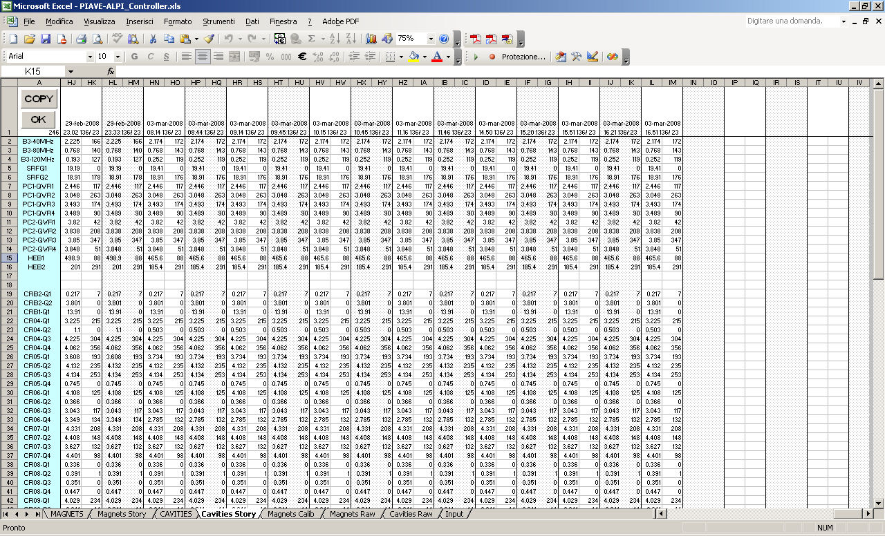
Smooth transition from an all-on-paper to all-on DB E-Logbook
All the value of the magnets, and RF, are recorded every second
LNL – INFN – Legnaro -- Italy

Slide 33
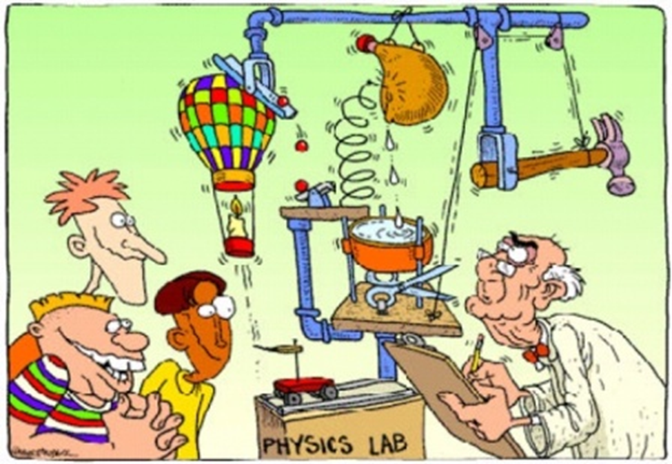
This presentation, it is not a lesson of Phisics Lab, or a lesson of Reliability Modeling but: Just my experience
Summary
LNL – INFN – Legnaro -- Italy

Slide 34
Thank you for your attention
LNL – INFN – Legnaro -- Italy

