Slide 1


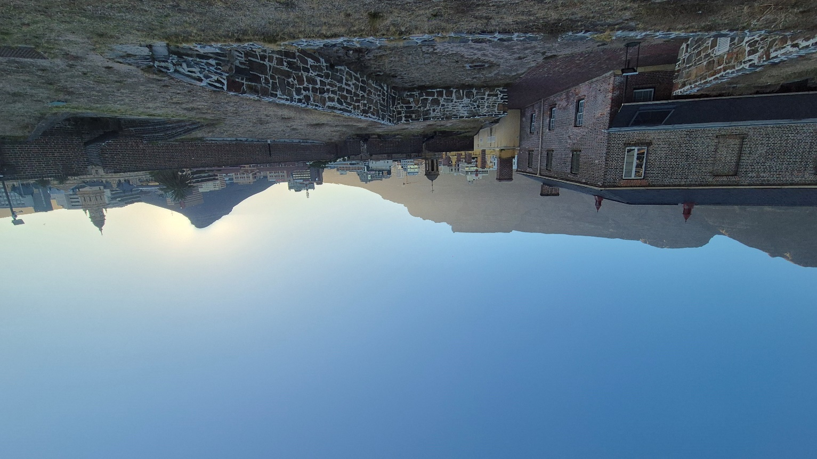

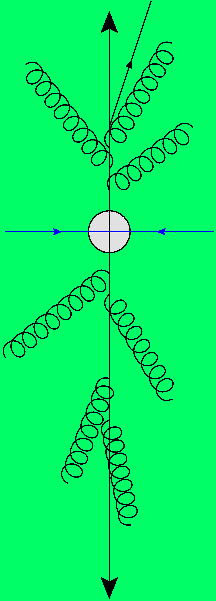
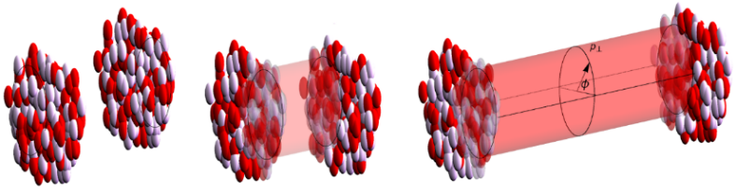
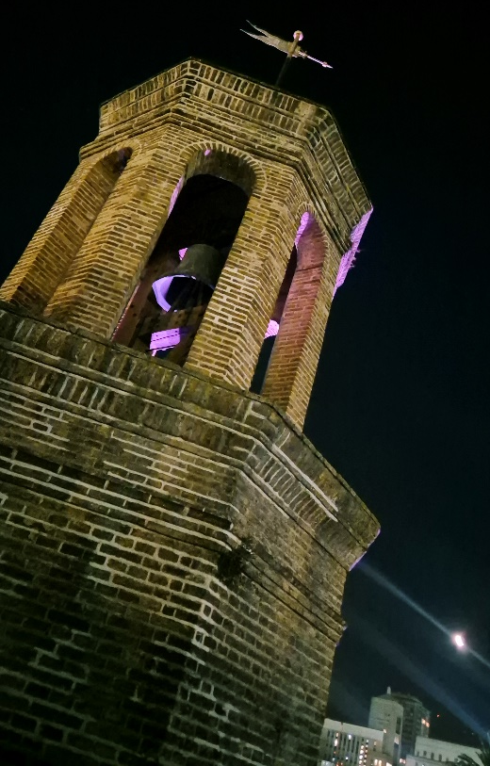
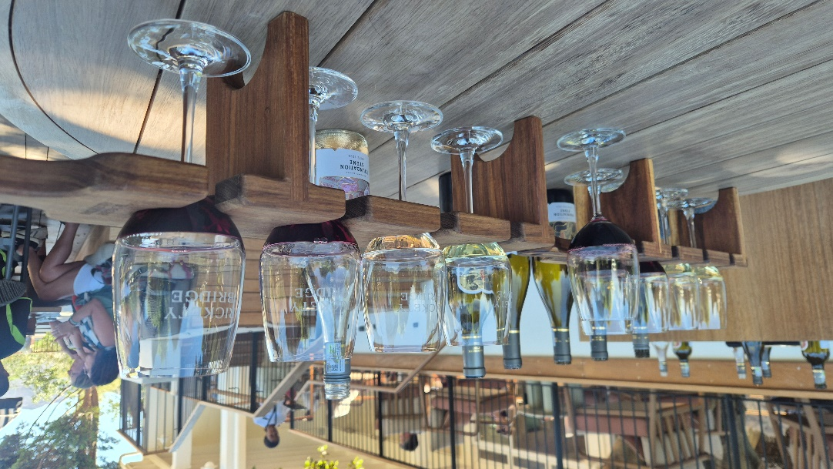
Theory of heavy ion collisions
For an experimental audience; including neutron stars and light ions ☺
Wilke van der Schee
QGP@Mzansi
Cape Town, 26 January 2026

Slide 2

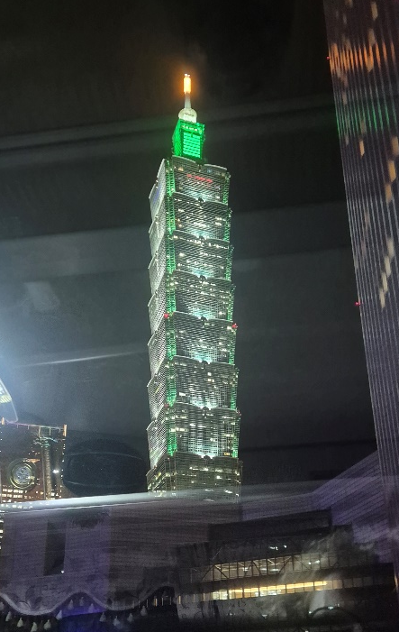
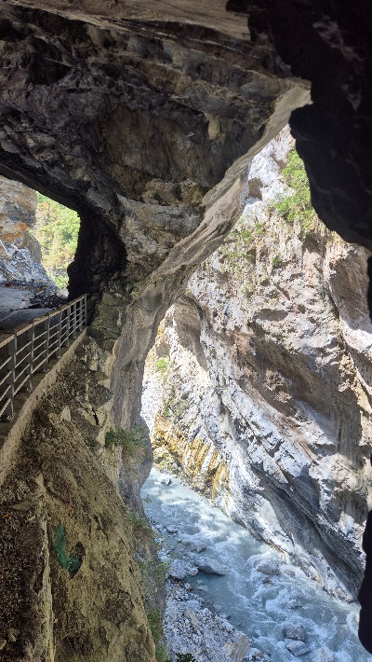

Outline
The phase diagram of QCD: from neutron stars to quark-gluon plasma
A brief interlude on neutron skin and neutron star mergers
The `standard model’ of heavy ion collisions
What is the smallest droplet of QGP? Is there hydrodynamics even in proton-proton collisions?
¹⁶Oxygen and ²⁰Neon (!) collisions in July 2025 at the LHC
Neon approved only months before the run
First time LHC switched between ions within hours
A first glimpse into the results (from September Initial Stages)

Slide 3
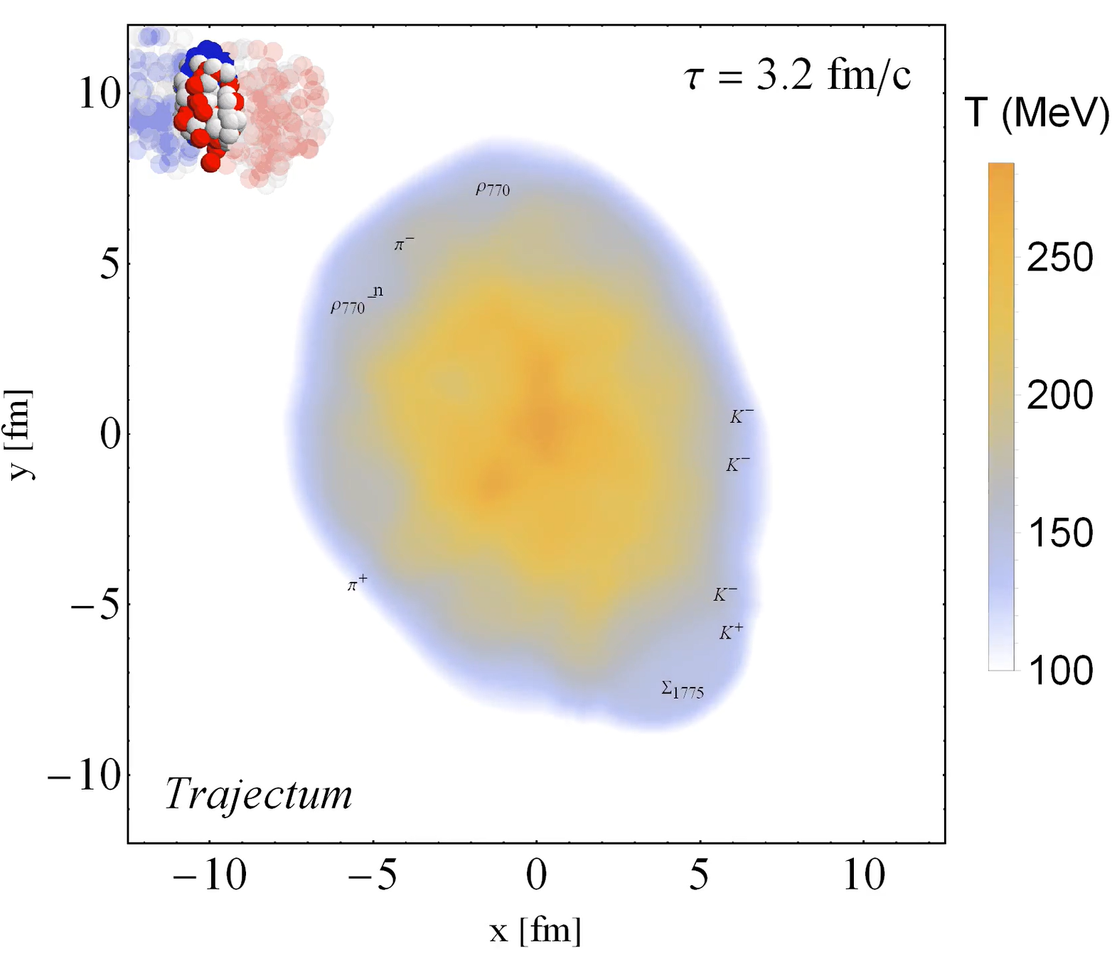
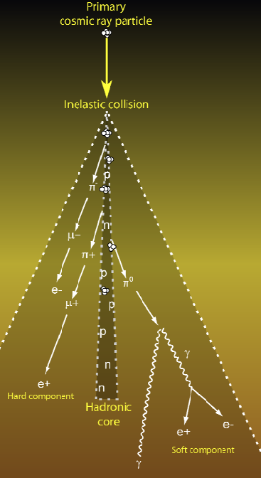
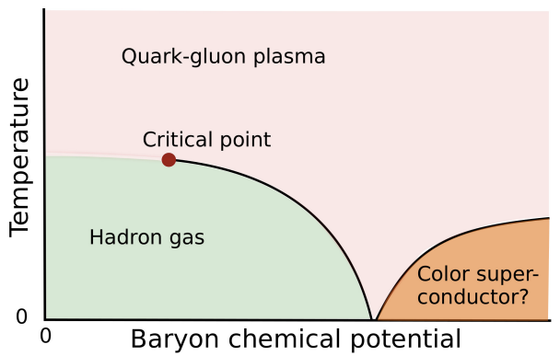
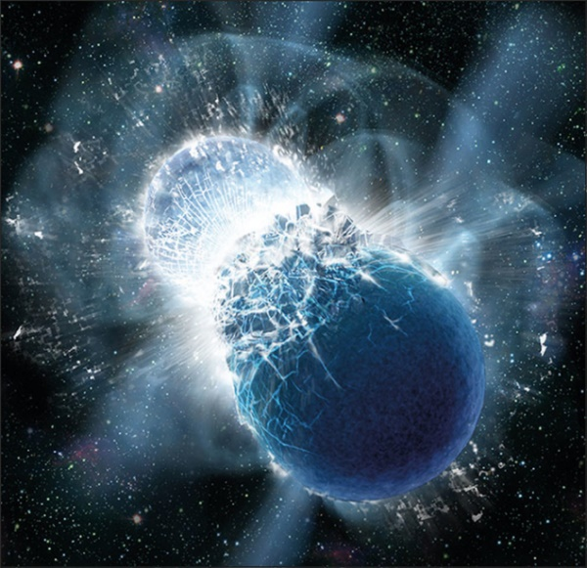
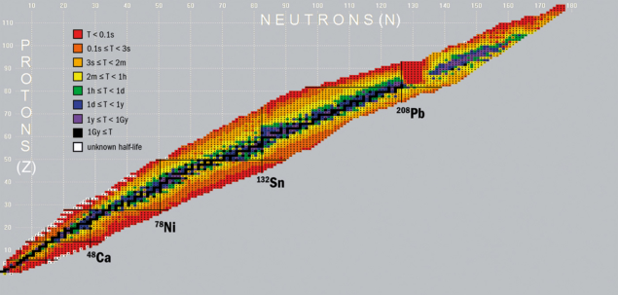
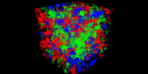
The scope of QCD
Particle showers
Quark-gluon plasma
?
Neutron star (mergers)
Nuclear structure
Lattice QCD
https://cerncourier.com/a/exploring-nuclei-at-the-limits/, https://cerncourier.com/a/neutron-star-mergers-create-heaviest-elements/

Slide 4
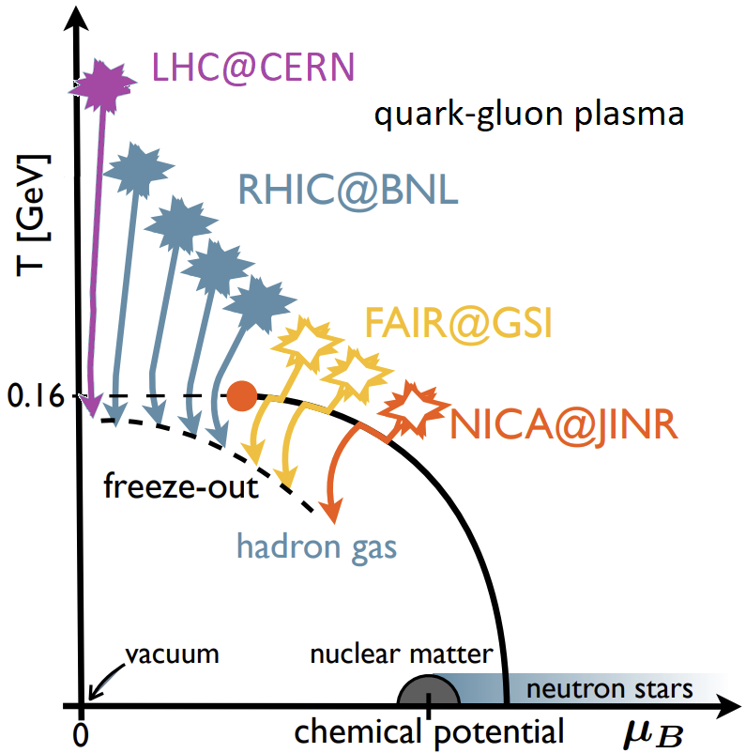
From neutron stars to QGP
Wilke van der Schee, CERN/Utrecht
Lattice provides equation of state at zero chemical potential
Cross-over from hadron gas to quark-gluon plasma (QGP)
Big questions:
Equation of state at zero temperature
Neutron star EoS
Is there quark matter?
Conjectured critical point? And where?
Experiment:
RHIC beam energy scan
Neutron star mergers/GW
In this talk: a link with the neutron skin of ²⁰⁸Pb? LHC?
?
Christian Schmidt and HotQCD and BNL-Bielefeld Collaborations, QCD bulk thermodynamics and conserved charge fluctuations with HISQ fermions (2013)

Slide 5
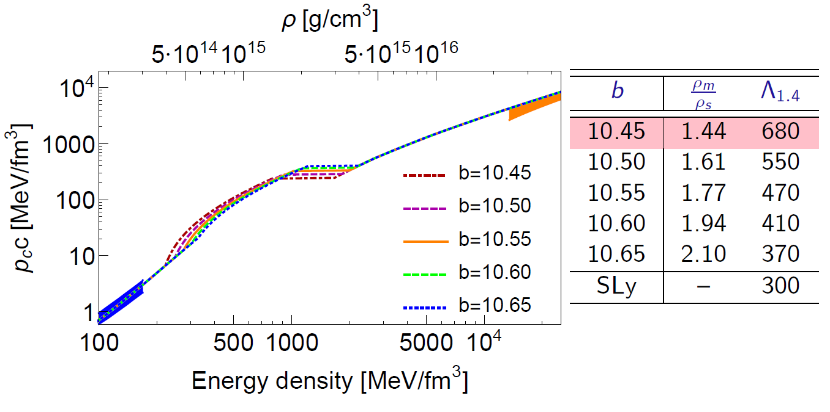
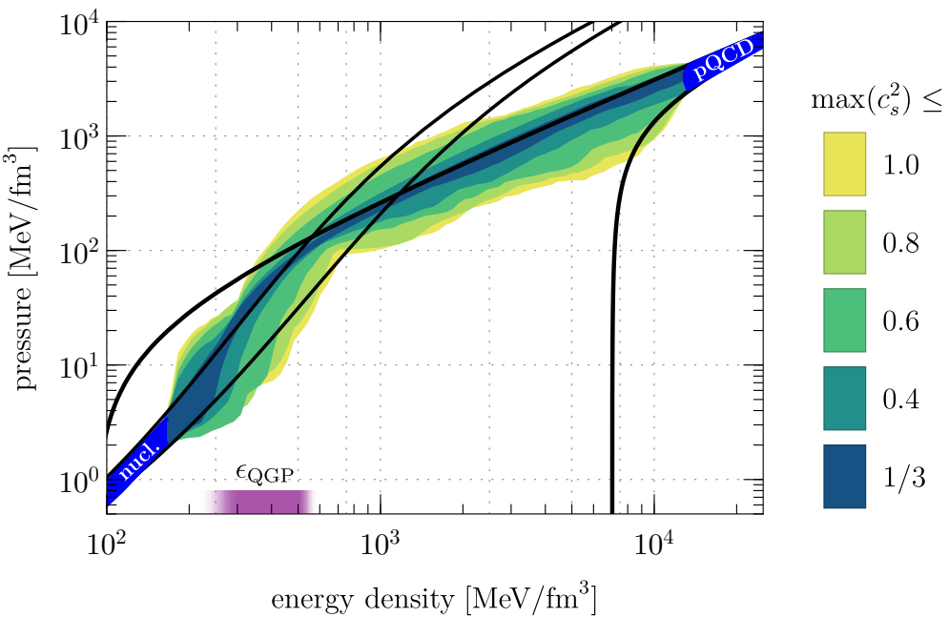
Two equations of state for dense (baryonic) matter
Wilke van der Schee, CERN/Utrecht
A phenomenological EOS
Constrained at low energy: nuclear theory
Constrained at high energy: Asymptotic freedom / perturbative QCD
Intermediate: speed of sound < 1
A holographic EOS
From holography (AdS/CFT) non-perturbative QFT model
Not exactly QCD (supersymmetric, etc)
First order phase transition
Christian Ecker, Matti Järvinen, Govert Nijs and WS, Gravitational Waves from Holographic Neutron Star Mergers (2019)
Eemeli Annala, Tyler Gorda, Aleksi Kurkela, Joonas Nättilä and Aleksi Vuorinen, Quark-matter cores in neutron stars (2019)

Slide 6
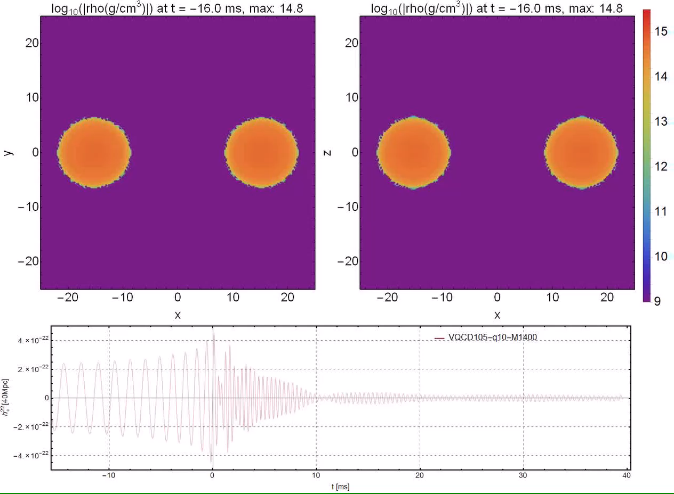
Wilke van der Schee, CERN/Utrecht
Mergers (Lorene+Einstein toolkit)
1.3 x 1.3: formation of hypermassive neutron star:

Slide 7
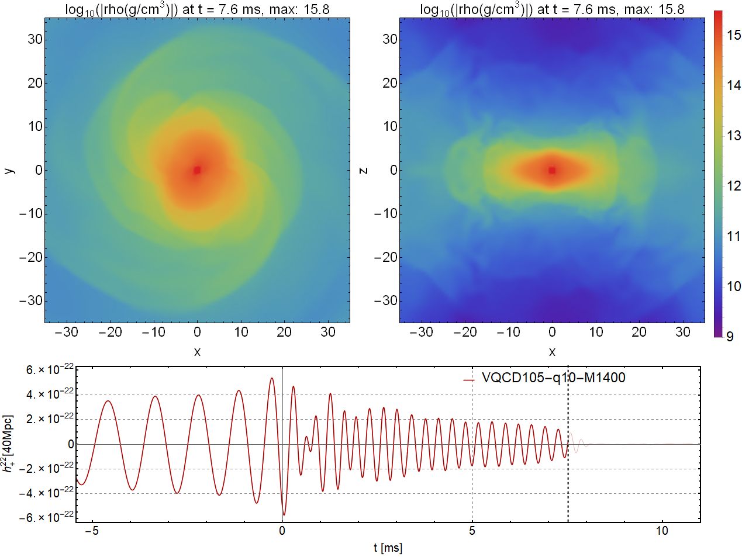
Wilke van der Schee, CERN/Utrecht
Phase transition: collapse
1.4 x 1.4: one frame before horizon is formed (detected?):
Phase transition such that pressure to small to support star

Slide 8
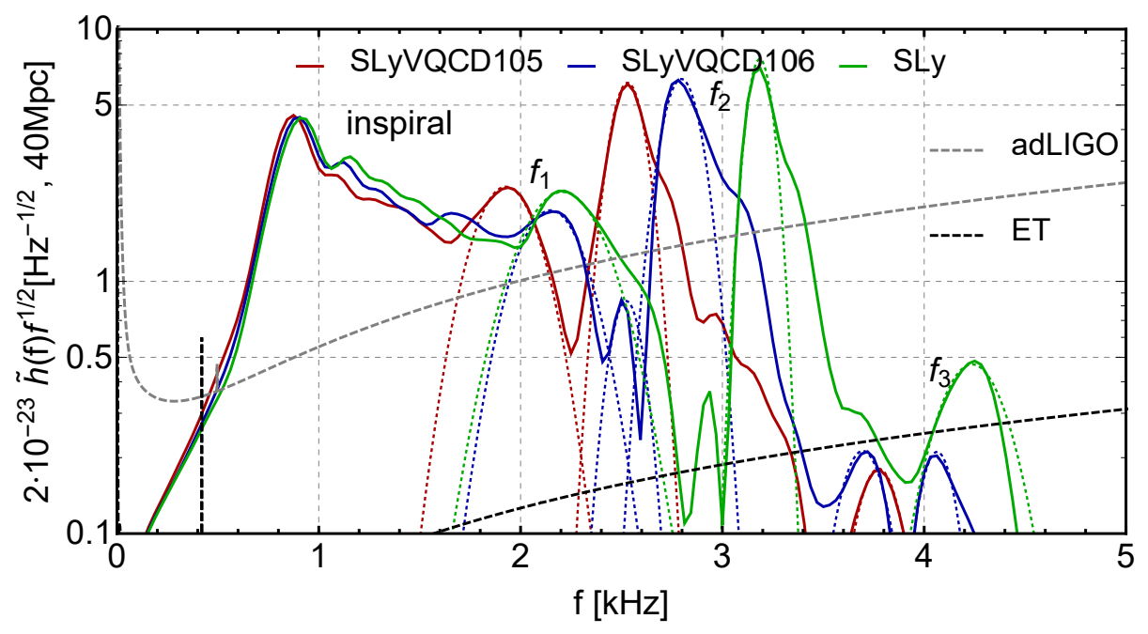
Power spectrum
Wilke van der Schee, CERN/Utrecht
Different equations of state: smaller frequencies
Also matches with intuition: SLyVQCD106 has `more’ SLy
Christian Ecker, Matti Järvinen, Govert Nijs and WS, Gravitational Waves from Holographic Neutron Star Mergers (2019)

Slide 9
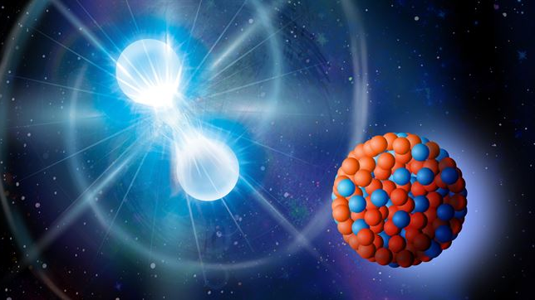
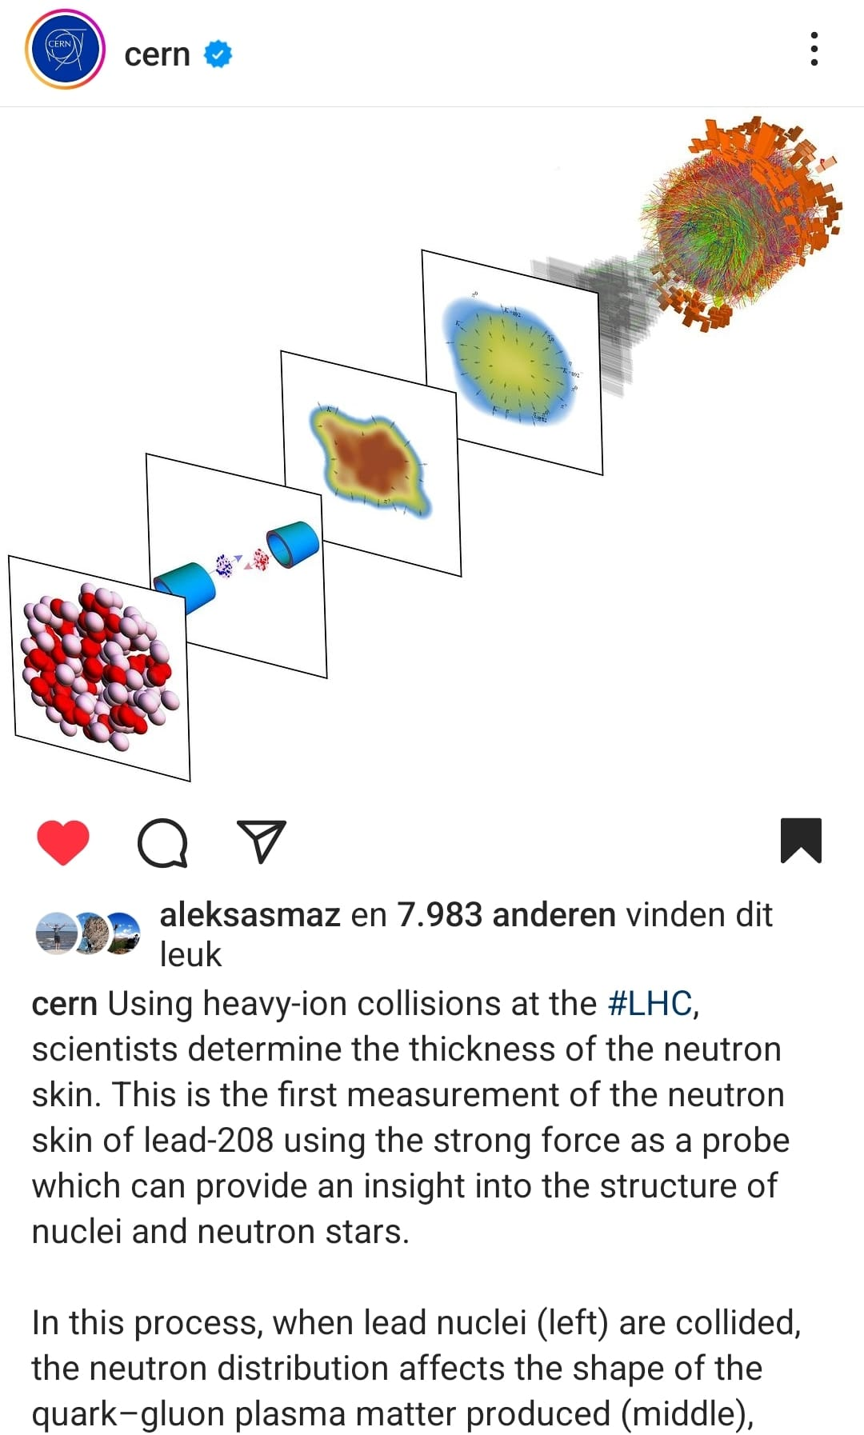
Neutron skin
With a short intro on Bayesian analysis

Slide 10
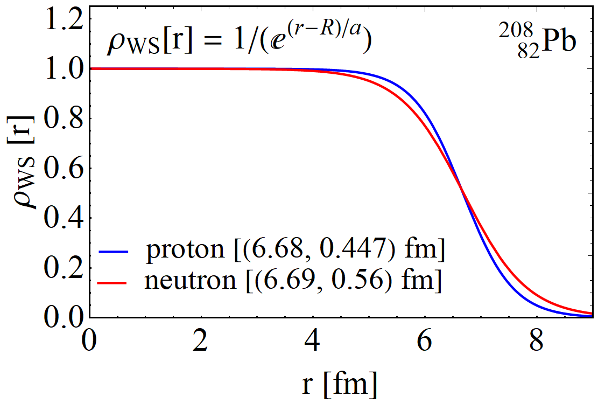
Short intro on neutron skin
Wilke van der Schee, CERN/Utrecht
In neutron rich nuclei the neutrons are on the outside
Typical examples
²⁰⁸Pb⁸²⁺ (PREX: Pb Radius Experiment, Jefferson Lab)
⁴⁸Ca²⁰⁺ (CREX: Calcium Radius Experiment)
All `doubly magic’ and spherical; also, compare ⁴⁰Ca²⁰⁺
The interesting fact
Pauli pressure (no two fermions at the same place) pushes neutrons out
The same pressure is there in neutron stars Remember, no space for electrons in neutrons stars, so no protons
(Outside) of neutron stars has a similar density as nuclei
→ The pressure in neutron stars is 1-to-1 related to neutron skin of Ca and Pb
?
Christian Schmidt and HotQCD and BNL-Bielefeld Collaborations, QCD bulk thermodynamics and conserved charge fluctuations with HISQ fermions (2013)

Slide 11
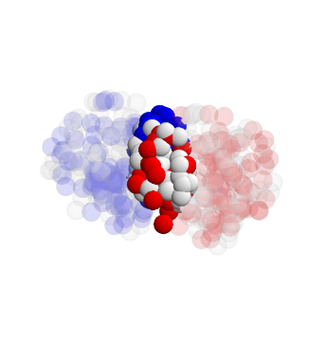
The neutron skin and QGP
Trento:
Nucleus charge profile can be measured very accurately
Much more uncertainty in the profile of the neutrons
Can we make progress using heavy ion collisions?
Isospin symmetry makes distinction neutron/proton difficult
Leverage accurate proton knowledge and obtain profile of nucleus?
How to obtain the profile of a nucleus?
We infer the profile from heavy ion collisions and QGP
Profile influences many observables
Interplay with viscosity, Trento model etc
Likely need a full global (Bayesian) analysis
Constantin Loizides, Jason Kamin and David d'Enterria, Improved Monte Carlo Glauber predictions at present and future nuclear colliders (2017)

Slide 12
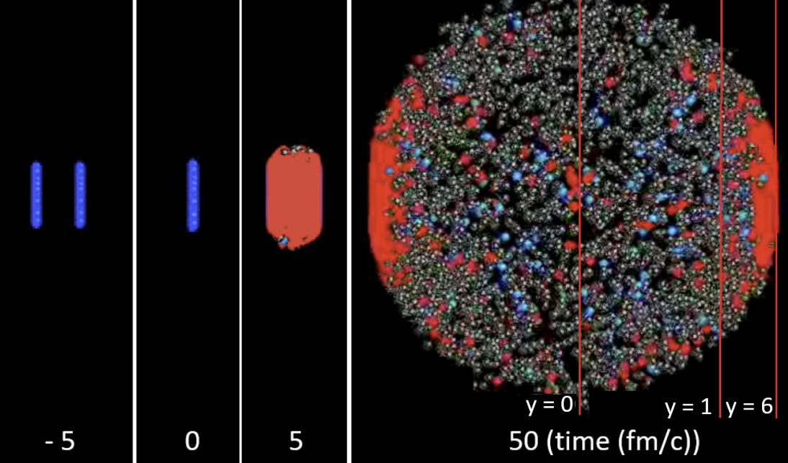
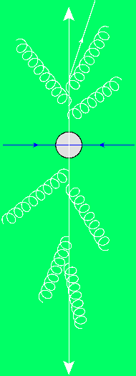
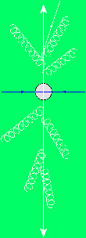
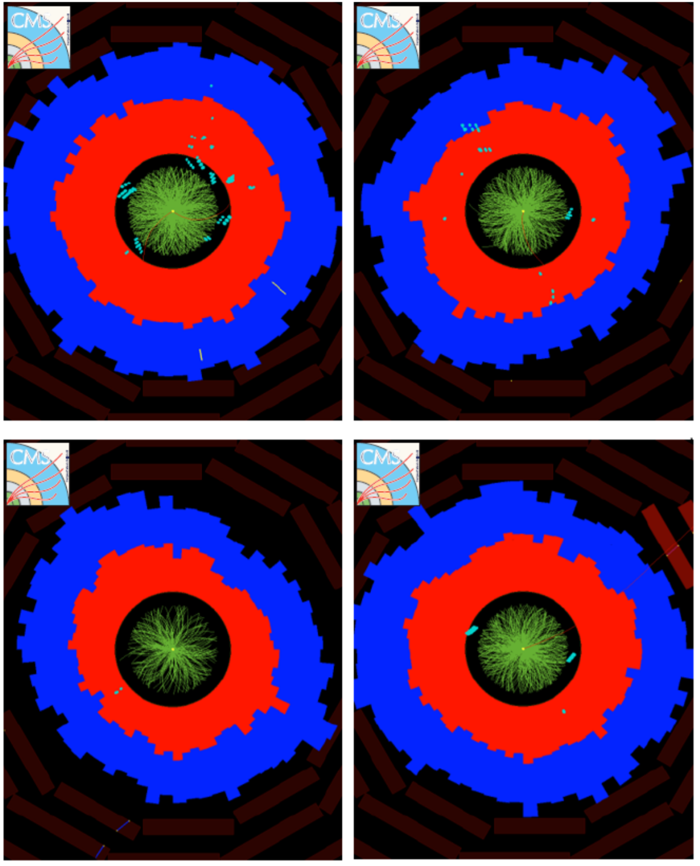

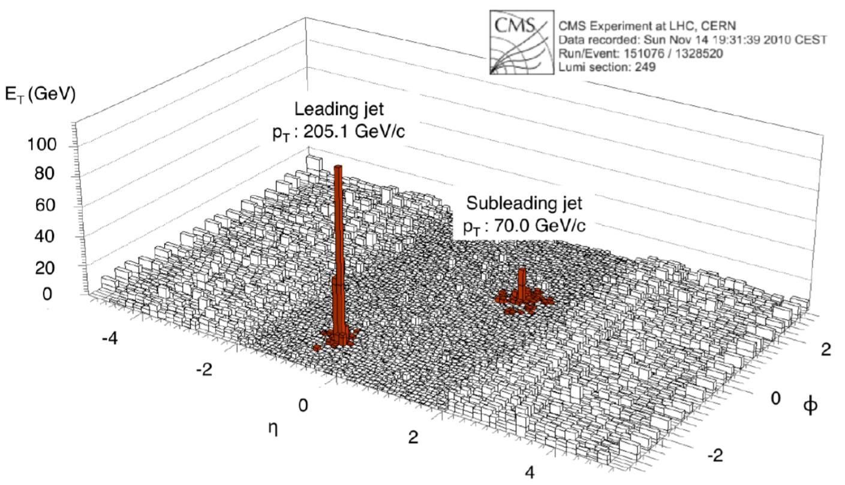
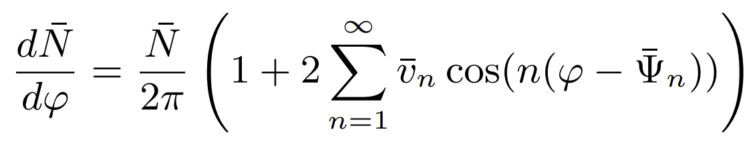
Relativistic Heavy Ion Collisions and Quark-gluon plasma
Wilke van der Schee, CERN
Initial stage - QGP - hadronic phase
Anisotropic flow (small viscosity)
Jet energy loss in dijet pair
Wit Busza, Krishna Rajagopal and WS, Heavy Ion Collisions: The Big Picture, and the Big Questions (2018)
Notes:
Historically: Weak coupling: slow thermalization and larger viscosity
Review: spectra at RHIC and LHC → fast QGP

Slide 13

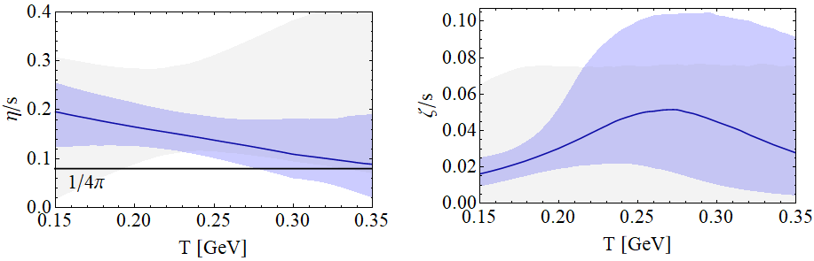

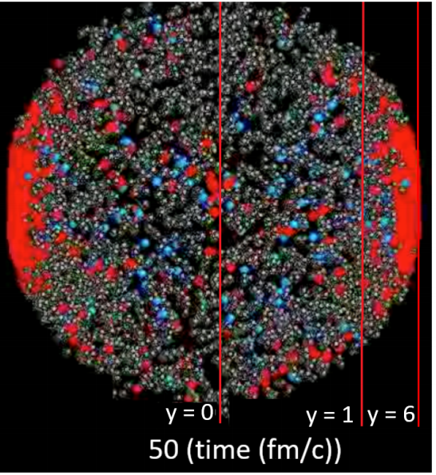
Standard model of heavy ion collisions
Wilke van der Schee, CERN/Utrecht
(# parameters)
Initial stage (13)
Viscous hydrodynamics (10)
Cascade of hadrons (2)
SMASH
Subnucleonic structure? (8)
Non-thermal flow? (2) with hydrodynamised initial stage
Fluctuations? (1)
Shape (2)
Shear viscosity (4)
Bulk viscosity (3)
Second order transports: 2
EOS: 1
Jonah Bernhard, Scott Moreland and Steffen Bass, Bayesian estimation of the specific shear and bulk viscosity of quark–gluon plasma (2019)
Govert Nijs, WS, Umut Gursoy and Raimond Snellings, A Bayesian analysis of Heavy Ion Collisions with Trajectum (2020)

Slide 14

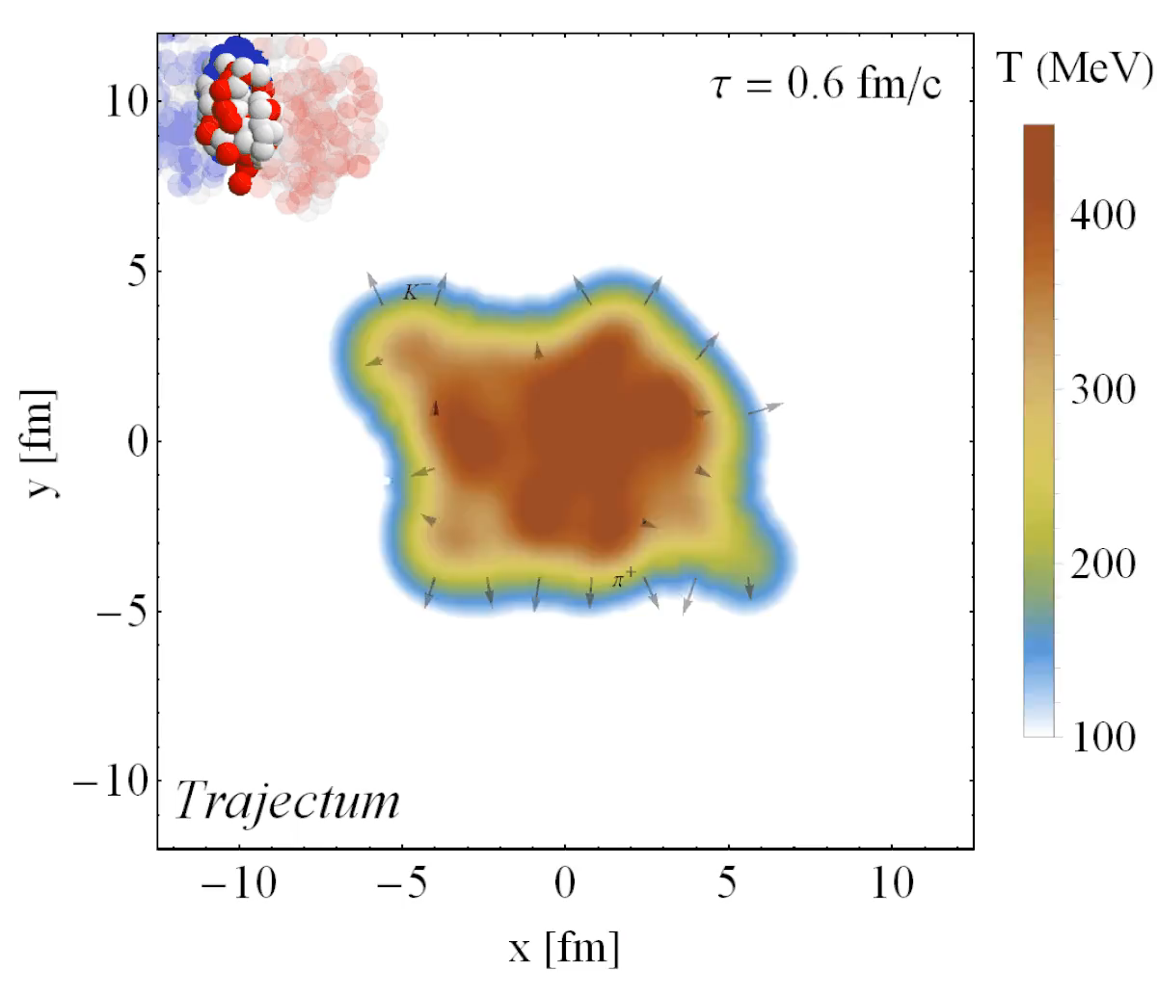
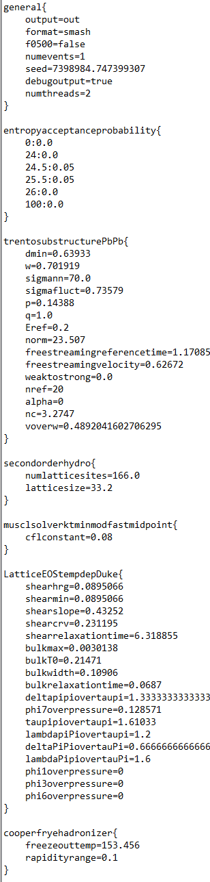
Trajectum
Developed as PhD thesis by Govert Nijs and Umut Gursoy
Quite straightforward to use (see param file, right)
Includes analyse routine
Parallelised: can analyse unlimited number of events
http://sites.google.com/view/govertnijs/trajectum
http://wilkevanderschee.nl/trajectum

Slide 15
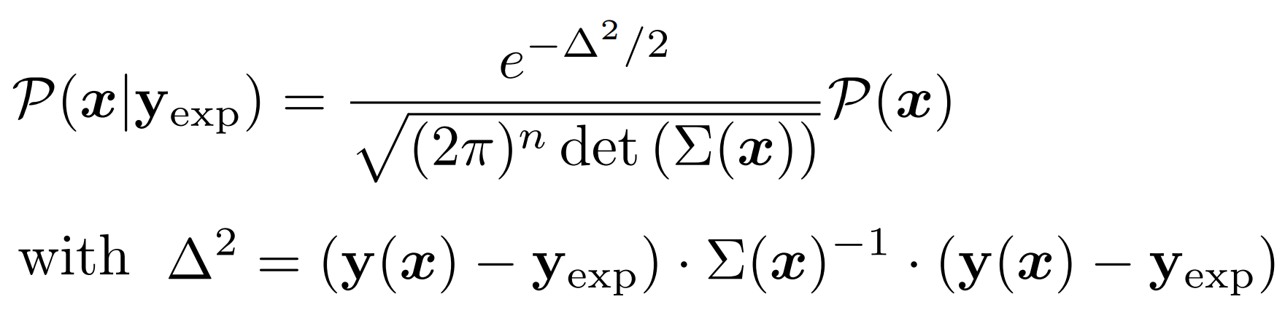
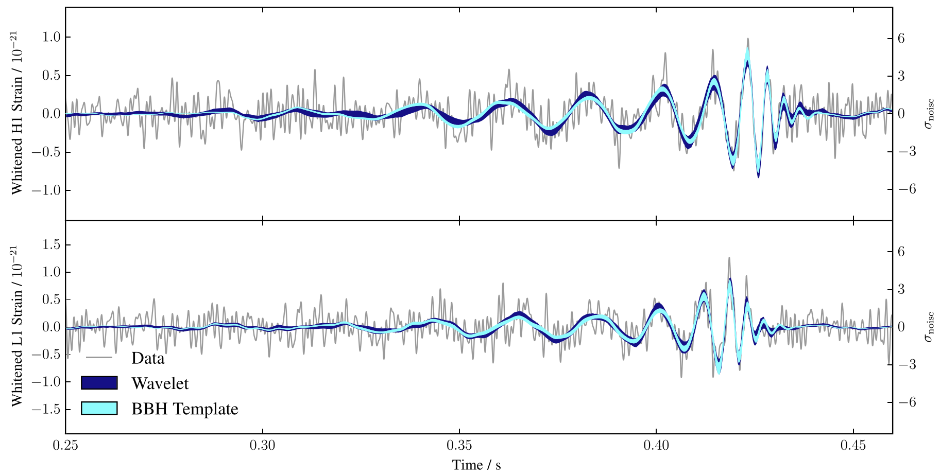
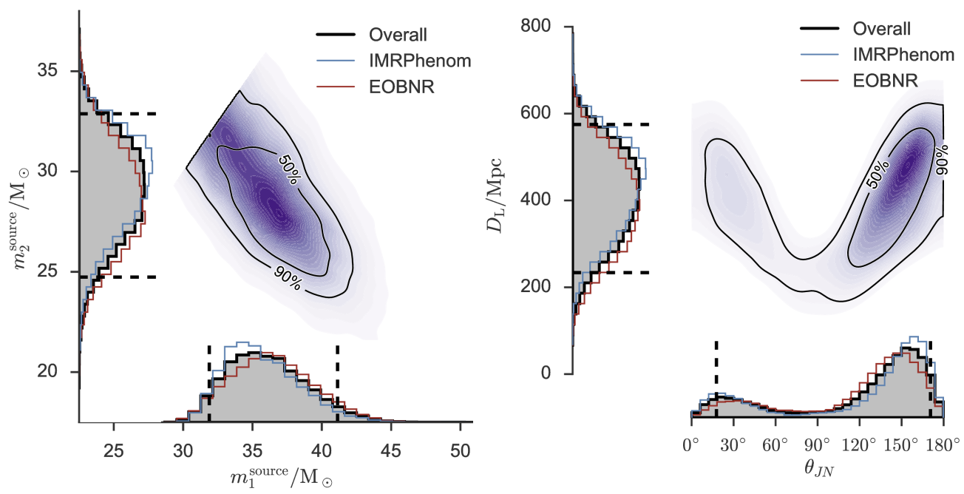
Performing a global analysis
Wilke van der Schee, CERN/Utrecht
Bayes theorem:
Same technique: gravitational waves
Model depends on parameters non-linearly
Run model on 3000 `design’ points
Use an emulator for any point in parameter space (GP)
Markov Chain Monte Carlo
653 data points
Obtain posterior probability density of parameters
Compare posterior with data
Can include high statistics run
LIGO, Properties of the Binary Black Hole Merger GW150914 (2016)
Notes:
Parameters influence observables in complex and non-linear way
Global analysis needed
Run on design points + emulate
MCMC with Bayes theorem and over 500 datapoints
Verify that high probability parameter set works well with other observables
Similar to gravitational waves with for instance waveform determines correlation between distance and inclination

Slide 16
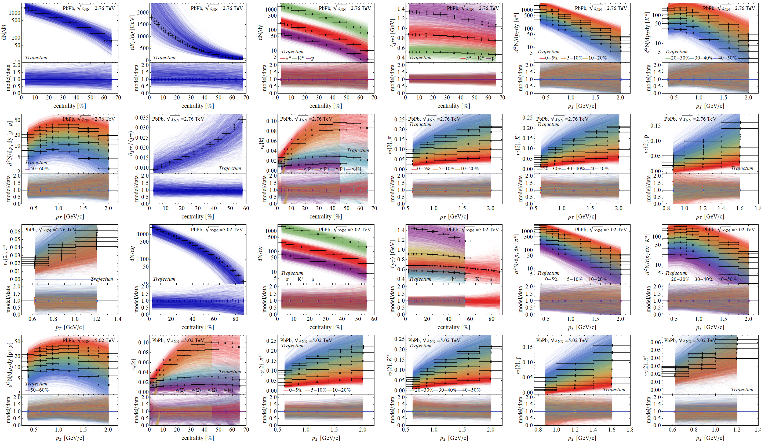
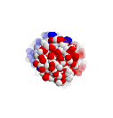

Experimental observables: a wealth of data
Prior

Slide 17
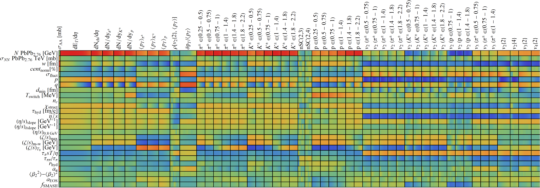
Design parameter-observable correlations:
Wilke van der Schee, CERN/Utrecht

Slide 18
Experimental observables: a wealth of data
Prior

Slide 19
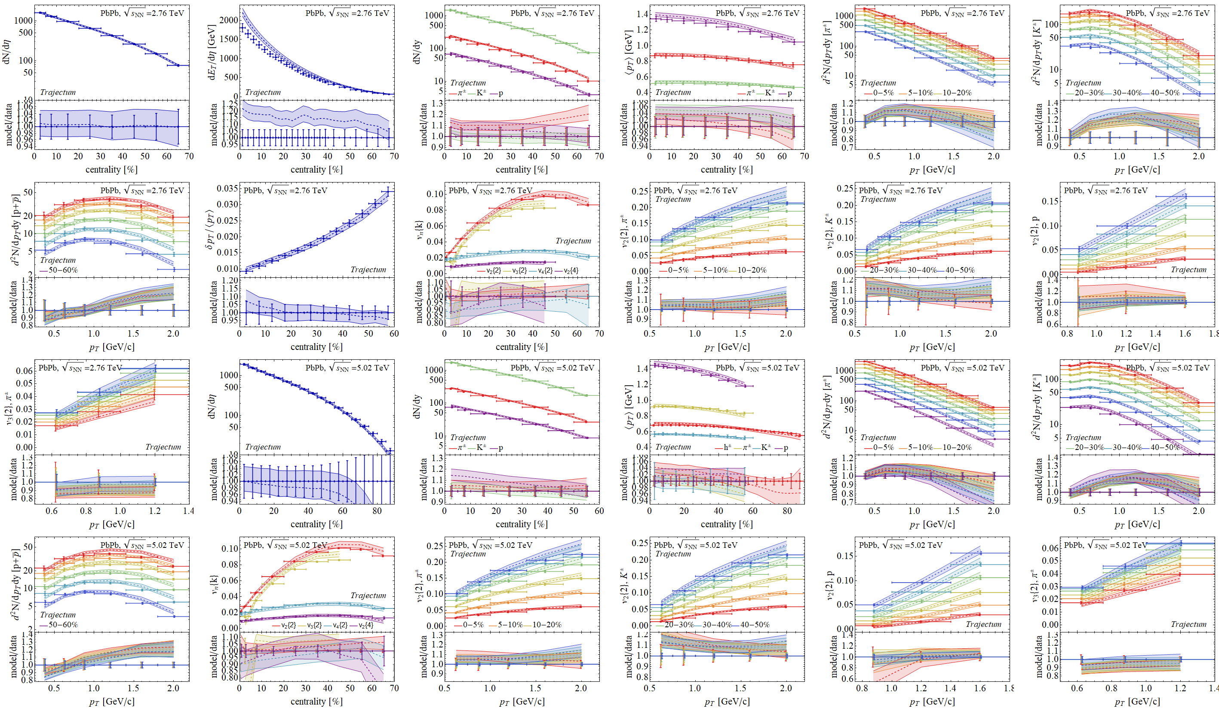
Experimental observables: a wealth of data
Posterior

Slide 20


Posterior

Slide 21
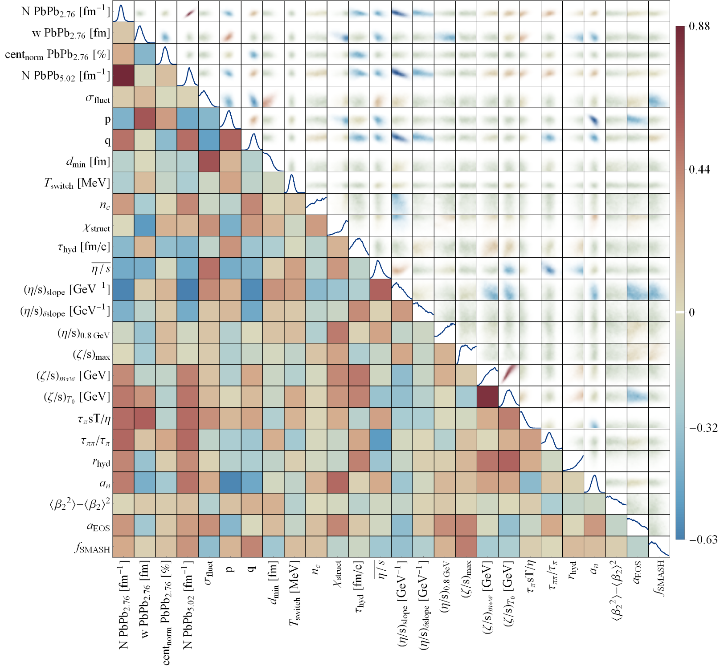
Full posterior distributions
Wilke van der Schee, CERN/Utrecht
Some parameters better constrained than others
Correlations add important information, e.g. average shear viscosity better constrained than its value

Slide 22
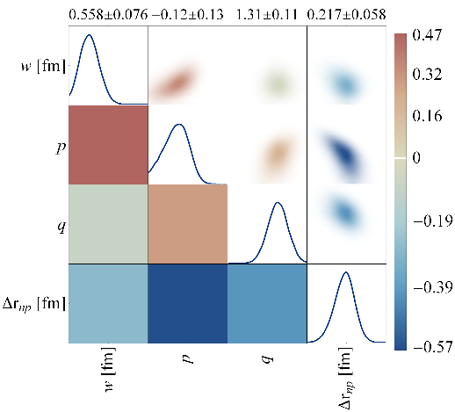
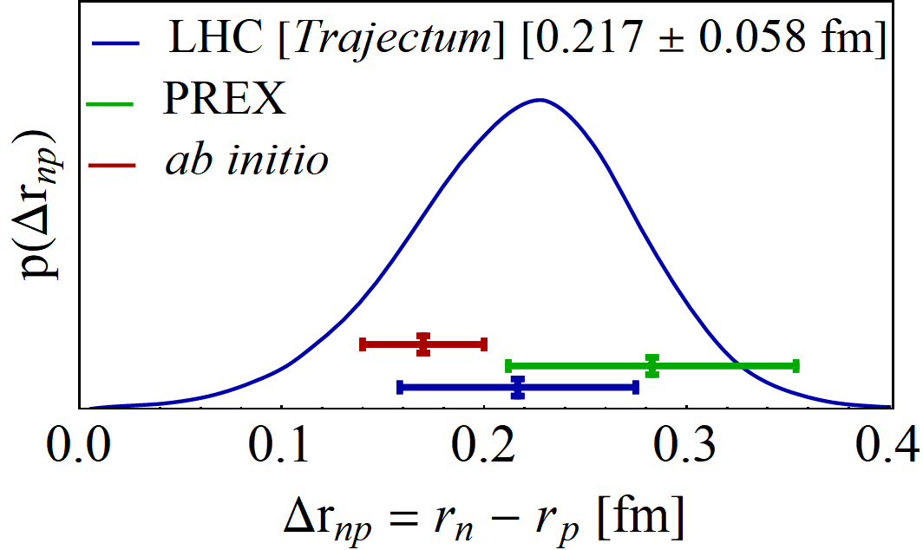
The neutron skin – final result
Transform to neutron radius minus proton radius
Final result consistent but smaller than PREX II
Uncertainty is about 20% smaller than PREX II
Cross section is crucially important, but also centrality dependence
Important to vary Trento parameters in particular
PREX II, Accurate Determination of the Neutron Skin Thickness of ²⁰⁸Pb through Parity-Violation in Electron Scattering (2022)
Baishan Hu et al, Ab initio predictions link the neutron skin of 208Pb to nuclear forces (2021)

Slide 23
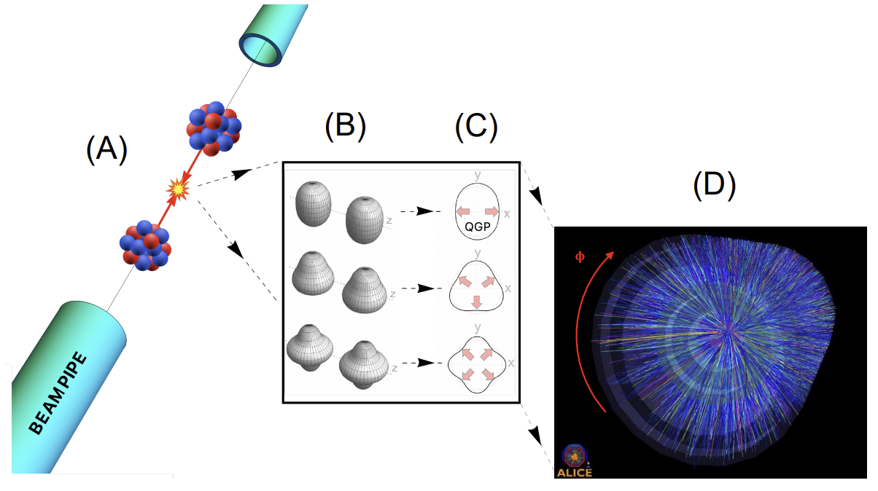
The shape of nuclei
Hydrodynamics converts position space anisotropy into momentum space anisotropy
Benjamin Bally, James Daniel Brandenburg, Giuliano Giacalone, Ulrich Heinz, Shengli Huang, Jiangoyng Jia, Dean Lee, Yen-Jie Lee, Wei Li, Constantin Loizides, Matthew Luzum, Govert Nijs, Jacquelyn Noronha-Hostler, Mateusz Ploskon, WS, Bjoern Schenke, Chun Shen, Vittorio Somà, Anthony Timmins, Zhangbu Xu and You Zhou
Imaging the initial condition of heavy-ion collisions and nuclear structure across the nuclide chart (2022)

Slide 24
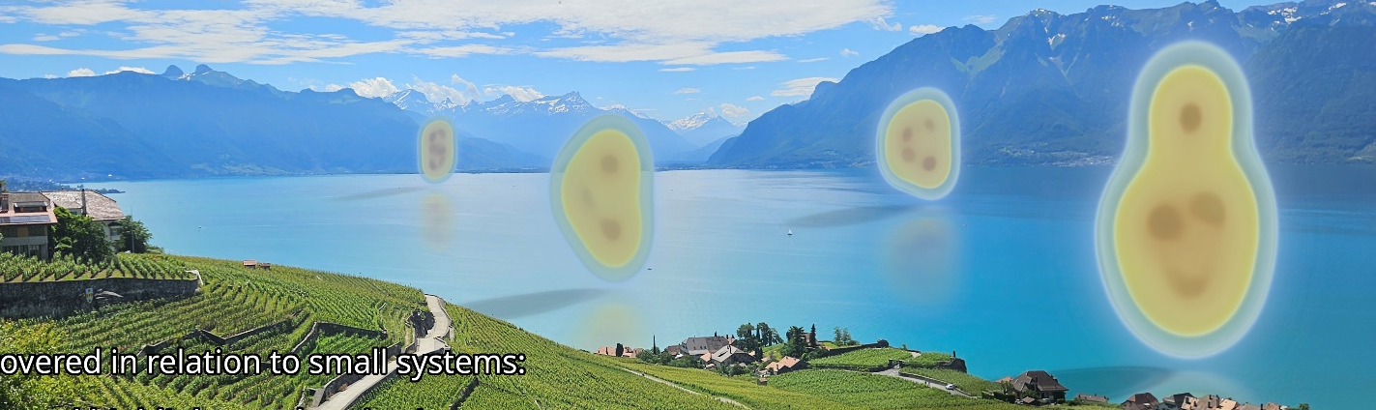
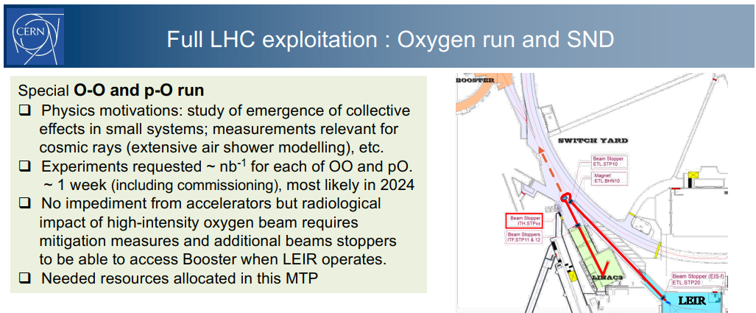
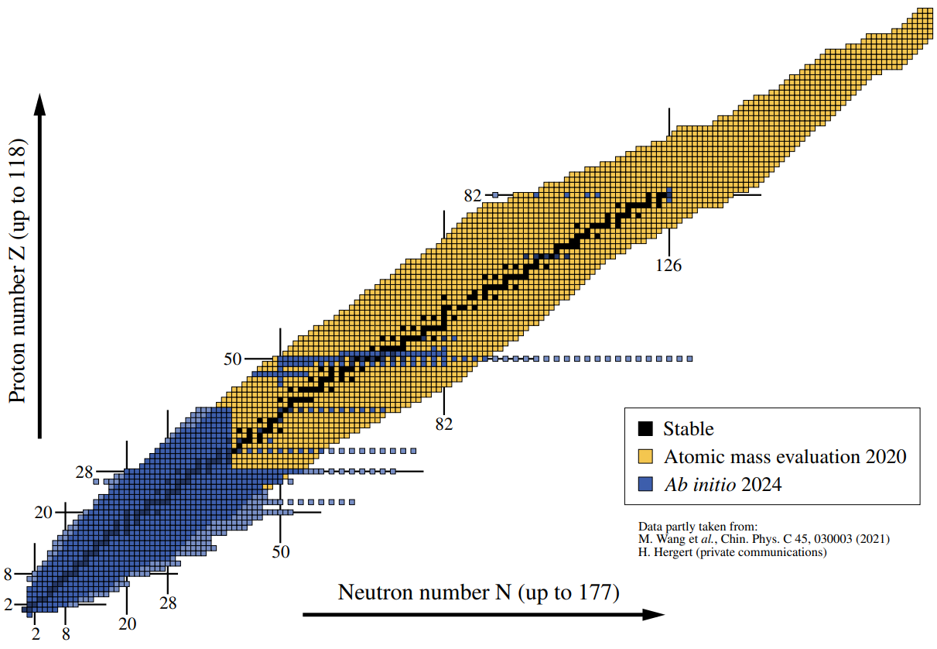
Light ion collisions at the Large Hadron Collider
Key to answering questions about `small systems’
When does hydrodynamics stop applying? What’s the smallest droplet?
New interesting physics
How do these light ions look like?
Interesting interplay with nuclear structure community
A related question
Can we see quarks/gluons losing energy in these small droplets of QGP?
https://cern.ch/lightions2025

Slide 25
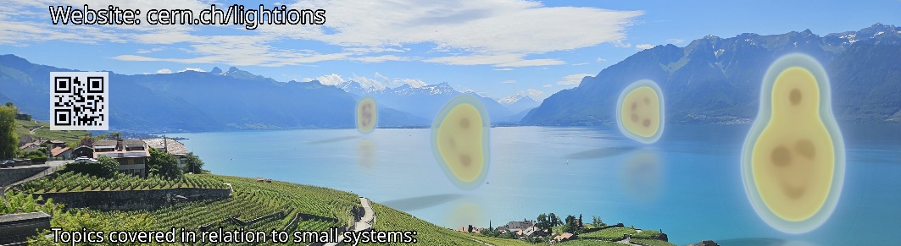

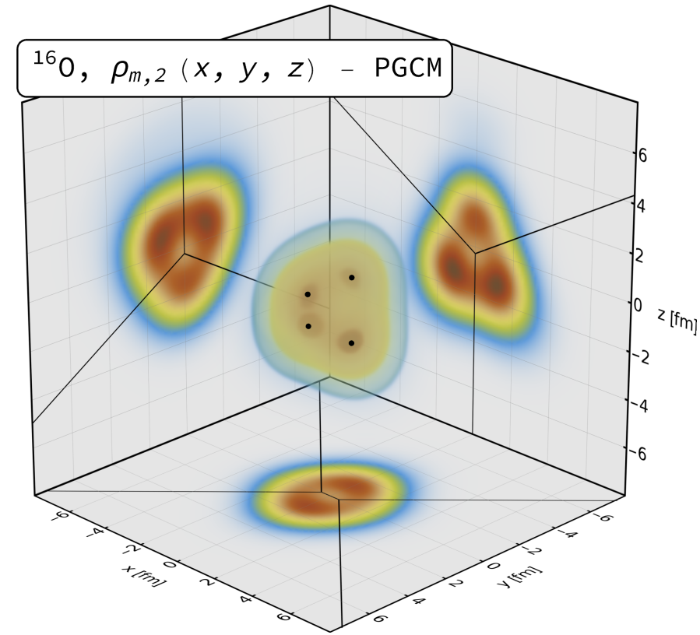
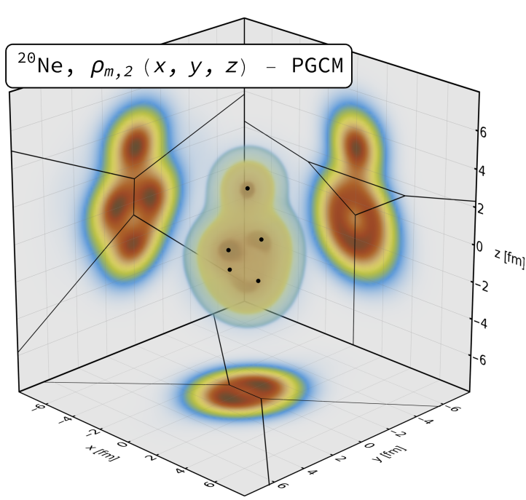

¹⁶Oxygen and ²⁰Neon nuclear structure
Studied using two complementary nuclear structure methods:
State-of-the-art Projected Generator Coordinate Method (PGCM)
N³LO chiral EFT with Hartree-Fock-Bogoliubov constrained states
We sample 4 nucleons in Voronoi regions determined by 4 or 5 local maxima
`Pinhole’ configurations from Nuclear Lattice Effective Field Theory (NLEFT)
Minimal pionless EFT Hamiltonian, lattice of eight sites (spacing = 1.315fm)
Output is directly nucleon positions (!)
Giuliano Giacalone, Benjamin Bally, Govert Nijs, Shihang Shen et al,The unexpected uses of a bowling pin: exploiting 20Ne isotopes for precision characterizations of collectivity in small systems (2024)

Slide 26





Did we see α – clustering? (I think yes)
After 10 hours convincingly 2% ²⁰Ne – ⁴He collisions in ALICE
Not seen in Oxygen collisions (!)
Not yet seen in other experiments (pile-up, different bunches?)
The (only?) convincing argument why this happens:
Neon top α breaks off
Related: First excited state Neon much lower energy
Much more convincing than flow measurements
Unexpected benefit: first time asymmetric nuclear collisions at top LHC energy (!)
Govert Nijs and WS, Transmutation of 16O and 20Ne at the Large Hadron Collider (2025)
https://indico.cern.ch/event/1436085/contributions/6107509/attachments/2966206/5218662/talk_bally_cern_13112024.pdf
https://indico.cern.ch/event/1479384/contributions/6631982/attachments/3130687/5553818/JFGO8p.pdf

Slide 27




Exciting times: light ion collisions allow(ed?) for genuine predictions
Hydrodynamic predictions for light ion collisions All the way to dN/dη ~ 10; hydro at its limits?
Model is (only!) fitted to PbPb data
Agreement almost too good to be true? Actually ALICE and CMS do not agree.. Also: non-hydro models tend to be off (but notice lack of syst uncertainty)
Giuliano Giacalone et al, The unexpected uses of a bowling pin: exploiting 20Ne isotopes for precision characterizations of collectivity in small systems (2024)
CMS, First measurement of pseudorapidity distributions of charged hadrons in oxygen-oxygen collisions at √s_{NN}= 5.36 TeV (2025)
https://indico.cern.ch/event/1479384/contributions/6663047/attachments/3131557/5555439/IS_mult_v3.pdf

Slide 28





Anisotropic flow
Overall very good agreement
AMPT and IP-GLASMA about 20% too high for central elliptic flow
Trajectum about 20% low for peripheral (but see ATLAS for non-flow subtraction)
ATLAS
CMS
ALICE
https://cds.cern.ch/record/2942004/files/HIN-25-009-pas.pdf (CMS)
https://arxiv.org/pdf/2509.05171 (ATLAS)
https://arxiv.org/abs/2509.06428 (ALICE)

Slide 29



Anisotropic flow --- Neon over Oxygen ratio
Ratio: many of the (systematic) uncertainties cancel (stat. error negligible, 10B collisions (!))
0-1% elliptic flow ratio significantly overestimated
But: uncertainty is only one standard deviation (treat uncertainty seriously)
Also: PGCM significantly closer
Finally: learning more about subnucleonic structure can be important (backup)
https://cds.cern.ch/record/2942004/files/HIN-25-009-pas.pdf (CMS)
https://arxiv.org/pdf/2509.05171 (ATLAS)
https://arxiv.org/abs/2509.06428 (ALICE)

Slide 30








Exciting times: light ion collisions allow(ed?) for genuine predictions
Big thanks to LHC and the experiments for hard work and excellent performance

Slide 31
Back-up

Slide 32

A true prediction using hydrodynamics (rare these days…)
Non-trivial curve; non-monotonicity was unexpected
Extremely precise (<0.1%) due to uncertainty cancellations in the ratio (theory & experiment (!))
Fernando G. Gardim, Giuliano Giacalone and Jean-Yves Ollitrault, The mean transverse momentum of ultracentral heavy-ion collisions: A new probe of hydrodynamics (2019)
Govert Nijs and WS, Predictions and postdictions for relativistic lead and oxygen collisions with the computational simulation code Trajectum (2021)
Austin Baty, Overview of Recent CMS results, https://indico.cern.ch/event/1139644/contributions/5343932/ (see also Cesar Bernardes)

Slide 33


What is happening?
(Extremely) ultracentral collisions are not driven by impact parameter
Size does not extend beyond radius Lead nucleus
(Local) fluctuations drive up multiplicity
Average temperature can still increase
A simplified picture:
Entropy increase → multiplicity increases
Temperature increases → mean pt increases (assuming ideal hydro + constant `work’ done in rapidity direction)
Slope: sensitive to speed of sound (solely ?!):
Fernando G. Gardim, Giuliano Giacalone and Jean-Yves Ollitrault, The mean transverse momentum of ultracentral heavy-ion collisions: A new probe of hydrodynamics (2019)

Slide 34



Quark-gluon plasma (QGP)
Wilke van der Schee, CERN/Utrecht
Quantum-Chromodynamics (QCD)
Recreating the big bang
At age 1 μs the entire universe was QGP!
QGP turns out interesting
Strongly coupled quantum matter
A fundamental force of nature
Notes:
QGP is perhaps simplest interesting fluid in nature
Elementary particles, cosmology
Not a free gas: strongly interacting quantum matter
Theoretical perspective: strong and QCD point of view
Experimental data

Slide 35





Wilke van der Schee, CERN/Utrecht
CERN accelerator complex
Le reculet/Jura
ATLAS/TH
ALICE
Rhône
SPS/Prévessin
CMS
LHCb
Lac Léman/Lake Geneva
Notes:
QGP created at hadron colliders
Contribution Utrecht to ALICE
Contributions from all experiments

Slide 36



The neutron skin - posterior
Trento:
Three parameters are most sensitive to the neutron skin:
The nucleon width and the Trento parameters p and q
Small correlation with width (cross section is highly sensitive to w)
Very strong anticorrelation with p; centrality dependence is important

Slide 37



Alphas from nuclear structure
Two big surprises (at least to me ☺)
¹⁶O alphas do not form a regular tetrahedron (!) → more like two coupled rods Similar results in NLEFT
²⁰Ne alphas do not form a bipyramid (!) → seemingly randomly placed on top… (was a challenge to find due to breaking of symmetry, credit to Benjamin Bally)
Of course the intuition of alphas as point particles with interaction energy is really quite naïve…
Giuliano Giacalone, Benjamin Bally, Govert Nijs, Shihang Shen et al,The unexpected uses of a bowling pin: exploiting 20Ne isotopes for precision characterizations of collectivity in small systems (2024)

Slide 38


How do we see α-clustering?
The first obvious try: compare Woods-Saxon with alpha clustered shape
Significantly different flow
PGCM ab initio close to case II (green, not very different from WS)
But how to correct for systematic uncertainty due to viscosity etc etc?
Nicholas Summerfield, Bing-Nan Lu, Christopher Plumberg, Dean Lee, Jacquelyn Noronha-Hostler and Anthony Timmins, 16O16O at RHIC and the LHC comparing α clustering vs substructure (2021)
Yuanyuan Wang, Shujun Zhao, Boxing Cao, Ho-jie Xu and Huichao Song, Exploring the compactness of α cluster in 16O nuclei with relativistic 16O+16O Collisions (2024)

Slide 39




The mean transverse momentum – an interplay with hard probes
A path-length approach to energy loss: assume energy loss ~ T³ and extrapolate from (central) PbPb
Also significant difference between PGCM and NLEFT
CMS data somewhere in the middle? (no uncertainties available though…)
WS, Isobel Kolbe, Govert Nijs, Kumail Ruhani, Ishtiaq Ahmed and Shahin Iqbal, Three models for charged hadron nuclear modification from light to heavy ions (2025)

Slide 40

Transmutation: a prediction
The mean transverse momentum of Ne-He will be measured and large
Close analogy with `speed of sound’, or ultracentral PbPb
But in much smaller system (!)
WS and Govert Nijs, Transmutation of 16O and 20Ne at the Large Hadron Collide (2025)

Slide 41



Anisotropic flow --- ratio: subnucleonic structure
Actually: not all uncertainties cancel in the ratio
Subnucleonic structure affects oxygen significantly more than neon
Reducing 0-1% ratio by up to 10%
Potentially even making NLEFT viable as a structure
Consistent with IP-Glasma?
→ Seeing first hints about how we can learn about hydro, small systems, initial stage, nuclear structure etc etc
NEW in IS2025

Slide 42
The mean transverse momentum
Uncertainty (especially in ratio) completely dominated by nuclear structure
Mean transverse momentum dominated by size plasma
Actually the (charged) radius of oxygen and neon is well constrainted:
¹⁶O [fm]: 2.76 (NLEFT), 2.87 (PGCM), 2.6955 (exp)
²⁰Ne [fm]: 3.17 (NLEFT) 3.09 (PGCM), 3.0055 (exp)
Ratio: 1.14 (NLEFT), 1.08 (PGCM), 1.11 (experiment)
So the discrepancy is fairly well understood and the true mean p_{T} ratio likely lies somewhere in the middle

Slide 43

Anisotropic flow --- SMOG2
Fixed target mode LHCb
Lower energy, asymmetric 3+1D hydro
Very accurate predictions from NLEFT + Chun Shen QM25, including v₃
https://indico.cern.ch/event/1479384/contributions/6663093/attachments/3132588/5557527/IS25.pdf (SMOG2)
https://indico.cern.ch/event/1334113/contributions/6289808/ (Bjoern Schenke, Chun Shen,Heikki Mäntysaari and Wenbin Zhao)

Slide 44

















Exciting times!
Many more measurements will follow
Mean p_{T}, higher order correlations like ρ₂, ultracentral fluctuations, spectra, jets
Much better understanding of the shape
Hydrodynamics at its limits!
Energy loss in small systems
Ne-He collisions

