Slide 1


Heavy Ion Physics with ATLAS
בס"ד
Zvi Citron
for the ATLAS Collaboration
INTERNATIONAL WORKSHOP ON DISCOVERY PHYSICS AT THE LHC
Kruger 2012

Slide 2
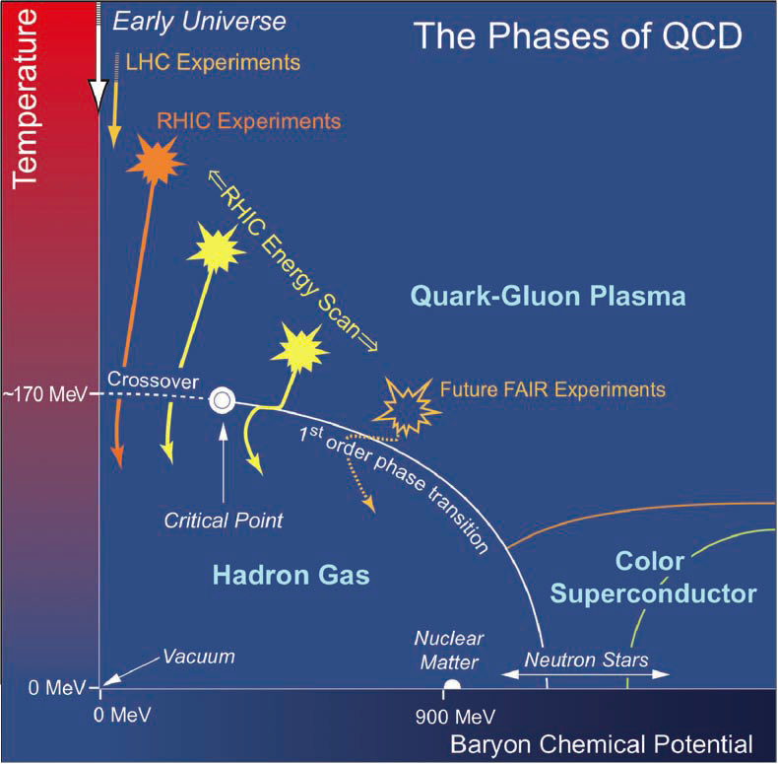
Heavy Ion Collisions
Collide heavy ions in order to (re)create a hot, dense QCD medium of deconfined quarks

Slide 3
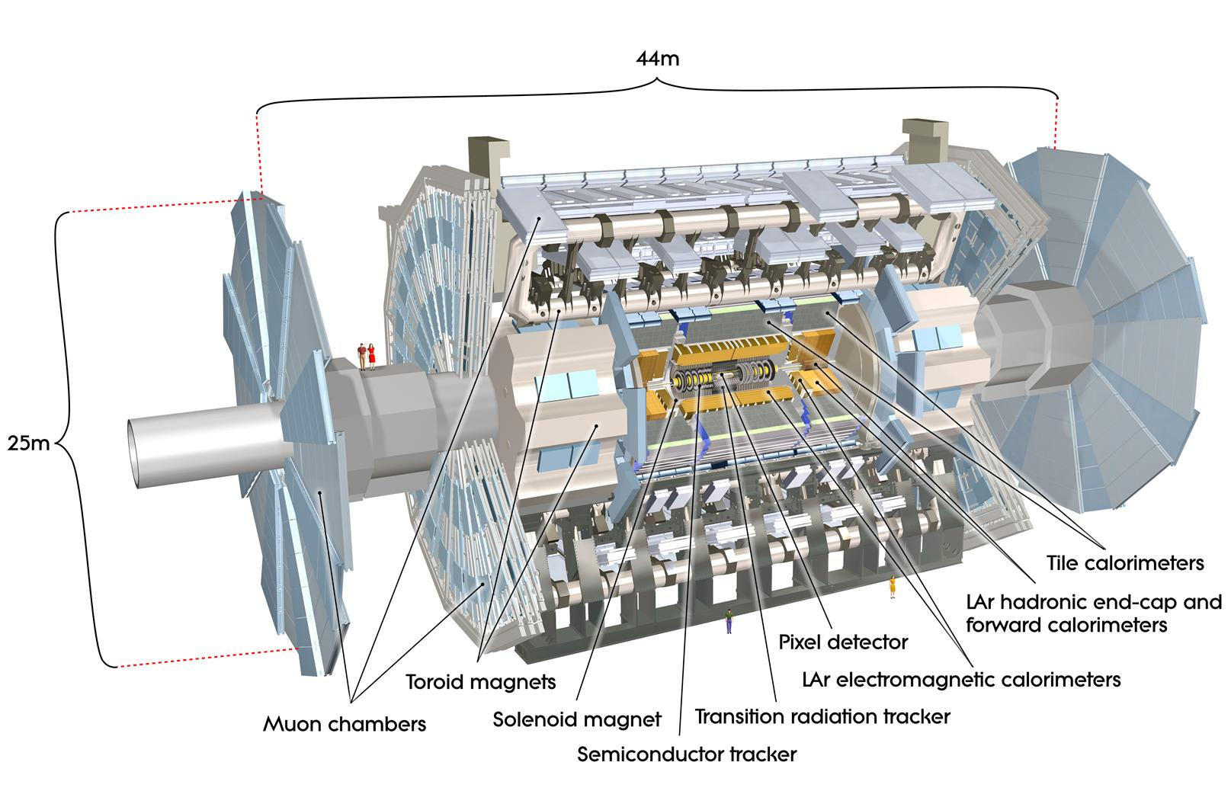
HI at ATLAS
In addition to the high energy p+p program, LHC and ATLAS have a robust Heavy Ion program
Muon spectrometry, calorimetry, and charged tracking are well suited for HI
2010 and 2011 included Pb+Pb runs at √s=2.76 TeV
(p+Pb coming soon …)
Bulk/Collective Properties
  Bulk yield
  Event by event fluctuations
  Particle Flow
Penetrating Probes
  High momentum charged particles (inclusive and HF)
  Jets and jet properties
  EW Bosons

Slide 4
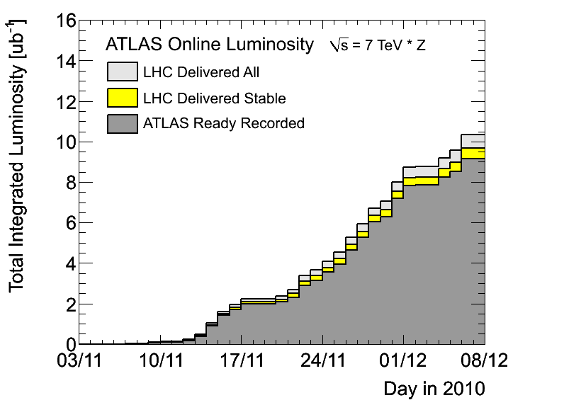
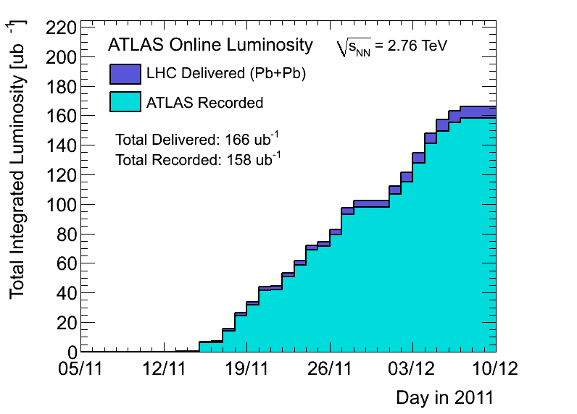
Data Samples
2010
2011
Run: | 2010 | 2011
L_{int} | 8 ub⁻¹ | 0.15 nb⁻¹
Triggers | Min Bias | γ(e), μ, jets, Min Bias, UPC
N_{events} (0-80)% | 30-40M | 750-800M

Slide 5
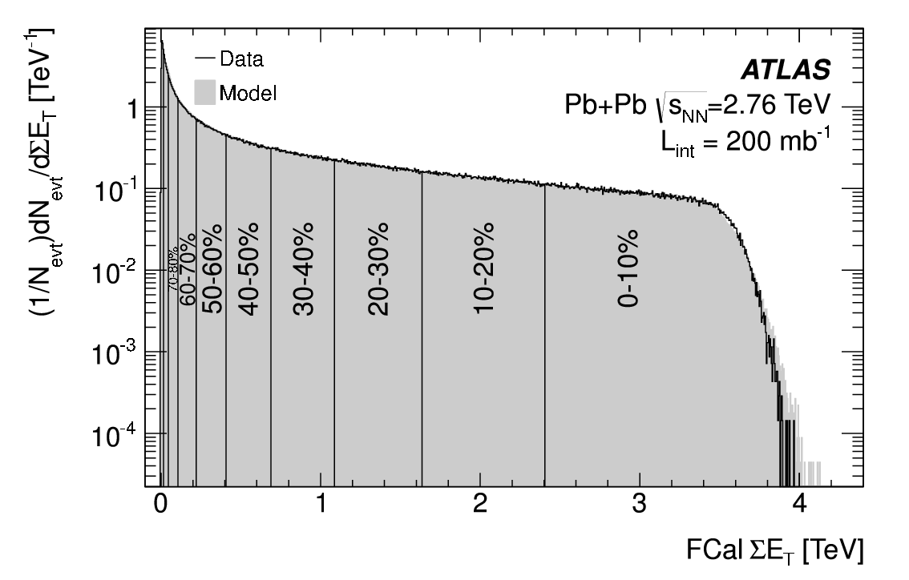
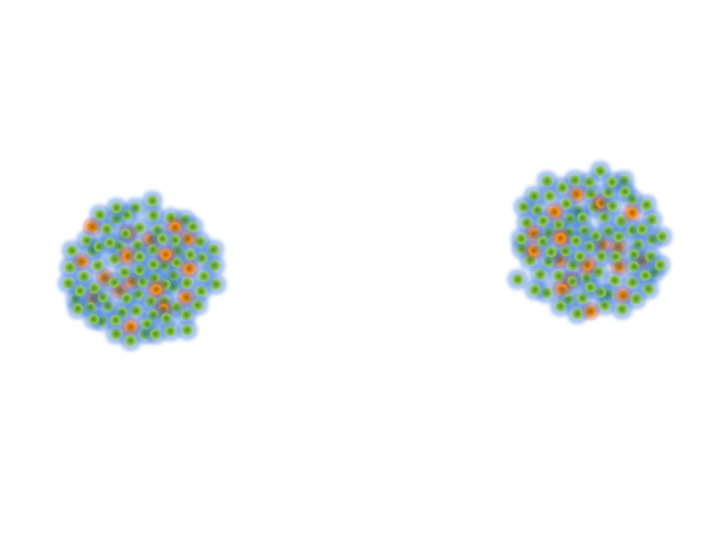
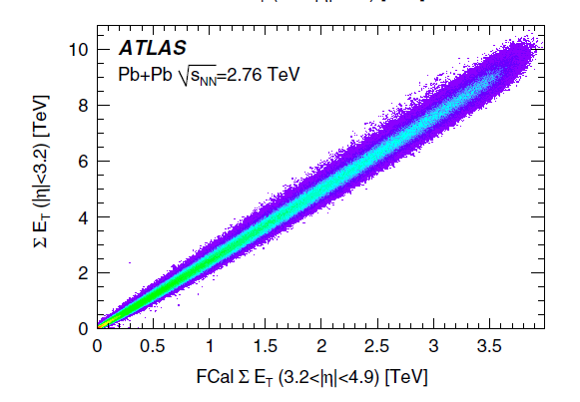
Centrality
Phys.Lett. B707 (2012) 330-348
Spectators
Participants
Binary
Collisions
Precise control over collision geometry!
 | <N_{part}>
0-5% | 382 ± 1%
5-10% | 330 ± 1%
10-20% | 261 ± 2%
20-40% | 158 ± 3%
40-80% | 46 ± 6%
<N_{coll}>
1683 ± 8%
1318 ± 8%
923 ± 7%
441 ± 7%
78 ± 9%
5

Slide 6
Charged Particle Multiplicity
Central A+A multiplicity grows faster with √s_{NN} than p+p
Log – scaling (seen up to RHIC energies) is ruled out
Shape consistent between LHC and RHIC despite order of magnitude increase in √s_{NN}
Phys.Lett.B710 (2012) 363-382

Slide 7
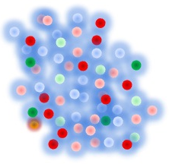
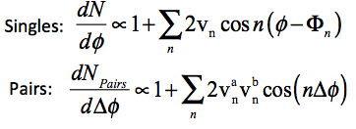
Particle Flow in HI Collisions
Initial geometry (and fluctuations) lead to n moments of deformation of the fireball
Spatial anisotropies observable in momentum space due to collective flow
Study of the moments, v_{n}, and correlations between reaction planes, Φ_{n}, teaches us about the initial geometry and expansion
Φ₂
Reaction plane
Φ₄
Φ₃

Slide 8
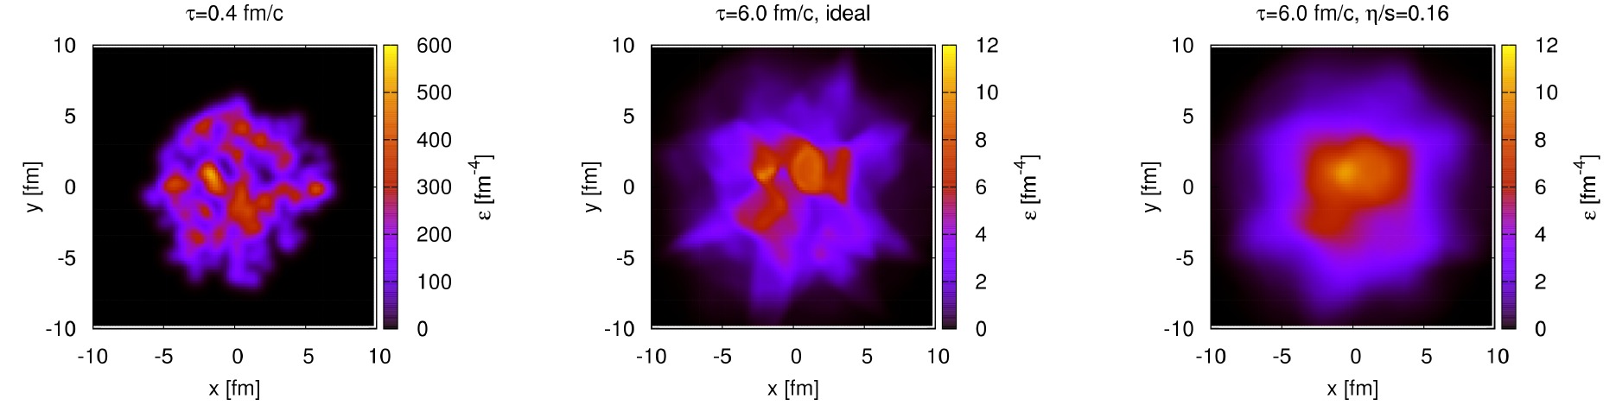
Initial → Final
Hydrodynamic evolution of the system
Natural parameter: viscosity scaled with the particle density (entropy density, s)
low η/s means strong coupling
Ideal
6 fm / c
viscous
Phys.Rev.Lett.106, 042301 (2011)

Slide 9
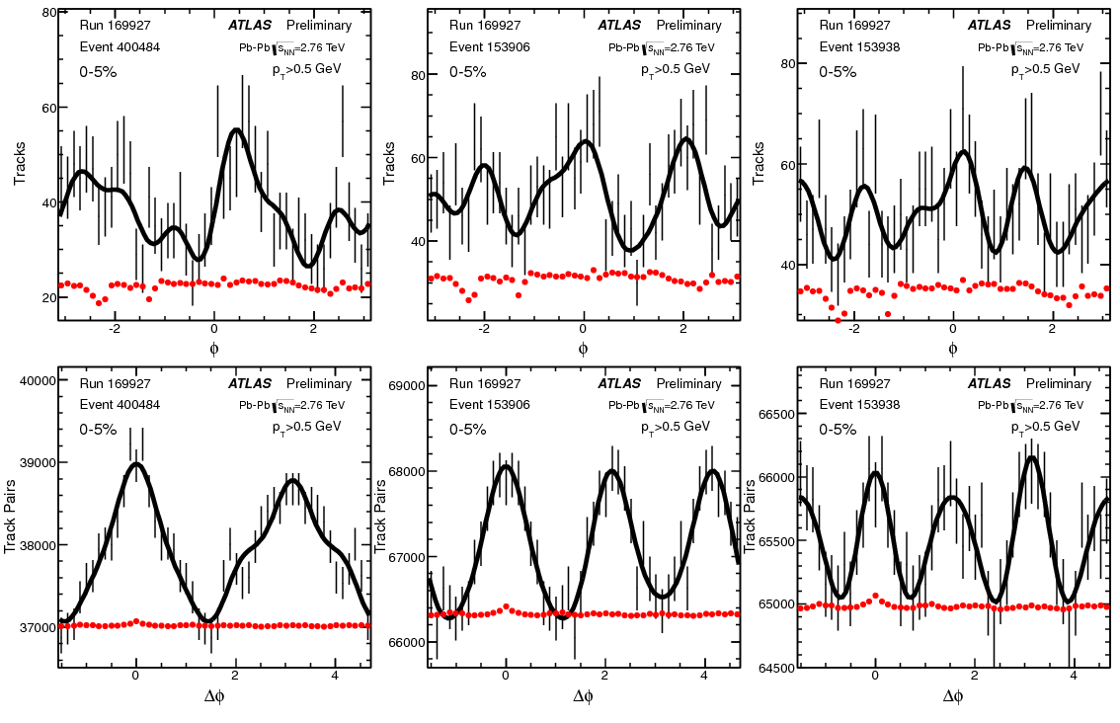
Event-by-Event Fluctuations
Azimuthal angle distribution
Significant fluctuations, factor of ~2
Cannot be explained by detector effects
Sizable event by event fluctuations in keeping with hydro expectations
https://cdsweb.cern.ch/record/1472935

Slide 10
Flow Probability Distributions
v₂
v₃
v₄
v_{n} probability distributions in p_{T} and centrality
Fully corrected for detector effects and unfolded for limited statistics
https://cdsweb.cern.ch/record/1472935

Slide 11
p_{T} Scaling of Flow Probability
v₂
v₃
v₄
Hydrodynamic response of the system to initial geometry eccentricity is p_{T} independent
mean scaled v₂
mean scaled v₃
mean scaled v₄
All p_{T} bins have similar shape
True for all measured n
https://cdsweb.cern.ch/record/1472935

Slide 12

Hydrodynamic Models
Glauber CGC MC
Hydrodynamic models capture basic physics, but fail to provide complete description
0-1%
5-10%
20-25%
30-35%
40-45%
55-60%
https://cdsweb.cern.ch/record/1472935

Slide 13
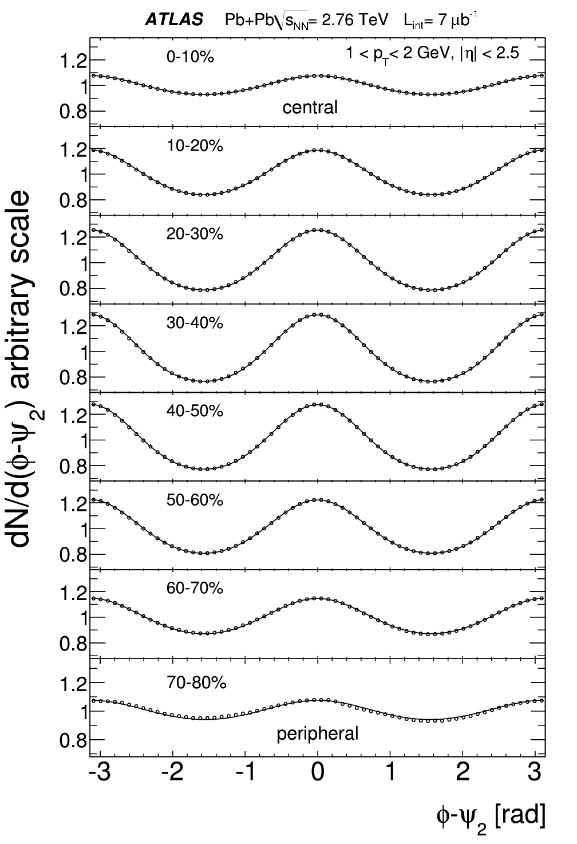
Fluctuations Event-by-Event
Φ₂
Φ₂
Φ₂

Slide 14
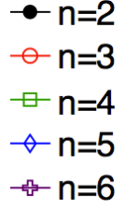
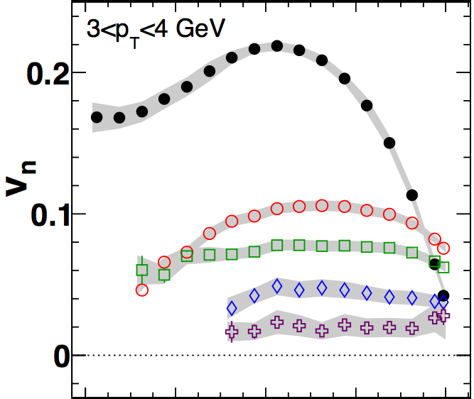

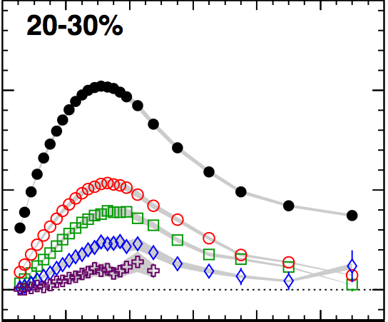
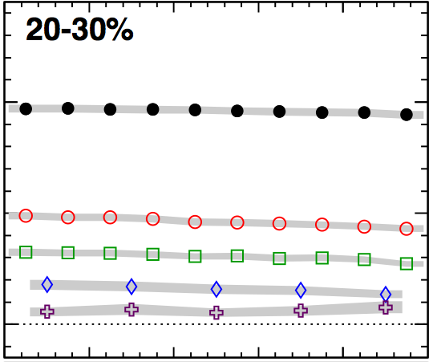





Averaged Flow
Features of Fourier coefficients
  v₂ rises and falls with centrality, higher orders flatter - consistent with fluctuation origin
  v_{n} coefficients rise and fall with p_{T}.
  v_{n} coefficients are largely boost invariant.
Caveat: Event planes are correlated
Phys. Rev. C 86, 014907 (2012)

Slide 15
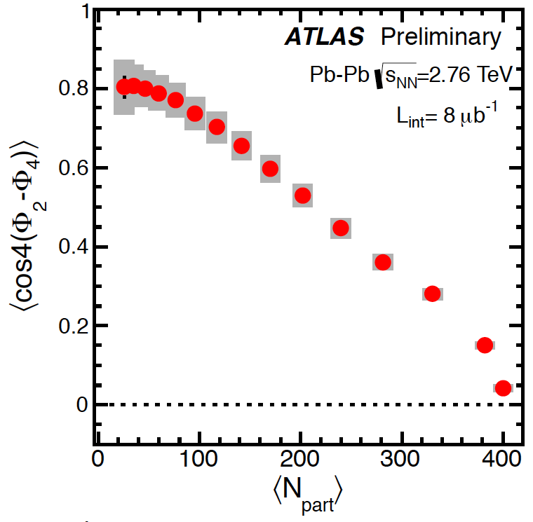
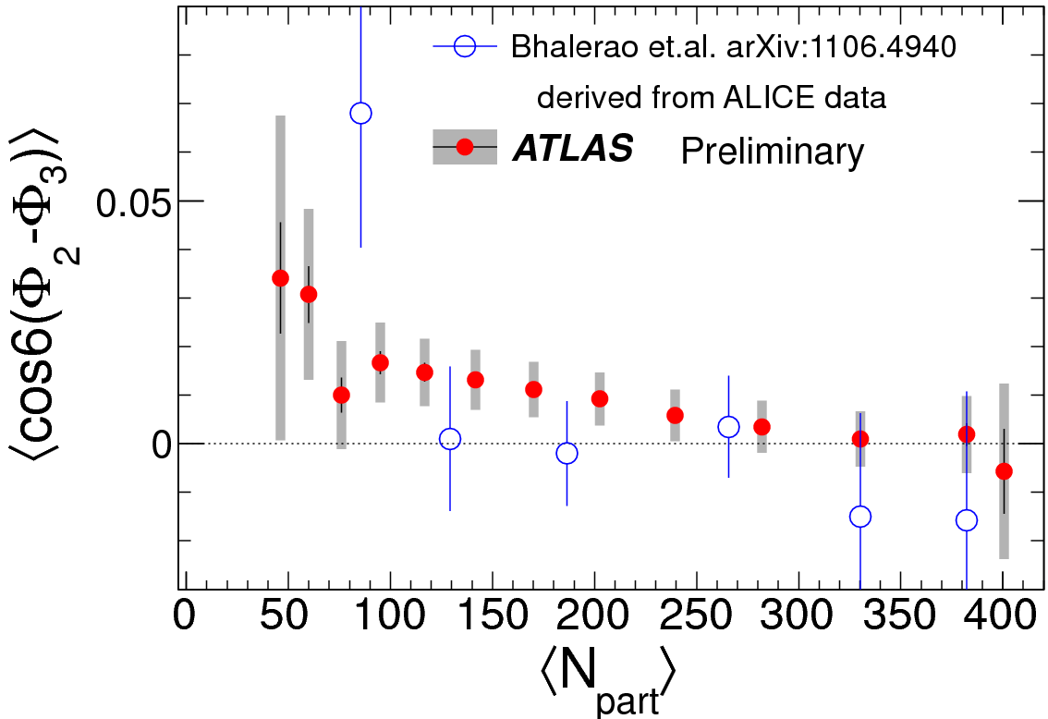
Event Plane Correlations
Φ₂
Φ₄
Φ₃
Measured event plane correlations give us another handle to test understanding of collision geometry
Models predict that even planes be correlated.
Data shows correlation of Φ₂ and Φ₄, stronger than expected
Correlations between even and odd planes are not expected
Data shows significant correlations between Φ₂ and Φ₃
https://cdsweb.cern.ch/record/1451882

Slide 16
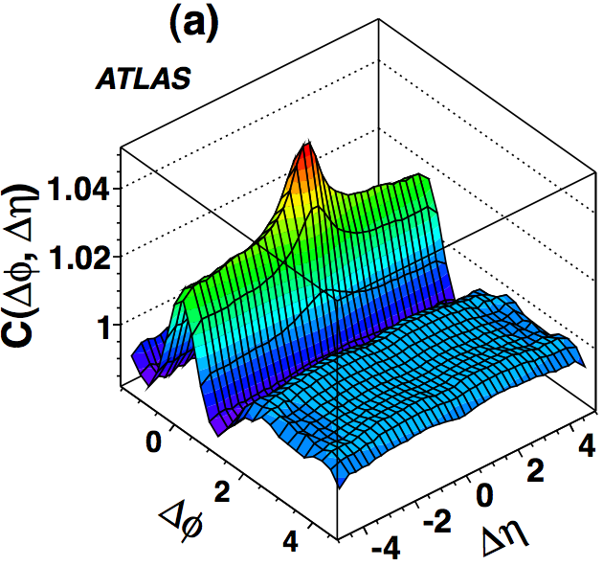
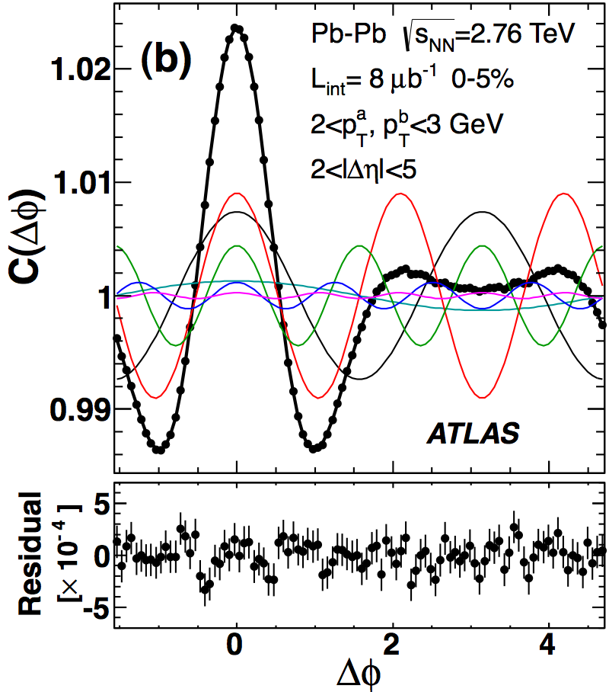
Shape via Two Particle Correlations
|Δη|>2
Long range structures (“ridge”) described by harmonics v_{1,1}-v_{6,6}
(significant influence from global p conservation for v₁)
Phys. Rev. C 86, 014907 (2012)

Slide 17
What Hard Probes Teach Us
Hadrons, Jets, HF
Electroweak Bosons
Access to quarks, glouns
Interact with the QCD medium
Modification of color sensitive objects in the medium
Quantify and understand where energy goes, what happens in medium interactions
Are heavy quarks affected in the same way as light quarks?
Color Neutral
Do not interact with the QCD medium
No energy loss expected, should scale with <N_{coll}>
Check pQCD predictions
Check for modification, effects of nuclear PDF

Slide 18
Charged Hadron Suppression
Apparent flattening at highest measured p_{T}
High p_{T} charged particle suppression
Increase hinted at in RHIC data, dramatically measured
Charged particle production (suppression) mapped to ~100 GeV!
‘Nuclear modification factor’ quantifies the difference between A+A and many p+p collisions
If HI peripheral≈p+p
https://cdsweb.cern.ch/record/1355702

Slide 19
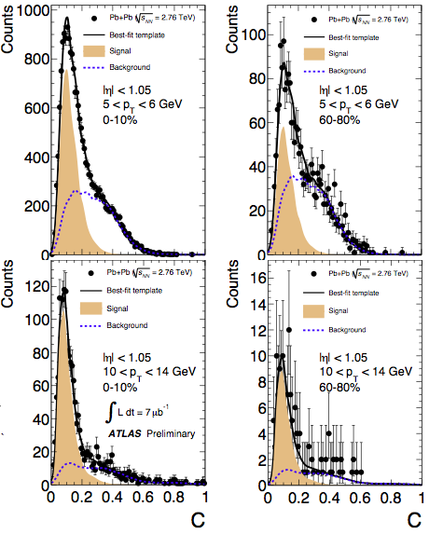
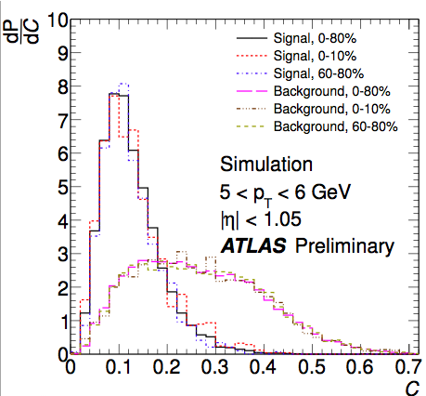
Heavy Quark Measurement with μ
Inclusive muon spectrum dominated by heavy flavor decays
Decompose muons (4<p_{T}<14 GeV) into those from HF and background
Ability to select muons from heavy flavor decay, with good purity
p balance
Scattering angle significance
https://cdsweb.cern.ch/record/1451883

Slide 20
Heavy Quark Yield
Suppression of muons from heavy flavor, but less suppression than unidentified hadrons!
R_{CP}^{hadrons}
Roughly flat in p_{T}
Somewhat different from inclusive hadrons – HF acting ‘heavy’?
https://cdsweb.cern.ch/record/1451883

Slide 21
Jets as a Probe of the Medium
Qin and Müller QM2011
Partonic jet shower in vacuum composed of: Leading Parton and Radiated Gluons
Add the medium:
E transfer to medium via elastic collsions
Gluons radiated due to medium interactions
E transfer to medium via elastic collsions
Shunted out of jet cone from multiple scattering

Slide 22
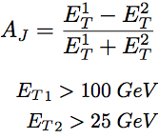
Di-Jet Asymmetry
Full jet reconstruction with anti-k_{t} algorithm (R=0.4)
Azimuthal correlation consistent in all systems p+p, MC, and peripheral Pb+Pb consistent – asymmetry peaked at zero
Central Pb+Pb has peak away from zero
Momentum balance from hard scattering not kept within di-jets
Direct observation of jet quenching – jets still back to back!
Phys. Rev. Lett. 105, 252303 (2010)

Slide 23
Jet Nuclear Modification Factor
Centrality dependent suppression of inclusive jet production!
Inclusive jet production measured
Increasing suppression with centrality
Roughly flat in p_{T} for central events
http://arxiv.org/abs/1208.1967

Slide 24
Azimuthal Distribution of Jets
Δϕ
Φ₂
Jet v₂ is not “Jet hydrodynamic flow”
Rather, a look at the jets as a function of the amount of medium they traverse
https://cdsweb.cern.ch/record/1472938

Slide 25
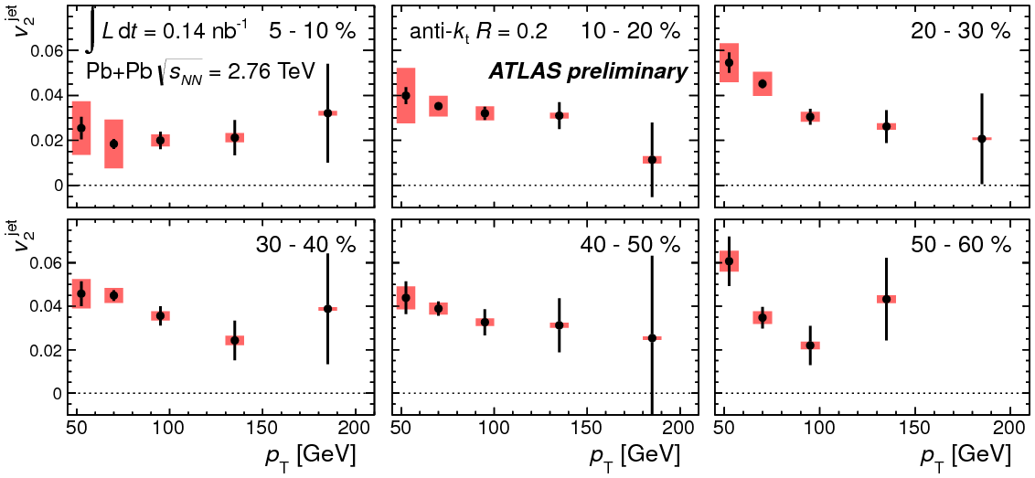
Azimuthal Distribution of Jets
Jet yields show significant variation in angle with respect to reaction plane, i.e. quenching varies with path length traversed
https://cdsweb.cern.ch/record1472938

Slide 26
Jet Cone Size Dependence
Is lost energy hiding in larger cones?
Vary cone sizes (R) in anti-k_{t} algorithm
R dependence seen at lower p_{T}
Small but significant increase in R_{CP} with larger cone size – jets broadened?
http://arxiv.org/abs/1208.1967

Slide 27
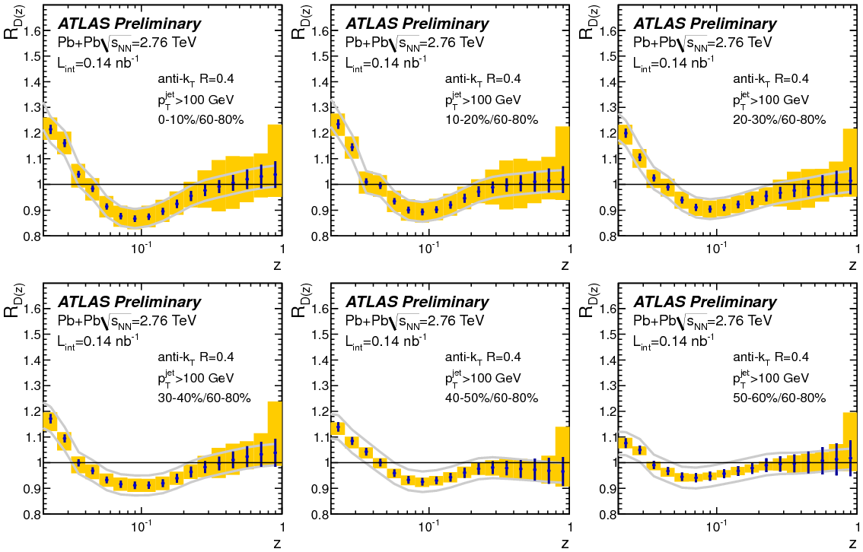
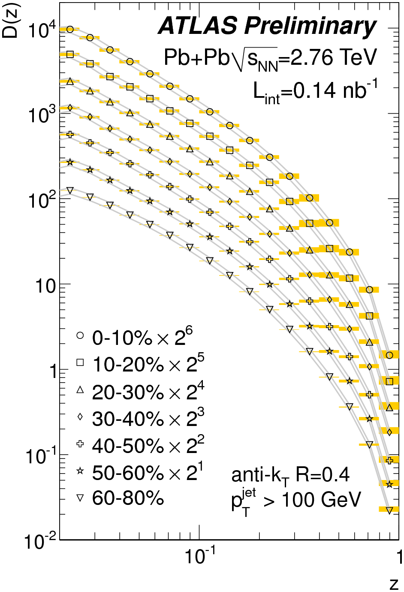
Internal Jet Structure
Significant modification of jet structure, a direct look at the modification of the parton shower
D(z) are background subtracted and unfolded
Enhancement at low z
Suppression at intermediate z
No change at high z - leading particle unaffected?
http://cdsweb.cern.ch/record/1472936

Slide 28
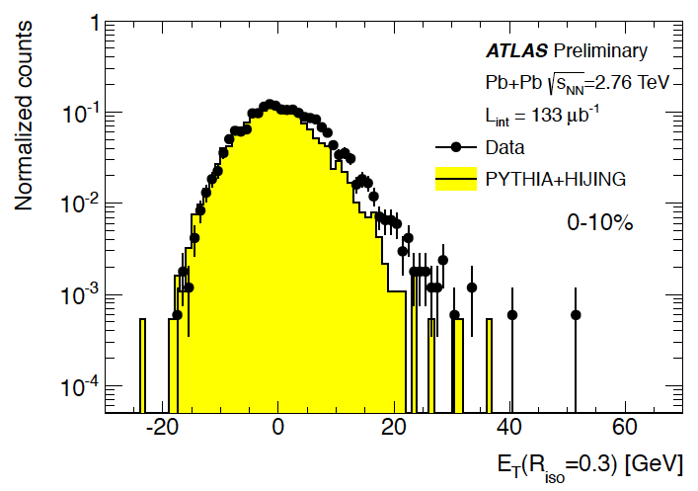
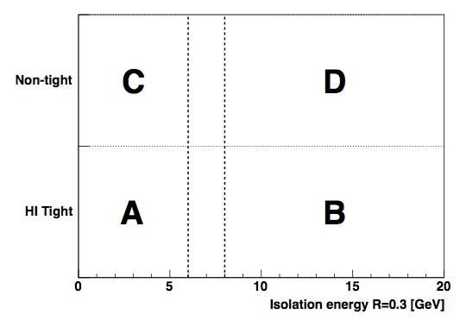
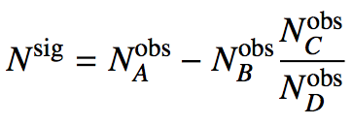
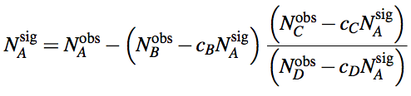
Direct Photon Measurement
Subtract underlying event
  Iterative subtraction in Δη=0.1 slices, excluding jets
  Elliptic flow sensitive
Isolated photons
  Cut on a maximum energy in cone around photon
  Fragmentation photons reduced
Shower shape cuts
  Multiple layers of EM calorimeter, and hadronic calorimeter
  Rejection of jet fakes
Signal Extraction
  “Double sideband” method
Isolation E
https://cdsweb.cern.ch/record/1451913

Slide 29
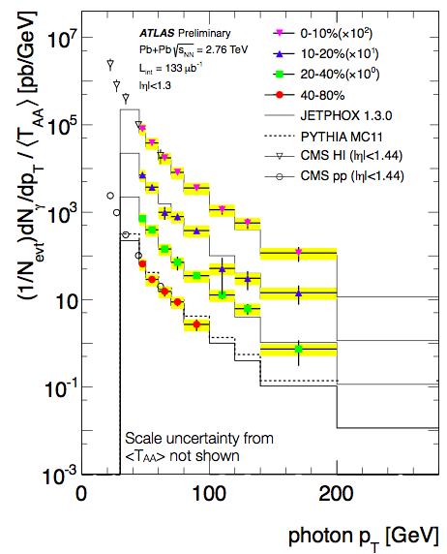
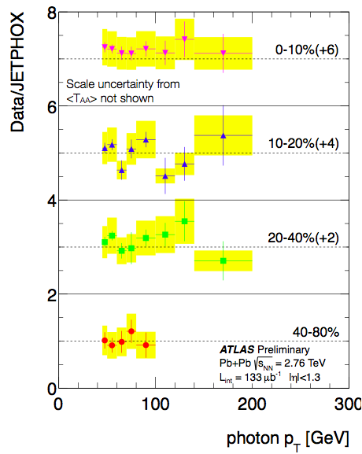
Direct Photon Spectra
Agreement with pQCD model, binary collision scaling observed to 200 GeV!
Corrected yield scaled by nuclear thickness ~ <N_{coll}>, and compared to JETPHOX predictions
https://cdsweb.cern.ch/record/1451913

Slide 30
Z→ee, Z→μμ Mass
Select leptons (underlying event subtraction for electrons)
Pair the selected leptons
Select Z boson in mass window 66-102 GeV
Signal Purity ~ 95% in Z➔ee and ~99% in Z➔μμ
Simulation is PYTHIA in HIJING events, reconstructed
http://arxiv.org/abs/1210.6486

Slide 31
Z→ll Corrected Yields
Model is composed of Pythia
events normalized to the Z → ll cross section in p + p taken from next-to-next-to-leading-order (NNLO) calculations and scaled by ⟨TAA⟩.
Good model agreement in y shape and binary collision scaling observed!
http://arxiv.org/abs/1210.6486 → Accepted to PRL!

Slide 32
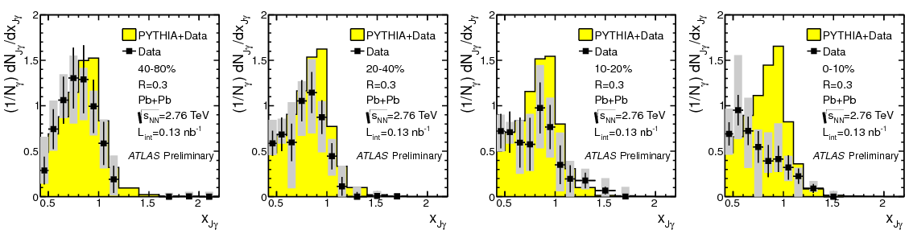
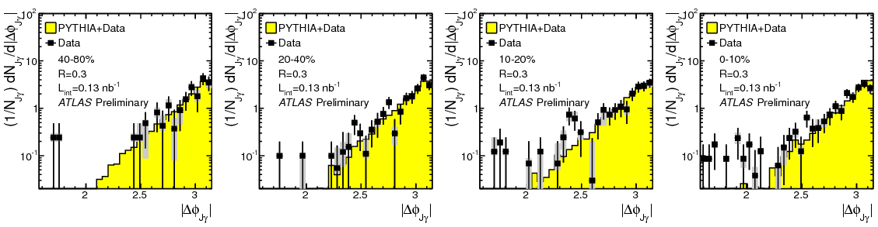
Photon+jet
Back to back correlation preserved, momentum ratio of jet/photon reduced in central events
Fully unfolded and corrected data
https://cdsweb.cern.ch/record/1473135

Slide 33
…and Z+jet
Low statistics but intriguing qualitative observation
Fully unfolded and corrected data
Back-to-back correlation preserved
Reduction in the momentum ratio of jet / Z boson
https://cdsweb.cern.ch/record/1472941

Slide 34
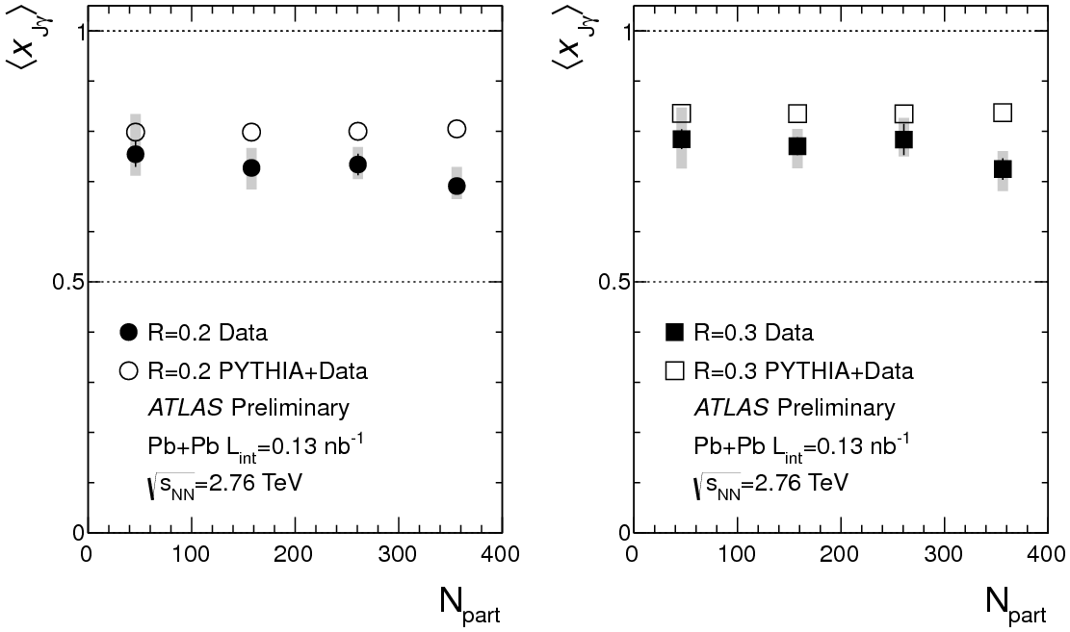
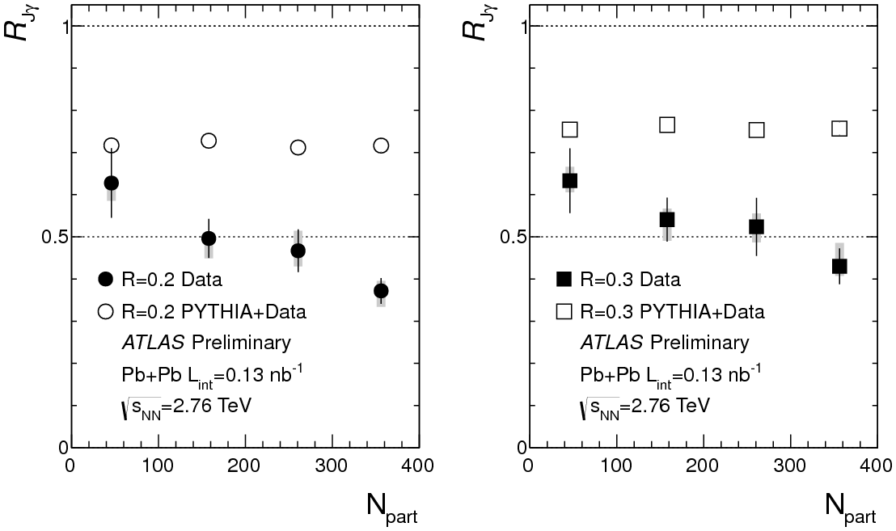
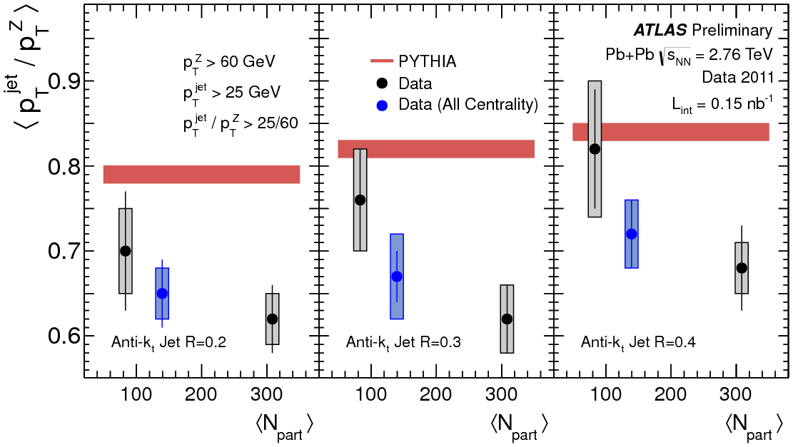
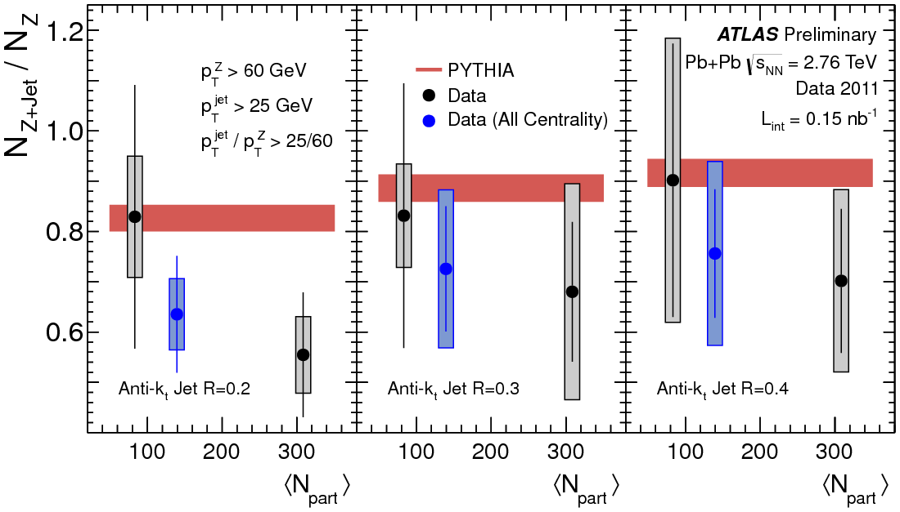
Boson+Jet
Reduction in momentum ratio and jet yield per boson increasing with centrality
ATLAS-CONF-2012-121
Consistent results from jet correlations with photon and Z
Reduction in momentum ratio
Reduction in jet yield per boson
https://cdsweb.cern.ch/record/1473135 , https://cdsweb.cern.ch/record/1472941

Slide 35
Summary
  Charged particle multiplicity – √s_{NN} log scaling broken, centrality shape √s_{NN} independent
  Flow measurements
  Event by event fluctuation measurements directly explore collision
  Averaged flow measured to 6th moment
  Event plane to plane correlations measured
  Filling in our knowledge of geometry and expansion
Suppression of particles sensitive to color interactions
  Inclusive hadrons are suppressed
  Muons from HF are also suppressed, but not as much
  Di-Jet asymmetry for a direct look at quenching, but di-jets still back to back
  Jet rate suppression, and path length dependence observed
  Cone size dependence of jet suppression may hint at broadening
  Fragmentation measurement shows modification of parton showering
  Electroweak bosons - Direct photons, and Z➔ee,μμ measured consistent with binary collision scaling
EW boson + jet – the ‘Golden Channel’
  Attenuation of jet momentum and reduced yield compared to boson
  Back to back correlation maintained
p+Pb coming soon!

