Slide 1
Is it Hard Yet? The Qualitative Agreement of pQCD Energy Loss with RHIC and LHC Data
W. A. Horowitz
University of Cape Town
December 3, 2012
With many thanks to Razieh Morad,
Miklos Gyulassy, and Yuri Kovchegov

Slide 2
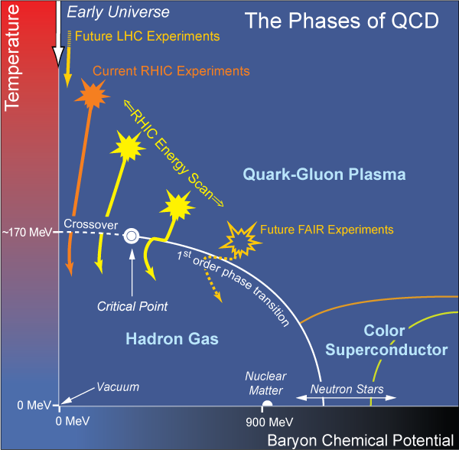
What Are We Interested In?
Measure the prop-erties of many-body strong force
Test & understand theory of many-body non-Abelian fields
Long Range Plan, 2008
Notes:
Unique as compared to strongly coupled Abelian problems

Slide 3
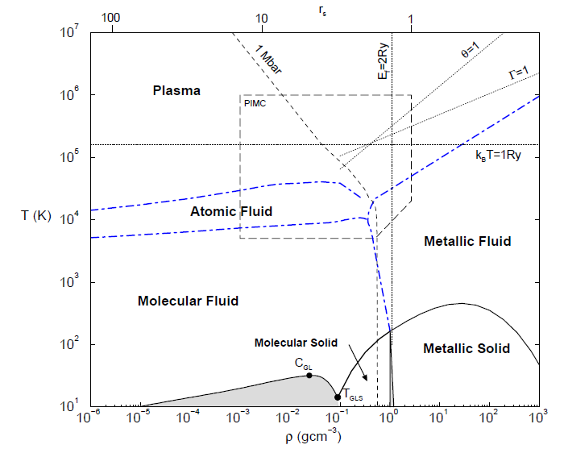
Compare to Easiest QED
“Simple” Hydrogen Phase Diagram
Calculated, Burkhard Militzer, Diploma Thesis, Berlin, 2000

Slide 4
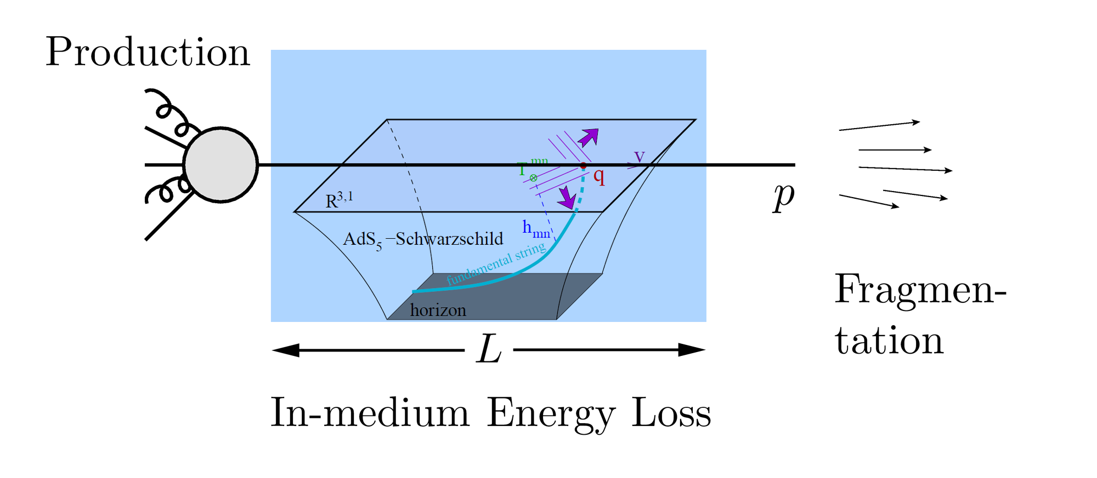
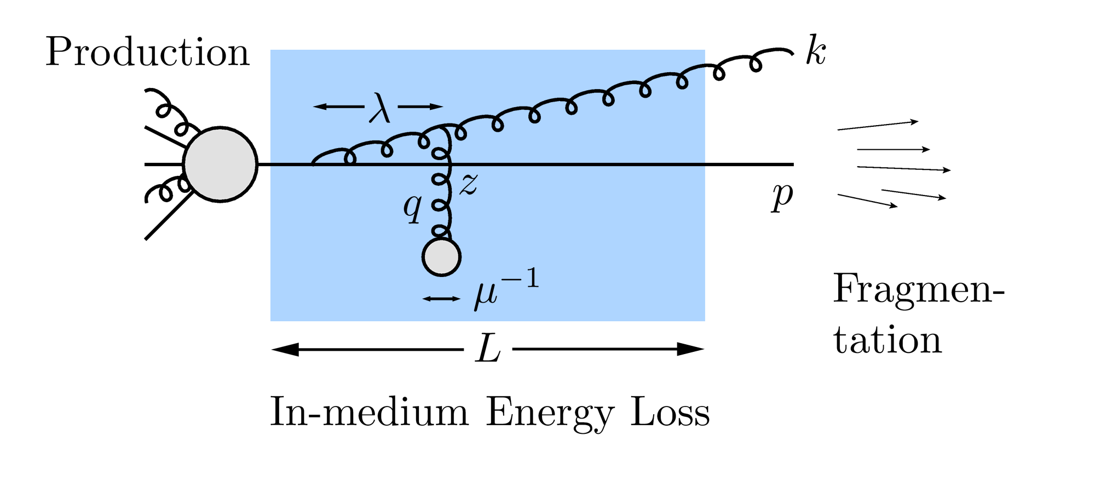
Why Energy Loss?
Most direct probe of DOF of QGP
pQCD Picture
AdS/CFT Picture

Slide 5
Energy Loss in Context
High p_{T} Light Hadrons
EM Probes
Low-p_{T} particles
Your least favorite
measurement
QGP
Open Heavy Flavor
Quarkonia
Searching for this coherent, consistent picture

Slide 6
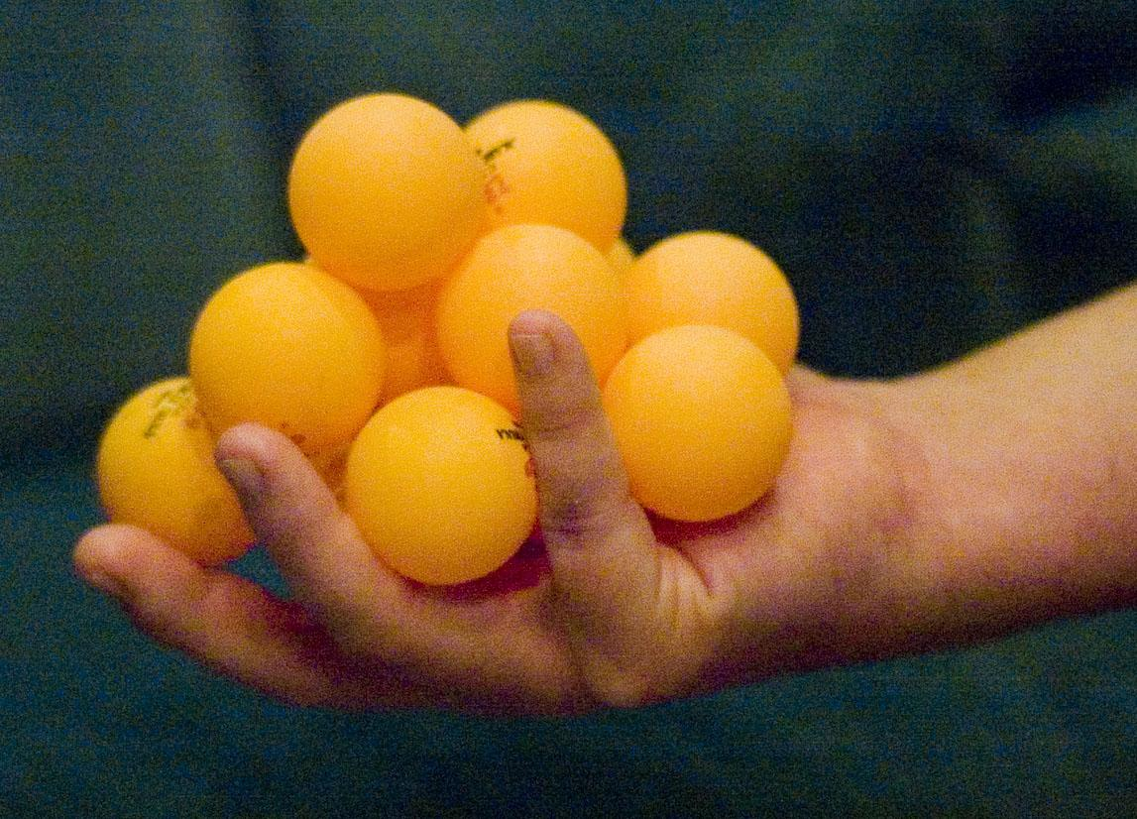
Energy Loss Systematics
E-loss picture assumes QGP properties => P(Δp_{T} | p_{T}, L, T, M_{Q}, R)
Want to test P(Δp_{T})
A+B, √s, centrality, M_{h}, …

Slide 7
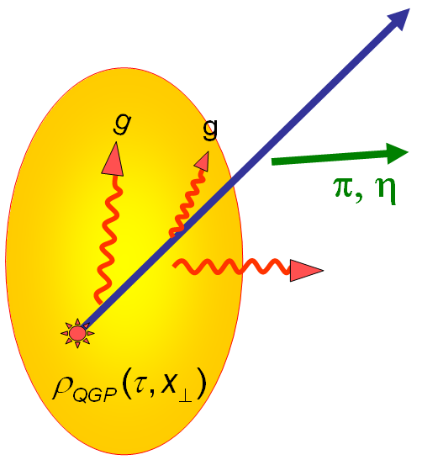
Observing Energy Loss
Naively: if medium has no effect, then R_{AA} = 1
Common variables used are transverse momentum, p_{T}, and angle with respect to the reaction plane, φ
p_{T}
, γ, e⁻
Fourier expand R_{AA}:
φ

Slide 8
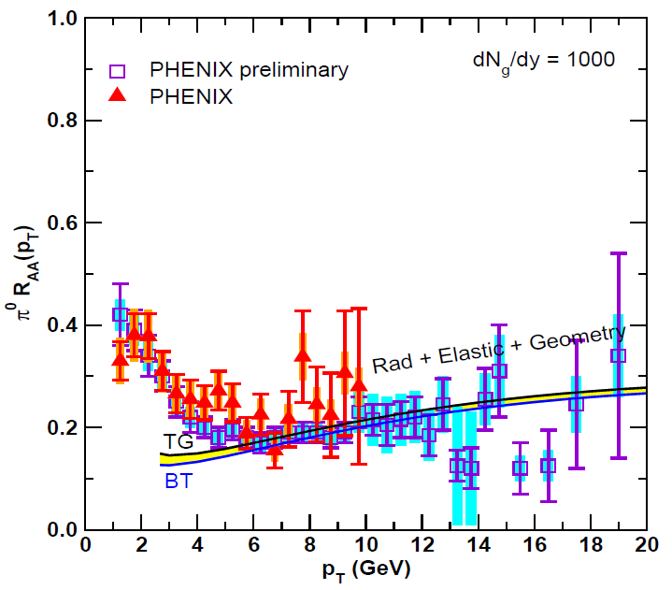
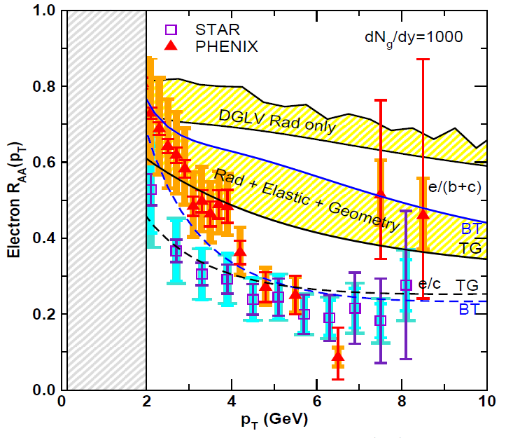
Lesson from RHIC
Extremely difficult to consistently describe all observables
Ex: Light+heavy suppression places stringent constraint on possible E-loss mechanism
π⁰ from g, u, d decay
e⁻ from c, b decay
Wicks, WAH, Djordjevic, Gyulassy, NPA784 (2007)

Slide 9
Demonstrating E-loss Value
Compare E-loss observables to data with two very different assumptions of properties of QGP:
Strongly coupled medium coupling strongly to a high-p_{T} particle
Weakly coupled medium coupling weakly to a high-p_{T} particle

Slide 10
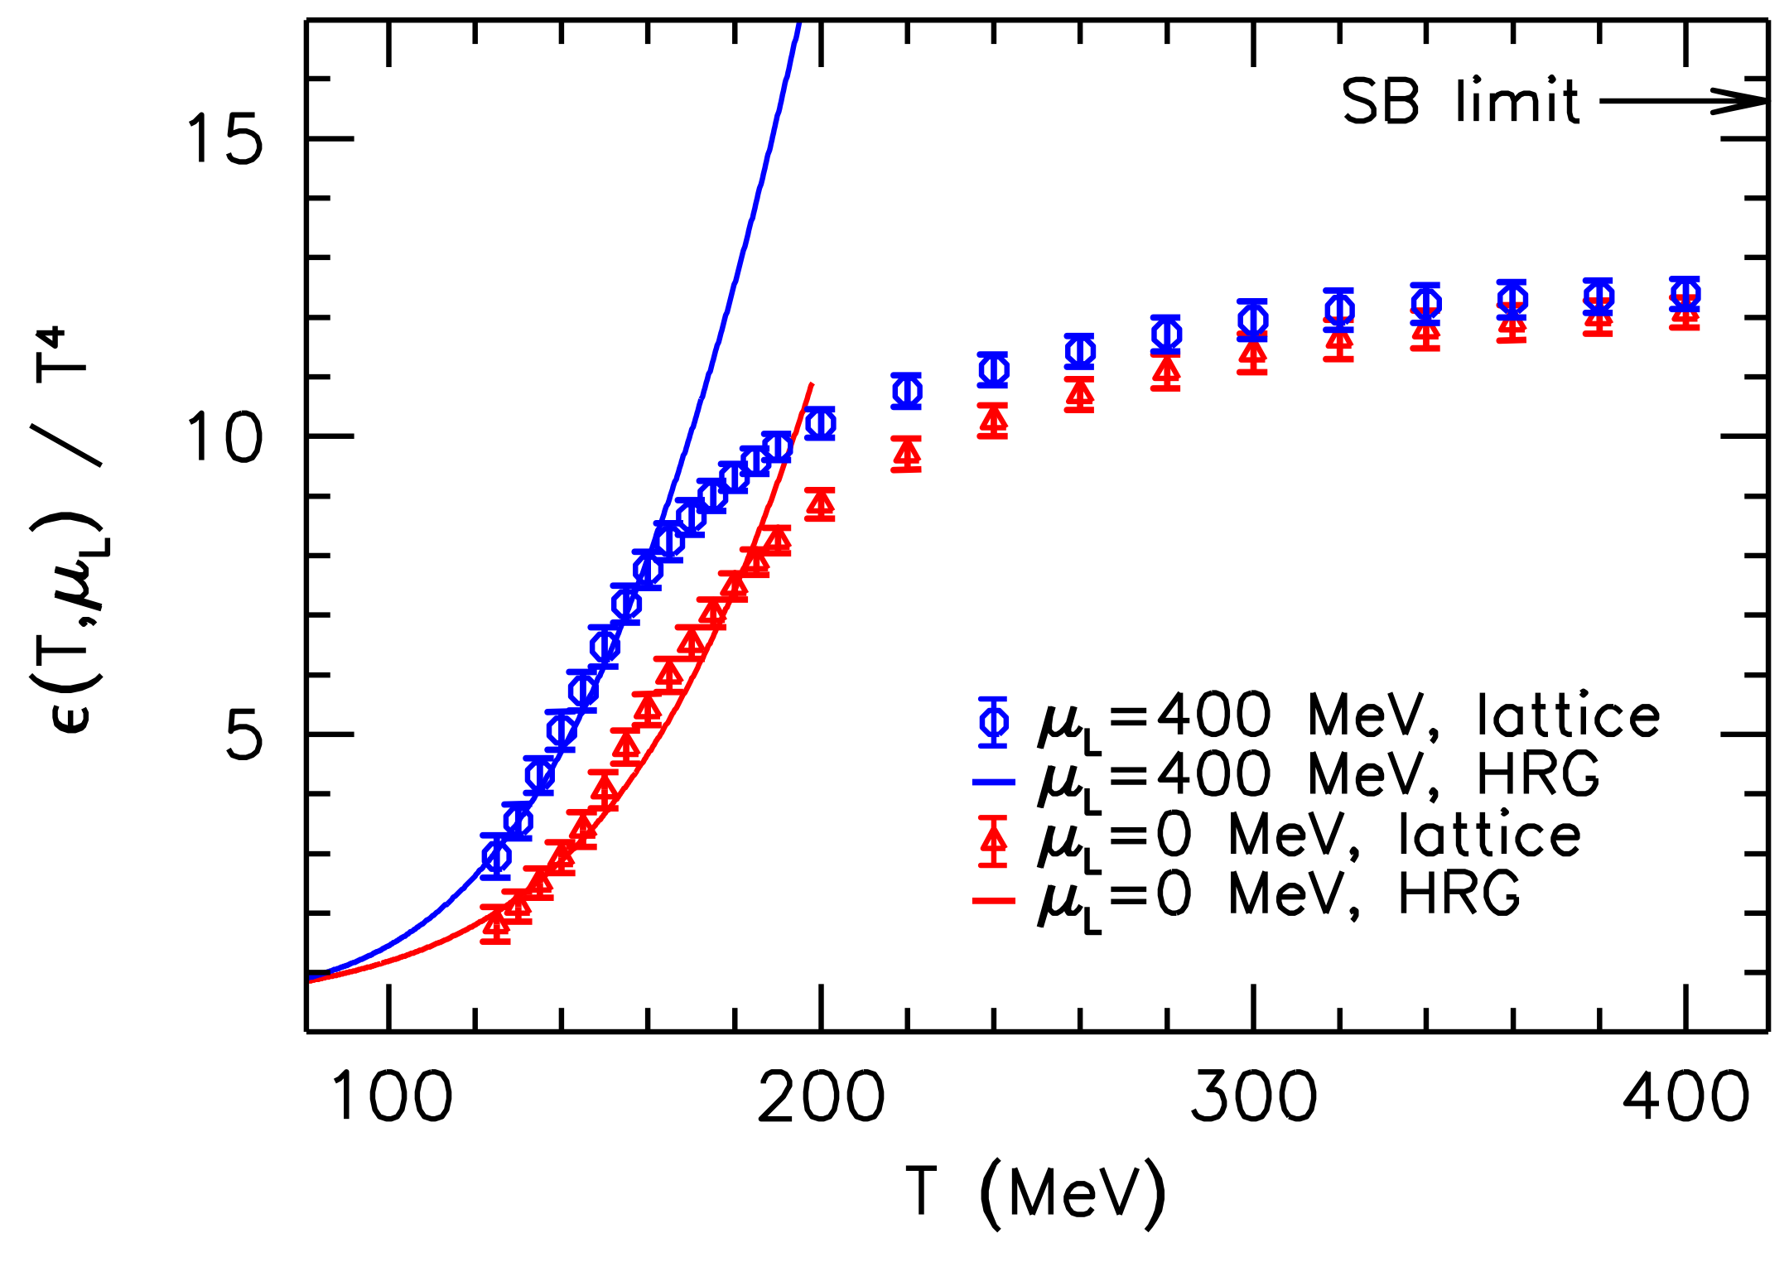
Let’s Assume Strong Coupling
Not crazy
T ~ 250 MeV, g(2πT) ~ 2, λ = g²N_{c} ~ 12 ≫1
Always small T scale
T ≳ T_{c}, lattice deviates from Stefan-Boltzmann
η/s ~ 1/4π readily explained by AdS/CFT
Luzum and Romatschke, PC78 (2008)
Wuppertal, arXiv:1204.6710

Slide 11
Heavy Quark E-Loss in AdS/CFT
Model heavy quark jet energy loss by embedding string in AdS space
dp_{T}/dt = - μ p_{T}
μ = πλ^{1/2} T²/2M_{q}
Herzog et al., JHEP 0607 (2006)
Gubser, PRD74 (2006)
Similar to Bethe-Heitler
dp_{T}/dt ~ -(T³/M_{q}²) p_{T}
Very different from usual pQCD and LPM
dp_{T}/dt ~ -LT³ log(p_{T}/M_{q})
J Friess, S Gubser, G Michalogiorgakis, S Pufu, Phys Rev D75 (2007)

Slide 12
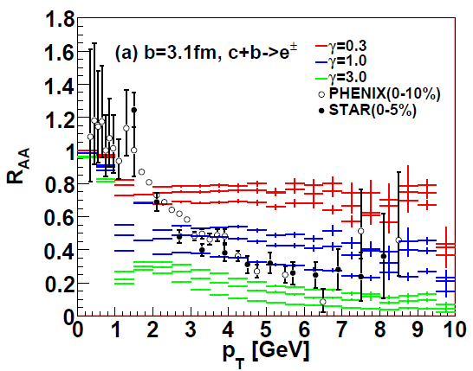
AdS/CFT and HQ
String drag: qualitative agreement at RHIC
WAH, PhD Thesis, arXiv:1011.4316
Akamatsu, Hatsuda, and Hirano, PRC79, 2009

Slide 13
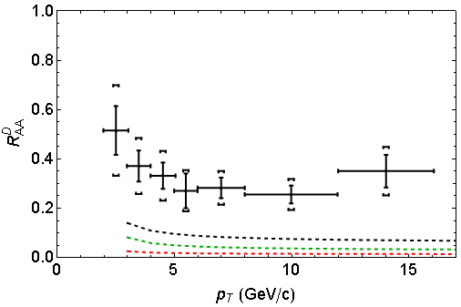
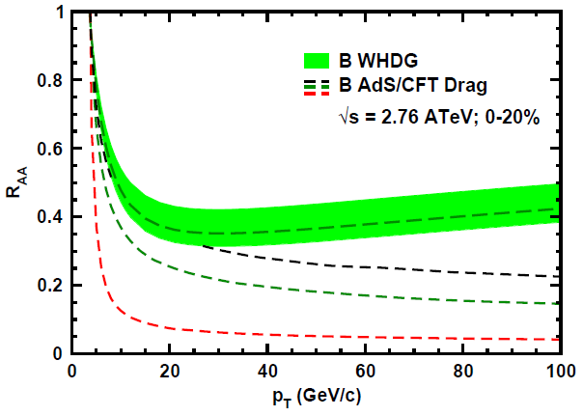
AdS/CFT and HQ at LHC
D Predictions
B Predictions
ALICE 0-20%
D
CMS B→J/ψ
(
(
]
(
(
(
WAH, PANIC11 (arXiv:1108.5876)
ALICE, arXiv:1203.2160
CMS, JHEP 1205 (2012) 063
AdS HQ Drag appears to oversuppress c→D
Long. fluctuations likely important, not included
Roughly correct description of b→B→J/ψ

Slide 14
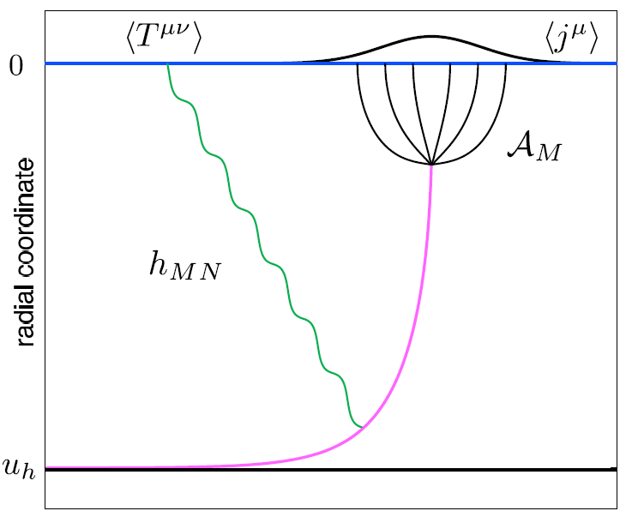
Light Quark E-Loss in AdS
Chesler et al., PRD79 (2009)
Complications:
string endpoints fall
=> painful numerics
relation to HI meas.
less obvious than HQ
In principle, E-loss from graviton emission
Extremely hard

Slide 15
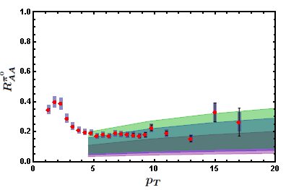
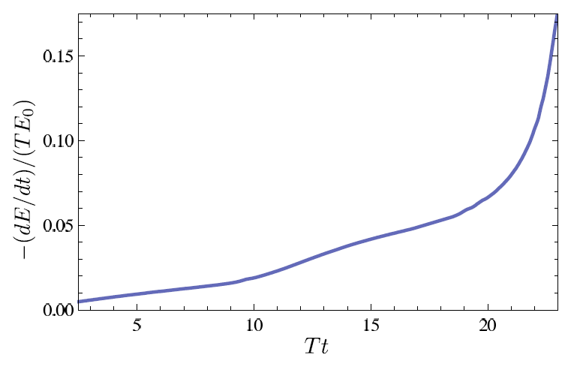
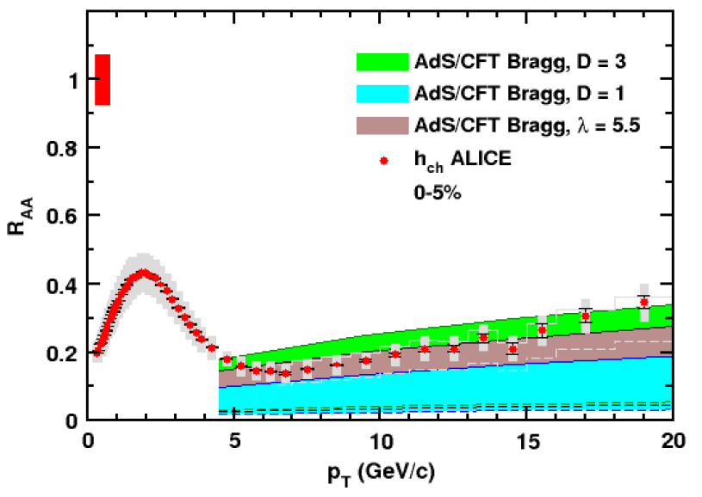
1st Attempt: Generic Bragg Peak Model
0.2 TeV
E-loss w Bragg peak
2.76 TeV
Chesler et al. PRD79 (2009)
Ficnar, arXiv:1201.1780
Razieh Morad and WAH, in prep
Simple Bragg peak model
WAH, JPhysG38 (2011)

Slide 16
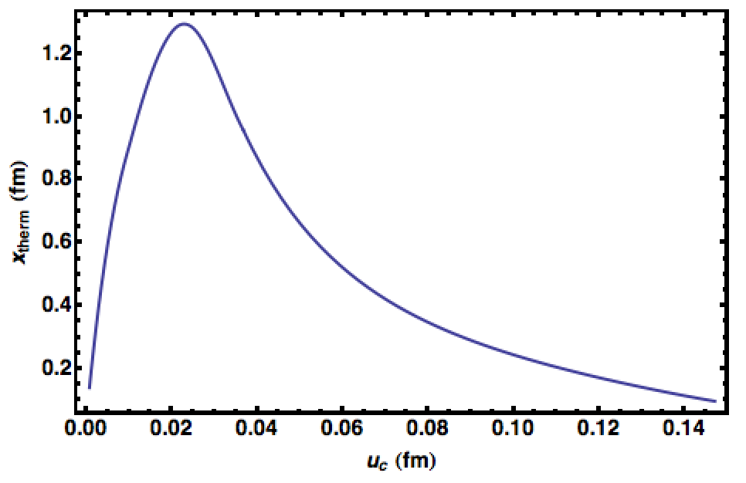
Moving Forward
Is Bragg generic?
Yes or No, depending on E-loss def & background geometry
Improve AdS E-loss
Difficult to reduce th. unc.
pQCD production ⬄ AdS IC? Imp. consequences
Virtuality
Morad and WAH, in prep

Slide 17
Strongly Coupled HF in p+A
Test CNM HF E-loss
Embedded String in Shock
Before
After
v_{shock}
z
Q
v_{shock}
z
Q
x
x
WAH and Kovchegov, PLB680 (2009)

Slide 18
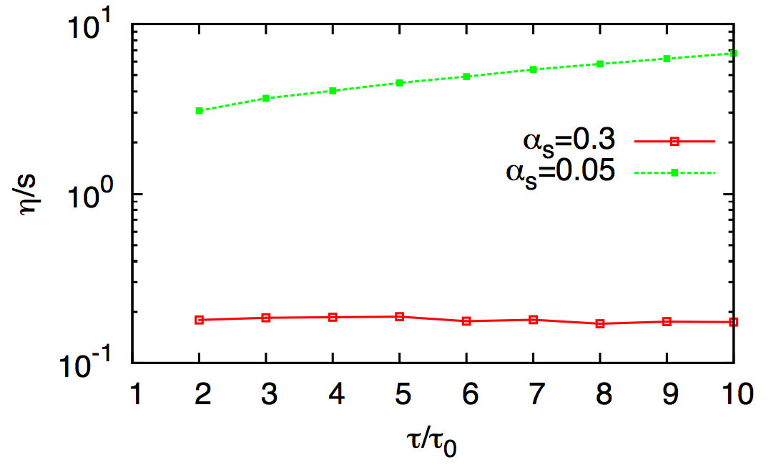
Let’s Assume pQCD is the Best Approx
Also not unreasonable
α_{s}(2πT) = 0.3
Always large p_{T} scale
2➞2 & 2➞3 pQCD MC suggests η/s ~ few/4π
See C Greiner, Parallel XIII Friday
El, Muronga, Xu, and Greiner, PRC79 (2009)

Slide 19
Let’s Assume pQCD is the Way to Go
Thermal Field Theory =>
Debye mass μ ~ gT
Mean free path λ_{mfp} ~ 1/g²T
Entropy/Hydro => T_{RHIC(LHC)} ~ 350 (450) MeV
μ ~ gT ~ 0.7 (0.8) GeV => 1/μ ~ 0.3 (0.2) fm
λ_{mfp} ~ 1/g²T ~ 0.8 (0.7) fm
R_{Au,Pb} ~ 6 fm
1/μ << λ_{mfp} << L
Scattering off separated, well-defined quasiparticles
For HQ, order a few collisions, ~ 4
gluon

Slide 20
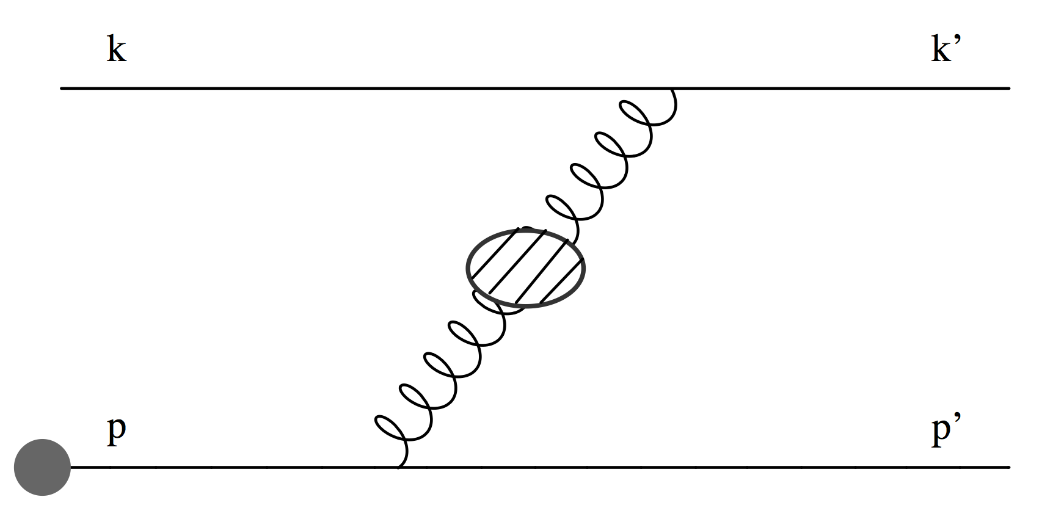
pQCD Continued
Two types of E-loss
Collisional (elastic) 2➞2
Radiative (inelastic) 2➞3
Scales => ~few scatterings, mult. coh. em. => LPM
Must include interference with production radiation
Bjorken, FERMILAB-PUB-82-059-THY
Braaten and Thoma, PRD44:2625–2630, 1991
Djordjevic, Phys.Rev. C74 (2006) 064907
Adil et al., Phys.Rev. C75 (2007) 044906
Djordjevic, PRC74 (2006)
Majumder and van Leeuwen, PPNPA66 (2011), and refs therein

Slide 21
Asymptotic Analytic pQCD
Naively, ΔE_{el} << ΔE_{rad} as E➞∞
Elastic E-loss:
dp_{T}/dt ~ -T² log(p_{T}/M)
Radiative E-loss, in expected deep LPM regime:
dp_{T}/dt ~ -L T³ log(p_{T}/M)
Compare to Bethe-Heitler dp_{T}/dt ~ -(T³/M²)p_{T}

Slide 22
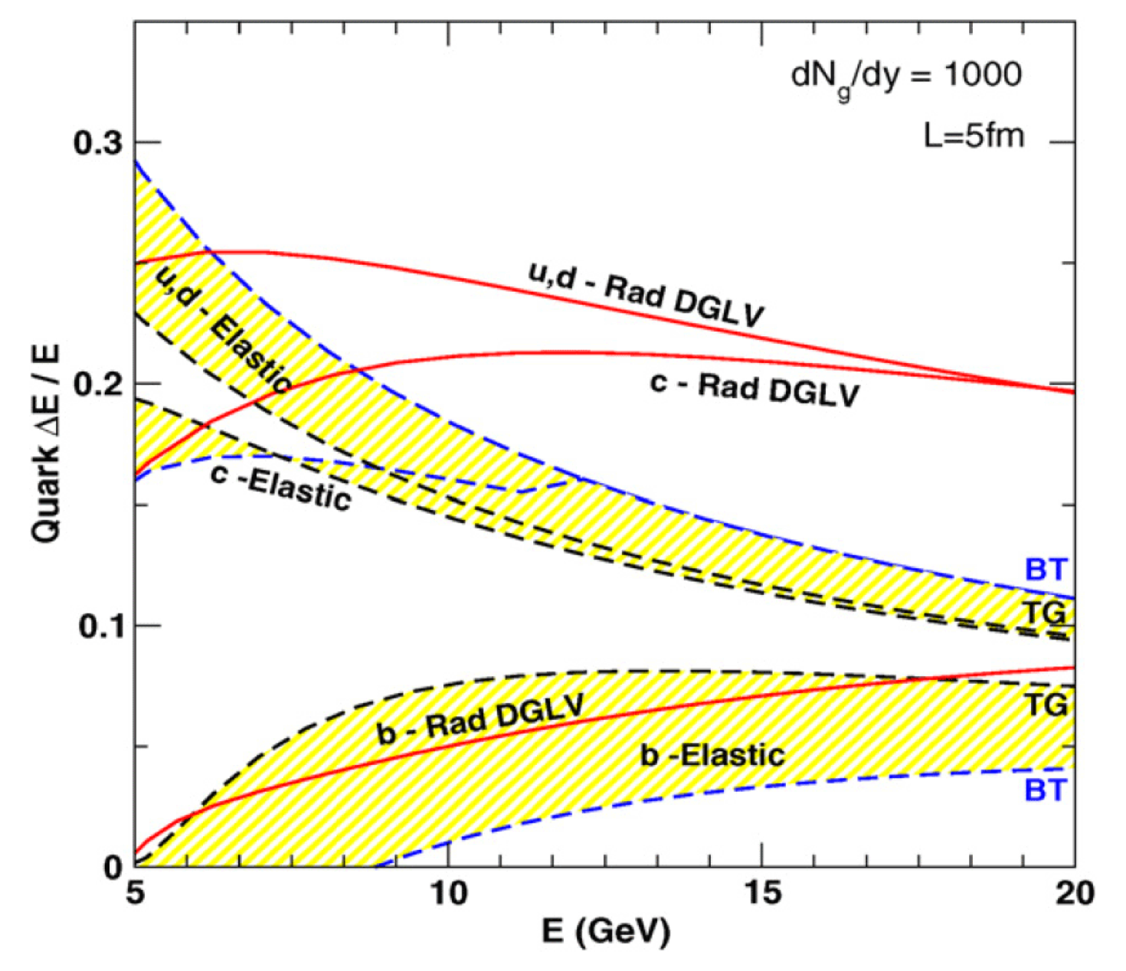
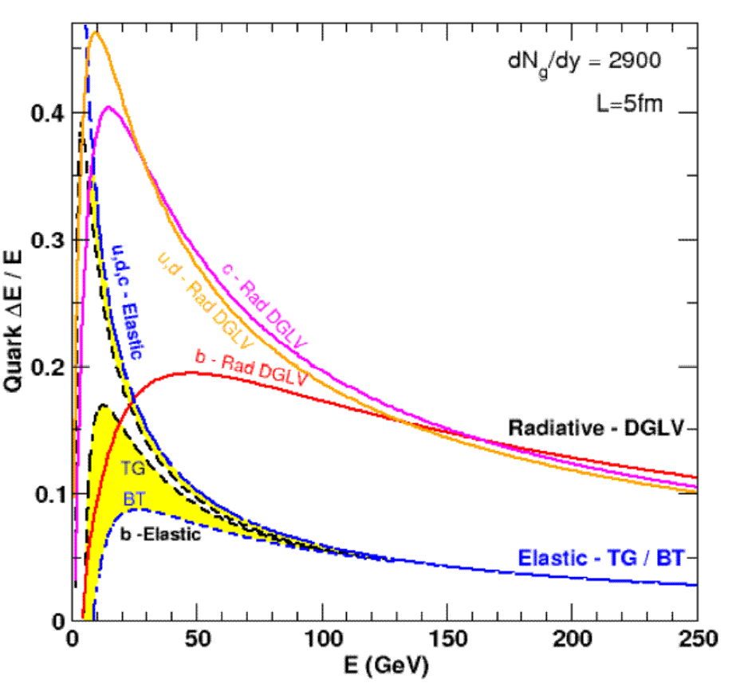
Results
Naively, ΔE_{el} << ΔE_{rad} as E➞∞
RHIC
LHC
WAH, PhD Thesis, arXiv:1011.4316
Finite RHIC/LHC kinematics: both radiative and collisional energy loss processes are important for p_{T} ~ 5 GeV/c and higher

Slide 23
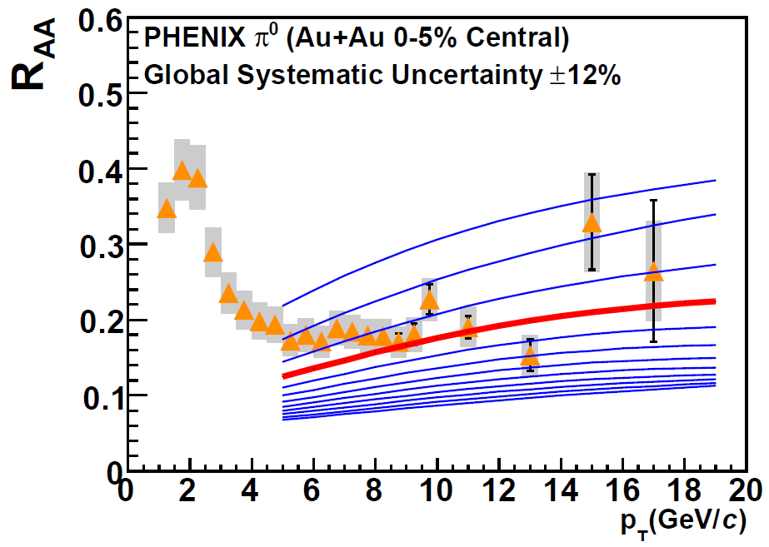
Compare to RHIC & LHC
Use WHDG
conv. Rad + Coll
RHIC R_{AA}: not unreasonable ρ_{med}
dN_{g}/dy = 1400⁺²⁰⁰
α_{s} = 0.3, fixed
1400₋₃₇₅
PHENIX, PRC77 (2008)
For LHC predictions: change only ρ_{med} ∝dN_{ch}/dη

Slide 24
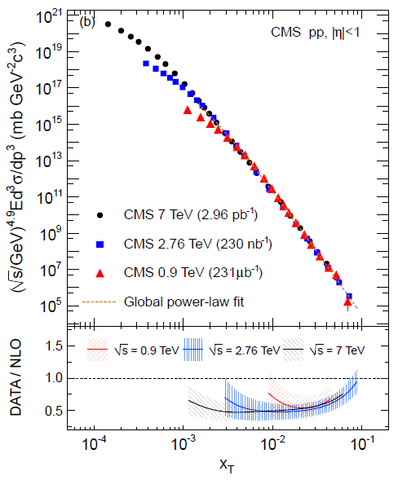
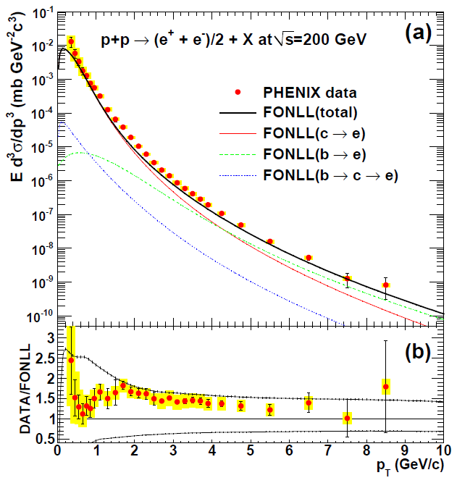
Set Scale for our Expectations
NLO pQCD in pp System ~ factor of 2
CMS, EurPhysJC72 (2012)
PHENIX, PRC84 (2011)

Slide 25
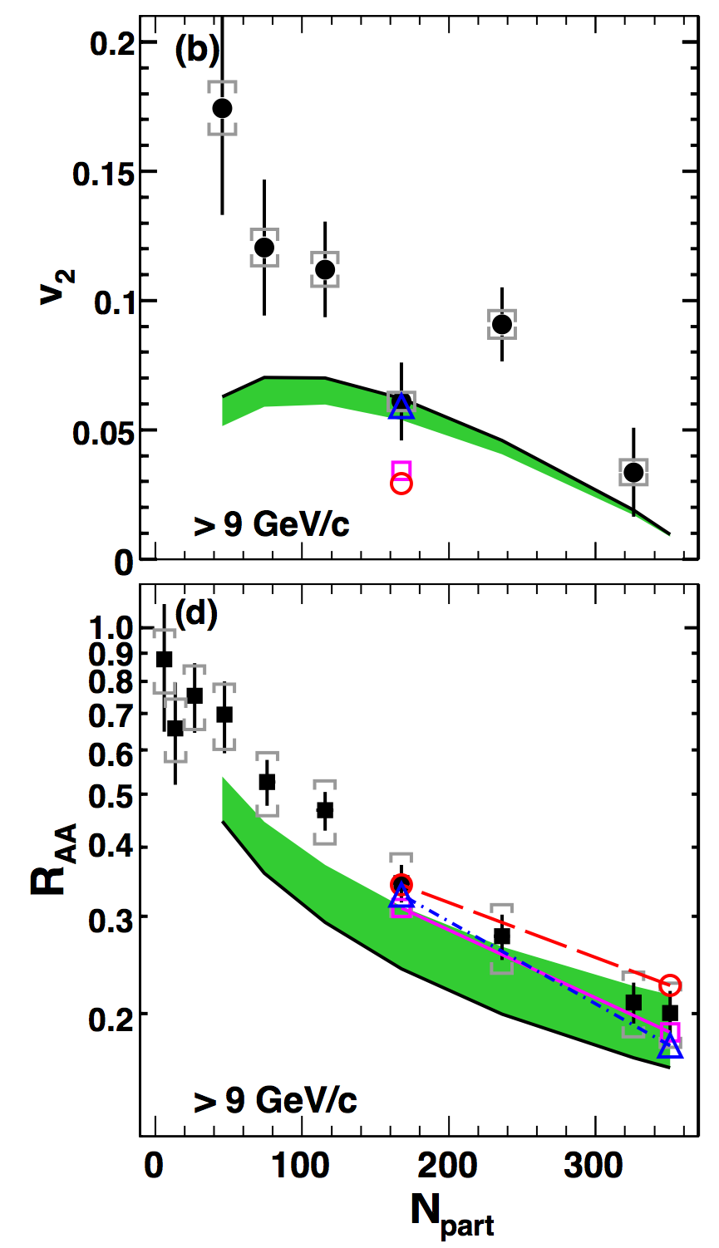
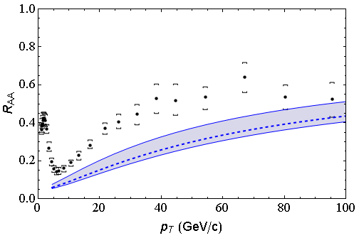
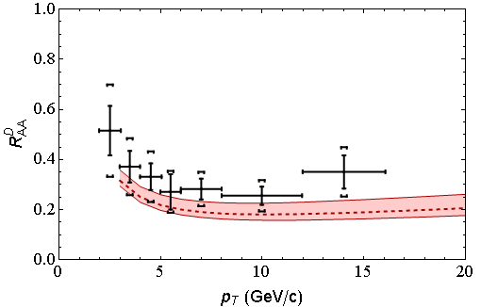
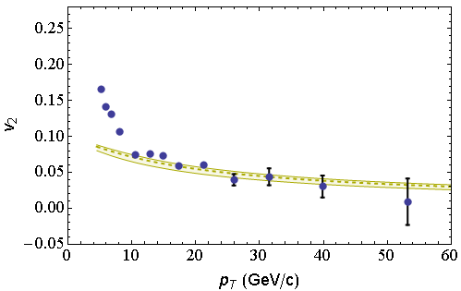
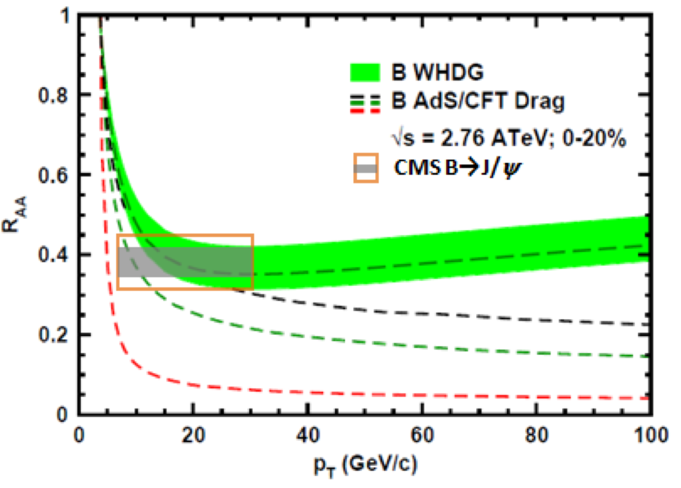
Global Qualitative Agreement
LO pQCD E-loss correct to factor ~2
LHC
CMS h± 0-5%
WHDG π⁰
LHC
ALICE D
WHDG D
RHIC
RHIC
LHC
CMS h± 40-50%
WHDG π⁰
LHC
CMS, Eur.Phys.J. C72 (2012)
CMS, arXiv:1204.1850
ALICE, arXiv:1203.2160
CMS, JHEP 1205 (2012) 063
PHENIX PRL105 (2010)

Slide 26
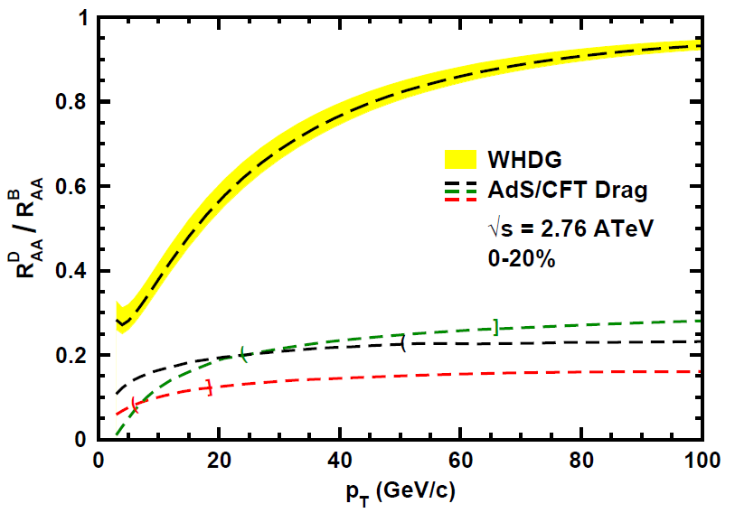
Does pQCD or AdS Yield Correct Mass & Momentum Dependecies at LHC?
WAH, PANIC11 (arXiv:1108.5876)
T(τ₀): “(”, corrections likely small for smaller momenta
T_{c}: “]”, corrections likely large for higher momenta
Qualitatively, corrections to AdS/CFT result will drive double ratio to unity
See also:
WAH, M. Gyulassy, PLB666 (2008)

Slide 27
Conclusions
Exciting times in HI physics!
Difficult to reconcile AdS/CFT with new LHC data
Tends to oversuppress: corrections, fluctuations?
LHC & RHIC converging on picture of pQCD E-loss in sQGP
LO thermal pQCD qualitatively describes LHC single particle observables
Much interesting research to do!

Slide 29
Qualitative Expectations for E-loss
Energy loss decreases with M_{Q}
ΔE_{b} < ΔE_{c} < ΔE_{u,d} < ΔE_{g}
For experts: not always true for pQCD
(τ_{form} decreases with M_{Q})
DOES NOT IMPLY R_{AA} ORDERING
For approx. power law production and energy loss probability P(ε), ε = (E_{i} - E_{f})/E_{i}
Larger n => smaller R_{AA} for same energy loss

Slide 30
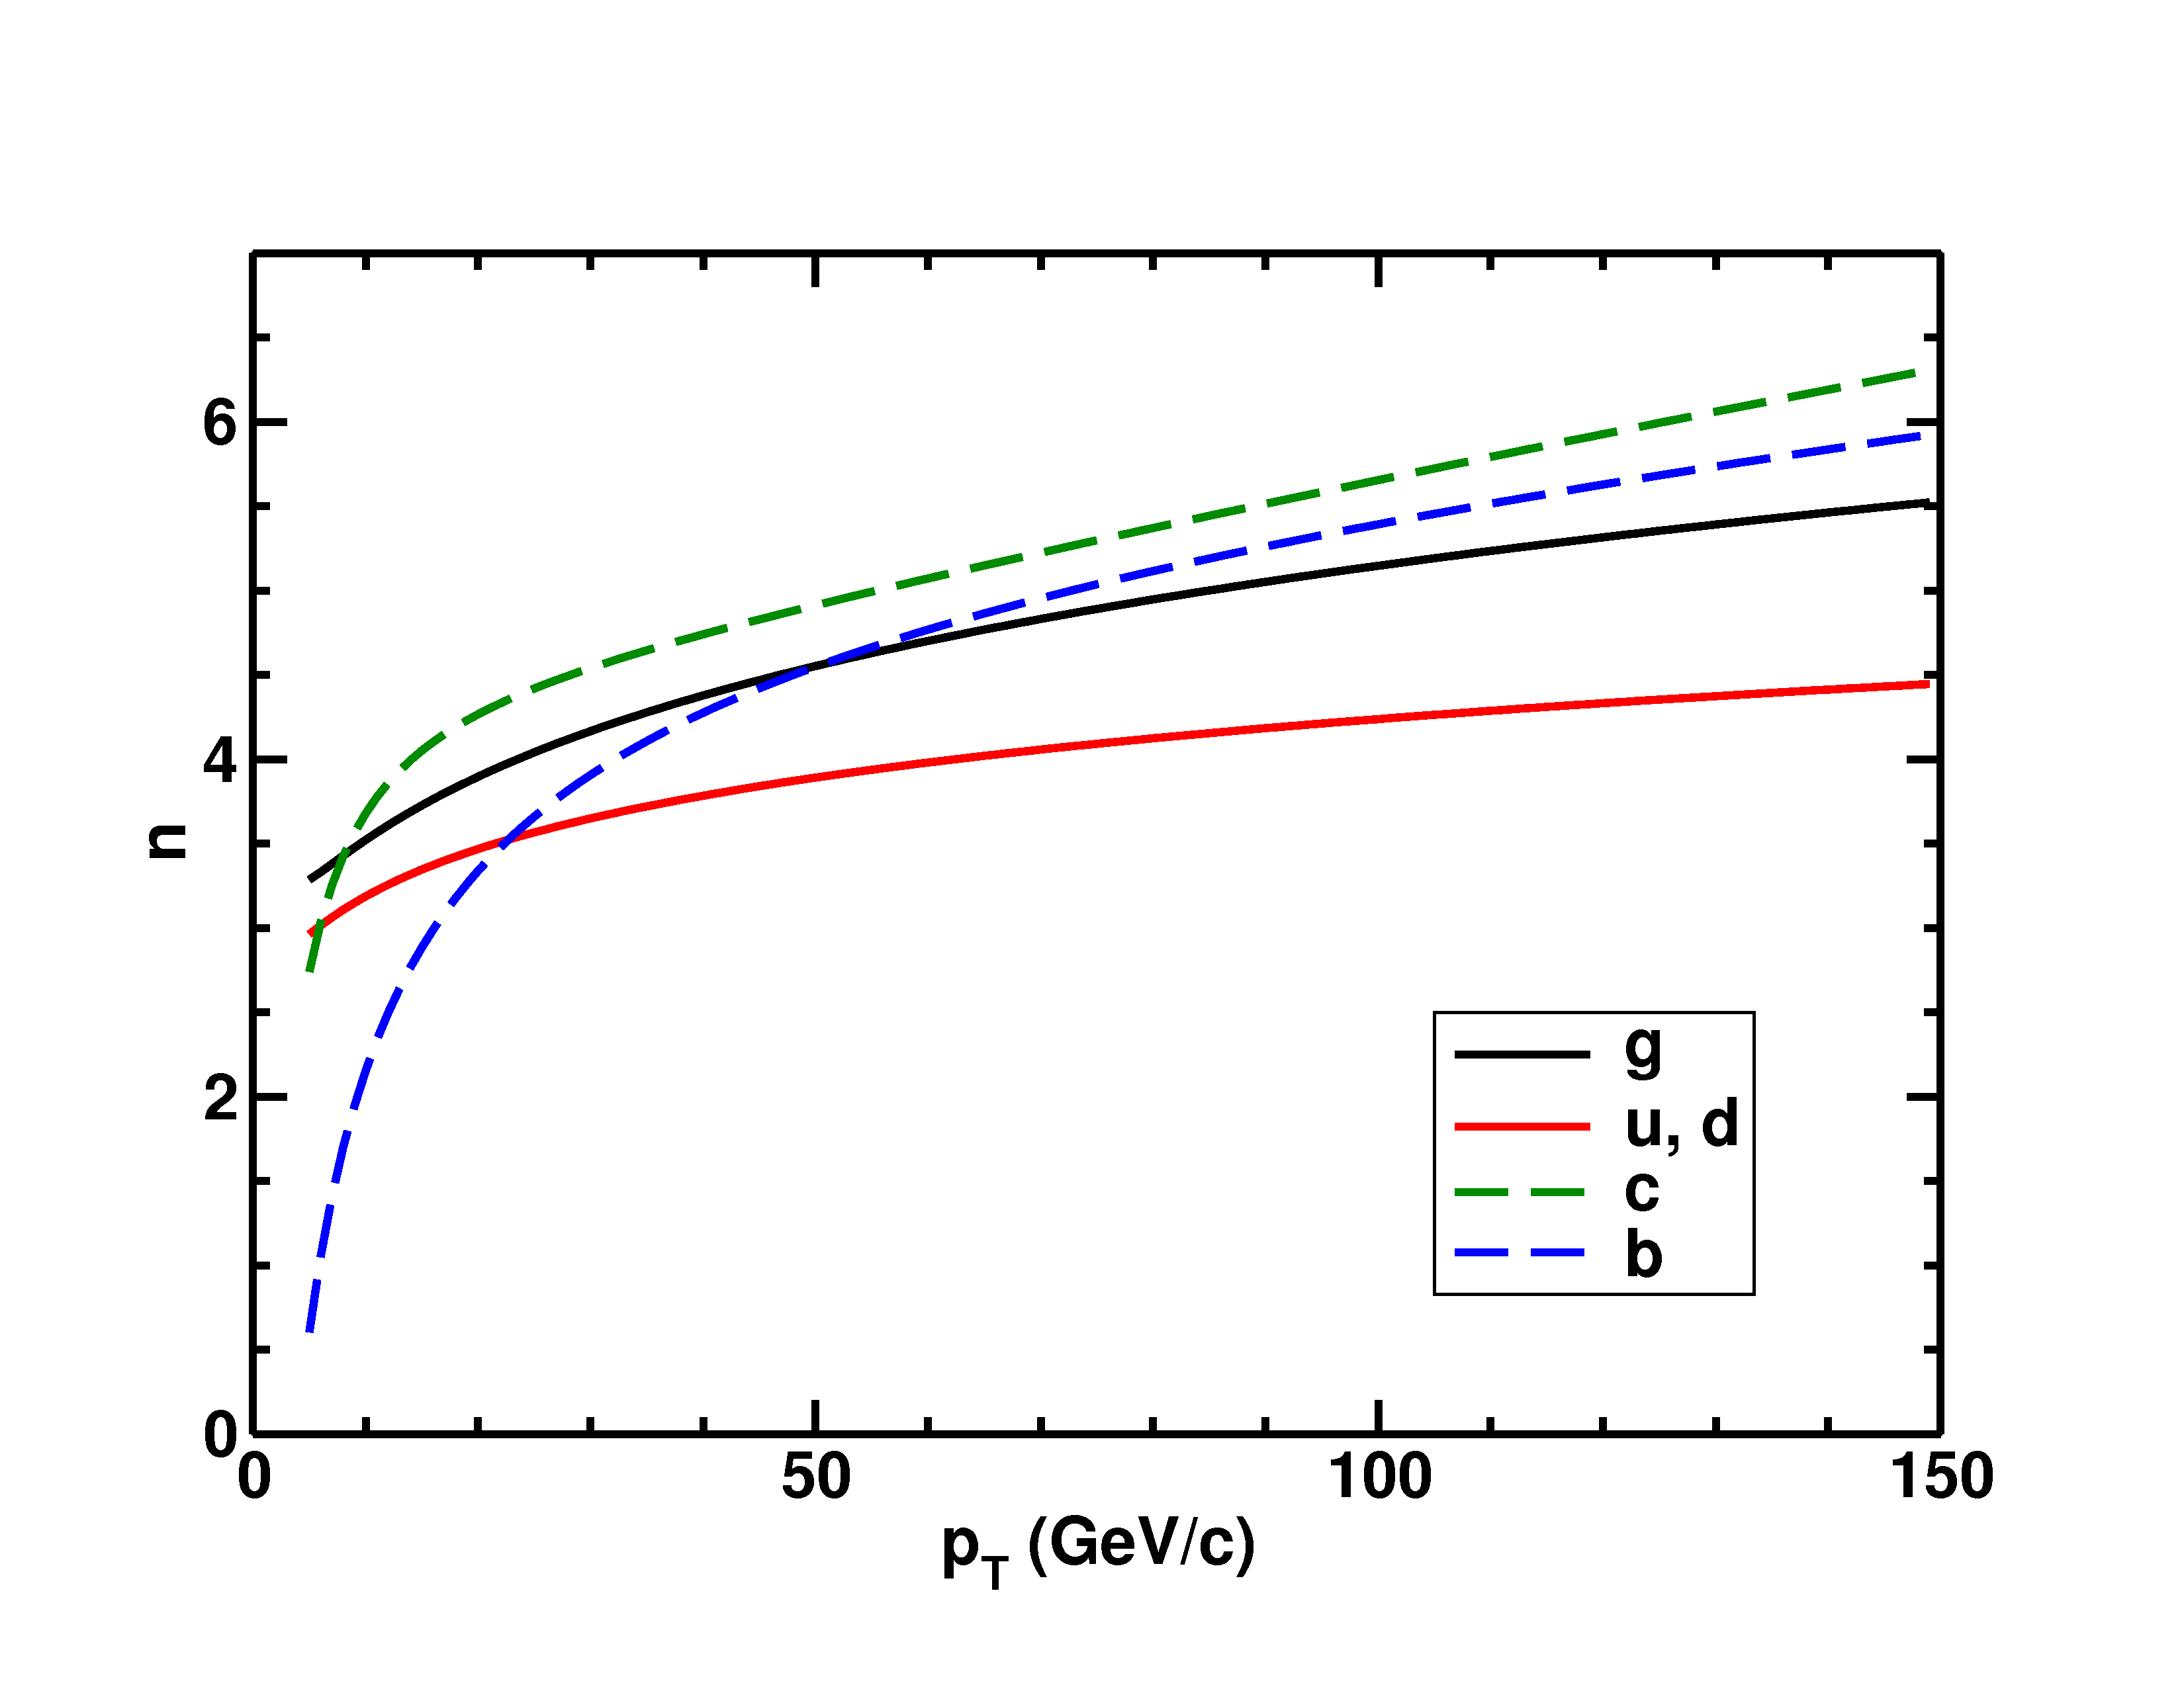
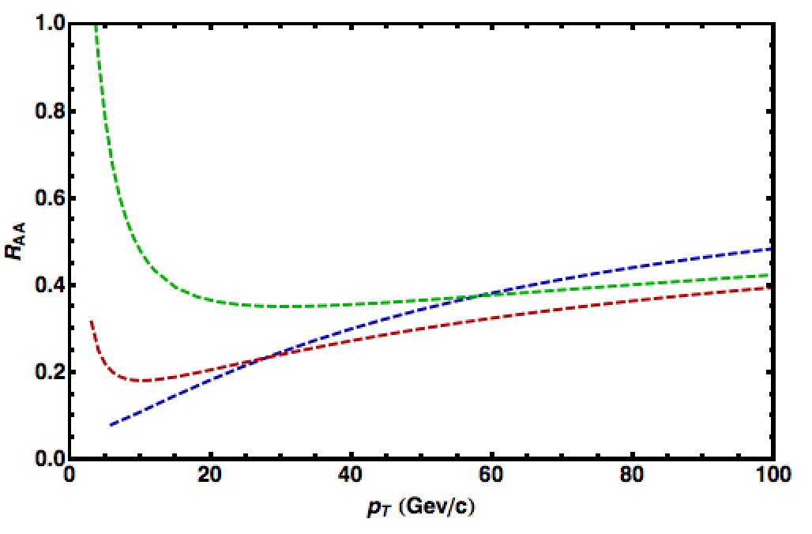
Importance of Production
HQ production spectra softer than lights
=> Nontrivial ordering of R_{AA}(p_{T})
√s = 2.76 TeV
LHC
0-20%
π⁰ WHDG
D WHDG
B WHDG
NB: observe hadrons, not partons
π⁰’s are decay fragments of g, u, d
D’s from c; B’s from b
See also
Buzzatti and Gyulassy, PRL 108 (2012)

