Slide 1
LHC status
Mike Lamont on behalf of the LHC team

Slide 2
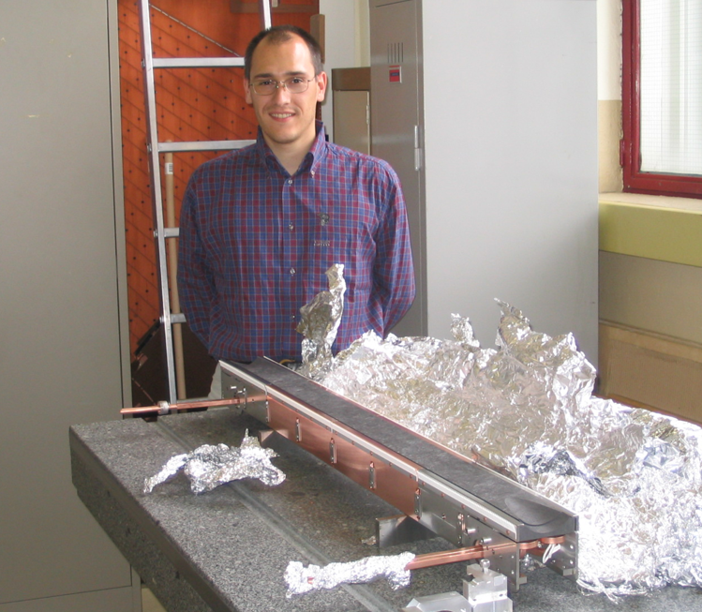
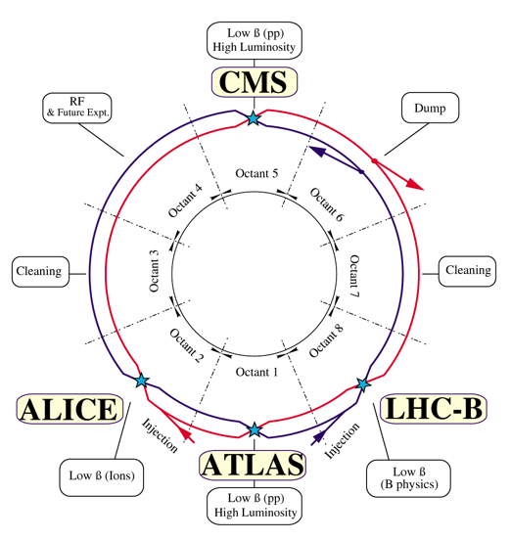
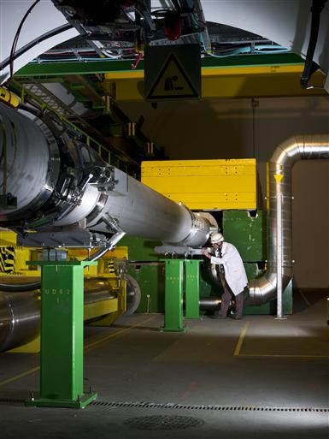
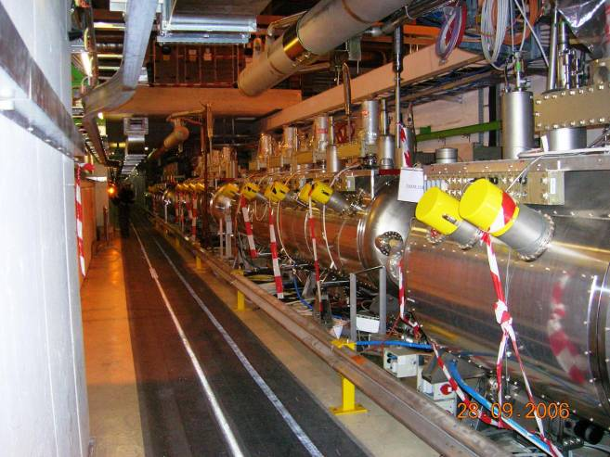
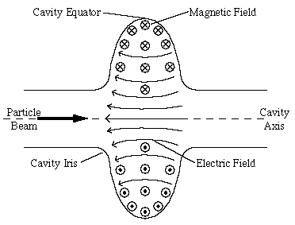

Radio Frequency
Beam dumps
Cleaning
Cleaning

Slide 3
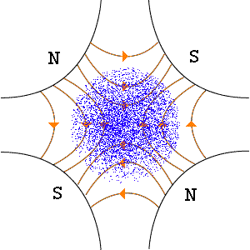

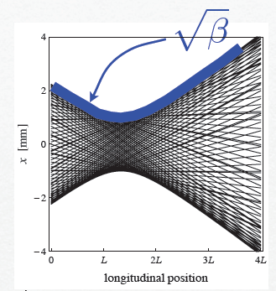
Alternate gradient focusing
Phase
Amplitude

Slide 4
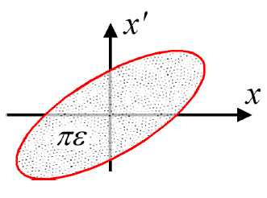
Emittance
Linear motion → beam ellipse in 2-d-space
Ellipse area in (x,x’) plane:
Define emittance by a contour confining some fraction of particles depending on distribution (typically Gaussian)
Units: mm.mrad (but you will see microns)
Normalized emittance: emittance shrinks naturally as we go up in energy

Slide 5



Luminosity
N | Number of particles per bunch
K_{b} | Number of bunches
f | Revolution frequency
 | Beam size at interaction point
F | Reduction factor due to crossing angle
 | Emittance
 | Normalized emittance
 | Beta function at IP

Slide 6
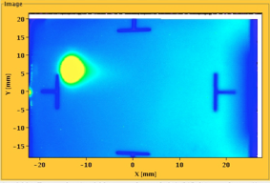

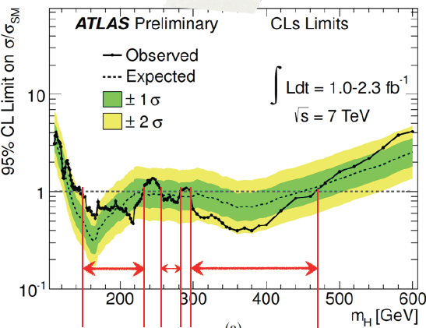
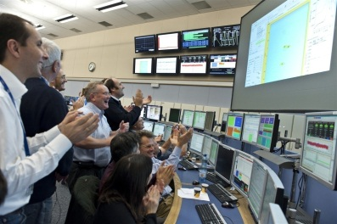

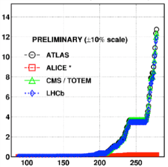
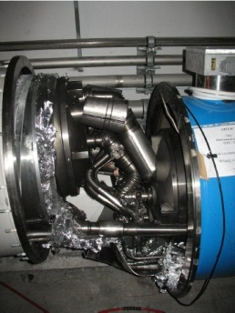
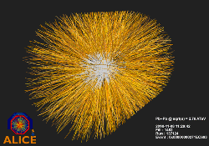
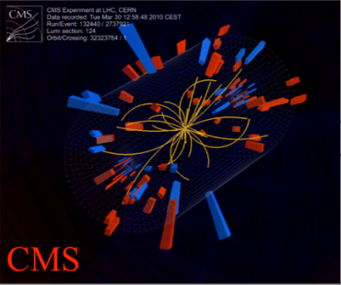
August 2008
First injection test
November 29, 2009
Beam back
August, 2011
2.3e33, 2.6 fb⁻¹
1380 bunches
4 July, 2012
Higgs discovery
September 10, 2008
First beams around
June 28 2011
1380 bunches
October 14 2010
1e32
248 bunches
1380
6 June, 2012
6.8e33
April 2010
Squeeze to 3.5 m
2008
2009
2010
2011
2012
November 2010
Ions
March 30, 2010
First collisions at 3.5 TeV
September 19, 2008
Disaster
Accidental release of 600 MJ stored in one sector of LHC dipole magnets
18 June, 2012
6.6 fb⁻¹
to ATLAS & CMS
LHC Timeline

Slide 7
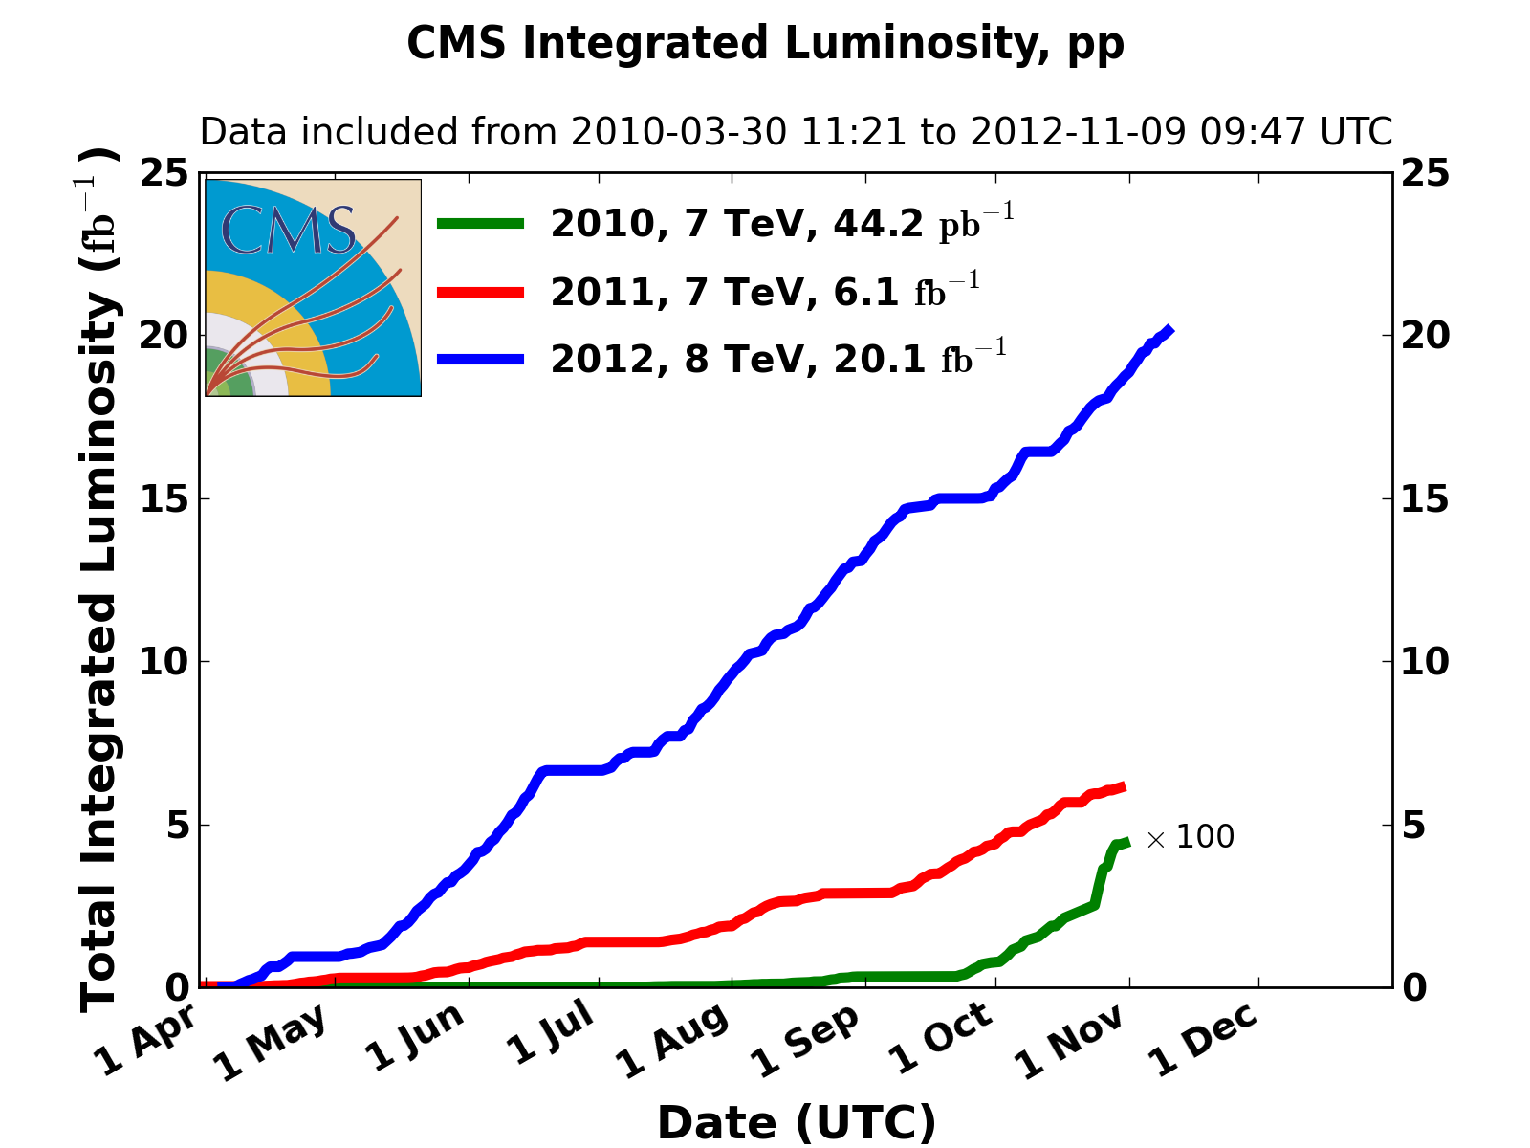
Integrated luminosity 2010-2012
2010: 0.04 fb⁻¹
  7 TeV CoM
  Commissioning
2011: 6.1 fb⁻¹
  7 TeV CoM
  … exploring the limits
2012: 23 fb⁻¹ so far
  8 TeV CoM
  … production

Slide 8
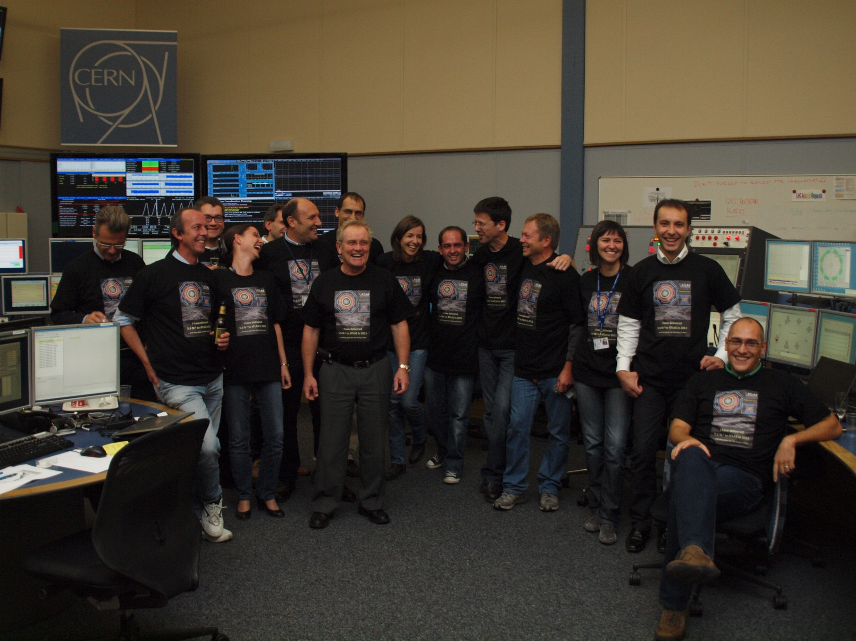
We delivered 5.6 fb⁻¹ to Atlas in 2011 and all we got was a blooming tee shirt

Slide 9
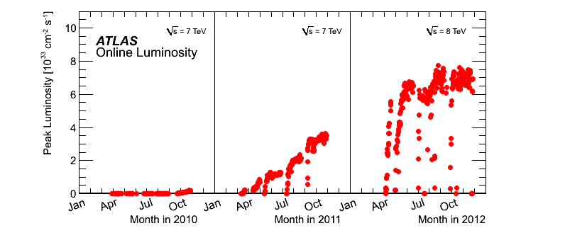
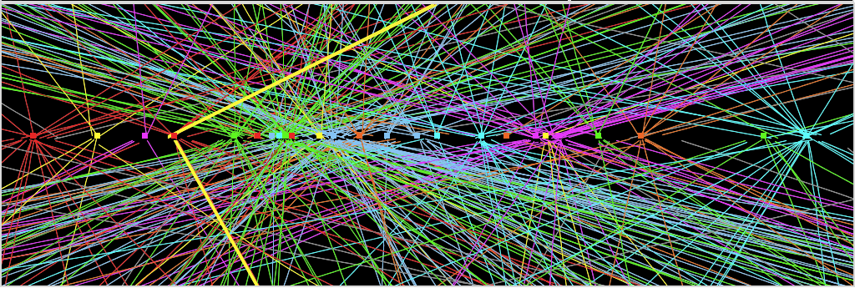
2011: average
12 events/xing,
with tails up to ~20
2012: ~30 events/xing
at beginning of fill
with tails up to ~ 40.
Z→ μμ event from 2012 data with 25 reconstructed vertices
Huge efforts over last months to prepare for high lumi and pile-up expected in 2012:
optimized trigger and offline algorithms (tracking, calo noise treatment, physics objects)
→ mitigate impact of pile-up on CPU, rates, efficiency, identification, resolution
in spite of x2 larger CPU/event and event size → we do not request additional computing
resources (optimized computing model, increased fraction of fast simulation, etc.)
Z→ μμ

Slide 10
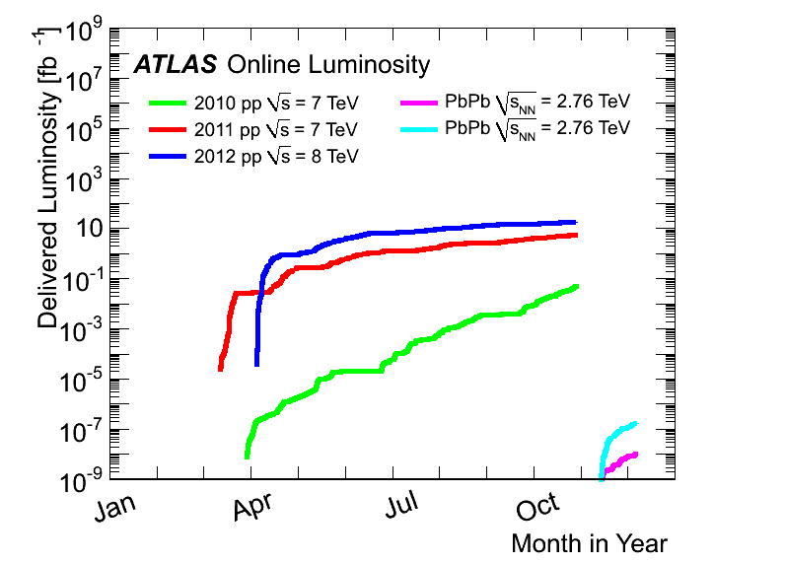
On a log scale
3.5 Z TeV | 9.7 + 166 microbarn⁻¹

Slide 11
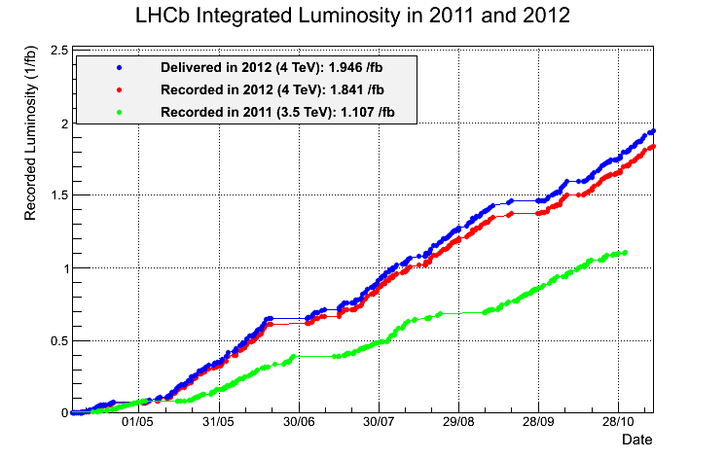
ALICE and LHCb
(and TOTEM and ALFA)
Luminosity levelling at around 4e32 cm⁻²s⁻¹ via transverse separation (with a tilted crossing angle)
Non-trivial!
ALICE enjoying some sustained running at around 5e30 cm⁻²s⁻¹ with collisions between enhanced satellites on main bunches
Successful beta* = 1 km run for TOTEM and ALFA: With t_{min} ~ 0.0004 GeV² first LHC measurement in Coulomb-Nuclear Interference region

Slide 12
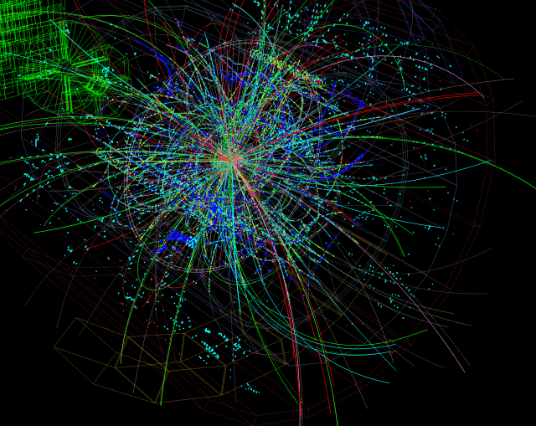
Successful proton-lead pilot in preparation for the 4 weeks run in the new year
ALICE

Slide 13
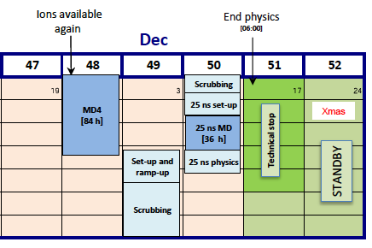
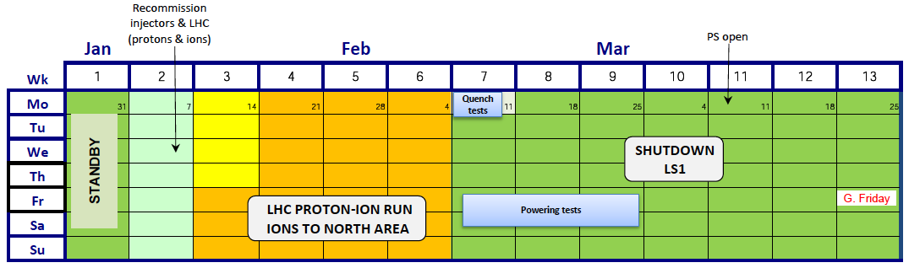
End game 2013
2012
Later this week: ~7 days of 25 ns
2013: one week of re-commissioning followed by 4 weeks of proton-lead (and lead-proton)
2013

Slide 14
pA – potential performance
Numbers for CMS
 | Extrapolated from pilot run | All out optimism
Number of bunches | 318 | 318
Number colliding bunches | 300 | 300
Beta* [cm] | 80 | 60
Pb bunch intensity | 1.2 x 10⁸ | 1.3 x 10⁸
Pb emittance (H/V) [micron] | 1.0/1.4 | 1.0/1.4
p bunch intensity | 1.5 x 10¹⁰ | 5 x 10¹⁰
p emittance [micron] | 1.7 | 1.7
Luminosity | 7.07 x 10²⁸ | 3.4 x 10²⁹
mu | 0.042 | 0.202
Source: John Jowett LPC 26th November

Slide 15
PERFORMANCE
In slightly more detail…

Slide 16
Peak performance – the numbers
Energy [TeV] | 4.0
Beta* [m] IP 1,2,5,8 | 0.6, 3.0, 0.6, 3.0
Bunch spacing [ns] | 50
Normalized emittance [microns] | ~2.5 start of fill
Bunch intensity [protons per bunch] | 1.6 – 1.7e11
Number of bunches | 1374 1368 collisions/IP1&5
Stored energy [MJ] | ~140/beam
Peak luminosity [cm⁻²s⁻¹] | 7.73e33
Pile-up | mean ~30 peak ~40

Slide 17
Performance
Max. luminosity in one fill | 237 pb⁻¹
Max. luminosity delivered in 7 days | 1350 pb⁻¹
Longest time in stable beams (2012) | 22.8 hours
Longest time in stable beams for 7 days | 91.8 hours (55%)
77% of design luminosity:
- 4/7 design energy
- nominal bunch intensity++
- ~70% nominal emittance
- beta* = 0.6 m (design 0.55 m)
- half nominal number of bunches
(This is not bad)

Slide 18
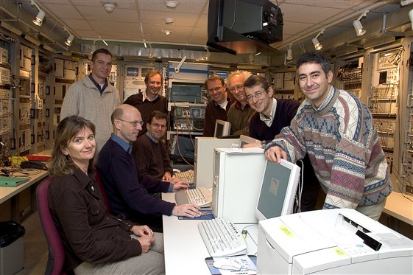
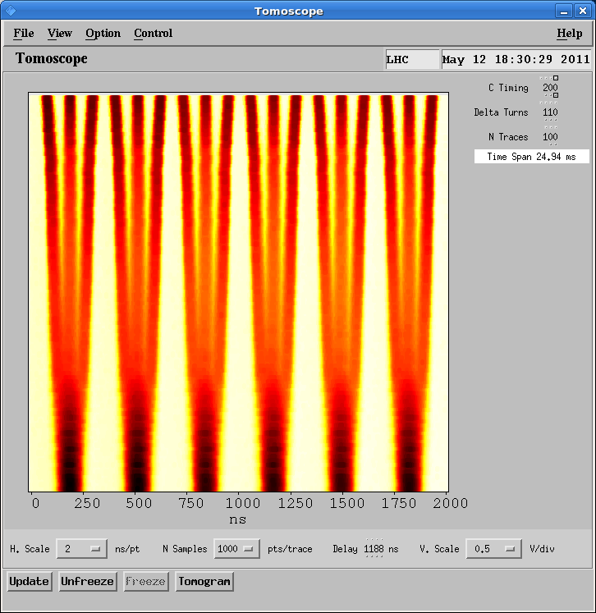
Beam from injectors
Excellent performance – years in the preparation
Best in 2012 with 50 ns:
~1.7 x 10¹¹ ppb
~2.5 microns into collision
Design report with 25 ns:
1.15 x 10¹¹ ppb
Normalized emittance 3.75 microns

Slide 19
Performance from injectors 2012
Bunch spacing [ns] | Protons per bunch [ppb] | Norm. emittance H&V [microns] Exit SPS
50 | 1.7 x 10¹¹ | 1.8
25 | 1.2 x 10¹¹ | 2.7
N.B. the importance of 50 ns in the performance so far.
This at the expense of high pile-up.
(And they are in the process of re-inventing themselves again)

Slide 20
LHC performance: summary
Number of bunches | 1380 | Given by 50 ns
Bunch spacing | 50 ns | Exploiting important advantage that high bunch intensities bring (luminosity proportional to I_{b}²)
Bunch intensity | 1.7e11 ppb | 150% of nominal NB can collide these intensities without problems – not expected
Total intensity | 2.2e14 | 70% of nominal – some issues
Normalized emittance | 2.5 microns | 67% of nominal – again injector performance and ability to conserve PSB-PS-SPS(-LHC)
Beta* | 60 cm | Aggressive, exploiting: Available aperture Tight collimator settings Stability

Slide 21
What we know so far

Slide 22
In general - beam
Excellent single beam lifetime – vacuum
Excellent field quality, good correction of non-linarites (dynamic aperture – not an issue)
Low tune modulation, low power converter ripple, low RF noise
Beam-Beam
  Head-on is not a limitation
  Long range taken reasonably seriously
Collective effects – had some fun here:
  Single and coupled bunch instabilities

Slide 23
In general – optics etc.
Linear optics: remarkably close to model, beating good and corrected to excellent
Very good magnetic model
  including dynamic effects
Better than expected aperture
  tolerances, alignment
Beta* reach established and exploited
  aperture, collimation, optics

Slide 24
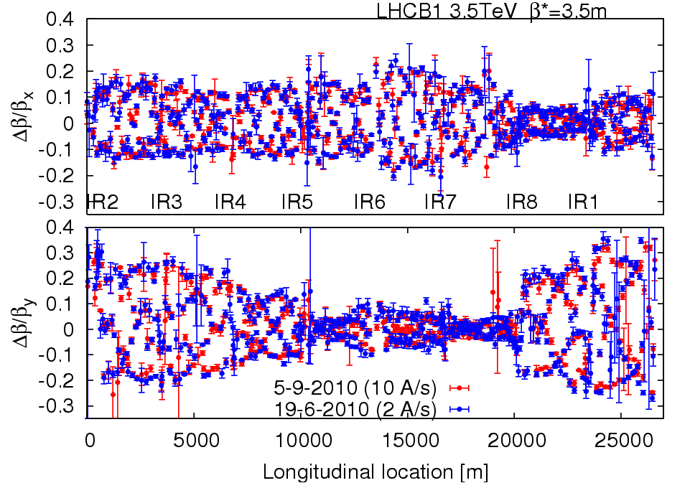
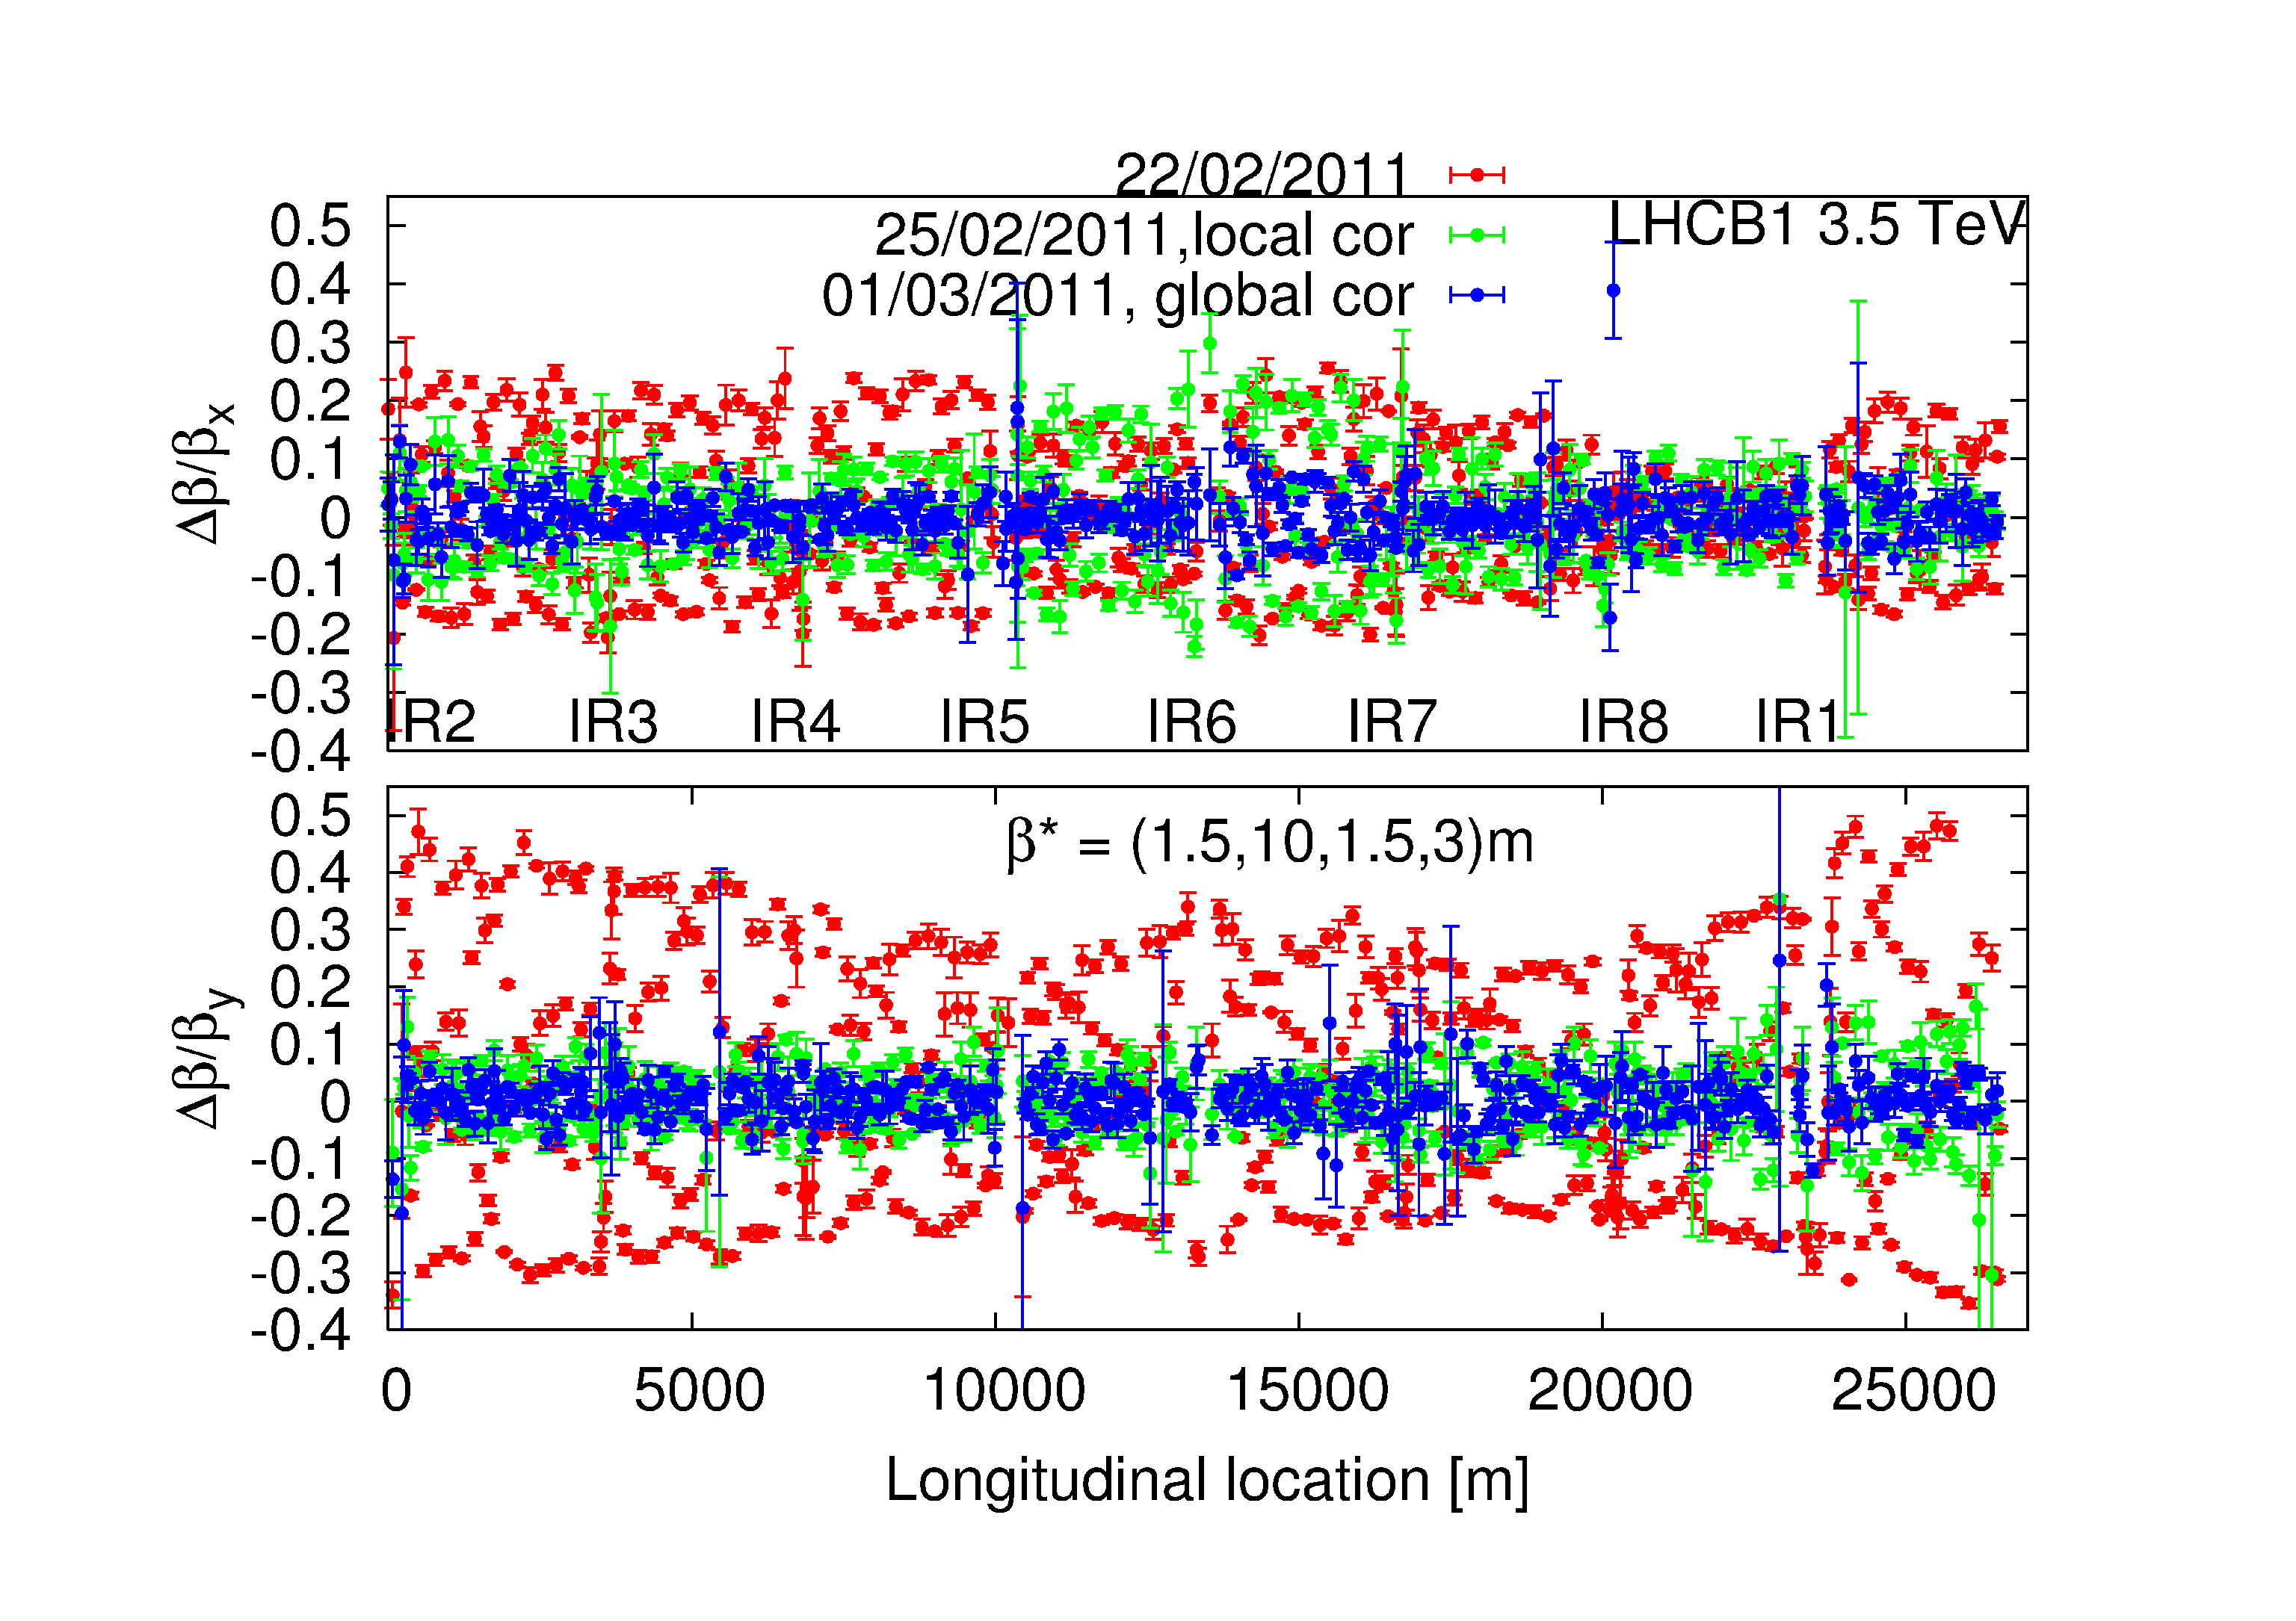
Optics
Optics stunningly stable
and well corrected
Two measurements of beating at 3.5 m
3 months apart
Local and global correction at 1.5 m
Record Low Beta-beat of 10% in the LHC
G. Vanbavinckhove, M. Aiba, R. Calaga, R. Miyamoto and R. Tomas

Slide 25
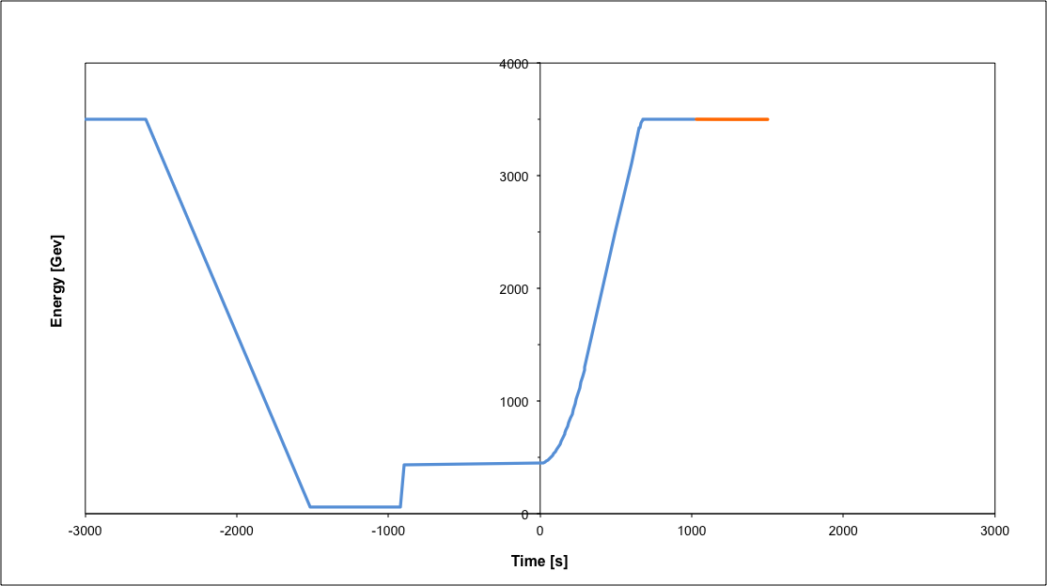
Nominal cycle
Beam dump
Squeeze
Stable beams
Collide
Ramp
Ramp down/precycle
Ramp down | 35 mins
Injection | ~30 mins
Ramp | 12 mins
Squeeze | 15 mins
Collide | 5 mins
Stable beams | 0 – 30 hours
Injection
Turn around 2 to 3 hours on a good day

Slide 26
Operational robustness
Pre-cycle, injection, 450 GeV, ramp, squeeze, collide:
  devils in the details - we have some fun - but remarkably robust
  good lifetime throughout the whole process (on the whole)
Machine remarkably reproducible
  optics, orbit, collimator set-up, tune…

Slide 27
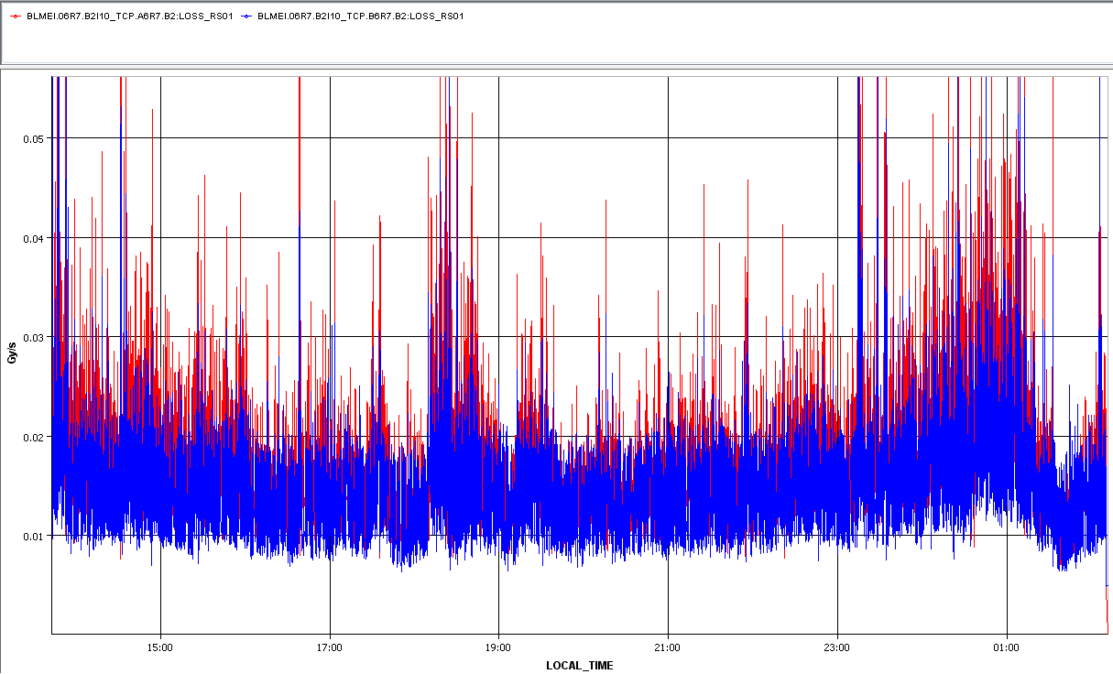
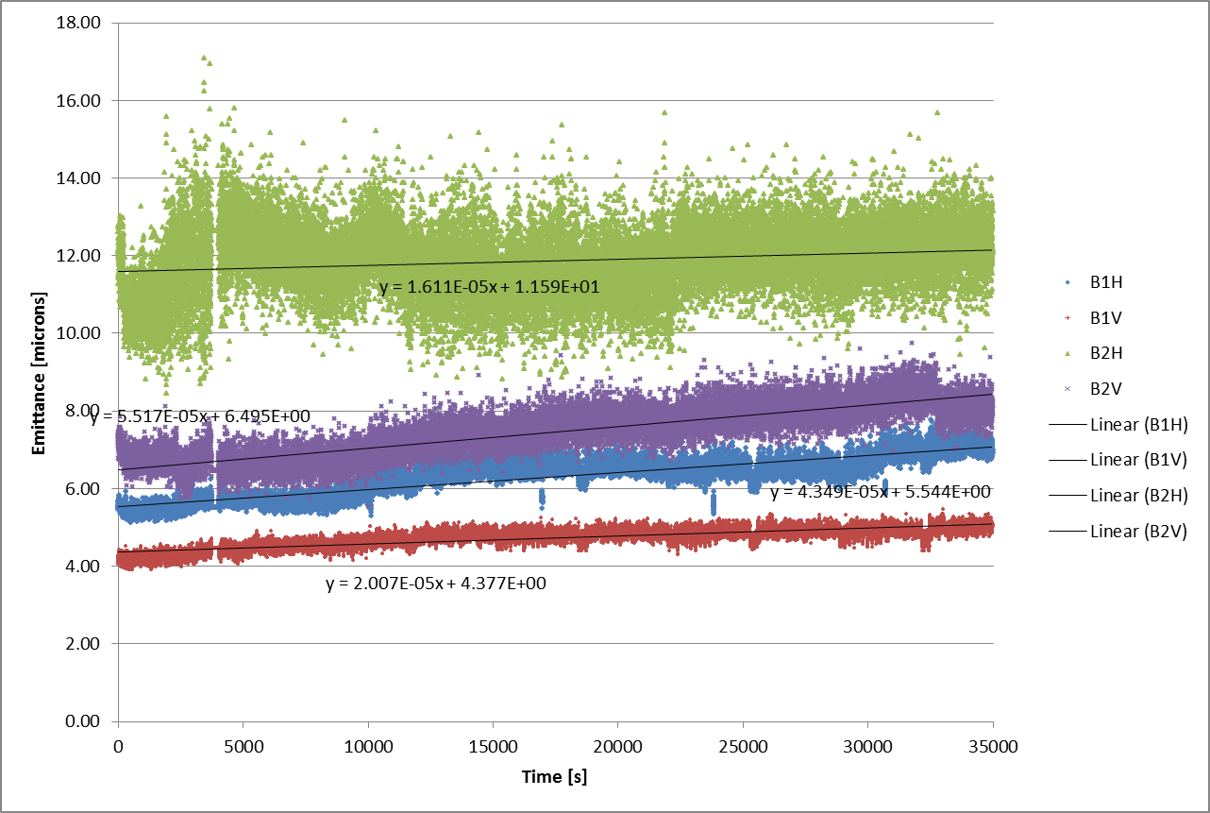
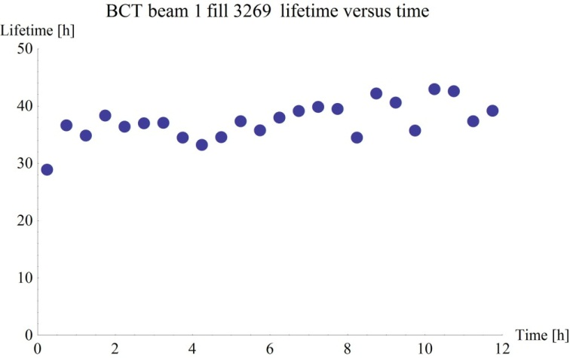
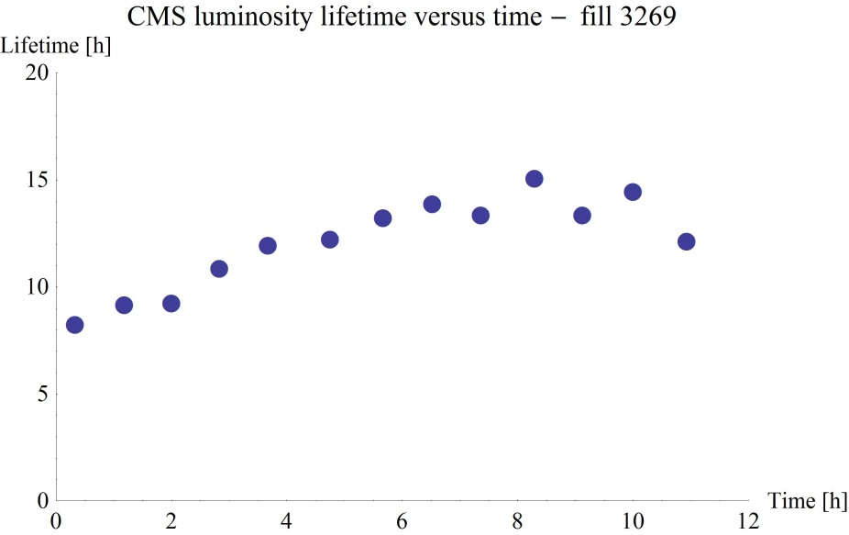
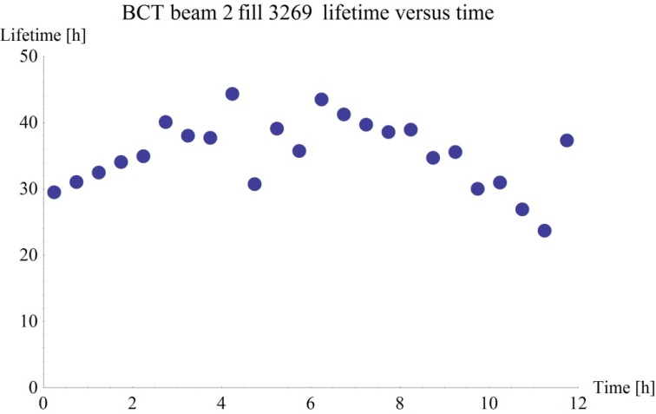
Luminosity
Losses at collimators
Emittance blow-up
Single beam lifetime
Reasonably comfortable life in Stable BeamS

Slide 28
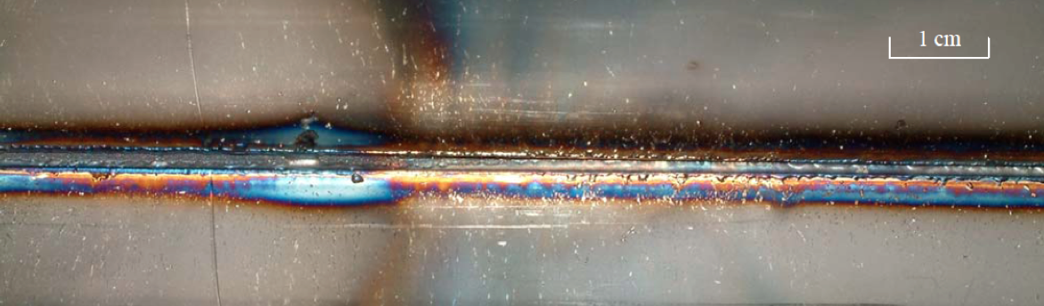
Energy
3.5 TeV with 1380 bunches – September 2011
~3 GJ of energy stored in the magnets
100 MJ stored in each beam ~21 kg of TNT.
During an SPS extraction test in 2005…
The beam was a 450 GeV full LHC injection batch of 3.4 10¹³ p+ in 288 bunches [2.5 MJ]

Slide 29
Beam Interlock System
Safe Beam Parameter Distribution
Jaw Position
Temperature
Special
BLMs
Safe
LHC
Parameter
Software
Interlock
System
Operator Buttons
CCC
Vacuum
System
Screens and Mirrors
beam observation
RF
System
(f_RF + P)
Access
System
Collimation
System
Beam Interlock System
Beam
Dumping System
Safe
Beam
Flag
Injection Interlock
Powering
Interlocks
superconducting magnets
Powering
Interlocks
normal conducting magnets
Fast Magnet Current
change Monitor
BPMs
LHC
Experiments
Beam loss monitors
BLM
Timing System
(Post Mortem Trigger)
Magnets
Power Converters
Beam Loss
Monitors
BCM
Monitors
aperture limits
(some 100)
Monitors in arcs
(several 1000)
Magnet protection system
(20000 channels)
Power
Converters
~1600
AUG
UPS
Cryogenics
some 10000 channels

Slide 30
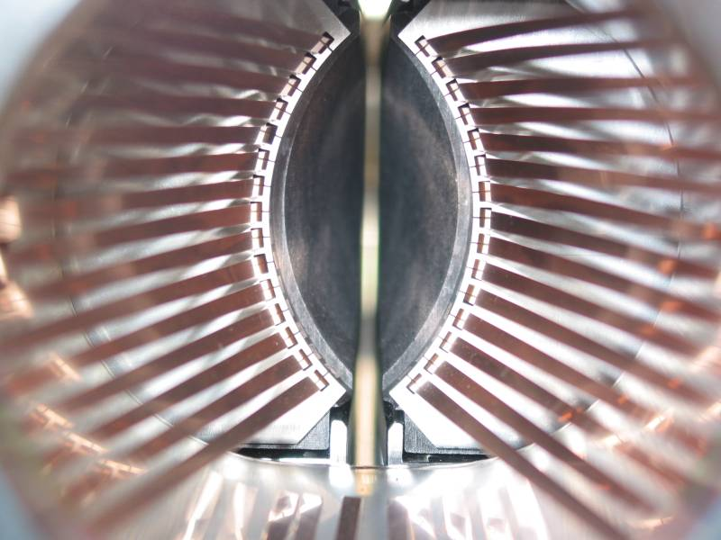
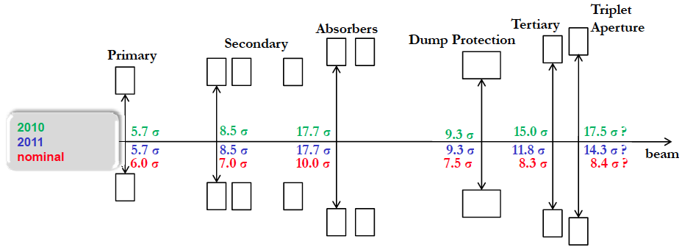
Collimation
Triplet aperture must be protected by tertiary collimators (TCTs)
TCTs must be shadowed by dump protection (not robust)
Dump protection must be outside primary and secondary collimators
Hierarchy must be satisfied even if orbit and optics drift after setup

Slide 31


Tight collimator settings
Norway
Iberian
peninsula
Intermediate settings (2011):
~3.1 mm gap at
primary collimator
Tight settings (2012):
~2.2 mm gap at
primary collimator
Roderik Bruce

Slide 32
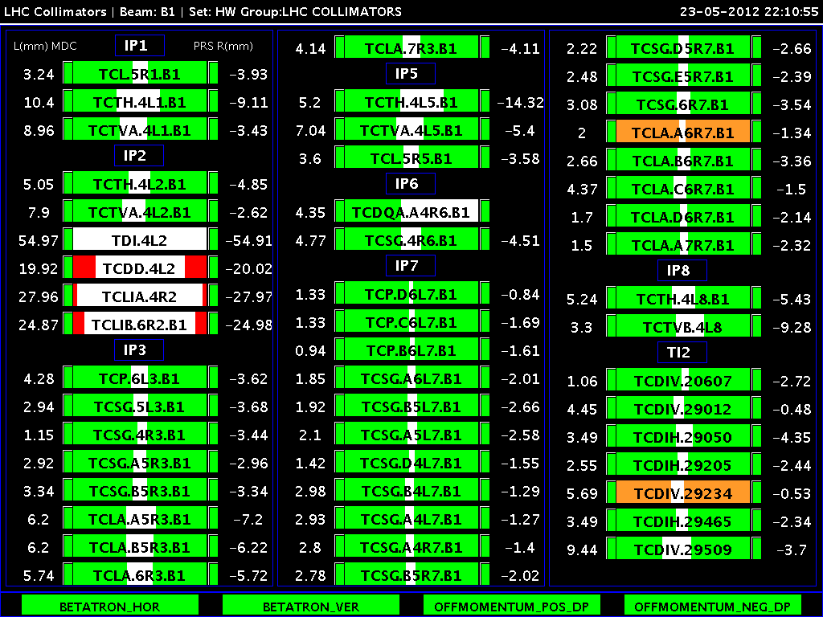

Slide 33
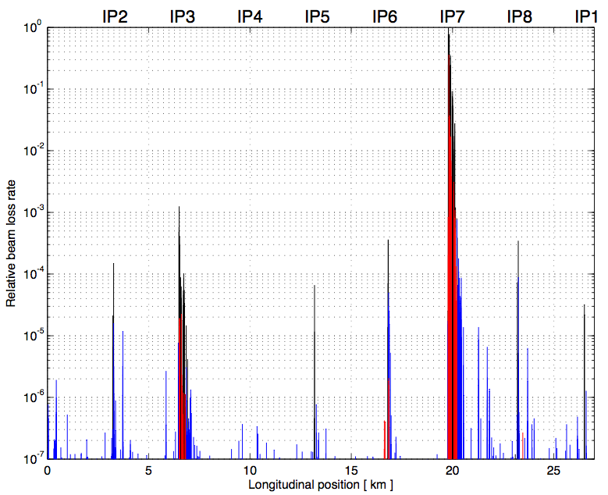
Collimation
Generate higher loss rates: excite beam with transverse dampers
Beam 1
Betatron
Off-momentum
0.00001
Dump
TCTs
TCTs
TCTs
TCTs
Legend:
Collimators
Cold losses
Warm losses
0.000001
Routine collimation of 140 MJ beams without a single quench from stored beam
Stefano Redaelli

Slide 34
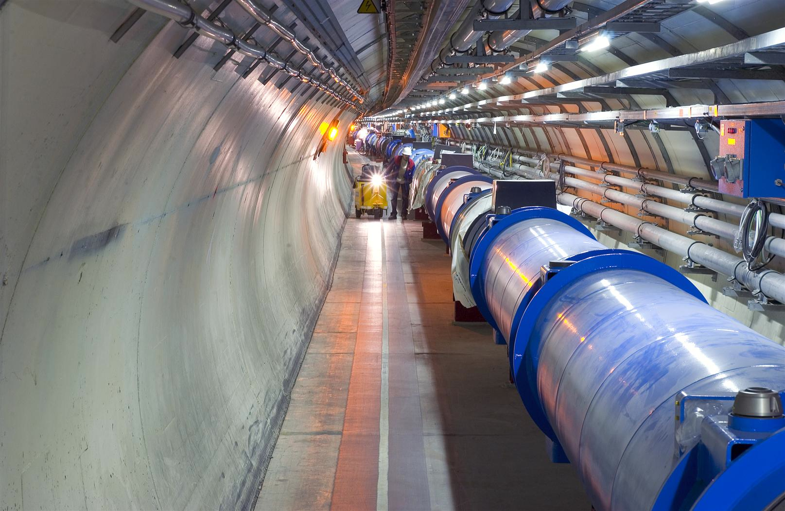
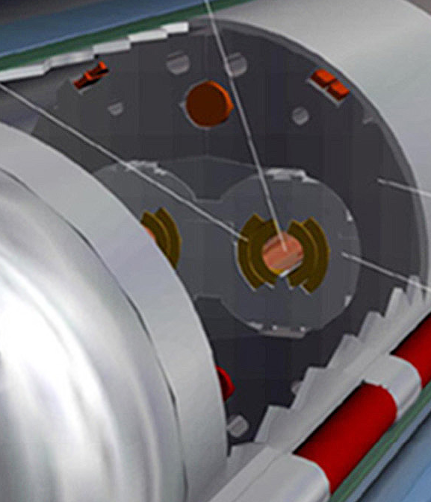
Machine protection – the challenge met
Beam
140 MJ
Not a single beam-induced quench at 4 TeV
… YET
11 magnet quench at 450 GeV – injection kicker flash-over
56 mm
SC Coil:
quench limit
15-100 mJ/cm³

Slide 35
Machine protection
Operations unpinned by superb performance of machine protection and associated systems
Rigorous machine protection follow-up, qualification, and monitoring
  all non-conformities jumped on
Can’t over stress the importance of this to the success of the LHC (so far). From commissioning to real confidence in under two years.

Slide 36
AVAILABILITY

Slide 37

Availability in 2012 (so far)
In general – pretty good considering
Issues (SEUs, vacuum, UFOs, cryogenics…) have seen vigorous follow-up and consolidation performed and planned

Slide 38
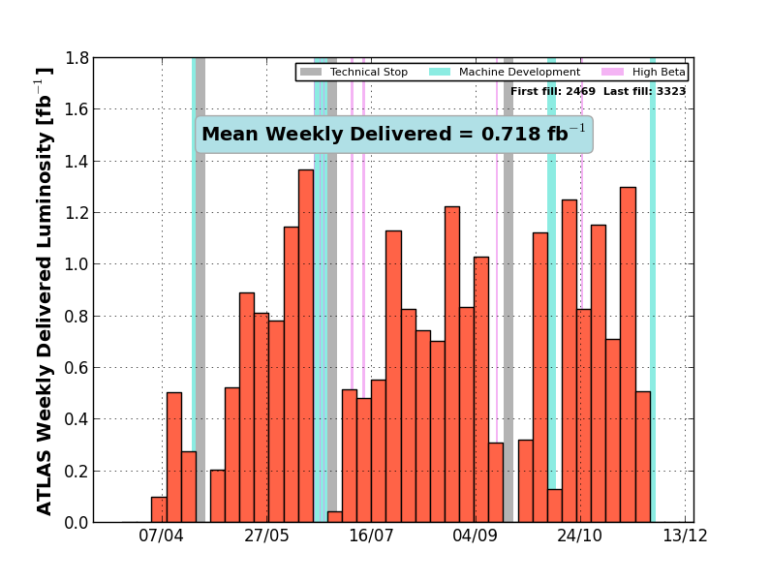

Slide 39
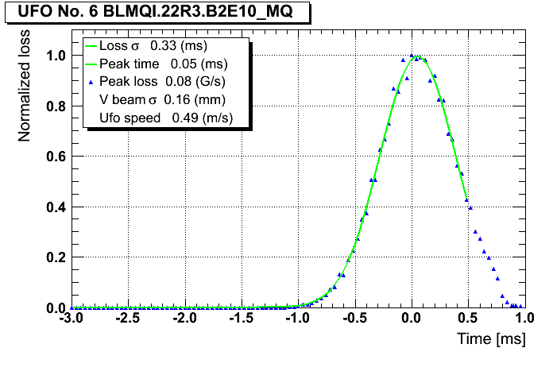
Issues 1/2
SEUs
  Radiation to tunnel electronics: impact considerably reduced following sustained program of mitigation measures
UFOs (Unidentified Falling Objects)
  Occasional dumps following adjustment of BLM thresholds at appropriate timescales
  Potentially serious problem at higher energies – investigations continue

Slide 40
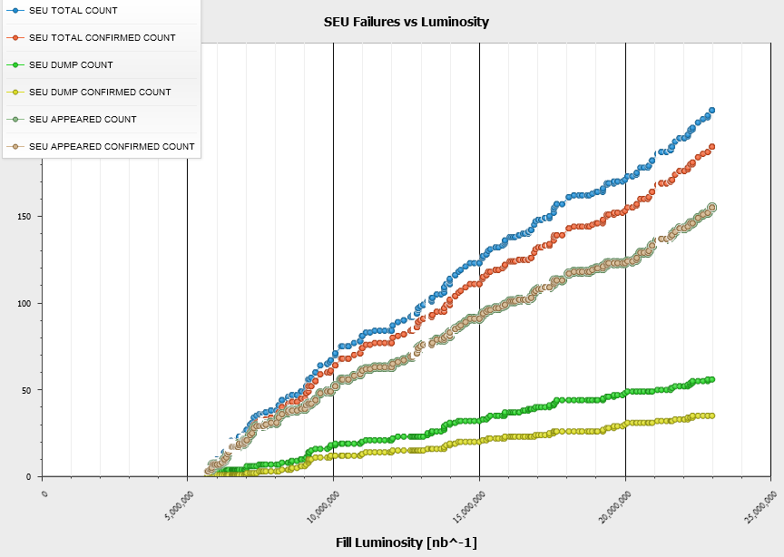
R2E: Past/Present/Future
2012 SEE Failure Analysis
2011
Several shielding
campaigns prior
the 2011 Run +
Relocations ‘on the fly’
+ Equipment Upgrades
~12 dumps per fb⁻¹
2011/12 xMasBreak
‘Early’ Relocation
+ Additional Shielding
+ Equipment Upgrades
~3 dumps per fb⁻¹
2012
R2E-Project aiming for …
< 0.5 dump per fb⁻¹
>LS1 (nominal -> ultimate)
Equipment relocations @ 4 LHC Points
(>100 Racks, >60 weeks of work)
Additional shielding
Critical system upgrades (QPS, FGC)

Slide 41
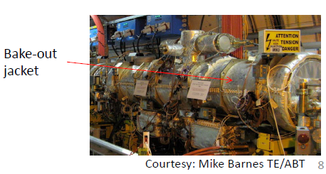
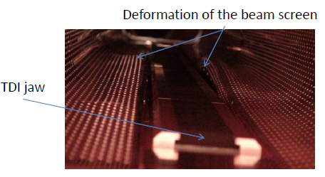
Issues 2/2
Beam induced heating
Instabilities:
  intermittent instabilities at end squeeze and going into collisions with high-bunch intensities
Vacuum instabilities, e-cloud etc.
  Non-conformities (installation, design) – thorough review ongoing

Slide 42
Machine performing well,
huge amount of experience & understanding gained,
good system performance,
excellent tools, reasonable availability following targeted consolidation.
This is the legacy for post LS1

Slide 43
LS1

Slide 44
2013 – 2015: LS1
Primary aim: consolidation for 6.5 to 7 TeV
Measure all splices and repair the defective ones
Consolidate interconnects with new design (clamp, shunt)
Finish installation of pressure release valves (DN200)
Magnet consolidation - exchange of weak cryo-magnets
Consolidation of the DFBAs
Measures to further reduce SEE (R2E):
  relocation, redesign, shielding…
Install collimators with integrated button BPMs (tertiary collimators and a few secondary collimators)
Experiments consolidation/upgrades
Plus a lot of other work ongoing
  Cryogenics, Quench Protection, electrical infrastructure, cooling & ventilation, Radio Frequency, beam dump absorber & magnet, change of dump switches (radiation), electron cloud mitigations …

Slide 45
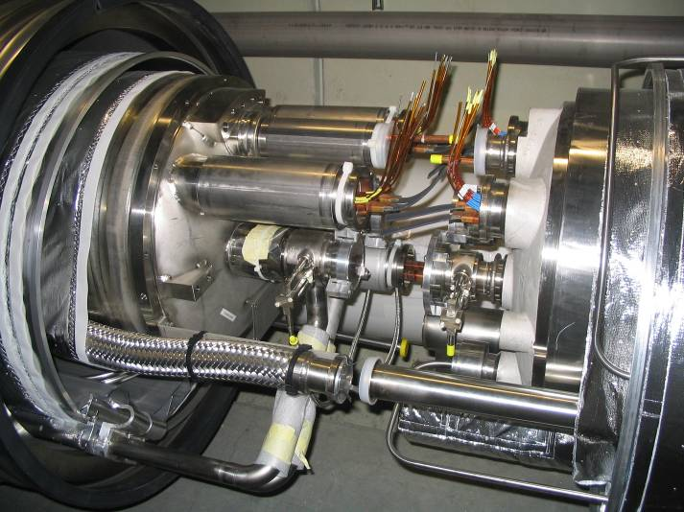
LHC MB circuit splice consolidation proposal
Repeat 3 times per interconnect (1MB, 2MQ) and for ~1700 Interconnects in the machine
Phase I
Surfacing of bus bar and installation of redundant shunts by soldering
Phase II
Application of clamp and reinforcement of nearby bus bar insulation
Phase III
Insulation between bus bar and to ground, Lorentz force clamping

Slide 46
After LS1

Slide 47
Post LS1 energy
Magnets coming from 3-4 do not show degradation of performance
Our best estimates to train the LHC (with large errors)
  ∼ 30 quenches to reach 6.25 TeV
  ∼ 100 quenches to reach 6.5 TeV
Two quenches/day → 2 to 5 days of training per sector
  With 100 quenches one expects 400 quench heater firings
The plan
  Try to reach 6.5 TeV in four sectors in March 2014
  Based on that experience, we decide if to go at 6.5 TeV or step back to 6.25 TeV in March 2014
Ezio Todesco – Chamonix 12

Slide 48
50 versus 25 ns
 | 50 ns | 25 ns
GOOD | Lower total beam current Higher bunch intensity Lower emittance | Lower PILE-UP
BAD | High pile-up Need to level Pile-up stays high | More long range collisions: larger crossing angle; higher beta* Higher emittance Electron cloud: need for scrubbing; emittance blow-up; Higher UFO rate Higher injected bunch train intensity Higher total beam current
Expect to move to 25 ns because of pile up!

Slide 49
Injector plans - summary
As we’ve seen very good already, but big improvements required to meet demands of HL-LHC
Some potential improvements after LS1
  Low emittance beams – to be tested Q4/2012
  SPS improvements (optics, RF, impedance)
LINAC4 connection baseline is now LS2
  Injectors unable to exploit LINAC4 before LS2 anyway
Major upgrades within LIU project, including increase of PSB-PS transfer energy only during LS2

Slide 50
Beam from injectors LS1 to LS2
 | Bunch intensity [10¹¹ p/b] | Emittance, βγε [mm.mrad] | Relative intensity/luminosity in LHC
25 ns ~nominal OP production | 1.15 | 2.8 | 1.0/1.2
50 ns OP production | 1.7 | 2.1 | 0.7/1.7
50 ns 32 bunches | 1.7 | 1.5 | 0.96/1.3
50 ns 24 bunches | 1.7 | 1.2 | 0.92/1.6
25 ns 48 bunches | 1.15 | 1.4 | 0.83/1.6
Heiko Damerau, Steve Hancock, Alan Findlay

Slide 51
Potential performance
 | Number of bunches | Ib LHC FT[1e11] | Collimator scenario | Emit LHC (SPS) [um] | Peak Lumi [cm-²s⁻¹] | ~Pile-up | Int. Lumi [fb⁻¹]
25 ns | 2760 | 1.15 | S1 | 3.5 (2.8) | 9.2e33 | 21 | 24
25 ns low emit | 2320 | 1.15 | S4 | 1.9 (1.4) | 1.6e34 | 43 | 42
50 ns | 1380 | 1.6 | S1 | 2.3 (1.7) | 1.7e34 level 0.9e34 | 76 level 40 | ~45*
50 ns low emit | 1260 | 1.6 | S4 | 1.6 (1.2) | 2.2e34 | 108 | …
6.5 TeV
1.1 ns bunch length
150 days proton physics, HF = 0.2
70 mb visible cross-section
* different operational model – caveat - unproven
All number approximate

Slide 52
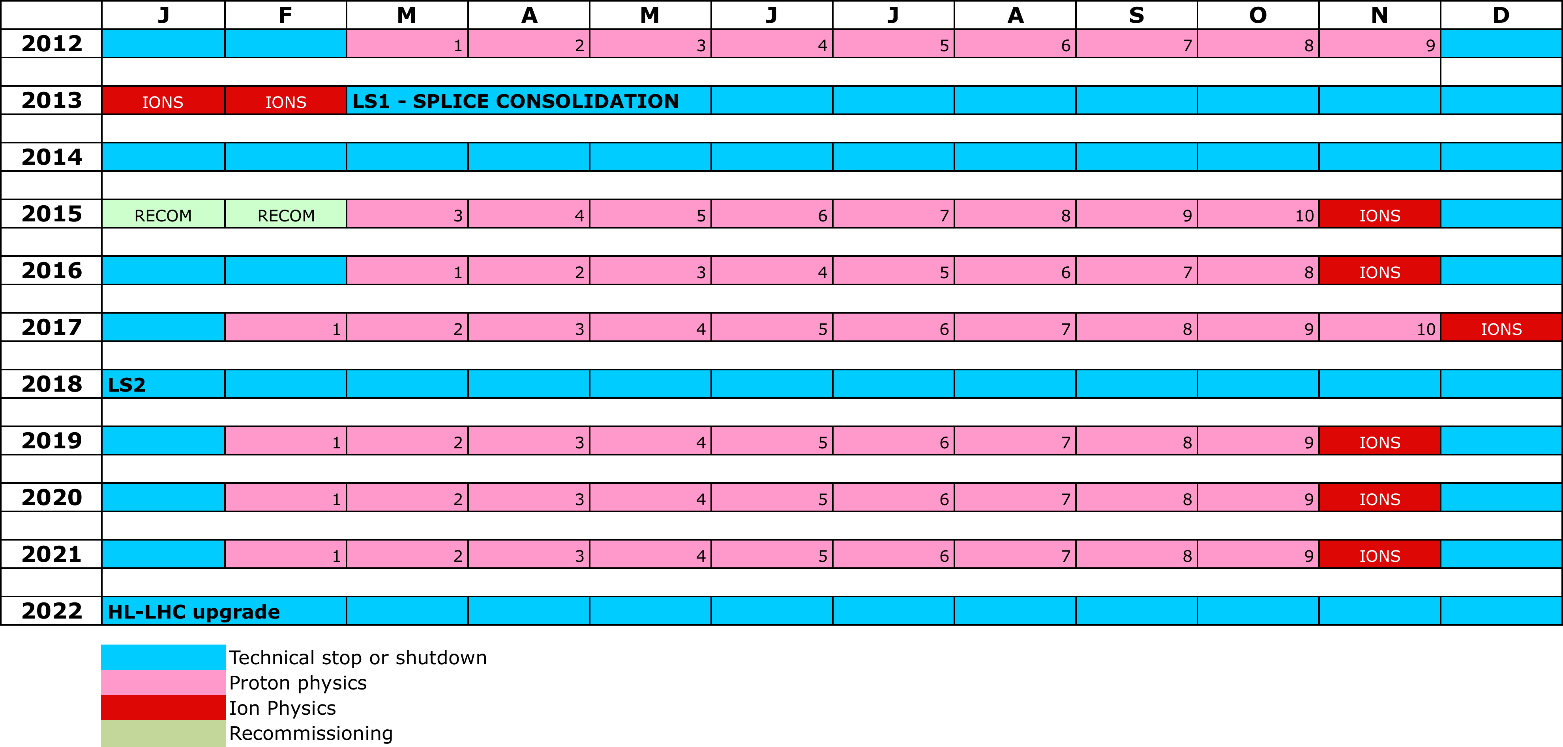
10 year plan
LS1
PHYSICS AT 6.5/7 TeV
LS2 – Injector upgrade
“ULTIMATE” PHYSICS (~2.4e34 cm⁻²s⁻¹)
LS3 – HL-LHC upgrade
Plus: HE-LHC, LHeC, LEP3, DLEP, TLEP….

Slide 53
Conclusions
LHC operation has shown the results of excellent design, construction, and installation
Injector complex has performed exceptionally
Both the above have been fully exploited to give very acceptable performance
Carrying forward a wealth of experience from operation at 3.5 and 4 TeV.
There are issues. Measures to address these are under close examination.

