Slide 1
Review of results from the Tevatron
Sahal Yacoob
University of Kwazulu-Natal /
Northwestern University

Slide 2
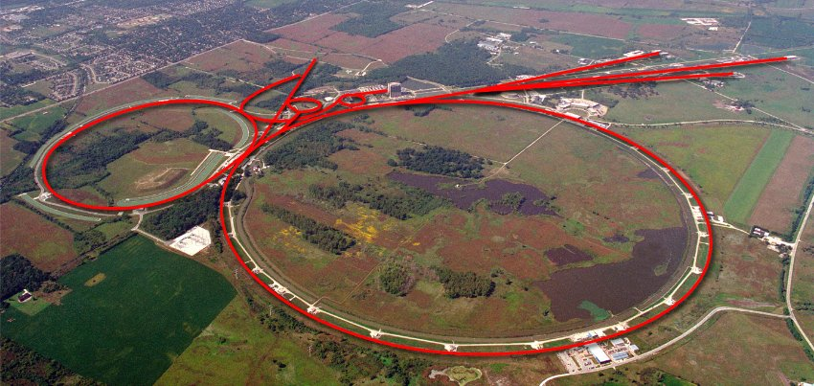
The Tevatron
p p collider at 1.96 TeV
From March 2001 till Sep. 2011
12 fb⁻¹ delivered to each experiment
Notes:
1 KM Radius

Slide 3
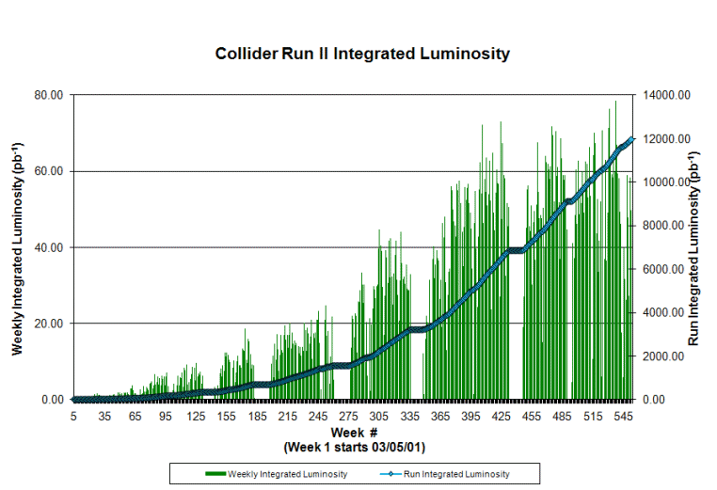
Performance
Notes:
CDf recorded just under 10 fb and D0 10.7

Slide 4
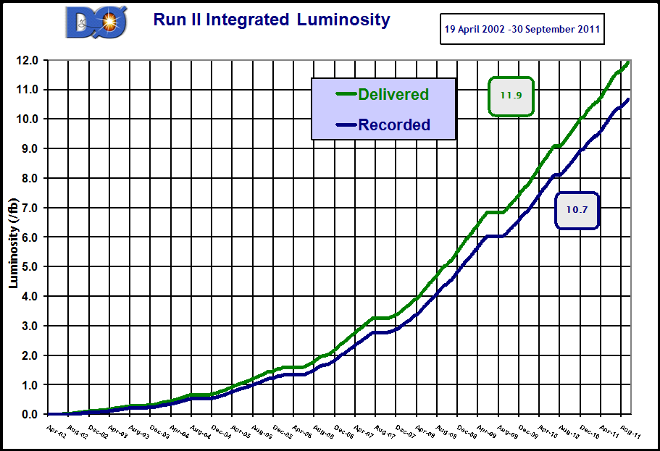
Detector Performance

Slide 5
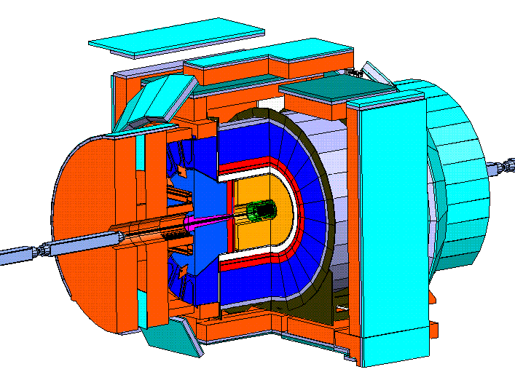
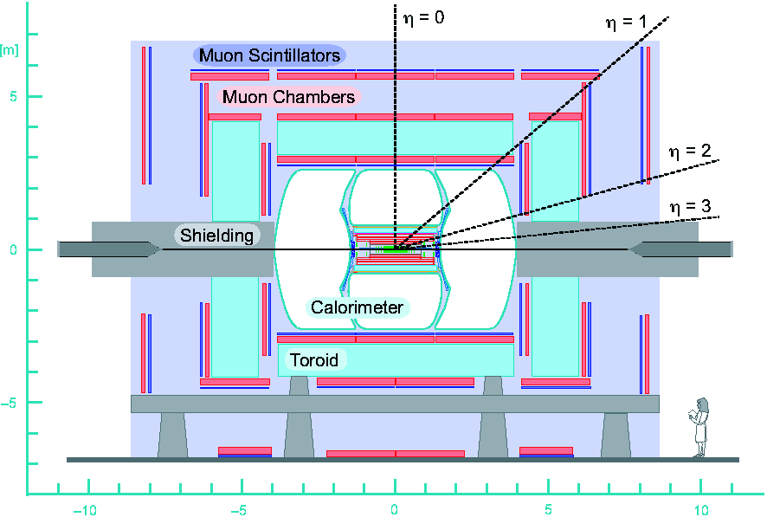
Detectors
CDF
D0
Notes:
Multipurpose detectors:
Central tracking system embedded in a solenoidal magnetic field:
Silicon vertex detector
Tracking chamber (CDF) Fiber tracker (DØ)
Preshowers
Electromagnetic and hadronic calorimeters
Muon system

Slide 6
Top Quark Properties
The first physics impact of the Tevatron was the discovery of the Top Quark in 1995

Slide 7
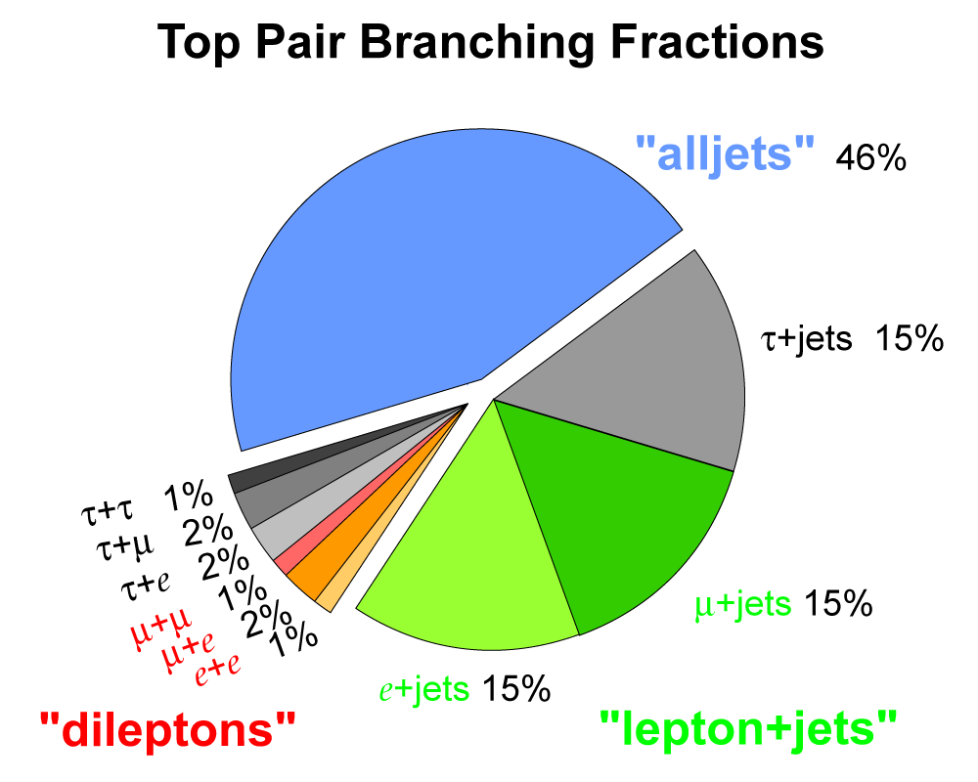
Top Quark Mass Measurements
In-situ Jet Energy Scale (JES) calibration
Use the reconstructed invariant mass of the two light jets from the W boson decay to constrain the JES
Extract an overall JES correction factor and apply this to all jets
Template Method:
Compare distributions to Monte-Carlo generated with different masses
Matrix Element:
compute event probability (event-by-event) that the measured event correspond to a particular input mass.

Slide 8
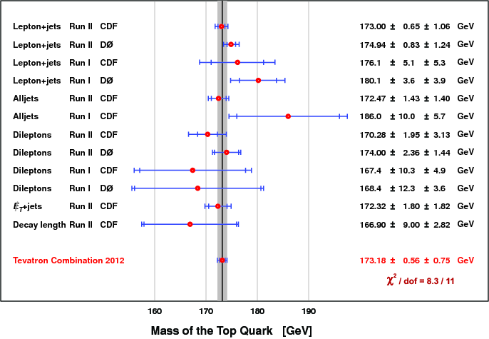
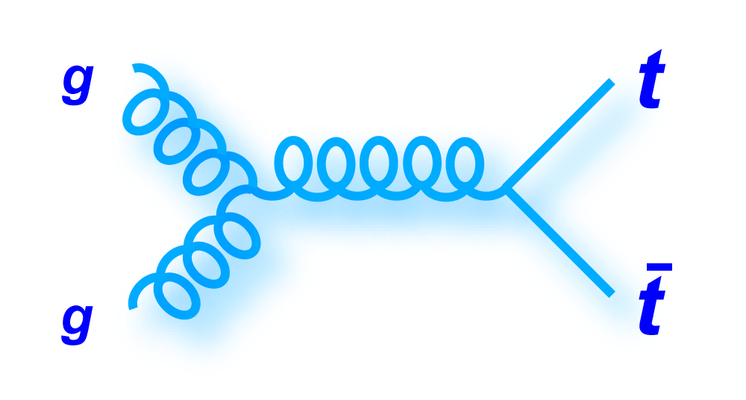
Top Quark Mass (5.6 fb⁻¹)
Accel. | Top Mass (GeV)
LHC | 173.3 ± 0.5 ± 1.3
Tevatron | 173.2 ± 0.6 ± 0.8
Major production channel at the Tevatron is gluon fusion

Slide 9
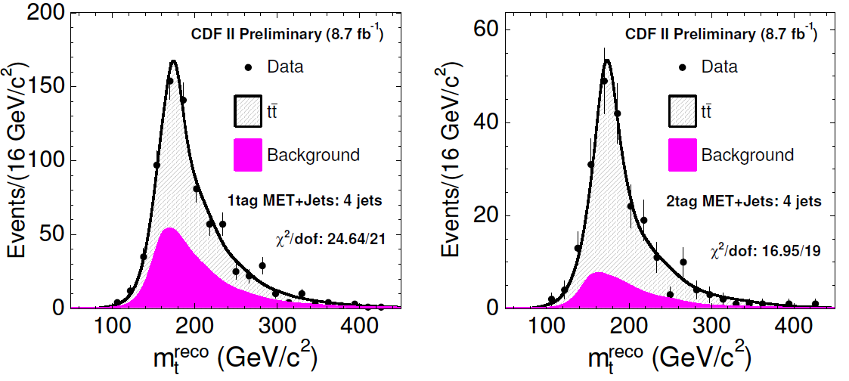
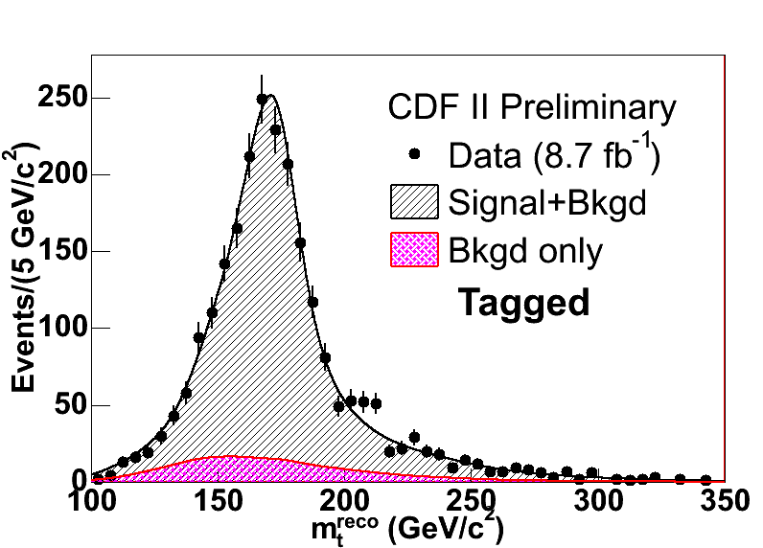
Updates from CDF (8.7 fb⁻¹)
MET + Jets
M_{top} = 173.9 ± 1.6 ± 0.9 GeV
Lepton + Jets
M_{top} = 172.85 ± 0.71 ± 0.85 GeV
Template Fit
In-Situ JES Calibration
Notes:
lep+jets: Three variables : two of mass terms and one hadronic W mass (in situ JES calibration) from kinematic fitter
D0 di-lepton channel updated from matrix element method to template fit method and new JES Calibration
174.0 ± 1.8 (stat.) ± 2.4 (syst.) GeV/c2
173.9 ± 1.9 (stat.) ±1.6

Slide 10
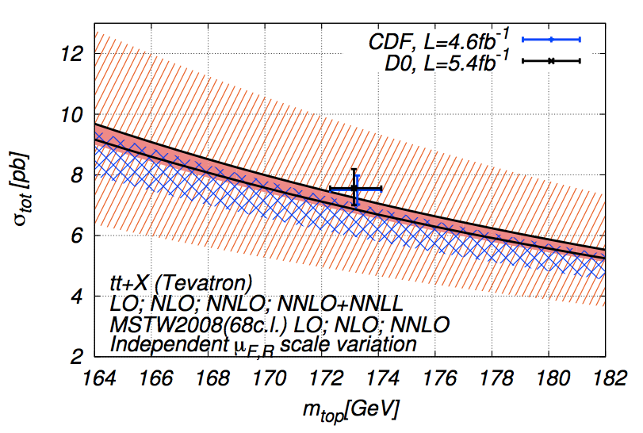
M_{top} is scheme dependent
Direct measurements of M_{top} depend on soft interactions
In direct measurements the measured quantity depends on the mass definition in the M.C. generator
This usually involves a M.E. calculation and a parton shower evolution, which doesn’t fix a renormalization scheme
Extracting the top mass by comparing the measured inclusive σ_{tt} to fully inclusive calculations at high-order QCD provides an unambiguous definition of m_{t}
Notes:
173.3 GeV used

Slide 11
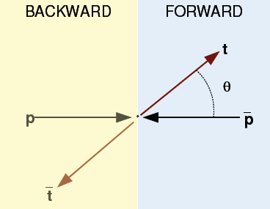
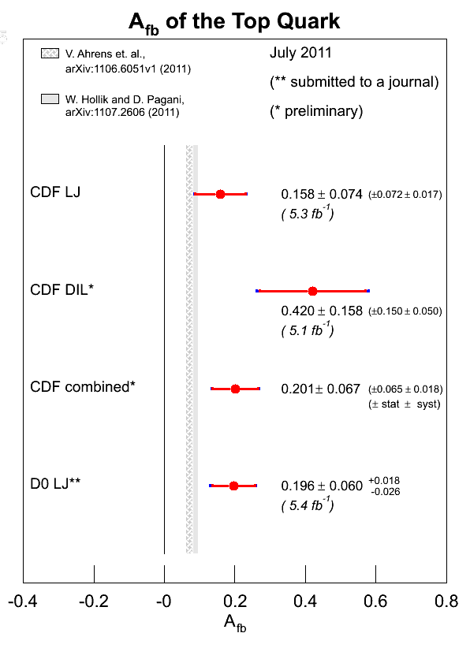
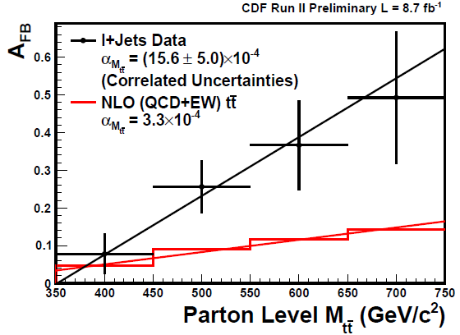
Top F-B Asymmetry
$$A_{fb}=\frac{N\left(∆y>0\right)−N\left(∆y<0\right)}{N\left(∆y>0\right)+N\left(∆y<0\right)}$$
Notes:
Small non-zero value predicted by S.M 0.066 Powheg + EW corrections
Cdf update 8.7 = 0.162% ± 0.047%

Slide 12
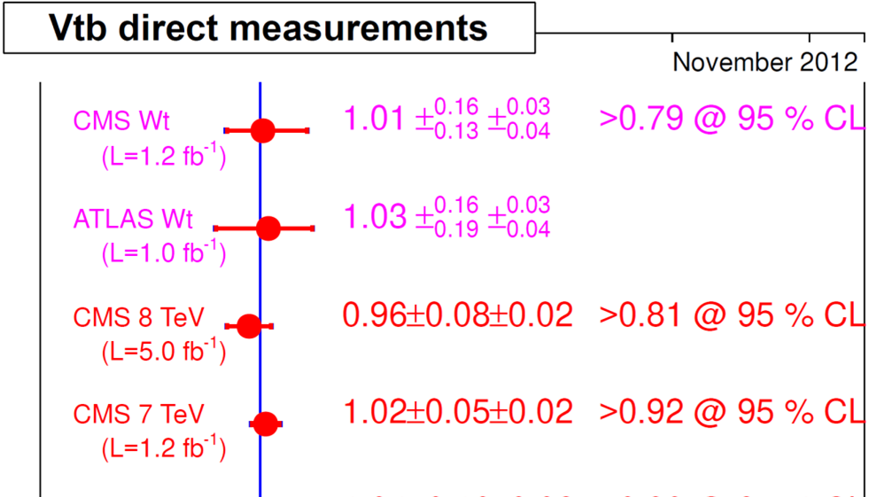
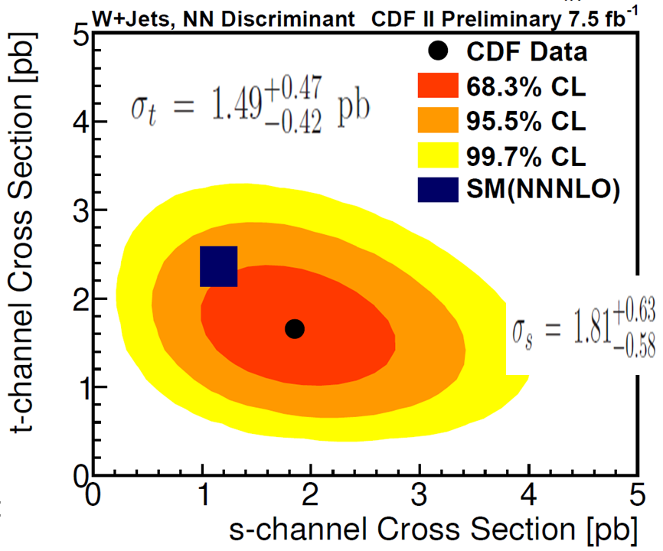
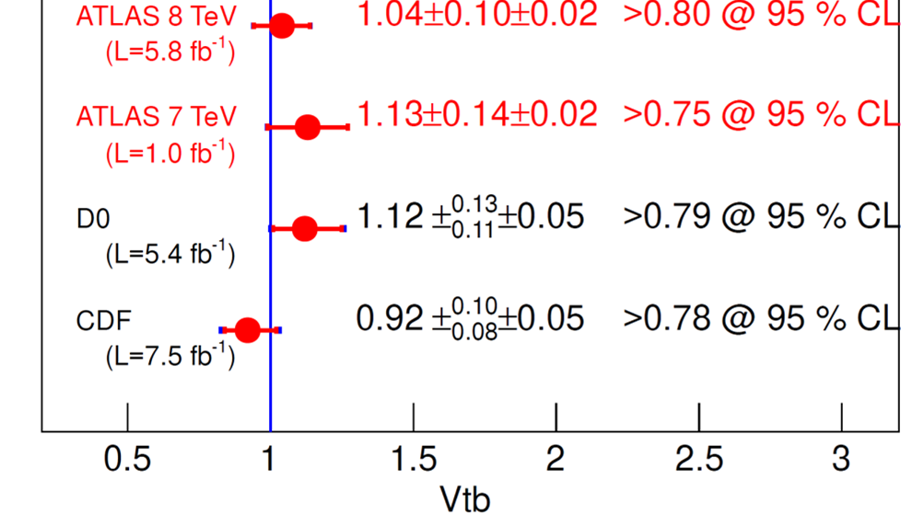
Single Top
s-channel: W + 2 b-jets
t-channel: W + 1 b-jet, 1 forward jet (+1 jet)
Notes:
Direct probe of V(tb) CKM matrix element

Slide 13
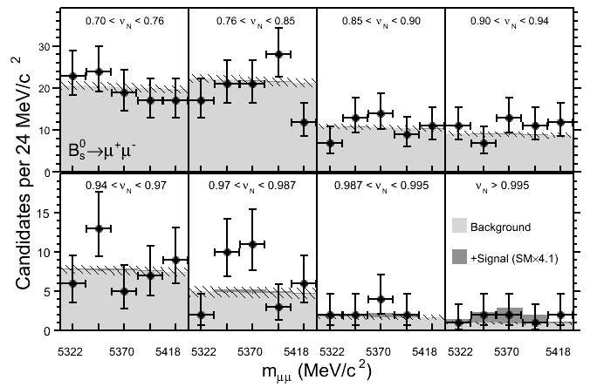
CDF B_{s}→μμ
Supressed at tree level
Proceeds via box, or penguin diagrams only
Sensitive to new phenomena
S.M. cross-section
BR(B_{s} → μμ) = (3.2±0.2)x10⁻⁹
0.8x10⁻⁹ < BR(Bs → μμ) < 3.4x10⁻⁸ (95%)
BR(Bs → μμ) < 3.1x10⁻⁸ (95%)
Notes:
Sensitivity to new physics, e.g. extended
Higgs sector and SUSY particles:
2HDM branching ~(tanb)4 and m(H+)
MSSM branching ~(tanb)6 CDF 9.7 TeV

Slide 14
ᴧ_{b} Lifetime
Measurements don’t agree with each other, or predictions
D0 analysis with Full (10.4 fb⁻¹) dataset:
τ(Λb) = 1.303 ± 0.075 ± 0.035 ps
τ(Λb) = 1.425 ± 0.032 ps
(PDG 2011)
τ(Λb) = 1.537 ± 0.045 ± 0.014 ps
(CDF, PRL 106, 121804 (2011))

Slide 15
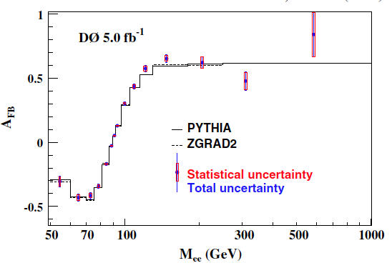
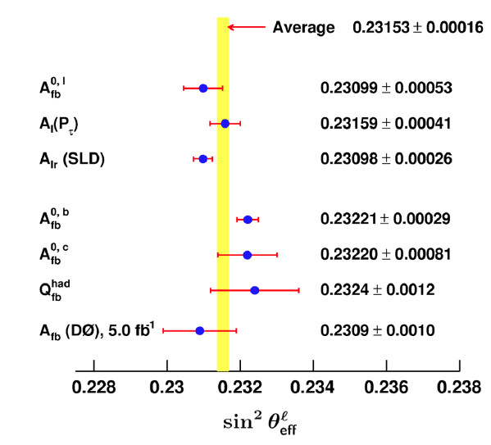
Sin² θ_{w}
A_{fb} (Z) is sensitive to the weak mixing angle
Notes:
and the vector and axial-vector couplings of the u- and d-quarks. 70 – m – 130)

Slide 16
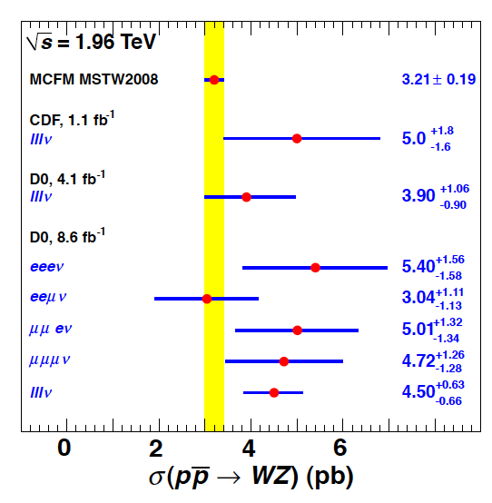
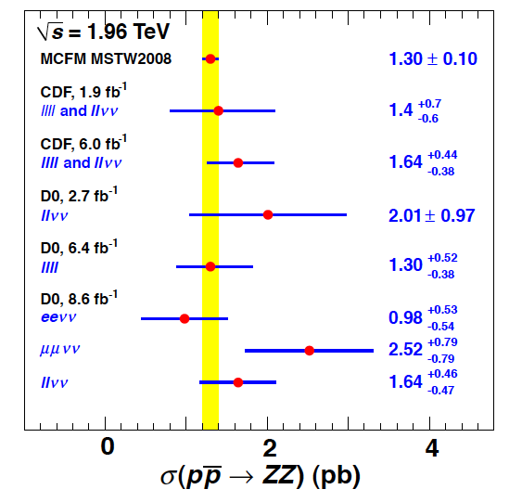
WZ / ZZ Production
Notes:
Searches for BSM physics (test of gauge structure on the S.M)

Slide 17
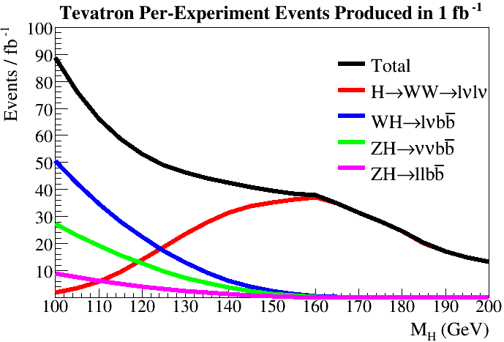
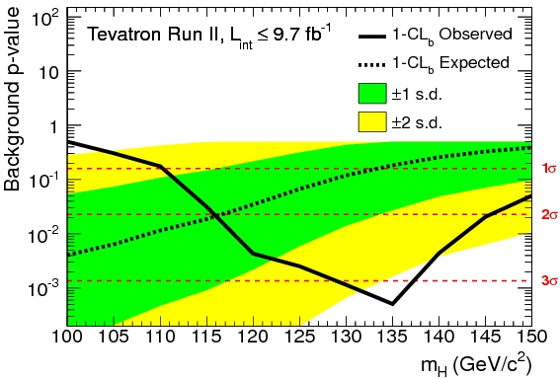
Higgs Searches
~ 126 GeV Boson Discovered at the LHC
The Tevatron experiments see excesses consistent with the Discovery

Slide 18
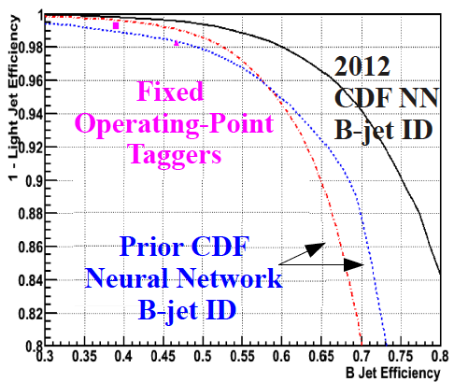
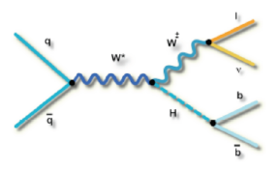
Higgs → bb
Most sensitive channel for low mass Higgs
Identify events with leptonic W/Z decays + jets
B-tagging is crucial
Both experiments use multivariate techniques
Efficiency 50 – 80 %
Fake Rate 0.5 – 10.0 %

Slide 19
Higgs → bb
Check by measuring similar known processes
Differences:
Cross section for diboson production is x4.5 larger than for W/ZH.
There is relatively more signal contribution from Z→cc than from H→cc.
Diboson signal sits at low mass where there is a significant peaking background from WW→lνcs and systematic uncertainties are larger.

Slide 20
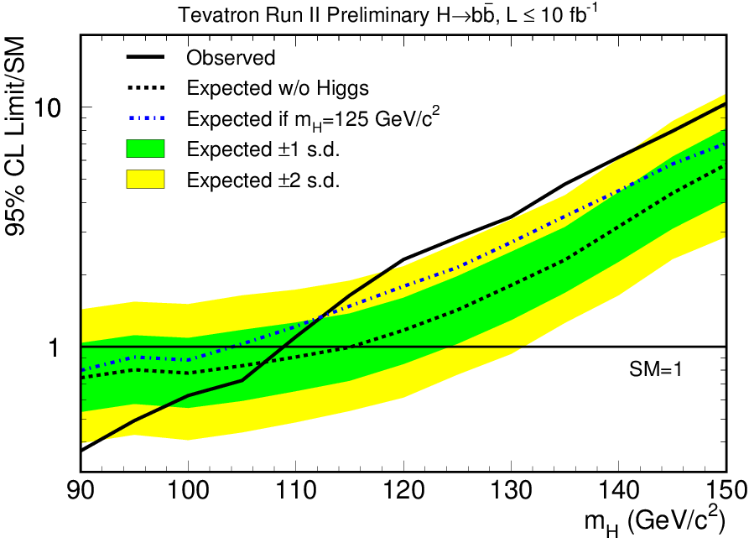
Higgs → bb
σ(WH+ZH)×Br(H → bb) = 0.19 ± 0.09 (stat+syst) pb⁻¹
μ = 1.56 ± 0.72 @M_{H}= 125 GeV
Notes:
σ(WZ+ZZ) = 3.0 ± 0.9 pb (NLO exp. : 4.4 ± 0.3 pb)

Slide 21
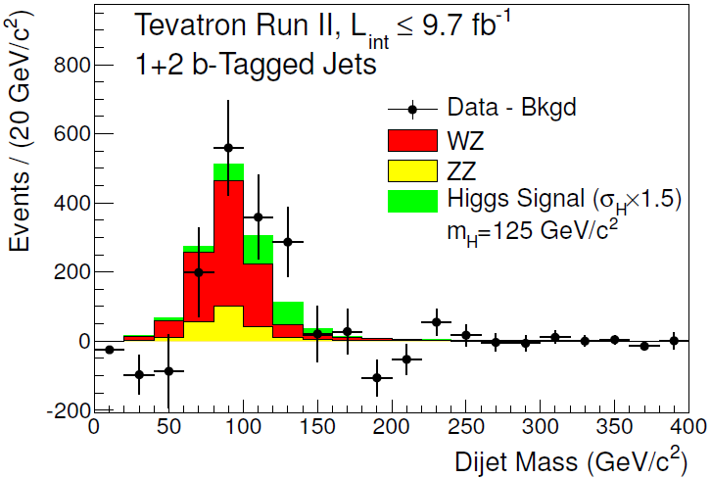
Higgs → bb

Slide 22
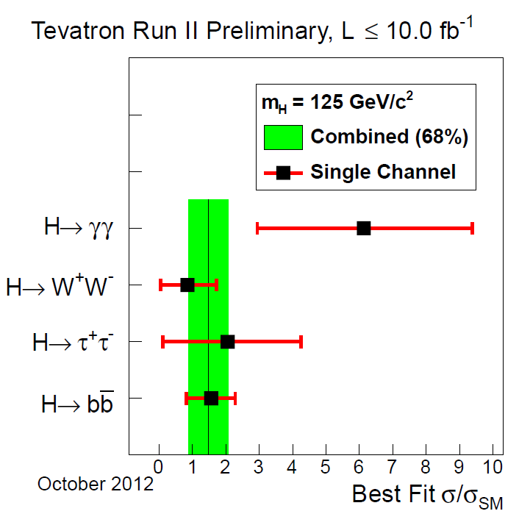
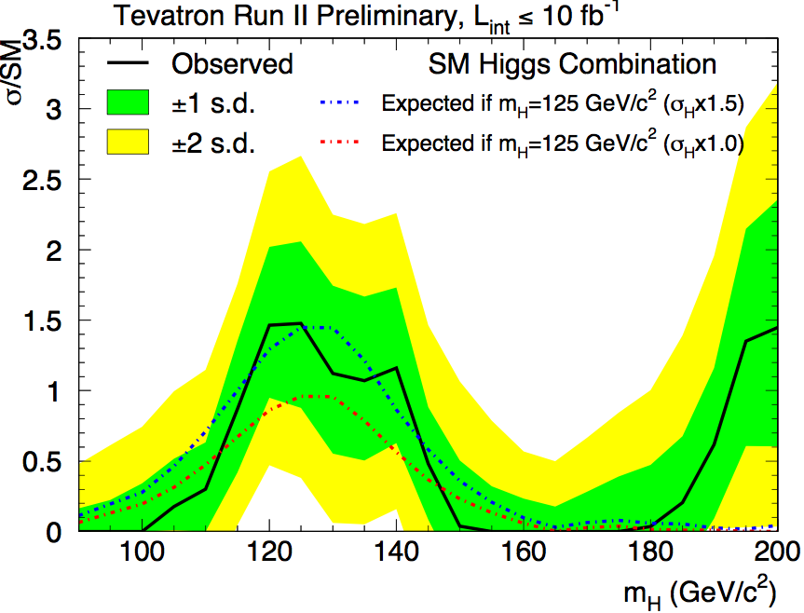
Combined Results
1.5 ± 0.6

Slide 23
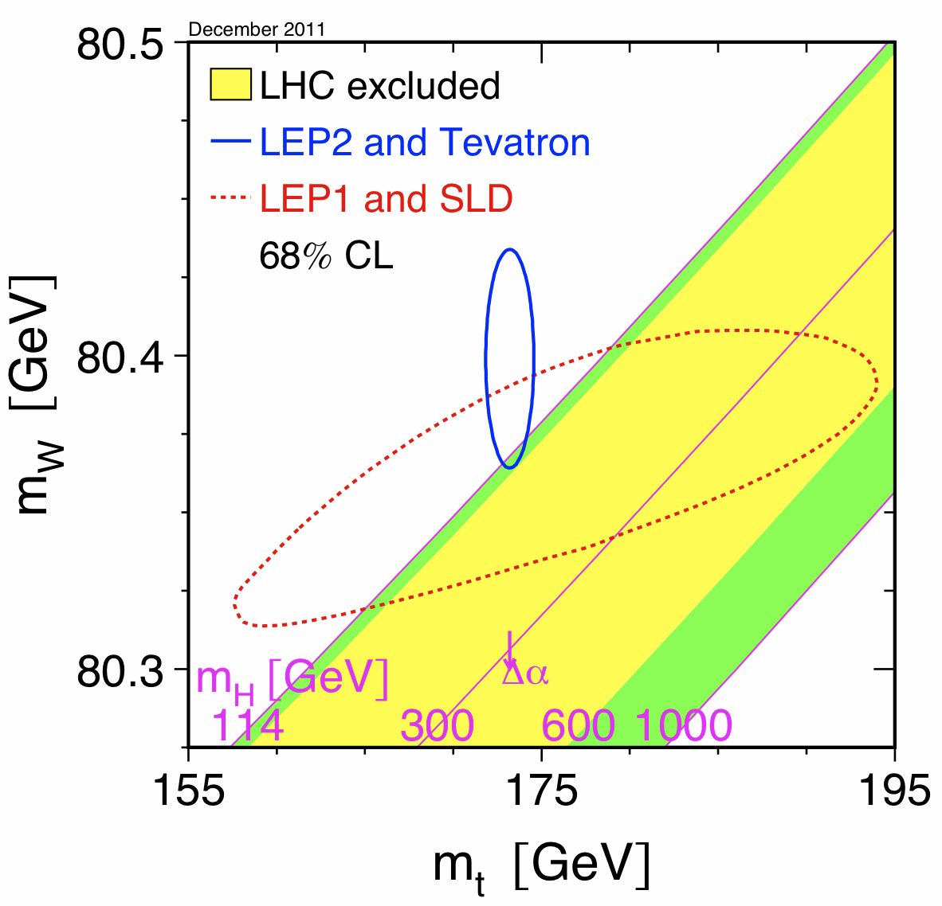
W Mass
For equal contribution to the Higgs mass uncertainty need:
Δm_{w}≈0.006Δm_{t}
Current Tevatron average:
Δm_{t} = 0.9 GeV (arXiv:1107.5255)
⇒ would need: Δm_{W} = 5 MeV
Prior to April 2012: Δm_{w} = 23 MeV

Slide 24
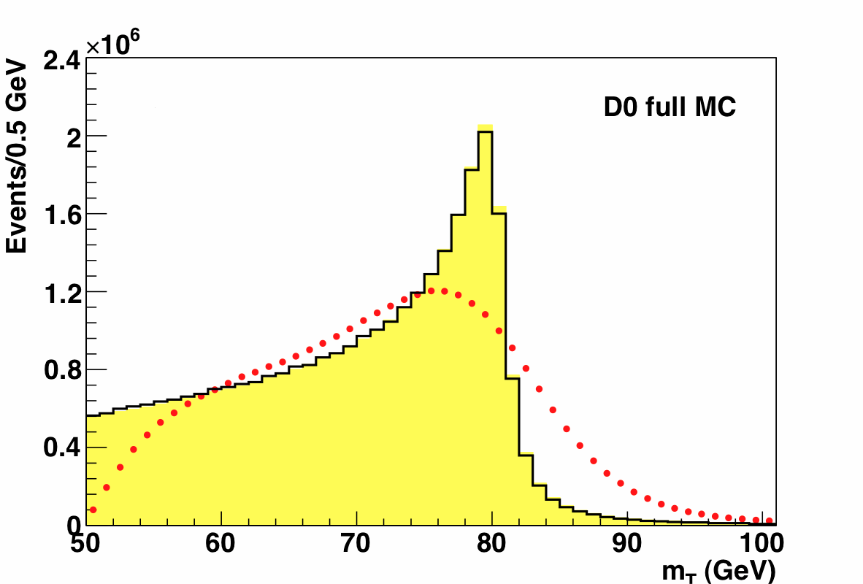
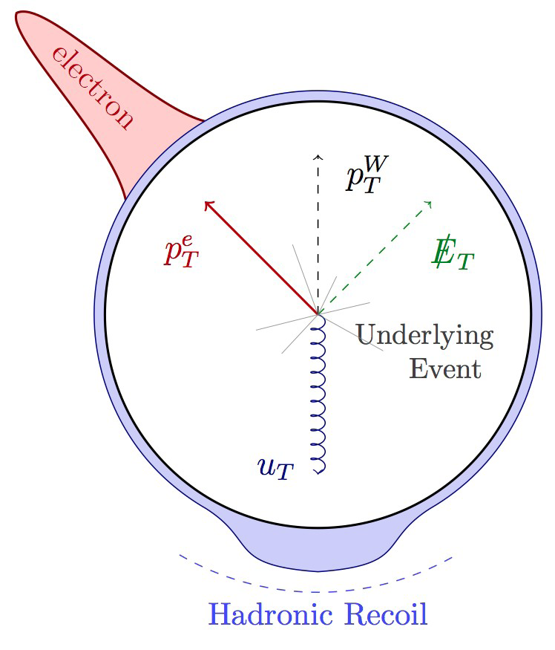
W Mass
The transverse mass (m_{T} is sensitive to detector effects (via the recoil system)
m_{T}² = (E_{T}^{e} + E_{t}^{ν})² - (p_{T}^{e} + p_{T}^{ν})²
No p_{T} (W) or detector effects
p_{T}(W) included
Detector effects added
The electron transverse momentum p_{T} (e) is sensitive to the boson transverse momentum

Slide 25
Analysis Cuts
CDF
D0
Analyzed 2.2 fb⁻¹
Uses W → eν and W → μν decay channels.
Central leptons |η| < 1 with
30 < p_{T} < 55 GeV
Missing transverse energy
30 < =E_{T} < 55 GeV
Transverse mass
60 < m_{T} < 100 GeV
Hadronic recoil momentum
u_{T} < 15 GeV
Analyzed 4.3 fb⁻¹ (1 fb⁻¹ analyzed before)
Uses W → eη decay channel.
Central electrons |η| < 1:05 with
p_{T} > 25 GeV
Missing transverse energy
E_{T} > 25 GeV
Transverse mass
50 < m_{T} < 200 GeV
Hadronic recoil momentum
u_{T} < 15 GeV

Slide 26
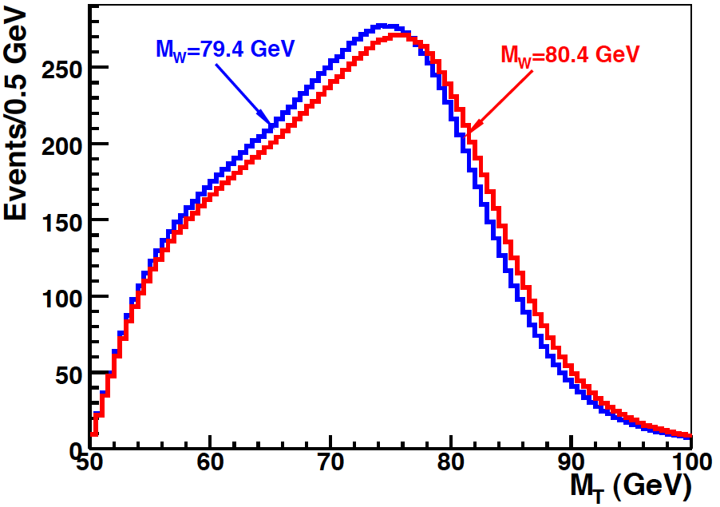
Rely on Detailed Simulations to compare to Data
The observables cannot be described analytically, We rely on detailed M.C. And detector response simulations.
Full GEANT detector simulations are not fast nor accurate enough to describe the kinematical distributions used to measure the W boson mass.
Both CDF and D0 develop parametrised fast simulations of the detector response to W events. The parametrisations are calibrated with data, using very different strategies.
Detector Simulation
Notes:
A bit about event generation, and then a bit about the fitting proceedure. The simulations must be accurate, and quick, in order ot generate large template statistics, after changes in tuning.

Slide 27
Calibration Strategy
CDF
D0
Detailed model of lepton interactions at the central tracker.
Precise alignment using cosmic rays.
Momentum scale calibrated using J/ψ → μμ , ϒ→ μμ and Z → μμ mass fits.
Use calibrated momentum scale and E=p distribution in W →e ν events to calibrate the calorimeter energy scale.
Detailed model of the calorimeter
response to electrons and photons.
Detailed model of the underlying energy flow.
Detailed model of efficiencies.
Calibrate the calorimeter energy scale using the di-electron invariant mass and angular distribution in Z → ee decays (electron energy scale and energy offset ).

Slide 28
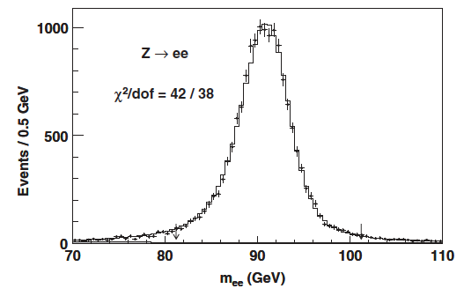
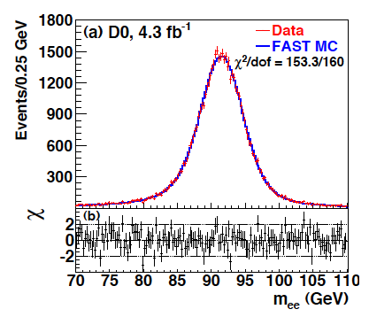
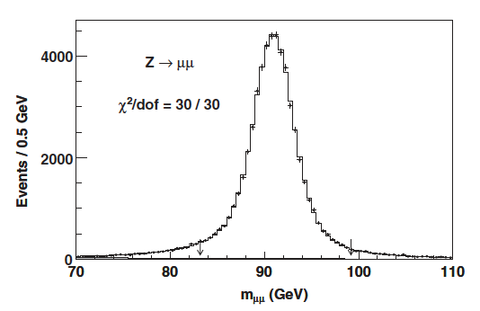
Calibration Tests
M_{Z} = 91230±30(stat) ±14(syst)MeV
M_{Z} = 91 193±17(stat)MeV
M_{Z} = 91180± 12(stat) ±10(syst)MeV
Notes:
91188 2MeV

Slide 29
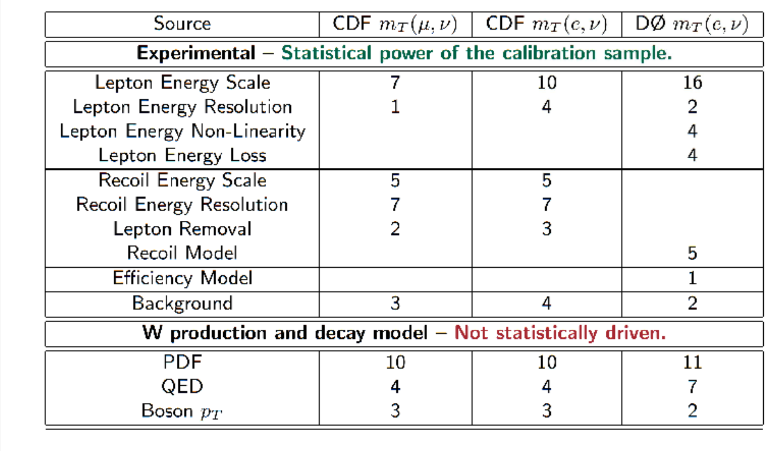
Comparison of Systematic Uncertainties (MeV)

Slide 30
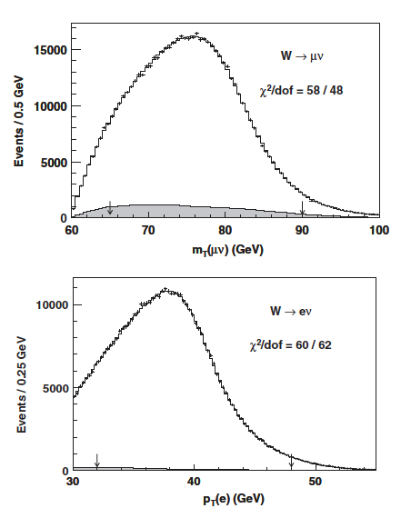
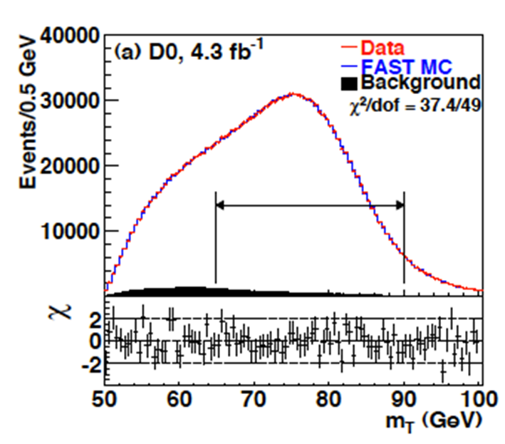
Final Comparisons

Slide 31
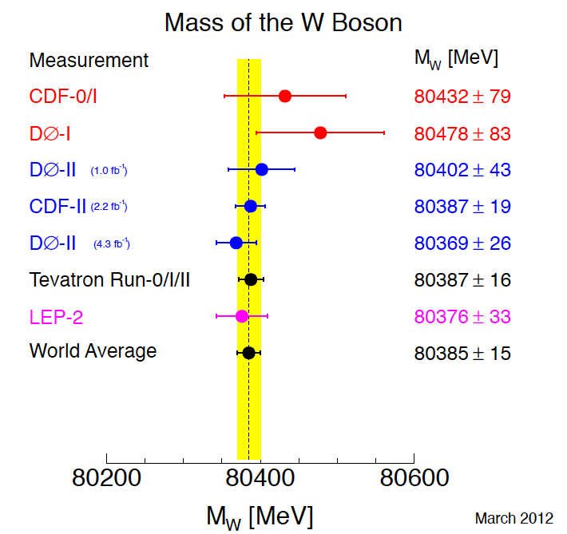
Results
Notes:
MH = 94+29-24 GeV (was MH = 92+34-26 GeV before)

Slide 32
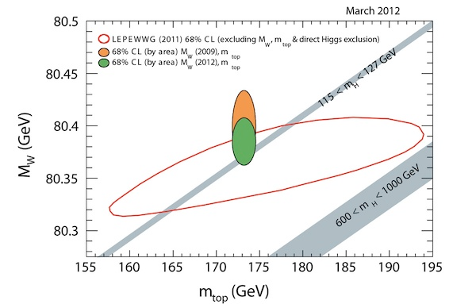
Higgs Constraint, or rather compatibility
Notes:
MH = 94+29-24 GeV (was MH = 92+34-26 GeV before)

Slide 33
The Tevatron experiments have continued to produce results in 2012
There are further recent results not covered

