Slide 1

Heavy quark potential at non-zero temperature
Péter Petreczky
Motivation : the study and interpretation of static meson correlators is much more
easier than the analysis of heavy meson correlators
static correlators → potential model → spectral functions
Free energy and singlet free energy of static quark anti-quark pair in 2+1 flavor QCD with HISQ action => controlled discretization effects
Wilson loops at T>0 on the lattice
Wilson loops in HTL perturbation theory
Extracting the real and the imaginary parts of the potential
in collaboration with Alexei Bazavov, Eur. Phys. J. A49 (2013) 85, work in progress
Hard Probes 2013, Stellenbosch, South Africa, November 4-8, 2013

Slide 2
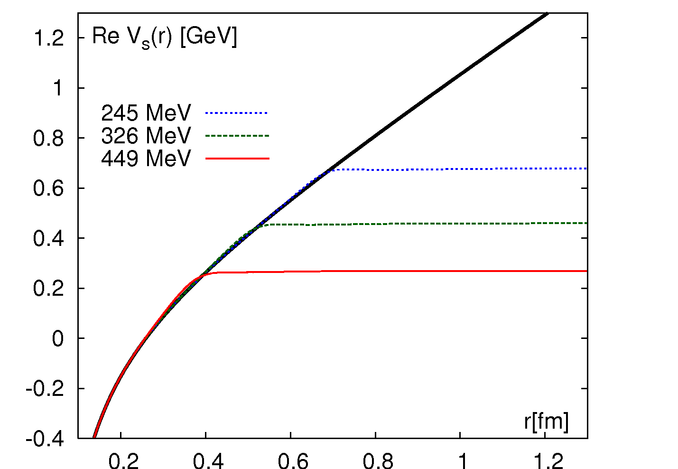
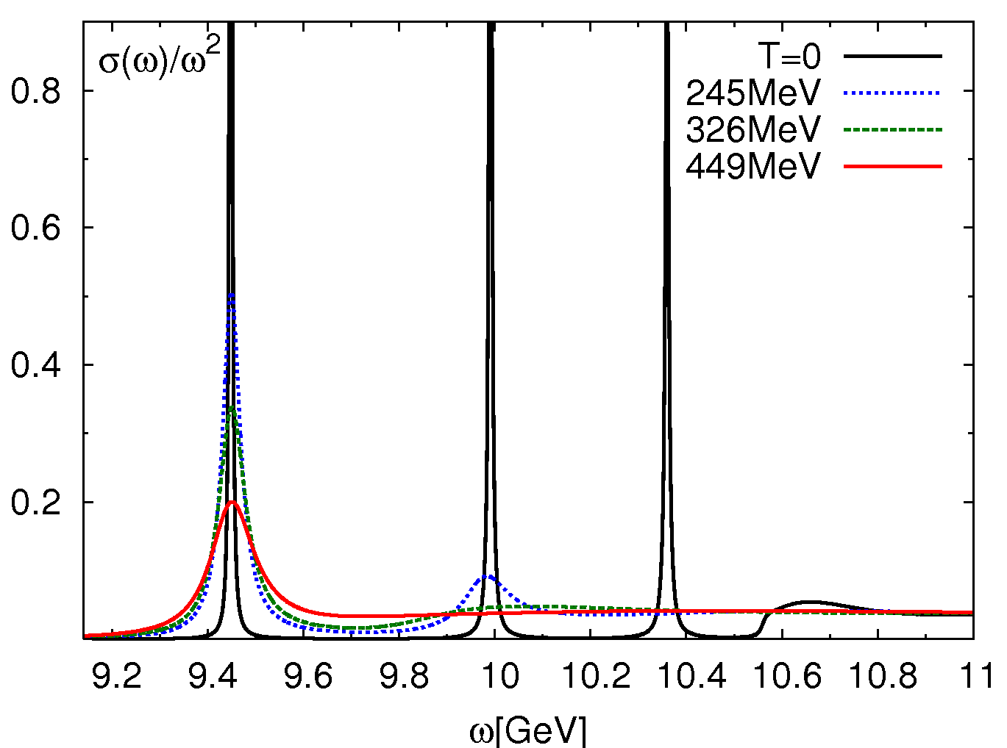
EFT, potential models and static energy
Above deconfinement the binding energy is reduced and eventually E_{bind}~mv² is the smallest
scale in the problem (zero binding) mv² >> Λ_{QCD}, 2πT, m_{D} => most of medium effects can be
described by a T-dependent potential
Potential = Static Energy
Determine the potential by non-perturbative matching to static quark anti-quark potential
calculated on the lattice
Caveat : it is difficult to extract static quark anti-quark energies from lattice correlators =>
constrain Re V_{s}(r) by lattice QCD data on the singlet free energy, take Im V_{s}(r) from pQCD calculations
“Maximal” value for the real part
Minimal (perturbative) value for imaginary part
Mócsy, P.P., 2007
Laine et al, 2007, Brambilla et al, 2008
Miao, Mocsy, PP 2010

Slide 3
Static quark anti-quark pair in T>0 QCD

Slide 4
Static quark anti-quark pair in T>0 QCD (cont’d)
McLerran, Svetitsky 1981
Jahn, Philipsen, 2004
Brambilla, Ghiglieri, PP, Vairo 2010

Slide 5
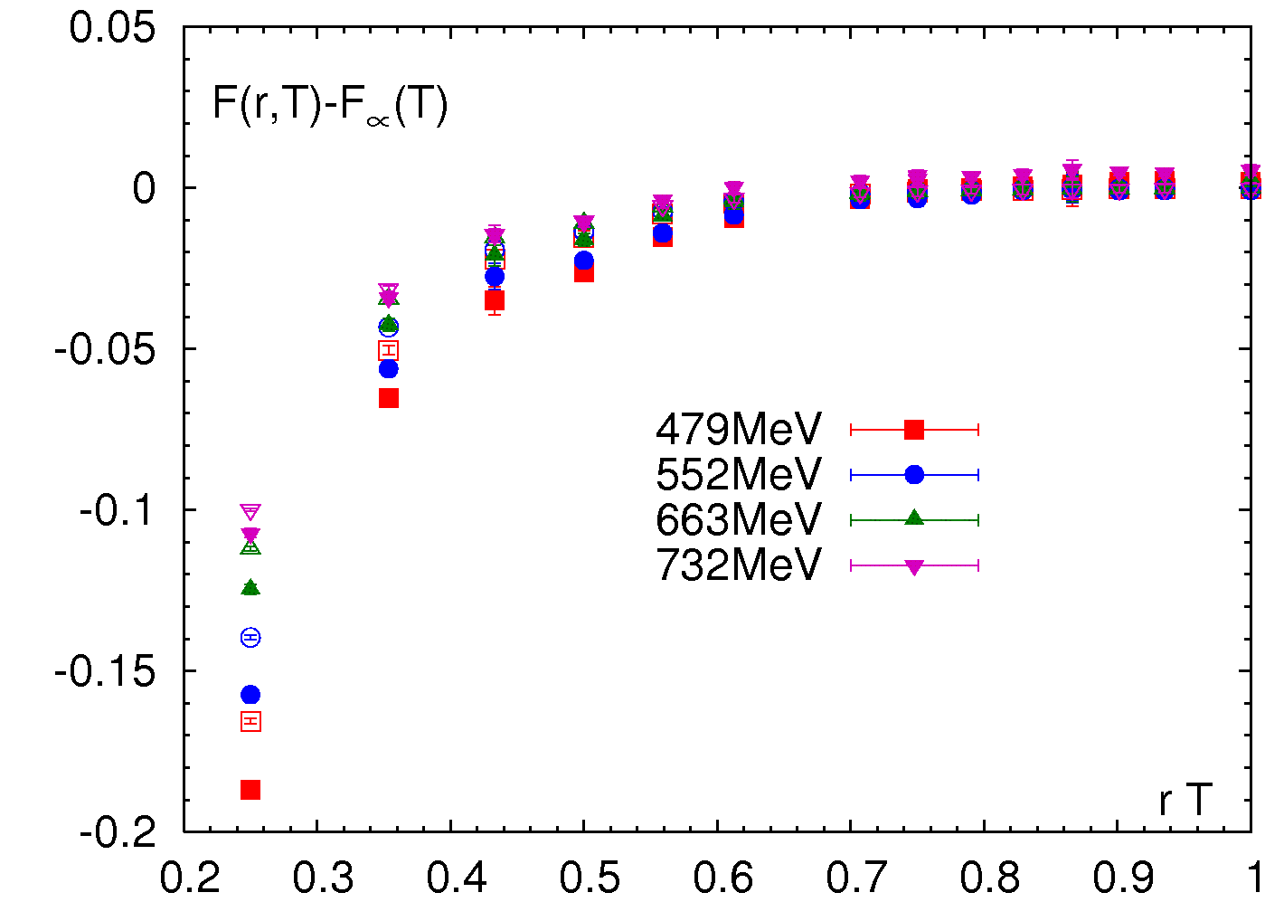
Static quark anti-quark free energy in 2+1f QCD
The strong T-dependence for T<200 MeV
is not necessarily related to color screening
The free energy has much stronger
T-dependence than the singlet free energy
due to the octet contribution
At high T the temperature dependence
of the free energy can be entirely understood
in terms of F₁ and Casimir scaling F₁=-8 F₈

Slide 6
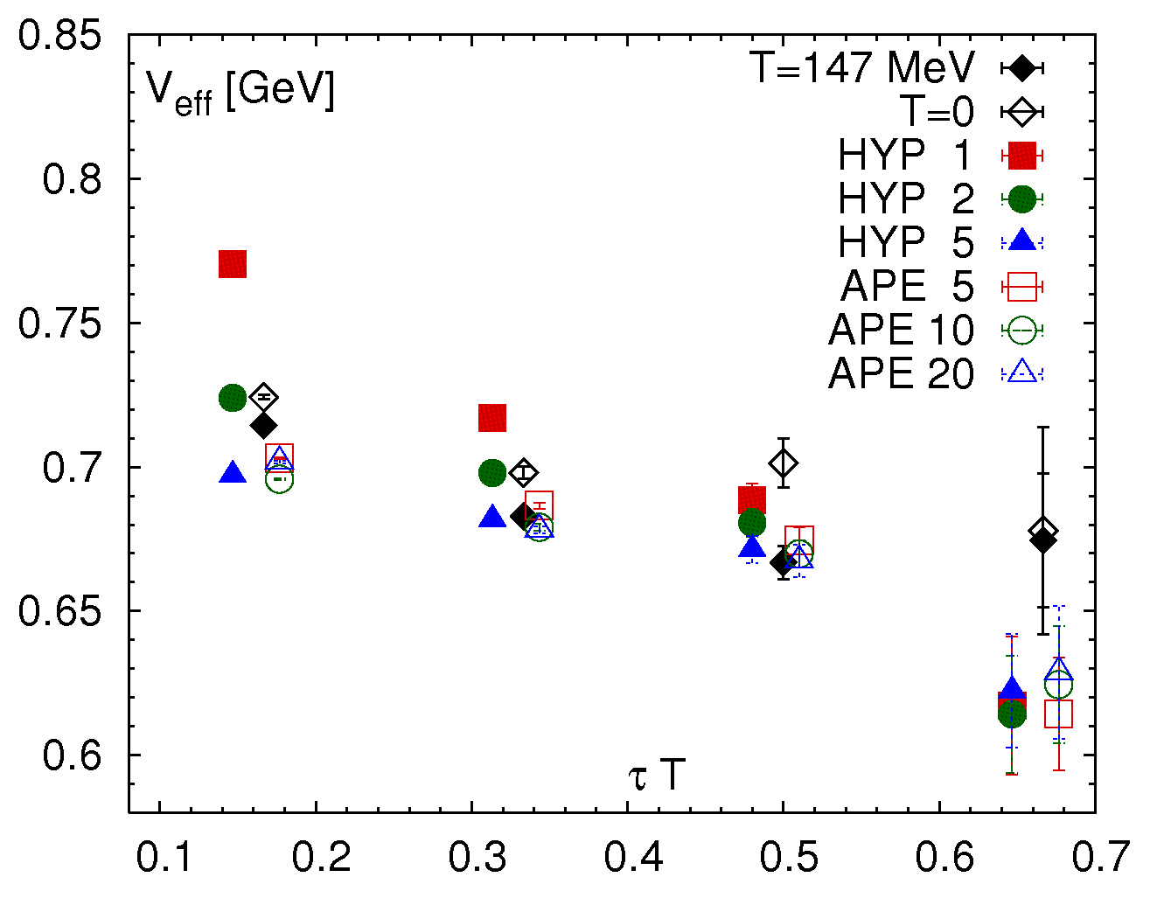
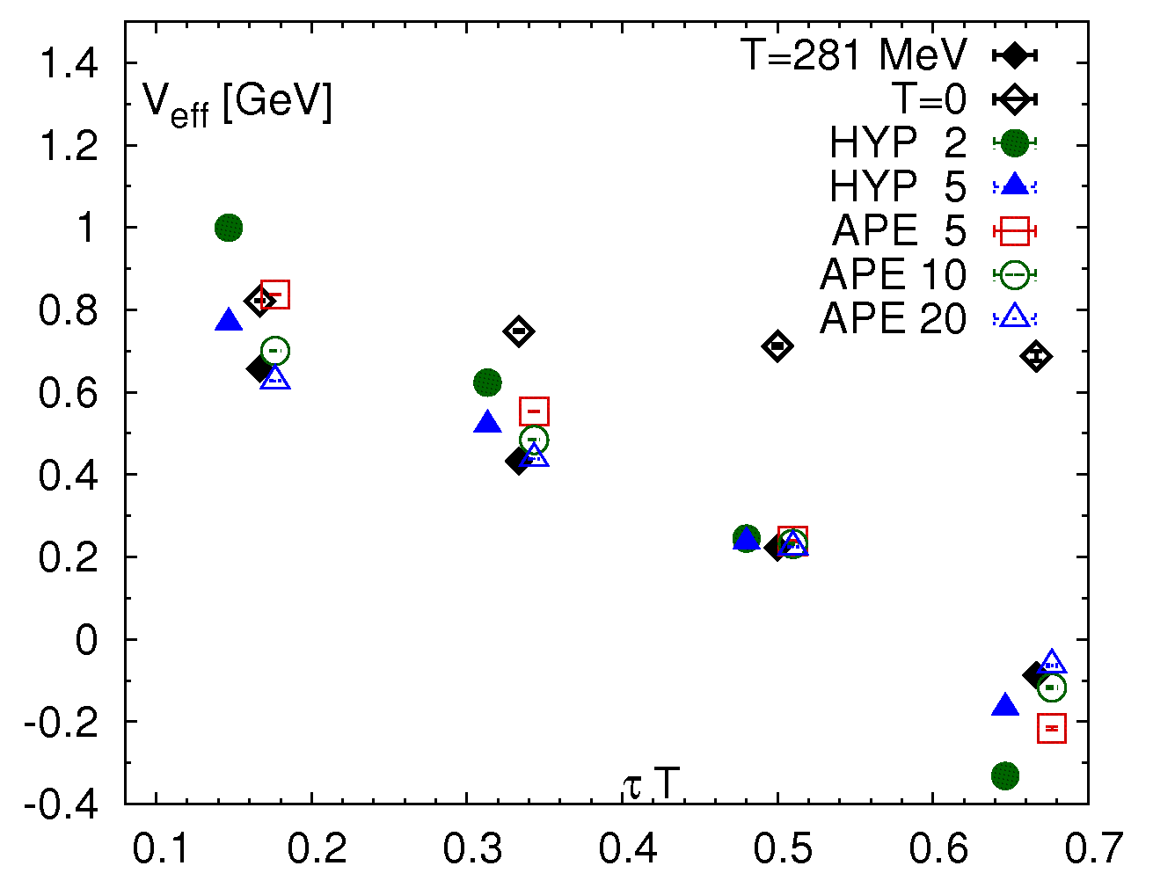

The temperature dependence of the effective potentials
Assume single state dominance
$V_{eff}\left(r,τ\right)=−ln (W(r,{τ))}$/$τ→V\left(r\right), \text{for} \text{large} τ$
Can be seen at T=0 in the considered range
r T =1/2
r T =1
At T>0 the effective potential V_{eff} does not reach a plateau but shows an approximately
linear decrease in τ, and V_{eff} is always smaller than for T=0
For large enough τ all smeared Wilson loops and Colomb gauge correlators give the same V_{eff}
The observed decrease in τ is a physical effect (width ?) independent of the choice of the correlators

Slide 7
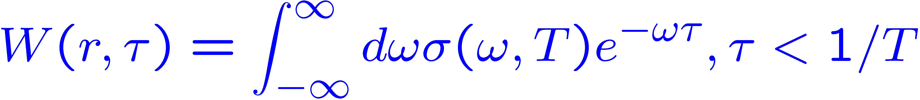
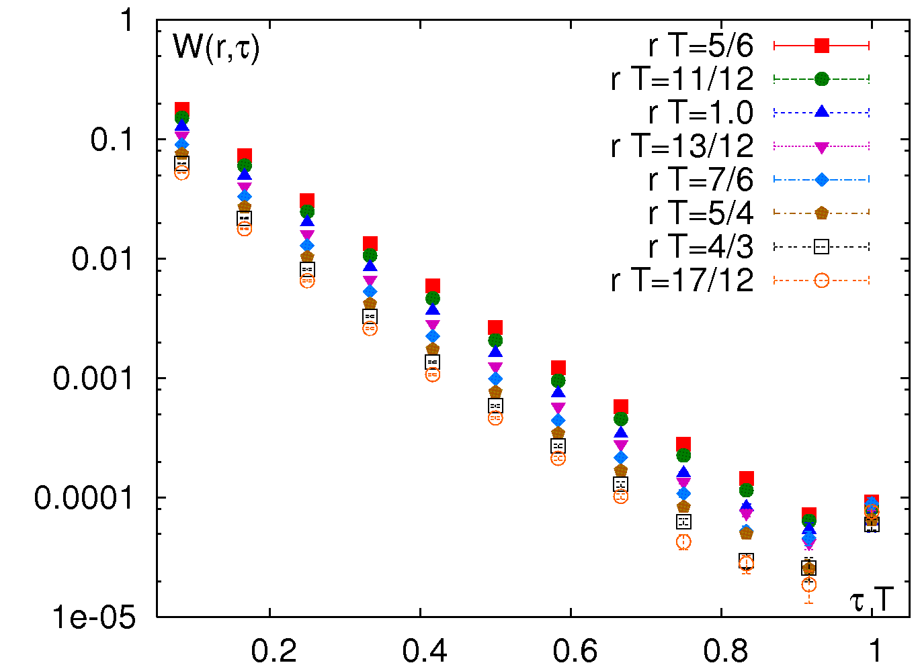
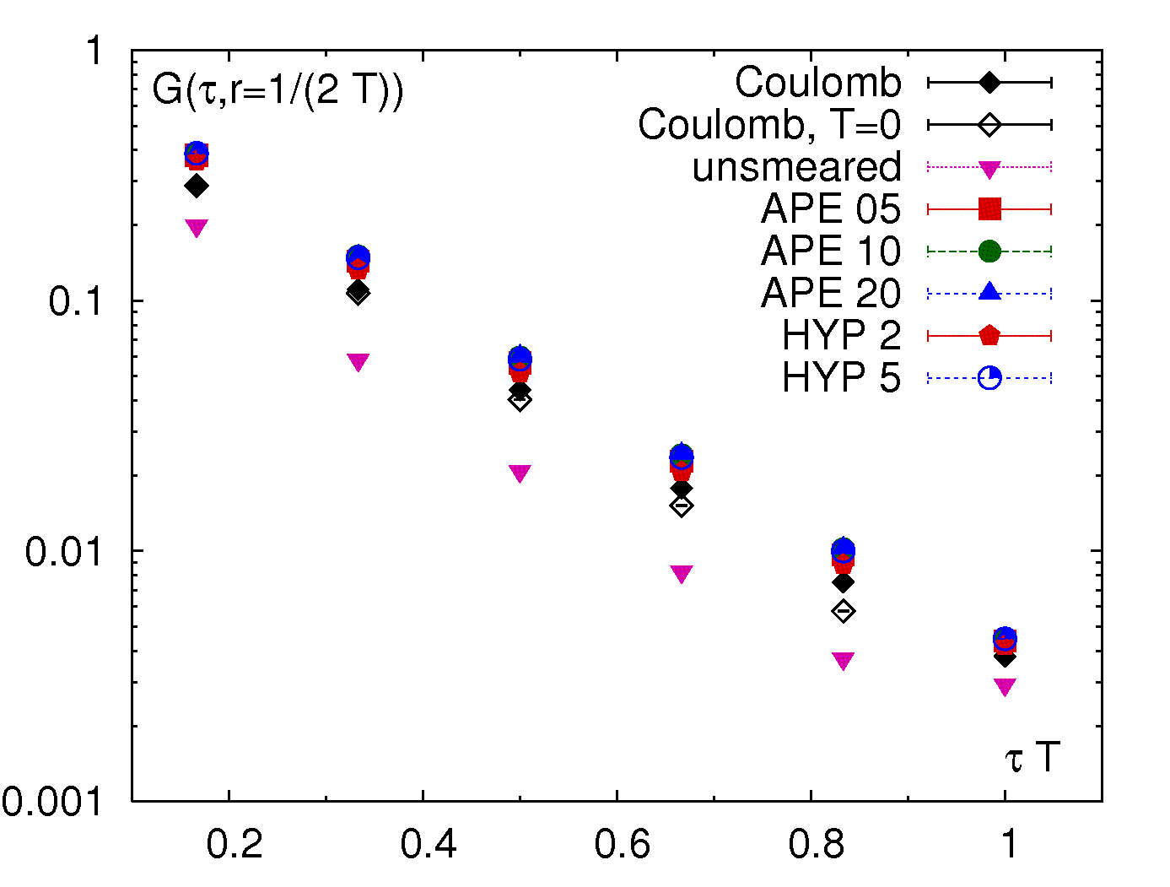
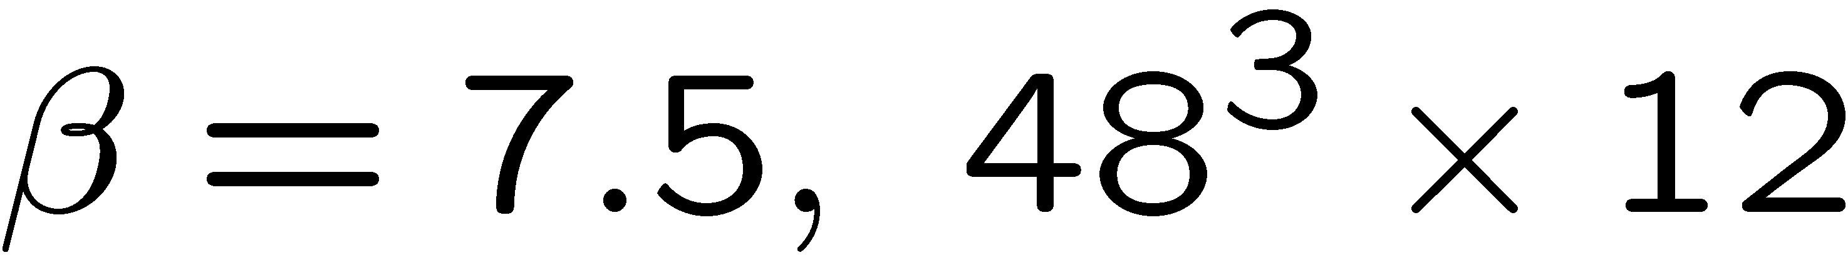
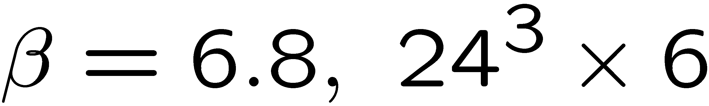
Wilson loops and potential at T>0
Rothkopf 2009, Hatsuda, Rothkopf, Hatsuda 2011
not related to the free energy !
Choices of the spatial links:
Naïve= un-smeared
smeared
or use Coulomb gauge and
U(x,y)=1
=
+
x
y
Un-smeared Wilson loops show non-exponential behavior and are suppressed compared to the smeared Wilson loops and Coulomb gauge corr. which decay exponentially, except for τ T ~ 1

Slide 8
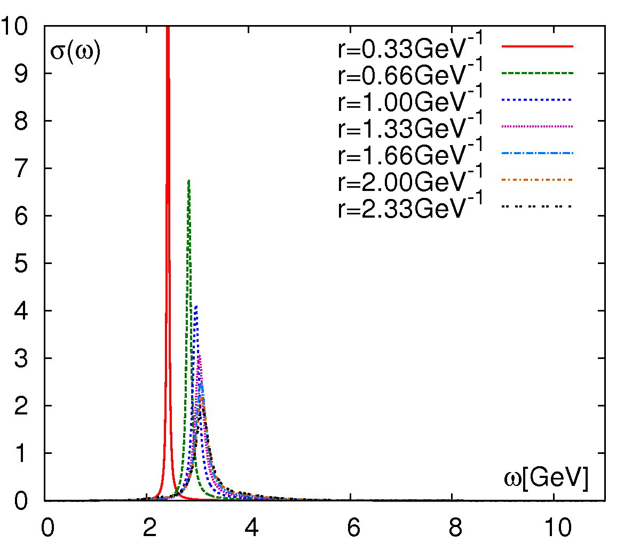
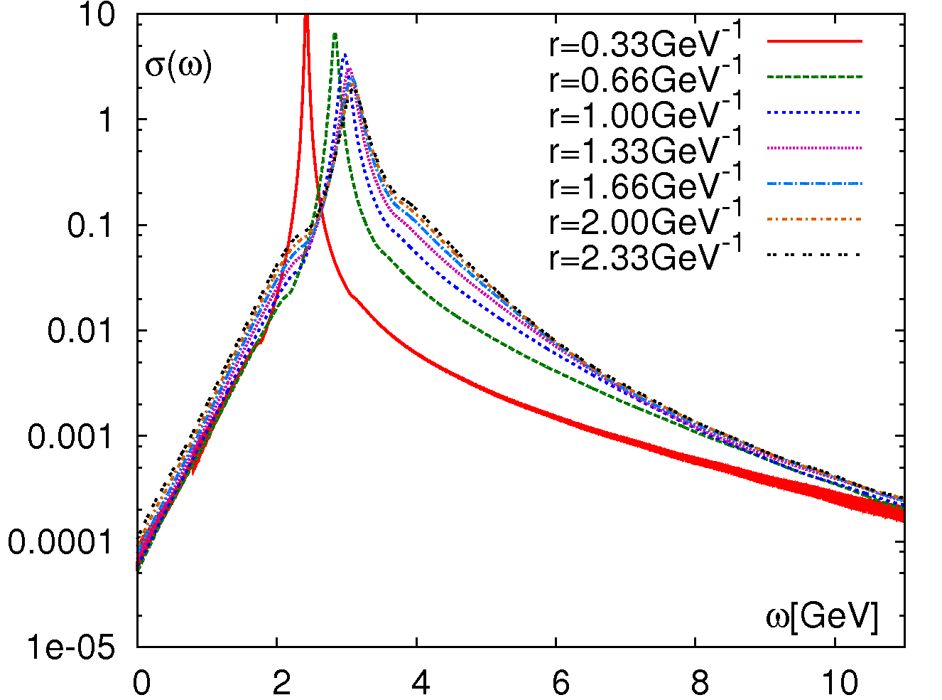
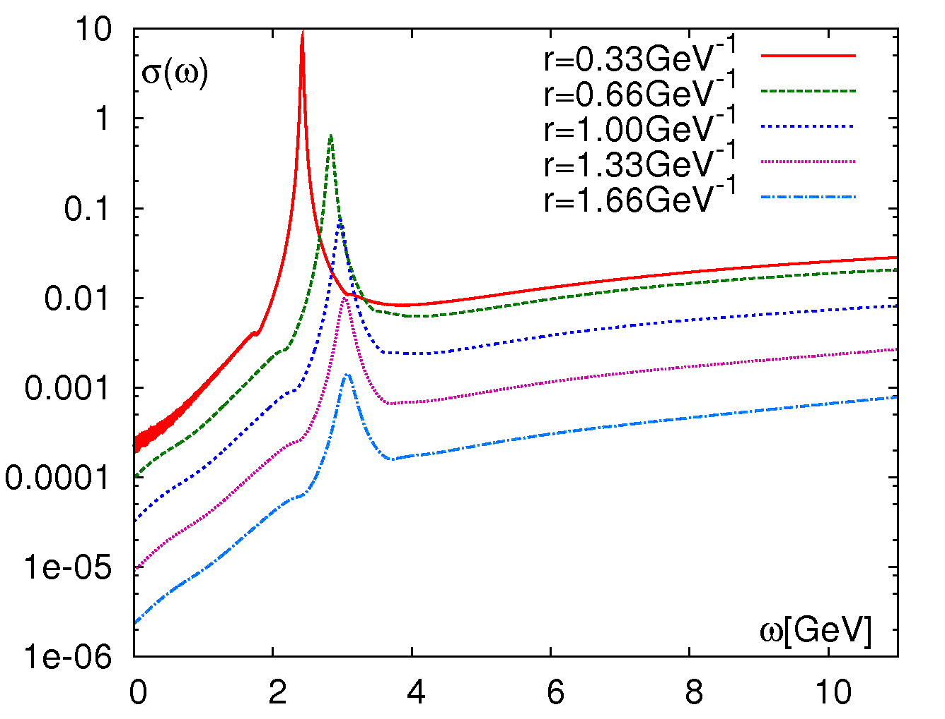
Spectral functions in HTL perturbation theory
Perturbative hard thermal loop (HTL) calculations for T=2.33 T_{c} , T_{c}=270 MeV (N_{f} = 0) :
Burnier, Rothkopf, 2013
Coulomb gauge
Coulomb gauge
Spectral functions has long tails and
non-Lorentzian away from the peak,
explanation for the behavior of the Wilson loops and V_{eff} at large times
For un-smeared Wilson loops the peak heigh is much suppressed compared to the
Coulomb gauge case
un-smeared Wilson loops

Slide 9
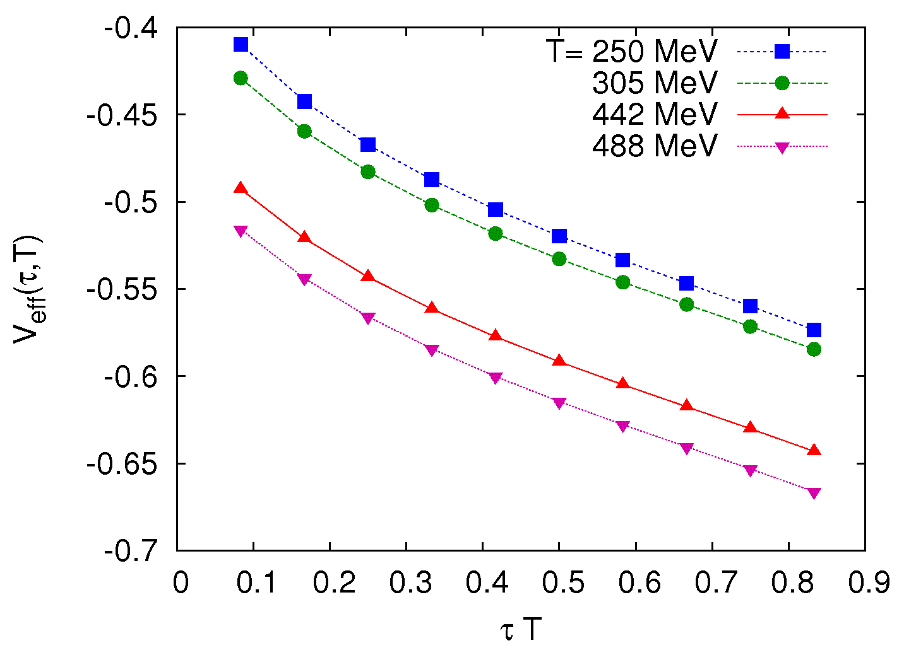
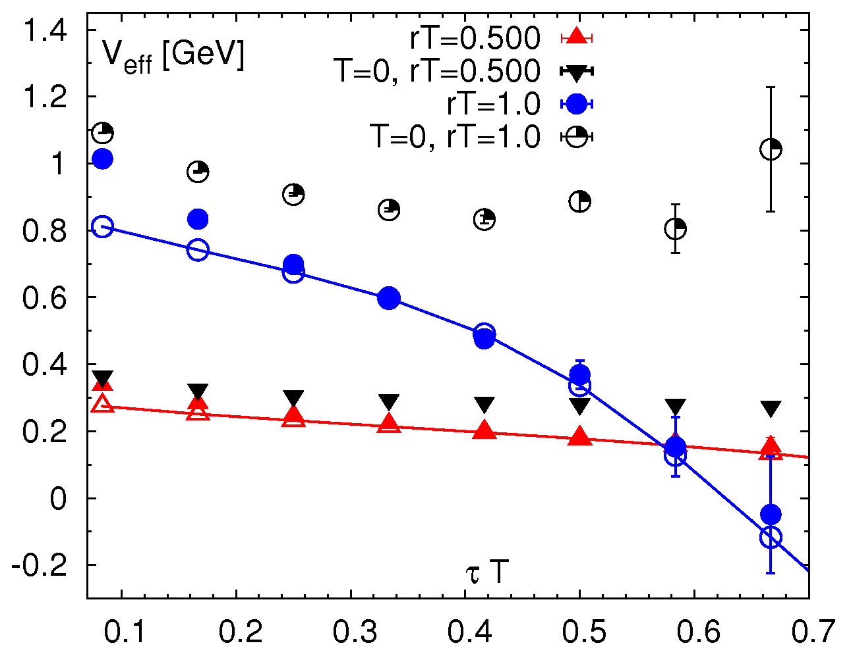
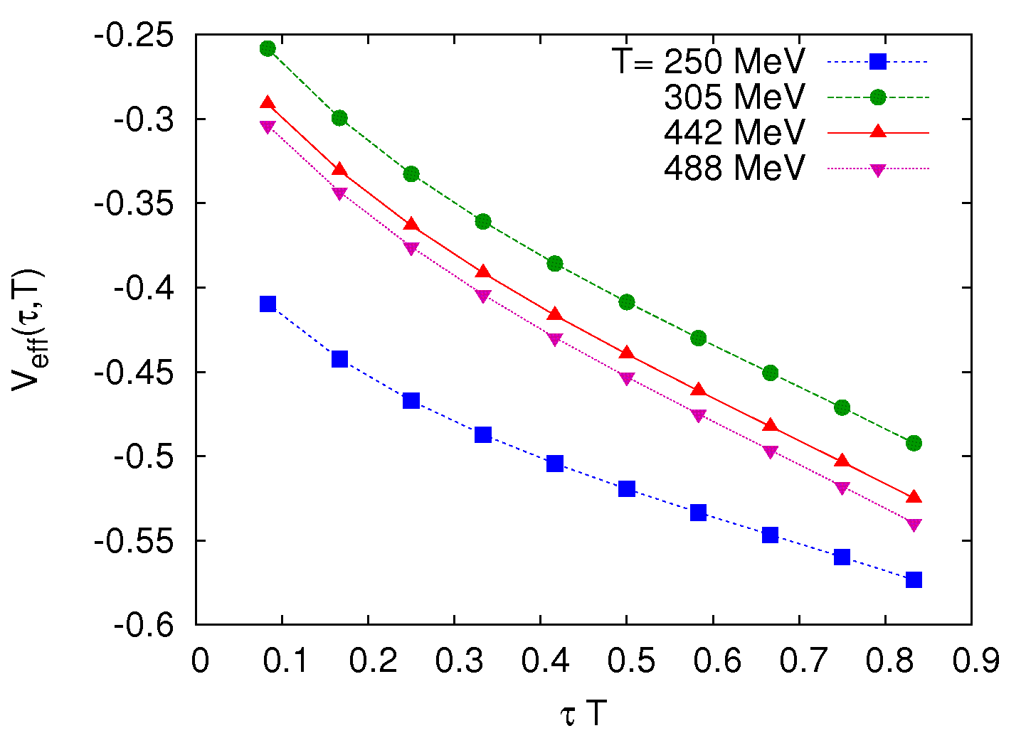
Effective potential at high temperatures
Effective potential V_{eff} in HTL perturbation theory:
V_{eff} decreases with τ due to the width
of the spectral functions, its slope increases
with T and the distance r as observed in the
lattice calculations
Use σ ^{HTL} ((ω-E) λ ) as a 2-parameter
fit Ansatz for the lattice results:
r T = 1/2
N_{τ} = 12
r T = 1

Slide 10
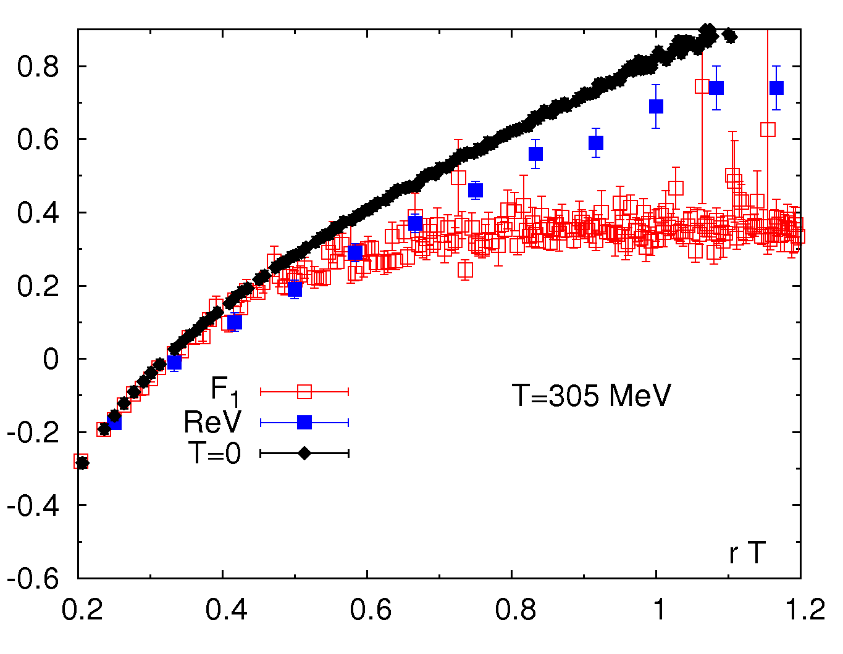
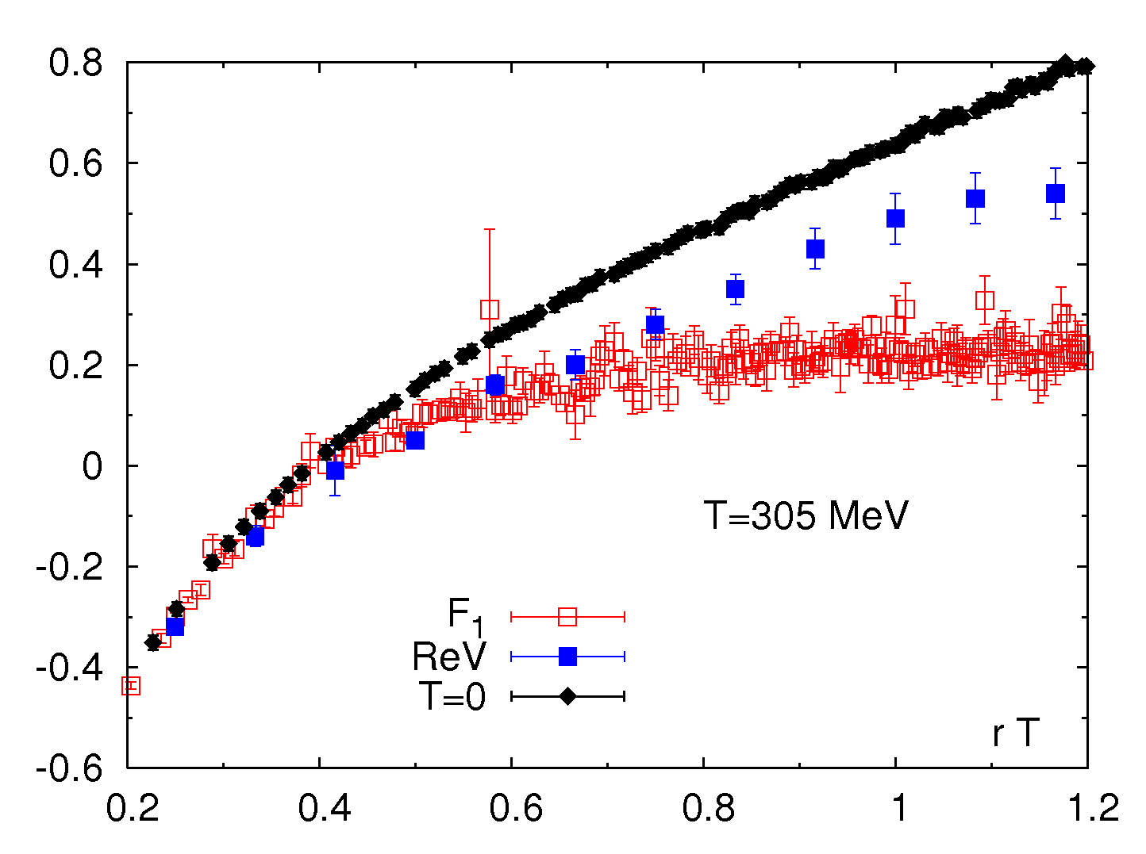
Real part of the potential above deconfinement
Results for N_{τ} = 12 lattices using σ ^{HTL} ((ω-E) λ ) as a 2-parameter fit Ansatz:
T=250 MeV
For r T < 0.7 the real part of the potential is roughly equal to the singlet free energy
At larger distances it is between the singlet free energy and the T=0 potential
The real part of the potential saturates at r T ~ 1 (screening) at a fairly large value
(non-perturbative effects)

Slide 11
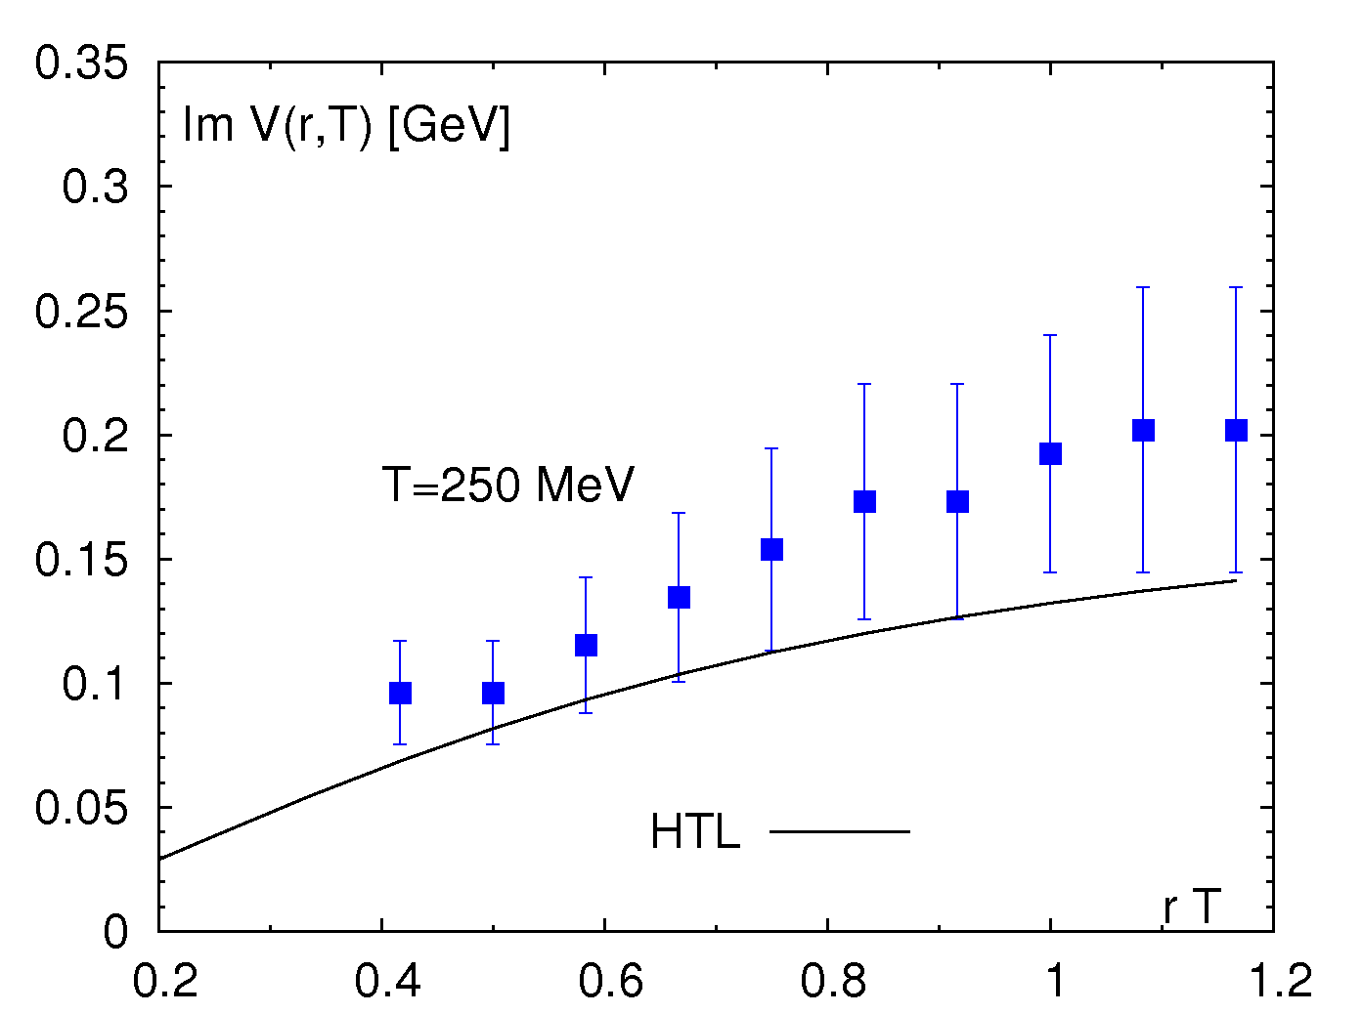
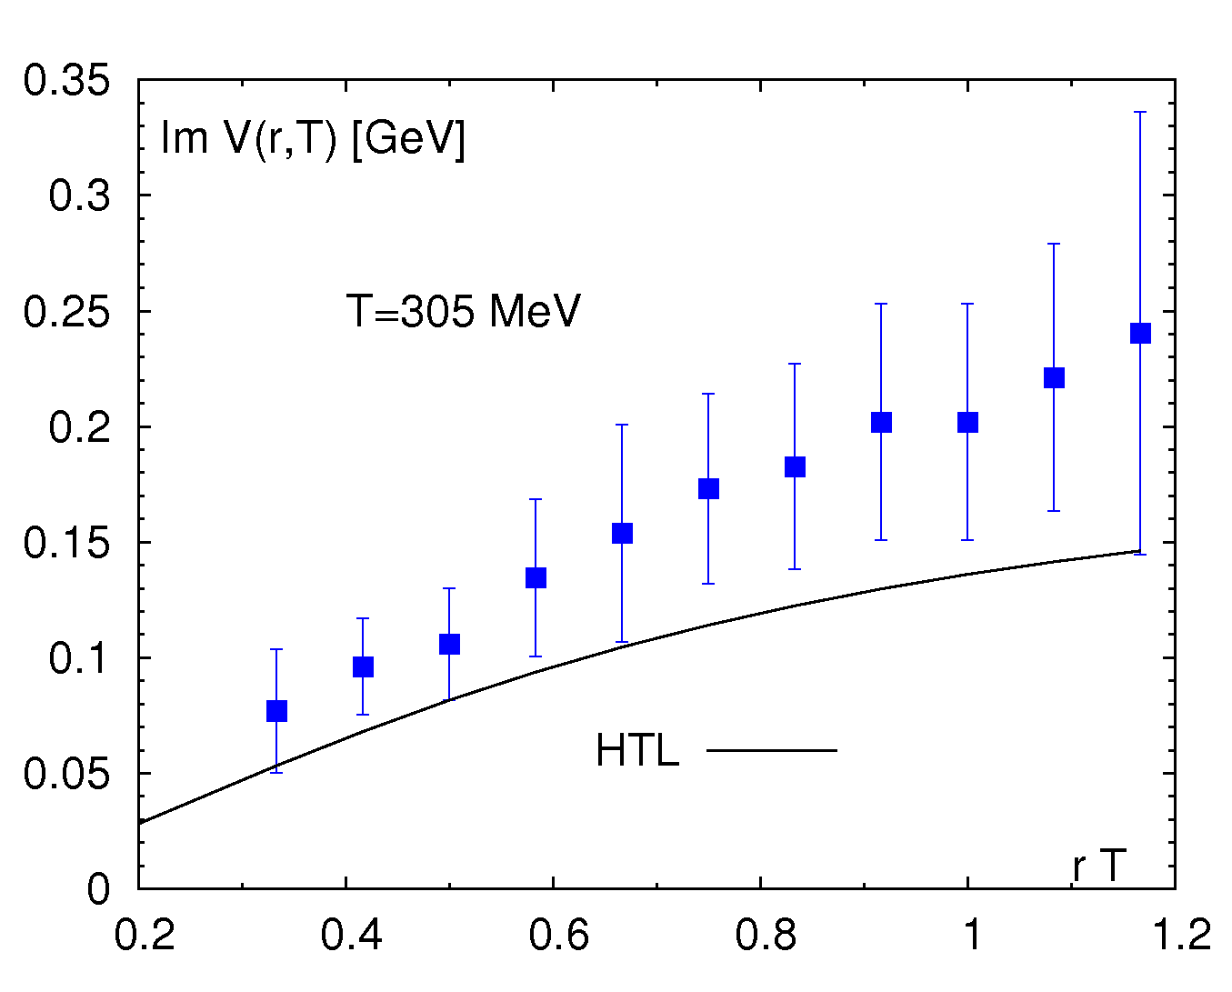
Imaginary part of the potential above deconfinement
Results for N_{τ} = 12 lattices using σ ^{HTL} ((ω-E) λ ) as a 2-parameter fit Ansatz:
The imaginary part of the potential has large errors as the width of the spectral
functions is difficult to extract from the lattice correlators
The imaginary part increases with r and saturates at r T ~ 1
The central value imaginary part of the potential is (1.5 - 2.0) larger than in
HTL perturbation theory

Slide 12
Summary
The free energy and singlet free energy of static quark anti-quark pair calculated with HISQ action show strong screening effects for T>200 MeV and the results are
in agreement with earlier calculations perfromed with p4 action
The behavior of the Wilson loops calculated on the lattice is qualitatively the same
as in HTL perturbation theory
It is possible to extract the potential at T>0 from the Wilson loops using fits based
on HTL spectral functions
The potential at T>0 shows strong screening effects at for T>200 MeV and its real
part is larger than the singlet free energy
The imaginary part of the potential is about a factor of two larger than the HTL
perturbation theory result
The potential extracted from the lattice is similar to the phenomenological
“maximally binding” potential used in potential model calculations but differs
in details
consequences for the quarkonium spectral functions and melting temperatures ?

Slide 13
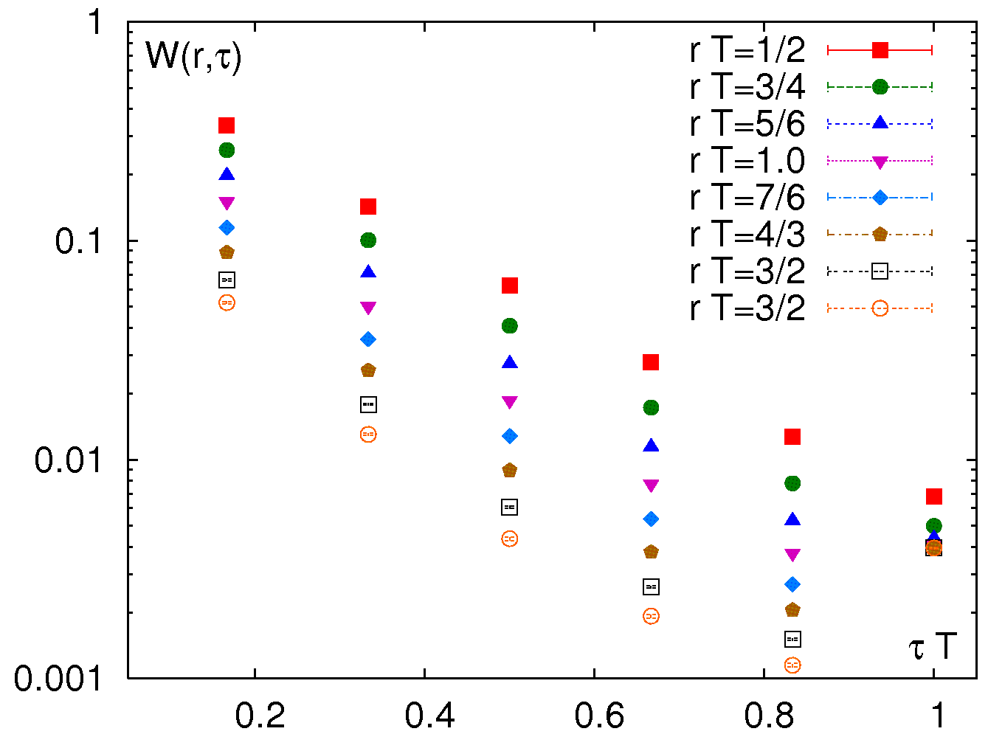
Back-up slides

Slide 14
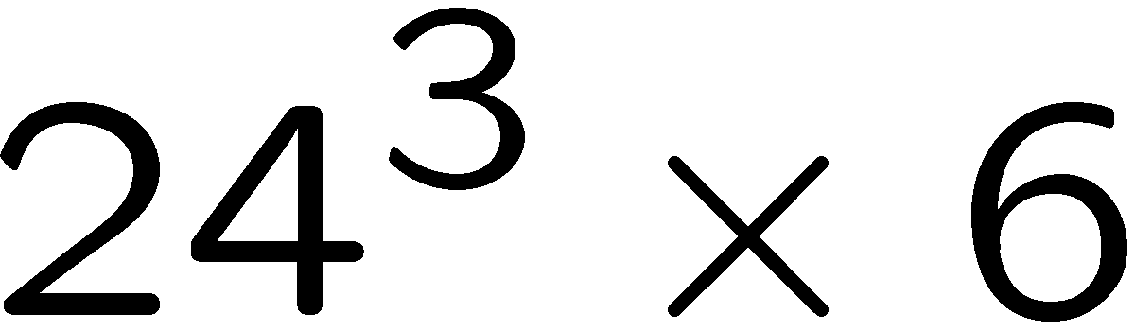
for T>200 MeV the potential is
significantly modified compared to the
T=0 result
the potential is larger than the singlet
free energy but approaches it from above
as the temperature increases
similar behavior in quenched QCD
Burnier, Rothkopf 2012

