Slide 1




Initial Flow
Of Gluon Fields in Heavy Ion Collisions
Rainer J. Fries, GuangYao Chen
Texas A&M University
Hard Probes VI
Capetown, November 4, 2013

Slide 2
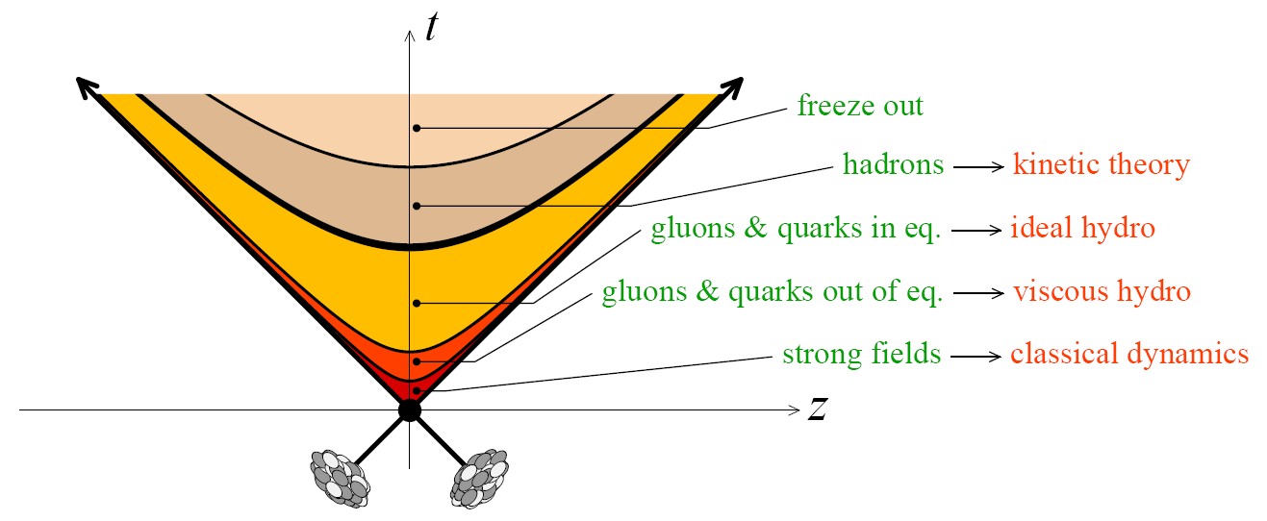
The “Standard Model” of URHICs
Bulk evolution
  Local thermal equilibrium with small dissipative corrections after time 0.2-1 fm/c.
  Expansion and cooling via viscous hydrodynamics.
  Large dissipation in the hadronic phase? Transport.
Pre-equilibrium: color glass condensate (CGC); successful predictions of eccentricities and fluctuations of the energy density.
  IP-Glasma
  Poor constraints on initial flow and other variables.
Here: initial global event shape from CGC has a rich structure.
[B. Schenke et al., PRL108 (2012); C. Gale et al. , PRL 110 (2013)]

Slide 3
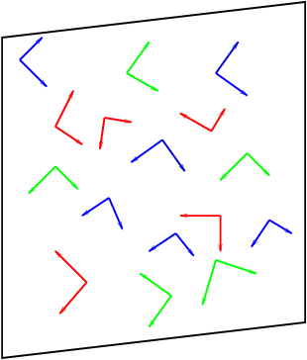
Color Glass: MV Model
Nuclei/hadrons at asymptotically high energy:
  Saturated gluon density ~ Q_{s}⁻² → scale Q_{s} >> Λ_{QCD}, classical fields.
Single nucleus: solve Yang-Mills equations for gluon field A^{μ}(ρ).
  Source = light cone current J (given by SU(3) charge distribution ρ .
  Calculate observables O(ρ ) from the gluon field A^{μ}(ρ).
  ρ = random Gaussian color fluctuations of a color-neutral nucleus
Two nuclei: intersecting currents J₁, J₂ (given by ρ ₁, ρ₂), gluon field A^{μ}(ρ ₁, ρ₂) from YM.
  Boundary conditions
[L. McLerran, R. Venugopalan]
[A. Kovner, L. McLerran, H. Weigert]

Slide 4
Gluon Fields in The Forward Lightcone
Here: analytic solution using small-time expansion for gauge field
Recursive solution for gluon field:
  0th order = boundary conditions
Numerical solutions by several groups
[T. Lappi:]
[RJF, J. Kapusta, Y. Li, 2006]
[Fujii, Fukushima, Hidaka, 2009]

Slide 5
Result: Fields
Before the collision: color glass = pulse of strictly transverse (color) electric and magnetic fields, mutually orthogonal, with random color orientations, in each nucleus.

Slide 6
Result: Fields
Before the collision: color glass = pulse of strictly transverse (color) electric and magnetic fields, mutually orthogonal, with random color orientations, in each nucleus.
Immediately after overlap (forward light cone, τ → 0): strong longitudinal electric & magnetic fields. Non-abelian effect!
E₀
B₀
[L. McLerran, T. Lappi, 2006]
[RJF, J.I. Kapusta, Y. Li, 2006]

Slide 7
Result: Fields
Before the collision: color glass = pulse of strictly transverse (color) electric and magnetic fields, mutually orthogonal, with random color orientations, in each nucleus.
Immediately after overlap (forward light cone, τ → 0): strong longitudinal electric & magnetic fields. Non-abelian effect!
Transverse E, B fields start linearly in time τ
[RJF, J.I. Kapusta, Y. Li, 2006]
[G. Chen, RJF, PLB 723 (2013)]

Slide 8

Energy Momentum Tensor
Initial (τ = 0) structure of the energy-momentum tensor vs hydrodynamics.
Gauge fields:
$$ε_{0}=\frac{1}{2}\left(E_{0}^{2}+B_{0}^{2}\right)$$
Transverse pressure
P_{T} = ε₀
Longitudinal pressure
P_{L} = –ε₀

Slide 9
Energy Momentum Tensor
Flow emerges from pressure at order τ¹:
Transverse Poynting vector gives transverse flow.
Example for second order:
[RJF, J.I. Kapusta, Y. Li, (2006)]
[G. Chen, RJF, PLB 723 (2013)]
Like hydrodynamic flow, determined by gradient of
transverse pressure P_{T} = ε₀; even in rapidity.
Non-hydro like; odd in rapidity ??
Depletion/increase of energy density due to transverse flow
Due to longitudinal flow

Slide 10
Modelling Color Charges
So far color charge densities ρ ₁, ρ₂ fixed.
MV: Gaussian distribution around color-neutral average
  Sample distribution to obtain event-by-event observables.
  Here: focus on analytic calculation of expectation value (as function of average color charge densities μ₁, μ₂).
Transverse flow comes from gradients in nuclear profiles.
Original MV model μ = const. Here: relaxed condition, μ constant on length scales 1/Q_{s} , allow variations on larger length scales 1/m where m << Q_{s}.
  Calculation of expectation values well-behaved.
[G. Chen, RJF, PLB 723 (2013)]
[G. Chen et al., in preparation]

Slide 11
Averaging
Energy density ~ product of nuclear gluon distributions ~ product of color source densities
“Hydro” flow:
“Odd“ flow term:
[T. Lappi, 2006]
[RJF, Kapusta, Li, 2006]
[Fujii, Fukushima, Hidaka, 2009]
[G. Chen, RJF, PLB 723 (2013)]
[G. Chen et al., in preparation]

Slide 12
Transverse Field: Abelian Arguments
Once the non-abelian longitudinal fields E₀, B₀ are seeded, the averaged transverse flow field is an abelian effect.
Can be understood in terms of Ampere’s, Faraday’s and Gauss’ Law.
  Longitudinal fields E₀, B₀ decrease in both z and t away from the light cone
Gauss at fixed time t:
  Long. flux imbalance compensated by transverse flux
  Gauss: rapidity-odd radial field
Ampere/Faraday as function of t:
  Decreasing long. flux induces transverse field
  Ampere/Faraday: rapidity-even curling field
Full classical QCD:
[Guangyao Chen, RJF]

Slide 13
Averaging: From Fields To Flow
Calculating the transverse Poynting vector to first order in τ :
Averaging over source configurations: what are and ?
With we have
Symmetry and dimensionality dictate shape of
[G. Chen, RJF, 2013]

Slide 14
Transverse Field: Visualization
Transverse fields for randomly seeded A₁, A₂ fields.

Slide 15
Transverse Flow: Visualization
Transverse Poynting vector for randomly seeded A₁, A₂ fields.

Slide 16
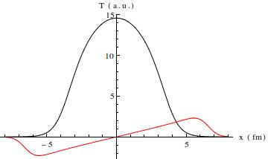
Phenomenology: b ≠ 0
Odd flow needs asymmetry between sources. Here: finite impact parameter
Flow field for Au+Au collision, b = 4 fm.
Radial flow following gradients in the fireball at η = 0.
In addition: directed flow away from η = 0.
Fireball rotating, angular momentum present.
|V| ~ 0.1 at the surface @ τ ~ 0.1

Slide 17
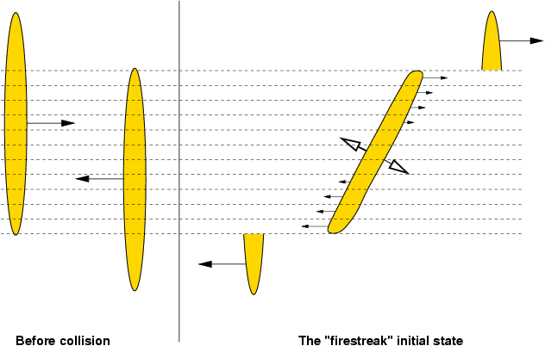
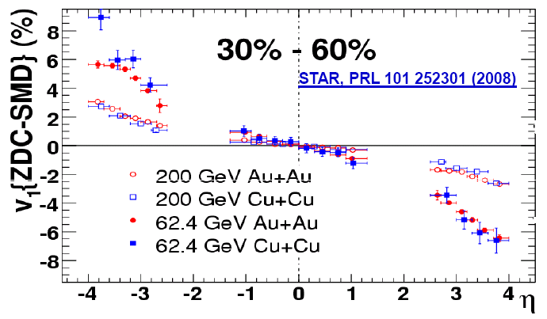
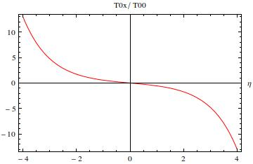
Phenomenology: b ≠ 0
Angular momentum is natural: some old models have it, most modern hydro calculations don’t.
  Some exceptions
  Do we determine flow incorrectly when we miss the rotation?
Directed flow v₁:
  Compatible with hydro with suitable initial conditions.
[L. Csernai et al. PRC 84 (2011)] …
[Gosset, Kapusta, Westfall (1978)]
MV only, integrated over transverse plane, no hydro

Slide 18
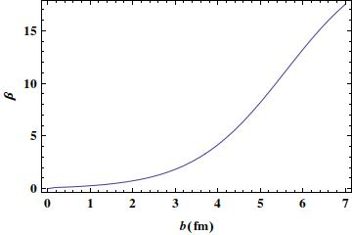
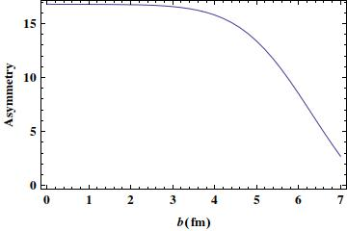

Phenomenology: A ≠ B
Odd flow needs asymmetry between sources. Here: asymmetric system
Flow field for Cu+Au collision:
Odd flow increases expansion in the wake of the larger nucleus, suppresses flow on the other side ⇒ characteristic flow patterns in asymmetric systems.
Example: Forward-backward asymmetries. (here p+Pb)
Similar:
$$\frac{\left\langle T^{0x}\right\rangle }{\left\langle T^{00}\right\rangle }\left(η=−2\right)−\frac{\left\langle T^{0x}\right\rangle }{\left\langle T^{00}\right\rangle }\left(η=+2\right)$$
Directed flow asymmetry
Radial flow asymmetry

Slide 19
Event-By-Event Picture
Numerical simulation of β in Au+Au, sampling charge distributions in the nuclei.
Individual events dominated by fluctuations.
Averaging over events: recover directed flow.
PRELIMINARY

Slide 20
Matching to Hydrodynamics
No equilibration in clQCD.
Pragmatic solution: extrapolate from both sides (r(τ) = interpolating fct.)
, enforce
and other conservation laws.
Fast equilibration assumption:
Analytic solution possible for matching to ideal hydro.
  4 equations + EOS to determine 5 fields in ideal hydro. Up to second order in time:
  Odd flow β drops out: we are missing angular momentum!
p
T
τ
L

Slide 21
Matching to Hydrodynamics
Instantaneous matching to viscous hydrodynamics using in addition
  Mathematically equivalent to imposing smoothness condition on all components of T_{μν}.
Numerical solution for hydro fields:
Rotation and odd flow terms readily translate into hydrodynamics fields.

Slide 22
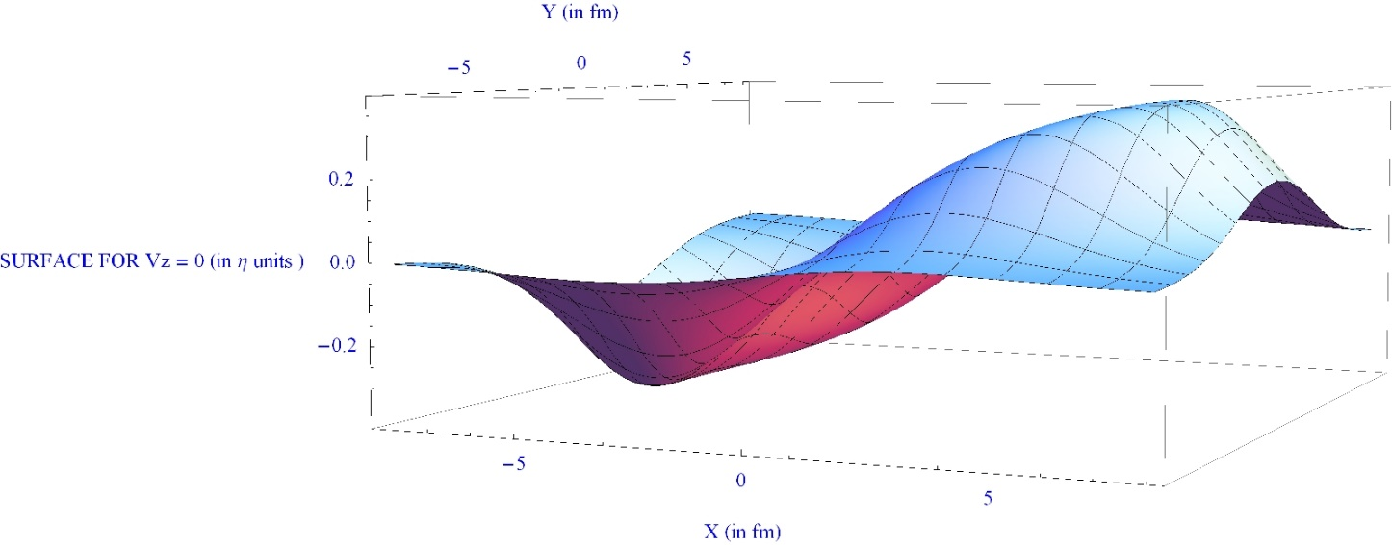
Initial Event Shape
Intricate 3+1 D global structure emerges
Example: nodal plane of longitudinal flow, i.e. v_{z} = 0 in x-y-η space
Further analysis: Need to run viscous 3+1-D hydro with large viscous corrections.
Work in progress.

Slide 23
Summary
We can calculate the fields and energy momentum tensor in the clQCD approximation for the early stage of high energy nuclear collisions.
Transverse energy flow shows interesting and unique (?) features: directed flow, A+B asymmetries, etc.
Interesting features of the energy flow are naturally translated into their counterparts in hydrodynamic fields in a simple thermalization model. These features are often not included in hydrodynamic simulations.
Future phenomenology needs hydrodynamics with large dissipative corrections.
3 Questions:
  Are there corrections to observables we know well (like elliptic flow)?
  Are there phenomena that we completely miss with too simplistic state-of-the art initial conditions?
  Are there flow signatures unique to CGC initial conditions that we can observe?

