Slide 1



ALICE Status Update
8 May 2015
Tom Dietel
University of Cape Town

Slide 2
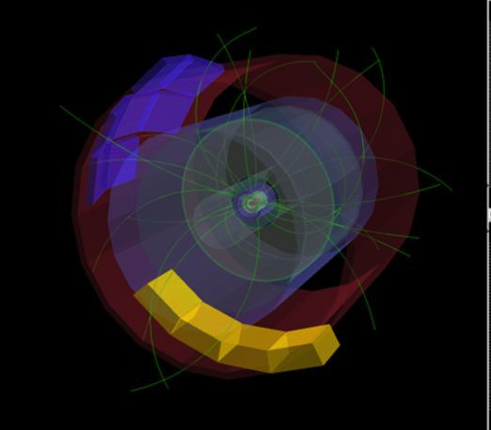
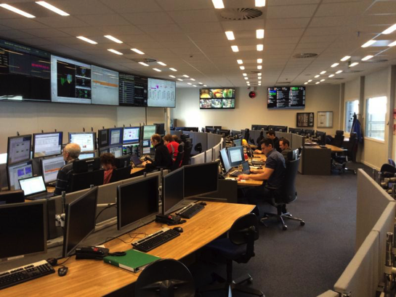
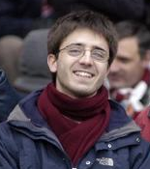
LHC Restart
5 April: First circulating beams
5 May: First collisions at 900 GeV
Francesco Bossu
MUON SRC

Slide 3
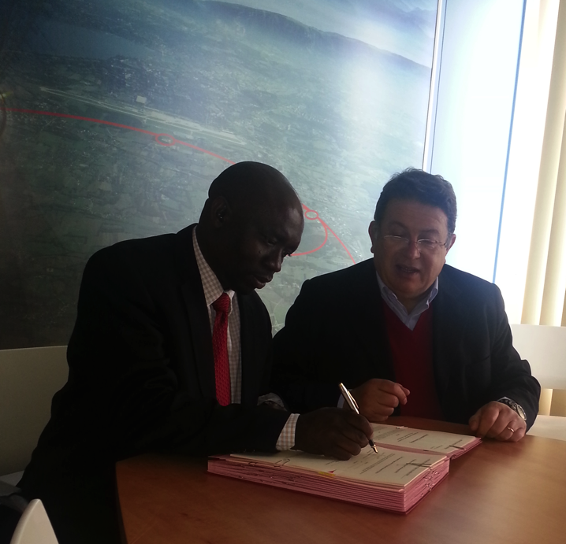


CHPC – Signing of MoU
CHPC is now a
WLCG Tier-2
MoU signed on
28 April 2015
Happy Sithole (CHPC/CSIR)
Sergio Bertolluci (CERN)

Slide 4

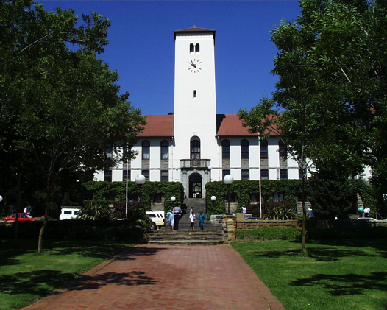
Rhodes University
Department for Physics & Electronics
Dino Giovannoni, Anthony Sullivan, Andrew Youthed
applied for associate membership
aim: technical contribution
no authorship fees, shift duties
sign only technical papers with own contribution
to be presented to ALICE collaboration at next ALICE week (22-26 June)
CRU* workshop around same time
*CRU = common readout unit

Slide 5
International Masterclass
Sat, 28 March
21 learners from 12 schools

Slide 6
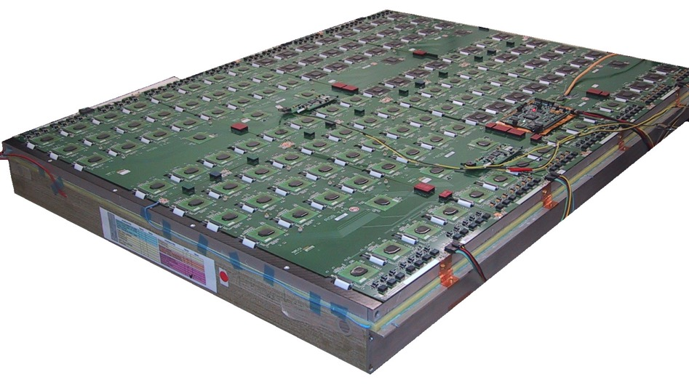
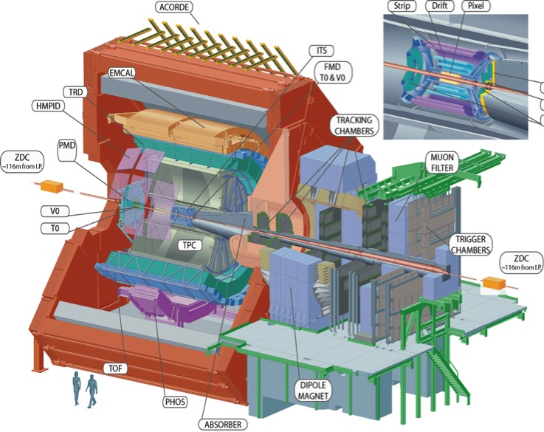
TRD Readout Chamber for UCT
ALICE TRD
readout & trigger module received
interest by Rhodes in similar setup
Hons student working on setup

Slide 7
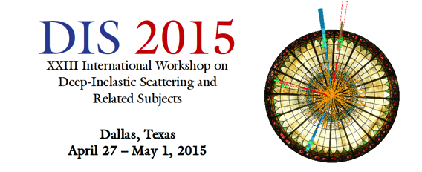

Conferences
Zinhle Buthelezi
Production of W bosons in p-Pb collisions measured with ALICE at the LHC
DIS2015, 27 April – 1 May 2015, Dallas, USA
upcoming:
Francesco Bossu
Heavy flavour and W boson production measurements via leptonic decay channels with ALICE at the LHC
SQM 2015, 6-11 July 2015, Dubna, Russia

Slide 8

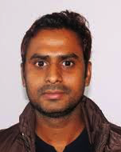
Post-Docs
Massimiliano Marchisone
starts in July 2015
analysis of Υ→μμ
work on muon trigger
Danish Azmi
waiting for visa
thermal model / Tsallis
muon spectrometer

Slide 9
Student Activities
Kgotlaesele Johnson Senosi (PhD – UCT)
W production in pp,P-Pb and Pb-Pb collisions at LHC energies
Sean Murray (PhD – UCT)
High-Level Trigger for the ALICE Muon Detector
Andile Whitehead (PhD – UCT)
Direct Photon Measurements
Sibaliso Mhlanga (MSc – UCT)
Heavy Flavour production vs multiplicity at forward rapidity with ALICE
project on detector control system for ALICE during CERN summer student programme (June/August 2014)
Nomvelo Dindikazi (MSc/MANuS – U Zululand)
Single muon production vs multiplicity in pp collisions at 7 TeV with ALICE

Slide 10
People
Academics
Jean Cleymans
Tom Dietel
Zeblon Vilakazi
Dino Giovannoni
Anthony Sullivan
Staff
Zinhle Buthelezi
Siegie Förtsch
Deon Steyn
Andrew Youthed
Post-docs
Francesco Bossu
Danish Azmi (TBC)
Massimiliano Marchisone (July)
PhD students
Sean Murray
Johnson Senosi
Andile Whitehead
MSc students
Sibaliso Mhlanga
Nomvelo Dindikazi (MANuS)

