Slide 1
RAM Benchmarking on ARM-based SoCs
Thomas Wrigley
In collaboration with Gerhard harmsen
University of the witwatersrand

Slide 2
A Paradigm Shift – High-Throughput vs High-Performance Computing
Most high performance computers are quite a bit like Jeremy Clarkson (from Top Gear):
Very large
And obsessed with

Slide 3
A Paradigm Shift – High-Throughput vs High-Performance Computing
The majority of supercomputers used in industry and academia (e.g. see TOP 500 list) are high-
performance computing (HPC) designs – computational intensity
Certain problems in Big Science like ATLAS and the SKA produce large amounts of data which
do not necessarily require intensive computation (change)
Current HPC designs tend to prove inefficient and inadequate for these purposes
We need a design which is focused on high-throughput computing (HTC)
Industry is not solving this problem for us, which means that we have to solve it ourselves
Wits HEP group-led affordable HTC design project

Slide 4
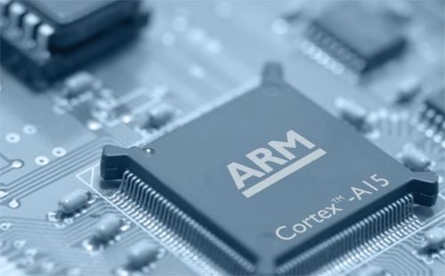
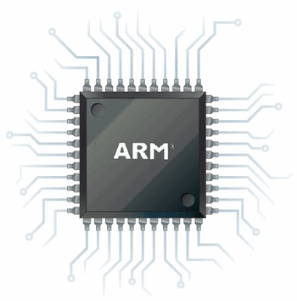
ARM Processors
Widely used in smartphones and tablets – less powerful, consume less energy, cheaper to
produce and potentially more energy-efficient that x86-based chips
The HEP HTC project is exploring the potential of ARM processors in an affordable high-
throughput computer design

Slide 5
RAM Benchmarking
Memory performance important for:
High-throughput | Affordability
Memory and CPU cache latencies | Bottlenecks $=$ CPU & power wastage
Memory bandwidth – bottlenecks | Memory is expensive – want to use optimal amount
We need to fully understand ARM processors
and what they are capable of.
Robert Reed has just spoken about
CPU (computational intensity) performance
For this presentation, the focus is on how RAM
(memory) performance can affect SoC performance
HTC design focus is both on high-throughput and
affordability.

Slide 6
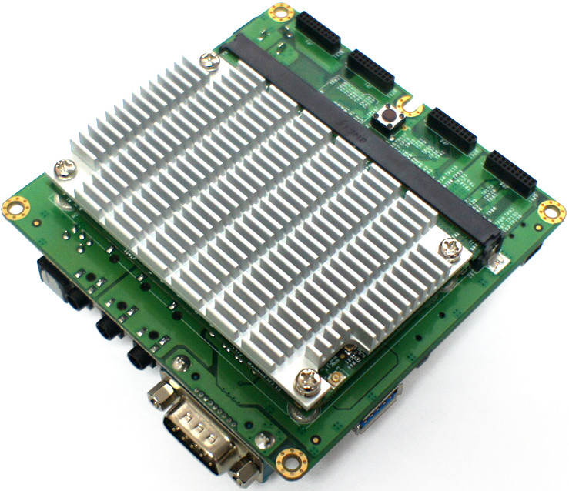
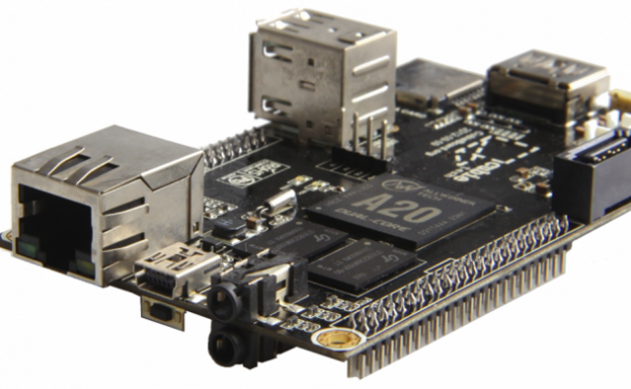
Dev Boards Used
Wandboard
Cubieboard 2

Slide 7
RAM Benchmarking
The best way to characterise performance is to run benchmarks
We have chosen two benchmarks – the STREAM benchmark and LMBench
STREAM
Widely-used memory bandwidth benchmark
LMBench
Runs a series of tests which evaluate various aspects of memory and CPU cache
performance

Slide 8
RAM Benchmarks – Pros and Cons
Pros | Cons
STREAM
Industry standard memory bandwidth benchmark | Optimisations can backfire
Responsive to optimisation | Only specific optimisation flags work
Existing results database | Not strict requirements – database not necessarily reliable
LMBench
Wide array of tests included in benchmark | Not as simple to optimise and less responsive to optimisations
Existing results database | Database outdated

Slide 9
The STREAM Benchmark
Generates an array of random numbers (which is stored in the RAM) and performs a series of mathematical operations, tests which are called: copy, scale, add, and triad
Test | Equation
Copy | $$A\left(i\right)=B(i)$$
Scale | $$A\left(i\right)=q ×B\left(i\right)$$
Add | $$A\left(i\right)=B\left(i\right)+C(i)$$
Triad | $$A\left(i\right)=B\left(i\right)+q ×C(i)$$
Array size can be specified
Needs to be greater than a specific size (system dependent) – or will be stored in cache(s) instead of RAM

Slide 10
STREAM Results – Cubieboard (1 Thread)
L1
Cache
L1 + L2
Cache
RAM
Notes:
Peaks at exact size of L1 cache. Dips thereafter due to swapping between L1 and L2 caches. Plateaus beyond size of L2 cache – because it is RAM only at this point

Slide 11
STREAM Results – Cubieboard (2 Threads)
L1 + L2
Cache
L1 Cache
RAM
Notes:
Peaks at exact size of L1 cache. Dips thereafter due to swapping between L1 and L2 caches. Plateaus beyond size of L2 cache – because it is RAM only at this point

Slide 12
STREAM Results - Wandboard
L1 + L2
L1
Notes:
Same pattern as with Cubieboard – L1 cache, L2 cache, main memory

Slide 13
STREAM Results - Wandboard
L1 + L2
L1
Notes:
Same pattern as with Cubieboard – L1 cache, L2 cache, main memory

Slide 14
STREAM – Wandboard Plateau (1 Thread)
Approx.
400 MB/s

Slide 15
STREAM – Wandboard Plateau (2 Threads)
Approx.
650 MB/s

Slide 16
STREAM – Wandboard Plateau (3 Threads)
Approx.
970 MB/s

Slide 17
STREAM – Wandboard Plateau (4 Threads)
Approx.
1010 MB/s

Slide 18
STREAM Results - Wandboard
Memory Bandwidth of the Wandboard tends towards plateau beyond an array size greater than approx. 1 MB
Table shows plateaus for 1, 2, 3, and 4 threads
Not yet sure what is causing this plateau – more investigation needed
RAM could be close to saturated at 3 cores – leaving 4th core underutilised
Number of Threads | Approx. Bandwidth Plateau (MB/s)
1 | 400
2 | 650
3 | 970
4 | 1010

Slide 19
STREAM Results
Theoretical Bandwidth for Cubieboard
(RAM set at 432 MHz):
$$\frac{432 ×{10}^{6} MHz ×32 bits ×2 (dual rate)}{8 (bits per byte)}$$
$$=3456 MB/s$$
Theoretical Bandwidth for Wandboard
(RAM set at 432 MHz):
$$\frac{432 ×{10}^{6} MHz ×32 bits ×2 (dual rate)}{8 (bits per byte)}$$
$$=3456 MB/s$$
Both boards have different DDR memory controllers
Typical (Intel) MC efficiency – $±$50 %
Cubieboard doesn’t appear close to saturation yet – only 2 cores
Wandboard may be close to saturation – efficiency of significantly less than 50 %
More investigation is needed to determine true cause

Slide 20
LMBench
Runs a series of tests which evaluate various aspects of memory and CPU cache performance –
basic operations, float operations, double operations, memory bandwidth and memory (incl.
cache) latency
We will focus on two categories, namely (1) time taken to perform:
basic integer operations
basic 64 bit integer operations
basic float operations
double operations
And (2) memory latency (CPU cache and main memory)

Slide 21
LMBench – Basic Integer Operations
Cubieboard
Time taken to perform operations:
Bit (ns) | Add (ns) | Multiply (ns) | Divide (ns)
Basic Integer Operations
1 | 0.99 | 2.98 | 73.2
Basic 64 bit integer operations
2 | - | 5.02 | 292.1
Basic Float Operations
- | 3.98 | 3.98 | 17.9
Basic Double Operations
- | 3.98 | 6.95 | 31.8

Slide 22
LMBench – Basic Integer Operations
Wandboard
Time taken to perform operations:
Bit (ns) | Add (ns) | Multiply (ns) | Divide (ns)
Basic Integer Operations
1.01 | 1.01 | 4.12 | 96.1
Basic 64 bit integer operations
1.03 | - | 10.1 | 246.7
Basic Float Operations
- | 5.03 | 6.03 | 16
Basic Double Operations
- | 5.03 | 7.04 | 26.1

Slide 23
LMBench – Memory Latencies
Table shows specific latencies recorded for Cubieboard and Wandboard
CPU Frequency (MHz) | Clock Cycle Period (ns) | L1 Cache Latency (ns) | L2 Cache Latency (ns) | Main Memory Latency (ns)
Cubieboard
1008 | 0.992 | 3.02 | 9.231 | 58.5
Wandboard
996 | 1.004 | 4.019 | 30.8 | 119.8
33.1 % diff.
233.7 % diff.
104.8 % diff.

Slide 24
LMBench Results
Cubieboard significantly outperforms the Wandboard
Although the two chips come from different manufacturers, differences are probably due to
age of design – A7 is newer
A7 is several upgrades ahead of the A9
Differences are probably caused by newer, better RAM as well as SoC design and components

Slide 25
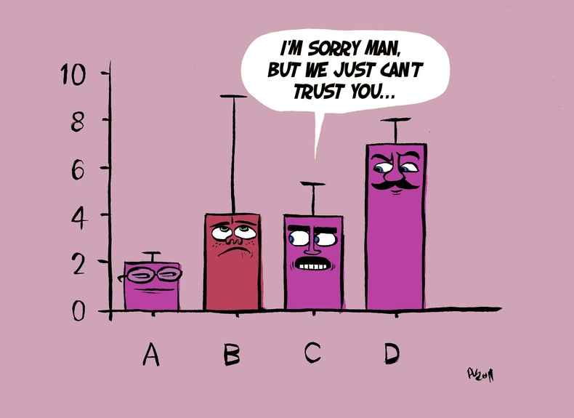
Bit Error Rate (BET)
Rate at which individual bit errors occur in the physical memory
Thought to be caused by cosmic rays
Usually managed by Error Correcting Code (ECC) RAM
Most BET studies – very small-scale & short time period laboratory attempts
One study used Google’s vast network of servers over a period of 2.5 years (Schroeder,
Pinheiro, & Weber, 2009)
Concluded that: bit errors appear to be more dependent on hardware than previously thought
Implication for us: bit errors are counter-productive for us – ECC RAM recommended

Slide 26
Implications & Next Steps
ARM SoC memory controller may be less efficient than previously thought
More investigation is necessary to determine root causes of observed results
New ARM chip and SoC (v8 & 64 bit) designs must be evaluated for improvements
Any eventual design should make use of ECC memory
HEP HTC project will continue moving forward

Slide 27
Conclusion
Memory size and speed is crucial for optimally efficient performance (right proportions, not
necessarily bigger).
Though memory specifications almost entirely dependent on SoC design – not wise to treat as
an afterthought.

Slide 28
Just Joking :)

Slide 30
You’ve gone too far!
(These are back up slides)

Slide 31
LMBench – Flags Used
Wandboard (A9)
-mfloat-abi=hard -ffast-math –O3 -mfpu=neon -march=armv7-a
Cubieboard (A7)
-mfloat-abi=hard -ffast-math –O3 -mfpu=neon -mtune=cortex-a7

Slide 32
STREAM Comparisons – 1 Thread

Slide 33
STREAM Comparisons – 2 Threads

Slide 34
STREAM Comparisons – 3 Threads

Slide 35
STREAM Comparisons – 4 Threads

Slide 36
Bit Error Rate (BET)
Rate at which individual bit errors occur in the physical memory
Thought to be caused by cosmic rays
Usually managed by Error Correcting Code (ECC) RAM

Slide 37
RAM Benchmarking
To use ARM processors in a HTC design, we need to fully understand the performance
and capabilities of these processors and the systems-on-chip which they are part of.
Robert Reed has just spoken about CPU performance (number-crunching ability).
For this presentation – focus is on how RAM (memory) can affect ARM-based SoC performance
Our design focus is on both high-throughput and on affordability.
High-throughput: necessary to identify and limit memory bandwidth & latency bottlenecks.
Affordability:
Memory is relatively expensive – optimising will reduce hardware and power consumption costs
Memory bottlenecks leave CPU cores idle – wastage.

