Slide 1
Data Processing for the
ALICE at the LHC
High-performance Signal and Data Processing
Wits – 26-31 January 2014

Slide 2
Contents
Physics Motivation
heavy-ion physics and QGP
hard and soft probes
Present ALICE Setup
detectors
triggering
ALICE upgrade
ITS, TPC upgrades
challenges
O² project

Slide 3
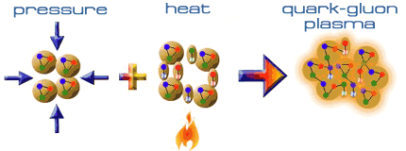
Quark-Gluon Plasma
Compression
reduce distance between nucleons
Heating
thermally create pions
fill space between nucleons
hadrons overlap
quarks roam freely over large volume (deconfinement)
Quark-Gluon Plasma

Slide 4

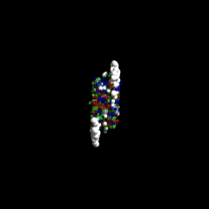
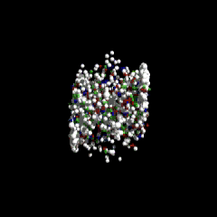
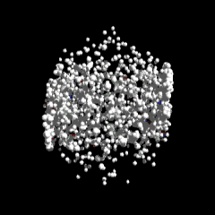
QGP in the Laboratory
raw material: nuclei
  density: 2×10¹⁷ kg/m³ ≈ 0.1 GeV/(fm³ c²)
kinetic energy
  up to E=2.76 TeV per nucleon
  about 3000 times rest energy (938 MeV)
collision: ²⁰⁸Pb + ²⁰⁸Pb @ √s_{NN}=2.76 TeV
  E_{total} = 1.15 PeV ≈ 0.2 mJ
  typ. volume: (10 fm)³
  energy density: TeV/fm³ ≈ 10³⁸ J/m³
  typ. time: 10 fm/c ≈ 10⁻²²s

Slide 5
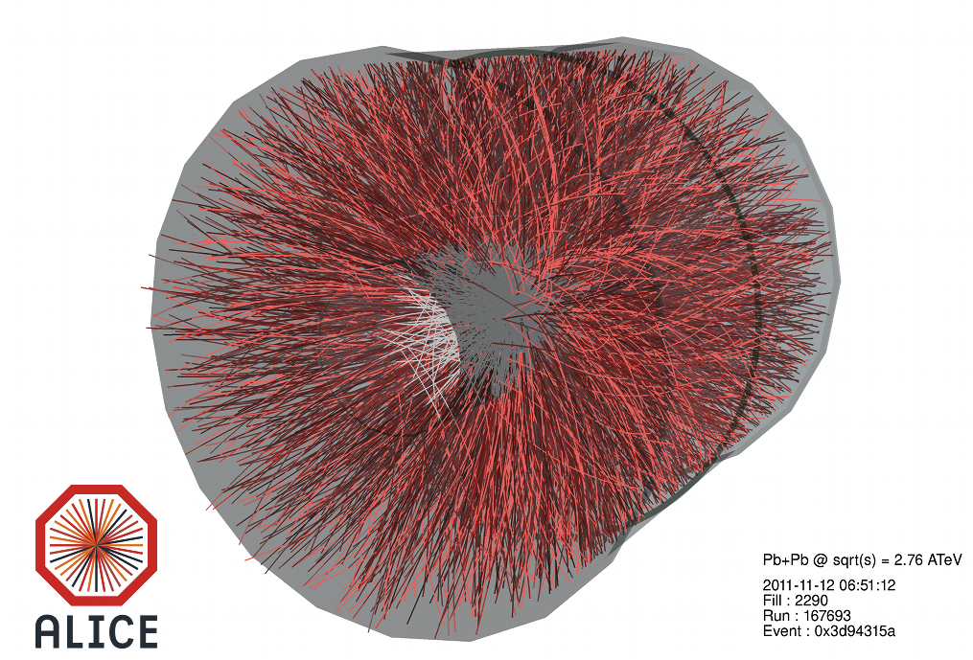

Slide 6

Bulk Properties
global observables of
particle production
  hadron species
  anisotropy and momentum
  distribution
direct access to thermodynamic properties
  freeze-out temperature
  baryo-chemical potential at freeze-out
  pressure gradients and hydro-dynamic flow

Slide 7
Statistical Model
Assumption: thermal production of all hadrons in macro-canonical ensemble
→ hadron abundances are fixed by partition function
+ : fermions
- : bosons
For any conserved quantum number exists a chemical
potential μ, conservation laws give boundary conditions:
Baryon number:
Leaving two free
parameters:
Strangeness:
Charge:

Slide 8
Statistical Model in ALICE
Fit particle ratios to extract freeze-out temperature
T=152 MeV
2 trillion K
µ_{B} = 1 MeV (fixed)
exclude protons to improve fit
Consistent with phase transition around 150-160 MeV

Slide 9
Phase Diagram of Nuclear Matter
increasing T for small √s_{NN}
const T≈160 MeV
for √s_{NN}>10GeV
consistent with lattice QCD
  crossover phase transition at SPS,RHIC energies
  1st order phase transition, critial point predicted
  search ongoing
baryon free region at mid-rapidity

Slide 10
Bulk Properties – Data Sets
abundant probes
  1000s of pions, 100s of
  kaons, protons… per collision
small data sets required
  first analyses with few
  hours worth of data
typical triggers:
  minimum-bias (MB): simple interaction trigger
  centrality trigger: select e.g. 10% collisions with smallest impact parameters

Slide 11
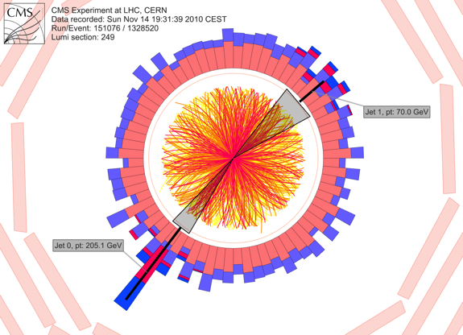
Hard Probes
created in early hard
N-N scatterings
typical examples:
  jets
  high-p_{T} prompt photons
  W/Z bosons
penetrating probes for the QGP (jets) or reference (photons, W/Z)

Slide 12
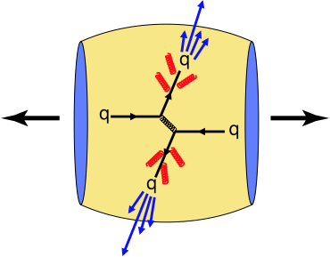
Jets in Heavy-Ion Collisions
hard production process
  well understood in pQCD
propagation in medium
  gluon-Bremsstrahlung
  collisions with partons
  energy loss – „jet quenching“
jet modifications carry information about parton-medium interaction
→ probe of the medium

Slide 13
Single Particle Spectra
Jet Quenching:
shift from high to low jet energies
fewer hard jet fragments
suppression of high-p_{T} single particle spectra
  strongest for central Pb-Pb
  absent in p-Pb
Phys Rev Lett 110, 082302

Slide 14
Hard Probes - Requirements
rare probes
  1 jet > 100 GeV in 10⁶ MB
  Pb-Pb events
  1 direct photon > 10 GeV
  in 10⁴ events
easy to trigger
  jets: energy deposition in large calorimeter area
  photons: large energy in few calorimeter cells
  muons: penetration of absorbers

Slide 15
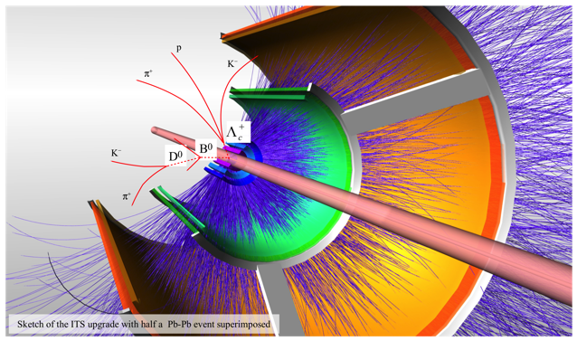
“Semi-hard” Observables
observables
between bulk
and hard probes
examples
  heavy quarks (c,b)
    hydro-dynamics
    charm quark energy loss / jet quenching
    J/ψ suppression
  thermal photons at low-p_{T}

Slide 16
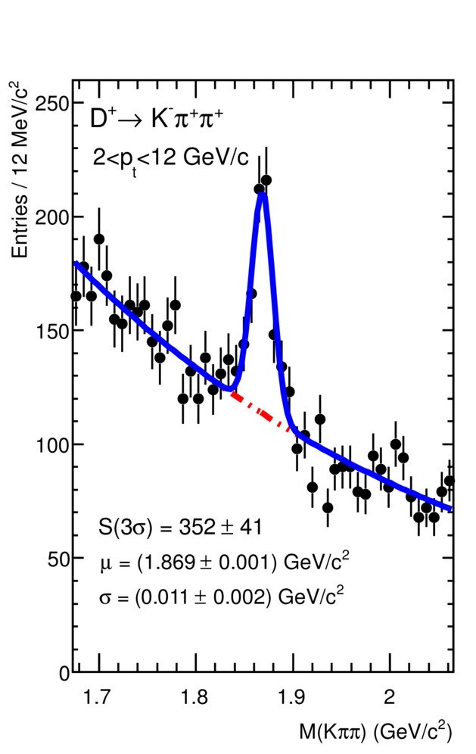
D-Mesons
test charm quark transport in the QGP
mass dependence of jet quenching
hydrodynamics and thermalization
difficult reconstruction
secondary vertex and invariant mass
e.g. D⁺ → K⁻π⁺π⁺
JHEP 1207 (2012) 191

Slide 17
Identified Charm R_{AA}
  reconstructed D-mesons
  D⁰, D⁺, D*
  semi-leptonic decays
  b,c → e + X
  b,c → μ + X
  suppression of heavy flavor slightly less than for light hadrons

Slide 18
“Semi-Hard” Observables - Requirements
rarely produced
  large event samples
  required
no clear trigger signal
  decay into many soft particles
  indistinguishable from background at trigger level
  online event selection not possible
focus of ALICE upgrade program

Slide 19
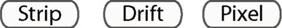




Slide 20
ALICE / LHC Heavy-Ion Running
1 month heavy-ion running per year
  Pb-Pb @ 2.76 (5.5) TeV – up to 8 kHz
  p-Pb @ 5.02 (8) TeV – 100-200 kHz
  other systems under discussion (Ar-Ar)
10 months pp running per year
  reduced luminosity at ALICE (100-200 kHz)
  mainly as reference for HI data

Slide 21
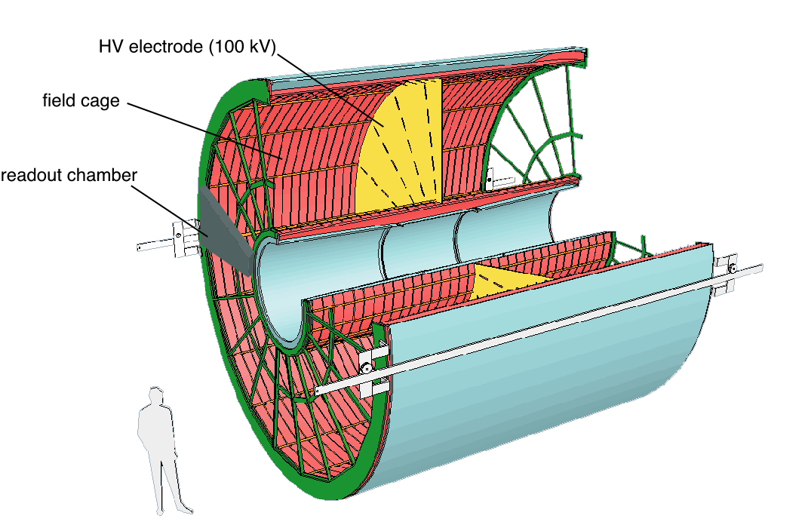
Time Projection Chamber
largest TPC ever built
L=5m, d=5m, V=88m³
570 000 readout pads
1 event = up to 1000
10-bit samples
@ 5.66 MHz
t_{drift} ≈ 90 μs
max event rate 3.5 kHz
reconstruction and identification of charged particles with up to 160 space points
Notes:
note: gating grid: needs to be closed between events – space charge

Slide 23
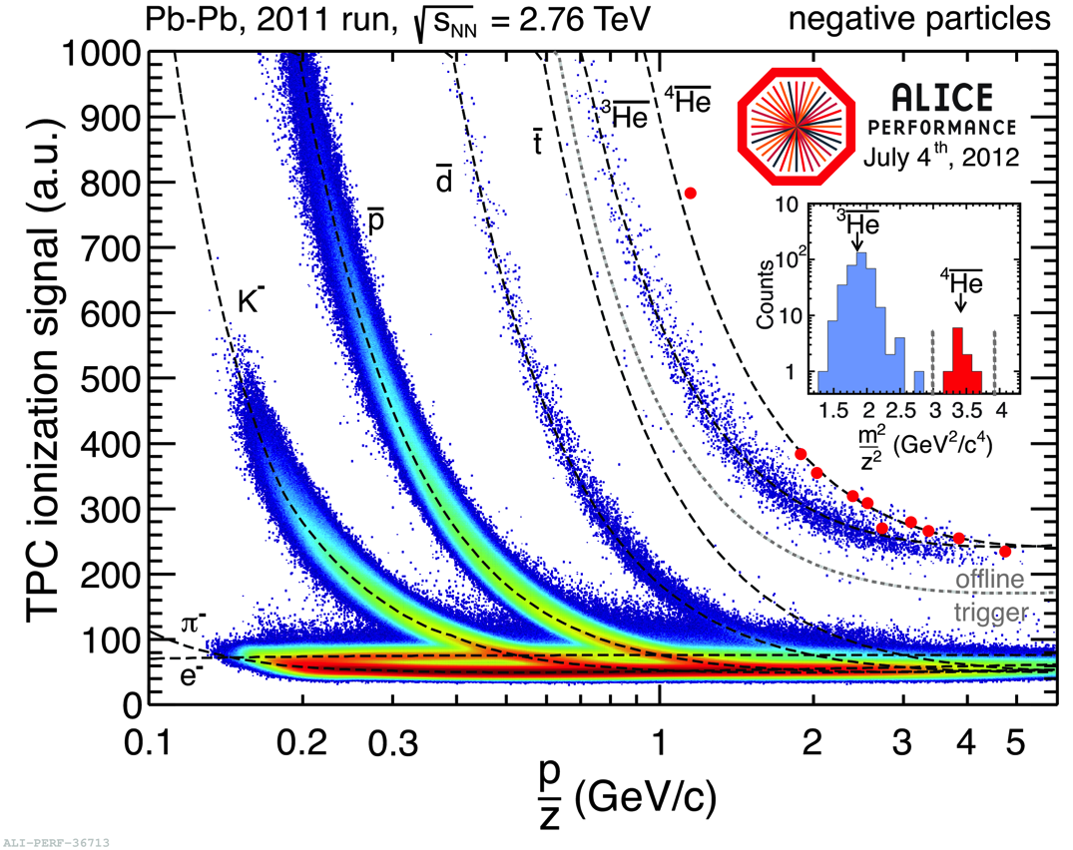
TPC – Particle Identification
negative particles → no nuclear fragments from detector
separation of anti-helium 3 / 4 with TOF

Slide 24
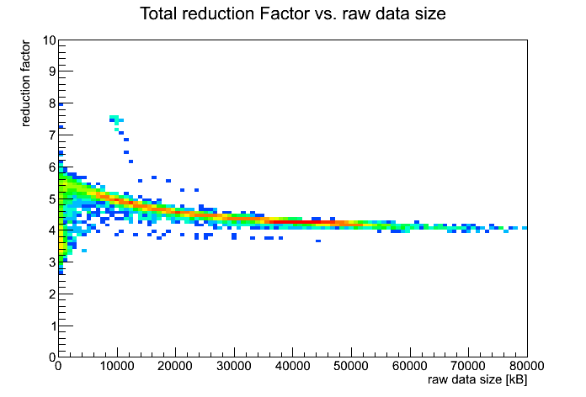
TPC – Event Size and Data Rate
TPC is largest data source
limiting factor for Pb-Pb
(ZS: 1 GB/s @ 50 Hz)
→ record cluster data
cluster reco in FPGAs in High-Level Trigger
discard raw data
increase max event rate to 400 Hz (still at 1GB/s)
rate limit in pp ≈ 3.5 kHz (gating grid)
Data Format | Event Size (MByte)
Raw Data | 700
Zero Suppression | 20
Cluster Data | ~3
HLT Pb-Pb 2011

Slide 25
ALICE Trigger Scheme
LHC: 8 kHz Pb-Pb
100 kHz pp @ ALICE
Collision
Level-0 Trigger | t = 1.2 μs | T0, V0, TOF | interaction, centrality
 | R_{max} ≈ 100 kHz
Level-1 Trigger | t = 6.5 μs | TRD PHOS,EMCAL | high-p_{T} hadrons, photons, jets, electrons
Level-2 Trigger | t = 88 μs
 | R_{max} ≈ 1 kHz
High-Level Trigger | BW_{max} ≈ 1GB/s | all detectors | arbitrary observables
Pretrigger
1 μs
Level-0
Level-1
10 μs
Level-2
100 μs
high levels: detailed information, precise decisions
low Levels: high event rates – 10x statistics per level

Slide 26
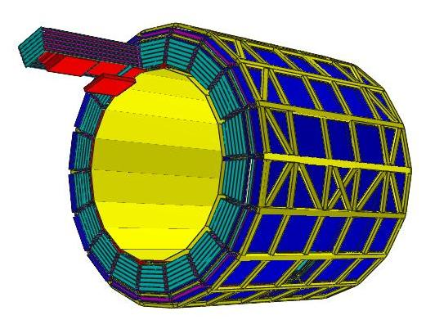
ALICE Transition Radiation Detector
electron identification
  using transition radiation and ionization
  pion efficiency < 1%, with electron efficiency > 90%
Level-1 trigger
  for electrons, high-p_{T} hadrons
  6.5 μs processing
  requires tracking and PID
  implemented in ASICs and FPGAs
Notes:
Spurrekonstuktion
Elektronidentifikation
Trigger
6 Ebenen, 18 Supermodule, 540 Kammern
Radiator + MWPC mit Drift

Slide 27
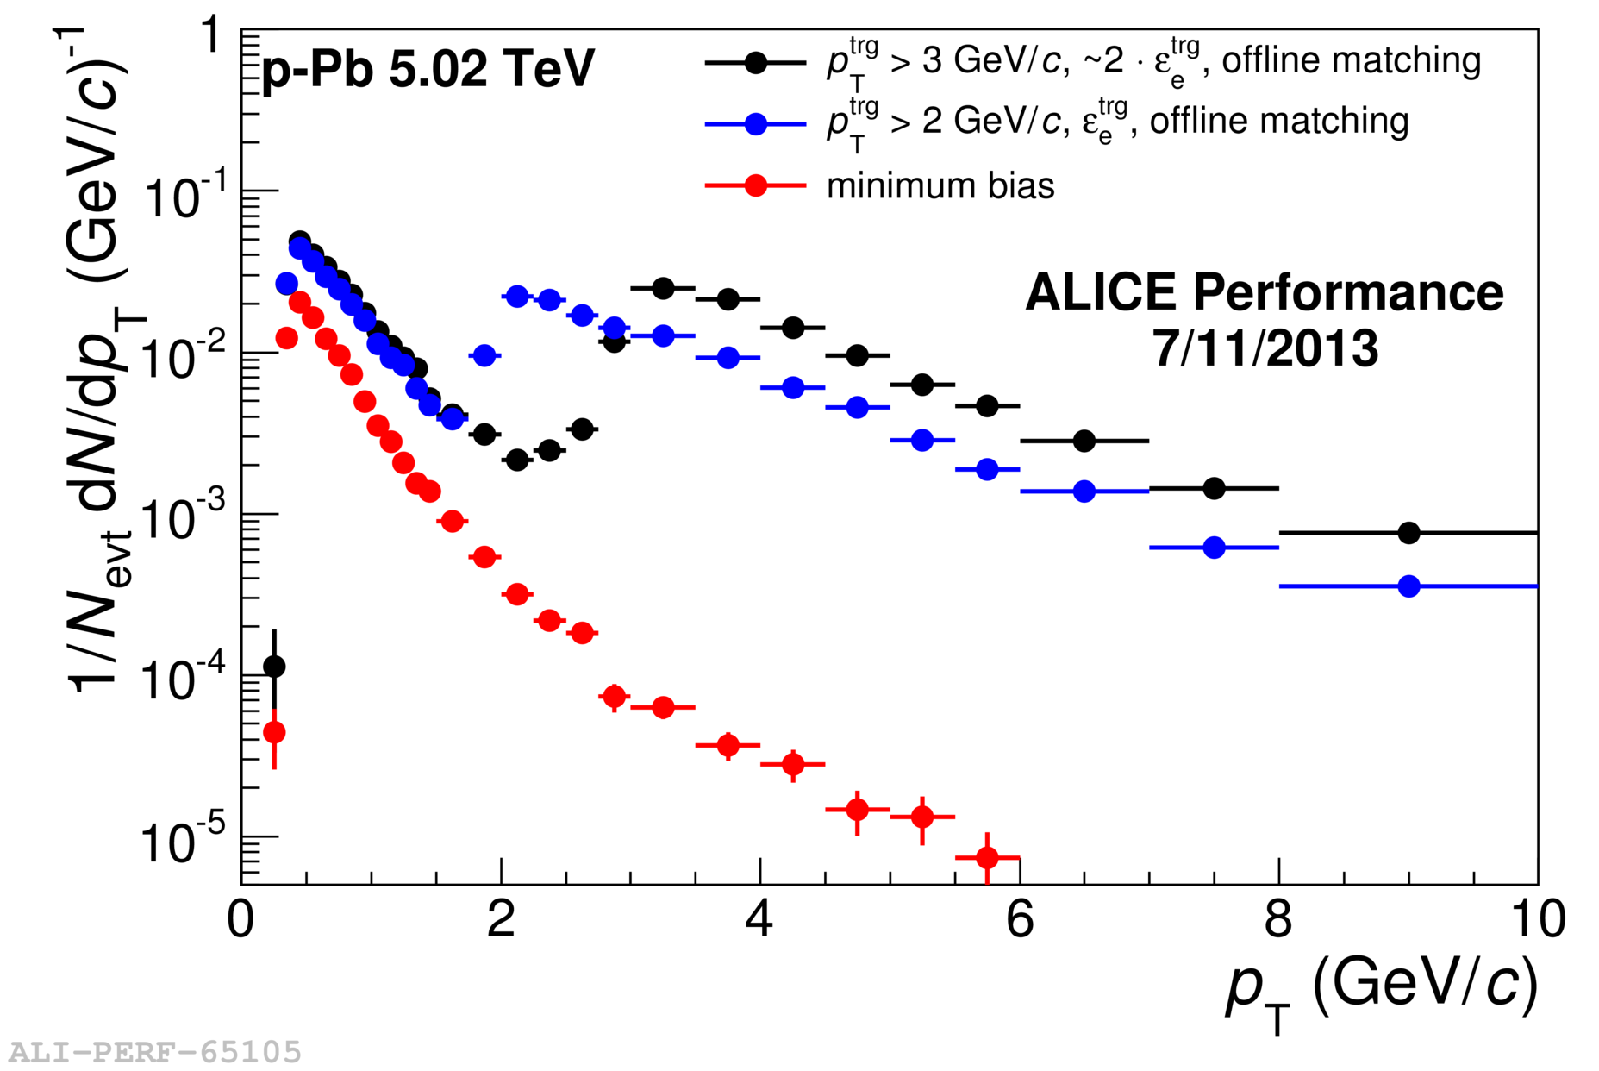
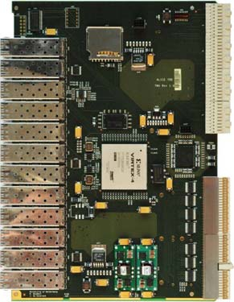
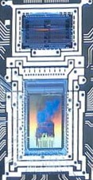
TRD Electron Trigger
Front-End Electronics
70000 ASICs
tracklet reconstruction
tracklet particle ID
Global Tracking Unit
109 FPGAs
track reco using tracklets
combined PID
trigger decision
Triggers in p-Pb run 2013
high-p_{T} electrons (high eff.)
low-p_{T} electrons (less eff.)
jets

Slide 28
ALICE Long Term Plan
CERN-LHCC-2012-012
Main goal: inspect 100x more events
focus on unique selling points:
  thermalisation and energy loss of
  heavy quarks (c,b)
  low-momentum quarkonium
  dissociation and regeneration
  photons and low mass dileptons
  anti- and hyper-nuclei
complementary to ATLAS and CMS
LHC: high luminosity running after 2018 “HL-LHC”
Pb-Pb: max. interaction rate 8 kHz → 50 kHz

Slide 29
New ITS
higher readout rate
current: 1 kHz
planned:
  50 kHz Pb-Pb
  several 100 kHz pp
  triggered or
  continuous RO
smaller material budget
reduced BG from photon conversions
better vertex resolution
closer to beam line
improve D-meson measurements

Slide 30
TPC Rate Limitations
gating grid
  open during drift time to allow electrons into MWPC
  closed afterwards to prevent ion back-flow
  limits readout rate to 3.5 kHz
opening GG permanently not possible
  ion back flow creates large space charge
  space point distortions up to 1 m – not tolerable

Slide 31
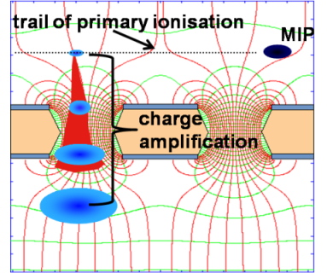
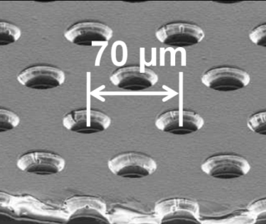
TPC Upgrade
replace MWPCs with GEMs
no gating
continuous operation
small ion back-flow
continuous readout
sample at 10 MHz (7 TB/s)
ship zero-suppressed raw data stream to DAQ (1 TB/s)
continuous stream – no “events” in FEE
R&D ongoing
promising test run 2012/13
investigation of gain stability

Slide 32
Challenge: Data Volume
Detector | Event Size | Bandwidth @50 kHz Pb-Pb (GByte/s)
 | After Zero Suppression (MByte)
TPC | 20.0 | 1000
TRD | 1.6 | 81.5
ITS | 0.8 | 40
Others | 0.5 | 25
Total | 22.9 | 1146.5
Massive data volume reduction needed
Only option is by online processing

Slide 33
TPC Data Volume Reduction
 | Data Format | Data Reduction Factor | Event Size (MByte)
 | Raw Data | 1 | 700
FEE | Zero Suppression | 35 | 20
HLT | Clustering & Compression | 5-7 | ~3
 | Remove clusters not associated to relevant tracks | 2 | 1.5
 | Data format optimization | 2-3 | <1
TPC data volume reduction by online event reconstruction
Discarding original raw data
In production from the 2011 Pb-Pb run
some optimization still needed
HLT Pb-Pb 2011

Slide 34
Total Data Volume
Detector | Input to Online System (GByte/s) | Peak Output to Local Data Storage (GByte/s) | Avg. Output to Computing Center (GByte/s)
TPC | 1000 | 50.0 | 8.0
TRD | 81.5 | 10.0 | 1.6
ITS | 40 | 10.0 | 1.6
Others | 25 | 12.5 | 2.0
Total | 1146.5 | 82.5 | 13.2
LHC luminosity variation during fill and efficiency taken into account for average output to computing center

Slide 35

O² Project
optimization and upgrade of all computing efforts necessary:
DAQ (data acquisition): handle data volume
offline: reconstruction and data analysis
HLT (High-Level Trigger): online reconstruction and data reduction
common effort: Online-Offline project
close collaboration
15 computing working groups (CWG):
overall system, computing platforms,
hardware, reconstruction, calibration,
software lifecycle…

Slide 36
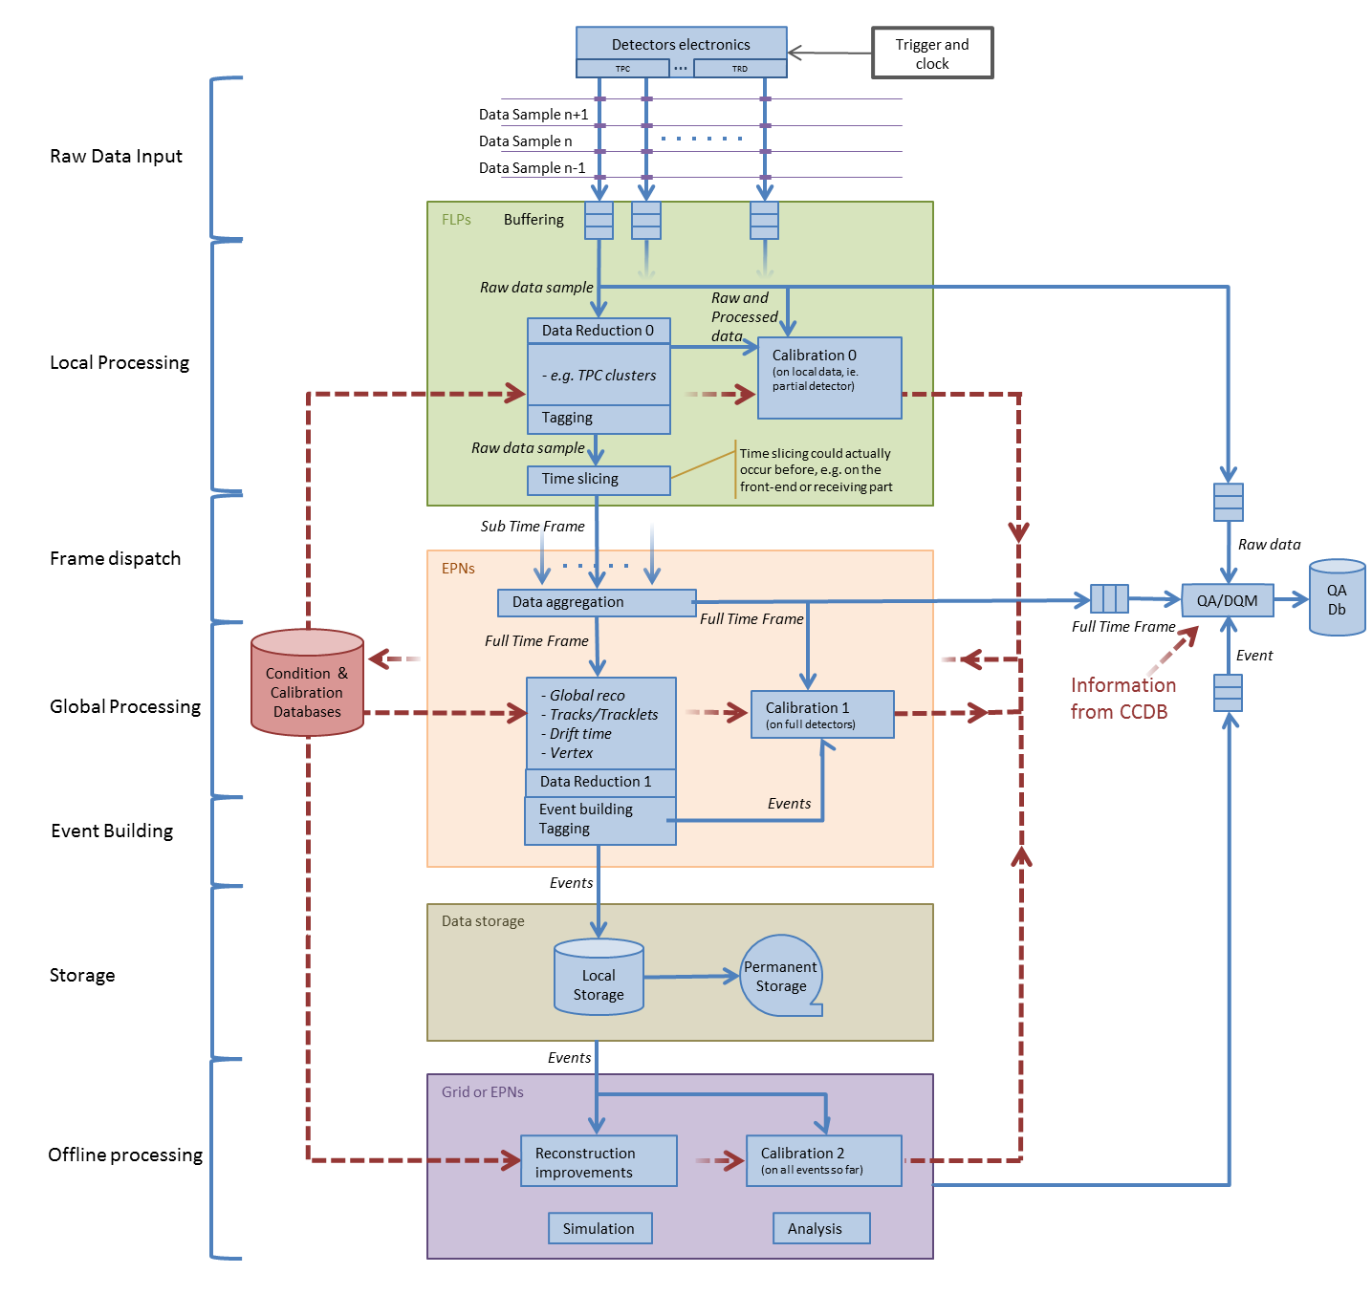
Dataflow Model

Slide 37
Dataflow Model
detector local processing
data reduction, e.g. cluster finding
time slicing → data from consecutive 100-1000 events
first calibration procedures

Slide 38
Dataflow Model
global processing
full online reconstruction
further data reduction
  using track info → keep only clusters on tracks
  keep sufficient information for re-processing with improved calibration
requires and provides online calibration

Slide 39
Dataflow Model
offline processing
improved reconstruction passes with better calibration
100x more events → tuning necessary
offline analysis
scaling to 100x more events?

Slide 40

O² Hardware System
ITS
FLP
Farm
Network
Storage
Network
10 Gb/s
2 x 10 or
40 Gb/s
10 Gb/s
TPC
FLP
EPN
~ 2500 links
in total
TRD
FLP
FLP
EPN
Data
Storage
EMC
PHO
FLP
Data
Storage
EPN
TOF
FLP
Muon
FLP
L0
L1
EPN
FTP
FLP
Trigger Detectors
~ 250 FLPs
First Level Processors
~ 1250 EPNs
Event Processing Nodes

Slide 41
Summary
Heavy-Ion Physics
bulk and hard probes to study deconfined state of nuclear matter – QGP
Present ALICE Setup
dedicated heavy-ion experiment
excellent PID capabilities
event based readout
trigger for jets, electrons, muons
ALICE Upgrade
100 times more statistics - recording of all events
major detector upgrades: TPC and ITS
must be accompanied my new online & offline computing
→ O² upgrade

