Slide 1
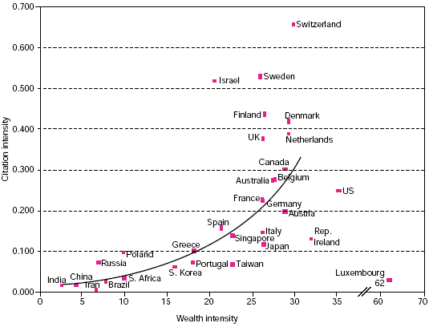

Slide 2
Funding of R&D
 | 2006/07 | 2007/08 | 2008/09 | 2009/10 | 2010/11
GERD (Rb) | 16.521 | 18.624 | 21.041 | 20.955 | 20.254
GERD (% of GDP) | 0.95 | 0.93 | 0.92 | 0.87 | 0.76
Public sector R&D spend (Rb) | 7.065 | 7.662 | 8.468 | 9.629 | 10.032
Private sector R&D spend (Rb) (including SOE) | 9.243 | 10.738 | 12.332 | 11.139 | 10.059
Public sector R&D spend (% of government budget) | 0.21 | 0.21 | 0.18 | 0.14 | 0.12
Public sector R&D spend (% of GERD) | 42.8 | 41.1 | 40.2 | 45.9 | 49.6
Private sector R&D spend (% of GERD)* | 55.9 | 57.7 | 58.6 | 53.2 | 49.7

Slide 3
Human capital provision
 | 2006/07 | 2007/08 | 2008/09 | 2009/10 | 2010/11
Headcount of R&D personnel | 58 706 | 59 334 | 58 895 | 59 494 | 55 531
Researchers (headcount of PhDs) | 6 973 | 7 756 | 8 143 | 8 498 | 7 456
Public sector researchers (headcount of PhDs) | 5 998 | 6 686 | 6 729 | 7 305 | 6 561
Private sector researchers (headcount of PhDs) | 942 | 1 032 | 1 368 | 1 143 | 839
Female researchers (% of all researchers)# | 39.7 | 40.3 | 39.7 | 40.8 | 42
Total FTE researchers per 1000 employees | 1.5 | 1.5 | 1.4 | 1.5 | 1.4

Slide 4
Research output

Slide 5
Impact of research output

Slide 6
PhD grads / million population

Slide 7
High-level HCD challenges (2)
Demographic drop-off
For 2010 | U/B | H | M | D
Number enrolled | 440 000 | 57 000 | 46 000 | 11 600
Number of graduates | 61 000 | 20 500 | 4 600 | 1 400
% of black enrolled | 73 | 79 | 65 | 58
% of female enrolled | 57 | 63 | 48 | 42
For 2012 | U/B | H | M | D
Number enrolled | 781 711 | 85 500 | 49 560 | 13 965
Number of graduates | 120 394 | 33 284 | 10 331 | 1 878
% of black enrolled | 83 | 78 | 66 | 60
% of female enrolled | 58 | 63 | 48 | 43
Presentation www.dst.gov.za

