Slide 1
ARM CPU Benchmarking
Robert Reed | University of the Witwatersrand
Notes:
We are living in a world more connected than ever before. I am not talking about internet access but rather mobile internet access.
Email, Instant messaging, Navigation and Information are literally at our fingertips.
This has all been made possible by a little guy in this Smartphone. The ARM processor.
My name is Robert Reed and I will be presenting a Benchmarking Characterization of ARM based processors.

Slide 2
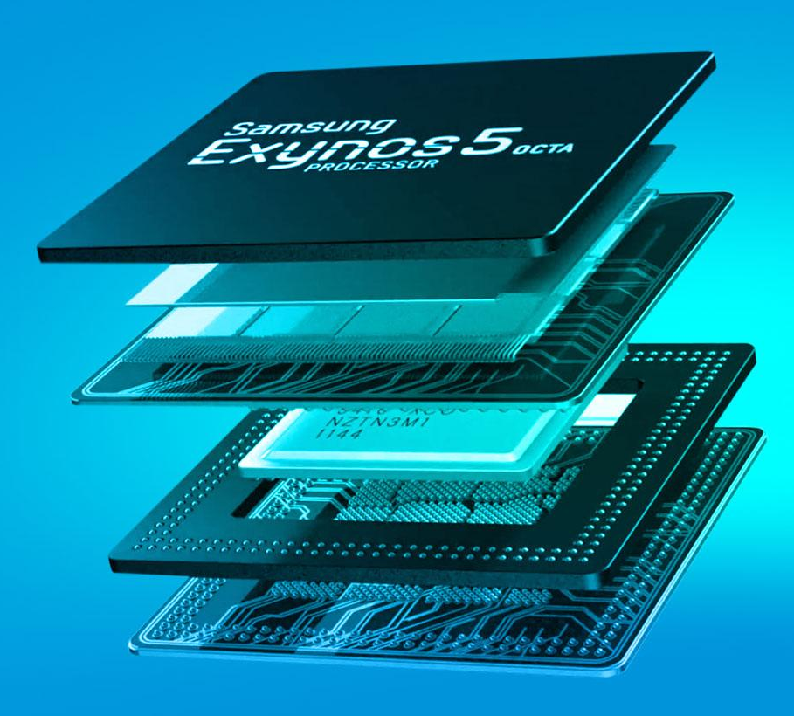
Introduction
What is an ARM Processor
Advanced RISC Machine
Where is it being used
95% of Smartphone Market
Consumer Products
Supercomputers
(K-Supercomputer Japan - RISC)
Why use them?
Power efficient
Low capital cost
2 Quad Cores in the Samsung S4
Notes:
Advanced RISC machine. Reduced instruction set computing. This was introduced in the 1970’s when IBM did a study which showed that 20% of the instructions being used were doing almost 80% of the work. Simpler instructions offer the potential of better performance and require less transistors and hence use less power.
This explains why they are largely being used in the Mobile Market. Almost 95% of smartphones today have ARM processors. Consumer products like tablets or digital televisions. RISC is even used in supercomputers such as the K-Supercomputer in Japan.
Since the ARM technology is being driven by the consumer market it results in the chips being quite inexpensive.

Slide 3
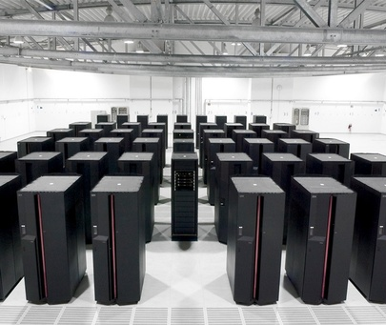
Introduction
How are we going to use ARMs
High-Throughput Supercomputer
Large numbers of ARMs = many cores = parallel
ARMS
$
X86
$$
$$
$
Problem
Solution
China’s Tianhe-2
Notes:
Our ultimate goal is to build an affordable high through-put supercomputer. Why use ARM processors?
We know that they are not as powerful as Intels or AMD’s. So that means we need more chips to reach a comparable performance. The more arms, the more cores, the better for parallel computing.
Tianhe-2 is currently ranked #1 on the TOP500 supercomputing list. It consumes almost 24 MW of power at an estimated $20 million a year.
The Green500 is a list dedicated to performance per Watt where the performance is measured in floating point operations per second (FLOPS) and the Tianhe-2 attains 1.42 GFLOPS/Watt.
Looking at the #1 on the Green500 which has 4.5 GFLOPS/Watt it is over 3 X more efficient. Theoretically this could reduce the cost down to $6.5 million per year.
Using ARMs (which are designed with power in mind from the ground up) it now makes High throughput supercomputing affordable and accessible.

Slide 4
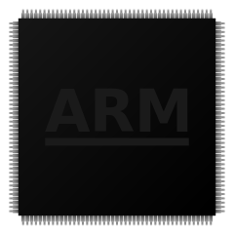
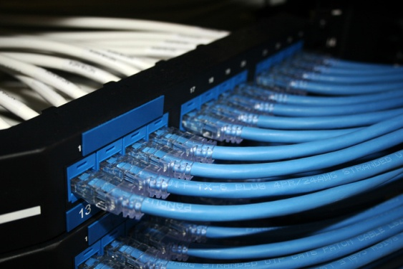
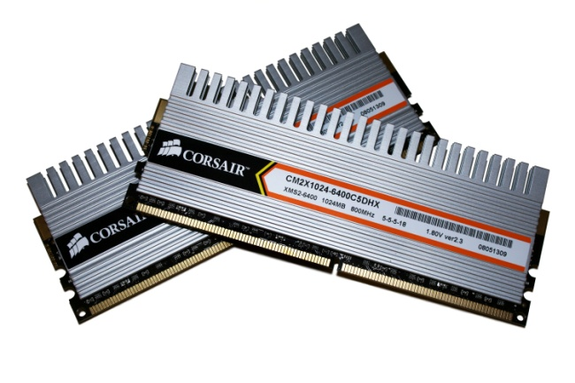
Benchmark Selection
Characterising the ARM architecture
The main factors to look at:
CPU
Cache
RAM
Connectivity
Notes:
But before we start building a high throughput supercomputer we need to learn how to crawl before we start running.
We need to characterise the ARM architecture.
The main factors to look at CPU Cache … And connectivity is not just Ethernet but also the interconnection between the RAM and CPU and physical layout for example.
As the title of this presentation suggests Ill be focusing on the CPU.

Slide 5
Benchmark Selection
CoreMark by EEMBC
Supported by ARM Holdings
Uses common algorithms
Strict submission rules
Notes:
To gain an understanding of the overall performance we are using a program called CoreMark. Firstly it is supported by ARM holdings so we tend to trust the benchmark.
It uses 4 common algorithms in real world problems and performs iterations of these tests. The result is then displayed as Iterations per second. This allows one to compare across different platforms.
Using different combinations of compiler flags showed that the GCC compiler was better at tuning code for the A7 than the A9. The A9 is a 2008 model and was the first armv7-a platform which means there is little room for tuning to that specific core. The a7 is newer and has more functionality.
CoreMark also has Strict submission rules. One being the test must run for 10 seconds or more we can see from the graph on the right that at 10s we are well on the plateau. This means that the database of CoreMark results is a good standard to compare platforms against one another.

Slide 6
Results - Coremark
1x Intel i7 3930K
1 X $630
130 W
6 Cores
14x Cortex A9
14 X $60 = $840
56 W
56 Cores
Notes:
To make the comparison more fair I am normalising the Coremark to the number of cores used as well as the frequency of the cpu. The first two results are our own recorded values and the rest are from the online database. I have compared them to the high end Atom CPU and two Intel i7 cores. One being a Quad Core and the other being the top of the range Hexa Core.
We can clearly see the i7’s dominate in terms of pure performance. Overall its 14 X more powerful than the A9 and about 30 X more powerful than the A7. If we look at normalised CoreMark its about 3 times more powerful than the A9 and similarly for the A7.
Interestingly if we look at the Normalised CoreMark per Watt then we see how the ARMs far out perform the i7’s.
So if we take 14 A9’s to match the performance of the I7 then we end up paying more for the initial cost but we will use only 40% of the energy. We also end up with 56 Cores as apposed to the 6. This leads us back to the idea that many cores are better for high throughput computing.

Slide 7
Benchmark Selection
High Performance LINPACK by Jack Dongarra
Used in TOP500 list
Notes:
CoreMark gives an over all performance index for the cpu but not the number of calculations it can achieve per second. For this we turn to High Performance Linpack.
This benchmark was introduced by Jack Dongarra and is currently used as the metric for the Top500 supercomputer list. As a result its well understood. Linpack is extremely system dependant and must be specifically tuned for the hardware its run on. This means we can extract a peak performance out of the hardware we are investigating. The performance is measured as the number of Floating Point Operations Per Second or FLOPS.
Unlike with CoreMark the compiler flags didn’t seem to make much of a difference. Only about 1.6% increase from worst case to best case. This is probably due to the fact that the work is done by the math libraries and not the code of HPL itself. So using different flags affects the way we call those libraries and not the libraries themselves.
HPL solves a N x N matrix and the size of this is limited by the available RAM. Similarly to CoreMark we can see for small problem sizes that there is large overheads but it does not reach a plateau. Its logarithmic. We use this fact to decrease the problem size when tuning the program so the tests run faster and we lose little performance.

Slide 8
Understanding the benchmarks
Math Libraries
Linear Algebra Package (ATLAS)
Improvement: Almost 30%
Compile time: Approx 22 hours
Notes:
I mentioned that the Math Libraries are doing all the grunt work. So naturally using a better library will increase performance. We used the Advanced Tuning Linear Algebra Software (ATLAS) has nothing to do with CERN, as its name suggests it tunes the library according to the system it is compiling on. Since we are compiling on an ARM processor its incredibly slow. Approximately 22 hours to compile once but showed an improvement of over 30%.
If we want to determine the affects caused by different compiler flags then this is the place to do it. There is one reasons why we did not. To compile 16 different ATLAS versions on all boards would take almost a month and we didn’t have the time. So we settled for similar flags to the ones we used in CoreMark.

Slide 9
Results - HPL
Cortex A7
0.753 GFLOPS
Cortex A9
2.382 GFLOPS
Intel I7 3930k
125 GFLOPS
0.264 GFLOPS/Watt
0.471 GFLOPS/Watt
0.961 GFLOPS/Watt
Notes:
At first glance it looks quite dismal but we must remember that we are not trying to out perform current CPU’s one on one. The whole idea is to use more ARMs to reach a comparable speed and thus have more cores to parallelise a problem. We knew that they were not going to be anywhere near the Intel I7s so this wasn’t a shock.
What is interesting though is that the Cortex A9 is a 2008 model, so it is 6 years old, and it is achieving half the GFLOPS/Watt of the Intel i7. Imagine what the new ARM cpu’s will do in the next year or so.

Slide 10
Results - HPL
Cortex A7
1.696 GFLOPS
Cortex A9
4.428 GFLOPS
0.595 GFLOPS/Watt
0.876 GFLOPS/Watt
Notes:
I mentioned briefly that HPL tested using double precision. Some applications such as Radio Astronomy can use single precision. So how does the ARM respond to single precision.
The answer is very well! This is largely due to the NEON extension. The performance is more than doubled and we can see that the performance/watt also increased from the double precision. I mentioned earlier that the math libraries did the work so it made sense to compile ATLAS with the correct flags for single and double precision.
With the improvement of ARMs we expect to see a double precision version of this NEON extension. This will dramatically increase the performance of these chips.

Slide 11
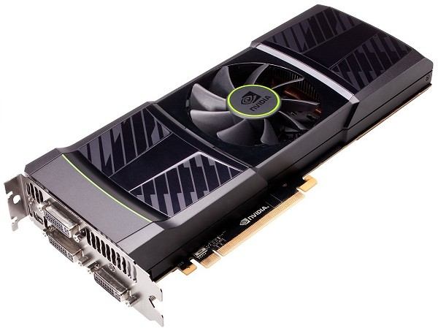
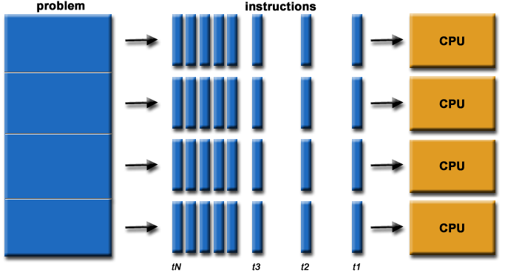
Conclusion
Great for high throughput
Energy Efficient
Need better performance
GPU co processing
Problem Specific
Notes:
What can we conclude. By combining multiple ARMs together to get comparable speeds such as in the CoreMark case we find ourselves with a large number of cores. This lends itself to promote parallel computing and at higher energy efficiency.
However, looking at the HPL results show that there is still some improvements that need to be made. Even for high throughput the smaller problems may still require complex calculations. A possible solution would be to use the in built GPU’s as co processors which would give a significant boost to the floating point operations and this is something we are currently looking into. It also shows that the applications in question is critical. Some applications will promote parallelising and some will not.
With the coming of new cpus such as the Cortex A50s we expect a new era of high throughput computing.

Slide 12
ARM CPU Benchmarking

Slide 13
ARM CPU Benchmarking
BACKUP SLIDES
Notes:
We are living in a world more connected than ever before. I am not talking about internet access but rather mobile internet access.
Email, Instant messaging, Navigation and Information are literally at our fingertips.
This has all been made possible by a little guy in this Smartphone. The ARM processor.
My name is Robert Reed and I will be presenting a Benchmarking Characterization of ARM based processors.

Slide 14
Layout
Physical Layout
A7
Cubieboard
Server
Switch
X5
INTERNET
X5
A9
Wandboard
X1
A15
ODroid

Slide 15
CoreMark Flags
Cortex A7 Flag Testing
Test | Floating Point | Neon AutoVec | Optimisation | -mfpu | -march | -mtune | -mcpu
0
1 | mfloat-abi=hard | ffastmath | O2 | neon-vfpv4 | armv7-a | cortex-a7
2 | mfloat-abi=hard | ffastmath | O2 | neon-vfpv4 | armv7-a
3 | mfloat-abi=hard | ffastmath | O2 | neon-vfpv4 |  | cortex-a7
4 | mfloat-abi=hard | ffastmath | O2 | neon-vfpv4 |  |  | cortex-a7
5 | mfloat-abi=hard | ffastmath | O2 | neon | armv7-a | cortex-a7
6 | mfloat-abi=hard | ffastmath | O2 | neon | armv7-a
7 | mfloat-abi=hard | ffastmath | O2 | neon |  | cortex-a7
8 | mfloat-abi=hard | ffastmath | O2 | neon |  |  | cortex-a7
9 | mfloat-abi=hard | ffastmath | O3 | neon-vfpv4 | armv7-a | cortex-a7
10 | mfloat-abi=hard | ffastmath | O3 | neon-vfpv4 | armv7-a
11 | mfloat-abi=hard | ffastmath | O3 | neon-vfpv4 |  | cortex-a7
12 | mfloat-abi=hard | ffastmath | O3 | neon-vfpv4 |  |  | cortex-a7
13 | mfloat-abi=hard | ffastmath | O3 | neon | armv7-a | cortex-a7
14 | mfloat-abi=hard | ffastmath | O3 | neon | armv7-a
15 | mfloat-abi=hard | ffastmath | O3 | neon |  | cortex-a7
16 | mfloat-abi=hard | ffastmath | O3 | neon |  |  | cortex-a7

Slide 16
CoreMark Comparisons
 | Our Results |  | Reported Results
Processor | Cortex A7 | Cortex A9 | Cortex A9 DB | Atom N2800 | Intel i7 2600 | Intel i7 3930k
Frequency | 1000 | 996 | 996 | 1860 | 3392 | 3200
Cores | 2 | 4 | 4 | 2 | 4 | 6
Power (Watts) | 2.3 | 3.65 | 3.65 | 6.5 | 95 | 130
CoreMark | 4859.97 | 11323.34 | 10370.75 | 12286.9 | 99562.34 | 150962.39
CoreMark/Core | 2429.99 | 2830.84 | 2592.69 | 6143.45 | 24890.585 | 25160.4
CoreMark/MHz | 4.86 | 11.37 | 10.41 | 6.61 | 29.35 | 47.17
CoreMark/Core/MHz | 2.43 | 2.84 | 2.60 | 3.30 | 7.34 | 7.86
CoreMark/Core/MHz/Watt | 1.06 | 0.78 | 0.71 | 0.51 | 0.08 | 0.06

Slide 17
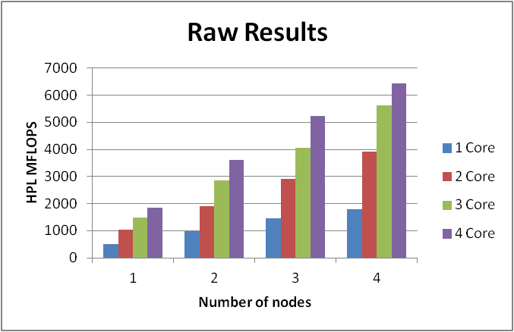
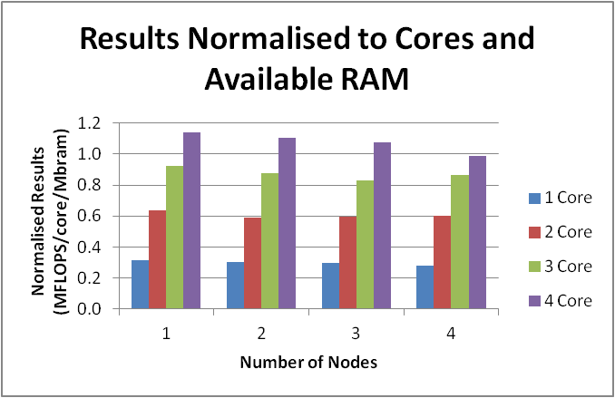
Results - HPL
Scalability – 4x A9
Raw results
Cores | Nodes
 | 1 | 2 | 3 | 4
1 | 509.4 | 984.5 | 1452.0 | 1803.0
2 | 1030.0 | 1915.0 | 2905.0 | 3908.0
3 | 1497.0 | 2854.0 | 4052.0 | 5626.0
4 | 1851.0 | 3595.0 | 5239.0 | 6437.0
Problem Size | 14592.0 | 20672.0 | 25280.0 | 29184.0
Total Problem MB | 1624.5 | 3260.3 | 4875.8 | 6498.0

Slide 18
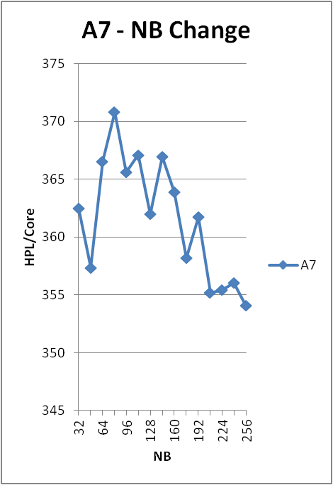
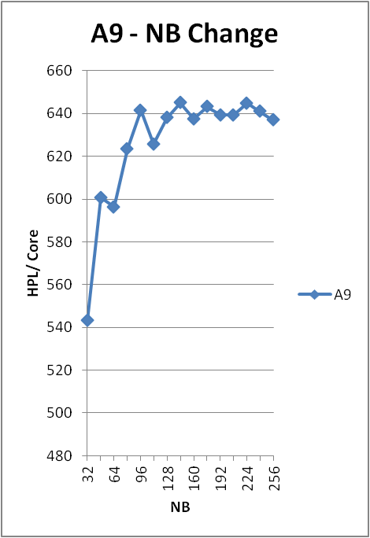
Results - HPL
Block Size
 | A7 | A9
Peak NB | 80 | 144

Slide 19
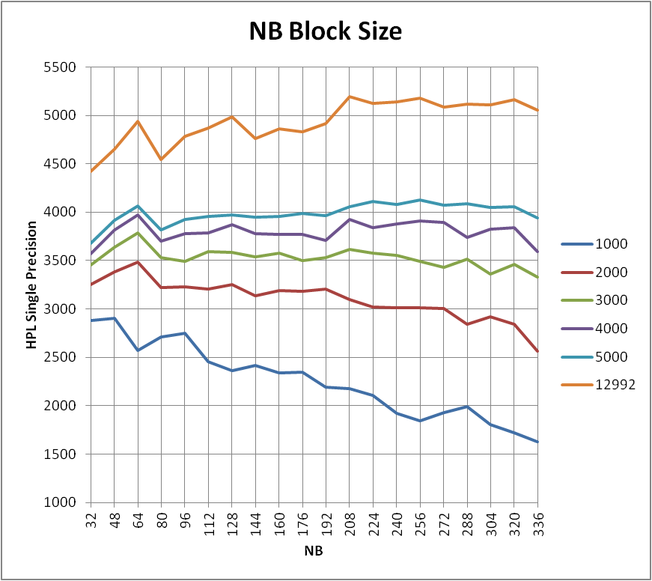
Understanding the benchmarks
Changing Block Allocation NB
NB test for the A9
Dependant on array size
Larger array = large NB
Dependant on whole system
Notes:
Backup

Slide 20
Results - HPL
Multi Precision
Total RAM | Cortex A9 |  |  | Cortex A7
1972 | ATLAS-vfpv3d16 | ATLAS-neon | % Improved | ATLAS-vfpv4d16 | ATLAS-neonvfpv4 | ATLAS-neon | % Improved
Real Single | 4.184 | 4.602 | 9.990% | 3.170 | 3.280 | 3.286 | 3.659%
Real Double | 2.335 | 2.272 | 2.773% | 1.315 | 1.439 | 1.398 | 9.430%
Complex Single | 4.363 | 4.835 | 10.818% | 3.374 | 3.113 | 3.213 | 8.384%
Complex Double | 2.470 | 2.502 | 1.296% | 1.251 | 1.355 | 1.363 | 8.953%
Old Complex Double | 2.519 | 2.55 | 1.231%
Notes:
I mentioned briefly that HPL tested using double precision. Some applications such as Radio Astronomy can use single precision. So how does the ARM respond to single precision.

Slide 21
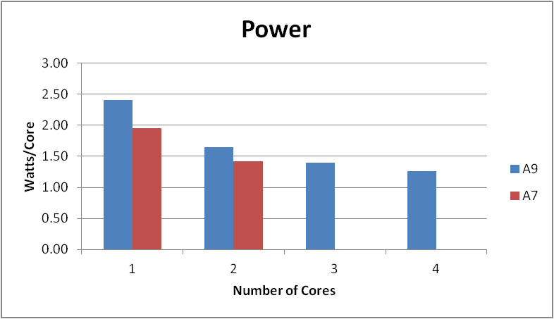
Results - HPL
Power Measurements
A9 |  |  |  |  | A7
Voltage | 5 | V |  |  | Voltage | 5 | V
Resistor | 0.01 | Ohms |  |  | Resistor | 0.01 | Ohms
IDLE | 2.5 | mV |  |  | IDLE | 2.3 | mV
Cores | 1 | 2 | 3 | 4 | 1 | 2
mVolts | 4.80 | 6.60 | 8.40 | 10.10 | 3.90 | 5.70
Amps | 0.48 | 0.66 | 0.84 | 1.01 | 0.39 | 0.57
Watts | 2.40 | 3.30 | 4.20 | 5.05 | 1.95 | 2.85
Watts/core | 2.40 | 1.65 | 1.40 | 1.26 | 1.95 | 1.43
Notes:
Mention flops/watt

