Slide 1


The ATLAS Computing Model
Sahal Yacoob
UKZN
On behalf of the ATLAS collaboration

Slide 2
Outline
The Large Hadron Collider
The ATLAS experiment
The Tiers concept
The current ATLAS analysis computing model
Updates for the Future

Slide 3
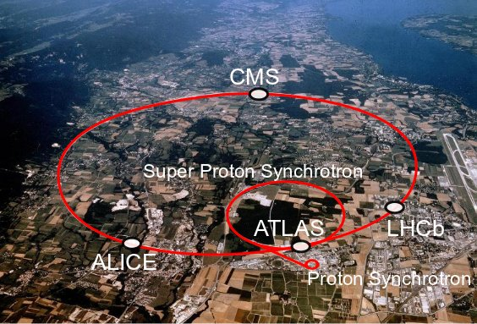
The LHC
Notes:
27 Km’s 100 m down
7 TeV / 8 TeV 13 / 14 TeV 2015

Slide 4
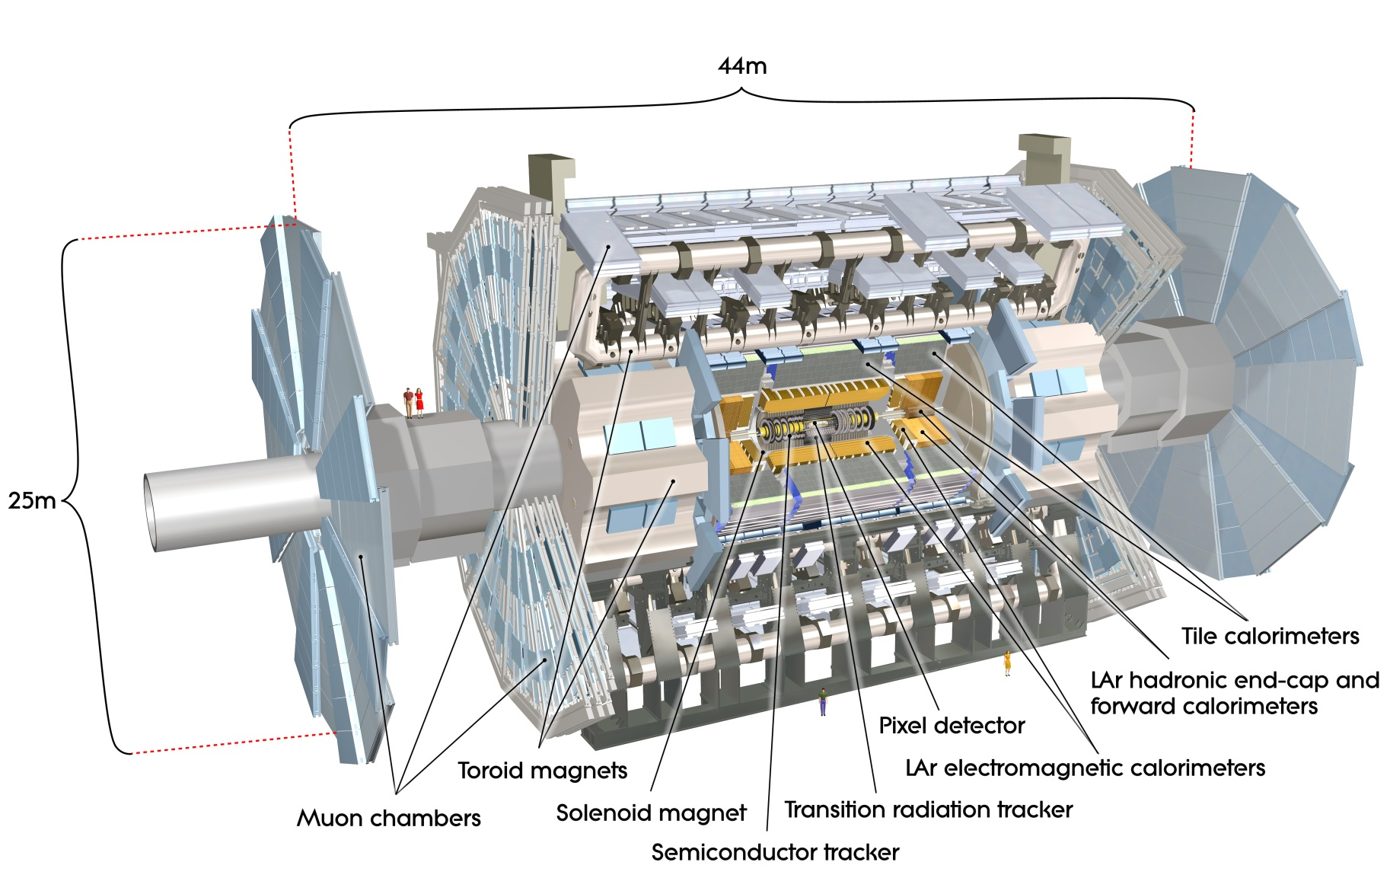
The ATLAS Detector

Slide 5
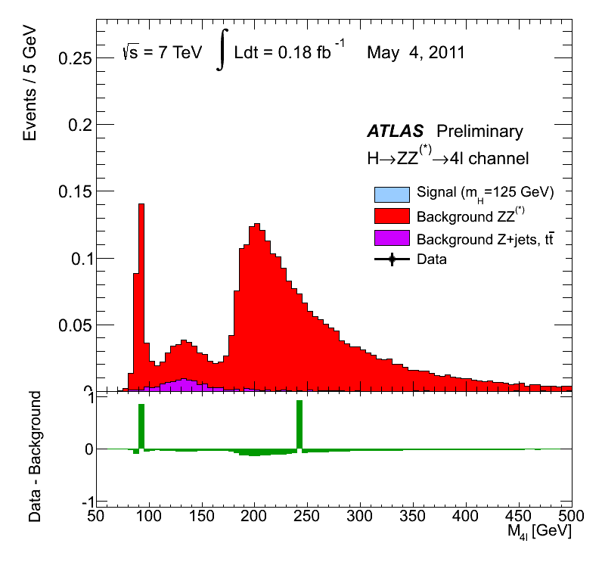
The most famous ATLAS result

Slide 6

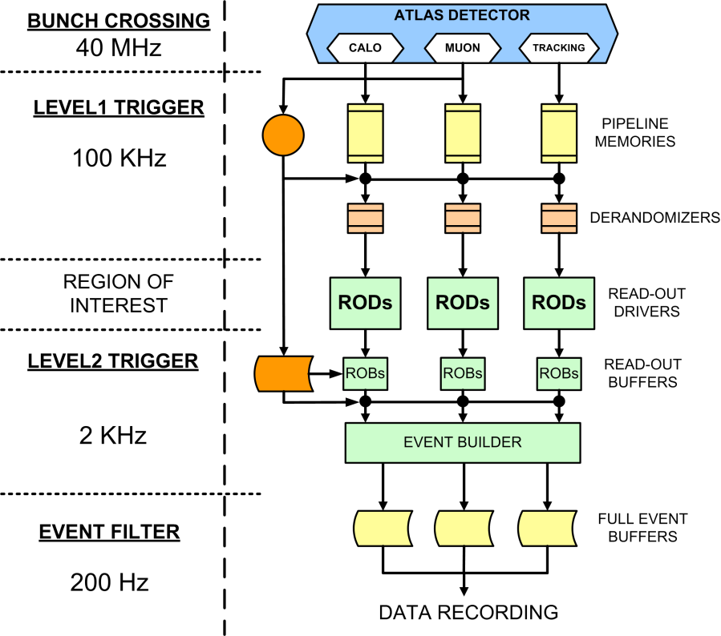
ATLAS Data Acquisition
Design Values
See Alberto Valero’s Talk tomorrow
Notes:
Approximately 300 MB/s

Slide 7
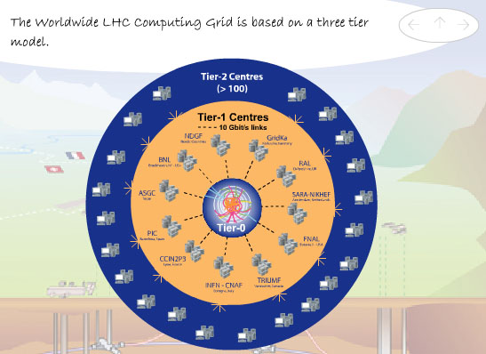
Distributed Computing Resources
ATLAS V0 Structure
CERN (Tier 0)
12 Tier 1 sites
Notes:
CA / CERN / DE / ES / FR / IT / ND / NL / TW / UK / US
Sites do storage and analysis

Slide 8
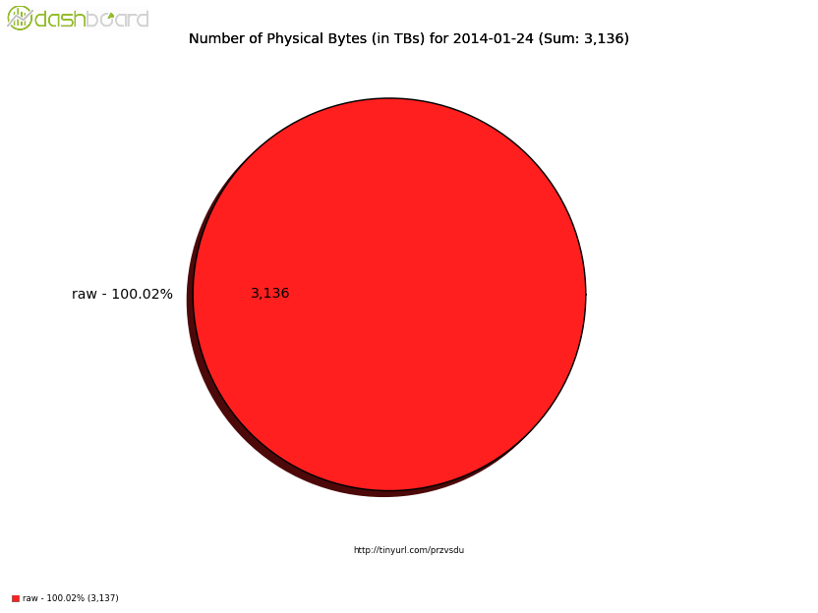
ATLAS Data
Raw Data (300MB/s)
Is transferred to ‘Tier 0’ Storage at CERN via a dedicated 10 Gb/s connection for reconstruction
Design Values
400 Hz
Tier 0
Notes:
Approximately 300 MB/s

Slide 9
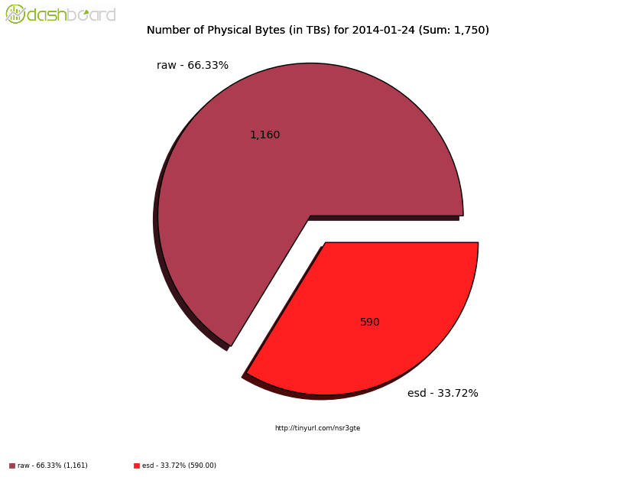
ATLAS Data
The Raw Data (~1.7 – 1.1 MB/ event) is reconstructed to a temporary data format called Event Summary Data (approximately 1 MB/event)
Initial Production at T0. Copies of Raw and ESD sent to T1’s
ESD are remade at T1’s
Design Values
400 Hz
Tier 0
Notes:
Initial production at CERN T0

Slide 10
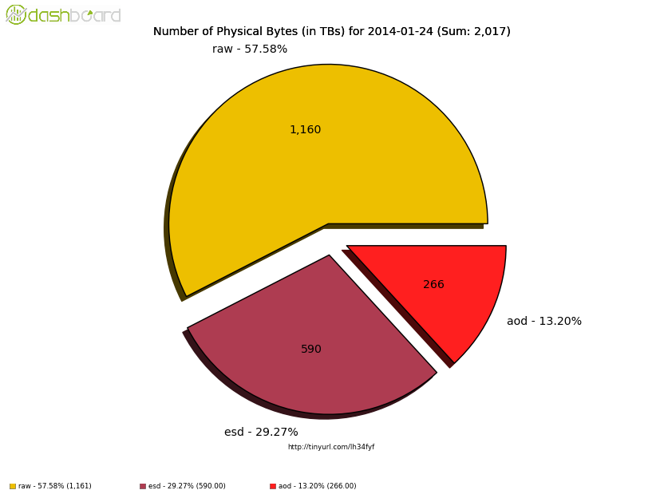
ATLAS Data
ESD (~1 MB/event) is then converted again to Analysis Object Data (~0.1 MB/event). AOD was the initial format for planned data analysis using ‘Athena’
Design Values
400 Hz
Tier 0
Notes:
Approximately 300 MB/s

Slide 11
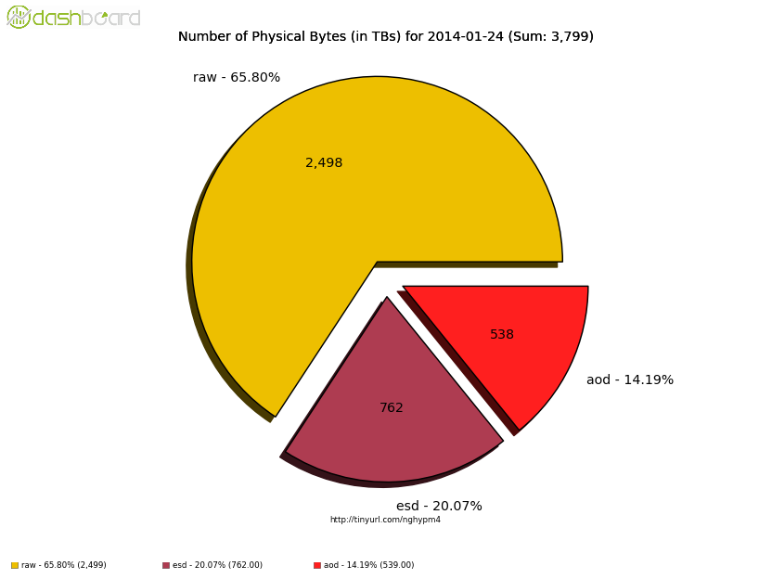
ATLAS Data
ESD (~1 MB/event) is then converted again to Analysis Object Data (~0.1 MB/event). AOD was the initial format for planned data analysis using ‘Athena’
Tier 0
Tier 1
Notes:
Approximately 300 MB/s

Slide 12
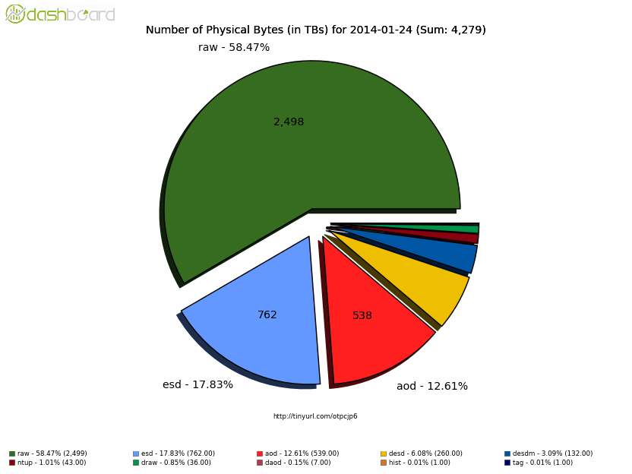
ATLAS Data
Analysis is actually done on derived data formats, using either ROOT or Athena – but mainly ROOT to perform analyses.
The derived data formats are usually skimmed with a particular class of event, and specialised for a particular goal
Tier 0
Tier 1
Tier 2/3
Notes:
Approximately 300 MB/s

Slide 13
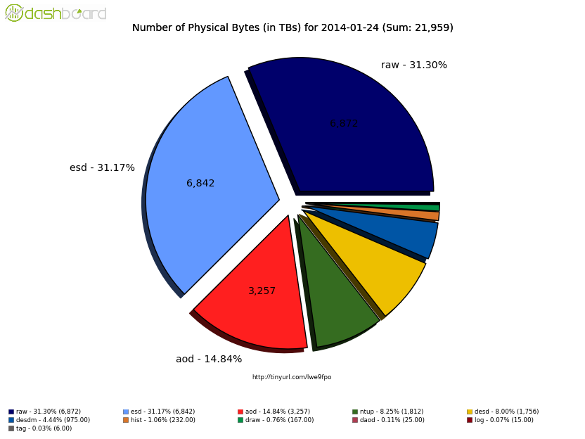
ATLAS Data
Analysis is actually done on derived data formats, using either ROOT or Athena – but mainly ROOT to perform analyses.
The derived data formats are usually skimmed with a particular class of event, and specialised for a particular goal
Tier 0
Tier 1
Tier 2/3
Notes:
Approximately 300 MB/s

Slide 14
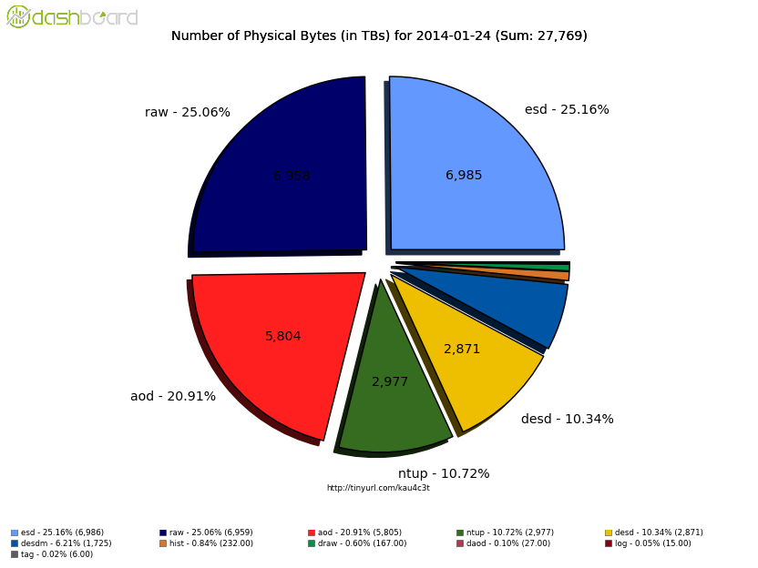
ATLAS Data
Analysis is actually done on derived data formats, using either ROOT or Athena – but mainly ROOT to perform analyses.
The derived data formats are usually skimmed with a particular class of event, and specialised for a particular goal
Tier 0
Tier 1
Tier 2/3
Notes:
Approximately 300 MB/s

Slide 15
Site Storage
The Data available at each grid site are accessible via a Storage Element (SE)
  There are many implementation options
  XRootD is favoured and is capable of managing resources across different locations.
Tracking of data has been via LFC (LHC File Catalogue) which links physical file names to logical file names
  This is changing to a ‘hashing’ method where there is a deterministic function that allows for transformation between names without a catalogue
  This requires that files stored using LFC need to be renamed – this is one of the activities during the shutdown

Slide 16
Distributed Data Management
DQ2
Rucio
150 PB
130 Grid Sites
~1500 Users
0.6 M files downloaded daily
DQ2 has scaling and functional limitations such that it will not be able to meet future data management needs
New and Better
  No increase of database latency
  Global management of space
  Automatic management of data subscriptions according to predefined rules,

Slide 17
A Standard Run 1 Analysis Model

Slide 18

Analysis happens at the data
since the analysis executable is usually relatively small compared to the size of a data sample
Each site on the on the grid that is part of the ATLAS VO publishes it’s available resources (hardware, and software) as well as the data that are subscribed there
  Data can be moved to a particular site by a user with appropriate authority
A user will submit their analysis via PanDA (Production and Distributed Analysis System) listing the required resources and the input and output dataset names.
The code is compiled at the job site, and the output dataset can be copied back to the user.

Slide 19



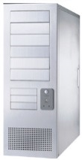
PanDA System Overview
Production
managers
PanDA server
Data Management
System (DQ2)
production
job
https
Local
Replica
Catalog
(LFC)
Local
Replica
Catalog
(LFC)
Local
Replica
Catalog
(LFC)
submitter
(bamboo)
https
https
define
Logging
System
task/job
repository
(Production DB)
pull
https
https
https
NDGF
analysis
job
pilot
https
OSG
job
pilot
submit
arc
EGEE/EGI
ARC Interface
(aCT)
pilot
condor-g
End-user
pilot
scheduler
(autopyfactory)
Worker Nodes

Slide 20
Workflow
Storage
Element
PanDA server
source files
User
input
dataset
container
binary
jobset
jobsubset
output
dataset
container
compile job
output dataset
outputs
execution job
inputs
outputs
execution job
inputs
outputs
execution job
inputs
output dataset
produced by
another jobsubset
at another site
input datasets

Slide 21
Panda Job distribution
  A jobset may be split to be brokered to multiple sites
    jobset → jobsubsets → jobs
    output dataset container → output datasets
    → output files
    One jobsubset per site
Matchmaking per site without cloud-boundaries
  Scratch disk size on WN
  Memory size on WN
  Software availability
  Downtime
  Occupancy
  = the number of running jobs / the number of
  queued jobs
  Availability of input datasets

Slide 22
Simulation Overview
An important part of our ability to extract physically meaningful information from our reconstructed data is comparison with simulated data samples
Event Generation
  The physics processes that take place prior to interaction with the detector
Simulation
  Simulating energy deposits and movement of generated particles through the detector.
  Accurate simulation may require overlay of multiple Generated events
Digitisation
  Simulation of the electronic readout
Reconstruction of Physics objects

Slide 23
Event Generation
~ 50 Different generators used
~ 34 000 samples produced in 2012
100MB output file size (5000 events per job)

Slide 24
Reconstruction
Simulation
Propagation of stable particles through the detector handled by GEANT 4
~ 10 minutes per event
  Majority of time spent in Calorimeter
  Consequently the calorimeter simulation of all particles except muons are described by a parametrised model
100 events per job → merged up to 1000 events for transfer and storage
Similar to Data:
  RAW →ESD→AOD

Slide 25
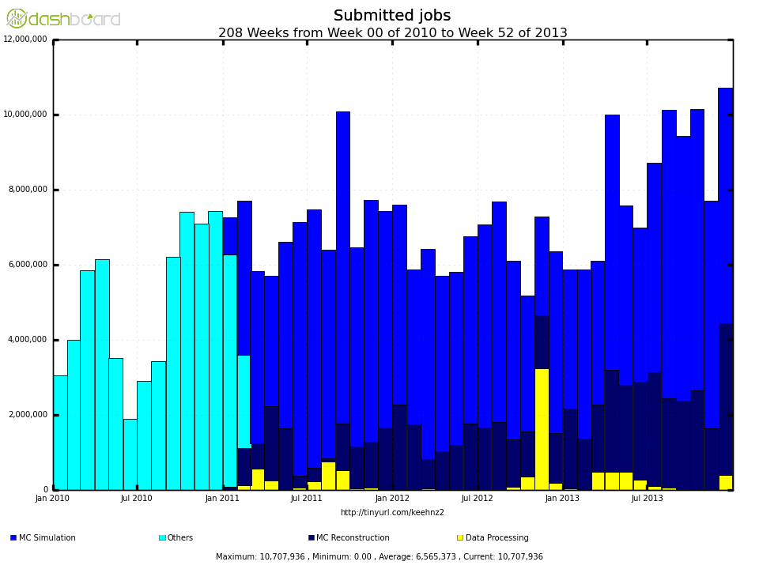
Simulation Production CPU Usage
Simulating the data is CPU intensive

Slide 26
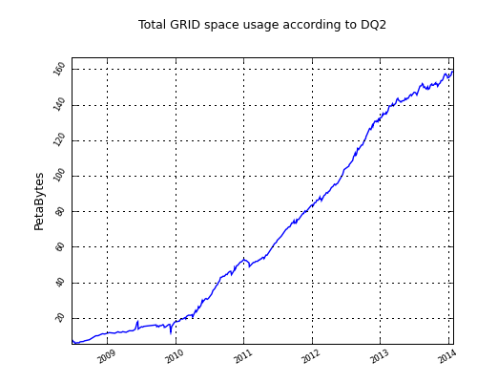
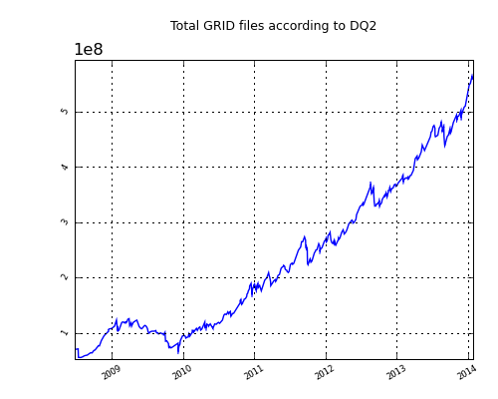
Over 150 PB of Data being managed

Slide 27
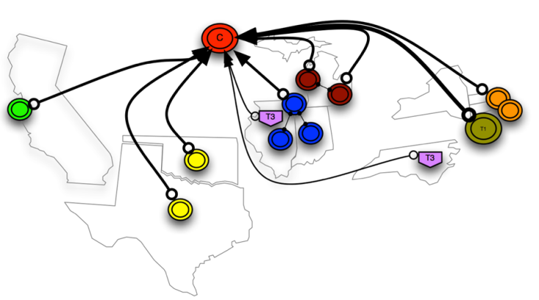
Developments– Federated Storage
A collection of disparate storage resources managed by cooperating but independent administrative domains transparently accessible via a common namespace.
Storage within a Cloud (T1, T2, T3) will be available across sites.
  Made possible be improvements in bandwidth and Latency and a data structure aware caching mechanism.
  Jobs access data via WAN (shared storage)
  Partial dataset transfers available
  Invisible to the user
  Fewer failures due to unavailable files
  Relaxed Data-CPU locality

Slide 28
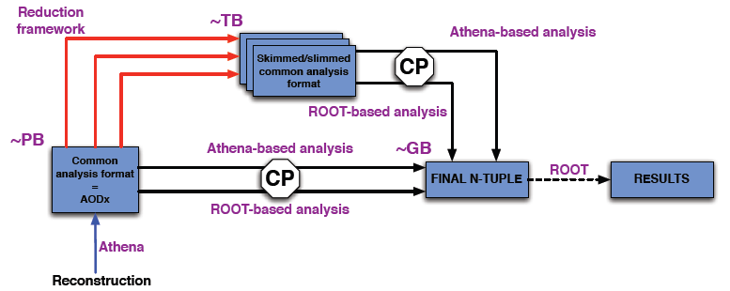
Run 2 Analysis Model

Slide 29
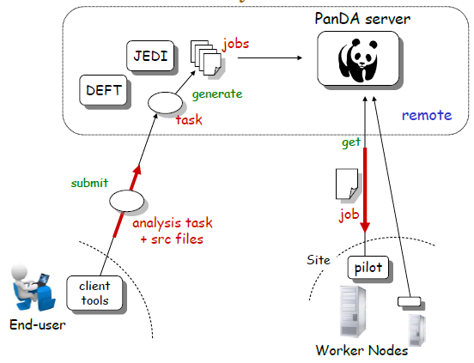
Developments – Production System
More efficient usage of
Grid resources
– Better retrial mechanism for failed jobs
– faster job submission times

Slide 30
2014 Estimated ATLAS computing requirements
 | 2014 Estimated requirement | 2013 resources provided | SA Contribution by author (1/300) | SA contribution as an institute (1/174)
CPU | 849 kHS06 | 669 kHS06 | 3 kHS06 | 4.9 kHS06
Storage | 100 PB | 84 PB | 300 TB | 575 TB
Re-processing | 29 kHS06 | 29 kHS06
Simulation Production | 511 kHS06 | 521 kHS06
Simulation reconstruction | 240 kHS06 | 181 kHS06
Analysis | 190 kHS06 | 170 kHS06
1 core ~ 5-8 HS06

Slide 31
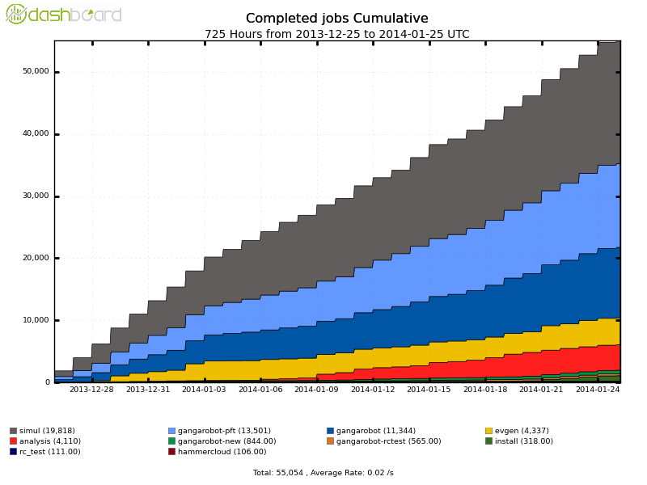
Resources in SA
First Successful ATLAS Grid job in Africa
JobID/Site : 4378/ANALY_ZA-WITS-CORE
Created : 2011-05-04 14:33:20 (UTC)
Ended : 2011-05-05 13:56:35 (UTC)
Total Number of Jobs : 1
Succeeded : 1
Available and in use (or meant to be in use)
  Cluster at UJ:
    10 TB 220 Cores (1.1 - 2.2 kHS06) 200 kB/s
  Cluster at Wits:
    32 TB, 130 Cores (0.65 -- 1.3 kHS06) 450 kB/s
  Total 1.75 – 3.5 kHS06 (we should provide between 3 and 5 kHS06)
Available and not in use:
  There is a grid enabled cluster at UCT
  CHPC resources
UKZN does not have a cluster on the grid

Slide 32
SA Specific Challenges
Geographically remote
Low Bandwidth
Ideal contribution to the ATLAS joint effort would be generating samples of simulated data.

Slide 33
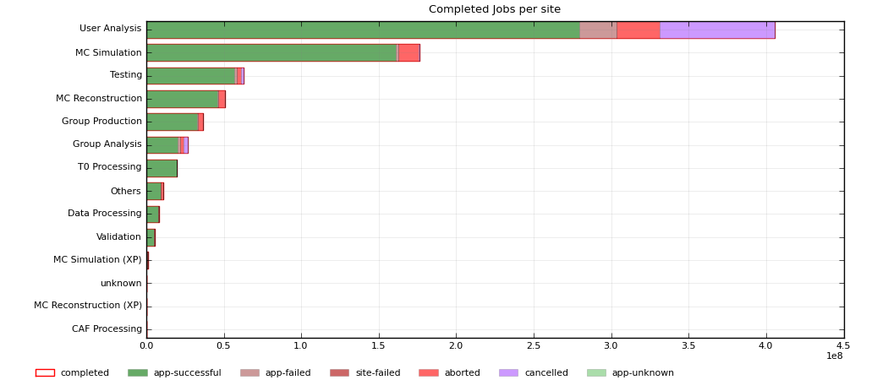
Conclusions
The current ATLAS computing model / environment has been successful about 270 publication from Run 1

Slide 34
Conclusions
The current ATLAS computing model / environment has been successful – 270 Publications
There are improvements under way to enable this to continue when running resumes in 2015

