Slide 1
Upgrade of the ATLAS Tile calorimeter electronics
Carlos Solans
High-performance Signal and Data Processing
29th January 2014

Slide 2
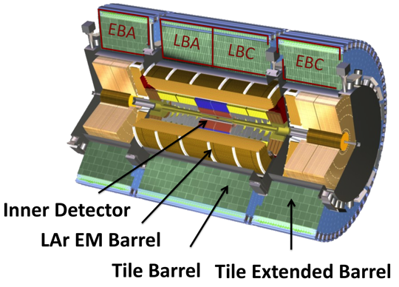
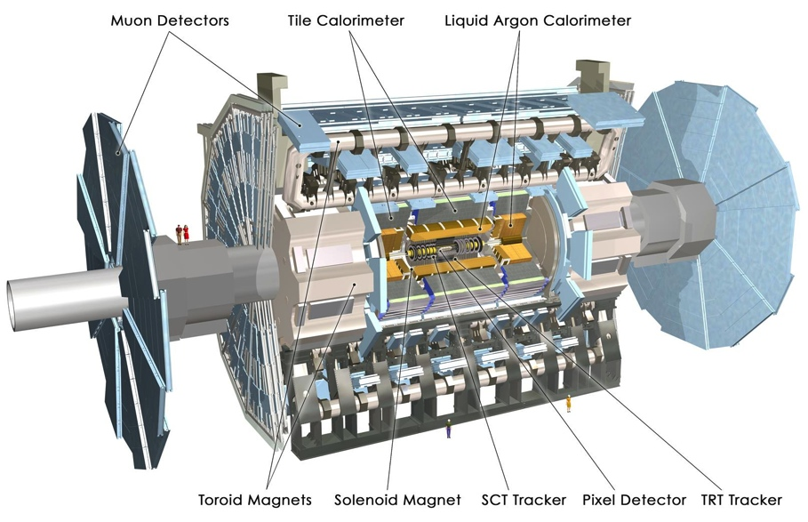
The ATLAS Tile calorimeter
The hadronic Tile calorimeter is a hollow cylinder that covers the range |η| < 1.7
  Mechanically divided into three barrels and staggered in ϕ is the central structure of ATLAS and weighs 2900 tons
Based on a sampling technique where plastic scintillating tiles are embedded in a steel absorber plates
  Each tile is read-out on both sides by wavelength shifting (WLS) fibers
  Groups of tiles are bundled together
  into cells, each of them is read-out by two photo-multiplier tubes (PMTs).
  Front-end electronics and pipeline memories are located in the outer most region of the modules.
Note in ATLAS:

Slide 3
Tile modules
Each barrel is divided into 64 modules providing a ϕ granularity of 0.1 rad
Tiles are trapezoidal shaped scintillators which are placed in the gaps of the module, perpendicular to the beam direction
  Eleven rows of tiles are used for each module
  Two calibration source tubes cross each row
Each tile is read-out on both sides by wavelength shifting fibers WLS that are coupled to the tiles along the external faces of the module
  Read-out electronics are located in the outermost region of the module
D
BC
A

Slide 4
Cell layout
Layers | Size [mm]
10-11 | 187
7-9 | 147
4-6 | 127
1-3 | 97
Radial size of tile rows
2013 JINST 8 P01005
ATLAS Tile calorimeter cell layout
Groups of tiles are bundled together into cells and read out by photo-multipliers tubes (PMTs)
Cells are laid out in order to have a projective geometry around the interaction point in steps of Δη = 0.1
Tile is made out of 5182 cells of three types
A (1.5λ), BC (4.1λ) and D (1.8λ)

Slide 5
Detector concept
Digitizer
Tile
WLS fiber
PMT
Integrator
ATLAS Tile calorimeter detector concept
The Tile calorimeter is based on a simple detector concept
  Scintillation light is produced in the tile
  Light is collected by 2 WLS fibers (1 cell is read out by 2 PMTs)
  Electrical pulse produced by the photo-multiplier (9852 in total)
  Signal is sampled (and also integrated)
Samples are stored in pipeline memories located in the front-end electronics and transferred to back-end electronics on reception of a L1A signal
ATLAS Tile calorimeter read-out

Slide 6
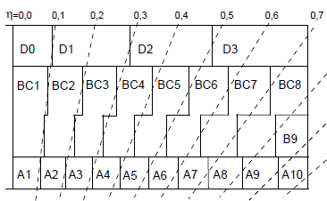
Signal reconstruction
The signal reconstruction in Tile is
based on the Optimal Filtering
  Amplitude and time are obtained
  through a linear combination
  of the digital samples
  Weights are obtained from the signal
  pulse shape and the correlation matrix
  between the samples for an expected
  time of the pulse
Energy is proportional to the amplitude
Cell energy is the sum of the two PMTs
Fast and reliable for deterministic pulses.
  Alternative reconstruction methods are under evaluation
Signal deposits from particles originated in the IP should have reconstructed time equal to zero
Notes:
As everyone knows the energy and time reconstruction…
The pedestal is the baseline
The time is the difference between the expected and received time of the pulse
The amplitude is the distance from the pedestal to the reconstructed peak

Slide 7
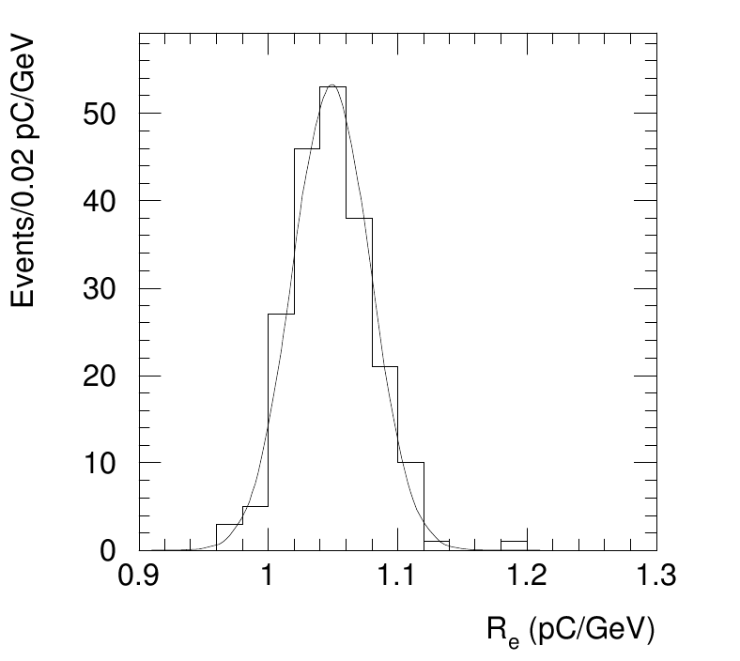
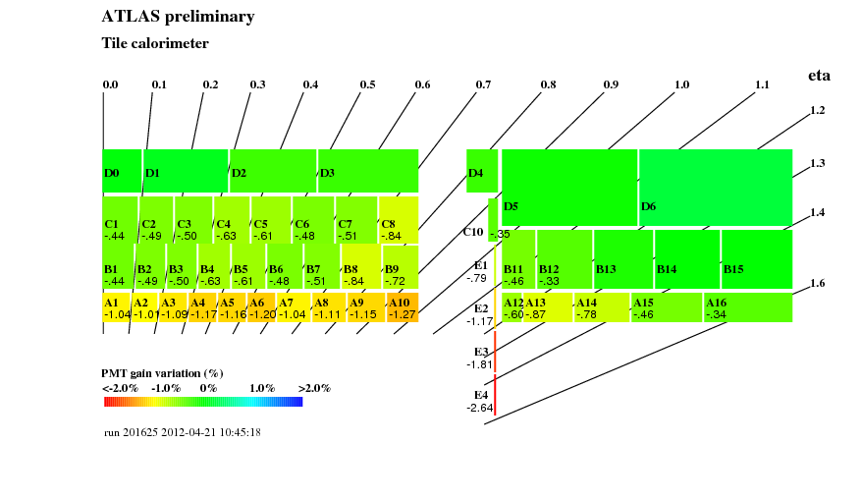
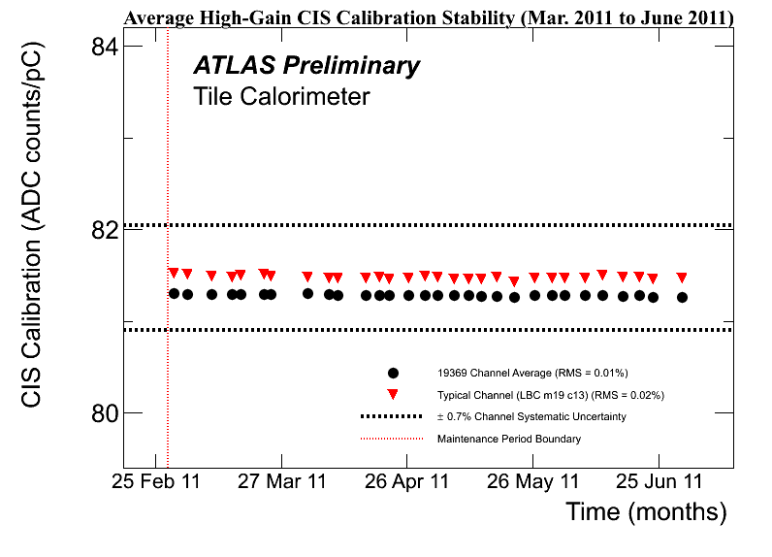
Energy calibration in Tile
Half cell energy
EM constant
Cesium equalization
Laser equalization
Charge Injection System
Reconstructed amplitude
Tile EM calibration is preserved in ATLAS by the Cs calibration system
ATLAS preliminary
Tile Calorimeter
~monthly
~weekly
~weekly

Slide 8
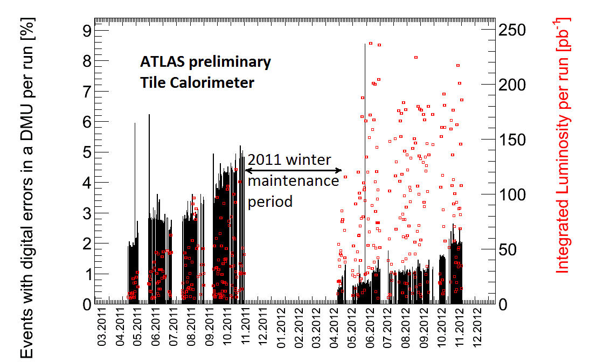
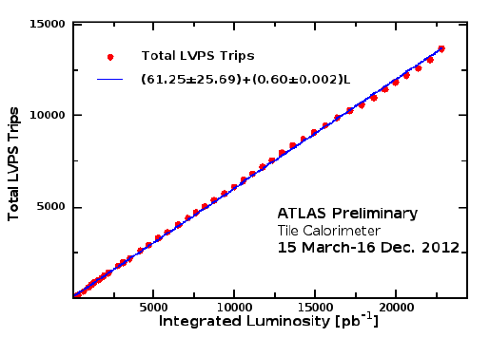
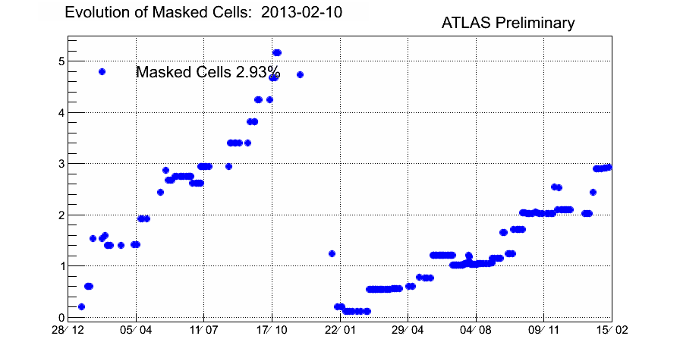
Tile operation summary in Run 1
ATLAS Tile has been easy to operate in Run 1, despite...

Slide 9
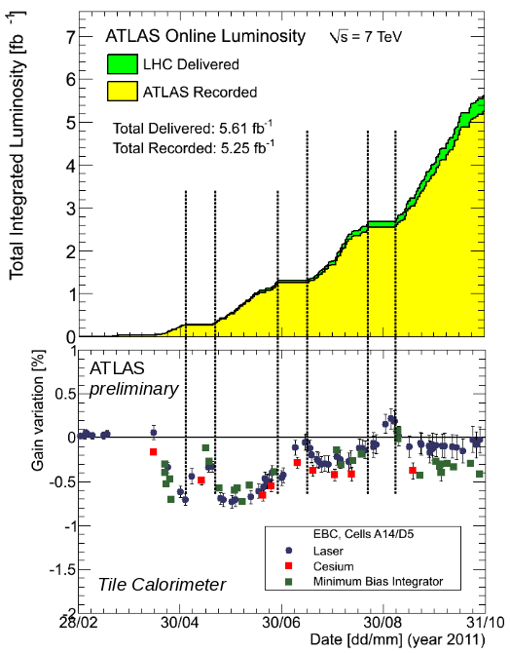
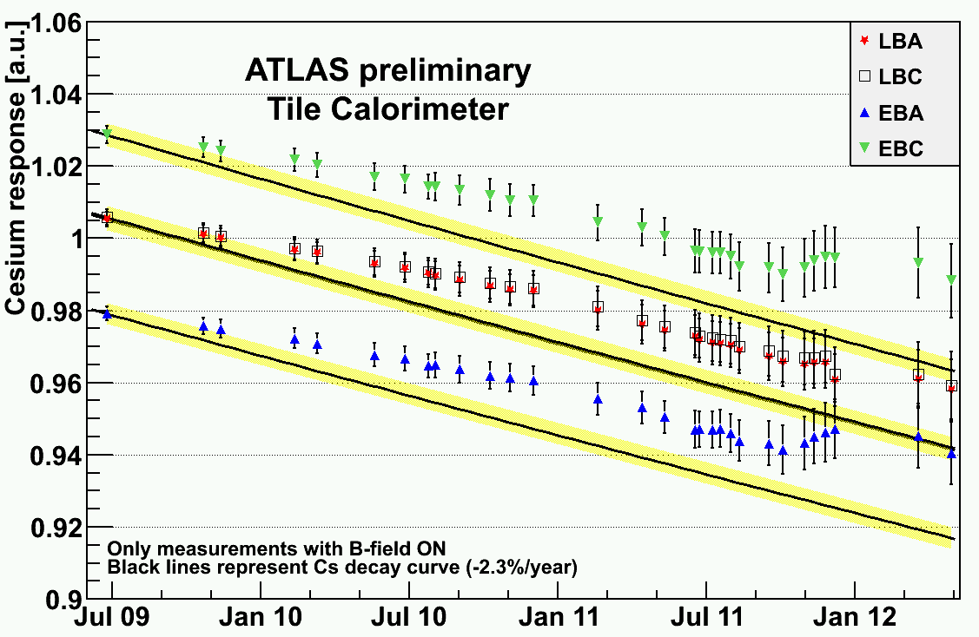
Response calibration in 2011
2010: up drift of Cs response (~1%)
2011: Up/Down drift oscillation (<1%) during beam/no beam periods
  Consistent behaviour seen by all three calibration systems
  Drift dominated by PMT gain effects
  Corrections applied to the PMT response to compensate this effect

Slide 10
Response calibration in 2012
Tile response was very stable, maximum drift was ~3.5% for A13 cell, inner most layer at |η|~1.3 in 2012 proton-proton run
  Estimated ~50% PMT gain down-drift ~50% scintillator damage
Up and down drifts follow data-taking and machine development periods
  Recovery started after proton period ended
Observed 2/3 of the total damage in 4 months after run start
  Applied weekly calibration to PMT response

Slide 11
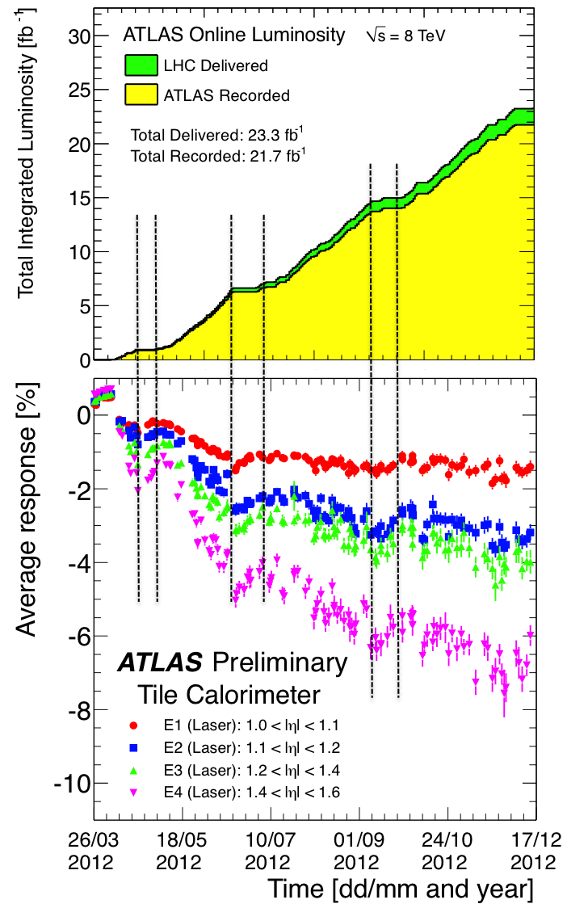
Most irradiated cells
Gap/crack scintillators (E cells), located in 1.0 < η < 1.6 are the most irradiated cells in Tile
Up to 6% down-drift was observed for E4 cell with Laser calibration
  E3 and E4 cells don’t have Cs calibration
In E1 cells, ~50% down-drift was due to PMT drift
In E2 cells, PMT drift was responsible for ¾ of the gain variation
Expect additional 1-2% in E3, E4 cells

Slide 12
Upgrade of the Tile calorimeter
During the LHC run 1, the performance of Tile calorimeter has been outstanding
  The PMT and scintillator response drifts are well measured and compensated
  Radiation damage only on most exposed scintillators (Gap/Crack and MBTS)
Phase - 0 upgrade (2015)
  Refurbishment of on-detector readout electronics
  New low voltage power supplies
  Replacement of laser system
  Improvement of Cesium system
Phase - I upgrade (2019)
  D-Layer muon trigger
  Replacement of gap and crack
  scintillators
Phase - II upgrade (~2024)
  Major upgrade of on- and off-detector
  electronics
  New active HV dividers for the PMTs
LHC TID simulation map

Slide 13
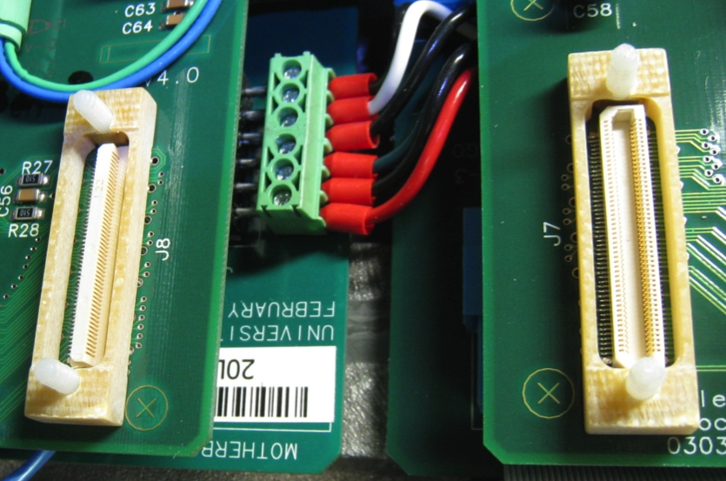
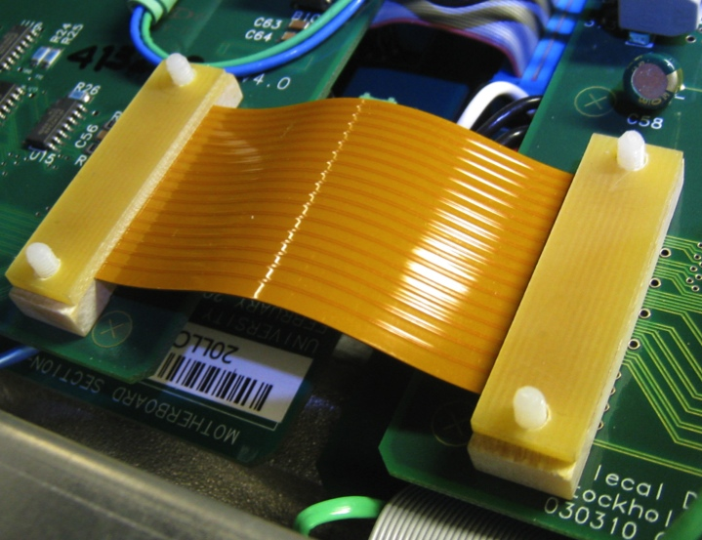
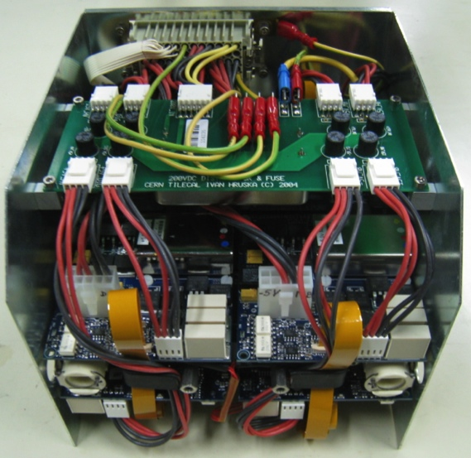
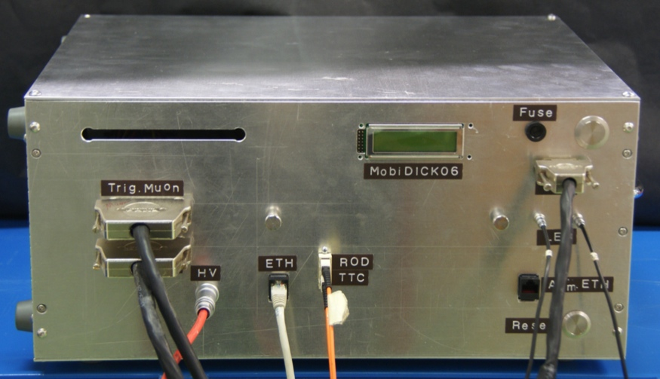

Phase-0 upgrade
Collars
Flex foil
LVPS
The upgrade of the Tile calorimeter during LS1 (Phase-0) is to consolidate the front-end electronics
  Finger low voltage power supply replacement
  Flex foil replacement and addition of collars in connectors
  Access to all 256 modules is mandatory
In-situ QA is assessed on the modules with the MobiDICK system
  Recently upgraded to extend lifetime and provide more precision measurements
MobiDICK

Slide 14
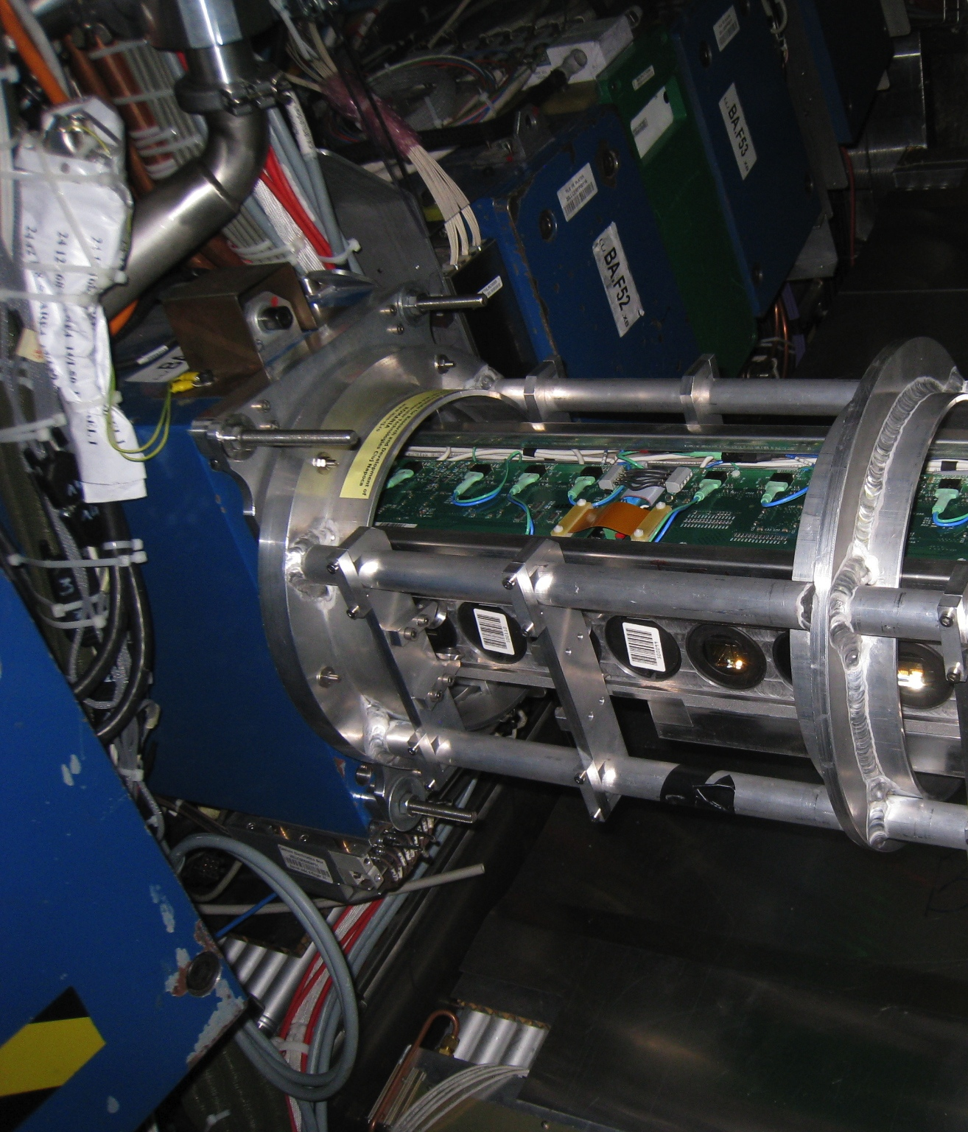
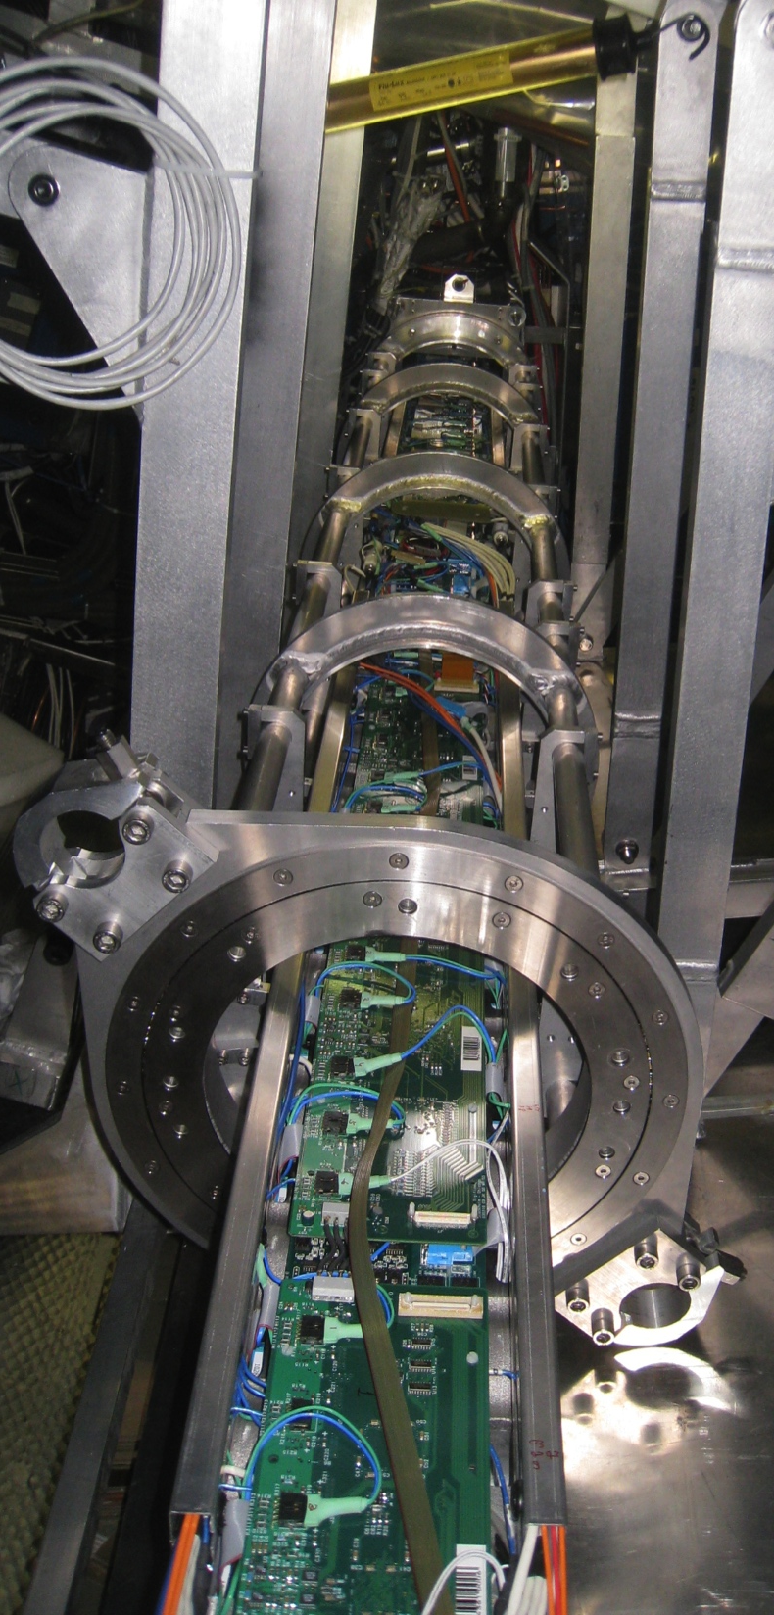
Detail of a super-drawer extraction from a barrel module

Slide 15
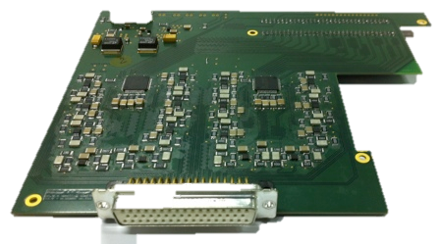
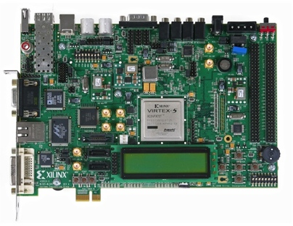

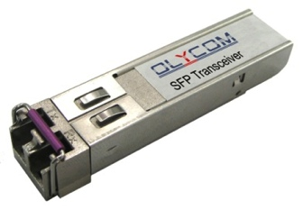
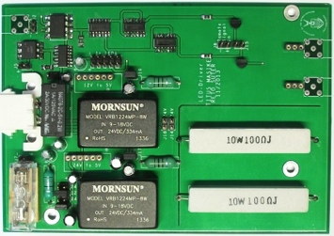
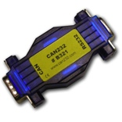
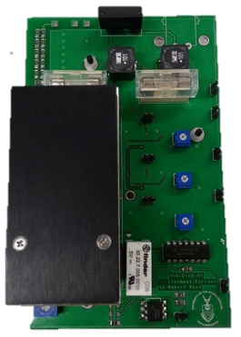
A Mobile Data Integrity Check system
Virtex 5
PowerPC
440 MHz
256 MB RAM
16 channel ADC
TTC emulator
ADC board
ML507
GLink receiver
SFP
PLB 46 BUS - 100 MHz
HV/LED controller
2 serial ports
Ethernet
Orbit clock
LED driver
Embedded System
CAN bus dongles
HV board
Embedded OS controls custom hardware boards through dedicated firmware modules
See talk by Titus Masike

Slide 16
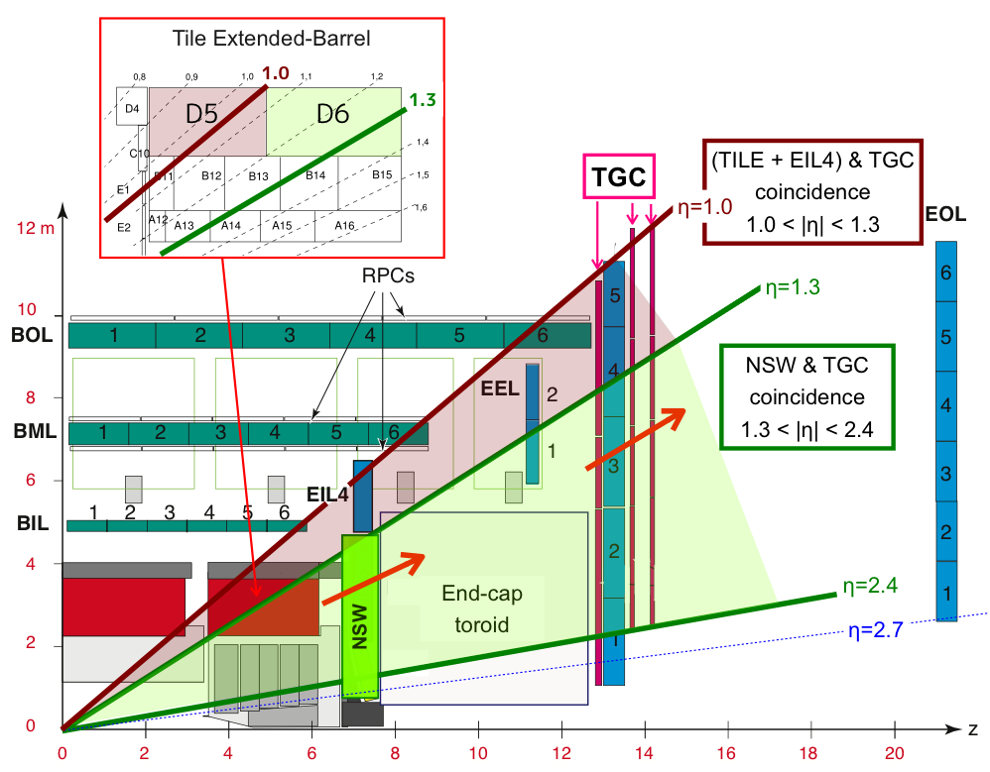
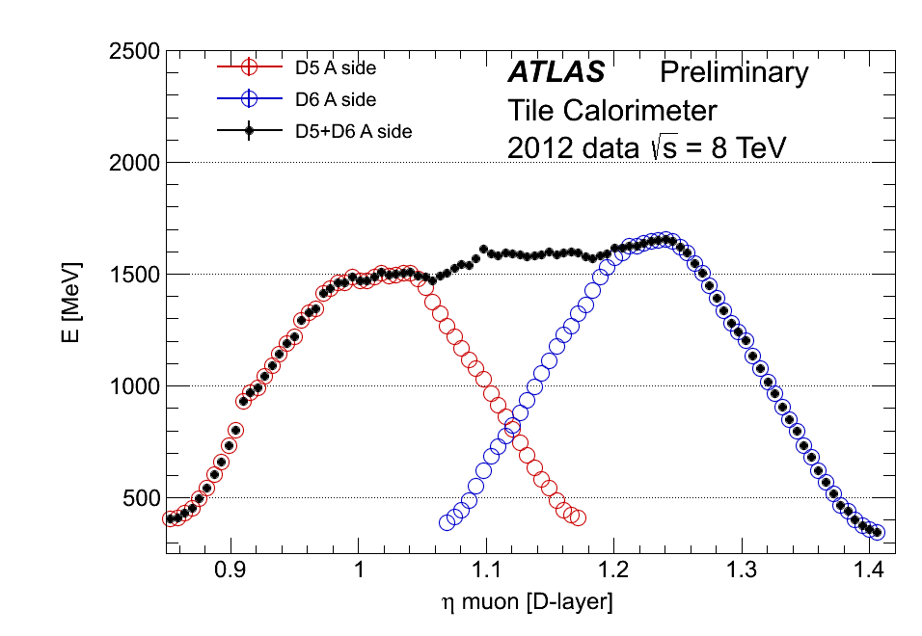
Phase-I upgrade
Level 1 single Muon trigger at 20 GeV is expected to be 34 kHz but Trigger can only handle below 25 kHz
  Should be reduced otherwise will be heavily scaled down randomly
A New Small Wheel (NSW) covering 1.3 < η < 2.4 will do coincidence with TGC
Complemented by the coincidence in the outermost radial layer of Tile (D-cell) covering 1.0 < η < 1.3
Possibility to reduce the large fake rate in the end-cap region up to ~60%
  In D5 D6 region we expect a 82% reduction rate at 500 MeV threshold
ATLAS TDAQ Phase-I Upgrade TDR

Slide 17
Tile Muon D-layer Board
New Tile Muon D-layer boards will read-out 512 muon outputs ( 64 modules x 2 barrels x 2 cells x 2 channels / cell ), eight modules per board
Provide the correct calibration and perform signal detection for each cell along with Bunch Crossing Identification
Transmit the η, φ, and bunch number from the detected cells to the new sector logic board through GLink
Connect to neighbour receiver boards due to different granularity in φ, 64 tile modules for 48 muon trigger sector logic
Provide ROD data fragments to the DAQ system through SLink
Detector signals
TTC Clock
η, φ, BCID
@40 MHz
(Glink)
digitization
Signal detection + BCID
Sector
Logic
Calibration + cross comm
L1A@100kHz
CTP
Pipeline
ROS
Trigger details @100 kHz (SLink)
Tile muon D-layer board block diagram

Slide 18
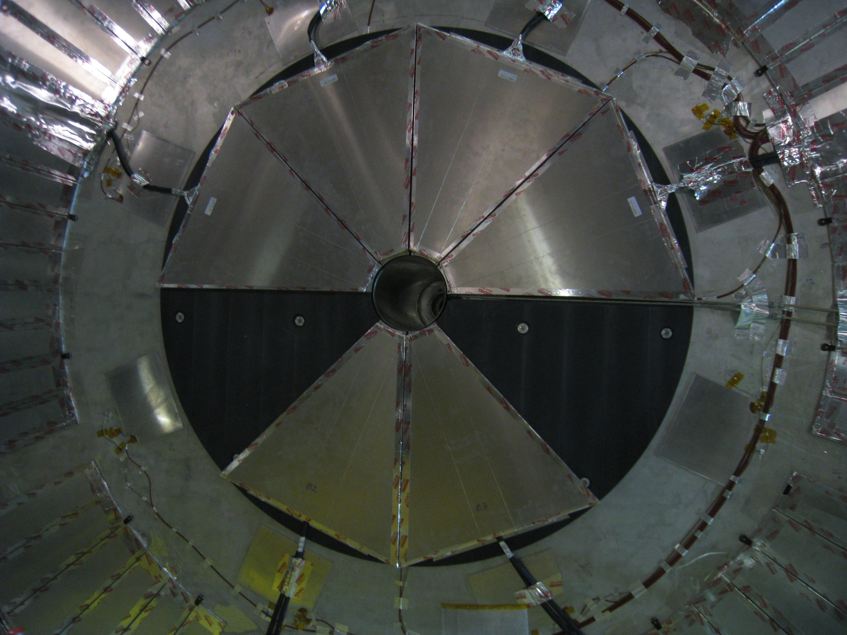
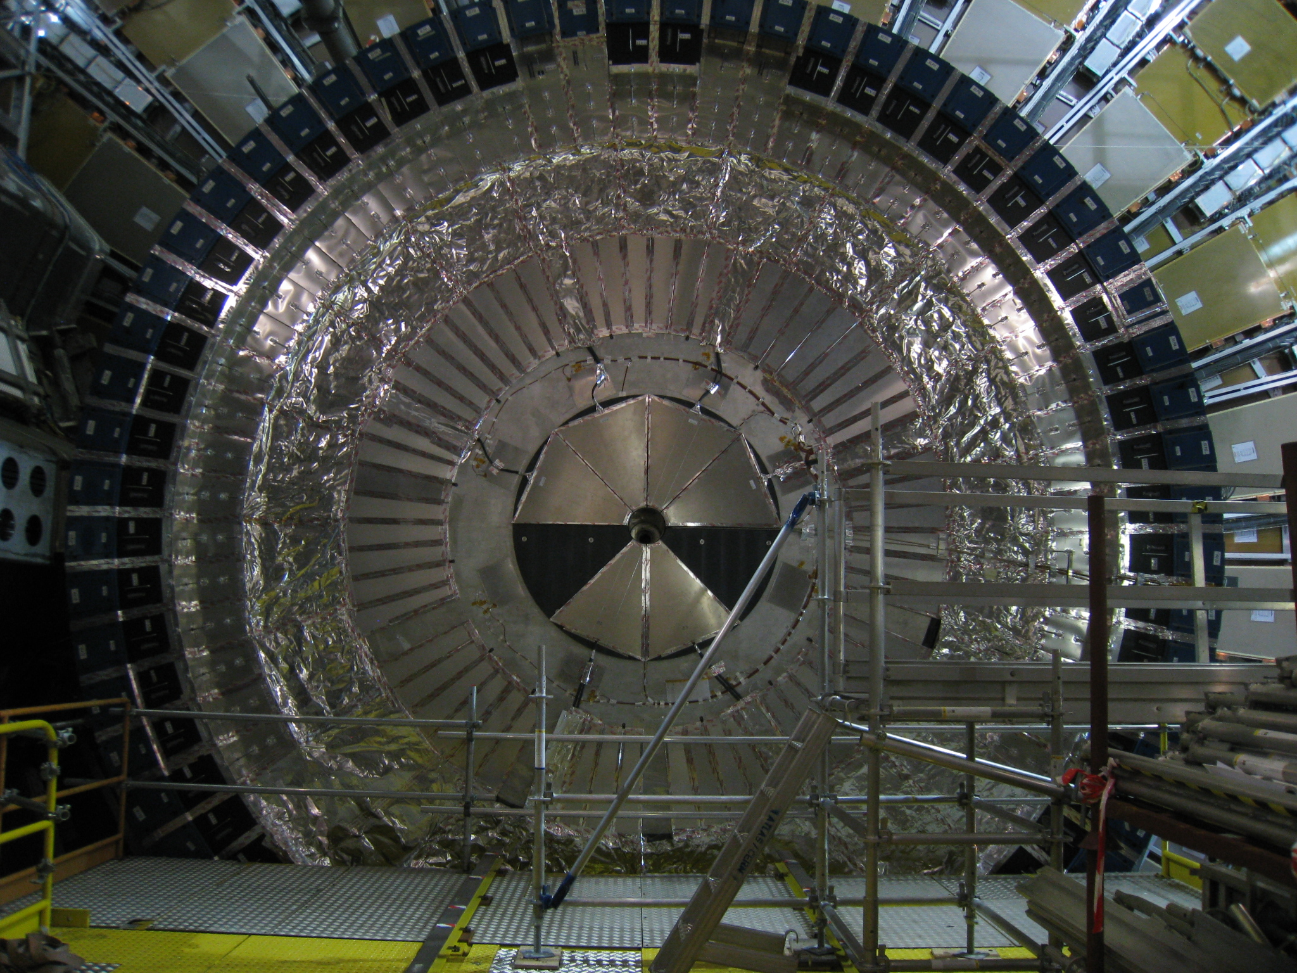
Detail of a gap/crack cells and MBTS (most irradiated cells)
to be replaced during phase-I upgrade

Slide 19
Phase-II upgrade
Present front-end electronics
Equivalent electronics for phase-II upgrade
Back-end electronics
Tile’s plans for the upgrade phase-II of the LHC are to completely replace the front-end and back-end electronics introducing a new read-out strategy
  Full digitization of signals at BC rate and transmission to off-detector electronics
  Reduction of single point failures
  Digital input to trigger Levels 0 and 1

Slide 20
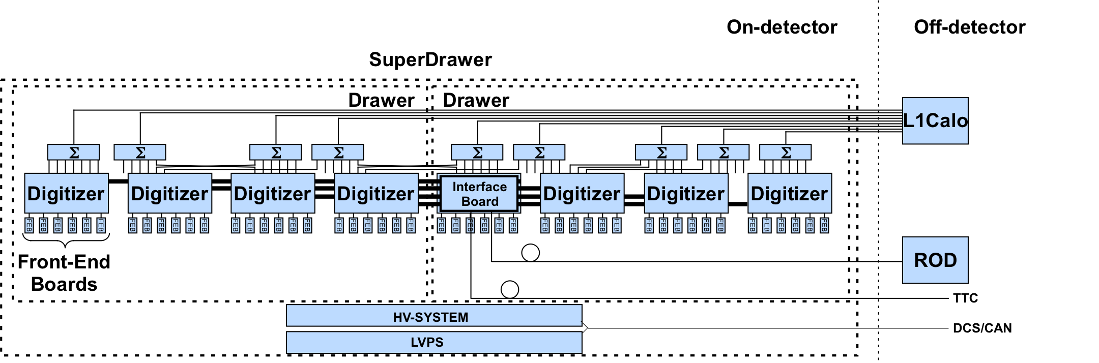
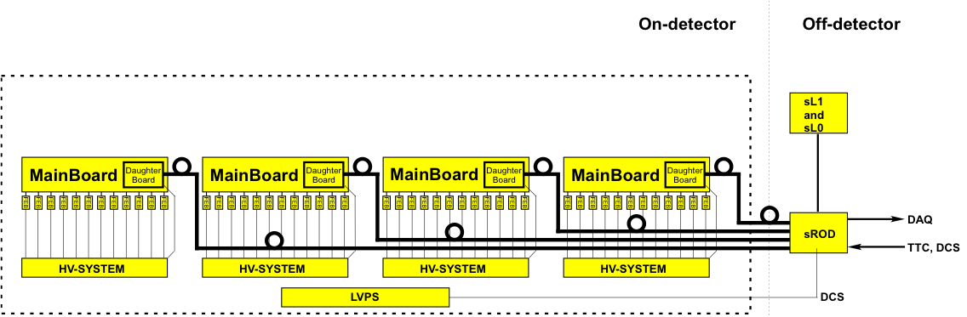
Changes in the front-end
Aim to cope with luminosity increase and reduce single point failures (improve reliability)
  Fewer failure-prone connectors in the new system, but also the challenge of routing more fiber optic and LV cables. Moving from dependent drawers to independent mini-drawers
  Increase the redundancy in the read-out path from the cell to the backend
  Similar redundancy in the power distribution and introduction of Point-Of-Load regulators
Present
Proposal for phase-II
SuperDrawer
MiniDrawer
MiniDrawer
MiniDrawer
MiniDrawer

Slide 21
Changes in the back-end
 | Present | Phase-II upgrade
Total bandwidth | ~165 Gb/s | ~40 Tb/s
Front-end links | 256 | 4096
Bandwidth per link | 640 Mb/s | 10 Gb/s
Links per super-drawer | 1 (+1 redundant) | 4x4 (+4x4 redundant)
Bandwidth per super-drawer | 640 Mb/s | 160 Gb/s
Block diagram of the Level-0/Level-1 hardware trigger
Notes:
ATLAS performance will be degraded unless LAr and Tile calorimeters and Muon spectrometer read-out are upgraded

Slide 22
Tile upgrade demonstrator
In order to test the technology for phase-II upgrade we are developing a hybrid demonstrator slice containing the new components but compatible at the functional level with the current design
  Redundancy against SPF
  Radiation tolerance up to 100 kRad
  Error correction and triple redundant designs
  Sampling and read-out in all BCs
  Precision of 16 bits above noise level in two 12 bit gains

Slide 23
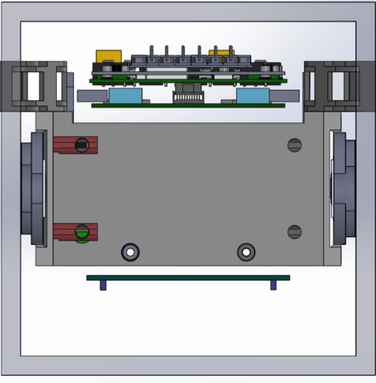
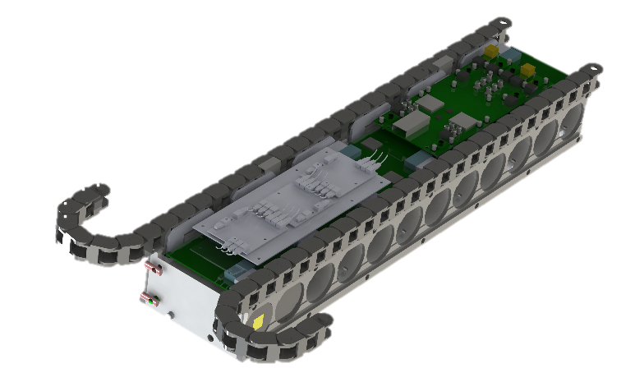
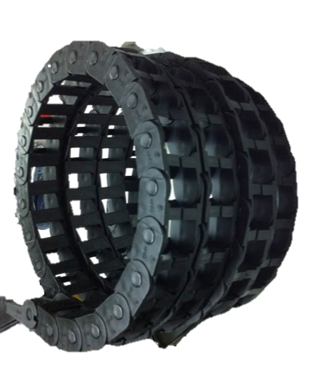
Mini-drawers
Super-drawer demonstrator will be composed of 4 mini-drawers, each one containing
  12 front-end boards: 1 out of 3 different options
  1 main-board: for the corresponding FEB option
  1 daughter-board: single design
  1 HV regulation board: 1 out of 2 different options
  1 adder base board + 3 adder cards: for hybrid demonstrator
Daughter-board
Cross section of a mini-drawer
Main-board
Adder base board (only
for hybrid demonstrator)
Cable carrier
(1 adders, 1 digital)
Empty cable carrier
HV board
(underneath)
Rigid mechanical links
DIFP
~75 cm
Cooling pipe links
AL body
Mini-drawer with cable carriers

Slide 24

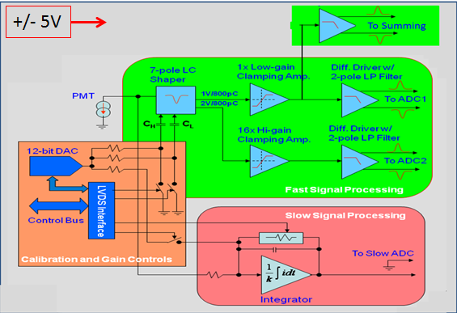
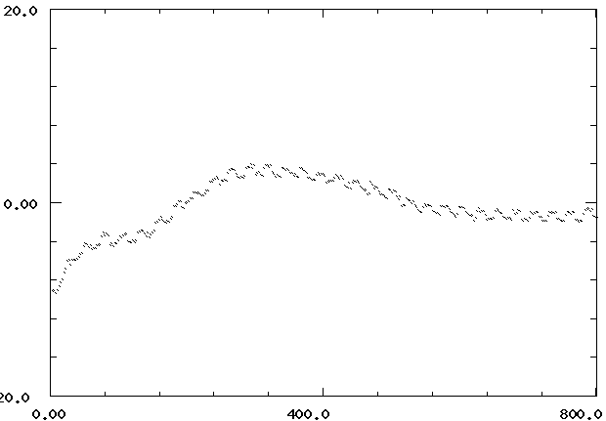
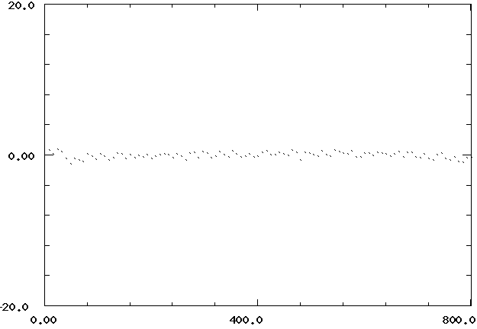
Front-end board option 1: New 3-in-1
Only option for first demonstrator
Based on current 3-in-1 cards that provides 3 functionalities
  High and low gain analog outputs
  Charge injection calibration
  Integrator read-out for dedicated and in-physics calibration data
HL-LHC design has higher radiation tolerance and better performance
  One component failed radiation test for sLHC, reverted to previous
  Longer cable needed to accommodate parity flip
LHC 3-in-1 card
Low gain linearity
HL-LHC 3-in-1 card
Low gain linearity
This option will be used in the hybrid demonstrator since it can provide the analog output to the present Level 1 trigger
Linear Fit – Data (ADC counts)
Charge (pC)
Charge (pC)

Slide 25
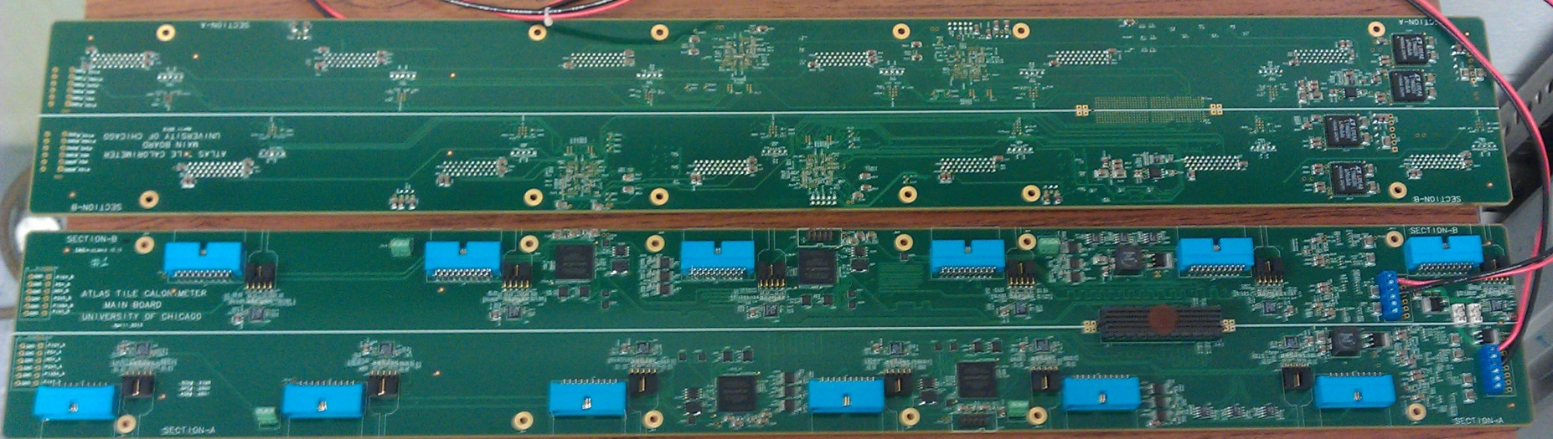
Mainboard for new 3-in-1 FEBs only option for first demonstrator
ADCs
Regulators
High Radiation - Patch Panel End
4 control FPGAs
DaughterBoard connector
Mainboard digitizes signals from FEBs with independent discrete ADCs
  Mainboard is split into two halves
  Each cell will be read-out by two PMTs, one on each side of the mainboard
  Samples are transferred serially to the daughterboard at 600 MHz
  Commands are sent in parallel to 2 control FPGAs on each side
This front-end board + mainboard option will be evaluated together with the other two in test beams starting in 2015

Slide 26
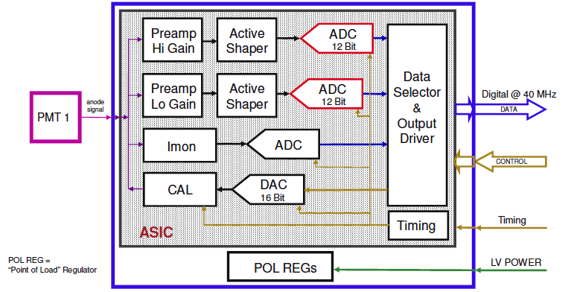
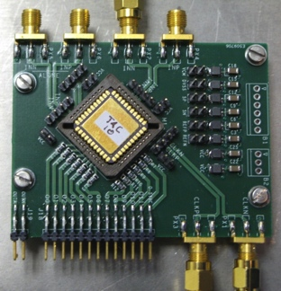
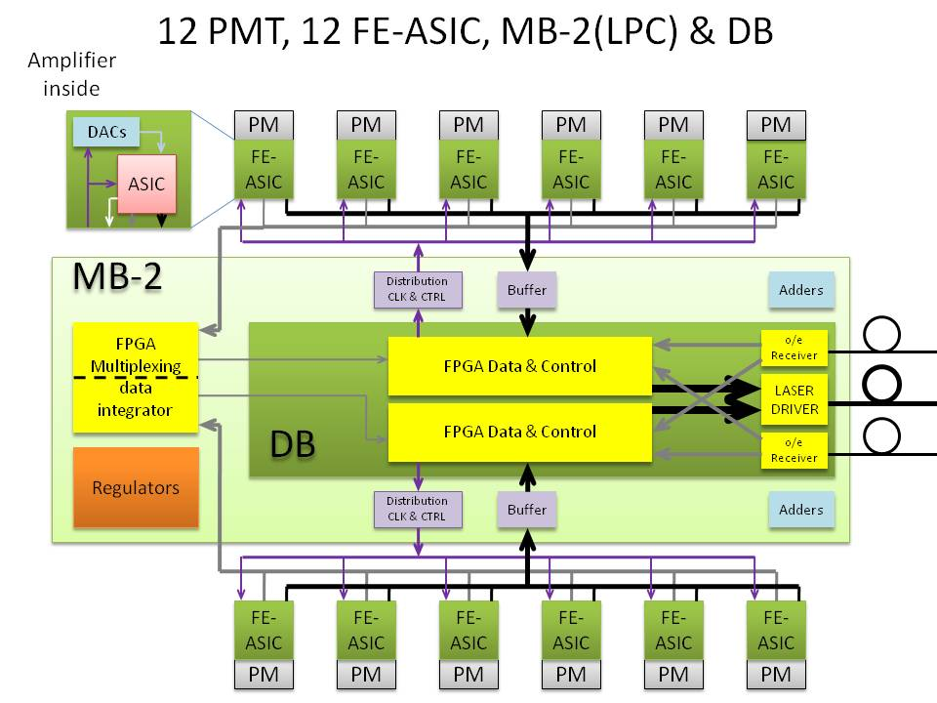
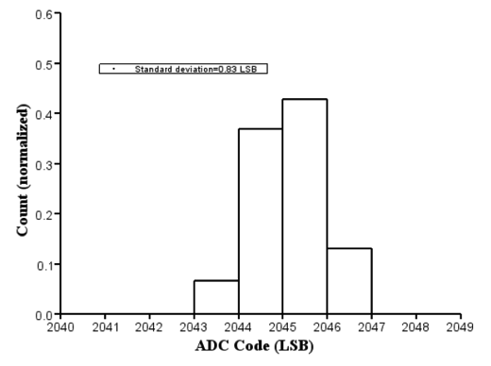
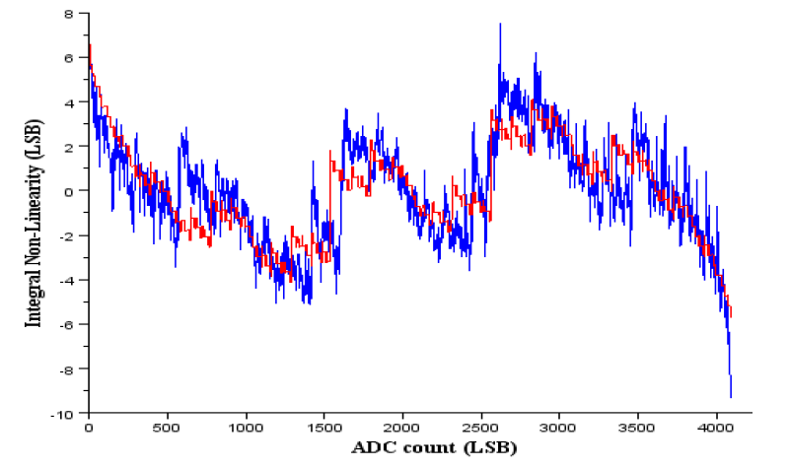
Front-end board option 2: FE-ASIC
Second option for a front-end board is based on an ASIC using IBM CMOS 130 nm technology
FATALIC ASIC provides shaping in 3 gain ranges
  Third version being tested
TACTIC ADC is a 12-bit ADC@40 MHz
  First version delivered in January
  Power consumption 61 mW
  Measured noise smaller than one LSB
  Bad integral non linearity due to bad
  coupling of amplifier capacitors
  Second version needed
Next steps
  Tests with Cesium source before end of 2013
  Design front-end board with FATALIC and TACTIC for spring 2014
  Design of fourth version of FATALIC with 3 TACTIC ADCs embedded by May 2014 for delivery by November 2014
  Design of Mainboard for this Front-end board option
(1,8,64)
Conceptual Design of FE-ASIC Front-End Board
TACTIC ADC
FATALIC
TACTIC
toROD
Standard deviation 0.83 LSB
data
simulation

Slide 27
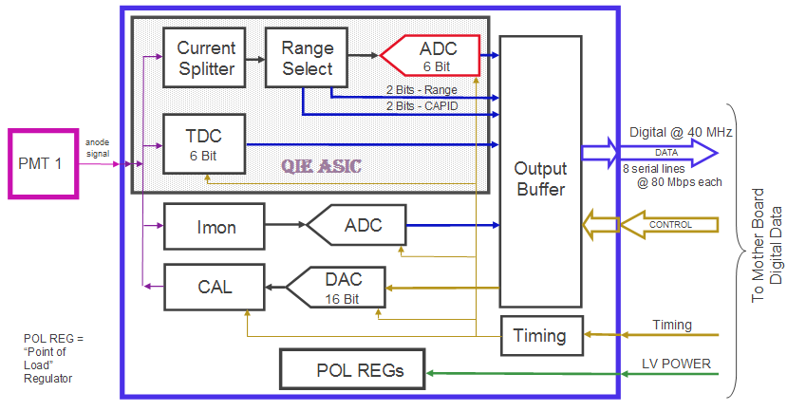
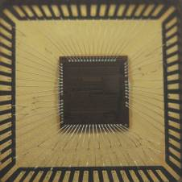
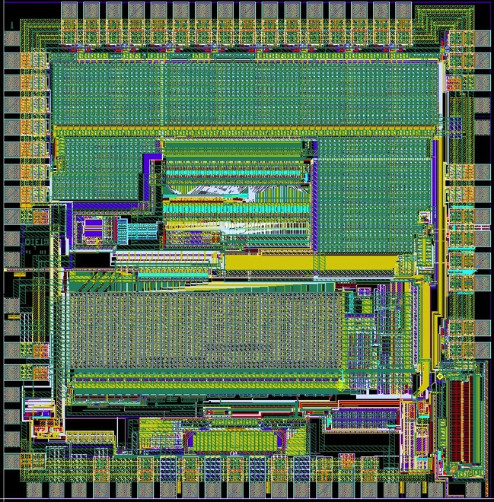
Front-end board option 3: QIE ASIC
Third option for the front-end board is a charge integrator (different concept)
  Performs a on-chip digitization with radiation tolerant design
  Needs 4 clock cycles to acquire the data
  Outputs a 17-bit dynamic range in 10 bits: 6‐bit ADC value, 2 bits range (4 ranges), 2 bits CAPID
  Clean measurement every 25 ns: No pulse shaping
  Can be very useful against pile-up but requires technology change decision
  Collaboration between ANL and FNAL
Status with QIE10 design
  20 chips in hand, another 40 coming
  Passed noise, dynamic response and TDC tests
  OK for TID test up to 50 kRad
  No SEUs in Shadow Register up to 6E12 p/cm2
Next steps:
  Front-end board for this option soon
  Full drawer tests in summer 2014 and Test beam in 2015
Conceptual Design of QIE Front-End Board
QIE10_P5 chip
Picture courtesy of Tom Zimmerman, Fermilab

Slide 28
Daughter-board
Daughter-board provides GBT communication with back-end electronics
  Implementing a redundant system on a single PCB + triple redundant FPGA programming
  Two Kintex 7 FPGAs and two QSFP Modulators at 40 Gb/s
  Firmware can be also uploaded through the optical link
Status
  First prototype tested in 2011
  Second prototype manufactured in 2012 managed to provide continuous data stream to back-end
  Third prototype under design
Conceptual design of daughter-board (second prototype)
Second prototype of daughter-board (still with one modulator and one PPOD)

Slide 29
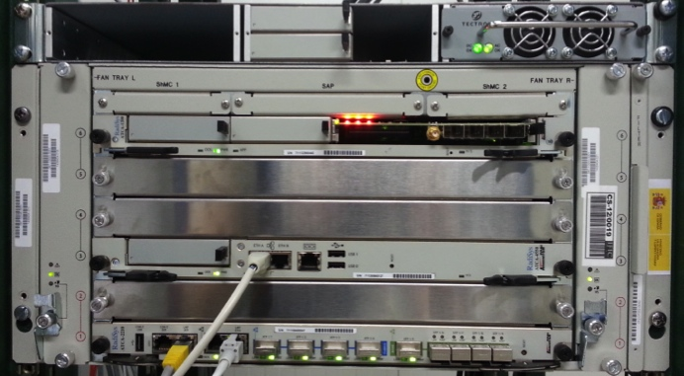
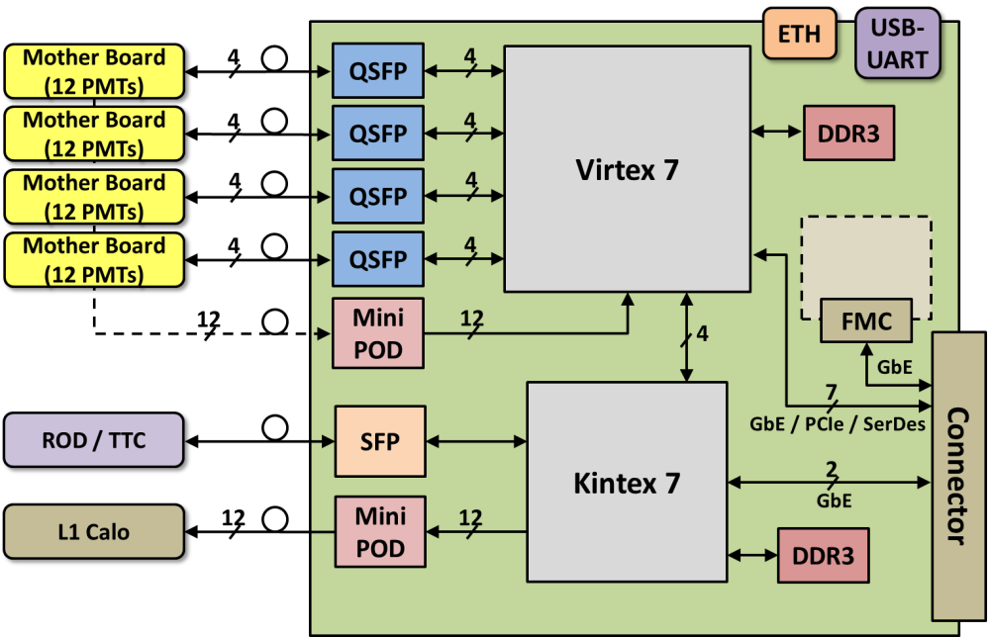
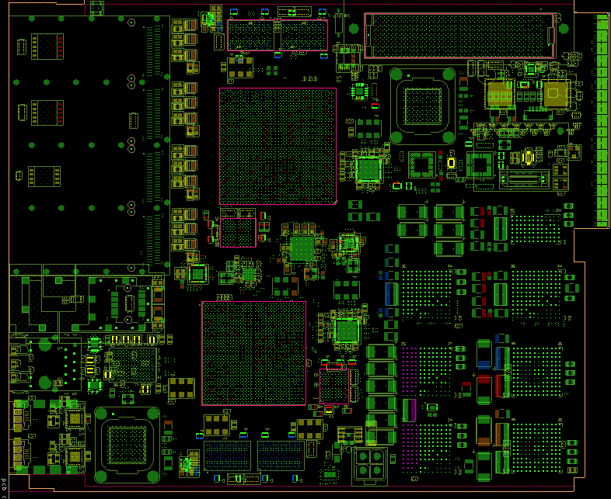
Super Read-Out Driver prototype
Super-ROD is the core back-end electronics component
  Prototype compliant with mid size AMC (180.6 mm x 148.5 mm)
  Read-out of a complete super-drawer (4 mini-drawers) with QSFPs
  Corresponding to ¼ of input links of the design for phase-II
  1 Xilinx Virtex 7 FPGA (XC7VX485T-2FFG1558) 48 GTX@10Gb/s for data/DCS input and TTC/DCS output
  1 Xilinx Kintex 7 FPGA (XC7K420T-2FFG901) 28 GTX@10Gb/s to interface current ROD/TTC and L1Calo
  512 MB DDR3 SDRAM and 1 Gb flash per FPGA
First prototype almost ready for manufacturer
  Stack-up 18 layers in ~1.7 mm (10 power, 8 signal)
  ATCA shelf
See talk by Robert Reed
Conceptual design of super-ROD prototype
  Super-ROD prototype layout view

Slide 30
Integration of the demonstrator
A demonstrator super-drawer of the upgrade phase-II front-end electronics will be installed in ATLAS during Run 2
A super-ROD prototype will read-out all the samples from the front-end and transfer a data frame to current RODs at nominal Level 1 trigger rate
detector
Demonstrator
40 Gb/s
@40 MHz
640 Mb/s
@100 kHz
Detector
Super-ROD prototype
Super-drawer
Super-drawer
ROS
Super-drawer
Super-drawer
Super-drawer
Super-drawer
1.2 Gb/s
@100 kHz
Super-drawer
Production Read-Out Driver module

Slide 31
Block diagram of sROD prototype

Slide 32
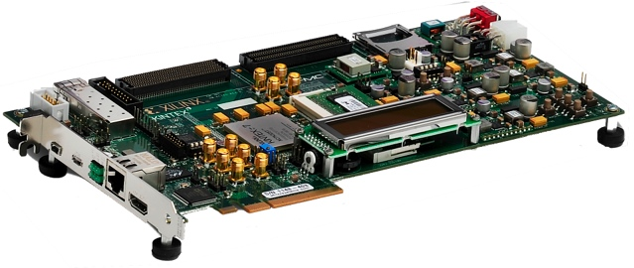

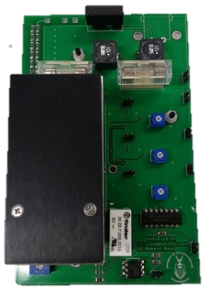






A portable test-bench for upgraded electronics
A portable readout module for mini-drawers (Prometeo) is under development
  Stand-alone test-bench to assess the QA of the electronics
Hardware
  Based on a Virtex 7 evaluation board
  QSFP module provides optical connection
  HV and LED driver boards test response of PMTs
  16 channel ADC mezzanine to digitize the output of trigger cables from previous test-bench
Software
  Based on IPbus, QT framework
  Modular implementation to allow particular test implementation
Status
  All hardware components in hand, casing and cabling in progress
  Firmware under design
Virtex7 evaluation board
QSFP FMC module
HV PS
LED driver
16 channel ADC (hybrid demonstrator only)
System power supply (commercial ATX + 24V)
Test communication software panel
See talk by Xifeng Ruan

Slide 33



Low Voltage Power Distribution
Based on a three stage power distribution system
Stage 1: bulk 200VDC PS in USA15
  Provide power to four super-drawers
Stage 2: LVPS boxes in front of super-drawers
  New design providing only +10V in 8 separate bricks
  Each brick serving half a mini-drawer
  Require a factor 2 in the current output for redundancy
  Already produced 3 units ready and shipped to CERN
Stage 3: Point‐of‐Load regulators
  Point to point connection from brick to mainboards
  If one brick stops working, redundancy supply provides power through diode on the mainboard
  Completed TID tests on 5 commercial off-the-shelf regulators with marginal results for -5V regulator
  NIEL and SEU tests to be done in December 2013
(V-V₀)/V₀
Redundancy Line
V8.0.1 brick
Power Connectivity Block Diagram

Slide 34





High Voltage Power Distribution
Two solutions are under evaluation to provide HV to the front-end based on commercial off-the-shelf components
  Voltage regulation in USA15 vs front-end (HV_Opto board)
First version of the HV_Opto board largely based on existing design
  Introducing possibility of switching on/off individual PMTs
  HV_micro replaced by the Kintex-7 FPGA in the daughter-board: Specifications being defined
  Interface to DCS through super-ROD: Discussions in progress
  Control of HV settings via VHDL module: Implementation in progress
  First board completely tested and performance meets specifications
Passive HV dividers of PMTs will be
replaced by active ones to maintain stability
  Tested for NEIL up to 1.5x10¹³ 1 MeV n/cm²
  Rejected huge number of first batch due to
  bad HV cable welding
  Massive test of active dividers in Run 2
First prototype of HV_Opto board ready for mini-drawer tests
Single Channel Board for radiation tests
Old Dividers: ~2% non linearity at ~7.5 µA
New Divider: ~1% non linearity at ~75 µA

Slide 35



Optical links
Directly modulated lasers (including VCSELs)
  Have been qualified at ~10 Gb/s per link with
  a Bit Error Rate (BER) ~10⁻¹²
  Increasing bandwidth increases problems
  Commercial VCSEL arrays (SNAP12) have shown Single Event Upset (SEU) at ~10¹⁰ p/cm²
  Also these use Multi Mode fibers which are more expensive
A commercial off-the-shelf solution exists that uses single mode fibers at high transfer rates from Molex using Silicon Photonics technology developed by Luxtera (QSFP Active Optical Cable)
  Can operate above 40 Gb/s (4x10) with BER < 10⁻¹⁸
  Made out of 130 nm Silicon On Insulator CMOS which should be very radiation hard
  Radiation tests showed no SEU at TID of 165 kRad and fluence of 8x10¹¹ p/cm²
  Problem is the PIC microcontroller used for configuration and monitoring survives ~20 kRad
  A PIC replacement board has been designed, and control done from FPGA
  Firmware to initialize the electro-optical chip has been developed
  Several anti-fuse FPGAs are being evaluated and will be tested for radiation tolerance
QSFPs are the preferred option for the demonstrator
  Less fibers vs lower clock frequency
10⁻¹² BER = ~900 errors per day
10⁻¹⁸ BER = 1 error in ~1000 days
PIC Replacement Board
Modulator
Per Super-Drawer:
MPO
connectors
MPO
connectors
4 x SNAP12
+ 8 x SFP
+ FEC
4 x SNAP12
+ 8 x SFP
+FEC
64 Multi Mode fibers
MPO
connectors
MPO
connectors
4 x QSFP
(Luxtera)
4 x QSFP
(Luxtera)
24 Single Mode fibers
PIC Microcontroller

Slide 36
Super ROD for phase-II

Slide 37

sROD block diagram

Slide 38
Conclusions
Upgrade phase-0 aims to consolidate the detector
Biggest challenge for upgrade phase-I is the read-out of the D-Layer cells to contribute to the Level 1 muon trigger
The plans for the upgrade phase-II are to completely replace the front-end and back-end electronics introducing a new read-out strategy
The upgrade of the ATLAS Tile calorimeter for the HL-LHC requires
  increase in radiation hardness and front-end redundancy
  Increase in the throughput and computing power of the back-end electronics
Mini-Drawer
PMTs – 6 per side
3 more
mini-drawers
cell
6 PMTs
FPGA
6 PMTs
FPGA
Redundancy line
Main
Board
HV_Opto
Board*
Daughter
Board
*On back side
Cartoon of a mini-drawer for phase-II upgrade
Cartoon of a read-out driver for the phase-II upgrade

Slide 39
Backup

Slide 40






A bit of ATLAS history
1993 – 1995: R&D
1996 – 2002: Construction
1999 – 2002: Instrumentation
2000 – 2004: Test-beam
2004 – 2006: Installation
2005 – 2009: Commissioning with particles and calibration systems
2010 – 2013: Operation in LHC run 1
2013 – 2015: Electronics consolidation during Long Shutdown 1

Slide 41
Tile module construction
  Each module is built out of 19 sub-modules (~29 cm) which are attached to the girder
    Constructed independently and before the optics instrumentation
  Spacer plates (4 mm) are placed in between two master plates (5 mm) leaving the space for the tiles (3 mm)
    Periodicity of 18 mm
    More details in 2013 JINST 8 T11001
  WLS fibers are placed along the spacer plates between two master plates without any compromise for extra space
  Similar assembly procedure can be followed for the LHeC detector

Slide 42
Functional representation
The analog pulses from the PMTs undergo shaping and amplification in the 3-in-1 cards in two gains (low and high) with a ratio of 1:64. Low gain signals which are summed in groups by adder boards are provided to the Level 1 Calorimeter Trigger. The analog pulses are received by digitizer boards where the signal is converted into digital samples every 25 ns, which are stored in the front-end pipeline memories, the so called Data Management Units (DMU). Upon Level 1 accept, an event-frame-­selector selects high gain samples unless the highest sample is saturated in which case the low gain samples are used and stores them in a buffer. Event frames are pulled from the DMUs by the Interface card which formats the data and transfers the frames to the off-detector Read-Out Drivers (RODs).

Slide 43
Overview of the MobiDICK4 system
HV
Detector
Laptop
MobiDICK
box
TTC
ROD
Willy
CAN
MobiDICK
server
Trigger
LED trigger
γ
LED
LED
MobiDICK box houses hardware needed to communicate with super-drawers
MobiDICK server is the control application of the box
Willy is the client software from which tests are executed
Standard linux laptop runs Willy

Slide 44
Mini-drawer CAD view

Slide 45
Mini-drawer cross section view

Slide 46
Redundancy in the electronics
Redundancy Line
Power Connectivity Block Diagram
One of the lessons we have learnt from the electronics consolidation process in ATLAS during the LS1 is that we need to think the electronics to maximize the redundancy in case of failure, minimize the coverage damage in case of failure
A double read-out for the cell should be accompanied by a redundant data path from the PMT up to the back-end electronics
  Split the super-drawers into four independent mini-drawers
  Split each mini-drawer into two independent halves (one cell read-out by one side)
  Use redundant powering scheme

Slide 47





Second HV option
External HV regulated from USA15 based on commercial off-the-shelf components
  Regulated HV for each PMT distributed via multiconductor cables 100 m long
Good progress: measured small noise and small voltage drop (~10 mV in 800V)
HV source
DCS
Multiconductor cables
Regulation
Regulation
crate

