Slide 1
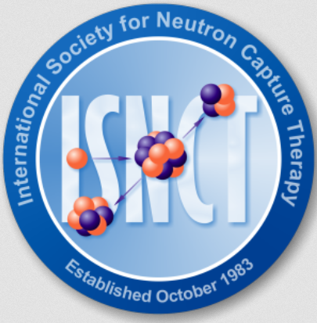


Perspectives in Boron Neutron Capture Therapy (BNCT) of cancer
Ignacio Porras
Departamento de Física Atómica, Molecular y Nuclear
Universidad de Granada, Granada, Spain.
E-mail: porras@ugr.es
President: Ignacio Porras
Secretary: Silva Bortolussi
www.isnct.net

Slide 2


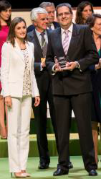






Sponsors of our research
Innovative Low energy neutron capture therapies.
Excelence Research Proyect P11-FQM-8229 (2012-2016).
Boron Nanostructures for BNCT. Research Project 20F12/41 (2012),
New production routes for medical radioisotopes. Project P-BS-64 (2014)
Internacional Excellence Campus of the University of Granada
Computer Monte Carlo Simulations.
FIS2015-69941-C2-1-P (2016-2018).
Grant for testing new boron compounds (2018-2019)
Study and design of new neutron capture treatments. Spanish Society Against Cancer (AECC) Singular Projects 2016 (2016-2019).
Donation for research (2019)
Cofounds a PhD student at ILL Grenoble
Founding a University Chair: Neutrons for Medicine

Slide 3


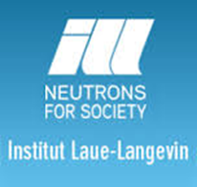

Our team and collaborators
Ignacio Porras, Javier Praena, Fernando Arias de Saavedra,
María Pedrosa, Pablo Torres-Sánchez, Nataliya Ramos-Chernenko
Departamento de Física Atómica, Molecular y Nuclear, Universidad de Granada.
M. Carmen Ruiz-Ruiz, M. José Ruiz-Magaña
Departamento de Bioquímica y Biología Molecular III e Inmunobiología
Centro de Investigación Biomédica, Granada.
José Expósito
UCG Oncología, H.U. Virgen de las Nieves de Granada, Junta de Andalucía
José M. Llamas, Ángel Ramírez, Antonio Rodríguez
UGC Medicina Nuclear. H.U. Virgen de las Nieves de Granada, Junta de Andalucía
Juan L. Osorio, José C. Ramírez, Clara Jover, Eduard Massana
Servicio de Radiofísica y Protección Radiológica. H.U. Virgen de las Nieves de Granada, Junta de Andalucía
The Neutron Time of Flight
(n_TOF) Collaboration
CERN, Geneva, Switzerland
Ulli Köster, Torsten Soldner, Trevor Forsyth
NPP and Life Sciences groups
Institute Laue-Langevin, Grenoble, France

Slide 4
Outline
Introduction to BNCT
Accelerator-based neutron sources for BNCT
Research problems
Conclusions

Slide 5
Introduction to Boron Neutron Capture Therapy (BNCT)

Slide 6
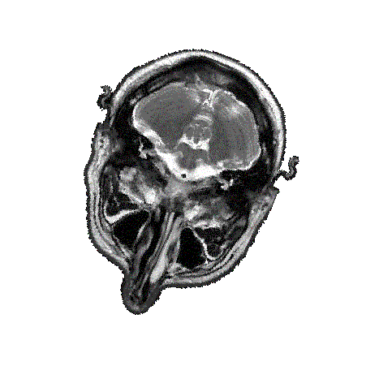
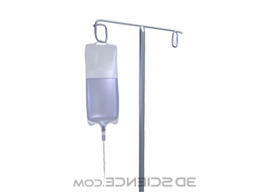
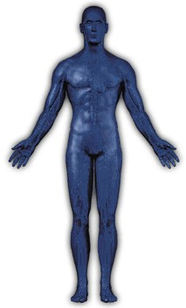
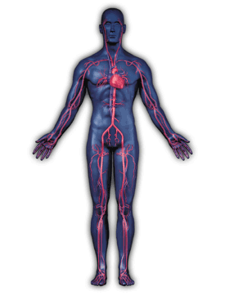
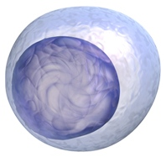
BNCT: Effective Treatment In One Day
Boron is accumulating in the cancer cells
Targeted neutron irradiation is given according to the Monte Carlo dose plan
BNCT treatment starts with a 2 hour intravenous boron compound infusion
~2x20min
Alpha particle
¹⁰B[n,α]⁷Li
rection
neutron
¹⁰B -nucleus
⁷Li recoil nucleus
The boron atoms capture neutrons, leading to nuclear reaction emitting alpha and lithium recoil particles that cause extensive radiation damage in the cancer cells
(Courtesy of L. Kankaanranta & M. Kortesniemi, HUCH)
Notes:
6

Slide 7
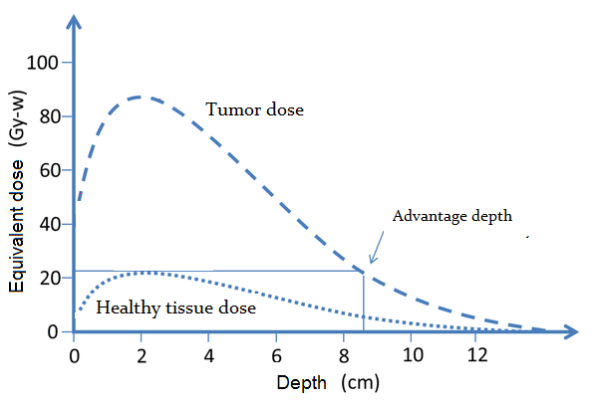
Key: diferent depth dose profiles

Slide 8
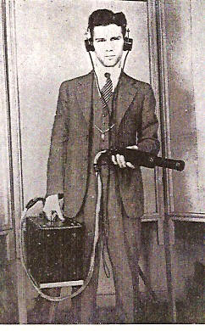
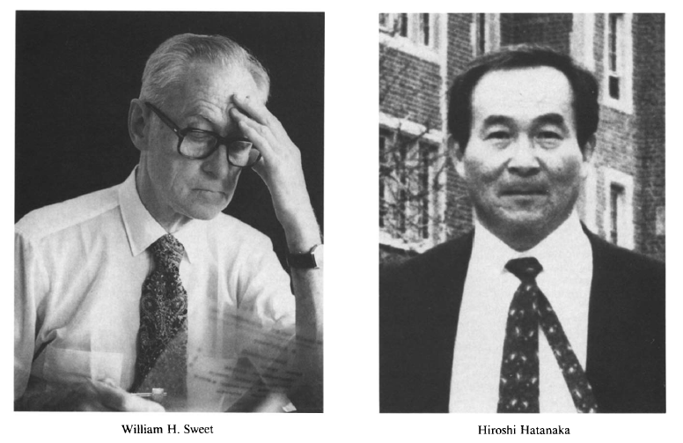
Pioneers of BNCT
Gordon L. Locher
Biological effects and therapeutic
possibilities of neutrons.
Am.J. Roentgen. Radium Ther. 36, 1 (1936).
William H. Sweet
First BNCT clinical trials
MGH + BNL, USA
Hiroshi Hatanaka
Developed BNCT programme in Japan

Slide 9
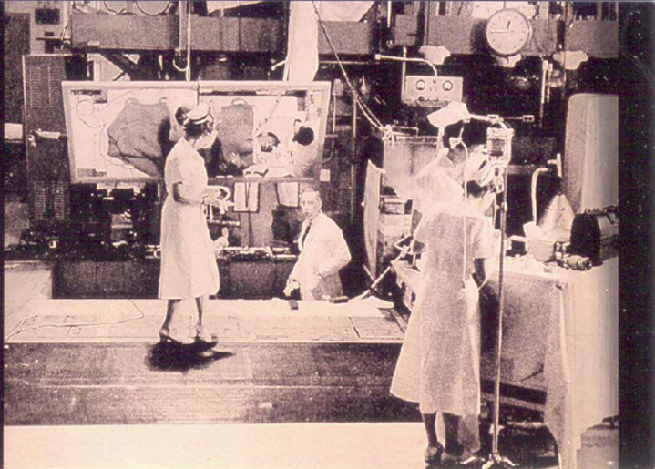
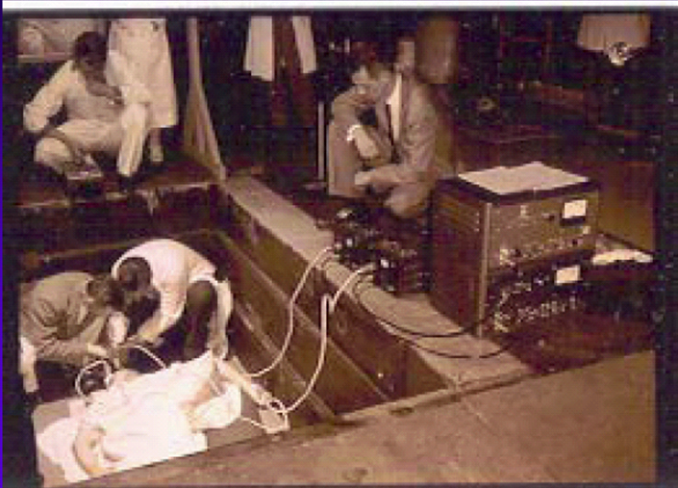
Early clinical trials in the 50’s for brain tumors
Brookhaven Medical Research Reactor

Slide 10
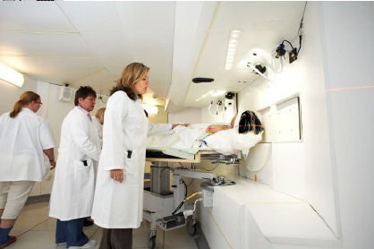
Modern BNCT (from 1990)
Phase II clinical trials
Epithermal neutron beams from reactors
- Kyoto University Research Reactor
- FiR1 in Helsinki
- THOR in Taiwan
… and others
Epithermal: 1 eV to 10 keV
More selective compound (BPA)
Application to Brain tumors, Head & Neck local recurrent
Other applications:
- melanoma
- liver metastasis (extracorporeal)
- other tumors are in study
Treatment Room at FiR1 Research Reactor, Helsinki

Slide 11
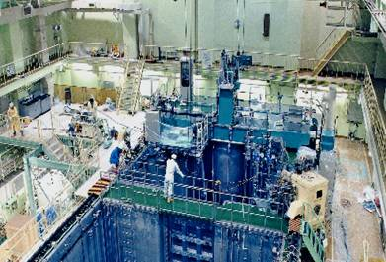
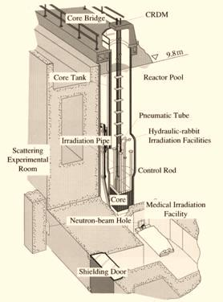
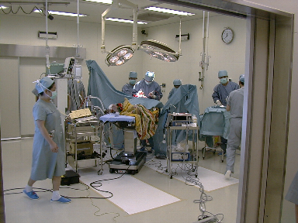
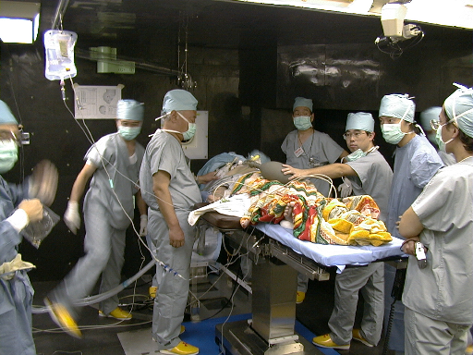
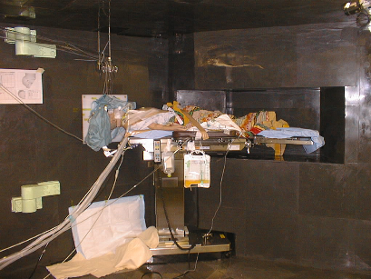
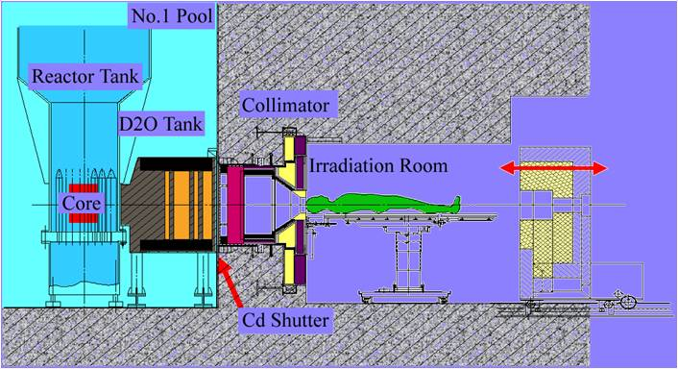
JRR-4 Japan Atomic Energy Agency (JAEA) at Tokai
Developed for the nuclear-powered ship “Mutsu”
First critical state 1965
Remodeling for BNCT 1998
1st human treatment Aug 26, 1999

Slide 12
Modern clinical trials under protocol (reactors)
Medical institution | Neutron source | Glioblastoma | Head & Neck
Osaka Medical College, Japan & Kyoto U., Japan | Kyoto University Research reactor (KURR) | 50 p. (1998-2008) | 94 p. (2001-2008)
University of Tsukuba, Japan | JRR-4 reactor | 24 p. (2002-2007) | 30 p. (2003-2008)
University of Tokushima, Japan | JRR-4 or KURR | 23 p. (1998-2008)
Harvard Medical School, USA | MIT Research Reactor | 28 p. (1998-2003)
Helsinki Univ. Central Hospital, Finland | FiR-1 reactor | 52 p. (1999-2008) | 35 p. (2003-2011)
Universität Essen, Germany | High flux reactor JRC Petten | 27 p. (1997-2006)
Nyköping Hospital, Sweden | R2-0 Studsvik Reactor | 43 p. (2001-2005)
Taipei Veteran General Hospital, Taiwan | THOR research reactor |  | 10 p. (2010-2011)

Slide 13
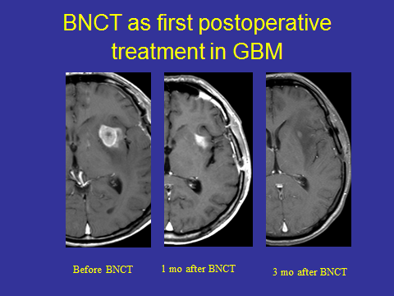
Clinical results for Glioblastoma - Finland
Joensuu et al. Journal of Neuro-Oncology, 2003.

Slide 14
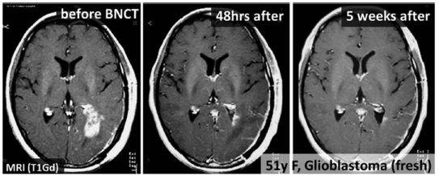
Clinical results for Glioblastoma - Japan
Barth et al. Radiation Oncology 2012, 7:146

Slide 15
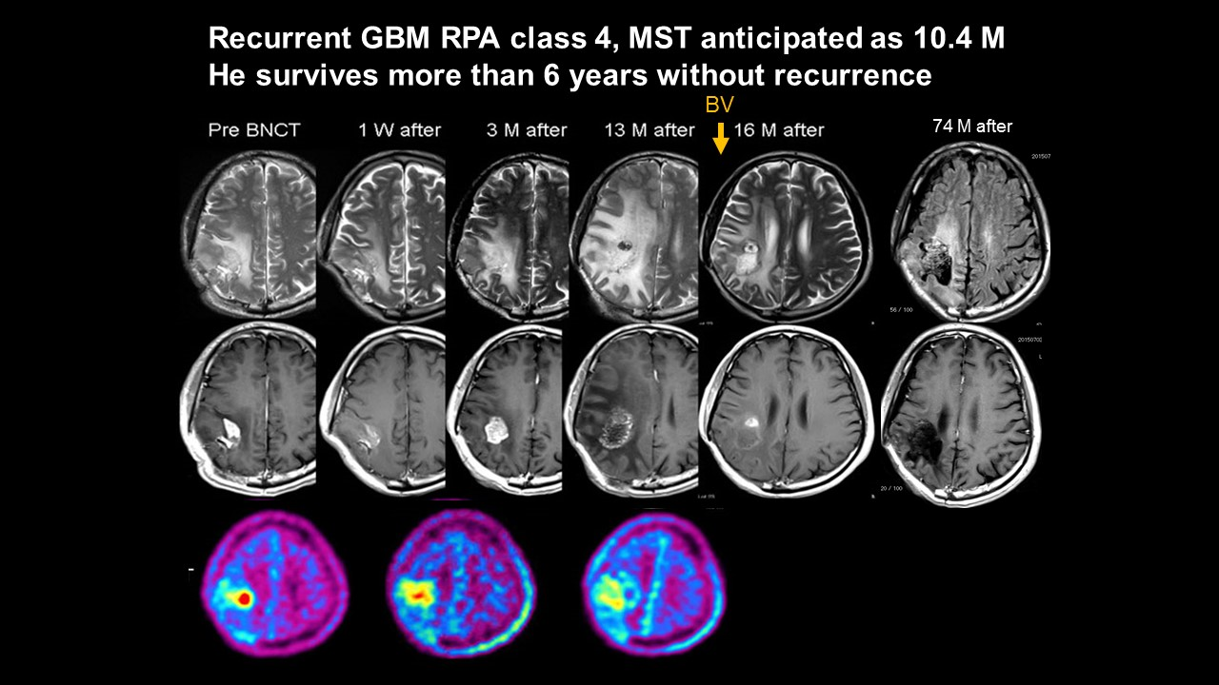
Shin-Ichi Miyatake, Osaka Medical Center
：bevacizumab
F-BPA-PET

Slide 16
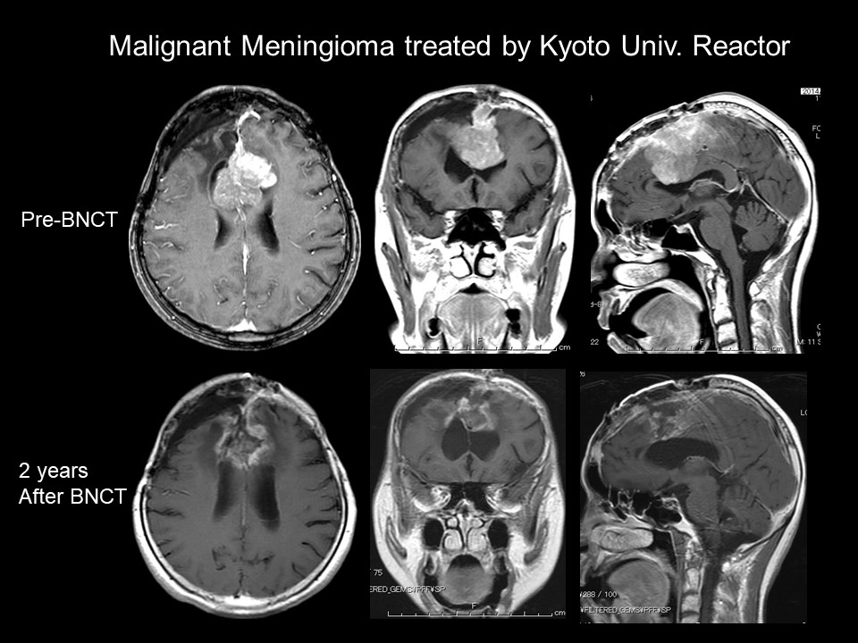
Shin-Ichi Miyatake, Osaka Medical Center

Slide 17
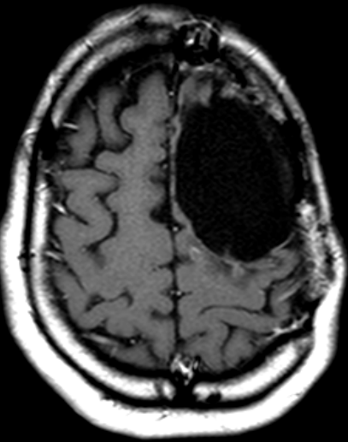
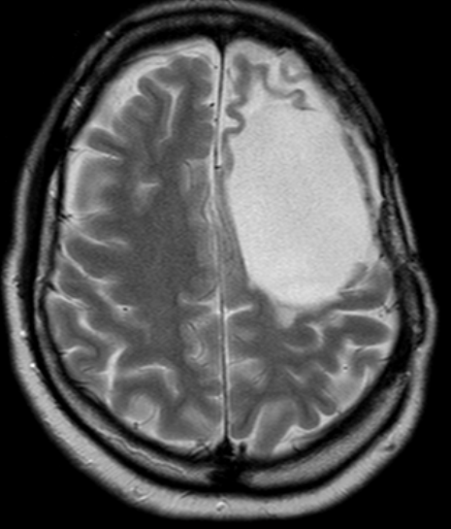
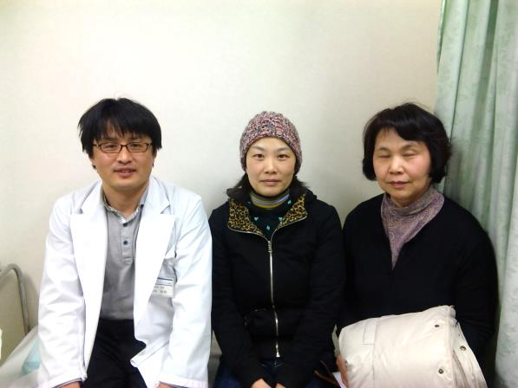
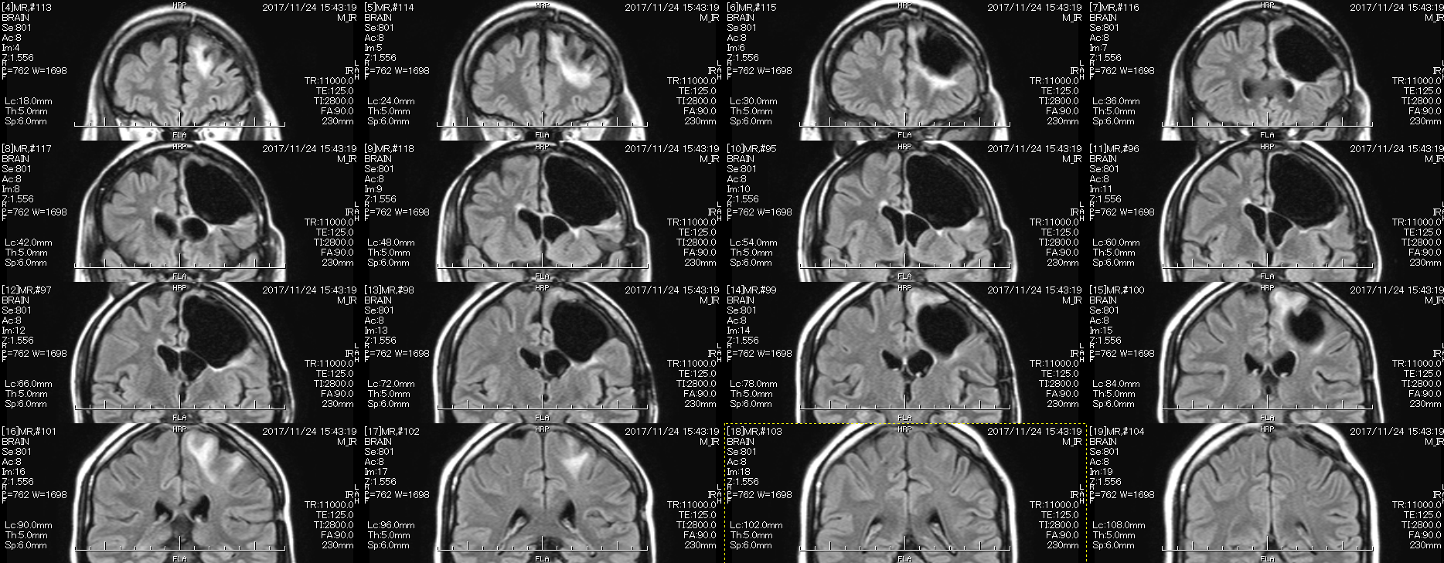
11-year survivor no neurological deficit
Tetsuya Yamamoto, Neurosurgery Dpt.,
Yohohama City University,
Japan

Slide 18


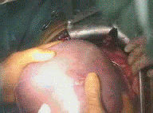
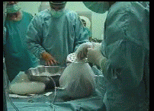
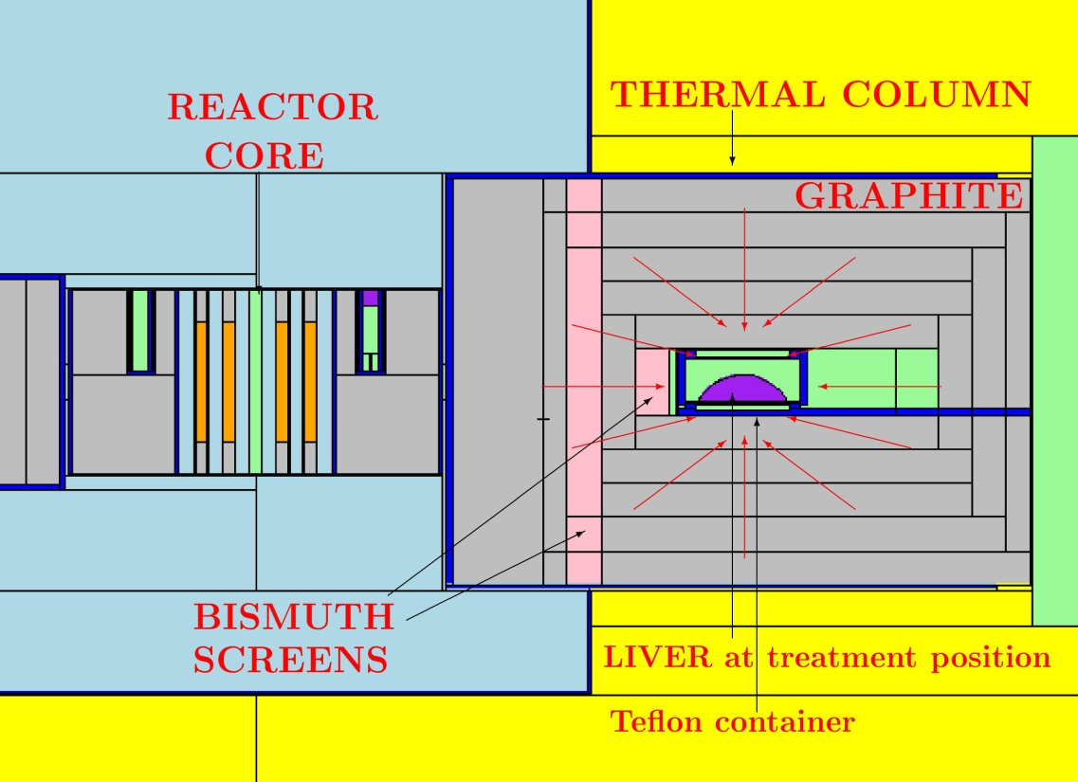
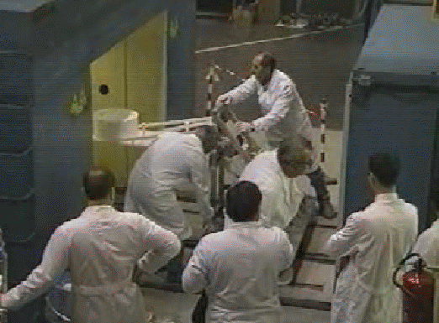
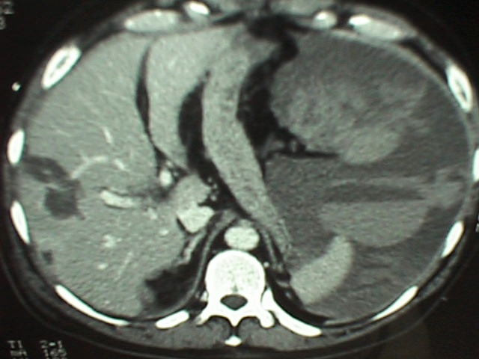
BNCT of Explanted Liver at Triga reactor
Liver metastases from colon carcinoma
washed and
refrigerated
explanted
Triga Mark II reactor
irradiated in the thermal column
destroyed metastases
Notes:
In Pavia we have a long tradition on BNCT
We started with the Taormina project dedicated to BNCT of the spread liver metastases
After the BPA infusion the explanted liver was irradiated in the T.C. of the Triga Mark II reactor
All metasatases where very selectively destroyed

Slide 19
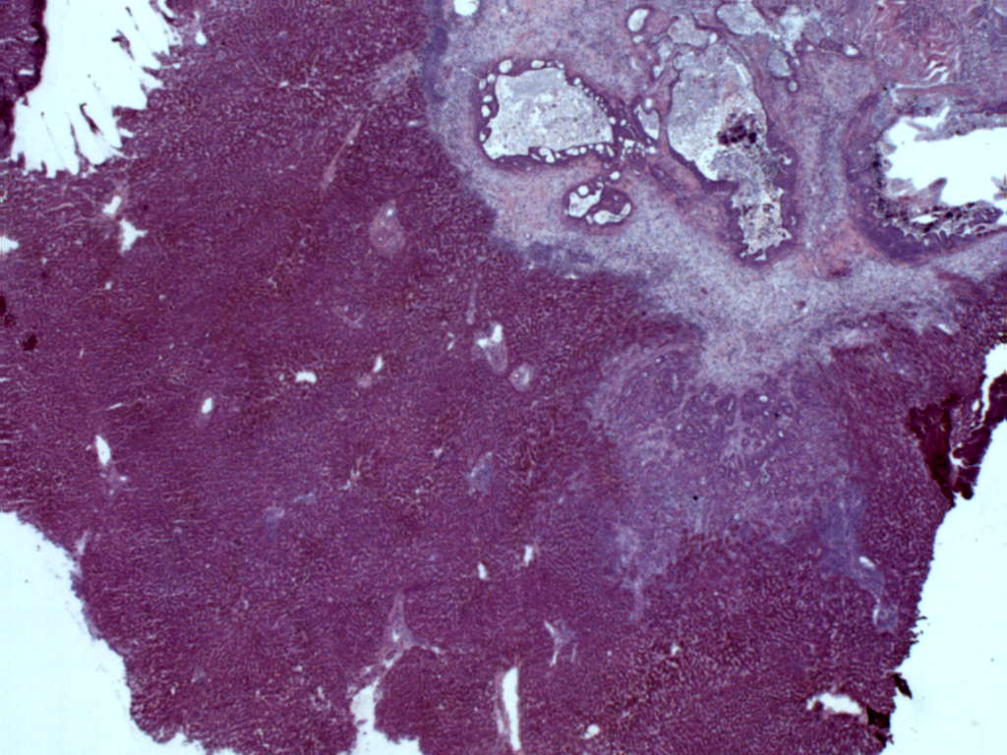
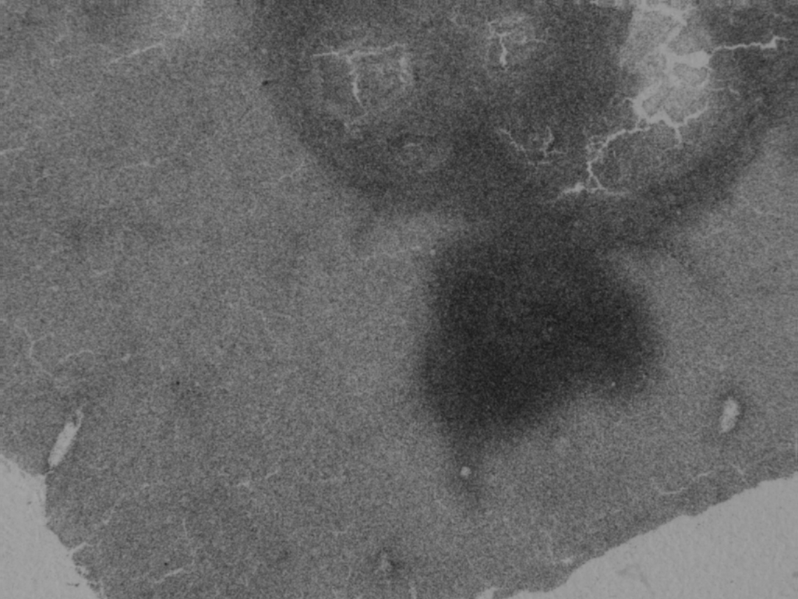
BPA infusion and Boron concentration measurement
BPA administered at a dose of 300 mg/Kg
body weight,
during surgery, through a colic vein.
To measure Boron concentration
some biopsies were taken
both from healthy and tumour
1h/2h after BPA infusion.
Alpha spectrometry
 | FIRST PATIENT | SECOND PAT.
TUMOR (ppm) | 47 ± 2 | 45 ± 5
LIVER (ppm) | 8 ± 1 | 8 ± 1
TUMOR/LIVER | 5.9 | 5.6
Neutron autoradiography
necrotic areas
Normal hepatocytes
tumor cells
histological image
neutron autoradiography image

Slide 20
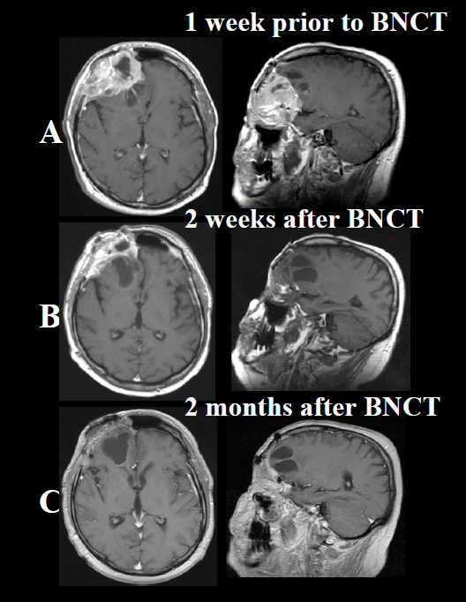
Clinical results for Head and Neck
Kouri et al. Radiotherapy and Oncology, 2004.

Slide 21
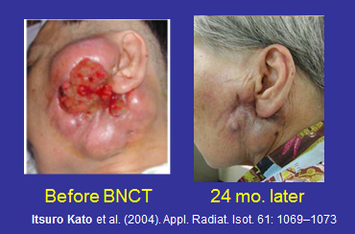
Clinical results for Head and Neck
Kouri et al. Radiotherapy and Oncology, 2004.

Slide 22
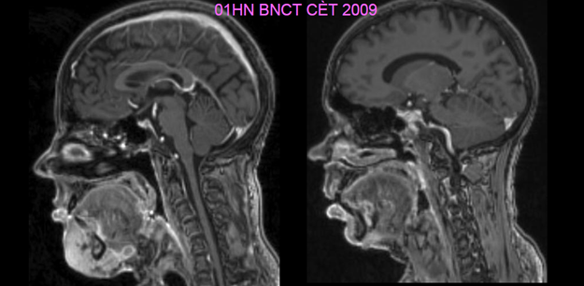
Clinical results for Head and Neck
Kouri et al. Radiotherapy and Oncology, 2004.

Slide 23
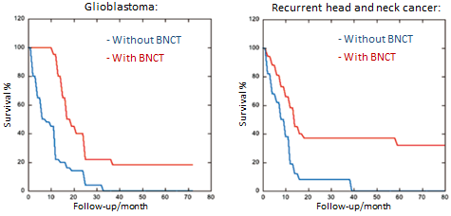
Survival plots
NUPECC Report: Nuclear Physics for Medicine (2014)

Slide 24
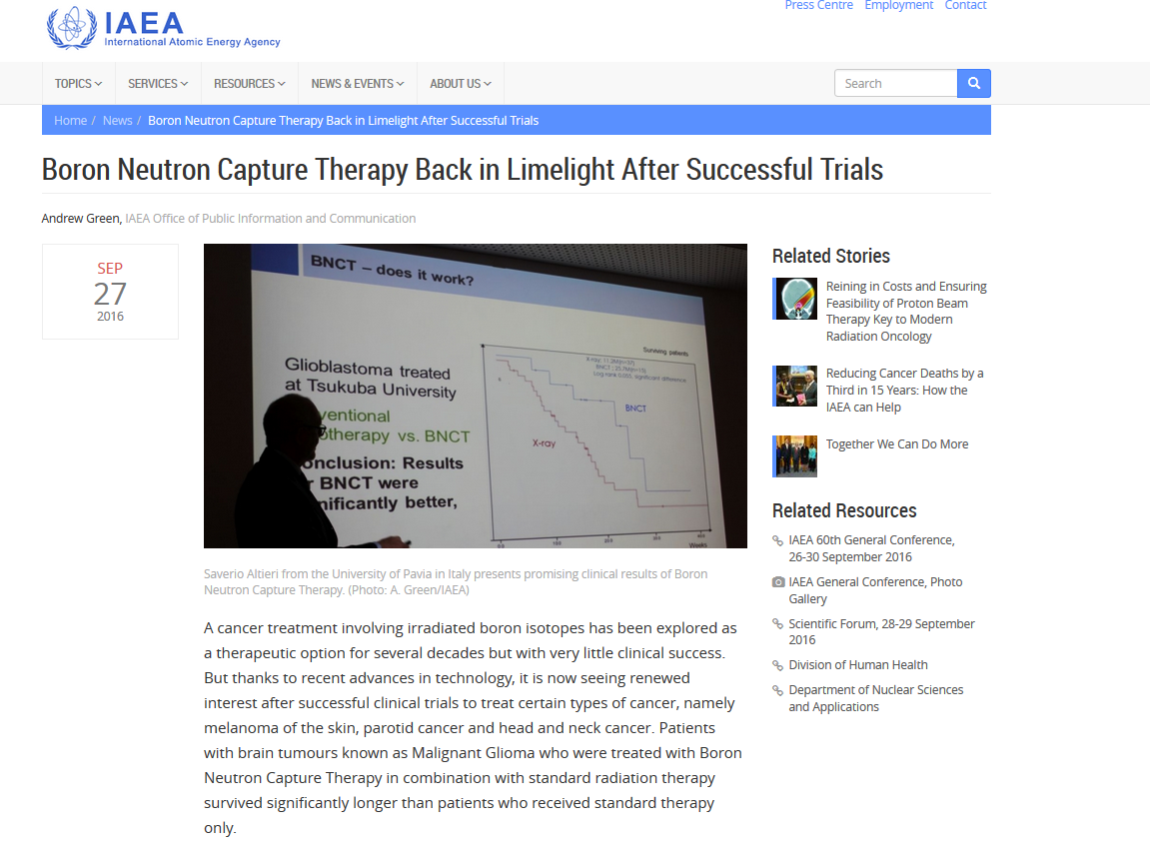
IAEA recognizes BNCT progress

Slide 25
Accelerator-based neutron sources (ABNS)

Slide 26
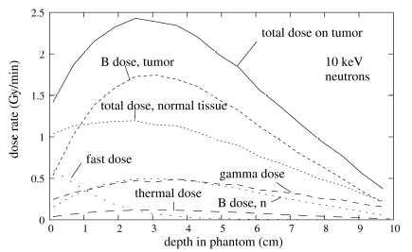
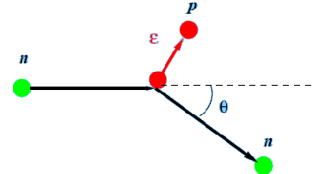
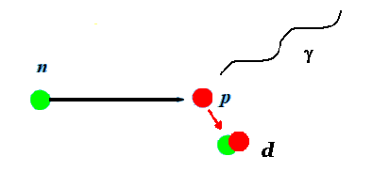
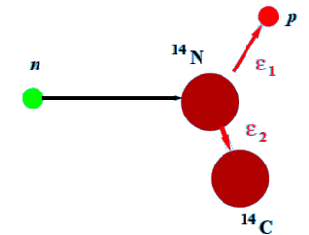
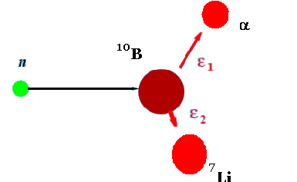




Dose components
Complex dosimetry: main dose contributions
Fast (and epithermal) neutrons
(elastic collisions)
Gamma emission
(hydrogen capture)
$$D_{f}$$
$$D_{γ }$$
¹H(n,n’)p
¹H(nγ) ²H
Thermal neutrons
(nitrogen capture)
Boron capture
$$D_{t}$$
$$D_{B}$$
¹⁴N(n,p) ¹⁴C
¹⁰B(n,α) ⁷Li
$$D={ D}_{t} + D_{f}+{ D}_{γ}+{ D}_{B}$$
Physical Dose:

Slide 27
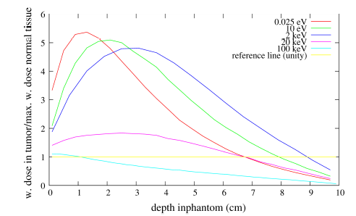
What is the optimal neutron energy for BNCT?
Monoenergetic neutrons: plot of weighted dose ratio tumor/max normal tissue
Range of “useful” neutrons for deep seated tumor: epithermal (1 eV to 20 keV)
Optimal neutrons are at 2 keV

Slide 28
Accelerator-based compact neutron sources for BNCT
Requires low energy but high intensity (tens of mA) particle accelerator, now available!
Will allow in-hospital facilities
More patients, more cases…

Slide 29
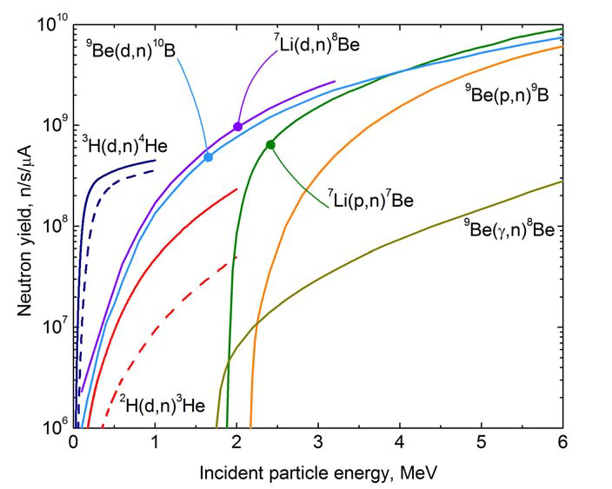
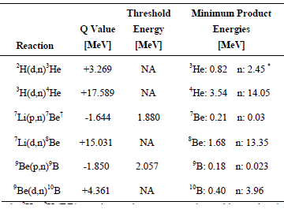
Reactions considered
Reactions proposed

Slide 30
Current projects
Institute | Accelerator | Beam energy | Intensity | Reaction | Max. n energy
Kyoto Univ, Japan (in clinical trials) | Cyclotron | 30 MeV | 1 mA | ⁹Be(p,n) | 28 MeV
Helsinki Univ. Cent. Hospital, Finland | Electrostatic (Hyperion) | 2.6 MeV | 30 mA | ⁷Li(p,n) | 0.89 MeV
Budker Institute, Novosibirsk, Russia | Vacuum insulated Tandem | 2 MeV | 2 mA | ^{7,}Li(p,n) | 0.23 MeV
IPPE Obninsk, Russia | Cascade generator KG-2.5 | 2.3 MeV | 3 mA | ⁷Li(p,n) | 0.57 MeV
Birmingham Univ., UK | Electrostatic (Dynamitron) | 2.8 MeV | 1 mA | ⁷Li(p,n) | 1.1 MeV
Tsukuba Univ., Japan | RFQ-DTL ª | 8 MeV | 10 mA | ⁹Be(p,n) | 6.1 MeV
CNEA Bs. As., Argentina | Tandem Electrost. Quadrupole | 1.4 MeV 2.5 MeV | 30 mA 30 mA | ⁹Be(d,n) ⁷Li(p,n) | 5.7 MeV 0.79 MeV
INFN, Italia | RFQ ª | 5 MeV | 50 mA | ⁹Be(p,n) | 3.1 MeV
SOREQ, Israel | RFQ-DTL ª | 4 MeV | 2 mA | ⁷Li(p,n) | 2.3 MeV
LBNL, USA | Electrostatic | 2.5 MeV | 50 mA | ⁷Li(p,n) | 0.79 MeV
National Cancer Center, Japan | RFQ ª | 2.5 MeV | 20 mA | ⁷Li(p,n) | 0.79 MeV
Xiamen Humanity Hospital, China | Electrostatic (VITA) | 2.5 MeV | 10 mA | ⁷Li(p,n) | 0.79 MeV
Nagoya Univ., Japan | Electrostatic (Dynamitron) | 2.8 MeV | 15 mA | ⁷Li(p,n) | 1.1 MeV
Gachon Univ. Gil Med. Center, S.Korea | RFQ-DTL ª | 10 MeV | 8 mA | ⁹Be(p,n) | 8.1 MeV
Southern Tohoku Hosp, Fukushima, JP | Cyclotron | 30 MeV | 1 mA | ⁹Be(p,n) | 28 MeV
Granada Univ., Spain | Electrostatic (Hyperion) | 2.1 MeV | 30 mA | ⁷Li(p,n) | 0.35 MeV
ª RFQ stands for Radio Frequency Quadrupole and DTL for Drift Tube Linac.

Slide 31
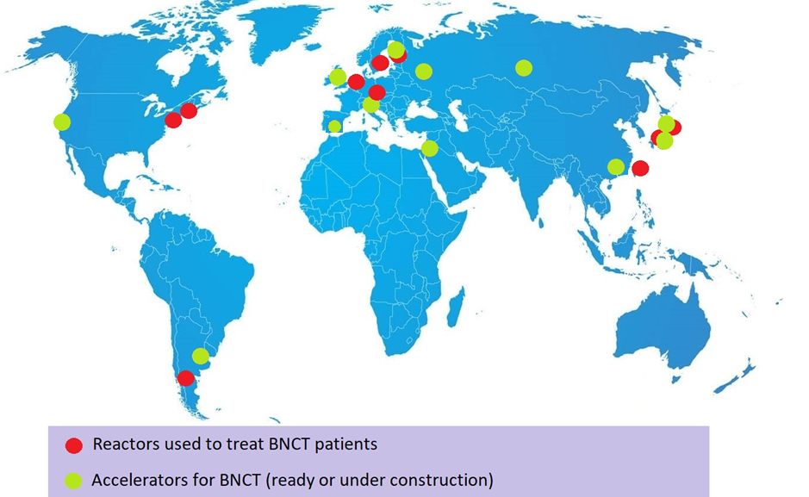
Boost of BNCT in new AB-facilities
FINLAND: Helsinki
RUSSIA: Obninsk, Novosibirsk
SOUTH KOREA: Incheon
UK: Birmingham
JAPAN:
C-BENS (Kyoto-Osaka)
i-BNCT (Tsukuba)
Tokio
Nagoya
Fukushima
Kanagawa
ITALY: Pavia
SPAIN: Granada
USA:
LLNL
ISRAEL: Soreq
CHINA: Xiamen
The number of projects for future BNCT ABNS is larger than the number of facilities where BNCT has been applied clinically in all history.
Most in-hospital facilities
ARGENTINA:
CNEA
(Buenos Aires)

Slide 32
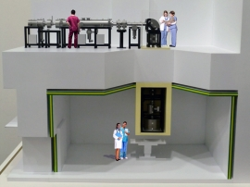
Japan projects
Japan is the world leader in BNCT
The first and only ABNS doing clinical trials is C-BENS at Kyoto
Six different projects for BNCT with different accelerators in development
New treatments foreseen: pancreatic cancer, other disseminated tumors
Project at National Cancer Center, Tokio

Slide 33

Finnish project
New facility in Finland expected for the end of 2019 at Helsinki University Central Hospital
Electrostatic accelerator of Neutron Therapeutics
Only facility in Europe expected soon

Slide 34











LINAC based A-BNCT center in Korea
LINAC based A-BNCT center in Korea
Dosimetry Lab
BTL
DTL
RFQ
Treatment Room #1
Treatment Room #2
Moderator
Assembly
(Inside)
Proton Injector
Accelerator Room
Be Target & Moderator Assembly (BSA)
Treatment Room #3
(BNCT Lab.)
Radiation
Safety
Management
Control
Room
Post-treatment
Treatment Preparation Room
Reception
Injection
Room
Control Room
BNCT Lab
Building : 35.3 x 21.8 m² with shielding
Utility : Electricity, Cooling, Air Cond.
Emergency Exit
Entrance

Slide 35

Elements of ABNS
Neutron producing target
BSA (Beam Shape
Assembly): moderator (MgF2, AlF, etc.), reflector (Bi, Pb), filter and shielding (Li-poly, LiF)
The spectrum can also be improved

Slide 36

International Society for Neutron Capture Therapy
ISNCT: Involves multidisciplinary researchers in the field collaborate in a spirit of close collaboration
Promotes the future development of BNCT
President: Ignacio Porras
Vice-President: Akira Matsumura
Gen. Secretary: Silva Bortolussi
www.isnct.net

Slide 37
Open research problems in BNCT

Slide 38
The boron carrier

Slide 39





Nanoparticles
Nanoparticles:
Until now:
BPA
boronophenylalanine
BSH
10 atoms of boron in each
carborane cage
boron-rich dendrimers with porphyrin nucleus:
J. Cabrera et al., Inorg. Chem., 2015, 54 (10), 5021–5031
sodium borocaptate

Slide 40

Functionalized liposomes
BNCT will probably benefit from the important advances in nanobiotechnology for tumor targeting
Hiroyuki Nakamura, Future Med Chem. 2013, 5(6):715-30.

Slide 41
The treatment planning

Slide 42
Sources of uncertaintites
Physical dose > Cross section of processes not well known – Nuclear data (n_tof at CERN)
Equivalent (biological) dose > requires RBE factors not well known – Radiobiological data from ILL

Slide 43

Most important processes contributing to dose in brain (healthy tissue)
44

Slide 44


Cross section measurements at n_TOF
35Cl(n,g)
14N(n,p)
Wagemans (2001)
Guber (2002)
Koehler (1993)
45

Slide 45


¹⁴N(n,p) cross section measured at n_TOF-EAR2
(preliminary)
Measured with Micromegas and silicon detectors
in 2018
44

Slide 46
³⁵Cl(n,γ) cross section measured at n_TOF-EAR1
Measured at n_TOF in 2018
- 4 C6D6 detectors (n insensitive)
44

Slide 47



Biological dose in BNCT
Physical Dose:
$$D={ D}_{t} + D_{f}+{ D}_{γ}+{ D}_{B}$$
To introduce relative different biological effect:
Weighting factors (RBE).
Weighted dose:
$$D_{W}≡w_{t}{ D}_{t} +w_{f} D_{f}+{w_{γ} D}_{γ}+w_{B} D_{B}$$
weighting factors currently used (Coderre et al.)
$$w_{t}=w_{f}=3.2$$
$$w_{γ}=1$$
$w_{B}=3.8$ (tumour) $w_{B}=1.3$ (Healthy tissue)
A major source of uncertainty:
$w_{t}, w_{f}$ could not be separated (assumed the same)
In current measurements of $w_{t}$ , gamma dose is dominating -> loss of precision
$w_{t}, w_{B}$ should be measured in a pure thermal beam (or equivalent, like PF1b at ILL)
$w_{f}$ depends on facility, requires $w_{t}$
$w_{γ}$ assumed 1, should be confirmed

Slide 48




Thermal and boron factor: determination at ILL
PF1B - cold neutron beam facility
PF1B is dedicated to the particle and nuclear physics experiments. It provides an intense polarized or unpolarized cold neutron beam.
- $D_{f}=0$
- $D_{γ}$ low value
2 cm Ø beam at Experimental Zone
Capture flux 2 10⁹ n/(s cm²)
Bent guide: avoid contamination by gammas and fast neutrons.
Additional collimation after guide exit to minimize lateral captures

Slide 49






ILL irradiation procedure
1. Fill quartz cuvettes with cell culture and let them attach to one side
2. Place the cuvette on the setup at Pf1b and irradiate. (2,4 Gy/h)
3. Take the irradiated cuvettes, recover the cells and prepare for clonogenicity
4. After 8 days, analyse the clonogenicity assays:
5. Results:
0 Gy
4 Gy

Slide 50


A new class 2 Bio Lab was built for this purpose
We need a lot of samples
The samples need to be prepared in a level P2 lab
NEW!
P2 lab inside the ILL7 (instruments hall)

Slide 51





First results: thermal factor
A375 (melanoma cells) in quartz cuvettes
$α_{o}$= 0.187 Gy⁻¹ , $β_{o}$= 0.035 Gy⁻²
Survival (%) | $D_{n}$(Gy) | $D_{γ,ref}$ (Gy) | $w_{t}$ (RBE)
100 - limit | Limit → 0 | Limit → 0 | 7.096 ($w_{t}^{∗}$)
75 | 0.217 | 1.247 | 5.753
50 | 0.522 | 2.519 | 4.823
37 | 0.749 | 3.290 | 4.392
25 | 1.045 | 4.166 | 3.987
10 | 1.735 | 5.868 | 3.382
5 | 2.258 | 6.958 | 3.082
1 | 3.470 | 9.106 | 2.624
$S{=e}^{−α_{n}D_{n}}$
$α_{n}$ = 1.327 ± 0.049 Gy⁻¹
We are in a experimental campaign of measuring these weighting factors for different cell lines of both tumor and normal cells (ILL-PhD fellowship of Maria Pedrosa)

Slide 52
Conclusions

Slide 53
Conclusions
BNCT is the “last line” in the fight of cancer (provides a hope when everything else fails)
Every new application tried has led to a great success
Accelerator-based neutron sources will allow:
  Increase statistics (randomized clinical trials)
  Improved treatments
  Increased visibility (more public and private funding)
Great potential (translation of research results)

Slide 54


Thank you for your attention!
19th International Conference on Neutron Capture Therapy
Granada (Spain),
13-18 September 2020
E-mail porras@ugr.es for being included in the info list

